Slide 1



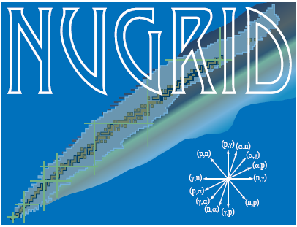

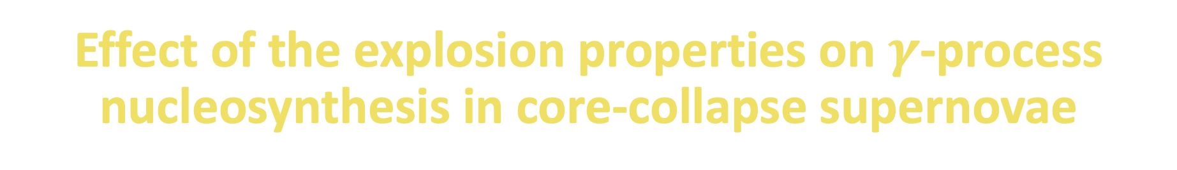
Effect of the explosion properties on $γ$-process nucleosynthesis in core-collapse supernovae
The 8th p-process workshop
Budapest, Oct 16, 2024
Lorenzo Roberti
Konkoly Observatory, HUN-REN CSFK, Budapest, Hungary

Slide 2
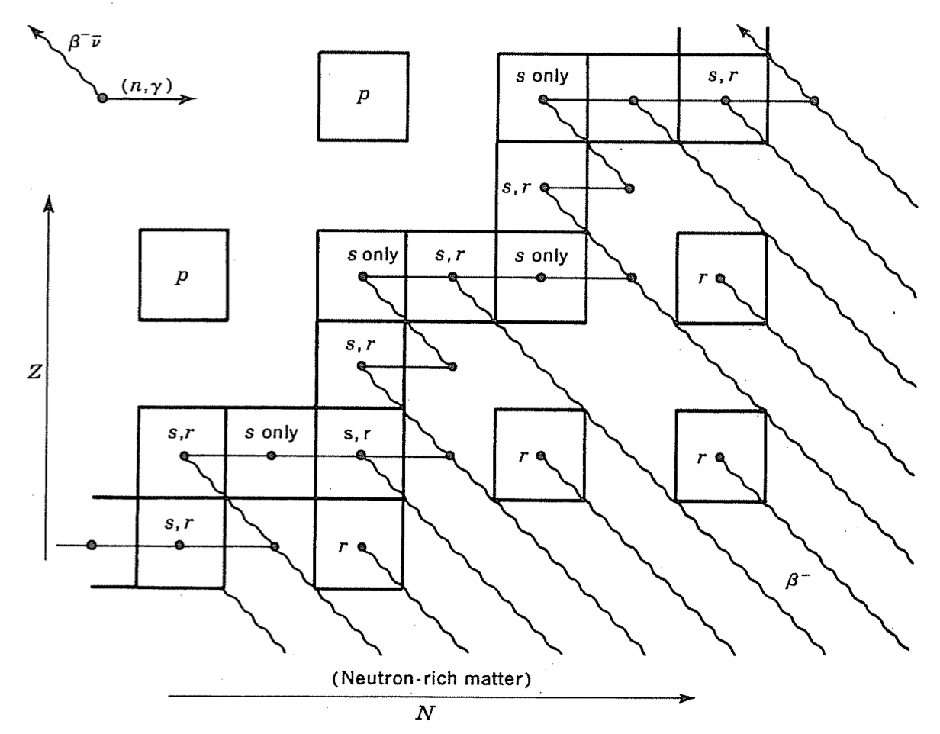


The $γ$-process nucleosynthesis in CCSNe
The γ-process: a sequence of photodisintegrations (γ,n), (γ,p), and (γ,$α$) in O/Ne rich layers in CCSN explosions from massive star progenitors (e.g., Woosley & Howard, 1978; Rayet et al., 1995);
Production of p-nuclei: 35 neutron-deficient isotopes of elements heavier than Fe;
Underproduction of typical γ-process yields from massive stars (factor of $\sim$2-4) compared to the solar system abundances. Larger underproduction of ^{92,94}Mo and ^{96,98}Ru yields ($\sim 1$ order of magnitude).
Clayton, D.D. (1968) Principles of Stellar Evolution and Nucleosynthesis. University of Chicago Press, Chicago.

Slide 3
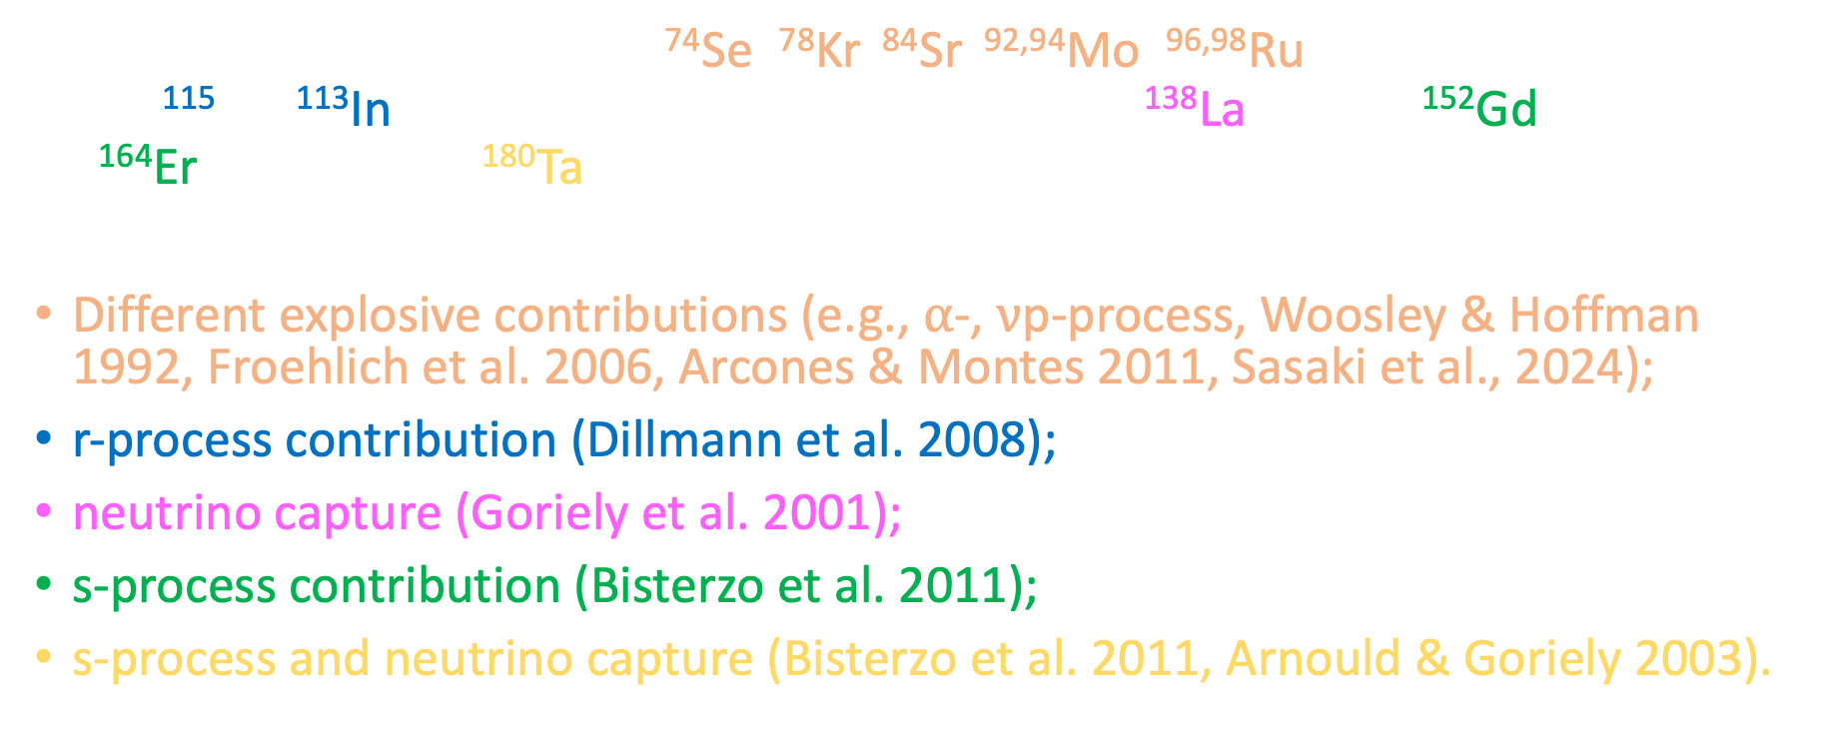
The $γ$-process nucleosynthesis in CCSNe
35 stable proton-rich nuclei: ⁷⁴Se, ⁷⁸Kr, ⁸⁴Sr, ^{92,94}Mo, ^{96,98}Ru, ¹⁰²Pd, ^{106,108}Cd, ^{112,114,115}Sn, ¹¹³In, ¹²⁰Te, ^{124,126}Xe, ^{130,132}Ba, ^{136,138}Ce, ¹³⁸La, ¹⁴⁴Sm, ¹⁵²Gd, ^{156,158}Dy, ^{162,164}Er, ¹⁶⁸Yb, ¹⁷⁴Hf, ¹⁸⁰Ta, ¹⁸⁰W, ¹⁸⁴Os, ¹⁹⁰Pt and ¹⁹⁶Hg.
Different explosive contributions (e.g., $α$-, $ν$p-process, Woosley & Hoffman 1992, Froehlich et al. 2006, Arcones & Montes 2011, Sasaki et al., 2024);
r-process contribution (Dillmann et al. 2008);
neutrino capture (Goriely et al. 2001);
s-process contribution (Bisterzo et al. 2011);
s-process and neutrino capture (Bisterzo et al. 2011, Arnould & Goriely 2003).

Slide 4



The $γ$-process nucleosynthesis in CCSN models
The pre-supernova structure of the model is crucial to determine the properties of the explosive O/Ne nucleosynthesis;
The explosion parametrization affects the production of all p-nuclei;
Different sets of reaction rates lead to significant differences in isotopic ratios.
Roberti+23
Roberti+24

Slide 5

Carbon-oxygen shell mergers in massive stars
Ingestion of some C (and Ne) in the O burning shell during late stages of the evolution → C burning material burnt at O burning temperature;
Formation of an extended (both in mass and radius) mixed convective zone;
Peculiar nucleosynthesis and impact on the explodability;
Intrinsically 3D occurrence: studied by hydro simulations (e.g., Andrassy+20, Rizzuti+24);
Found in several 1D stellar models with M_{ini}$≤$25 M$⊙$ (e.g., Rauscher+02, Ritter+18, Roberti+24).

Slide 6
Carbon-oxygen shell mergers in massive stars
CO shell merger
dashed = pre-supernova
solid = after explosion
15 M$\text{⨀}$ at Z=0.02 from Ritter et al., 2018, MNRAS 480, 538

Slide 7
Carbon-oxygen shell mergers in massive stars
See also J. Issa’s talk
CO shell merger
dashed = pre-supernova
solid = after explosion
15 M$\text{⨀}$ at Z=0.02 from Ritter et al., 2018, MNRAS 480, 538

Slide 8

The $γ$-process in C-O shell mergers

Slide 9
Summary and conclusions
The production of p-nuclei in CCSNe depends on progenitor evolution → crucial having accurate and refined stellar models;
Nuclear reactions affect the progenitor evolution and the nucleosynthesis;
Different explosion prescriptions change the production of p-nuclei;
The C– O shell merger dominates the production of p-nuclei heavier than Pd and it does not depend on the explosion energy;
Frequency of C-O shell merger in a stellar population? Trend with mass/metallicity/rotation? Update GCE?

Slide 10
Summary and conclusions
The production of p-nuclei in CCSNe depends on progenitor evolution → crucial having accurate and refined stellar models;
Nuclear reactions affect the progenitor evolution and the nucleosynthesis;
Different explosion prescriptions change the production of p-nuclei;
The C– O shell merger dominates the production of p-nuclei heavier than Pd and it does not depend on the explosion energy;
Frequency of C-O shell merger in a stellar population? Trend with mass/metallicity/rotation? Update GCE?

Slide 12


Impact of explosion models on the $γ$-process
$$F_{0}=\frac{\sum_{i}^{35}{F_{i}}}{35}$$
$F_{γ}=\frac{\sum_{i}^{3 }{F_{i}}}{3}$
for 3 most produced $γ$-only nuclei

Slide 13

Impact of explosion models on the $γ$-process
C-O merger
$$F_{0}=\frac{\sum_{i}^{35}{F_{i}}}{35}$$
$F_{γ}=\frac{\sum_{i}^{3 }{F_{i}}}{3}$
for 3 most produced $γ$-only nuclei

Slide 14
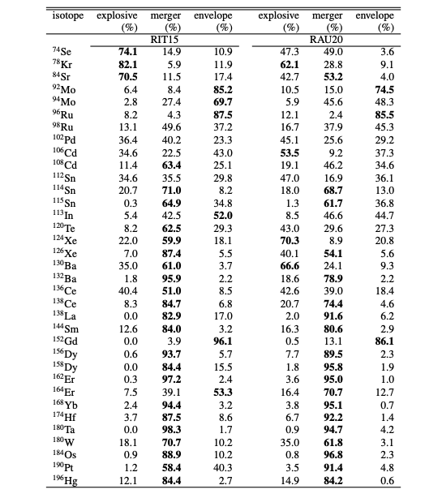
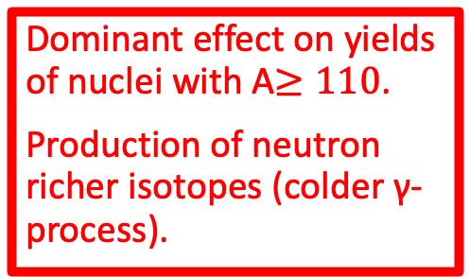
The $γ$-process in C-O shell mergers
Dominant effect on yields of nuclei with A$≥110$.
Production of neutron richer isotopes (colder γ-process).

