Slide 1
Spectrometry of the Earth using neutrino oscillations
Akimichi Taketa
ERI, University of Tokyo
CHEER,
Center for High Energy gEophysics Resarch

Slide 2
Table of contents
Applied Cosmic Ray Physics
  Introduction
    What is the applied cosmic ray physics?
    History of the applied cosmic ray physics
Spectrometry of the Earth using neutrino oscillations
Summary

Slide 3
Table of contents
Applied Cosmic Ray Physics
  Introduction
    What is the applied cosmic ray physics?
    History of the applied cosmic ray physics
Spectrometry of the Earth using neutrino oscillations
Summary

Slide 4
Principle: tomography using cosmic rays
Detector
Object
Inversion
Penetrative
particles
Image

Slide 5

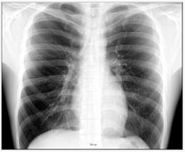

Slide 6
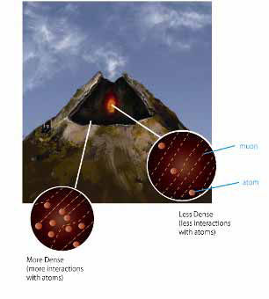
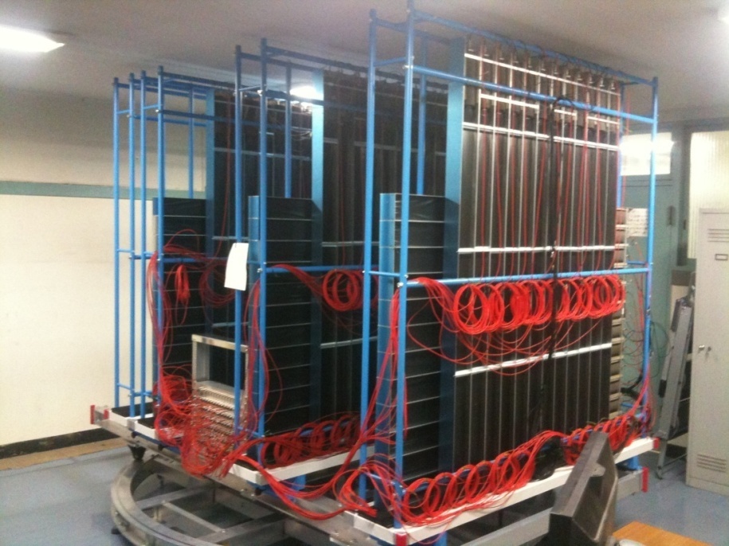
Muon tomography
Initial muon flux (E)
Absorption length (E)
Observed muon flux
→ Density length
DEM
→ Average density
2m

Slide 7
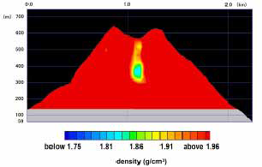
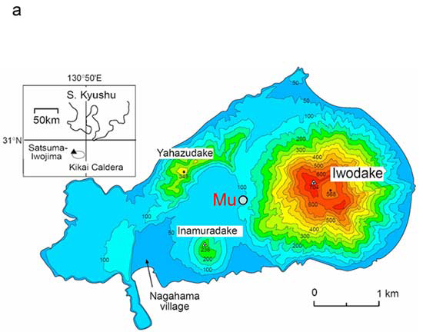
Mt. Satsuma Iwo Jima
0 1 2 (km)
(m) 700
600
500
400
300
200
100
1.75 1.81 1.86 1.91 1.96
density (g/cc)

Slide 8
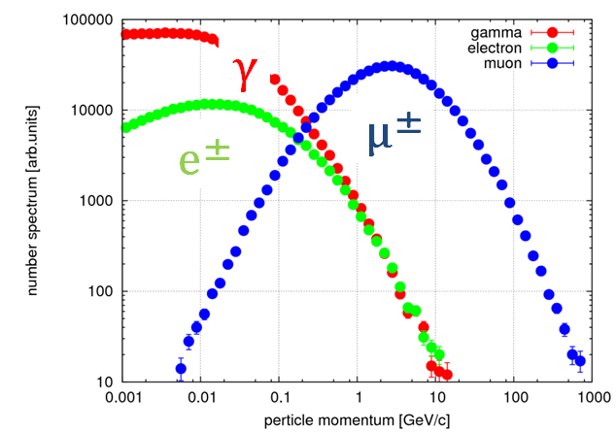
Muon is not applicable for small object
20m w. eq.

Slide 9
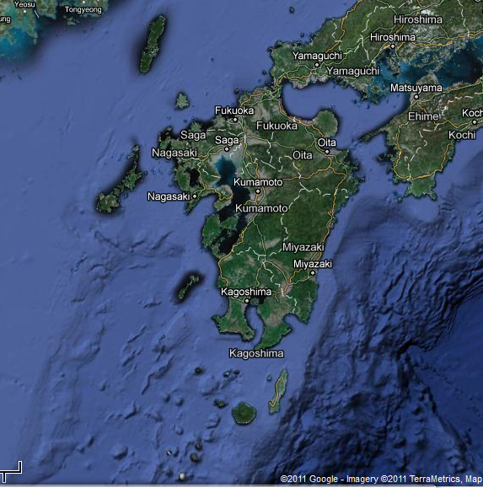
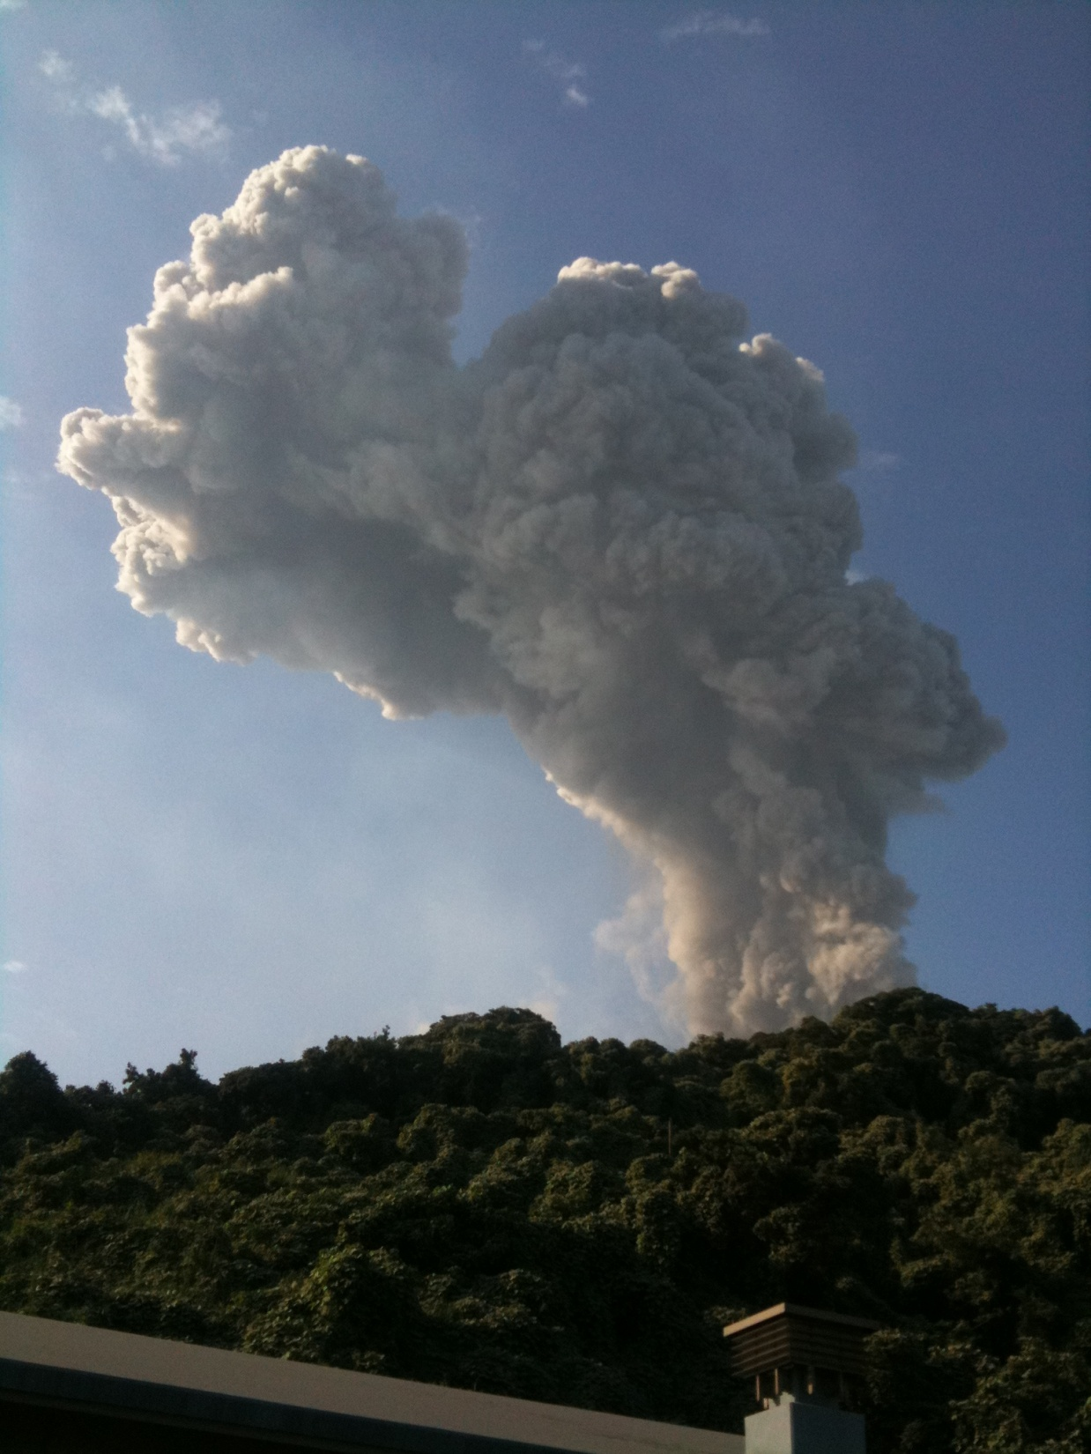
Ground water measurement using AS for Mt Skurajima eruption prediction
Active volcano in Japan
Large eruption expected
soil
rock
Blid.
Vault inside
Grav. meter

Slide 10
Density length measured by AS
Notes:
Bin size , delay

Slide 11
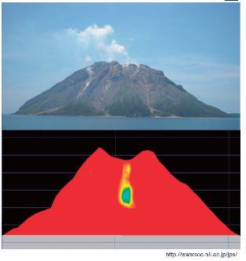
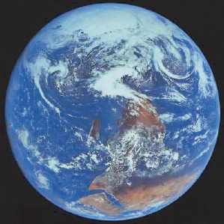
Cosmic Ray tomographies
There are unmeasurable ranges!
Photon(X-ray)
muon
neutrino
Photography
Muography
Neutrinography
Air shower
(Electro-
magnetic
component)
The holy grail
of geophysics
Polarization
EM field
Spin
Magnetism
Oscillation
composition
0.1 1 10 10² 10³ 10⁴ 10⁵ 10⁶ m

Slide 12
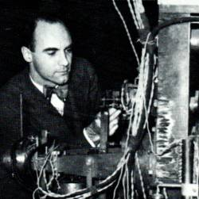

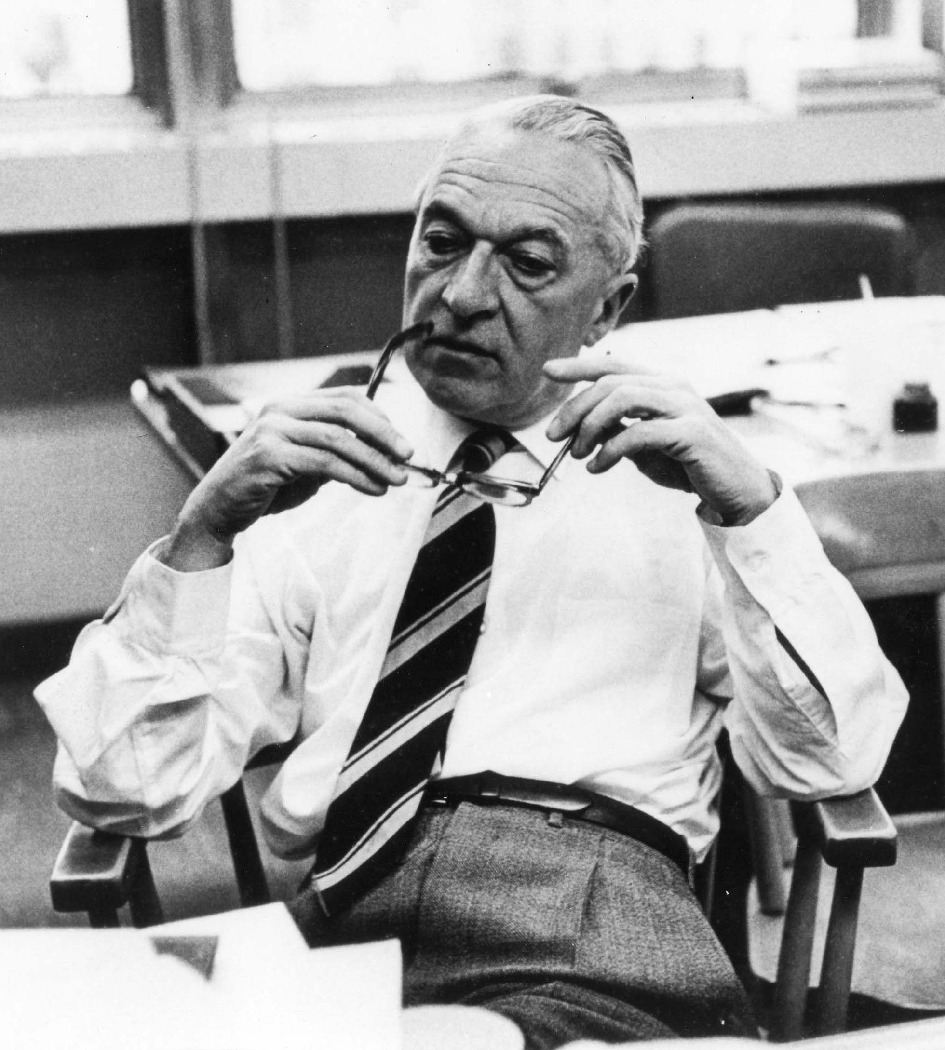

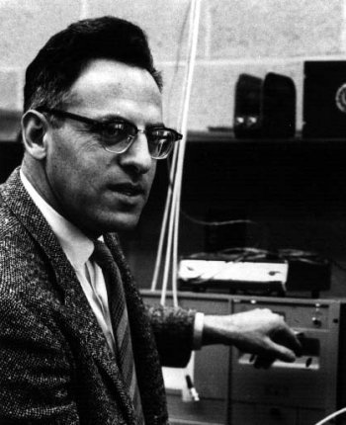
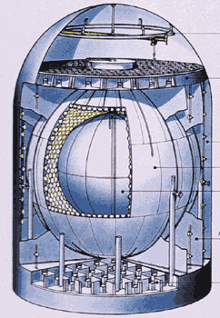

History of applied cosmic ray physics for geophysics
Muon
  discovery 1936
  applied 1990s
Air shower
  discovery 1934
  applied 2011
Neutrino
  discovery 1956
  applied 2000s
Neutrino oscillation
  discovery 1960s
C. Anderson
K. Nagamine
B. Rossi
A. Taketa
F. Reines
KamLAND
R. Davis
Notes:
Muon: Carl Devid Anderson, AS: Bruno Rossi

Slide 13
Table of contents
Applied Cosmic Ray Physics
  Introduction
    What is the applied cosmic ray physics?
    History of the applied cosmic ray physics
Spectrometry of the Earth using neutrino oscillations
Summary

Slide 14
Neutrino Oscillation Formulae

Slide 15
Question
“What are the precise neutrino mixing parameter measurements useful for ?”

Slide 16
Order
“Do something related with geophysics using neutrino oscillations”

Slide 17
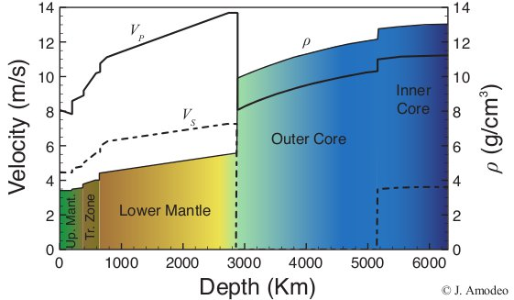
Current understanding of the Earth
Matter density profile is well known
  Seismic measurement and free oscillation
  The composition is not known, maybe.
Outer core is assumed to be liquid iron (+5wt%Ni)
  And some other light element
  But it’s not measured

Slide 18
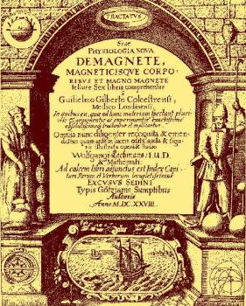
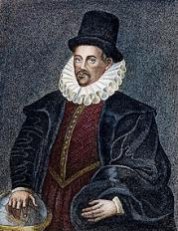
Why is light element important ?
History of the Earth’s evolution
What is the geomagnetic field ? Who order it ?
  W. Gilbert 1600
  A. Einstein 1905
  It requires the metal convection : dynamo theory
Outer core composition is essentially important
  Especially light component
  Pure iron cannot maintain the convection
  H? O? C? Si? S?

Slide 19
Let’s measure it !
Neutrino oscillation probability depend on electron density, not matter density
By using neutrino oscillation, we can measure the electron density of the medium
  If we know the neutrino property very well
We have the precise matter density of the earth
  From seismic wave tomography and free oscillation
Combining matter density and electron density, we can measure the average chemical composition of the deep earth !
  Ratio of atomic number to mass number (Z/A)

Slide 20
Hypothesis
Z/A ratio of materials
  Fe :0.466, Light material :~0.5, Hydrogen :1
  More sensitive to Hydrogen
Matter density model : modified PREM
Initial neutrino flux : Honda flux 2011
Mantle is pyrolite (Z/A=0.496)
Inner Core is Pure Iron (Z/A=0.467)
Z/A of outer core : free parameter
Normal hierarchy
Oscillation parameter : Capozzi et al. 2014

Slide 21
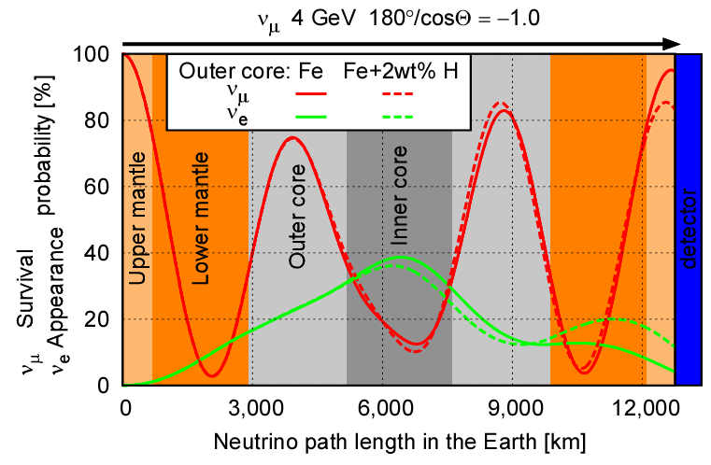
Neutrino oscillation in the Earth
Notes:
Ref calcmemo1.doc

Slide 22
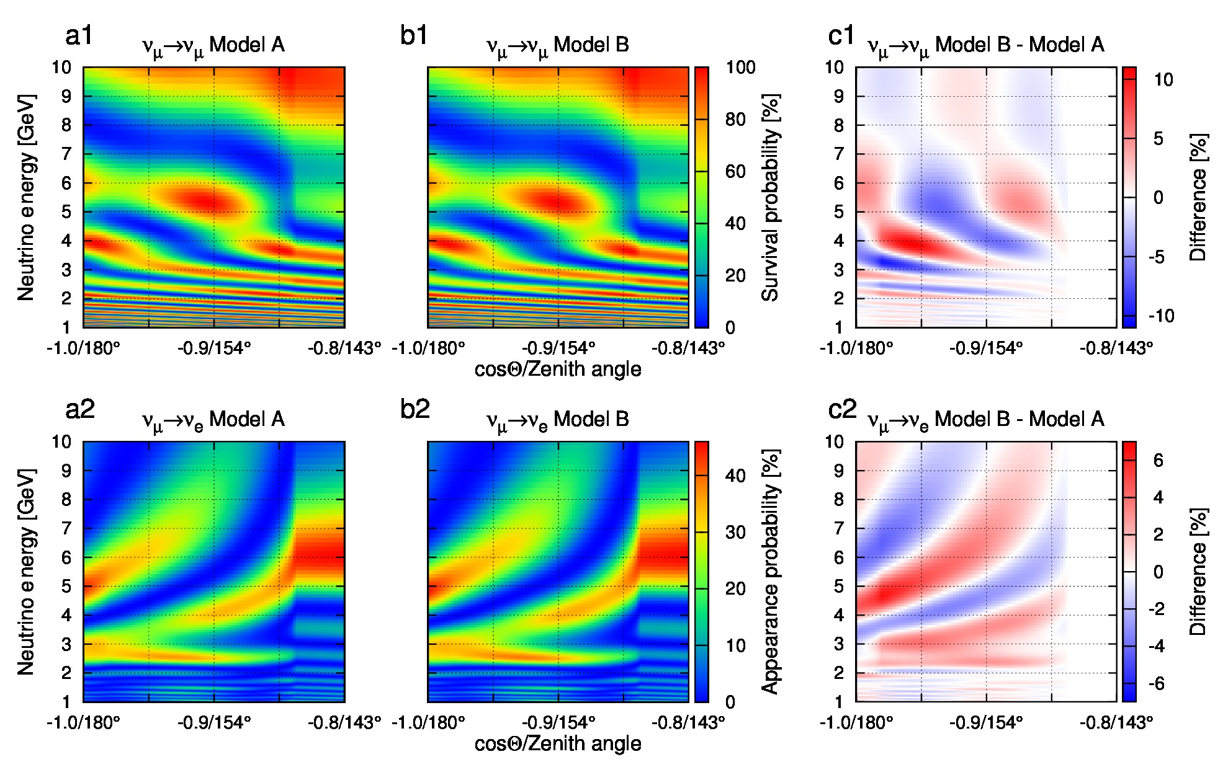
Oscillograms (Fe OC VS Fe+2wt%H OC)

Slide 23
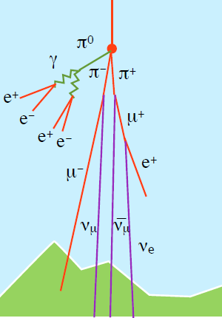
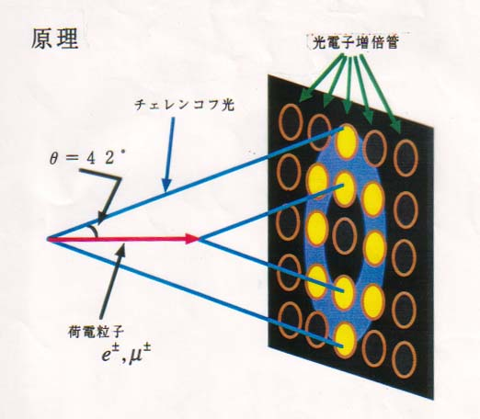

How we measure the Earth composition ?
Atmospheric neutrino
  Energy and incident angle of ν_{e} and ν_{μ}
Cherenkov based detector
  ν_{e} , ν_{μ} identification, high E/angular resolotion
Cosmic ray
PMT
C.light
θ=42°
C.particle
e±,μ±
Atm. ν

Slide 24
Detectors
 | HK | PINGU | ORCA | BAIKAL
Mass[MT] | 0.6 | ~5 | ~5 | ?
Particle | ν_{e}, ν_{μ} | ν_{e}, ν_{μ} | ν_{e}, ν_{μ} | ?
E range | <~5MeV | <~2GeV | <~3GeV | ?
Requirement for spectrometry
  E range : 2 - 8 GeV
  Good energy and angular resolution (ν_{e}, ν_{μ})
  Exposure : larger is better

Slide 25
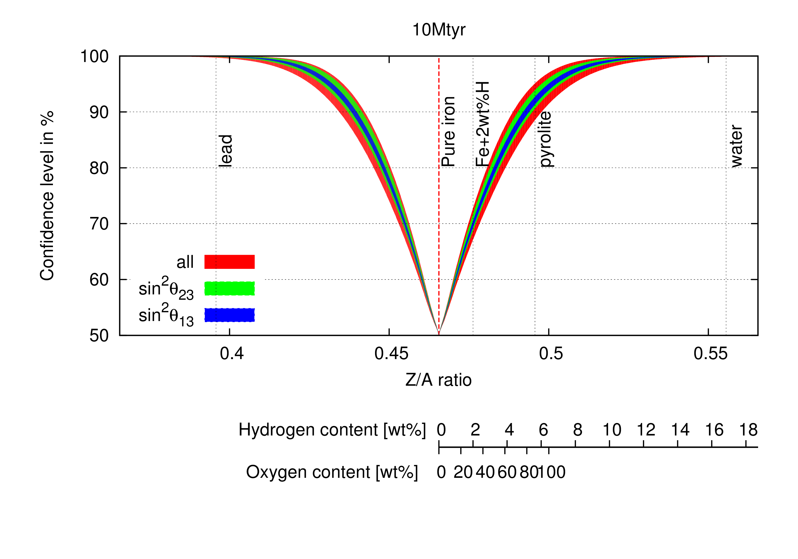
Expected sensitivity (10Mtyrs)

Slide 26
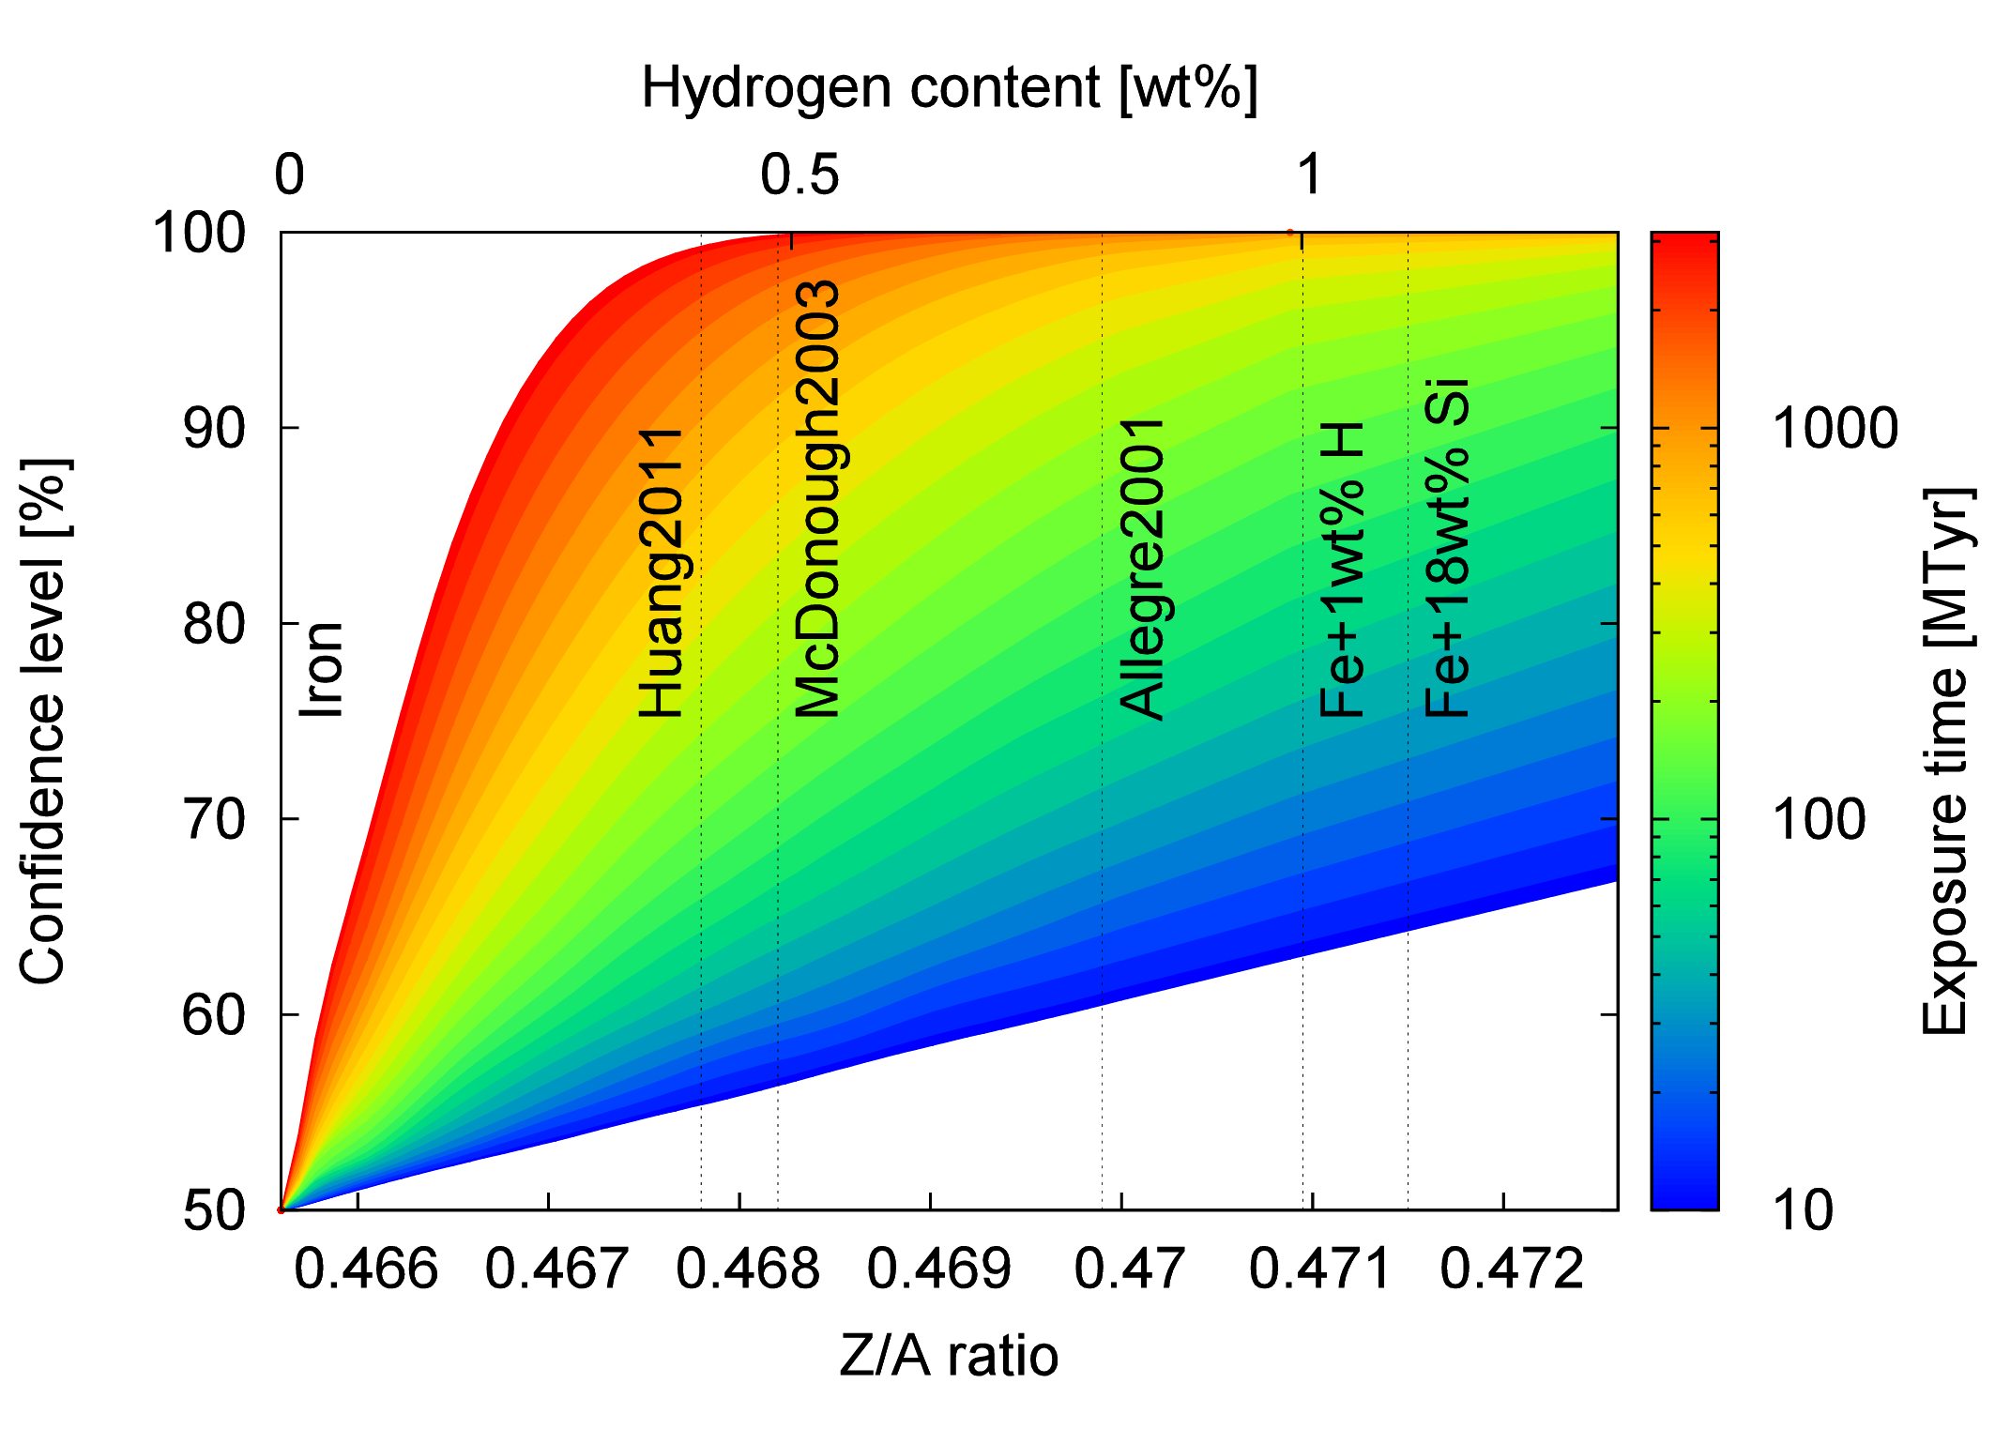
Expected sensitivity (Future)

Slide 27
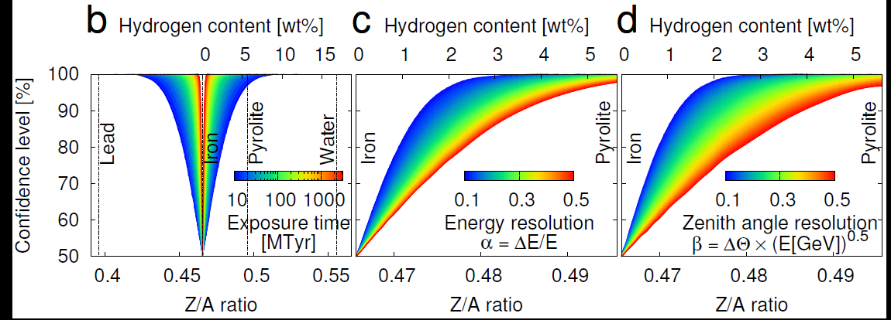
Resolution effect (30 MTyrs)

Slide 28
Remark
Neutrino oscillation is applicable to geophysics
  Only way to measure the chemical composition of the deep Earth
  Exposure is essentially important for this study
  Sensitive energy range : >2GeV
Spectrometry of the Earth is possible in near future
  Fe, Pb, water can be resolved in near future
  Compositional convection can be measured

Slide 29
Table of contents
Applied Cosmic Ray Physics
  Introduction
    What is the applied cosmic ray physics?
    History of the applied cosmic ray physics
Spectrometry of the Earth using neutrino oscillations
Summary

Slide 30
Question:
“What are the precise neutrino mixing parameter measurements useful for ?”
Answer:
“It’s useful for the geophysics ! ”
“At least !”
Notes:
Eventually, I could find the answer by myself.
But I’m still waiting the answer from the physicist.

Slide 31


Geo-scientist meets physicists…
Thank you!
Notes:
Please keep imagination.

