Slide 1


Composition of the Earth
from Ab Initio Mineral Physics
Taku Tsuchiya
Geodynamics Research Center, Ehime University, Japan
Dearth-Life Science Institute, Tokyo Institute of Technology, Japan
2016/01/07 ERI, U Tokyo

Slide 2
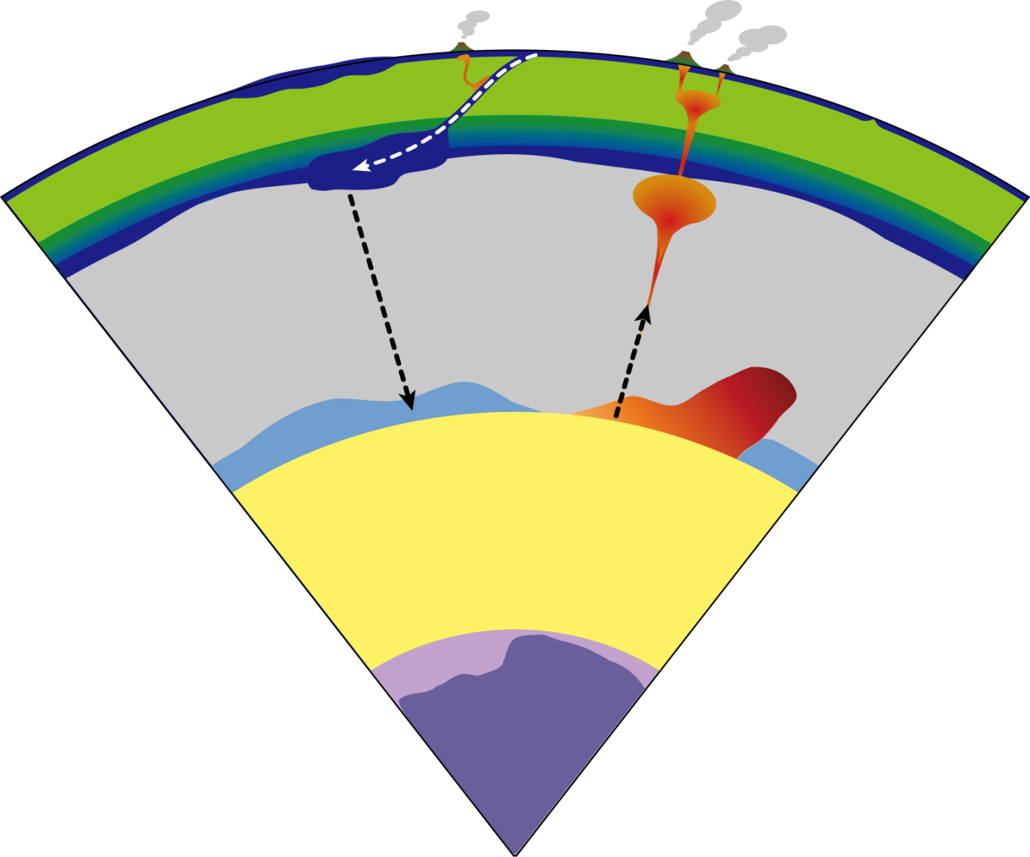
Chemical composition of Earth’s interior
Crust
0GPa, 300K
UM
24GPa, 1900K
LM
Silicate
136GPa, 4000K
OC
Fe
+ light elements
329GPa, 5500K
IC
Details still remain unclear!
364GPa, 6000K

Slide 3
Seismological reference model
PREM (Dziewonski & Anderson 81)
Mineral physics:
Search for ｌithology which can reproduce the references

Slide 4
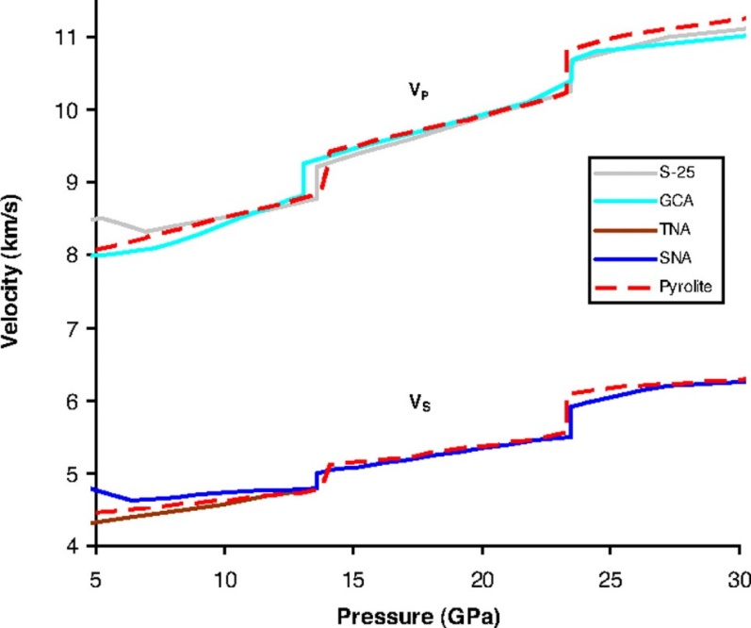
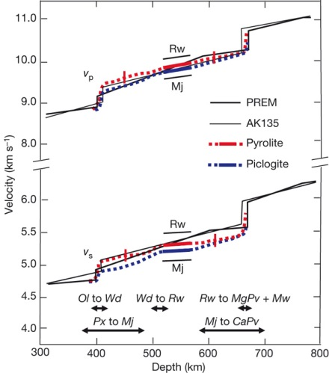
Mineralogical model of the upper mantle
UM & TZ
LM
UM & TZ
LM
Li & Leibermann (07)
UM = Pyrolitic (Peridotite/Basalt ~ 4/1)
LM … remain controversial
Irifune+ (08)

Slide 5
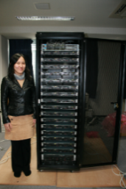
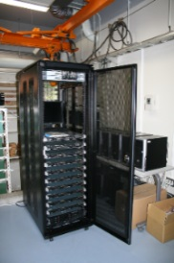
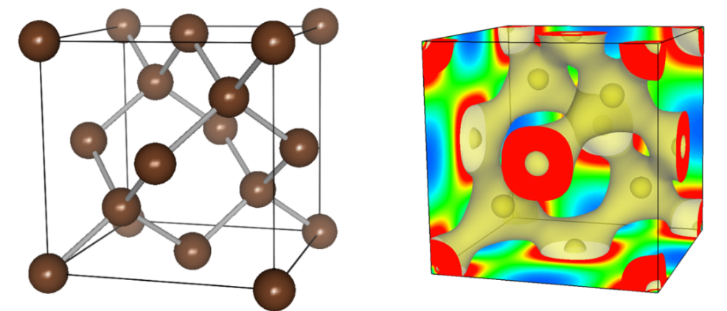
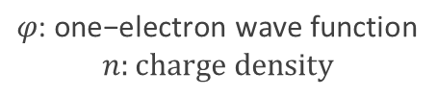
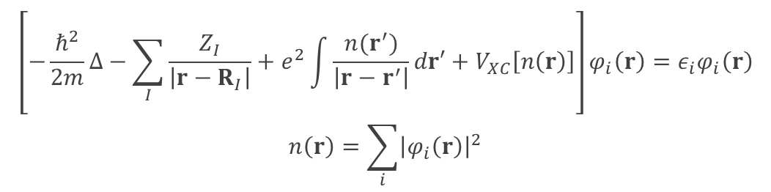
Ab initio quantum mechanical calculation method
Method to compute electronic structure and chemical bonding nonempirically, based only on fundamental quantum mechanical principles
with basic information such as atomic number
Density Functional Theory (Hohenberg & Kohn 64; Kohn & Sham 65; Nobel prize in chemistry 98)
$$\left[−\frac{ℏ^{2}}{2m}∆−\sum_{I}{\frac{Z_{I}}{\left|r−R_{I}\right|}}+e^{2}\int{\frac{n(r^{′})}{\left|r−r^{′}\right|}dr′}+V_{XC}\left[n\left(r\right)\right]\right]φ_{i}\left(r\right)=ε_{i}φ_{i}\left(r\right)$$
$$n\left(r\right)=\sum_{i}{{\left|φ_{i}\left(r\right)\right|}^{2}}$$
$$φ \text{:} \text{one}\text{−}\text{electron} \text{wave} \text{function}$$
$$n:charge density$$
GRC Parallel Computation Systems

Slide 6
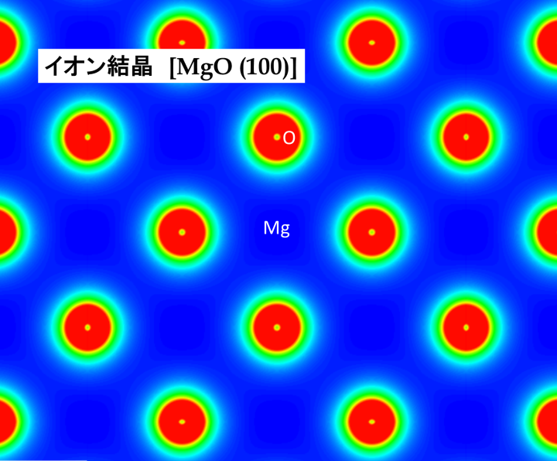
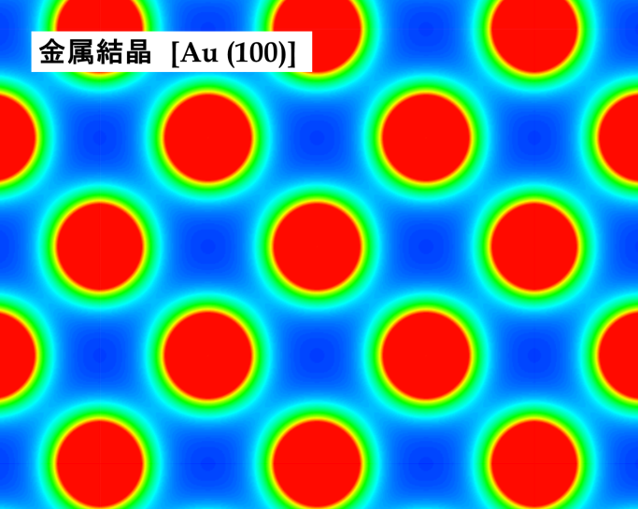
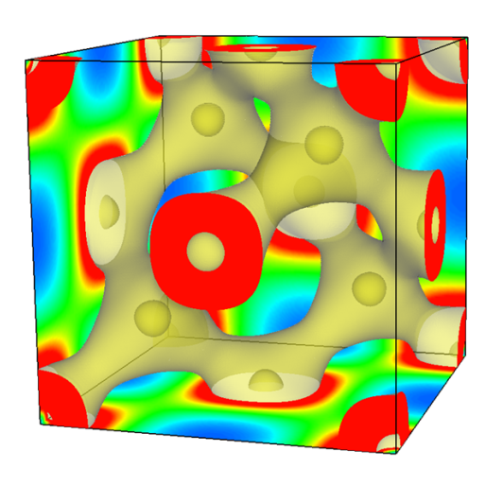
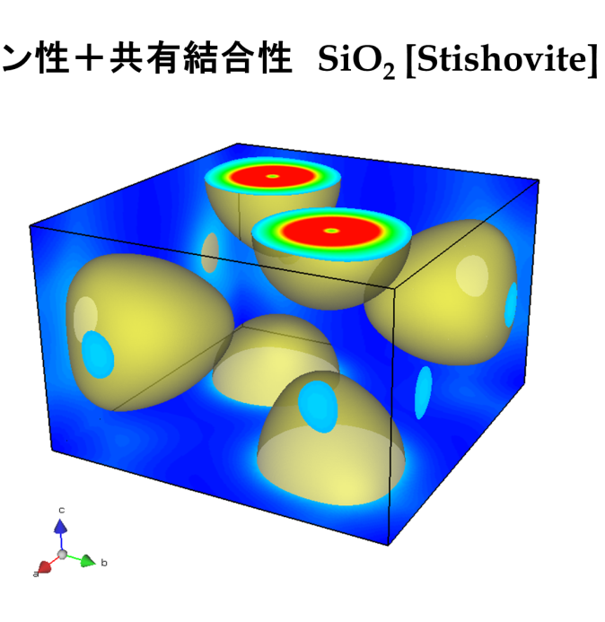
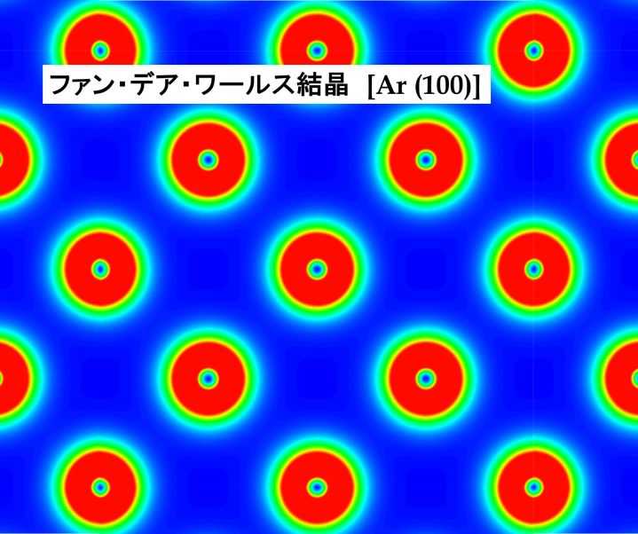
Universal applicability of DFT
Valence charge density of some representative bond types
Ionic crystal [MgO (100)]
Metal [Au (100)]
Au
Covalent crystal [diamond]
C
Ionic + covalent SiO₂ [Stishovite]
Van der Waals crystal [Ar (100)]
Ar
O
Si

Slide 7

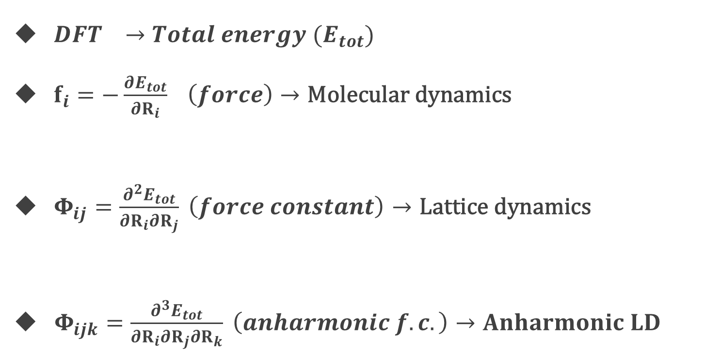


Fundamental tools
$DFT →Total energy (E_{tot})$
$f_{i}=−\frac{∂E_{tot}}{∂R_{i}} \left(force\right)→\text{Molecular} \text{dynamics}$
${ Φ}_{ij}=\frac{∂^{2}E_{tot}}{∂R_{i}∂R_{j}} \left(force constant\right)→\text{Lattice} \text{dynamics}$
$Φ_{ijk}=\frac{∂^{3}E_{tot}}{∂R_{i}∂R_{j}∂R_{k}} \left(anharmonic f.c.\right)→Anharmonic LD$
$$f=ma$$
$$phonon$$
$$Lattice thermal conductivity$$

Slide 8
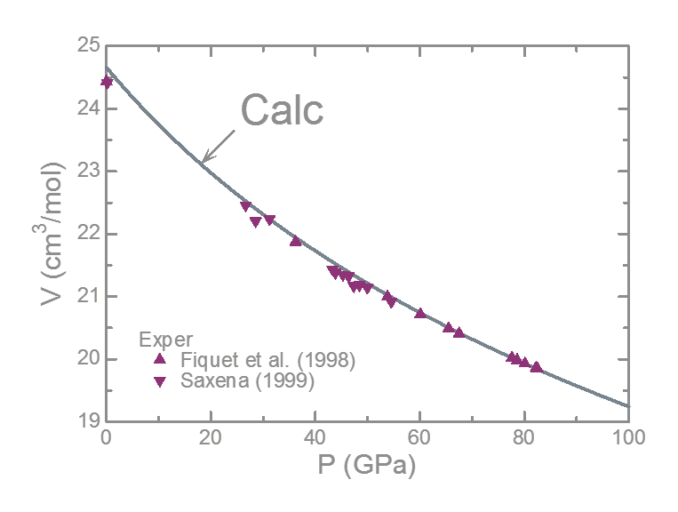
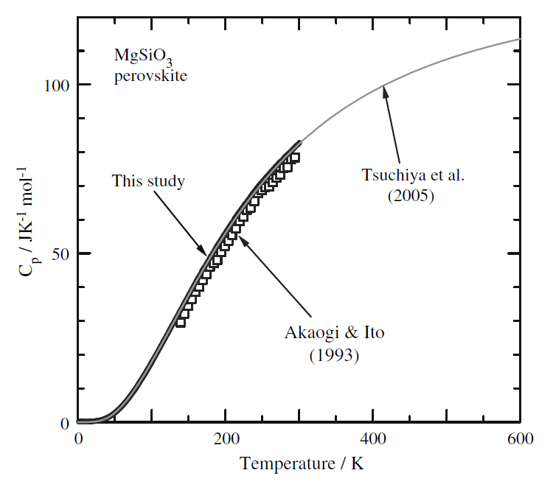
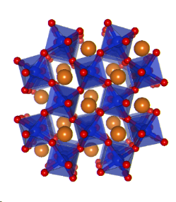

Predictability of DFT calculations
MgSiO₃ bridgmanite
Compression curve
Thermodynamics
(e.g. specific heat)
Earth’s lower mantle
0GPa
Calorimetry
$∆V≤1\sim 2\%$
Calculation
J. Tsuchiya+ (05) JGR
Akaogi+ (08) Phys Chem Miner
Quite high predictability!!

Slide 9
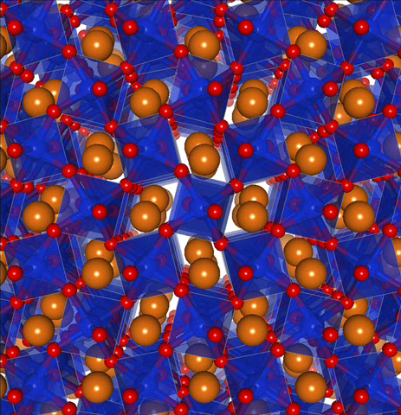
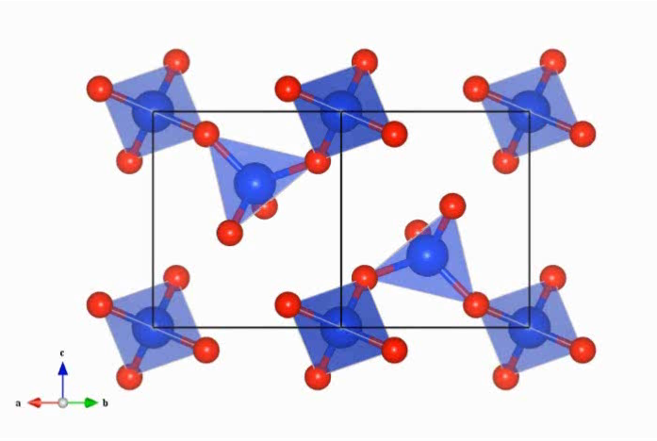
Structure search by ab initio molecular dynamics
MgSiO₃ Bridgmanite
SiO₂ α-Quartz
~700 GPa
Mg
Tsuchiya & Tsuchiya (11) PNAS
Si
~130 GPa
O
Tsuchiya+ (04) EPSL

Slide 10
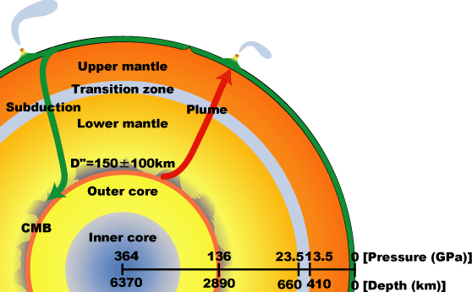
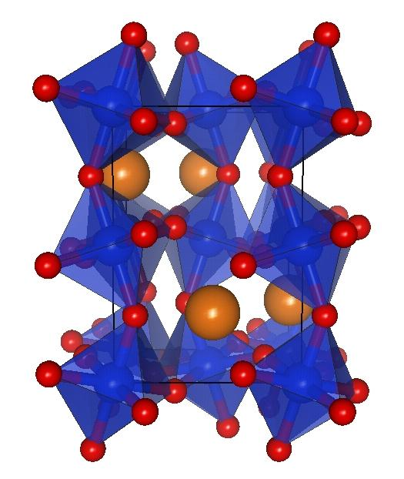
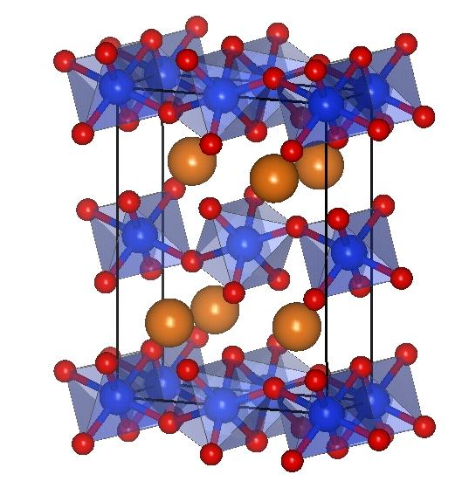
Phase diagram
LDA
GGA
LM
OC
D”
D” layer
7.5 MPa/K
1000K
Mantle adiabat
Murakami+ (04)
Bridgmanite
Post-
perovskite
ΔP_{T}~10 GPa
Valley bottom
Hill top
~8 GPa
~250 km
Tsuchiya+ (04) EPSL

Slide 11
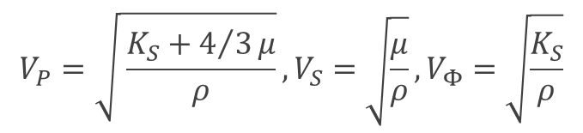

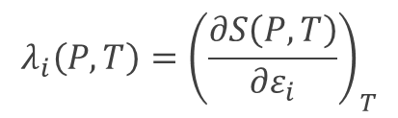
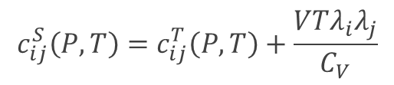
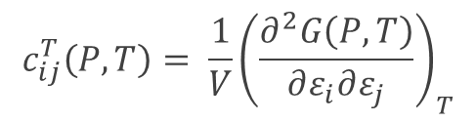


High-P,T elasticity
Method-1: stress-strain (MD)
$$σ_{ij}(P,T)=c_{ijkl}(P,T)ε_{kl}$$
$$kl$$
Method-2: energy-strain (LD)
$$c_{ij}^{T}\left(P,T\right)= \frac{1}{V}{\left(\frac{∂^{2}G\left(P,T\right)}{∂ε_{i}∂ε_{j}}\right)}_{T}$$
Equilibrium structure
Isothermal-adiabatic conversion
Relaxation for strained cell
$$c_{ij}^{S}\left(P,T\right)=c_{ij}^{T}\left(P,T\right)+\frac{VTλ_{i}λ_{j}}{C_{V}}$$
Elastic wave velocity
$$λ_{i}\left(P,T\right)={\left(\frac{∂S\left(P,T\right)}{∂ε_{i}}\right)}_{T}$$
$$V_{P}=\sqrt{ \frac{K_{S}+4/3μ}{ρ}}, V_{S}=\sqrt{\frac{μ}{ρ}}, V_{Φ}=\sqrt{\frac{K_{S}}{ρ}}$$
Polycrystalline average
$$c_{ij}^{S}\left(P,T\right)→K_{S} \& μ (Hill average)$$

Slide 12
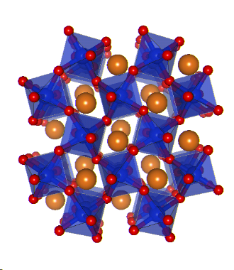
Elastic wave velocity (MgSiO₃ bridgmanite)

Slide 13
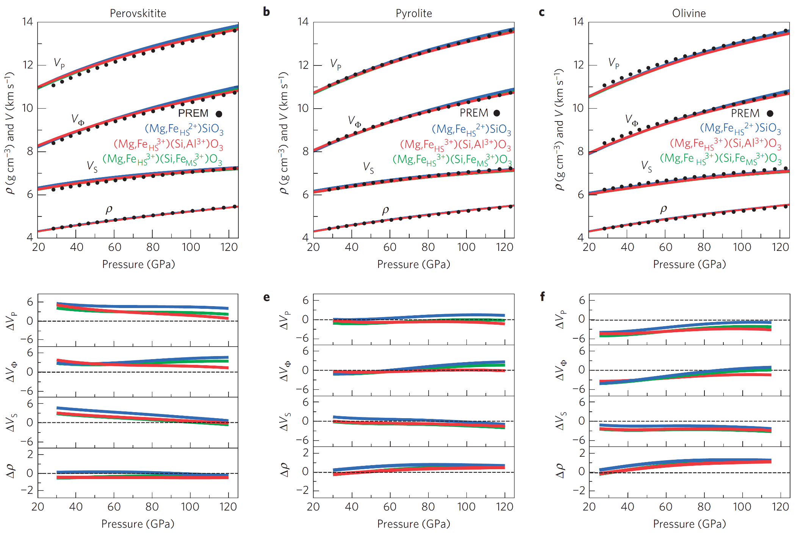
Representative lithology for the lower mantle
Chondrite
Pyrolite
Olivine
Pyrolite model agrees best with PREM in the whole LM P range
Along an adiabatic T profile with T_{P} =1600 K
Blue: Fe²⁺-bearing
Green：Fe³⁺-bearing
Red：Fe³⁺+Al-bearing
Wang, Tsuchiya & Hase (15) Nature Geo

Slide 14
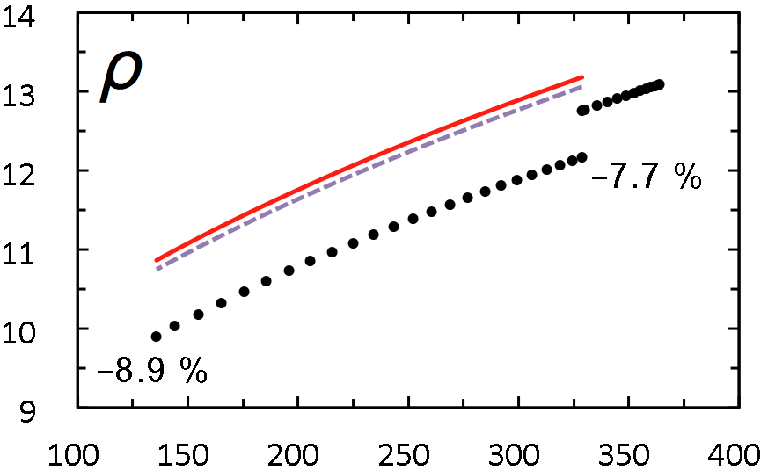
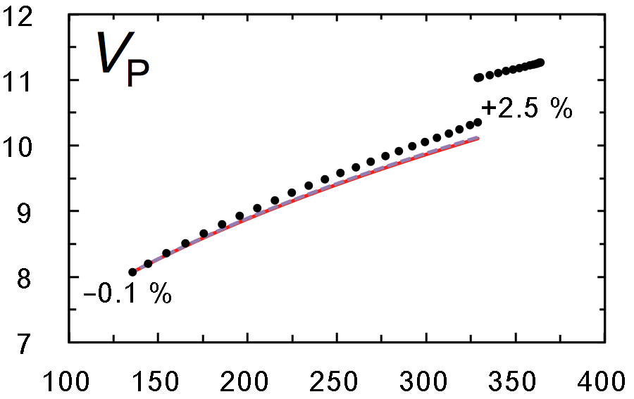
Liquid iron alloys in the outer core
  Fe-Ni + ~10 wt% light elements (O, S, Si, C, H…) (e.g., Birch 64)
CMB
outer core
ICB
CMB
outer core
ICB
T_{ICB} = 5000 K
PREM
Density (g/cm³)
P-wave velocity (km/s)
PREM
T_{ICB} = 5000 K
Pressure (GPa)
Pressure (GPa)
Pure Fe
8~9% denser than PREM
Already comparable V_{P}
Pozzo+ (13) PRB
Ichikawa+ (14) JGR

Slide 15
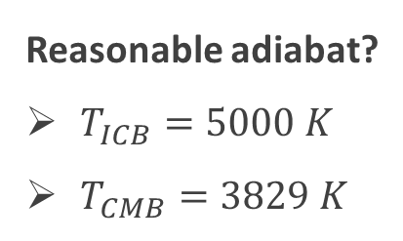
V_{P} and ρ along adiabat
CMB
outer core
ICB
Fe₁₀₀
V_{P}: almost T-independent
ρ: strongly T-dependent
PREM
Reasonable adiabat?
$T_{ICB}=5000 K$
$T_{CMB}=3829 K$
T_{ICB}=9000
T_{ICB}=7000
T_{ICB}=5000

Slide 16

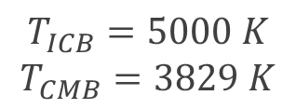
Optimized compositions of binary systems
(atomic %)
outer core
CMB
ICB
Fe₇₈O₂₂
$$T_{ICB}=5000 K$$
$$T_{CMB}=3829 K$$
Fe₈₂S₁₈
- - - $PREM$
Fe₇₀H₃₀
Fe₈₅Si₁₅
Further observations
Melting points
Partitioning
required
Comparable & indistinguishable
Fe₈₀C₂₀
Worse fit

Slide 17
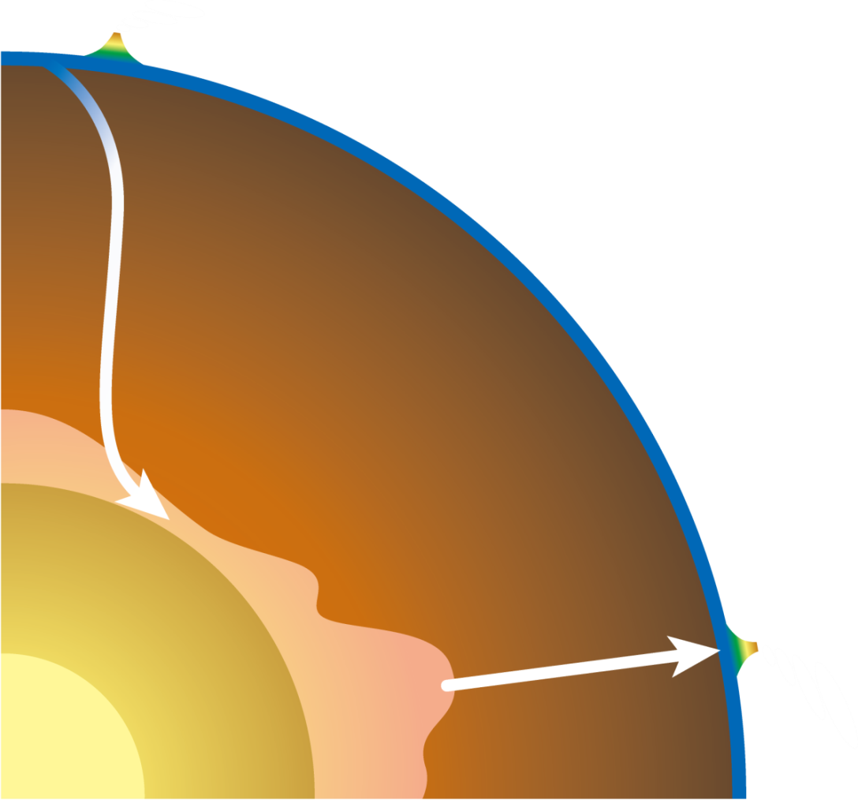
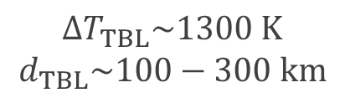
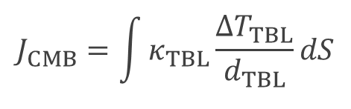
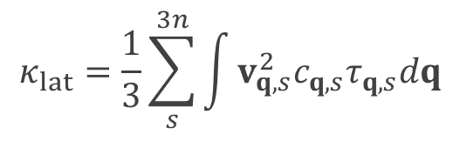
Core-mantle boundary heat flow (J_{CMB})
Heat flow
Arc
$$J_{CMB}=\int{κ_{TBL}\frac{∆T_{TBL}}{d_{TBL}}dS}$$
Thermal boundary layer
Subducting slab
$$∆T_{TBL}\sim 1300 K$$
$$d_{TBL}\sim 100−300 km$$
Global mantle convection
Cold region
Heat
Lattice thermal conductivity
$$κ_{lat}=\frac{1}{3}\sum_{s}^{3n}{\int{v_{q,s}^{2}c_{q,s}τ_{q,s}dq}}$$
Core
Hot region
Hot plume
q_{i}
q_{j}
q_{k}=q_{i}+q_{j}+G
q_{i}
Mantle convection strength
Core cooling rate
q_{j}
q_{k}

Slide 18



Thermal conductivity of the lower mantle
lower mantle
z = 660 km
ICMB
z = 2890 km
4000
$${\text{⇒} J}_{CMB}\sim 3−6 TW$$
3500
T_{sol} of peridotite (Fiquet+2010)
Dekura, Tsuchiya+ (13) Phys Rev Lett
3000
Hot
Close to the lower bound
of previous estimations
~10% of surface heat flow
Enough to sustain geodynamo
T (K)
2500
adiabat (Brown&Shankland1981)
2000
1500
Cold
PPv
+Fp
Tsuchiya+2004
Pv+Fp
1000
20
40
60
80
100
120
140
P (GPa)
0
5
10
15
(
W
m
-1
K
-1
)
LM

Slide 19
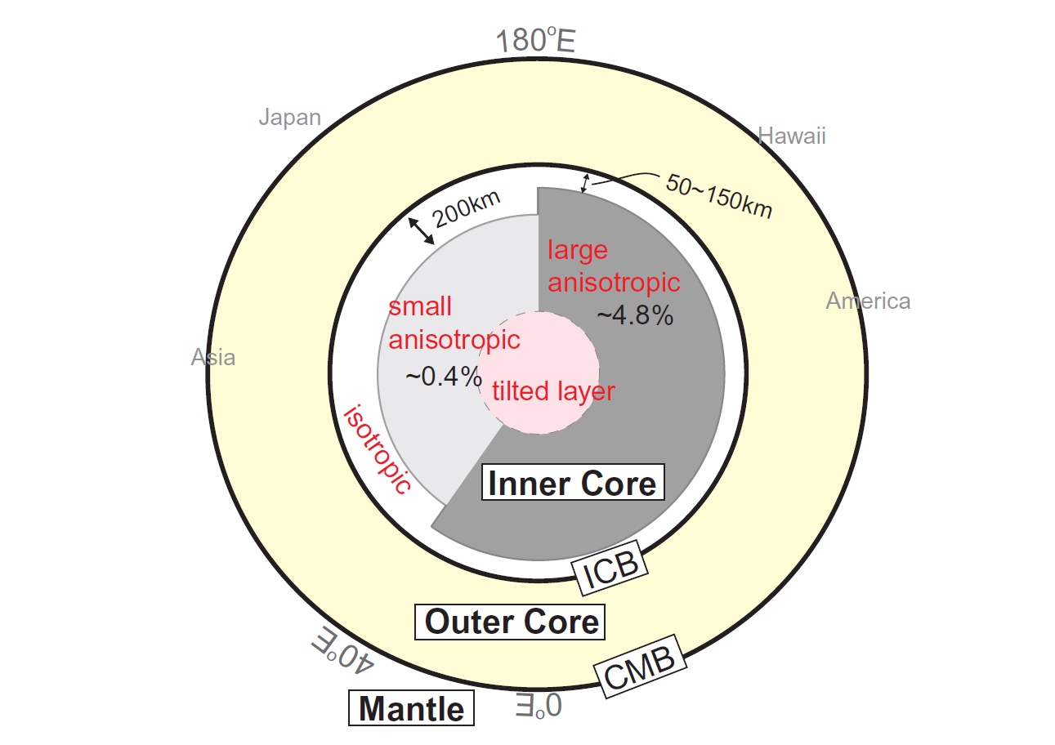
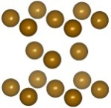
Earth’s inner core
5150 km-6370 km depth
Enigmatic properties
Anisotropy
Hemispherical asymmetry
Layering
Cold?
Hot?
Stable Fe phase
Hcp (ε)
Refs:
Tanaka+ (97)
Creager+ (00)
Ishii & Dziewonski (02)
etc

Slide 20
Density
Inner core
ICB
CoE
~3-5%
Pure hcp Fe:
~1.9% heavier than liquid Fe
~3-5% heavier than PREM
Reasonable agreements with some extrapolations
(Dubrovinski+ 00; Dewaele+ 06; etc)
PREM
Liq. (Ichikawa+ 14)

Slide 21
Elastic wave velocity of hcp-Fe
Inner core
ICB
CoE
Velocities of pure iron closer to PREM over 7000 K!
  Consistent with Sha & Cohen (10) & Martorell+ (13)
  But 7000 K is too high (> T_{melt})!!!
PREM
light elements
  Light elements may enhance discrepancy!

Slide 22


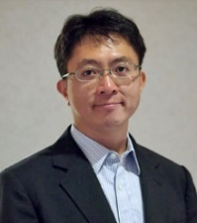
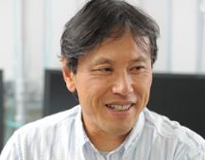
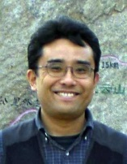
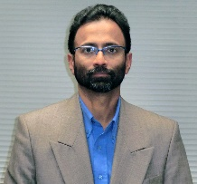
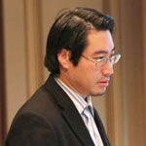

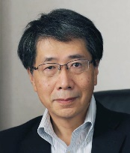
http://core-mantle.jp/
Leader
土屋卓久（愛媛大）
A04
Theory & Computation
参加機関
東北大
新潟大
東京大
東工大
京都大
大阪大
岡山大
広島大
愛媛大
九州大
JAMSTEC
共同利用
基盤施設
SPring-8
J-PARC
KEK
KamLAND
2015FY ~ 2020FY
Isotope
鈴木勝彦（JAMSTEC）
A02
Geochamical analysis
Seismology/
Geomagnetism
田中聡（JAMSTEC）
Core-Manlte
Coevolution
Partitioning
S. Kumar （新潟大）
A03
Geophysical observation
Neutrino
田中宏幸（東京大）
A01
High-P experiment
Dynamics
芳野極（岡山大）
Structure
鈴木昭夫（東北大）
Technique
入舩徹男（愛媛大）
44/45

