Slide 1
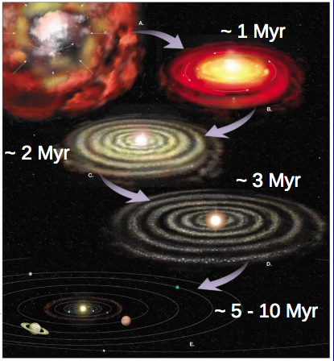
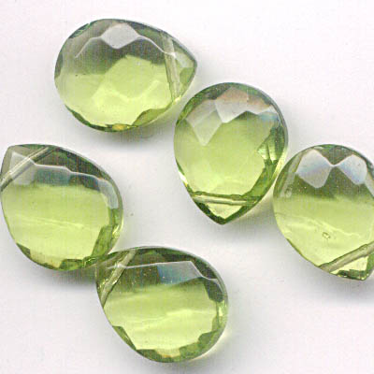
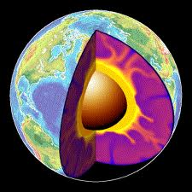
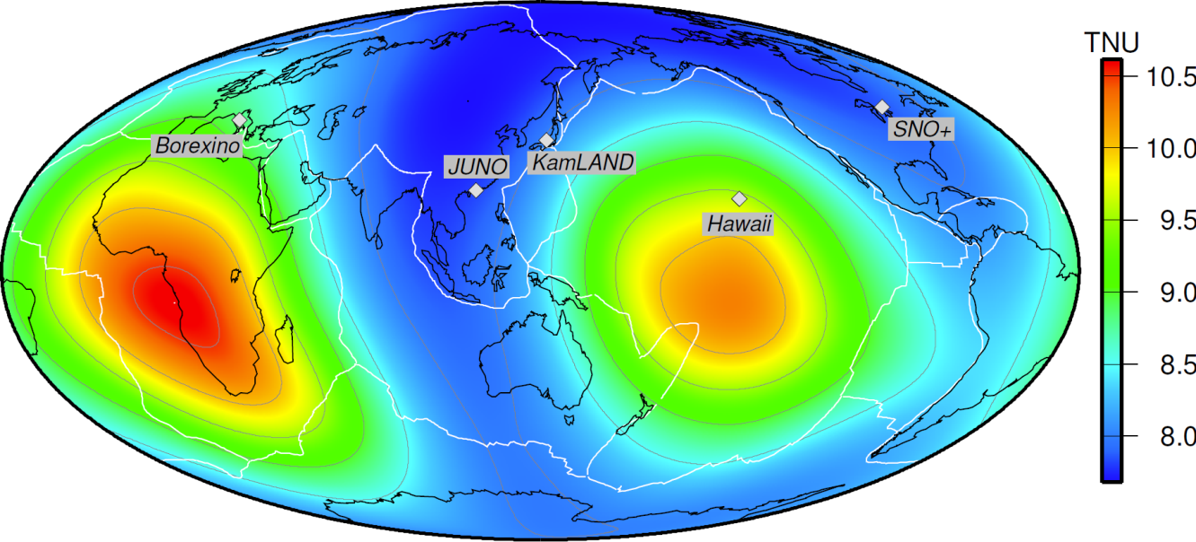



The Core and Mantle:
future prospects for understanding the Deep Earth
Bill McDonough
Geology, U Maryland

Slide 2
Big Unknowns:
  Composition of silicate Earth (Mg, Si, Fe, O)
    Amount of recycled basalt in the mantle
      In the Transition Zone?
      In the deep mantle
  Mineralogy of the Lower mantle
  Composition of the light element in the
      outer core
      Inner core
The Building Blocks of the Earth
  Chondrites, yes, but which?

Slide 3
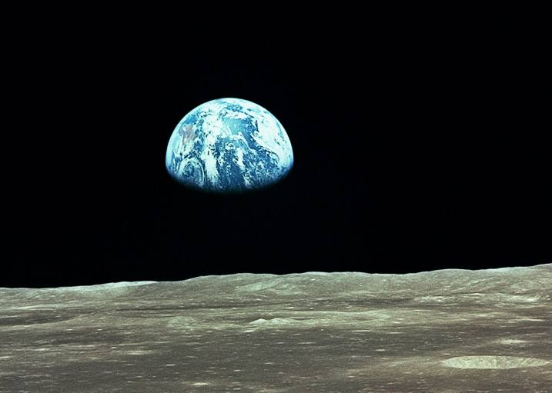
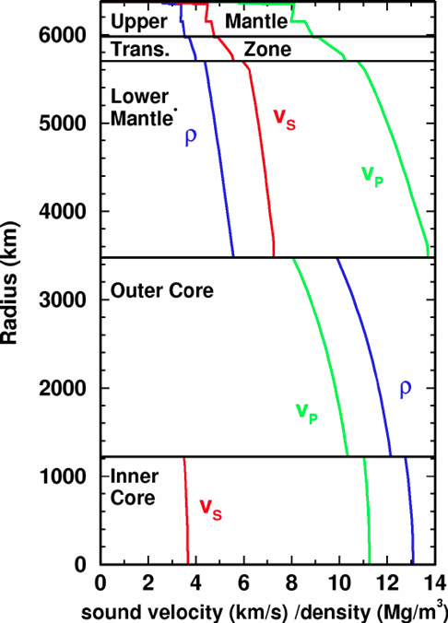
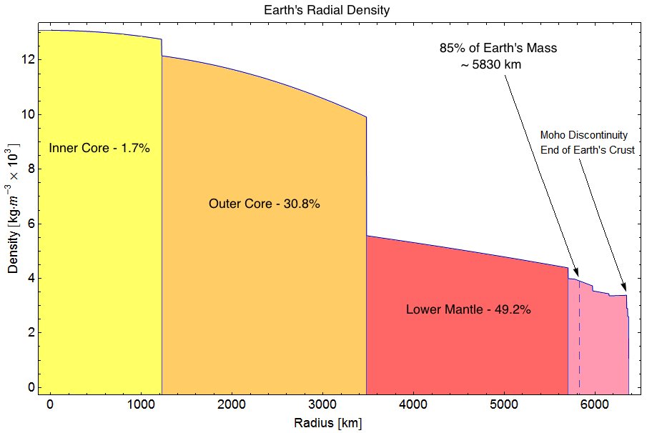
Observations of the Earth
moment of inertia
I/(MR)² = 0.329976(5)
radius
Mean = 6371.01
Equat. = 6378.14
Polar = 6356.75 km
Mass_{Earth}= 59,725.(8) x 10²⁴ kg
PREM Dziewonski and Anderson 1980

Slide 4
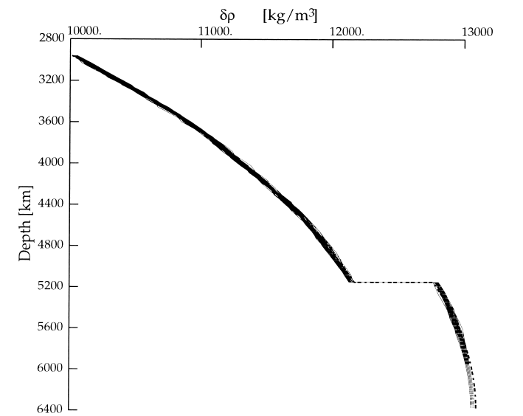
Observations of the Earth
Constraints:
PREM seismic model
Body wave (Vp, Vs)
Free oscillations
Density (kg/m³)
10,000
11,000
12,000
13,000
Outer core
Density
820 ± 170 kg/m³
Depth to the
Core-Mantle
Boundary
2895 ± 5 km
Inner-outer core
Boundary
5150 ± 10 km
Inner core
Core density: 50 model tested
Kennett (1998, GJI); Masters and Gubbins (2003, PEPI)

Slide 5
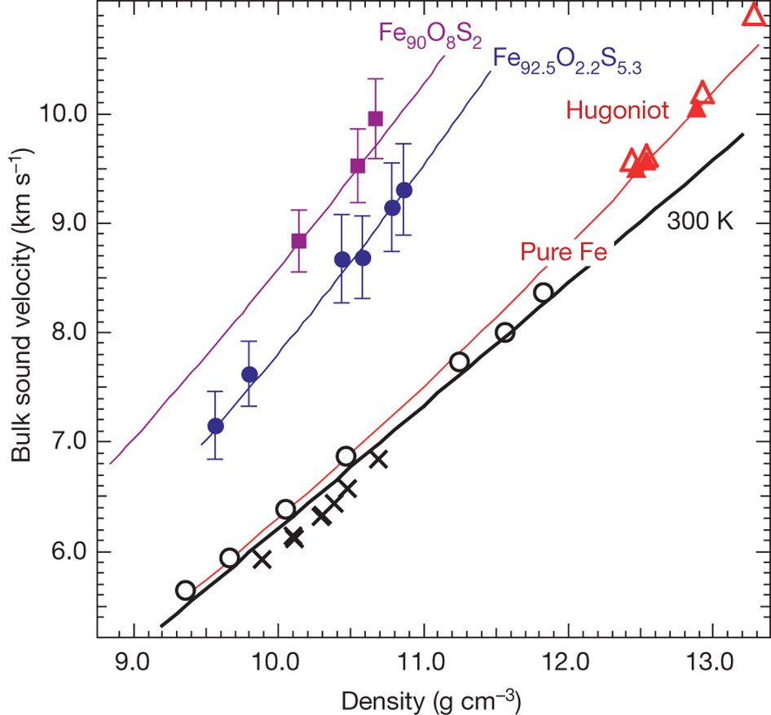
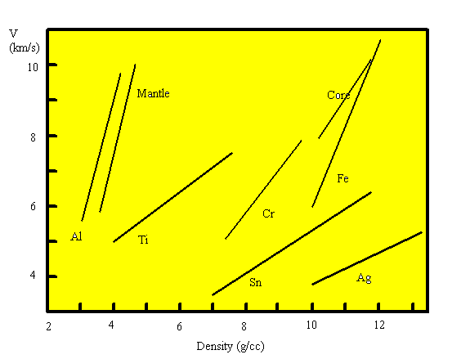
Sounds speed for the Core
Scaling between velocity
and bulk composition
Huang et al (2011, Nature)

Slide 6
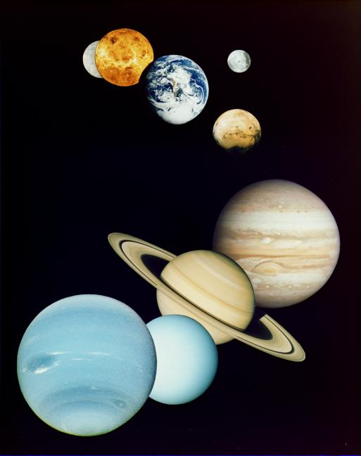
“Standard” Planetary Model
Orbital and seismic (if available) constraints
Chondrites, primitive meteorites, are key
So too, the composition of the solar photosphere
Refractory elements (RE) in chondritic proportions
Absolute abundances of RE – model dependent
Mg, Fe, Si & O are non-refractory elements
Chemical gradient in solar system
Non-refractory elements: model dependent
U & Th are RE, whereas K is moderately volatile

Slide 7
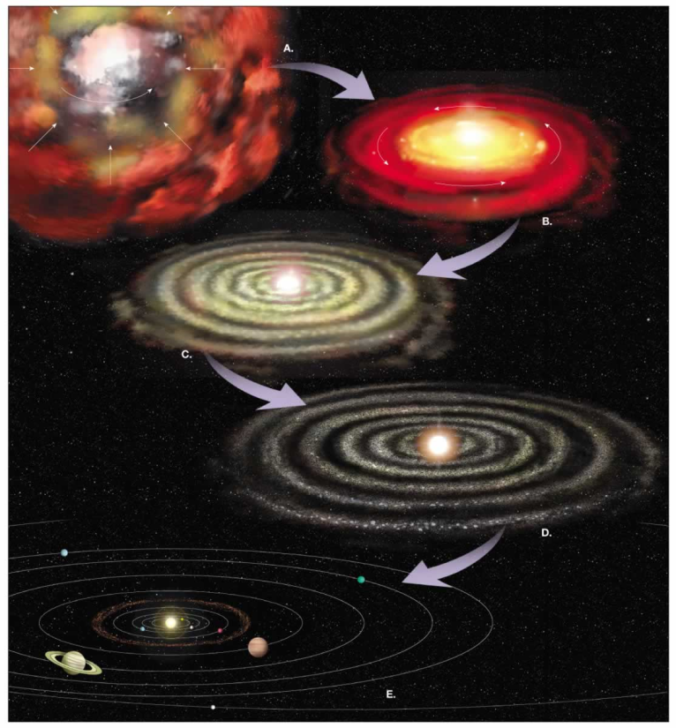
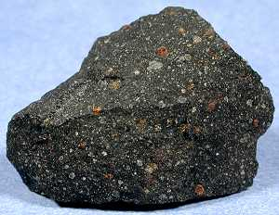

What is the composition of the Earth?
and where did this stuff come from?
Nebula
Meteorite
Heterogeneous mixtures of components with different formation temperatures and conditions
Planet:
mix of metal, silicate, volatiles

Slide 8
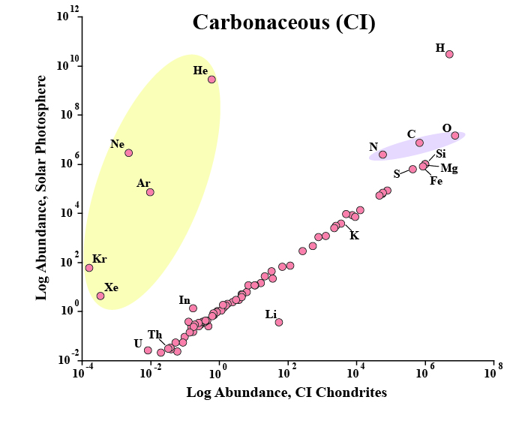
Sun and Chondrites are related
K, Th & U
heat producing elements
McDonough 2016

Slide 9
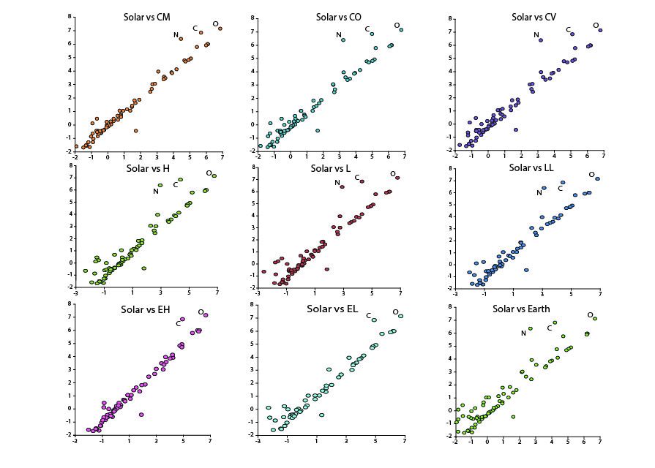
Engel and McDonough 2016

Slide 10
Most studied meteorites
fell to the Earth ≤0.5 Ma ago

Slide 11
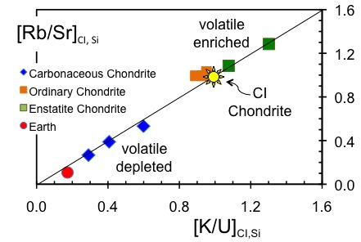
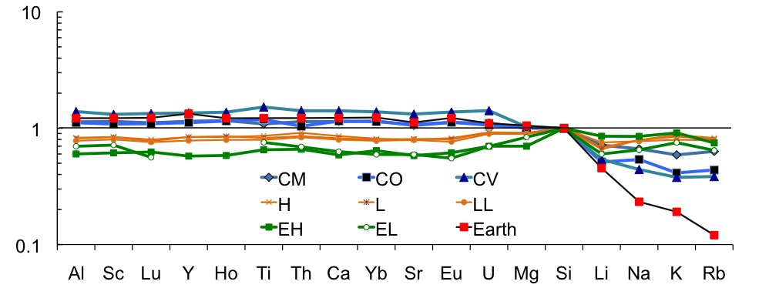
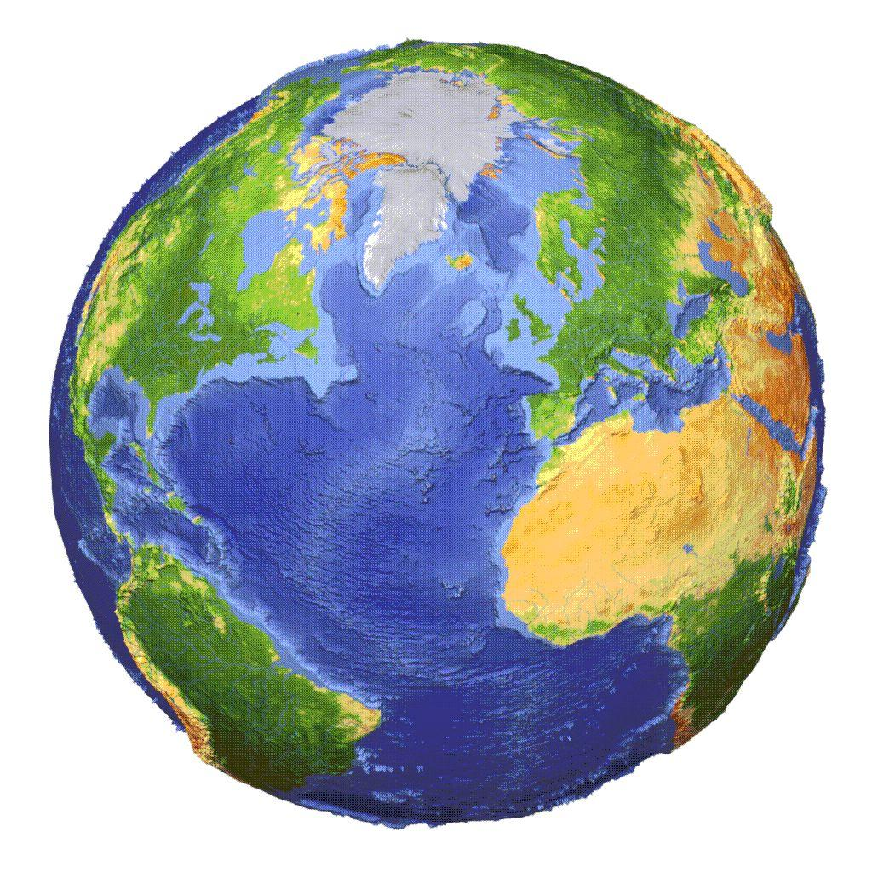
Volatiles
(alkali metals)
in Chondrites
Enstatite Chondrites
enriched in volatile elements
High ⁸⁷Sr/⁸⁶Sr [c.f. Earth]
⁴⁰Ar enriched [c.f. Earth]
CI and Si Normalized

Slide 12
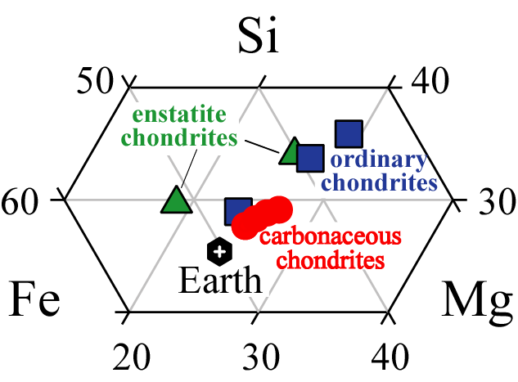
Si
Most studied meteorites
fell to the Earth ≤0.1 Ma ago
Fe
Mg
weight % elements
Moles Fe + Si + Mg + O = ~93% Earth’s mass
(with Ni, Al and Ca its >98%)

Slide 13
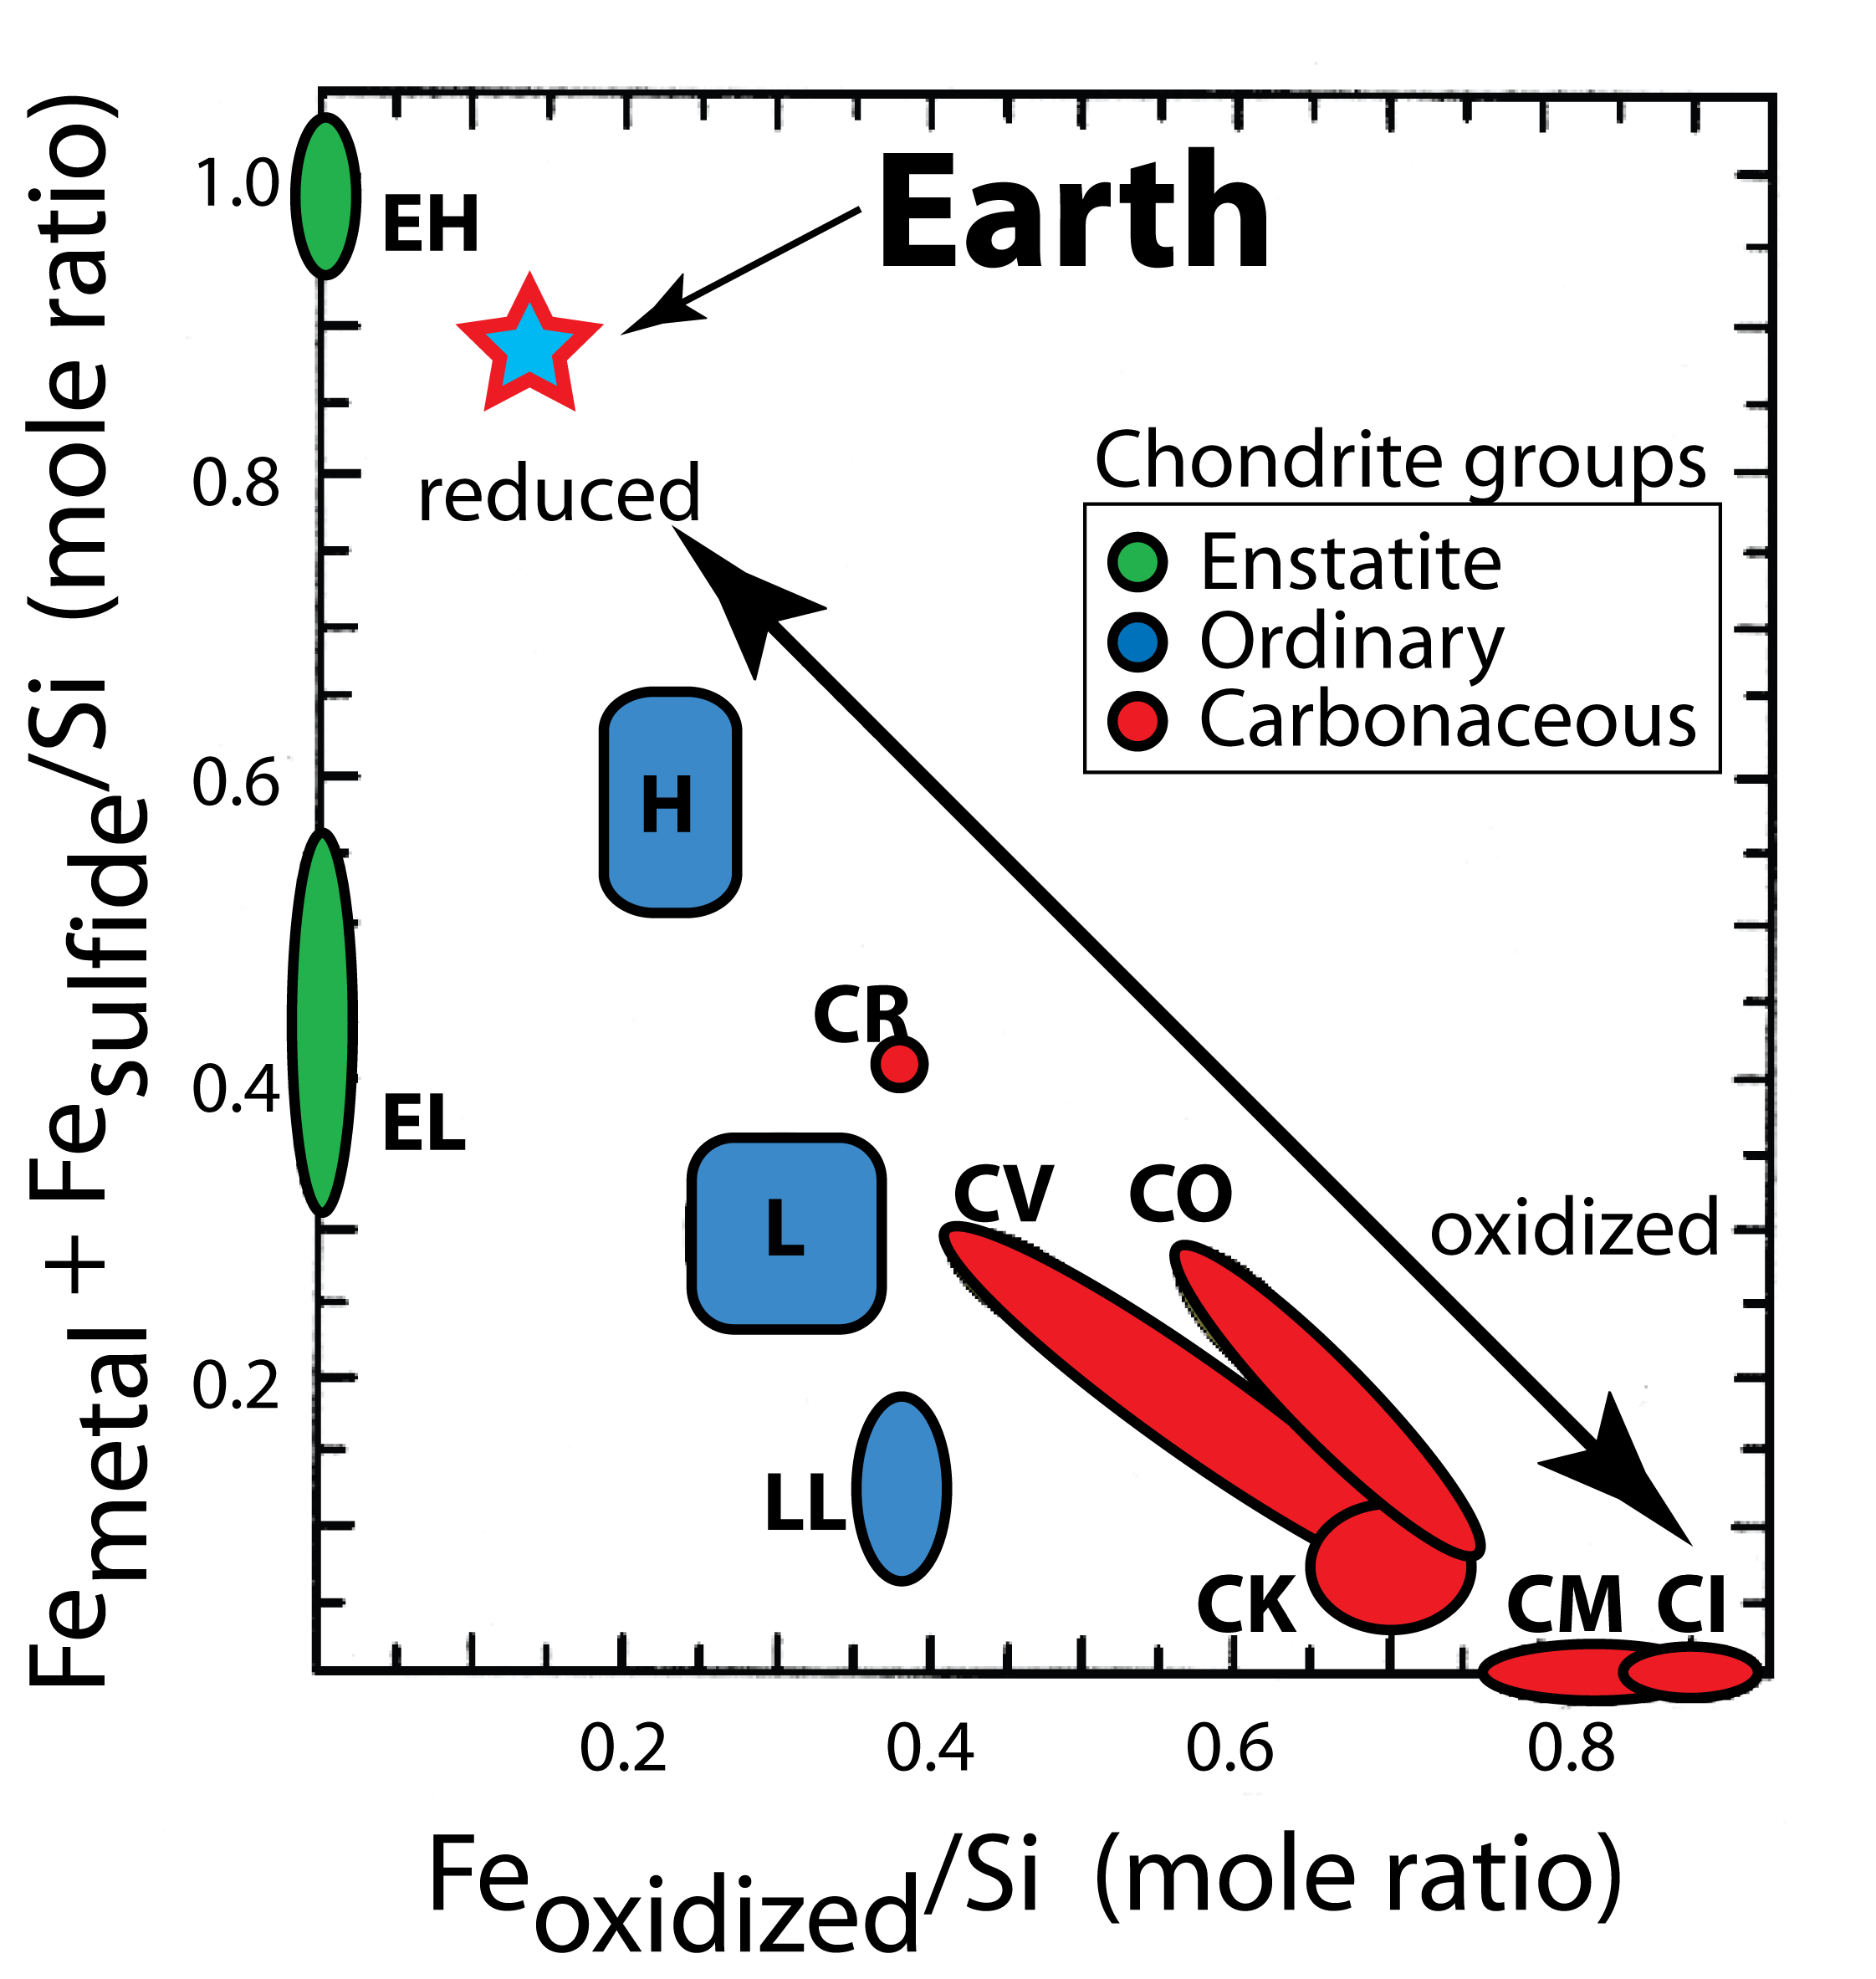
Redox state of the Earth
Which chondrite
is the Earth?

Slide 14
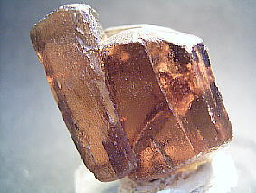
Mg/Si variation in a nebula disk
Forsterite
-high temperature
-early crystallization
-high Mg/Si
-fewer volatile elements
Enstatite
-lower temperature
-later crystallization
-low Mg/Si
-more volatile elements

Slide 15
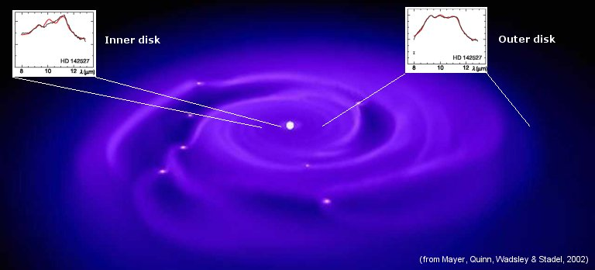
Inner nebular regions of dust to be highly crystallized,
Outer region of one star has
- equal amounts of pyroxene and olivine
- while the inner regions are dominated by olivine.
Boekel et al (2004; Nature)
Olivine-rich
Ol & Pyx

Slide 16
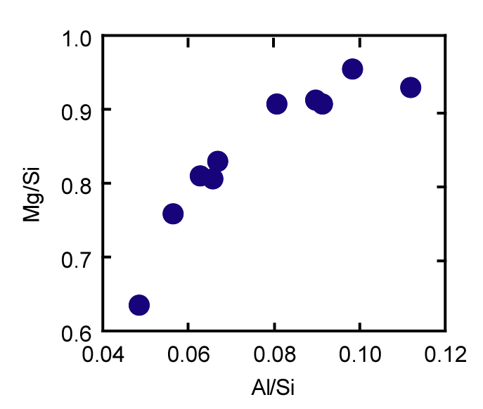

Olivine-rich
Mars @ 2.5 AU
Earth @ 1 AU
Closer to sun?
EARTH
CO
CV
CI
CM
H
LL
L
?
MARS
EL
SS Gradients
-thermal
-compositional
-redox
EH
Pyroxene-rich

Slide 17
Olivine
McD & Sun
EARTH
Table 6
Turcotte &
Schubert
EARTH
Javoy et al ‘10
EARTH
J&K’14
Carbonaceous
chondrites
(kg/kg)
Gradient in olivine/pyroxene
Ordinary
chondrites
Table 4
Enstatite
chondrites
Pyroxene
(kg/kg)

Slide 18
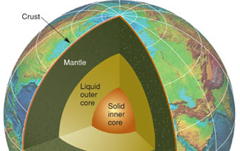
The Core: the source of the geodynamo
innermost 3500 km of the planet
Core-Mantle Boundary (CMB): zone of exchange
Outer surface: the flat underside of the CMB
Core (CMB) surface potential temperature: 3800-4200 K
“Core” uncertainties
Temperature: CMB, OC-IC
Light element(s): X_{i} and wt%
Presence of radioactivity
Age of inner core
Mode and rate of IC growth
Outermost outer core ??

Slide 19
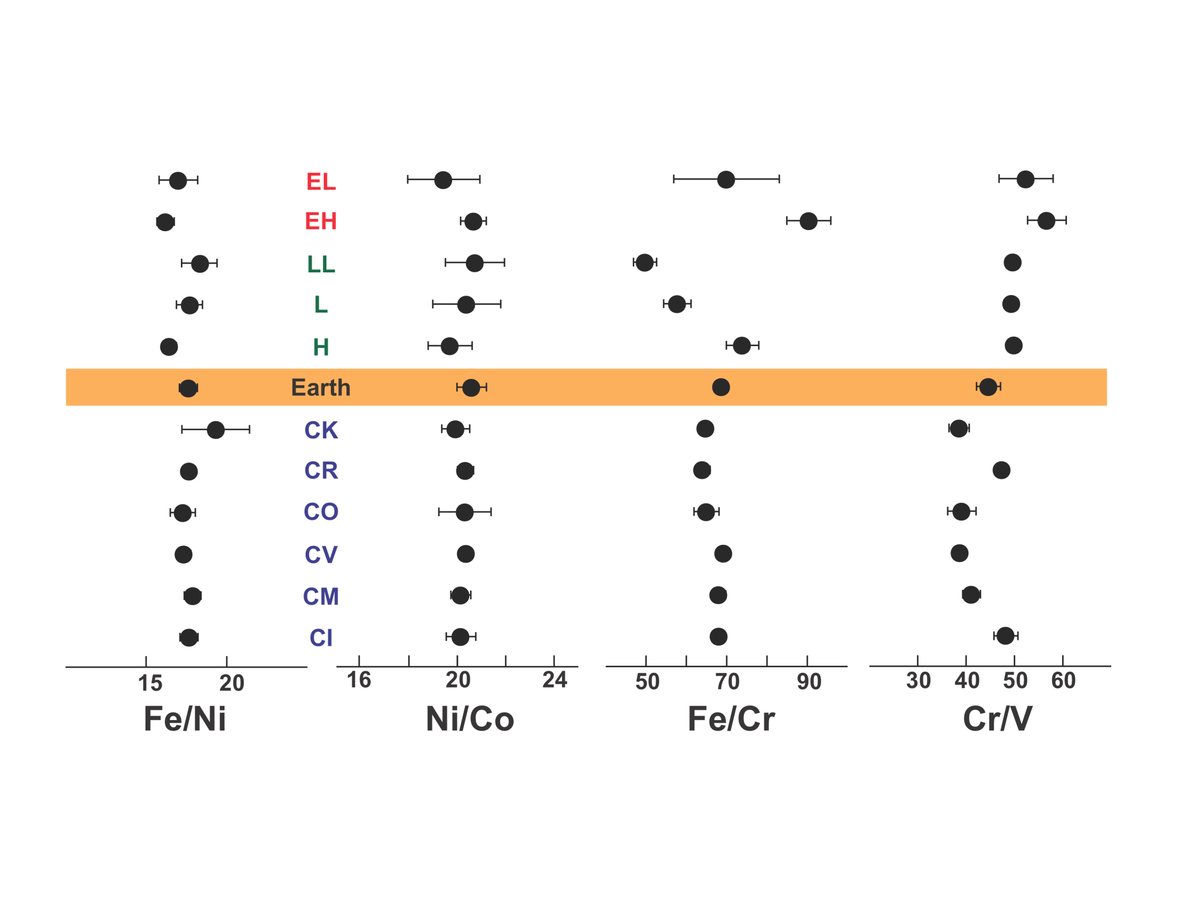
Constraining the core composition
Enstatite Ch.
(reduced)
Ordinary Ch.
(intermediate)
Carbonacoues
chondrites
(oxidized)
Given a bulk earth composition with Al = 1.6 wt% and Fe/Al = 20,
then core composition is calculated based on chondritic ratios.

Slide 20
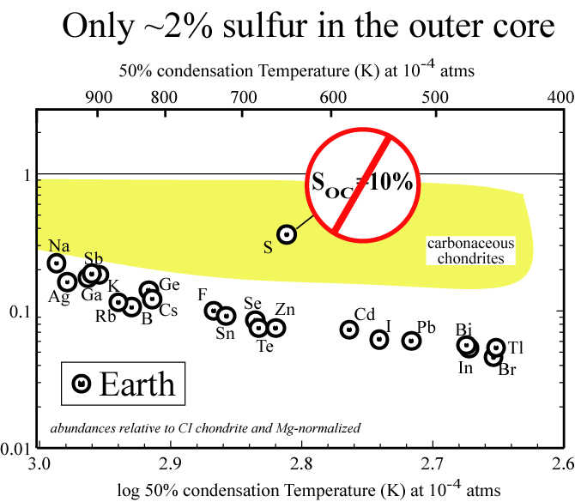

Slide 21
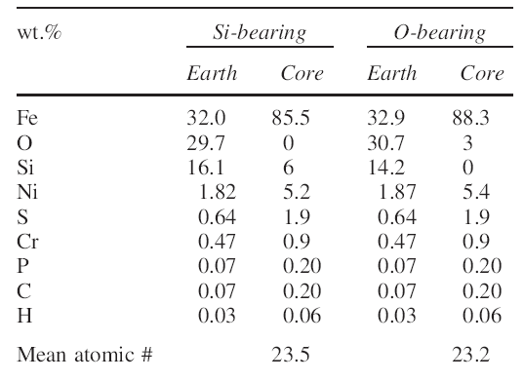
Core compositional models
Model 1
Model 2
others

Slide 22
The Mantle: source of basalts
2900 km thick
Surfaced by ~35km Continental or ~8km Oceanic Crust
Surface potential temperature ~1550 K
Core-Mantle Boundary (M-side) temperature 3000-3500 K
Depleted Mantle
- Depth/Volume ?
- Top of mantle
- Residua from production of Continental Crust
- Recorder of convection efficiency

Slide 23
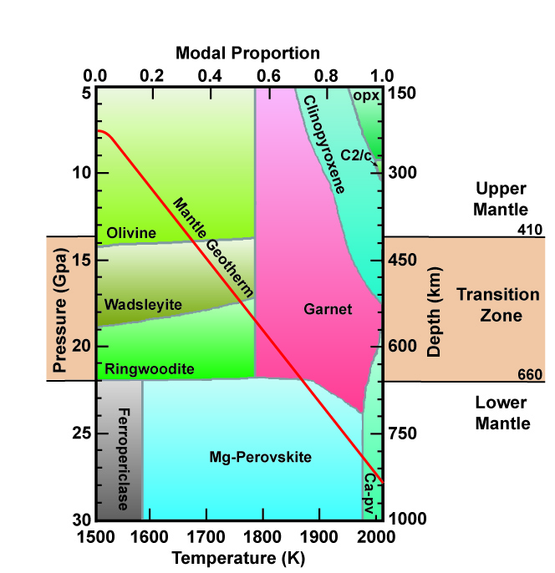
Mineral proportions in the Earth
UM
TZ
LM

Slide 24
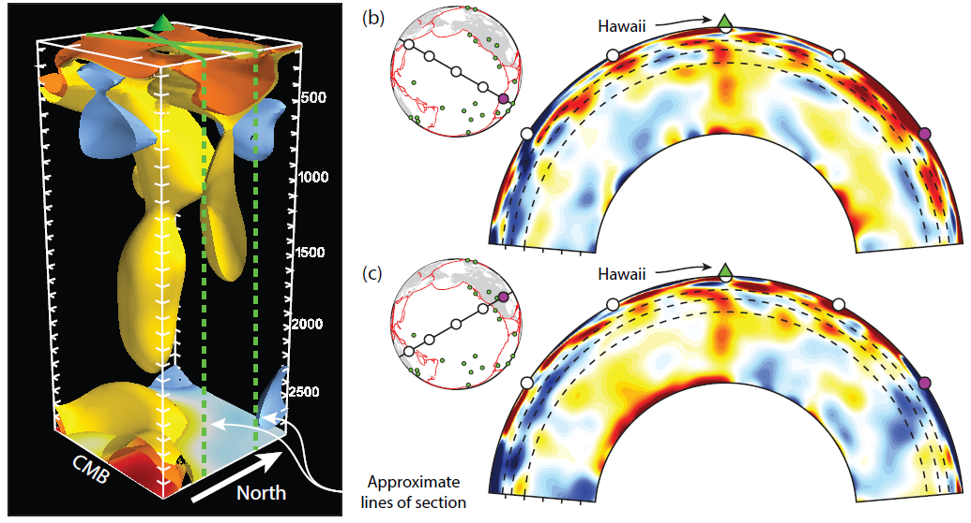
extending from CMB
rooted in large ULVZ
Hawaiian plume:
1st time: continuous connection between ULVZ's and mantle plumes
French & Romanowicz (Nature, 2015)

Slide 25
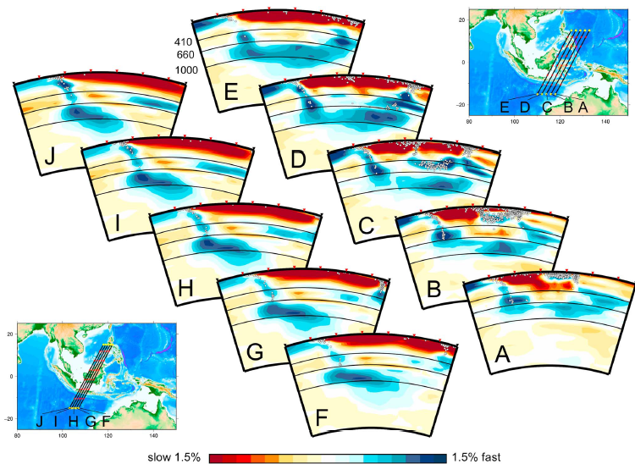
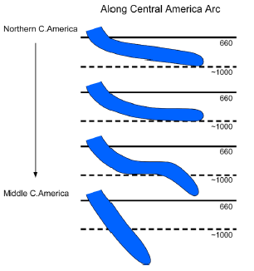
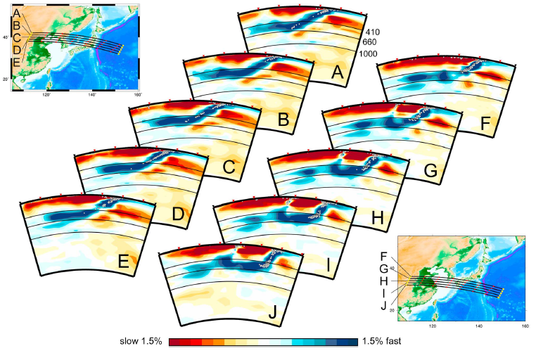
Oceanic Plate stagnation
- 660 km depth
- 1000 km depth
Understanding the
mantle viscosity structure
Fukao & Obayashi (JGR ‘13)

Slide 26
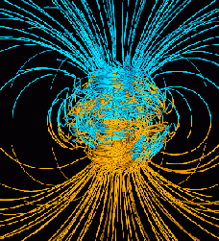
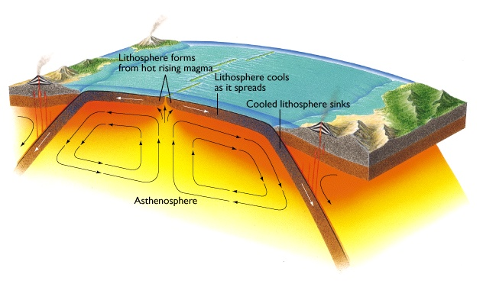
Plate Tectonics,
Convection,
Geodynamo
Radioactive decay driving the Earth’s engine!
K, Th & U!

Slide 27

Earth’s surface heat flow 46 ± 3 (47 ± 1) TW
Mantle cooling
(18 TW)
Crust R*
(7 ± 1 TW)
(Huang et al ‘13)
Core
(~9 TW)
-
(4-15 TW)
Mantle R*
(13 ± 4 TW)
total R*
20 ± 4
*R radiogenic heat
(after McDonough & Sun ’95)
(0.4 TW) Tidal dissipation
Chemical differentiation
after Jaupart et al 2008 Treatise of Geophysics

Slide 28
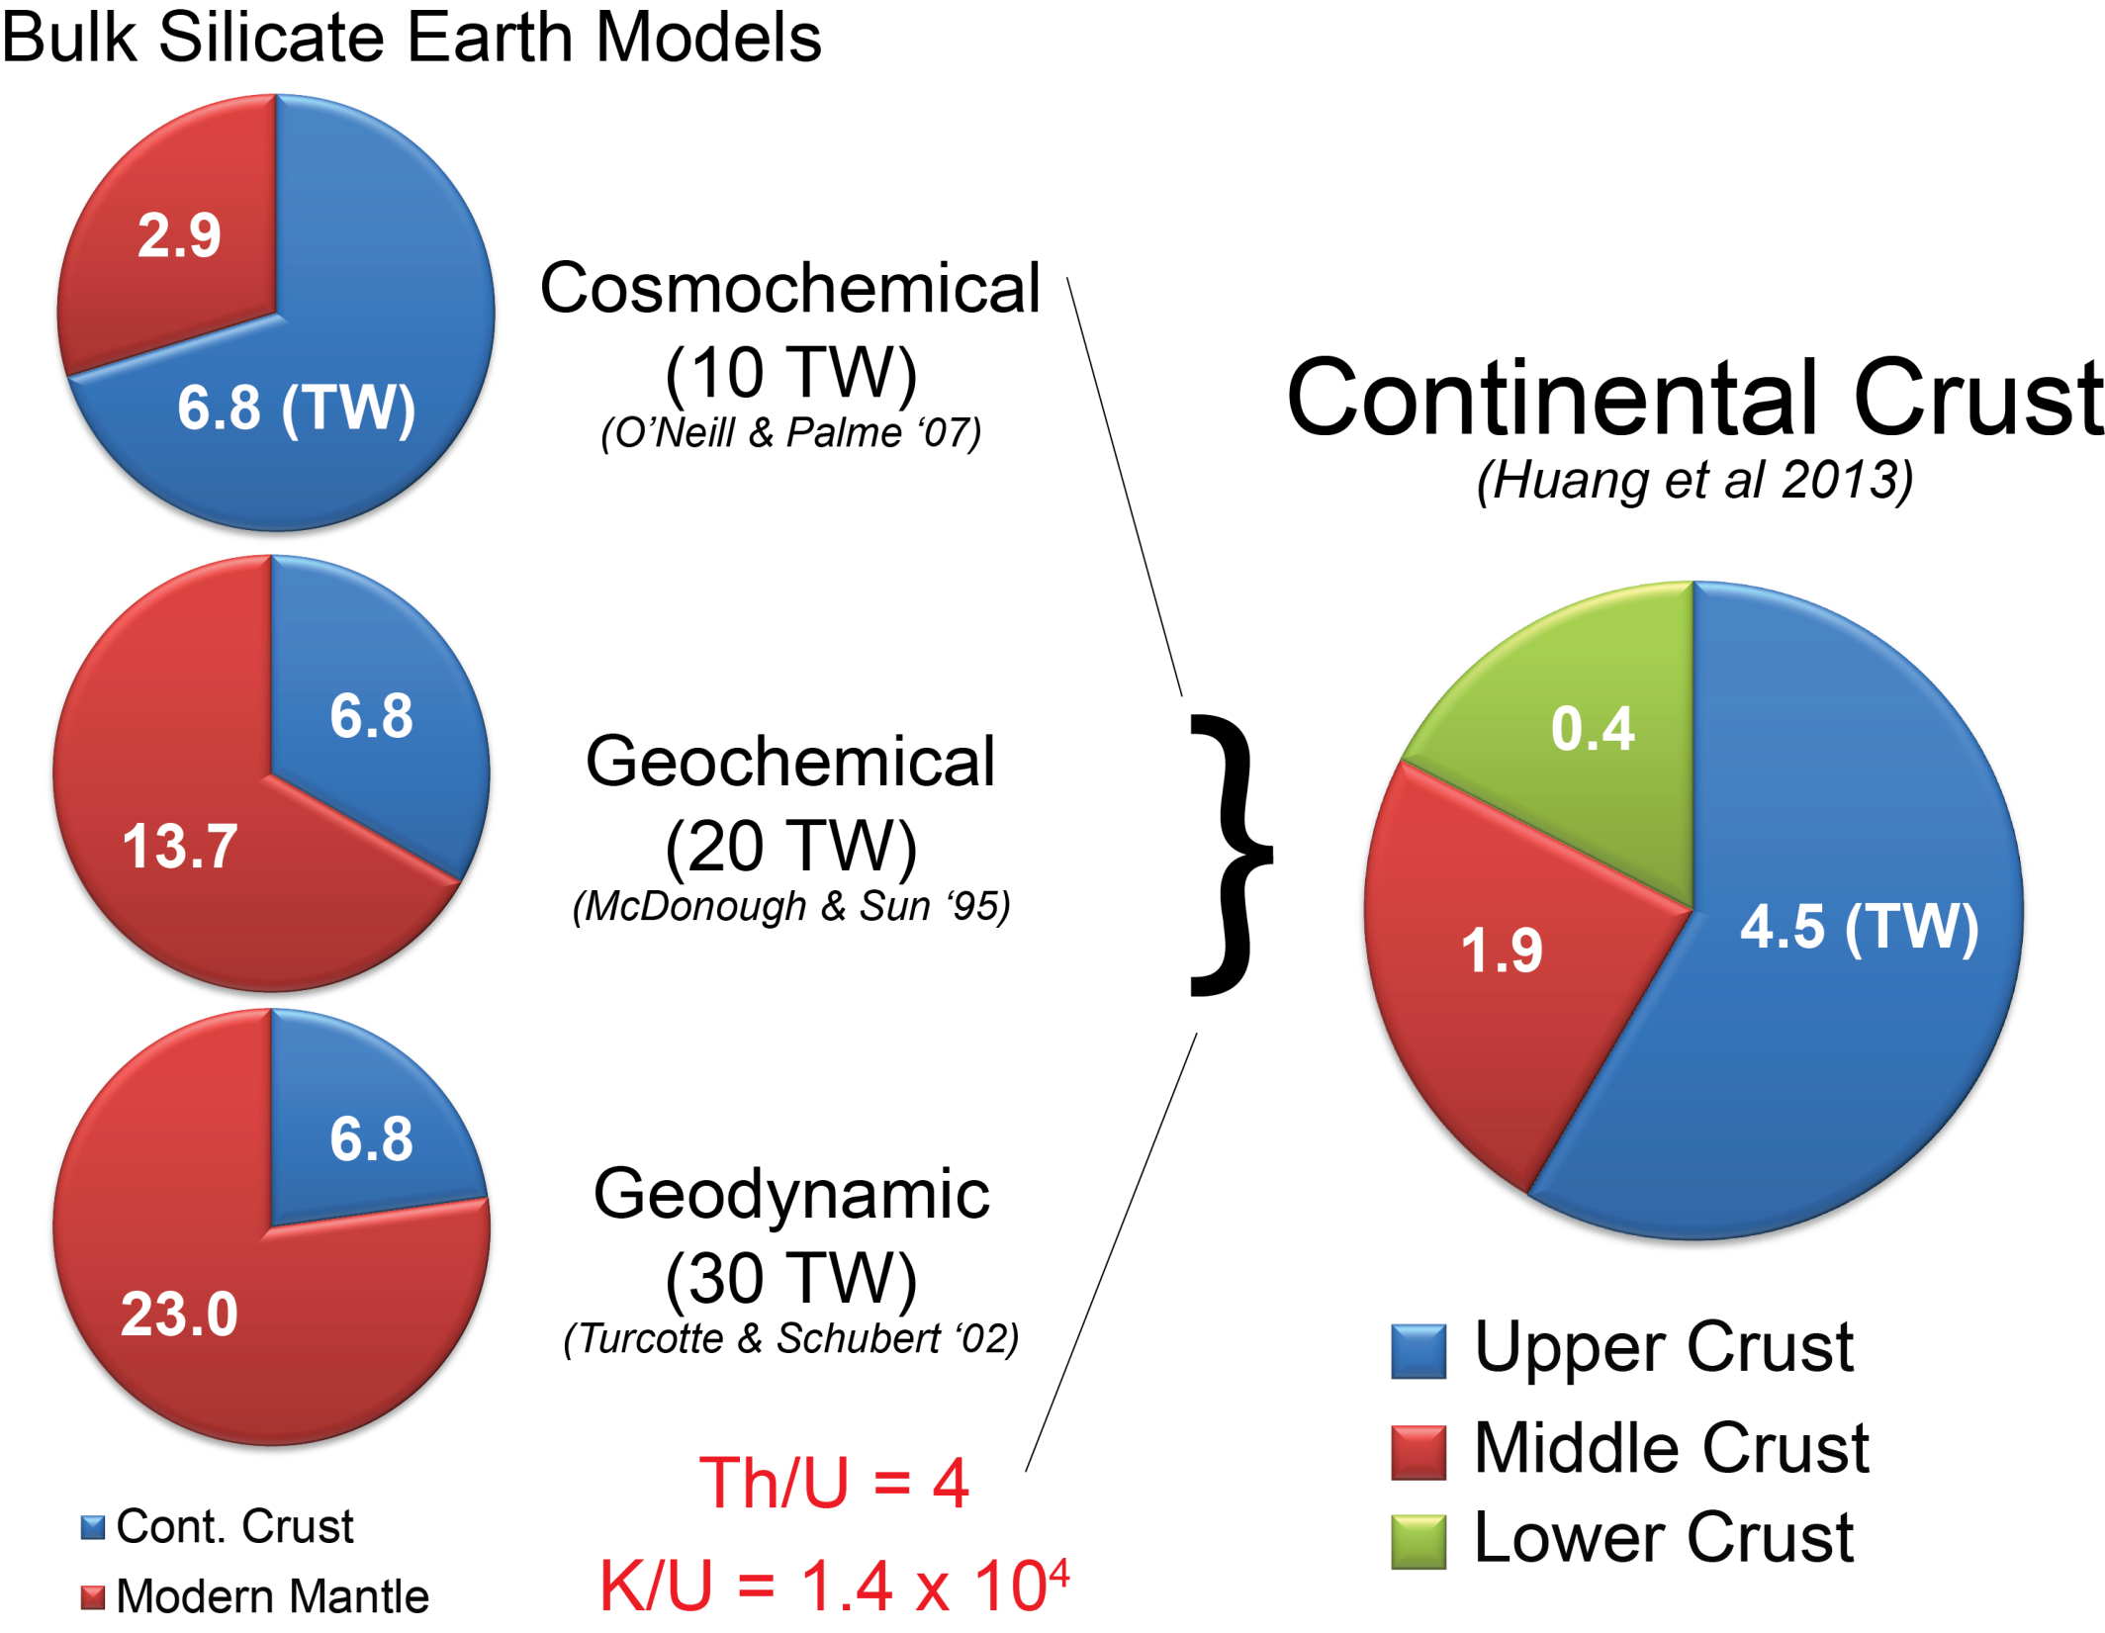
Internal Heat?

Slide 29
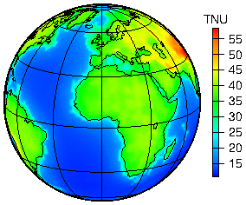
Predicted Global geoneutrino flux based on our new Reference Model
Huang et al (2013) G-cubed, 14:6, doi:10.1002/ggge.20129

Slide 30
Summary of geoneutrino results
fully radiogenic
Silicate Earth MODELS
Cosmochemical: uses meteorites – 10 TW
Geochemical: uses terrestrial rocks –20 TW
Geodynamical: parameterized convection – 30 TW
TNU: geo-nυ event seen by a kiloton detector in a year

Slide 31
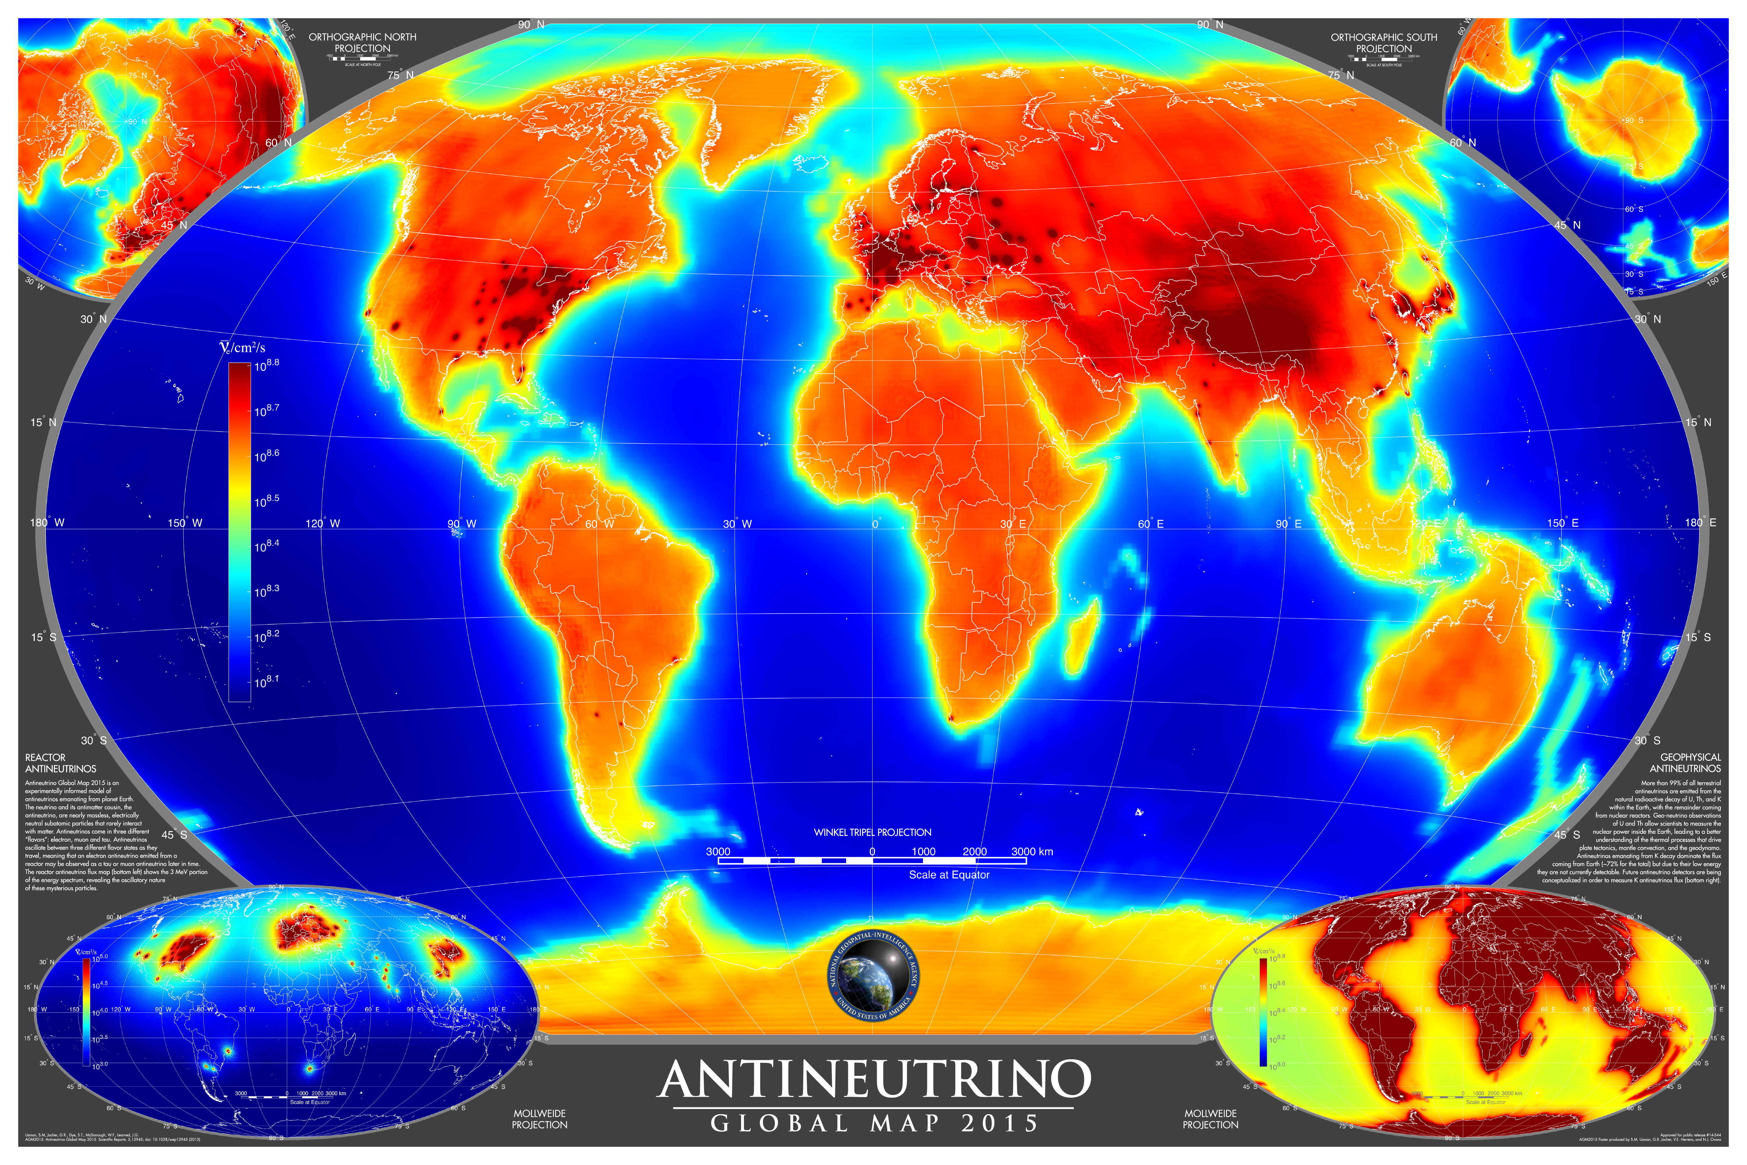
Antineutrino Map: geoneutrinos + reactor neutrinos

