Slide 1
Seismological Constraints on Velocity and
Density in the Earth’s Core
Nozomu Takeuchi
(University of Tokyo)
Standard Density Model
How was it obtained?
How accurate is it?
Hot Topics on the Core Structures

Slide 2
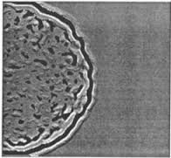
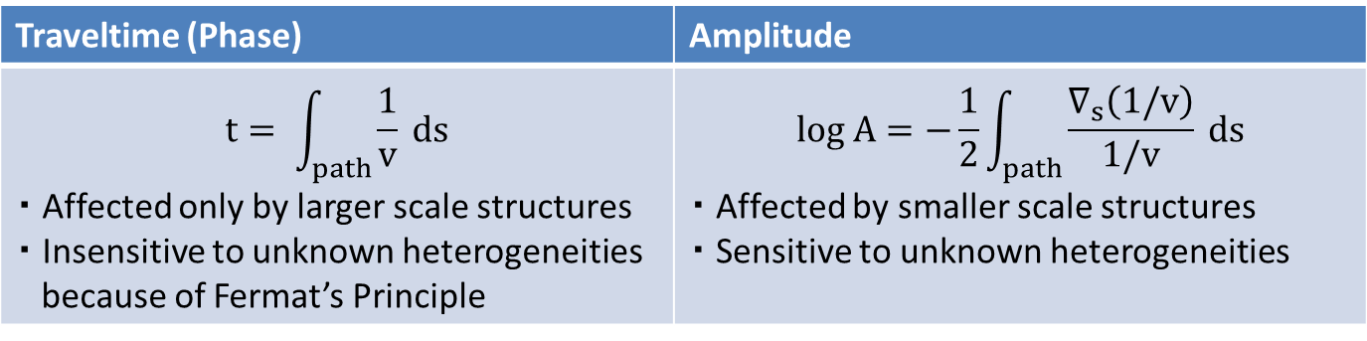
Primary Data in Seismology = Phase Data
Earth contains small scale heterogneities
that cannot be resolved by limited data.
We have to consider seismic wave
propagations in a medium with
unknown heterogeneities.
Traveltime (Phase) | Amplitude
$$t= \int_{path}{\frac{1}{v} ds}$$ ・ Affected only by larger scale structures ・ Insensitive to unknown heterogeneities because of Fermat’s Principle | $$log A=−\frac{1}{2}\int_{path}{\frac{∇_{s}\left(1/v\right)}{1/v} ds}$$ ・ Affected by smaller scale structures ・ Sensitive to unknown heterogeneities

Slide 3
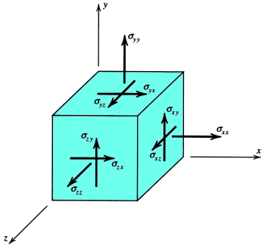
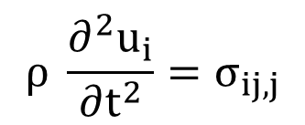
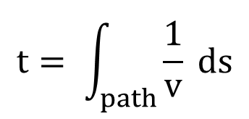
Phase Data are not Sensitive to the Density
< Dynamic Equation of Motion >
$$ρ \frac{∂^{2}u_{i}}{∂t^{2}}=σ_{ij,j}$$
+ Hook’s Law
Optical Ray Approximation
(high frequency approximation)
$$t= \int_{path}{\frac{1}{v} ds}$$
+ eq. for A
The density does not affect to traveltimes
(phase data).

Slide 4




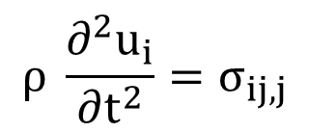

Phase Data are Slightly Sensitive to the Density
< Dynamic Equation of Motion >
$$ρ \frac{∂^{2}u_{i}}{∂t^{2}}=σ_{ij,j}$$
$$+ ρ δg_{i}$$
$$ρ δg_{i}$$
: perturbation of gravitational force
due to deformation of the Earth
$$ρ δg_{i}$$
are significant for longer-period waves.
$$σ_{ij,j}∝k^{2}$$
$$ρ δg_{i}∝k$$

Slide 5
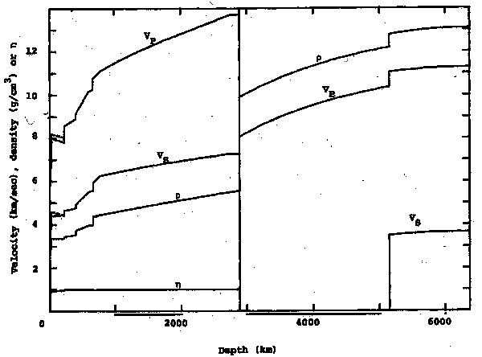
PREM Model (Standard Density Model)
Dziewonski & Anderson (1981)

Slide 6

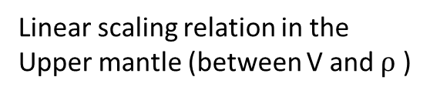
Standard Density Model of the Earth
Seismological Data
Phase Data of Longer Period Waves
(Eigenperiods of Free Oscillations)
Geodetic Data
Standard
Density Model
Earth’s total mass
Earth’s moment of inertia
Geodynamical Insight
Geological Insight
adiabatic compression and hydrostatic
equilibrium in the lower mantle and the core
location of discontinuities etc.
$$\frac{1}{κ}=\frac{1}{ρ} \frac{dρ}{dp}, \frac{dp}{dz}=ρg,$$
$$Vp^{2}−{\frac{4}{3} V}_{s}^{2}=\frac{κ}{ρ}$$
Linear scaling relation in the
Upper mantle (between V and $ρ$ )

Slide 7
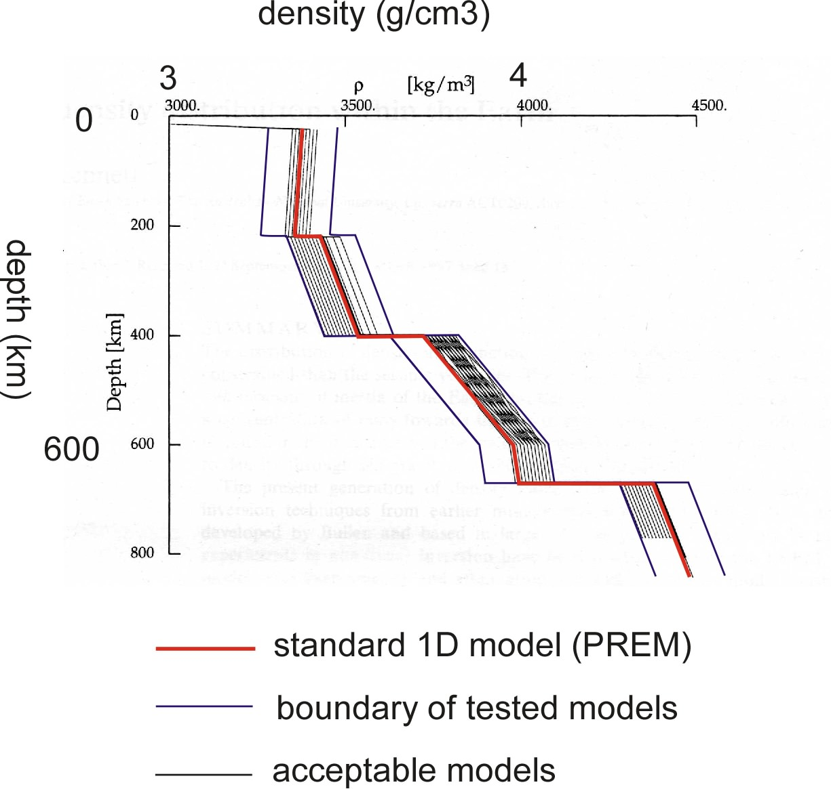
Uncertainty for Density Models Obtained
by Seismological Approach
Kennett (1998, GJI)
Method
Randomly generate density
models within the specified bounds
Compare the observed data with
synthetic for each postulated model
See the ensemble of the models
with acceptable fitting

Slide 8
Uncertainty for Density Models Obtained
by Seismological Approach
Kennett (1998, GJI)
Method
Randomly generate density
models within the specified bounds
Compare the observed data with
synthetic for each postulated model
See the ensemble of the models
with acceptable fitting
Results
Rooms for improvement for the
standard 1-D model
1-D structure has uncertainty with
a few percents. Difficulties in
obtaining 3-D models

Slide 9
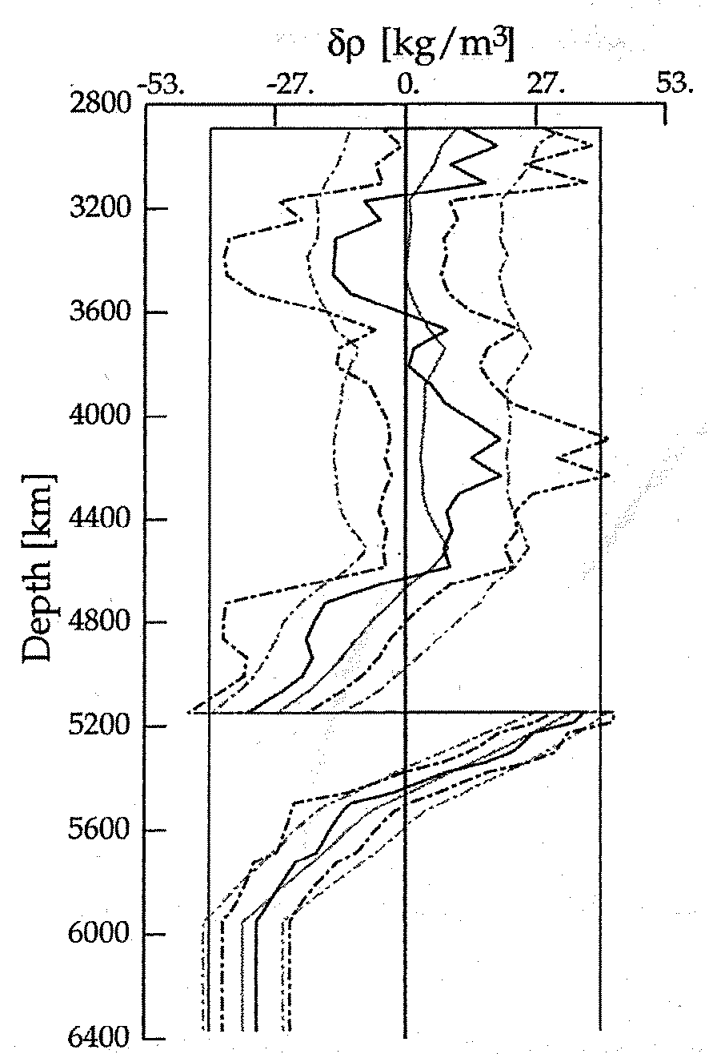
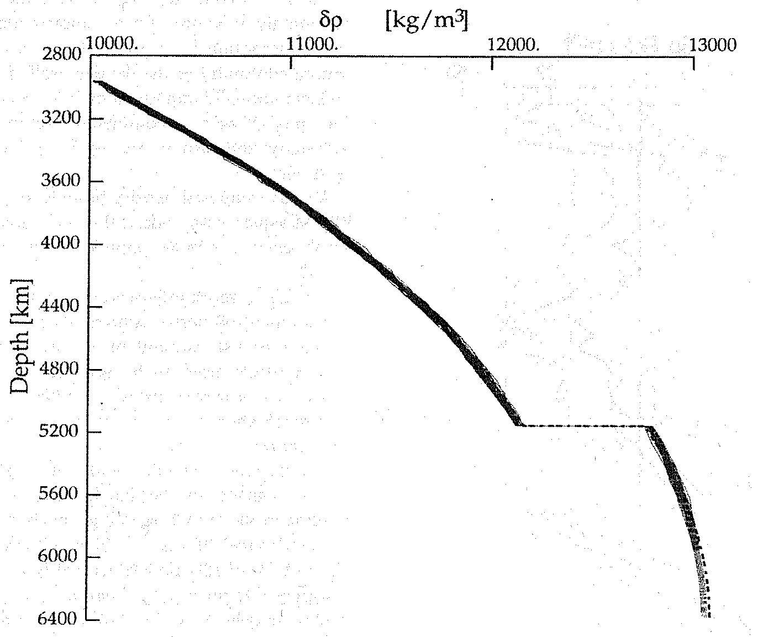
Uncertainty for Density Models Obtained
by Seismological Approach
Kennett (1998, GJI)
Differential Density (g/cm3)
-0.053
0.053
Density (g/cm3)
10
13
outer core
outer core
ICB
ICB
inner core
inner core

Slide 10
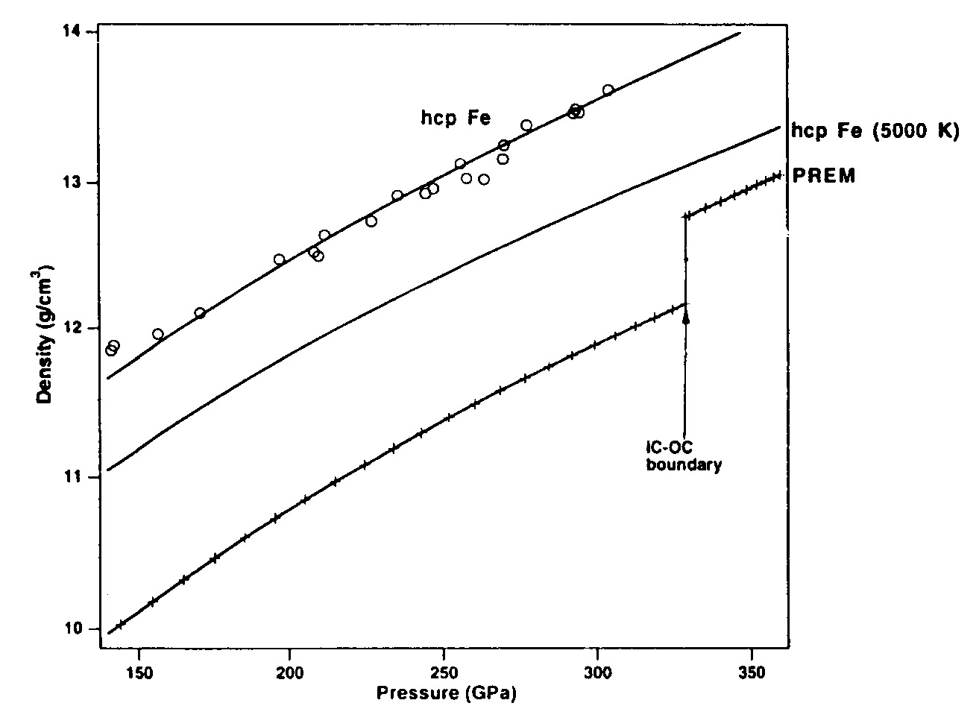
Standard Density Model vs. Densities of Pure Iron

Slide 11
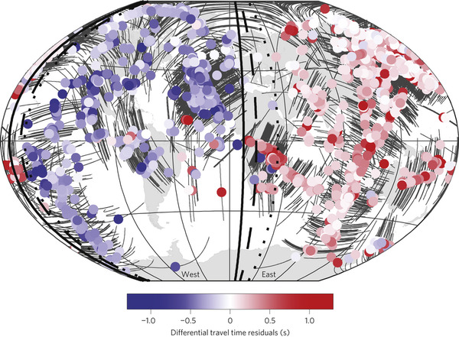
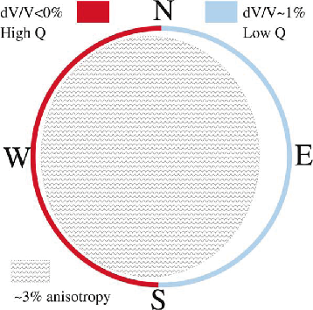
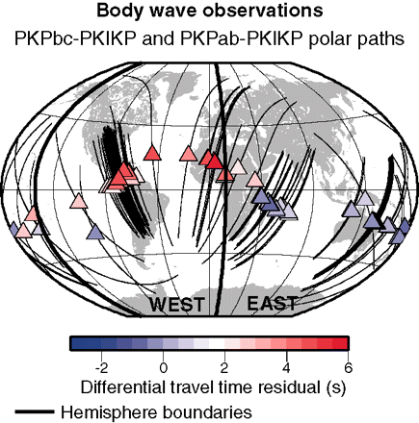
Hemispherical Heterogeneities in the Inner Core
West
East
Low V
Low attenuation (High Q)
High V
High Attenuation (Low Q)

Slide 12
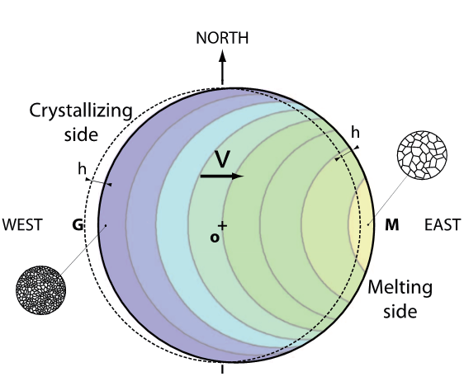
Dynamical Interpretation of the Hemispherical Heterogeneities

Slide 13
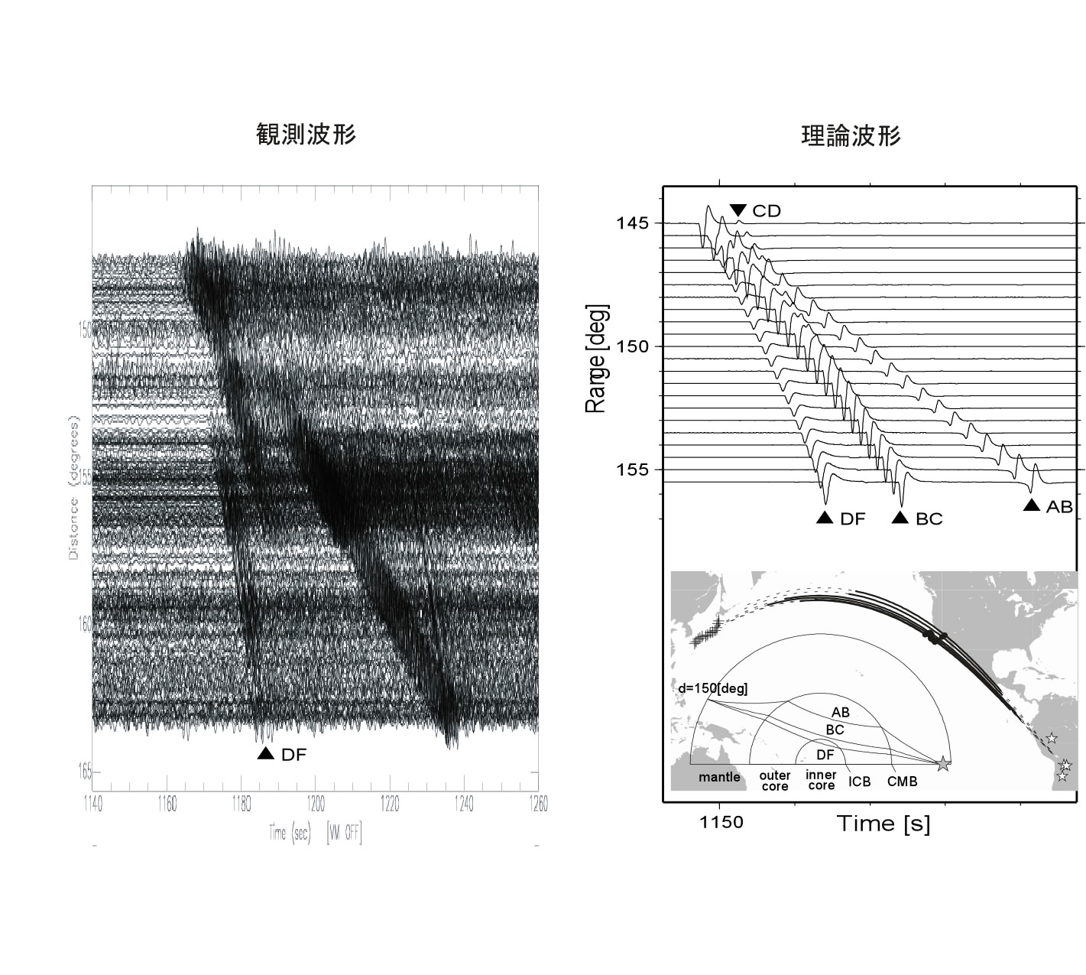
High Attenuation in the Western Hemisphere
Observed in Japan
Observed Seismograms
Synthetic Seismograms
West
Low Attenuation

Slide 14
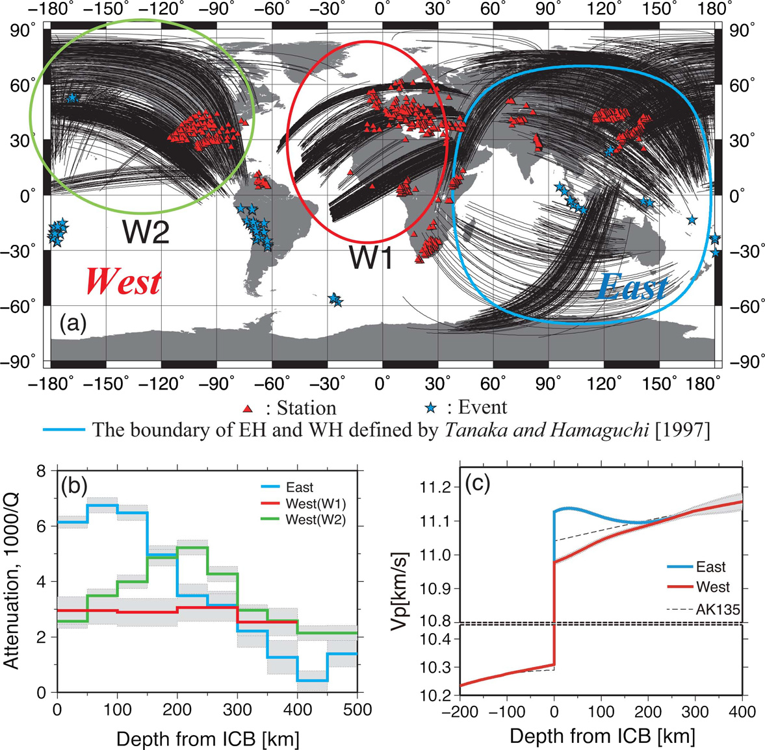
New Attenuation and Velocity Model of the Inner Core
Iritani, Takeuchi & Kawakatsu (2014)

Slide 15
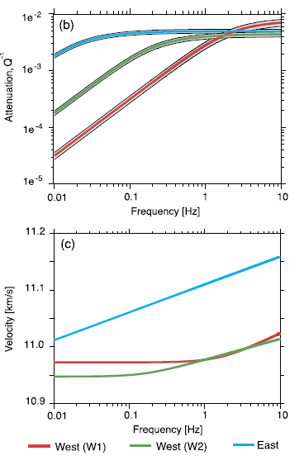
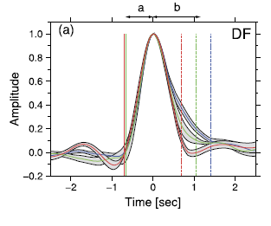
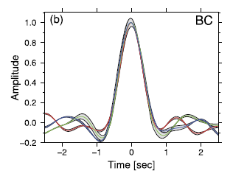
Frequency Dependence of the Velocity and Attenuation
Iritani, Takeuchi & Kawakatsu (2014)

Slide 16
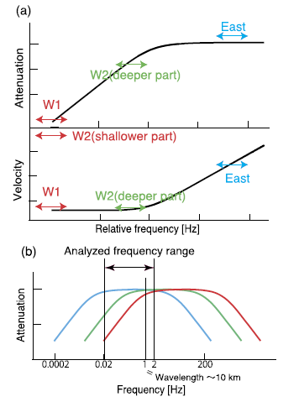
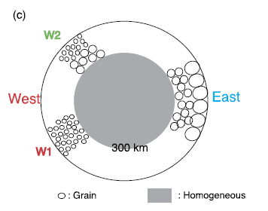
Unified Interpretation of the Observed Data：
Slide of the Absorption
Iritani, Takeuchi & Kawakatsu (2014)

Slide 17
Summary
Standard density model was obtained by using both of
data and insight.
Its uncertainty may depend on the accuracy of our insight.
Detailed heterogeneities and frequency dependence
are hot in seismology.

