Slide 1


ROOT: Functions & Fitting
Harinder Singh Bawa
California State University Fresno
Mar 31, 2016

Slide 2
Review of previous Exercise*:
* Good to practice some exercises side by side in order to understand

Slide 3
Exercise:
1)
Create a gaussian function using TF1 class of Root, set its parameters(500.,65.,5.), plot it and finally save the plot.
Hint: Gaussian function:
TF1 f1("gauss", "[0] / sqrt(2.0 * TMath::Pi()) / [2] * exp(-(x-[1])*(x-[1])/2./[2]/[2])", 0, 100)
Create a gaussian distributed random numbers using the Random number generator class TRandom3 and using the provided basic Random distribution "Gaus(mean=65,sigma=5)". Create a 1-dimensional histogram TH1D and fill in with the generated random numbers. Finally book a canvas TCanvas and plot the distribution and save it
Fit the histogram from (2) with function (1)

Slide 4
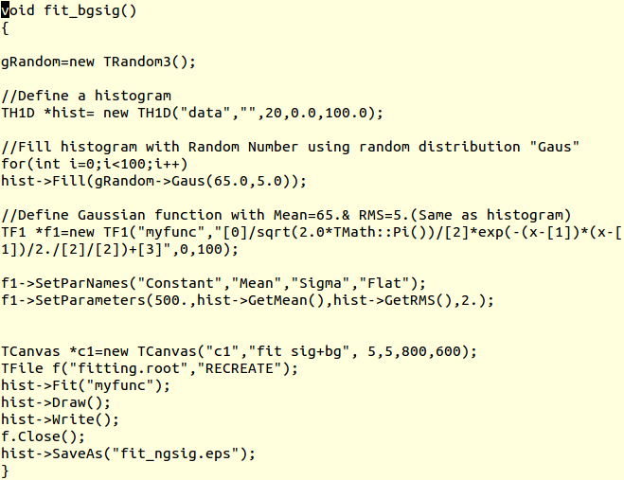

Slide 5
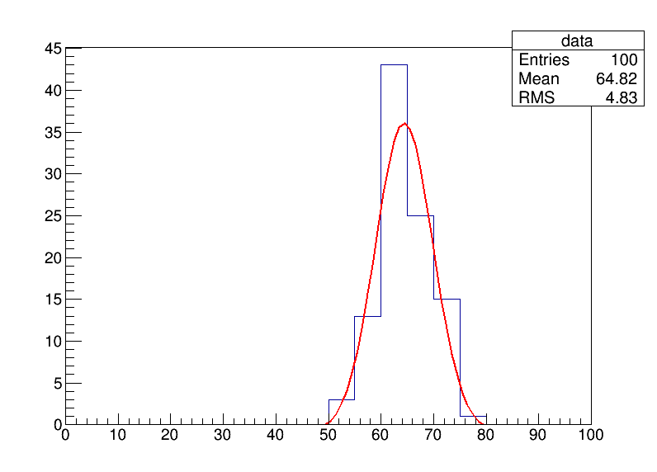

Slide 6
2) Write a root macro that creates randomly generated data as a signal peak (gaussian) with mean= 125.0 & sigma=10.0. Perform fit with a gaussian function and inspect the parameters .
Add background as uniform
Fit using function gaus+pol2
Write down the good parameters.

Slide 7
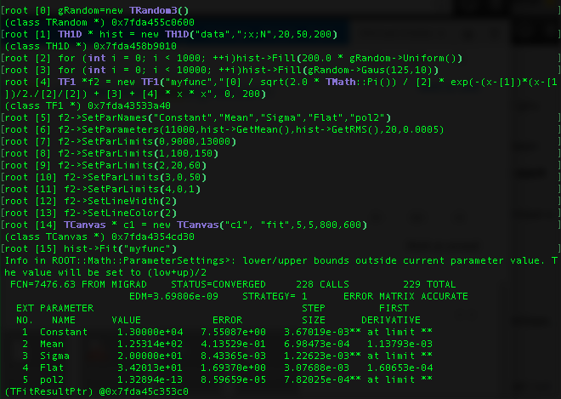

Slide 8
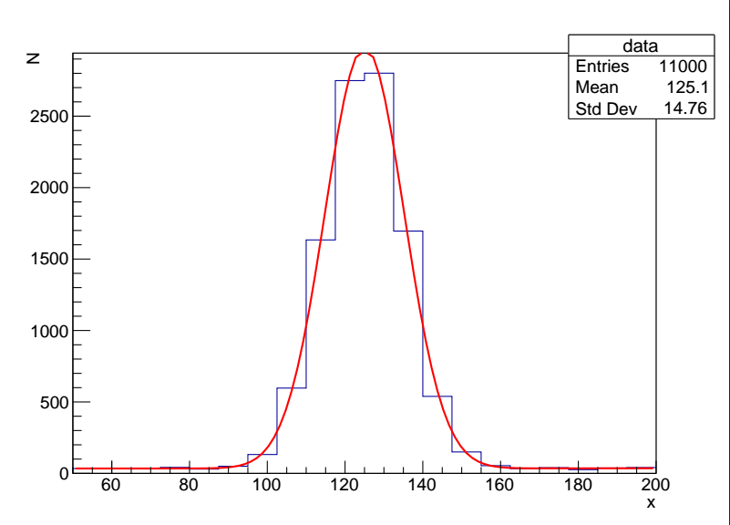

Slide 9
Full Exercise upto now
Fill a histogram randomly (n=~10,000) with a Landau distribution with a most probable value at 20 and a “width” of 5 (use the ROOT website to find out about the Landau function)
Fill the same histogram randomly (n=~5,000) with a Gaussian distribution centered at 5 with a “width” of 3
Write a compiled script with a fit function that describes the total histogram nicely (it might be a good idea to fit both peaks individually first and use the fit parameters for a combined fit)
Add titles to x- and y-axis
Include a legend of the histogram with number of entries, mean, and RMS values
Add text to the canvas with the fitted function parameters
Draw everything on a square-size canvas (histogram in blue, fit in red)
Save as png, eps, and root file

Slide 10
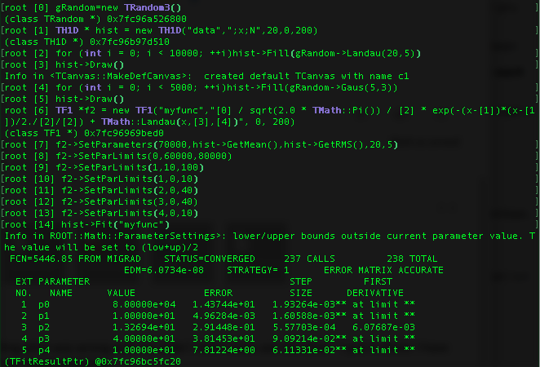

Slide 11
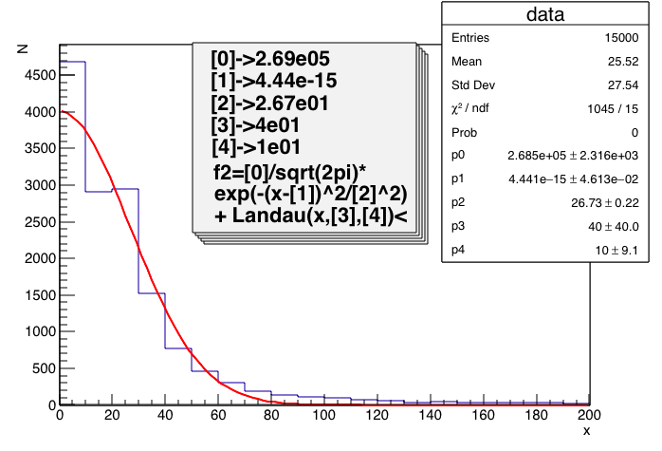

Slide 12
Simple Straight Line fitting

Slide 13
Straight line fit: y=mx + c
#include <iostream>
#include "TH1D.h"
#include <TMath.h>
#include <TROOT.h>
#include "TF1.h"
using namespace std;
//Declare a user defined function for fitting
Double_t fitf(Double_t *x, Double_t *par)
{
Double_t value=par[0]+(par[1]*x[0]); //Here par[0]=constant/intercept & par[1] is Gradient
return value;
}
int run(){
//Create a histogram to be fitted
TH1D* myhisto=new TH1D("myhisto","myhisto",10,0,10);
//Fill the histogram
for (int i=1; i<=10; i++){
myhisto->SetBinContent(i,i*4); //Randomly
}

Slide 14
Contd:
//Create a TF1 object with the function defined above..
//The last three parameters specify the range and number of parameters of the function.
TF1 *func=new TF1("fit", fitf,0,10,2);
//Set the initial paramters of the function
func->SetParameters(0.04,0.1);
//Give the parameters meaningful name
func->SetParNames("intercept","gradient");
//Call TH1::Fit with the name of TF1 Object
myhisto->Fit("fit");
//Access the Fit results directly
cout<<"The y-intercept is: "<<func->GetParameter(0)<<endl;
cout<<"The gradient(constant) is: "<<func->GetParameter(1)<<endl;
cout<<"Fitting completed...."<<endl;
return 0; }

Slide 15
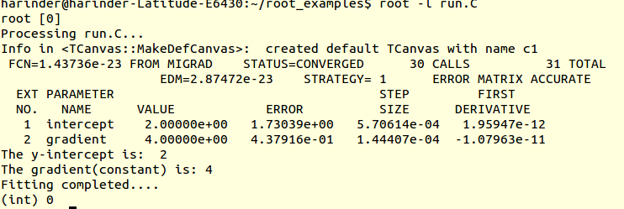
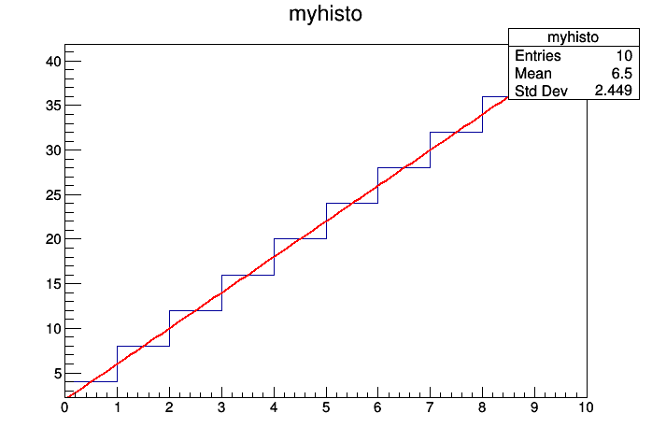

Slide 16
Complex fitting

Slide 17
Multi Peak Histogram Fitting
#include "TH1.h"
#include "TF1.h"
void multifit() {
const Int_t np = 49;
Float_t x[np] = {1.913521, 1.953769, 2.347435, 2.883654, 3.493567,
4.047560, 4.337210, 4.364347, 4.563004, 5.054247,
5.194183, 5.380521, 5.303213, 5.384578, 5.563983,
5.728500, 5.685752, 5.080029, 4.251809, 3.372246,
2.207432, 1.227541, 0.8597788,0.8220503,0.8046592,
0.7684097,0.7469761,0.8019787,0.8362375,0.8744895,
0.9143721,0.9462768,0.9285364,0.8954604,0.8410891,
0.7853871,0.7100883,0.6938808,0.7363682,0.7032954,
0.6029015,0.5600163,0.7477068,1.188785, 1.938228,
2.602717, 3.472962, 4.465014, 5.177035};
TH1F *h = new TH1F("h","Example of several fits in subranges",np,85,134);
h->SetMaximum(7);
for (int i=0;i<np;i++) {
h->SetBinContent(i+1,x[i]);
}
h->Draw();

Slide 18
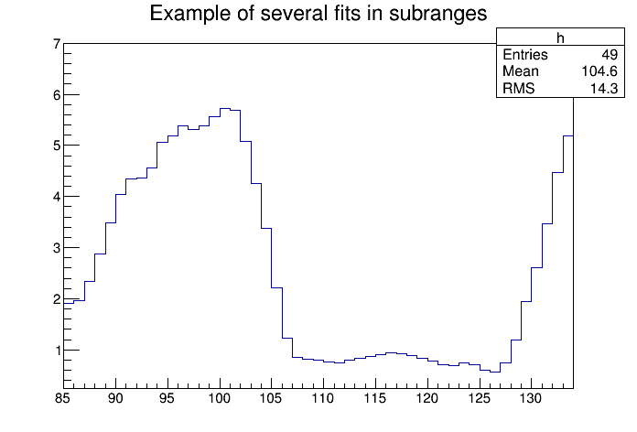

Slide 19
Fitting (Fitting multiple functions to different ranges of a 1-D histogram)
Double_t par[9];
//3 gaussians are fitted in sub-ranges of this histogram
TF1 *g1 = new TF1("g1","gaus",85,95);//sub-Range
TF1 *g2 = new TF1("g2","gaus",98,108);
TF1 *g3 = new TF1("g3","gaus",110,121);
//A new function (a sum of 3 gaussians) is fitted on another subrange
TF1 *total = new TF1("total","gaus(0)+gaus(3)+gaus(6)",85,125);
total->SetLineColor(2);
h->Fit(g1,"R"); //Fit according to sub-Range only
h->Fit(g2,"R+");
h->Fit(g3,"R+");
//Note that when fitting simple functions, such as gaussians, the initial values of parameters are automatically computed by ROOT.
// In the more complicated case of the sum of 3 gaussians, the initial values of parameters must be given. In this particular case, the initial values are taken from the result of the individual fits
g1->GetParameters(&par[0]);
g2->GetParameters(&par[3]);
g3->GetParameters(&par[6]);
total->SetParameters(par);
h->Fit(total,"R+"); }
https://root.cern.ch/doc/master/classTF1.html

Slide 20
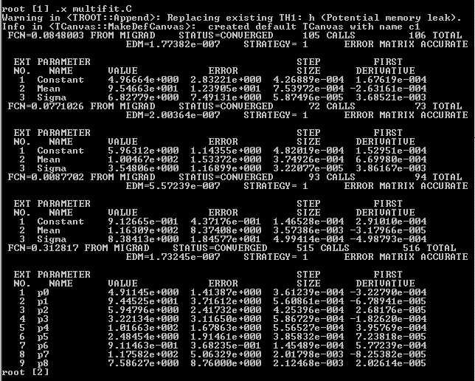

Slide 21
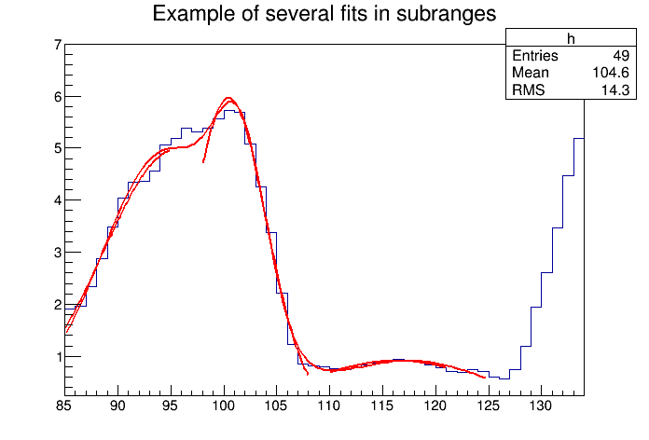

Slide 22
Exercise
First create an histogram with a double gaussian peaks and then we fit it.
Create an histogram with 100 bins between 0 and 10.
Fill with 5000 Gaussian number with mean 3 and width 1.5.
Fill with 5000 Gaussian number with a mean of 8 and width of 1.
Create a function composed of the sum of two Gaussian and fit to the histogram.
Do the fit works ? What do you need to do to make the fit working ?

Slide 23
Hint
Before fitting you need to set sensible parameter values. You can do this by fitting first a single Gaussian in the range [0,5] and then a second Gaussian in the range [5,10].If you don't set good initial parameter values, (for example if you set the amplitude of the Gaussians to 1, the means of the Gaussians to 5 and widths to 1), the fit will probably not converge.

Slide 24
BACKUP

Slide 25
Functions

Slide 26
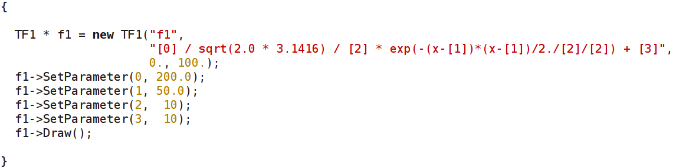
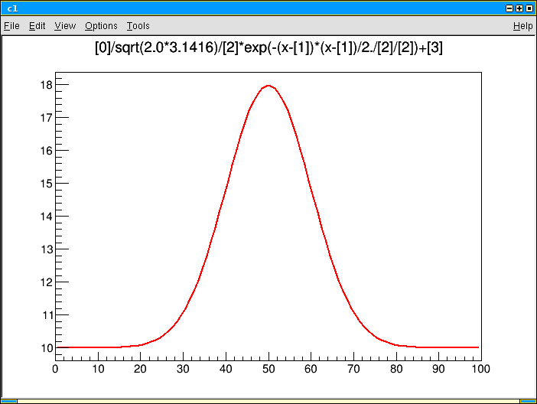
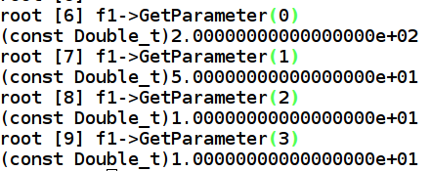
TF1 with parameters
A function can have parameters (e.g. floating parameters for fits...)

Slide 27
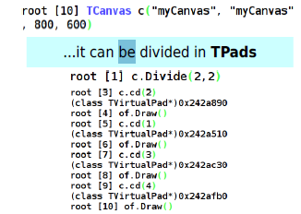

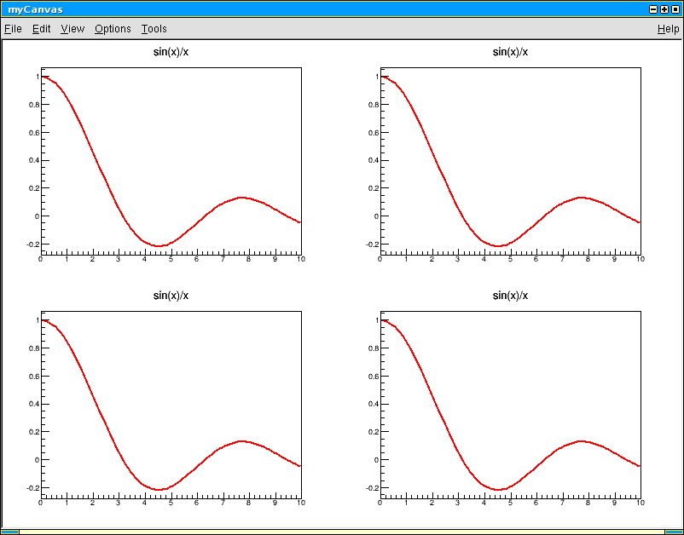


Let's draw a TF1 on a TCanvas
Like most objects in ROOT, functions can be drawn on a canvas
a TCanvas is an object too...

Slide 28
Functions and Histograms
Define a function:
TF1 *myfunc=new TF1(“myfunc”,”gaus”,0,3);
Myfunc->SetParameters(10., 1.5, 0.5);
Myfunc->Draw();
Generate histograms from functions:
(Myfunc->GetHistogram())->Draw();
Generate histograms with random numbers from a function:
TH1F *hgaus=new TH1F(“hgaus”,”histo from gaus”, 50, 0,3);
hgaus->FillRandom(“myfunc”,10000);
hgaus->Draw();
Write histogram to a rootfile:
TFile *myfile= new Tfile(“hgaus.root”,”RECREATE”);
hgaus->Write();
Myfile->Close();

Slide 29
Fitting Histograms
Let us try to fit the histogram created by the previous step:
Interactively:
Open rootfile containing histogram:
root –l hgaus.root
Draw histogram
hgaus->Draw()
Right click on the histogram and select “Fit Panel”
Check to ensure:
“gaus” is selected in the Function->Predefined pop-menu
“Chi-square” is selected in the Fit Settings->Method menu
Click on “Fit” at the bottom
[Display fit parameters: Select Options->FitParameters]

Slide 30
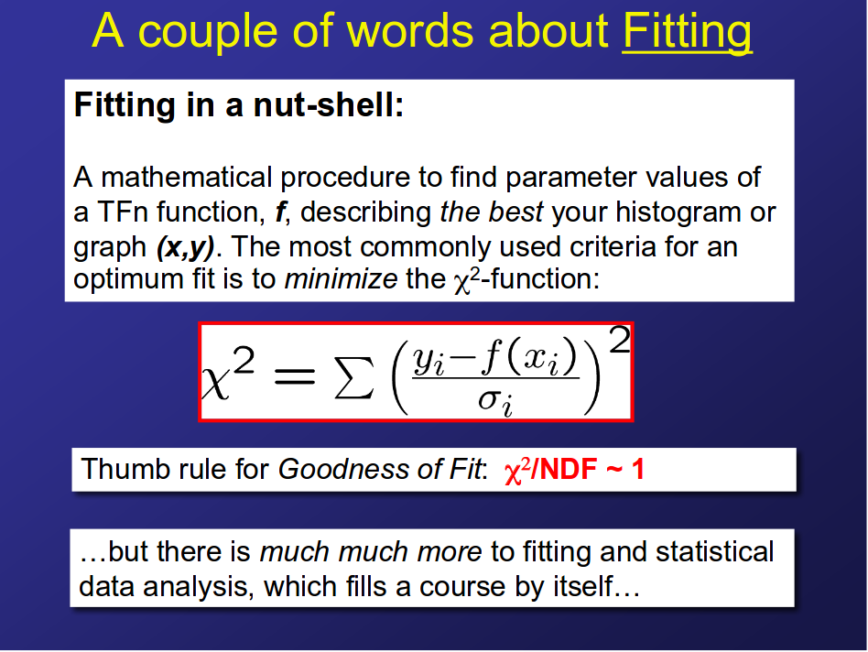

Slide 31
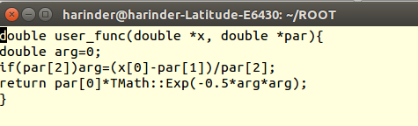
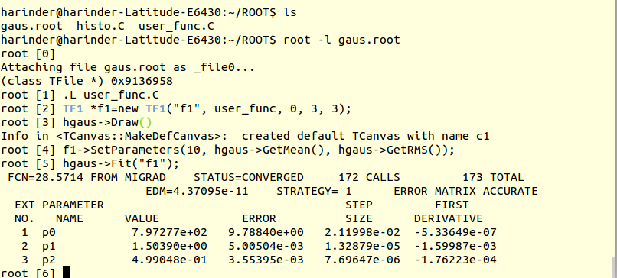
Fitting contd:
Using user defined functions:
Create a file called user_func.C with the following contents:
Last 3 parameters specify the number of parameters for the function

Slide 32
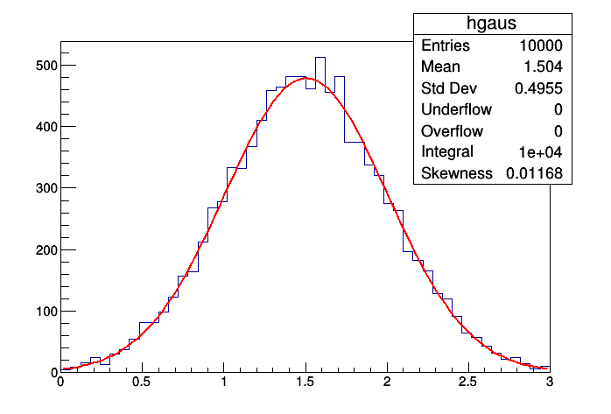
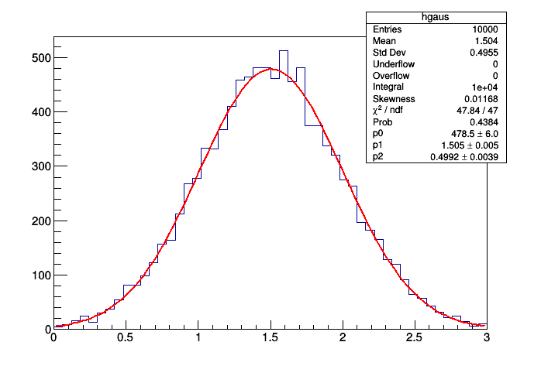
gStyle->SetOptStat(1111111)
Also can try :
gStyle->SetOptFit(1111)

Slide 33
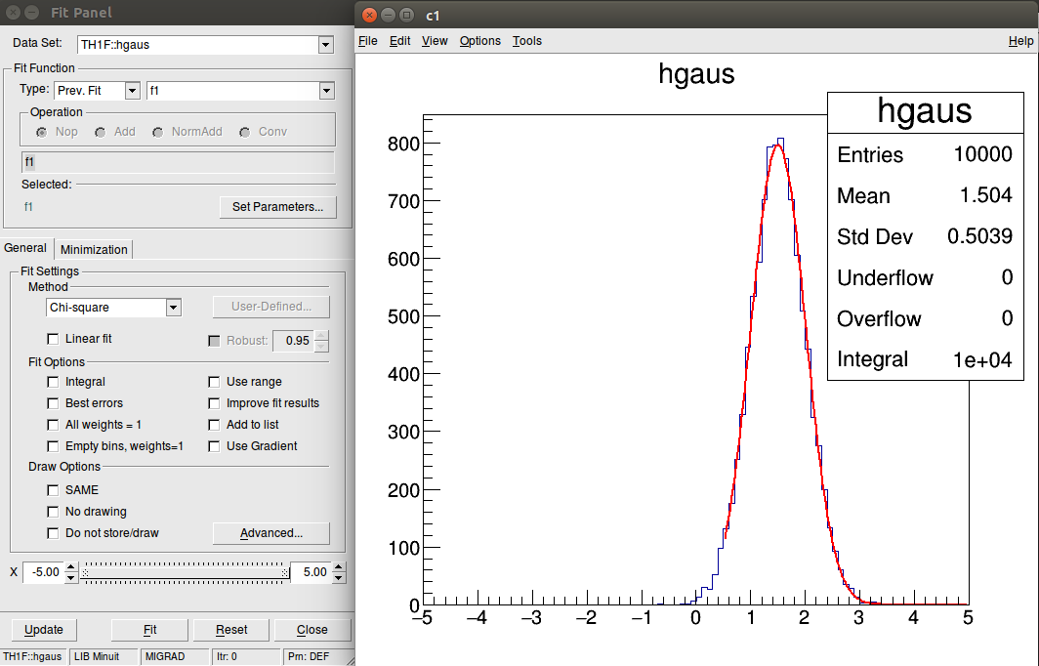
Fitting contd:
Move the slider to change fit Range

Slide 34
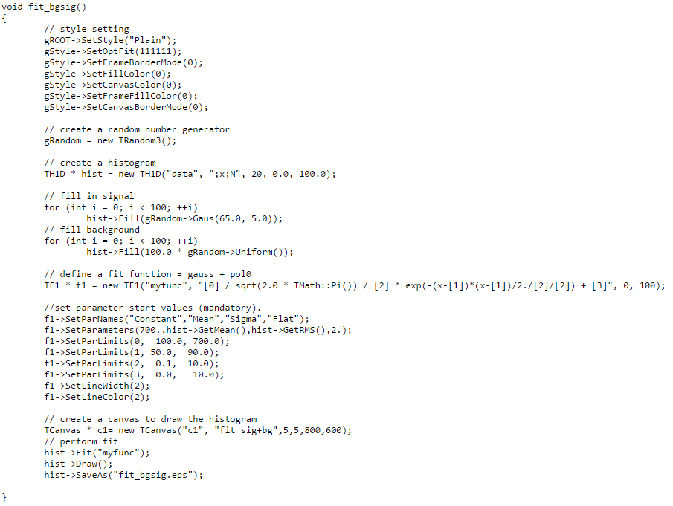
Mean=65, sigma=5.

Slide 35
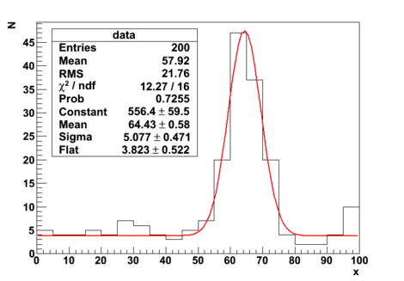

Slide 36
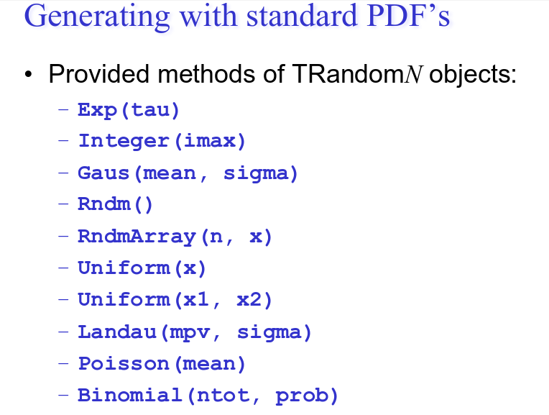
https://root.cern.ch/doc/master/classTRandom.html

