Slide 1









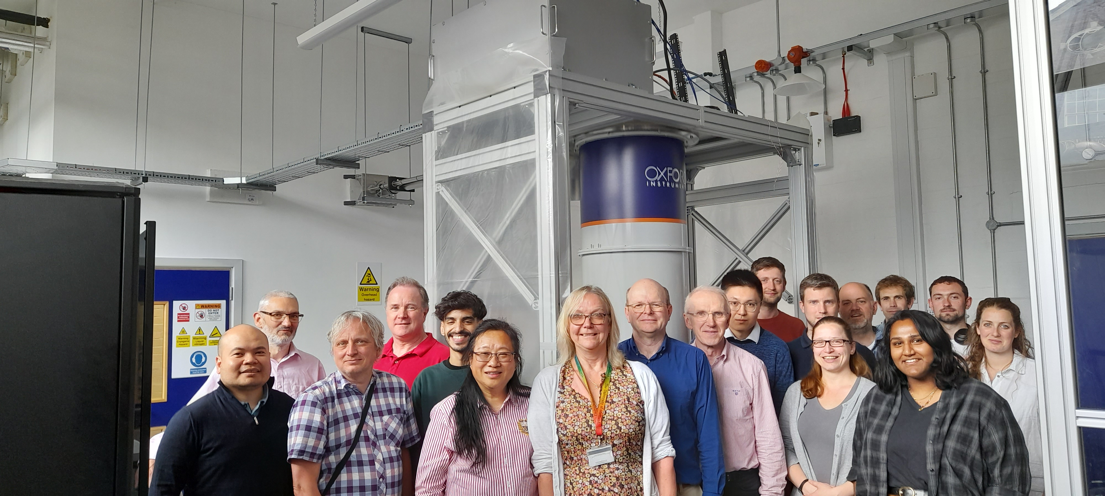
Progress Report on the QSHS Axion Search
+
Ed Daw, on behalf of the Quantum Sensors for the Hidden Sector collaboration

Slide 2
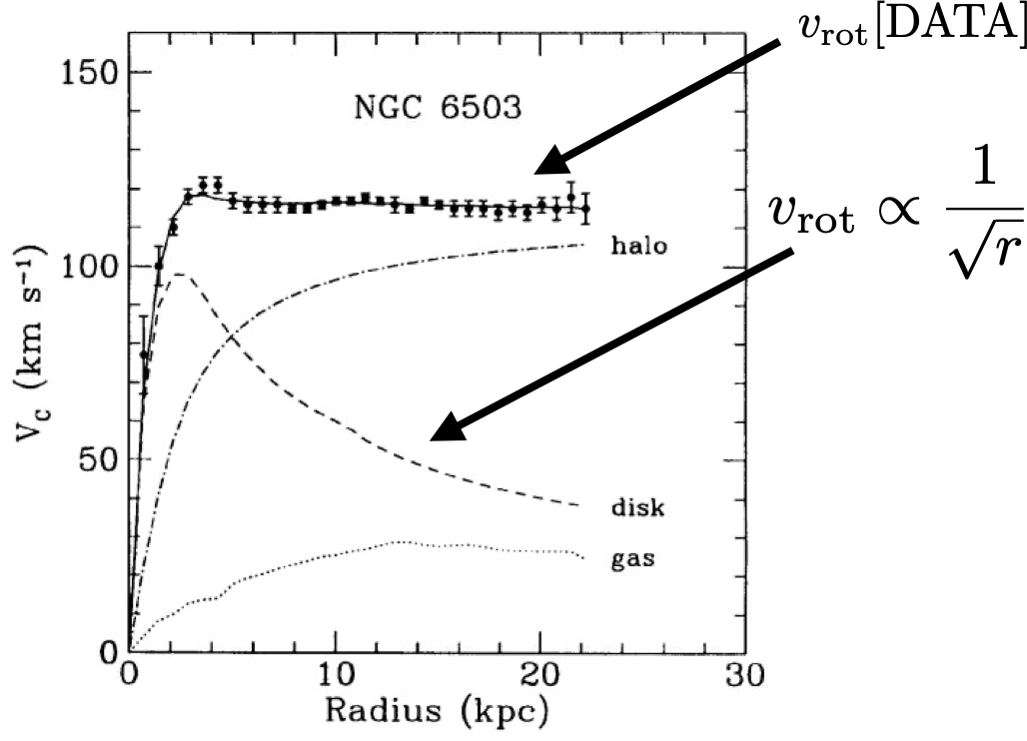
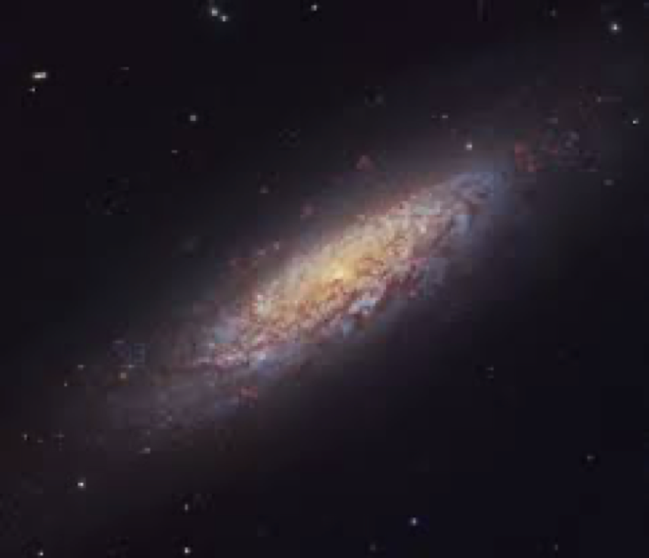


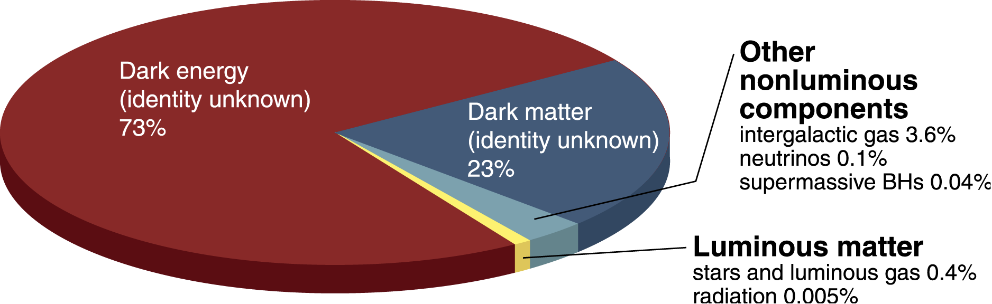
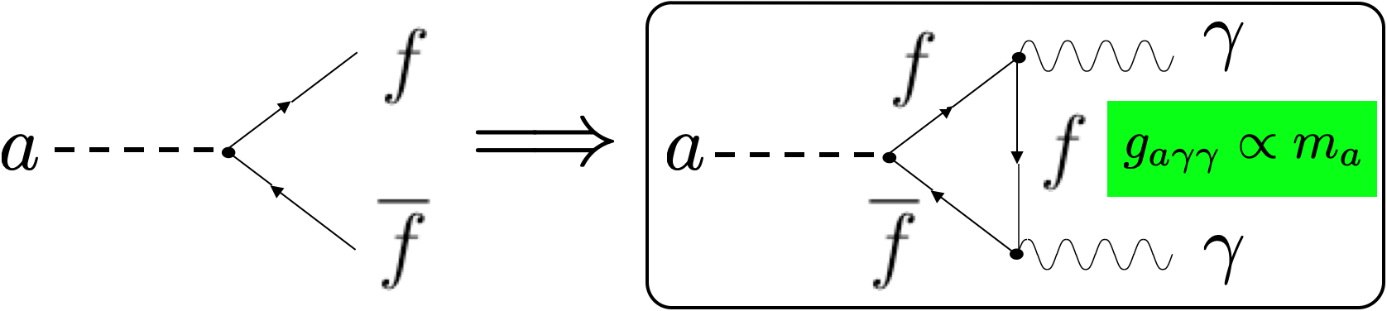
QCD Axions
Strong CP problem
Dark matter problem
Standard model symmetry group is
Neutron electric
dipole moment
<
Peccei Quinn mechanism: CP conserved below a symmetry breaking energy scale
Breaking of the Peccei Quinn symmetry yields axions
QCD axions are wave-like dark matter; at a mass of a micro-eV, dark matter axions thermalized locally in our halo have Debroglie wavelengths of hundreds of metres

Slide 3
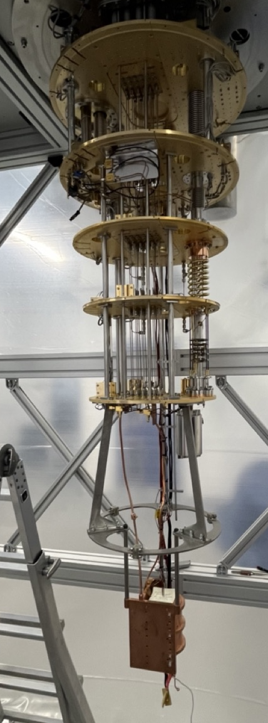
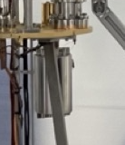
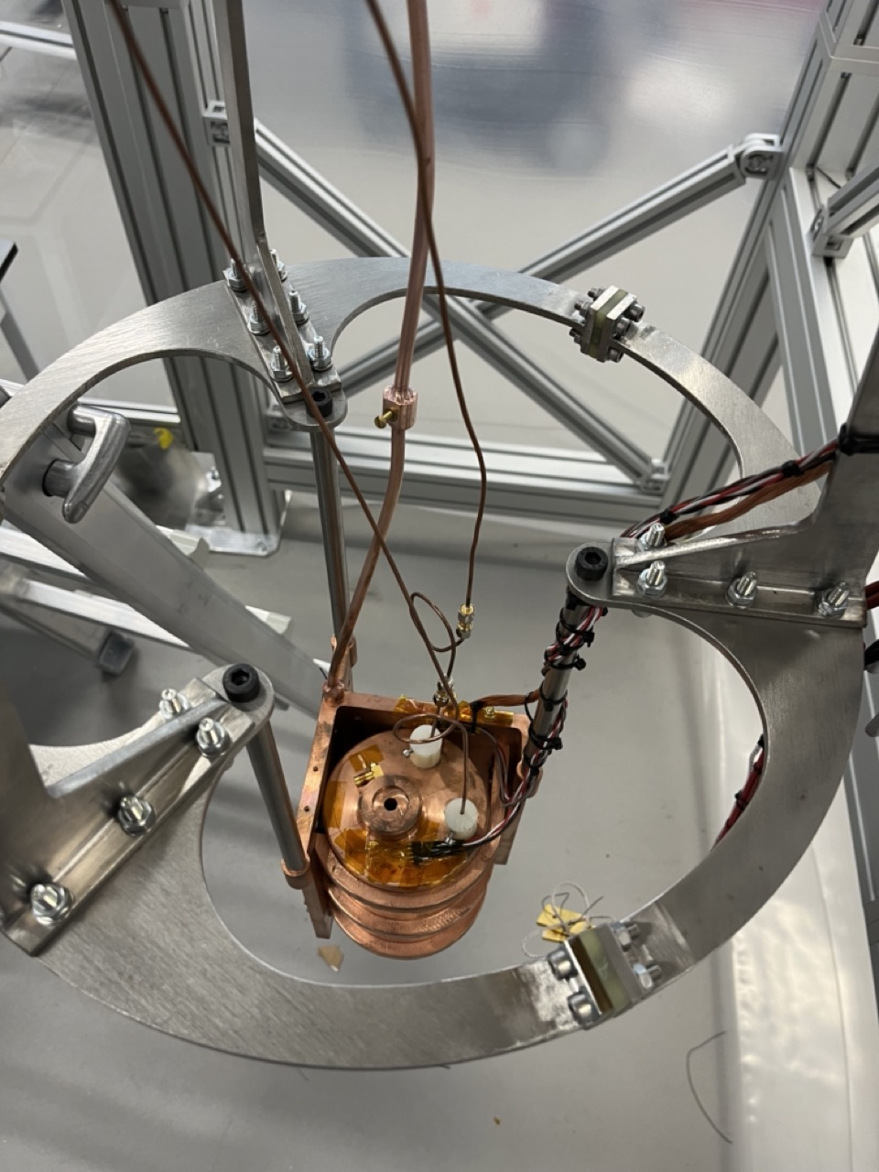
Quantum Sensors for the Hidden Sector
Network
Analyser
Bandpass
Filter
LO
AlazarTech
ATST146 60MHz
2 channel ADC
RF
IF
Piezo
motors
HEMT
amplifiers
Cryogenic
Attenuators
Superconducting
low noise amplifier
in magnetic field shield
Field Shield
design, Ed
Laird
(Lancaster)
Cryogenic
RF switch
weak
port
variable
port
Tuneable
resonant cavity
in magnetic field
18.5cm magnet
bore.
Static magnetic field

Slide 4
Boon Kok Tan, Senior Research Fellow and Ph.D. student Javier Navarro Montilla

Slide 5
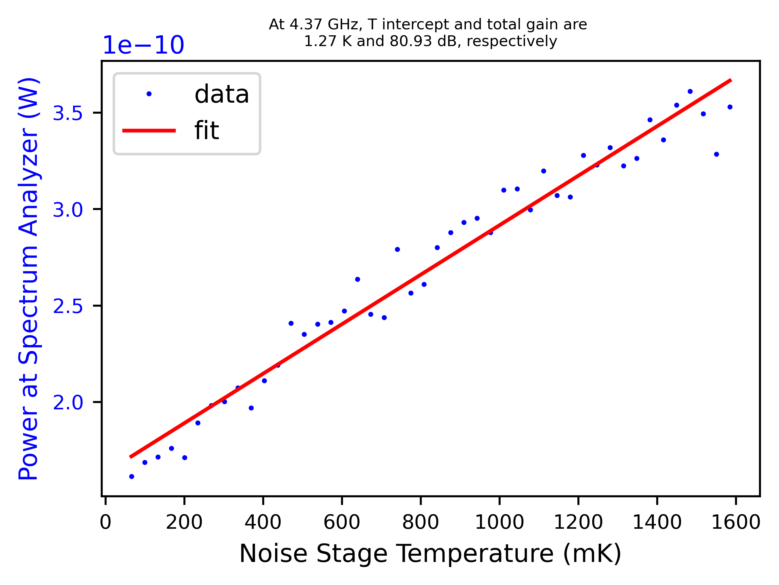
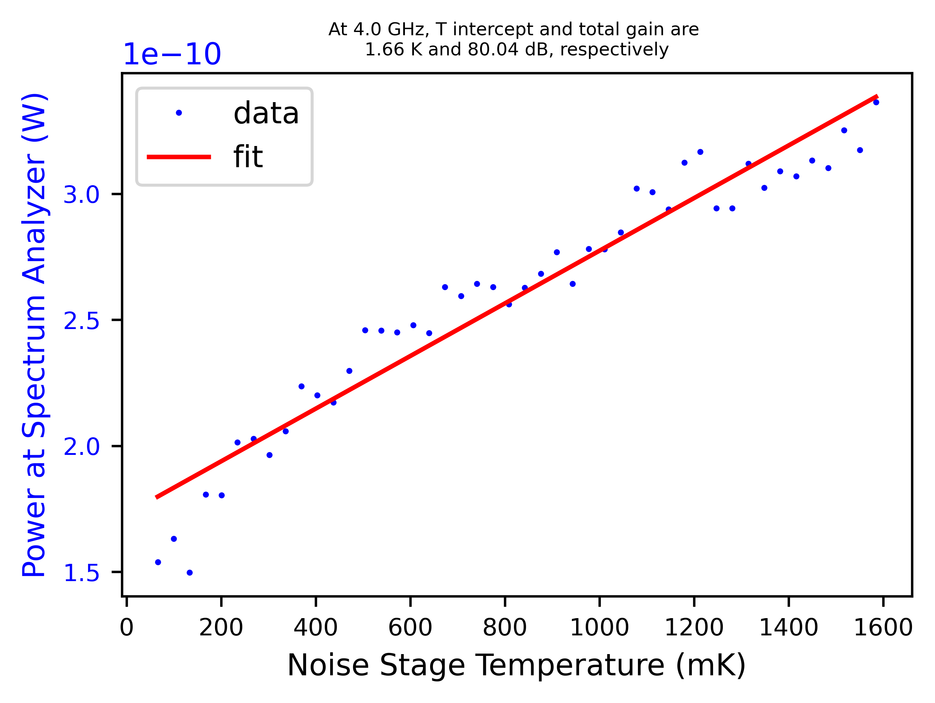
Characterisation of ‘Snail’ VTT
TWPA - Lancaster
Joshoua Esmenda –postdoctoral associate
Signal Frequency (GHz) | Bypass |  | Parameters 0 Pump=13 GHz, -61 dBm, BC = 670 uA |  |  |  | Parameters 1 Pump=12.4 GHz, -61 dBm, BC = 695 uA |  |  |  | Parameters 2 Pump=12.4 GHz, -61 dBm, BC = 705 uA
 | T_{bypass} (K) | G (dB) | T_{total} (K) | G (dB) | T_{TWPA} (K) | G_{TWPA} (dB) | T (K) | G (dB) | T_{TWPA} (K) | G_{TWPA} (dB) | T (K) | G (dB) | T_{TWPA} (K) | G_{TWPA} (dB)
4.00 | 9.3 | 69.34 | 1.91 | 79.05 | 0.915779 | 9.71 | 1.7 | 81.08 | 1.077007 | 11.74 | 1.66 | 80.04 | 0.868442 | 10.7
4.37 | 9.94 | 69.38 | 2.4 | 79.3 | 1.38752 | 9.92 | 1.27 | 80.93 | 0.574357 | 11.55 | 1.75 | 81.2 | 1.096288 | 11.82
5.00 | 8.75 | 68.62 | 1.85 | 80.18 | 1.239047 | 11.56 | 2.64 | 79.17 | 1.869082 | 10.55 | 2.13 | 80.51 | 1.56375 | 11.89
6.00 | 7.55 | 66.93 | 1.72 | 77.79 | 1.100635 | 10.86 | 1.85 | 75.81 | 0.872882 | 8.88 | 4.93 | 77.36 | 4.246172 | 10.43
6.20 | 7.94 | 66.79 | 1.95 | 76.85 | 1.166894 | 10.06 | NA | NA | NA | NA | NA | NA | NA | NA
8.00 | 7.85 | 67.76 | 1.88 | 81.05 | 1.511981 | 13.29 | 3.61 | 81.64 | 3.28873 | 13.88 | 4.58 | 79.71 | 4.078963 | 11.95
Through the y-factor method, the noise characteristics of the SNAIL JTWPA from VTT were obtained. This was done by heating a carefully calibrated noise stage from 30 mK to 1600 mK at the input of the TWPA while recording the power spectrum of the TWPA output. The same procedure is done for a bypass configuration, where the TWPA is replaced by a through line. Using different optimal parameters for the pump and bias current, the noise temperature obtained was as low as 600 mK on certain signal frequencies.

Slide 6
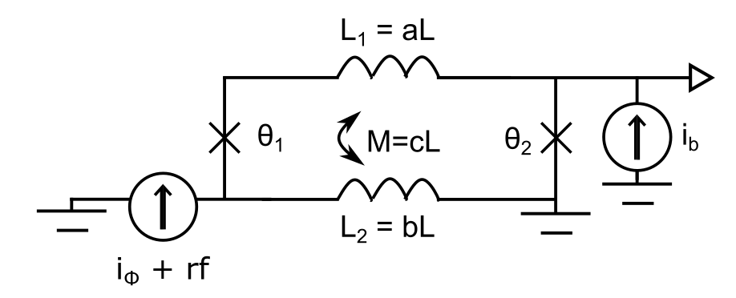
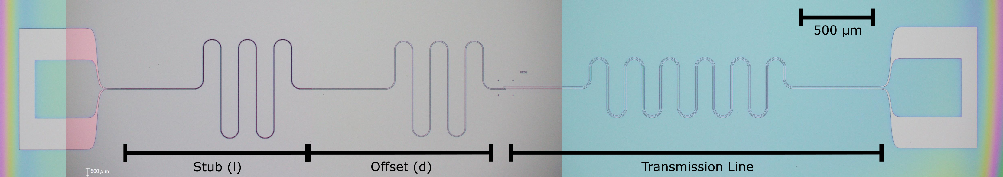
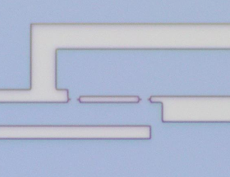
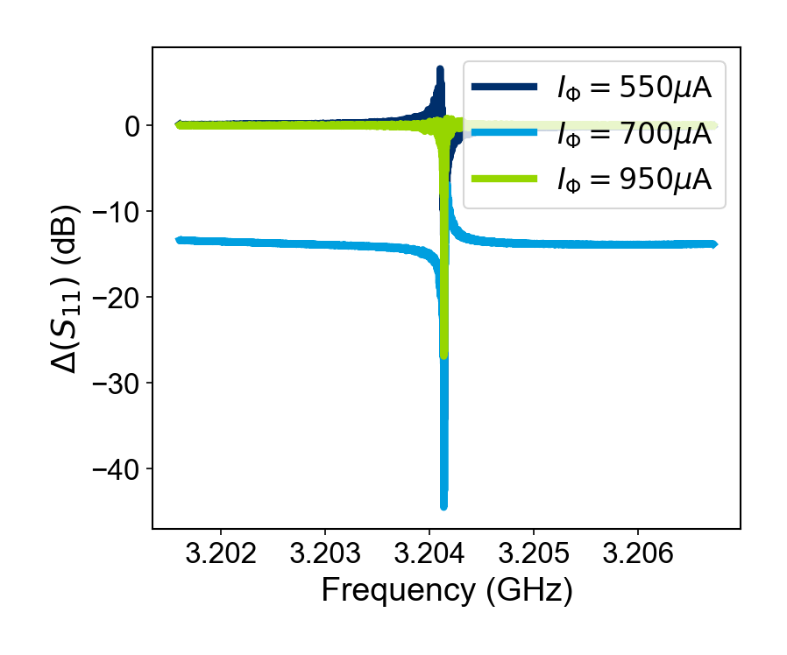
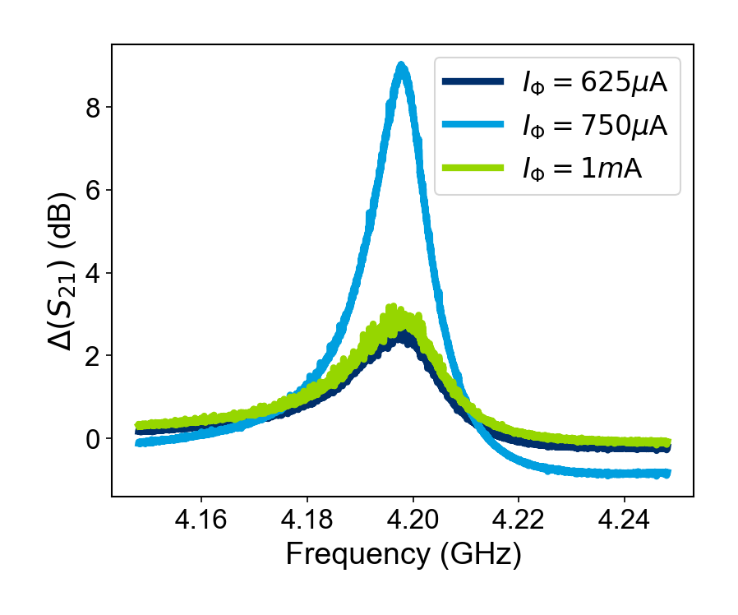
SLUG loaded SQUID amplifiers
2 µm
1 µm
Ling Hao (NPL)
Gemma Chapman (NPL)
Ed Romans (UCL)
Thomas Godfrey (UCL)
T = 6.4 K, P_{in} = -40 dBm
6
L = 3.1 pH, R = 5.8 Ω, V_{Φ} = 0.14 mV/Φ₀

Slide 7
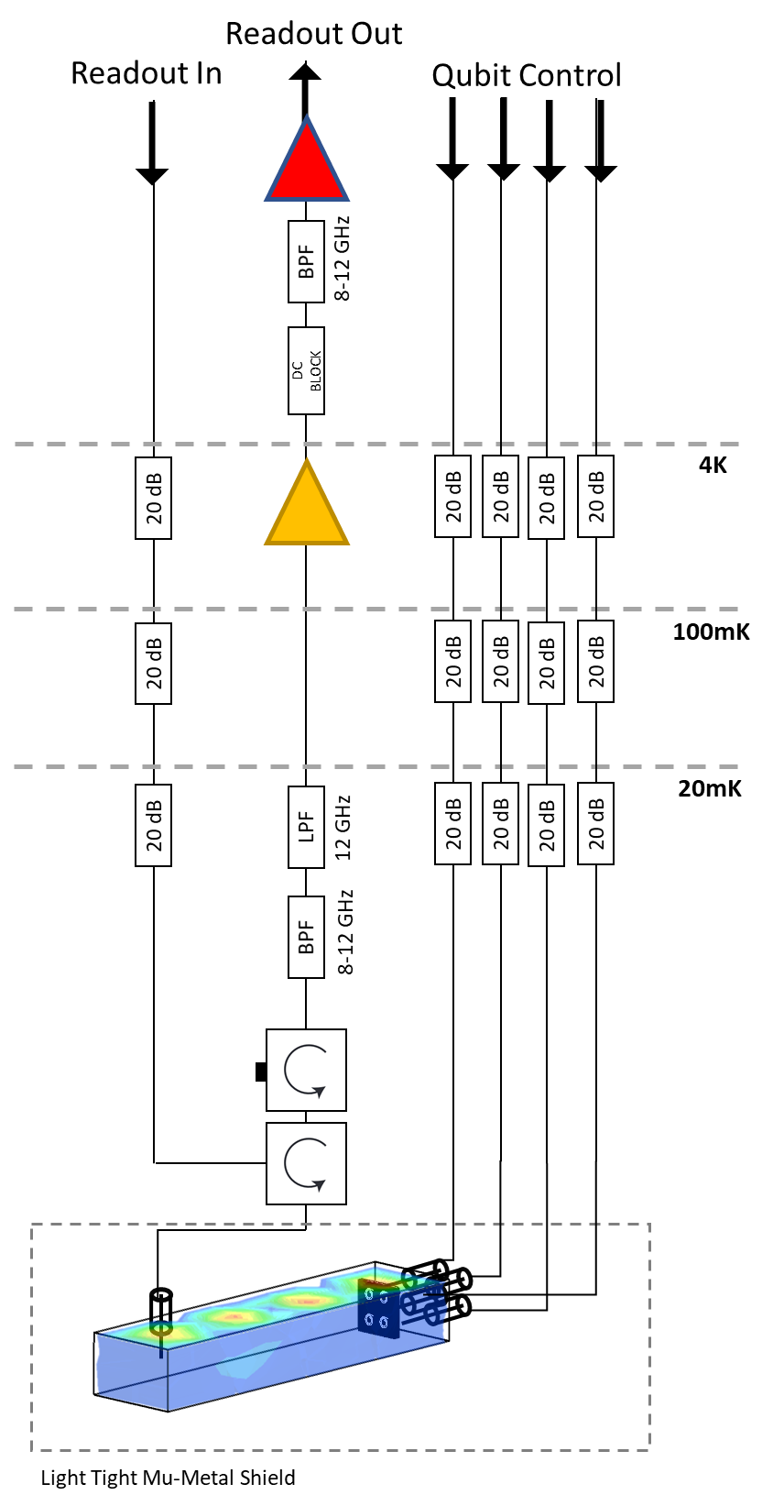
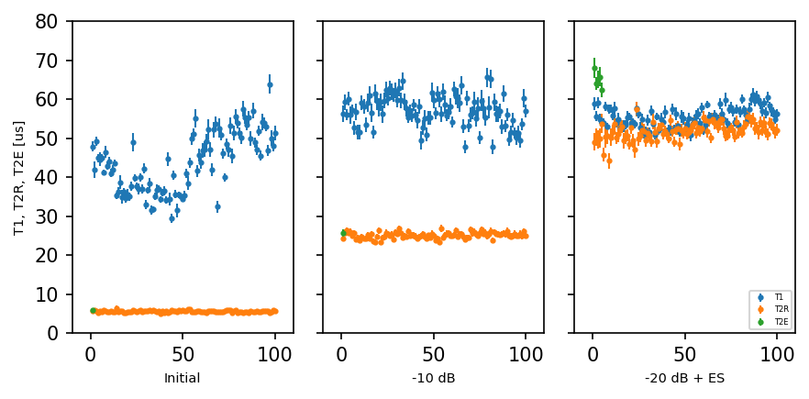
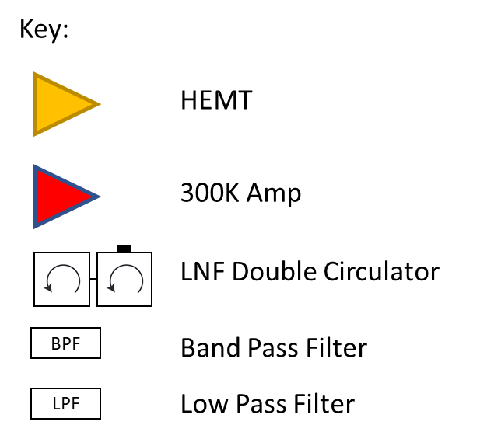
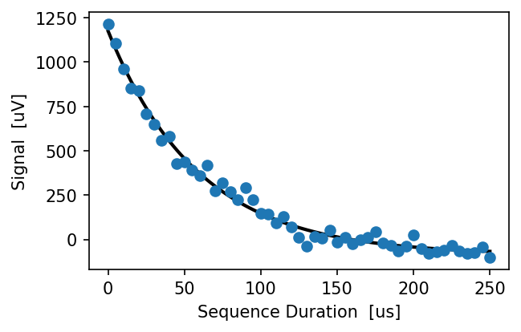
Qubit array sensors for fundamental physics
Michele Piscitelli
Peter Leek
T1 = 59.20 ± 2.51 us

Slide 8
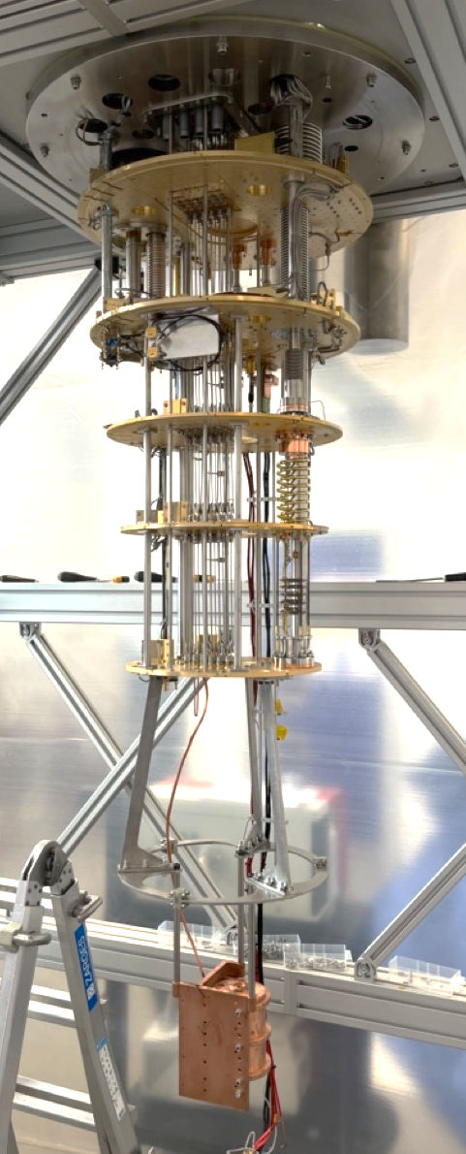
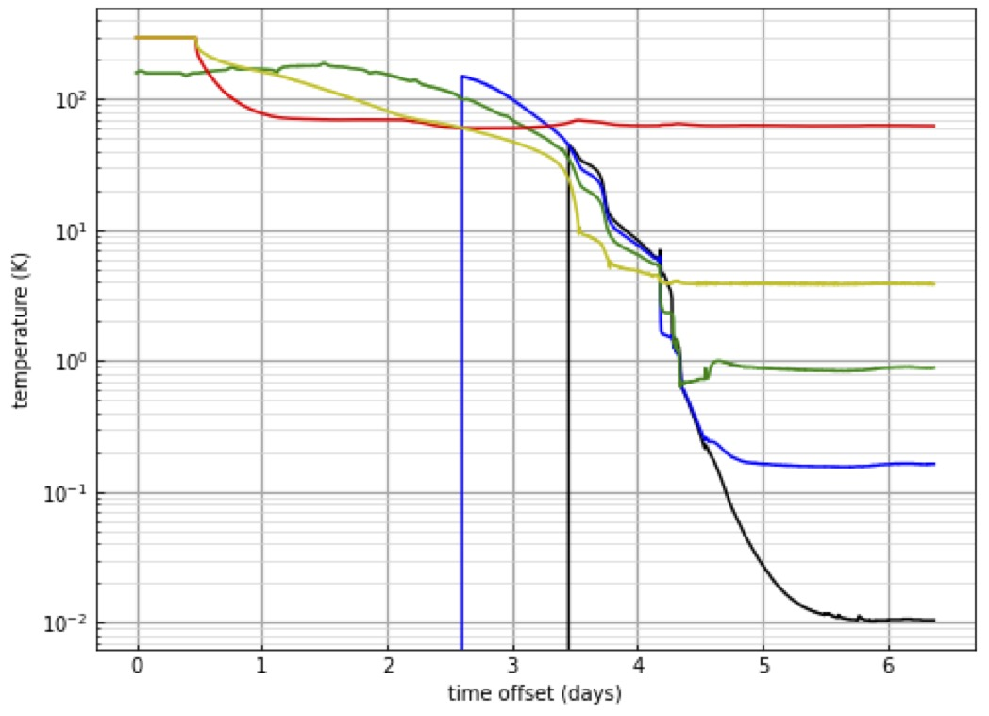
Sheffield Test Stand, First Cavity Cool
100
10
Temperature (K)
1
0.1
0.01
Cavity temperature
sensor at 18mK

Slide 9
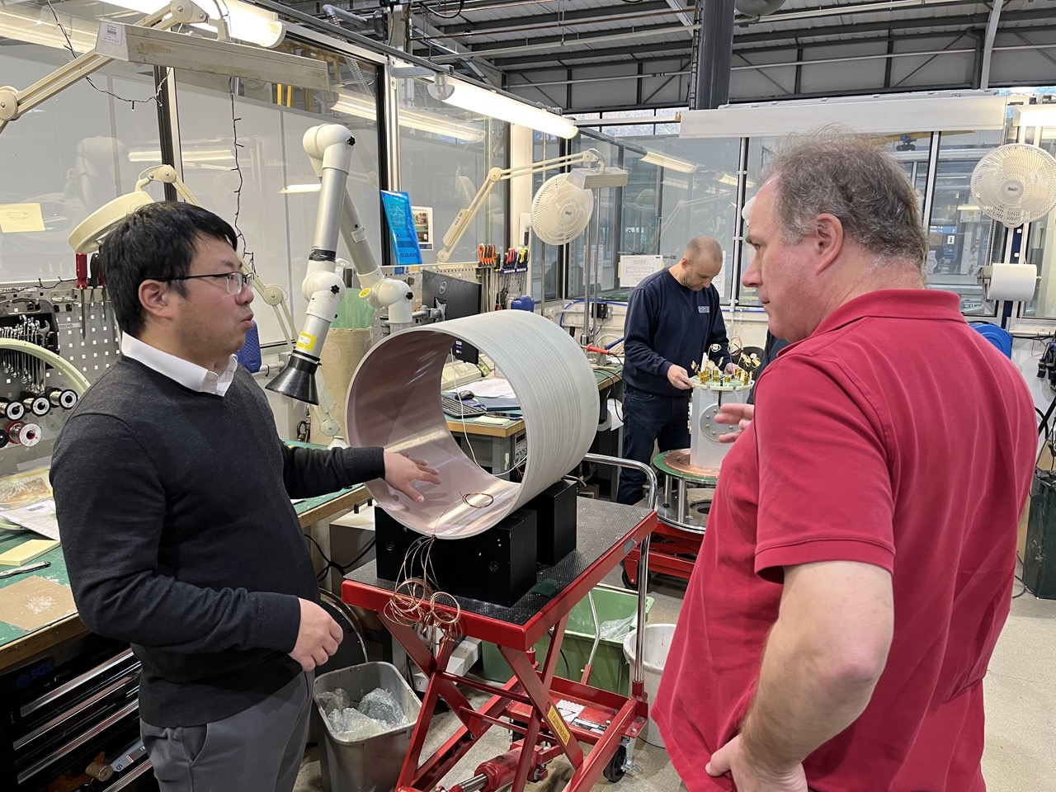
Current Magnet Status
Maximum field with initially delivered magnet was 6T. Design was for 8T.
Quench at higher fields. Suspected to be caused by mechanical deformation of outer shield coil due to force on windings from inner coils.
New formerless coil now fabricated at Oxford Instruments. Tests this month.
Gu Yuwei
Magnet Engineer, Oxford Instruments
Phil Meeson
RHUL

Slide 10
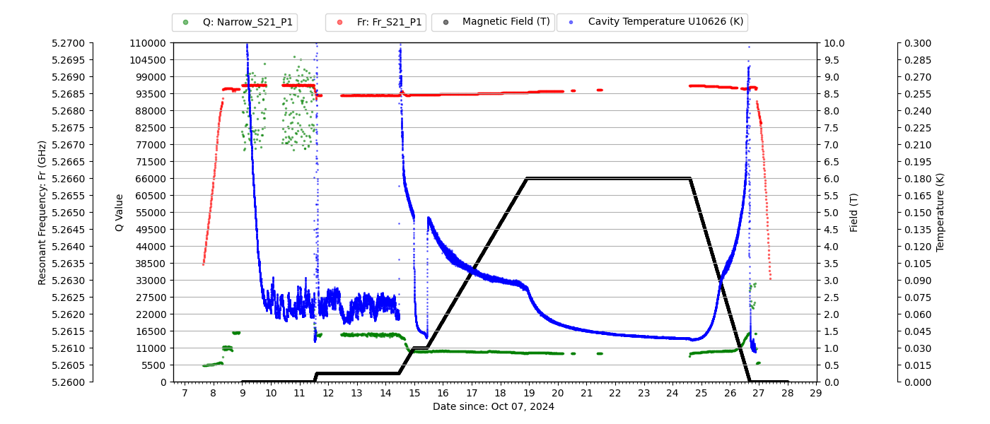
Characterisation of Superconducting Resonators in magnetic fields
PRELIMINARY
Paul Smith – Postdoctoral Associate, Nick Du (Livermore Lab research fellow, ADMX collaborator)

Slide 11
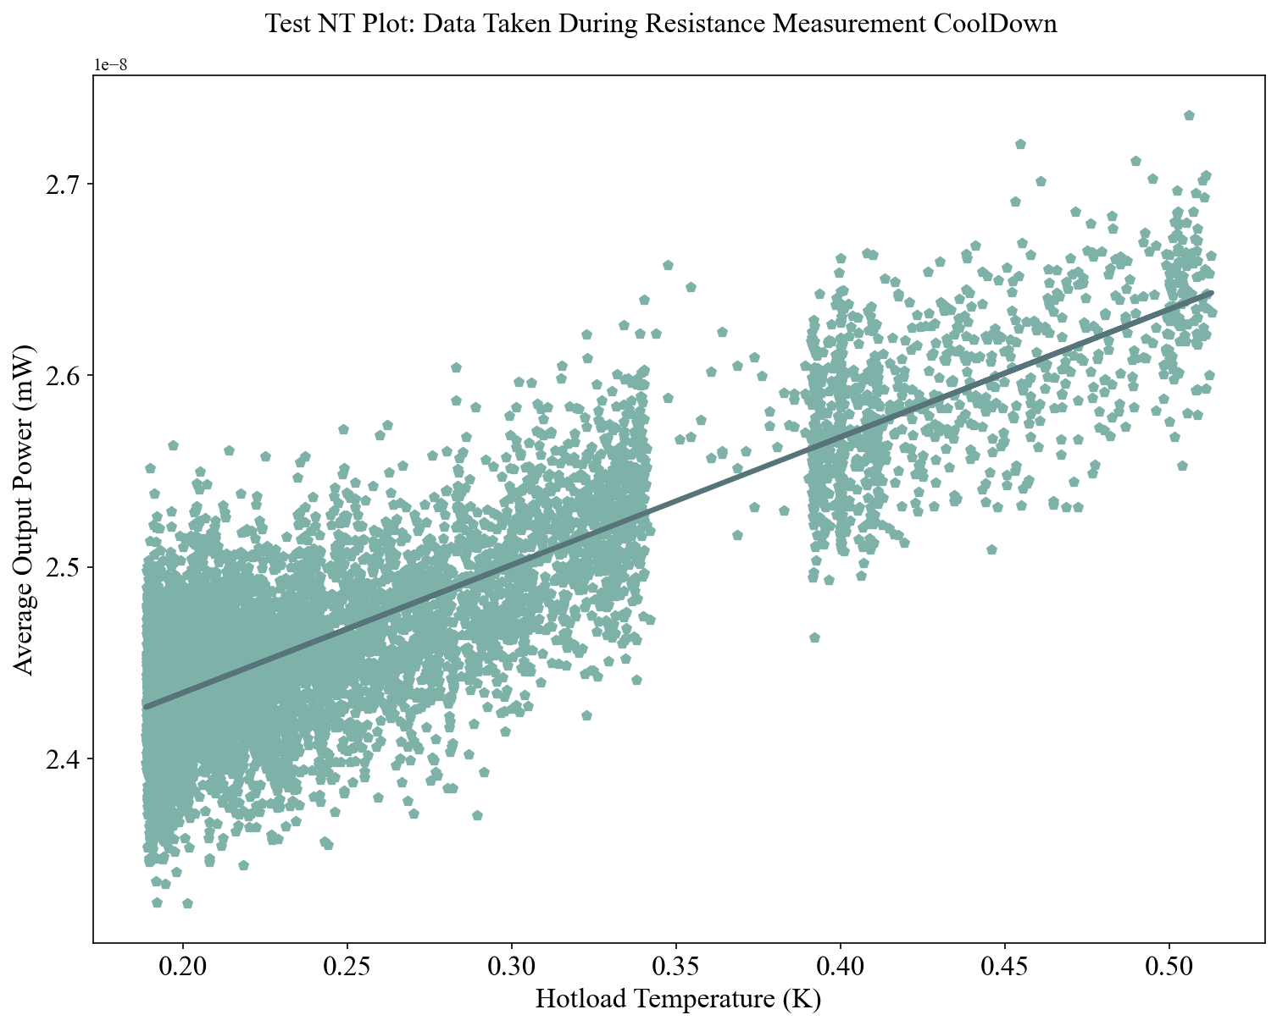
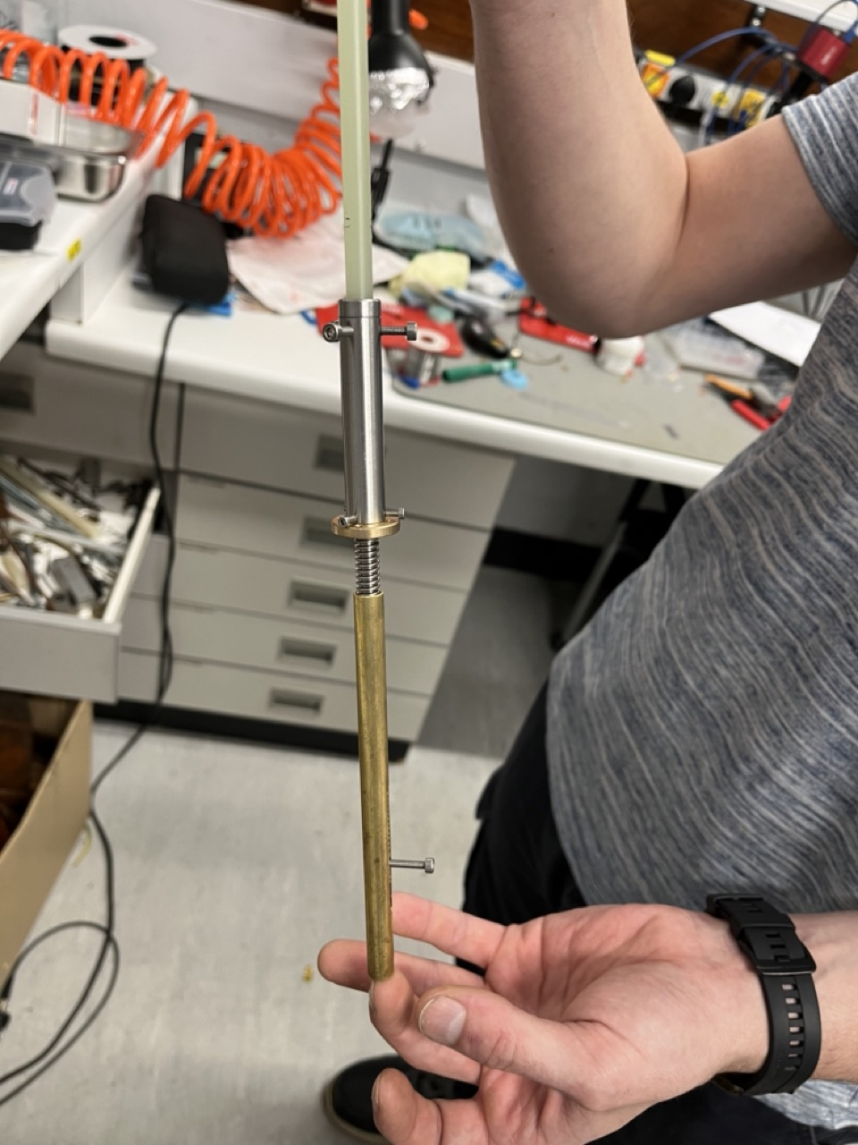
Preliminary noise temperature tests, Antenna drive
Limited
torque from
Attocube
piezo
actuators;
about
10N-cm.
Low friction
rotation to
linear motion
actuator for
antenna just
fabricated.
Mitch
Perry (Ph.D.
student)
PRELIMINARY
Claude Mostyn (Ph.D. student)
First hot-cold load measurement of
stage-2 HEMT amplifier noise
temperature was 3.5K. Attenuation of
cable between noise source and
amplifier at -4.6dB was too high. Modify
with a single length of NbTi coax.

Slide 12
Conclusions and Future Work
Fridge and cavity installed. Cavity temperature 20mK.
Several low noise amplifiers are far advanced in development at Oxford, Lancaster, UCL, NPL.
6T magnet installed. Can raise field and keep cool.
Upgraded shield coil fabricated, under test, for 8T field.
Currently commissioning motor drives for cavity tuning.
Tests with ADMX of NbSn coated tuning rod indicate that the coating is superconducting in 6T field.
First noise temperature measurements on HFET amplifiers performed in-situ.
First axion search using QSHS will happen in 2025!

