Slide 1

Science Opportunities with
Long-baseline Atom Interferometry
Jeremiah Mitchell
7 January 2025
DM-UK Workshop

Slide 2
Overview
AION and MAGIS-100 experiments
Atom interferometry crash course
Science opportunities and challenges

Slide 3

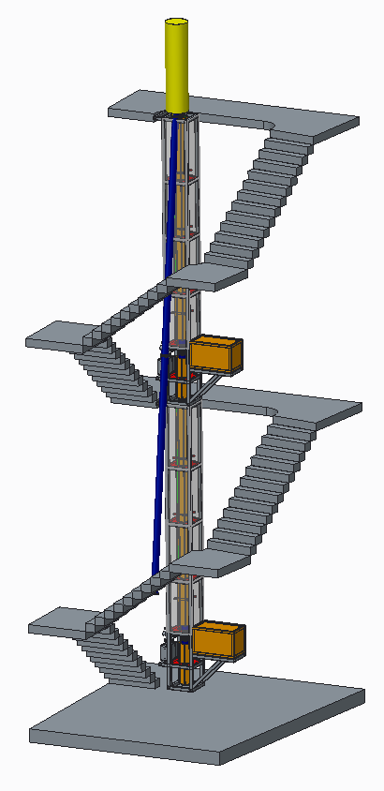
AION
Atom Interferometer Observatory and Network
UK consortium of 7 institutions
Multi-stage project
Develop 5 ultracold strontium UK laboratories for atom interferometry R&D
Design and deploy increased baseline atom interferometers 10m -> 100m -> 1km
Investigate technology development and network with MAGIS-100 for large-scale science goals
14.7m
Ground level
AI-10
10.0m
7.7m
Project executed in national partnership with UK National Quantum Technology Hub in Sensors and Timing, Birmingham, UK,
and international partnership with The MAGIS Collaboration
and The Fermi National Laboratory, US
5.0m
L. Badurina et al JCAP05(2020)011

Slide 4

MAGIS-100
Matter-wave Atomic Gradiometer Interferometric Sensor
Long-baseline atom interferometer being built at Fermilab US
3 strontium atom sources along vertical baseline
Test bed experiment for simultaneous atom interferometer control
Prototype 10m device at Stanford
Mahiro Abe et al 2021 Quantum Sci. Technol. 6 044003

Slide 5
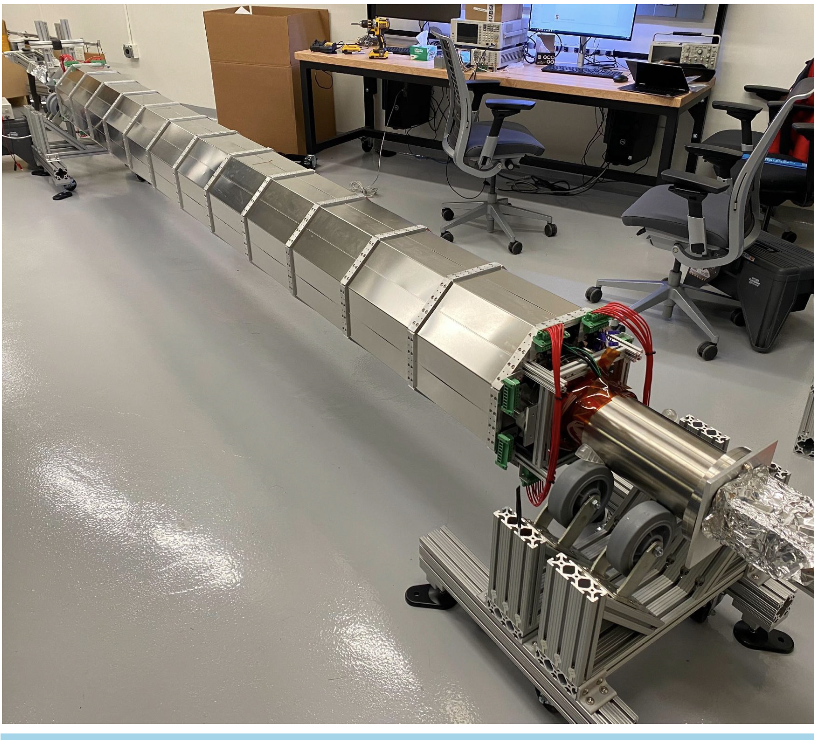
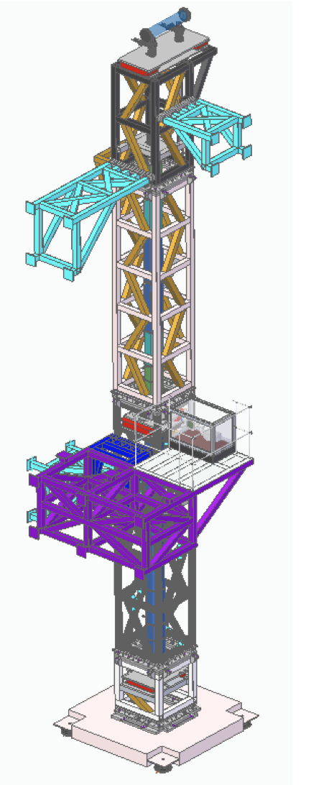
Long-baseline atom interferometer progress
MAGIS-100
AION
Design of Oxford
10 m Detector
Stanford 10 m tower assembly
Construction phase in progress
Surface laser lab and laser transport system started construction in 2023, completion and optical table install this year.
Civil construction waiting on contract to start summer 2025
Commissioning planned for early 2027
MAGIS-100 design is supported by development of Stanford 10 m Sr atom interferometer assembly started last summer.
5 ultracold Sr labs built in less than 24 months
Utilized cross-disciplinary large-scale Particle Physics production methods
All labs are commissioning R&D platforms
Finalized 10 m instrument design for Oxford
More than doubled the ultracold Sr R&D capacity in the UK and designed centralized ultra-high vacuum system production
AVS Quantum Sci. 6, 014409 (2024)

Slide 6
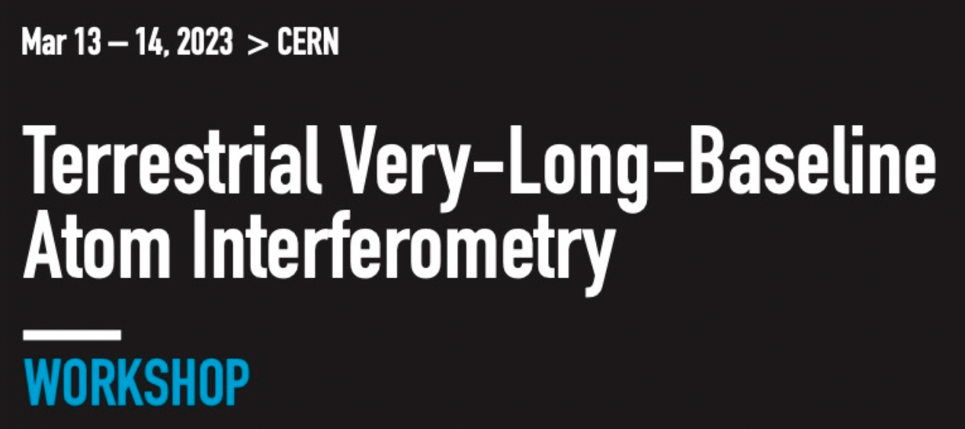
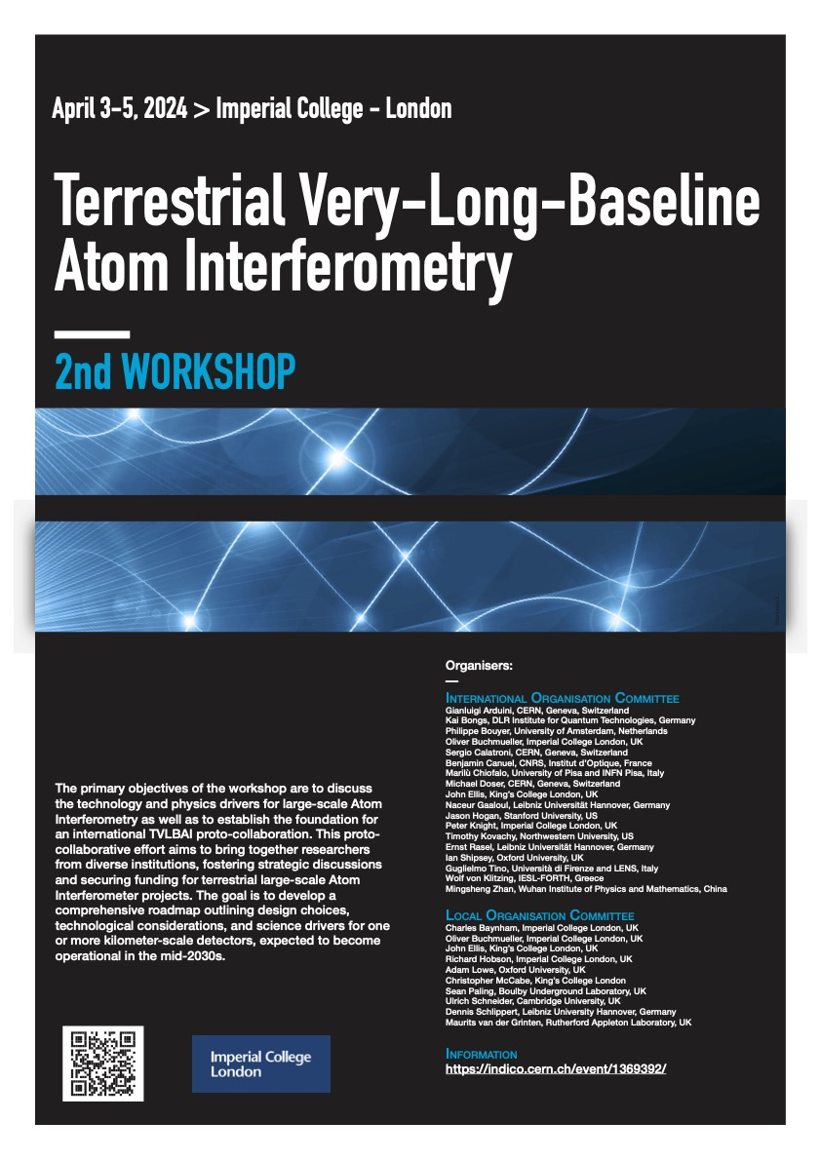
International efforts
Stage Expansion of Detector Length**
Stage 1: 2024 to 2027
10 m detector protype to be built in Oxford, focus fundamental science and R&D
10–20 m AION “spin-off” from Oxford design & experience at Boulby focus Earth Science applications.
Commissioning of MAGIS-100
Stage 2: 2028 to 2035
(Multi-)100 m detector: Site options are Boulby or Daresbury (UK), possibly also at CERN (France/Switzerland).
MAGIS-100 first science runs
Stage 3: 2035 onwards
Km-scale detector: Site options are Boulby and other international sites
AVS Quantum Science (Vol. 6, Issue 2)
https://doi.org/10.1116/5.0185291
** Sensitivity scales with length of detector
arXiv:2412.14960 (2024).

Slide 7
Atom interferometry
Mach-Zehnder laser interferometer
Mach-Zehnder atom interferometer
delay
detector
beamsplitter
mirror
beamsplitter
mirror
beamsplitter
Atom interferometry tutorials:
J. M. Hogan et al., arXiv:0806.3261 [physics] (2008).
O. Buchmueller, J. Ellis, and U. Schneider, arXiv:2306.17726 (2023).

Slide 8
Atom interferometry cont.
Atom interferometry ingredients
Quantum states that can be superposed
  Coherent
  Long-lived
  Technical feasibility
Laser system
  Extremely stable
  Quickly and precisely address the quantum states
  Controlled atom-light interactions
absorption
emission

Slide 9
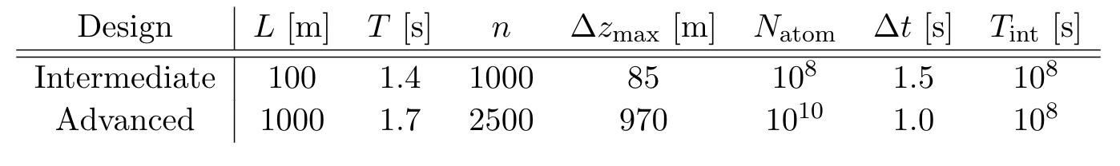
Science opportunities
Macroscopic tests of quantum mechanics
Searches for dark matter and gravitational waves
Tests of general relativity
Earth Science applications

Slide 10
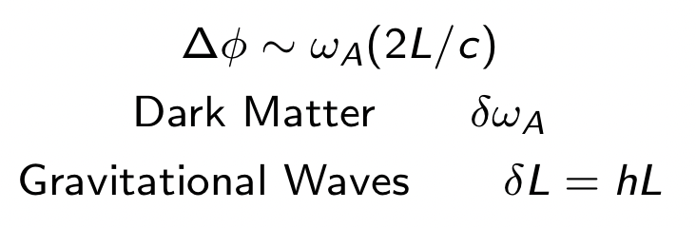
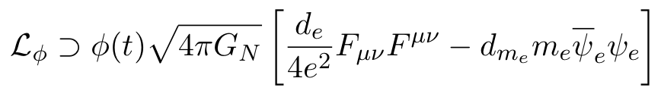
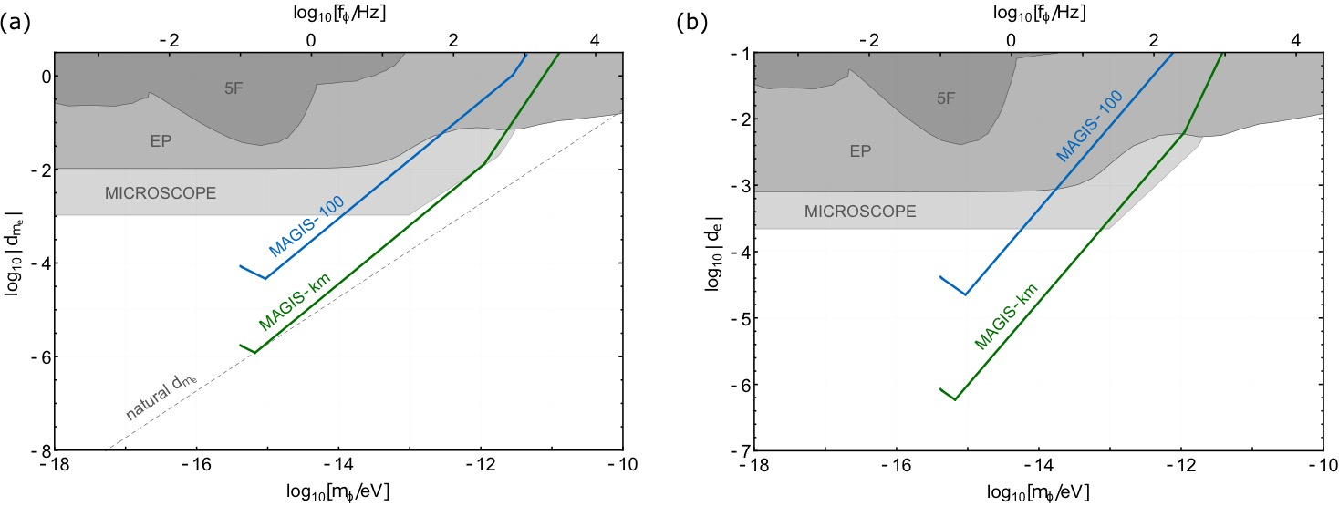
Dark matter
Ultralight dark matter
Ultralight scalar dark matter → high density, wave-like characteristics
10⁻²² eV
10⁻¹⁷ eV
10⁻¹² eV
10⁻⁷ eV
Photon Couplings
Electron Mass Couplings
Mahiro Abe et al 2021 Quantum Sci. Technol. 6 044003
Phys. Rev. D 97, 075020 (2018).

Slide 11
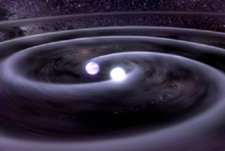
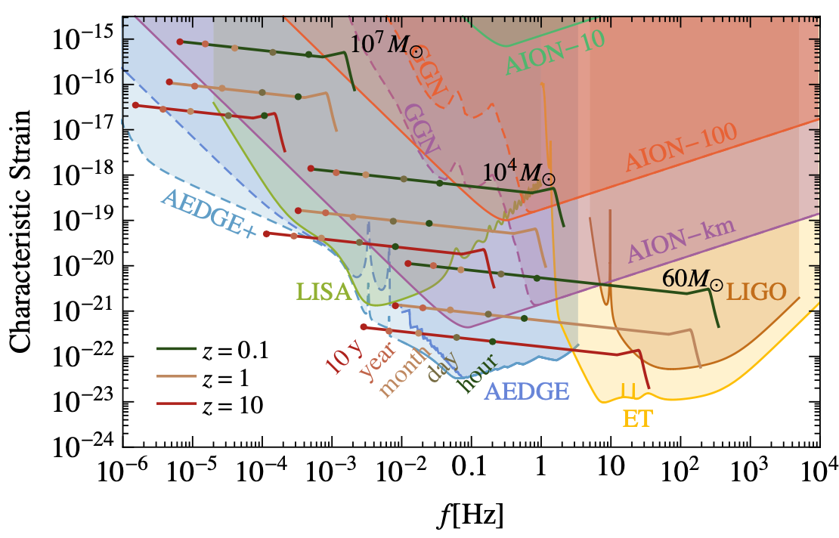


Gravitational waves
Gravitational waves
L. Badurina et al., JCAP 05 (2020) 011
Phys. Rev. Lett. 110, 171102 (2013).

Slide 12
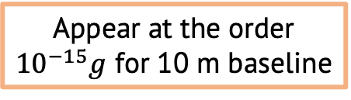
Tests of general relativity and dark energy
GR
Dark Energy
Atom acceleration in PPN Schwarzschild metric
Relativistic phase shift
Search for Chameleon field dark energy
Non-linear scalar interaction
Experimental setup requirements:
  High density source mass
  Perform atom interferometry near source mass in vacuum
  Chameleon acceleration alters atom trajectories leading to phase shift
Test for Newtonian violations
  Non-linear GR terms
  Velocity dependent forces
Set limits on PPN parameters
Appear at the order
${10}^{−15}g$ for 10 m baseline
B. Elder et al., Phys. Rev. D 94, 044051 (2016).
S. Dimopoulos et al., Phys. Rev. Lett., 2007

Slide 13
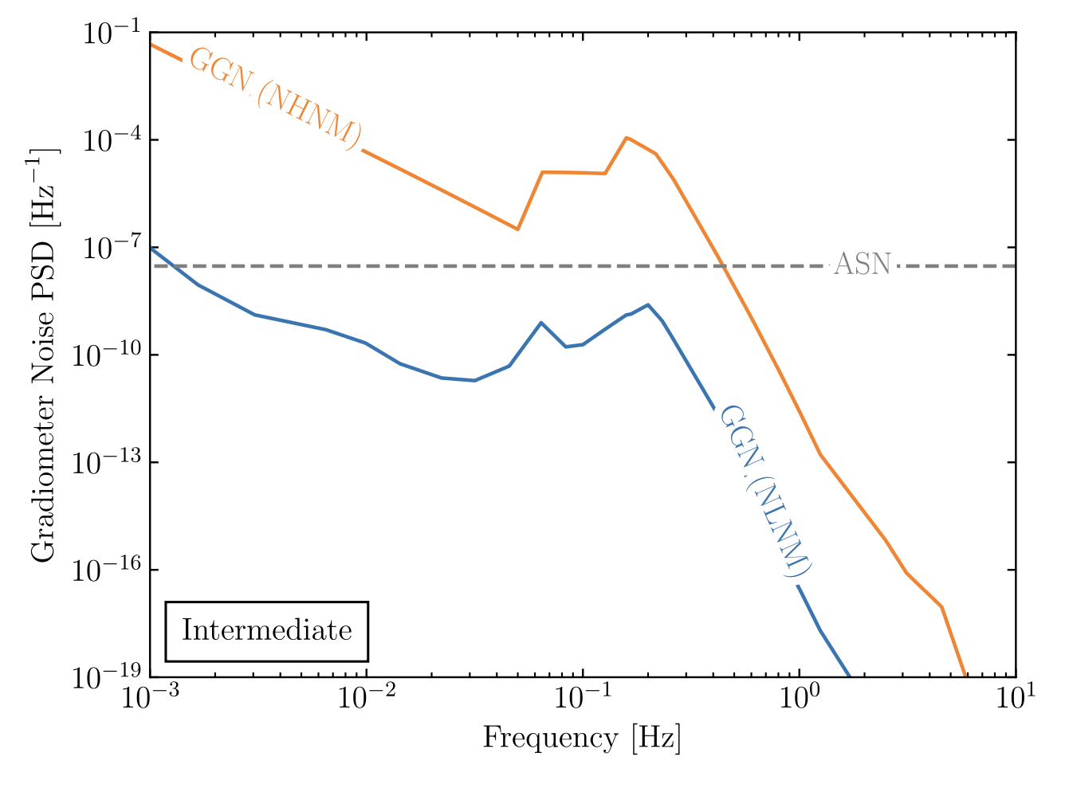
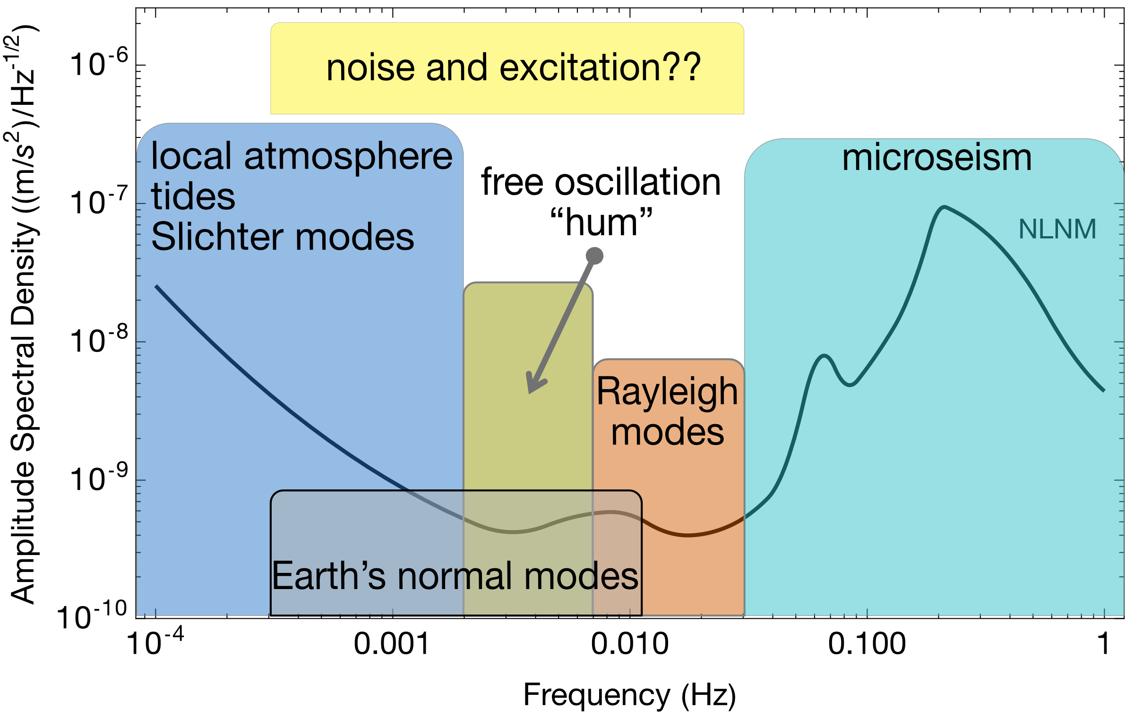
Earth Science applications
Rayleigh seismic waves source gravitational fluctuations
Terrestrial backgrounds cause gravity gradient noise limiting fundamental physics searches
AION can use gravitational signal channel to answer open questions in Earth science
  Earth’s free oscillation and normal modes
  Low-frequency Earth dynamics
Mitchell et al., J. Inst., vol. 17, 01, 2022.
Seismic Frequency Spectrum
Badurina, et al. Phys. Rev. D 107, 055002
Atmospheric infrasound and temperature gradient noise
Carlton et al., arXiv:2412.05379 (2024).

Slide 14
Challenges
Mahiro Abe et al 2021 Quantum Sci. Technol. 6 044003
Technical challenges require extreme precision for quantum control
  Atom flux, kinematics, atom temperature and collimation
  Laser frequency, phase, and pointing stability
  Temperature, vacuum, stray magnetic fields, and vibrations
  Gravitational static gradients and moving masses
  Subsampling instrument, aliasing
Exquisite sensitivity to gravity results in environmental noise sources which are harder to mitigate
  Seismic and atmospheric gravity gradient noise
  Random anthropogenic and synanthropic noise
L. Badurina, A. Beniwal, and C. McCabe, Phys. Rev. D 108, 083016 (2023).
J. Carlton and C. McCabe, Phys. Rev. D 108, 123004 (2023).
Badurina, et al. Phys. Rev. D 107, 055002

Slide 15



Summary and Thanks
Interferometers provide extreme sensitivity platform for searches of dark matter and gravitational waves
Quantum technologies have the potential to unlock unprecedented sensitivity for key scientific questions in fundamental physics, particle physics, and beyond
RAL

Slide 16
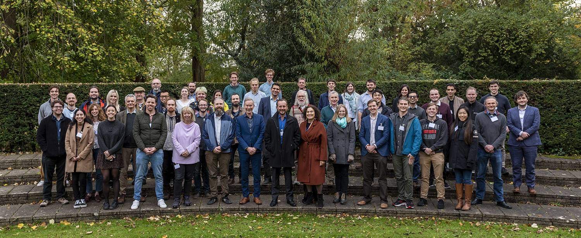


@AION_Science
Follow our progress!
aion_science

Slide 17
Backups

Slide 18

MAGIS-100 and AION partnership
Formalise UK-US Partnership
Formalising the long-standing UK-US partnership between MAGIS-100 and AION, in conjunction with the participating UK institutions.
This stands as a successful instance of UK-US cooperation in the fields of science and quantum technology development, with the potential to unlock additional synergies and opportunities.

Slide 19
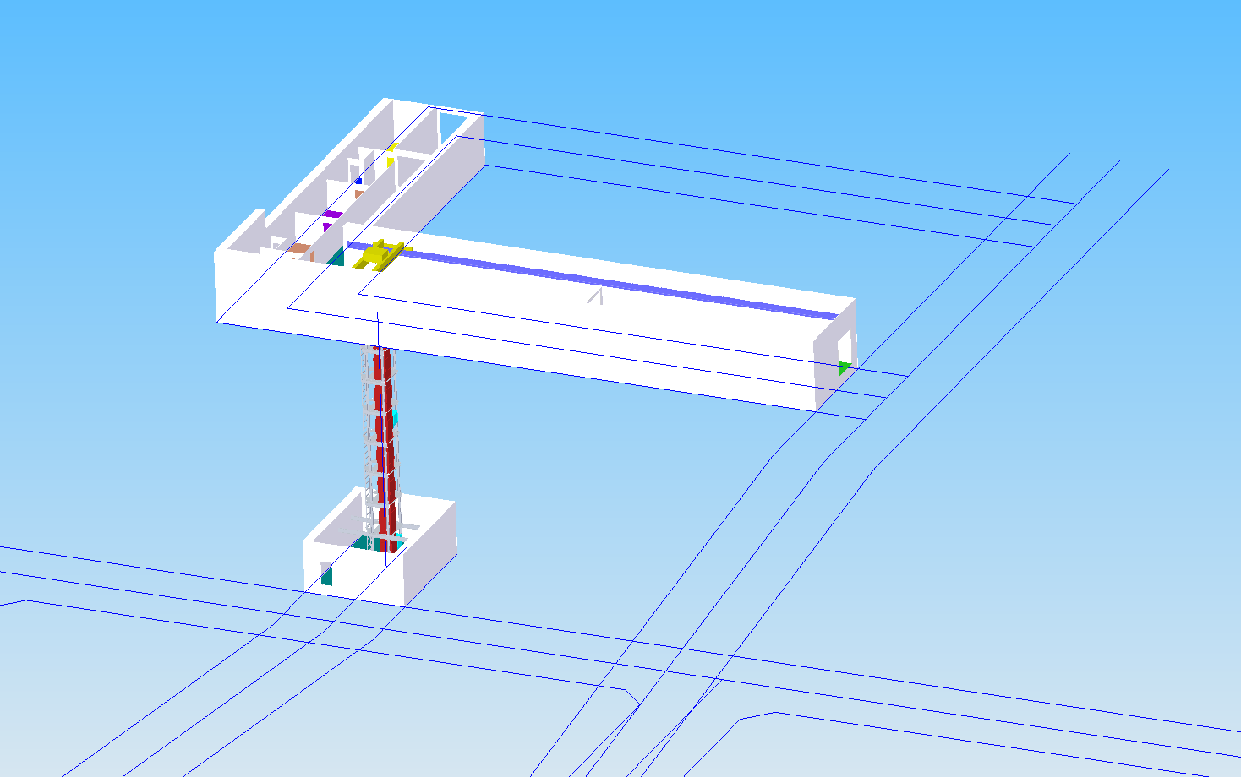
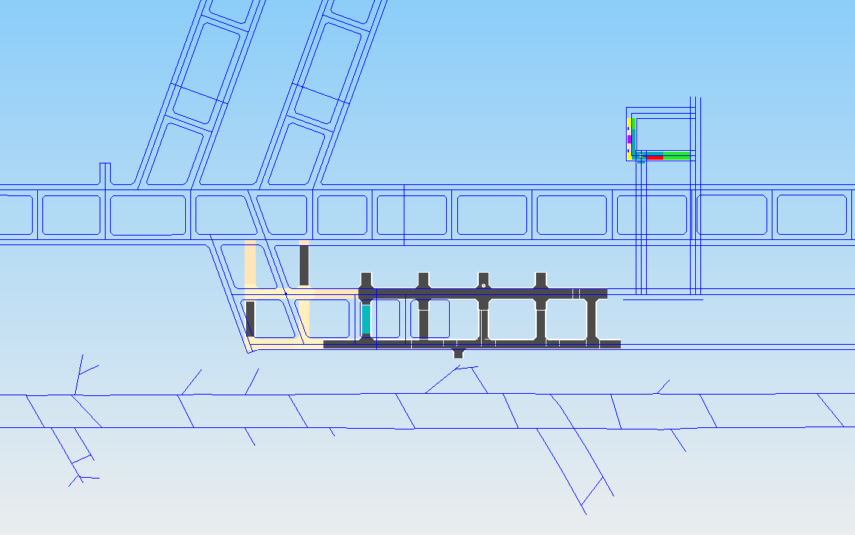
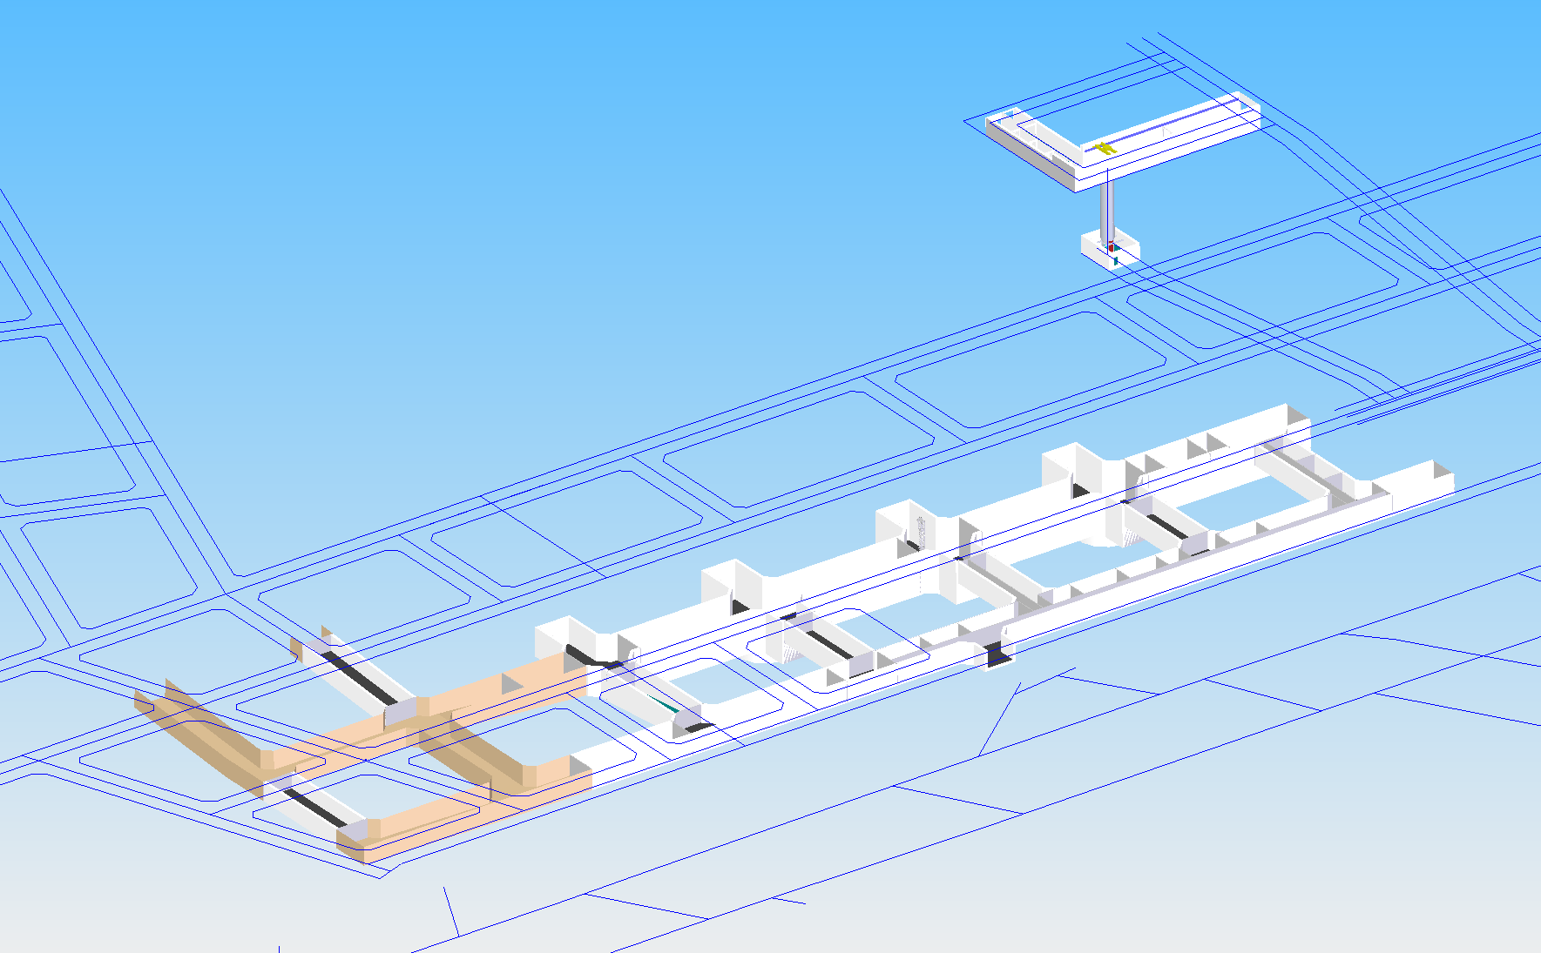
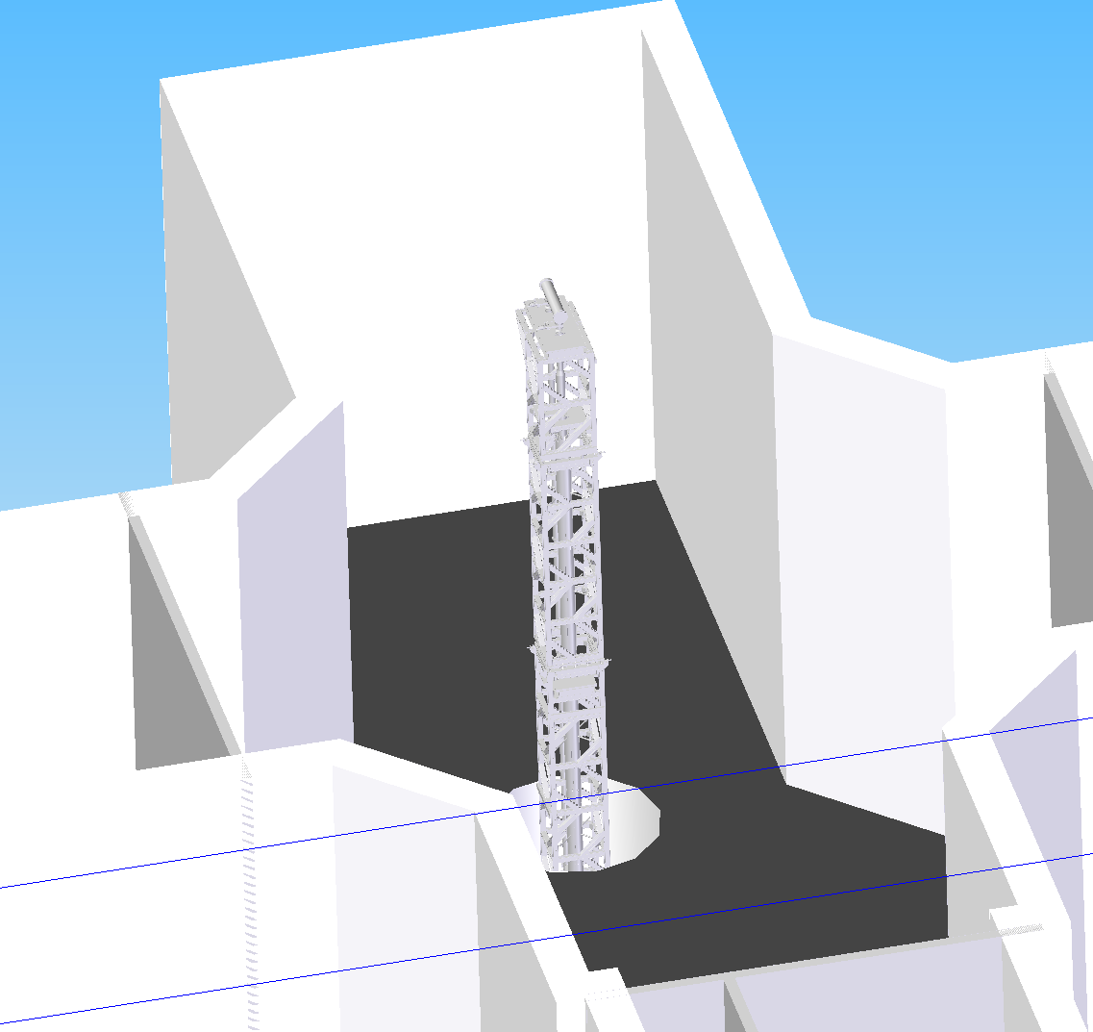
10–20 m detectors @Boulby
Quantum Campus
Utilising AION-10 design and operation experience from Oxford detector
Develop 10 m or 20 m detectors for deep underground Earth observation
Space for AION-20 in possible ‘Quantum Campus’
Quantum Campus
Space for AION 10 m Earth sensor in stage 1 experimental hall
Stage 1 main lab
Quantum Campus
Stage 1 main lab
Towards a world-leading low background Quantum Technology facility for fundamental science, seismic monitoring and more

Slide 20
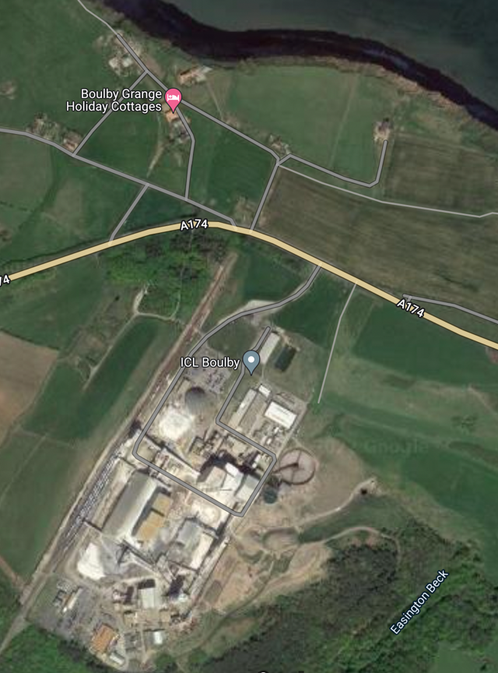
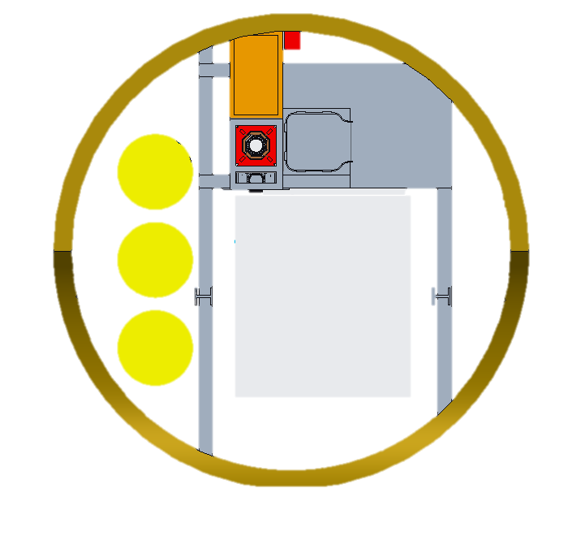
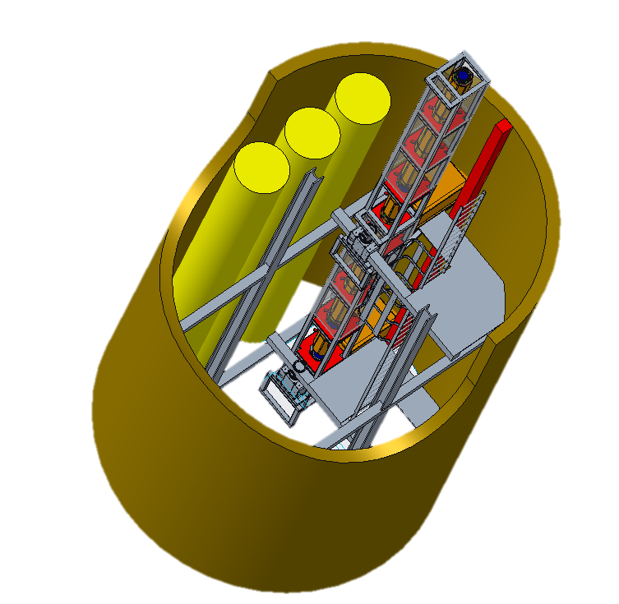
AION-100 @Boulby Options
Boulby 140 m Shaft 3
N
Side arm footprint
Grey: existing steel framework
Shaft 3
Existing water pipes
Vertical Ladder with platforms
AION-100 interferometer tube
Lift cage footprint
Shafts 1 & 2

Slide 21
title

