Slide 1



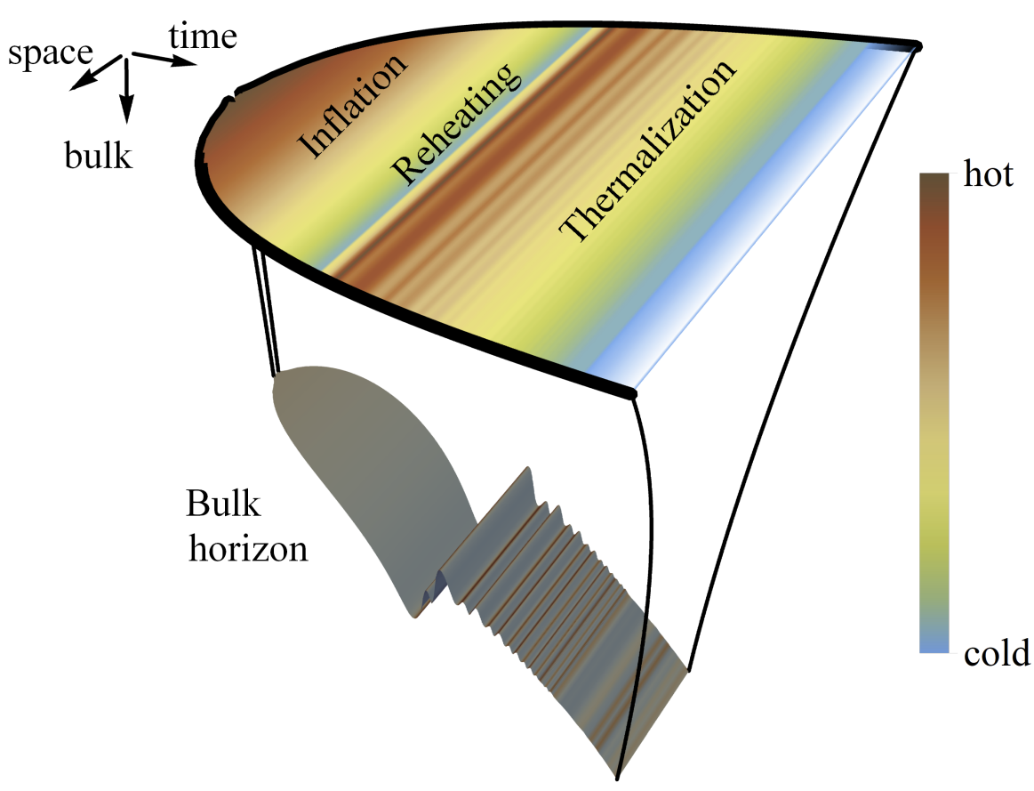
A dynamical inflaton coupled to strongly interacting matter
Holographic QFTs on curved backgrounds
With Christian Ecker, Elias Kiritsis, Jorge Casalderrey-Solana and David Mateos
Reference: 2011.08194 (JHEP), 2109.10355 (JHEP) and 2302.06618 (PRL)
Wilke van der Schee
Particle Production and Thermal Effects in Inflation
King’s College (virtual), 5 February 2024

Slide 2
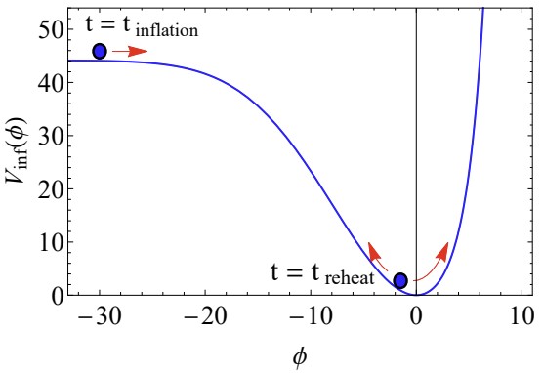
Conclusion
Wilke van der Schee, CERN/Utrecht
Boundary: FLRW₃₊₁ universe
Strongly coupled QFT as a mechanism for thermalization
  Proof-of-principle: sQFT plus inflaton with dynamical gravity
    Gravity is semi-classical; no quantum gravity
  Inflaton sources QFT: natural reheating when rolling down
  Boundary metric sources bulk metric
    Bulk thermalises `as fast as possible’ (time ~ 1/temperature)
Some crucial differences
  We start at high temperature; never `empty’ de Sitter
    Similar to warm inflation?
    Technical problem to get enough e-foldings?
  QFT similar to N=4 SYM, link with SM not obvious?
Bulk: anti-de-Sitter₄₊₁ with FLRW slices
Notes:
Many states + linearized

Slide 3
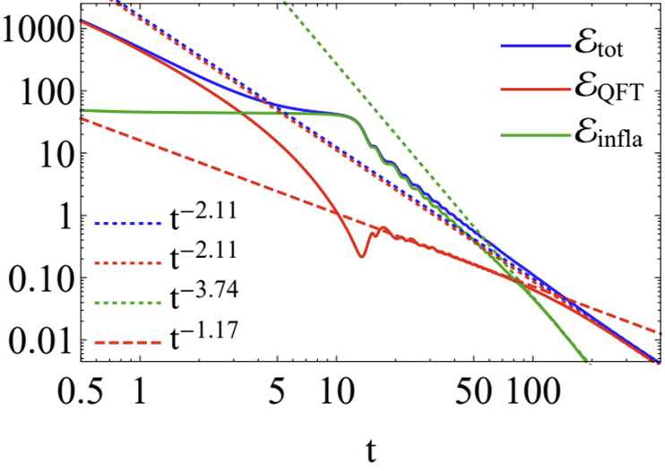
Conclusion
Wilke van der Schee, CERN/Utrecht
Inflation
Expanding Universe
Strongly coupled QFT as a mechanism for thermalization
  Proof-of-principle: sQFT plus inflaton with dynamical gravity
    Gravity is semi-classical; no quantum gravity
  Inflaton sources QFT: natural reheating when rolling down
  Boundary metric sources bulk metric
    Bulk thermalises `as fast as possible’ (time ~ 1/temperature)
Some crucial differences
  We start at high temperature; never `empty’ de Sitter
    Similar to warm inflation?
    Technical problem to get enough e-foldings?
  QFT similar to N=4 SYM, link with SM not obvious?
Reheating
Thermalization
Notes:
Many states + linearized

Slide 4
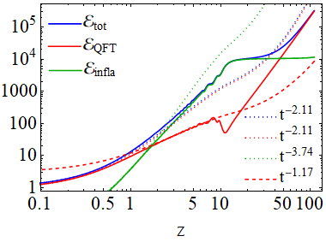
Conclusion
Wilke van der Schee, CERN/Utrecht
Expanding Universe
Inflation
Strongly coupled QFT as a mechanism for thermalization
  Proof-of-principle: sQFT plus inflaton with dynamical gravity
    Gravity is semi-classical; no quantum gravity
  Inflaton sources QFT: natural reheating when rolling down
  Boundary metric sources bulk metric
    Bulk thermalises `as fast as possible’ (time ~ 1/temperature)
Some crucial differences
  We start at high temperature; never `empty’ de Sitter
    Similar to warm inflation?
    Technical problem to get enough e-foldings?
  QFT similar to N=4 SYM, link with SM not obvious?
Reheating
Thermalization
Notes:
Many states + linearized

Slide 5
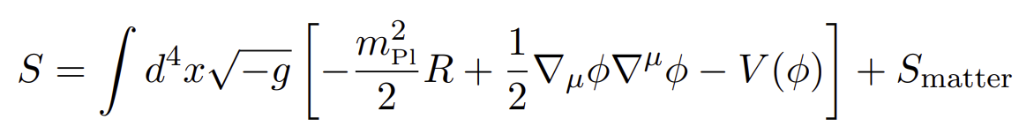

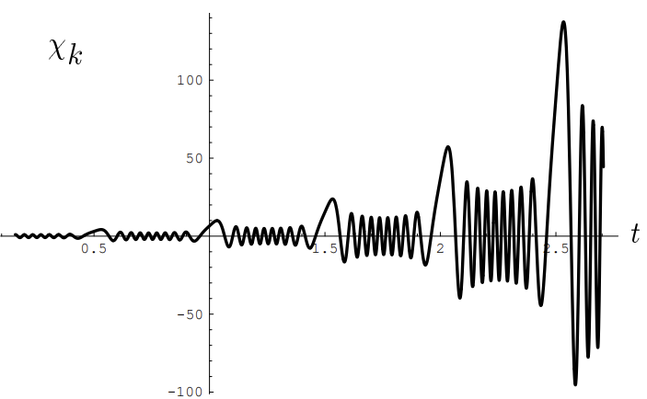
Inflation, preheating and reheating
Wilke van der Schee, CERN/Utrecht
How to get a working universe
  Inflation/cooling + reheating/thermalisation
  The inflaton energy needs to be transferred to Standard Model
Perturbative Reheating
  Inflaton decays at an (approximately) constant rate (faster than H)
  Decaying particles thermalise → big bang
Preheating
  Bose enhancement leads to resonances: exponential transfer of energy
  Bose enhanced states thermalise/reheat → big bang
Inflaton potential
Lev Kofman, Andrei Linde and Alexei A. Starobinsky, Towards the Theory of Reheating After Inflation (1997)
Notes:
Many states + linearized

Slide 6

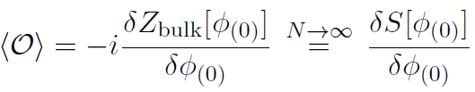
Short intro on holography
Wilke van der Schee, CERN/Utrecht
Exact equivalence between string theory and quantum field theory
Dictionary:
  Source operator is a boundary condition for the bulk field
  Expectation value as a near-boundary derivative
  Scalar operator ←→ scalar field
  Stress tensor ←→ metric
    Boundary metric as a source; not necessarily dynamic
  Simplifies in large N + strong coupling limit
Juan Maldacena, The large-N limit of superconformal field theories and supergravity (1997)
Notes:
Many states + linearized

Slide 7

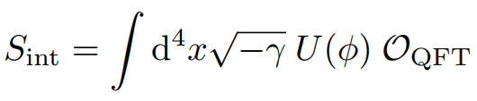
Inflation, reheating and holography
Wilke van der Schee, CERN/Utrecht
Holographic set-up
  ‘standard’ EH + inflaton + coupling to scalar:
  Inflaton acts as a source for the scalar operator
Two technical complications:
  Sources are now time-dependent numerical functions
  holographic renormalisation becomes more complicated
Trial and error:
  Initial inflaton position, inflaton velocity, coupling strength, shape potential
  Balance between numerical stability, runtime and making a ‘realistic’ universe
Inflaton potential
Notes:
Many states + linearized

Slide 8


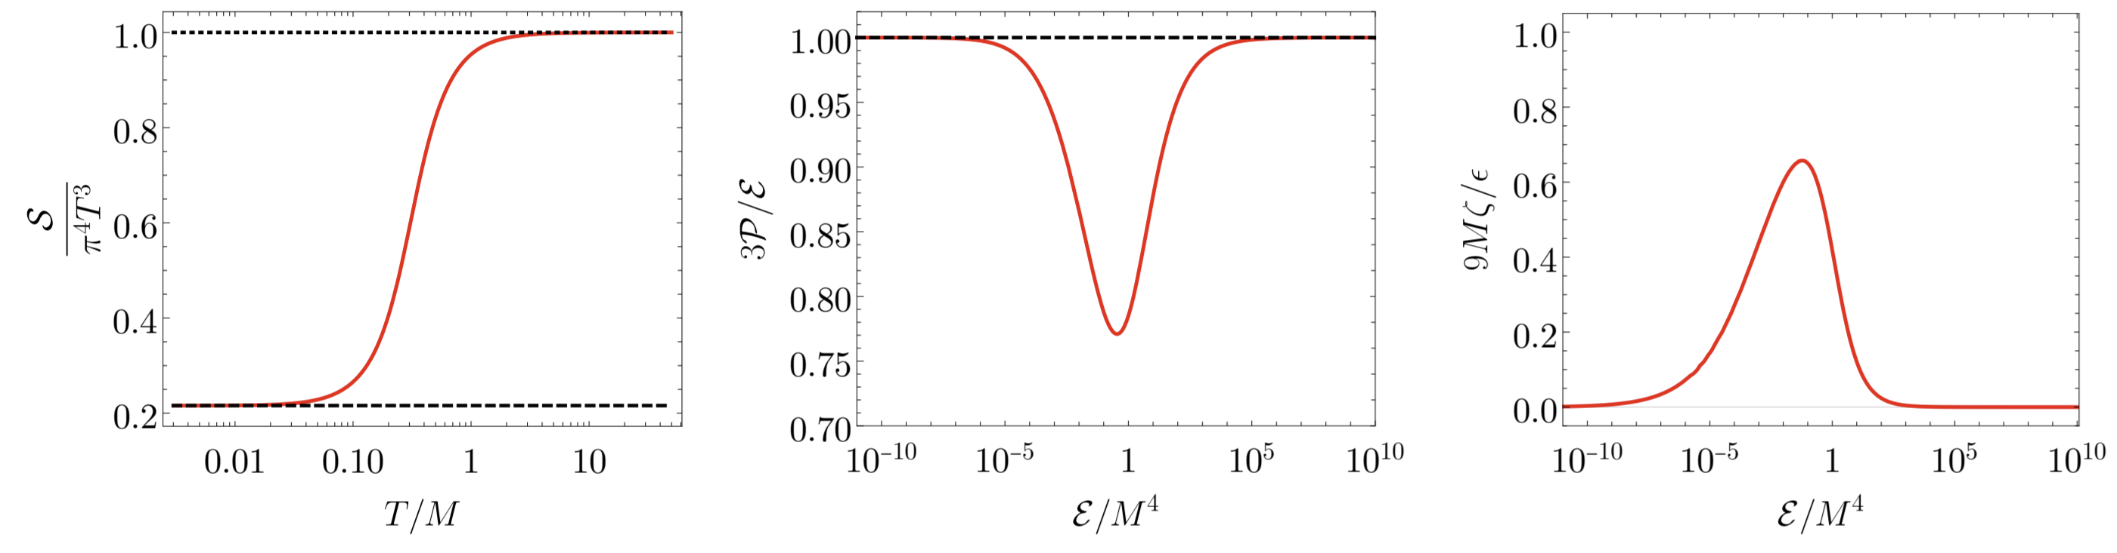
Non-conformal model on de sitter₄
Wilke van der Schee, CERN/Utrecht
De Sitter is conformally flat: almost trivial for CFT
Break scale invariance by V(Φ) with source M (will be inflaton)
Leads to non-trivial EOS and bulk viscosity (no shear considered):
Entropy density
Trace anomaly
Bulk viscosity
Jorge Casalderrey-Solana, Christian Ecker, David Mateos and WS, Strong-coupling dynamics and entanglement in de Sitter space (2020)
Notes:
Note ihQCD: is possible to change from N=4 SYM

Slide 9
A dynamical boundary
Wilke van der Schee, CERN/Utrecht
Study dynamics including semi-classical gravity:
  Stress-tensor includes possible cosmological constant
  NB: renormalisation counterterms are now physical
  We treat the boundary Newton constant as a (small) parameter
Dynamics of scale factor S₀(t) is a consequence of Friedmann equations
How to initialise the dynamics
  Start with thermal Minkowski profile and small boundary G_{N,4}
Jewel Ghosh, Elias Kiritsis, Francesco Nitti and Lukas Witkowski, Back-reaction in de Sitter QFTs: holography, gravitational DBI action and f(R) gravity (2020)
Paul Chesler and Abraham Loeb, Holographic duality and mode stability of de Sitter space in semiclassical gravity (2020)
Christian Ecker, WS, David Mateos and Jorge Casalderrey-Solana , Holographic evolution with dynamical boundary gravity (2021)
Notes:
Many states + linearized

Slide 10
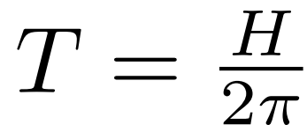
Intermezzo: empty de sitter
Wilke van der Schee, CERN/Utrecht
Two ways to study strongly coupled QFT on empty de Sitter:
  ‘Standard’: metric is non-normalisable mode, so just use
  Natural end-point of dynamical gravity with positive cosmological constant
Expectations:
  De Sitter has a Hawking temperature
  Expect an entropy proportional to the cosmological horizon (?)
  Is this related to the event or apparent horizon?
    A priori not: horizon gives a volume law entropy
    More robust: entanglement entropy, through bulk extremal surfaces
Jorge Casalderrey, Christian Ecker, David Mateos and WS, Strong-coupling dynamics and entanglement in de Sitter space (2020)
Notes:
Many states + linearized

Slide 11
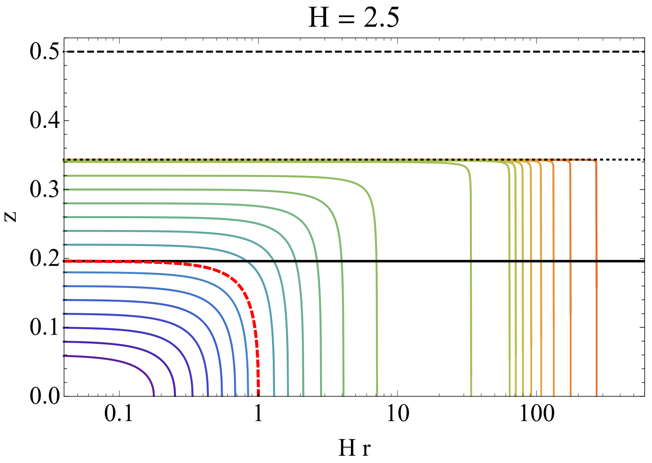
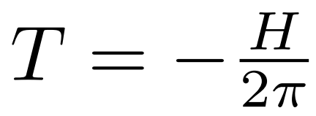
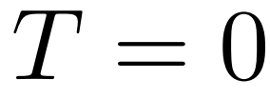
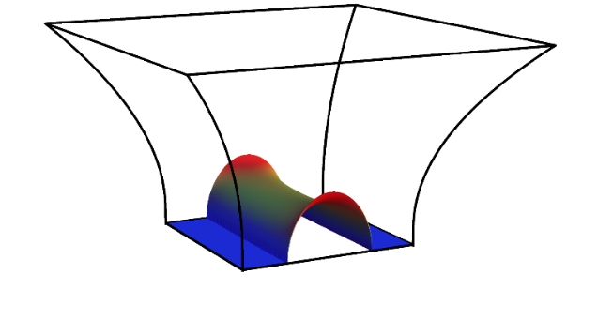
Bulk geometry with ds boundary
Wilke van der Schee, CERN/Utrecht
Event, apparent and ‘entanglement’ horizons for bulk dual to empty de Sitter
  The apparent horizon is much beyond the event horizon
  Also shown: extremal surfaces
  `Temperature’ of AH is negative; curiosity? (from surface gravity of bulk horizon)
  Only `superobservers’ can see behind event horizon (if and only if (!))
Apparent horizon:
Entanglement horizon:
Event horizon:
Boundary
Cosmological horizon
Jorge Casalderrey, Christian Ecker, David Mateos and WS, Strong-coupling dynamics and entanglement in de Sitter space (2020)

Slide 12
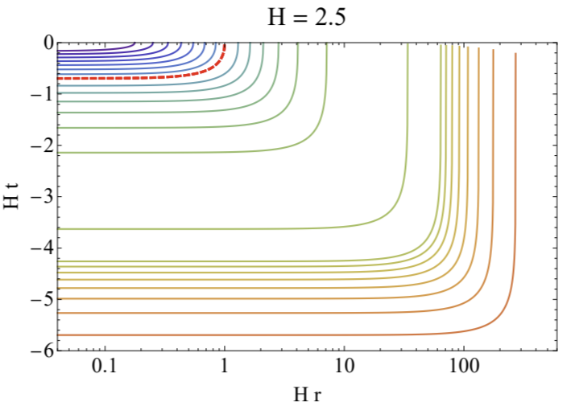
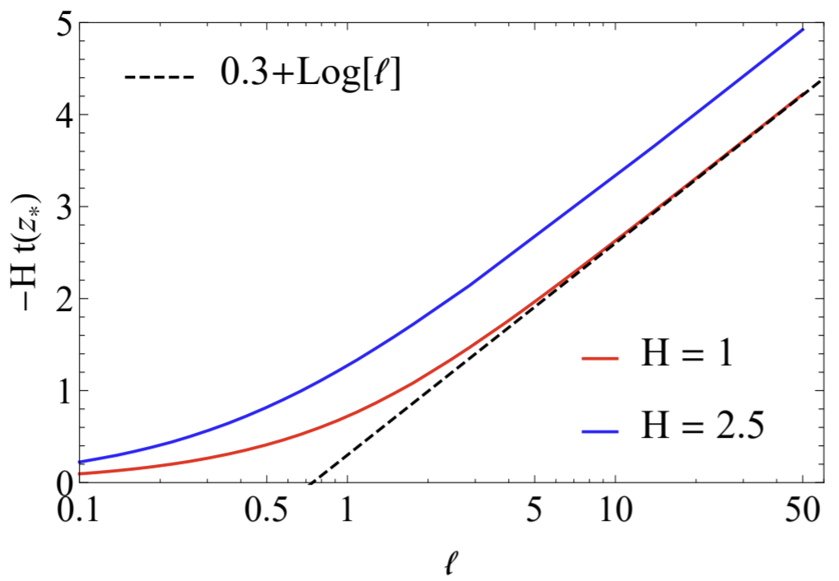
entanglement in de Sitter
Wilke van der Schee, CERN/Utrecht
Extremal surfaces go backward in time
Time at the deepest point grows exactly as log(l) for large l
Implies that `entanglement horizon’ contribution has a constant instead of volume law contribution
Standard `area law’ divergence still applies
Cosmological horizon

Slide 13
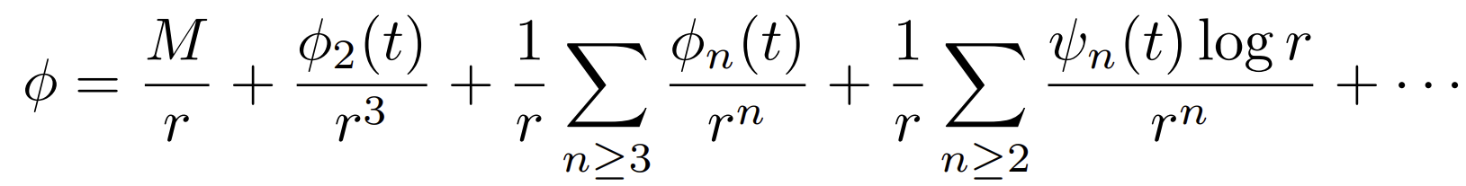

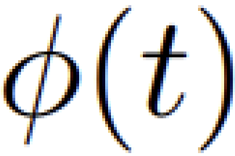

A dynamical boundary – consistent initial conditions
Wilke van der Schee, CERN/Utrecht
Near-boundary expansion scalar (and metric):
  Crucial subtlety: logarithmic terms ψ_{n} solely determined by sources S₀(t)
  Consistent IC not much of a problem with known source (ψ_{n} known analytically)
Dynamics of scale factor S₀(t) is now consequence of Friedmann equations
Sufficiently smooth solution requires knowledge of sufficient # of log’s
  Log’s depend on time derivatives of S₀(t)
  Solution: extract from near-boundary expansion of scalar (extract φ_{n})
  Use time derivates to treat first few logs analytically
Final subtlety: VEV and energy density depend on S₀’’(t) and φ’’(t)
  Solve resulting 6th order polynomial equation numerically
Sebastian de Haro, Kostas Skenderis and Sergey N. Solodukhin, Holographic Reconstruction of Spacetime and Renormalization in the AdS/CFT Correspondence (2001)
Notes:
Many states + linearized

Slide 14
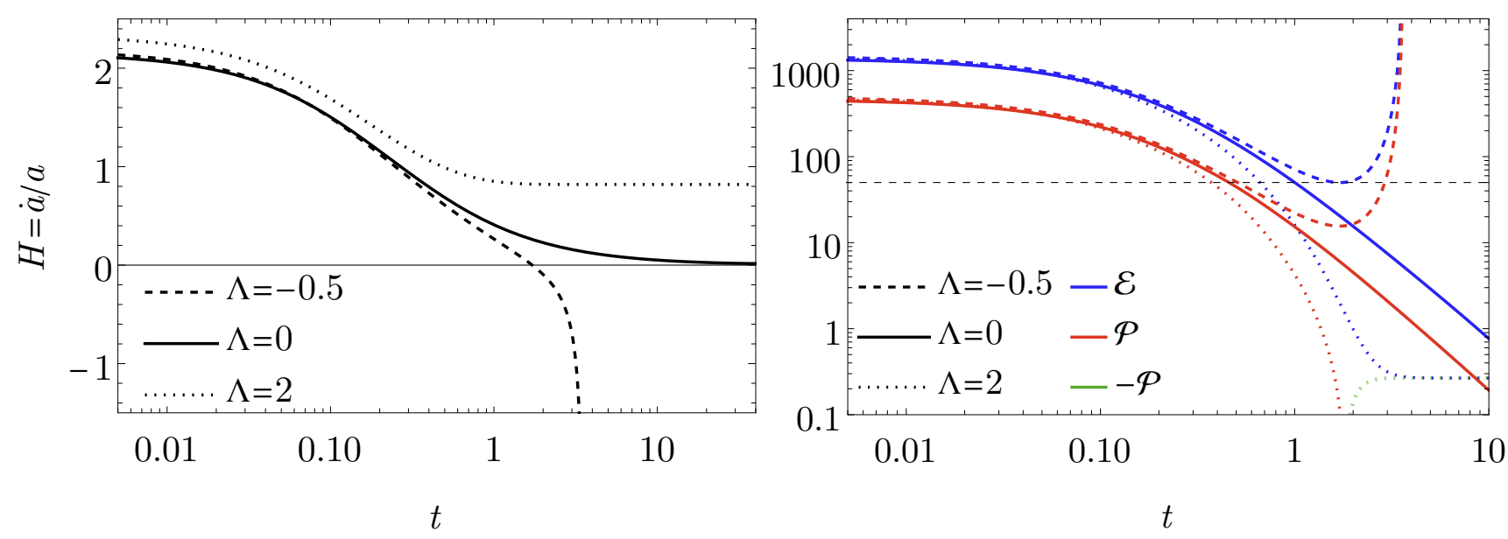
boundary gravity only
Wilke van der Schee, CERN/Utrecht
Stress-energy tensor for zero, positive and negative Λ
Positive Λ settles down to de Sitter state as studied before, includes (small) Casimir energy
Now also asymptotically flat + Big Crunch geometries
14/19
Christian Ecker, WS, David Mateos and Jorge Casalderrey-Solana, Holographic evolution with dynamical boundary gravity (2021)
Notes:
Many states + linearized

Slide 15
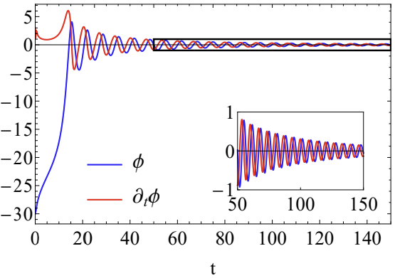
boundary gravity with an inflaton
Wilke van der Schee, CERN/Utrecht
Inflaton rolls down and undergoes damped oscillation
Rolls down relatively fast (helps numerical stability)
Inflaton potential
Inflaton dynamics
15/19
Notes:
Many states + linearized

Slide 16
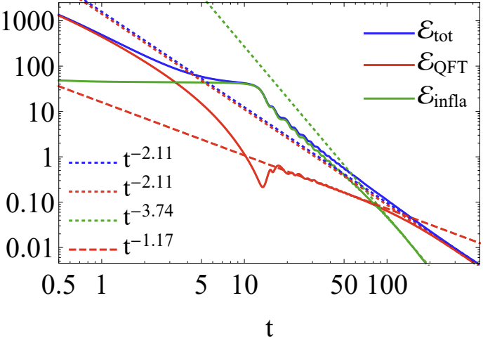
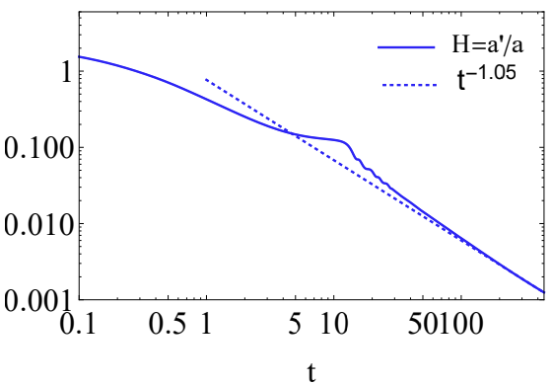
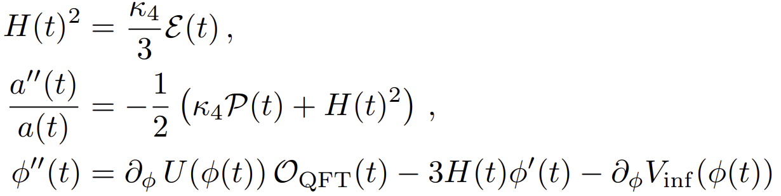
Inflation and reheating
Wilke van der Schee, CERN/Utrecht
Initially dominated by QFT energy
  Quickly dilutes due to expansion
Then dominated by inflaton
  Inflation, while slowly rolling down
Then inflaton reaches bottom: reheating
  Inflaton loses energy to QFT
Finally universe dominated by QFT in thermal equilibrium
Energy densities (log-log)
Hubble rate
16/19
Inflating phase (t ~ 5 till 12)
Reheating (around t=13)
Notes:
Many states + linearized

Slide 17
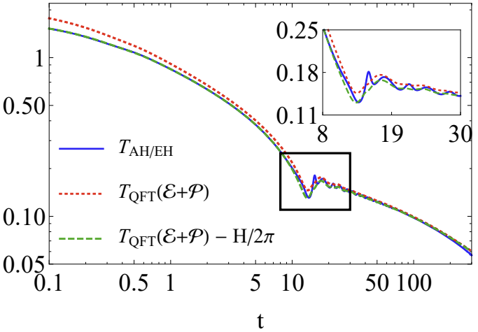
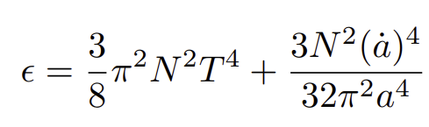
Temperature from bulk and qft
Wilke van der Schee, CERN/Utrecht
Temperature (log-log)
Three ways to determine temperature:
  From energy density and EOS
  From apparent horizon
  From event horizon (agrees to apparent horizon)
Always `close to equilibrium’
  Somewhat curious Casimir shift by de Sitter temperature
  Also present in analytical solution of conformal case
17/19
Alex Buchel, Michal P. Heller and Jorge Noronha, Entropy Production, Hydrodynamics, and Resurgence in the Primordial Quark-Gluon Plasma from Holography (2016)
Notes:
Many states + linearized

Slide 18
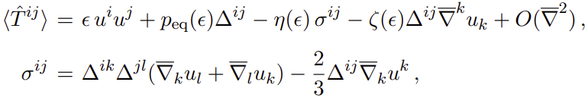
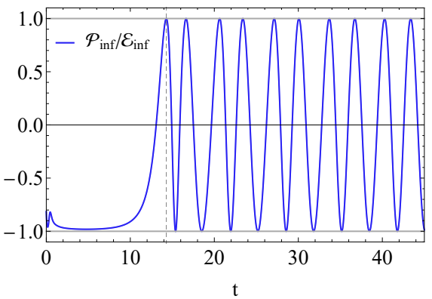

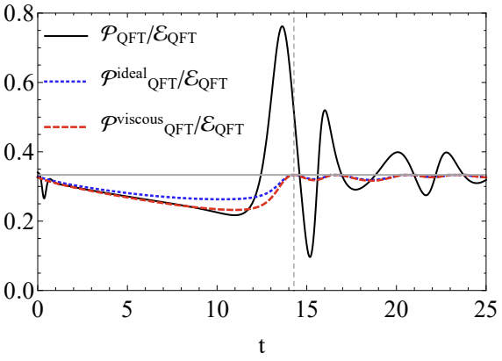
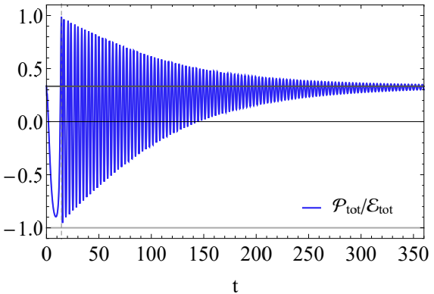
hydrodynamics
Wilke van der Schee, CERN/Utrecht
Hydrodynamic constitutive relation (ideal+viscous):
  Quick initial hydrodynamisation (t~1)
  Viscous hydrodynamics during inflation (t ~ 5 – 13)
  Far-from-equilibrium during reheating (t~ 13 – 20)
18/19
Notes:
Many states + linearized

Slide 19
Discussion
Dynamical gravity and inflaton on the boundary
  Technical progress: how to deal with the logs?
  Several interesting evolution: flat space, Big Crunch
  Interesting holographic temperatures and entropies in de Sitter
Inflation and reheating
  First principles computation of strongly coupled reheating
  Strongly coupled physics can thermalise after preheating
  Currently not a `realistic universe’
Future
  Realistic universe? Many e-foldings based on hydro?
  Do we understand entropy of de Sitter?

Slide 20
Back-up

Slide 21
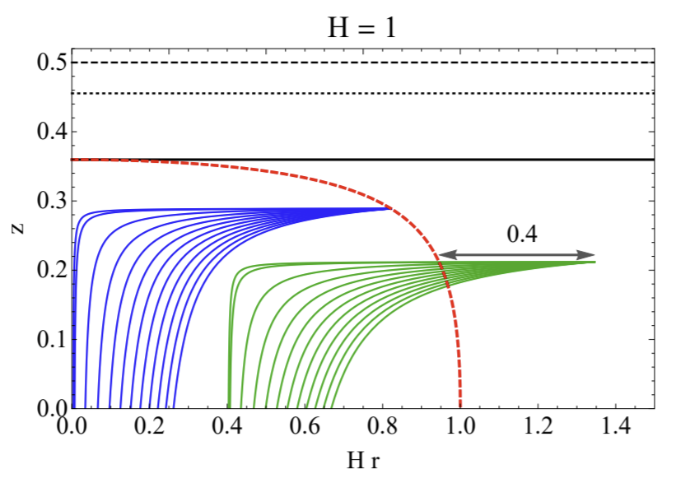
Cosmological horizon
Wilke van der Schee, CERN/Utrecht
Extremal surface dual to cosmological horizon:
Separates points in the bulk from which light can reach the (boundary) origin
Boundary cosmological horizon → full bulk cosmological horizon
Cosmological horizon
Jorge Casalderrey, Christian Ecker, David Mateos and WS, Strong-coupling dynamics and entanglement in de Sitter space (2020)

Slide 22
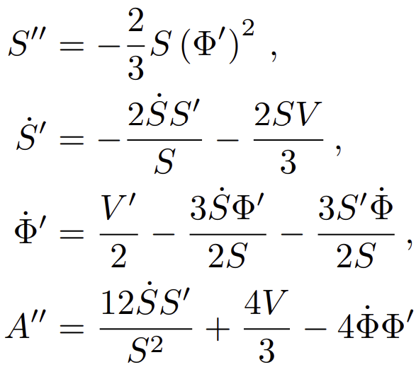
Some numerical details
Wilke van der Schee, CERN/Utrecht
Three bulk fields depending on time t and bulk direction r :
Characteristic formulation leads to nested set of linear ODEs (spectral elements):
S and Φ require boundary conditions: scale factor a(t) and inflaton φ(t)
  Normally sources are specified by hand; here: 4D Einstein-Inflaton equations
  Boundary conditions implemented through near-boundary expansion
  Subtract first few logs analytically (for stability in spectral elements)
  A requires initial boundary condition (energy density), then determined by SE-conservation
Boundary 4D Einstein-inflaton equations:
See also www.wilkevanderschee.nl for the full numerical code.
Notes:
Many states + linearized

Slide 23
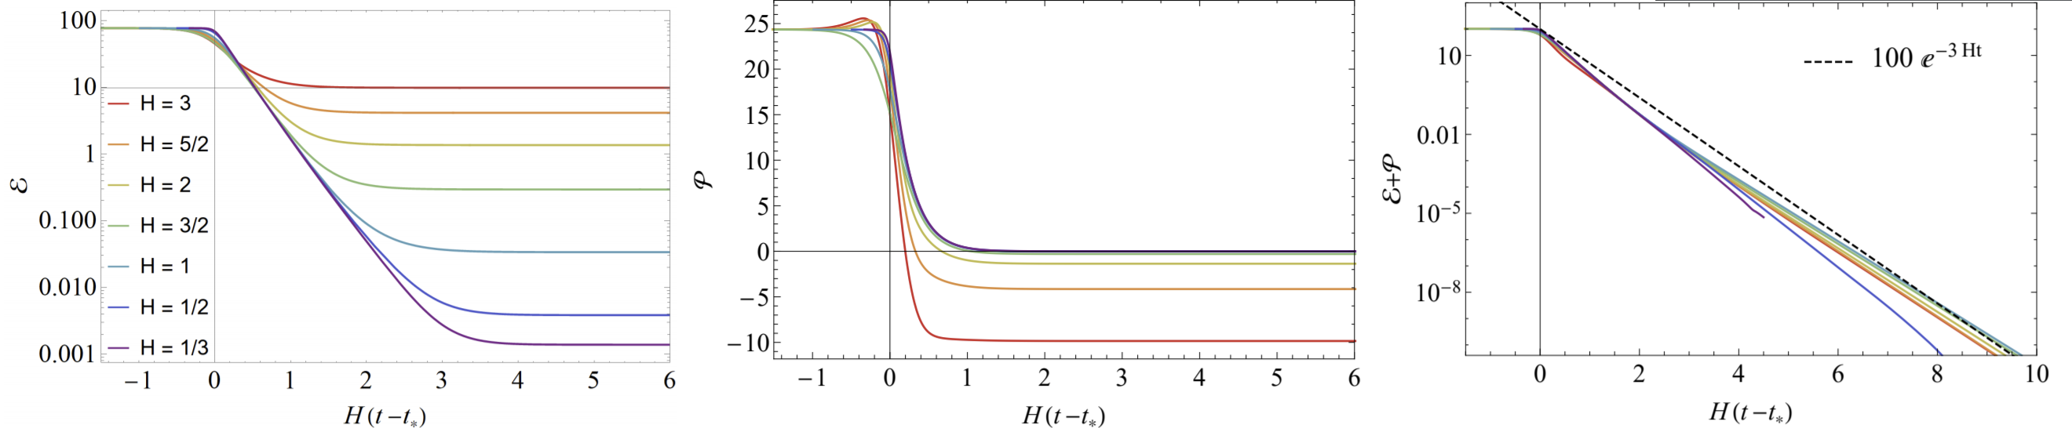
Time evolution of the protocol
Wilke van der Schee, CERN/Utrecht
Evolution of stress tensor for different Hubble constants
Energy density decreases towards vacuum energy (VE) (afterwards renormalised to zero)
Pressure decreases, changes sign and becomes –VE
Enthalpy is scheme independent, decays due to expansion
Energy density
Pressure
Enthalpy
Notes:
Note ihQCD: is possible to change from N=4 SYM

Slide 24

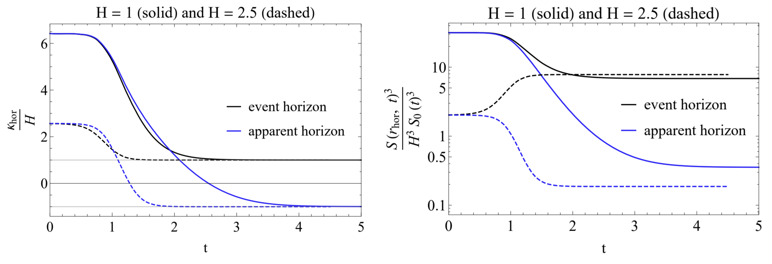
Black hole Thermodynamics
Wilke van der Schee, CERN/Utrecht
Keep track of bulk event and apparent horizons (EF coordinates)
Dynamical setting: horizons not coincide at late times:
Surface gravities can be shown analytically:
EH confirms Hawking’s temperature in de Sitter
Area density apparent horizon vanishes for conformal theory
Surface gravity
Area densities
Willy Fischler, Sandipan Kundu and Juan Pedraza, Entanglement and out-of-equilibrium dynamics in holographic models of de Sitter QFTs (2013)
Alex Buchel, Entanglement entropy of N = 2∗ de Sitter vacuum (2019)
Notes:
Note ihQCD: is possible to change from N=4 SYM

Slide 25
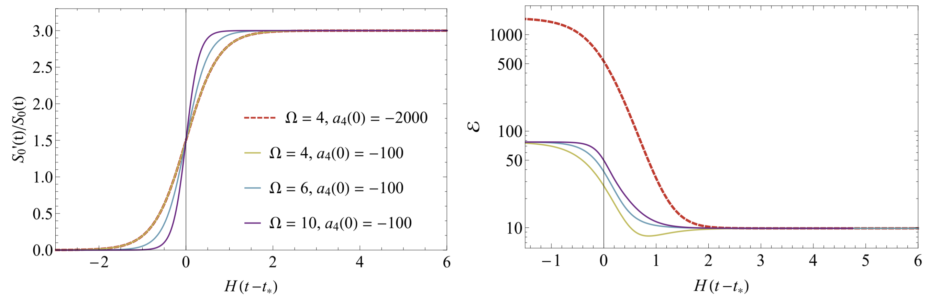
How we set up a state
Wilke van der Schee, CERN/Utrecht
Non-trivial boundary metric:
Start with thermal (high-temperature) state in flat space
Quench system by suitable fast tanh to constant Hubble parameter
Energy density decreases towards final `vacuum energy’ (VE)
Final (Bunch-Davis)-VE is ambiguous → chose scheme with zero VE
Hubble parameter
Energy density
Notes:
Note ihQCD: is possible to change from N=4 SYM

Slide 26
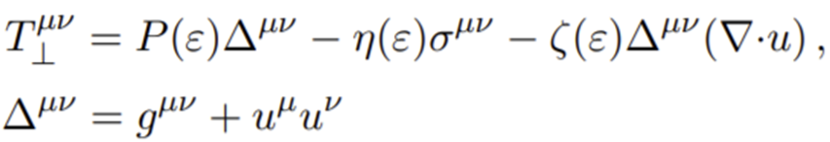
The approach towards hydrodynamics
Wilke van der Schee, CERN/Utrecht
Comparing with the hydrodynamic constituent relations:
Symmetric set-up: only non-trivial part is bulk viscosity:
A subtlety: EOS and viscosity computed in flat space;
what is the energy density in de Sitter space?
We decided to fix renormalisation freedom so that late time solution has zero energy density
(in any case: ambiguity is order H²)
(also, note that scheme depends on H for our choice)
Notes:
Note ihQCD: is possible to change from N=4 SYM

Slide 27
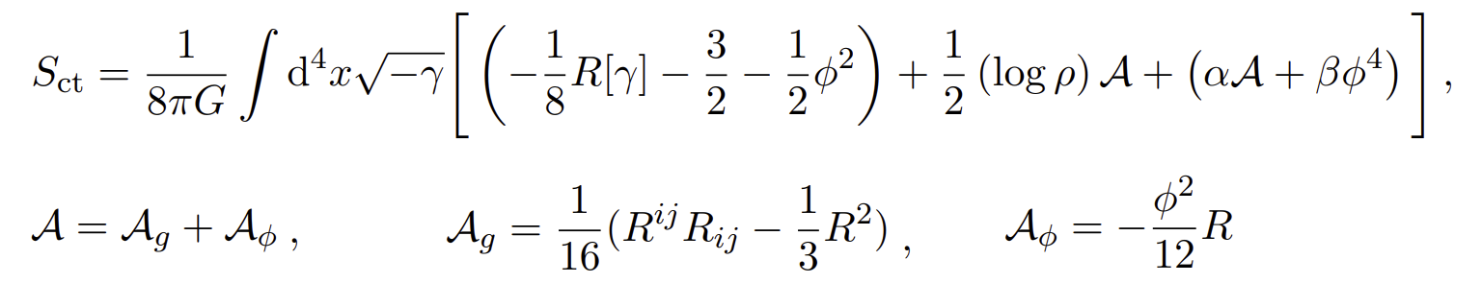
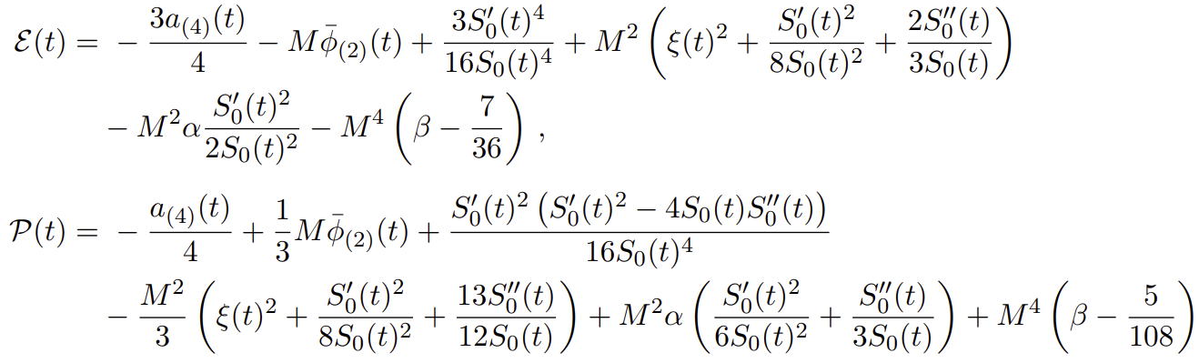
Holographic renormalisation
Wilke van der Schee, CERN/Utrecht
Action needs (scheme-dependent) counter-terms:
Leads to an ambiguity in the stress-tensor:
α and β encode scheme dependencies (cosmological constant);
fixed such that late time solution has vanishing energy
Ambiguities come in at order H ²
Notes:
Note ihQCD: is possible to change from N=4 SYM

Slide 28
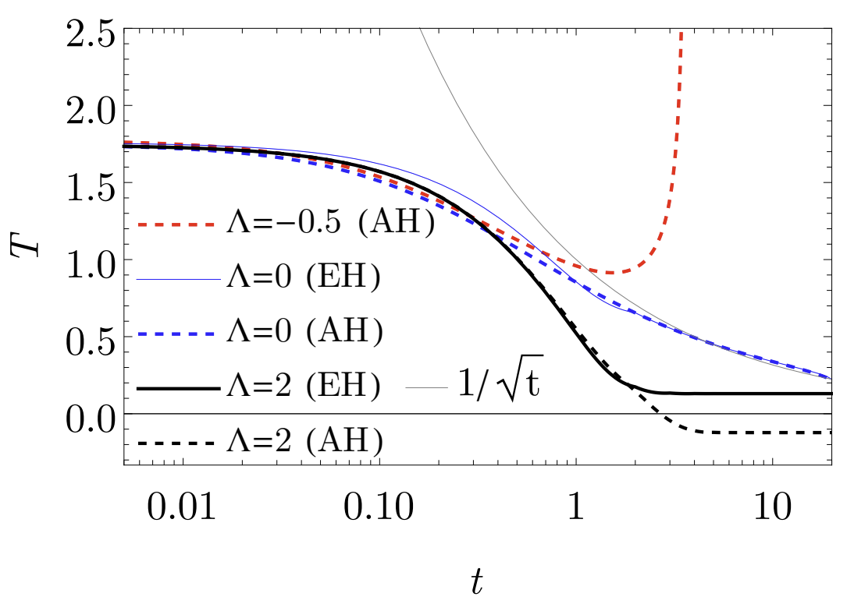
boundary gravity - Temperatures
Wilke van der Schee, CERN/Utrecht
Temperatures extracted from surface gravity event and apparent horizons
De Sitter case again settles down with negative AH ‘temperature’
For the big crunch geometry the EH location is not obvious (no future timelike infinity)
28/19
Notes:
Many states + linearized

Slide 29
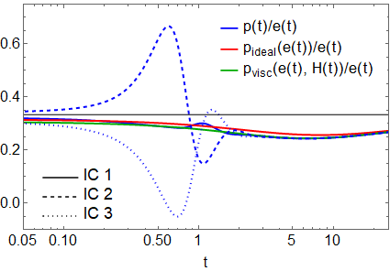
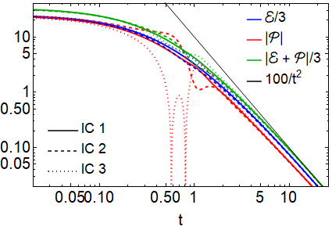
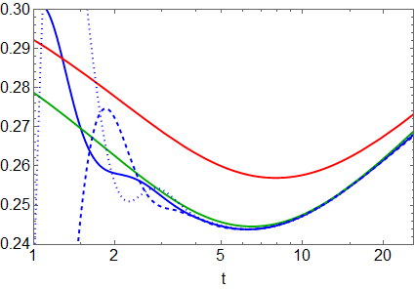
Hydrodynamisation and boundary gravity
Wilke van der Schee, CERN/Utrecht
Three different initial conditions for Λ = 0:
Stress-tensor, and hydrodynamisation:
all hydrodynamise within a time of ~1/T
29/19
Notes:
Many states + linearized

Slide 30
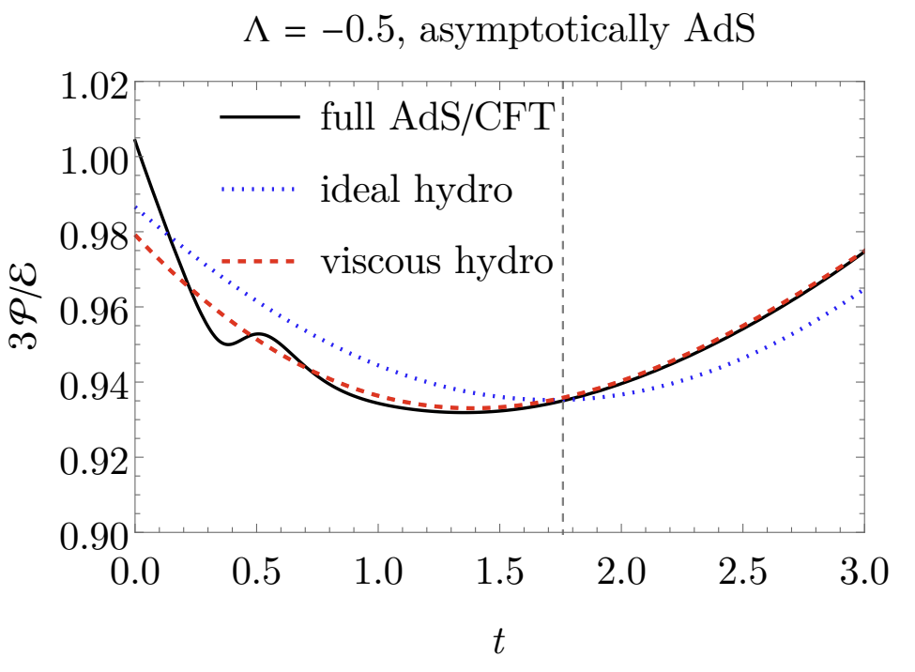
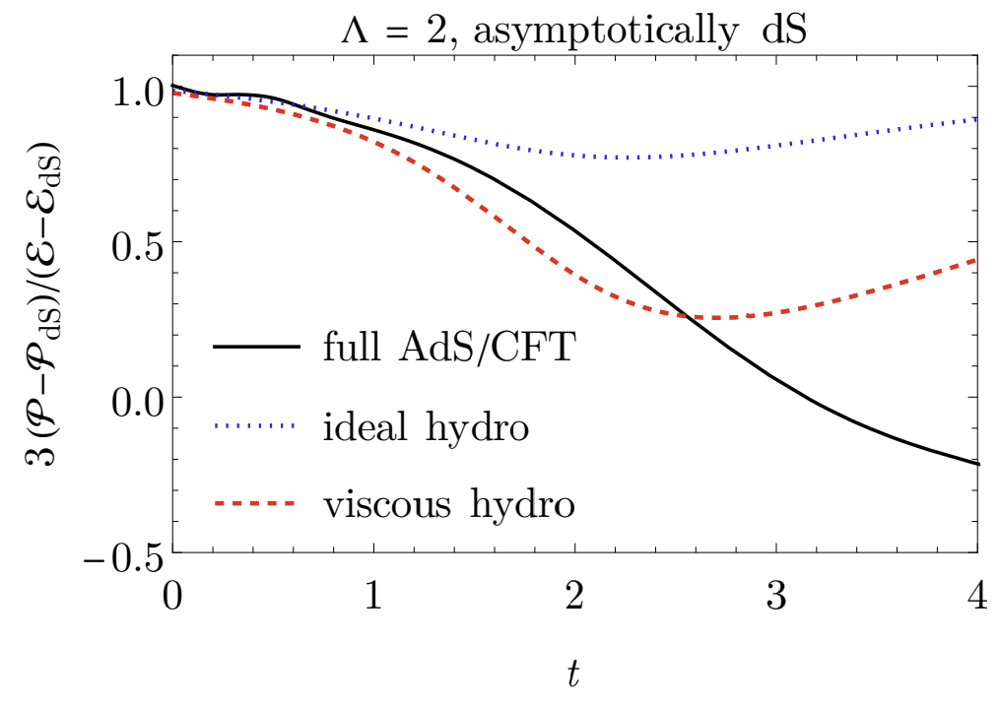
Hydrodynamisation and boundary gravity
Wilke van der Schee, CERN/Utrecht
AdS case: fast hydrodynamisation, hydro all the way till big crunch
dS case: hydrodynamisation, but falls out of equilibrium.
Casimir energy important.
30/19
Notes:
Many states + linearized

