Slide 1

Terrestrial Limits on Ultralight Dark Matter Detection with MAGIS-100 and AION
Jeremiah Mitchell
3 Apr 2023
IOP HEPP & APP 2023

Slide 2
Outline
Ultralight dark matter (ULDM) signal in atom interferometer
Gravity gradient noise (GGN)
Impact and mitigation potential

Slide 3
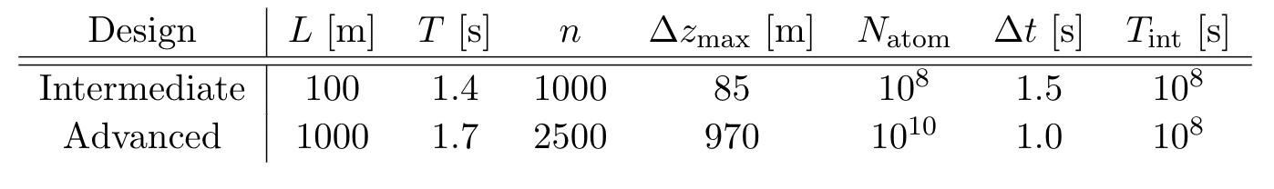
Multi-gradiometry
Multiple atom interferometers synchronized along the baseline run in tandem
Badurina, et al. Phys. Rev. D 107, 055002

Slide 4
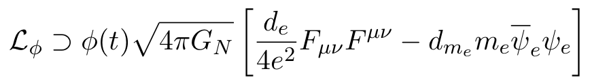
ULDM
Ultralight scalar dark matter → high density, wave-like characteristics
10⁻²² eV
10⁻¹⁷ eV
10⁻¹² eV
10⁻⁷ eV
Photon Couplings
Electron Mass Couplings
A. Arvanitaki, et al., Phys. Rev. D, 97(7), 2018

Slide 5
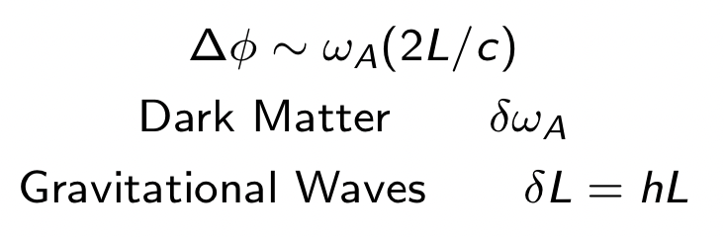
ULDM signal
Time varying atom transition frequency
Δ𝜔

Slide 6
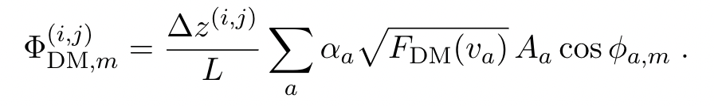
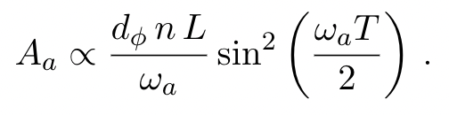
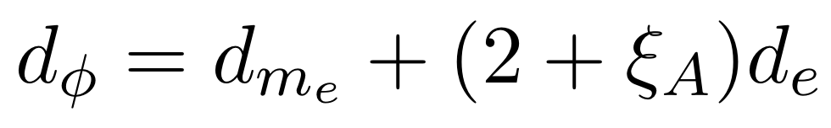
Atom interferometer ULDM signal
Gradiometer phase shift parameterization for dark matter signal
Important scaling factors are the experiment specific n, L, T as well as the ULDM-Standard Model coupling d_{𝜙}

Slide 7
GGN
Low and High noise global bounds
Rayleigh surface waves (fundamental mode)

Slide 8
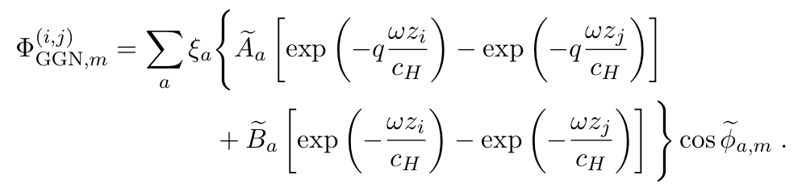
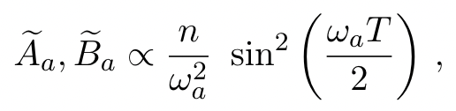
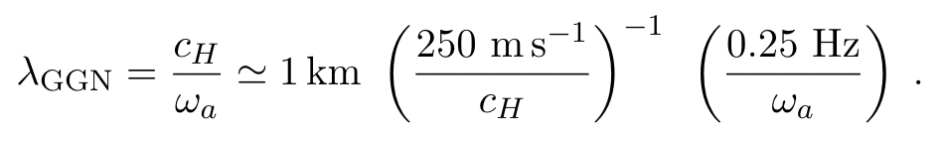
GGN signal characteristics
Modes are site specific with exponential fall-off
Various regimes to consider w.r.t. characteristic wavelength
Seismic wave speed important in ULDM searches

Slide 9
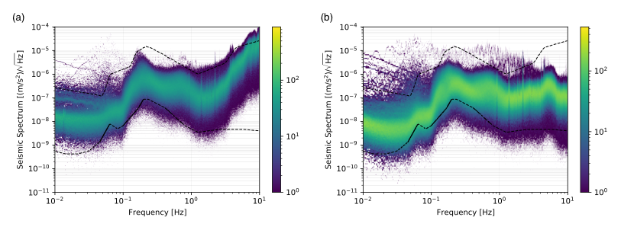
GGN background
Can be characterized with seismometer array
Varys seasonally
Instrumentation required is readily available
J. Mitchell et al., J. Inst., vol. 17, 01, 2022.

Slide 10
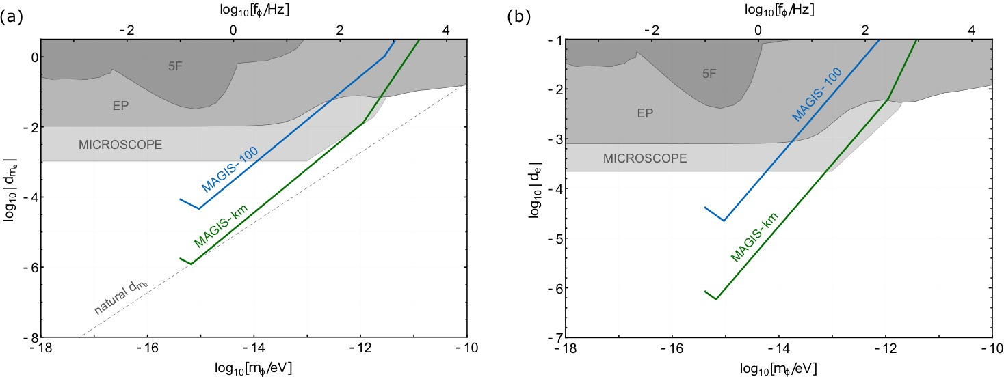
Atom interferometer sensitivity
M. Abe et al., Quantum Sci. Technol., 6, 4, 2021.

Slide 11
Sensitivity with GGN backgrounds

Slide 12
Multi-gradiometer impact

Slide 13
Summary
Long-baseline atom interferometers are a platform for searches of ULDM and benefit from a multi-gradiometry approach
Terrestrial limitations, GGN, impose a low-frequency cut-off
Passive mitigation through multi-gradiometry and maximum-likelihood analysis can reclaim sensitivity
Future investigations will explore:
  More robust terrestrial models
  Active mitigations with instrument arrays
  Impact into gravitational wave searches

Slide 14
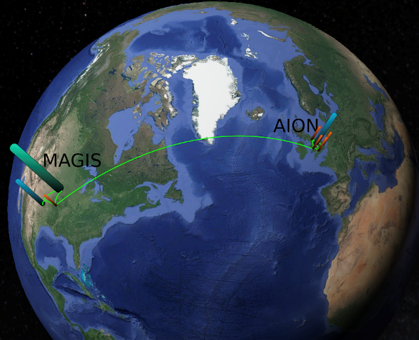
Thank You!
Support from the Kavli-Newton Trust

