Slide 1
Improving Variational Autoencoders for New Physics Detection at the LHC with Normalizing Flows
Pratik Jawahar*, Thea Aarrestad, Nadezda Chernyavskaya, Maurizio Pierini, Kinga A. Wozniak, Jennifer Ngadiuba, Javier Duarte, Steven Tsan
https://doi.org/10.3389/fdata.2022.803685

Slide 2
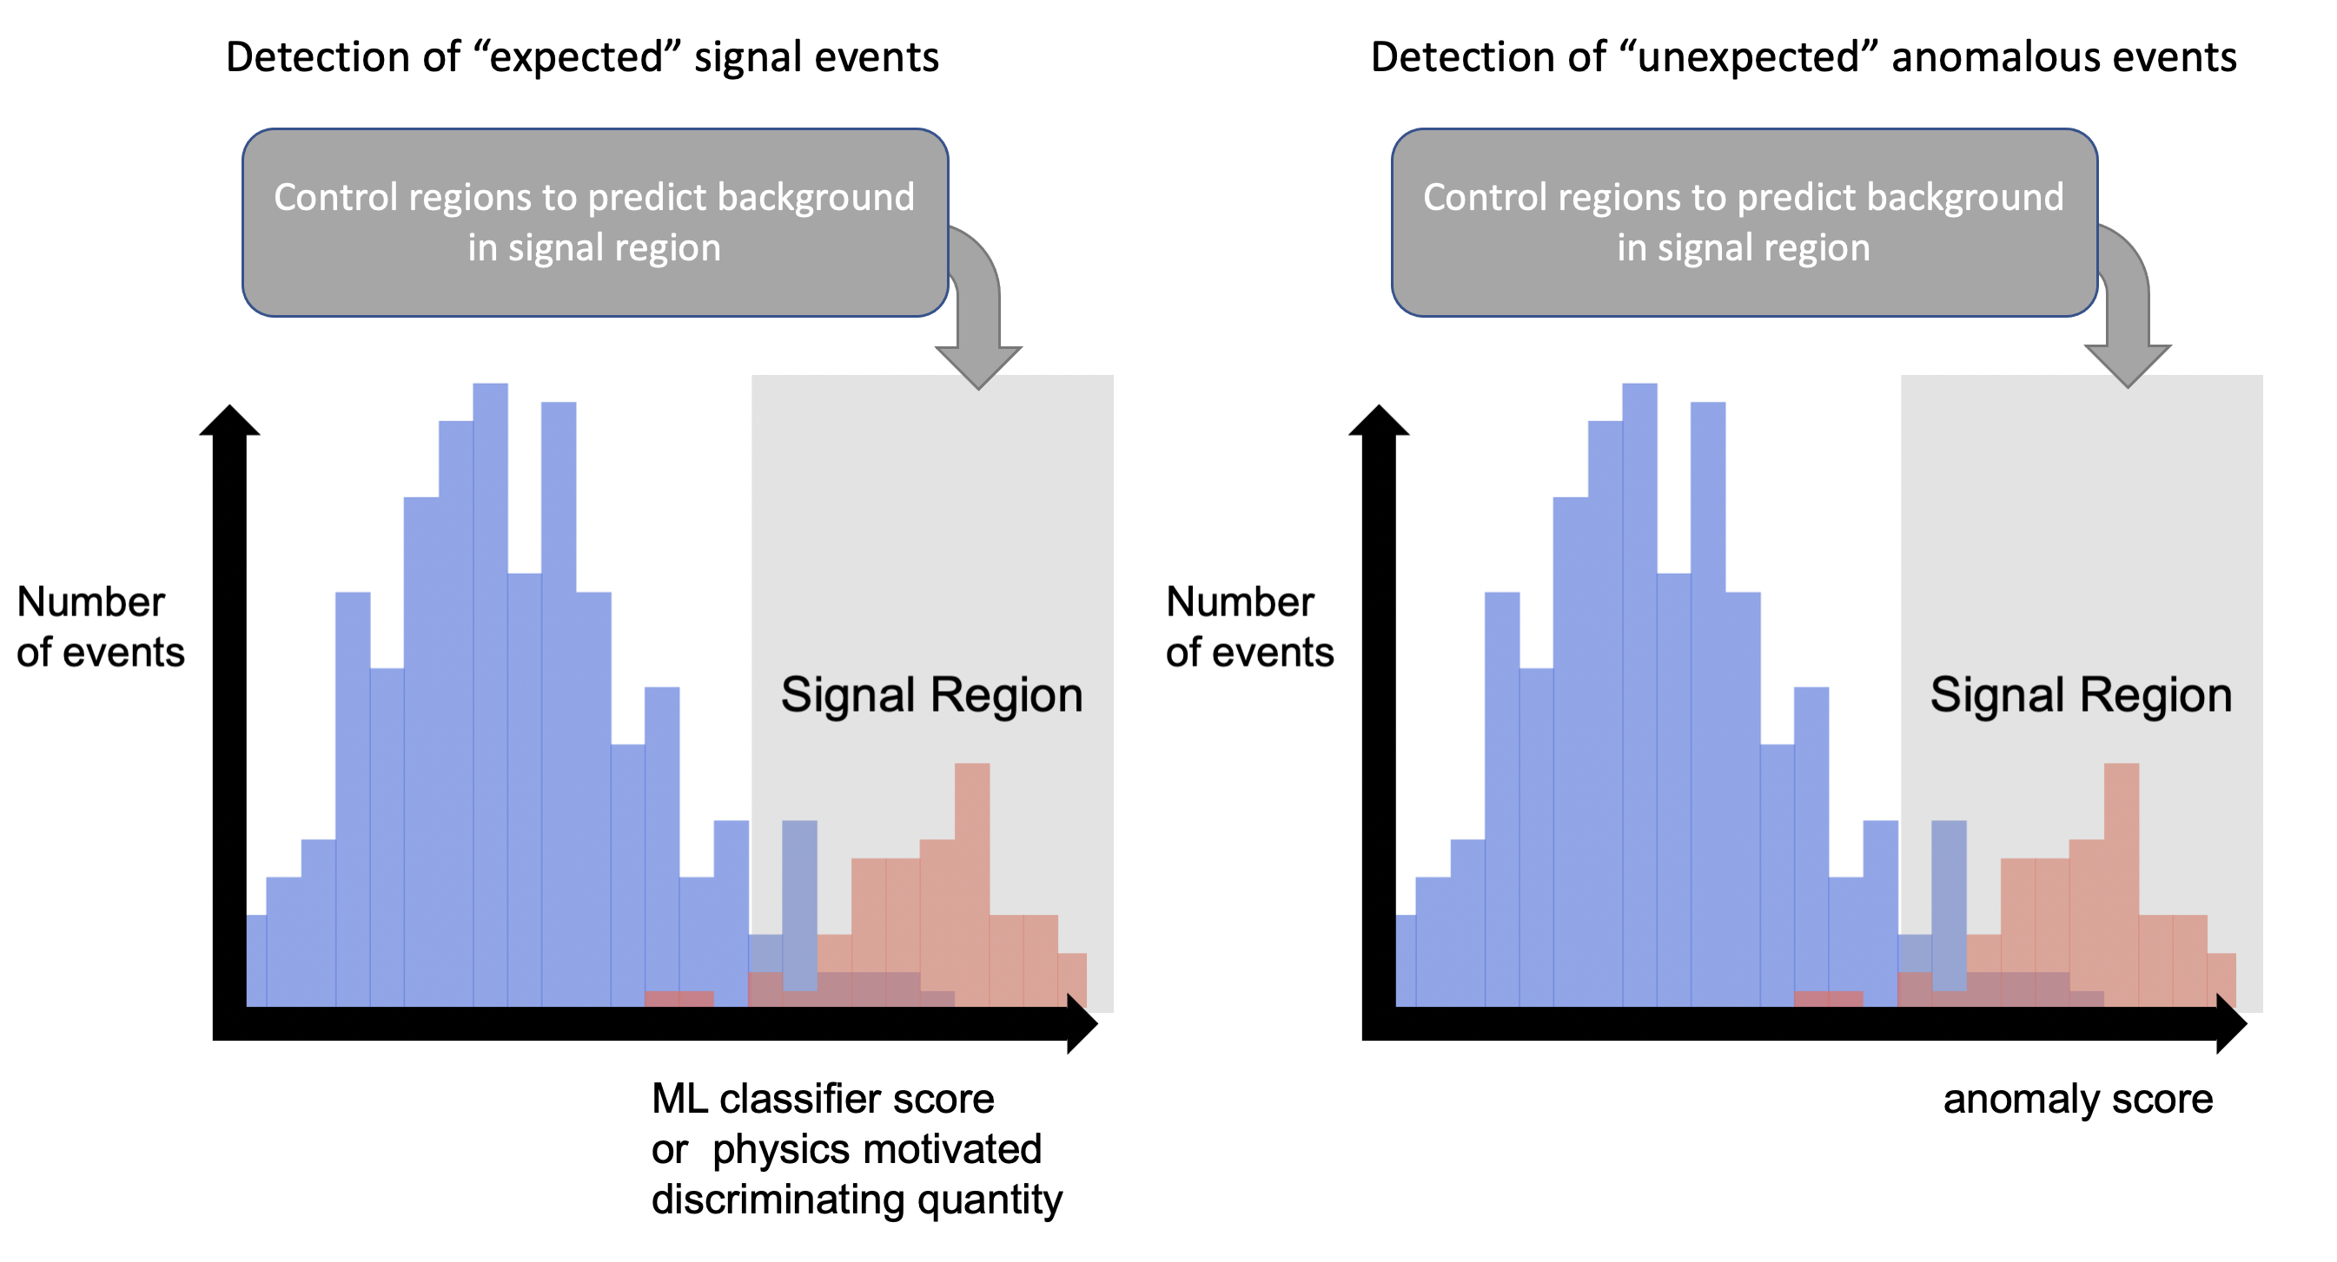
Anomaly Detection - Unsupervised Regimes
Supervised (Model Dependent)
  Detecting specific “expected” signal events
  How? Derive physics motivated observable which can be used for bkg-sig discrimination
  Tradeoff - Limited to specific set of signal models per search algorithm
Unsupervised (Model Independent)
  Detecting and selecting “unexpected” anomalies which can then be analyzed
  How? Define suitable anomaly score for bkg-sig discrimination
  Tradeoff – Detected anomalies require further analysis to extract physics-level information

Slide 3
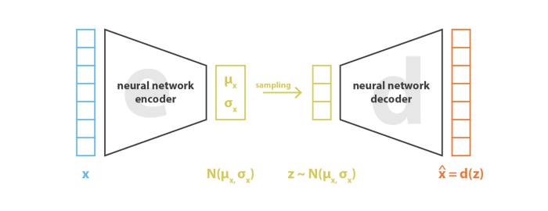


Variational Autoencoders as Anomaly Detectors
VAE:
  Unsupervised, Generative ML model
  Encoder: Learns to represent input x as an N-dimensional latent distribution (generally Gaussian)
  Decoder: Learns to reconstruct the input x given a random point sampled from the latent distribution
Anomaly Detection
  Train the VAE to reconstruct only bkg events
  Deploy trained model to reconstruct mixed set of sig and bkg
    Reconstruction of signal will ideally be much worse than reconstruction of background
  Use the reconstruction error as anomaly score to cut on

Slide 4
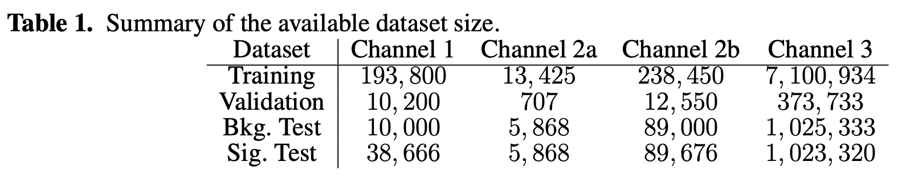
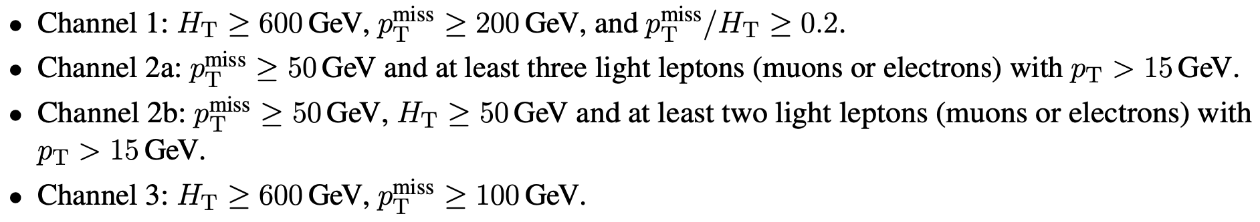
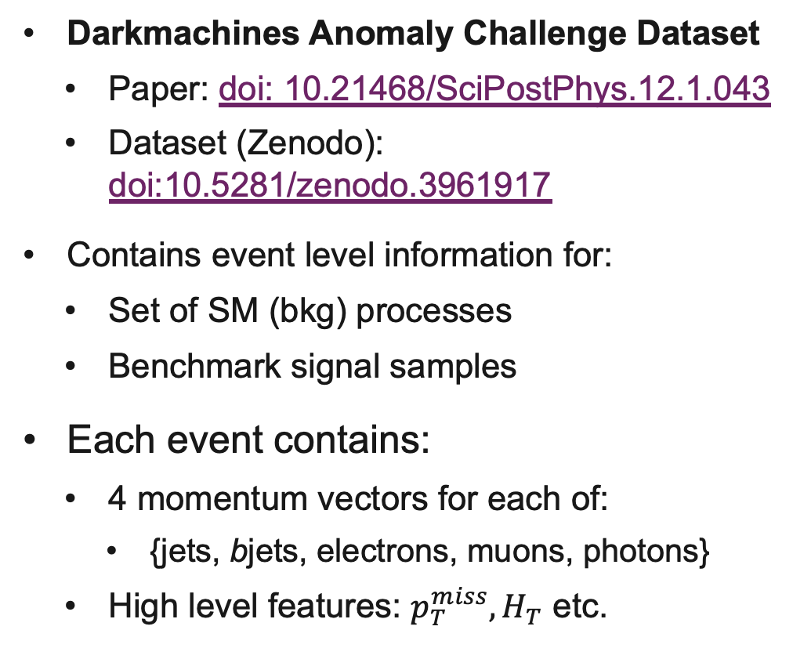
Datasets and Event Representations
Darkmachines Anomaly Challenge Dataset
  Paper: doi: 10.21468/SciPostPhys.12.1.043
  Dataset (Zenodo): doi:10.5281/zenodo.3961917
Contains event level information for:
  Set of SM (bkg) processes
  Benchmark signal samples
Each event contains:
  4 momentum vectors for each of:
    {jets, bjets, electrons, muons, photons}
  High level features: $p_{T}^{miss}, H_{T}$ etc.

Slide 5
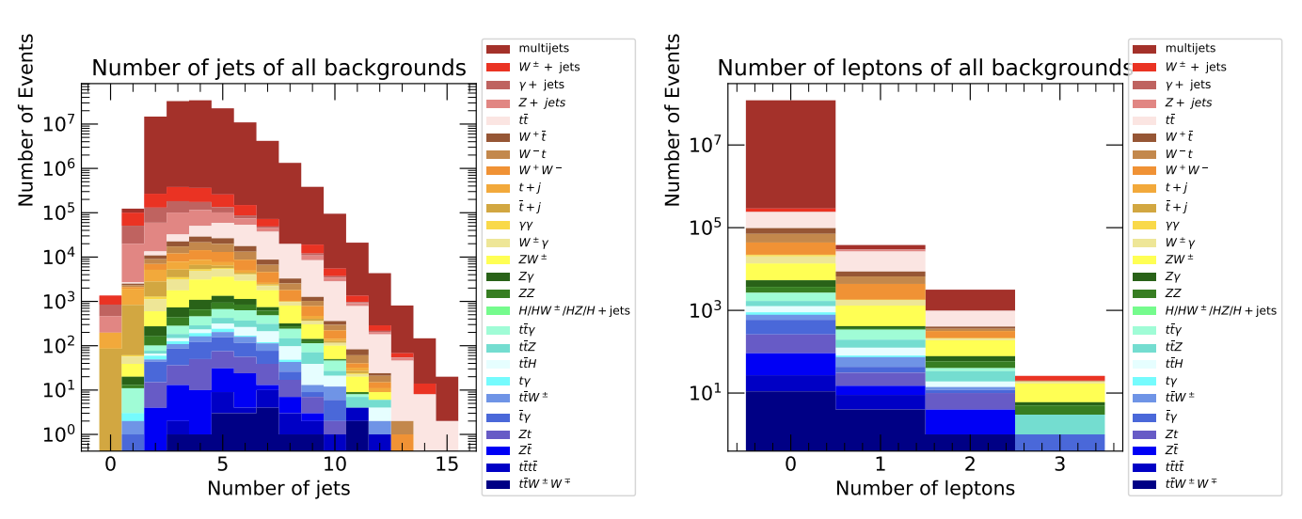
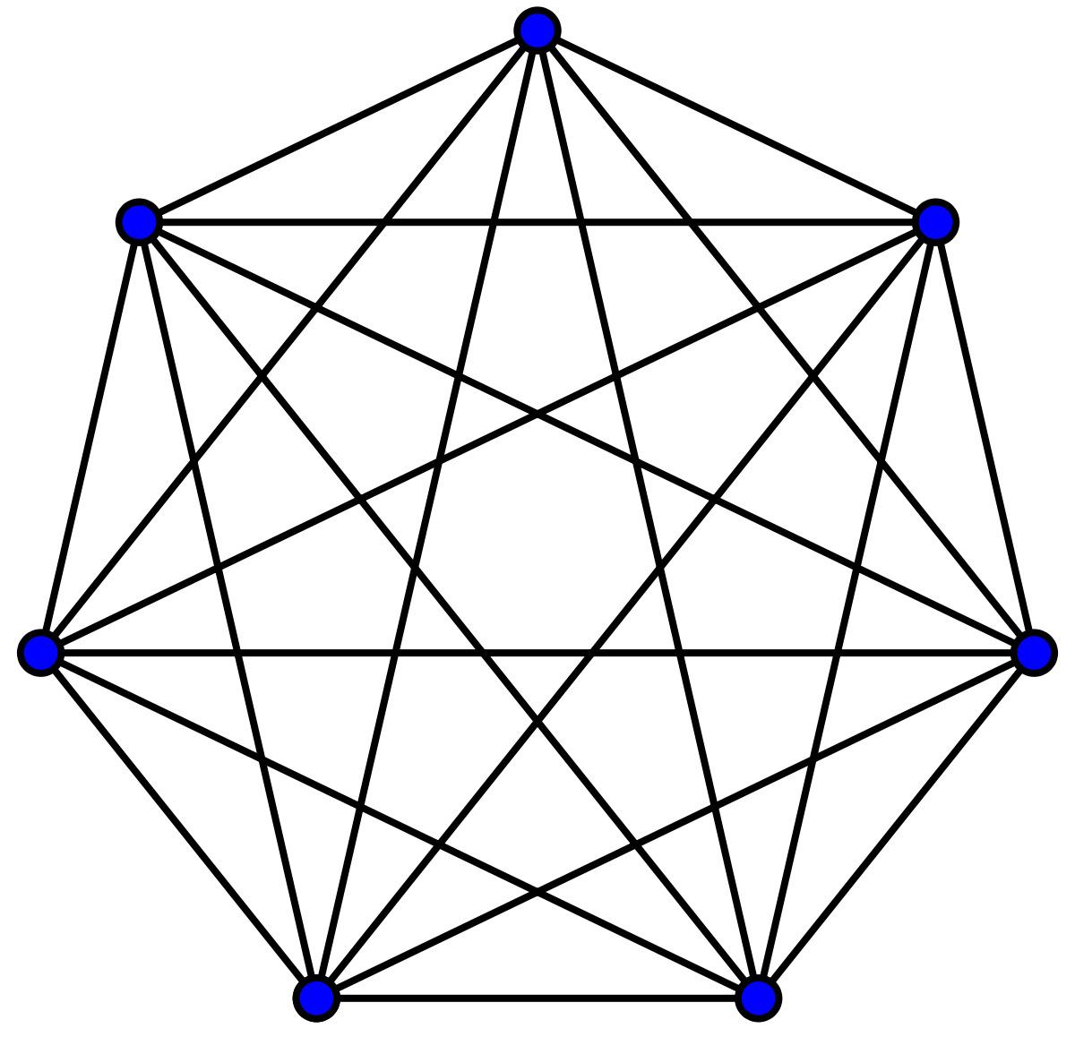
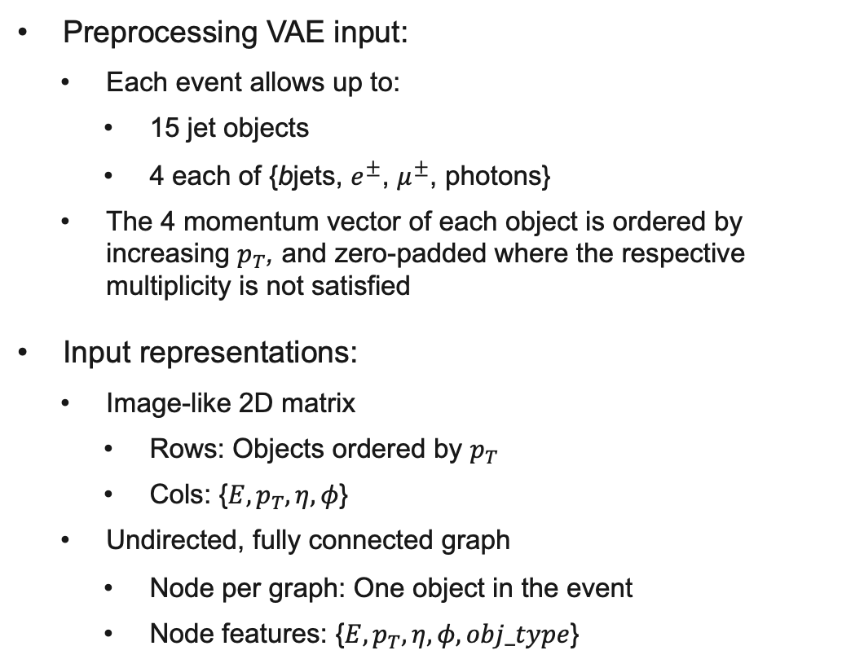
Datasets and Event Representations
Preprocessing VAE input:
  Each event allows up to:
    15 jet objects
    4 each of {bjets, $e^{±}$, $μ^{±}$, photons}
  The 4 momentum vector of each object is ordered by increasing $p_{T}$, and zero-padded where the respective multiplicity is not satisfied
Input representations:
  Image-like 2D matrix
    Rows: Objects ordered by $p_{T}$
    Cols: {$E,p_{T}, η, φ$}
  Undirected, fully connected graph
    Node per graph: One object in the event
    Node features: {$E,p_{T}, η, φ, obj_type$}

Slide 6
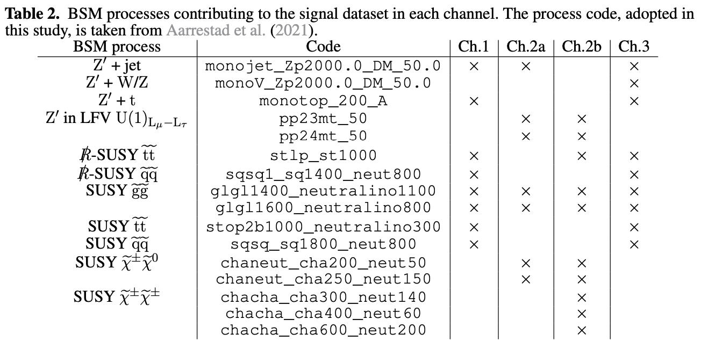
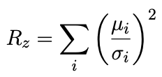
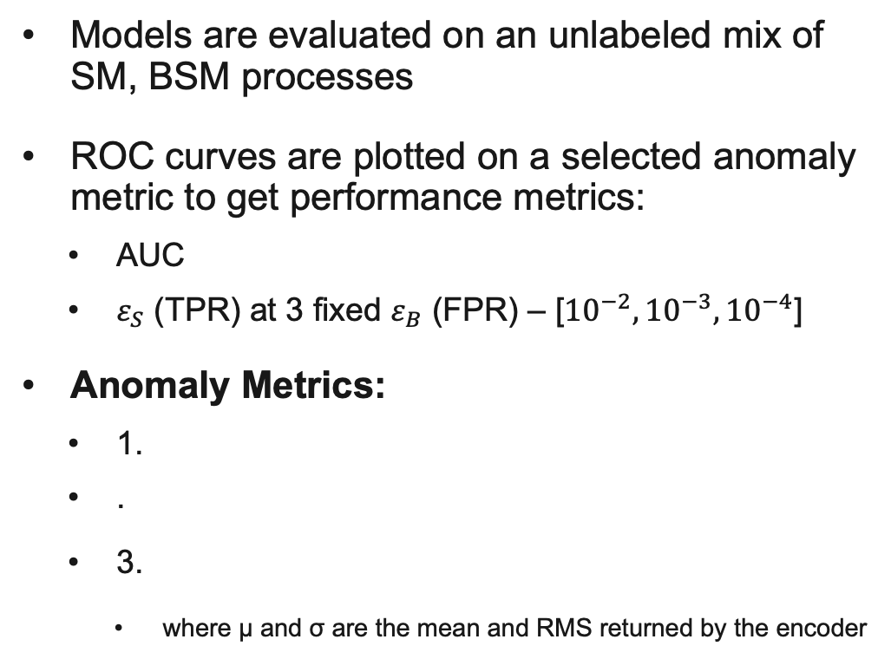
Evaluation Metrics
Models are evaluated on an unlabeled mix of SM, BSM processes
ROC curves are plotted on a selected anomaly metric to get performance metrics:
  AUC
  $ε_{S}$ (TPR) at 3 fixed $ε_{B}$ (FPR) – [${10}^{−2}, {10}^{−3},{10}^{−4}$]
Anomaly Metrics:
  1.
  .
  3.
    where µ and σ are the mean and RMS returned by the encoder

Slide 7
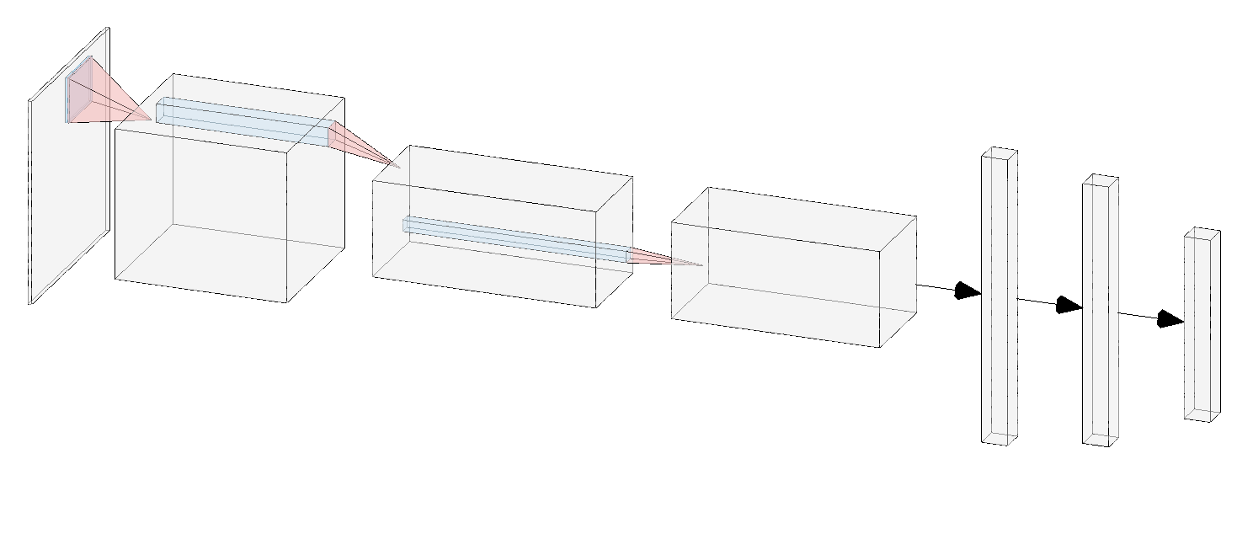
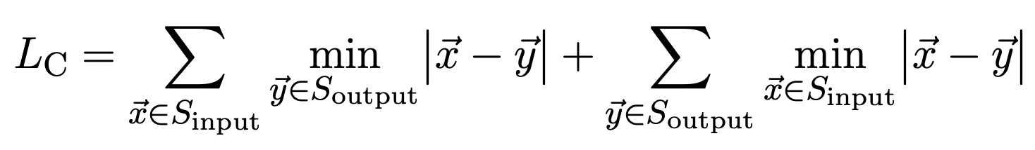
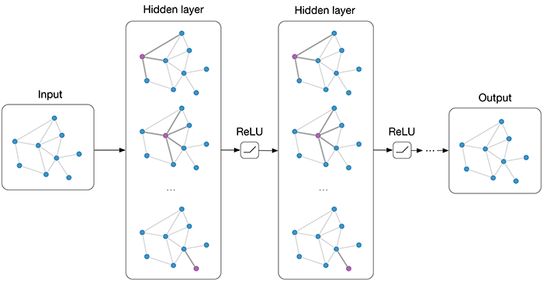
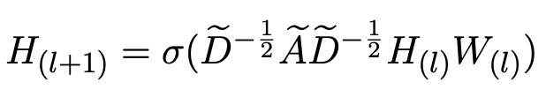
Baseline VAE
Conv-VAE:
GCN-VAE:
Image from: https://tkipf.github.io/graph-convolutional-networks/

Slide 8
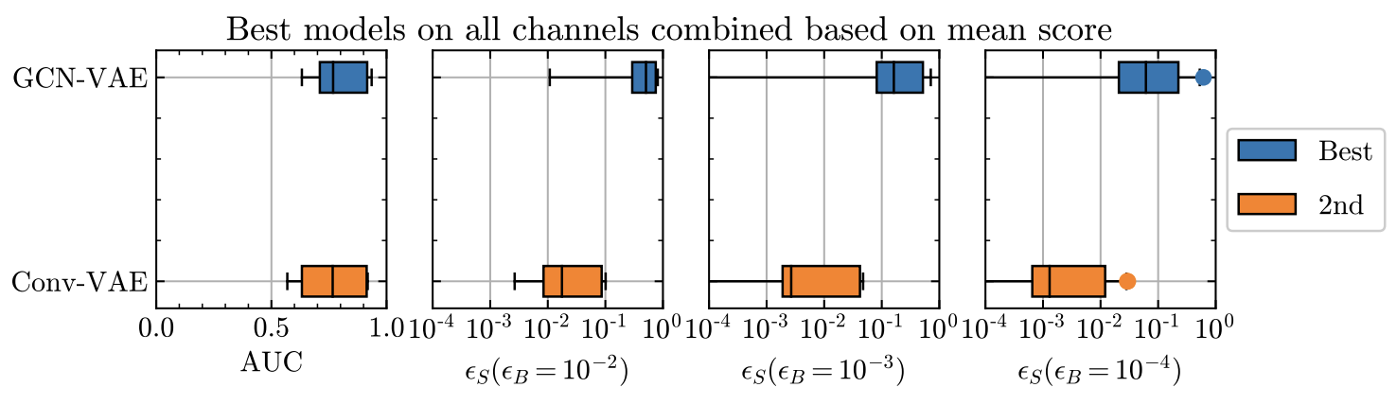
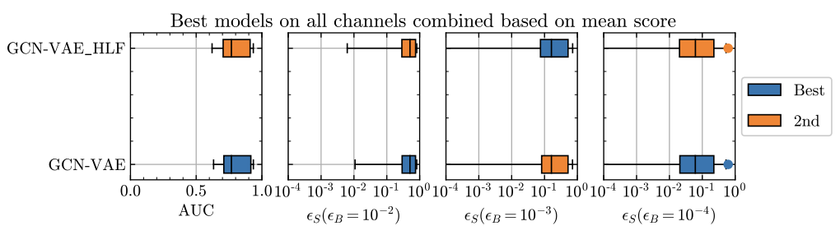
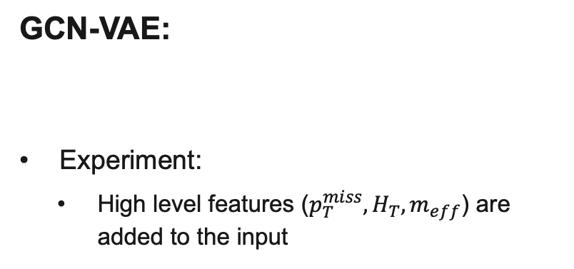
Baseline VAE
Conv-VAE:
GCN-VAE:
Experiment:
  High level features ($p_{T}^{miss}, H_{T}, m_{eff}$) are added to the input

Slide 9
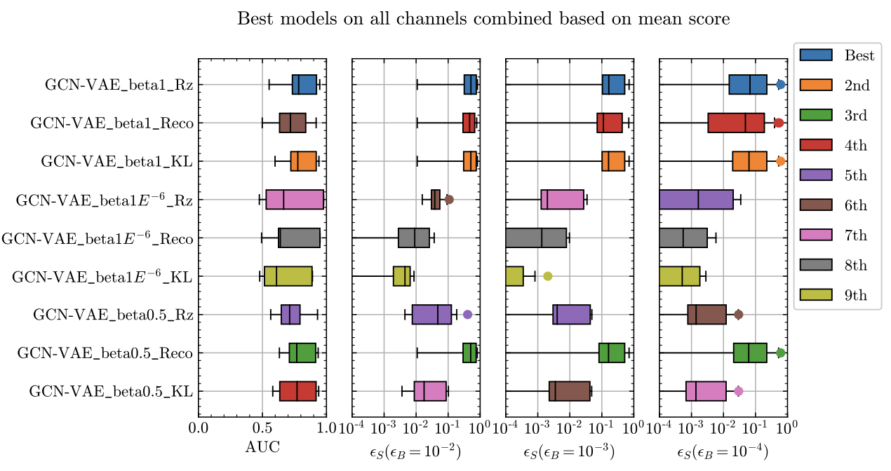
Beta VAE and Anomaly Metric Studies

Slide 10
Beta VAE and Anomaly Metric Studies

Slide 11
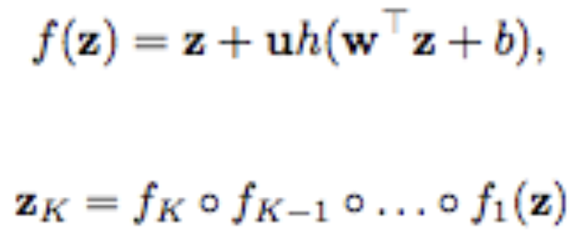
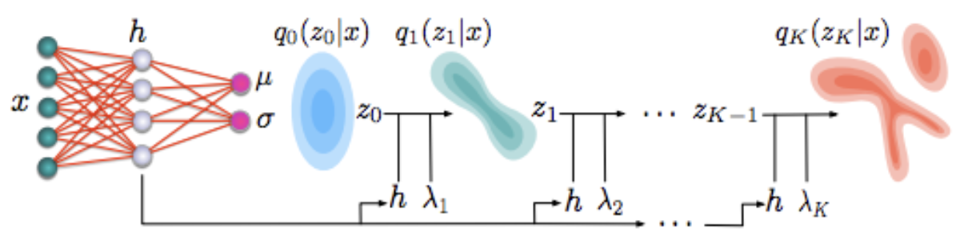
Normalizing Flows in Variational Inference
Tl;dr: Invertible Transformations
The Gaussian posterior approximation in the VAE is chosen for:
  Simplicity
  Good expressivity of the given marginal distribution - Generation
Not necessarily the best posterior for a given marginal distribution in the case of anomaly detection
Normalizing flows (NF) can be used to transform the Gaussian posterior to a “better” complex distribution
Image from: https://arxiv.org/abs/1803.05649

Slide 12
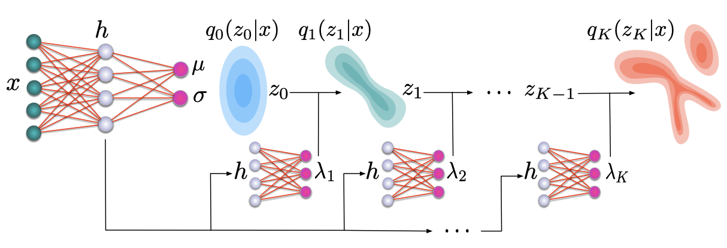
Normalizing Flows in Variational Inference
Best complex distribution is not known analytically
NFs are added as a hyper-network
  Hyper-network: Neural networks stacked between the encoder and decoder
  Hyper-network tracks flow parameters
This enables the NFs to learn a “better” complex distribution
Note better does not necessarily mean better reconstruction of trained class (bkg) inputs
Image from: https://arxiv.org/abs/1803.05649

Slide 13
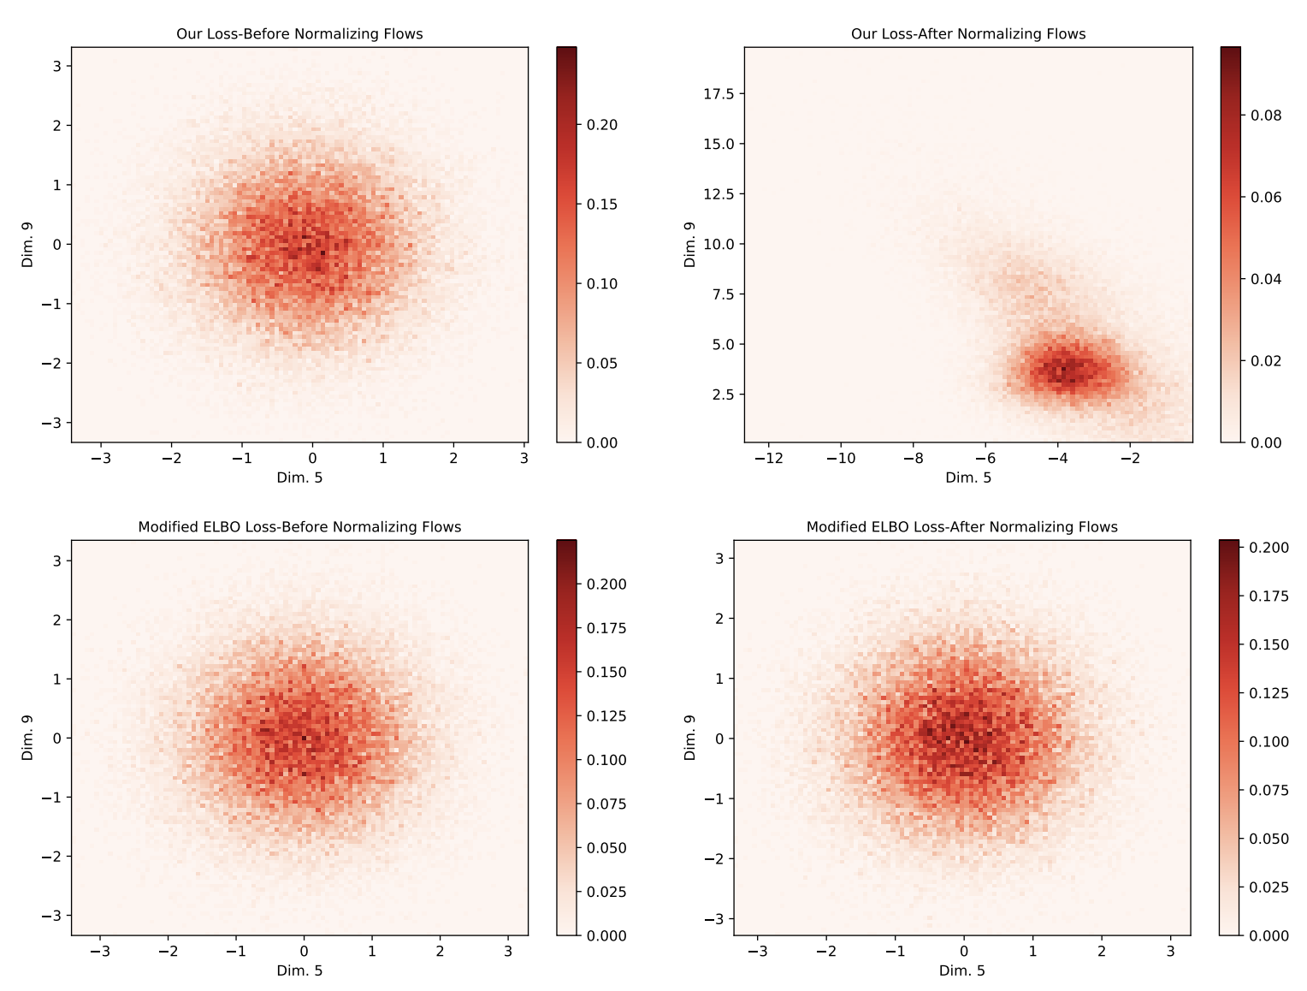
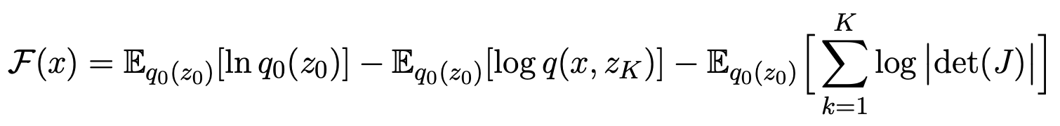
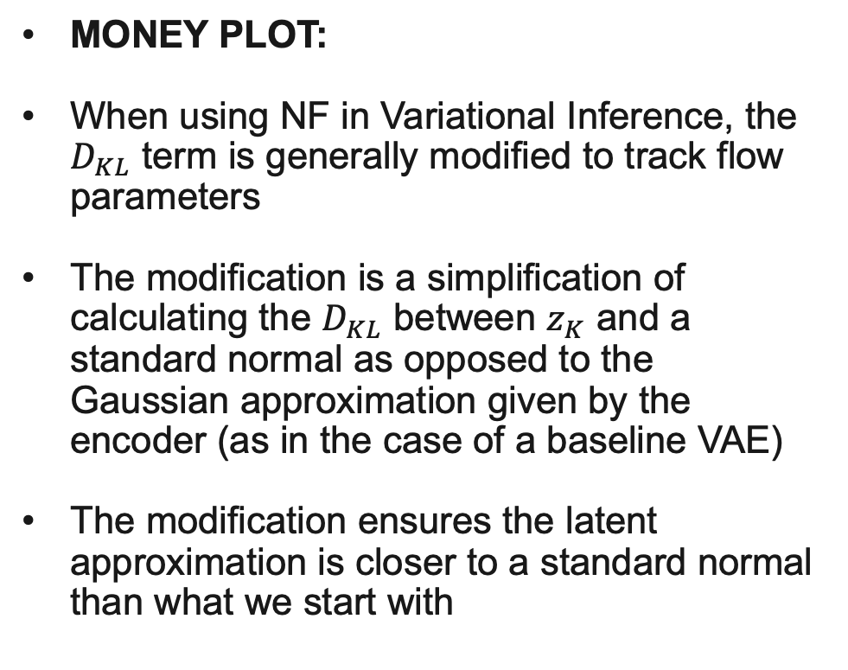
Normalizing Flows in Variational Inference
MONEY PLOT:
When using NF in Variational Inference, the $D_{KL}$ term is generally modified to track flow parameters
The modification is a simplification of calculating the $D_{KL}$ between $z_{K}$ and a standard normal as opposed to the Gaussian approximation given by the encoder (as in the case of a baseline VAE)
The modification ensures the latent approximation is closer to a standard normal than what we start with

Slide 14
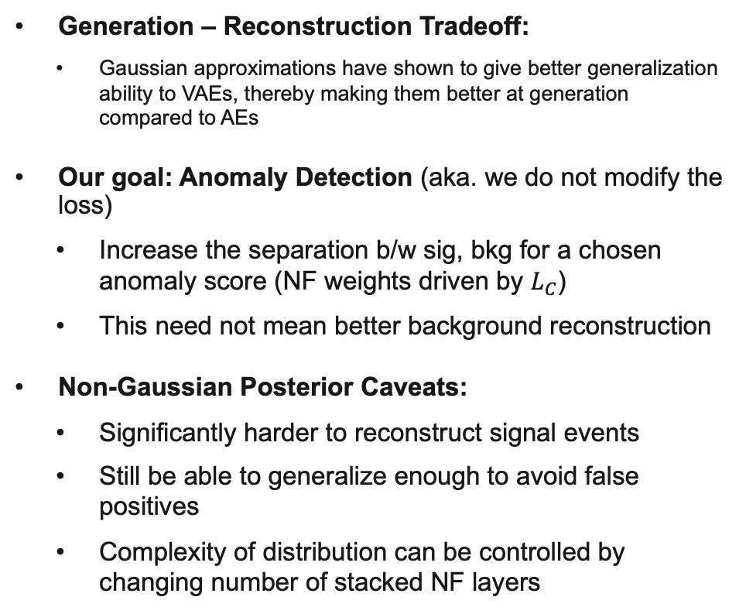
Normalizing Flows in Variational Inference
Generation – Reconstruction Tradeoff:
  Gaussian approximations have shown to give better generalization ability to VAEs, thereby making them better at generation compared to AEs
Our goal: Anomaly Detection (aka. we do not modify the loss)
  Increase the separation b/w sig, bkg for a chosen anomaly score (NF weights driven by $L_{C}$)
  This need not mean better background reconstruction
Non-Gaussian Posterior Caveats:
  Significantly harder to reconstruct signal events
  Still be able to generalize enough to avoid false positives
  Complexity of distribution can be controlled by changing number of stacked NF layers

Slide 15
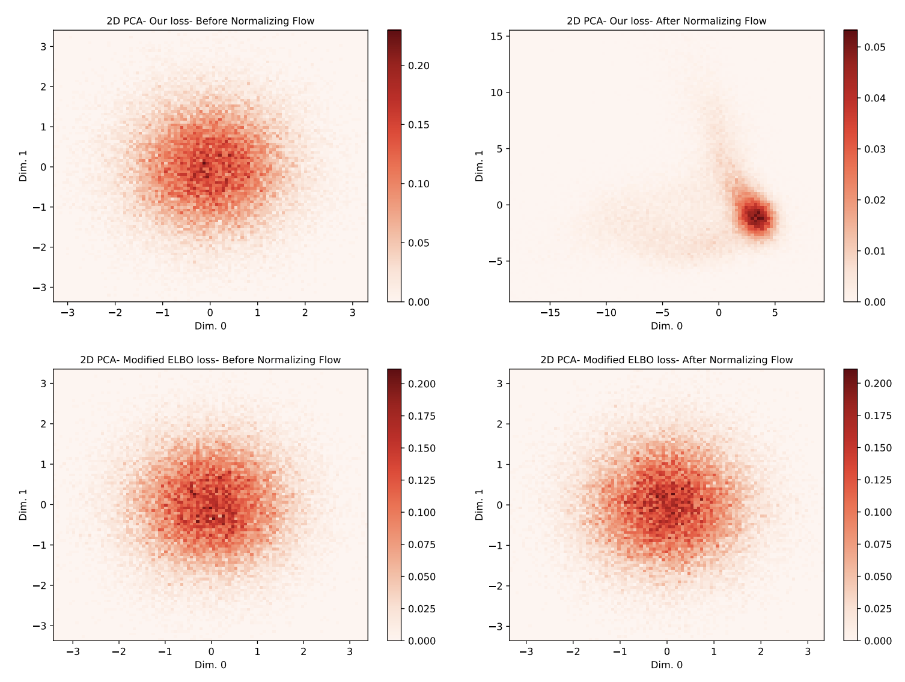
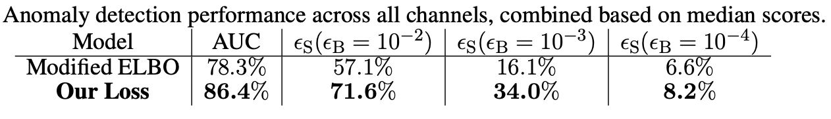
Normalizing Flows in Variational Inference
Generation – Reconstruction Tradeoff:
  Gaussian approximations have shown to give better generalization ability to VAEs, thereby making them better at generation compared to AEs
Our goal: Anomaly Detection (aka. we do not modify the loss)
  Increase the separation b/w sig, bkg for a chosen anomaly score (NF weights driven by $L_{C}$)
  This need not mean better background reconstruction
Non-Gaussian Posterior Caveats:
  Significantly harder to reconstruct signal events
  Still be able to generalize enough to avoid false positives
  Complexity of distribution can be controlled by changing number of stacked NF layers

Slide 16
Normalizing Flows in Variational Inference
We test 5 different classes of NF models:
  Planar Flow
  Sylvester Normalizing Flow
    Triangular
    Orthogonal
    Householder
  Inverse Autoregressive Flow
  Convolutional Flow
  Neural Spline Flow
    Autoregressive
Image from: https://arxiv.org/abs/1803.05649

Slide 17
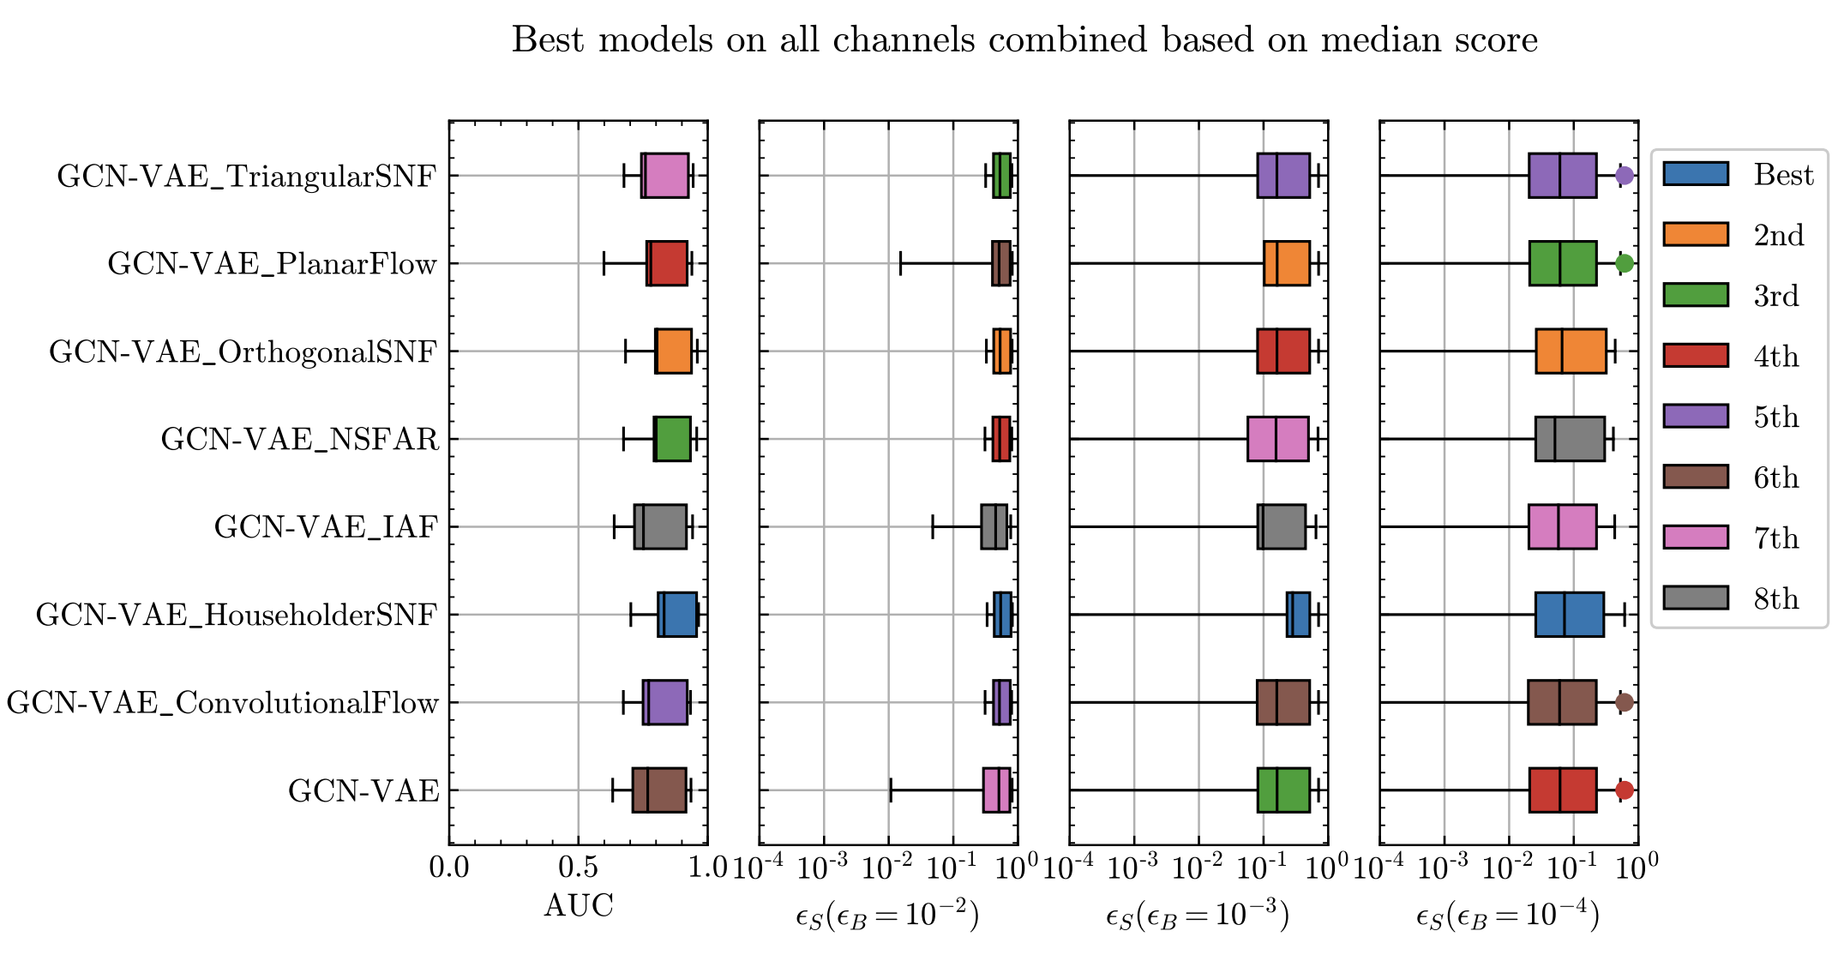
Normalizing Flows in Variational Inference

Slide 18
Thank You!

Slide 19
Backup

Slide 20
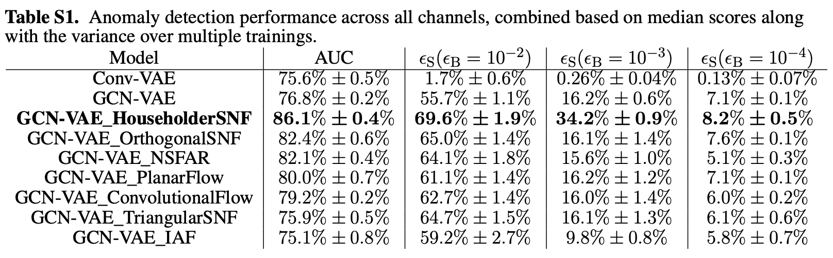

Slide 21
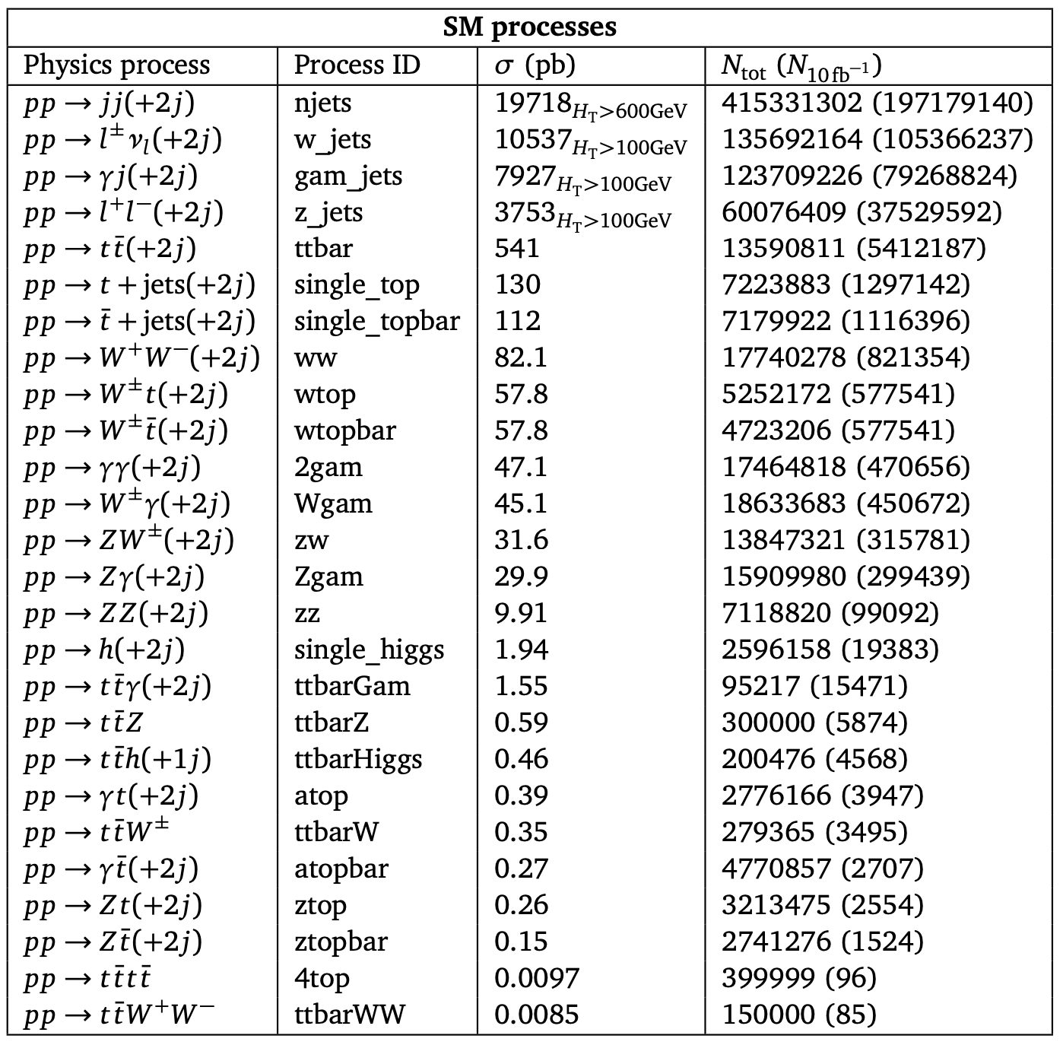
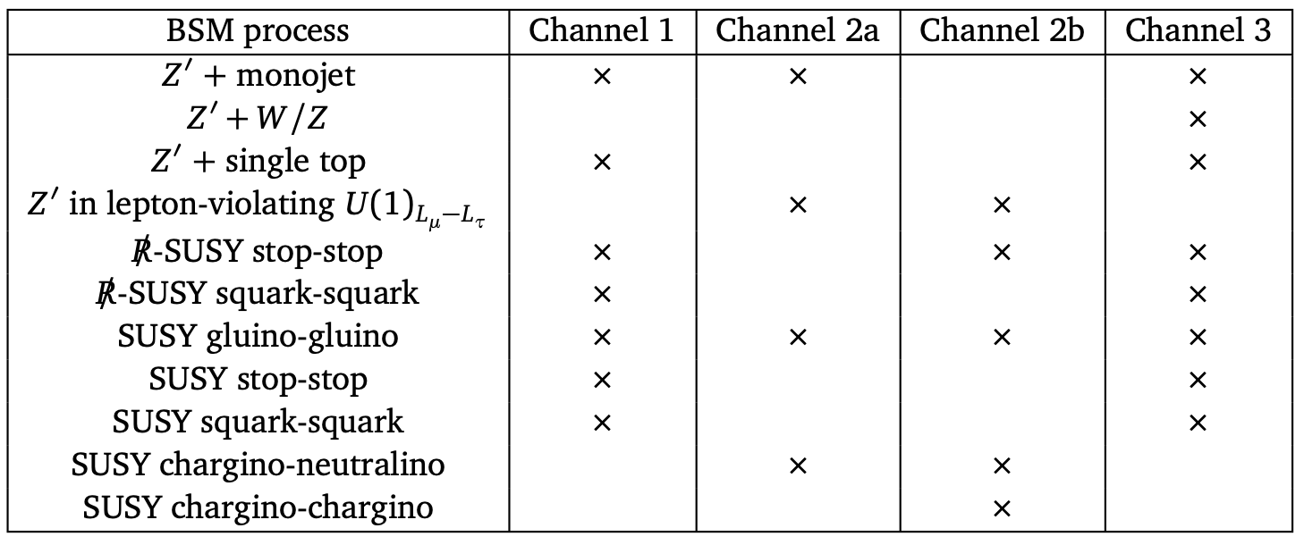

Slide 22
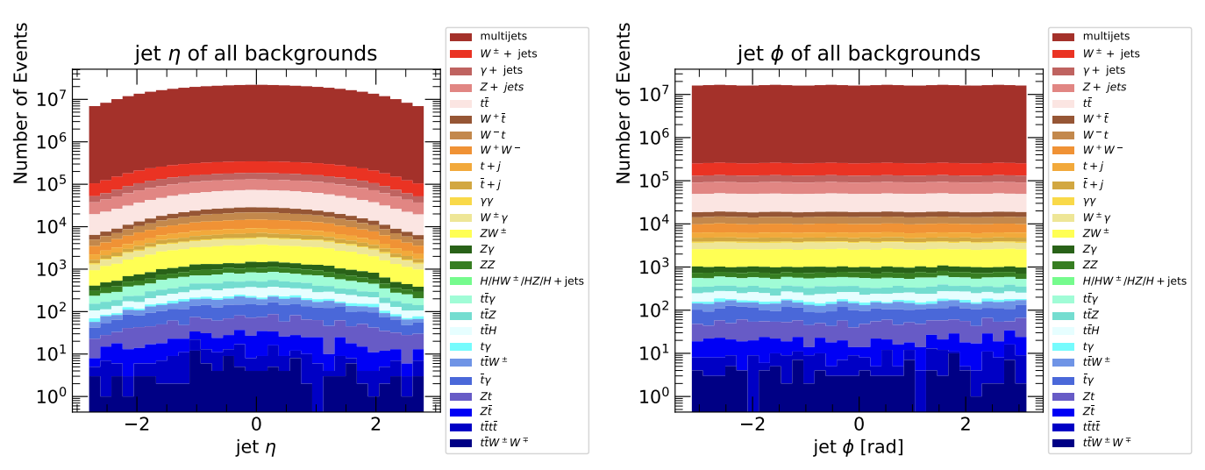
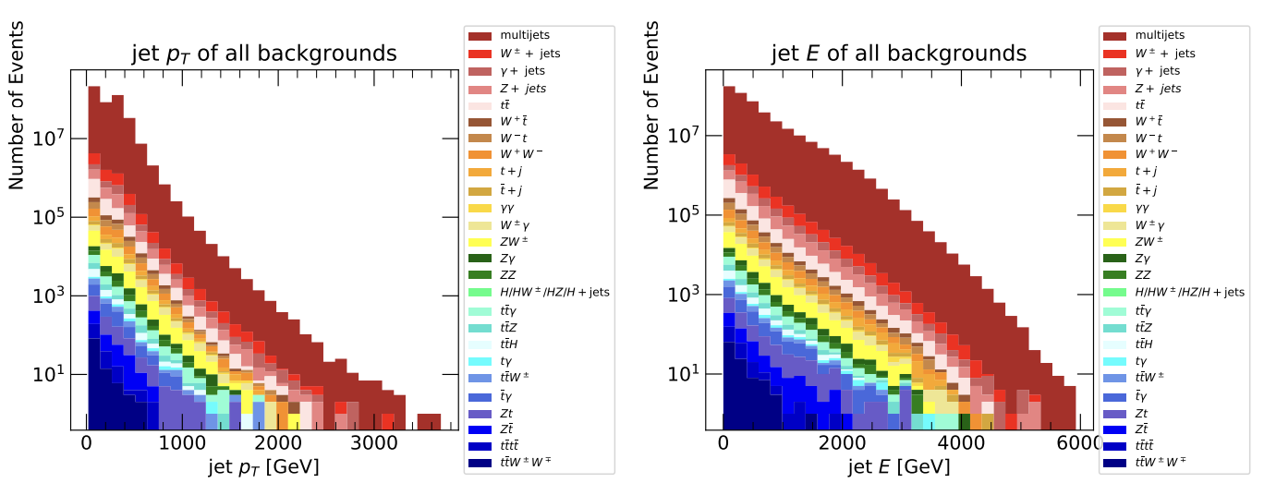

Slide 23
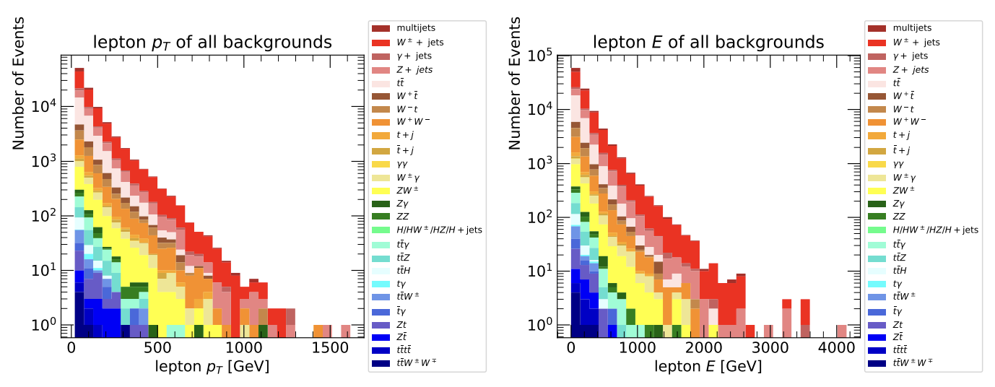
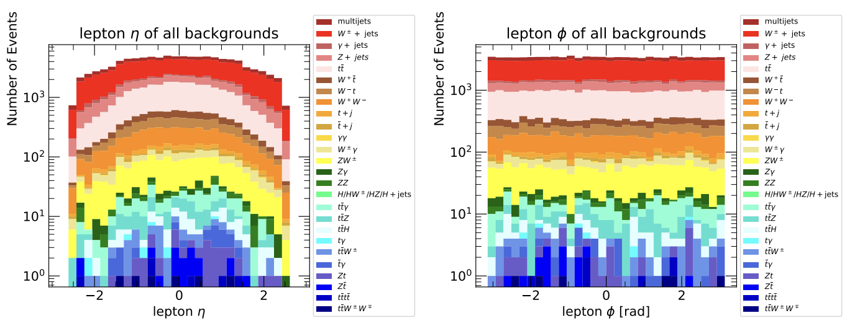

Slide 24
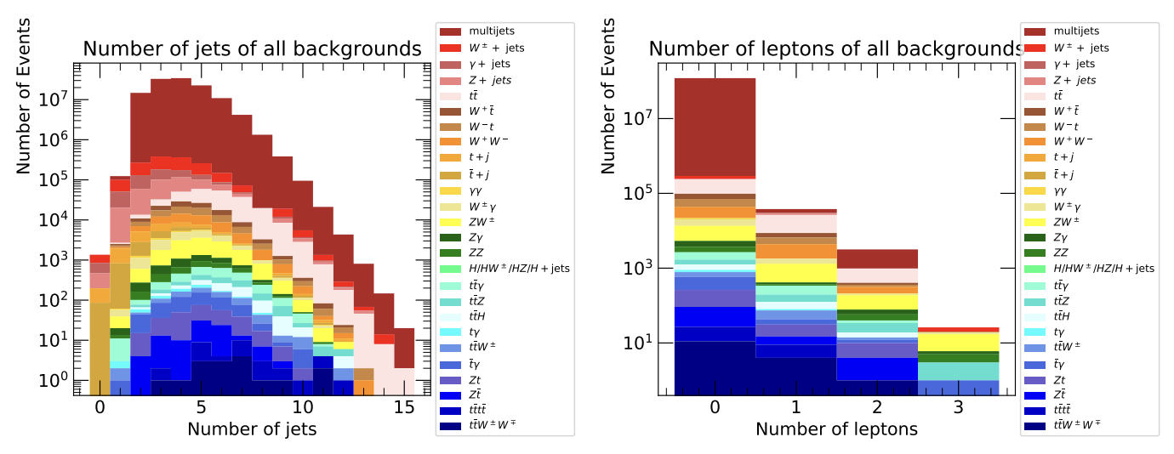
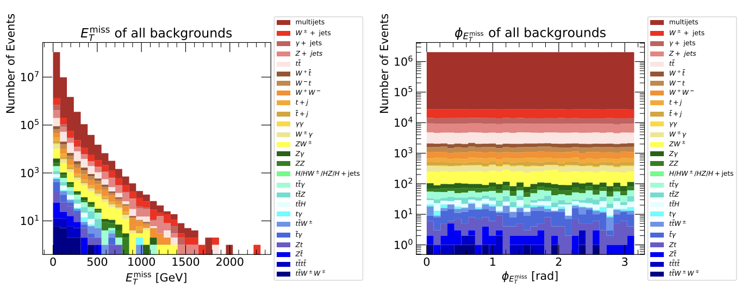

Slide 25
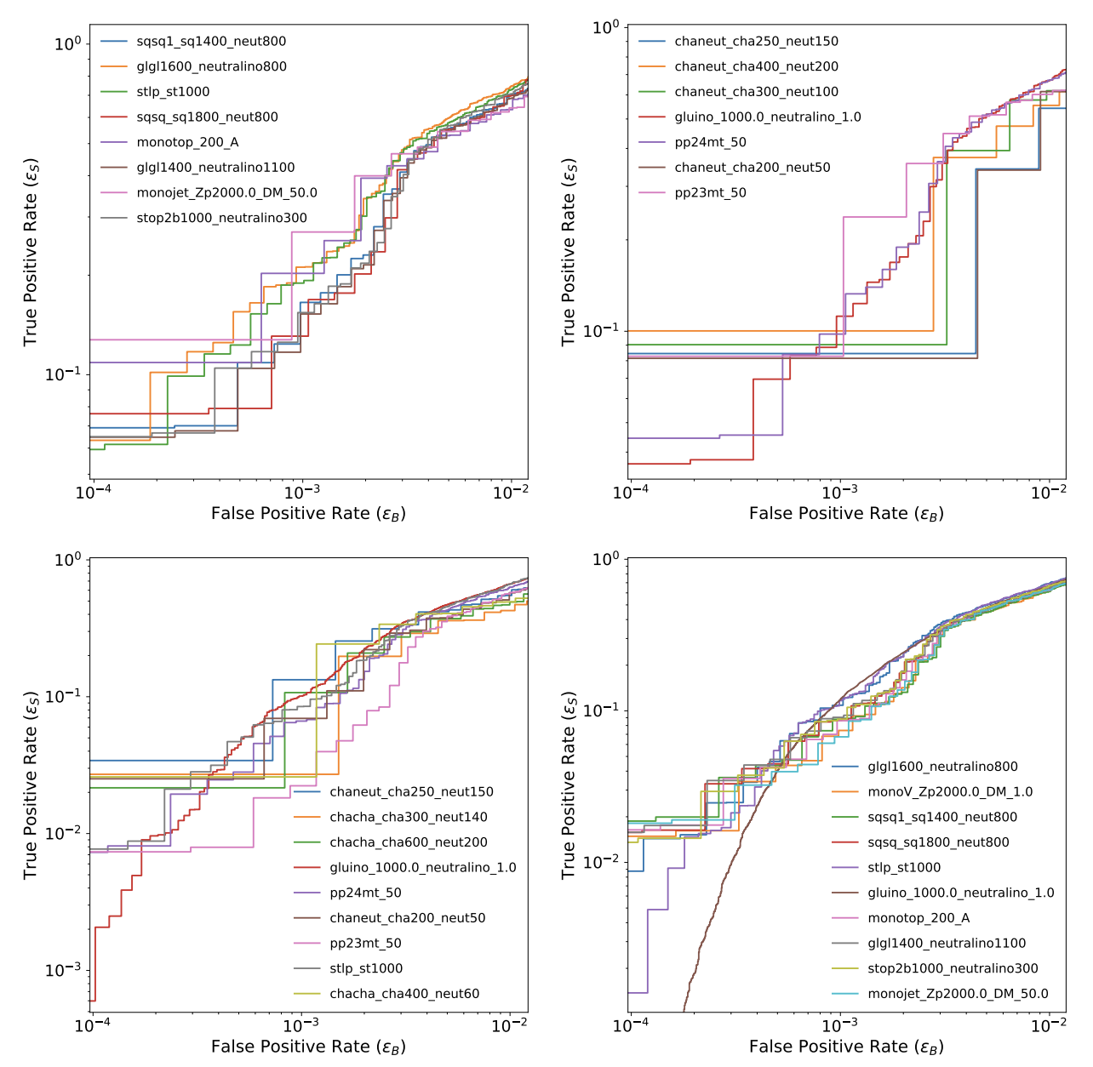
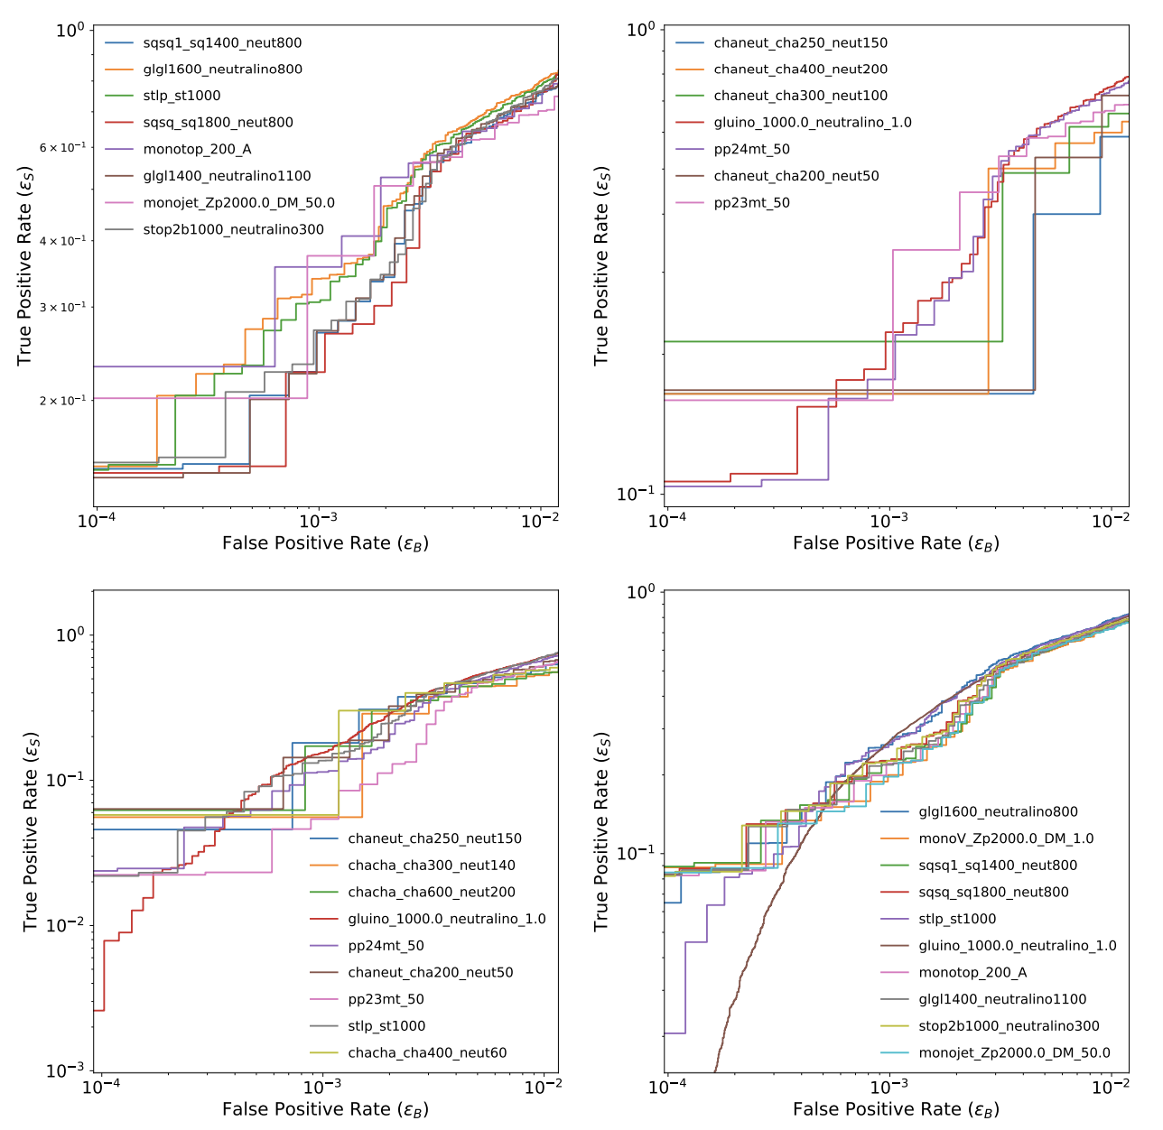
GCN-VAE
GCN-VAE_HouseholderSNF

