Slide 1



Science Board Update
Tara Shears
Chair, Science Board

Slide 2


Overview
Updates
Forthcoming activities
Current concerns
Image © STFC Alan Ford

Slide 3
Updates (from the last year)
Programme and Advisory panel interactions:
PPAP, PAAP, Advisory panel awayday, roadmap guidance
CTA Update, Boulby lab update, AIT-NEO overview
Funding recommendations:
SoI: LHCb Upgrade 2, Legend, MuEDM, dark matter XLZD
PPRP: Dirac-3 operations, ATLAS Upgrade (23-26)
Energy Recovery Linac panel report
PPGP (theory), PP responsive PDRA round panel report
+ Wave 3 Infrastructure Prioritisation, PPD update, governance review, UK strategy for engagement with CERN, strategic review of Particle Physics (both info)…
https://www.ukri.org/about-us/stfc/how-we-are-governed/advisory-boards/science-board/

Slide 4
Forthcoming: Science Board reorganisation
(details: Mark’s talk)
Science Board (PPAN) remit still includes standard PPAN activities
Remit also includes consideration of:
  long-term balance of the PPAN programme in the rolling STFC 10-year financial plan
  roadmaps for the different strands of the PPAN programme, in the context of the STFC 10-year financial plan
  proposed and existing STFC science and technology programmes and investments, considering individual projects in the broader context of the overall portfolio and longer-term science and technology prioritisation
We need new members (facility user SB members will move to the other Science Board): please apply in the membership call!

Slide 5
Membership of Science Board (PPAN)
Tara Shears (Liverpool) (Chair)
Keith Grainge (Manchester) (Deputy Chair)
Martin Bauer (Durham)
Dave Charlton (Birmingham)
Ineke de Moortel (St. Andrews)
Francesca di Ludovico (KCL)
George Efstathiou (IoA/Cambridge)
David Ireland (Glasgow)
Amelie Saintonge (UCL)
Patrick Sutton (Cardiff)
Ultimately need: 6 PP (including 1 theory),
6 astro/space science, 2 PA, 2 NP + chair
Membership call is live!!
new
STFC Office: Rachel Leader
https://stfc.ukri.org/about-us/how-we-are-governed/advisory-boards/science-board/

Slide 6
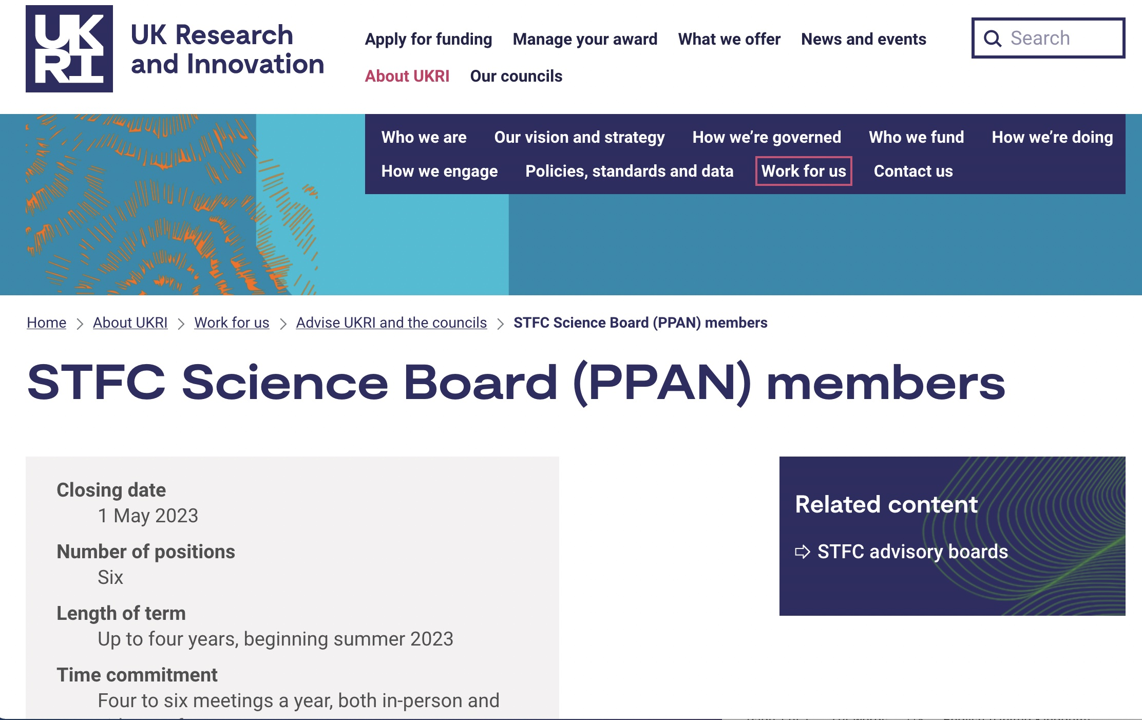
https://www.ukri.org/about-us/work-for-us/join-an-advisory-committee-panel-or-network/stfc-science-board-ppan-members/

Slide 7
Current concerns: funding
Last year: level of core funding is unsustainably low
Above inflationary pressures + flat cash have eroded grants rounds to the point where skills are lost and damage is done (in general within PPAN)
Biggest concern (across the programme).
We’ve seen an uplift in the past year (thanks STFC).
Future funding levels are always a concern but much pressure has been lifted.
Consolidated Grant uplifts have been baselined.

Slide 8
Current concerns: ECR representation
PPAP want to improve Early Career Researcher representation (roadmap recommendation 11.1)
  Potentially by establishing an ECR forum
  Potentially by encouraging ECR membership of panels
We agree. This is important (other communities do have ECR forums)
  We encourage ECRs to self-organise
  Please apply in the STFC membership round as your voice is valuable!

Slide 9
Current concerns: strategic detector R&D
There is a need for a strategic (not blue skies) detector R&D funding line
  Necessary for the UK to engage with European priorities
  There is no funding pathway at the moment
We agree (so do TAAB).
  Thank you for the statement/paper from the community meeting
  We have raised this at Council and stressed the need for it.

Slide 10
Current concerns: QTFP funding
Quantum Technologies for Fundamental Physics (QTFP) is a joint EPSRC/STFC funded call
  Communities are eager to sustain and develop effort
  No clear funding pathway yet
We agree.
  We have raised this at Council (most recently in Feb. 2023)
  STFC recognize how pressing this is, have made the case and are awaiting updates from UKRI.

Slide 11
Current issues – any others?
Communication:
Issues: please raise with your Advisory Panel or directly with us
Advisory Panels submit reports which document your concerns
  which we pass to Council and Executive Board
  I also present community concerns to Council in Council meetings

Slide 12
Summary
Future work: standard business plus reorganization into Science Board (PPAN)
Addressing concerns: funding, Early Career Researcher representation, strategic detector R&D call, QTFP funding, whatever you raise
Please consider the Science Board(s) membership call!
Please consider the STFC membership call!

Slide 13



Call for Applications to
STFC Advisory Bodies
and Peer Review Panels
Apply for panel membership now at
https://www.ukri.org/about-us/stfc/how-we-are-governed/advisory-boards/call-for-applications/
Deadline 14 May 2023

