Slide 1
Detector Innovation for High Energy Physics
Kirsty Hall
Sales Engineer
Research and Life Science
April 2025

Slide 2
Index
Who are we?
  Introduction to Hamamatsu Photonics
What do we do?
  Detectors for high energy physics
Why talk to us?
  Our expertise and how we can help you

Slide 3
Who are we?

Slide 4
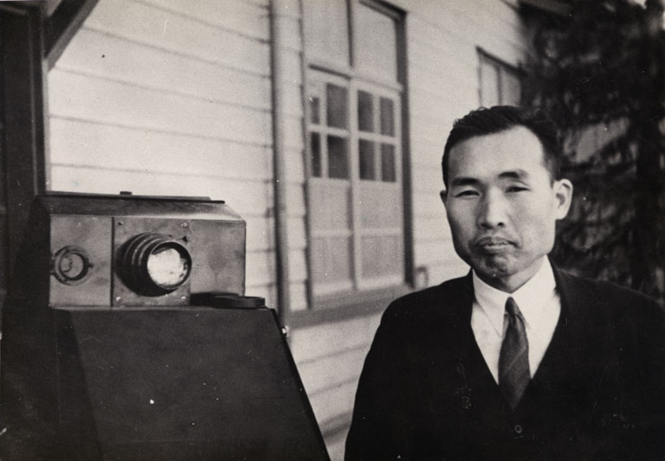
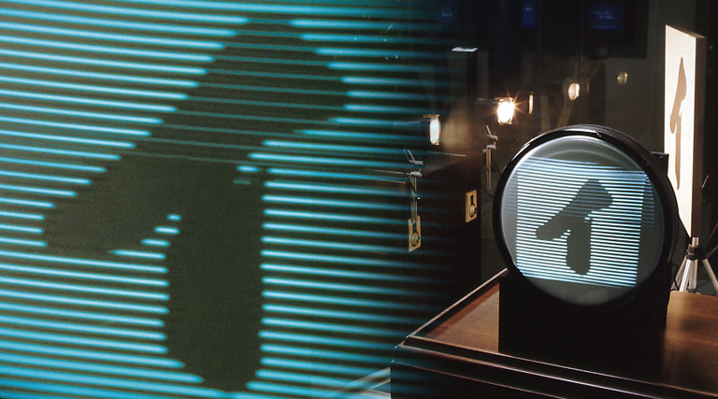
Pursuing another “イ” that will change the world
1899 – Dr. Kenjiro Takayanagi was born in Hamamatsu, Japan
1924 – Dr. Kenjiro Takayanagi begins research on television technology
1926 - the Japanese katakana “イ” was electronically transmitted and displayed for the first time on a cathode ray tube
The Japanese character “イ”displayed on a cathode-ray tube.
(The photograph shows a device reproducing the character in the Hamamatsu Science Museum.)
Dr. Kenjiro Takayanagi (1899 to 1990)

Slide 5
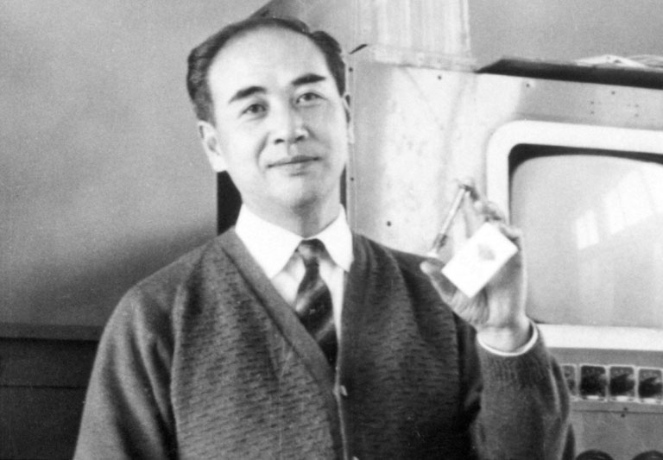
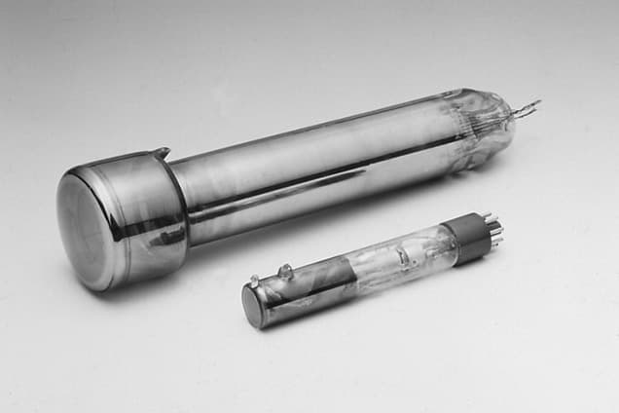
Pursuing another “イ” that will change the world
Heihachiro Horiuchi studied under Dr Takayanagi, who inspired his pursuit of light-based technologies
In 1948, Heihachiro Horiuchi founded the Tokai Electronics Laboratory
In 1953, he established Hamamatsu TV Co., Ltd.
Since then, Hamamatsu has continued its pursuit of technologies involving light in all its forms
Heihachiro Horiuchi (1915 to 1997) with a vidicon in hand.
Selenium photocathode vidicons

Slide 6
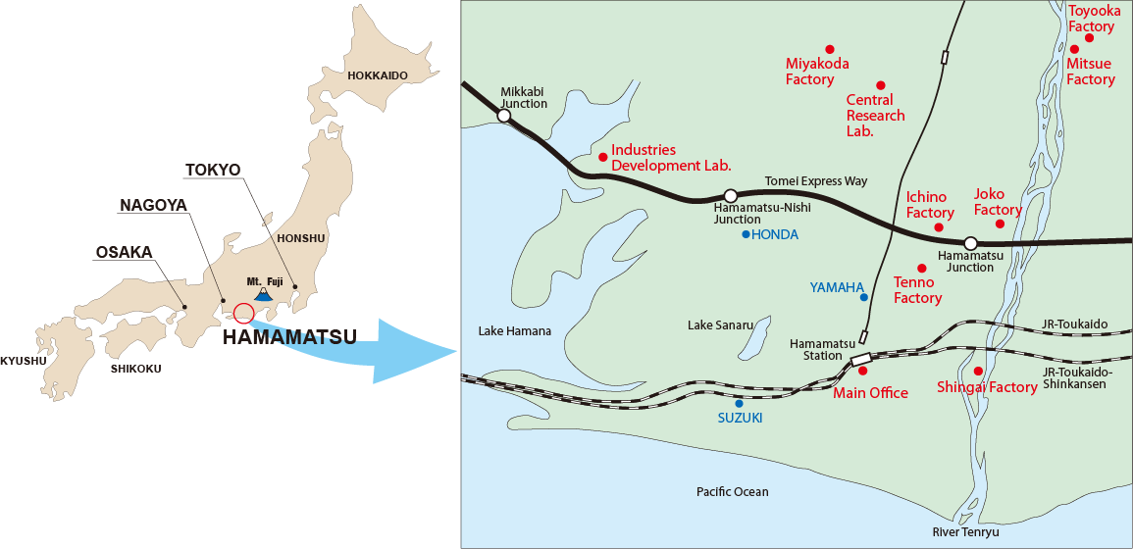
Where is Hamamatsu?

Slide 7
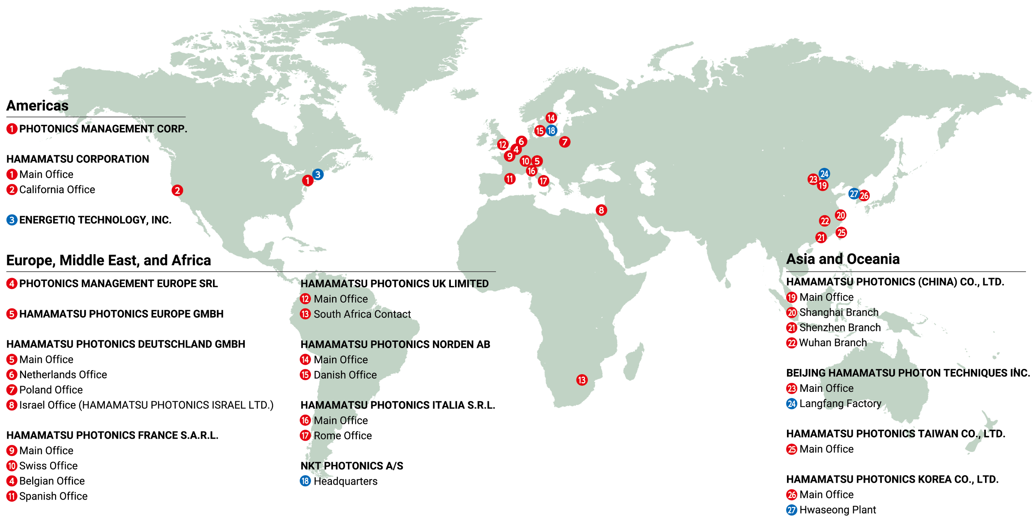
World-wide Sales Organization

Slide 8
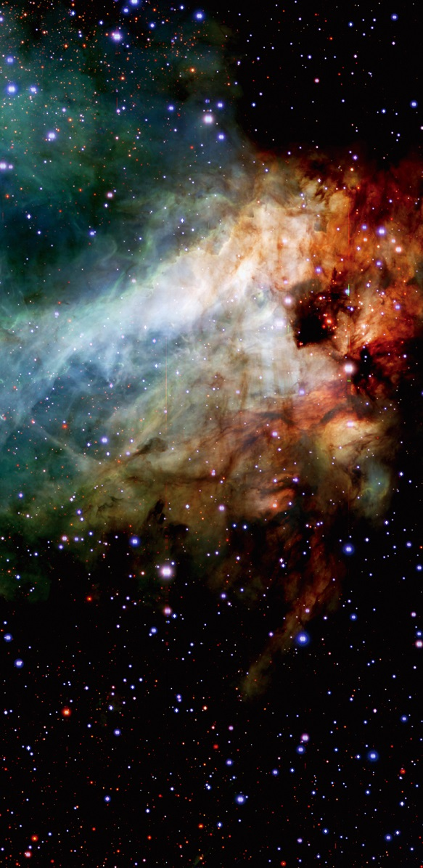
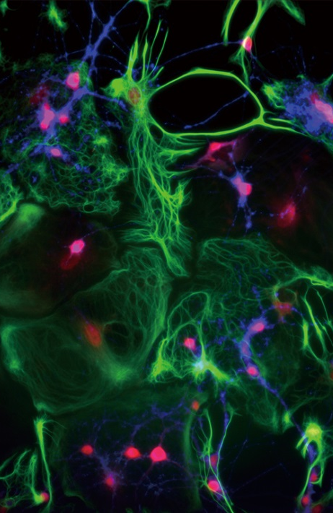
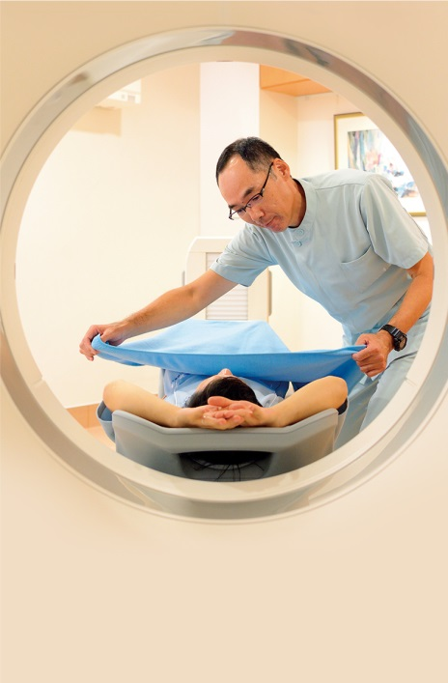
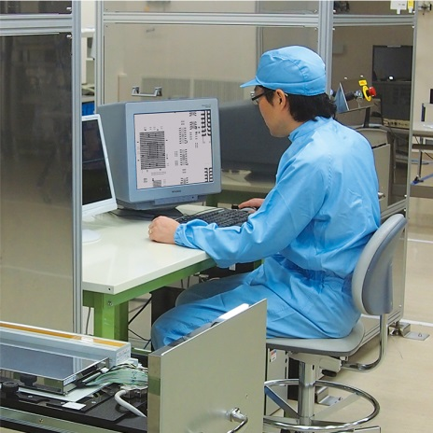



Markets
Manufacturing
Life Science
Medical Science
Environmental
Science
Fundamental Research
Automotive
Daily Life

Slide 9
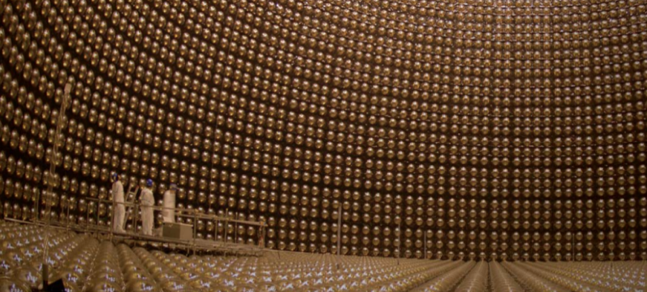
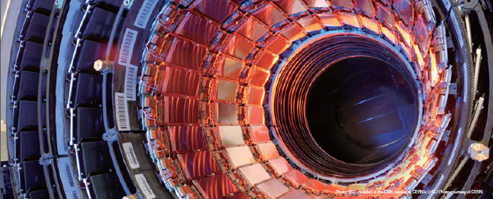
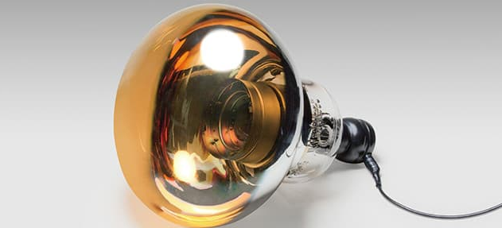
History in HEP
Kamiokande: in 2002 Prof. Masatoshi Koshiba was awarded the Nobel Prize in physics for history’s first observation of neutrinos that where released from a supernova explosion captured by the world’s largest 20-inch diameter PMT.
Large Hadron Collider: in 2013 Prof François Englert and Peter W. Higgs was awarded the Nobel Prize in physics for the discovery of the Higgs boson often called the God particle that gives mass to matter particles. Our Silicon Strip Detectors contributed to this great discovery.
Super Kamiokande: in 2015 Professor Takaaki Kajita, University of Tokyo, was awarded the Nobel Prize in Physics for the discovery of neutrino oscillations that indicate a neutrino has a mass. This breakthrough was the result of research at Super Kamiokande where our photomultiplier tubes were installed.

Slide 10
What do we do?

Slide 11
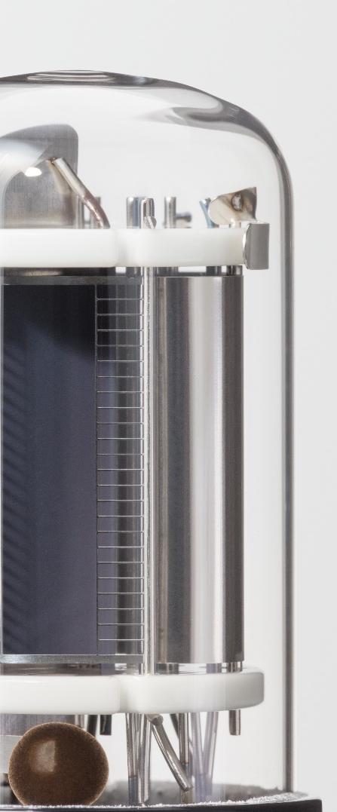
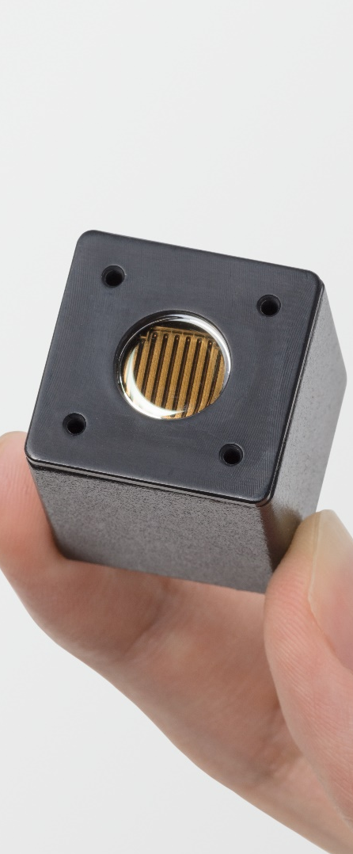
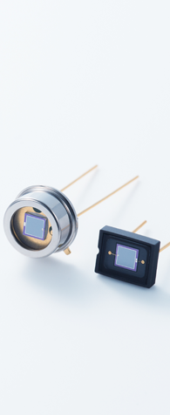
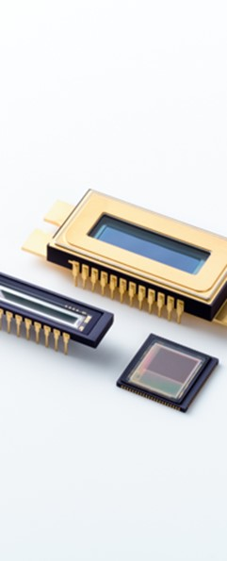
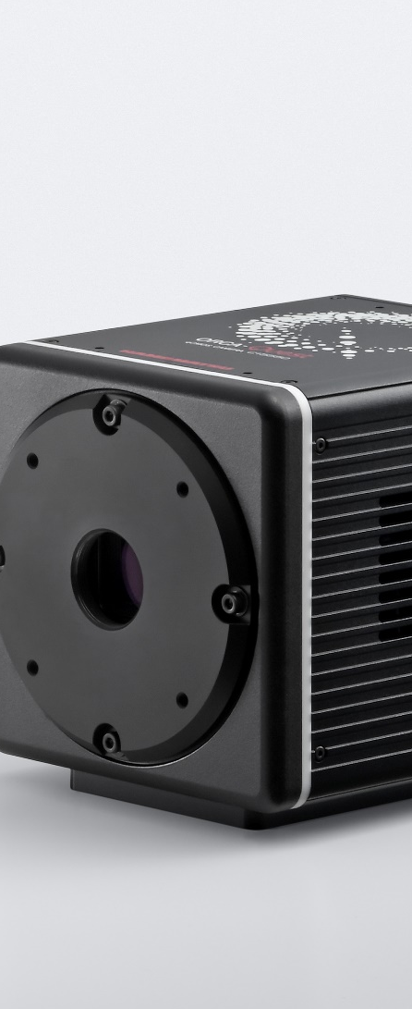

Detectors for High Energy Physics
Photomultiplier tubes (PMTs)
PMT modules
Si photodiodes, APDs, MPPC®
Image sensors
Cameras
X-ray related products

Slide 12
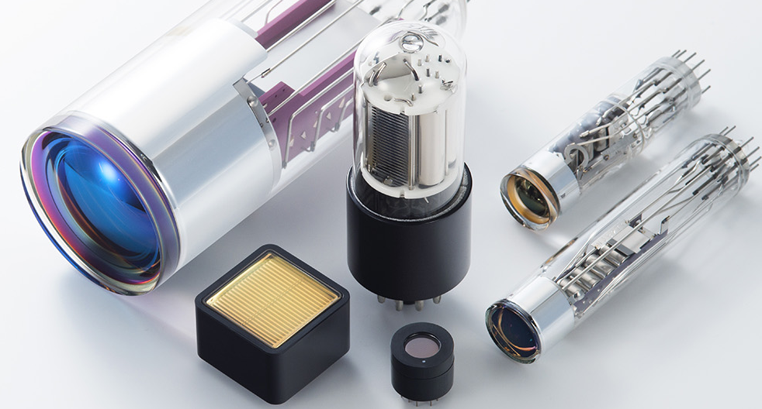
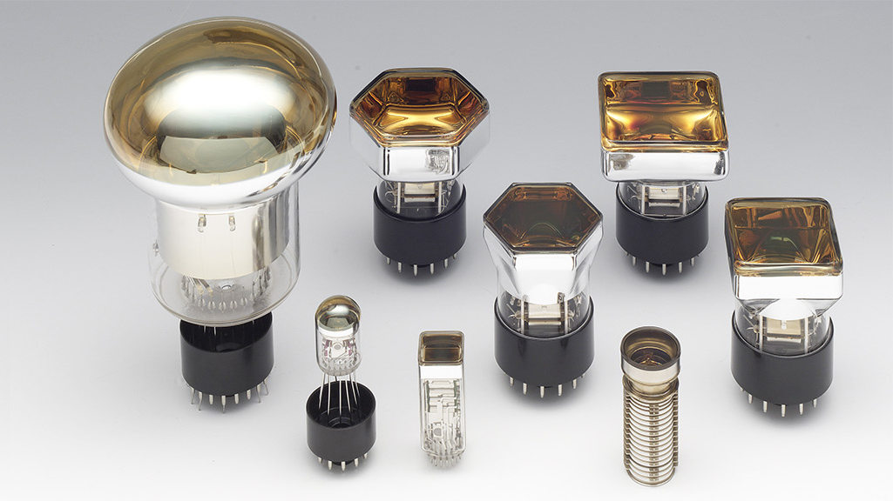
Photomultiplier Tubes (PMTs)
Wavelength range
Choice of window and photocathode material e.g. UV windows, high QE photocathodes, extended green options
Size and shape
Photocathode shapes and sizes e.g. square or circular, 8mm to 20” options
Multiplication method
Classic dynode structure, metal dynodes, multichannel plates (MCPs), hybrid detectors
Anode readout
Single channel and multianode array options
Accessories
Sockets, power supplies, amplifiers, coatings, shielding etc.

Slide 13
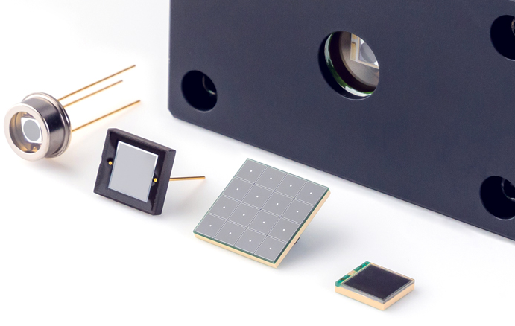
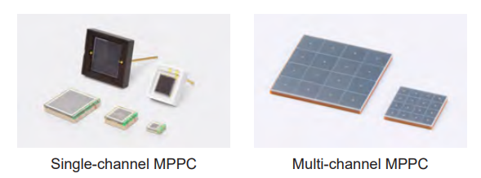
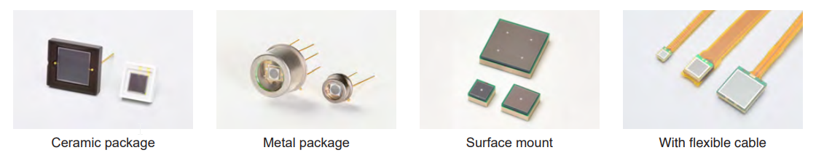
Silicon Photomultipliers (SiPMs)
Wavelength range
UV and NIR enhanced options
Photosensitive area
1.3mm to 6mm
Pixel size
10μm to 75μm pixel pitch
Single-channel or multi-channel
Single-element and array options
Cooling
Options for lowering dark noise
Ceramic, metal, and surface mount
Package type

Slide 14
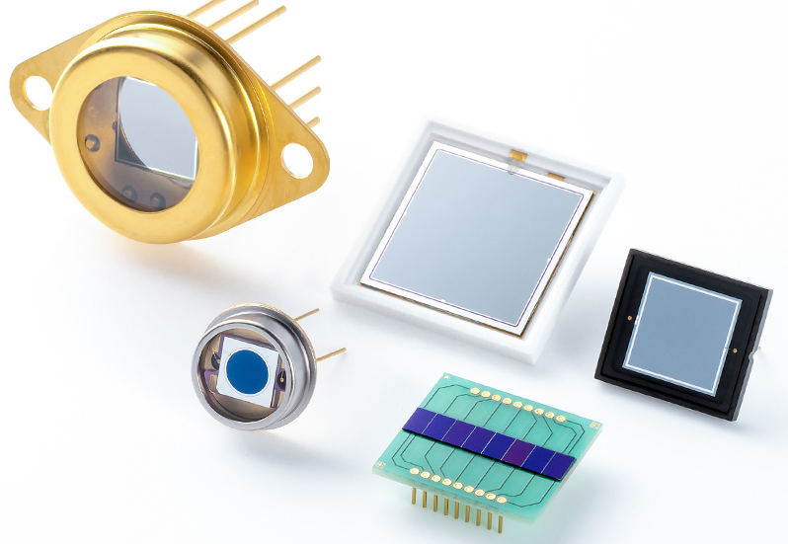
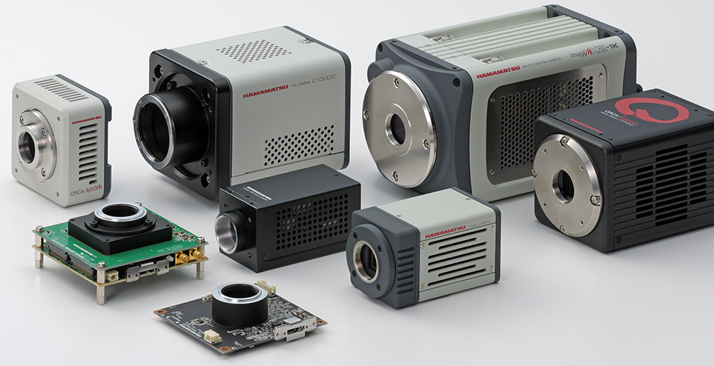
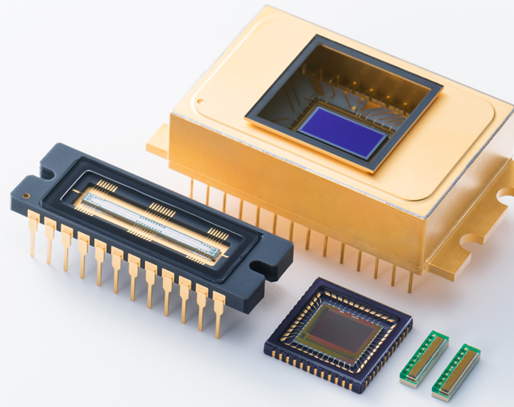
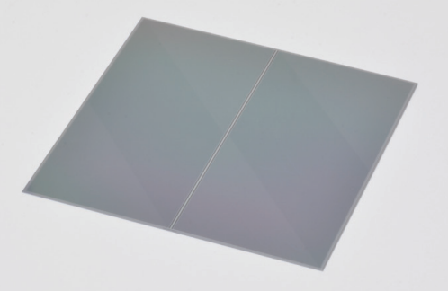
Anything else?
Photodiodes
Imaging solutions
Large area devices
Arrays
High speed options
Low noise camera
Quantitative CMOS
X-Ray TDI
Image sensors
Silicon array detectors
Linear devices
Area devices
Readout solutions
Photodiode arrays
Segmented photodiodes
Silicon strip detectors

Slide 15
Why talk to us?

Slide 16
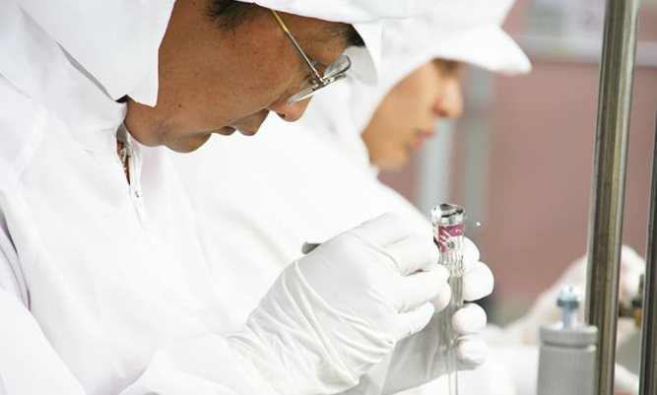

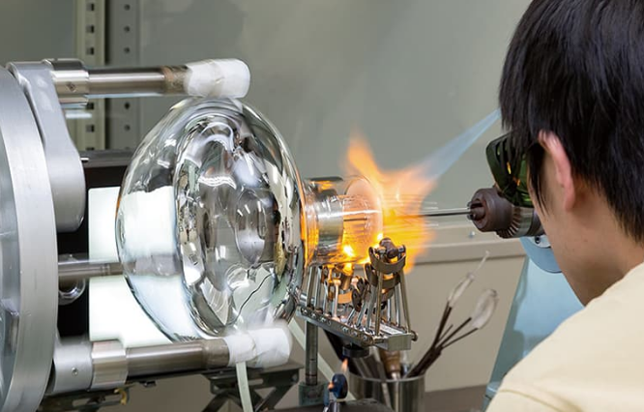
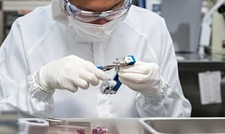
Why Hamamatsu?
Experience
Collaboration
Customization

Slide 17

To summarise...
Who are we?
What do we do?
Why talk to us?

