Slide 1
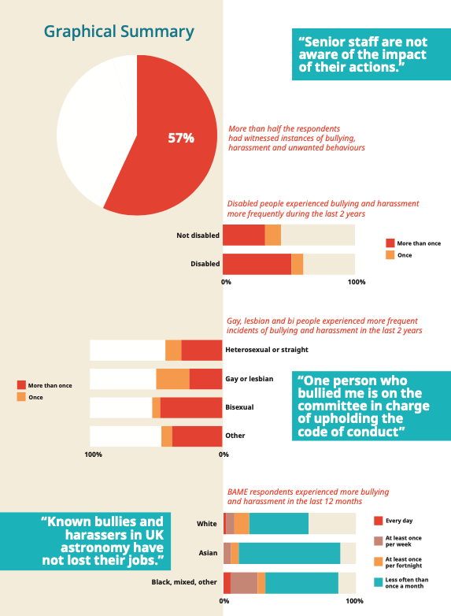
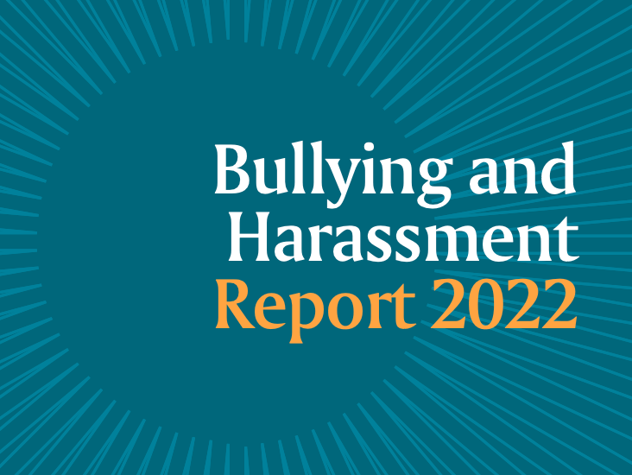

We acknowledge the lived experience of our respondents and thank them for taking part in the survey.
The RAS recognises its role in advocating for equal access to astronomy and geophysics for all, but cannot directly change the policies and procedures of workplaces and organisations in the field.
However, we hope that by giving a voice to the experiences of our Fellows and colleagues, universities, research councils and other workplaces in the sector will improve their working practices as a result.

Slide 2
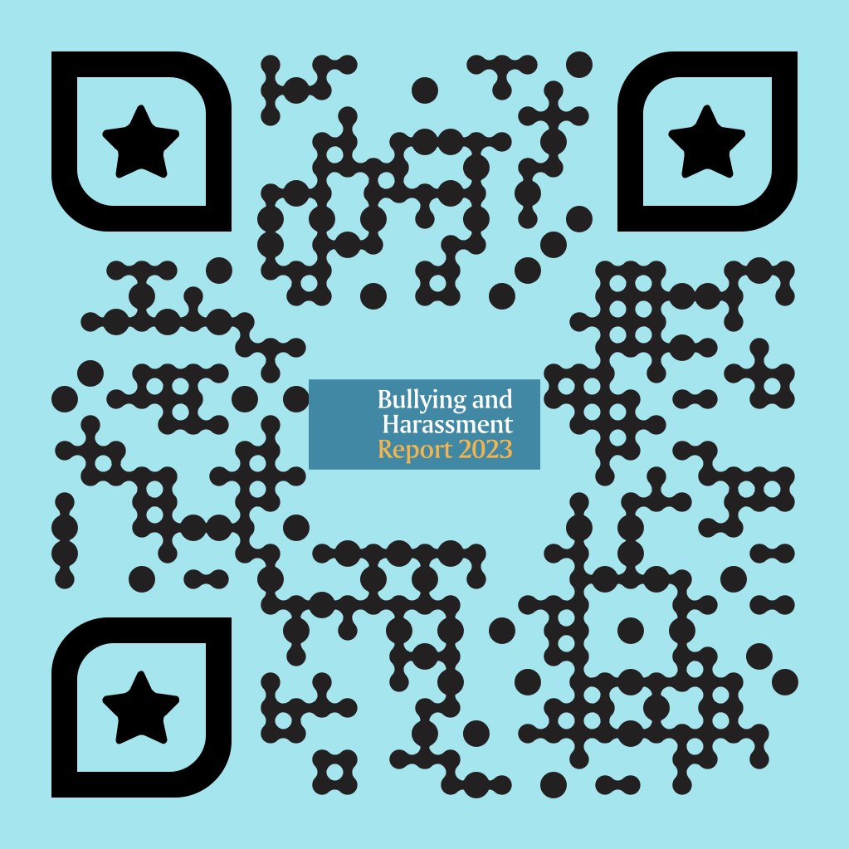
The report:

Slide 3
RAS Code of Conduct at meetings: https://ras.ac.uk/code-conduct-ras-meetings
RAS anonymous reporting form: https://ras.ac.uk/form/anonymous-reporting
Places you can find support: https://ras.ac.uk/education-and-careers/places-you-can-find-support
Bullying is defined by ACAS as: ‘Unwanted behaviour that can be offensive, intimidating, malicious or insulting, from a person or group. An abuse or misuse of power that undermines, humiliates, denigrate or causes physical or emotional harm to someone.’
Harassment is defined in the Equality Act 2010 as: ‘Unwanted conduct related to protected characteristics (age, sex, disability, gender reassignment, marriage and civil partnership, pregnancy and maternity/paternity, race, religion or belief, sexual orientation), which has the purpose or effect of violating an individual’s dignity or creating an intimidating, hostile, degrading, humiliating or offensive environment for that individual.’

Slide 4
anti-bullying and harassment progress
Reactive - case by case basis - Fellows coming to us.
Led to:
New RAS website - diversity section and anonymous reporting, diversity monitoring forms attached to every application form
Harassment hotline at events
Working with Prospect Union and other useful partnerships
Case by case basis still occurring – Fellow asked for us to run a survey
Harassment and bullying survey and results

Slide 5
INTRODUCTION
Evidence suggests, from high profile individual cases in astronomy and geophysics, that bullying and harassment is likely to occur frequently in many institutions.
Bullying and harassment affects mental health, staff retention, and people from minority groups are more likely to be affected by it.
Prior to this study no data capturing the extent of the issue in our sector had been collected.
Understanding the experience of employees in astronomy and geophysics, both positive and negative, is crucial for the future health of the sector.
We hope that these results will influence leaders in different workplaces, and in funding bodies, to shape a better workplace environment for all.

Slide 6
aims
The aims of the survey were to:
• Capture the experiences and perspectives of the astronomy and geophysics community regarding bullying and harassment, workplace culture and policies;
• Understand which communities are most likely to be adversely/disproportionately affected by these issues;
• Generate a robust dataset as a starting point and baseline for change in the fields.

Slide 7
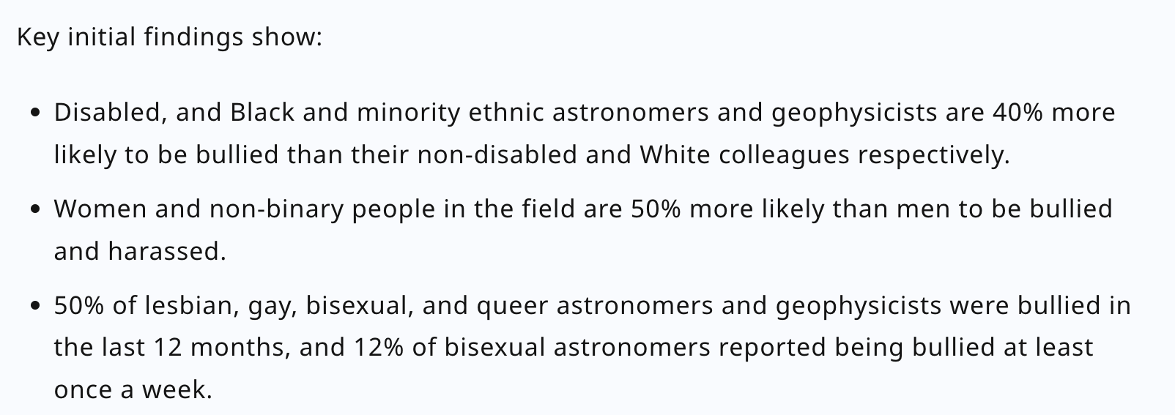
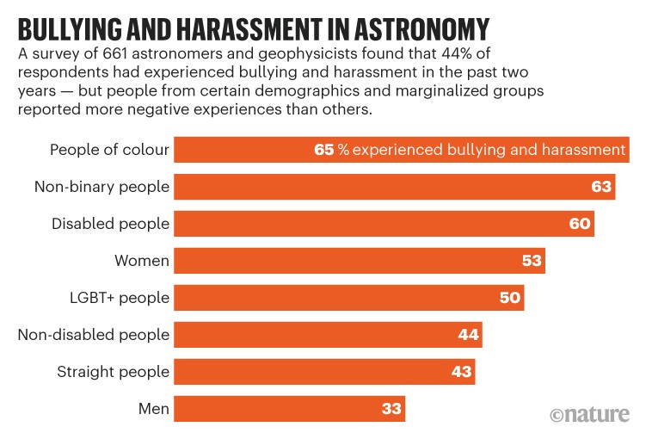
Notes:
The results show a systemic bullying problem across our field, with 44% of all respondents having suffered workplace bullying and harassment at least once in the two years prior to completing the questionnaire.
The results also showed that there was not a single demographic group, career stage or career path that has not suffered in the workplace, and perhaps unsurprisingly, that there were multiple marginalised communities that stood out as having suffered far more than their colleagues.

Slide 8

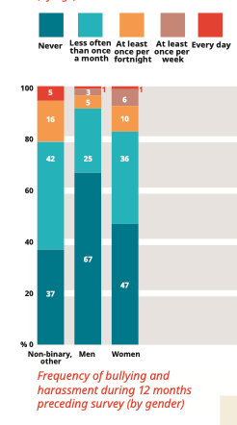
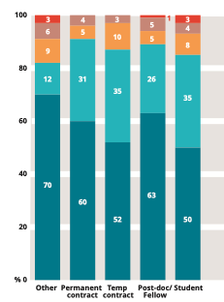

Experiences of harassment and bullying

Slide 9
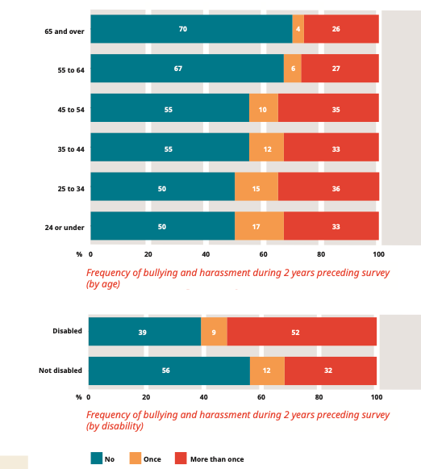


Experiences of harassment and bullying

Slide 10
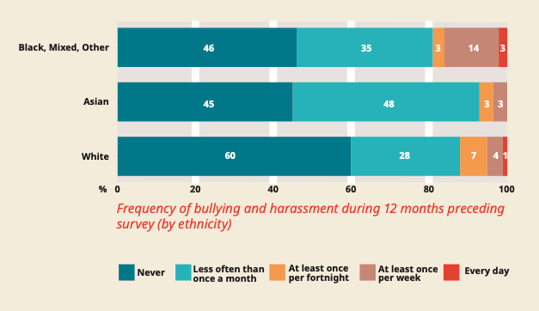
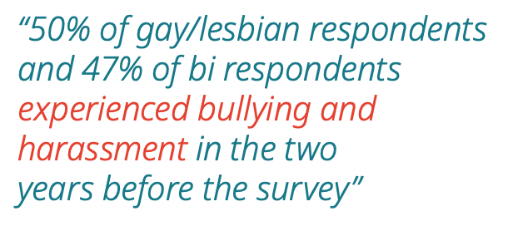
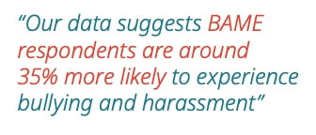
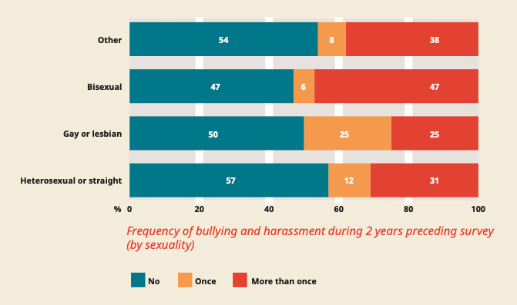
Experiences of harassment and bullying

Slide 11
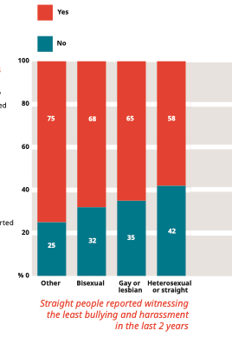
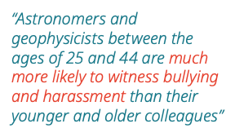
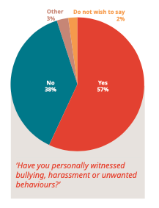
Witnessing bullying and harassment

Slide 12
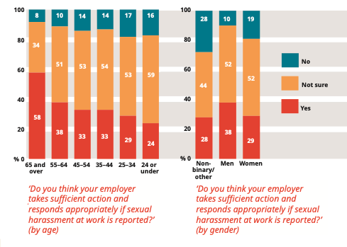
Perceptions of employers’ responses to harassment and bullying

Slide 13
Experiences of preventative measures in the workplace
“Do you think your employer takes sufficient action to prevent bullying and harassment or unwanted behaviours at work?”
37% of all respondents said yes to this, 33% said no, and 27% said they were not sure (3% responded with ‘other’).
Respondents had the opportunity to explain their answer. There were some positive examples:
Clear communication
Chains of command
Reporting procedures at their workplace. Although reporting differs from prevention, many respondents mentioned this. The existence of reporting procedures may deter perpetrators.

Slide 14

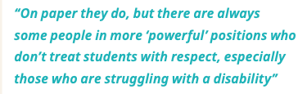
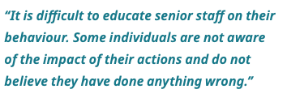
Experiences of preventative measures in the workplace
Many more respondents expanded on their answer with negative examples.
Unclear reporting procedures at many institution
Supervisor relationships make reporting/whistleblowing difficult
Policies aren’t there to protect staff or prevent bullying and harassment, they are there to cover organisations’ backs
Those in positions of power and influence are perceived as ‘invincible’ and are not punished; many perceived that there were no sanctions for those who secure large grants for their universities

Slide 15
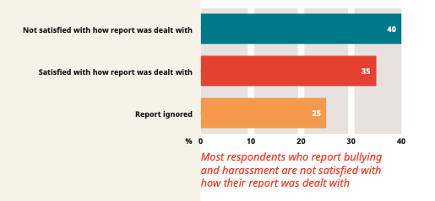
Reporting bullying and harassment
The sample size of the answers to this question was not large enough to allow us to look at disaggregated responses to this question for most demographic groups. This is because this question addresses only those who had reported bullying and harassment and a disaggregated analysis of this group would not be statistically sound. An elementary analysis suggested women were approximately twice as likely as men to be dissatisfied with how their reports were dealt with.

Slide 16
aims
The aims of the survey were to:
• Capture the experiences and perspectives of the astronomy and geophysics community regarding bullying and harassment, workplace culture and policies;
• Understand which communities are most likely to be adversely/disproportionately affected by these issues;
• Generate a robust dataset as a starting point and baseline for change in the fields.
RECOMMENDATIONS AND ACTIONS

Slide 17
Bullying and harassment working group
In analysing the report we realised that whilst the evidence was important, what would be more important would be to create a set of actions and recommendations for the RAS and the wider community.
A working group was set up to discuss what these actions and recommendations should look like.
The Bullying and Harassment working group met from May-July 2023 and consisted of:
Charlotte Thorley (chair)
Sheila Kanani (RAS staff lead)
Dominic Galliano (freelance)
Jonathan Piotrowski (UKRI)
Julie Wardlow (Lancaster University)
Claire Davies (University of Exeter)
Em Truman (UKSEDS)
Shanice Dunk (IOP)

Slide 18
What follows is a series of recommendations that can be actioned by individuals, by managers and workplaces, and by organisations and associations.
More explicit permission is needed to enable individuals to act, report, or disclose when harm is done. This permission is useless if those involved cannot also trust that this will be acted upon, and received with the support it requires.
To that end these recommendations are suggestions for how we might build that sense of permission and trust, focusing on three critical areas: prevention, reporting and accountability.
It is our intention that by enacting these recommendations, we can all make headway towards a safer and more inclusive workplace.

Slide 19
PREVENTION AND UNDERSTANDING
Prevention should be our ultimate goal.
Work is needed to:
  develop more constructive working patterns and relationships
  challenging systemic issues that lead to the normalisation of acceptance of bullying and harassment (B&H).
We need individuals and organisations to understand that it is the consequences of the bullying and harassment that matters most, not their own perceptions of what is acceptable.
We can achieve this by challenging the power dynamics and considering how structures and systems interact to perpetuate the issue.
We want to assure the next generation of astronomers and geophysicists that our community is safe and welcoming.

Slide 20
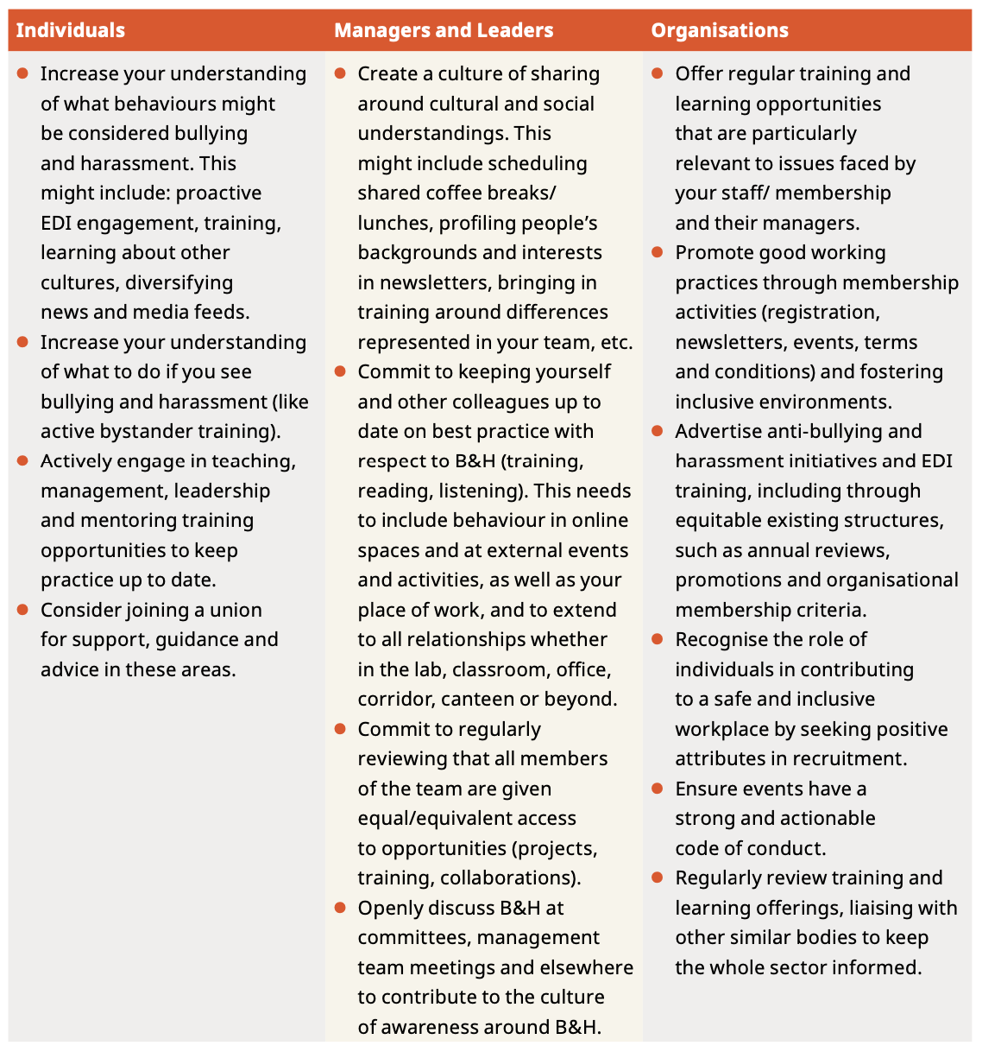

Slide 21
Reporting and related processes
Current reporting processes for individuals to report instances of B&H maintain the working cultures where bullying and harassment get overlooked or deliberately ignored.
Processes need challenging to ensure those who have been harmed are able to safely trust that their experience is being taken seriously.

Slide 22
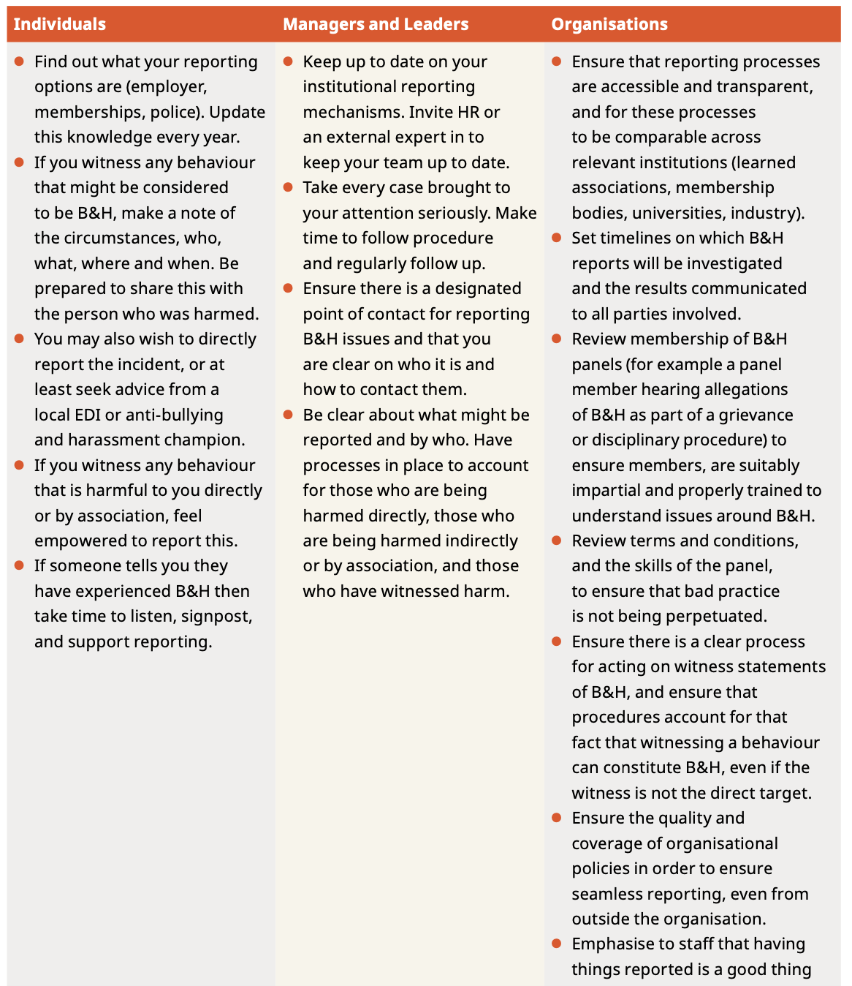

Slide 23
Accountability, consequences and communication
Individuals and institutions who have caused harm need to be held accountable for their actions in such a way that has real consequences.
These consequences should enable the injured party to go on and thrive in their career.
Communicating these clear and transparent procedures publicly, including potential sanctions if an allegation is upheld, and any other potential impacts (e.g. pay progression, and potential requirement to report B&H to certain grant funders), without creating more work for the injured party, should be prioritised.

Slide 24
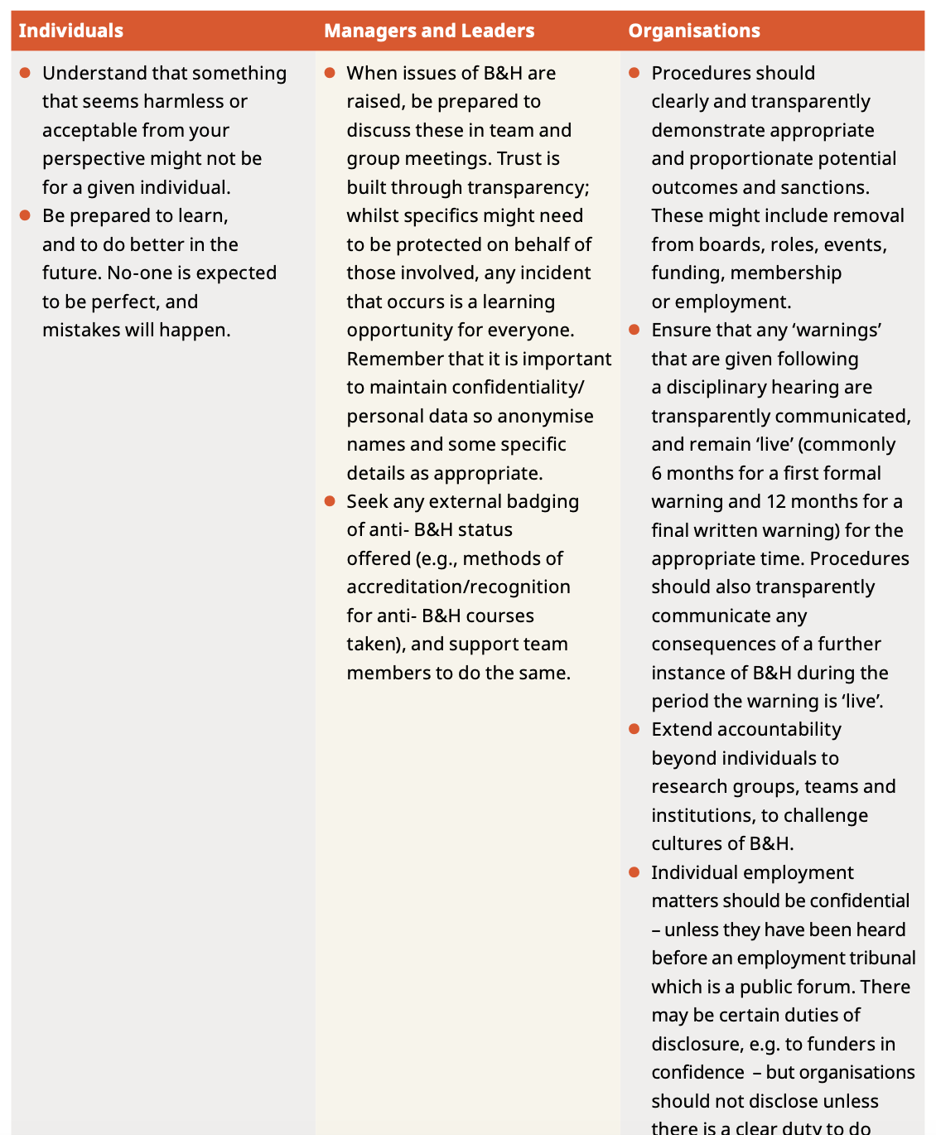

Slide 25
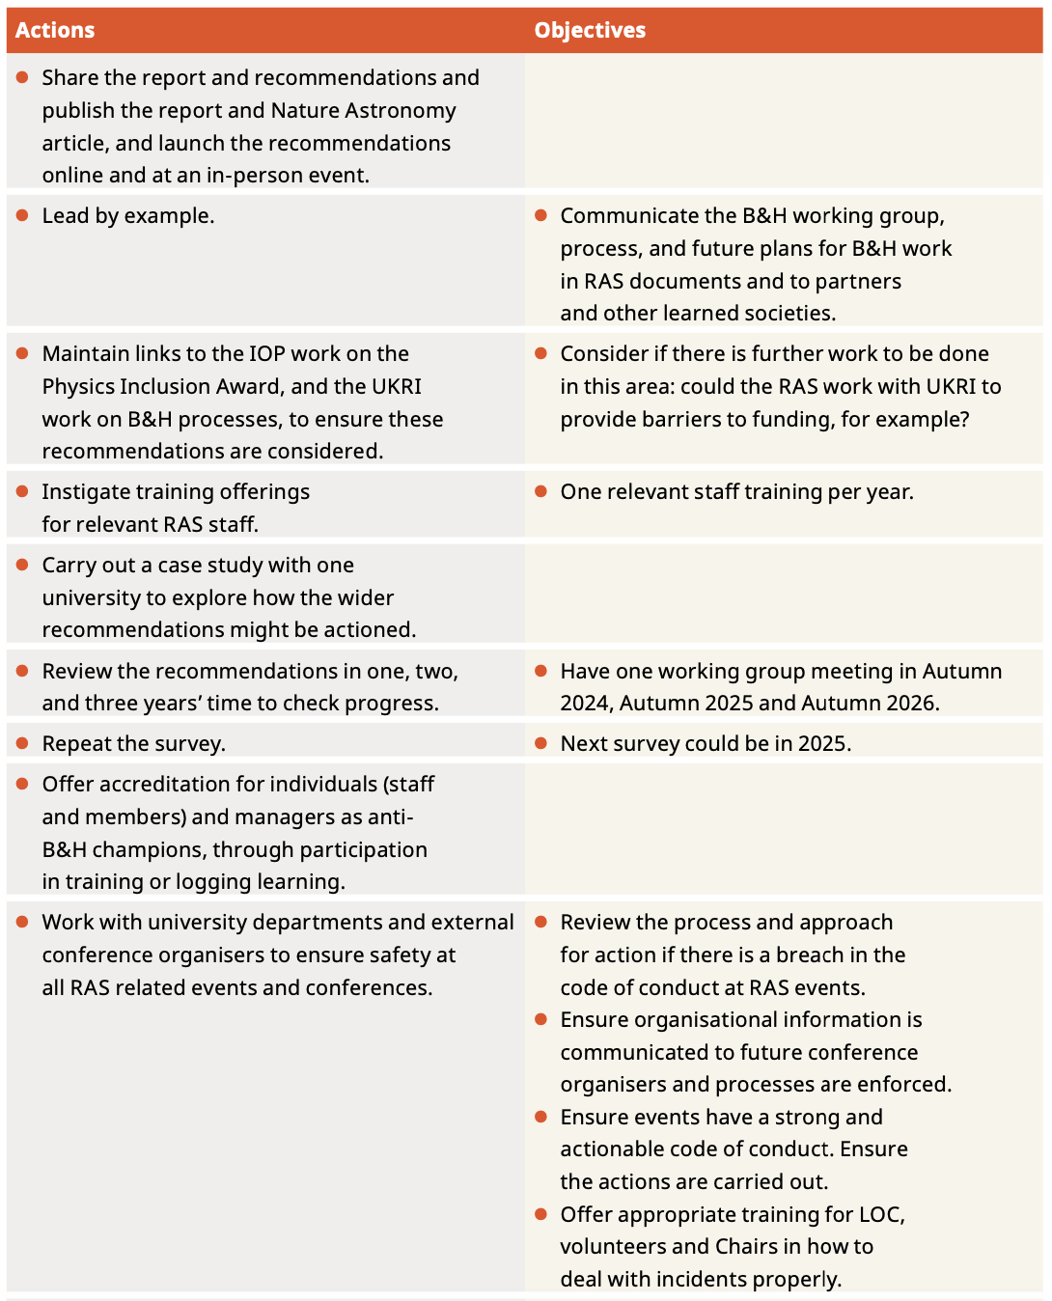
Actions for the RAS

Slide 26
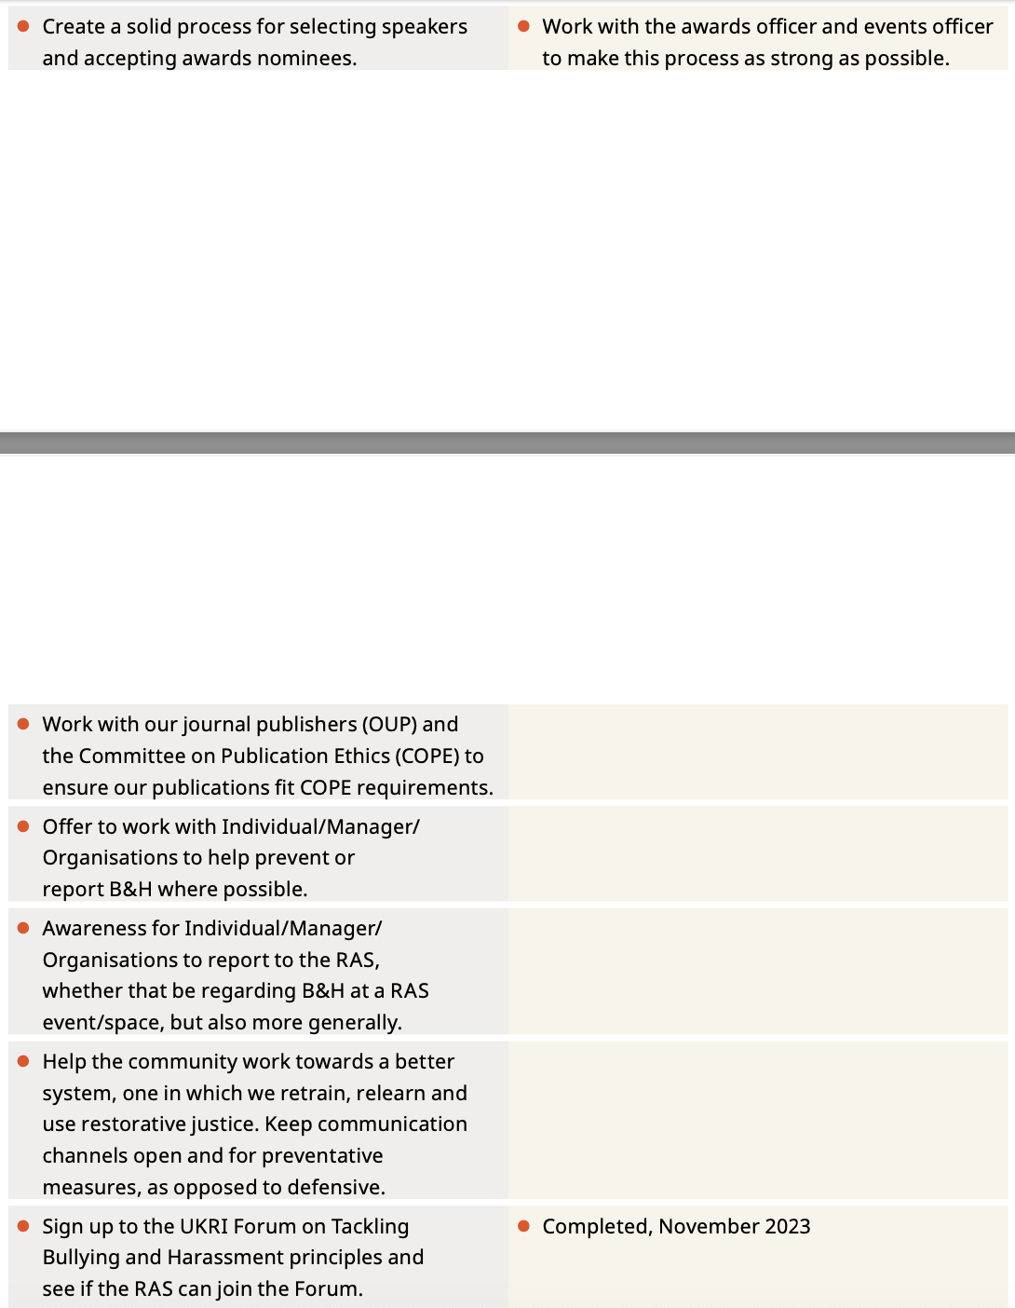

Slide 27
SUGGESTIONS FROM A UNIVERSITY HEAD OF DEPARTMENT
Use any resources you can.
EDI role in Senior Management Team.
Lead by example, educate senior managers.
Actively look at workload with staff who are more likely to experience bullying.
Actively check in with staff who are more likely to experience bullying.
Engage views of staff and students in multiple ways.
Support embedding inclusivity into Universities (inc. assessments, curriculum, review awarding gaps).
Role Modelling - posters representing a diversity of excellent scientists.
Fellowship application feedback, mentors for all PGR students outside their group.
Clear signposting - dignity at work contacts and staff with wellbeing training.
Collect data and use it. Feedback to Universities regarding cases.
Support RAS EDI staff to able to present their work at meetings.
Evaluate the EDI experience after large conferences and meetings.
Consider self nomination without a reference.
Continue to engage with the community - seek out unheard voices.

Slide 28
conclusions
This report is a snapshot of the workplace environment in 2020, but its results should concern the astronomy and geophysics community.
The survey data reveal that astronomy, solar system science and geophysics has a bullying and harassment problem - 44% of the 661 respondents reported suffering it in the workplace in the two years preceding the survey.
Historically marginalised and under-served groups are much more likely to be bullied and harassed. Our data also show that those at more precarious stages in their careers (students and those on temporary contracts) are also more likely to be bullied and harassed.
Respondents from these under-served groups had the least trust in workplace procedures and policies against bullying and harassment and feel their workplaces do the least to prevent bullying and harassment.
The majority (65%) of our respondents who reported concerns of bullying and harassment felt that their concerns had been handled inadequately.
We must put in more effective policies, procedures and safeguards to protect all our colleagues, to support students, and to ensure that everyone can achieve their potential and work in a safe and satisfying environment, regardless of their background.

Slide 29

Thank yoU!
Any questions?
saturnsheila@herplaceforspace.com
STEMM BHIP project coming soon!
Caption

