Slide 1




Axion Experiment and Theory
David J. E. Marsh
IOP Joint APP and HEPP Annual Conference
Cambridge, 2025

Slide 2
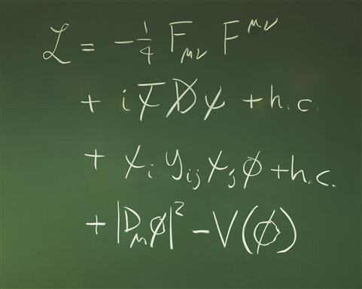
Axion
Dark Matter

Slide 3
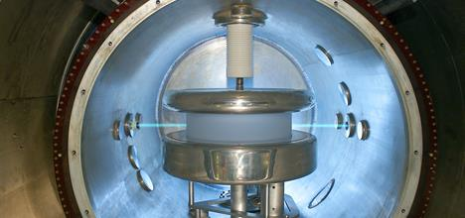
Axion Theories
Neutron observed to have EDM ~0. This can be explained by the QCD axion.
Extra dims. of string theory wrapped by gauge fields → axion-like particles.
Number of axions given by topological invariants.
Masses spread over log scale: “the string axiverse”.
One parameter DM model valid since 1980’s
High scale SSB → low mass particle.

Slide 4
Axion Relic Density
Relic density from solving the Klein-Gordon equation for a massive scalar field:
Damped SHM with time dependent “friction”. Oscillates and decays when H<m.
H~1/t → ρ ~ a⁻³. Harmonically oscillating scalar behaves like pressureless dust.

Slide 5
Axion Dark Matter
Axions can be modeled as an oscillating classical field:
From galactic rotation curve
Local DM density given as a harmonic oscillator:
→ if we know m_{a} we know field amplitude & frequency
=0.3-0.4 GeV cm⁻³

Slide 6
QCD axion searches
QCD axion
“Post-inflation”: miniclusters
QCD axion in string theory
String Axiverse
Heavy axions:
Decays, overproduction, constraints on cosmology
Ultralight axions:
structure formation
Axions in string theory
Hubble scale
~ (size of Universe)⁻¹
Planck scale (quantum gravity)

Slide 7
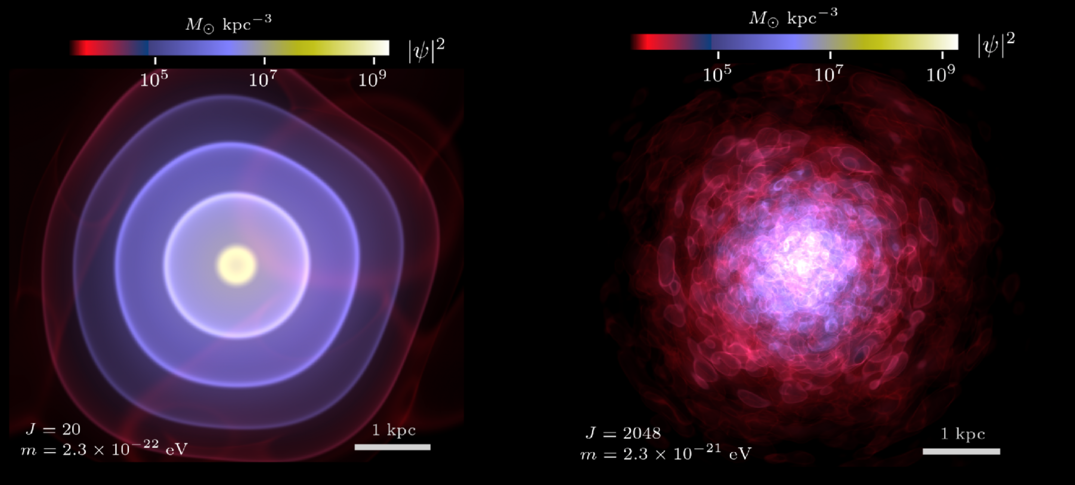
DM lower limit: 2.10⁻²¹ eV
Zimmermann, DJEM et al (PRL)
Folk wisdom: de Broglie wavelength must be smaller than dwarf galaxy radius.
“Bosonic Tremaine-Gunn bound”. Extremely difficult to compute precisely.
Leo-II is cuspy. Waves give cores. Compare self-consistent wavefunction to model-independent reconstruction of density + rigorous stats → strong limit.

Slide 8
Recent theory highlights

Slide 9
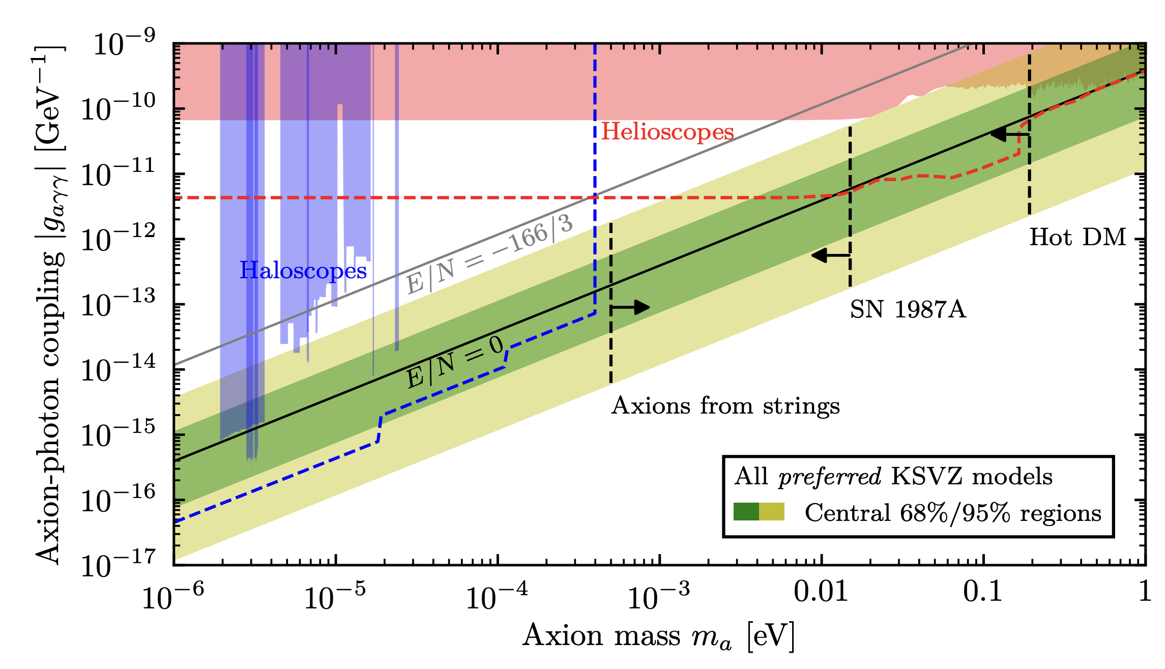
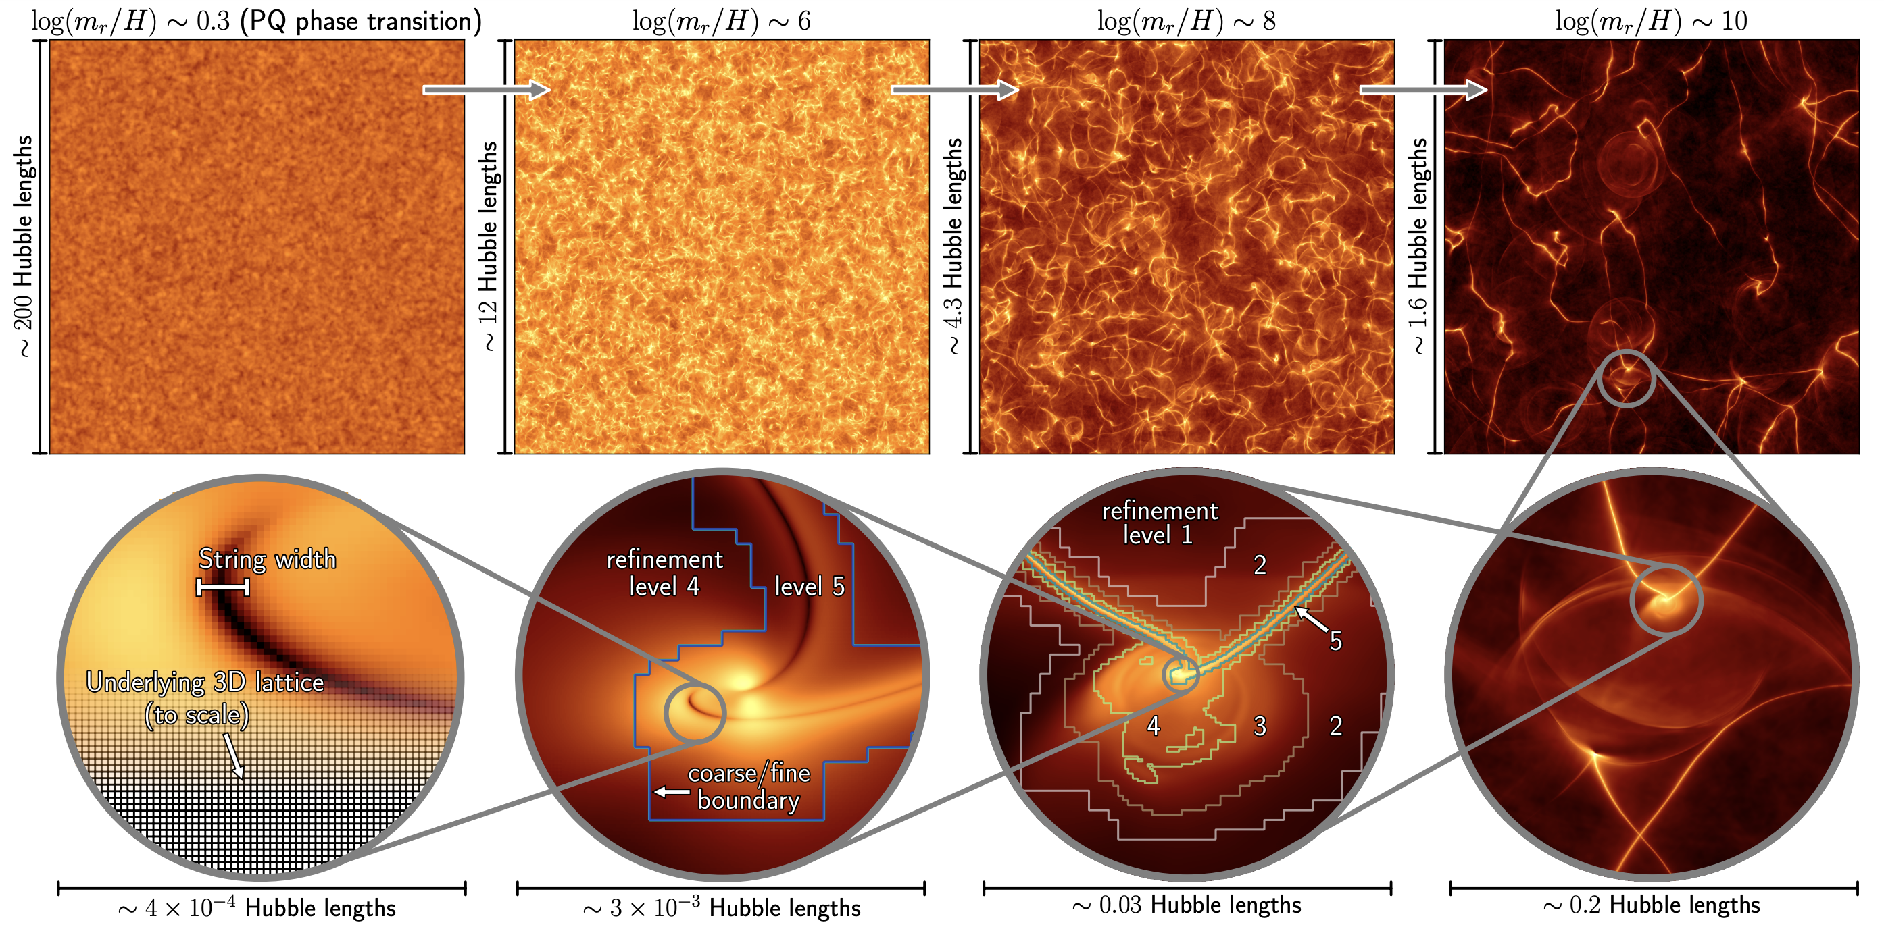
The QCD Axion
Recent highlight 1: the landscape of QCD axion models.
e.g. Di Luzio+ (2016+); Plakkot & Hoof (2021)
Recent highlight 2: predicting the axion mass in the “post-inflation” scenario.
e.g. Gorghetto et al (2018+);
Saikawa et al (2024); Buschmann et al (2018+)

Slide 10
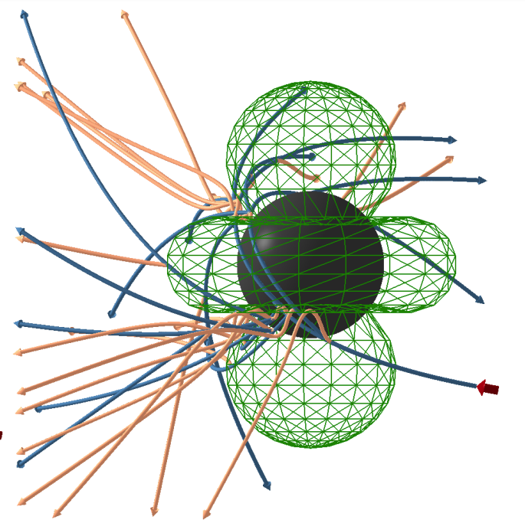
Astrophysics & Cosmology
MacDonald et al (2023)
Lägue, DJEM et al (2024)
Neutron star magnetospheres convert axions in radio waves.
Simulations allow modeling of wavelike effects on cosmic structure.

Slide 11

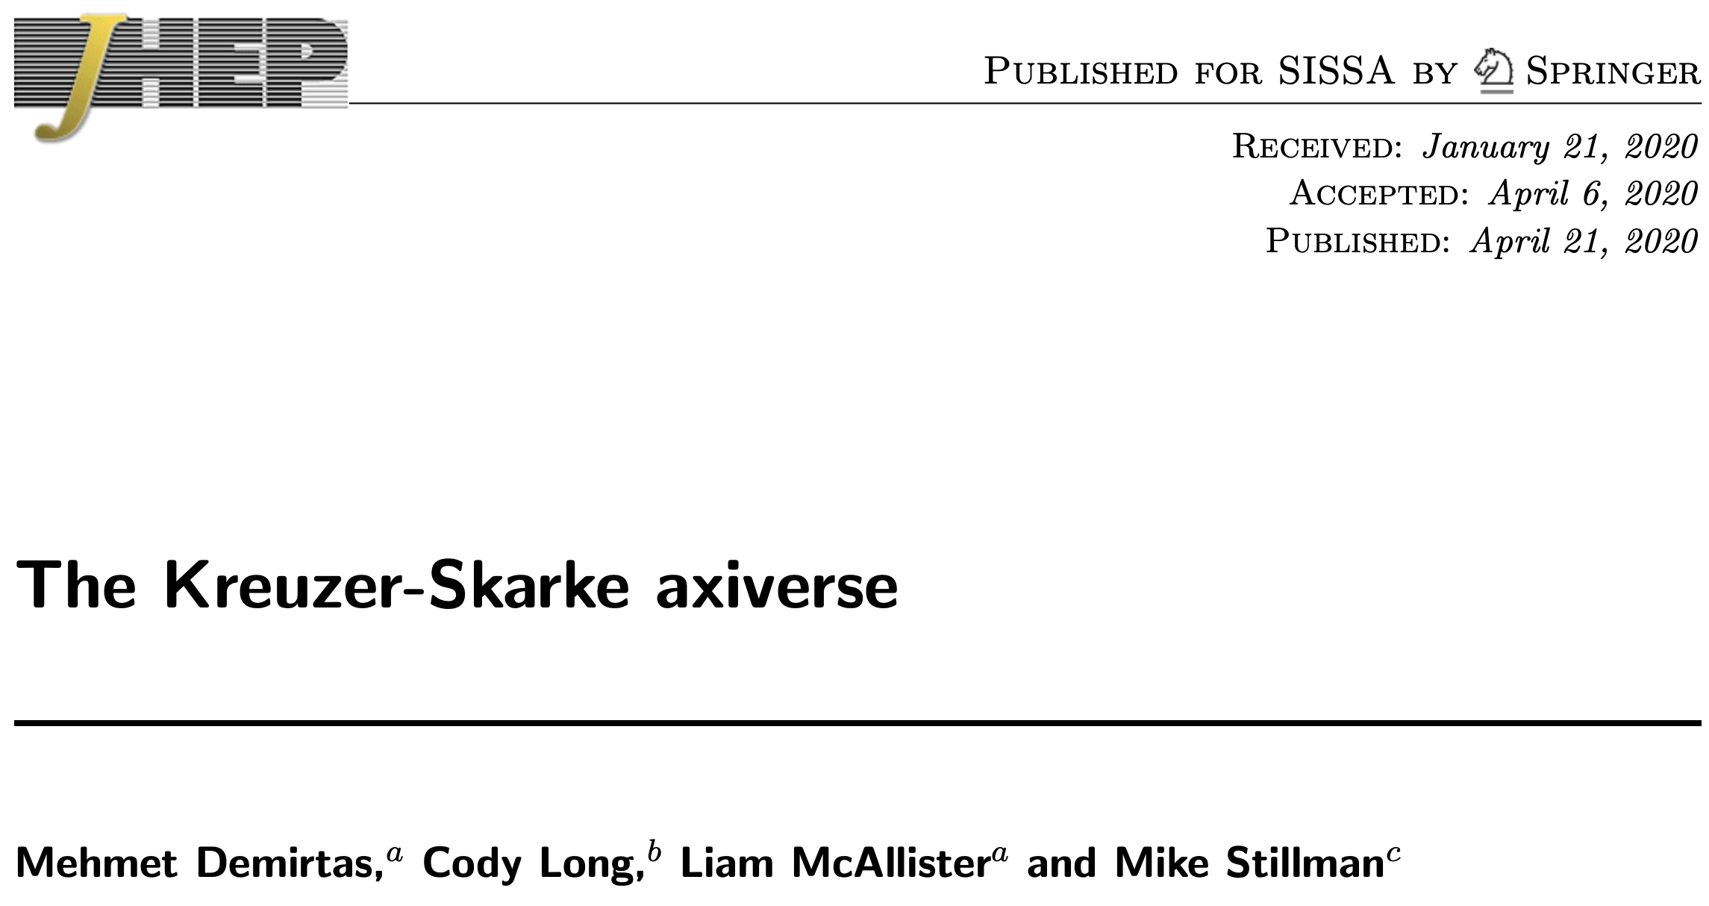
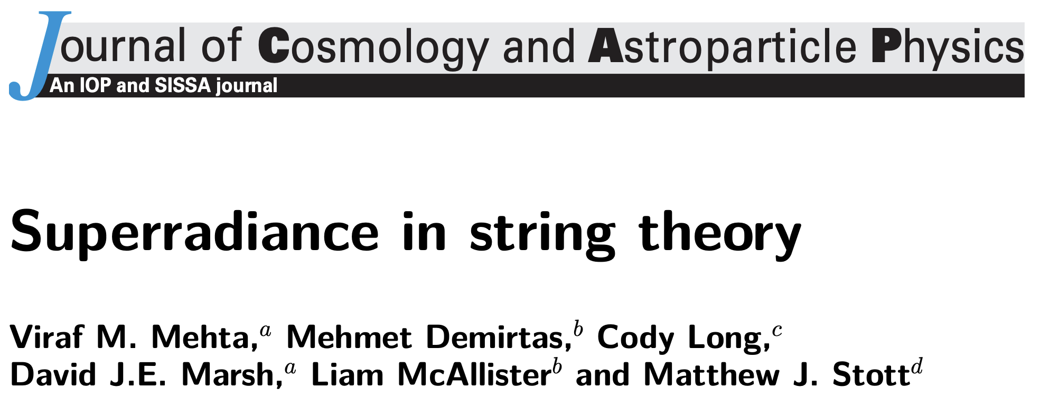
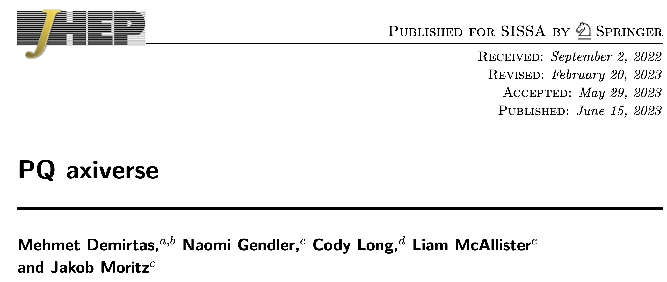
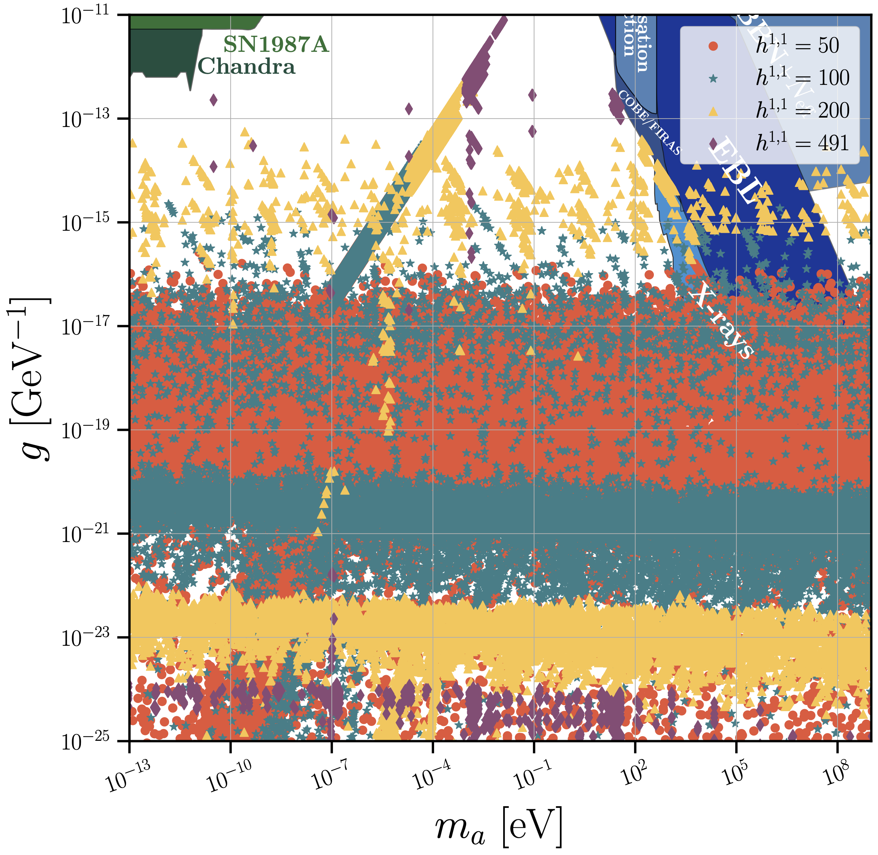
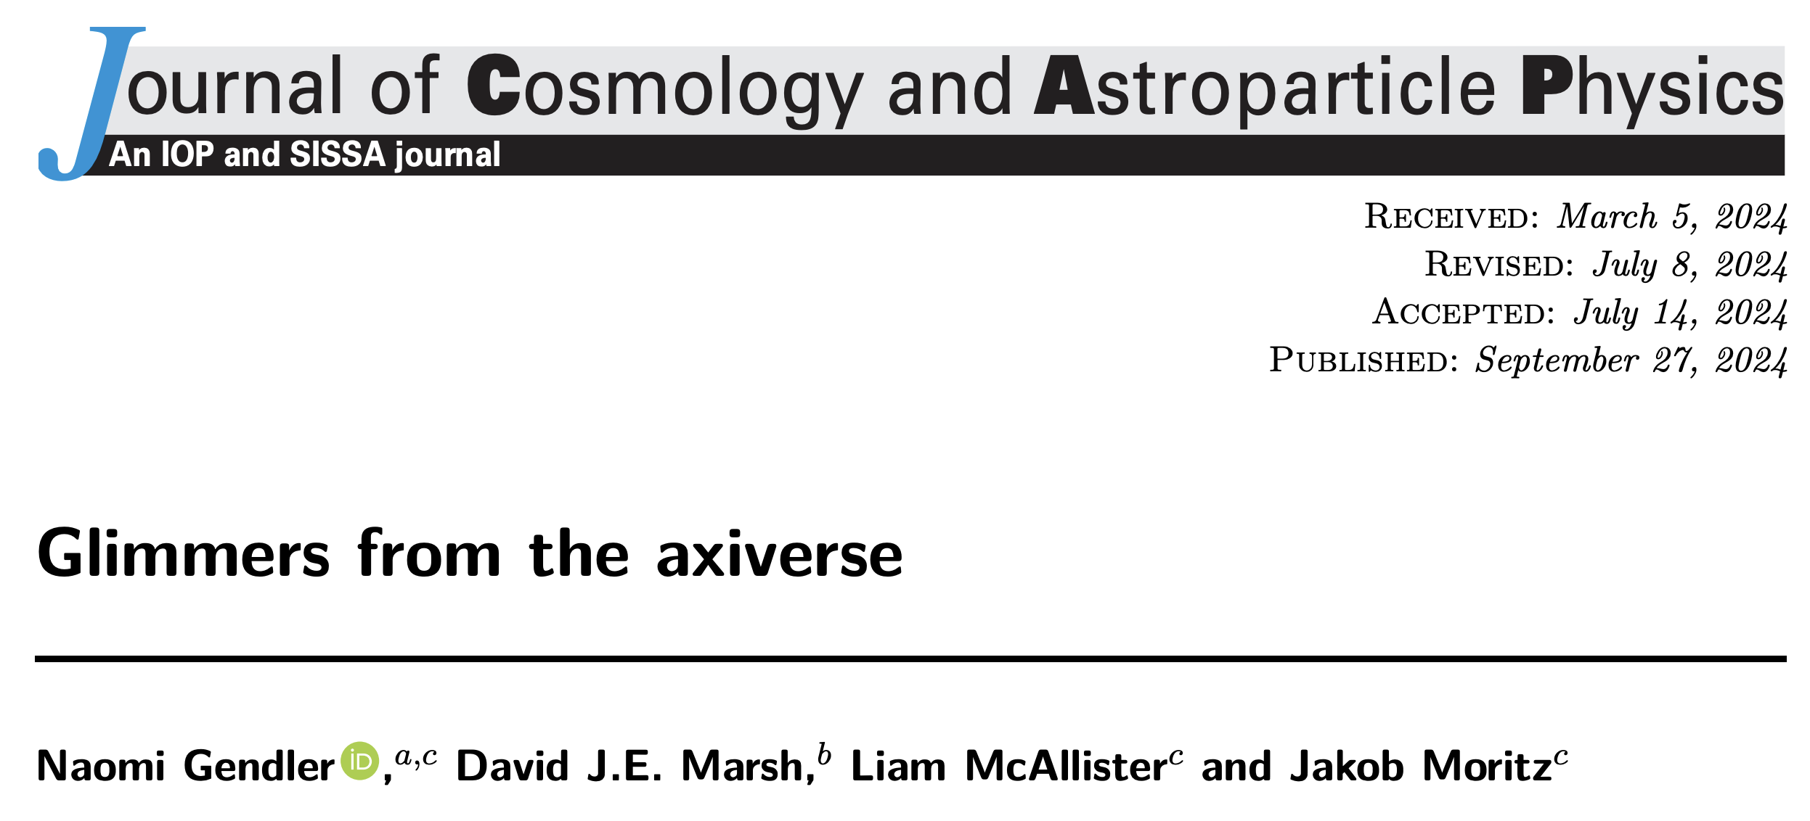
Type IIB String Theory
Rapid progress in understanding explicit Calabi-Yau compactifcations and constructing large ensembles. Characterised by “Hodge numbers” (h11,h21).

Slide 12
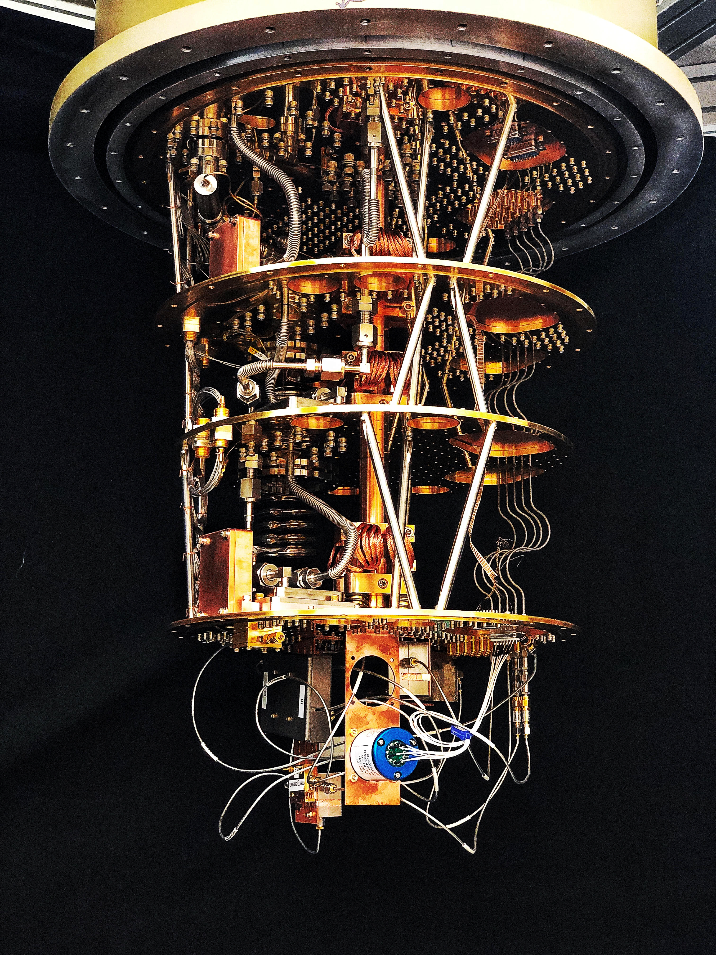
Direct detection:
“Haloscopes”

Slide 13
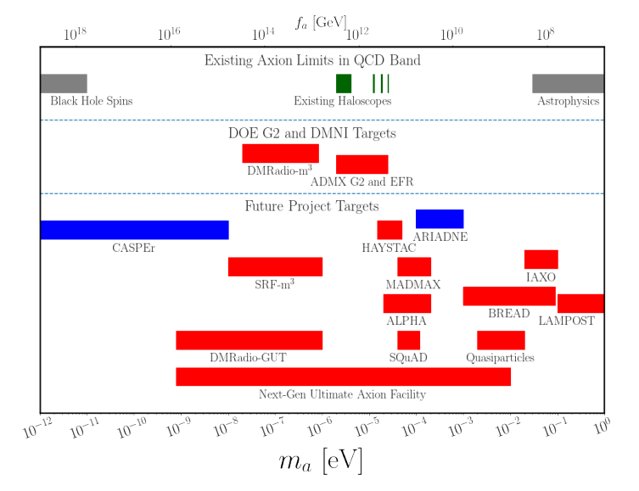
The QCD axion will be found
QCD axion mass:
kHz
THz
Bounded from above by SN1987A ν burst duration. Bounded from below by black hole superradiance.
Axion DM is an oscillating classical field in kHz to THz.
Snowmass “Axion Dark Matter” (inc DJEM)

Slide 14
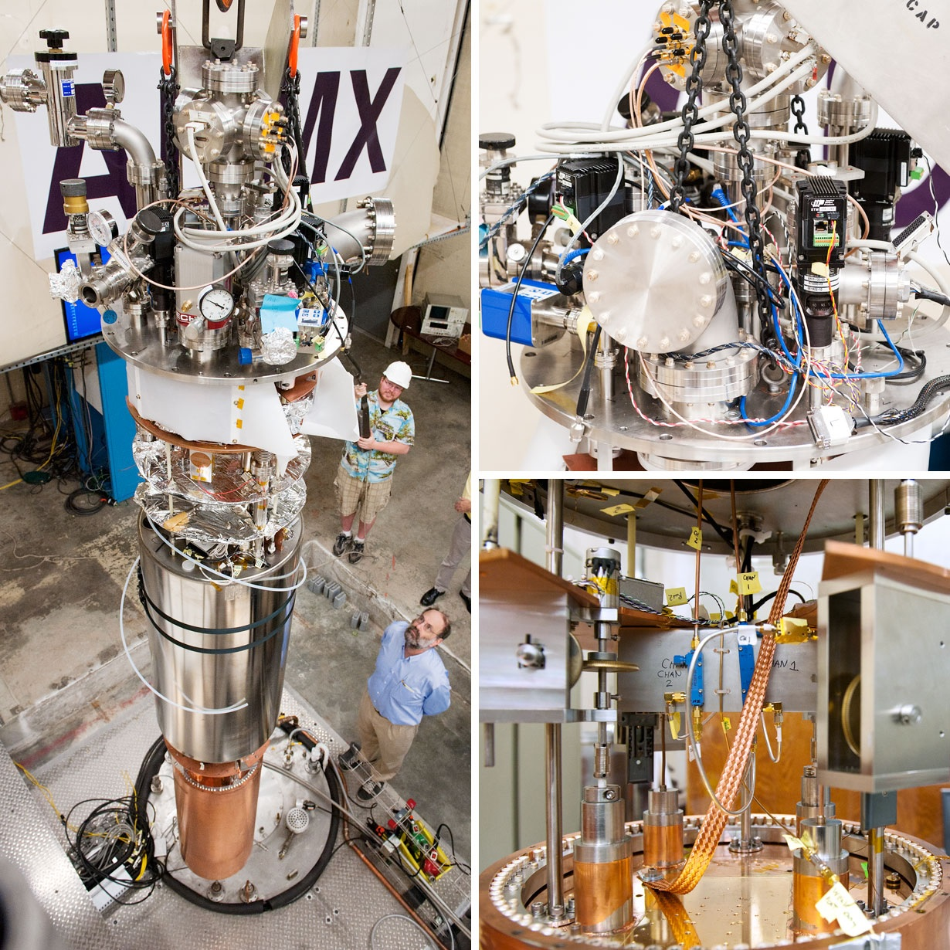
Resonant Cavities
Sikivie (1983); ADMX collab.
“Dark Matter” (DJEM et al)
Axions interact with electromagnetism via:
→ axions source Maxwell’s equations:
B source → linearise for E wave equation:
→ resonance via boundary conditions.
Power 10⁻²² W in typical experiment

Slide 15
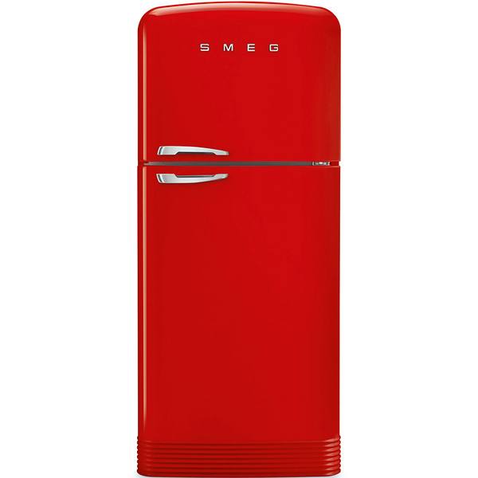
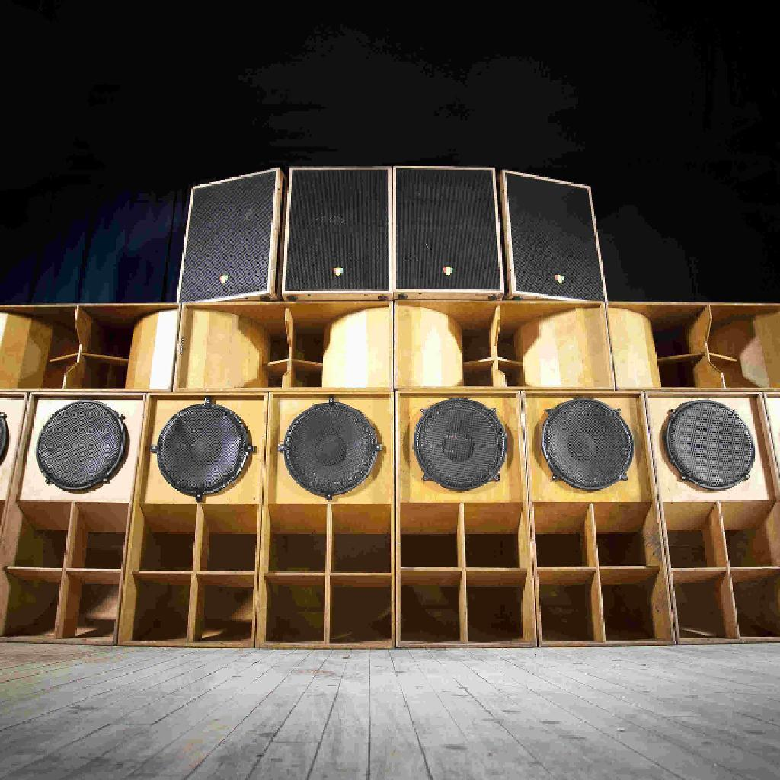
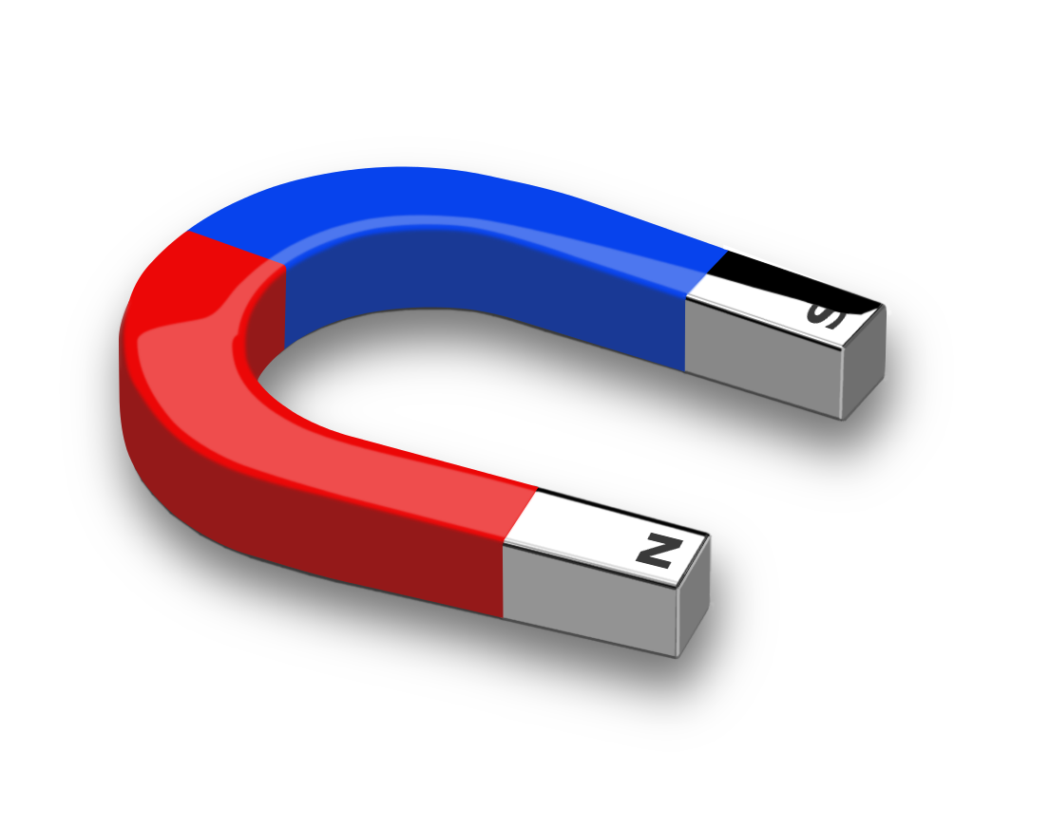
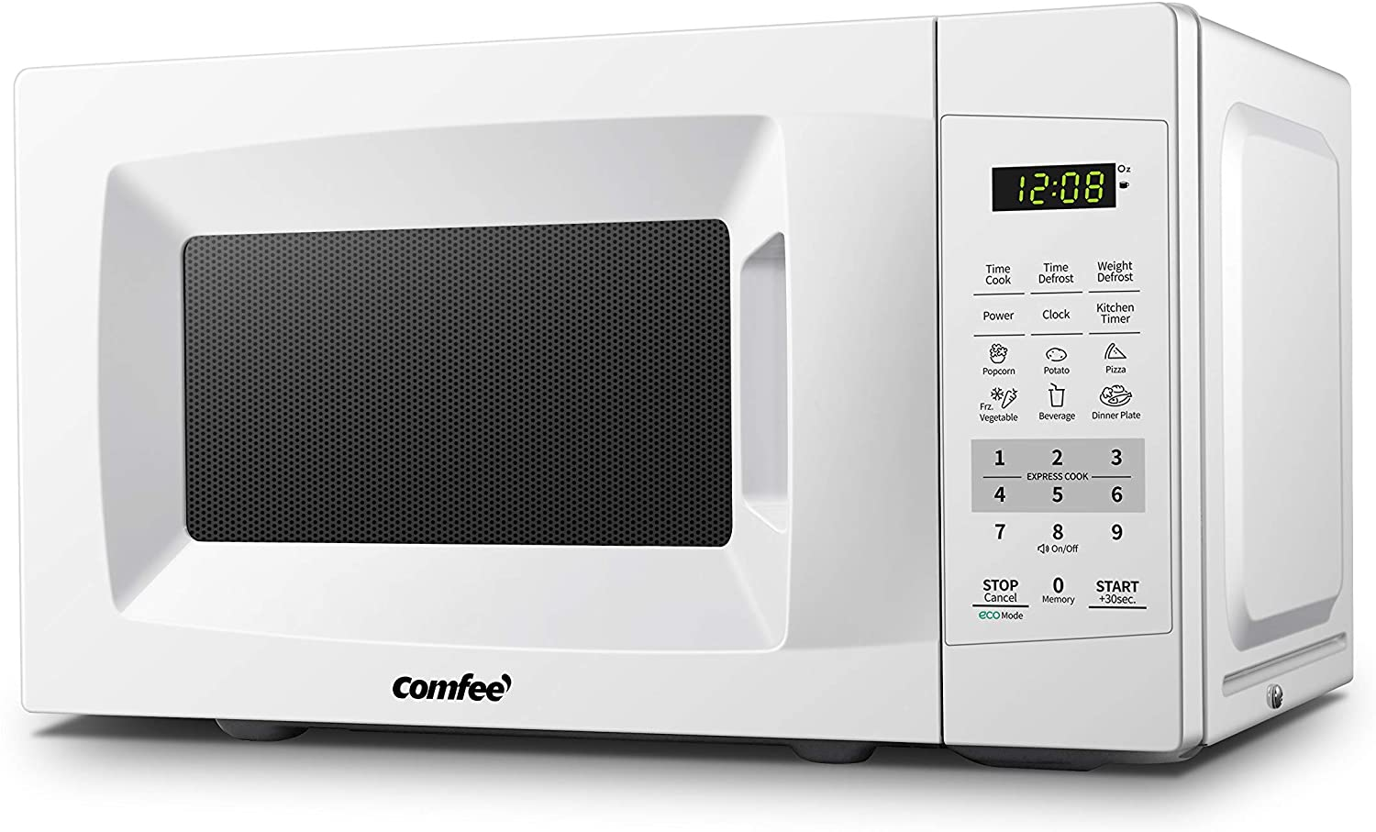
How to Detect Axions

Slide 16
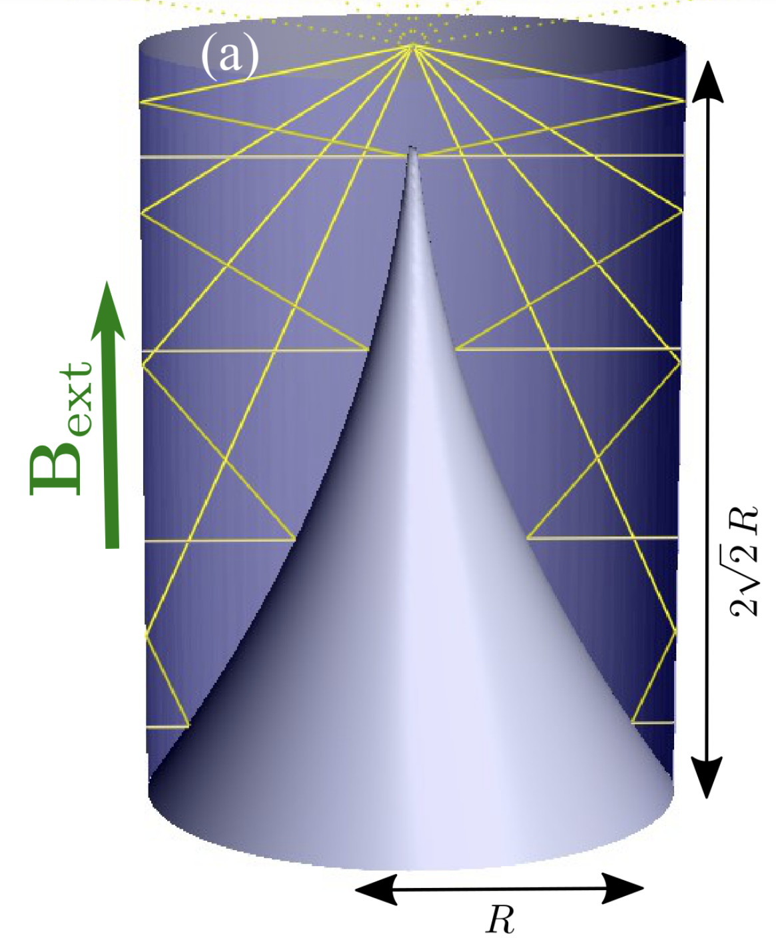
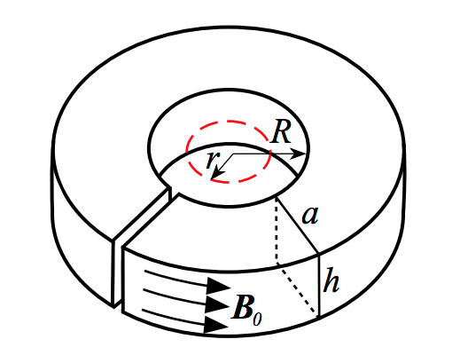
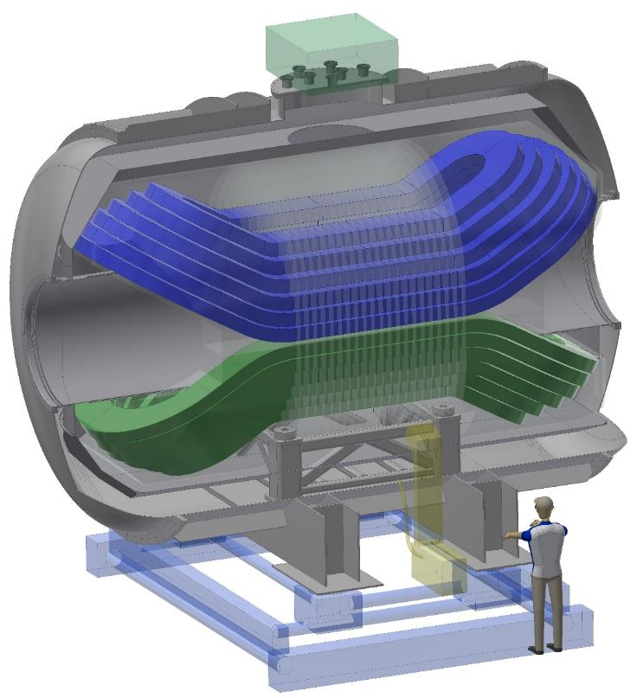
Haloscopes beyond GHz
Technology doesn’t scale well.
Many new ideas since ~2012.
Low frequency: DMRadio ABRA resonant circuits.
Mid: MADMAX dielectrics, ALPHA wire metamaterial.
High: BREAD dish antenna, quasiparticles (see later).

Slide 17
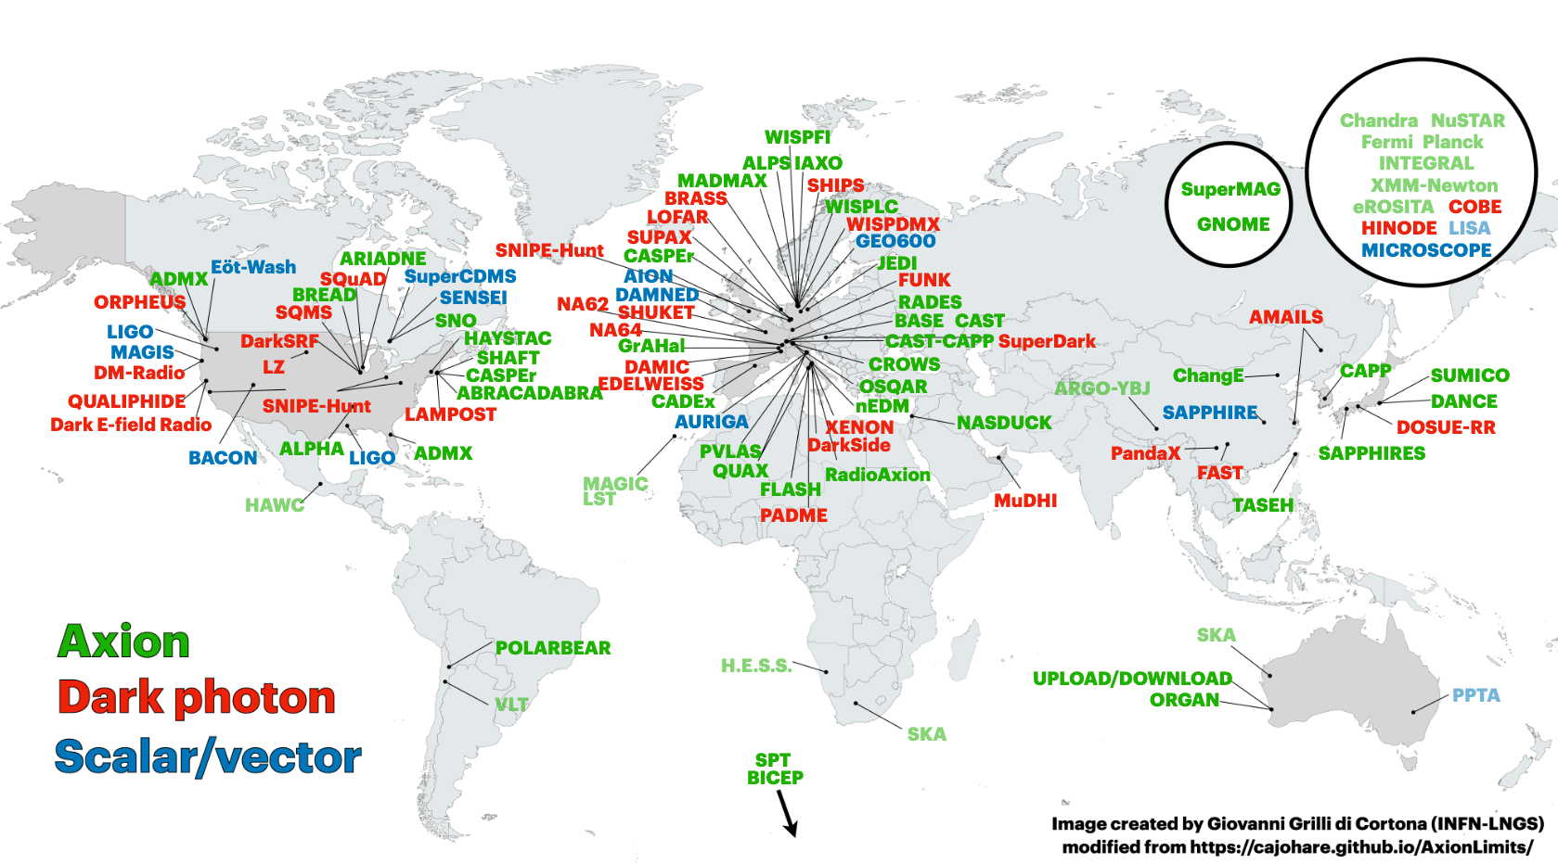

Slide 18
Ciaran O’Hare AxionLimits Github
Note: other couplings also probed.

Slide 19
CY topology in the lab
Gendler & DJEM (PRL)

Slide 20
Discovery of the axion quasiparticle
Qiu, DJEM et al, to appear in Nature

Slide 21
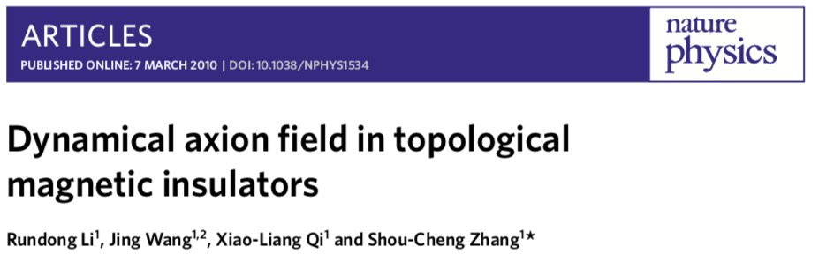
Axion Quasiparticles
Review: Sekine & Nomura (2021)
New insight: in-plane B tilts spins → order parameter fluctuation.
This can be achieved in more well understood “axion insulator” MnBi₂Te₄.
Fluctuating antiferromagnetic order can couple to E.B →axion quasiparticle.
Axion ~ magnetoelectric coupling α_{ii}. Static value π in topological insulators.
Until now, candidate materials included Mn₂Bi₂Te₅ using antiferromagnetic amplitude mode. Difficult to excite, materials unstable.

Slide 22
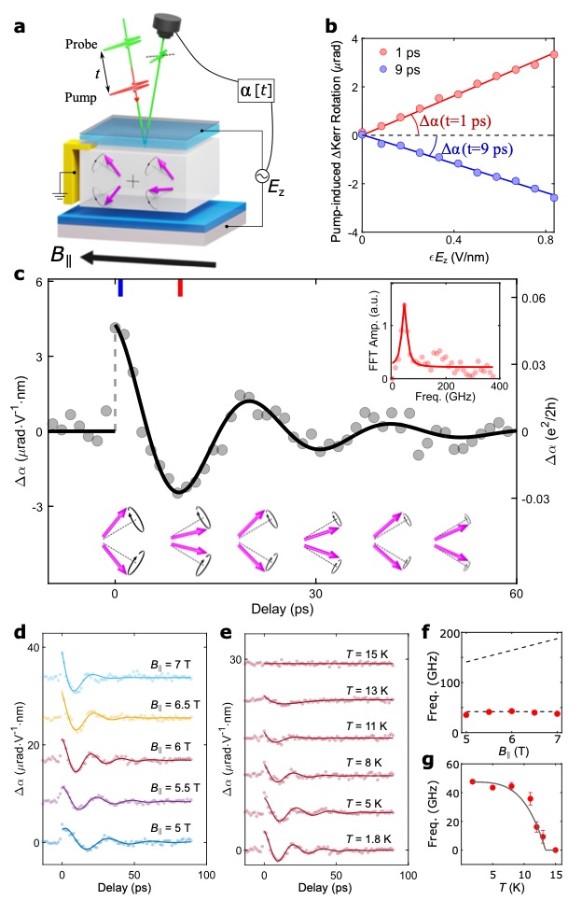
Measuring the Quasiparticle
Qiu, DJEM et al (2025)
Axion-photon coupling causes probe laser polarization angle to oscillate at frequency ~ axion mass. Measured frequency 44 GHz~0.2 meV.
Exciting laboratories for analogue physics, e.g. gravitational Chern-Simons.

Slide 23
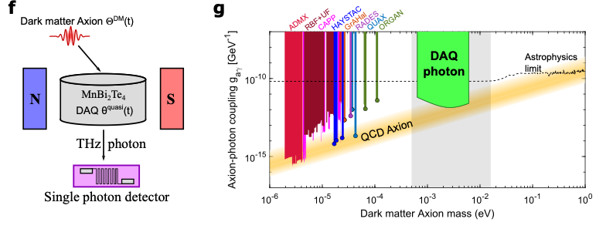
Axion quasiparticle polaritons provide a tunable axion DM detector in difficult THz.
Sample size ~ (20cm)² *mm
Integration ~ 3 years
Dark count 10⁻⁵ s⁻¹
DJEM et al (PRL, 2019); Schütte-Engel, DJEM et al (JCAP, 2021); Qiu, DJEM et al (Nature, 2025)

Slide 24
QCD axion searches
QCD axion
“Post-inflation”: miniclusters
QCD axion in string theory
String Axiverse
Heavy axions:
Decays, overproduction, constraints on cosmology
Ultralight axions:
structure formation
Axions in string theory
Hubble scale
~ (size of Universe)⁻¹
Planck scale (quantum gravity)

