Slide 1
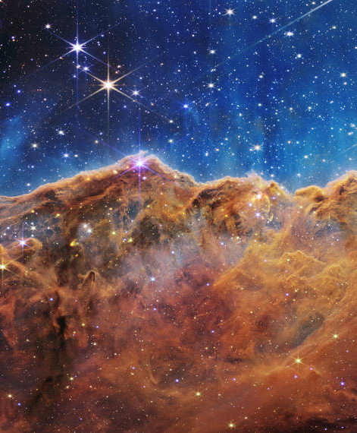




Formal theory developments:
Insights and lessons from scatterings
Mariana Carrillo González

Slide 2
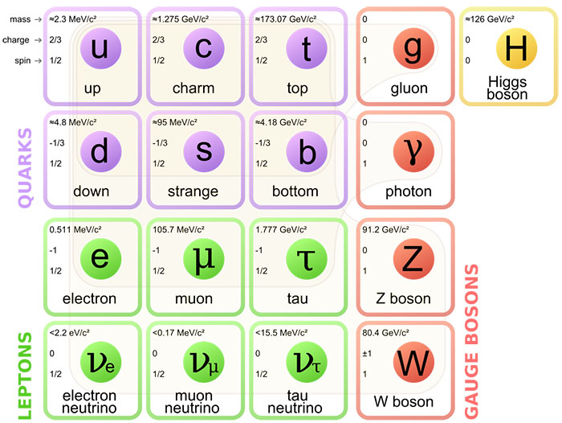

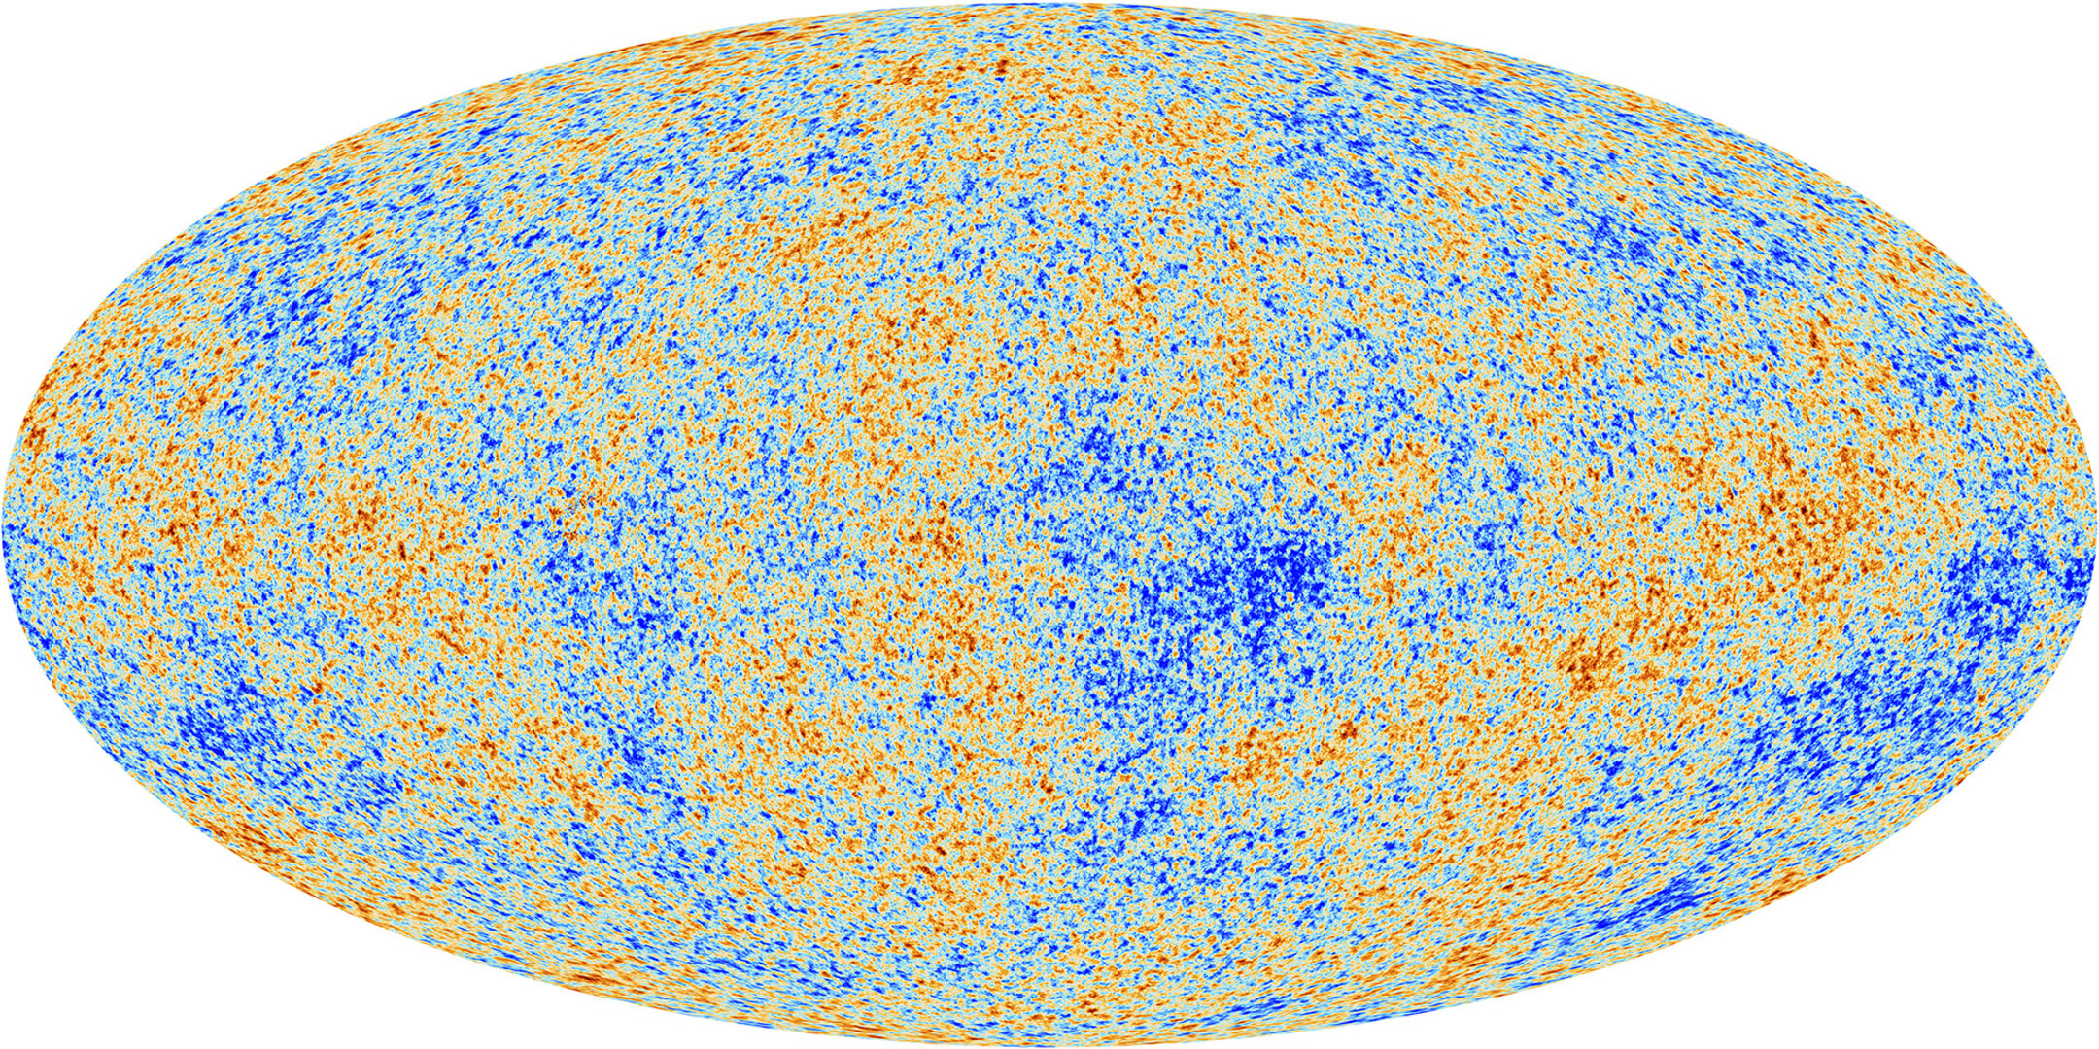
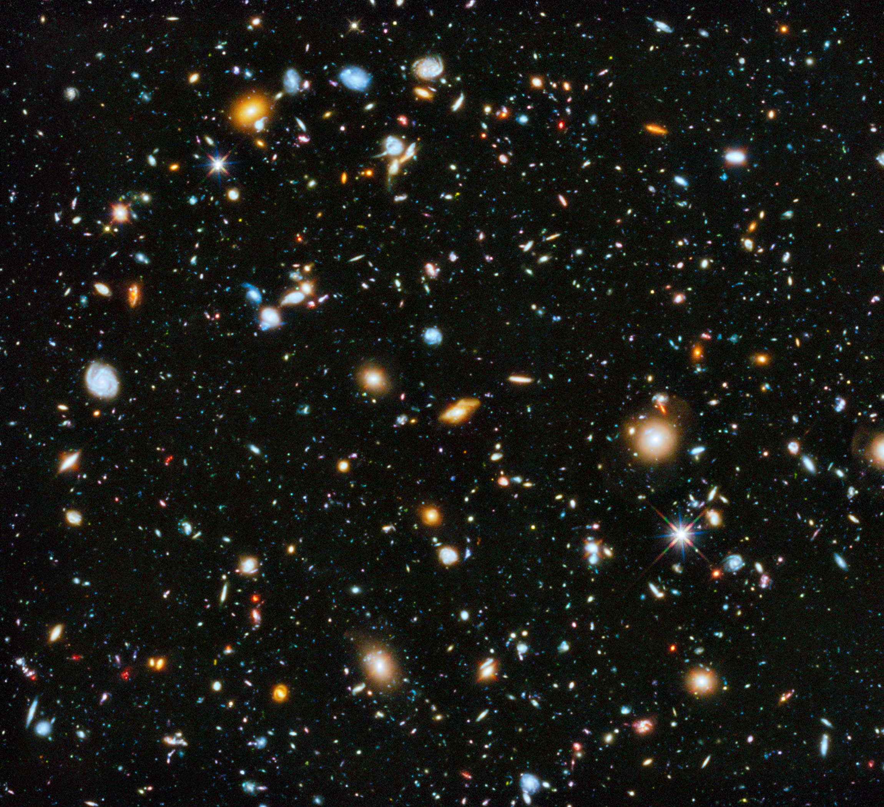
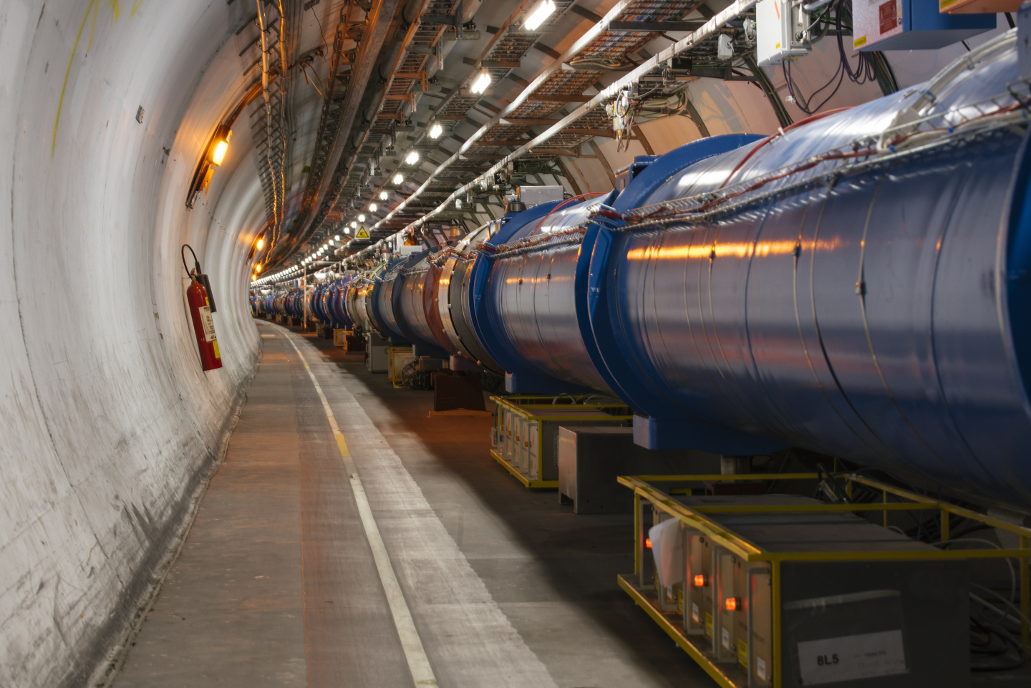
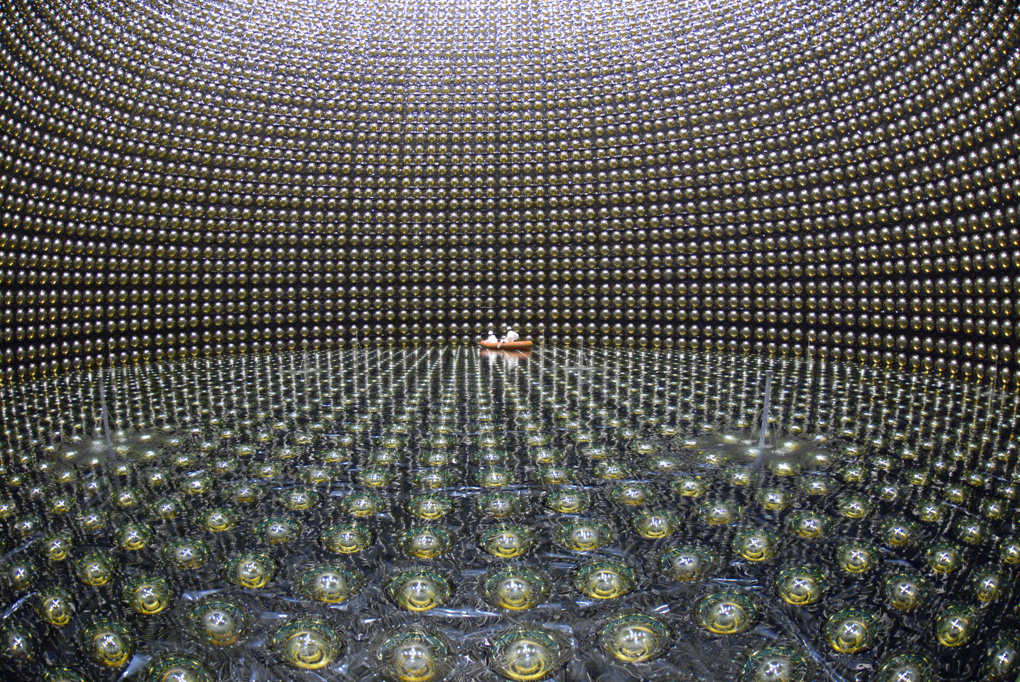
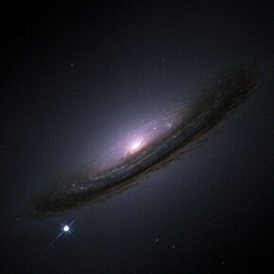
Standard Models: Particle Physics vs Cosmology

Slide 3
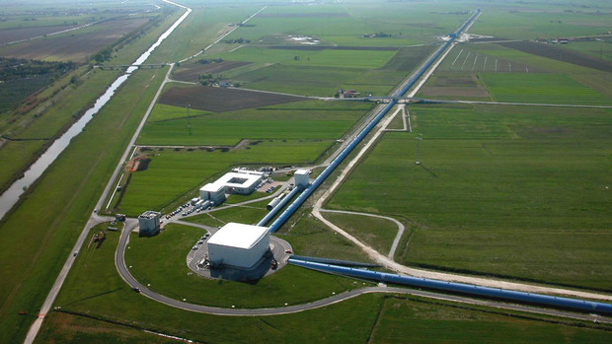
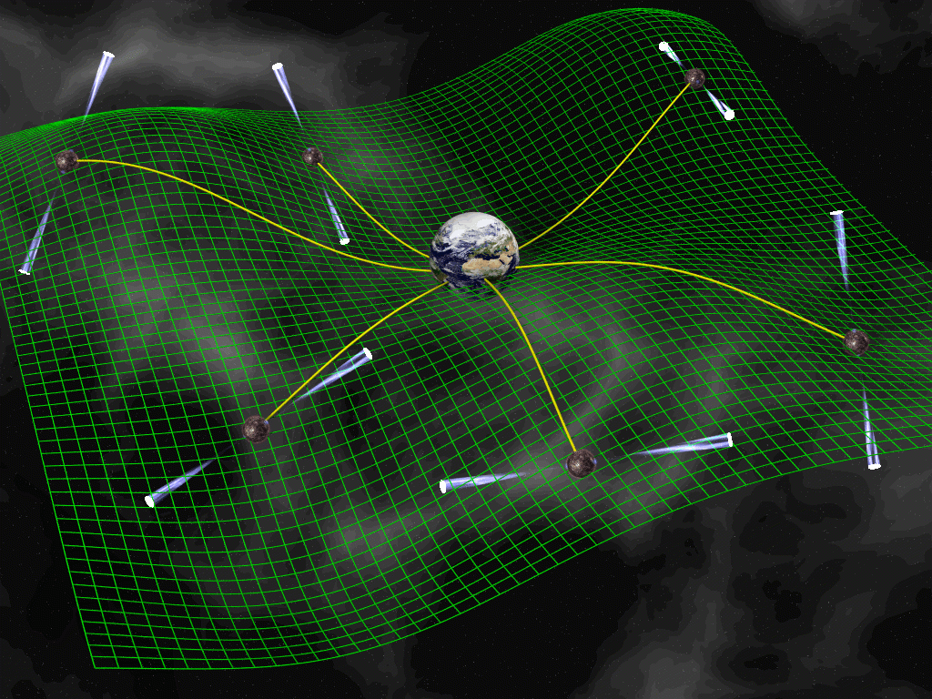
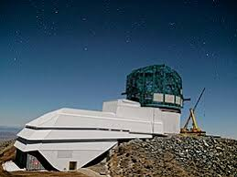
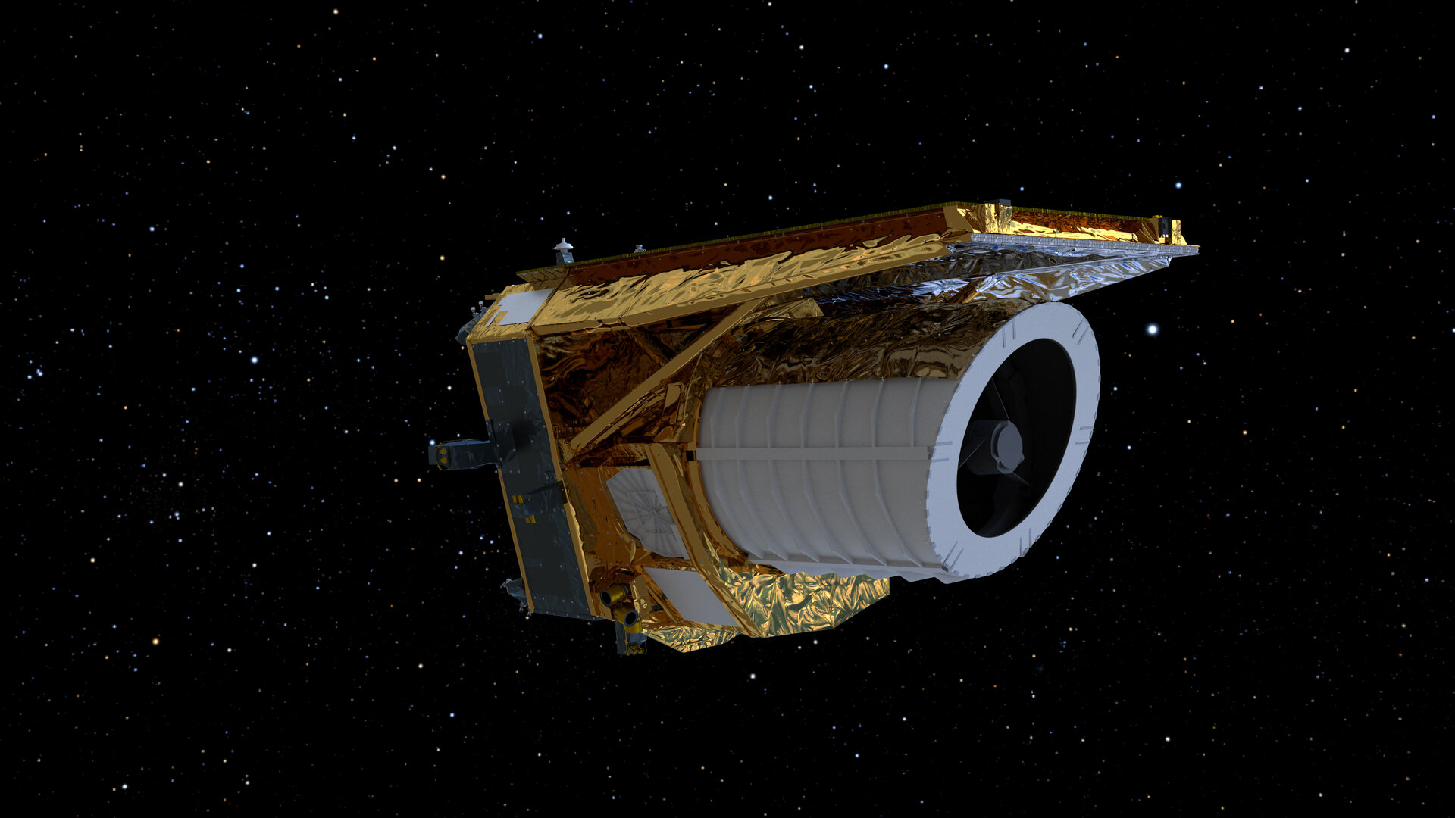
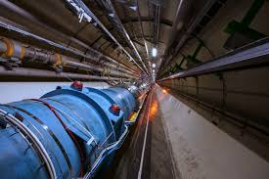
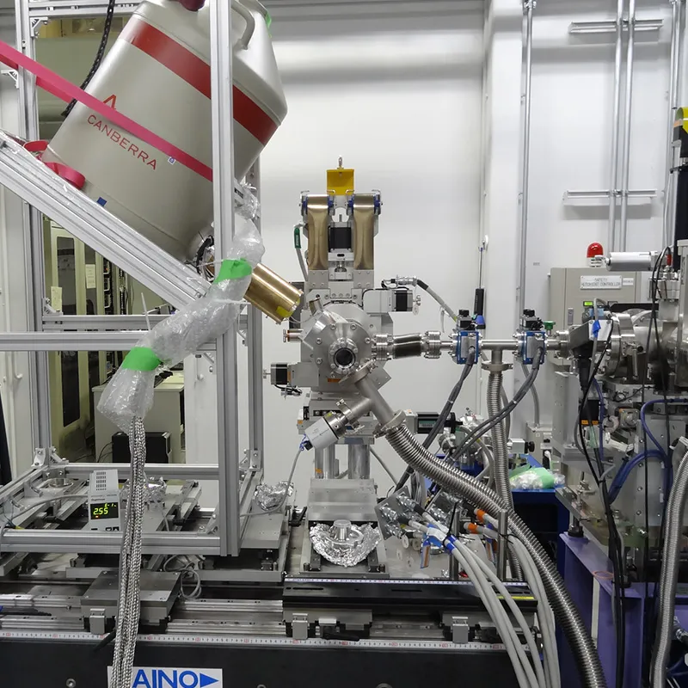
Many upcoming gravitational probes
Gravitational waves
Large scale structure & weak lensing
Developments in scattering amplitude techniques can aid in testing and understanding BSM
Dark matter
Dark energy
Standard Model
Collider high-precision tests and table-top experiments

Slide 4
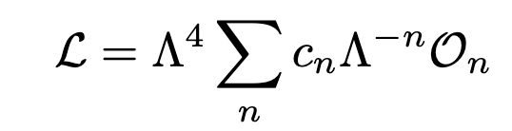
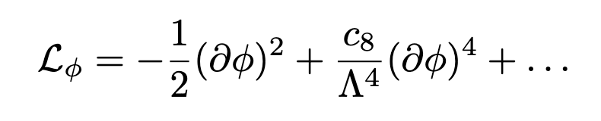
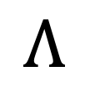
Effective field theories
UV
$$Λ$$
EFT
For example:
What are the values of the Wilson coefficients consistent with physical principles?
IR

Slide 5
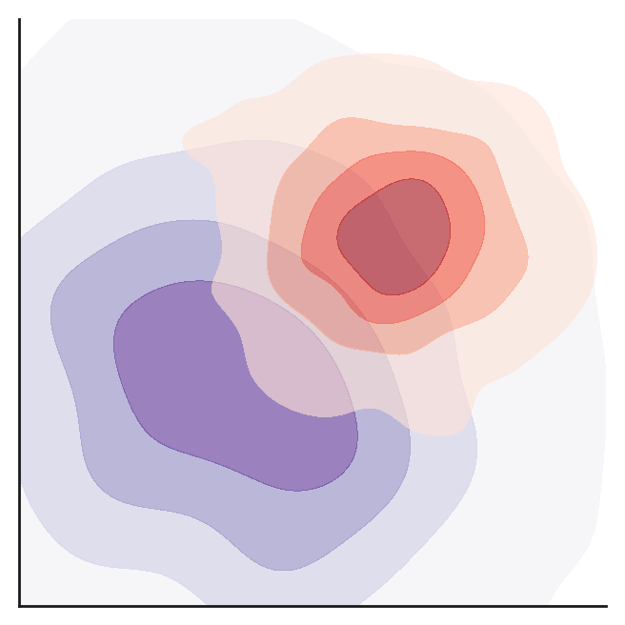
Why do the values of Wilson coefficients matter?
Theoretical priors can drastically
change the estimation of
parameters in a BSM model

Slide 6

UV = string theory, asymptotic safety, loop QG
Causal IR propagation
UV = local, unitary, causal, Lorentz invariant
Swampland conjectures
Positivity bounds / S-matrix bootstrap
(Flat space, mostly 2-2 scattering)
Causality bounds
(1-1 in any non-trivial background)
Positivity bounds
Chosen UV
theory
IR causality

Slide 7


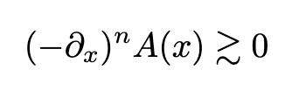
Positivity in scatterings
Positivity bounds Dispersion relations for 2-2 scattering connecting UV and IR
Recent review 2203.06805 (de Rham, Kundu, Reece, Tolley, Zhou)
Positive time delays Implications of causality
Positive geometry Geometric objects defined by kinematics
Recent review 2203.13018 (Herrmann, Trnka)
Completely monotonic amplitudes, wave function of the universe, and cusp anomalous dimensions (Henn, Raman; 2024)
Can test dim 6 operators and n-point scattering

Slide 8
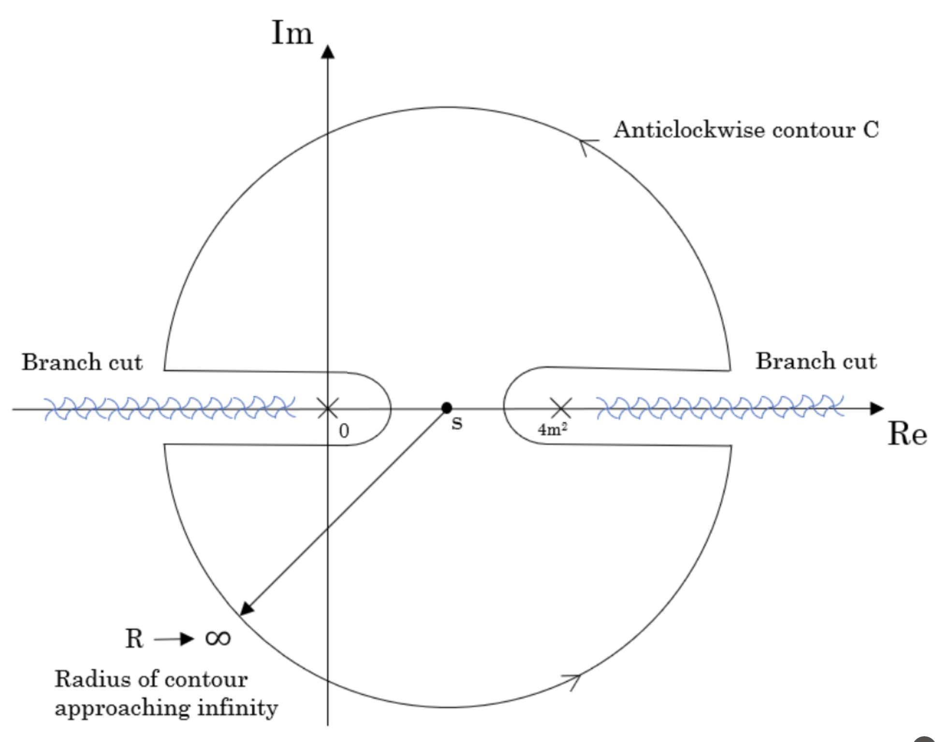
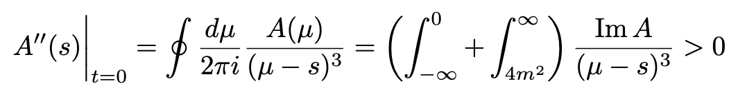
Positivity bounds
1
2
3
4
UV = local, unitary, causal, Lorentz invariant
1+3
2
related by 4

Slide 9
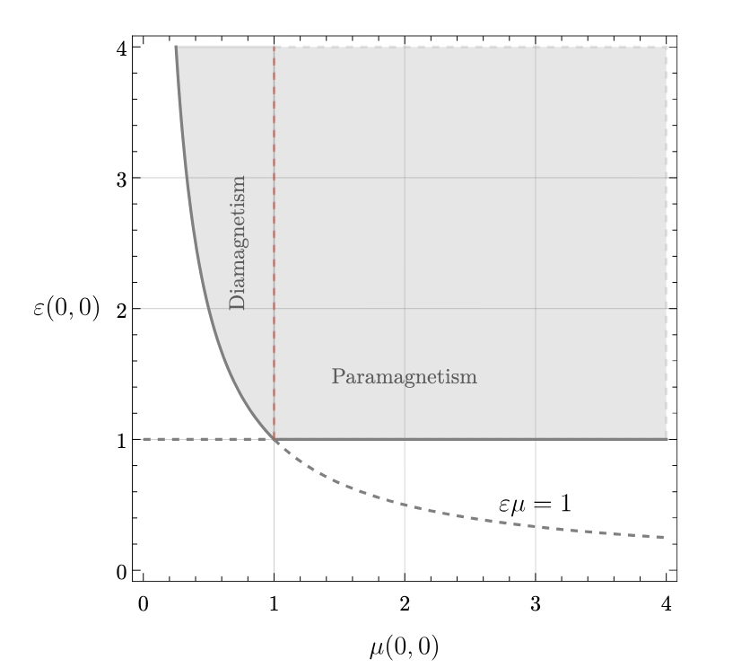
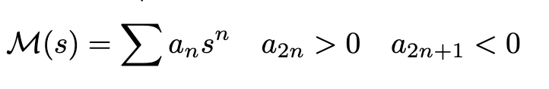
Positivity with Spontaneously Broken Lorentz Invariance
2–2 scattering in a superfluid (Hui, Kourkoulou, Nicolis, Podo, Zhou; Creminelli, Delladio, Janssen, Longo, Senatore)
  branch cut at tree-level
E&M on a medium (Creminelli, Janssen, Salchan, Senatore)
  Medium can only absorb energy from external fields -> bound on electric and magnetic permeabilities.

Slide 10
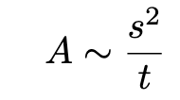


Positivity with gravity
Positivity bounds Avoid divergence in
forward limit: t --> 0
Higher-order subtractions (Z. Bern, D. Kosmopoulos, and A. Zhiboedov) (S. D. Chowdhury, K. Ghosh, P. Haldar, P. Raman, and A. Sinha) (L.-Y. Chiang, Y.-t. Huang, W. Li, L. Rodina, and H.-C. Weng)
Tame forward lim. divergence with transverse wavefunctions localized at small impact parameters (S. Caron-Huot, D. Mazac, L. Rastelli and D. Simmons-Duffin)
Including graviton loops (Chang, Parra-Martinez) (C. Beadle, G. Isabella, D. Perrone, S. Ricossa, F. Riva and F. Serra)
a

Slide 11
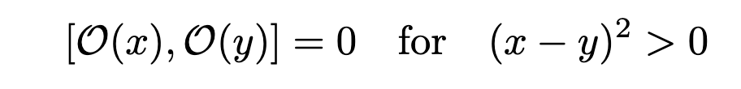
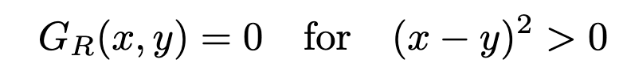
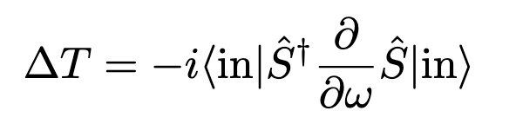


Positive time delays
Microcausality
Implications of causal propagation on Wilson coefficients (Adams et al. 2006, de Rham, Tolley: 2020)
In flat space, diagnose by looking at time delay:
EFT mode
Localized${ φ}^{bckg}$
High-energy mode
(Eisenbud; 48, Wigner; 55)
(T. J. Hollowood and G. M. Shore: 2015)

Slide 12
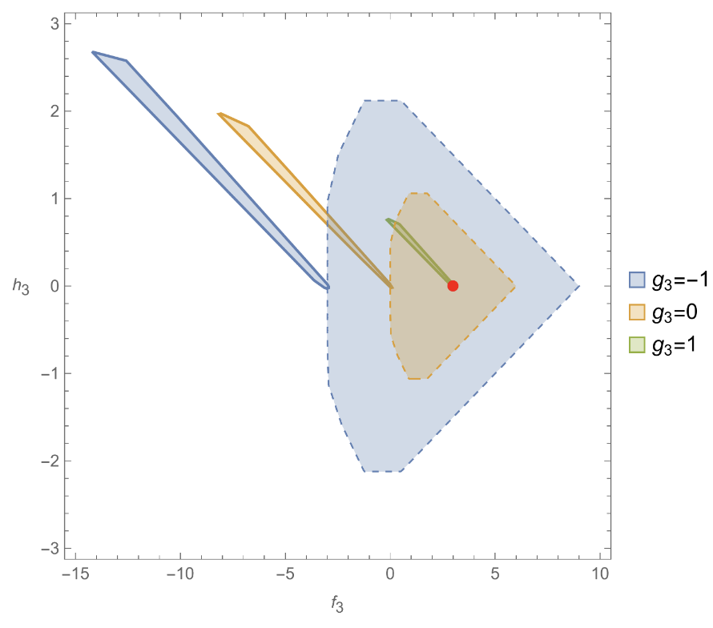
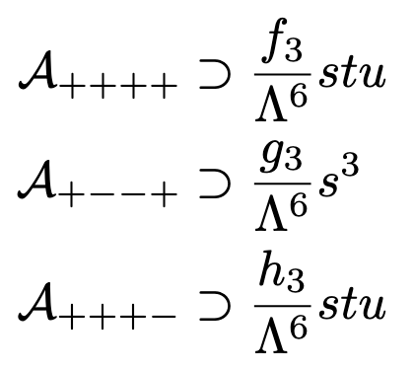
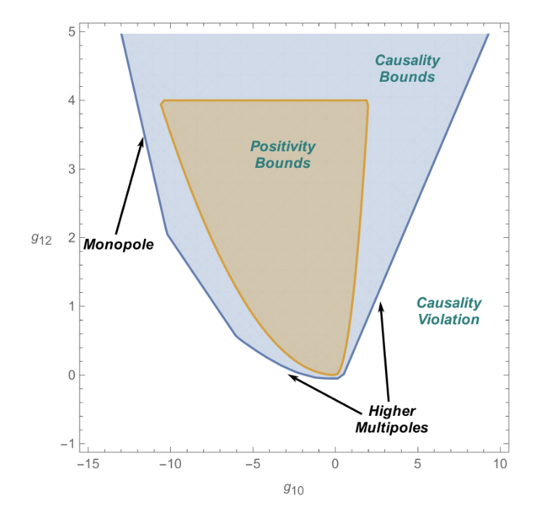
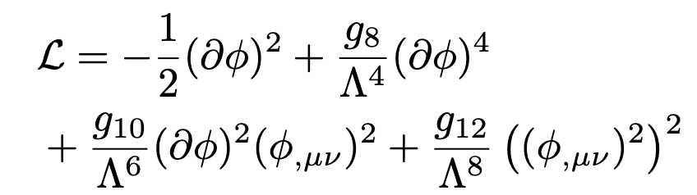
BOUNDS ON HIGHER ORDER OPERATORS
Photon EFT
Causal propagation around any localized background that can be continuously deformed to the trivial one.
Scalar EFT
(MCG, C. de Rham , V. Pozsgay, A. Tolley; 2022) (MCG, C. de Rham, S. Jaitly, V. Pozsgay, A. Tokareva; 2023)

Slide 13

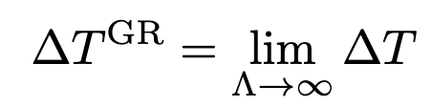
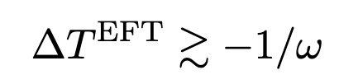




Notions of causality on curved backgrounds
Asymptotic Causality (A. flat space)
$$c_{s}^{curved}(∞)$$
$$c_{s}^{EFT}(x)$$
$$c_{s}^{curved}(x)$$
$$c_{s}^{EFT}(x)$$
Infrared Causality

Slide 14

CONSEQUENCES OF CAUSAL PROPAGATION IN A CURVED BACKGROUND
Weak Gravity Conjecture
Weakened positivity ( ): small violations of WGC are consistent with unitarity and causality (L. Alberte, C. de Rham, S. Jaitly and A.J. Tolley; 2020, Henriksson, B. McPeak, F. Russo and A. Vichi; 2022 )
Quasi-normal modes
Causal EFT corrections make quasi-normal mode perturbations decay faster. (Melville; 2024)

Slide 15
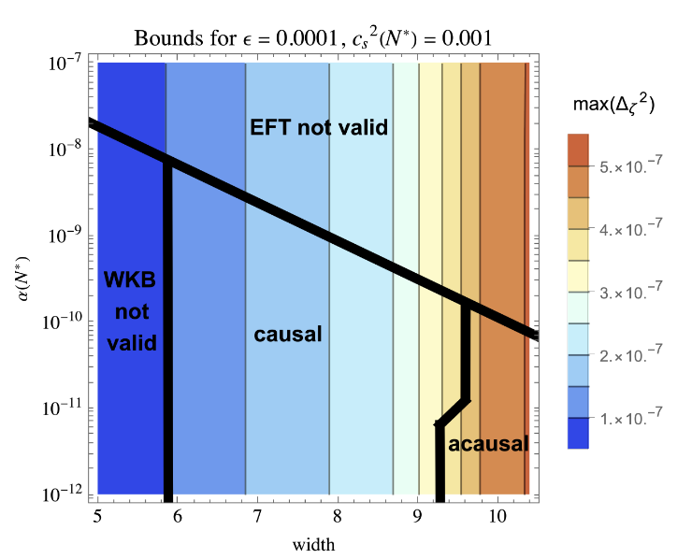
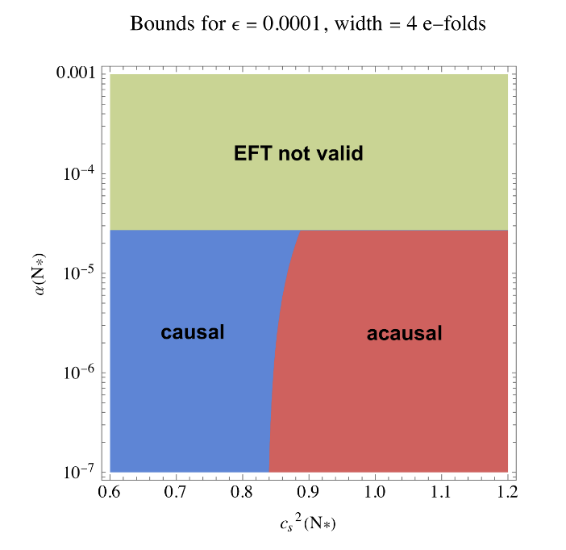
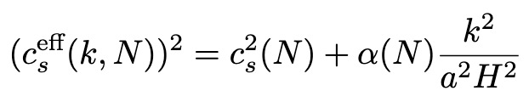
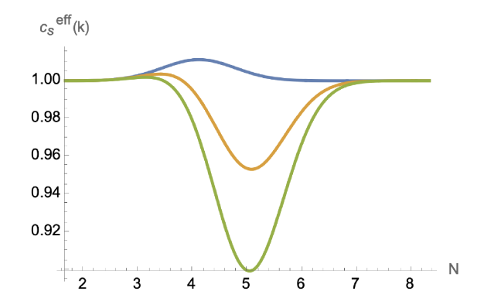


Causal EFT of inflation
Bounds on the growth of the power spectrum that can lead to primordial black holes
$$c_{s}^{FLRW}(x)$$
$$c_{s}^{EFT}(x)$$
Causality implies subluminal EFT speeds
Bounds on the time dependence of Wilson coefficients
(MCG; 2023) (MCG, S. Cespedes; 2025)

Slide 16
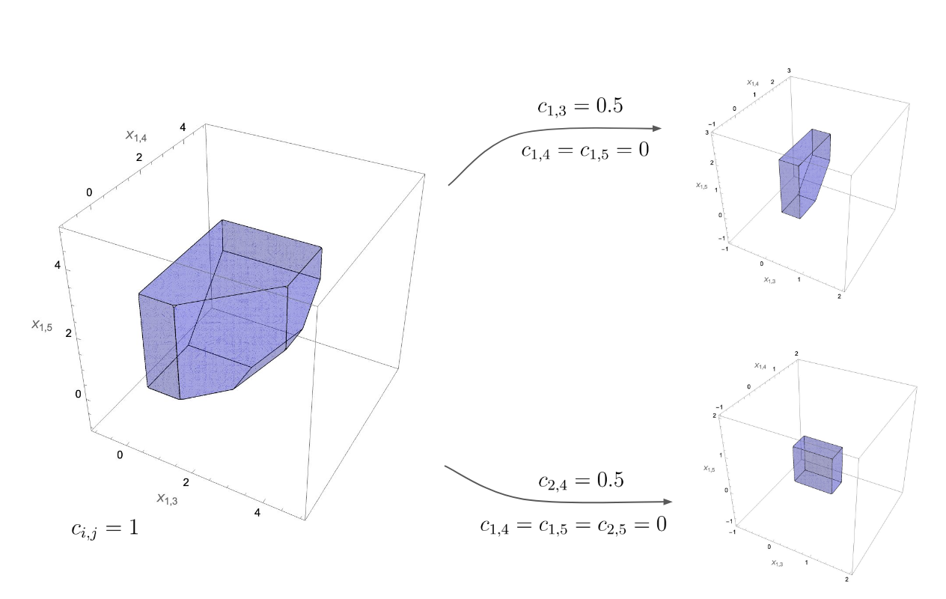
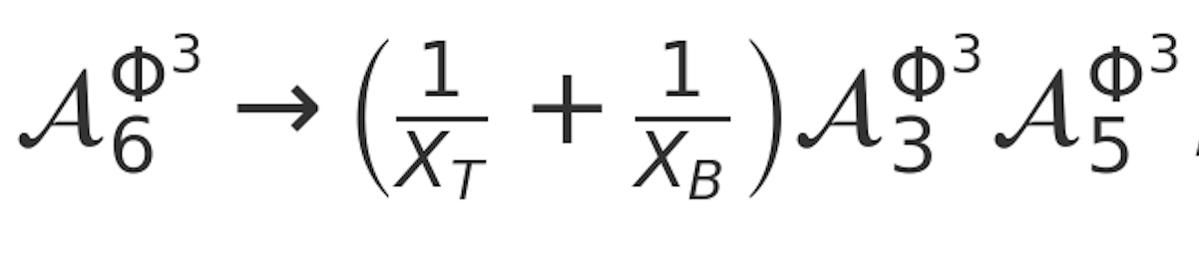
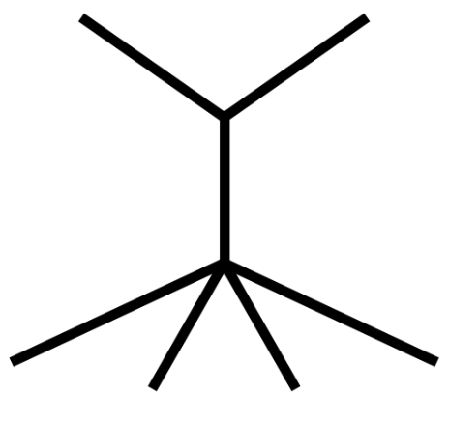
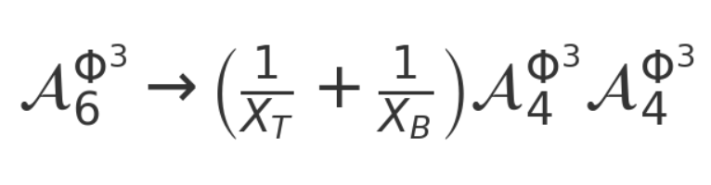
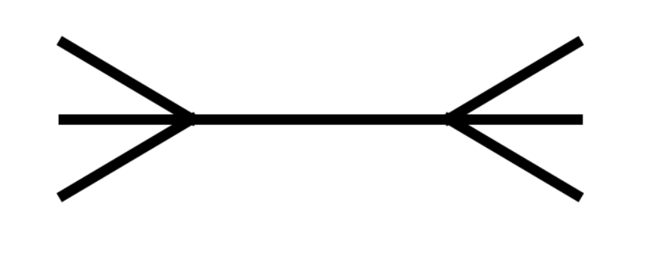
Positive geometries: (Tr φ³ case)
Hidden zeros and factorizations -> locality
(N. Arkani-Hamed, Q. Cao, J. Dong, C. Figueiredo and S. He)

Slide 17
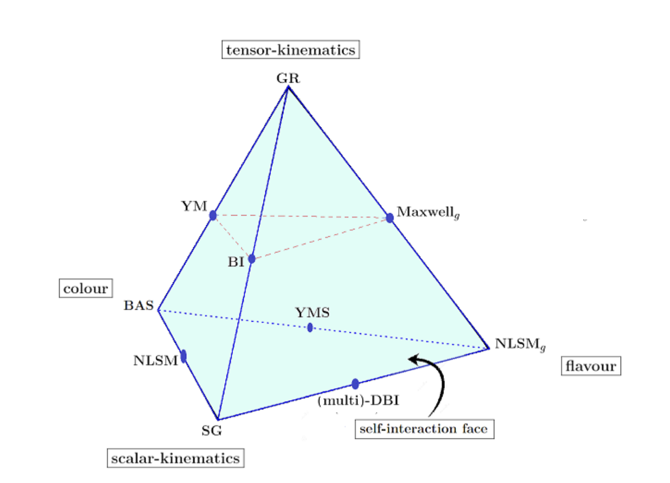
Theories with hidden zeros
Color-Kinematic replacements
Tr φ³ (Amplitudes + Wavefunction of the Universe)
NLSM
Scaffolded YM: gluons + adjoint scalars
Multi-DBI
Special Galileon
Scaffolded GR: graviton & flavored scalars (for some polarizations)
(Bartsch, Brown, Kampf, Oktem, Paranjape, Trnka)(Li, Roest, ter Veldhuis)(Cao, Dong, He, Shi)(De, Paranjape, Pokraka, Spradlin, Volovich)

Slide 18
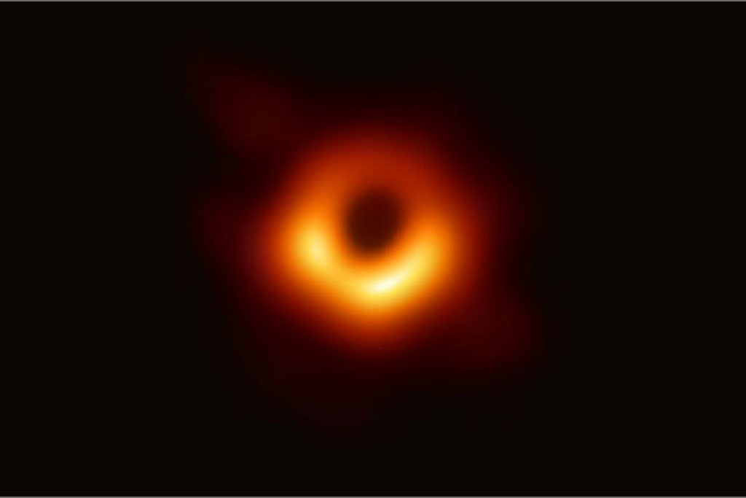
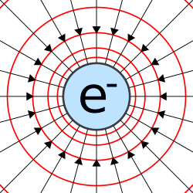
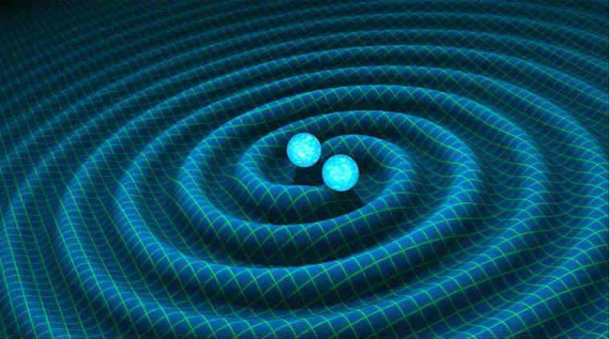
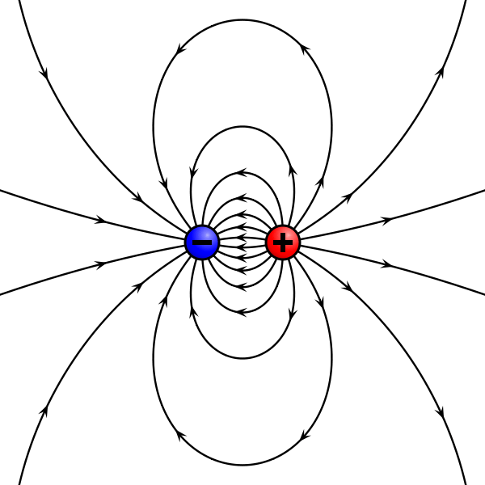
Gravity is simpler than it seems
Black hole
Electron
Electron
A black hole can be seen as the double copy of an electron

Slide 19





More precisely:
a black hole can be seen as the double copy of a colored charge
kinematics $×$ kinematics
color $×$ kinematics
color $×$ kinematics
$$\sim$$
color algebra: ``global’’ symmetries
kinematic algebra: local symmetries
color $−$ kinematics duality

Slide 20
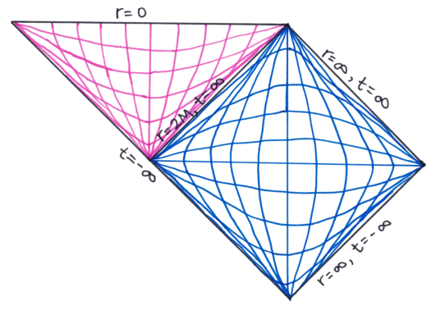
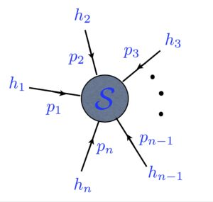
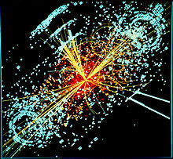
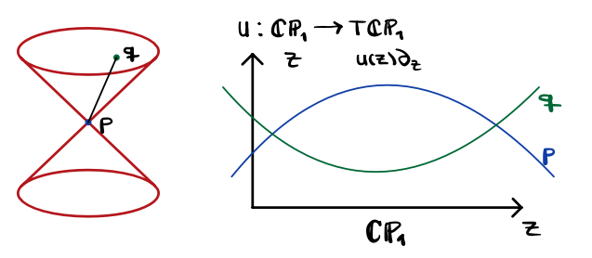
Double copy in different spaces
Inverse Fourier transform
Coordinate space: classical solutions
Twistor space
Momentum space: Amplitudes
(Monteiro, O’Connell, White) (MCG, Trodden, Penco) (Bahjat-Abbas, Luna, White)
(Kawai, Lewellen, Tye) (Bern, Carrasco, Johansson)
Half- Inverse Fourier transform
Penrose transform
(Chacon, Nagy, White) (MCG, Emond, Moynihan, Rumbutis, White) (Adamo, Kol)

Slide 21





Applications of the double copy & amplitude techniques
Gravitational waves
Large scale structure
(Snowmass: Alessandra Buonanno, Mohammed Khalil, Donal O'Connell, Radu Roiban, Mikhail P. Solon, Mao Zeng)
Curved backgrounds
Exact solutions
3-point,``4-point’’ correlators
EOM of subsectors
AdS + SUSY: 5 -points
(MCG, Trodden, Penco) (Bahjat-Abbas, Luna, White) (MCG, A. Lipstein and S. Nagy) (C. Beetar, MCG, S. Jaitly and T. Keseman) (C. Cheung, J. Parra-Martinez and A. Sivaramakrishnan) (X. Zhou) (C. Armstrong, H. Goodhew, A. Lipstein and J. Mei)
Phys. Rep. MCG in preparation
(C. Anastasiou, D. P. L. Braganca, L. Senatore, and H. Zheng)

Slide 22
Improved test of BSM physics in flat and curved backgrounds
Simplified calculations
Deeper understanding of fundamental (UV) theory
New developments based on scattering amplitude techniques

