Slide 1
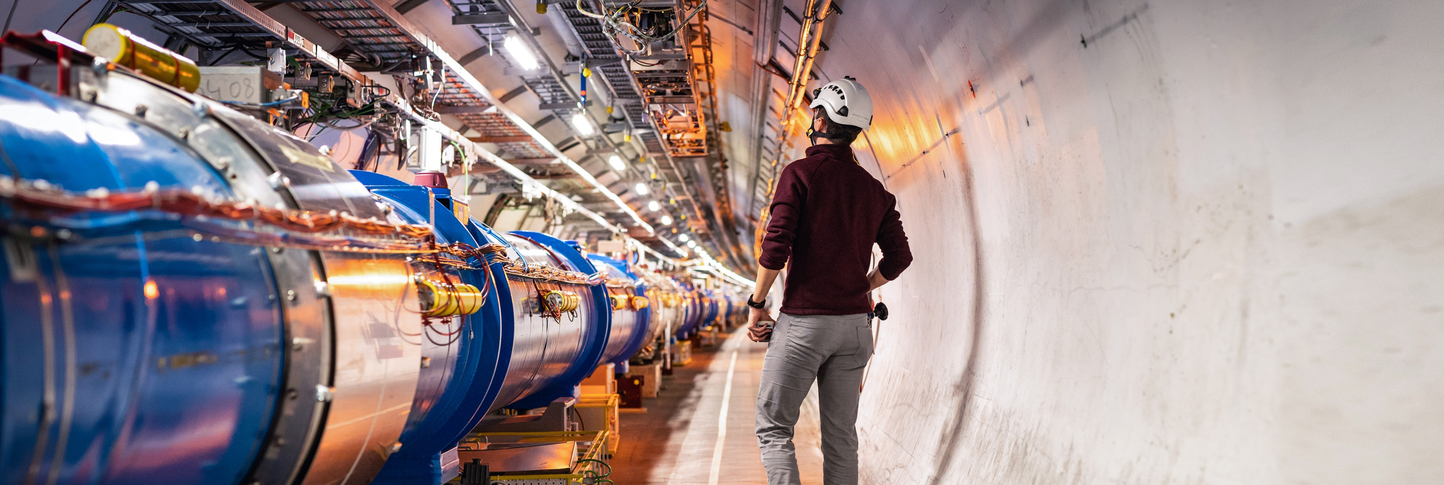
Particle Physics: Today and Tomorrow
Mark Thomson
Director-General Designate, CERN
Professor of Experimental Particle Physics, University of Cambridge

Slide 2
Today’s Presentation
Some personal perspectives on
where we are today with particle physics
what the next ten years might bring
and then what?
Looking back 30 years
The very massive top quark had just been discovered (1995)
Neutrinos were usually considered massless (although there was some evidence to the contrary) until 1998
Dark energy (1998 – 2013 – )
The Brout–Englert–Higgs mechanism was a beautiful theoretical idea (until the Higgs boson was discovered in 2012)
Gravitational waves had yet to be observed (until 2016)
…and super-symmetry was (and still is) a very promising theoretical extension of the SM
A profound discovery every ~10 years… not at all bad

Slide 3
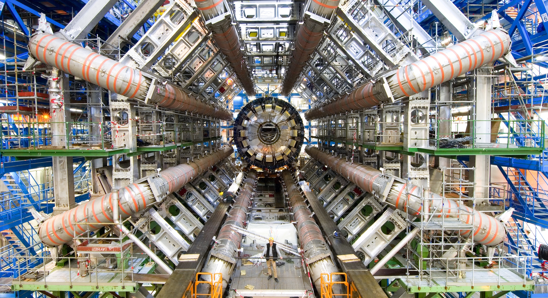
Exploring the universe
Today

Slide 4
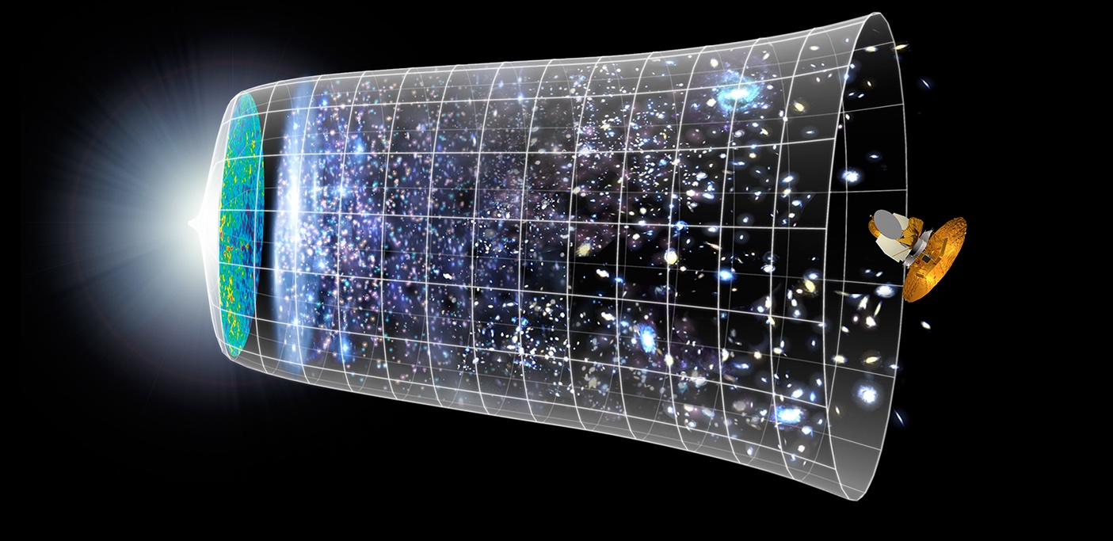

Uncovering the Secrets of the Universe
Fundamental physics: aim to understand the Universe from the Big Bang to the stars and galaxies we see today
Big Bang
We reproduce the conditions a fraction of
a second after the Big Bang, to gain insight into the structure and evolution
of the universe.
Telescopes
Accelerators
380 000 years
13.8 Billion Years
Today
10²⁸ cm

Slide 5


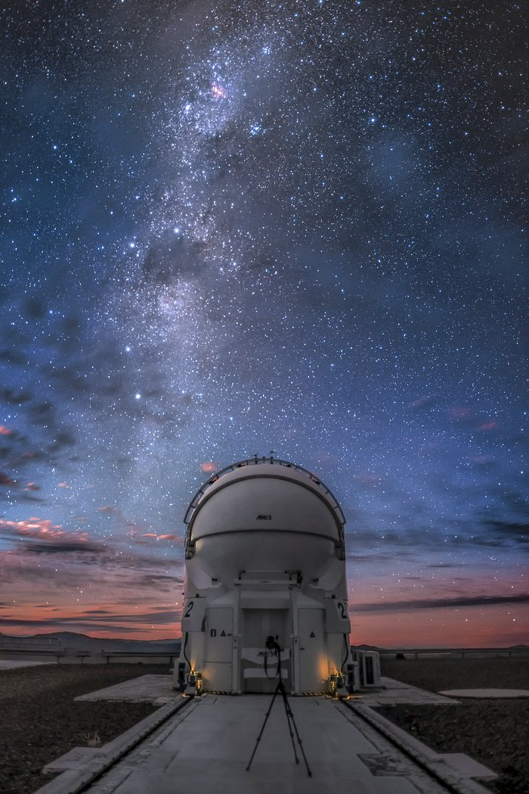
Uncovering the Secrets of the Universe
Fundamental physics: aim to understand the Universe from the Big Bang to the stars and galaxies we see today
What are the building blocks of the Universe: the particles
How does the Universe “work”: the forces, ultimately including gravity
How did the Universe evolve: galaxies, stars, black holes, role of Dark Matter

Slide 6
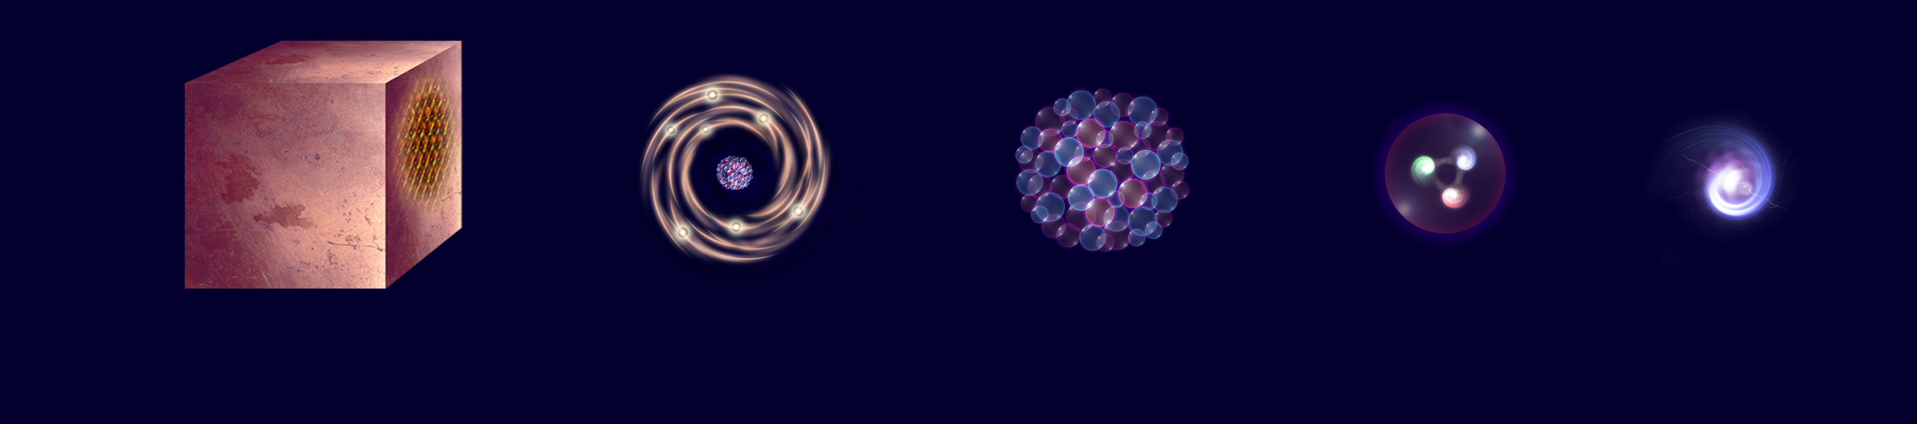
What is the universe made of?
The basic building blocks of most of the “low-energy” universe
The electrons: that orbit the nucleus in atoms : determines chemical properties
The “up-quarks” and “down-quarks”: the building blocks of protons and neutrons
The neutrino: very weakly interacting almost massless particles
The reality is somewhat (but not much) more complex… just 3(?) generations
and we also want to know “why the universe is like it is?”
Electron
Matter
0.1 m
Atom
~10⁻¹⁰ m
Nucleus
~10⁻¹⁴ m
Proton
~10⁻¹⁵ m
Quark
<10⁻¹⁸ m

Slide 7
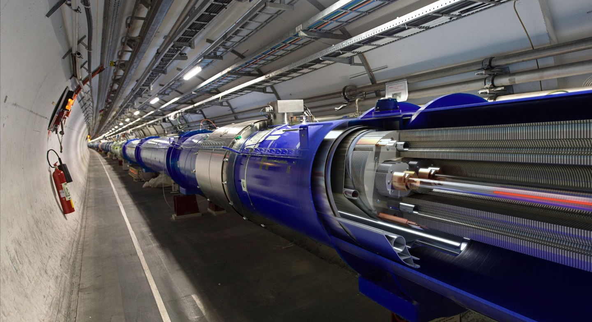
The Large Hadron Collider at CERN

Slide 8
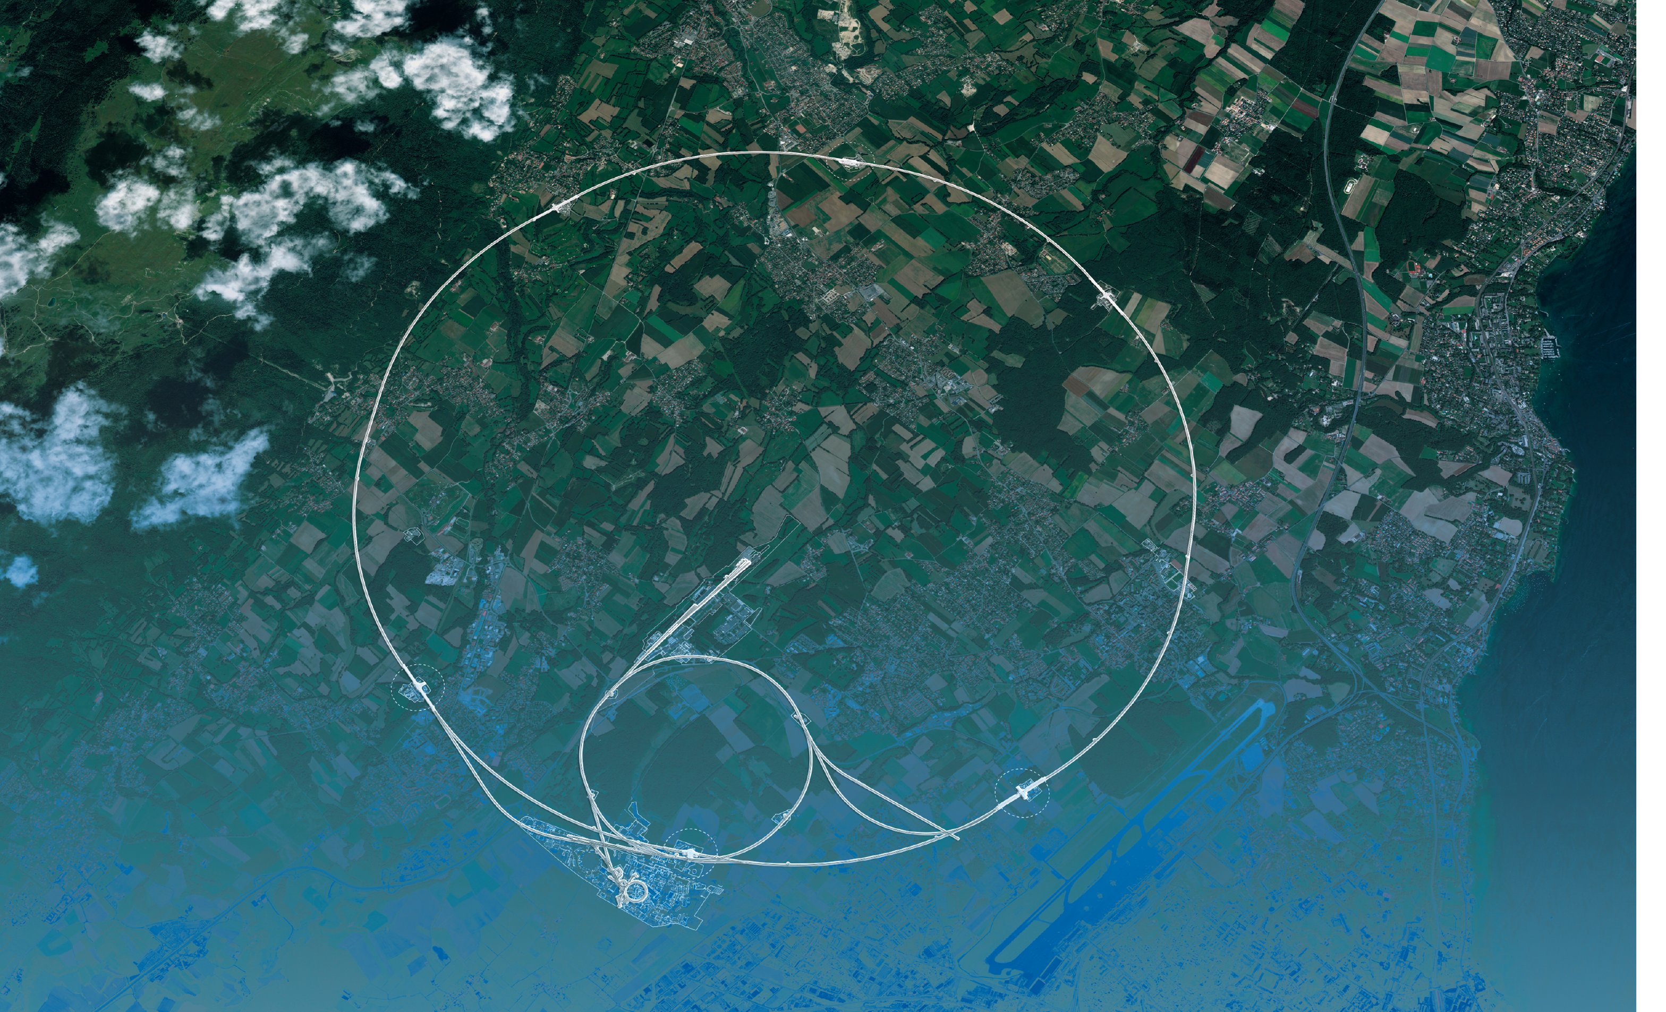
The Large Hadron Collider
Our most powerful “tool” to understand the “particle-verse”
Large: 27 km ring of superconducting magnets
Hadron: accelerates protons (hadrons) to almost the speed of light… 99.9999991%
Collider: two proton beams collide 40 million times a second at four points around the ring where the fragments are “photographed” with massive imaging detectors

Slide 9
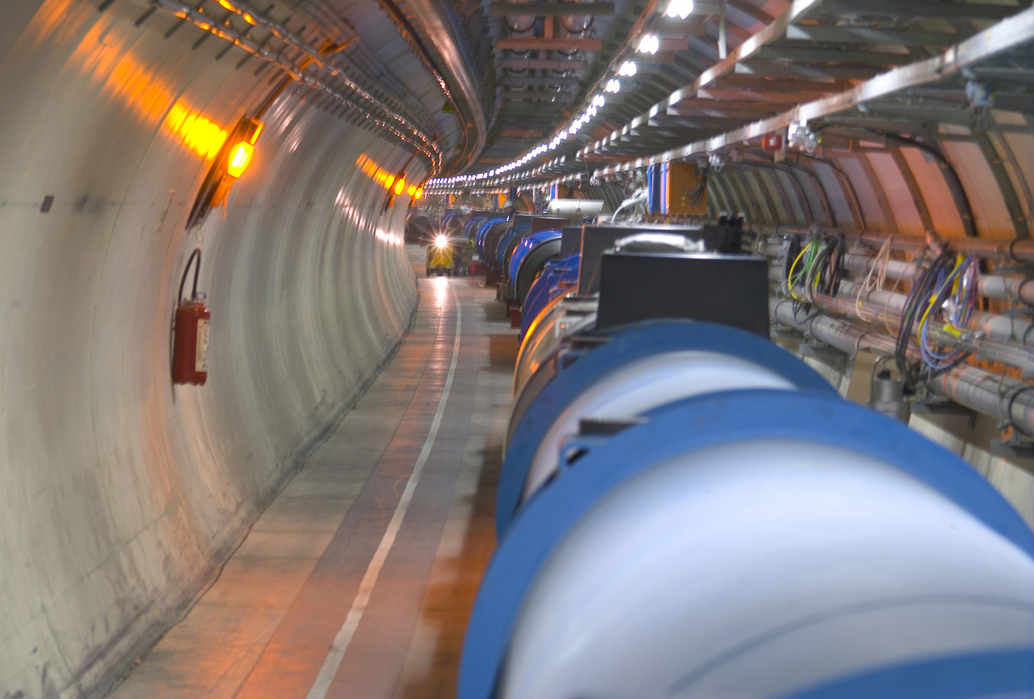

The LHC is Incredible
The LHC is the most powerful collider ever built
A truly remarkable feat of engineering
Accelerating protons to close to the speed of light and steer them around a 27km ring
The Proton beams brought into collision in four detectors areas 40 million times a second
The energy stored is huge: ~350 MJ
  Equivalent to the kinetic energy of 1000 stampeding African elephants
  Or equivalently, the kinetic energy of a Boeing 777 aircraft as it lands
  Or equivalently, more than enough energy to melt tonnes of Copper…

Slide 10
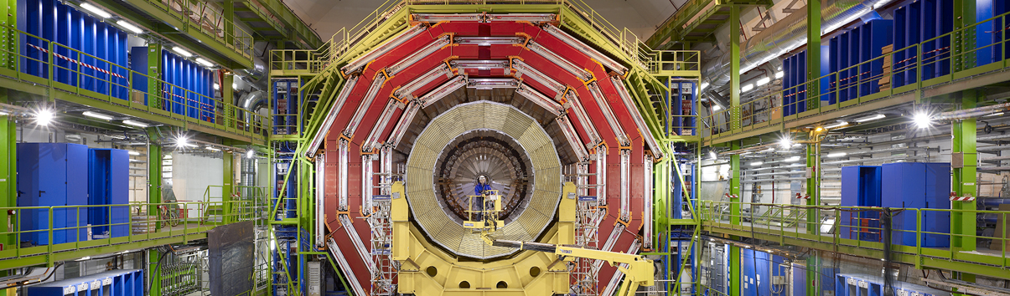
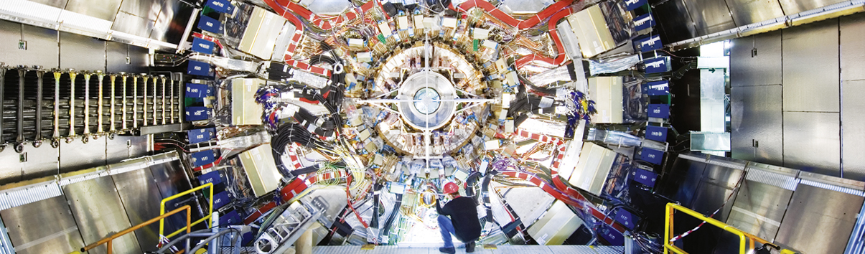
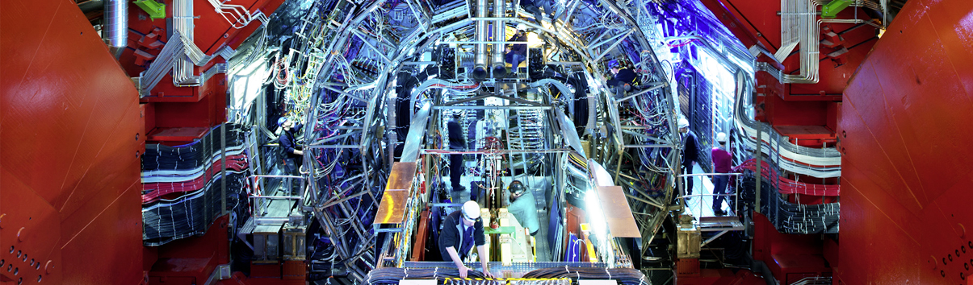
Giant detectors record the particles formed at the four collision points
CMS
CMS
CMS
ATLAS
ALICE
ALICE
ALICE
ATLAS
LHCb
ATLAS
LHCb
LHCb

Slide 11
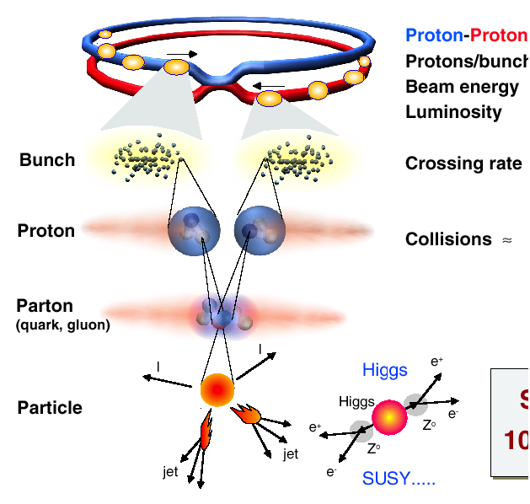
The LHC Detectors are also incredible
The most complex detector systems ever built
The challenges (are many)…
Proton/Proton collisions, with 10¹¹ protons per bunch every, 25 ns
25 ns
Very high event rate 1,000,000,000+ pp interactions per second
“the most interesting events” are very rare: 1 in 10,000,000,000,000 interactions
Detectors designed to image these “events” in great detail

Slide 12
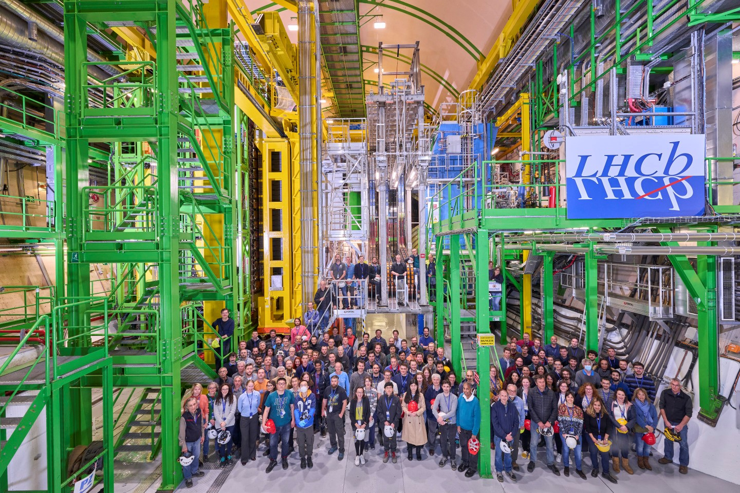
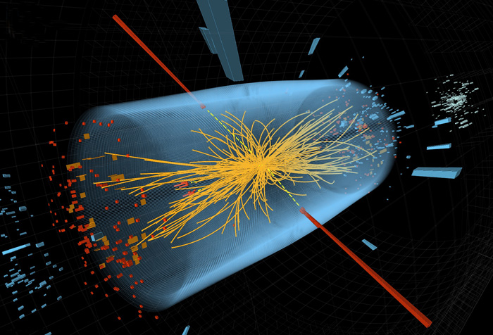
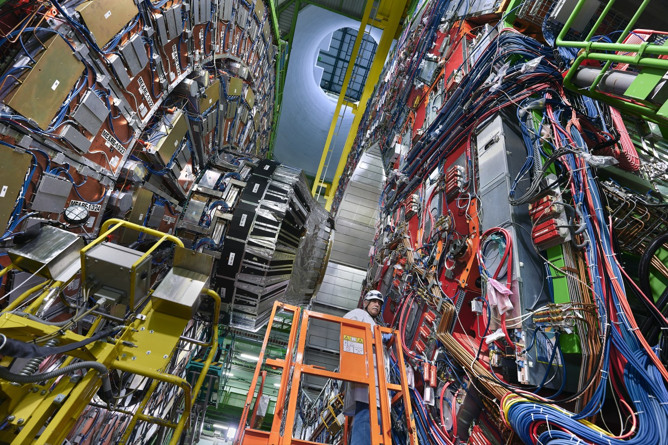
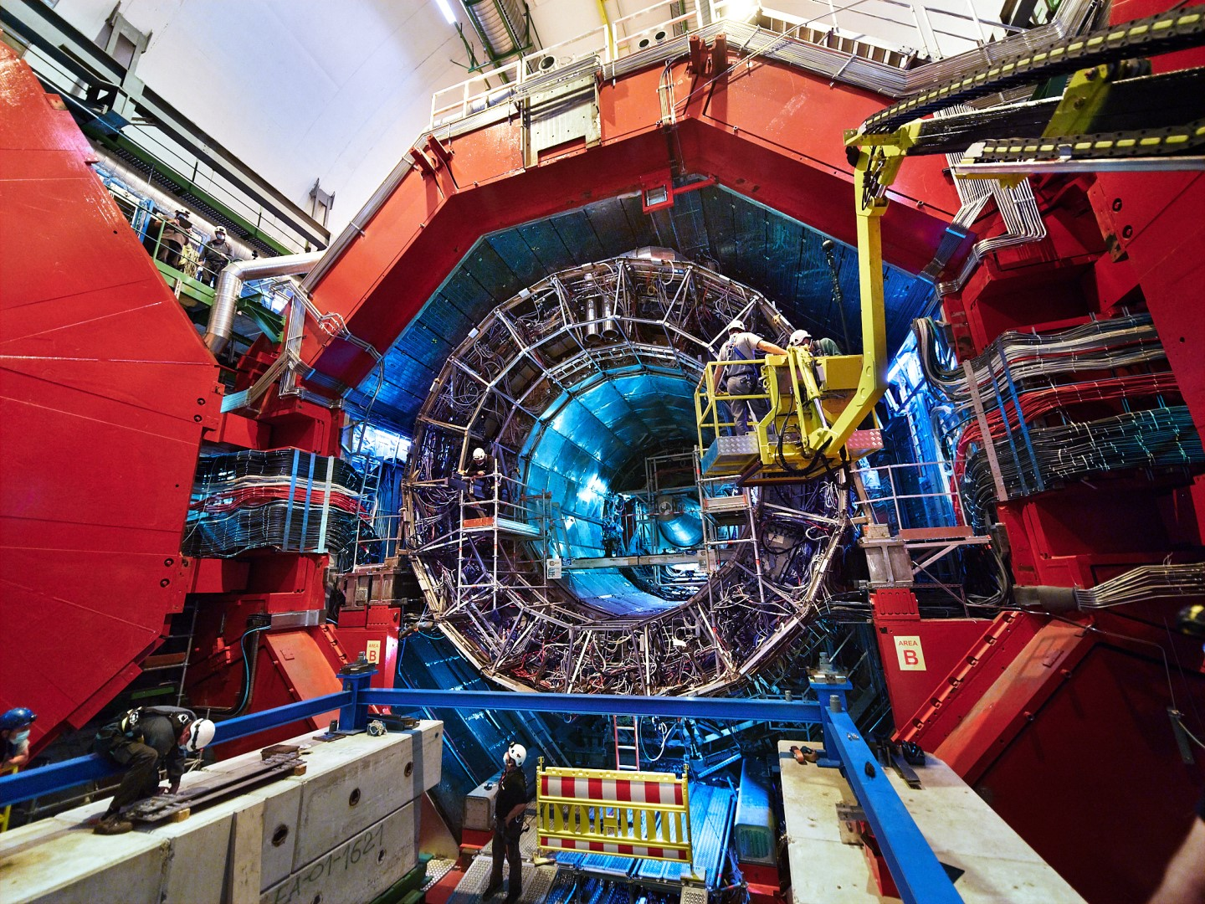
The Large LHC Detectors
Giant cameras operating at 40,000,000 frames per second

Slide 13
The Higgs Boson
is Special

Slide 14
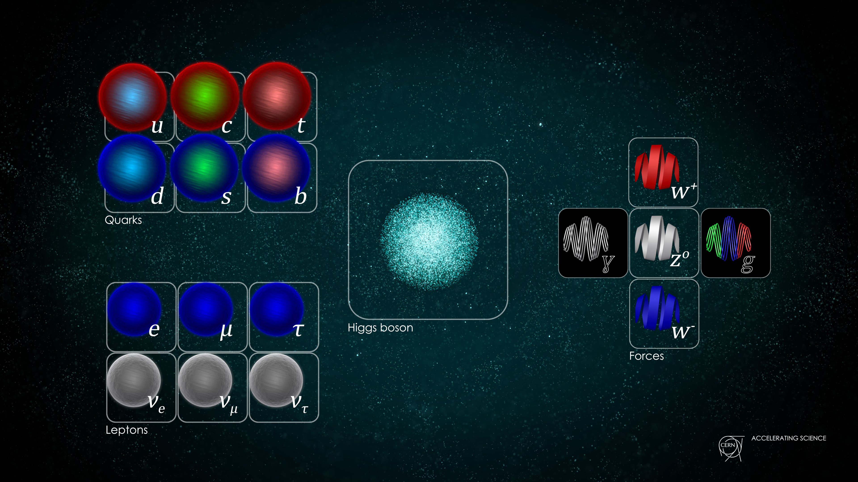
The Higgs Boson is Special
The Higgs Boson was and is a key component of the LHC science case
Not just “another” particle
Standard Model (SM) building blocks
12 matter particles (fermions)
5 force particles (bosons)
The Universe is a strange place…
As far as we know, fundamental particles have no size – pin pricks in space-time
Without some “magic”, the SM would only work for massless particles – but we know they are not massless…

Slide 15
The Higgs Boson is Special
The Higgs Boson was and is a key component of the LHC science case
Not just “another” particle
Standard Model (SM) building blocks
12 matter particles (fermions)
5 force particles (bosons)
1 Higgs boson (a scalar field!)
The Universe is a strange place indeed!
As far as we know, fundamental particles have no size – pin pricks in space-time
Particles, in some sense, are massless, but the Higgs field gives all particles their (apparent) masses

Slide 16


The Higgs Boson – a dubious analogy
Can think of the Higgs “field” as a property of the vacuum
All other particles have a zero “vacuum expectation value”
  makes sense – it is the vacuum, there is nothing there
But this is not the case for the Higgs “field”…
  in some sense it is always there – a non-zero vacuum expectation value
The Higgs field makes the vacuum “sticky”
Other particles feel the presence of Higgs field as they wander through space: this gives them inertia, a.k.a. mass
  generates a “Lagrangian” term that looks like mass
If you collide particles hard enough, they can cause ripples in the Higgs Field
  the Higgs Bosons that we can detect at the LHC

Slide 17
LHC Physics Today

Slide 18
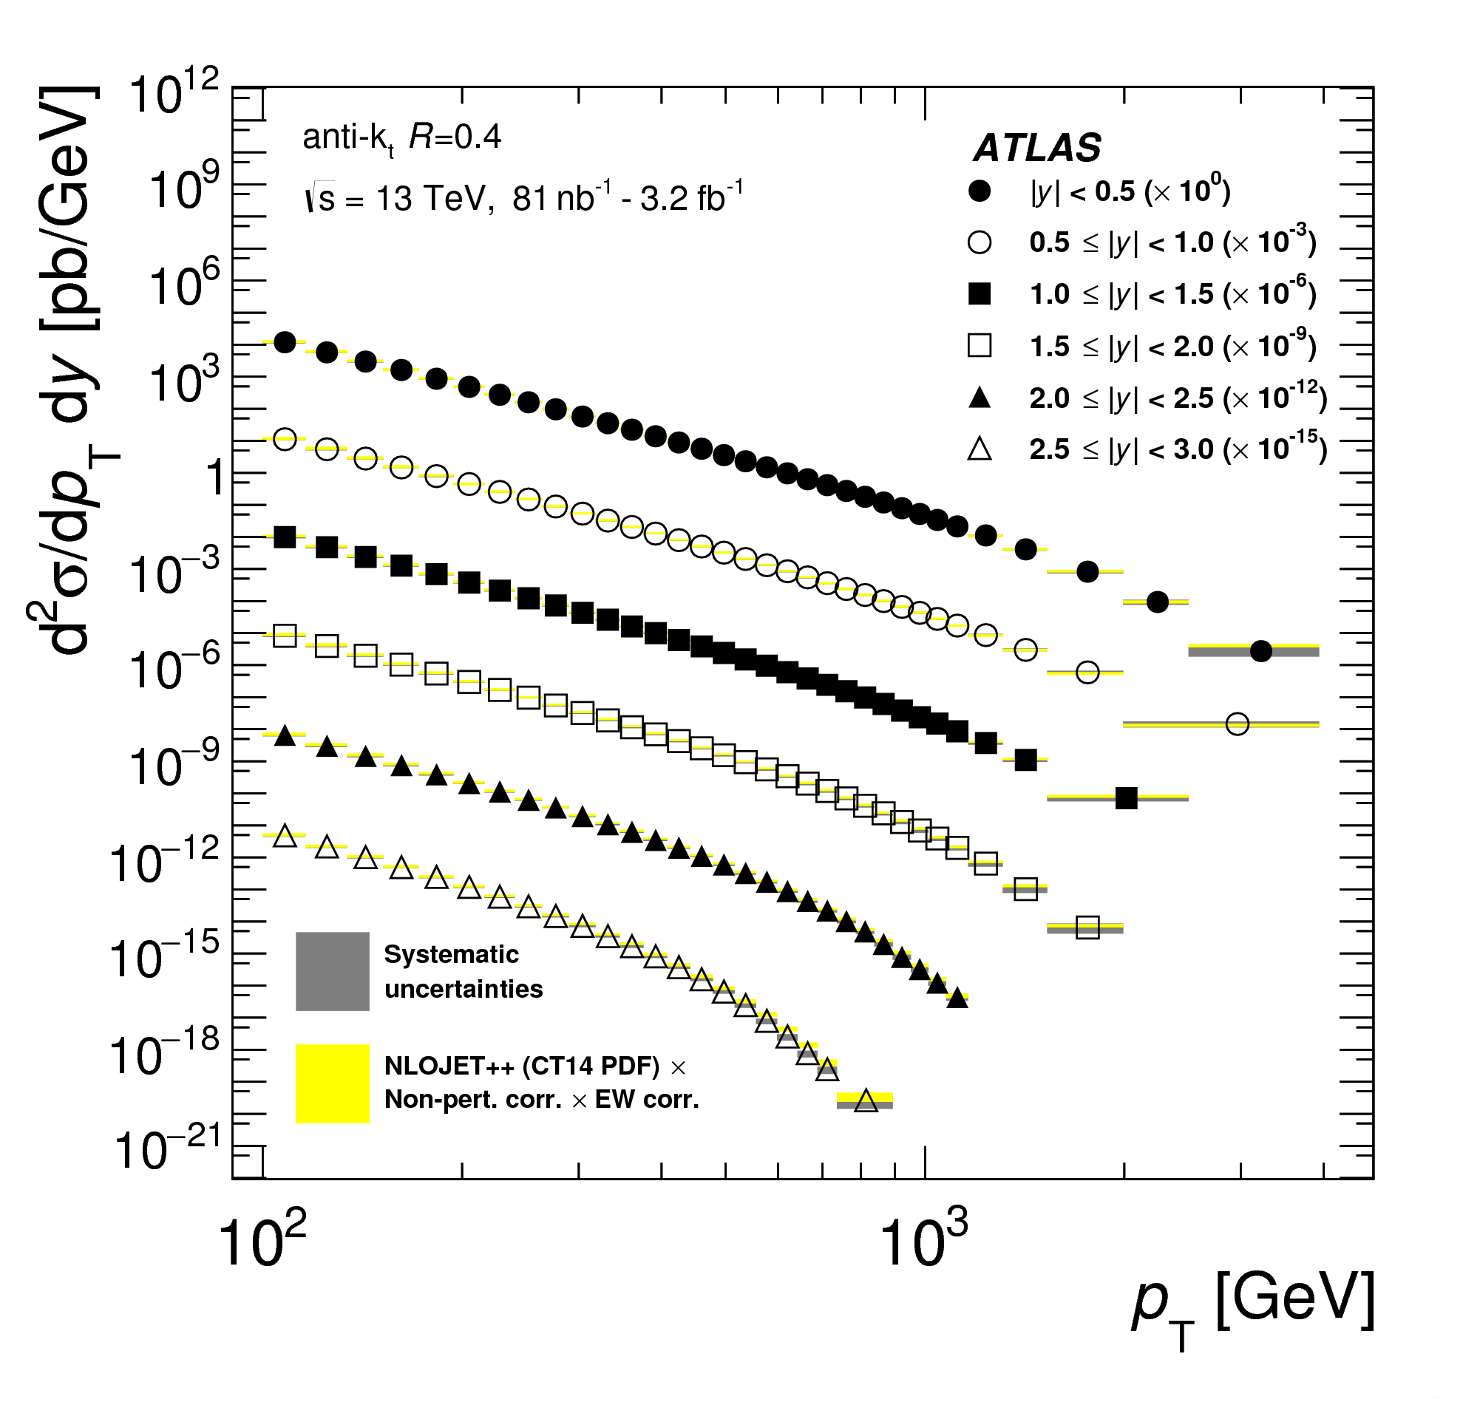

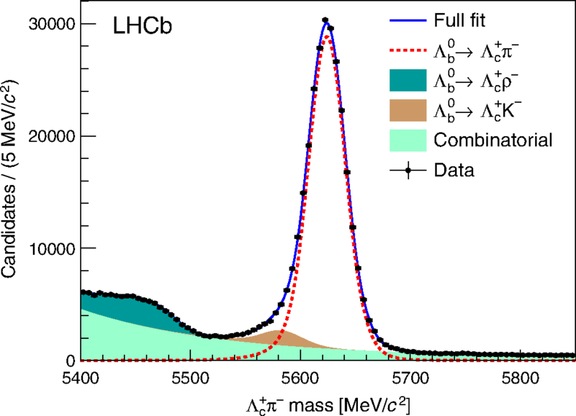
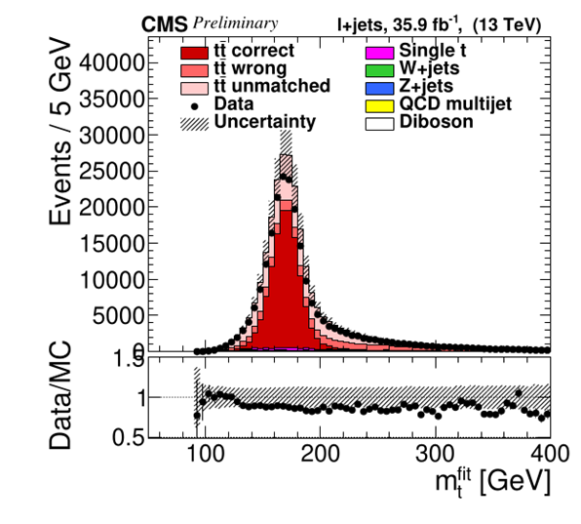
Many discoveries and new measurements
Covering a vast range of topics
Higgs boson discovery in 2012
Higgs boson properties
Over fifty new hadronic states
Rare decays like Z→eeμμ and B_{s}→ μμ
CP violation in the charm sector
Jet quenching in heavy ions
VVHH Higgs four-boson coupling

Slide 19
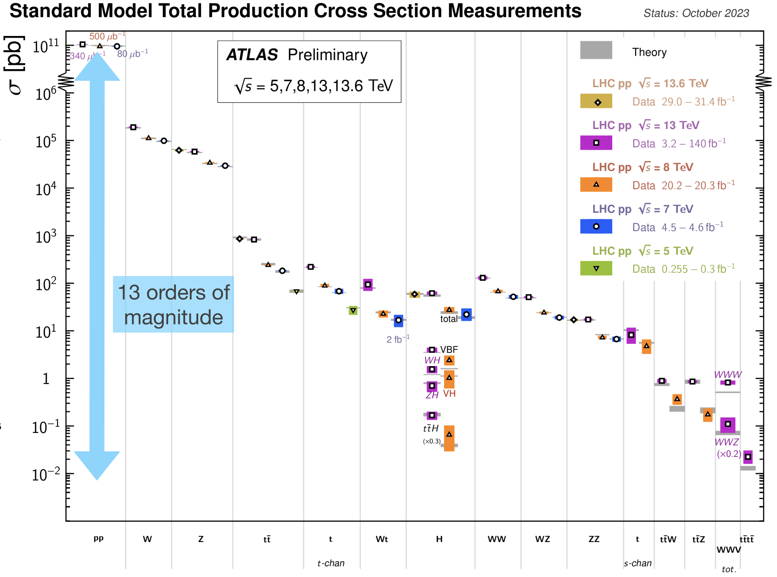
The Standard Model remains in good shape
The precision achieved is a great achievement by all involved
Often (usually) surpassing the original expectations
Despite occasional anomalies, the SM remains in very good health

Slide 20
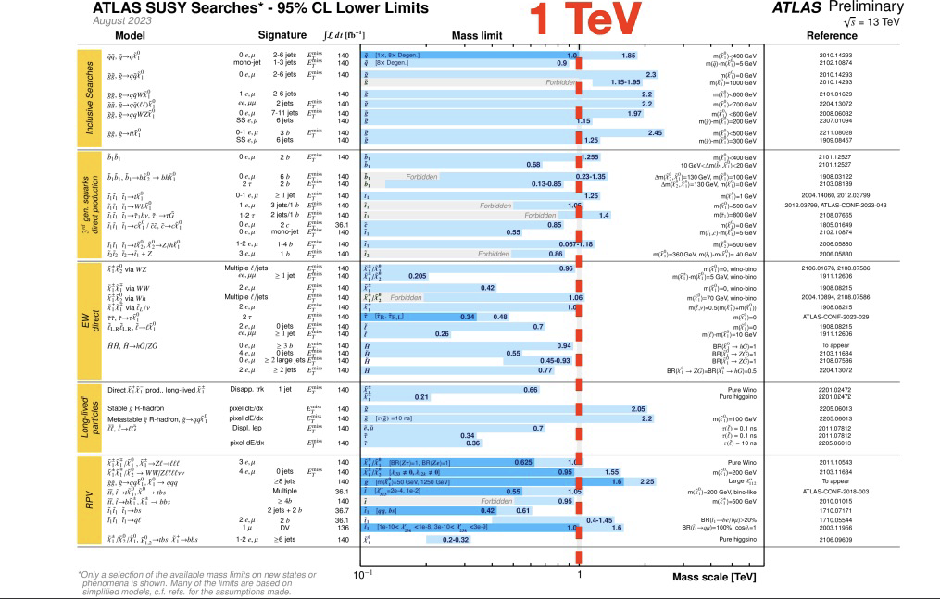
We continue to search far and wide
Precision measurements complemented by searches for a wide range of BSM phenomena
Despite occasional hints, no strong signals for the manifestation of BSM physics (yet)
Probing scales in the range of 1 – 10 TeV
  e.g. SUSY to ~1 TeV
  with a few blind spots

Slide 21
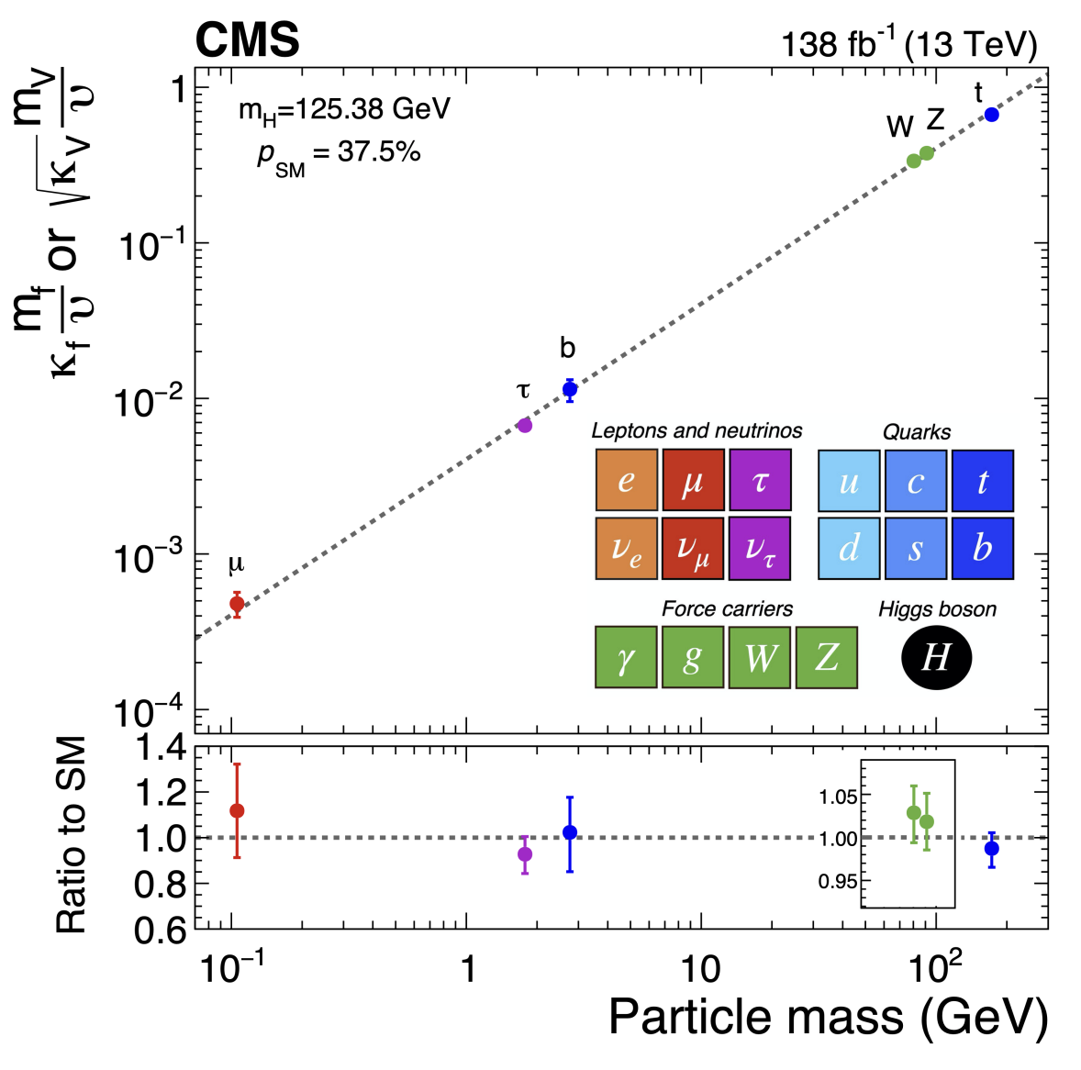
The Higgs Boson
Probing couplings over a mass-range of ~3 orders of magnitude
So far, couplings look SM-like, but we have just started to scratch the surface
  typically measurements at the 5% – 10% level
But should not get discouraged
  for the Higgs mechanism to “do its job” there are strong constraints on the size and nature of possible BSM deviations
  need to be aiming for ~1% level precision

Slide 22
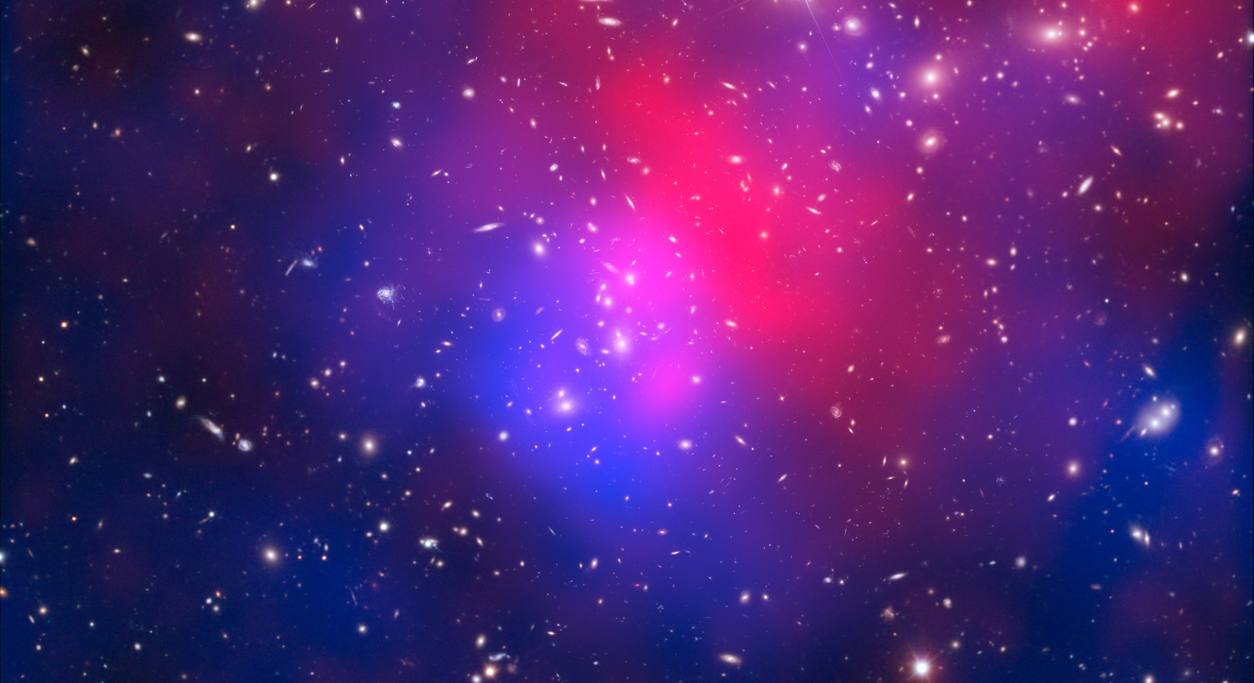
What next?
We know a vast amount about the nature of the universe, but…
…there are many deep mysteries, including
Why is the universe made only of matter, with hardly any antimatter?
What is the unknown 95% of the mass
and energy
of the universe?
Does the Higgs boson interact with dark matter?
Is the Higgs Boson a fundamental particle?
H
H
Unification and why is gravity so weak compared to the other forces?
Why three generations and are there more?
What determines the hierarchy of masses of the particles?
What is the nature and stability of the Higgs potential
H
H

Slide 23
The next major discoveries?
Where will the next breakthroughs/discoveries come from?
Obviously, we don’t know – and that’s OK, if we knew they wouldn’t be discoveries
But in the next ~10 years we are looking in the right places
HL-LHC: Higgs and more
Next generation neutrino experiments
Flavour sector (LHCb, Belle-II, mu2e, …)
Cosmology/astrophysics
….
And we are necessarily planning for the longer term
Higgs factory – e.g. FCC-ee
Pushing the energy frontier for discovery – e.g. FCC-hh
….

Slide 24
Coming Soon

Slide 25
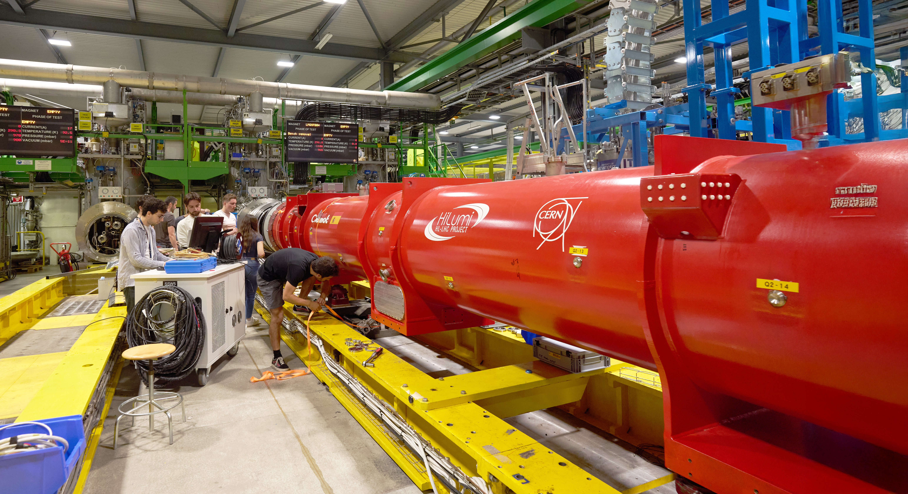
1) HL-LHC
The High-Luminosity LHC
major “upgrade” of the LHC, starting operations ~2030 and running until 2041
based on new cutting-edge technology that didn’t exist when the LHC was built
With 10 times increased “brightness” compared to the LHC
we are just at the start of the LHC/HL-LHC journey
Meanwhile the detectors and triggers become ever more capable
wider range of processes targeted more precisely
And never forget the people
Brilliant young researchers, aided by AI tools, will give ever greater power
We are very still early in the LHC story
  It is important not to forget this…

Slide 26
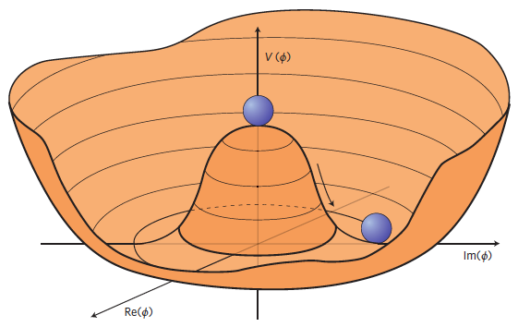
1) HL-LHC
We should not forget that
the LHC has already enabled the discovery of the Higgs Boson
  this was a major discovery of “something” completely new and unique
we are less than 10% into the LHC/HL-LHC programme
  there is real discovery potential beyond the Higgs
  many/most major discoveries in particle physics have not been expected
    Perhaps, this is exactly what we should expect when exploring the unknown?
The HL-LHC is an incredible scientific opportunity
- a lot more data, even better detectors, new techniques
- real discovery potential
we are exploring the Higgs sector…
  The Higgs miracle relies on the “Mexican Hat” potential, which leads to a non-zero VEV
    this means that the Higgs boson interacts with itself
    measuring this Higgs self-coupling is very much in reach

Slide 27
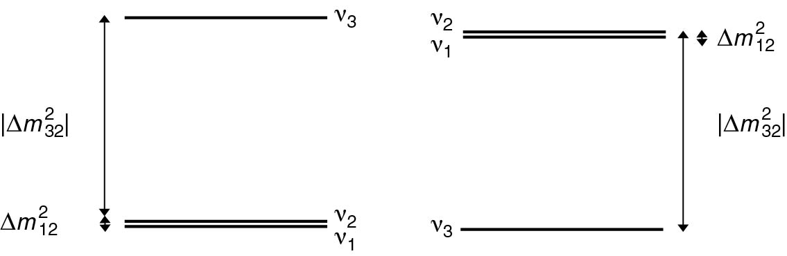
2) Neutrinos
Three big questions
Neutrino masses (mass ordering and absolute scale)
CP violation in the neutrino sector?
Are neutrinos Majorana particles?
?
NO
IO

Slide 28
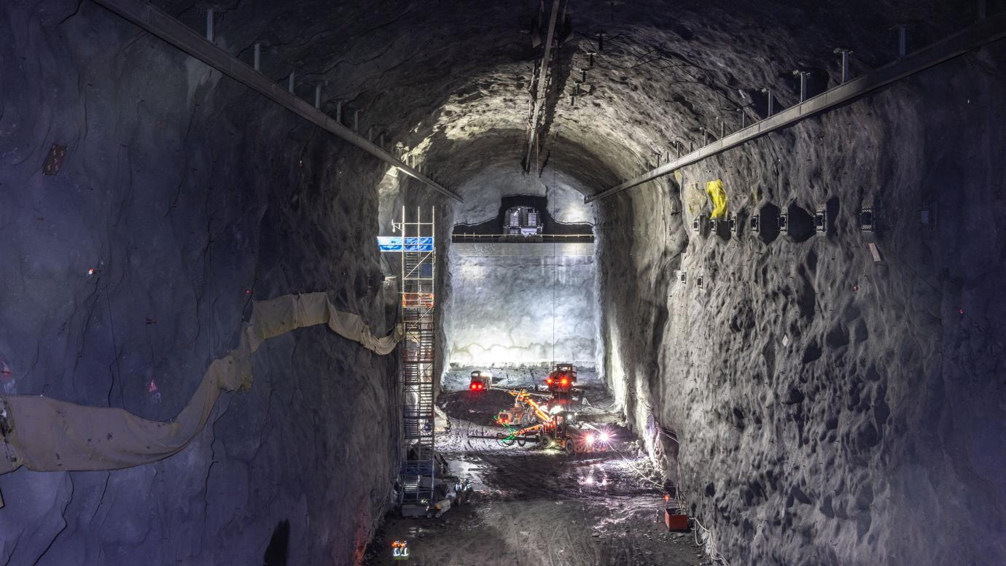
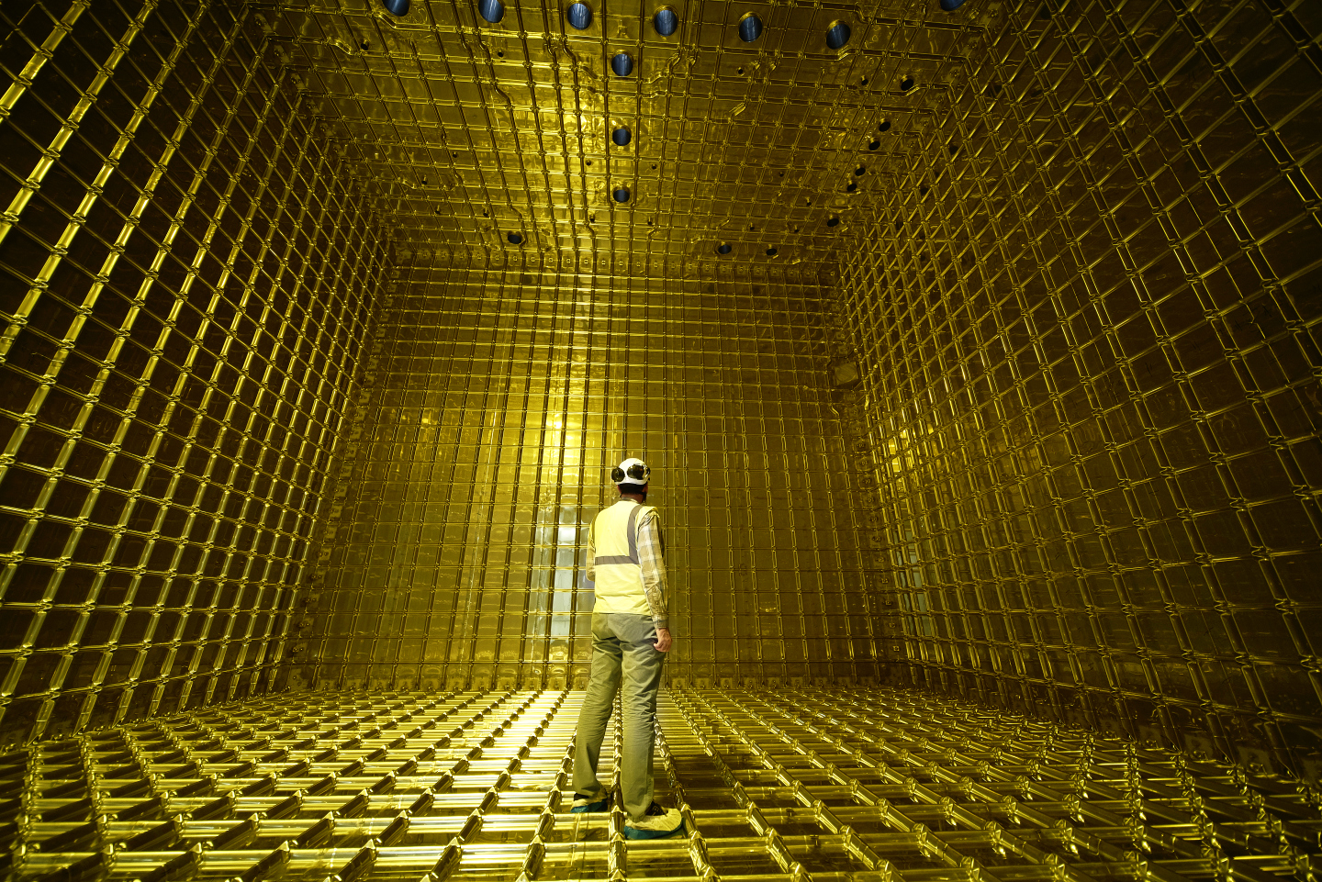
2) Neutrinos
Can be confident that we will have some answers in the next 10 years
We are building the right experiments
  DUNE in the US and Hyper-Kamiokande in Japan
By 2035, we will know the mass ordering and a lot more about CP violation
  … and there could be surprises

Slide 29
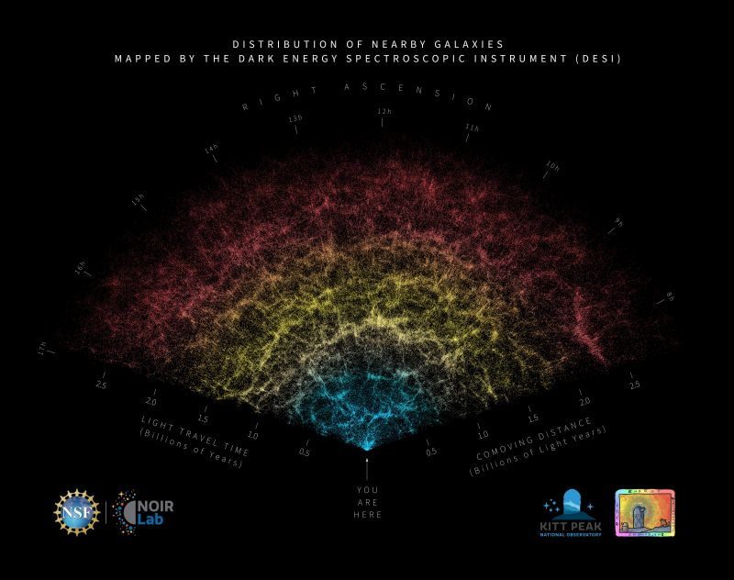
3) Cosmology: DESI, EUCLID, …
Current and next generation ground-based and space-based galaxy surveys looking at large-scale structure will increase knowledge of (for example)
Dark energy
…and particle physics
For example: Dark Energy Spectroscopic Instrument (DESI) Year 1 results
600,000 “local” galaxies
Indirect measurement of neutrino masses
Compared to what we know from oscillations
Taken at face value…
  But in the future, could see tensions

Slide 30
4) Uncharted Territory
There is an unexplored dark period in the evolution of the Universe
the “dark ages”, stars have yet to form, and the universe is filled with neutral hydrogen

Slide 31
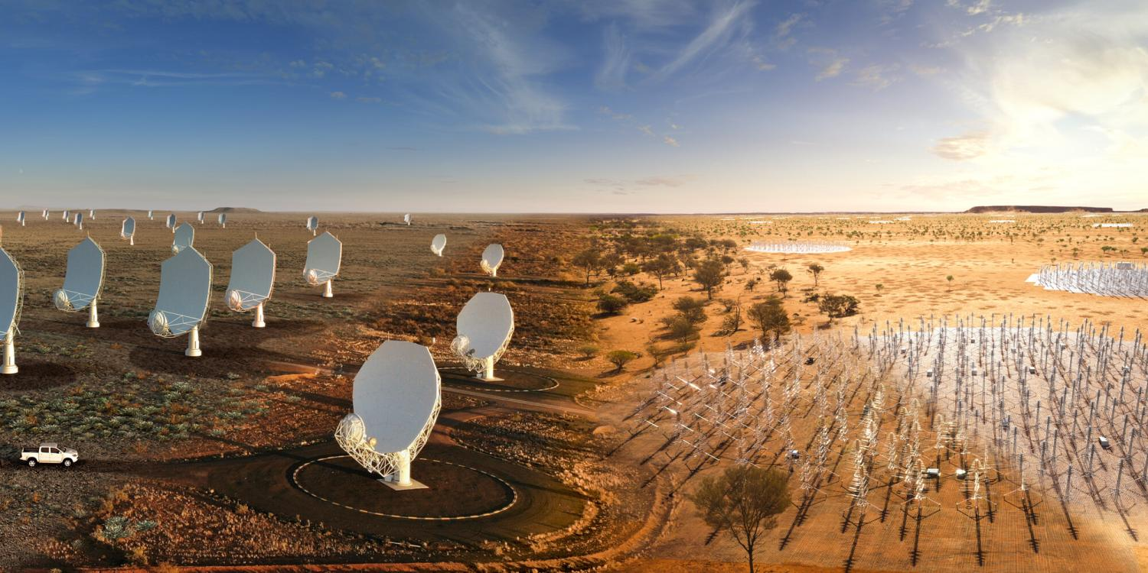
4) Uncharted Territory
There is an unexplored dark period in the evolution of the Universe
the “dark ages”, stars have yet to form, and the universe is filled with neutral hydrogen
By ~2030s the Square Kilometre Array Observatory will peer into the dark ages (and much more)…
Look at red-shifted 21cm hyper-fine transition in neutral hydrogen
In essence, when the stars illuminate the universe, hydrogen is ionized and the 21cm transitions largely stop
By measuring the red-shifted spectrum can map this process out in cosmic time
A new window on the universe…
  there may be surprises…

Slide 32
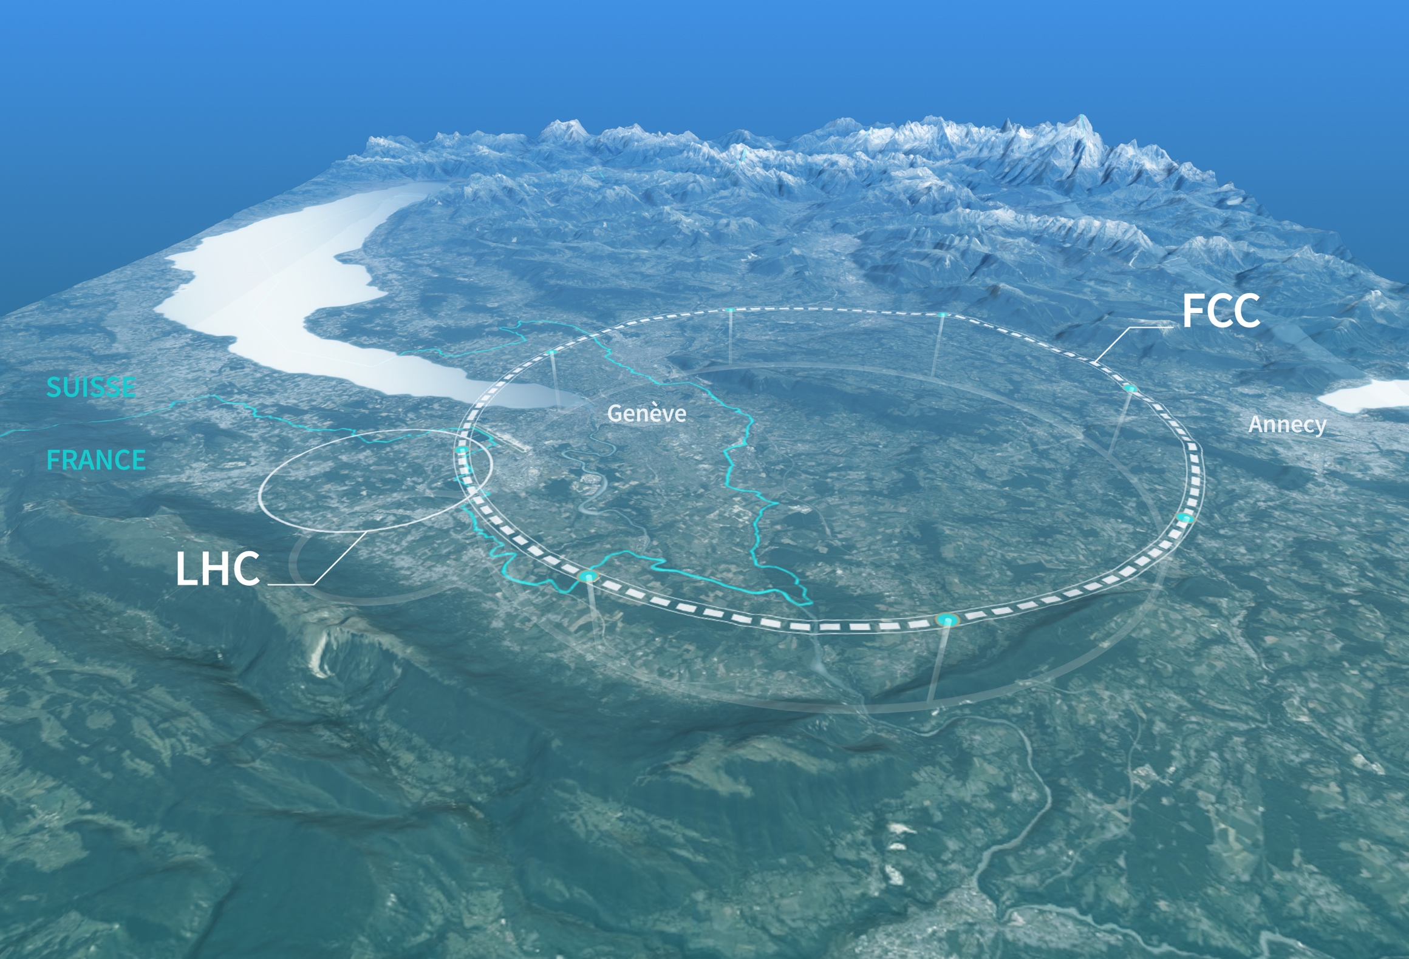
The longer term

Slide 33
The Higgs Boson: a window on the unknown?
The Higgs Boson is a genuinely new and unique type of matter
It is also very strange – and may well provide a new window for discovery
Many Questions
A (fundamental?) scalar
  maybe it is composite?
A field with a non-zero VEV
  mathematically makes sense, but intuitively…
Gives mass to all other know particles
  the properties of the Higgs field determine the nature of the physical Universe…
  but no understanding of the pattern of masses
What if…
  the Higgs also gives mass to dark matter…

Slide 34
CERN’s long-term vision
The Higgs Boson is a genuinely new and unique type of matter
It is also very strange – and may well provide a new window for discovery
We are now planning a new “Higgs Factory” machine to study it in great detail
The “Future Circular Collider”
A new 91km ring
First stage collides electrons & positrons
An ambitious and exciting scientific programme
  Higgs and much more
Targeting start of operations in ~2045-2048
Total cost over ~15 years of about 15 BCHF…
It is incredibly exciting and is a suitably ambitious next project for CERN
This is not yet approved, but we are hoping for a positive decision in ~2028

Slide 35
CERN’s long-term vision
Conceptual design:
Provides an exciting scientific vision for CERN’s future…
First stage: a luminosity-frontier electron-positron collider (FCC-ee)
Possible second stage: an energy-frontier hadron collider (FCC-hh)
FCC-ee: a precision instrument to study the Z, W, Higgs and top particles, unprecedented sensitivity to signs of new physics
  A precision Higgs factory and much more
FCC-hh: at some stage we are going to need a very high energy hadron collider to explore new mass scales…
  Much of the FCC-ee infrastructure could be reused (2060+) to provide p-p collisions at a centre-of-mass energy of ~100 TeV
  Is it the right option for the next collider at CERN?
    I believe the case is very strong

Slide 36
ESPP Update
CERN’s future vision must be ambitious:
The last European Particle Physics Strategy Update (EPPSU) identified an electron-positron “Higgs Factory” as the highest priority for the next collider:
  Explore this unique object that we recently discovered
  Scientifically, the Future Circular Collider (FCC) is the most capable option – it would be a wonderful machine. The question is mostly cost and affordability
  Need a viable approach that is based on a well-understood transparent cost model and a clear plan for resources from outside the CERN subscription
  It is also essential that at a future decision point, CERN Council is presented with options, including the alternatives
  Realising the FCC will be challenging, but I believe the prize is worth it
Must not forget environmental sustainability considerations
  an opportunity for particle physics to take the lead in large Research Infrastructure
This ongoing strategy process will be very important
- opportunity to set the strategic direction for the future

Slide 37
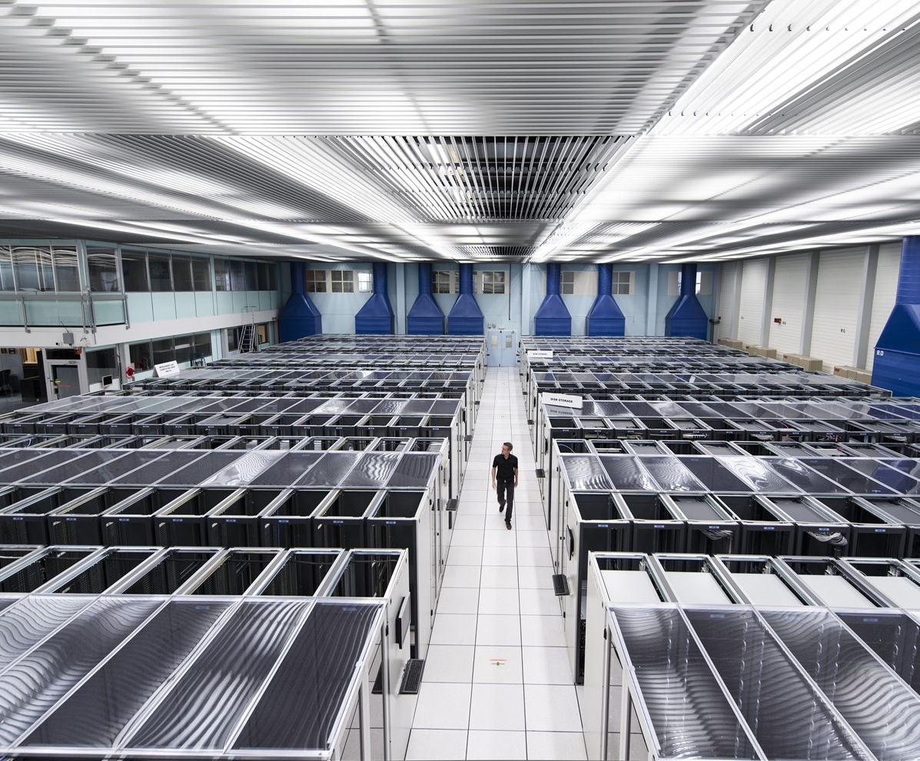
The wider impact of Particle Physics

Slide 38
The case for the FCC
I believe this needs to be based on three pillars
The scientific case
  ESPP is an opportunity for the particle physics community to make a clear statement of scientific priorities
  I believe the science case for the FCC is very strong - we as a community could perhaps do better at articulating it for the wider scientific audience
The diplomatic benefits of international collaboration
  Potentially even more important today in an increasingly uncertain world

Slide 39

Science for peace
CERN was founded in 1954 with 12 European Member States
Built on long-term deep international collaboration
24 Member States
Austria – Belgium – Bulgaria – Czech Republic
Denmark – Estonia – Finland – France – Germany
Greece – Hungary – Israel – Italy – Netherlands
Norway – Poland – Portugal – Romania – Serbia
Slovakia – Spain – Sweden – Switzerland – United Kingdom
CERN’s annual budget
is 1200 MCHF – equivalent
to a medium-sized European university
Employees:
~2700 staff, ~1000 graduates
Associates:
12 000+ users, ~1500 others
10 Associate Member States
Brazil – Croatia – Cyprus – India – Latvia – Lithuania Pakistan – Slovenia* – Türkiye – Ukraine
4 Observers
Japan – USA – European Union – UNESCO

Slide 40
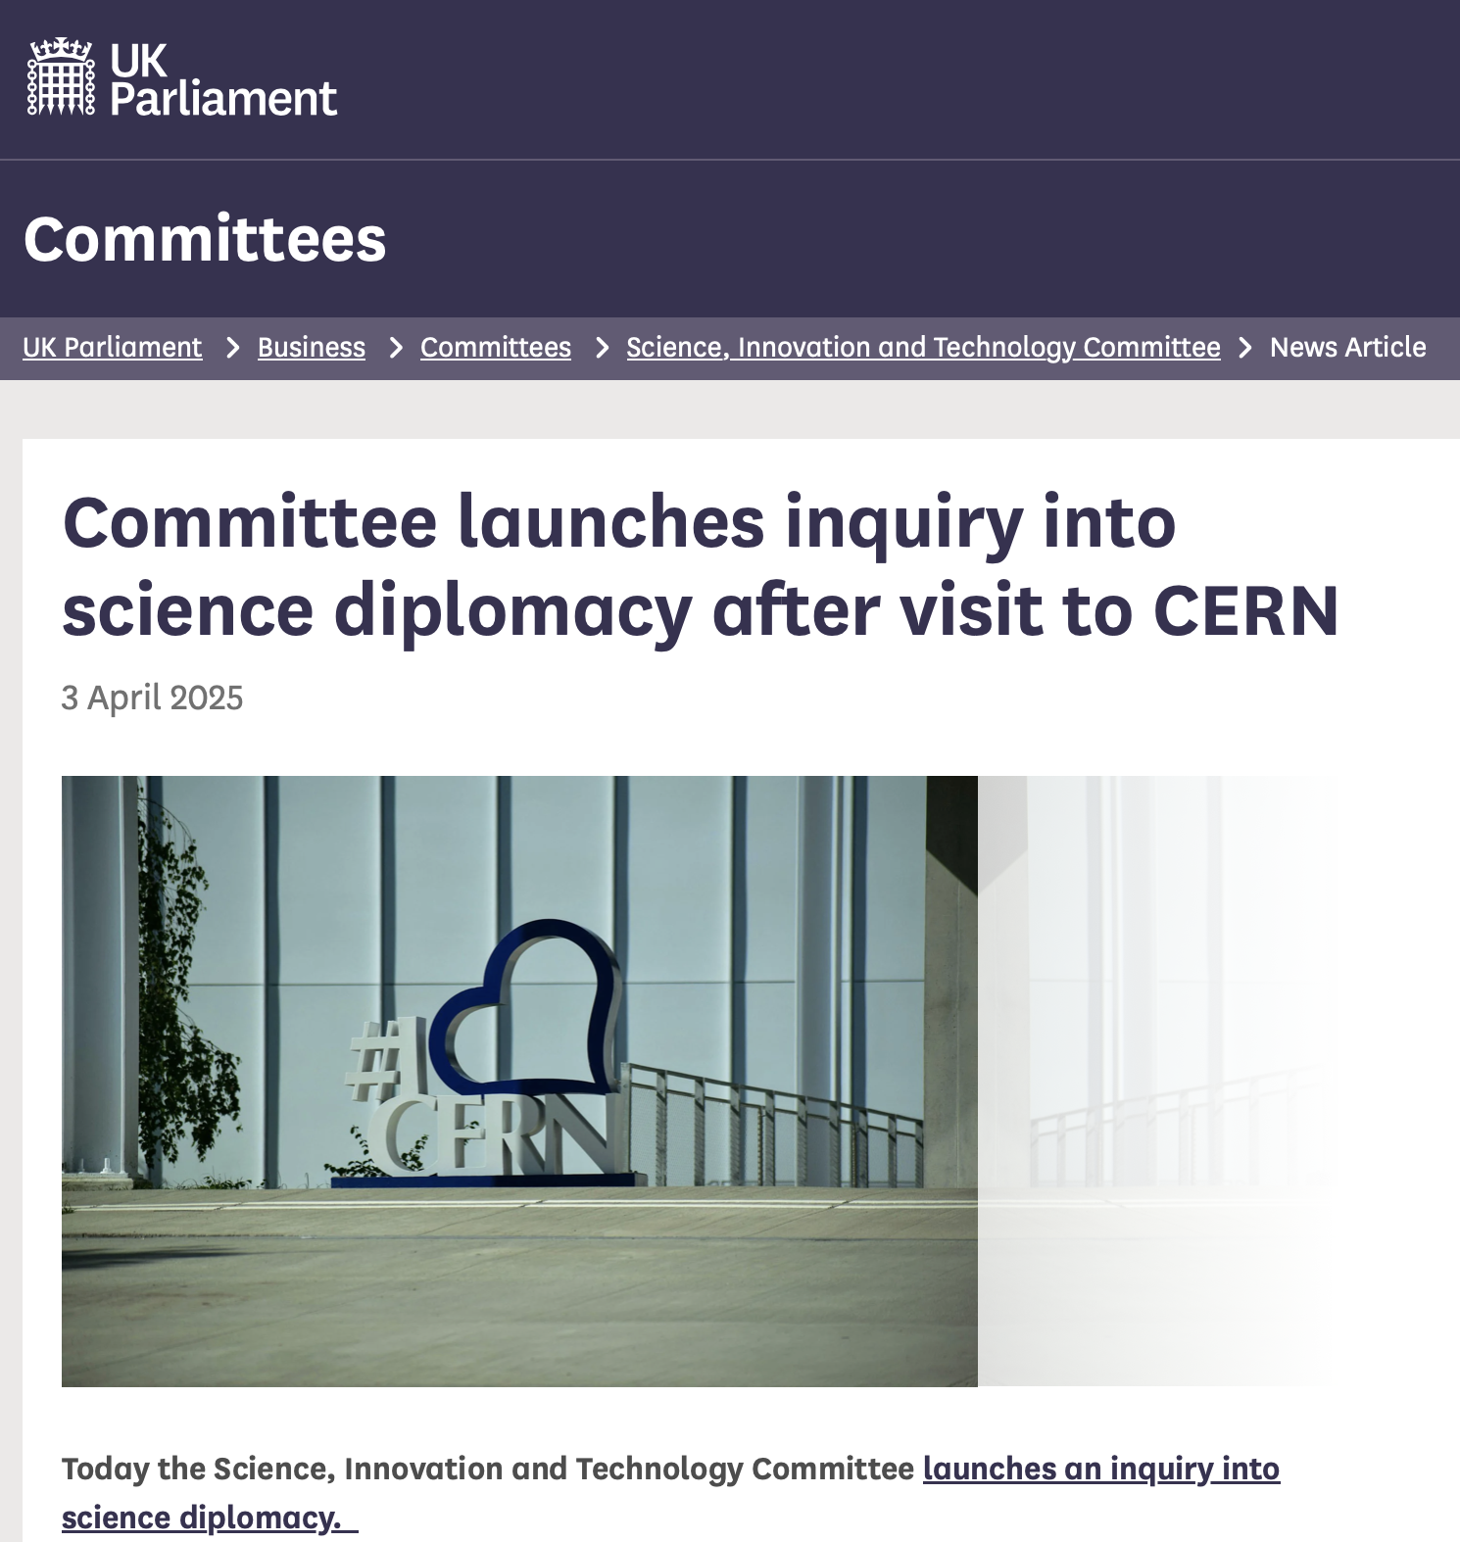
The importance of international collaboration
CERN is an amazing place where the world comes together to collaborate to address some of the biggest questions in Particle Physics
This type of international collaboration is particularly important today
Last week the UK HoC Science, Technology and Innovation announced…
“The committee’s visit to CERN showcased science diplomacy in action. CERN has helped build relationships of trust and co-operation between nations and led to ground-breaking innovations in particle physics and beyond. I was proud to hear about the UK’s commitment and involvement with CERN, as well as how our economy and science sector has benefited from the facility’s work.”
Chi Onwurah MP, Chair of the Science, Innovation and Technology Committee

Slide 41
The case for the FCC
I believe this needs to be based on three pillars
The scientific case
  ESPP is an opportunity for the particle physics community to make a clear statement of scientific priorities
  I believe the science case for the FCC is very strong - we as a community could perhaps do better at articulating it for the wider scientific audience
The diplomatic benefits of international collaboration
  Potentially even more important today in an increasingly uncertain world
The wider technological and economic benefits of particle physics, CERN and ultimately the FCC
  The long-term economic return in investing in “Big Science”
  In Europe, particle physics the domain where we have the global scientific and technological leadership…

Slide 42
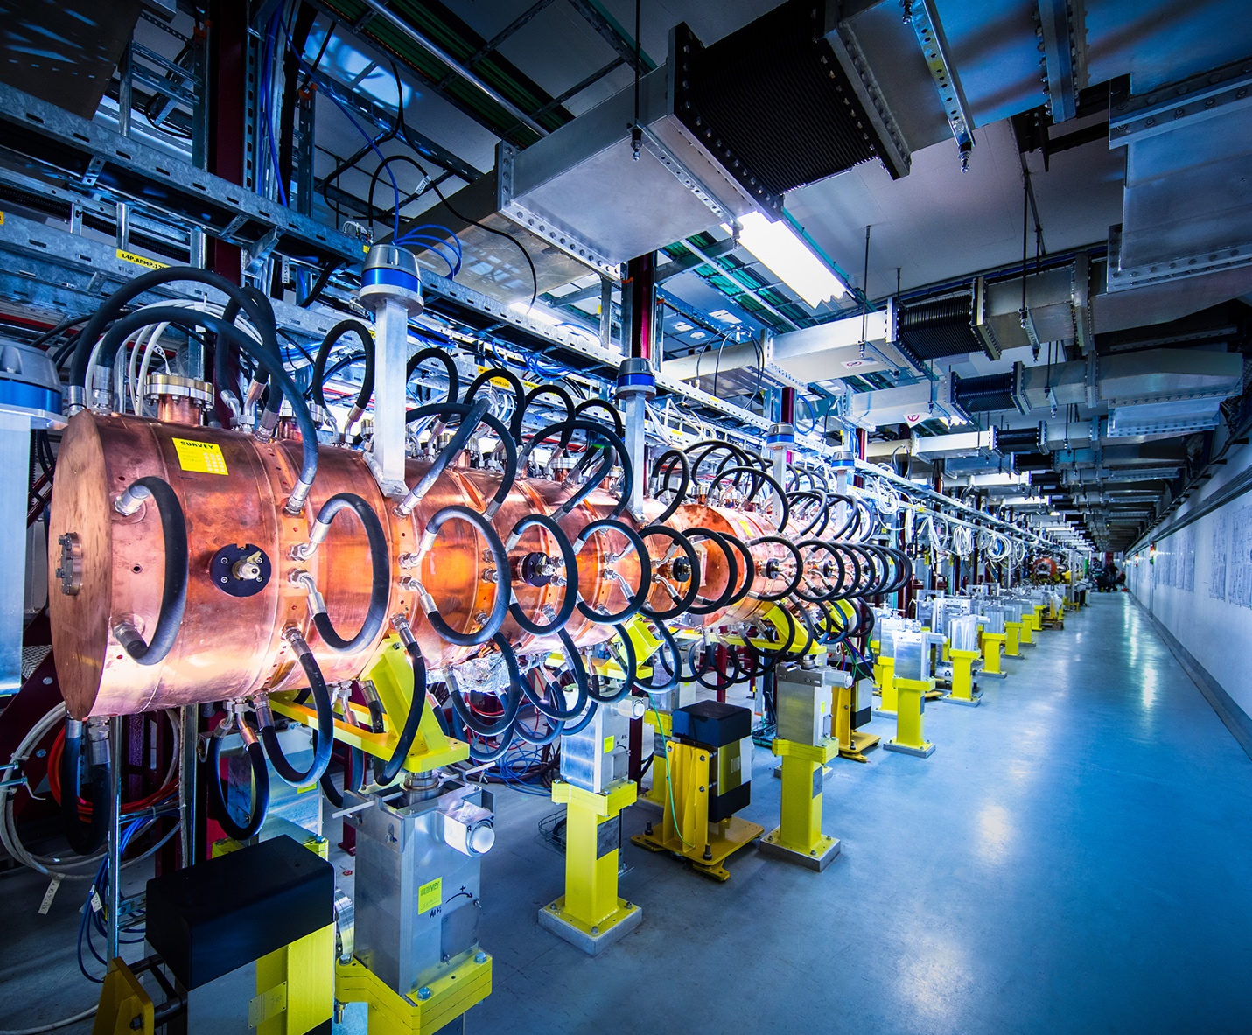
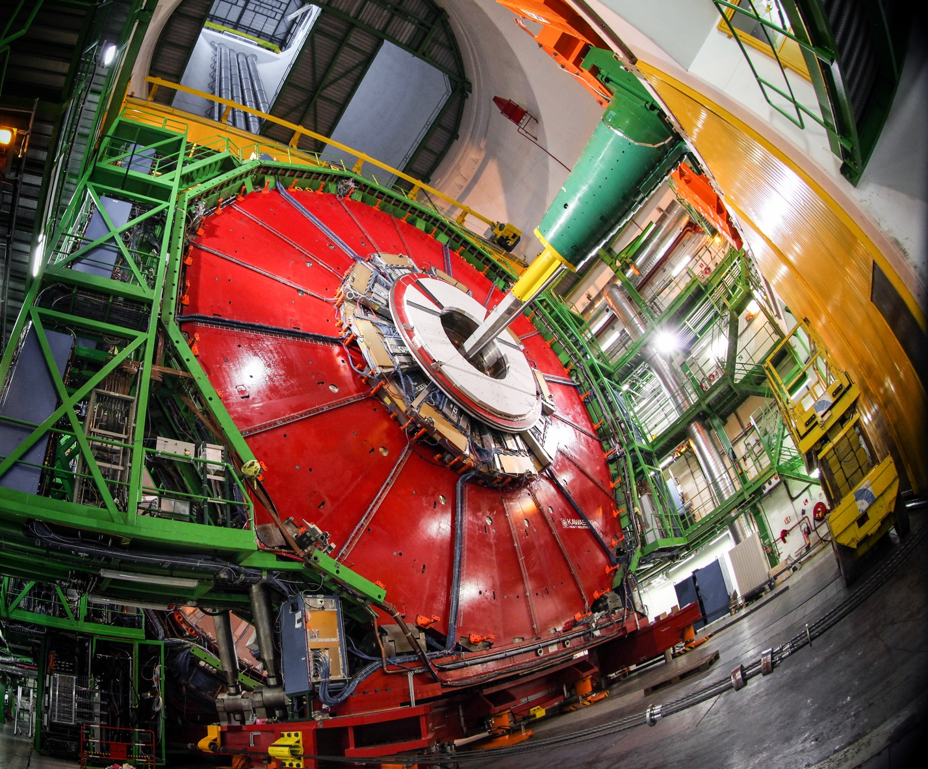
At CERN we need advanced technology
Technology and engineering is the driver for discovery in fundamental science
we are constantly pushing the boundaries beyond what exists today…
At CERN there are three central technology areas
ACCELERATORS
DETECTORS
COMPUTING

Slide 43
The Economics of “Big Science”
This is not easily quantified
very difficult to quote a reliable measure of “Return on Investment”
also defining the counterfactual for technology development is often hard
and sometimes the timescales for return on fundamental science / advanced technology are long…
Example: GPS
accurate GPS relies on being able to correct for General Relativistic corrections
a downstream “by-product” of Einstein’s General Theory of Relativity published 110 years ago
for a long-time there was no obvious practical benefit…

Slide 44

Driving Technology Forward
I believe that one of the largest impacts of “big fundamental science projects” is pushing technology beyond the current state-of-the art
Major fundamental discoveries in basic science happen because of a new technology or new technological capability
In particle physics we are often trying to do the “near impossible” to get a better or new understanding of the nature of the universe
This often requires a new capability or giant step forward in precision
We then try to develop the technology required to the answer the scientific question
The technology or new capability may then have wider applications
Being driven by the scientific need is the key difference

Slide 45
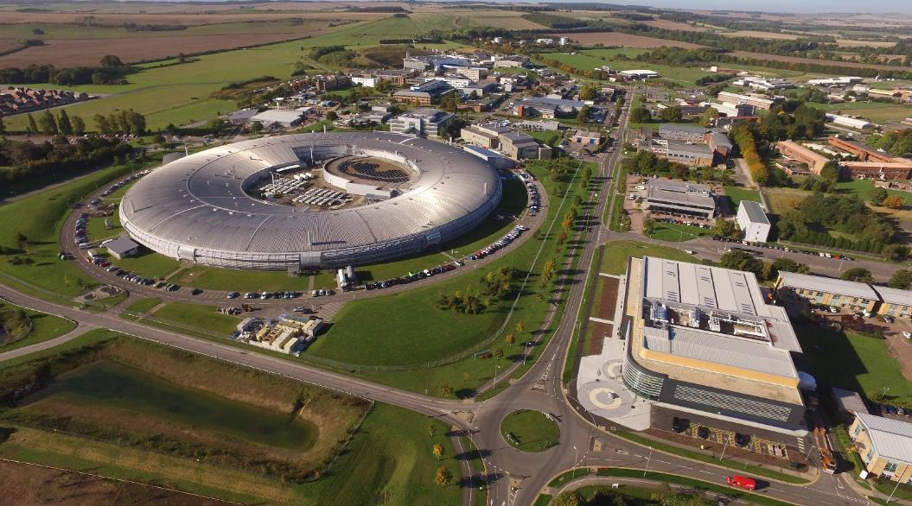
Disruptive Technologies
The big disruptive technologies have the largest long term impact
The World Wide Web – sharing information and data within CERN
  Probably would have been developed in some form – but possibly not “open”
Accelerators – technology developed as our main tools for particle physics
  Cancer treatment: Hadron therapy, Ion therapy, Medical isotopes, …
  Synchrotron Light Sources: underpin our understanding of structural biology, advanced materials, drug discovery and much more
I would argue…
The reason that we now have the underpinning accelerator technology is that it was needed for fundamental discovery science
Without this mission, it is arguable that we wouldn’t have large-scale accelerators today

Slide 46

Final “Case Study”
Silicon sensor development for the experiments at the LHC
Traditional silicon sensors, e.g. those in phone cameras, would not survive the high radiation environment at the LHC
Required designing special radiation-hard technology - a niche application?
Technology drives discovery: Richard Henderson won the 2017 Nobel Prize for Chemistry for developing cryo-electron microscopy to allow researchers to freeze and “see” biomolecules “mid-movement”
Cryo-EM microscopy was revolutionized by the radiation hard-sensors first developed for particle physics and which can be used to directly image energetic electrons
Cryo-EM is revolutionising structural biology… made possible by new technology

Slide 47
Final Words

Slide 48
Final Words
The future of particle physics is incredibly exciting – we should not forget this
We are going to address some profound fundamental questions
  the next breakthrough could come from many places, so it is essential that we keep asking the right questions
HL-LHC will be amazing
HL-LHC will be a massive step forward in capability
  ~10x the current LHC integrated luminosity, upgraded detectors, AI and more…
  Precision measurements (Higgs and more)
  Higgs self-coupling!
  Genuine opportunity for BSM discovery
Planning for next major collider facility is moving at pace
I believe the FCC is a truly outstanding scientific opportunity
To realize it, we need make the strongest possible case: science + technology + …

Slide 49
Thank You!

Slide 50
CERN

Slide 51
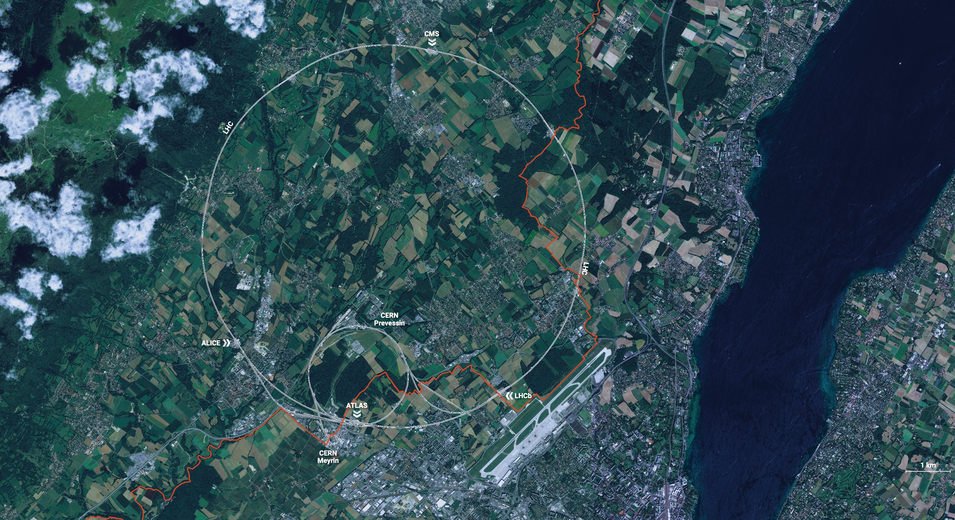

CERN
CERN is the world’s biggest laboratory
for particle physics.
Straddles the French – Swiss border near Geneva
Our mission is to understand the most fundamental particles and laws
of the universe.
Built on over 70 years of deep international collaboration

