Slide 1



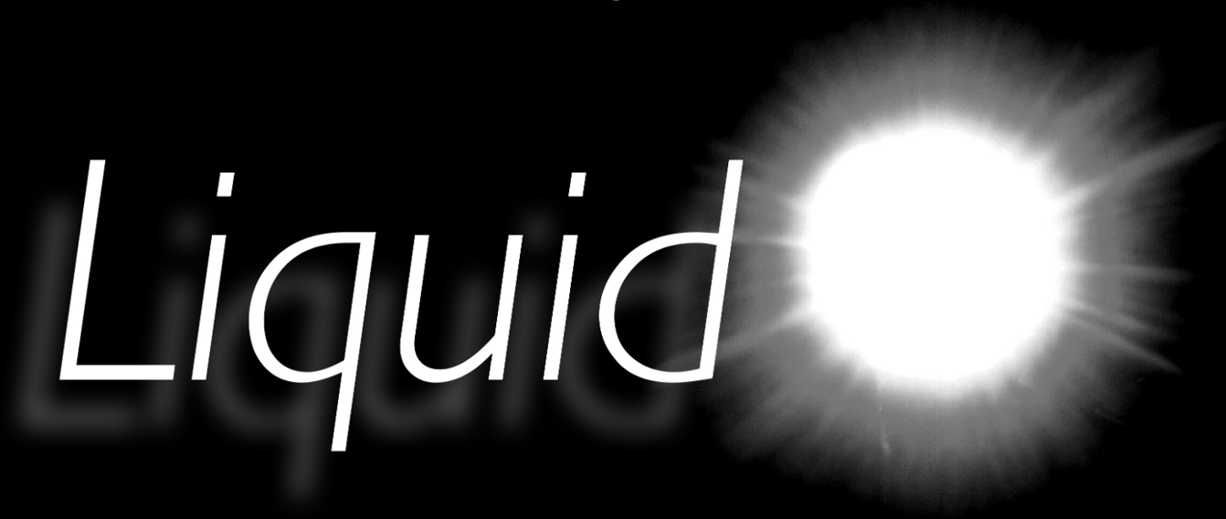
Simulating LiquidO detectors for prototype research and development
IOP Conference Cambridge 2025
Ben Cattermole

Slide 2
Ben Cattermole
Email: bc392@sussex.ac.uk
Overview
My presentation will cover:
LiquidO a description of the technology
  Why use opaque scintillator?
  How do we readout light?
How is light confined
  “Light Ball” formation
  “Light Cylinders” ?
Simulations of detector prototypes
  Sussex cubes
  Reconstruction

Slide 3
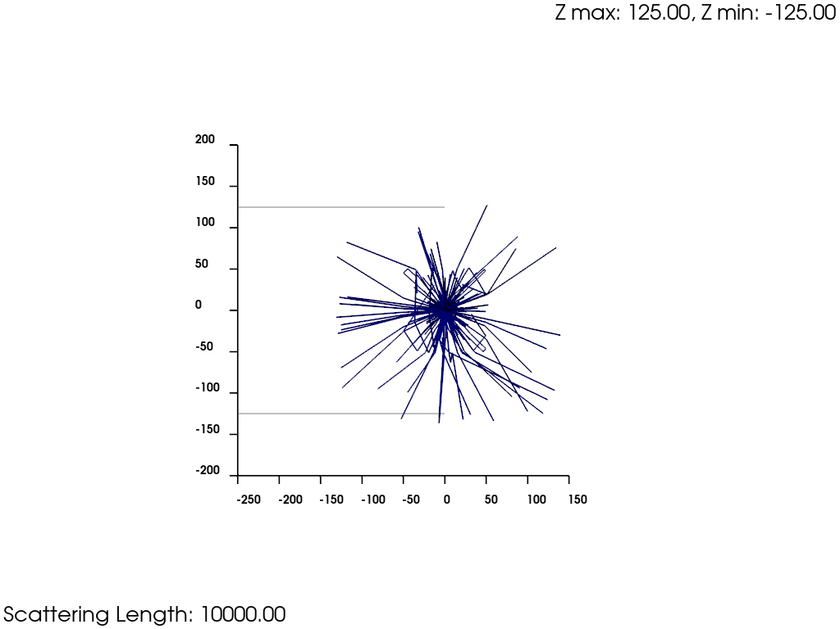
Ben Cattermole
Email: bc392@sussex.ac.uk
Simulation - LiquidO a description of the technology
Why use opaque scintillator?
An opaque medium means we stochastically confine light around its creation vertex
This creates “light balls” in our opaque scintillator
Leading to distinct event topology that we can use for particle identification

Slide 4
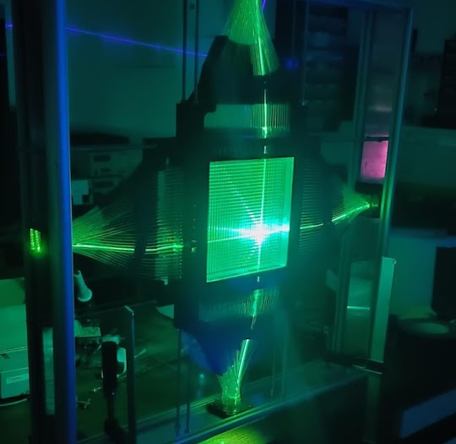
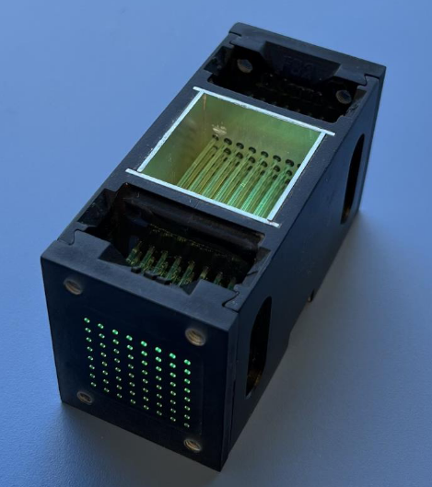
Ben Cattermole
Email: bc392@sussex.ac.uk
Simulation - LiquidO a description of the technology
How do we readout light if the light is confined close to where it is created?
Figure 2: Sussex Cube & Tile prototypes, Tile prototype lit up with laser pen
Alternating fibers Single direction fibers
The fibers pass through light balls and carry the light out of the opaque scintillator
We readout the light with Silicon PhotoMultipliers
SiPMs have a high gain, they have good timing resolution and detection efficiency
Inside the scintillator volume, there is an array of wavelength shifting fibers

Slide 5
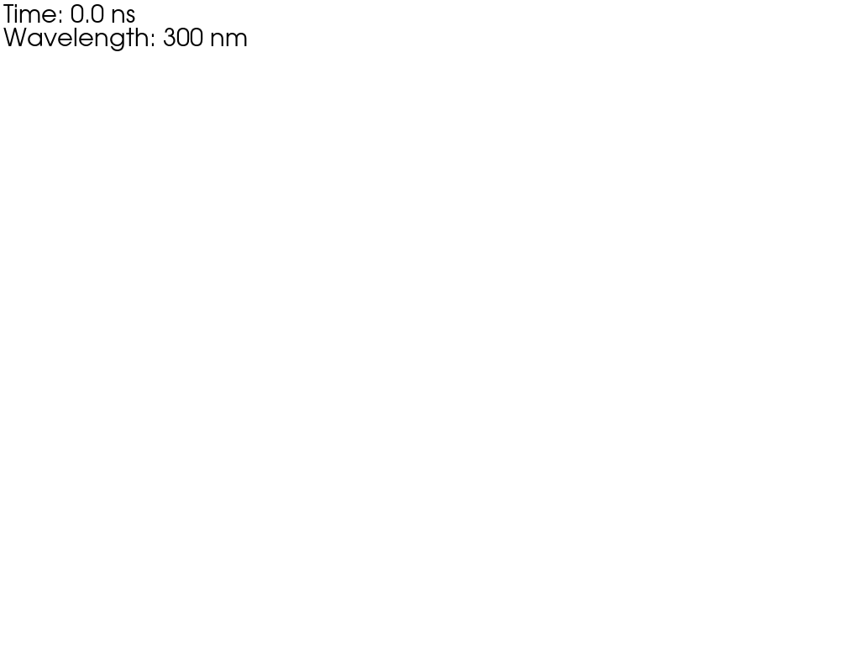
Ben Cattermole
Email: bc392@sussex.ac.uk
Simulation - LiquidO a description of the technology
How do we readout light if the light is confined close to where it is created?
The fibers pass through light balls and carry the light out of the opaque scintillator
We readout the light with Silicon PhotoMultipliers
SiPMs have a high gain, they have good timing resolution and detection efficiency

Slide 6
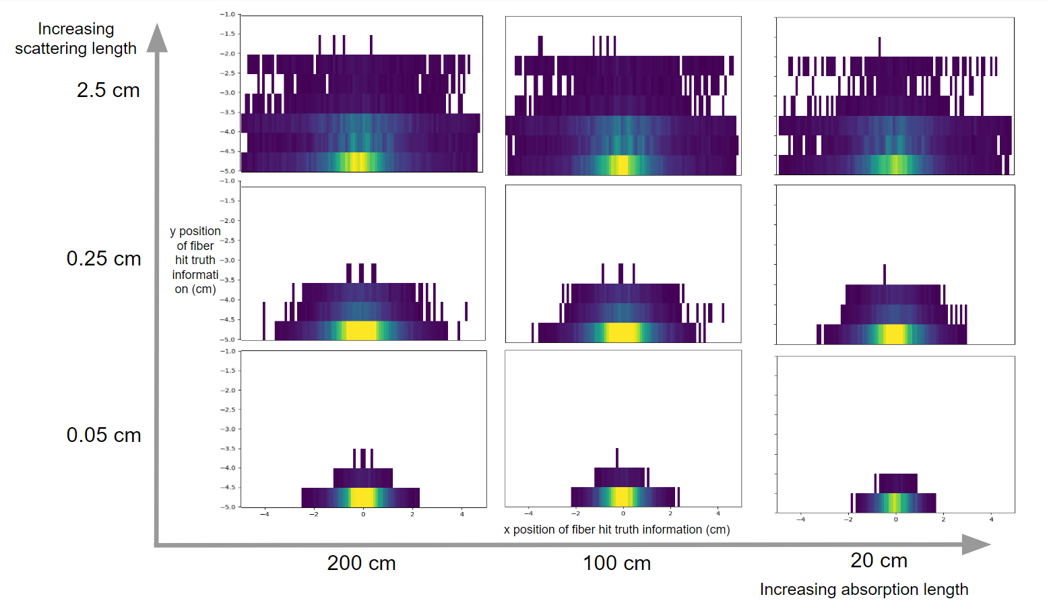

Ben Cattermole
Email: bc392@sussex.ac.uk
Simulation - LiquidO a description of the technology
Z scale shows the relative number of hits on a fiber
The size of light balls can be controlled with scattering and absorption lengths
Our ideal scenario:
Short scattering length
Long absorption length
Decreasing absorption length

Slide 7
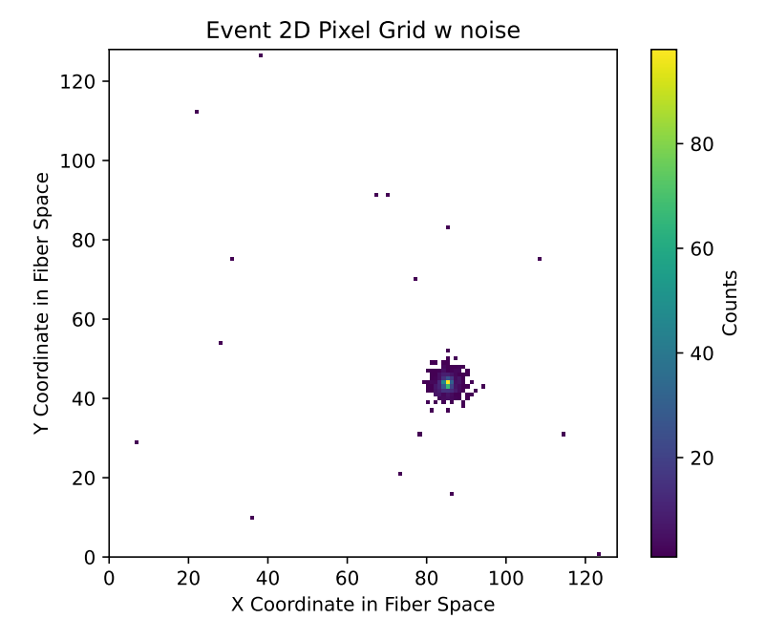
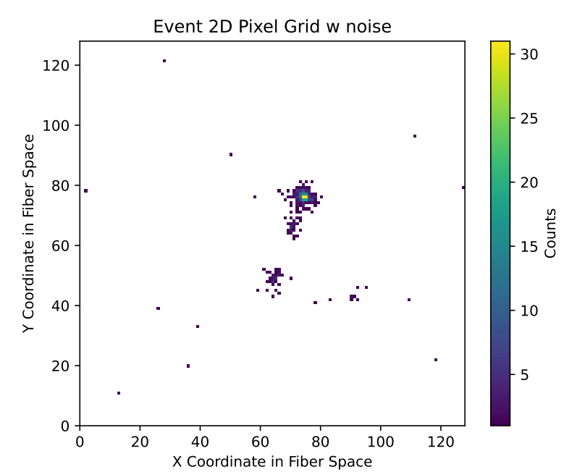
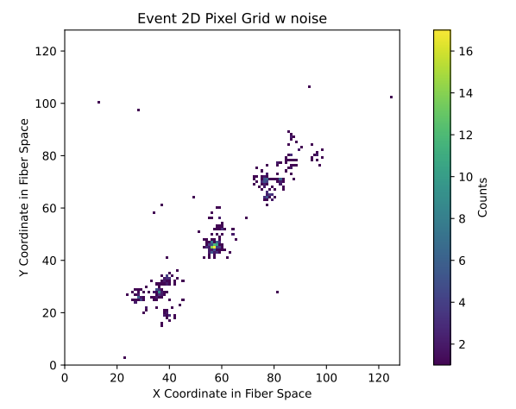
Ben Cattermole
Email: bc392@sussex.ac.uk
Simulation - Simulations of detector prototypes
Topological particle zoo
Electron event
Gamma event
Positron event
Noise hits

Slide 8
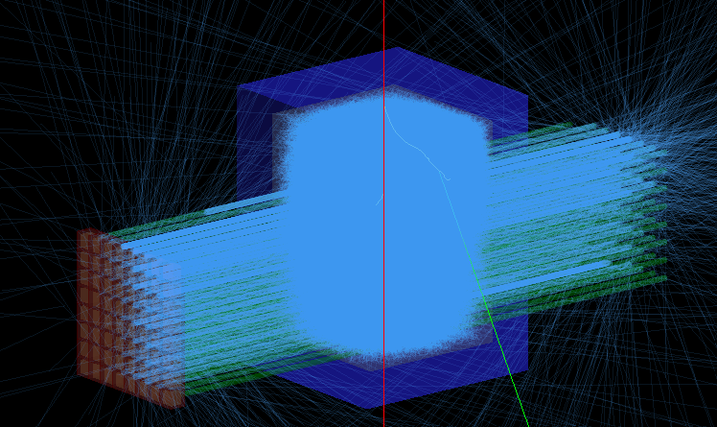
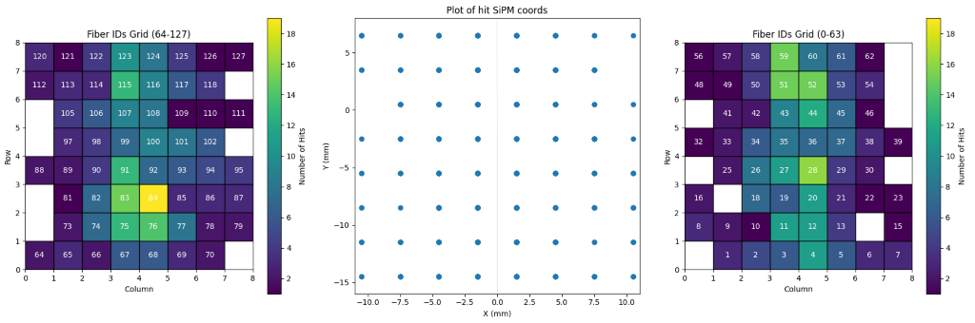
Ben Cattermole
Email: bc392@sussex.ac.uk
Simulation - Simulations of detector prototypes
Sussex Cubes
LiquidO cube prototypes developed at the University of Sussex
Muons passing through the cube have been studied in detail (See Jess Lock’s talk)
Simulation used to study effects of fiber width, scattering and absorption lengths and vessel reflectivity
Reconstruction of data from simulations…
Muon
Truth information

Slide 9
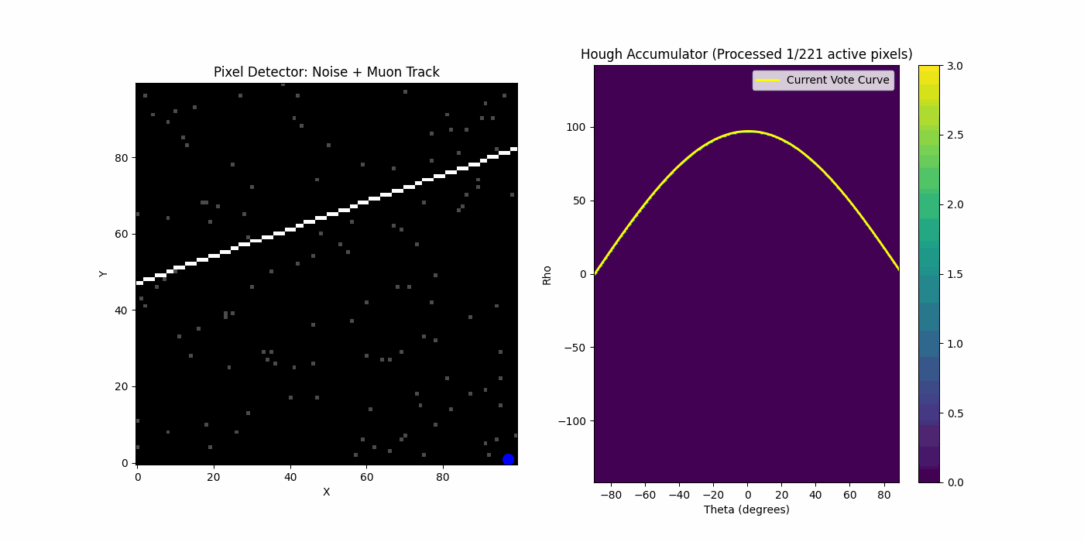
Ben Cattermole
Email: bc392@sussex.ac.uk
Simulation - Simulations of detector prototypes
The Hough transform can be used to find straight lines in images…
…or tracks in a pixel detector
Lines that pass through a pixel given by X, Y satisfy
c = y - mx
Use polar coordinates to avoid m = ∞
100 by 100 with fake muon track and noise

Slide 10
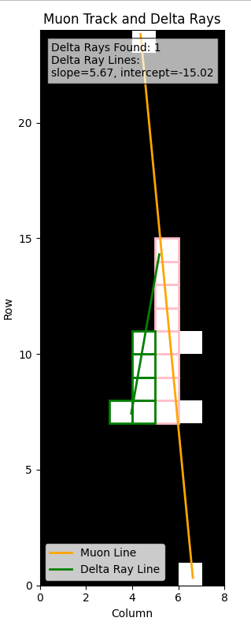
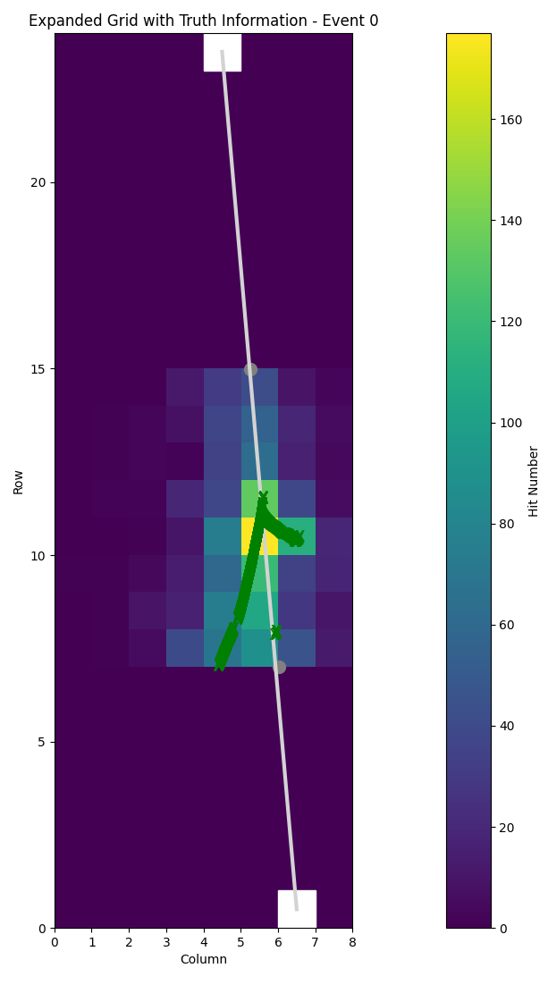
Ben Cattermole
Email: bc392@sussex.ac.uk
Simulation - Simulations of detector prototypes
The Hough transform is able to track muons in our cube prototype
It can also be used to find delta rays
We expect that in larger LiquidO detectors it will work even better
Possibility to use circular Hough transform to find light balls?

Slide 11
Ben Cattermole
Email: bc392@sussex.ac.uk
Final slide
Thank you for listening!
[1] Neutrino physics with an opaque detector. Commun Phys 4, 273 (2021)
[2] An Introduction to Convolutional Neural Networks. arXiv preprint arXiv:1511.08458 (2015).
[3] "GEANT4—a simulation toolkit." Nuclear instruments and methods in physics research section A: Accelerators, Spectrometers, Detectors and Associated Equipment 506.3 (2003): 250-303.
[4] Ratpac two. https://github.com/rat-pac/rat-pac
Contact: bc392@sussex.ac.uk

Slide 12
Final slide
Backups

Slide 13

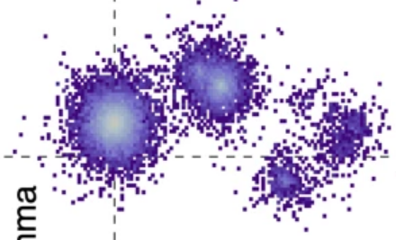
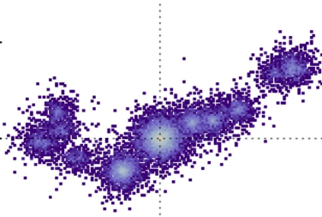
Simulation - CLOUD
What does a IBD event look like in a LiquidO detector?
Prompt signal:
Delayed signal:
Positron annihilation produces light ball
Time delay as neutron thermalises
Single gamma emitted when neutron captured
Two 0.511 MeV gammas, light ball for each compton scatter

Slide 14

Simulation - RATPAC
Simulations were built in Geant4 but there is now an effort to move to using the simulation toolkit ratpac two exclusively for every simulation (95% completed at time of writing this line)
Ratpac two offers a simple interface for macro and geometries that is easy to use and understand
The next big implementation will be a converted from 3d .stp files to gdml

