Slide 1



Cryogenic Characterisation of Veto Photodetectors for DarkSide-20k
S. Ravinthiran
M. Queiroga Bazetto, H. Frandini Gatti, A. Lowe, K. Mavrokoridis, A. Roberts, A.Taylor, J. Vossebeld
University of Liverpool

Slide 2
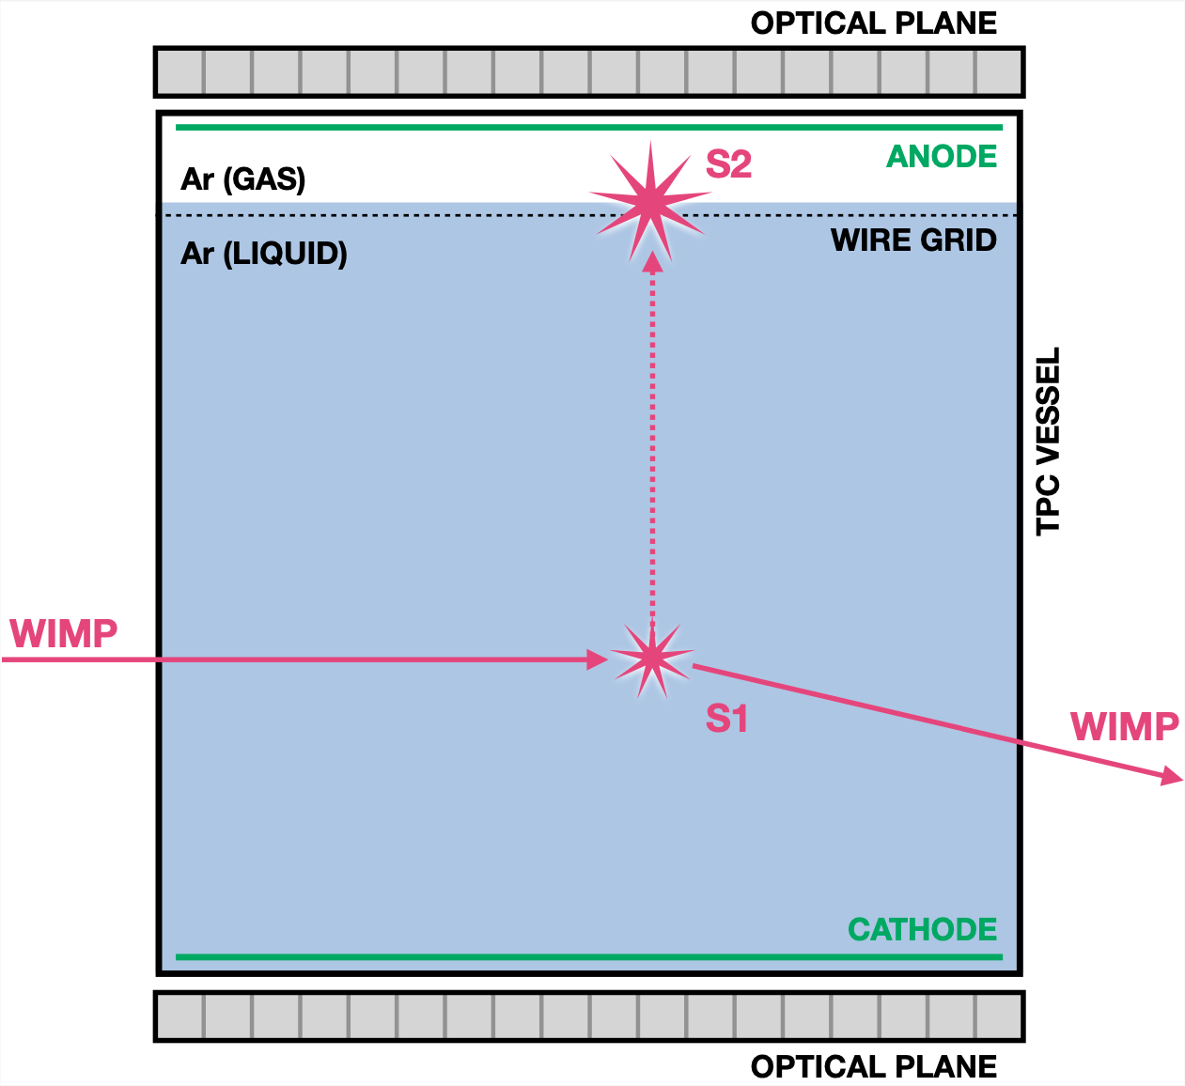
Liquid Argon Dual-Phase Time Projection Chamber
Interactions produce recoils that undergo ionisation energy loss in LAr
• producing excimers, dimers and free charges
Primary signal (S1)
• Decay of dimers produces scintillation, detected as S1 signal
• Timing distribution of S1 used for particle identification
Secondary signal (S2)
• Electrons drift in liquid, extracted into gas phase
• Electroluminescence in gas phase proportional to ionisation charge is detected as S2, with gain of ~20x relative to S1
Dark Matter Signal identification:
Single-scatter events, in the dark matter search energy region of interest (ROI)
S1 pulse shape discrimination to identify nuclear recoils
S2/S1 ionization/scintillation ratio discrimination
[1] DarkSide-20k dual-phase argon TPC for particle dark matter detection A. Kish, 2021, https://indico.cern.ch/event/1041835/

Slide 3
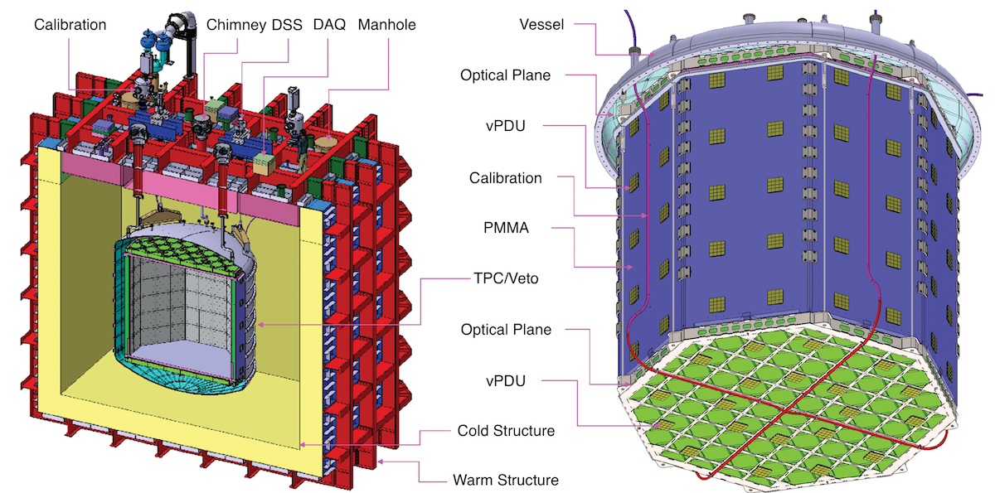
Darkside-20k experiment overview
Dark Matter direct detection experiment for candidates from keV mass to Planck scale
TPC vessel
(Inner veto)
TPC : 2 optical planes with 528 Photodetection Units (PDUs)
Veto: 120 veto-PDUs
Scintillation light in LAr: Wavelength 128 nm
Inner surfaces: coated with wavelength-shifter TPB + reflective film to shift scintillation to 420 nm
Lateral surfaces: coated with PEN + reflective film to shift scintillation to 420 nm
Detected by Silicon Photomultipliers (SiPMs), with >45% photon detection efficiency
UK producing veto photon detection system
Cryostat
[2] Direct Detection of Dark Matter with DarkSide-20k, Paolo Agnes, 2023 https://doi.org/10.1051/epjconf/202328006003

Slide 4
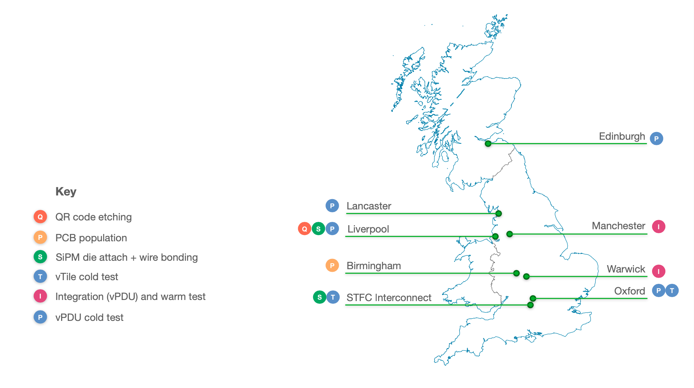

Geographical distribution of DarkSide-20k UK consortium members
AstroCeNT
RAL PPD
[4] Darkside-20k Update: Particle Physics Annual Meeting 2024 presentation by Alan Taylor, University of Liverpool

Slide 5
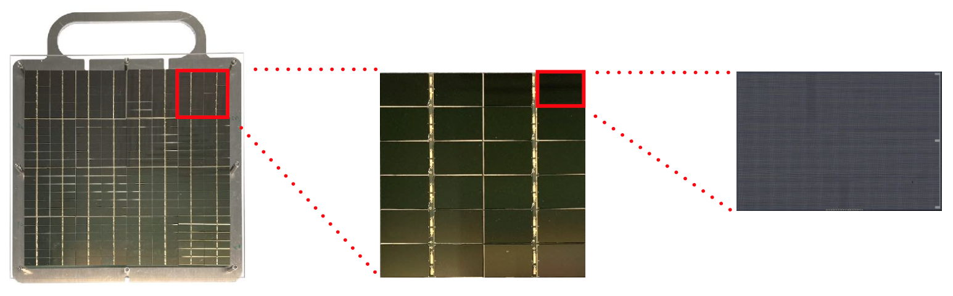
Veto Photo Detection Units (vPDU) assembly overview
SiPM*
(~94900 SPADS)
vTile
(24x SiPMs)
vPDU
(16x vTile)
11.7 x 7.9 mm
5 x 5 cm
20 x 20 cm
*FBK NUV-HD-Cryo triple dose SiPMs

Slide 6

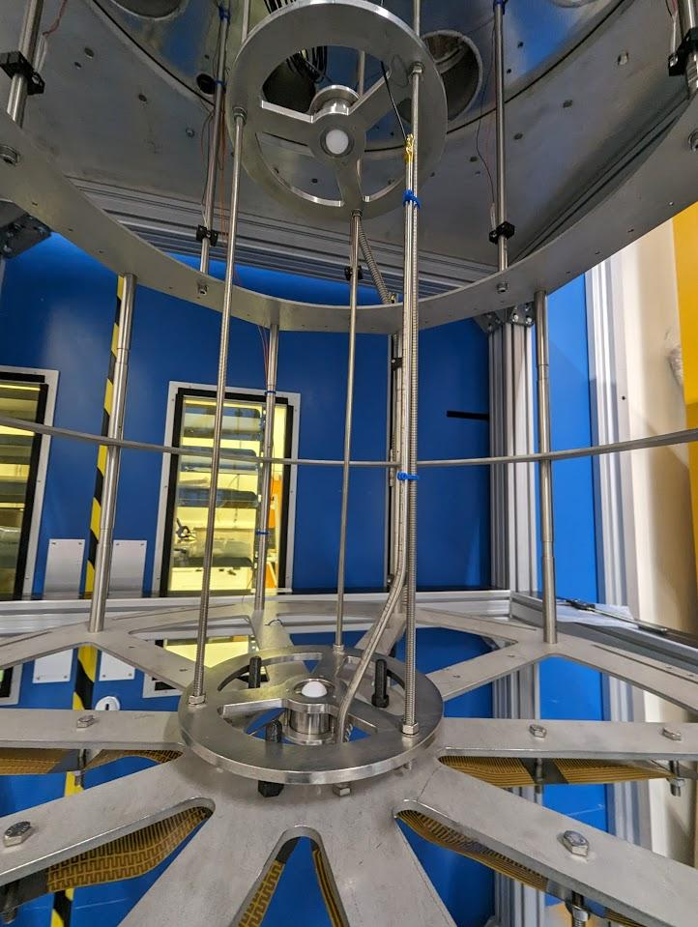
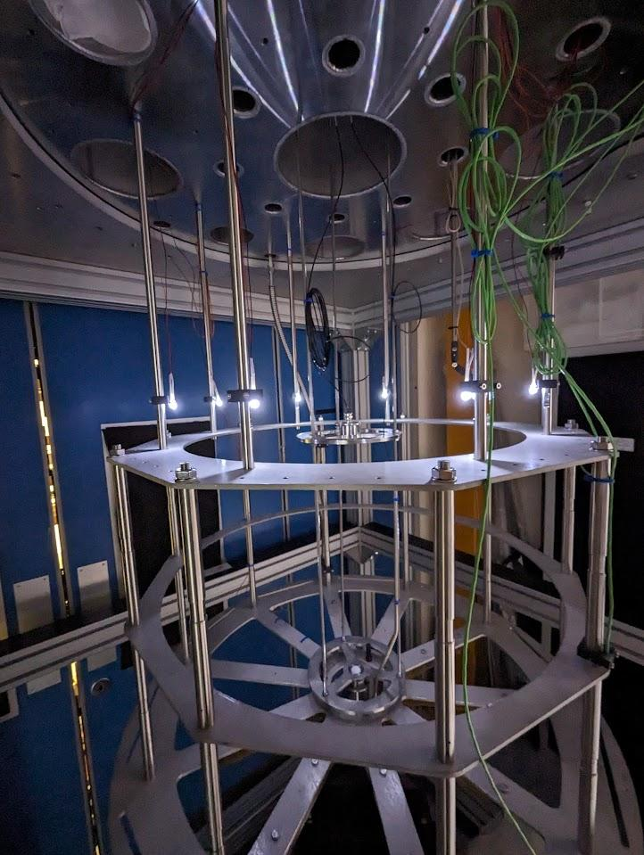
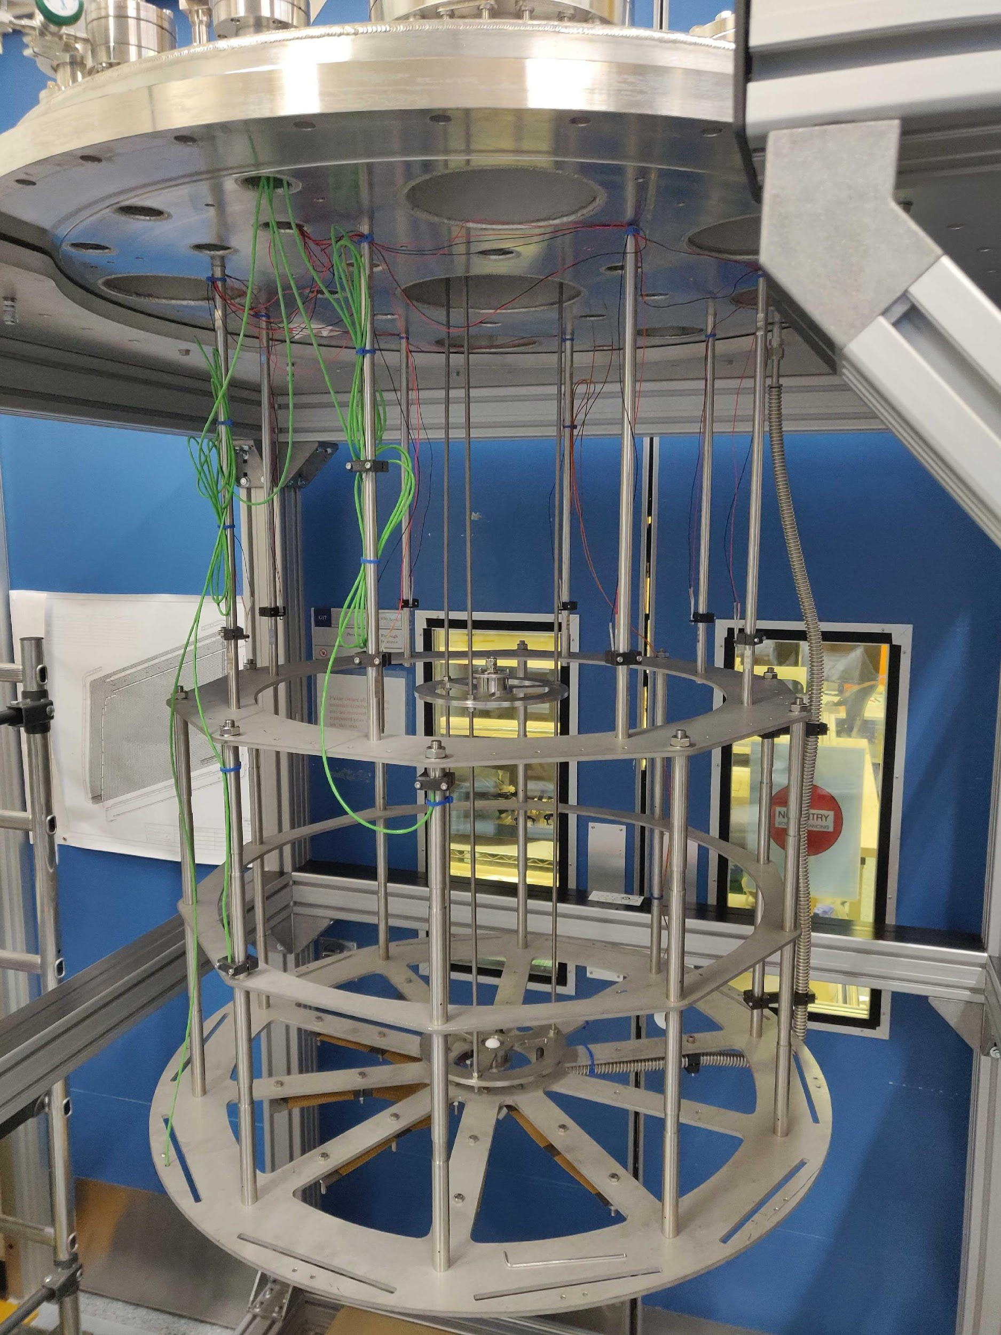
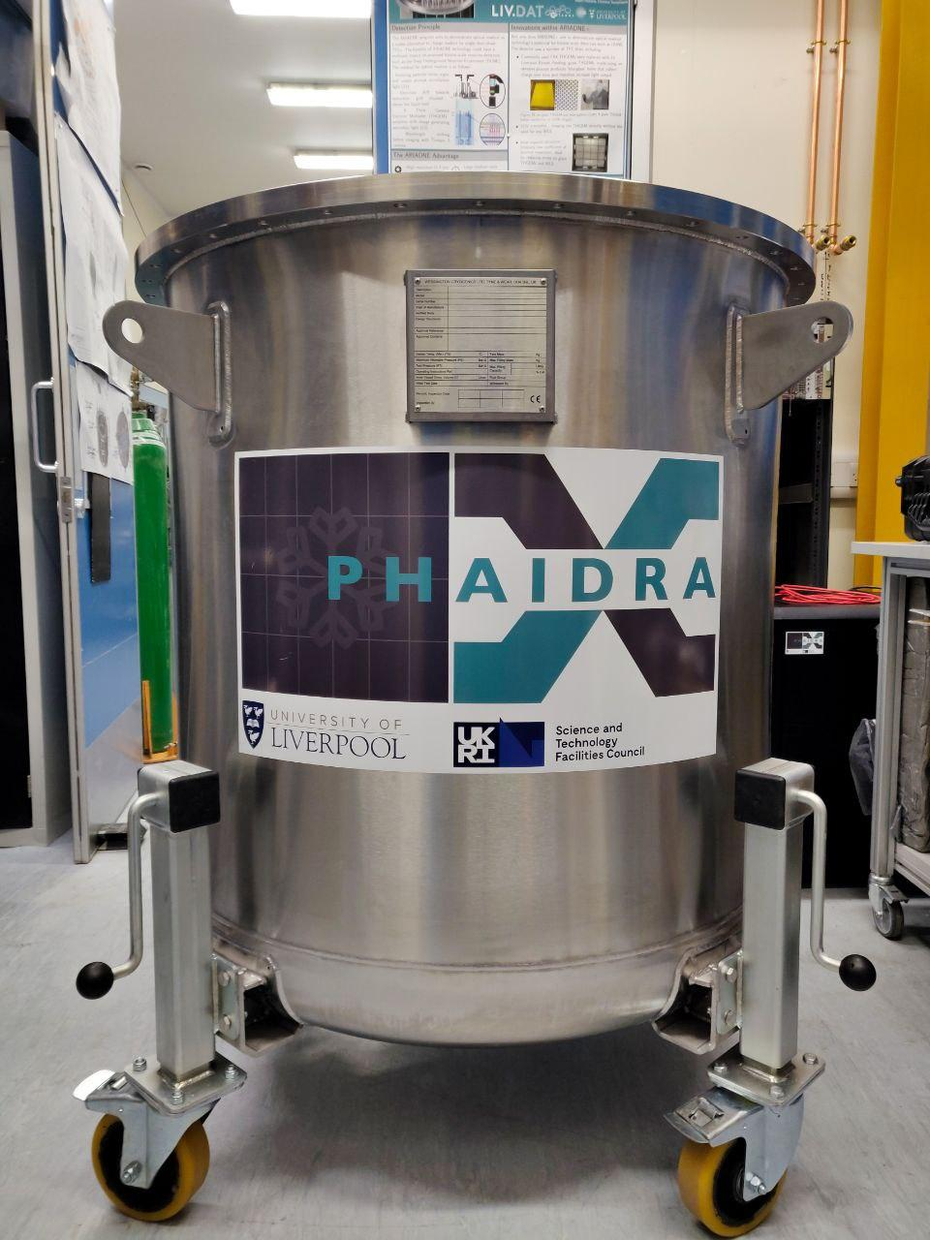
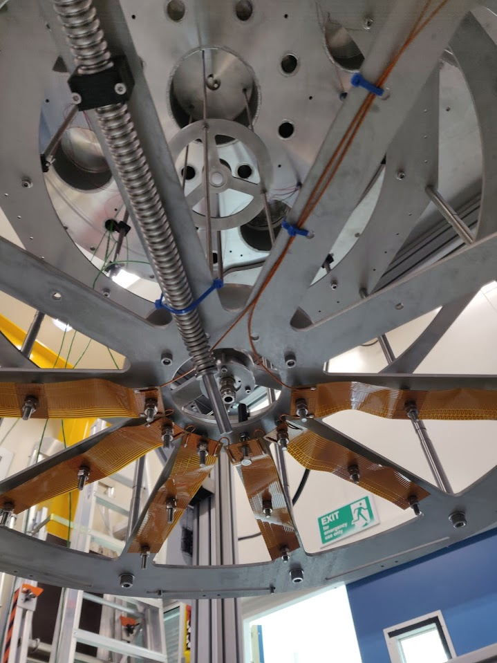
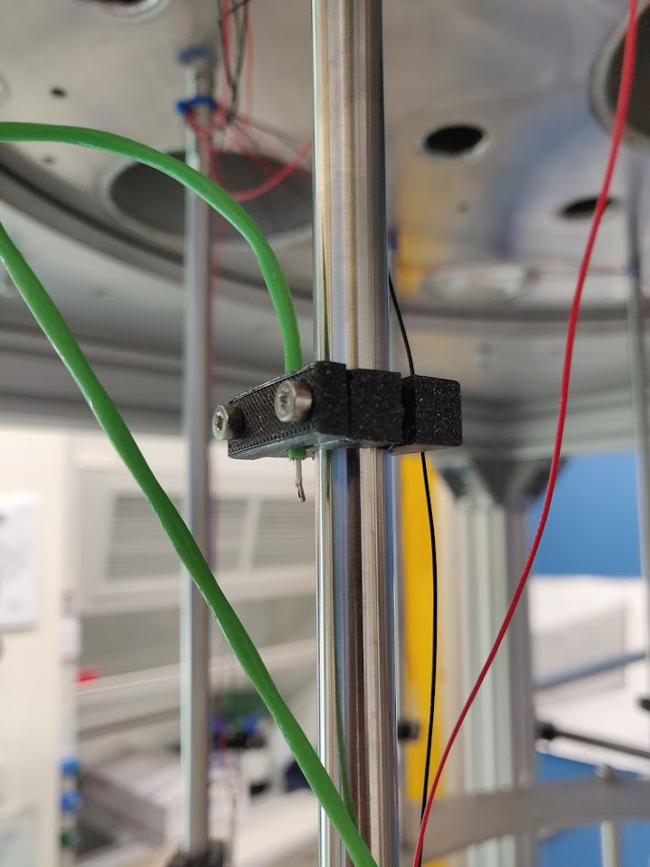
Cold test stand - PHAIDRA
Laser light diffuser
LED and Webcam
Designed to contain up to 16 vPDUs for cold test under Liquid Nitrogen.
Monitoring: 8 LEDs and a Webcam to allow viewing the inside of the vessel.
4 thermocouple sensors to monitor the temperature on the bottom, middle, top and full level of the fixture cage.
Heaters at the bottom of the fixture cage to speed up evaporation of the liquid nitrogen.
A bottom and top light diffuser to provide light around the cage when using the laser calibration system.
vPDU holder cage
Thermocouple
Heater

Slide 7
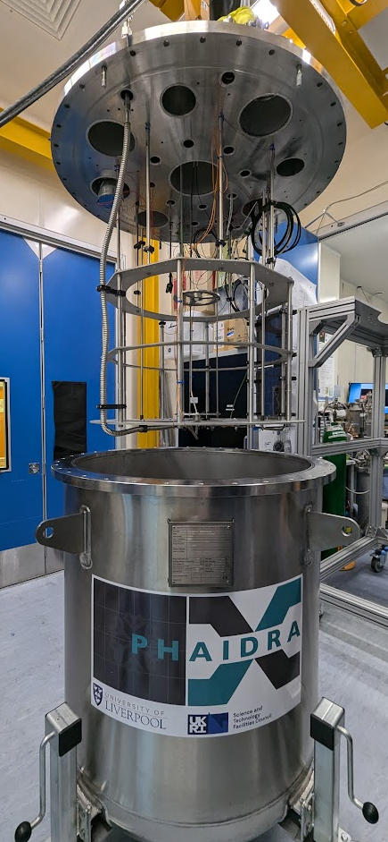
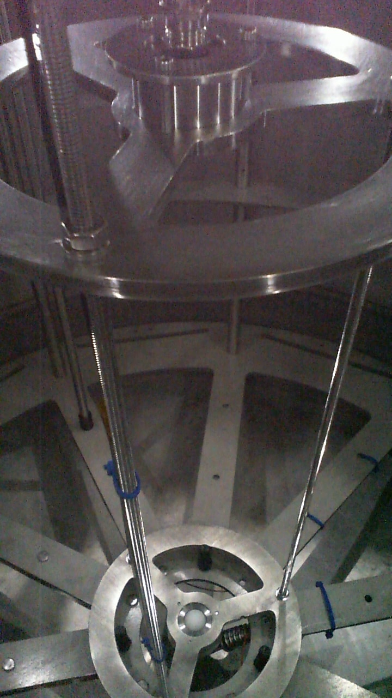
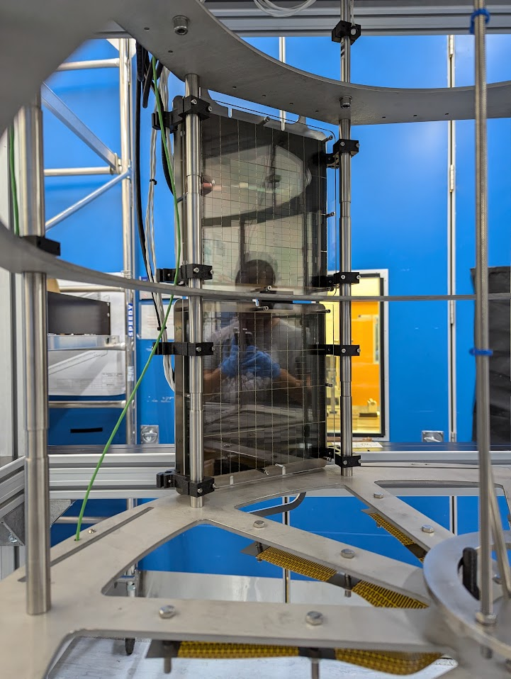
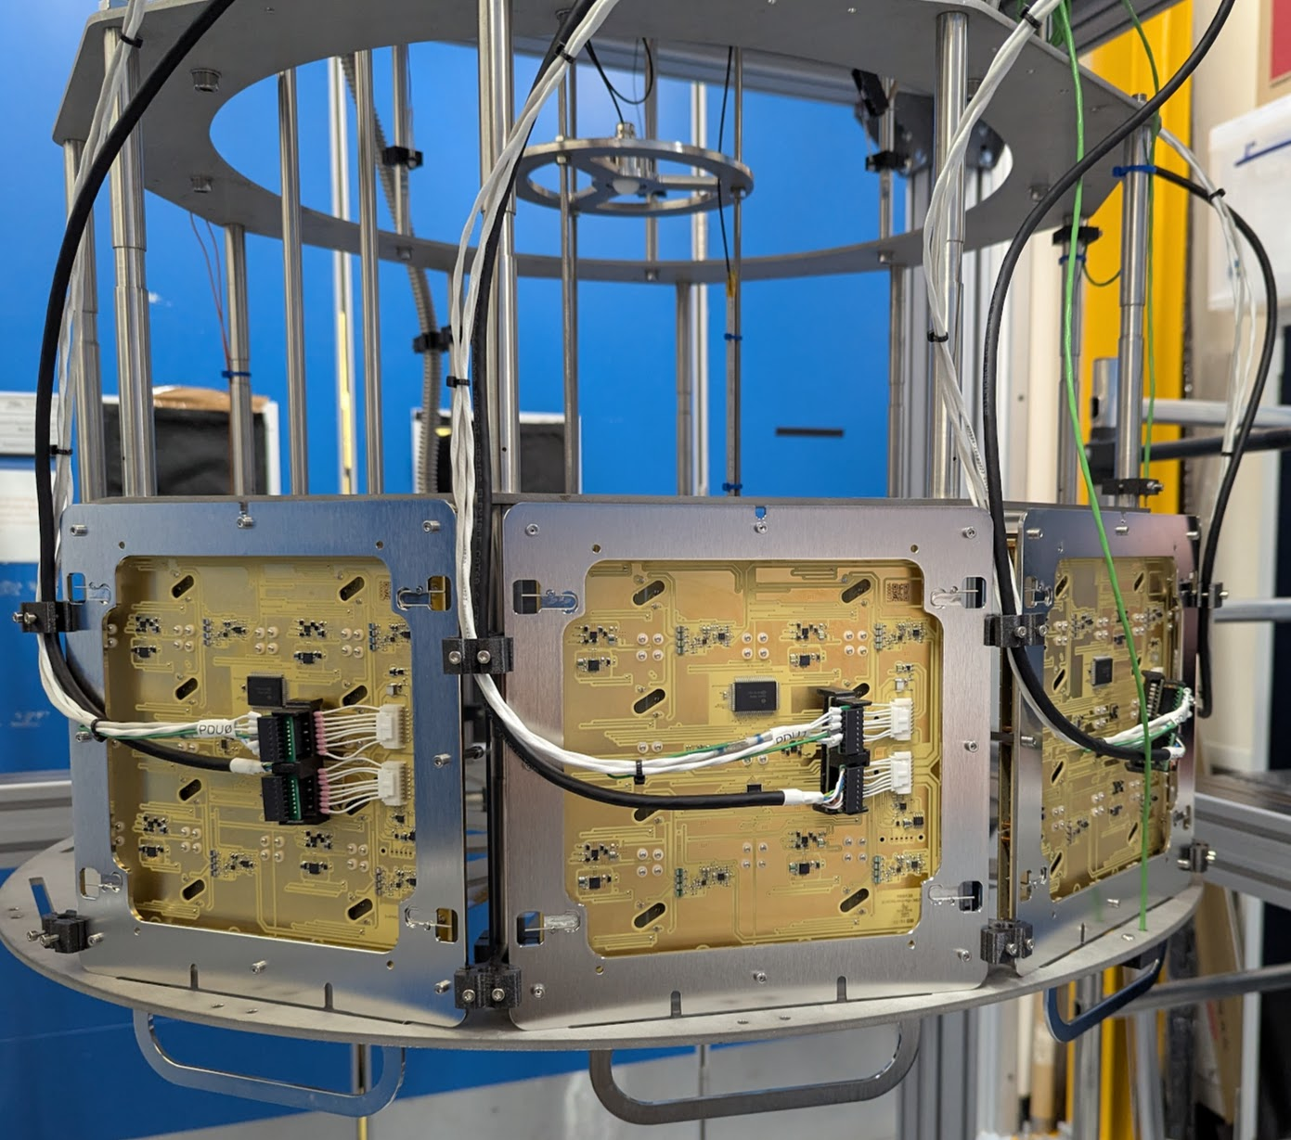
Installing VPDUs
These vPDUs are set on the cage using custom 3D printed fixtures.
Custom cable made to provide power and acquire signal data from each vPDU.
Temperature & pressure slow control available to monitor the liquid Nitrogen filling.

Slide 8
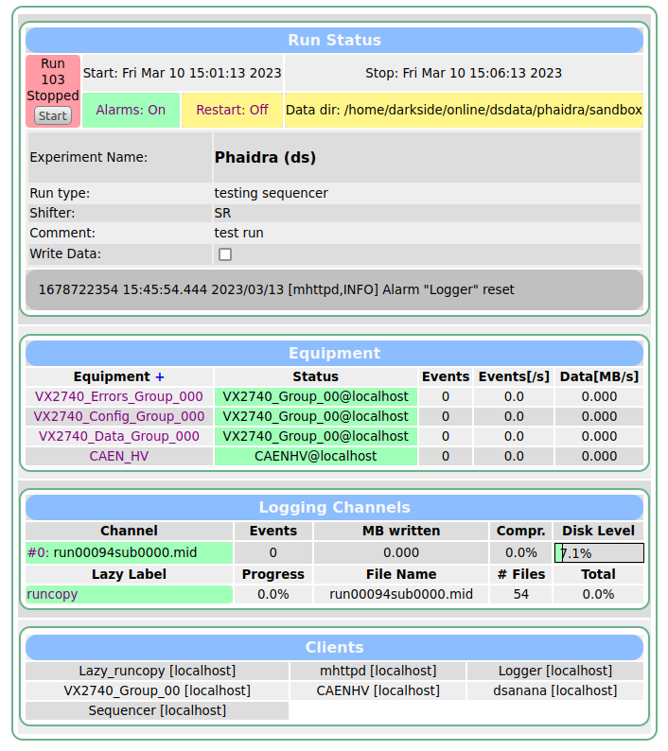
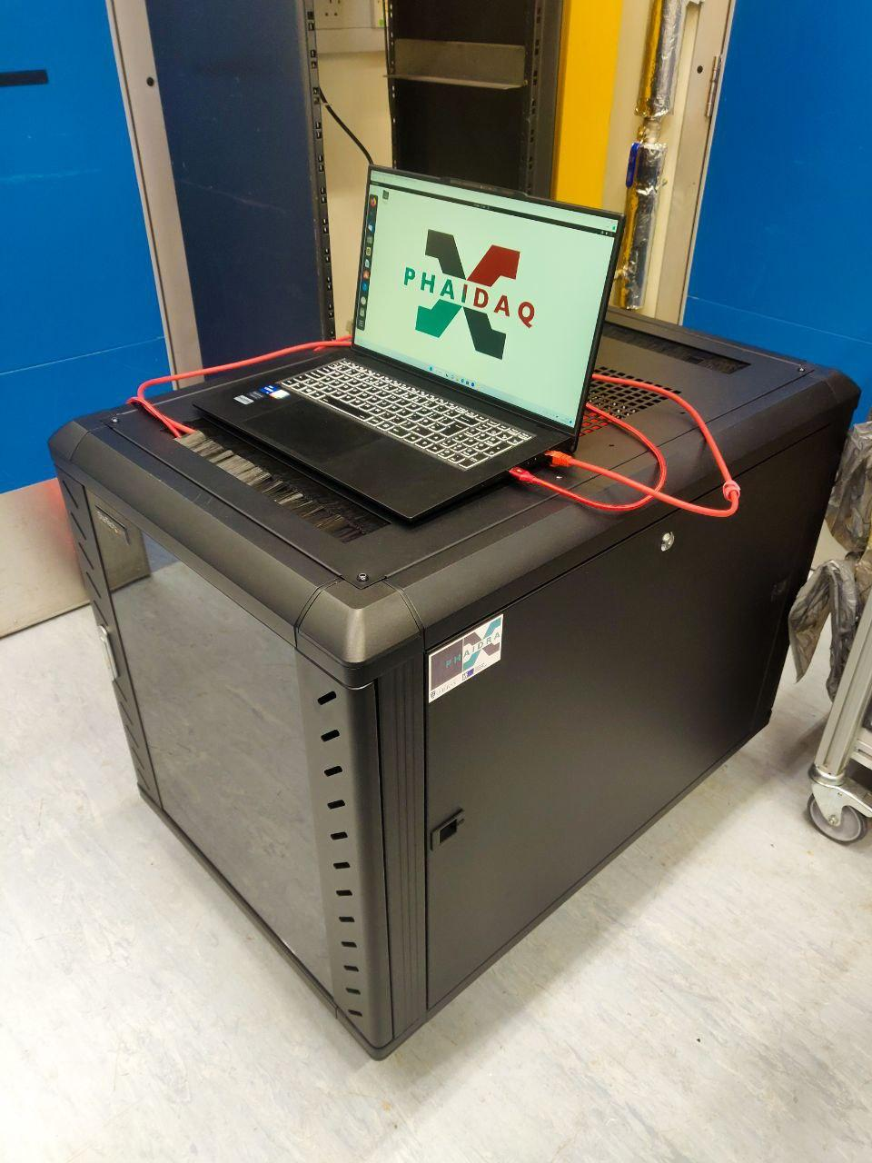
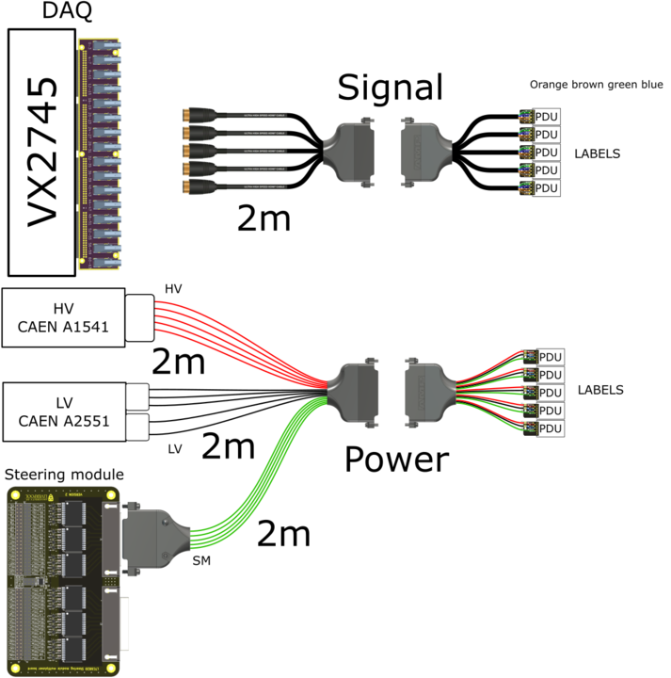

PHAIDAQ
DAQ system responsible for slow control for the cold test using Midas software.
Provides Low/High Voltage
Digitiser to acquire signal data from vPDUs

Slide 9
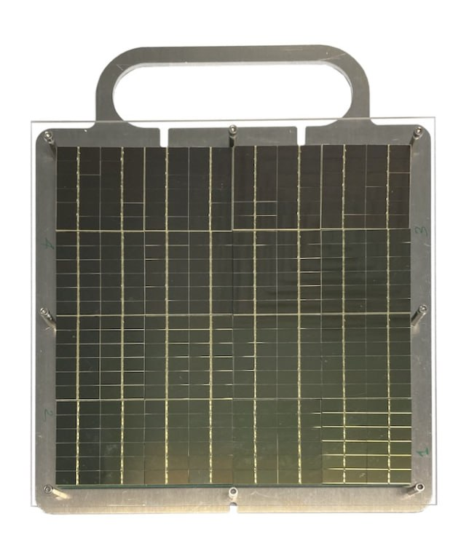
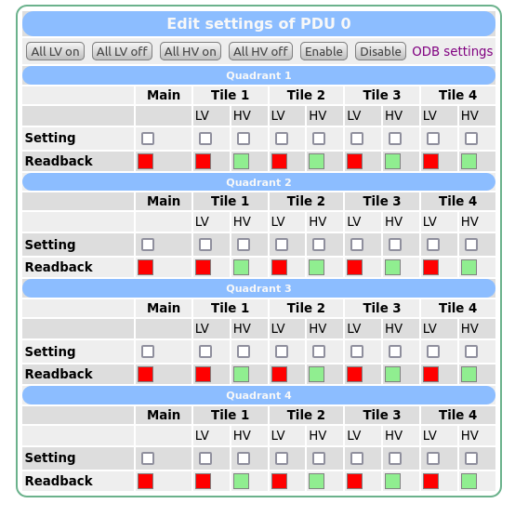
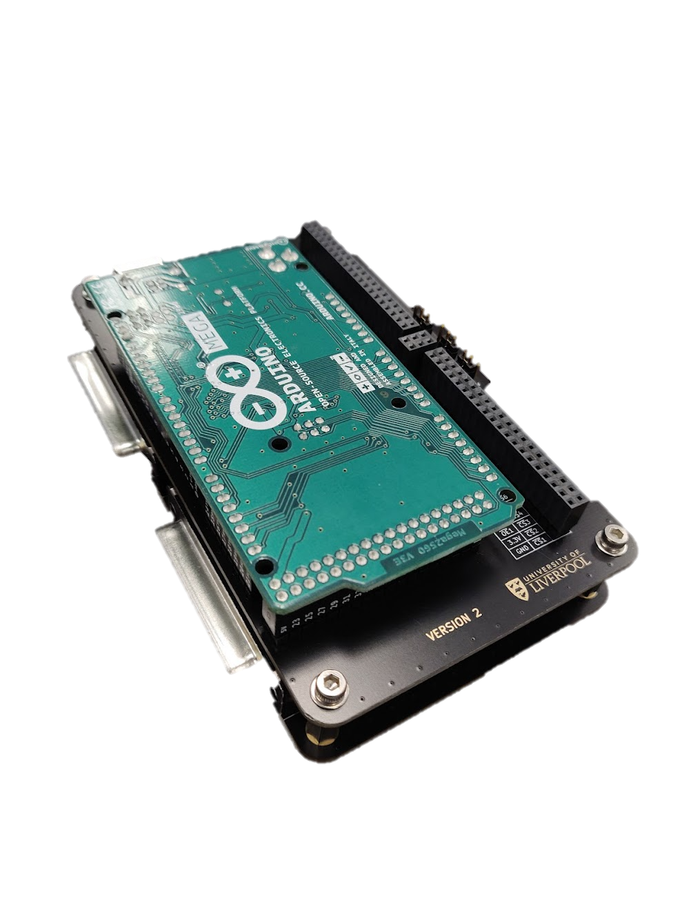
Slow control – Hardware & Software
Each quadrant of the vPDU is allocated a single data acquisition channel, resulting in a total of four channels per vPDU.
A custom-designed steering module has been implemented to apply a controlled bias to individual SiPM tiles.
Data from SiPM tiles within the same quadrant are summed into a single acquisition channel.
Reducing the number of channels per vPDU minimizes the overall load, thermal output and radioactivity associated with cabling.
Q1
Q2
T1
T2
T1
T2
T3
T4
T3
T4
T1
T2
T1
T2
T3
T4
T3
T4
Q3
Q4

Slide 10
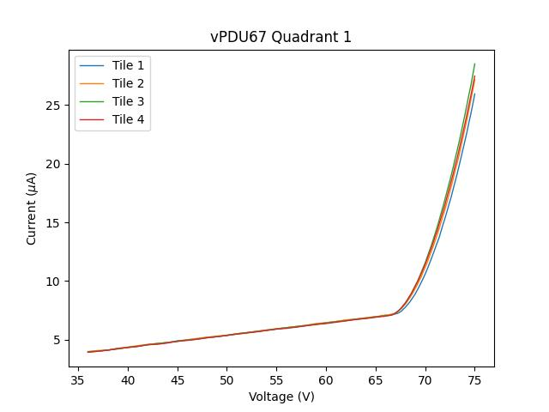
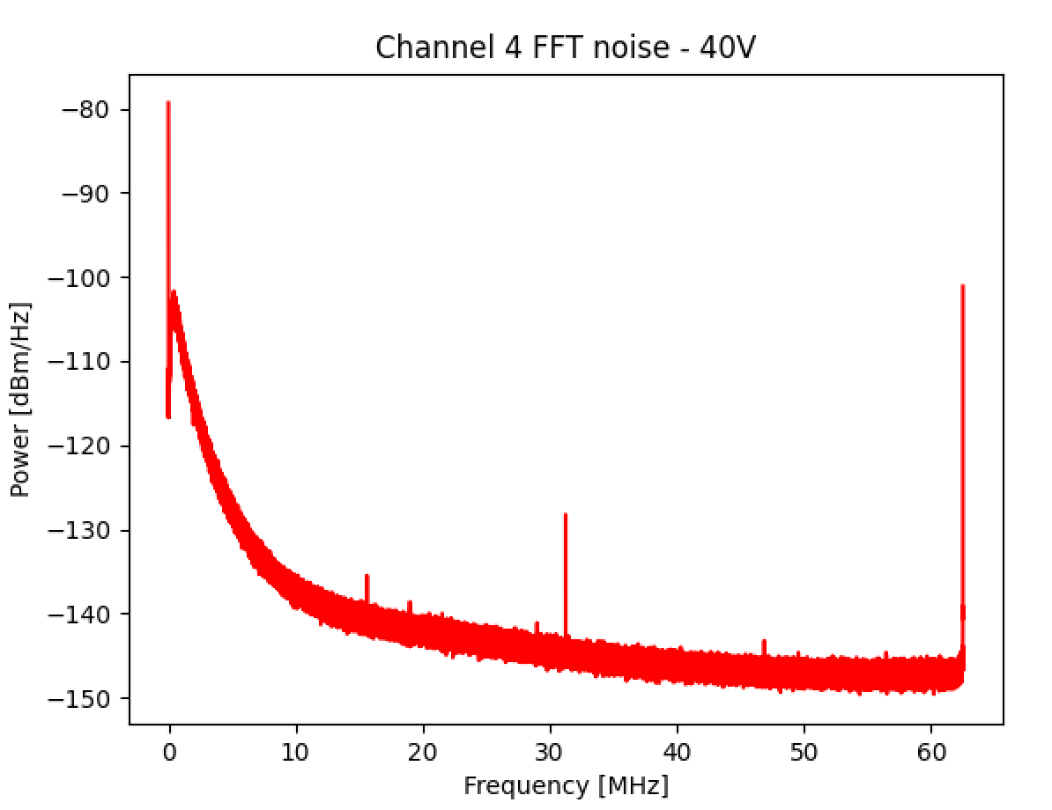
Warm test operations
Initial testing is conducted at room temperature to evaluate the performance of the vPDUs and SiPM tiles prior to their installation in PHAIDRA.
IV Characterization
Each SiPM tile is biased over a predefined voltage range while the corresponding current draw is recorded.
This process enables the assessment of tile performance and the determination of breakdown voltage.
Noise Analysis
Baseline waveforms are acquired from the vPDUs under breakdown voltage bias.
A Fast Fourier Transform (FFT) is applied to the data to identify high-frequency noise, which may indicate potential electrical issues.

Slide 11
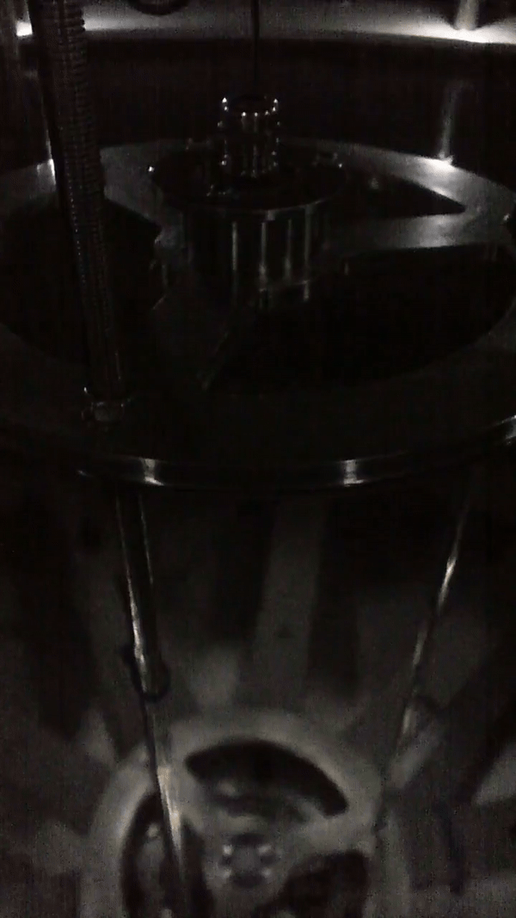
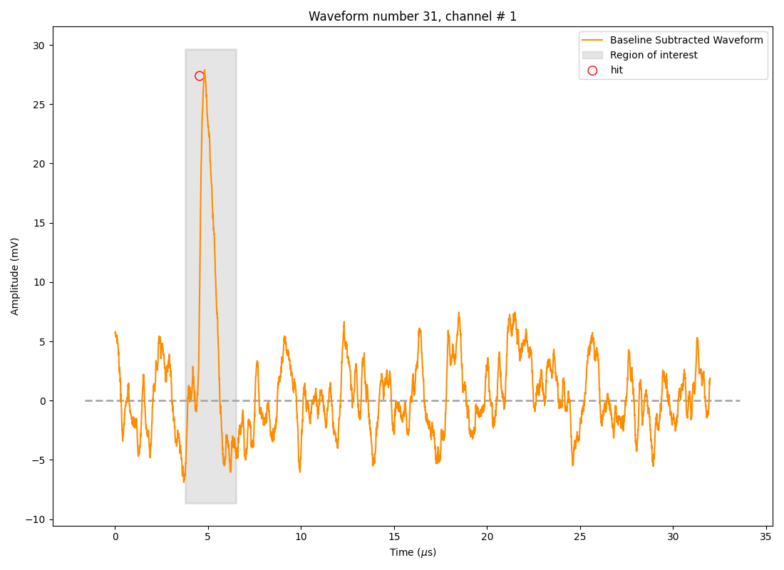
Cold test operations
Laser run
A collimated laser calibration system injects light into the vessel.
Waveform data from the vPDUs are recorded using the laser as the trigger.
vPDU is biased over the Breakdown voltage.
Waveform analysis
Find Max Amplitude: Identify the highest waveform peak in the ROI.
Compute Baseline RMS: Measure noise level from pre-trigger baseline.
Calculate Charge Integral: Sum waveform values in the ROI for total charge.
Light pulse waveform

Slide 12
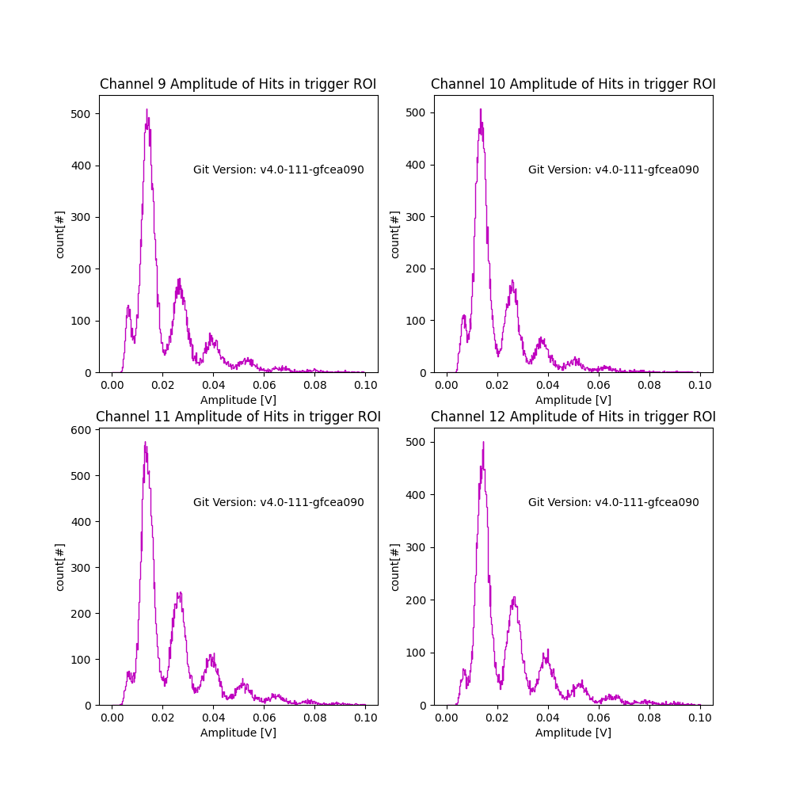
Cold test operations
Pulse Amplitude distribution
By measuring the maximum amplitude of each waveform, we can construct a light amplitude spectrum.
Identify 1 Photoelectron Peak: Locate the first distinct peak in the amplitude spectrum.
Calculate Signal-to-Noise Ratio (SNR): Use the separation between 1 and 2 photoelectron peaks and the RMS of the baseline.
Characterize vPDU Sensor: Extract gain, noise level, and detection efficiency from the spectrum.
Extracting these parameters from each vPDU contributes to their characterization. (Internally called a vPDU Passport)

Slide 13
Summary and next steps
The Darkside-UK team is currently assembling the vPDUs for the DS-20k experiment with a current yield of 78%.
Liverpool’s cold test stand, PHAIDRA, has been commissioned to conduct measurements on these vPDUs.
A future cold test, involving a full set of 16 vPDUs, is scheduled to take place in Liverpool.
Additionally, a potential Liquid Argon run is planned to be performed.

Slide 14
Thank you

Slide 15
Extra slides

Slide 16
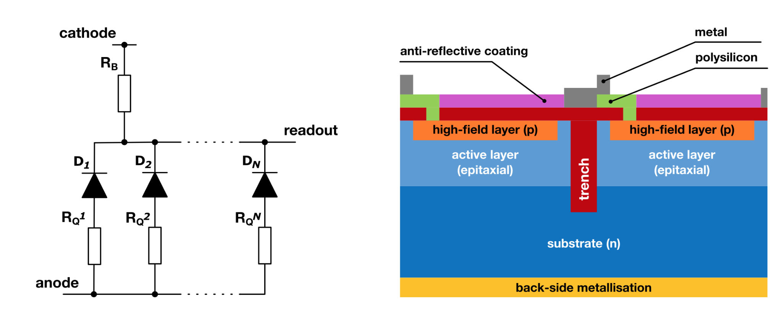
Silicon Photomultiplier’s structure (SiPM)
SiPMs consists of multiple Single Photon Avalanche Diodes (SPADs) paired with quenching resistors, forming microcells.
SiPMs behave like p-n junction photodiodes, meaning their performance depends on factors like reverse bias voltage, temperature, and pressure.
SiPMs have many benefits in comparisons to traditional Photomultipliers as they require lower voltage, are more radiopure, have higher photon detection efficiency, and can be optimized for lower noise at cryogenic conditions.
[3] Claudio Piemonte et al. “Performance of NUV-HD silicon photomultiplier technology”. In: IEEE Transactions on Electron Devices 63.3 (2016), pp. 1111–1116.

Slide 17
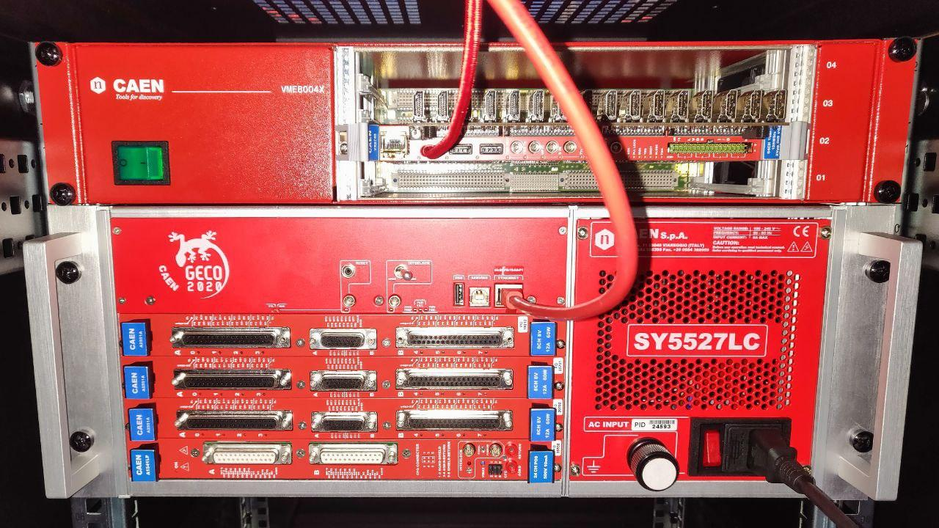
The current setup
Digitizer: Single VX2745 board currently in slot #2 of 4 in the VME80D4X rack:
It is currently connecting to the laptop via USB.
Has 64 channels.
Every 4 channel port is also connected to a single HDMI port. 16 HDMI ports in total.
DC offset of ± 2.5 V.

Slide 18
The current setup
Power Supply: Geco 2020 SY5527LC with:
3 CAEN A2551A boards inserted in the top 3 slots. Low Voltage with 8 channels.
A CAEN A1541LP board inserted in the bottom slot. The power supply is connected to the laptop via ethernet port. High Voltage with 24 channels.

Slide 19
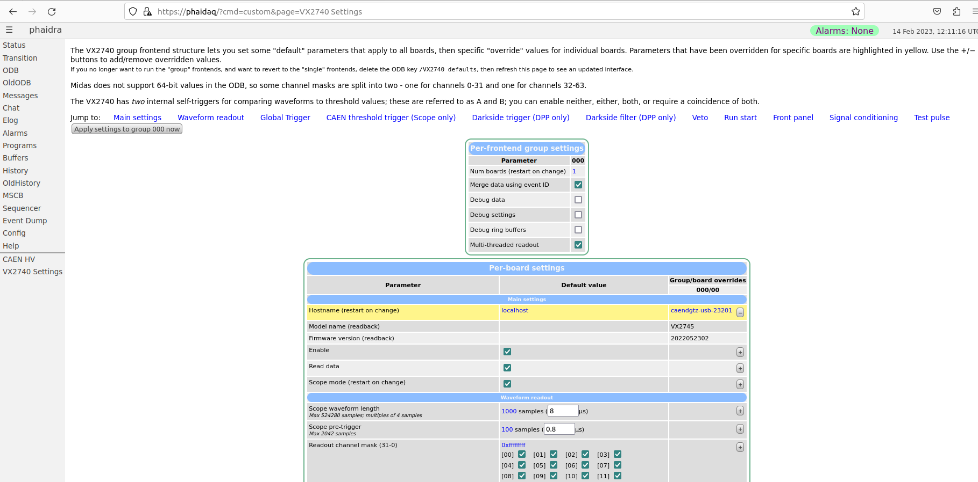
VX2740 Settings

Slide 20
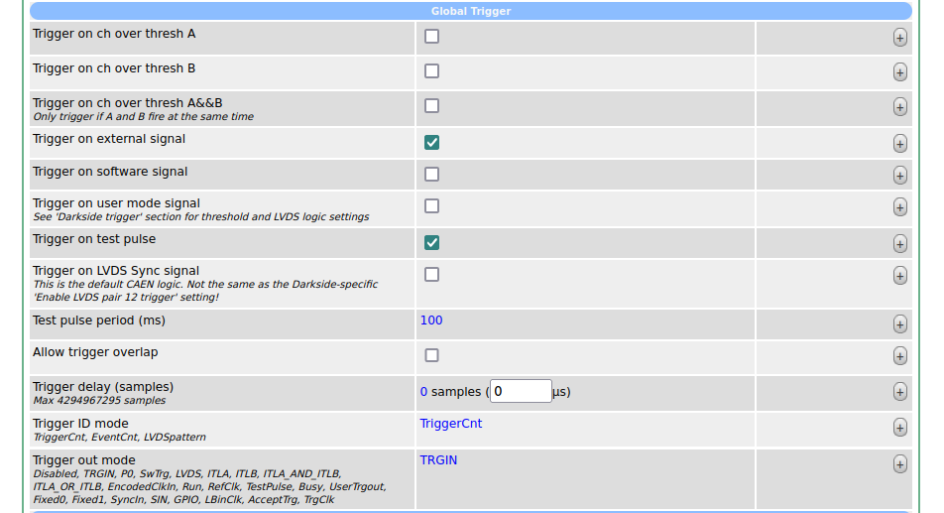
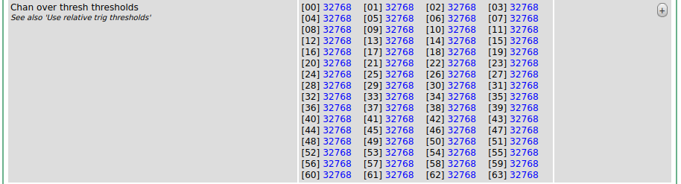
VX2740 Settings

Slide 21
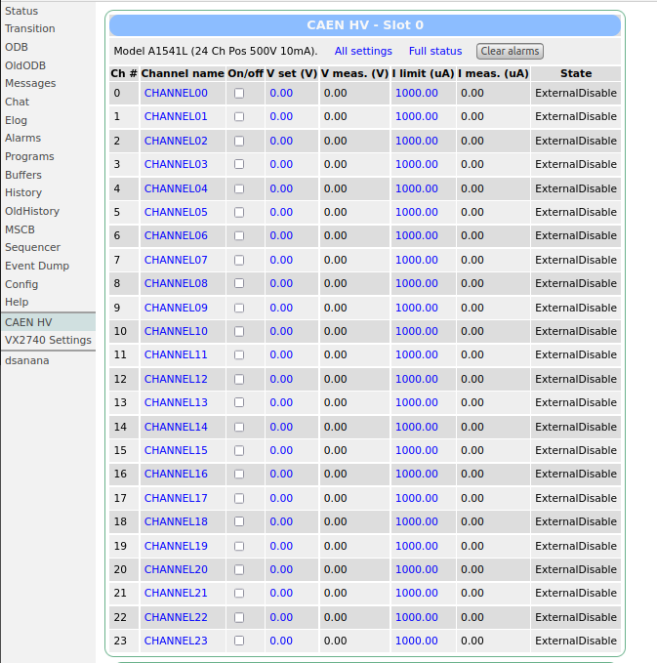
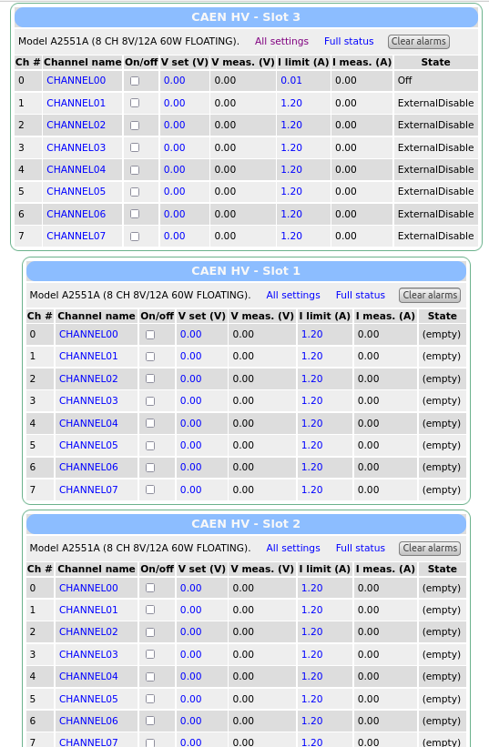
CAEN HV

Slide 22
Making a run

Slide 23

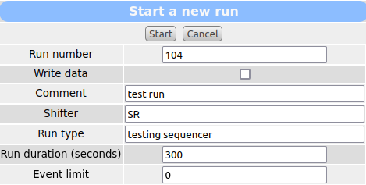
Making a run

Slide 24
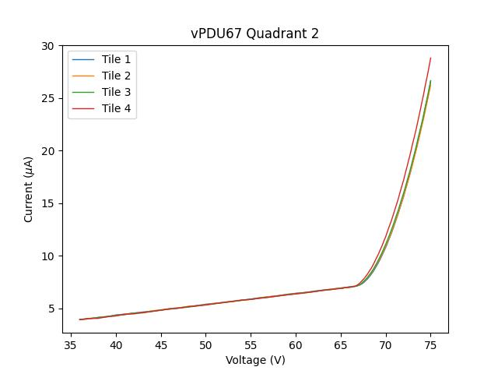
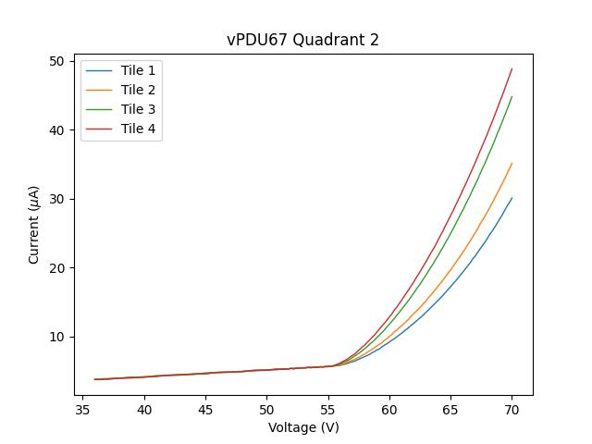
Tile IV warm vs cold
Warm
Cold

Slide 25
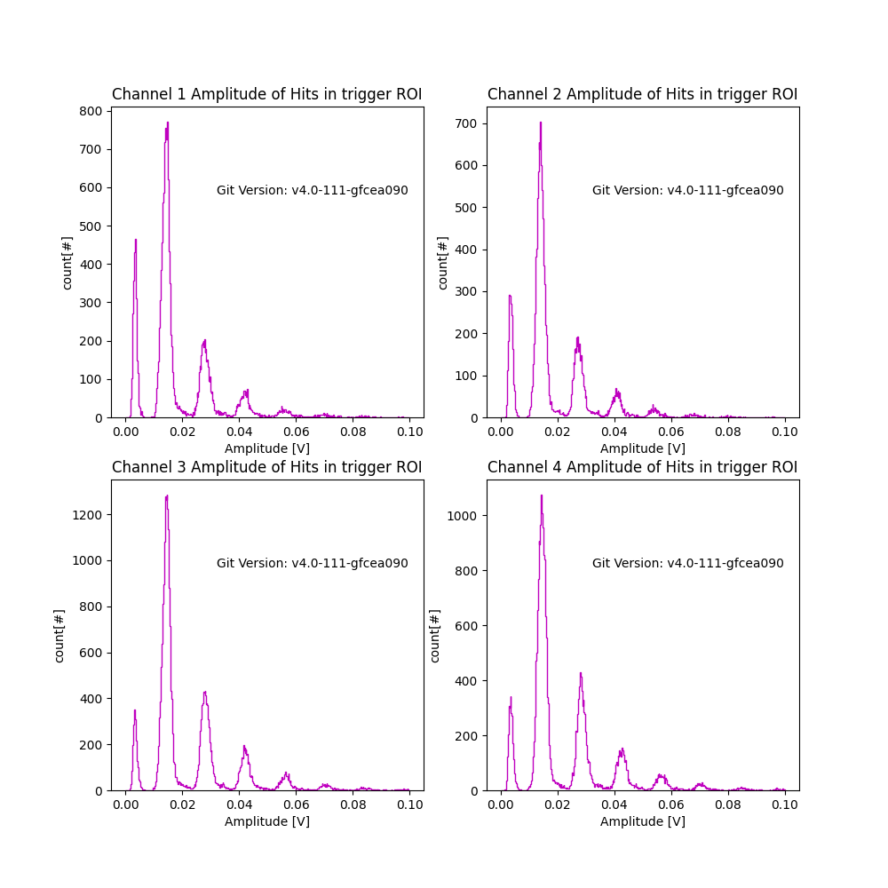
vPDU67 - Tiles 1
Laser setting: Minimum +5
Laser frequency: 500 Hz
Bias: 69V

Slide 26
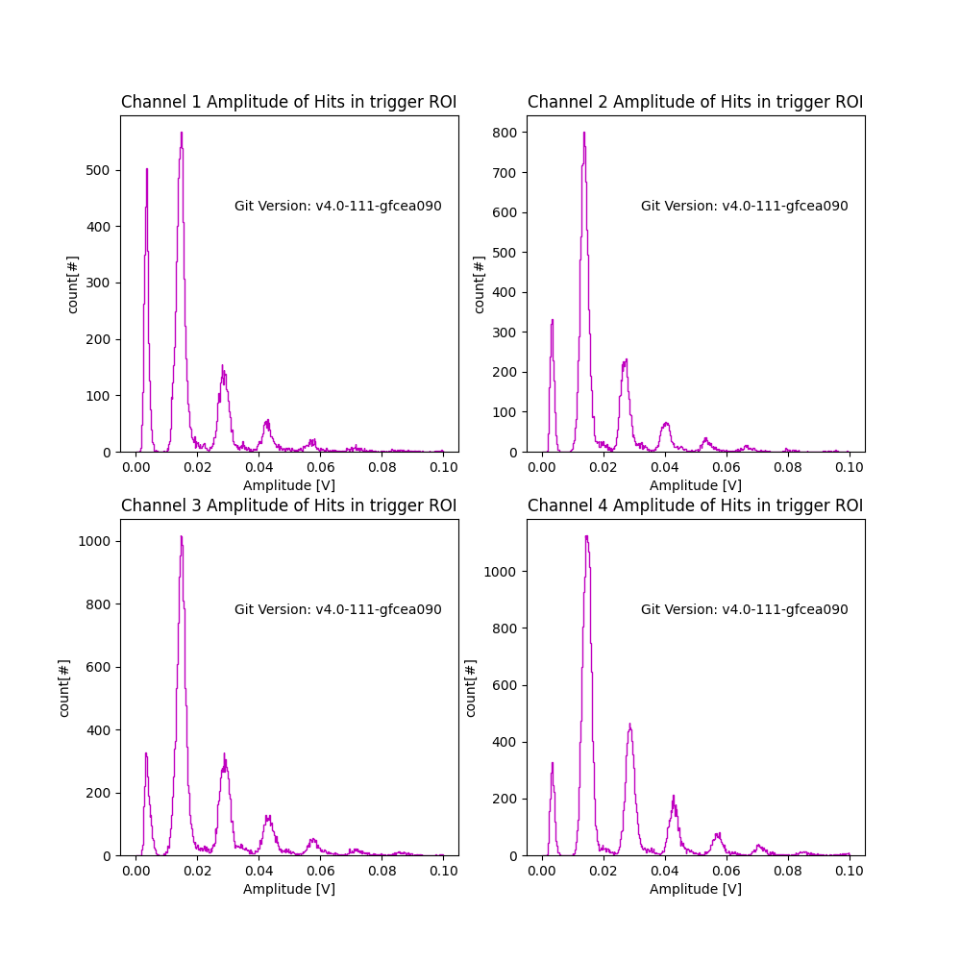
vPDU67 - Tiles 2
Laser setting: Minimum +5
Laser frequency: 500 Hz
Bias: 69V

Slide 27
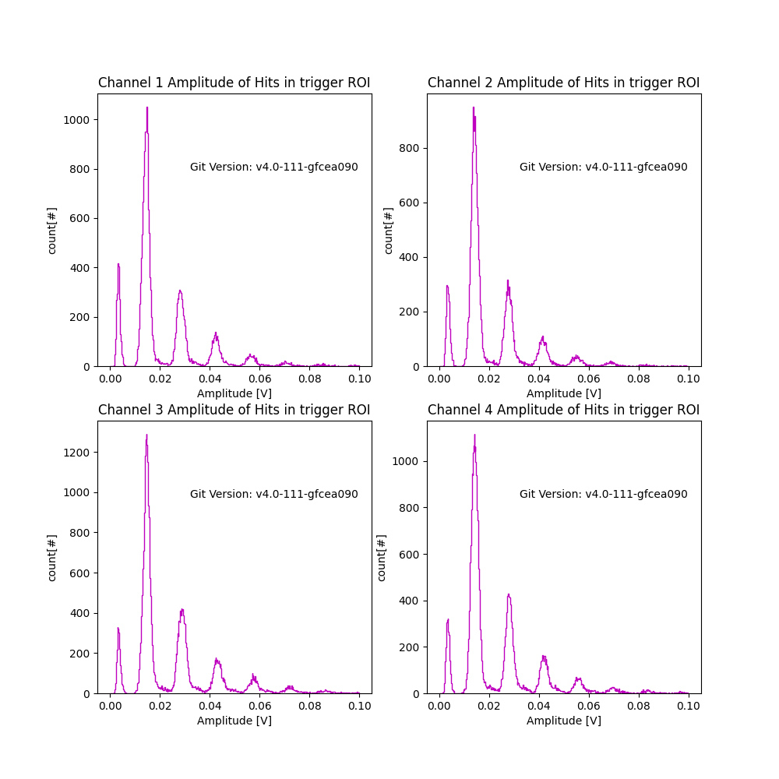
vPDU67 - Tiles 3
Laser setting: Minimum +5
Laser frequency: 500 Hz
Bias: 69V

Slide 28
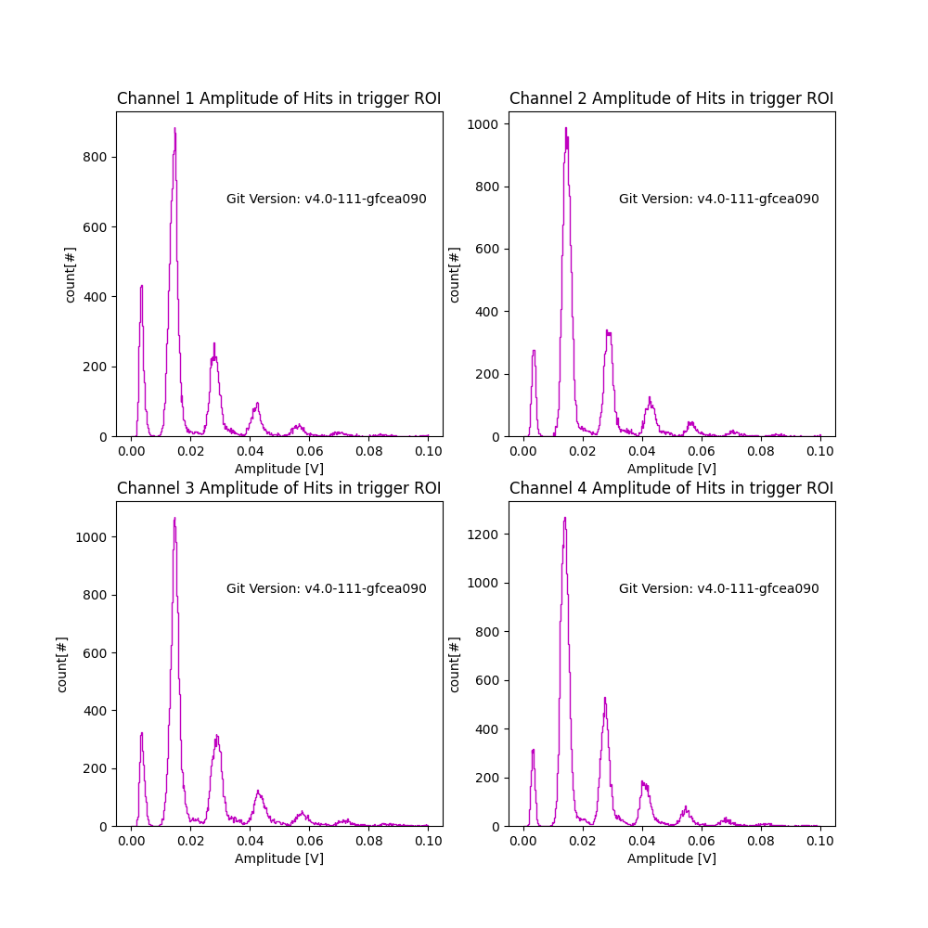
vPDU67 - Tiles 4
Laser setting: Minimum +5
Laser frequency: 500 Hz
Bias: 69V

Slide 29
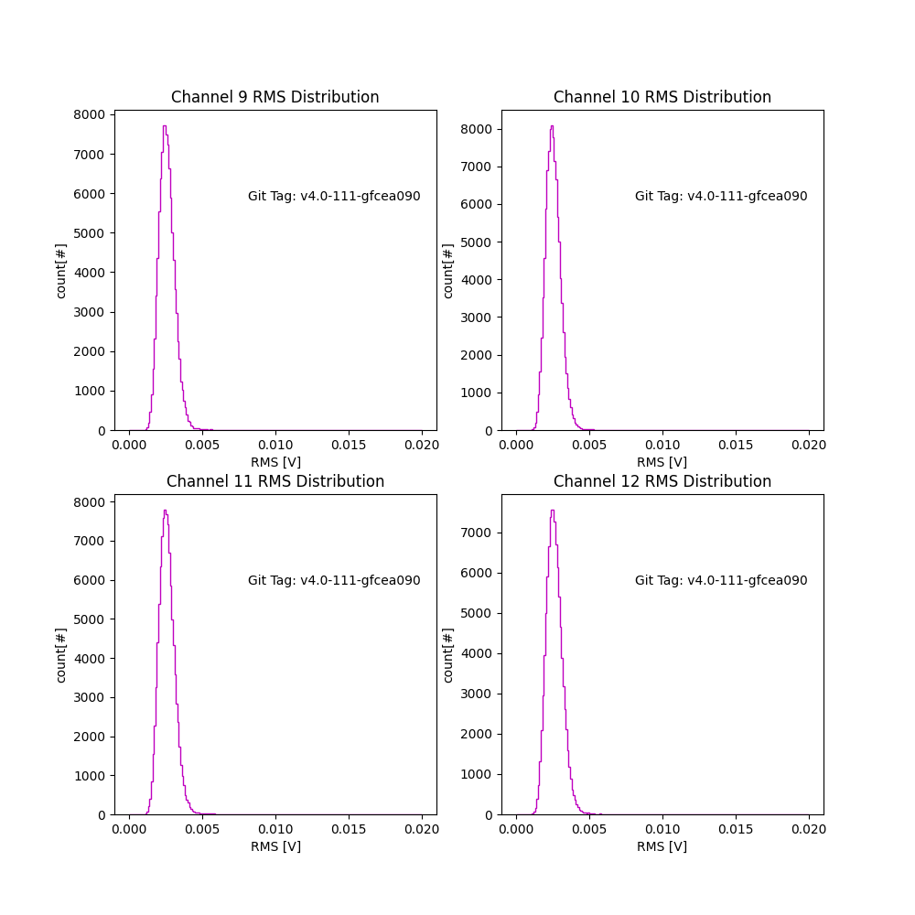
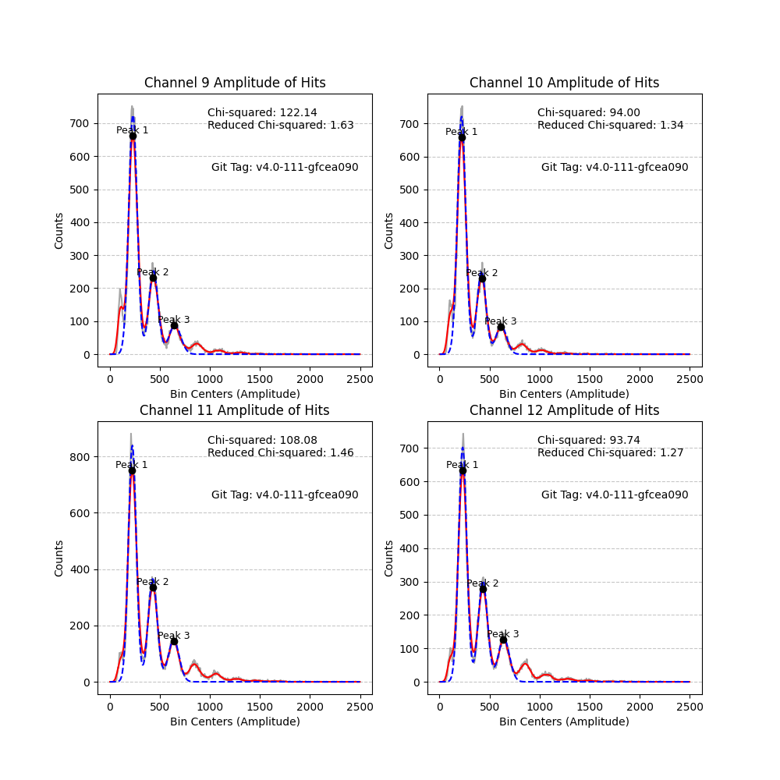
SNR

