Slide 1
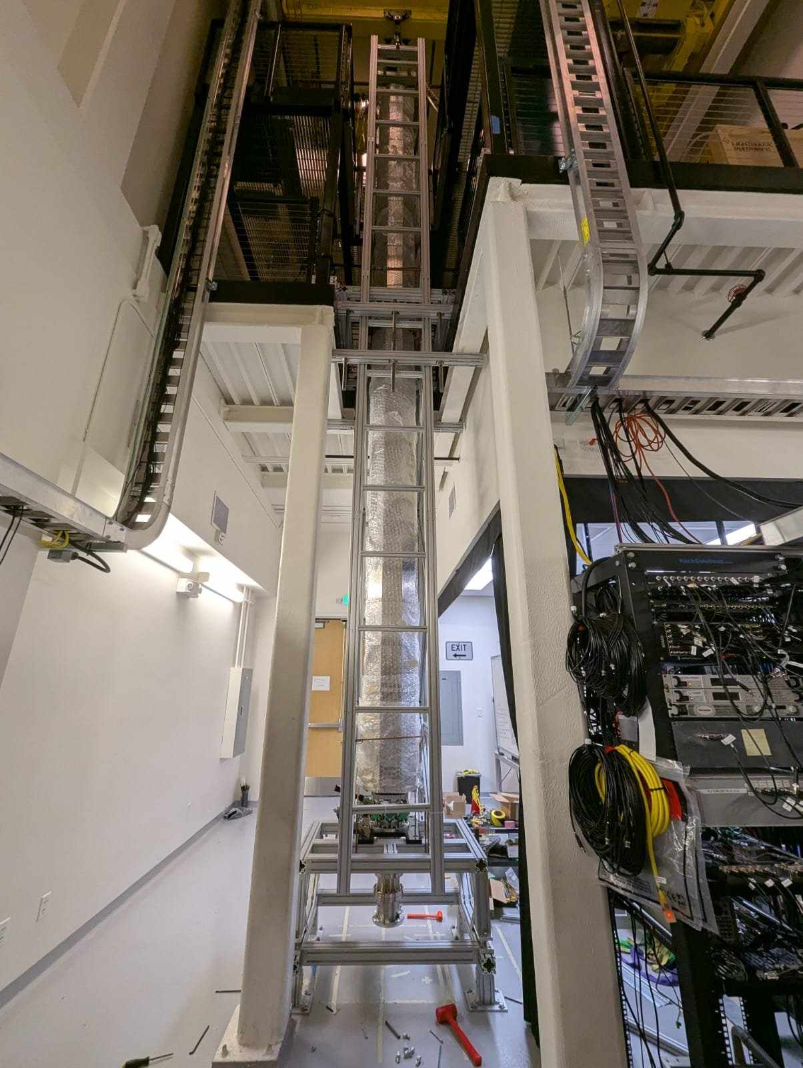
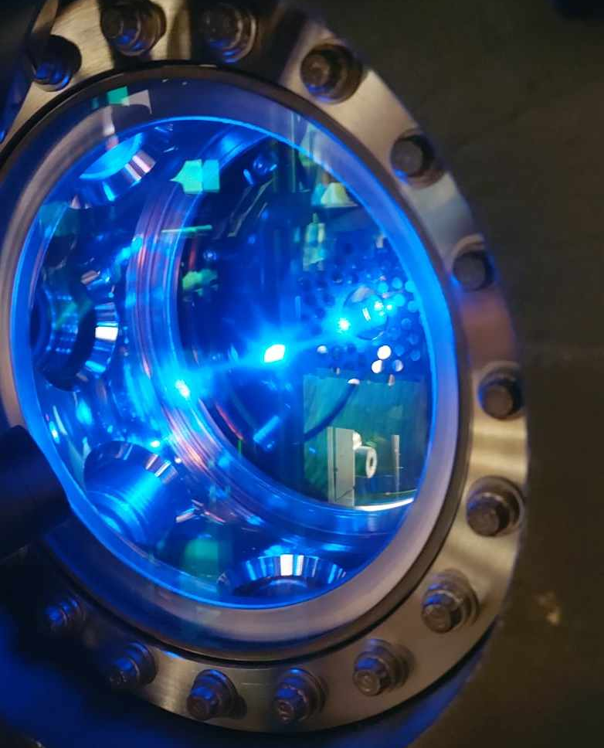
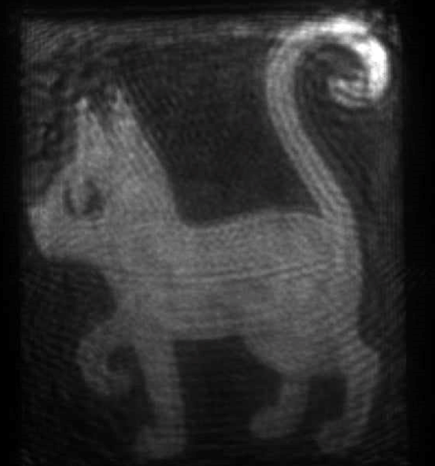


Rotation Compensation System for the MAGIS-100 Prototype
Henry Throssell
IOP HEPP and APP 2025 Meeting h.throssell@Liverpool.ac.uk
Top: The MAGIS-100 prototype
Top Right: A magneto optical trap of Sr-88 atoms
Bottom Right: A hologram of a cat made with the spatial light modulator used for atom trapping

Slide 2
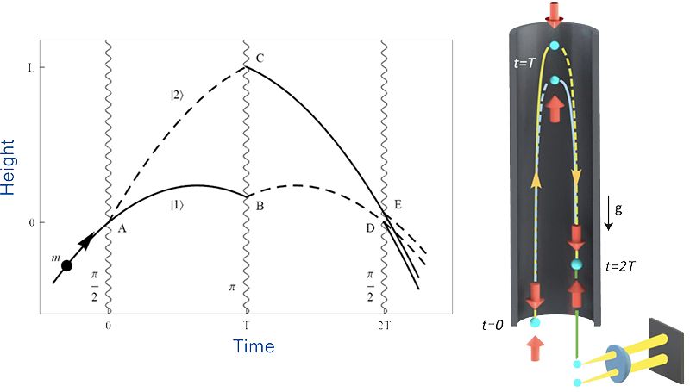
Light Pulse Atom Interferometry
Free falling ultracold atoms (μK-pK) as quantum sensors
Laser pulses open and close arms of a Mach-Zehnder matter wave interferometer
Laser interactions transfer momentum to excited state population
Additional laser pulses (LMT) increase the space time area of the interferometer and enhance sensitivity

Slide 3
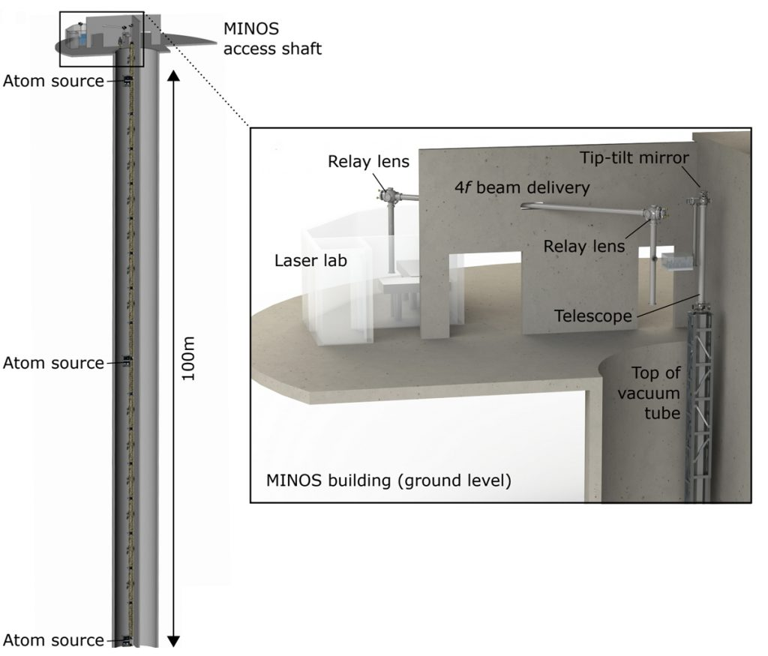
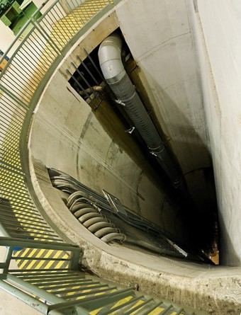
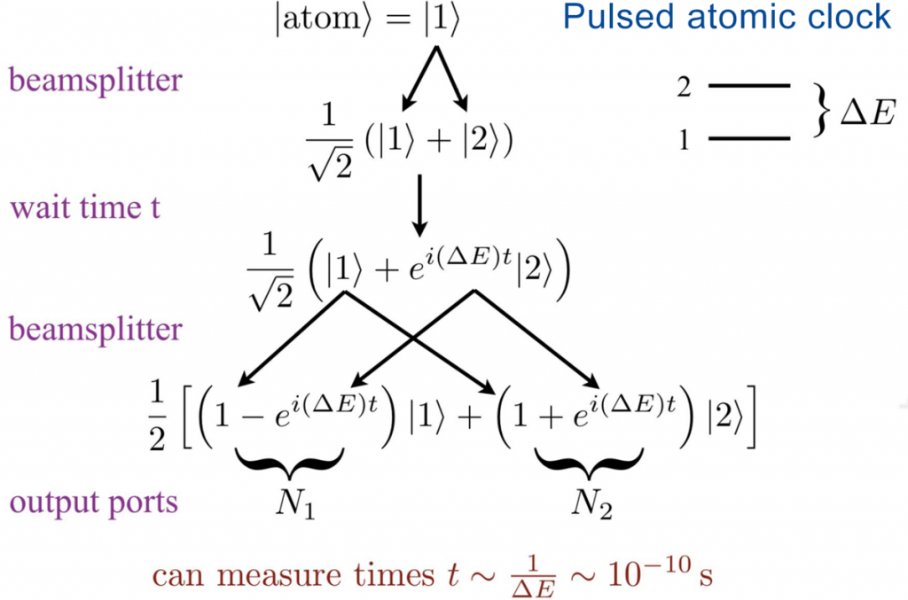
MAGIS-100 - Atom Interferometry for Gravitational Wave and Dark Matter Searches
The MAGIS experiment uses ultracold Sr atoms as a sensor for:
  Mid-band gravitational waves (10mHZ – 10 Hz)
  Ultralight dark matter (10⁻³ -10⁻²² eV)
100 m baseline device under construction at Fermilab, eventual goal of 1000 m and space-based experiments
Simultaneous atom interferometers over a long baseline measure the strain in spacetime caused by GWs
Phase shift recorded by each interferometer depends on the time spent in the excited state, which is directly tied to the light travel time across the baseline
DM induced oscillations of fundamental constants (α, m_{e}) shift atomic energy levels

Slide 4
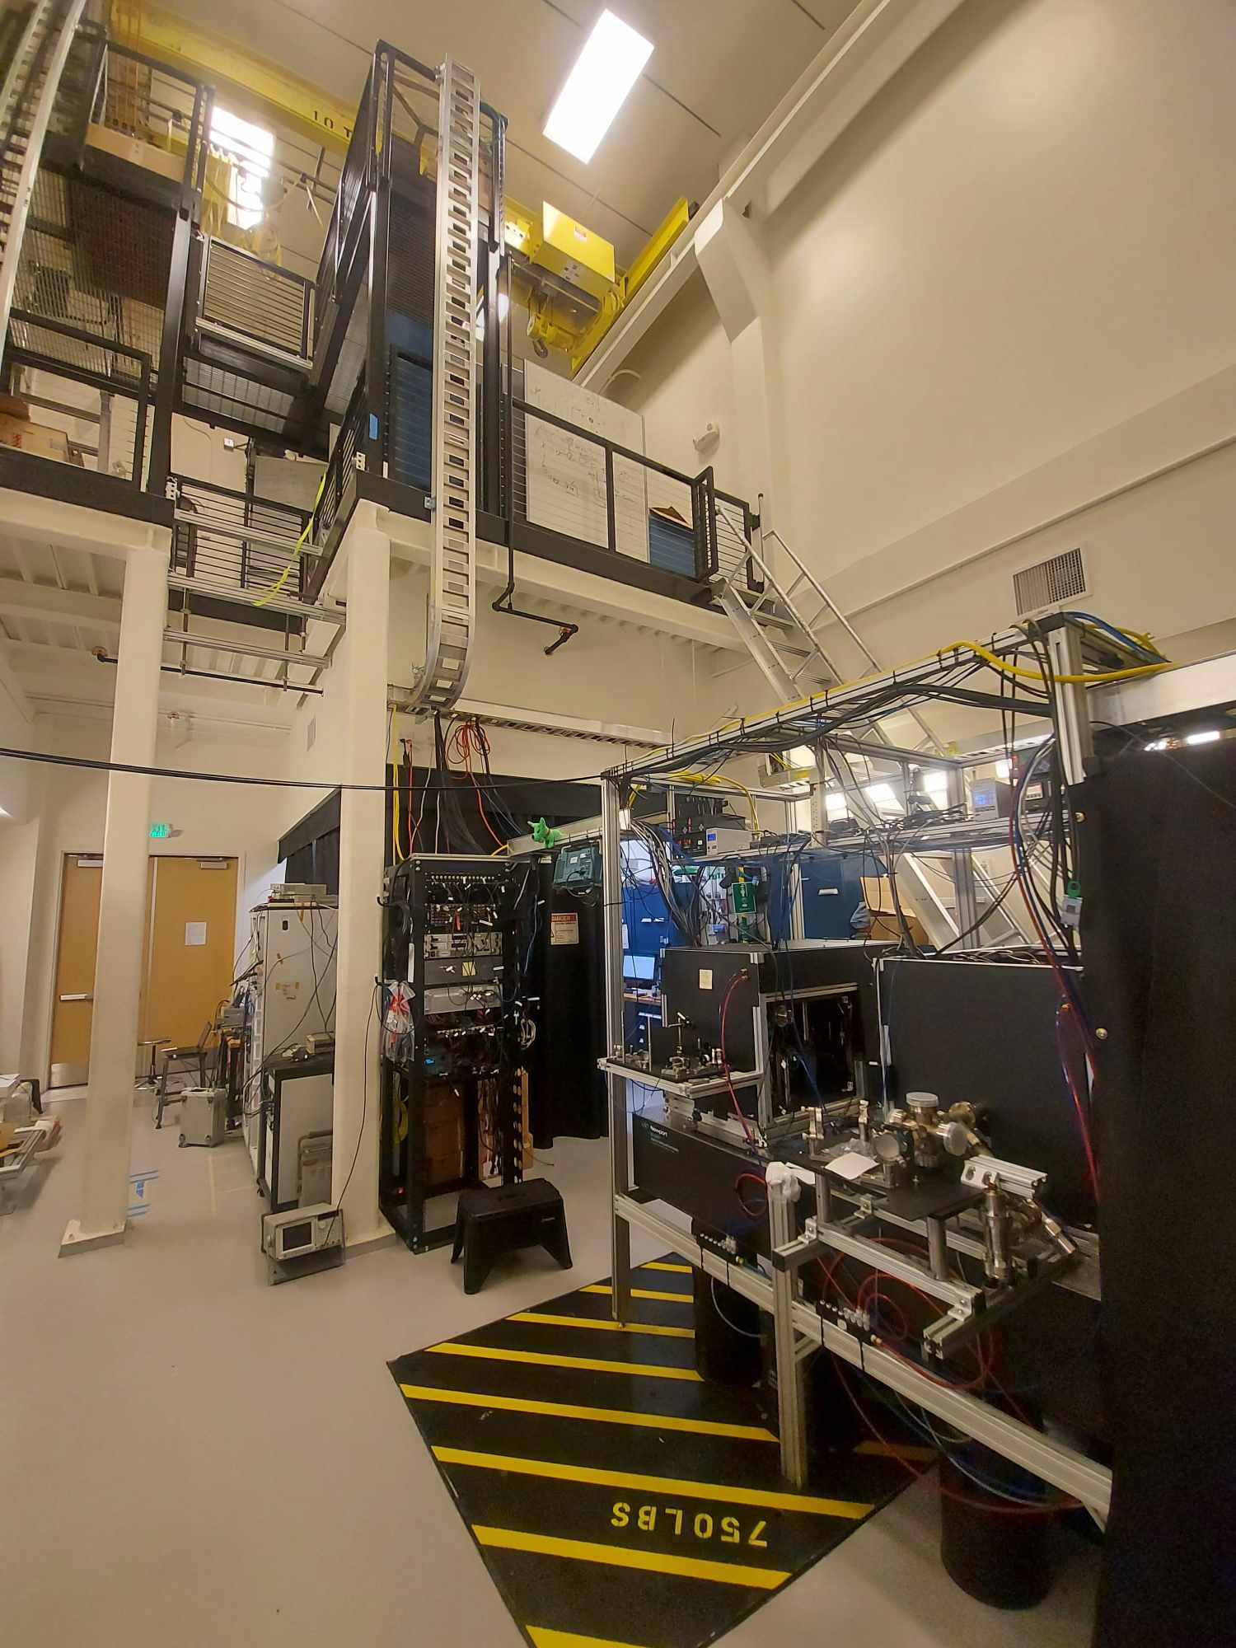
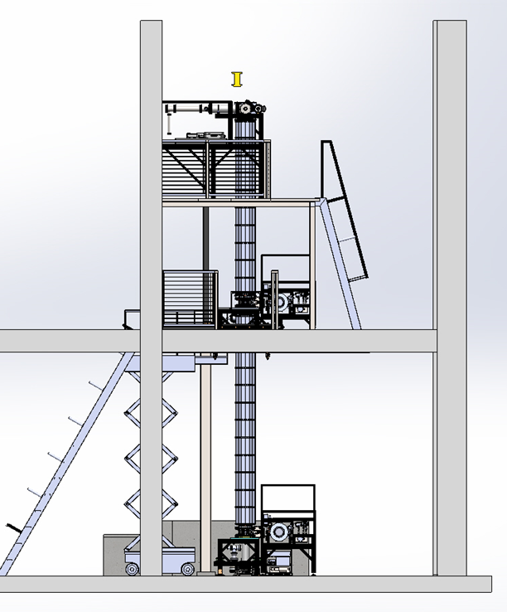
Stanford MAGIS Prototype
10 m atom interferometer under construction at Stanford University (90% complete!)
A prototype for MAGIS-100 with identical atom sources and laser system to develop technology and construction methods
Main tower section installed, atom sources and laser system assembled and already producing science results

Slide 5
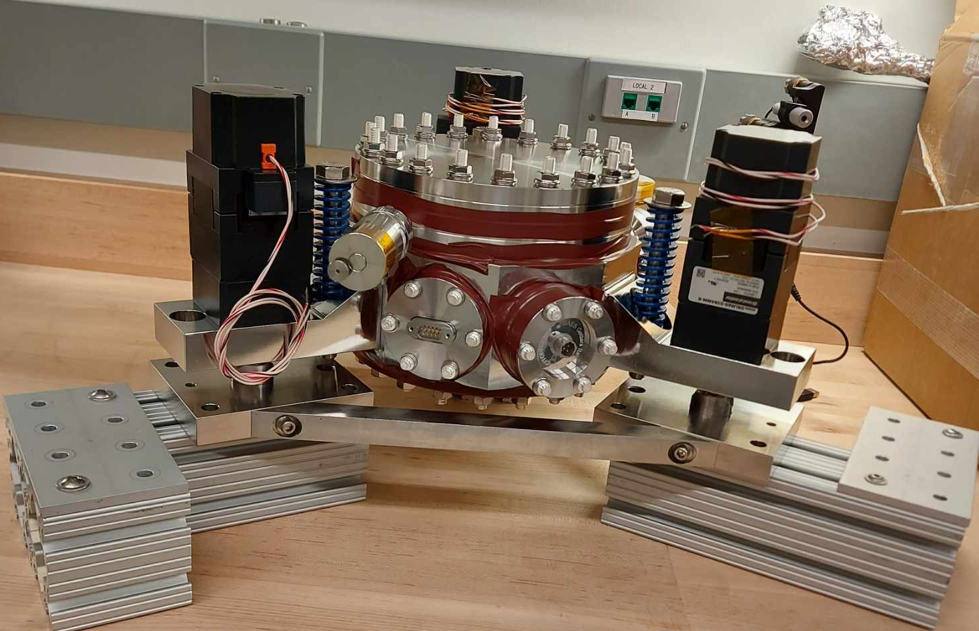
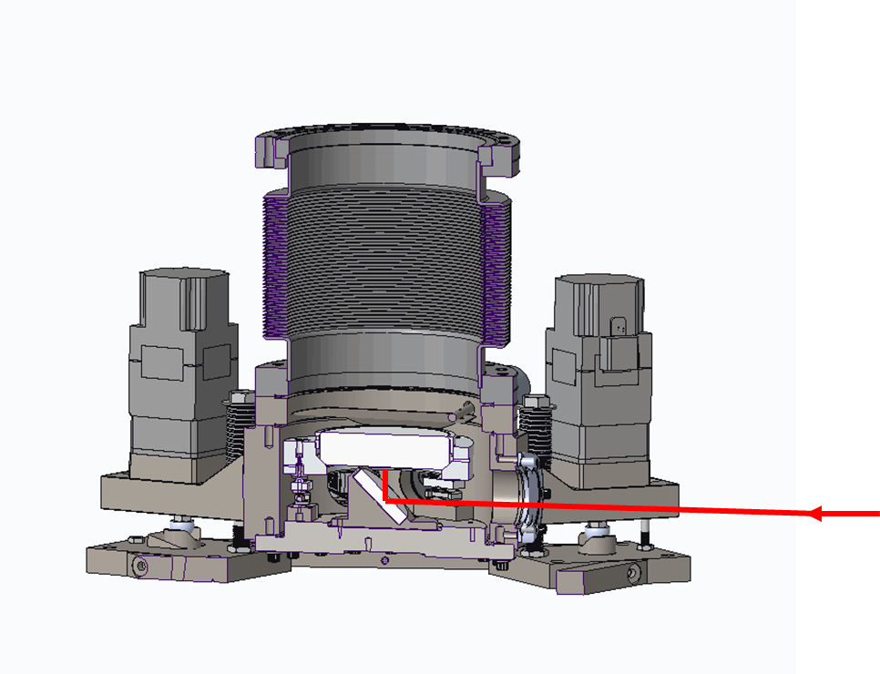
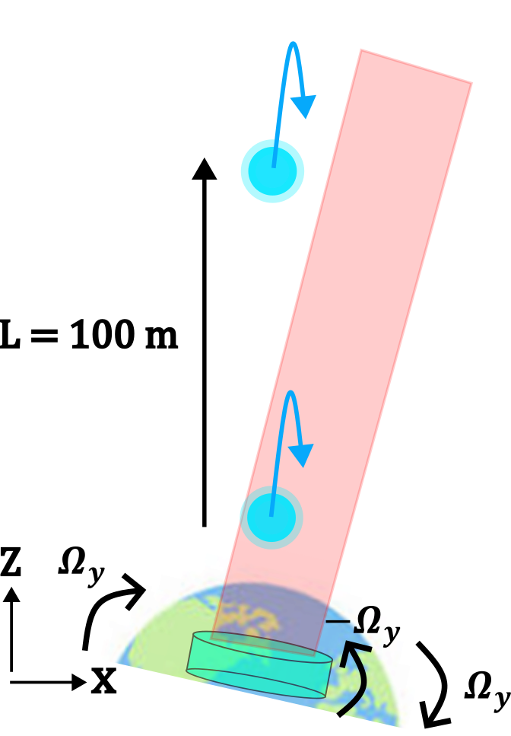
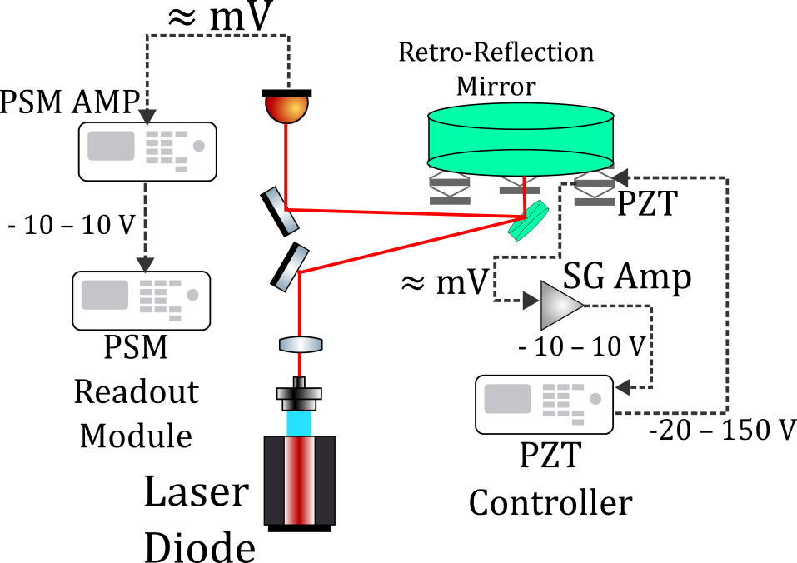
Rotation Compensation System
Long-baseline atom interferometers are very susceptible to the Coriolis force
To compensate, laser pulses are counter rotated with a UHV tip-tilt mirror at the bottom of the tower
Tip tilt mirror is controlled with tripod of PZT actuators
Mirror rotation must be controlled to a nrad level of precision with servo control
Additional optical monitoring system for secondary measurement, and future optical feedback loop

Slide 6
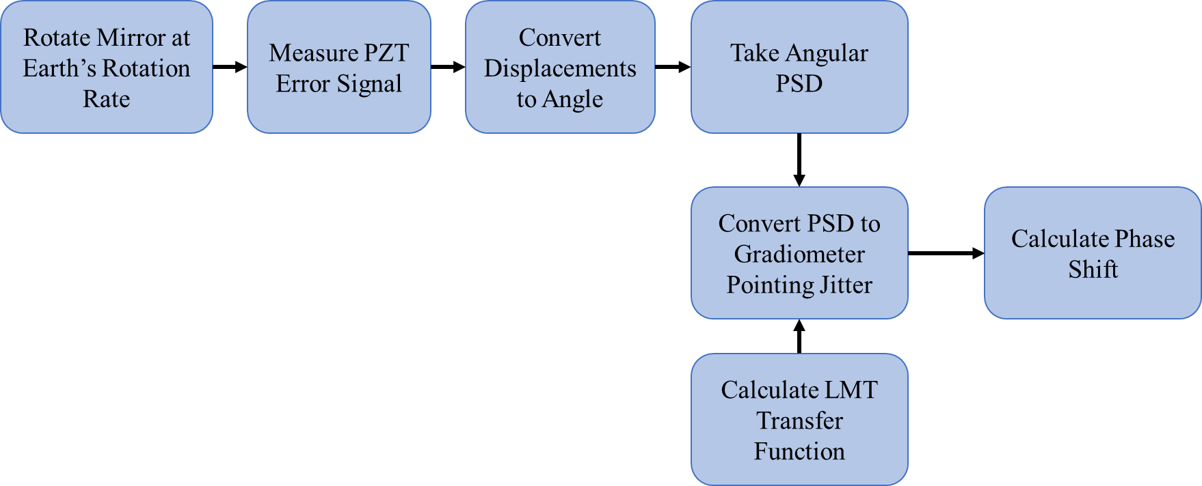
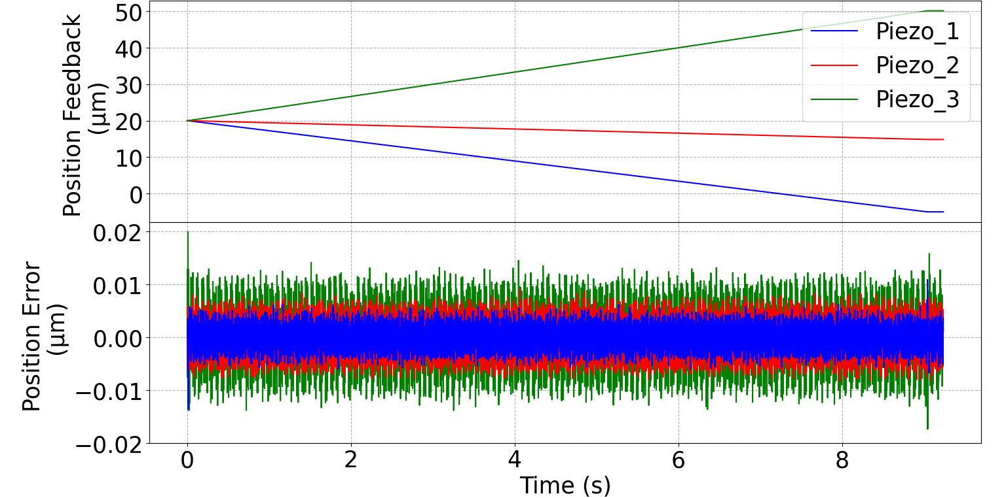
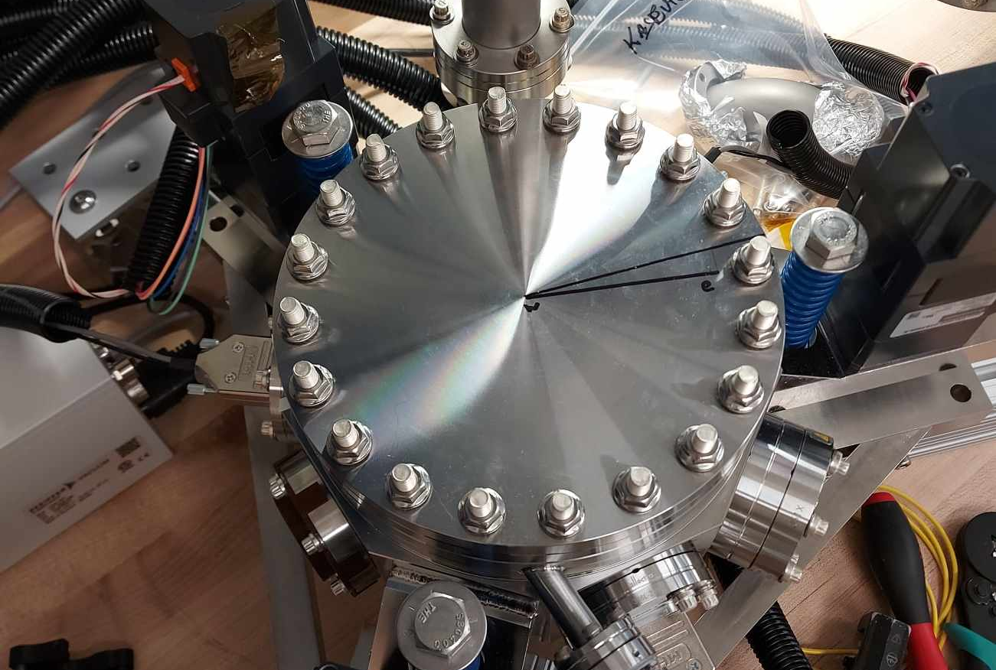
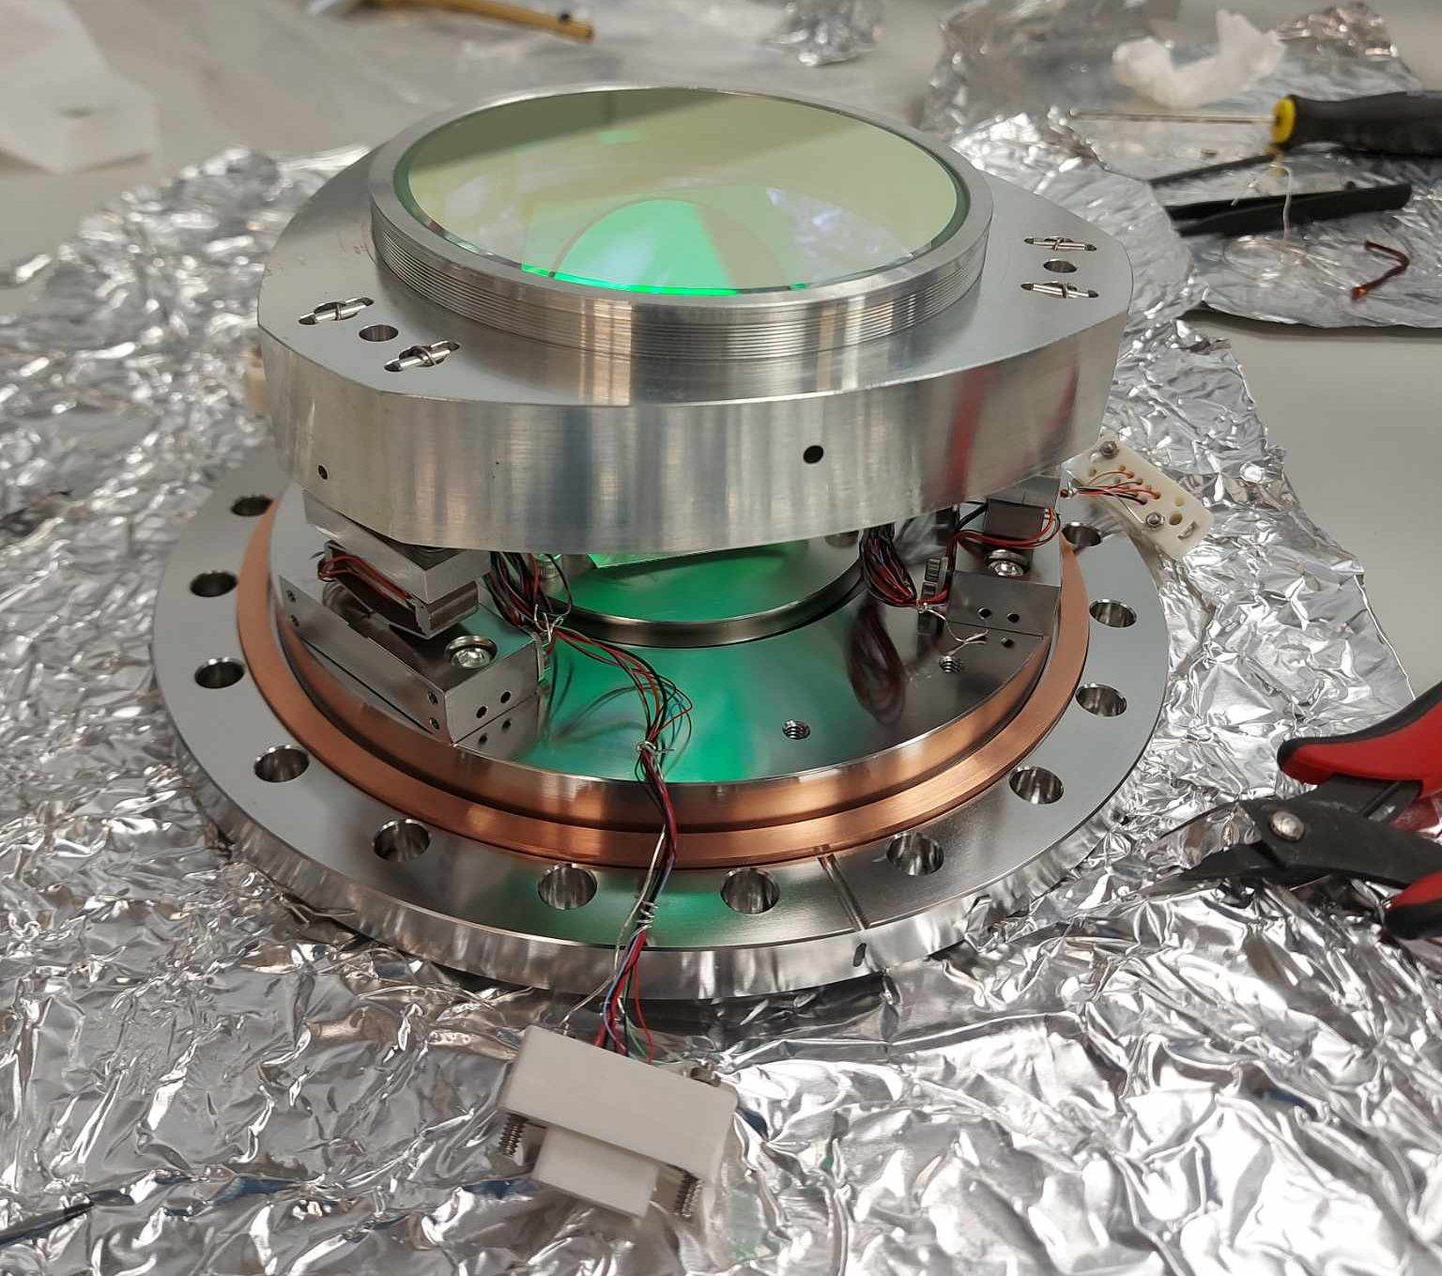
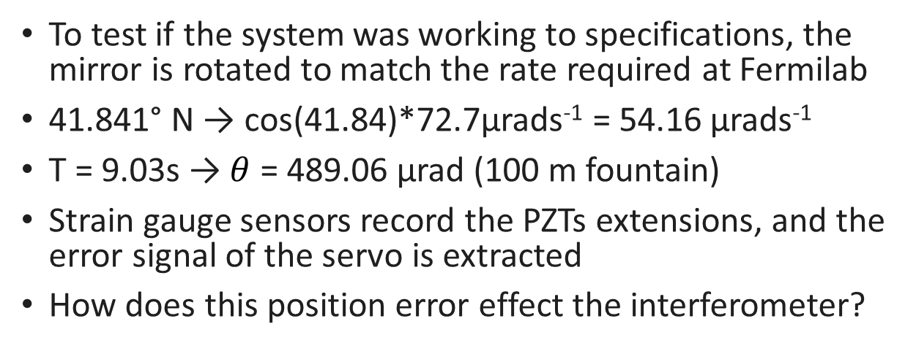
Coriolis Compensation Sequence
To test if the system was working to specifications, the mirror is rotated to match the rate required at Fermilab
41.841° N → cos(41.84)*72.7μrads⁻¹ = 54.16 μrads⁻¹
T = 9.03s → $θ$ = 489.06 μrad (100 m fountain)
Strain gauge sensors record the PZTs extensions, and the error signal of the servo is extracted
How does this position error effect the interferometer?

Slide 7
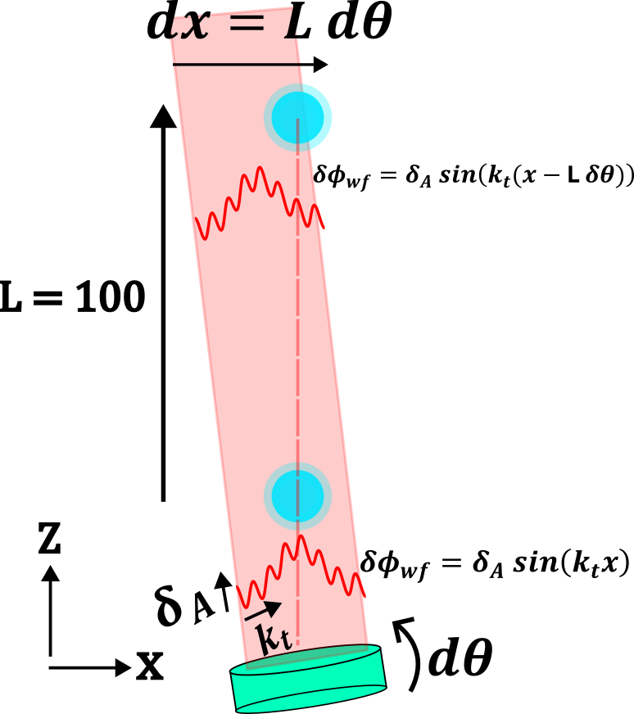
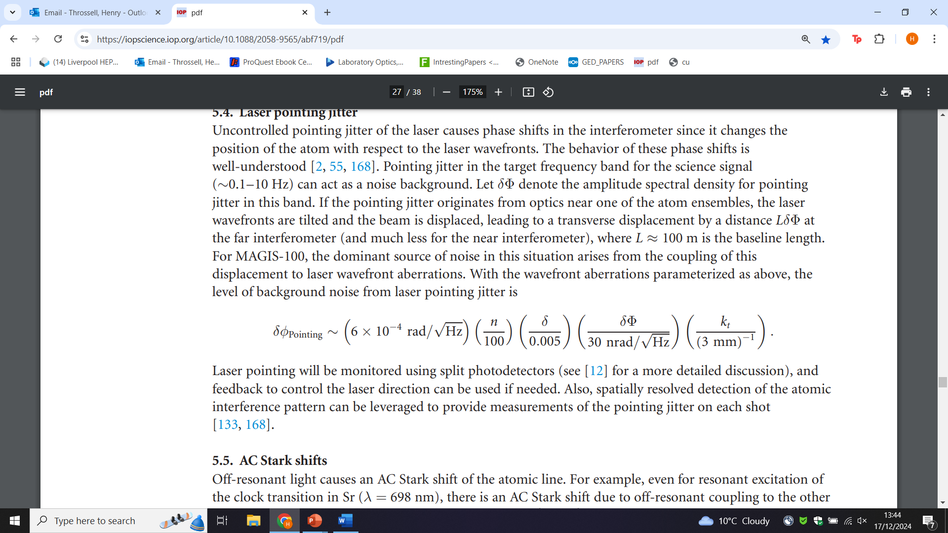
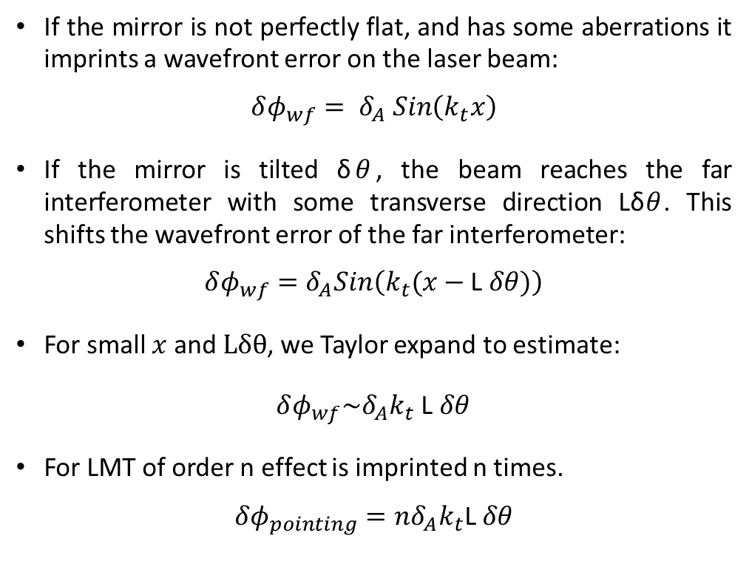
Pointing Jitter Laser Phase
If the mirror is not perfectly flat, and has some aberrations it imprints a wavefront error on the laser beam:
$$δφ_{wf}= δ_{A} Sin\left(k_{t}x\right)$$
If the mirror is tilted δ$θ$, the beam reaches the far interferometer with some transverse direction Lδ$θ$. This shifts the wavefront error of the far interferometer:
$$δφ_{wf}=δ_{A}Sin\left(k_{t}(x−\text{L} δθ)\right)$$
For small $x$ and $Lδθ$, we Taylor expand to estimate:
$δφ_{wf}\sim δ_{A}k_{t}$ $\text{L} δθ$
For LMT of order n effect is imprinted n times.
$$δφ_{pointing}=nδ_{A}k_{t}\text{L} δθ$$

Slide 8
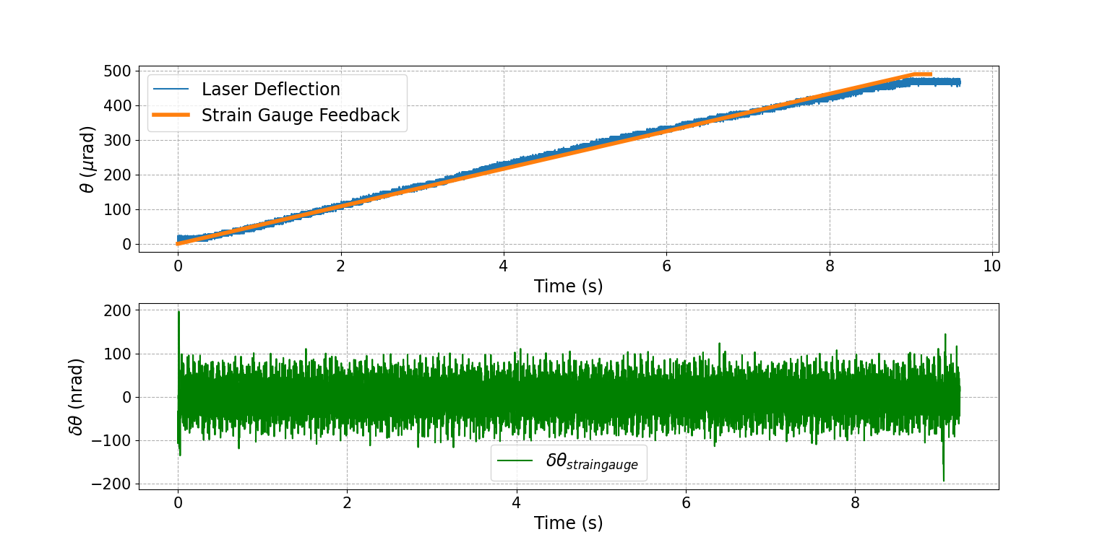
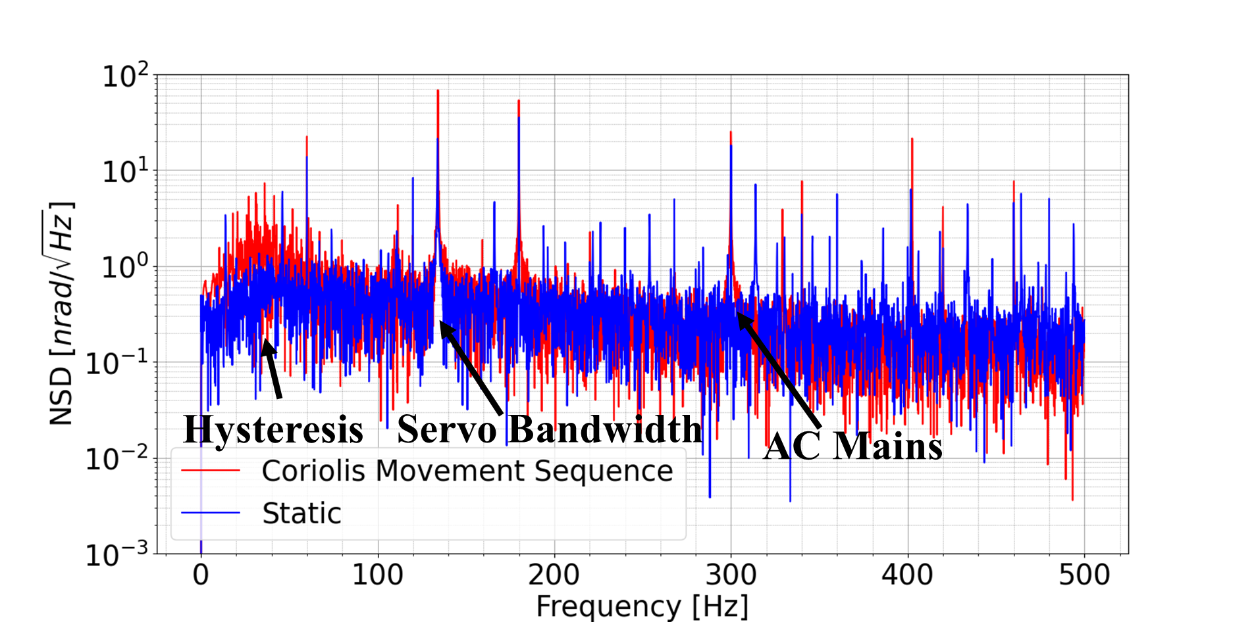
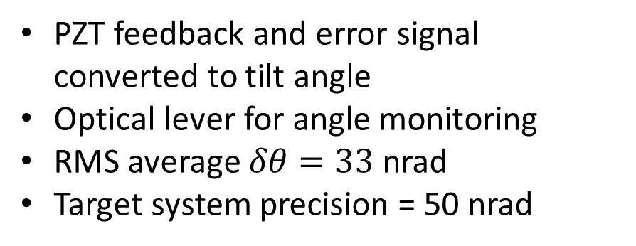
Tilt Angle and Error
PZT feedback and error signal converted to tilt angle
Optical lever for angle monitoring
RMS average $δθ=33$nrad
Target system precision = 50 nrad

Slide 9
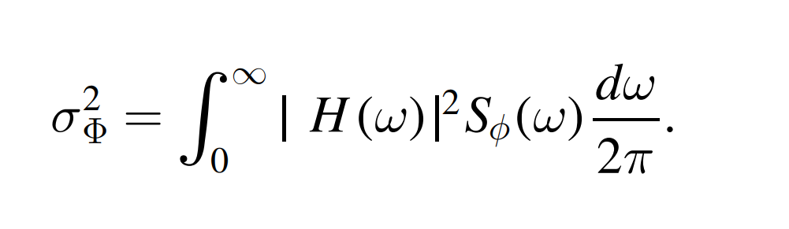
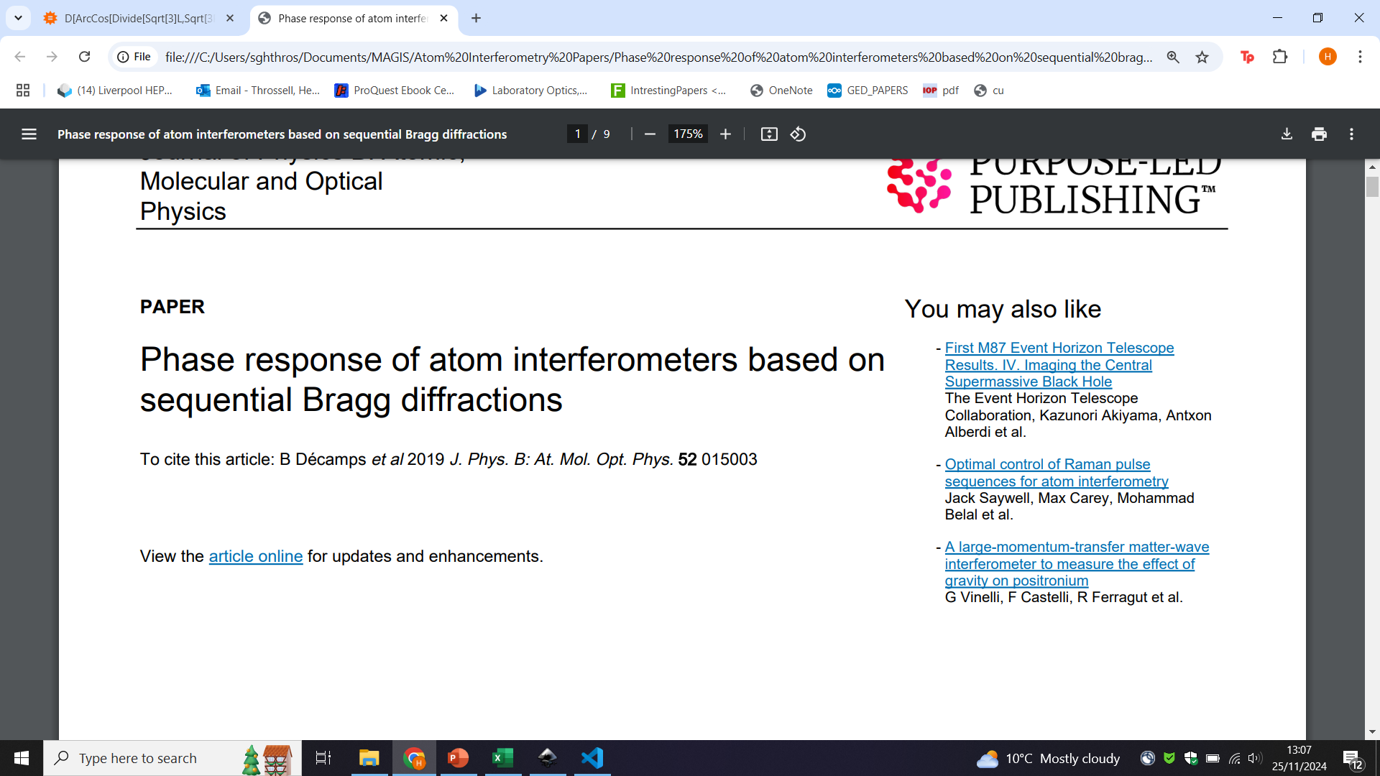
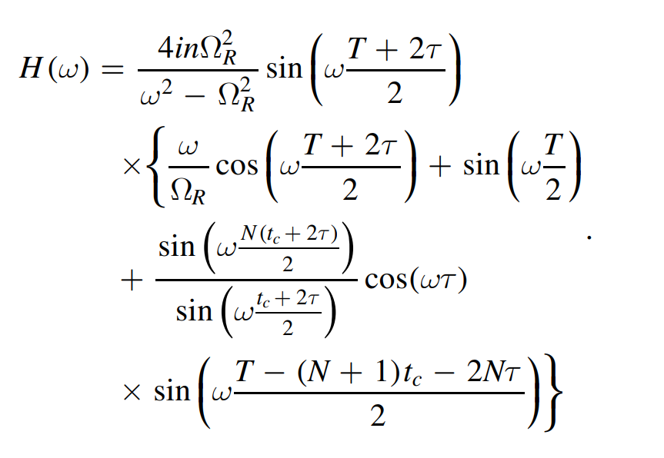
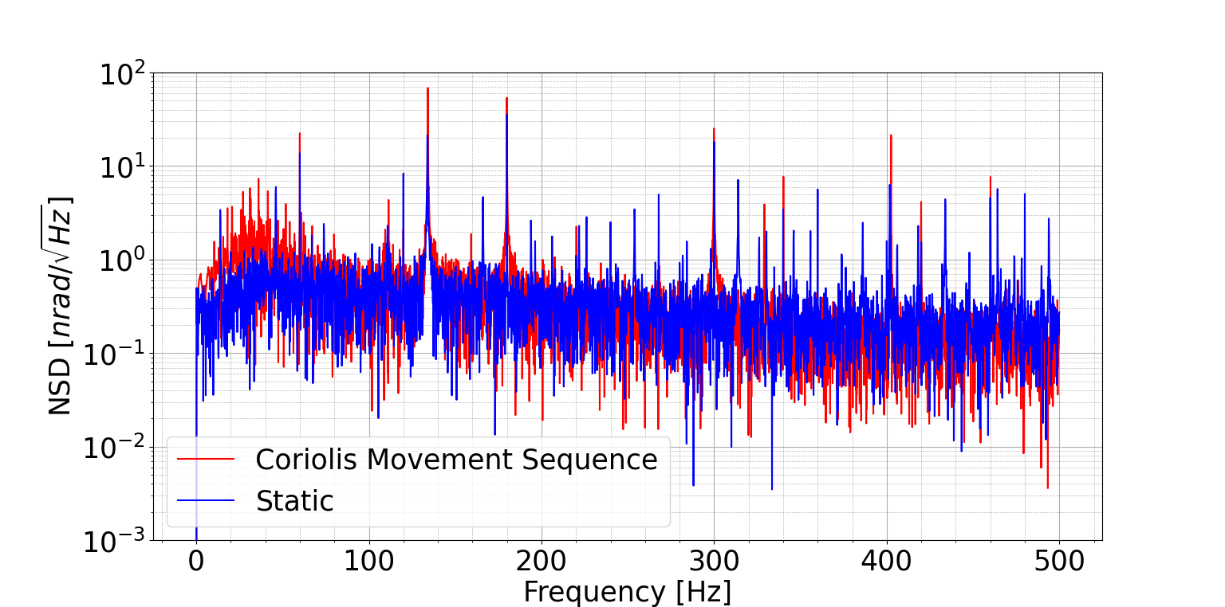

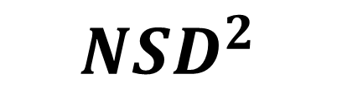
Variance of atom phase noise due to laser pointing jitter
Power spectral density of laser phase noise
TF of laser-atom interactions
$$S_{φ}\left(ω\right)= δ_{A}k_{t}\text{L} δφ(ω)$$
$${NSD}^{2}$$

Slide 10
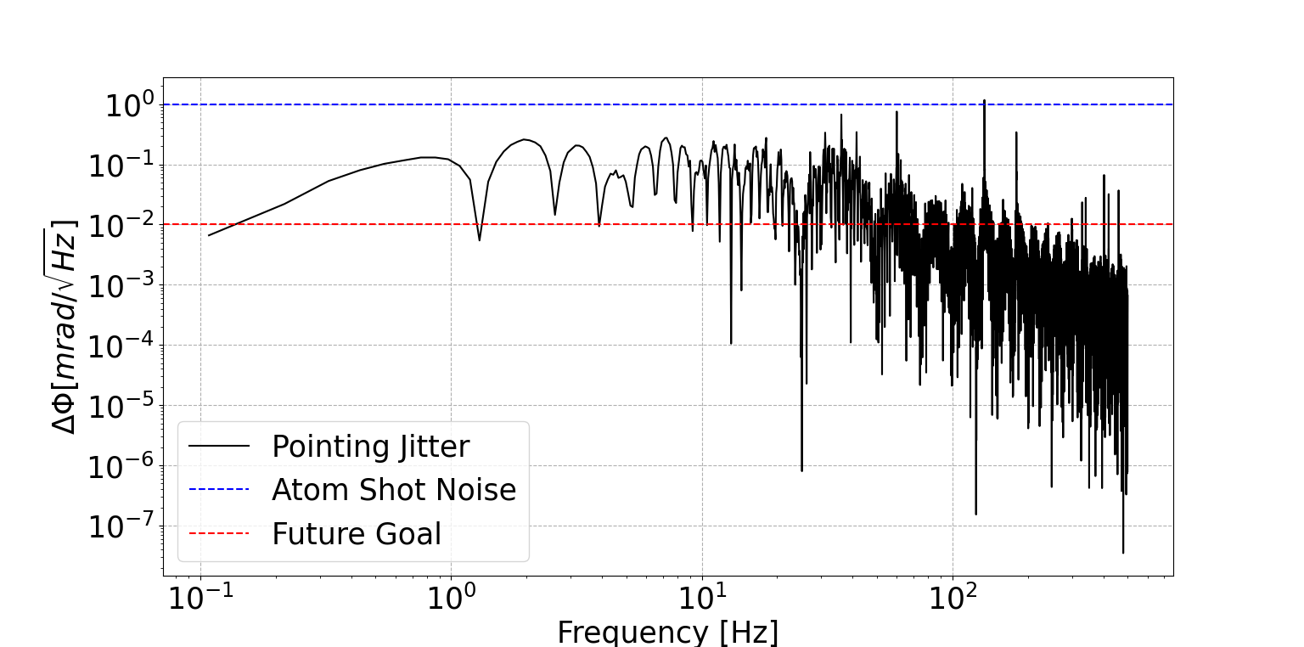
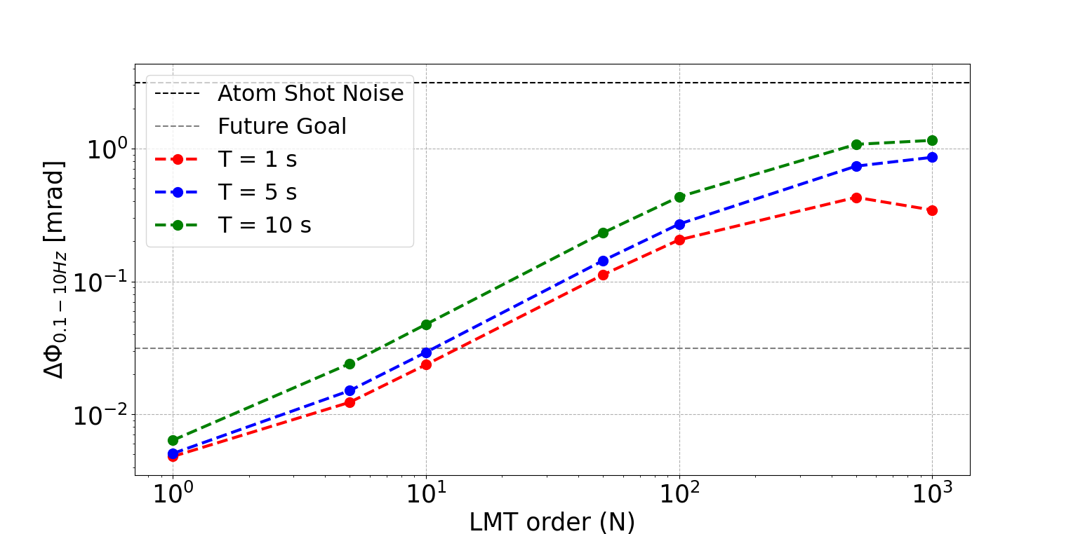
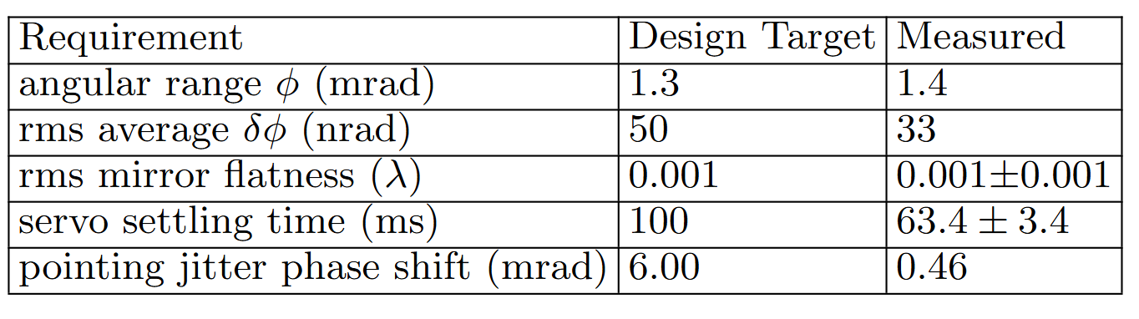
Atom Phase Shift due to Laser Pointing Jitter
MAGIS-100 is designed to be noise limited by the statistical uncertainty in the number of atoms during detection
The science sensitivity range of MAGIS-100 is 0.1-10 Hz
Varying the MAGIS-100 experimental parameters to their limit, the system’s noise does not exceed the atom shot noise
Future goal phase sensitivity can be met with upgraded optical feedback system

Slide 11
Conclusion
The RCS system has been successfully assembled and tested for the MAGIS prototype
The final installation is planned for late summer
The parts for the identical MAGIS-100 system have been shipped to Fermilab
The PSD for the angular jitter has been measured for the tip tilt mirror
A calculation of the associated phase shift due to laser pointing jitter is well below our target value
Varying the experimental parameters of MAGIS-100 show that we are still not limited by this noise source
We are working to further improve the angular jitter error using the optical lever as a position sensor / feedback loop
This measurement and analysis is being prepared for an upcoming publication

Slide 12
Back Up Slides

Slide 13
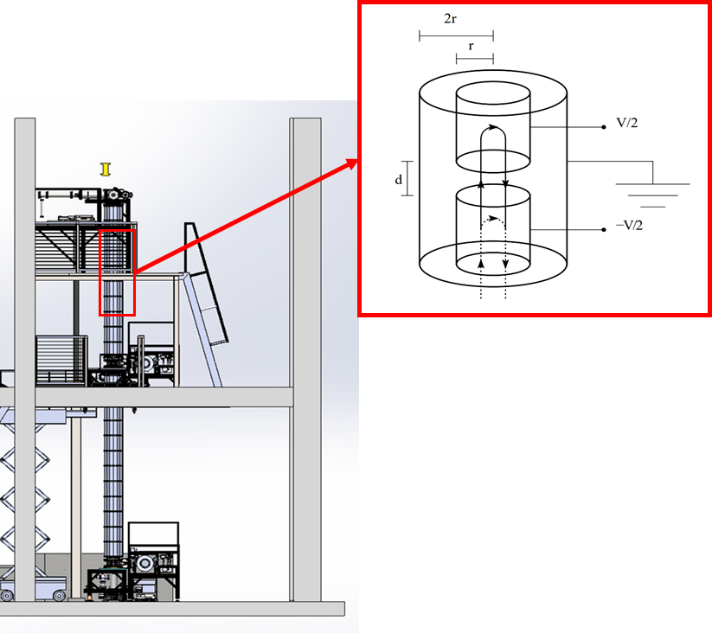
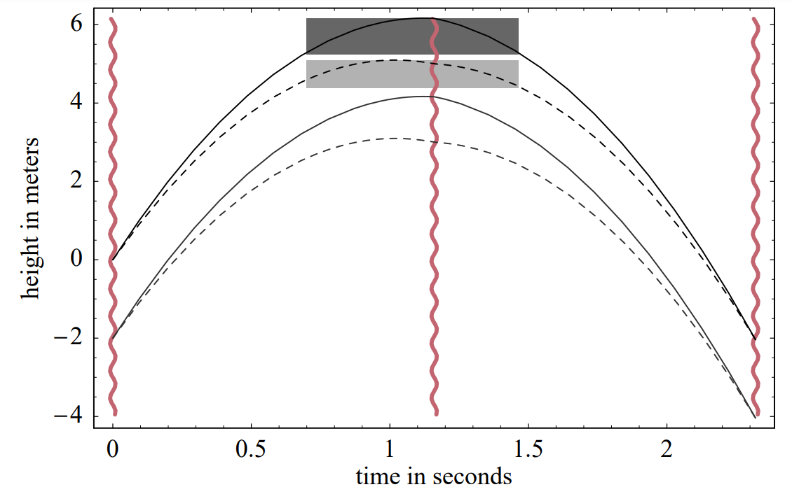
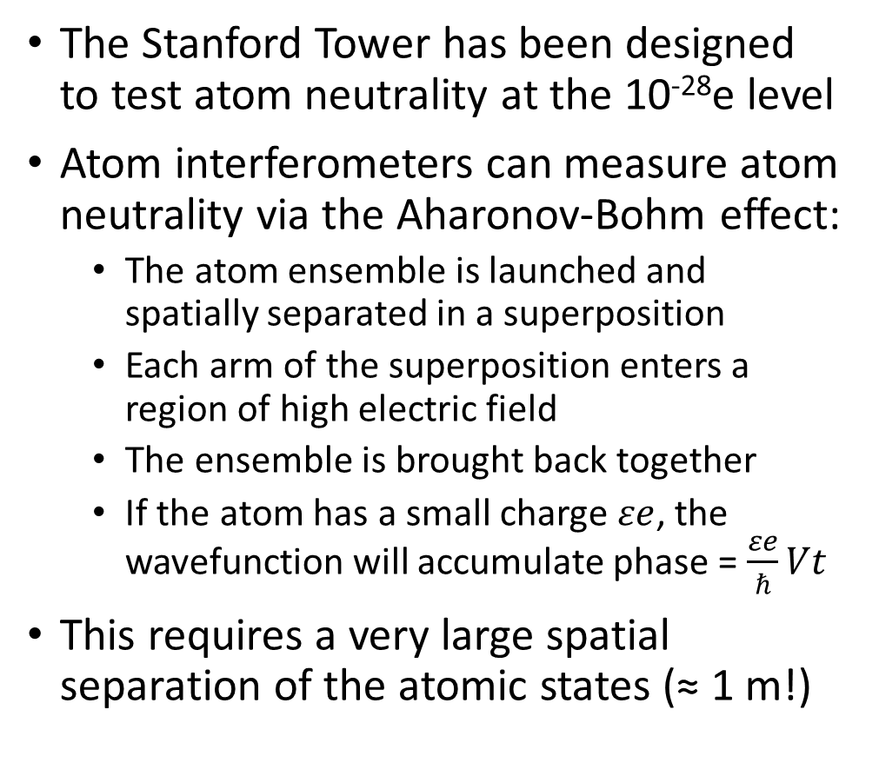
Atom Neutrality Test with Atom Interferometry
The Stanford Tower has been designed to test atom neutrality at the 10⁻²⁸e level
Atom interferometers can measure atom neutrality via the Aharonov-Bohm effect:
  The atom ensemble is launched and spatially separated in a superposition
  Each arm of the superposition enters a region of high electric field
  The ensemble is brought back together
  If the atom has a small charge $εe$, the wavefunction will accumulate phase = $\frac{εe}{ℏ}Vt$
This requires a very large spatial separation of the atomic states (≈ 1 m!)
Diagrams from: “Testing atom neutrality with an atom interferometer”, A.Arvanitaki, Phys.Rev.Lett.100:120407 (2008)

Slide 14
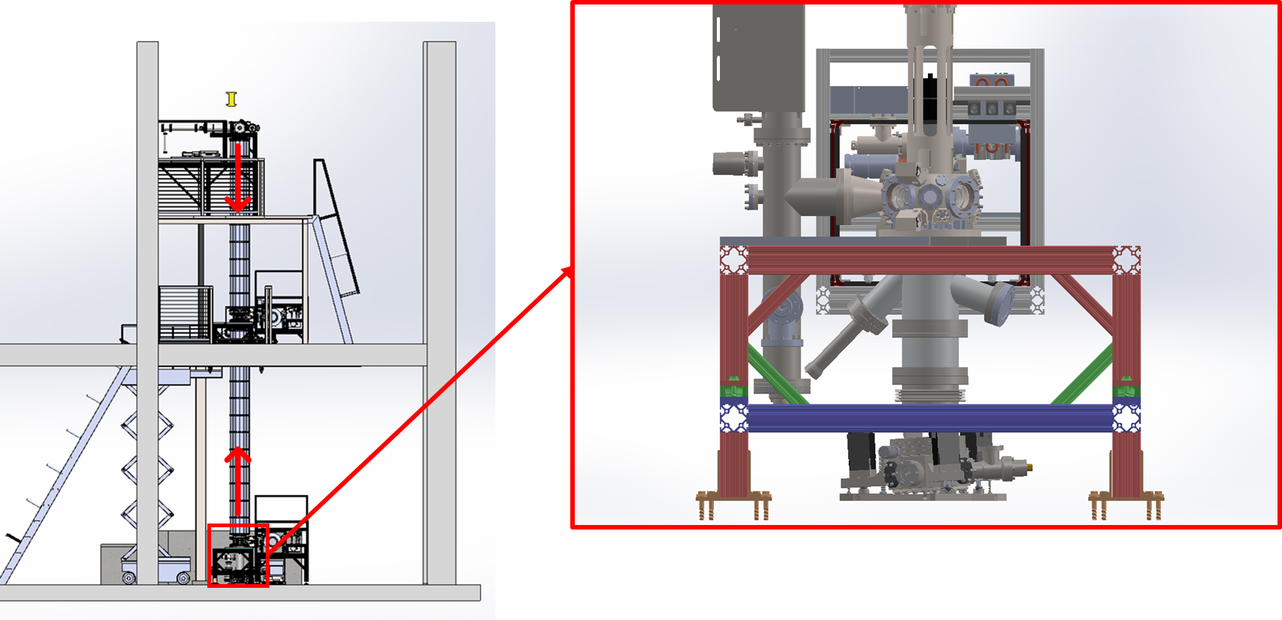
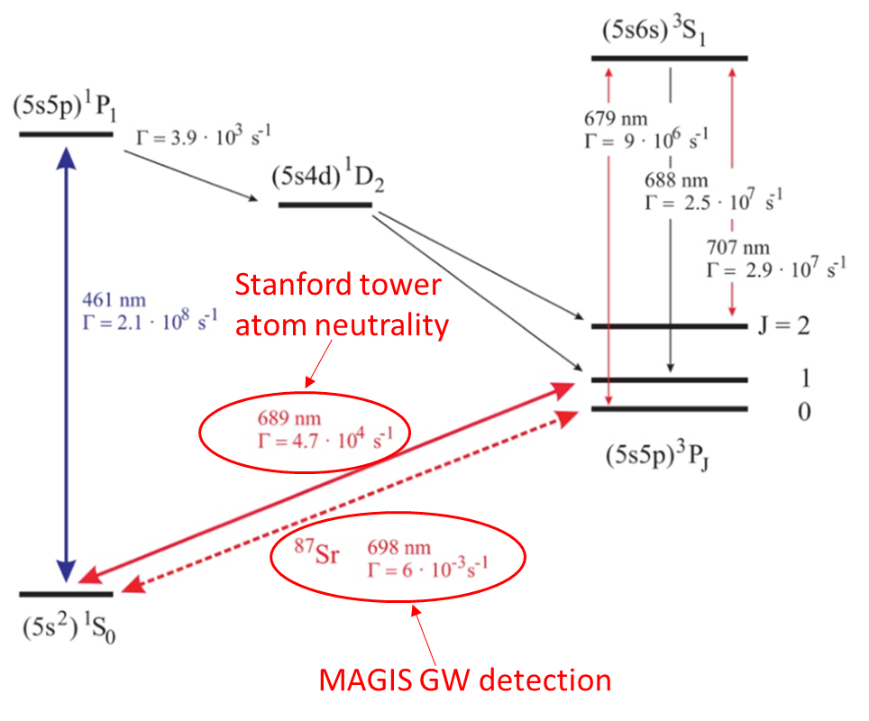
Laser Injection System for Broadband Atom Interferometry
The Stanford tower will test for atom neutrality with the (¹S₀→³P₁) 689 nm transition of Sr-87
Interferometry with large wave packet separations is easier to achieve with this transition
689 nm requires a laser injection from the lower section of the tower
The tower will still operate in a 698 nm (¹S₀→³P₀) mode for MAGIS prototyping

Slide 15
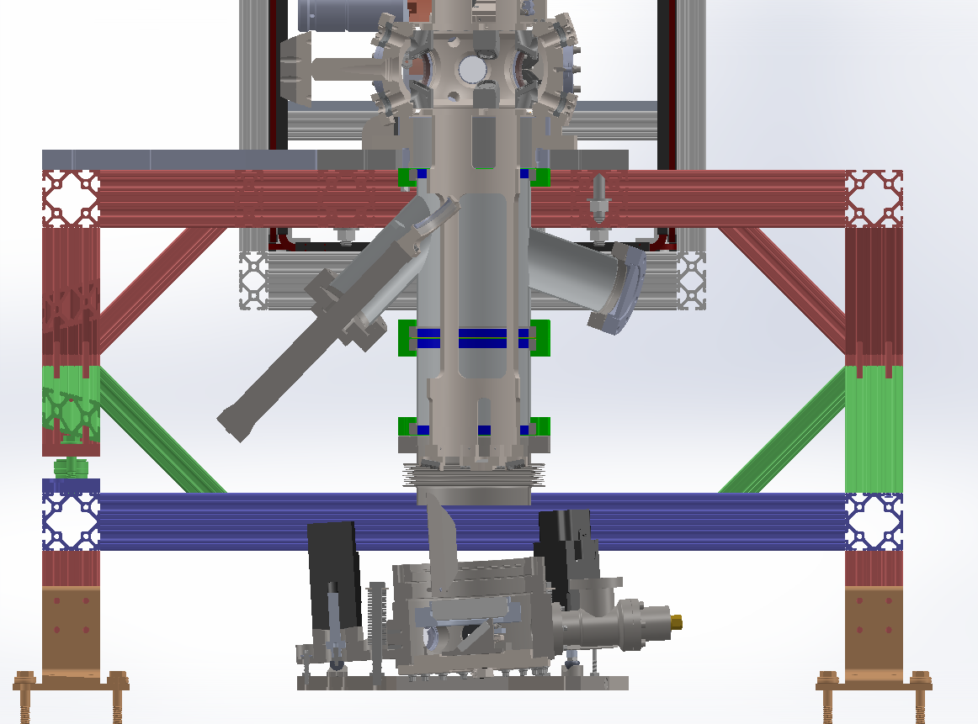
Laser Injection System for Broadband Atom Interferometry
689 nm laser enters the tower via this angled tee vacuum chamber
A retractable in-vacuum mirror reflects light down onto the tip tilt mirror
The lower retro reflection chamber is tilted at 3⁰ to reflect light upwards into the interferometry region
Extended UHV bellows allow for flexible tilting of the retro reflection platform
Atom lattice launch
In-vacuum mirror
Linear actuator
Rotation Compensation System

Slide 16
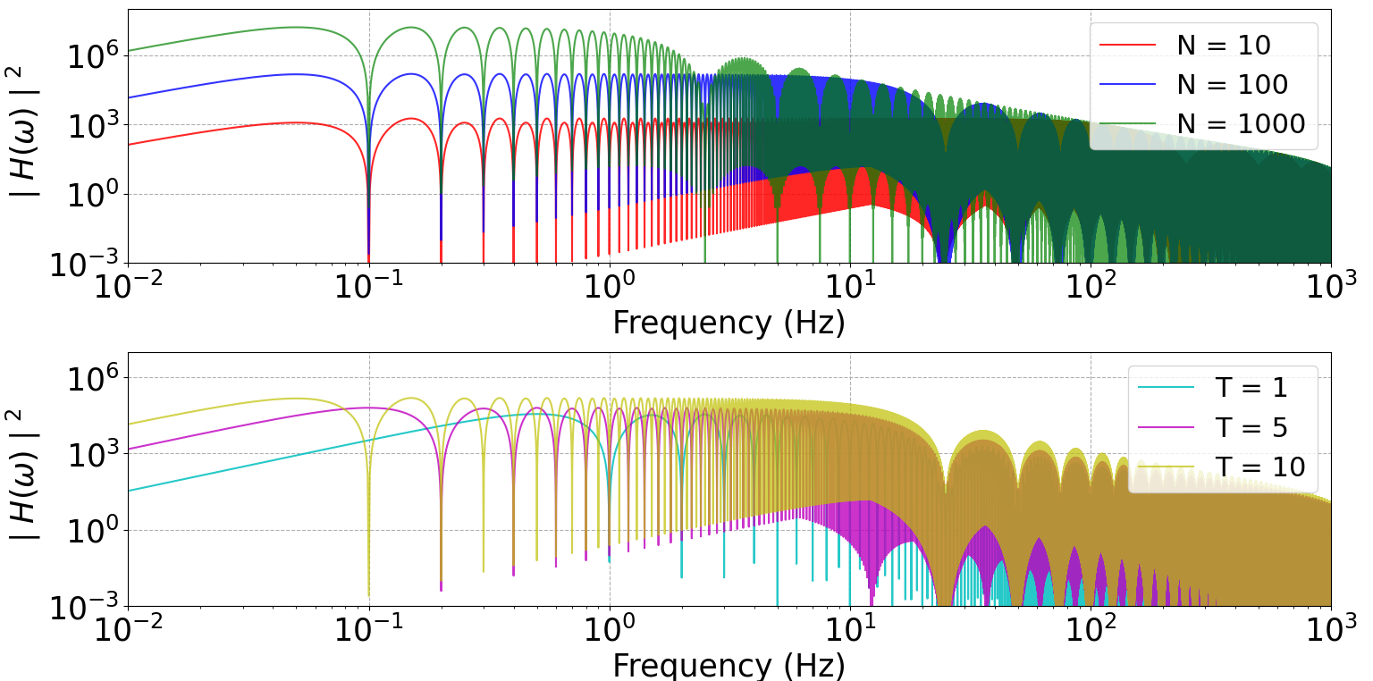

Slide 17
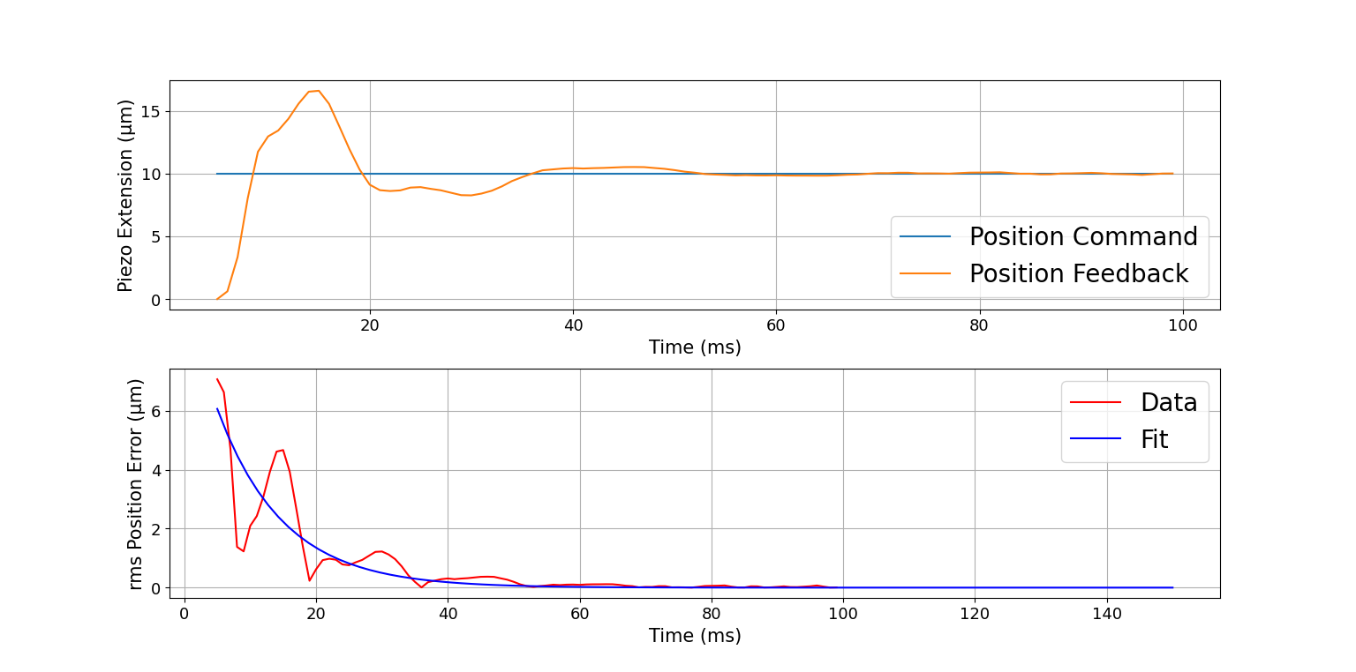

Slide 18
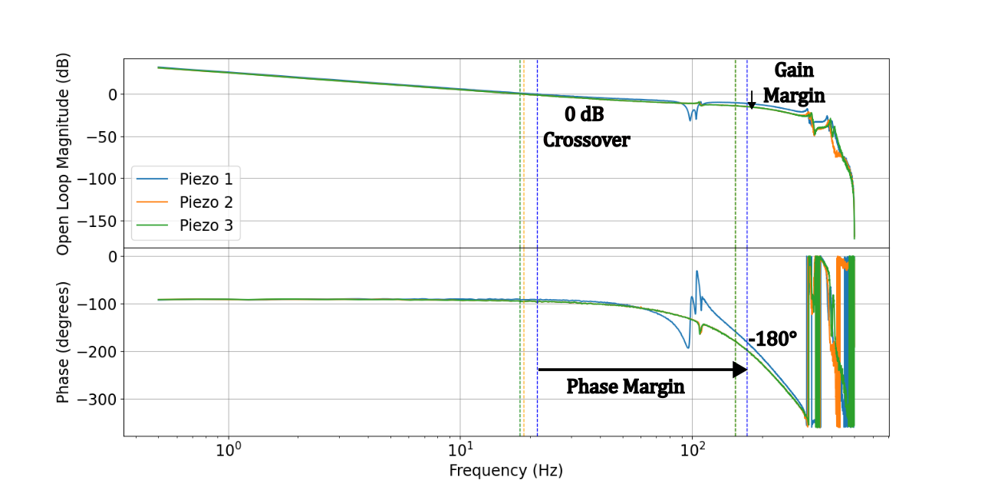

Slide 19
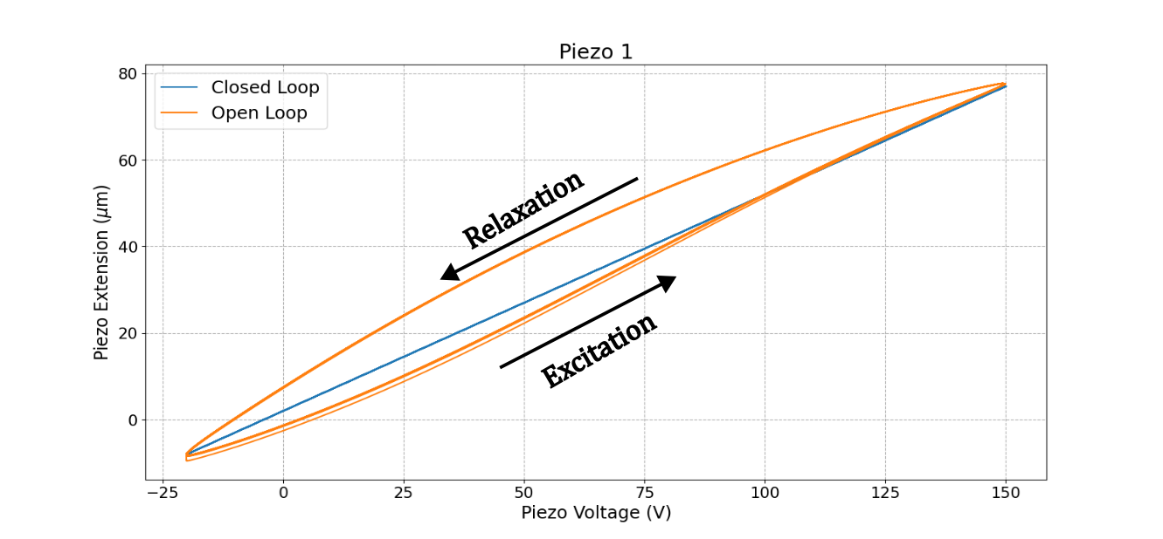

Slide 20
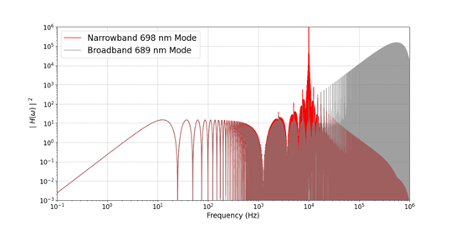

Slide 21
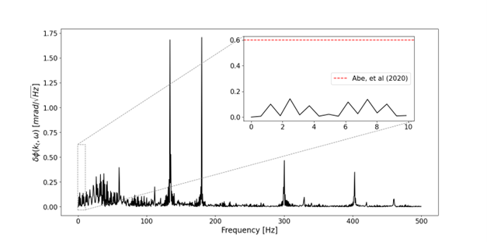

Slide 22
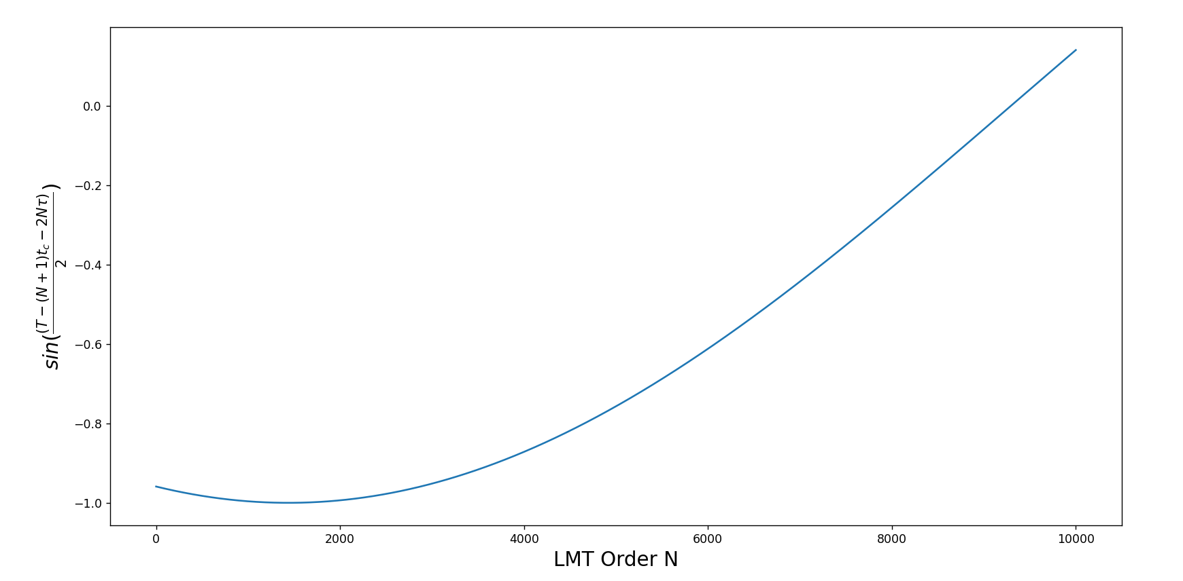

Slide 23
