Slide 1


Investigating Neutrino-Nucleus Interactions: Inclusive Cross-Sections Across Various Materials at MINERvA
9th April 2025
Akeem L Hart
On behalf of the MINER𝜈A collaboration
Supervisor: Dr Abbey Waldron

Slide 2
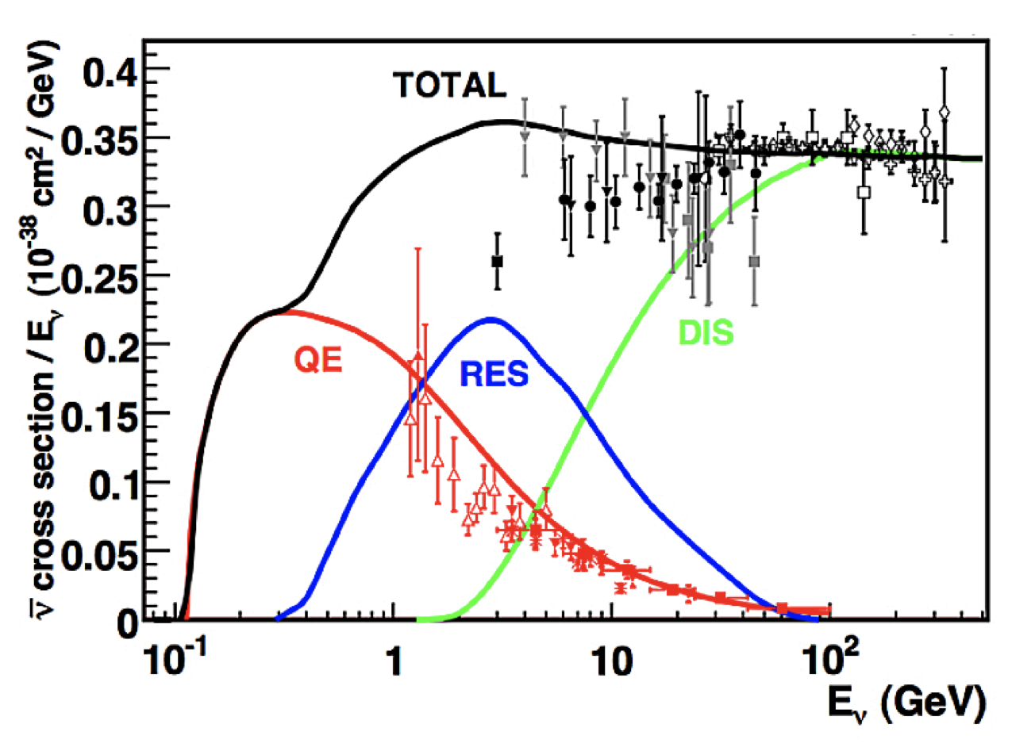
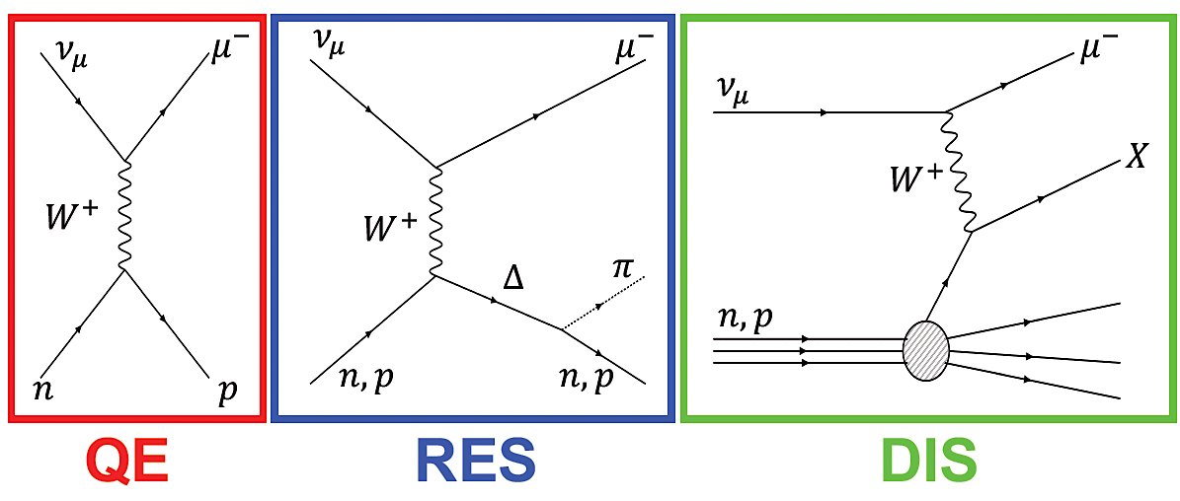
Neutrino-nucleus interactions
Different interaction modes contribute to total interaction rate dependent on E_{𝜈}
Current and future precision experiments need precise interaction reconstruction → Next-gen detectors need reduced interaction model uncertainties to achieve more ambitious physics goals
J.A. Formaggio, G.P. Zeller, Rev. Mod. Phys. 84, 1307 (2012).
Akeem L Hart (He/Him)
9th April 2025
‹#›
Notes:
Take a minute to explain QE, RES, DIS for non nu people

Slide 3
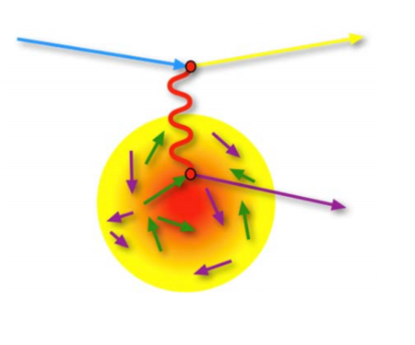
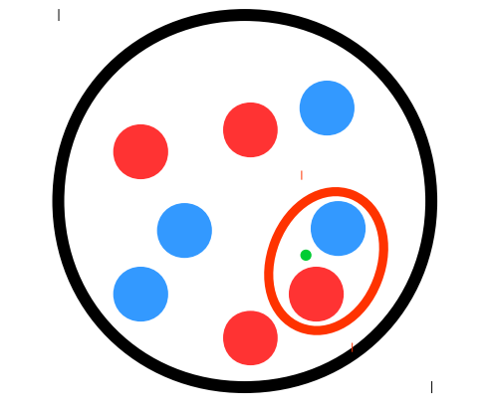
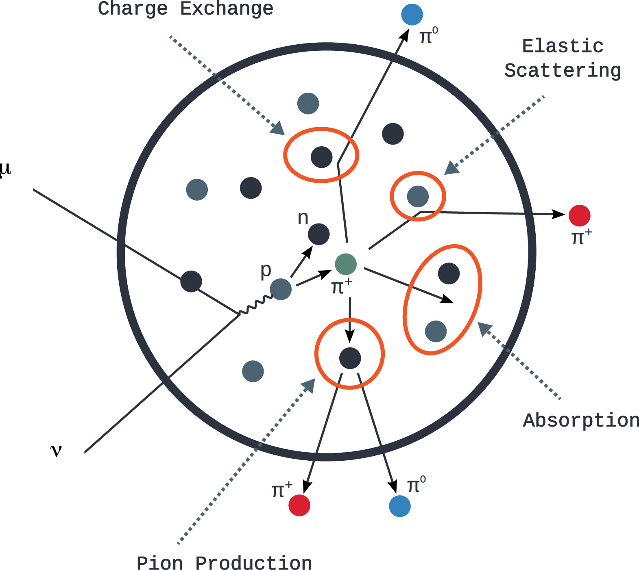
Nuclear effects
Understanding the properties of the underlying interaction from an observed event is complicated by various nuclear effects:
These can modify the particles present in the final state, as well as their observed kinematics
Fermi Motion
Multi-Nucleon Effects
Final State Interactions
Akeem L Hart (He/Him)
9th April 2025
‹#›
Notes:
Improve fermi-motion messaging -> Must account for it NOT OPTIONAL. The question is not whether we account for it but how accurate our account is
“Sometime interaction occurs on coupled nucelon pairs kicking both out”

Slide 4
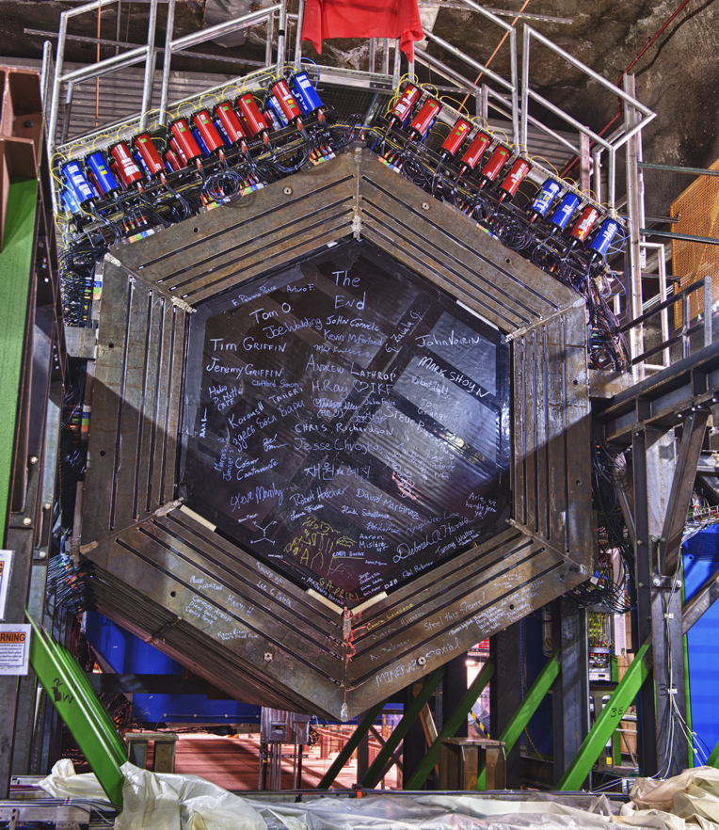
MINER𝛎A
Main INjector ExpeRiment for 𝜈-A scattering.
Took data in NuMI beam (On-Axis) at Fermilab, only ~1km from beam from 2009-2019.
Contains 6 different materials as nuclear targets: H₂O, CH, He, Fe, Pb & C → Directly investigate how differences in nuclear environment affects what we observe from a neutrino interaction.
Akeem L Hart (He/Him)
9th April 2025
‹#›

Slide 5
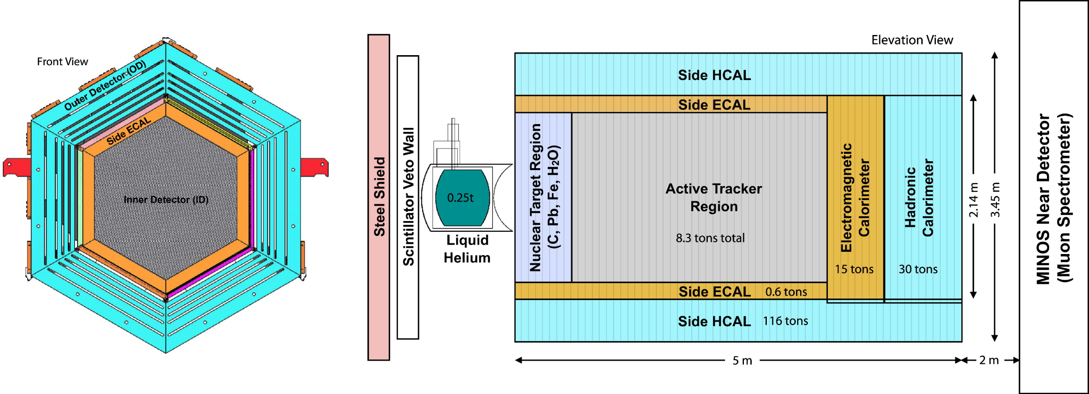
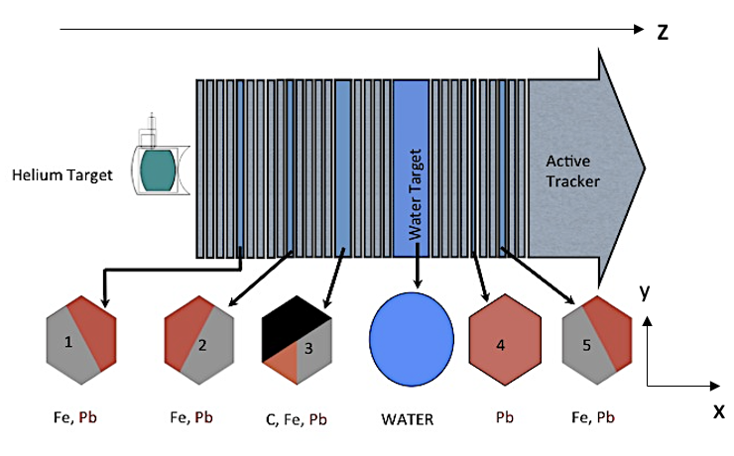
MINER𝛎A
High statistics and finely grained detector.
Uses MINOS Near-Detector to measure muon charge and momentum.
Beam direction
“That’s cool, but why should I care about MINERvA?”
MINERvA doesn't exist in a vacuum. Neutrino physics is a broad ecosystem, a number of detectors spanning a number of different nuclei (Ar, H₂O, CH, Fe etc) means a dedicated experiment specialised in exploring nuclear effects and nuclear dependencies has significant potential to benefit wider community.
Akeem L Hart (He/Him)
9th April 2025
‹#›
Notes:
Repeat that correct cross section modelling is essential. So we need data on the nuclei that we build these out of
(1.3 T Magnetic Field MINOS

Slide 6
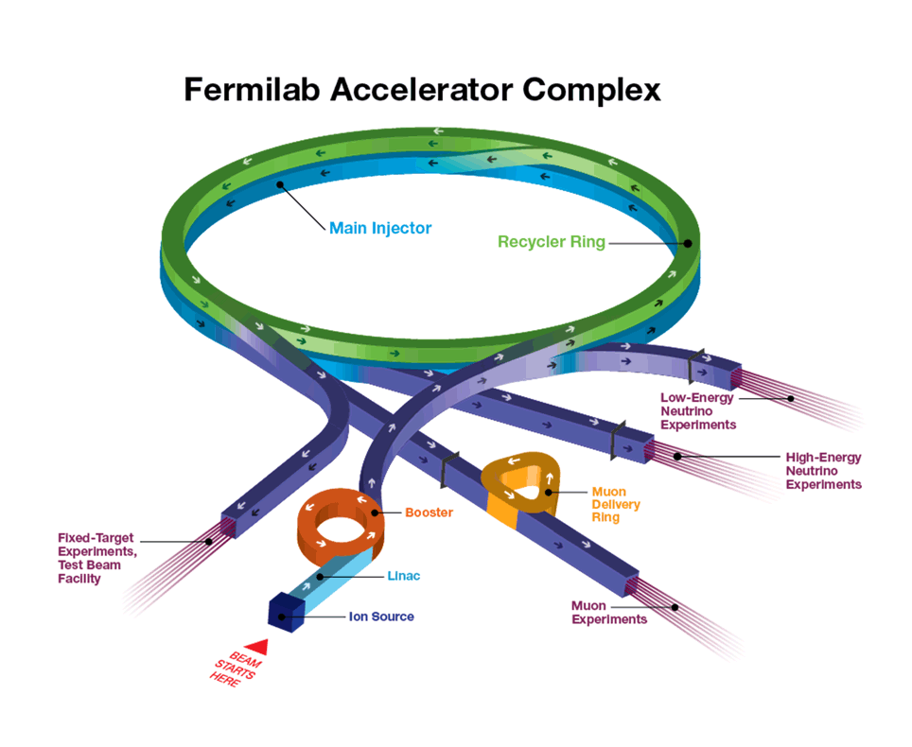
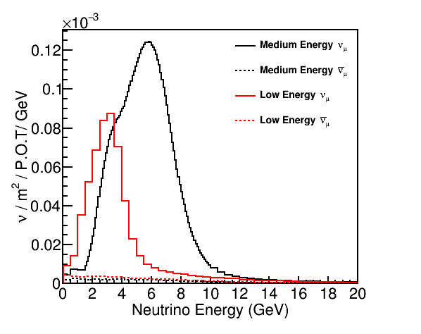
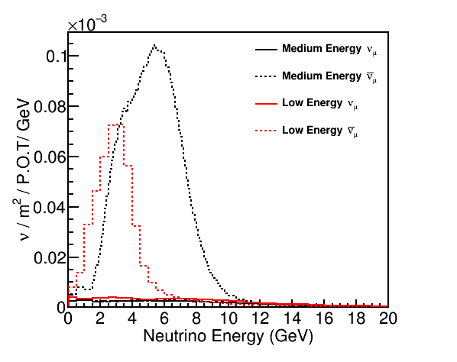

NuMI
Neutrinos at the Main Injector
@ Fermilab.
Well studied beam also used by
NOVA, MINOS & DUNE ND
Prototype “2x2”
ν - mode
To MINERvA
Energy | ν - P.O.T. | - P.O.T.
Low Energy “LE” - 3.5 GeV peak (2010-12) | 4.0 ⨉ 10²⁰ | 1.7 ⨉ 10²⁰
Medium Energy “ME” - 6 GeV peak (2013-19) | 12.1 ⨉ 10²⁰ | 12.4 ⨉ 10²⁰
- mode
POT/Protons-On-Target: The number of protons incident on the fixed target (C). Used as a proxy for number of neutrinos produced by the beam. Somewhat analogous to luminosity in collider experiments.
Akeem L Hart (He/Him)
9th April 2025
‹#›
Notes:
Explicitly mention what P.O.T means and what it’s used for - add to slides explicitly
Highlight 12.1E20 for my analysis

Slide 7
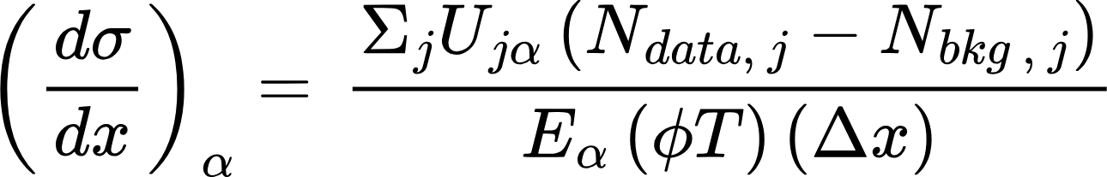
Measuring Cross Sections
𝑥 - Variable of interest 𝛼 - True Bin 𝑗 - Reconstructed bin
Unfolding
Selected Events
Background Subtraction
Efficiency Correction
Normalisations
Cross section measurements can be used to refine neutrino interaction models.
Akeem L Hart (He/Him)
9th April 2025
‹#›
Notes:
“The x sec is directly prop to ev rate” + highlight + “Here’s the corrections we then make”

Slide 8
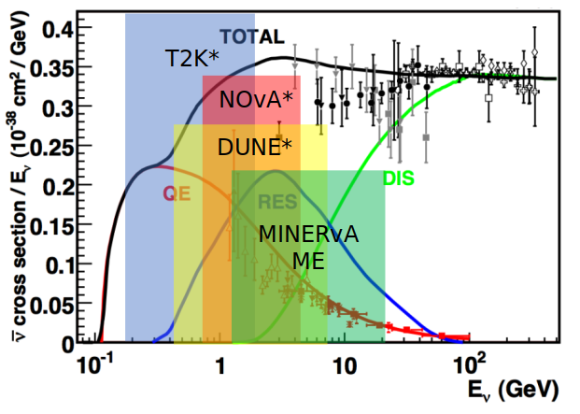
Analysis overview
Charge Current Inclusive ν_{μ} :
Looking for a μ⁻ in final state
10.5 ⨉ 10²⁰ useable POT
Medium Energy run (6 GeV peak) → significant contribution from a variety of interaction channels + wide range of E_{ν} overlapping T2K, DUNE & NO𝜈A + (more)
Materials: Water + C , Fe, Pb, CH
ν_{μ} + X → μ⁻ + Y
This aims to be MINERvA’s first inclusives analysis covering the water target→ Potential implications and uses with water based detectors and their associated interaction modelling.
Akeem L Hart (He/Him)
9th April 2025
‹#›
Notes:
Cite plot properly
Mention that in previous inclusive analyses water wasn’t ready

Slide 9
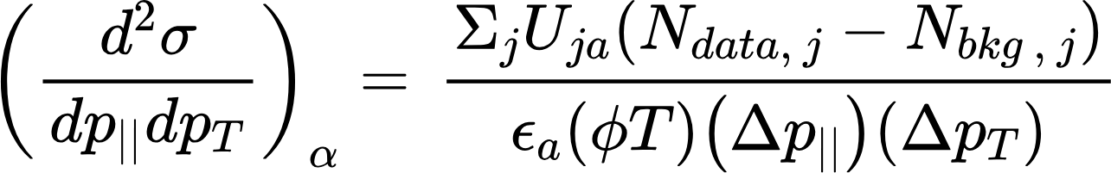
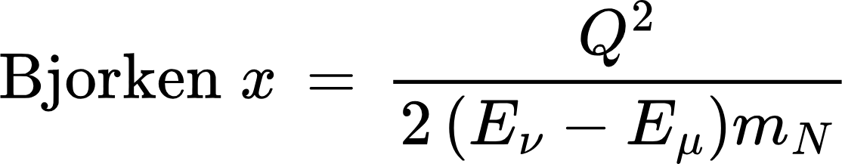
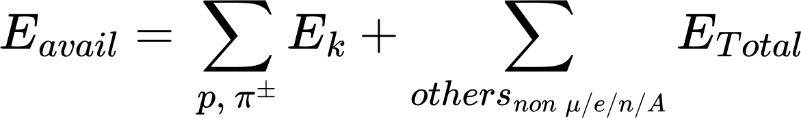
Analysis overview
These cross sections will also be reported as ratios relative to CH → Allowing for cancellation of systematic uncertainties
Target deliverables:
1D cross sections:
Transverse muon momentum (p_{tμ}), Longitudinal muon momentum (p_{zμ}), Bjorken 𝑥,
E_{avail} & E_{μ}
2D cross sections:
P_{tμ} vs p_{zμ}
Where, &
… and then do it 5 times ( H₂O, C , Fe, Pb, CH) - Very rich analysis!
Akeem L Hart (He/Him)
9th April 2025
‹#›
Notes:
Rephrase blue box
Eavail = what I’ve got = Ehad - E_neutrons
“X is a famous DIS scaling variable”

Slide 10
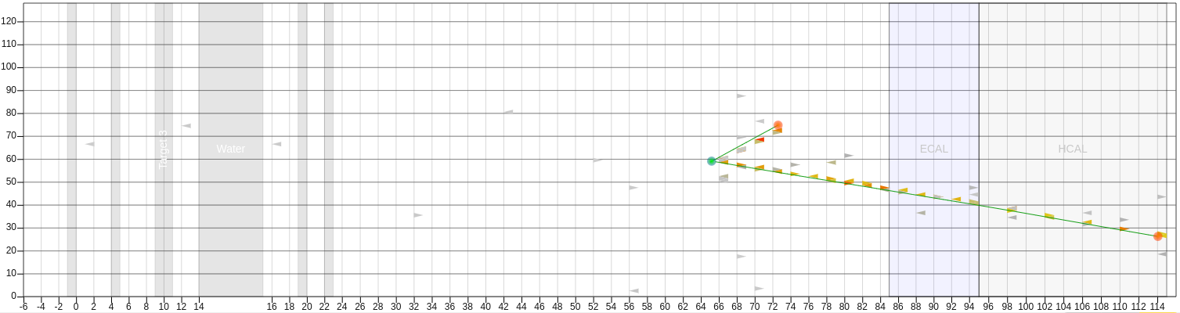
Analysis Event Selection
Reconstructed Z Position Cut → Material/Plane disambiguation
Various detector cuts
  Apothem
  Deadtime
  ANN Reconstruction Confidence
Muon Energy > 2 GeV and < 50 GeV → The range in which we can reconstruct well
Muon Angle Cut → Ensure MINOS Containment
MINOS Match
MINOS Muon Curvature → For charge determination & calorimetry
Akeem L Hart (He/Him)
9th April 2025
‹#›
Notes:
Rephrase blue box
Eavail = what I’ve got = Ehad - E_neutrons
“X is a famous DIS scaling variable”

Slide 11
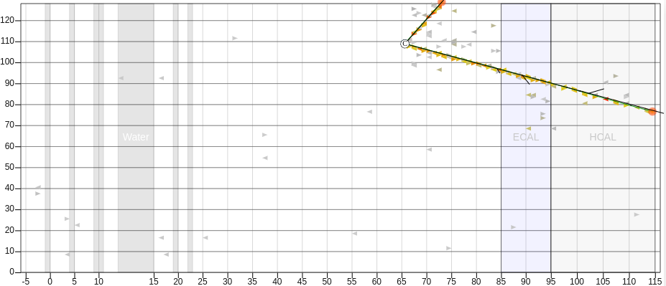
Analysis Event Selection
Reconstructed Z Position Cut
Various detector cuts
  Apothem
  Deadtime
  ANN Reconstruction Confidence
Muon Energy > 2 GeV and < 50 GeV
Muon Angle Cut
MINOS Match
MINOS Muon Curvature
CC QE - 1 μ⁻ + 1p (4.5GeV 𝜈)
Selected ✔️
Akeem L Hart (He/Him)
9th April 2025
‹#›
Notes:
Rephrase blue box
Eavail = what I’ve got = Ehad - E_neutrons
“X is a famous DIS scaling variable”

Slide 12
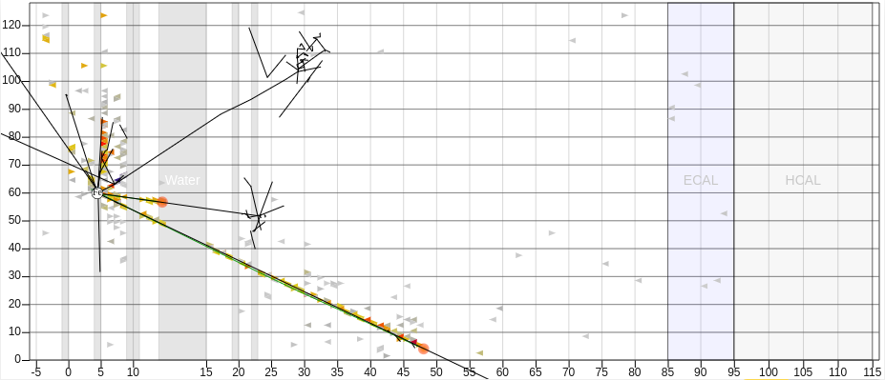
Analysis Event Selection
Reconstructed Z Position Cut
Various detector cuts
  Apothem
  Deadtime
  ANN Reconstruction Confidence
Muon Energy > 2 GeV and < 50 GeV
Muon Angle Cut
MINOS Match
MINOS Muon Curvature
CC RES - 1 μ⁻ + 1 ⲡ + others (4.7GeV 𝜈)
Not Selected ❌
Fails angle cut ∴ Isn’t MINOS captured
Akeem L Hart (He/Him)
9th April 2025
‹#›
Notes:
Rephrase blue box
Eavail = what I’ve got = Ehad - E_neutrons
“X is a famous DIS scaling variable”

Slide 13
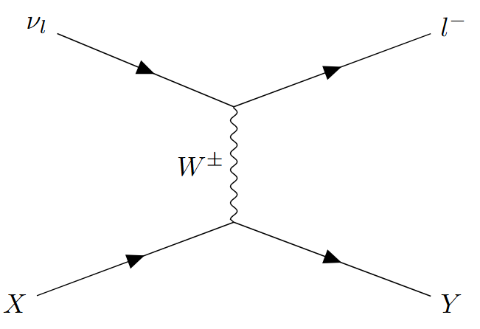
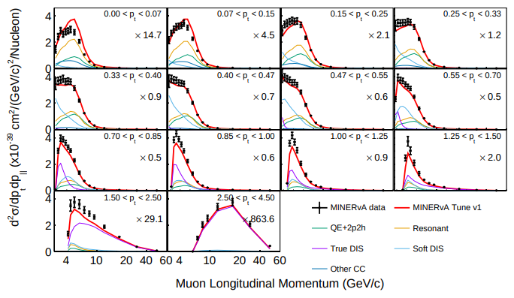
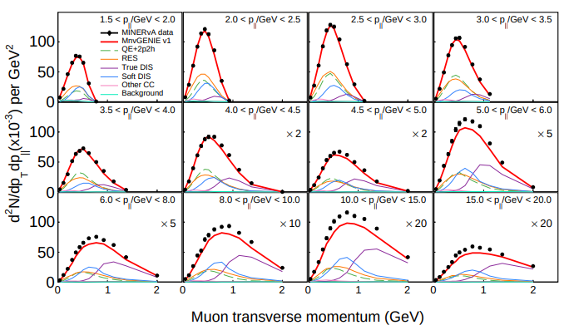
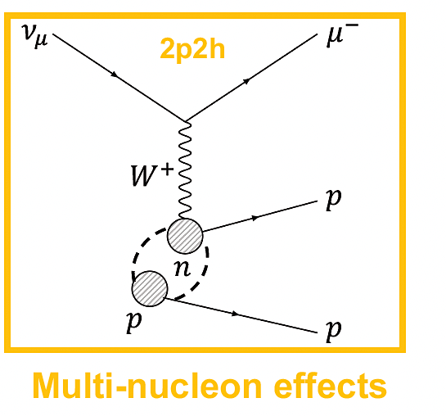
Inclusive Cross Sections at MINERvA
Inclusive cross sections are fully comprehensive tests of interaction modeling and a powerful tool to broadly understand model performance.
We explore all channels of interest simultaneously
We avoid detector-specific definitions
MINERvA has a rich history of inclusive cross section measurements:
doi.org/10.1103/PhysRevD.104.092007
doi.org/10.1103/PhysRevD.101.112007
Akeem L Hart (He/Him)
9th April 2025
‹#›
Notes:
2 options:
Our tracker data is so rich they’re hard to see when plotted as panels - my results will also be this rich for xyz targets
Get rid of LE plot, and just blow up ME
Highlight a given panel in a separate slide to highlight the precision we get with MINERvA

Slide 14
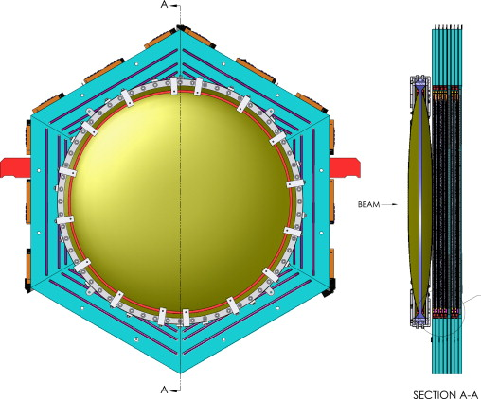



Water target
The water target has several key differences
when compared with the solid targets
which we need a handle on for comparisons
Different shape (Circular tank vs hexagonal segment)
Different materials (Water inside kevlar tank vs slab of material )
Can be drained & filled → Allows for a subtractive analysis to account for the water tank itself to 1st order:
Just Water
Filled
-
Empty
=
Akeem L Hart (He/Him)
9th April 2025
‹#›

Slide 15
Analysis status
This analysis has essentially been split into 2 streams - Tracker (CH) & Nuclear targets (H₂O, Fe, Pb, C) - this is due to the special considerations required by a nuclear target analysis not present in tracker analyses
Tracker Event Selection ✅ Background subtraction ✅ XSec extraction ✅ Closure tests - ✅ Warping Studies - 🟨 Model comparisons 🟥 Further studies… | Targets Event Selection ✅ Background subtraction ✅ XSec extraction ✅ Closure tests ✅ Water Target Studies - ✅/🟨 Warping Studies - 🟨 Model comparisons 🟥 Further studies…
✅ = Complete, 🟨 = In-Progress, 🟥 = Waiting for previous task
Akeem L Hart (He/Him)
9th April 2025
‹#›
Notes:
Mention that prior analyses did cover nuke but water wasn’t yet ready - building off work of several previous students including Anezka
MINERvA has rich history of analysis -> Building off decades of experience from prior analysers

Slide 16
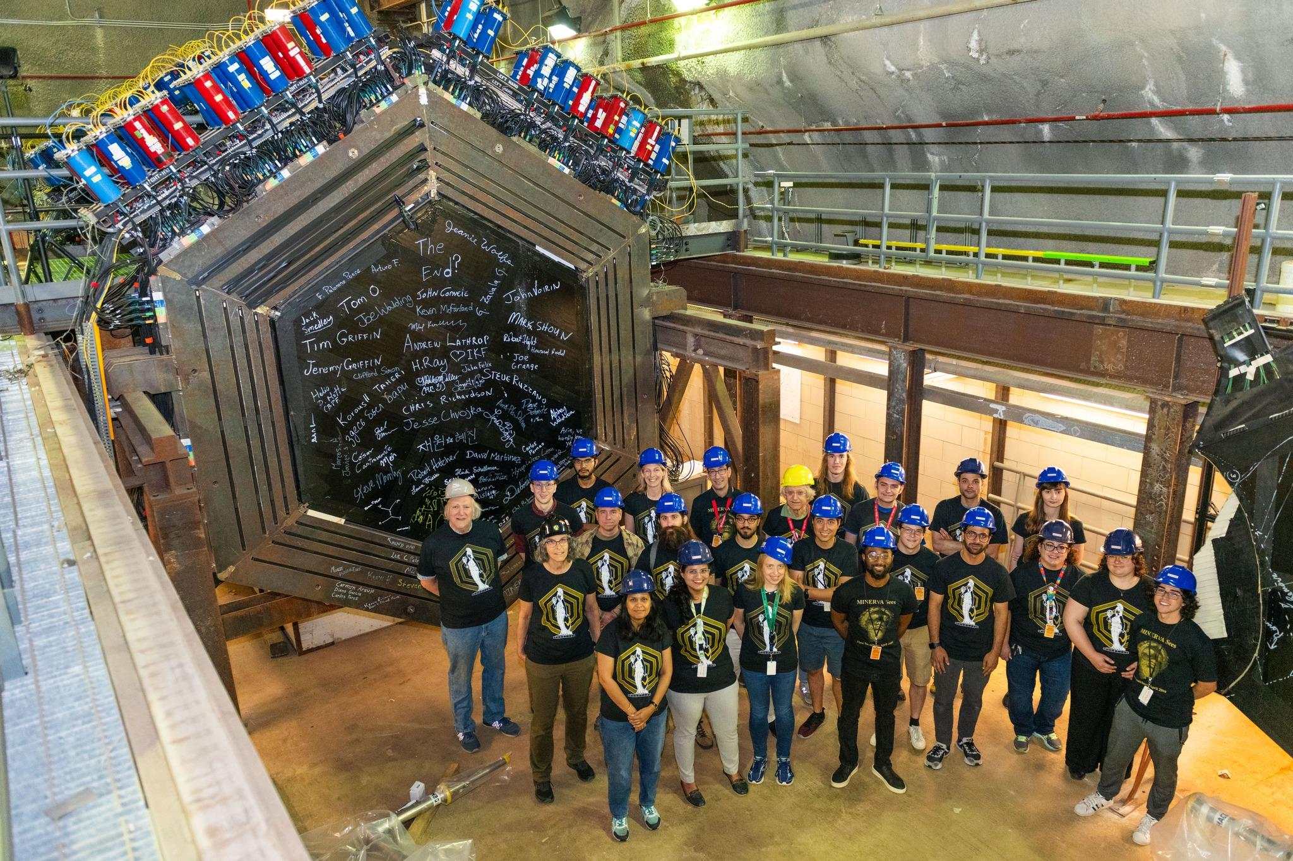
Thank you for listening!

