Slide 1
Fuzzy Dark Matter at the Galactic Centre
Barry Ginat
With bence Kocsis
Based on: 2502.08709
Iop joint app & hepp annual conference
Cambridge, 7.4.2025

Slide 2
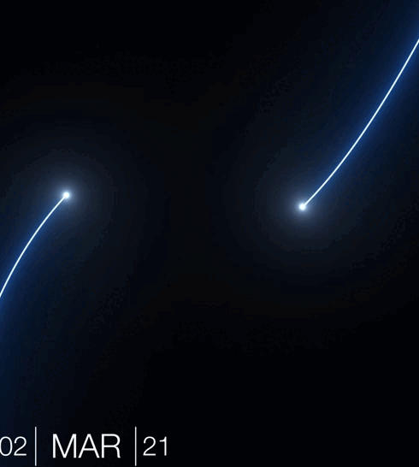
There is a super-massive black-hole at the galactic centre
[Event Horizon Telescope, 2022]
[GRAVITY collaboration, 2021, https://www.eso.org/public/news/eso2119/ ]

Slide 3

Inner parsec is dominated by the SMBH
$$L_{d}$$
A disc of young, massive stars is present around the SMBH (e.g. Levin & Beloborodov 2003, Bartko et al. 2009…).
Assume disc not too eccentric.
What happens to the disc under the influence of a perturbation?
SMBH
Disc

Slide 4
Resonant relaxation governs the dynamics
Evolution is slow over one orbital period.
Average over stars’ orbits to get rings.
Rings interact gravitationally by exerting torques.
Much faster than two-body relaxation (Rauch & Tremaine 1996).

Slide 5
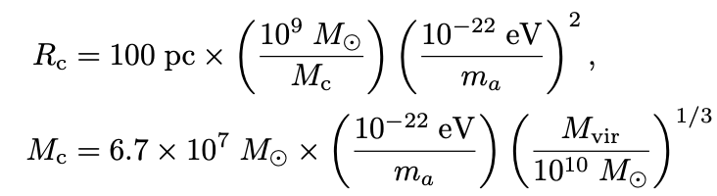
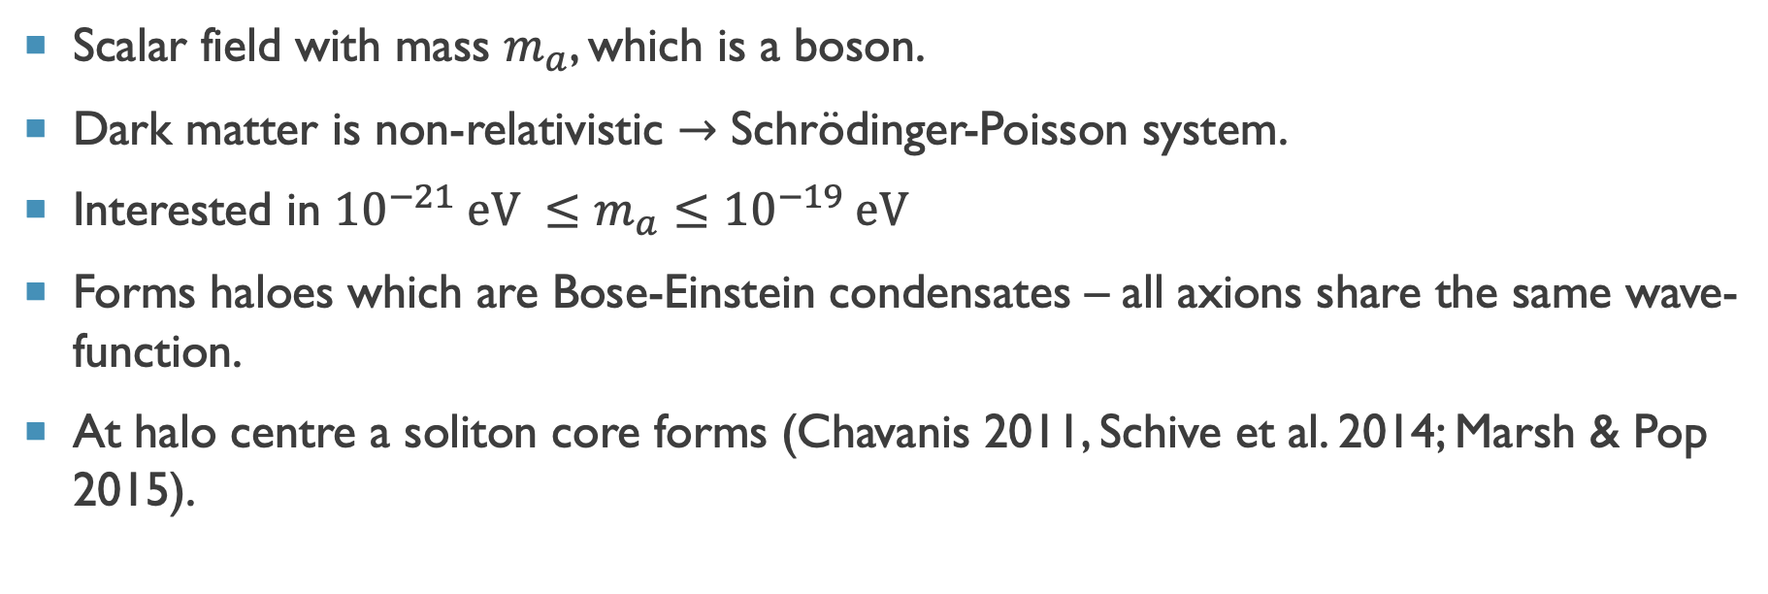
Fuzzy dark matter
Scalar field with mass $m_{a}$, which is a boson.
Dark matter is non-relativistic $→$ Schrödinger-Poisson system.
Interested in ${10}^{−21} eV ≤m_{a}≤{10}^{−19} eV$
Forms haloes which are Bose-Einstein condensates – all axions share the same wave-function.
At halo centre a soliton core forms (Chavanis 2011, Schive et al. 2014; Marsh & Pop 2015).

Slide 6
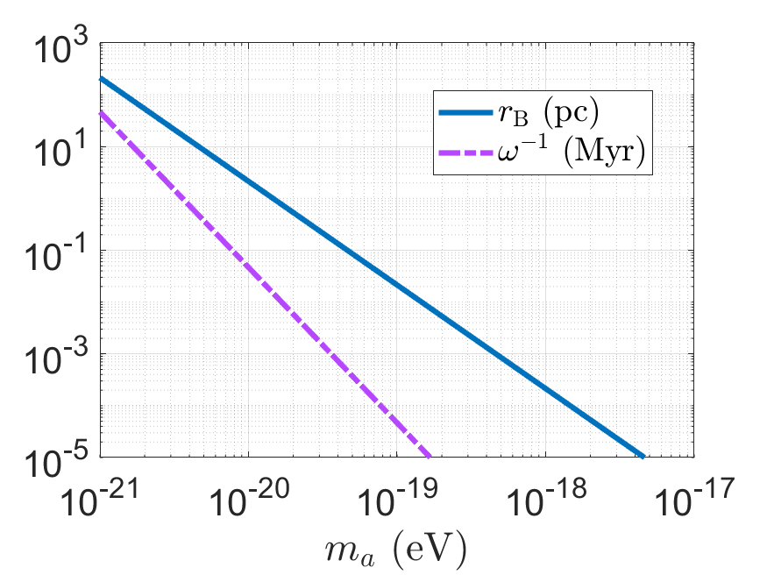

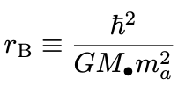
Axion cloud around super-massive black hole
Now insert into the core a super-massive black hole.
Gravitational atom will form, with Hydrogen-atom-like eigenfunctions.

Slide 7





Now add a gravitational atom
$$J_{d}$$
FDM
FDM
$$\left\langle L_{a}\right\rangle$$
$$\left\langle {\hat{L}}_{a}\right\rangle$$
$$J_{d}$$
Disc
SMBH
Disrupted disc
SMBH
$$m≪{M_{d}, M}_{a}≪M_{SMBH}$$

Slide 8
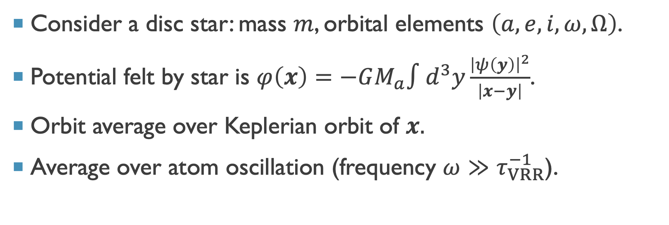
Calculate orbit-averaged axion potential
Consider a disc star: mass $m$, orbital elements $\left(a,e,i,ω,Ω\right)$.
Potential felt by star is $φ\left(x\right)=−GM_{a}∫d^{3}y\frac{{\left|ψ\left(y\right)\right|}^{2}}{\left|x−y\right|}$.
Orbit average over Keplerian orbit of $x.$
Average over atom oscillation (frequency $ω≫τ_{VRR}^{−1}$).

Slide 9
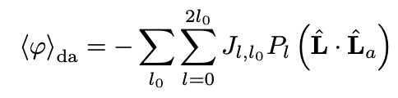

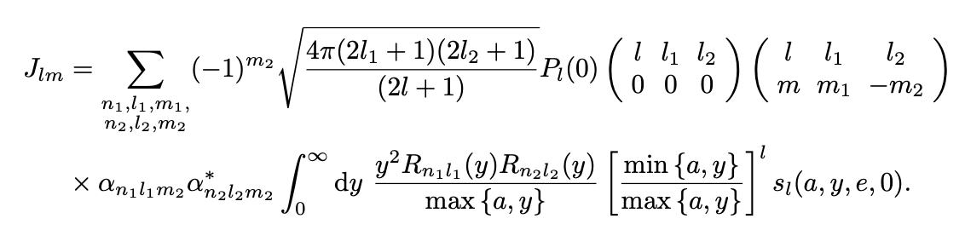
Resonant relaxation potential

Slide 10

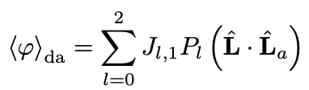

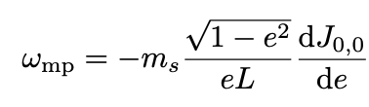
Take simple Atom wave-function

Slide 11
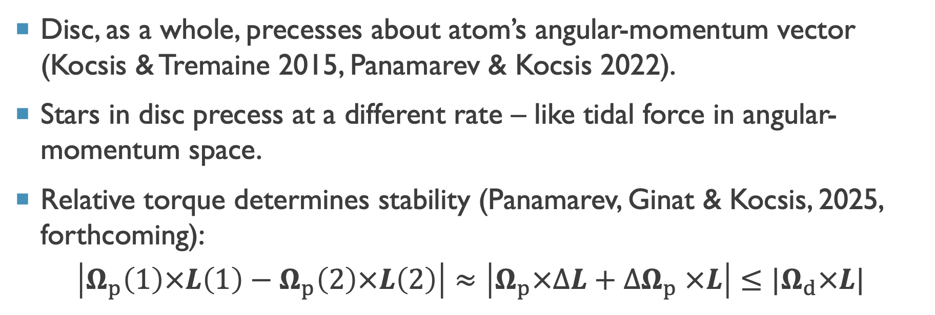
Can the perturber rip the disc apart?
Disc, as a whole, precesses about atom’s angular-momentum vector (Kocsis & Tremaine 2015, Panamarev & Kocsis 2022).
Stars in disc precess at a different rate – like tidal force in angular-momentum space.
Relative torque determines stability (Panamarev, Ginat & Kocsis, 2025, forthcoming):
$$\left|Ω_{p}\left(1\right)×L\left(1\right)−Ω_{p}\left(2\right)×L\left(2\right)\right|≈\left|Ω_{p}×ΔL+ΔΩ_{p} ×L\right|≤{|Ω}_{d}×L|$$

Slide 12
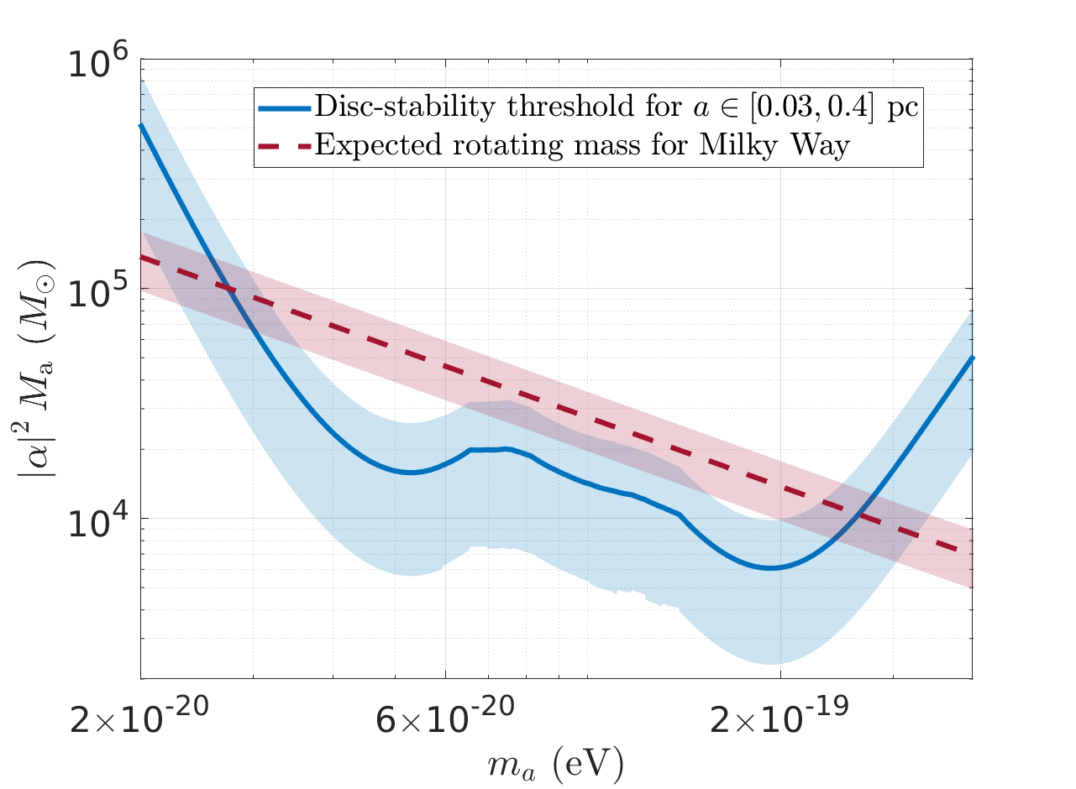

Disc stability
Reduces to:
$${\left|α_{211}\right|}^{2}M_{a}≤\frac{r_{B}}{a_{d}}M_{d}×\frac{f\left(\frac{a_{d}}{r_{B}},e,shape\right)}{\cos{2θ}}$$
[Ginat & Kocsis 2025]

Slide 13
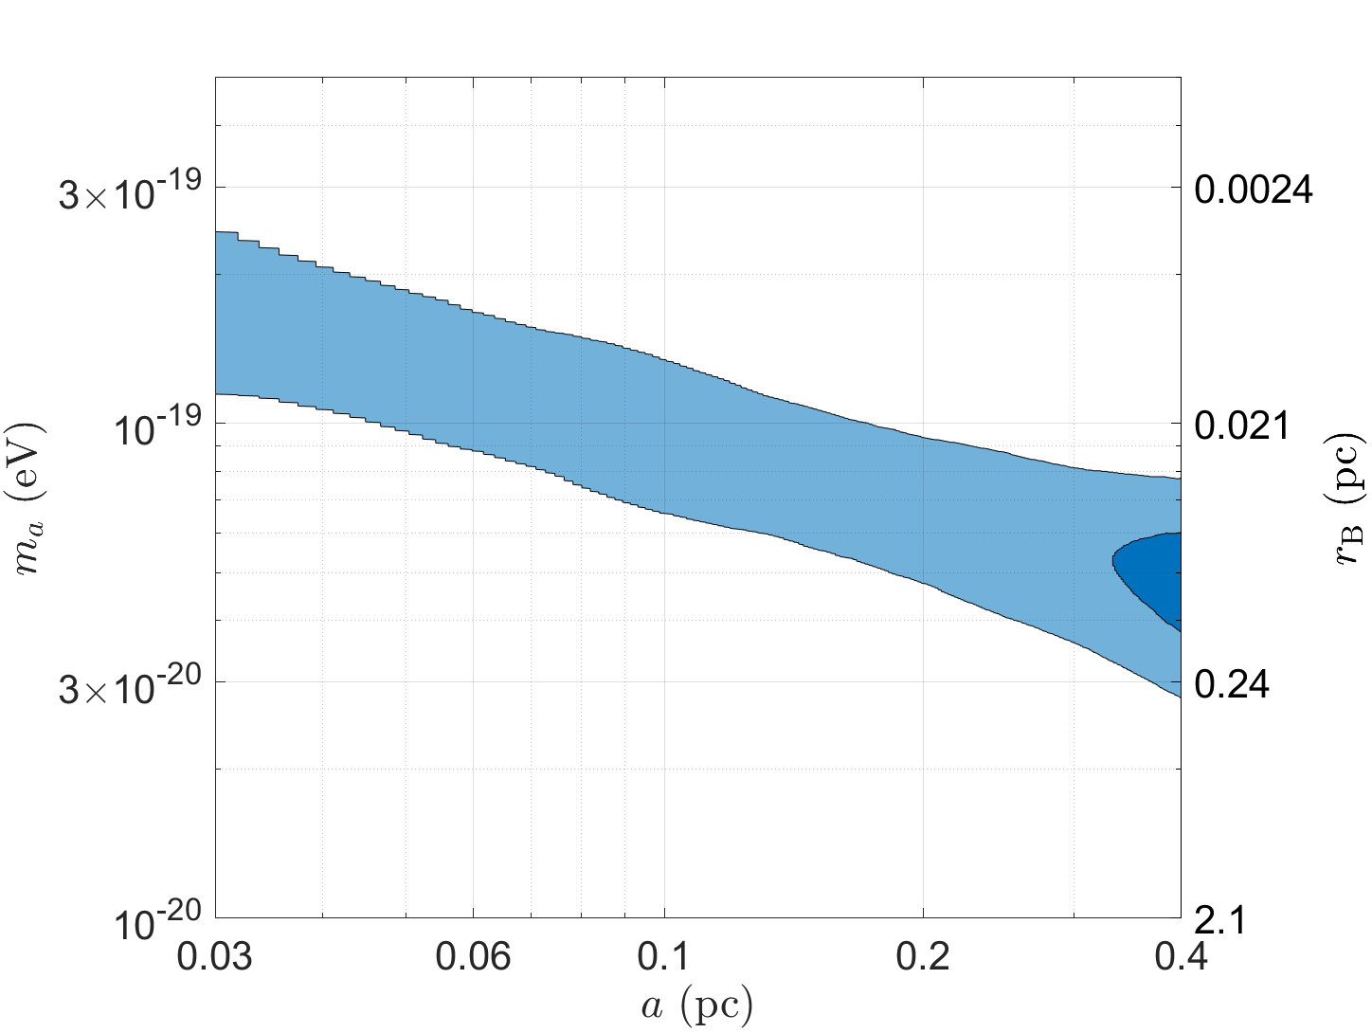
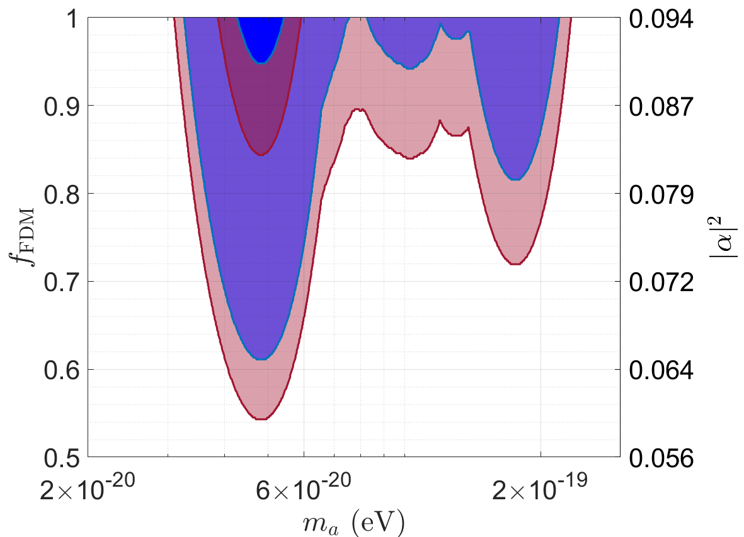
Is the atom massive enough?
[Ginat & Kocsis 2025]

Slide 14
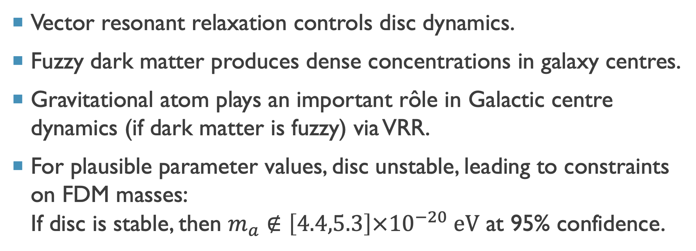
summary
Vector resonant relaxation controls disc dynamics.
Fuzzy dark matter produces dense concentrations in galaxy centres.
Gravitational atom plays an important rôle in Galactic centre dynamics (if dark matter is fuzzy) via VRR.
For plausible parameter values, disc unstable, leading to constraints on FDM masses:
If disc is stable, then $m_{a}∉\left[4.4,5.3\right]×{10}^{−20} eV$ at 95% confidence.

