Slide 1
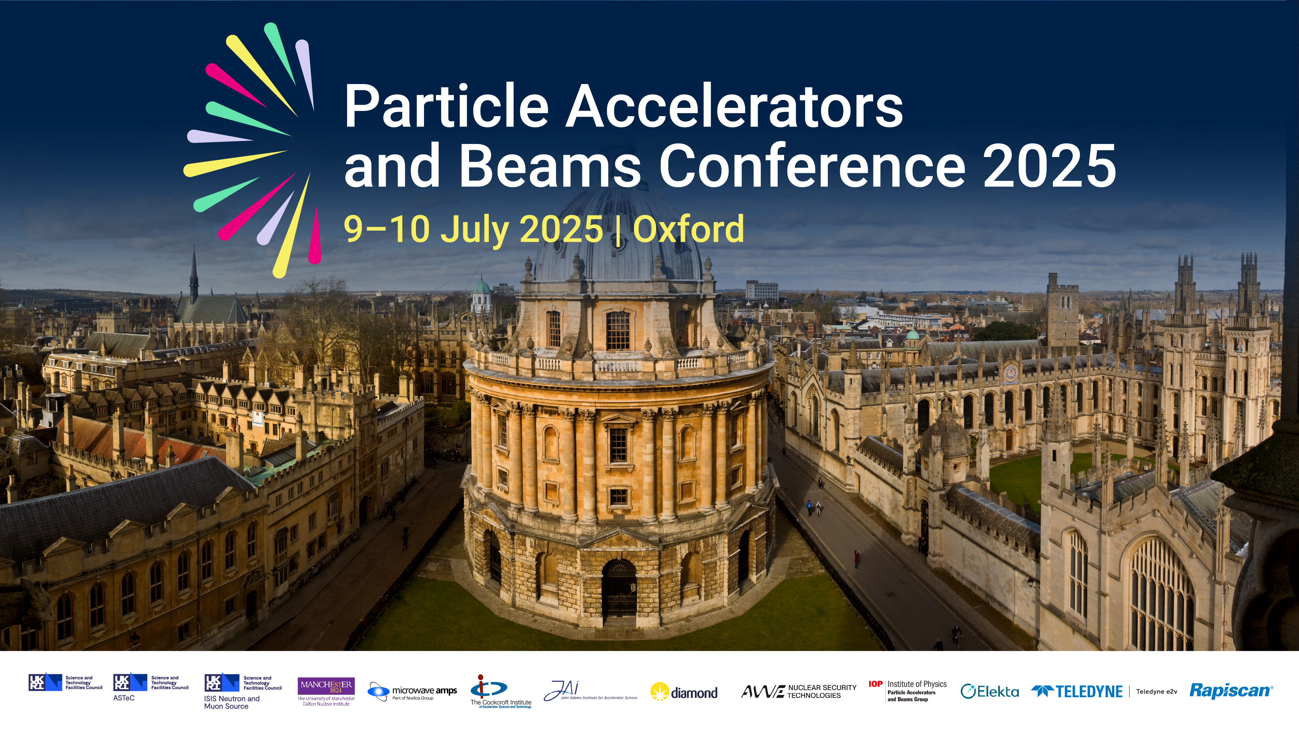

Slide 2



Slide 3

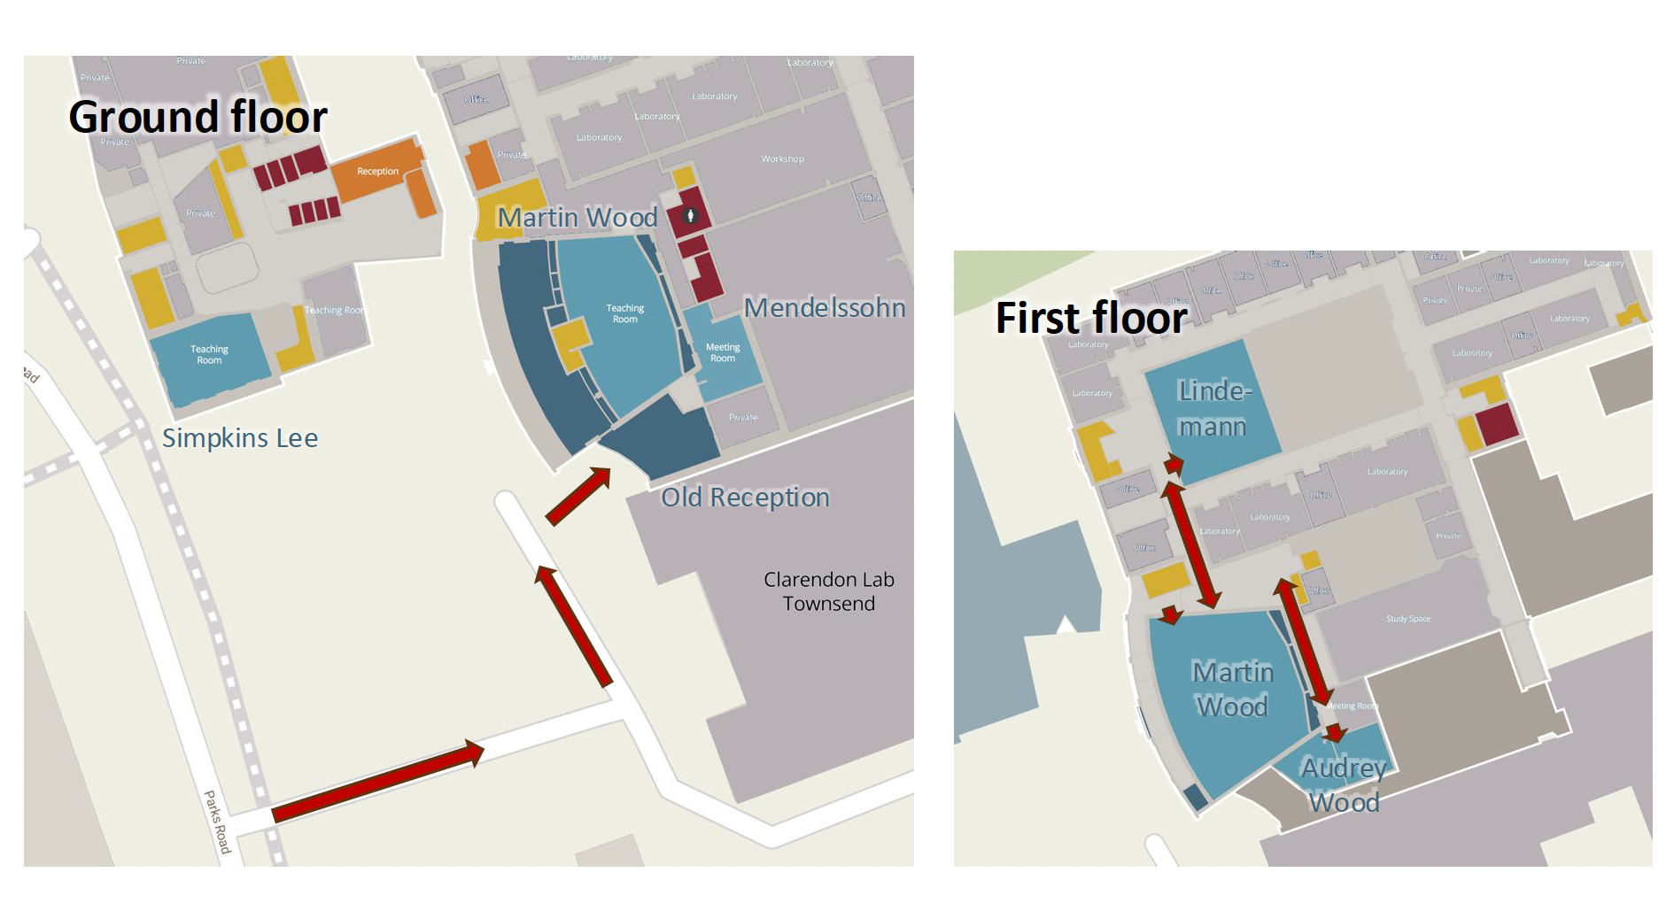
Slide Heading (Arial Bold 40pt)
Subheading (Arial Bold 24pt)
Copy in Arial regular 16pt.

Slide 4
Slide Heading (Arial Bold 40pt)
Parallel Sessions – Wednesday 9th July 2025
Martin Wood | Simpkin Lee | Lindemann
First High Energy Beam from the CLARA Electron Accelerator and Current Commissioning Progress Thomas Pacey | Coherent Stability versus Dynamic Aperture – Pushing the High-Intensity Frontier for Hadron Beam Production Adrian Oeftiger | The VENOM Project Simon Rice
Emittance Measurements and Beam Optics Matching for CLARA Mark Johnson | Diffusion Seb Wilkes | Muon Cooling for a Muon Collider Chris Rogers
Conclusions from the UK XFEL conceptual design and options analysis project David Dunning | Acceleration-Induced Self-Interactions of Ultra-Short Electron Bunches Ryan McGuigan | Laser energised Travelling Charge Accelerator for nuclear medicine and beyond Satyabrata Kar
Beam Brightness Preservation in a High-Brightness Free-Electron Laser Driver Alexander Brynes | Proton beam divergence measurements from radiation pressure driven shock acceleration Ginevra Casati | Communicating high-level environmental sustainability guidelines for large accelerator facilities Hannah Wakelin
Plasma-based energy and brightness booster stages for the UK XFEL Ahmed Fahim Habib | Terahertz-manipulated electron bunches for external injection into a laser-plasma wakefield accelerator Aras Amini | ECFA-UK: Lessons, Progress, and Opportunities for UK Accelerator Science Haroon Rafique
Subheading (Arial Bold 24pt)
Copy in Arial regular 16pt.

Slide 5
Slide Heading (Arial Bold 40pt)
Parallel Sessions – Thursday 10th July 2025
Martin Wood | Simpkin Lee
RF breakdown detection and localization using optical fibers Ana Maria Guisao Betancur | A Novel Moment-Based Particle In-Cell Code Finlay Gunneberg
Crosstalk studies of storage and booster ring DII magnets Syed Rishan Ahamad | Multi-objective genetic algorithm optimisation of the Diamond-II storage ring optics Neven Blaskovic Kraljevic
Optimization of Gas-Curtain based Ionization Profile Monitor for Laser-Driven Proton Therapy Applications Farhana Thensi Mada Parambi | Efficient Free-Electron Laser Modelling Using a Lorentz-Boosted Coordinate System Runfeng Lu
Microwave instability driven by terahertz-scale resistive-wall impedance in electron synchrotrons Dmitrii Rabusov | Comparison of end-to-end simulations of a novel optical fibre beam loss monitor for Geant4- and FLUKA-based models Angus Jones
Subheading (Arial Bold 24pt)
Copy in Arial regular 16pt.

Slide 6

Slide Heading (Arial Bold 40pt)
Subheading (Arial Bold 24pt)
Copy in Arial regular 16pt.

