Slide 1
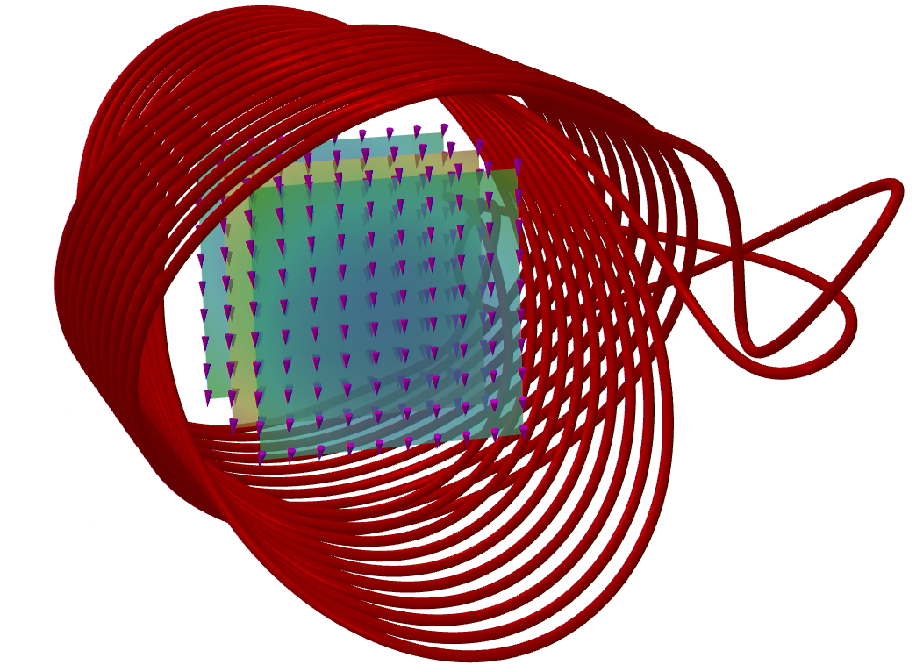
Magnet simulation
Dr Ben Pine Dassault Systemes
Notes:
IP Information:
Image made by BPE8

Slide 2
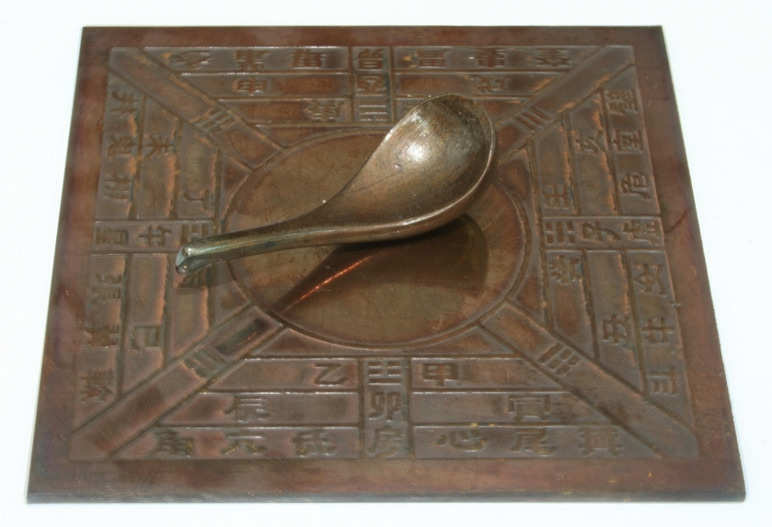
overview
Introduction
Demagnetization – STFC Quadrupole
ISIS Dipole Mesh
XFEL Undulator Simulations
STEP HTS Magnet Quench
Model Si Nan of Han Dynasty!! is licensed under the Creative Commons Attribution-Share Alike 3.0 Unported license
STEP HTS Magnet Rate Dependent Losses
Notes:
Wikipedia:
“The history of the compass started more than 2000 years ago during the Han dynasty (202 BC – 220 AD).”
“It was called the "South Pointing Fish" and was used for land navigation by the mid-11th century during the Song dynasty (960–1279 AD).”
IP Information:
Model Si Nan of Han Dynasty!! is licensed under the Creative Commons Attribution-Share Alike 3.0 Unported license CC BY-SA 3.0, https://commons.wikimedia.org/w/index.php?curid=553022

Slide 3
Introduction

Slide 4
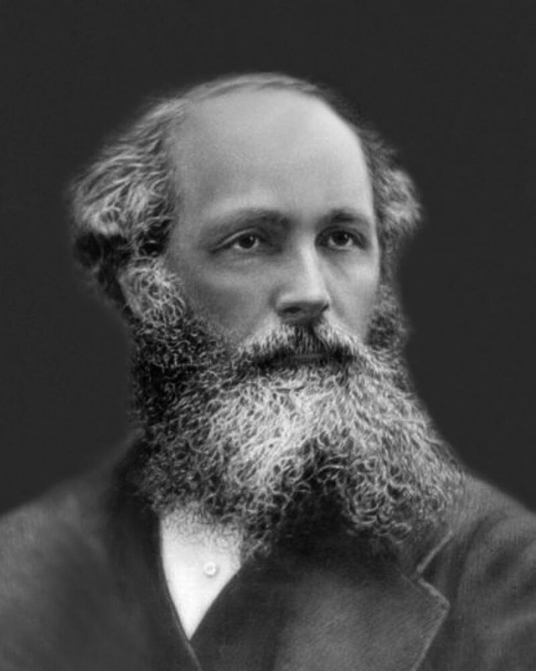
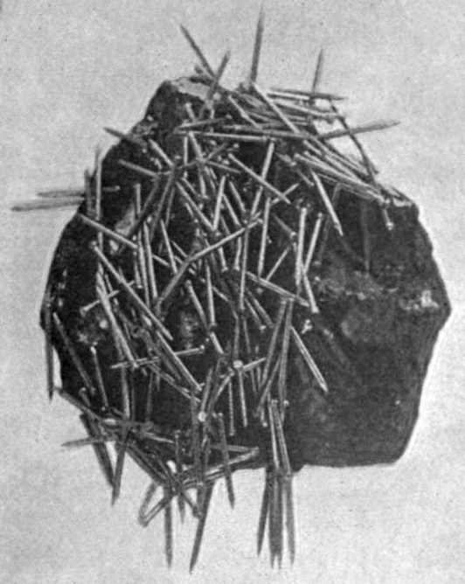

Maxwell’s equations
$$∇∙E=\frac{ρ}{ε_{0}}$$
$$∇∙B=0$$
$$∇×E=−\frac{∂B}{∂t}$$
$$∇×B=μ_{o}\left(J+ε_{0}\frac{∂E}{∂t}\right)$$
James Clerk Maxwell
1831 - 1879
Wikipedia:
“Lodestones are naturally magnetized pieces of the mineral magnetite. They are naturally occurring magnets, which can attract iron.”
Notes:
IP Information:
Left: Maxwell picture: https://www.researchgate.net/figure/James-Clerk-Maxwell-1831-1879_fig1_360164096 |Date=ca. 1870 |Author={{unknown}} |Permission= |other_versions= }}
Right: By Fred Anzley Annet - Downloaded 2008-11-04 from Fred Anzley Annet (1921) Electrical Machinery: A practical study course on installation, operation, and maintenance, 1st Ed., McGraw-Hill, New York, p.11, fig.3 on Google Books, Public Domain, https://commons.wikimedia.org/w/index.php?curid=7094465

Slide 5
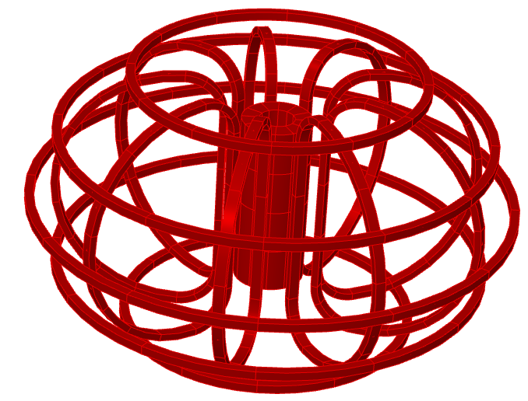

Maxwell ignoring displacement currents
$$∇∙E=\frac{ρ}{ε_{0}}$$
$$∇∙B=0$$
$$∇×E=−\frac{∂B}{∂t}$$
$$∇×\vec{H}=\vec{J}$$
Where
  $$\vec{J}=σ(\vec{E}+\vec{u}×\vec{B})$$
  $σ$ is the electrical conductivity and $\vec{u}$ is the velocity of media with respect to the field
The magnetic scalar and vector potential functions are defined using:
  $\vec{B}=∇×\vec{A}$ $\vec{E}=−∇V−\frac{∂ \vec{A}}{∂t}$
Notes:
IP Information:
Image created by BPE8

Slide 6
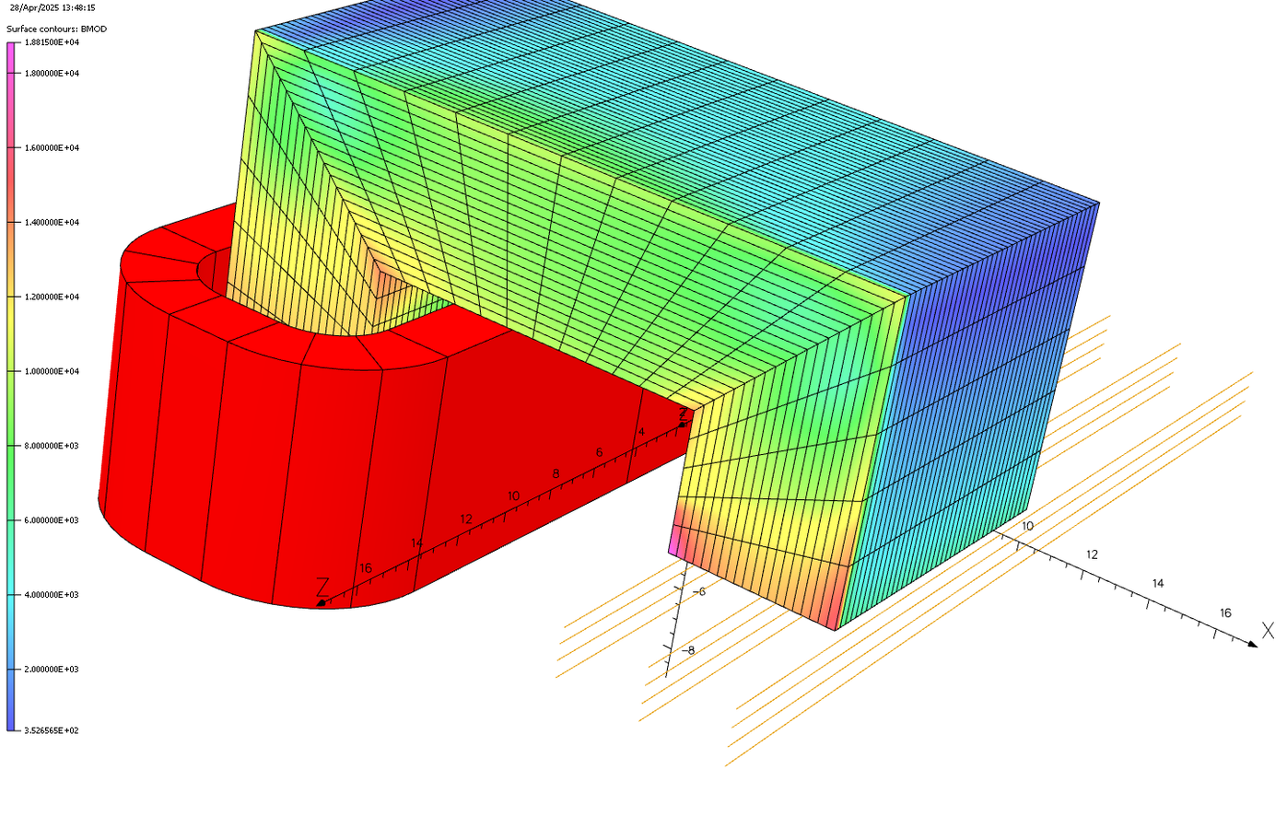

Finite element equations
Combining these equations gives the following equation for $\vec{A}$ where $\vec{u}$ is zero:
  $$∇×\frac{1}{μ}∇×\vec{A}=−σ\frac{∂\vec{A}}{∂t}−σ∇V$$
In conducting regions a secondary equation, derived from $∇⋅\vec{J}=0$ is introduced
$$∇⋅σ∇V+∇⋅\frac{∂\vec{A}}{∂t}=0$$
Transient circuit (Transient thermal and transient EM coupling)
$$\iiint_{Ω=w1}{{\vec{N}}_{w1}∙\frac{d\vec{A}}{dt}dΩ+R_{w1}I_{w1}+…}=V_{S}$$
  Circuit equations are coupled to EM equations
Notes:
IP Information:
Image created by BPE8

Slide 7
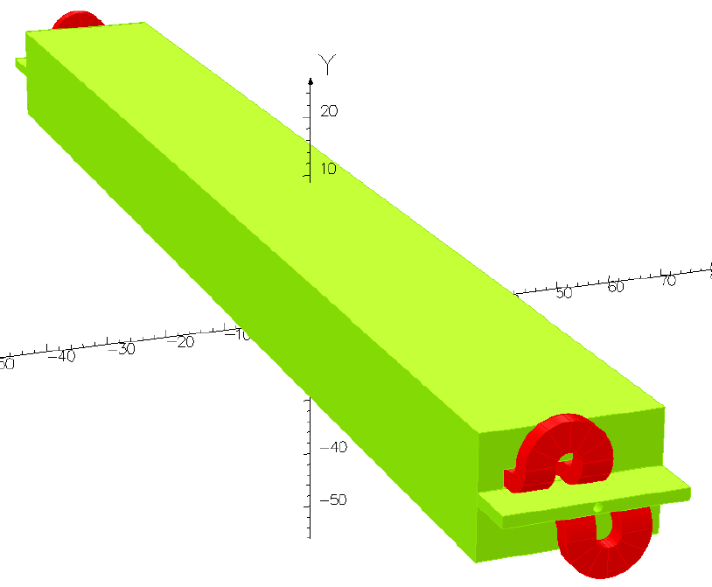
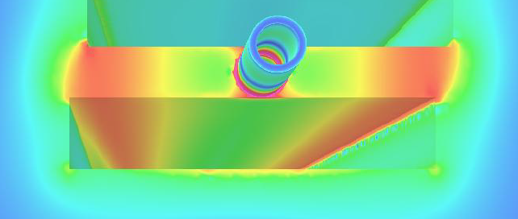
challenges
Speaking specifically of the low frequency regime
Maxwell’s equations coupled with finite element equations
  Have enabled the accurate simulation of magnetic devices of all kinds
  Including nonlinear materials
  Anisotropic materials
  Charged particle beam creation and transport
This success for accelerator magnets has gone on to enable many other applications
  MRI and NMR magnets
  Electrical machines like generators, motors and wind turbines
  Xray tubes and semiconductor manufacturing
This talk is focused on some of the remaining challenges
Which are illustrated by examples I have dealt with in the last year
With the kind permission of some of our customers
Lambertson septum magnet. Field on surface with both coils on.
Courtesy of Jefferson Laboratory.
Notes:
======================================
IP Information: Consent given for use of images by JLAB with appropriate IPinMedia consent to use form signed

Slide 8
Demagnetization – STFC quadrupole

Slide 9
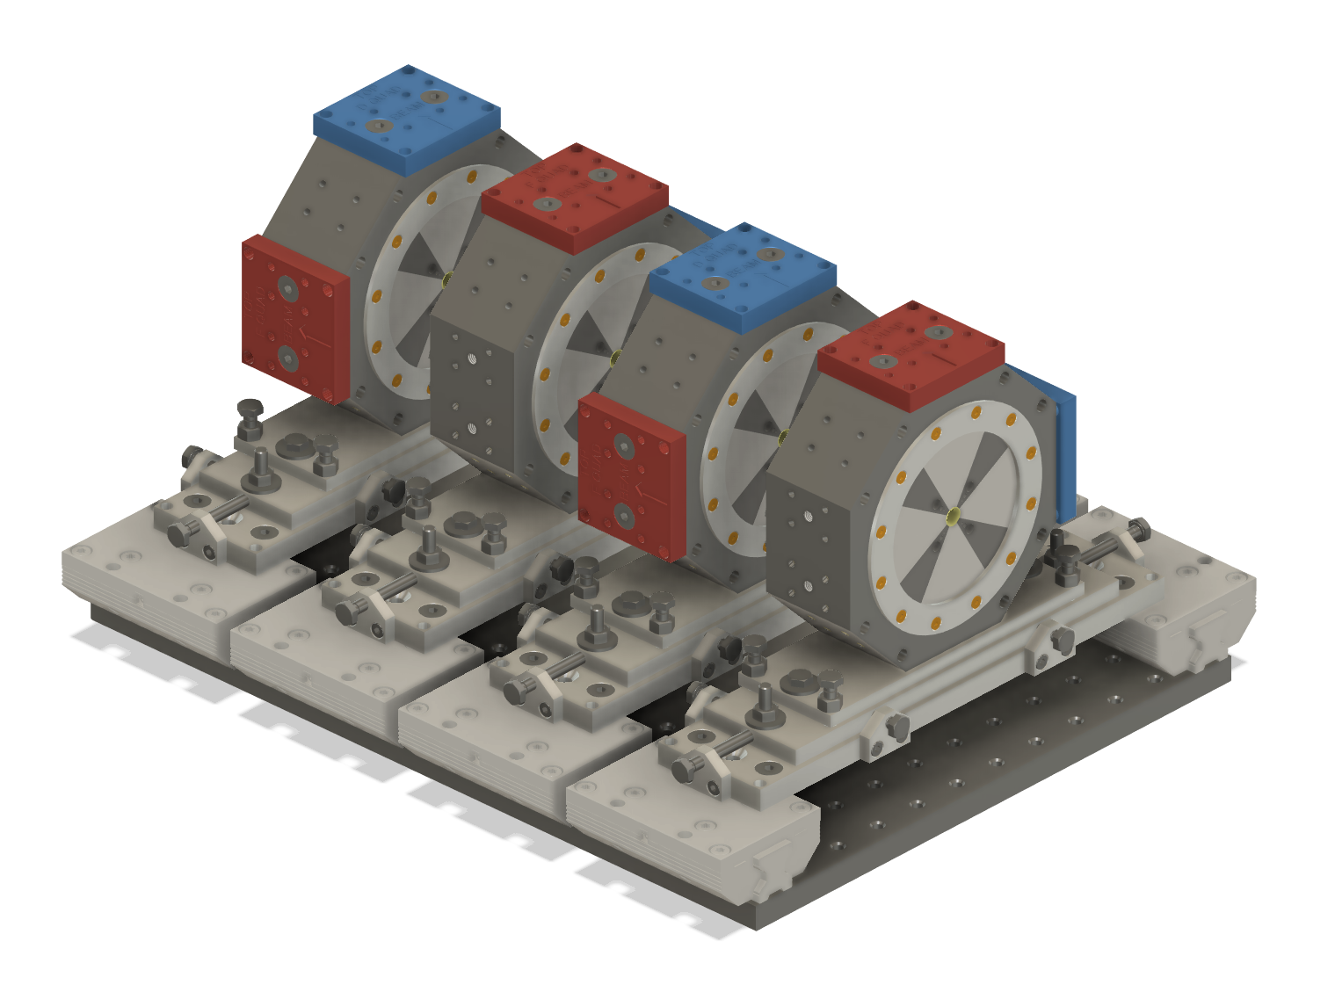
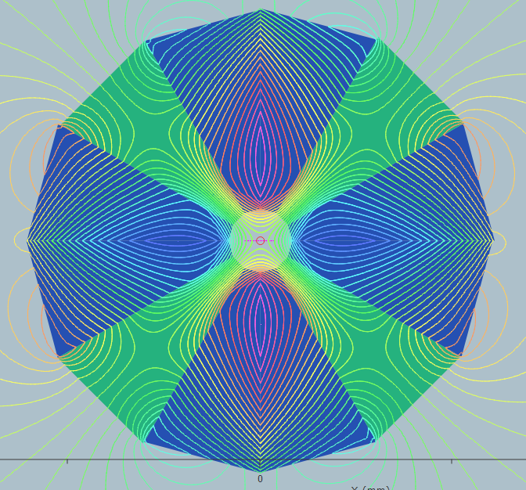
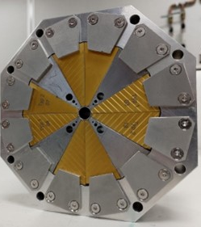

Measurement and simulation of demagnetization in a prototype Halbach array quadrupole
Prototype permanent magnet quadrupoles, designed by Neil Thompson, for a flexible beamline for use with plasma generated electron beams, at the Extreme Photonics Applications Centre, at Rutherford Appleton Laboratory
Notes:
IP Information:
Left and centre image provided by Alex Bainbridge. Consent to use granted in attached email
Right: image created by BPE8

Slide 10
Initial measurement – something wrong
Initial measurements were performed on the Hall probe bench using a Senis 3MH3 with type H probe.
Measured gradient on linear scan 340 T/m, but design gradient is 484.6 T/m for this configuration.

Slide 11
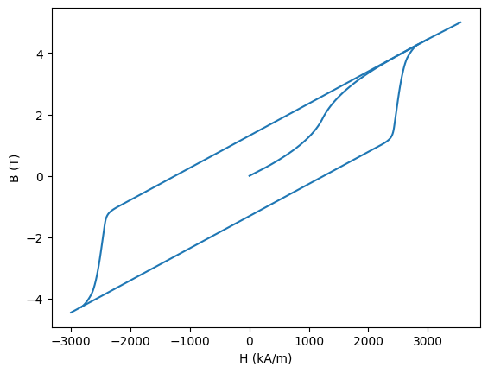
Simulia Opera® magnetization solver
Opera includes a solver for capturing magnetization of permanent magnets
  This is a transient electromagnetic solver which can track the progress of materials as their hysteretic behaviour evolves
  This progress applies element by element
In a typical magnetization, each element of a material will travel up the virgin curve, following an interpolated path. Their final magnetization will depend on the local field environment.
If an element has seen a minimum field which has “gone round the knee” it will be effectively demagnetized.
If an element goes far enough into the third quadrant, it can have a negative effective demagnetization.
If an element sees a larger peak field than its initial magnetization, its history will be forgotten, and it will be completely remagnetised. It will have a new magnetic orientation based on that peak field.
1
2
3
Notes:
IP Information:
Diagram made by BPE8

Slide 12
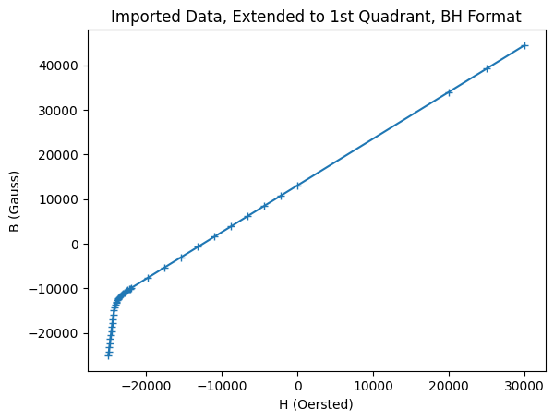

Extracted magnetization data – outer loop
Data from manufacturer stops at $H=0$
  First extend curve up to saturation
Data from manufacturer
Curve extended into first quadrant
Notes:
IP Information:
Diagram made by BPE8

Slide 13
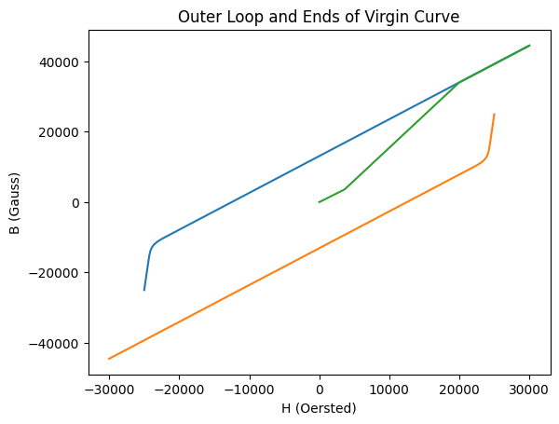
Hysteresis loop and virgin curve
Start constructing full hysteresis loop
  By rotating outer loop by 180 degrees
A template for the virgin curve can be prepared
  This must be linear at the start
  And saturated at the end
Starting curve
Template for virgin curve
Curve rotated by 180 degrees
Notes:
IP Information:
Diagram made by BPE8

Slide 14
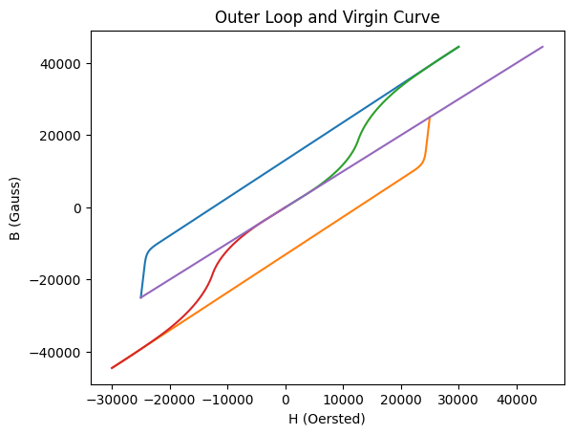
Interpolate virgin curve
Smoothly interpolated virgin curve added
A smoothly interpolated virgin curve has been added
Also extended by symmetry in the 3rd quadrant
Most of what is required is now in place
However there is a region where there is no data
Unfortunately this is the region of interest for the study at hand
This will be addressed next
Region where magnet data is missing
Notes:
IP Information:
Diagram made by BPE8

Slide 15
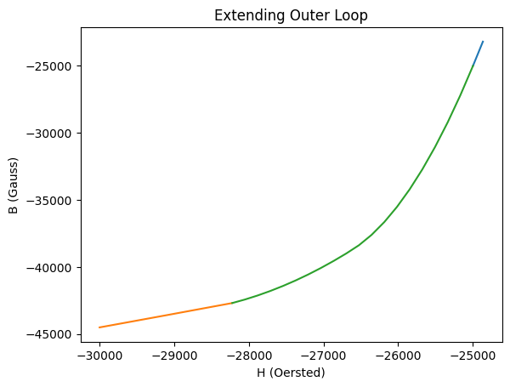
Fitting third quadrant
Manufacturer’s data
The missing part of the outer loop must:
  Start from the manufacturer’s data
  Finish at negative saturation on the virgin curve
  Vary smoothly between these lines
One possibility is shown on the right
There are other possibilities with more or less curvature
In the absence of explicit measurement this is a physically plausible solution
Interpolated function added between manufacturers data, and negative of virgin curve
Negative of virgin curve
Notes:
IP Information:
Diagram made by BPE8

Slide 16
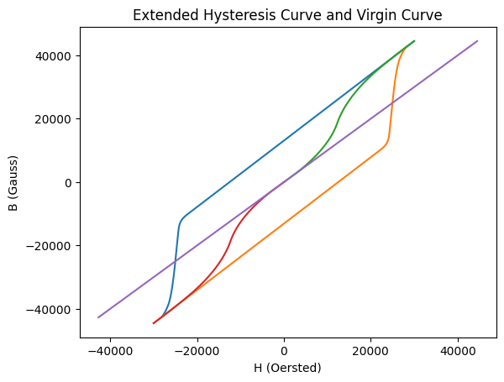
Extended Hysteresis loop and virgin curve
There is now a complete hysteresis loop and virgin curve
  Internal loops can be generated
  These will aid Opera’s internal interpolation
Notes:
IP Information:
Diagram made by BPE8

Slide 17
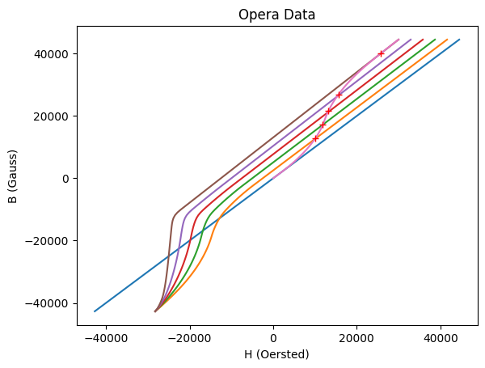
Data used by the opera solver
Notes:
IP Information:
Diagram made by BPE8

Slide 18


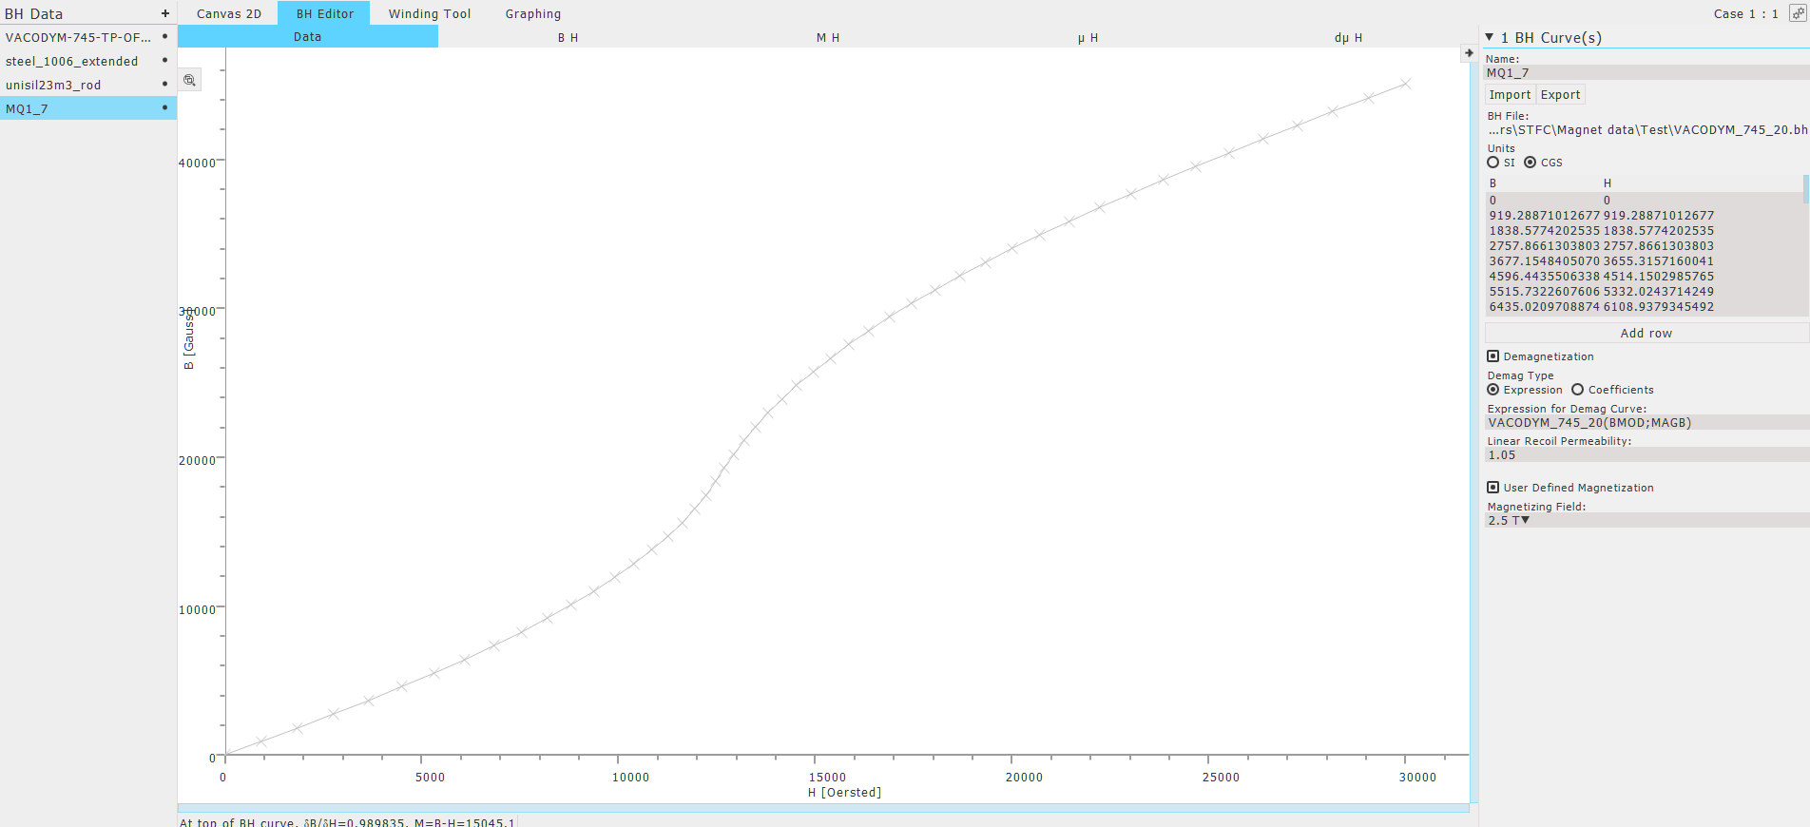
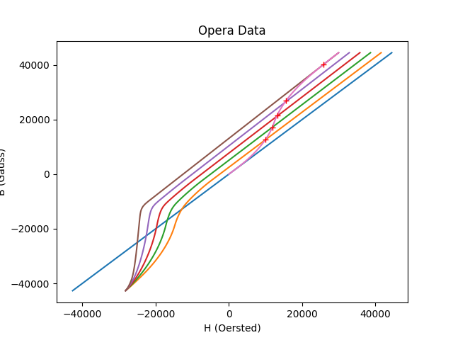
Our model
2.5
Notes:
IP Information:
Diagram and model made by BPE8

Slide 19
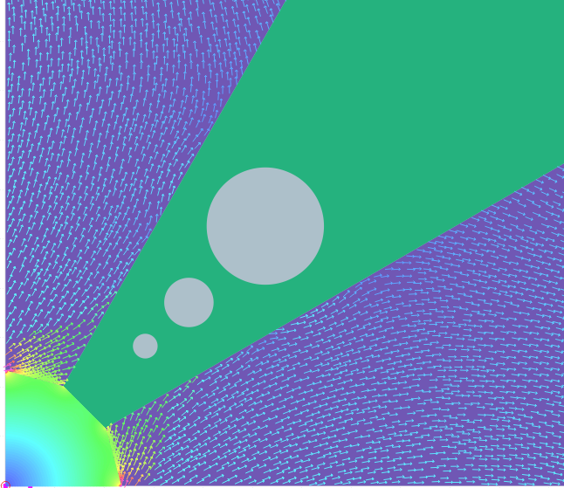
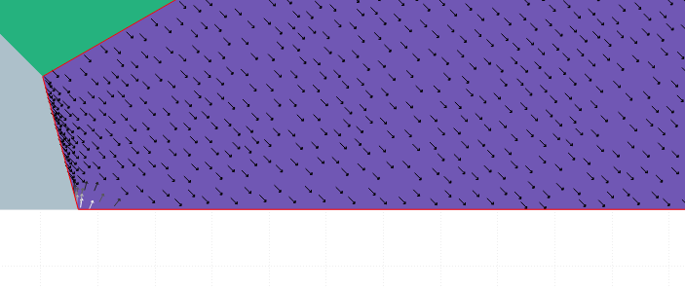
New results
Black vectors show magnetization
Effective demagnetization
Actual demagnetization
Coloured vectors show flux orientation
Notes:
IP Information:
Diagram and model made by BPE8

Slide 20
Accounting for demagnetization
With this updated simulation model, Opera now predicts 350 T/m!
Notes:
IP Information:
Diagram and model made by BPE8

Slide 21
ISIS dipole mesh

Slide 22
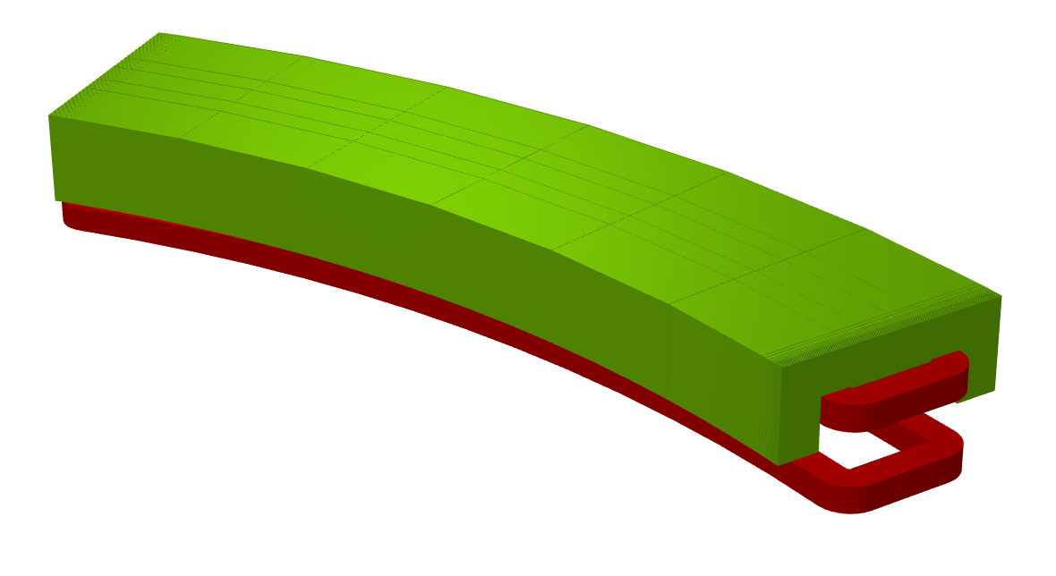
Isis spallation neutron source
Synchrotron Main Dipole Magnet
These are combined function magnets
50 Hz
AC
Laminated
Magnet field sweeps from 0.17 – 0.7 T
Model courtesy of Iker Rodriguez and Martin Hughes, ISIS Spallation Neutron Source, STFC
Notes:
IP Information:
Model courtesy of Iker Rodriguez and Martin Hughes, ISIS Spallation Neutron Source, STFC, consent to use granted in attached email
Image created by BPE8

Slide 23
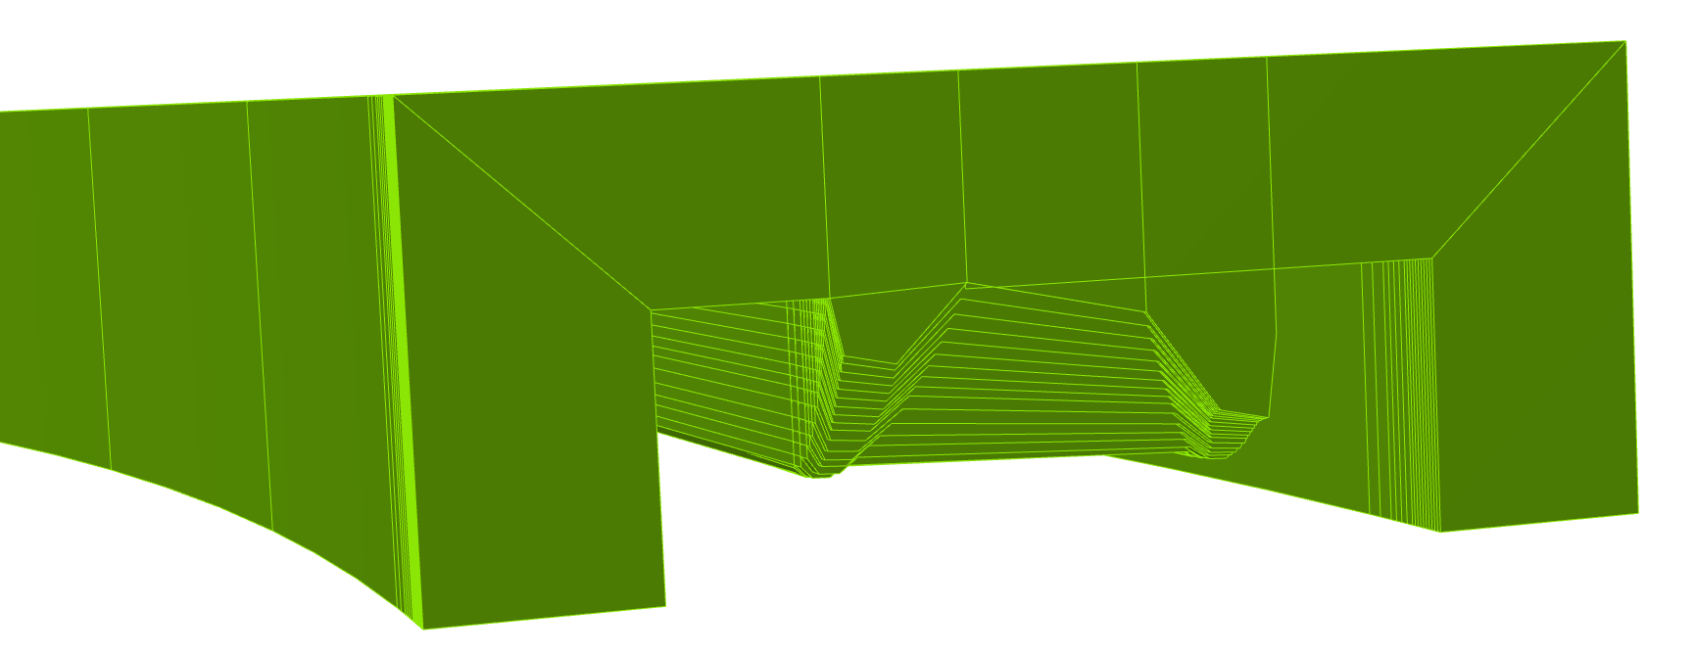
End pole laminations are complicated
Model courtesy of Iker Rodriguez and Martin Hughes, ISIS Spallation Neutron Source, STFC
Notes:
IP Information:
Model courtesy of Iker Rodriguez and Martin Hughes, ISIS Spallation Neutron Source, STFC, consent to use granted in attached email
Image created by BPE8

Slide 24
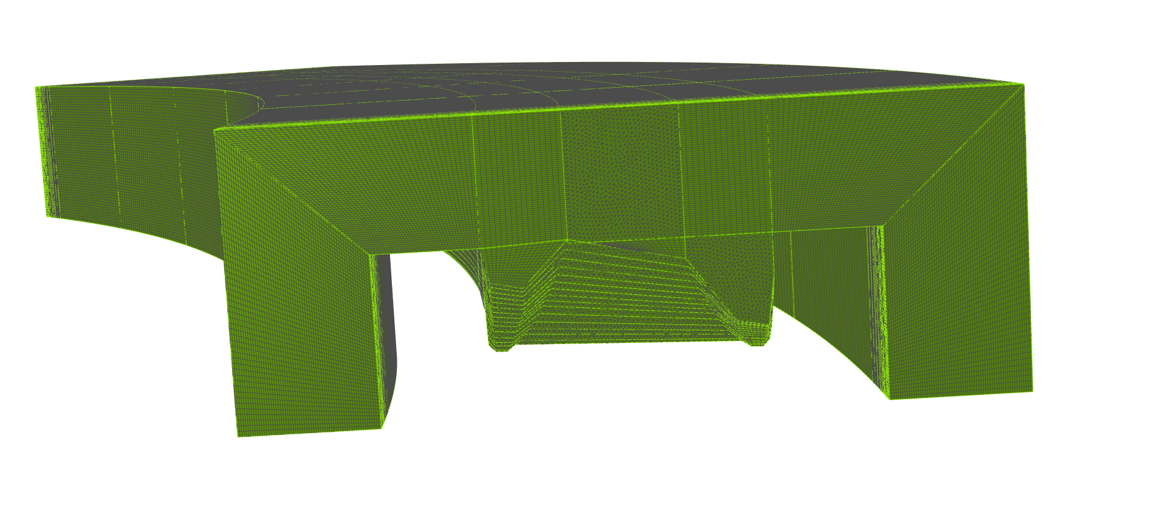
Meshing is a challenge
Model courtesy of Iker Rodriguez and Martin Hughes, ISIS Spallation Neutron Source, STFC
Notes:
IP Information:
Model courtesy of Iker Rodriguez and Martin Hughes, ISIS Spallation Neutron Source, STFC, consent to use granted in attached email
Image created by BPE8

Slide 25
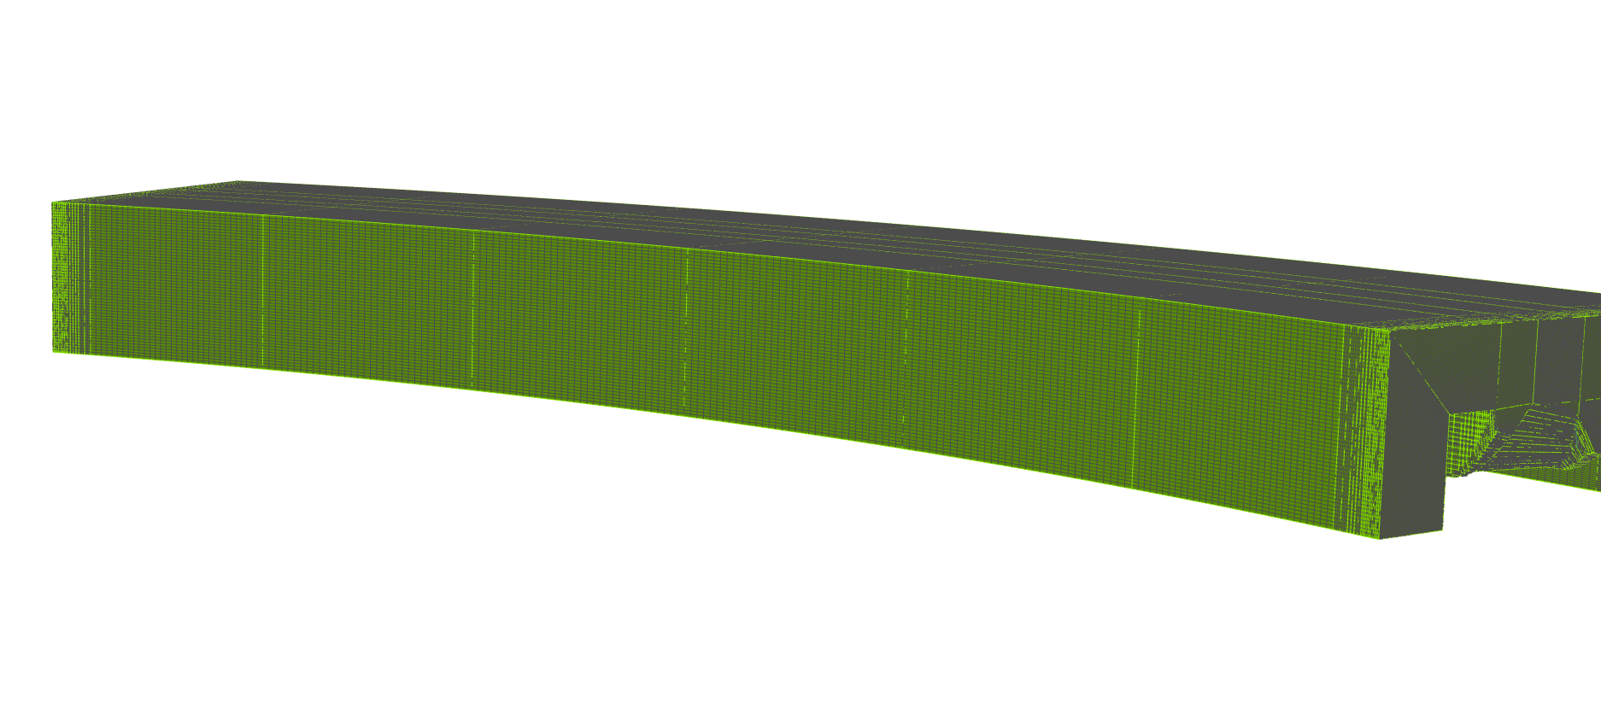
For transient simulations hex mesh is preferred
Model courtesy of Iker Rodriguez and Martin Hughes, ISIS Spallation Neutron Source, STFC
Notes:
IP Information:
Model courtesy of Iker Rodriguez and Martin Hughes, ISIS Spallation Neutron Source, STFC, consent to use granted in attached email
Image created by BPE8

Slide 26
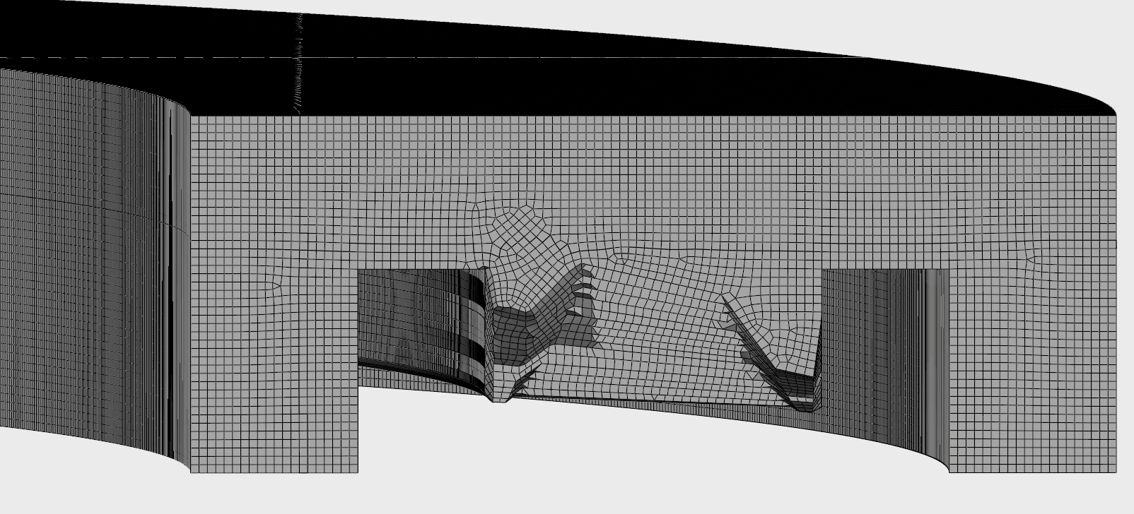
3dexperience® PLATFORM
Model courtesy of Iker Rodriguez and Martin Hughes, ISIS Spallation Neutron Source, STFC
Notes:
IP Information:
Model courtesy of Iker Rodriguez and Martin Hughes, ISIS Spallation Neutron Source, STFC, consent to use granted in attached email
Image created by BPE8

Slide 27
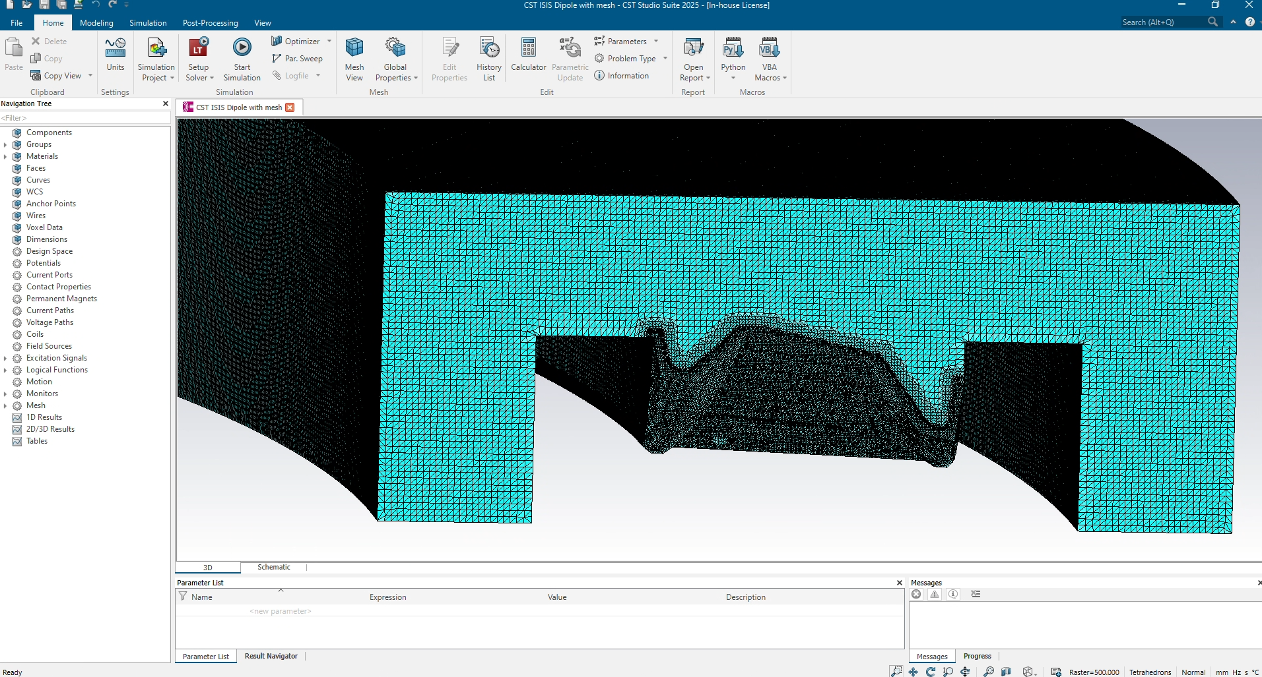
This mesh can be imported to simulia cst studio suite®, but…
Model courtesy of Iker Rodriguez and Martin Hughes, ISIS Spallation Neutron Source, STFC
Notes:
IP Information:
Model courtesy of Iker Rodriguez and Martin Hughes, ISIS Spallation Neutron Source, STFC, consent to use granted in attached email
Image created by BPE8

Slide 28
Xfel undulator simulations

Slide 29
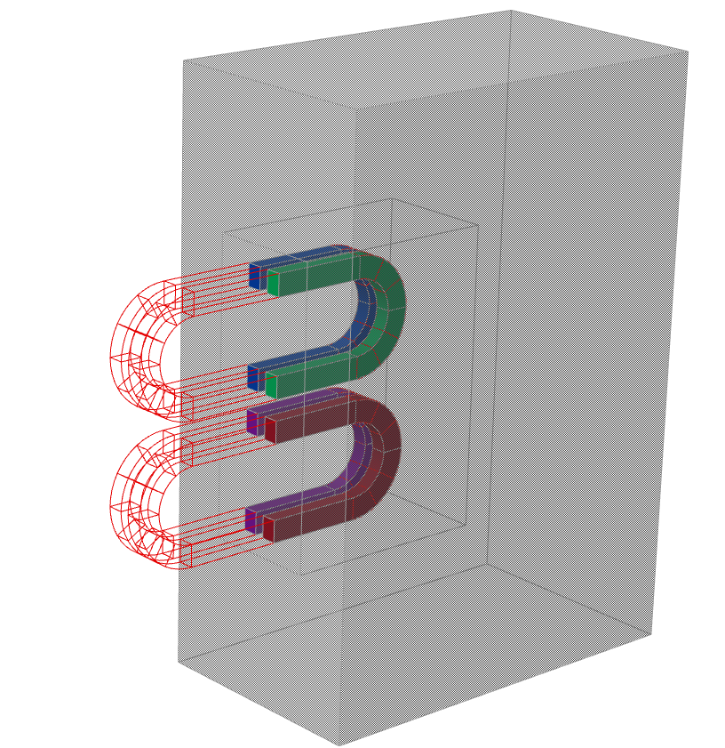
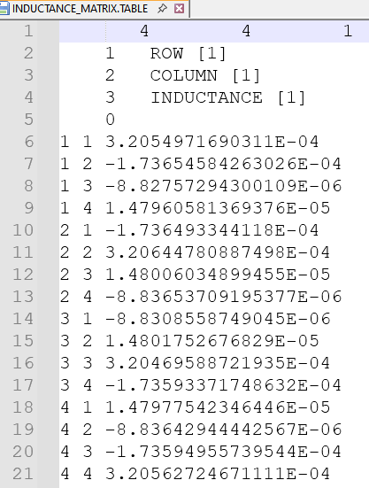
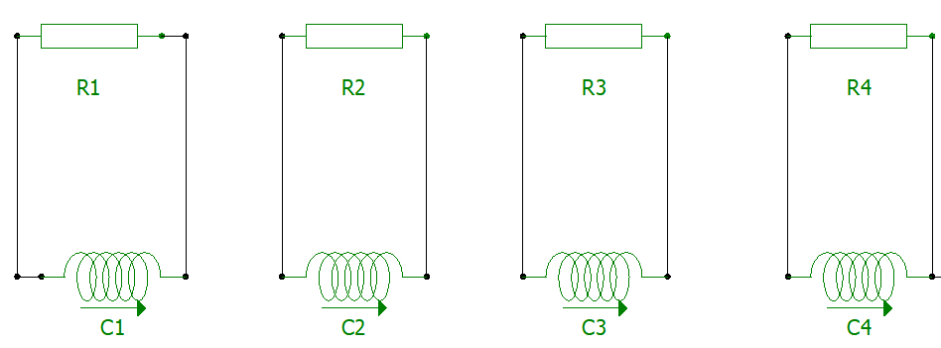

Coil only model with inductance
Simulated inductances agreed well with measurements
Model courtesy of Ajit Nandawadekar, XFEL Undulator Systems Group
Notes:
IP Information:
Model courtesy of Ajit Nandawadekar, XFEL Undulator Systems Group. Consent to use granted in attached email.
Model and pictures created by BPE8

Slide 30
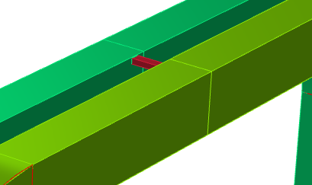
4 coil model including linking sections
Coil only model told us quite a lot
Actual coils all in series with linking turn
This is challenging to model
We tried adding a simple thermal link
Simulations become much harder
Model courtesy of Ajit Nandawadekar, XFEL Undulator Systems Group
Notes:
IP Information:
Model courtesy of Ajit Nandawadekar, XFEL Undulator Systems Group. Consent to use granted in attached email.
Model and pictures created by BPE8

Slide 31
Step hts magnet quench

Slide 32
Simulation of step single tape double pancake hts coil
Spherical Tokamak for Energy Production (STEP) Small Test Coil Programme
Provide relevant real-world experimental data to validate models and designs
Models can then be used with larger scale coils with increased confidence
SIMULIA Opera has been used to validate simulation models for these initial designs
Insulated single-tape double-pancake HTS coil
Heated to initiate quench
  Subsequent temperature and current measurements
Second experiment was measuring AC loss due to offset sinusoidal current
With many thanks to our partners at STEP and UKAEA for their assistance and support

Slide 33
Step team
Many thanks to the STEP team I have been working with
  Aziz Zaghloul, Magnet Design Engineer
  Stuart Wimbush, Principal Magnets Engineer
  Jiabin Yang
This work has been performed together with STEP, a major technology and infrastructure programme led by UK Industrial Fusion Solutions Ltd (UKIFS), which aims to deliver the UK’s prototype fusion powerplant and a path to the commercial viability of fusion.

Slide 34
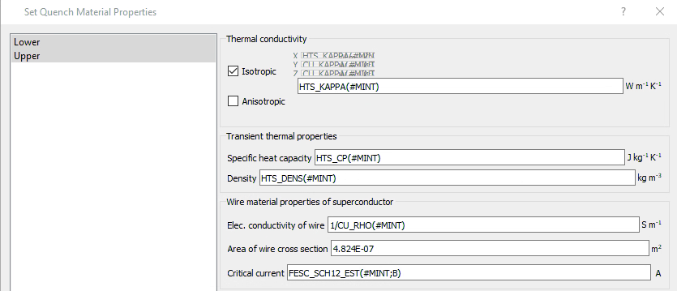
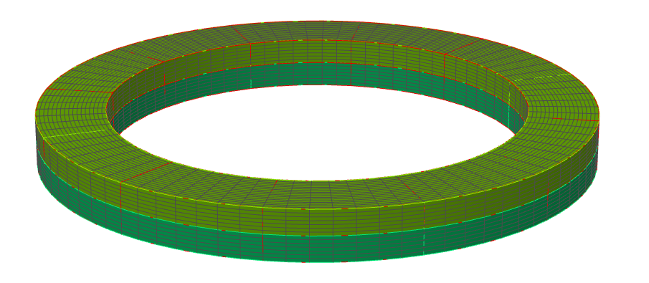
Nonlinear HTS material properties
Notes:
IP Information:
Image created by BPE8

Slide 35
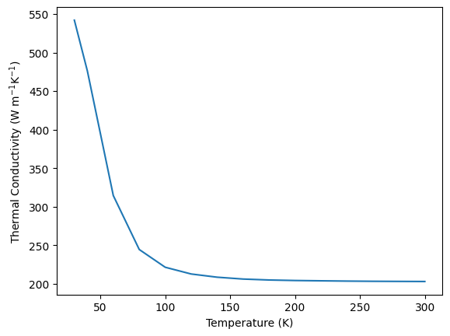
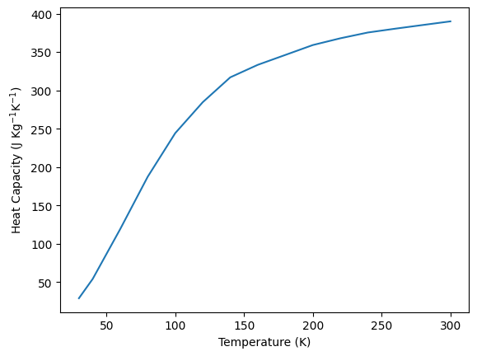
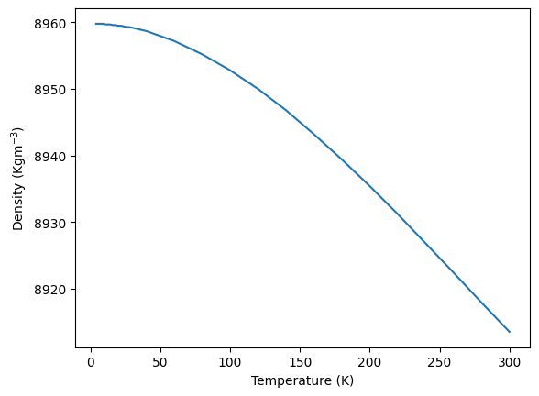
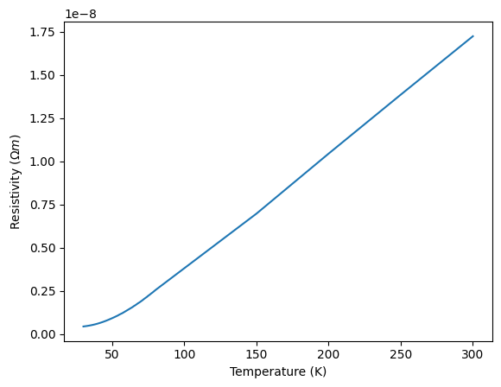
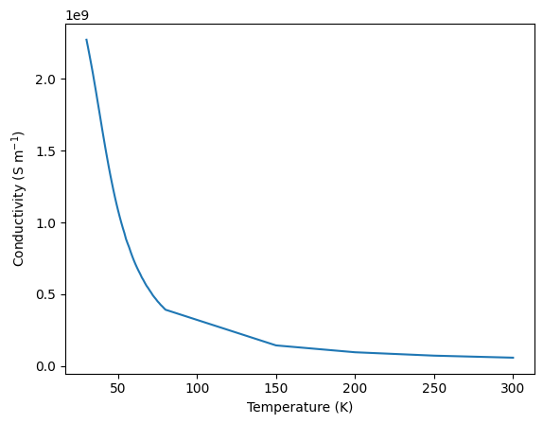
Nonlinear material properties
Notes:
IP Information:
Images created by BPE8

Slide 36
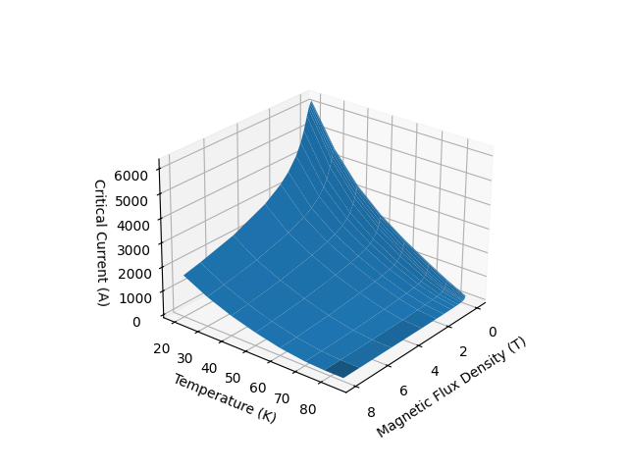
Converting critical current
Start with Robinson Research Institute Database Fujikura FESC 2G HTS
  0 or 90? 0 Is worst case?
Scale to measured values
  At 77K 0 T, measurement is average 726 A for a 12 mm tape
  This is 605 A per cm
  Scale everything else to this value
  i.e. multiply critical current data by 605/496.95 = 1.217
This is critical current per cm width
  Width of tapes is 12.18 mm, so need to multiply by 1.218
  Opera uses critical current
Notes:
IP Information:
Image created by BPE8

Slide 37
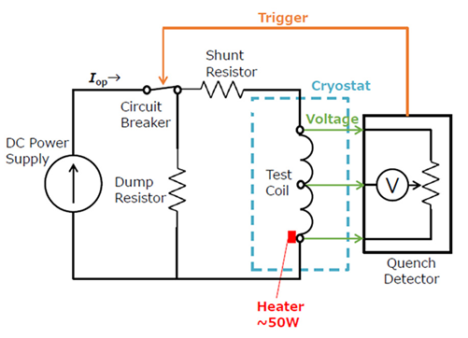
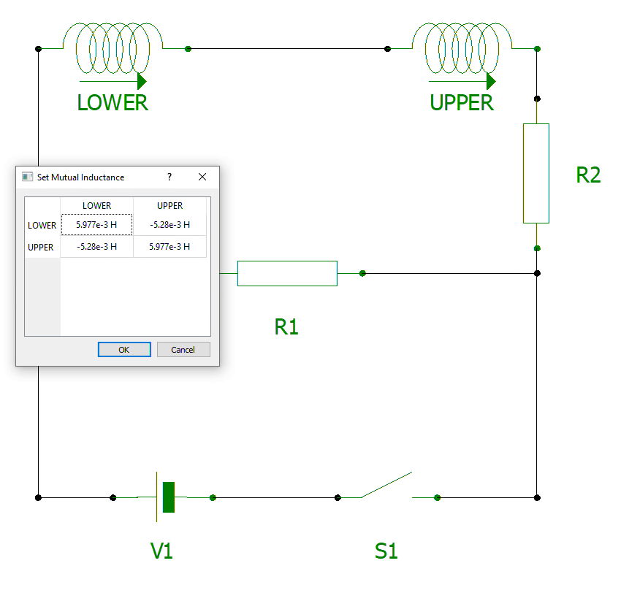
Circuit and mutual inductance
Circuit provided by STEP
Circuit used in Opera, mutual inductance table inset
Notes:
IP Information:
Left: Image provided by STEP team. Consent to use granted in attached email.
Right: Image created by BPE8

Slide 38
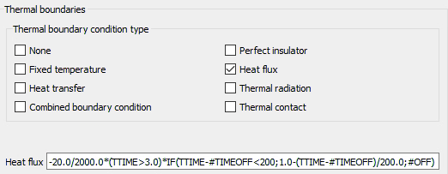
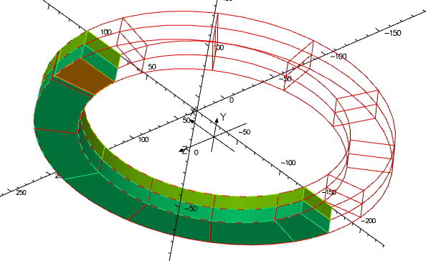
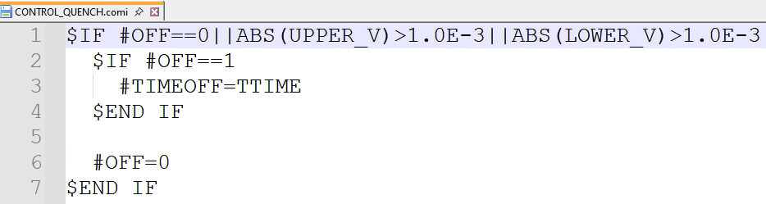
Heater definition
IF(TTIME-#TIMEOFF<200;1.0-(TTIME-#TIMEOFF)/200.0;#OFF)
- this allows 200s cool down after off
Notes:
IP Information:
Images created by BPE8

Slide 39
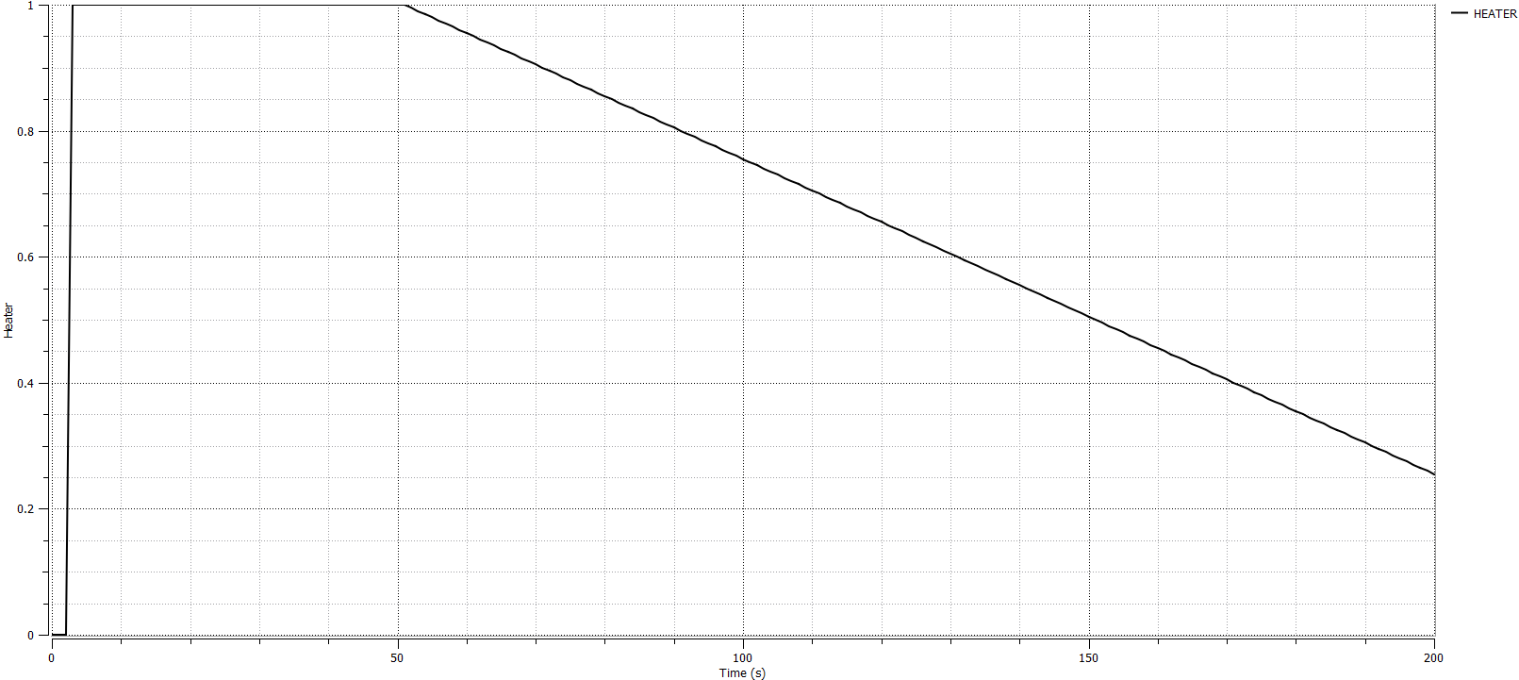
Heater with cool down
Notes:
IP Information:
Image created by BPE8

Slide 40

TEMPERATURE EVOLUTION with more cooldown
Opera simulation results
STEP measurements
Notes:
IP Information:
Left: Image created by BPE8
Right: Image provided by STEP team. Consent to use granted in attached email.

Slide 41
Step hts magnet rate dependent losses

Slide 42





Step AC loss measurements
20 K
40 K
65 K
70 K
77 K
Notes:
IP Information:
Data and images provided by STEP team. Consent to use given in attached email.

Slide 43





Linear fits of 150A data
Notes:
IP Information:
Images created by BPE8

Slide 44



How do we get frequency in the simulations?
Opera has circuit system variables for each coil for I and dI/dt, these can be used to obtain the frequency – assumes sinusoidal waveform
$$I=I_{T}×\sin{2 πf t}$$
$$\frac{dI}{dt}=2 πf I_{T}\cos{2 πf t}$$
$$I^{2}+{\left(\frac{1}{2 πf}\right)}^{2}{\left(\frac{dI}{dt}\right)}^{2}=I_{T}^{2}$$
$$f=\frac{1}{2×π×\sqrt{I_{T}^{2}−I^{2}}}×\frac{dI}{dt}$$
Opera table file
Notes:
IP Information:
Images created by BPE8

Slide 45



Before and after volume heating
Notes:
IP Information:
Images created by BPE8

Slide 46
conclusion
Introduction
Demagnetization – STFC Quadrupole
ISIS Dipole Mesh
XFEL Undulator Simulations
STEP HTS Magnet Quench
STEP HTS Magnet Rate Dependent Losses

Slide 48






