Slide 1


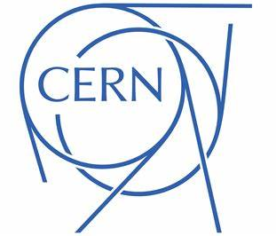





NOMAD - Compact Accelerators for Cultural Heritage
Tessa Charles¹,
Adelphine Bonneau², Pierre Couture³, Jamie Hampson⁴, Maxim Korostelev^{5,6}, Serge Mathot⁷, Courtney Nimura^{8,9}, Andy Wolski^{5,6}
1. ANSTO – Australian Synchrotron, 2. Université de Sherbrooke, 3. Surrey Ion Beam Centre, 4. University of Exeter, 5. Cockcroft Institute, 6. University of Liverpool, 7. CERN,
8. University of Oxford, 9. Ashmolean Museum

Slide 2
Accelerators can be powerful tools, revealing hidden secrets of cultural heritage.
A few examples….

Slide 3
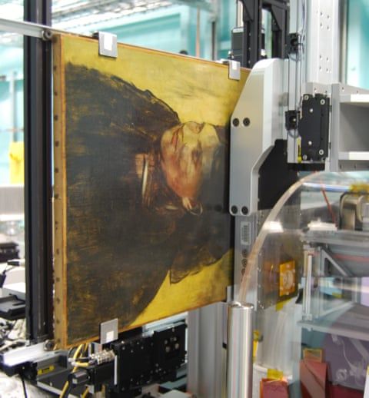
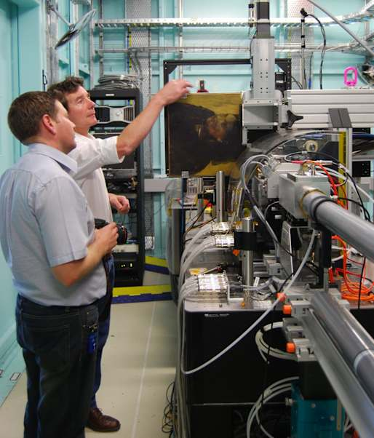
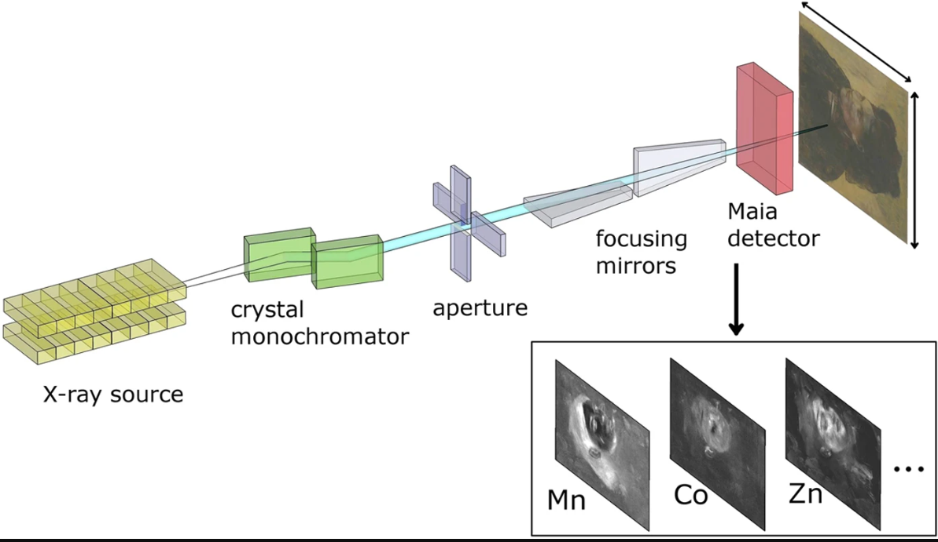
X-ray Fluorescence (XRF) elemental mapping
D. Thurrowgood et al Scientific Reports | 6:29594 | DOI: 10.1038/srep29594

Slide 4
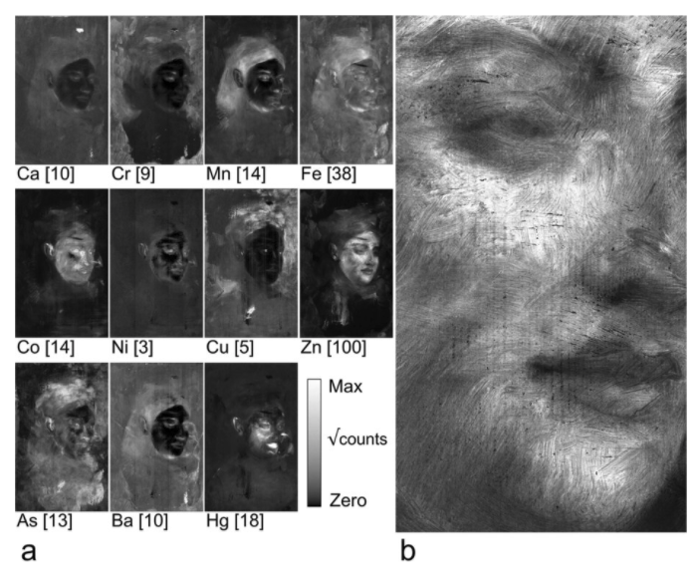
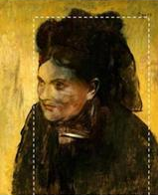
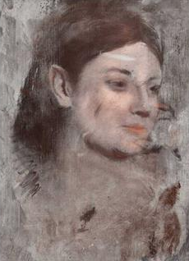
X-ray Fluorescence (XRF) elemental mapping to reveal hidden painting
Portrait of a Woman
Edgar Degas 1876
D. Thurrowgood et al Scientific Reports | 6:29594 | DOI: 10.1038/srep29594

Slide 5
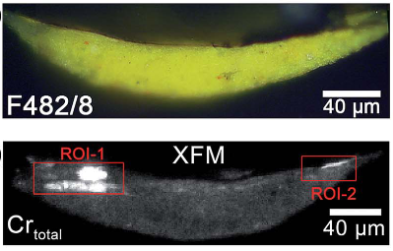
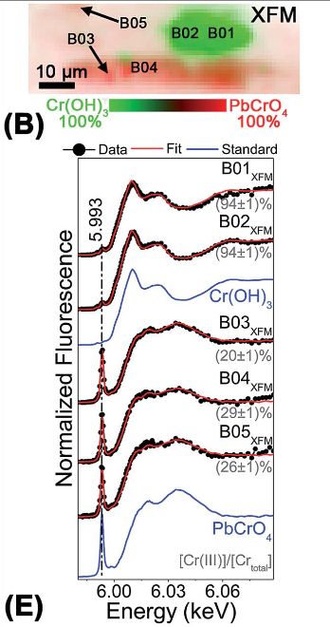
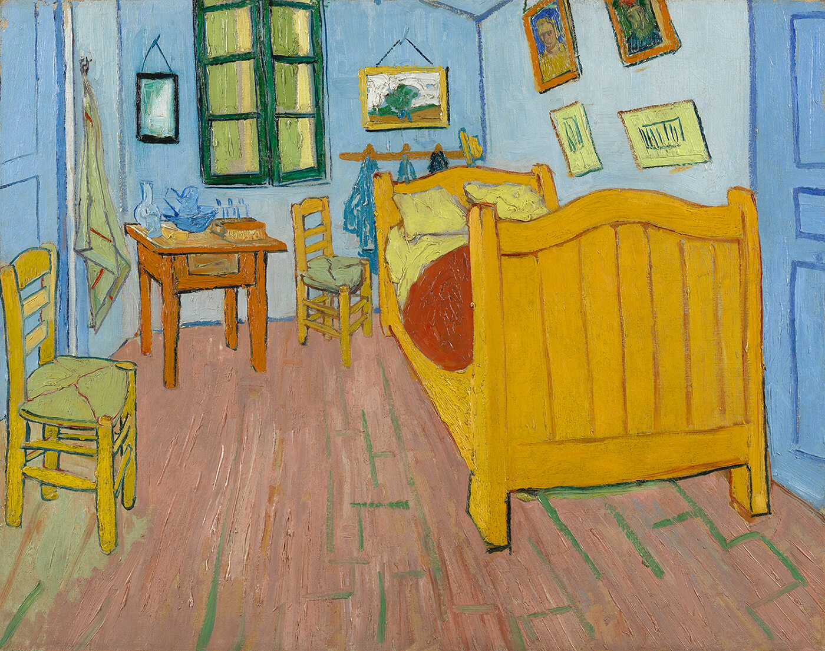

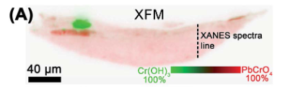
Full spectral XANES imaging revealed the alteration process of chrome yellow pigments in paintings by Vincent van Gogh
“This time it’s just simply my bedroom, only here colour is to do everything…”
- Van Gogh, in a letter to his brother Theo.
The Bedroom (Van Gogh Museum, Amsterdam, The Netherlands)
This study used:
the beamline ID21 at ESRF,
the XFM beamline of the Australian Synchrotron, and
the hard X-ray micro/nano-probe beamline at DESY
L. Monico et al, J. Anal. At. Spectrom., 2015, 30, 613-626, https://doi.org/10.1039/C4JA00419A
“…the walls pale lilac, the ﬂoor in a broken and faded red, the chairs and the bed chrome yellow, the pillows and the sheet very pale lemon green, the bedspread blood-red, the dressing-table orange, the washbasin blue, the window green. I had wished to express utter repose with all these very different tones.”
"This time it's just simply my bedroom, but colour is to do everything, and giving by its simplification a grander style to things, is to be suggestive here of rest or of sleep in general. In short, looking at the picture ought to rest the mind, or rather, the imagination"

Slide 6
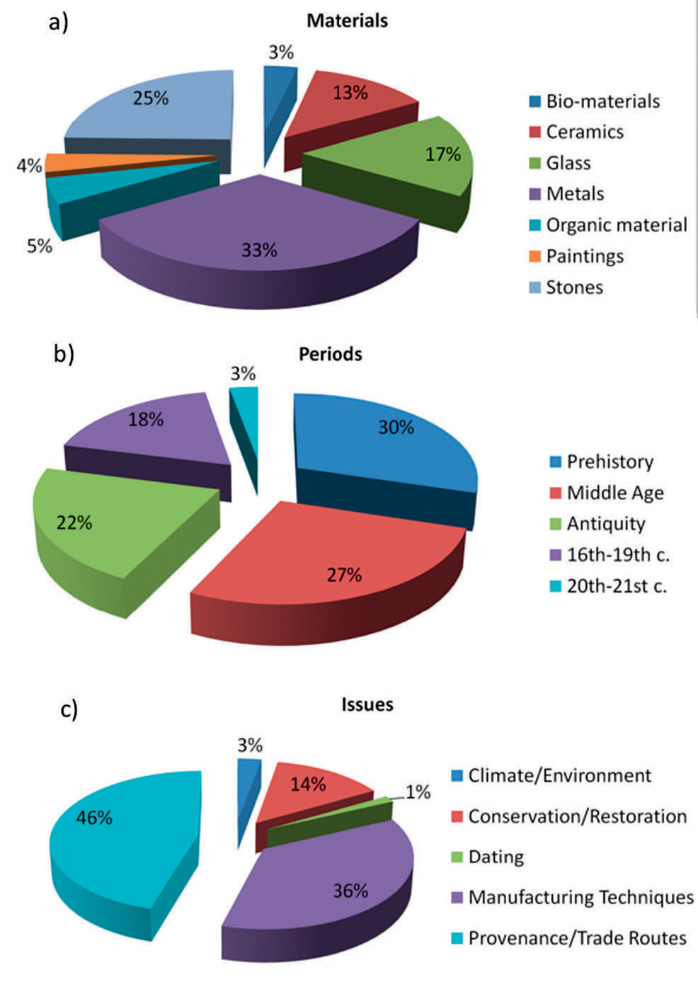
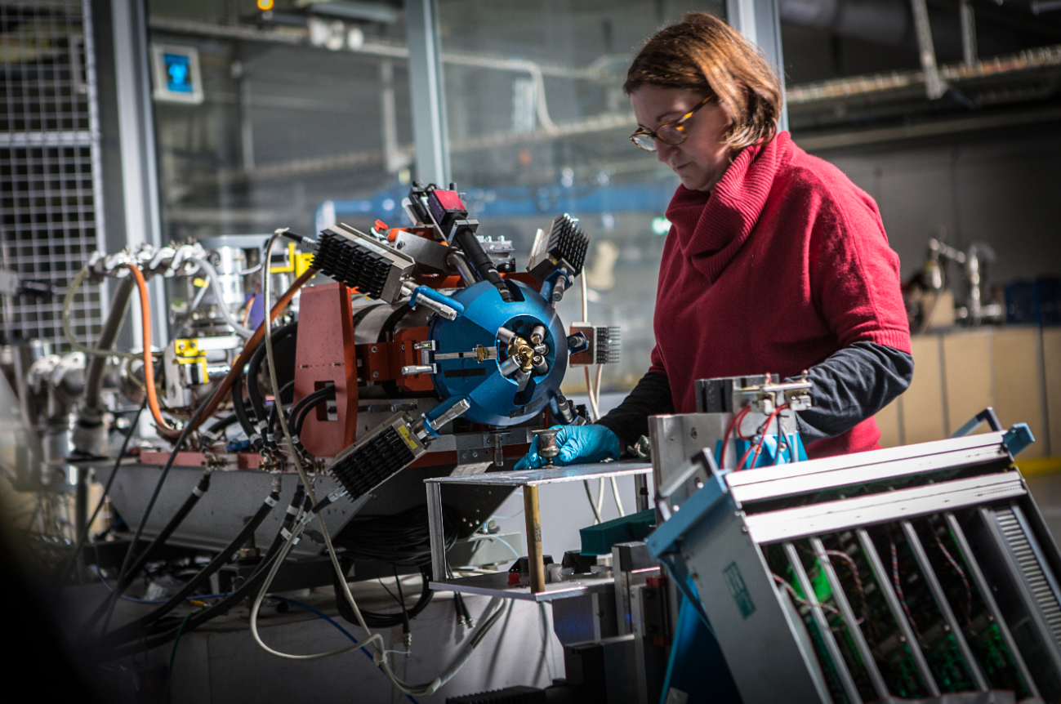
Accélérateur Grand Louvre d’analyse élémentaire
(AGLAE) at the Louvre
Claire Pacheco, Head of the C2RMF-New AGLAE facility (Paris, France) Image credit: C. Hargoues/C2RMF
C. Pacheco, Technè, 43 | 2016, 26-31.
https://doi.org/10.4000/techne.591

Slide 7
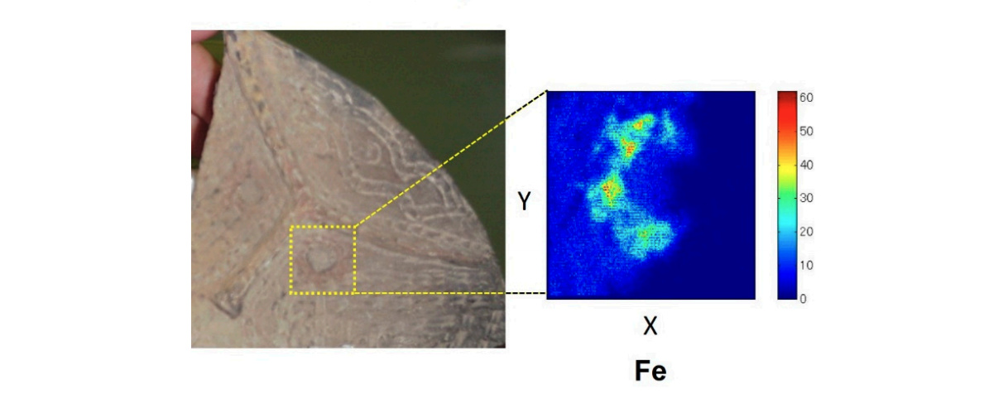
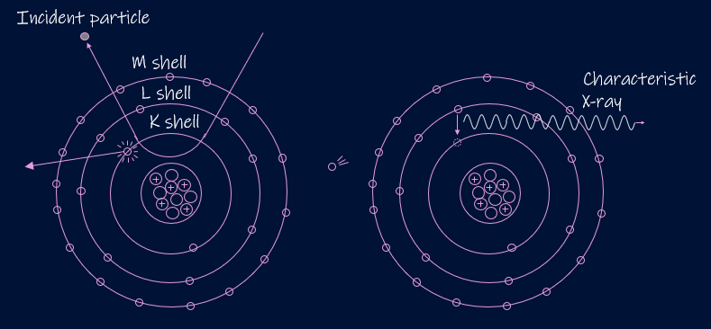
PIXE mapping revealing locations of trace elements
Earthenware depicting a human face, discovered at the ruins of the Miyagi Kamikawana shell mound. Approximately 7,000 years ago.
K. Ishii (2019) “PIXE and Its Applications to Elemental Analysis” Quantum Beam Sci. 2019, 3(2), 12
It is believed that Ancient Japanese people (Jomon) had the custom of painting eyes with red iron oxide.

Slide 8
Looking at any of these examples…
Benefits:
  Non-invasive ✓
  Non-destructive ✓
  Elemental specificity ✓
  Rapid ✓
  Sensitive ✓
Disadvantage:
  Requires travel to a synchrotron or ion beam accelerator

Slide 9
The problem:
Museum curators are often hesitant to risk moving valuable artworks. The insurance and security costs of transporting artworks can be prohibitively expensive. Taking samples of the artworks is done sparingly and prohibits the artworks being analysed as a whole.
Often cultural heritage objects and artefacts cannot be taken outside of their country of origin due to legal restrictions, or burdensome bureaucracy.
A solution?
NOMAD directly addresses these issues, with the portable accelerator becoming a self-contained mobile laboratory.
Being able to fit in a container, NOMAD could be taken to countries and regions that don’t have local access to accelerator facilities, allowing local researchers to examine and characterise artefacts.
As a compact, more affordable accelerator, the NOMAD accelerator could be housed in museums and universities.

Slide 10
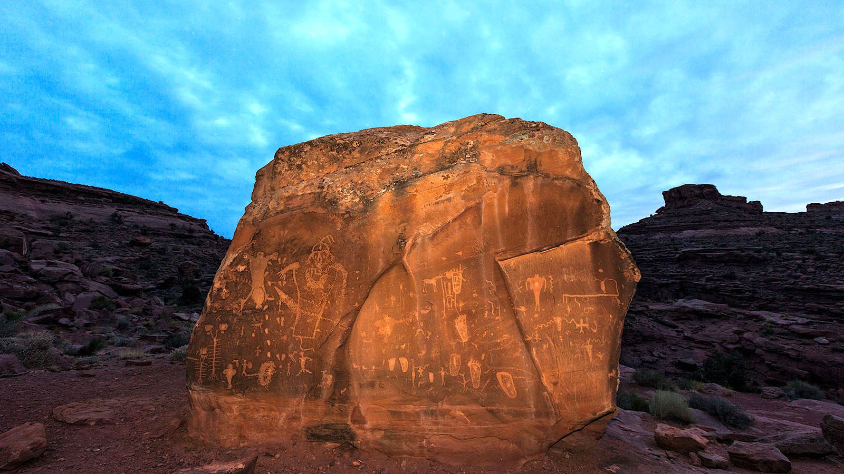
We can’t bring the rock to the accelerator.
But we might be able to bring the accelerator to the rock.
With so few artworks and artefacts being analysed, what could be discovered if we had greater access to accelerator facilities …
With so few artworks and artefacts being analysed, what could be discovered if we had greater access to accelerator facilities …
10

Slide 11
NOMAD (Non-destructive Movable Analysis Device) aims towards a conceptual design of a portable 2 MeV proton accelerator for Ion Beam Analysis.
Two technologies being considered.

Slide 12
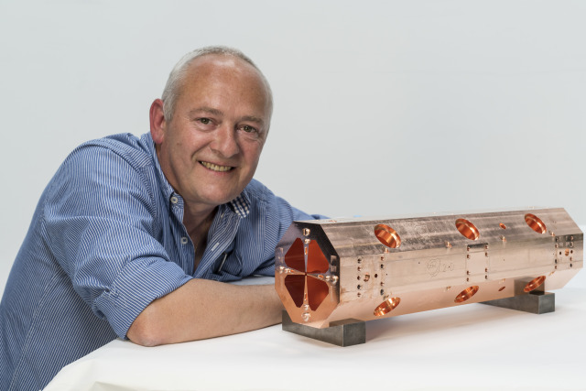
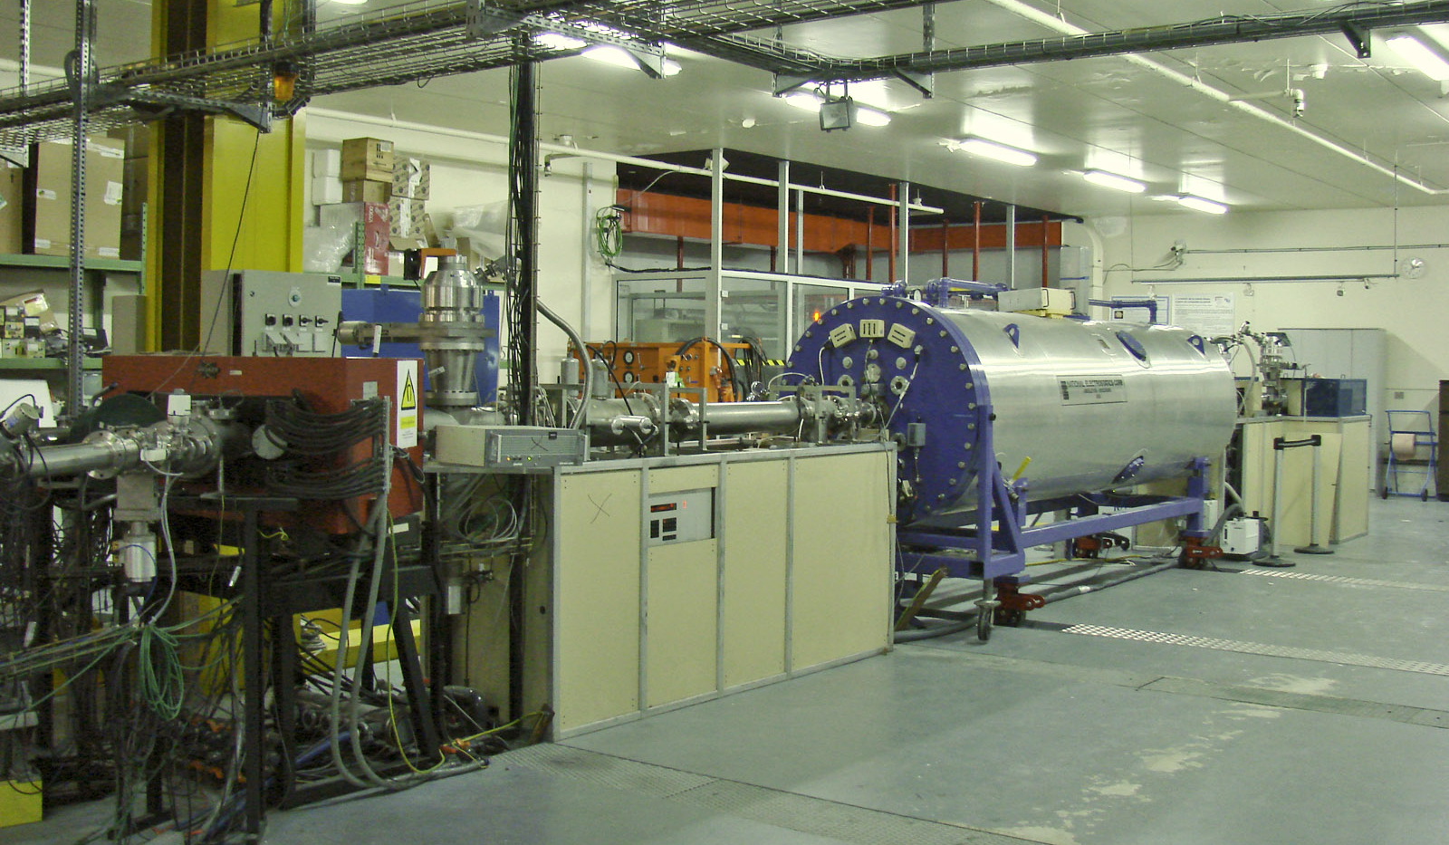
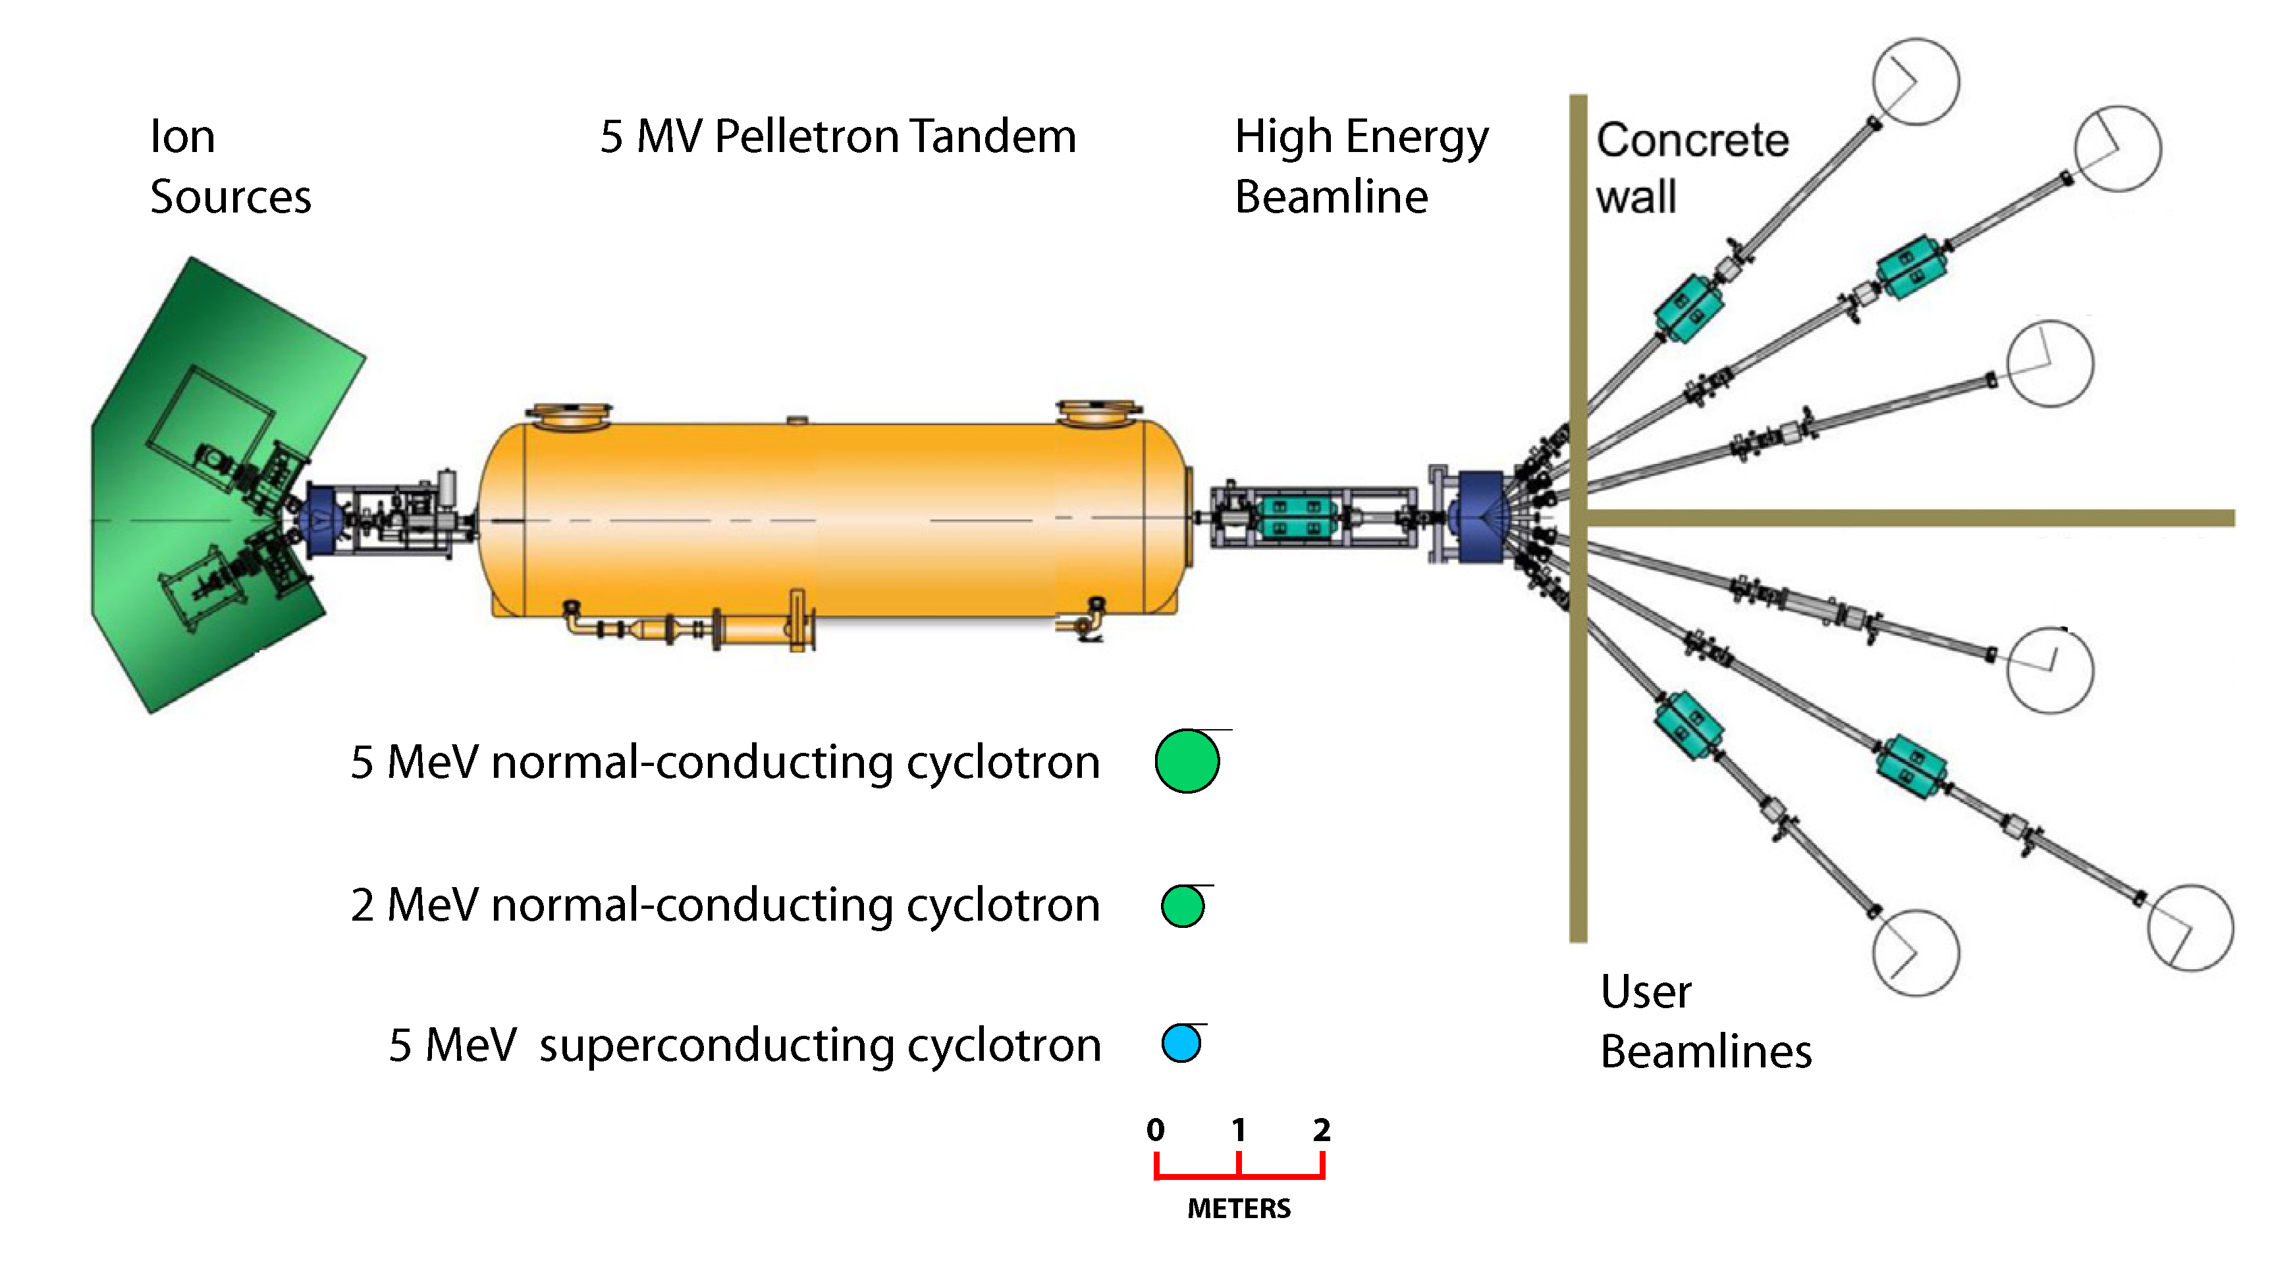
Comparison of size
Conventional Ion Beam Accelerators
CERN’s 750 MHz RFQ structure
AGLAE (Accélérateur Grand Louvre d'analyse élémentaire)
2 MeV in 1 m
2 MeV in ~16 m
Photo credit: Maximilien Brice/CERN
Photo credit: Jean-Pierre Dalbéra.
CERN 750 MHz RFQ structure. Credit: Maximilien Brice/CERN
Dalton Cumbrian Facility layout
ELISA (Experimental Linac for Surface Analysis) on the same scale as figure to left:
Image credit, L. Leay et al "Development of irradiation capabilities to address the challenges of the nuclear industry“, NIM B 343 (2015) 62–69.
12

Slide 13

High-frequency RFQ accelerators could provide a more compact and affordable accelerator, delivering short pulses of protons, ~180 $μ$s long.
However a question remains: how does the damage induced by a lower current continuous stream of protons, compare with short pulses with higher peak current?

Slide 14
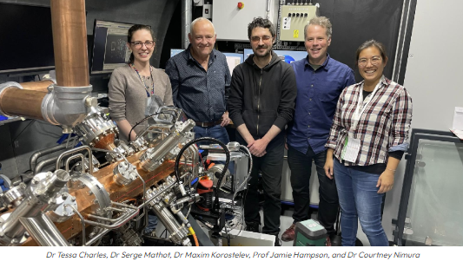
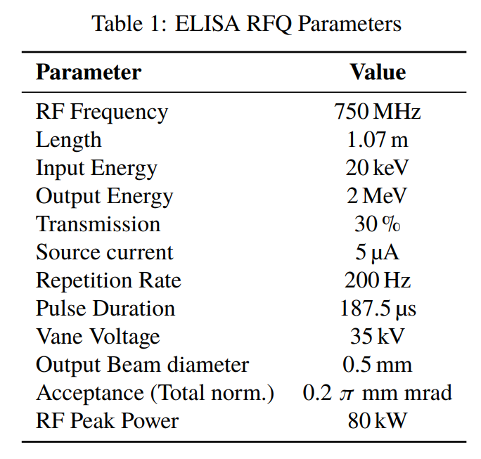
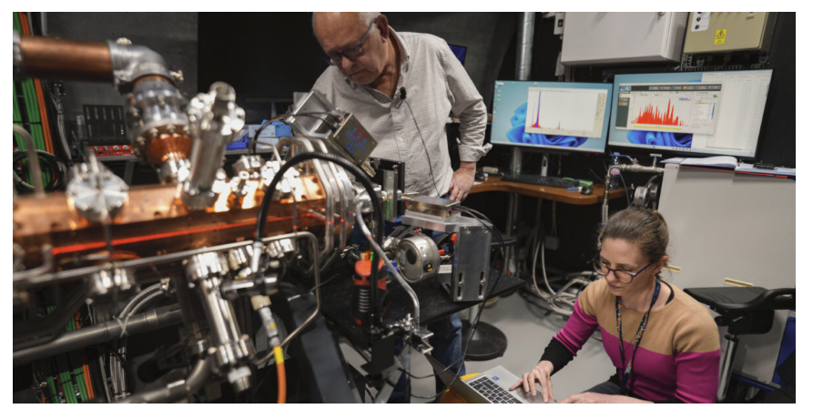
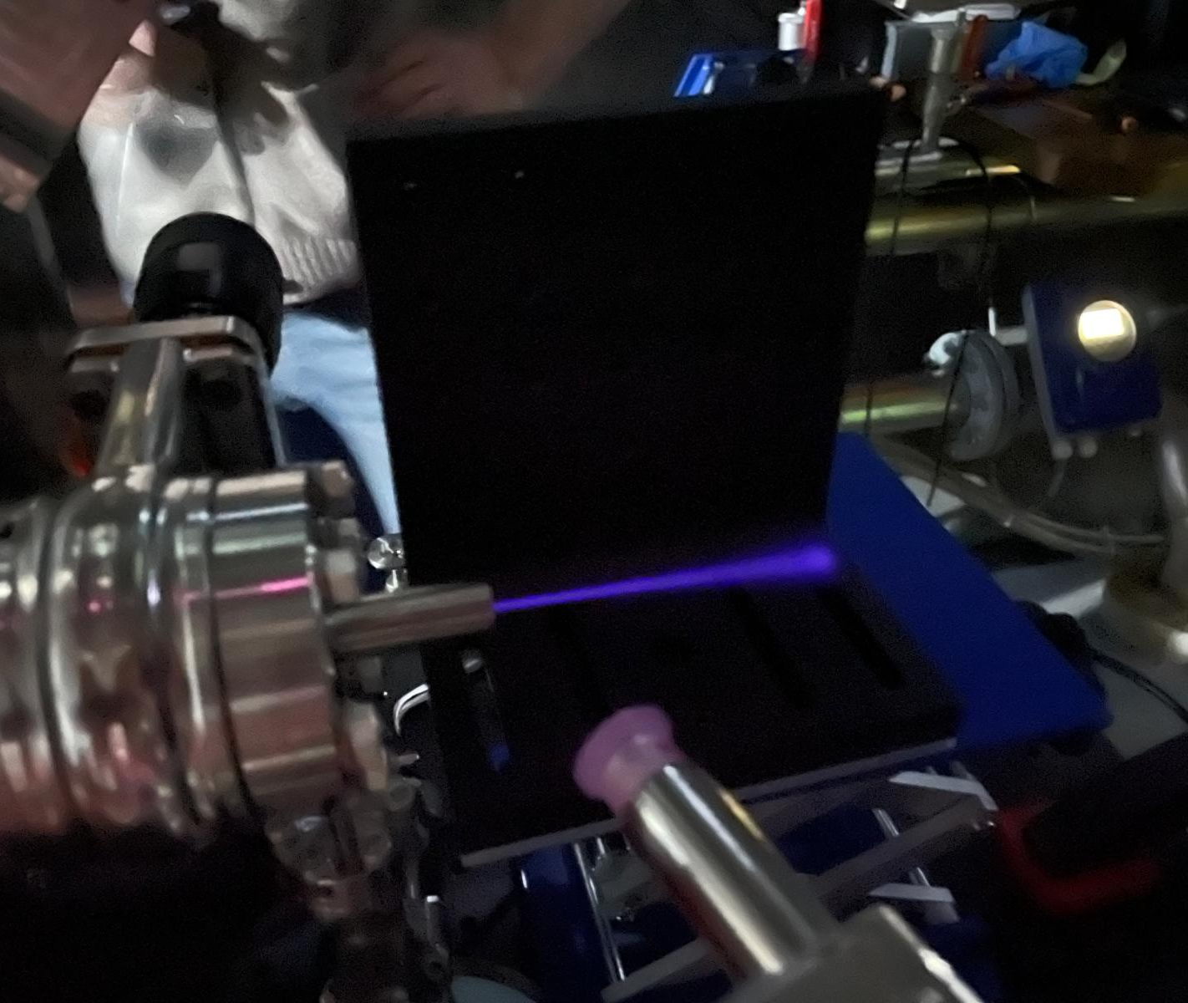
Experiment at
ELISA (Experimental Linac for Surface Analysis), CERN
Image credit: CERN
2 MeV proton beam
2 MeV proton beam

Slide 15
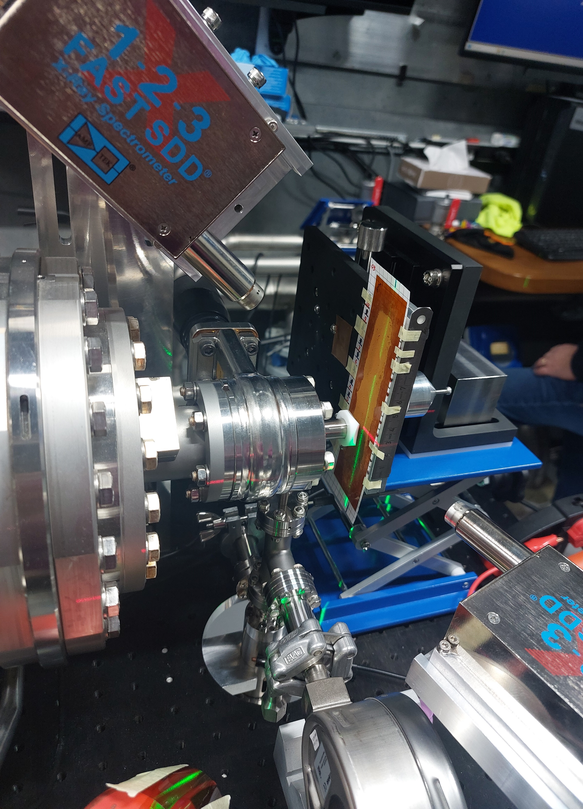
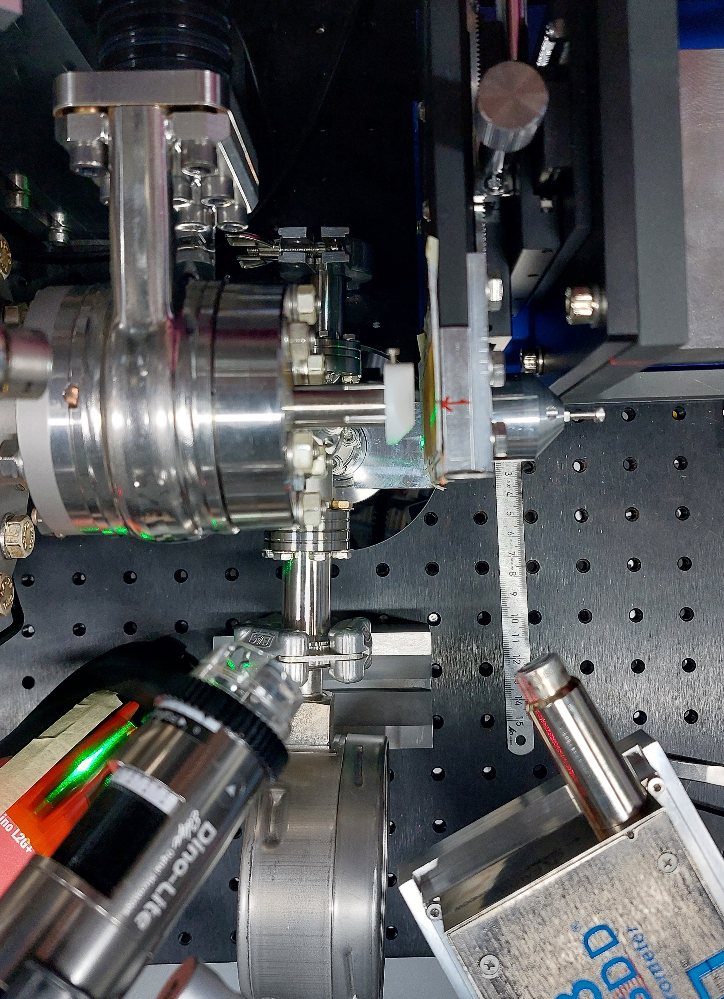
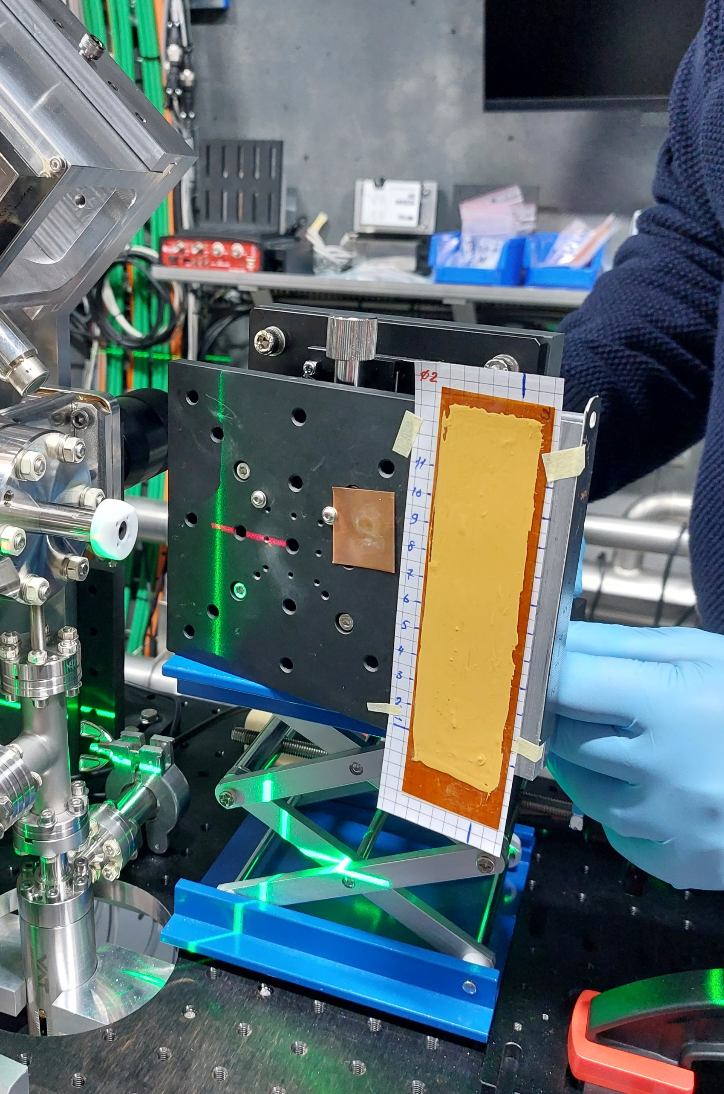
Experiment at
ELISA (Experimental Linac for Surface Analysis), CERN
Faraday cup
Side view:
Top view:
Sample:
Sample
Exit window
Samples prepared by Dr Adelphine Bonneau, Université de Sherbrooke
SDD detectors

Slide 16
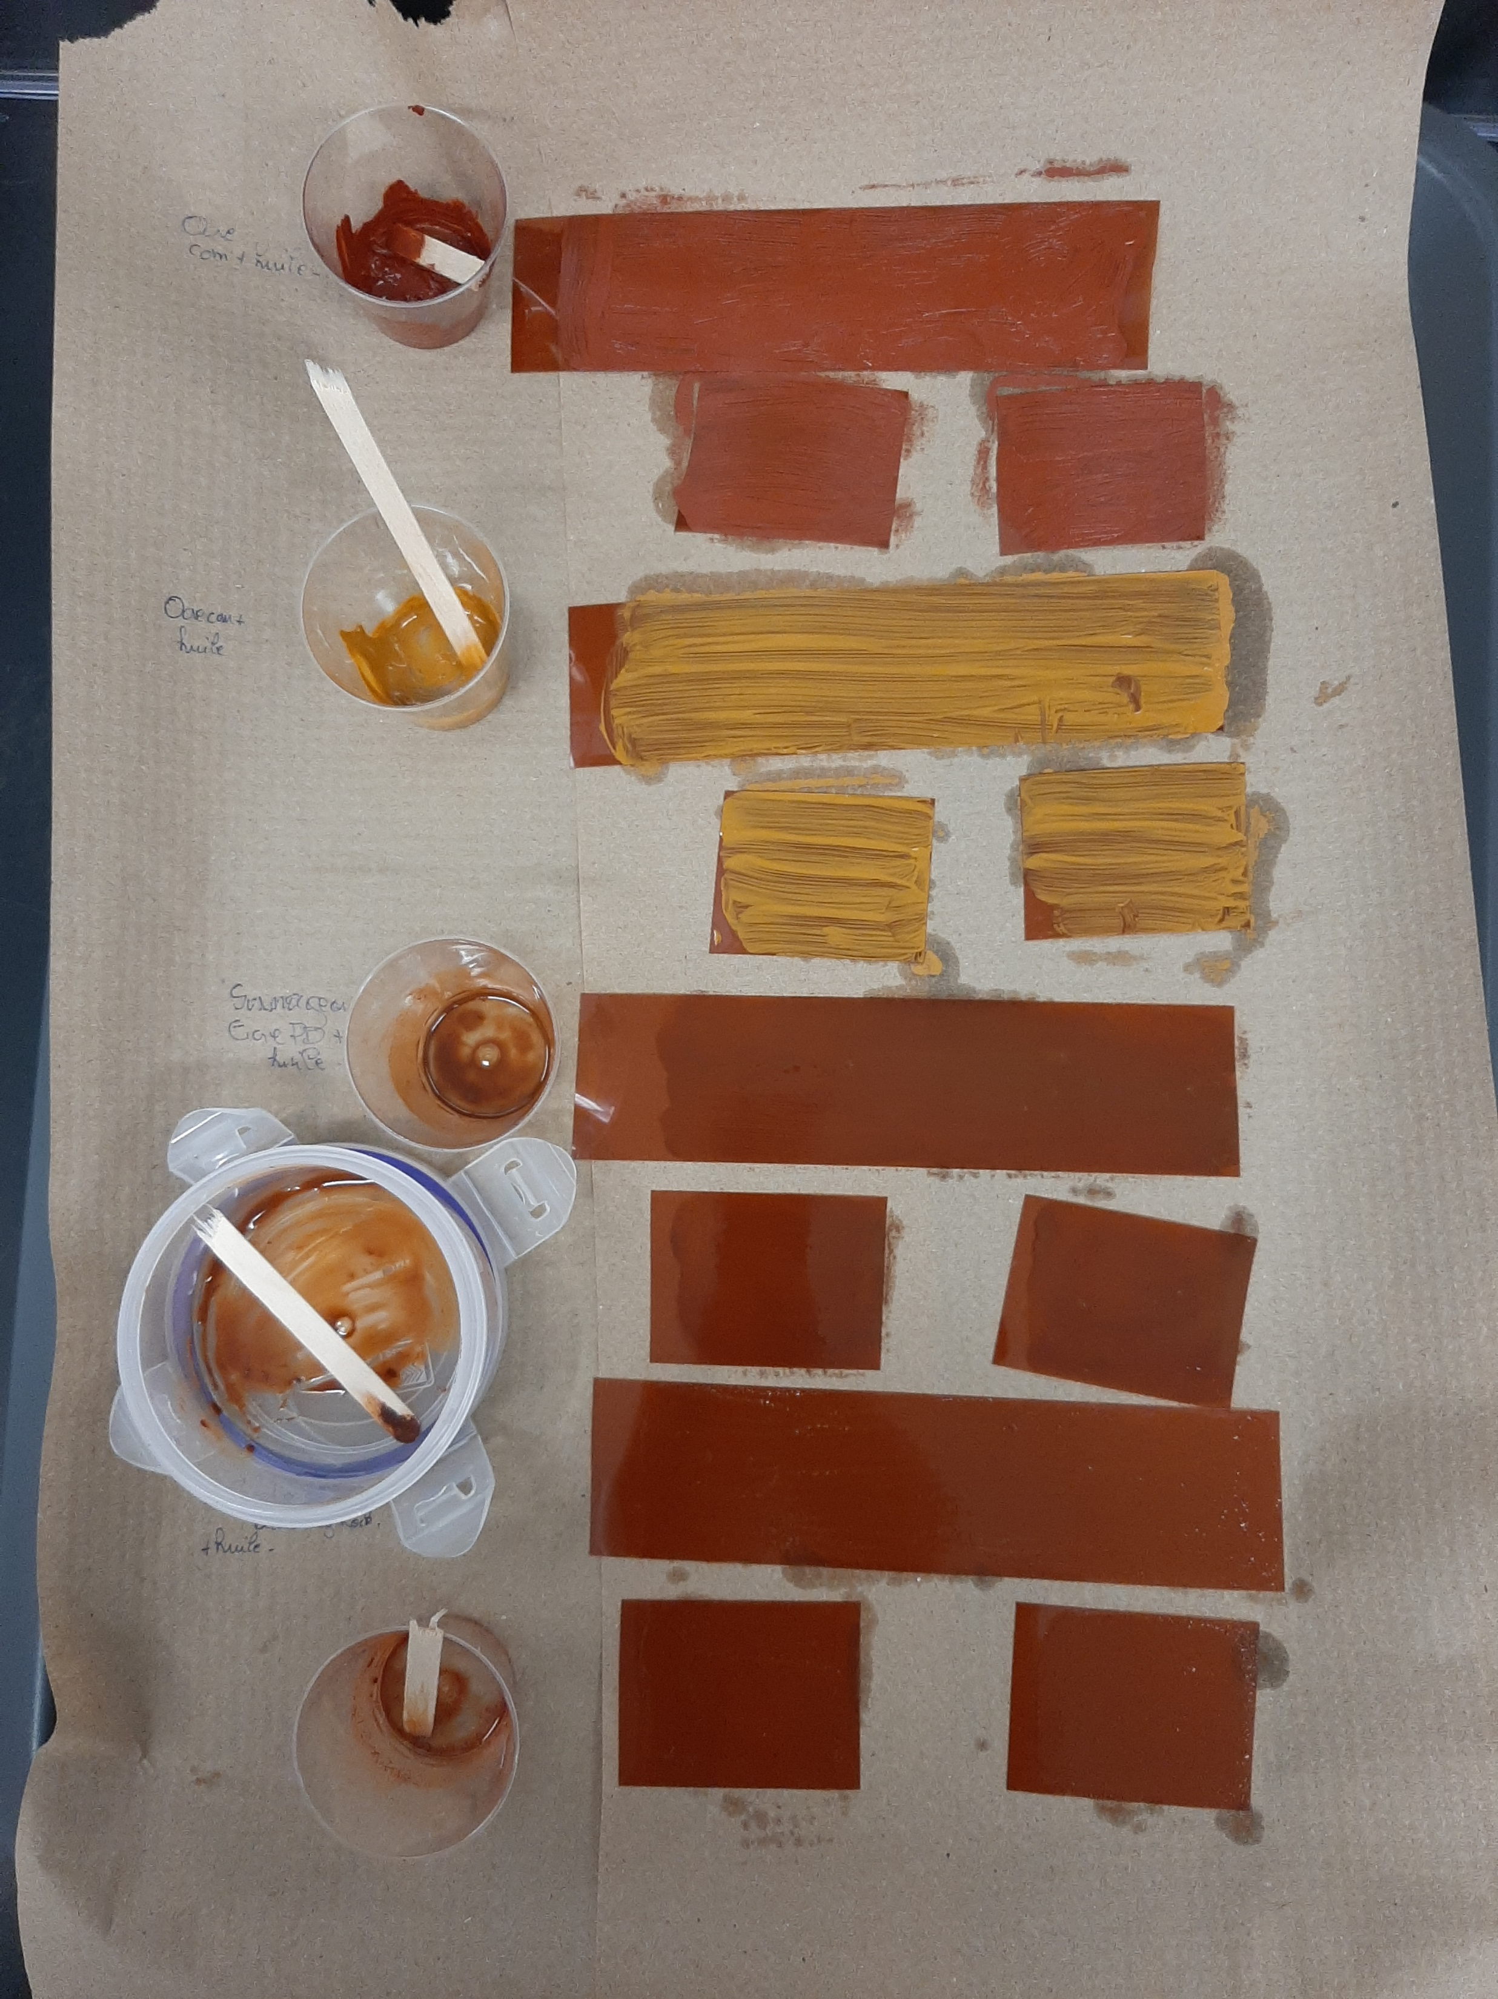
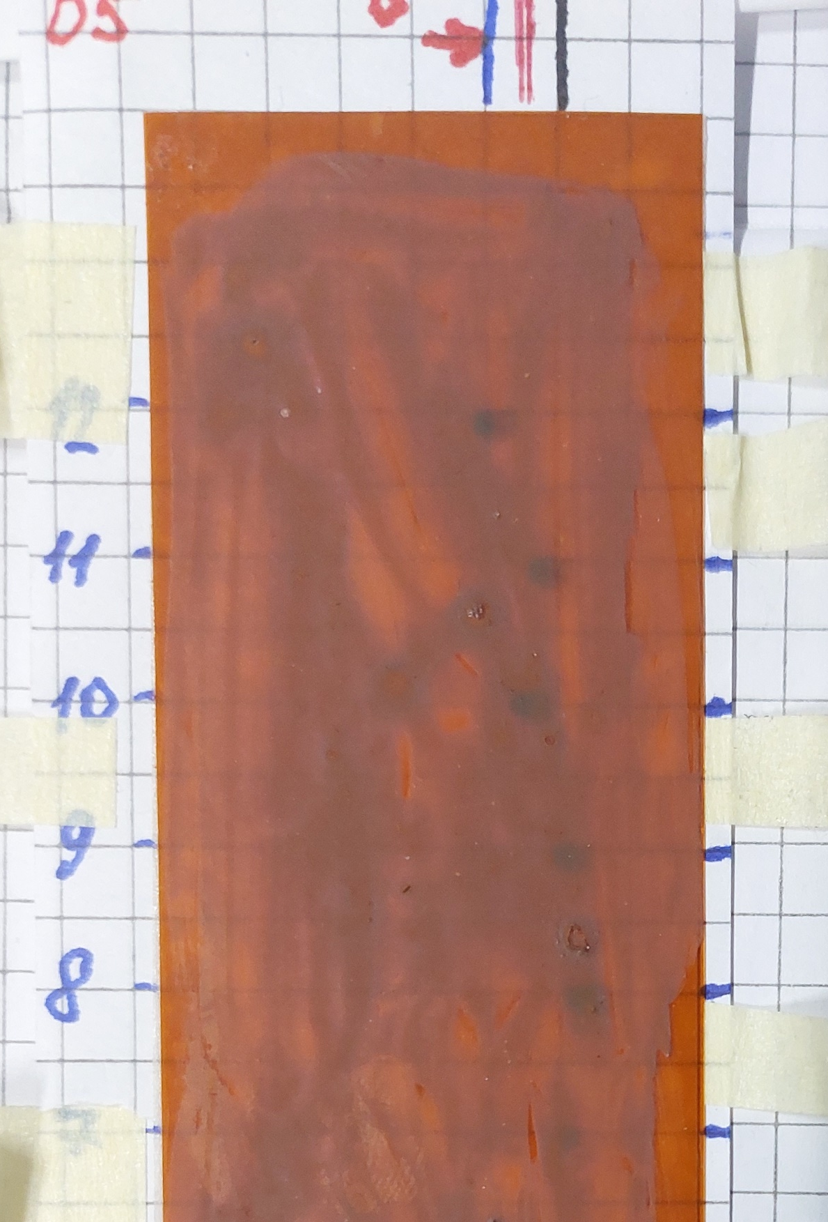
Experiment at
ELISA (Experimental Linac for Surface Analysis), CERN
Samples prepared by Dr Adelphine Bonneau, Université de Sherbrooke.
Paint samples made with:
ochre derived from different ground sedimentary rocks in South Africa (Eastern Cape Drakensberg and Stormberg region) and commercial ochre
water, egg yolk, blood or oil binder
Shown here painted on Kapton. Also painted on paper.
Many thanks to Andy Wolski and Adel Bonneau for sorting out the ethics approval required!

Slide 17
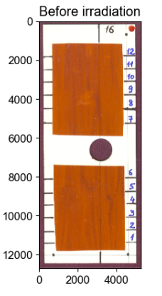
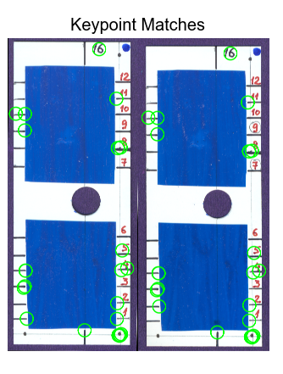
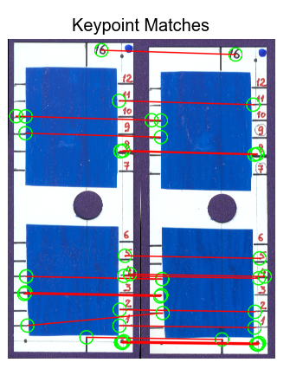
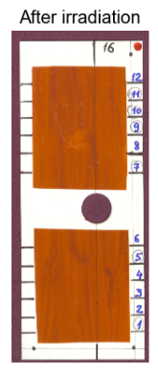
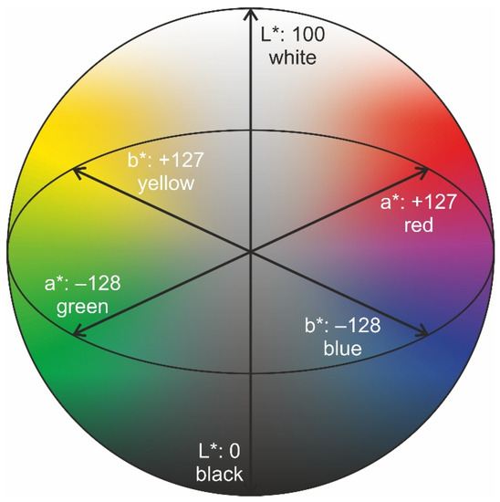
Analysing colour variation
1. Rotate original image to ensure line is vertical
2. Find keypoints using OpenCV modules
3. Match keypoints, dischard bad keypoints
4. Rotate and shift images to align with each other
5. CIELab evaluation
6. Fit gaussian to signal
Rotate original
Find keypoints
Match keypoints
Rotate and shift
CIELab evaluation
1. Rotate original image to ensure reference line is vertical
2. Find keypoints using OpenCV modules
3. Match keypoints, discard bad keypoint matches
4. Rotate and shift images to align with each other
5. CIELab evaluation

Slide 18

CIELab is a colour model for quantifying colour variation
L* represents lightness.
a* represents the red–green axis.
b* represents the yellow–blue axis.
ΔE is standardised metric for quantifying the difference between two colours.
$$ΔE=\sqrt{{\left(ΔL\right)}^{2}+{\left(Δa\right)}^{2}+{\left(Δb\right)}^{2}}$$

Slide 19
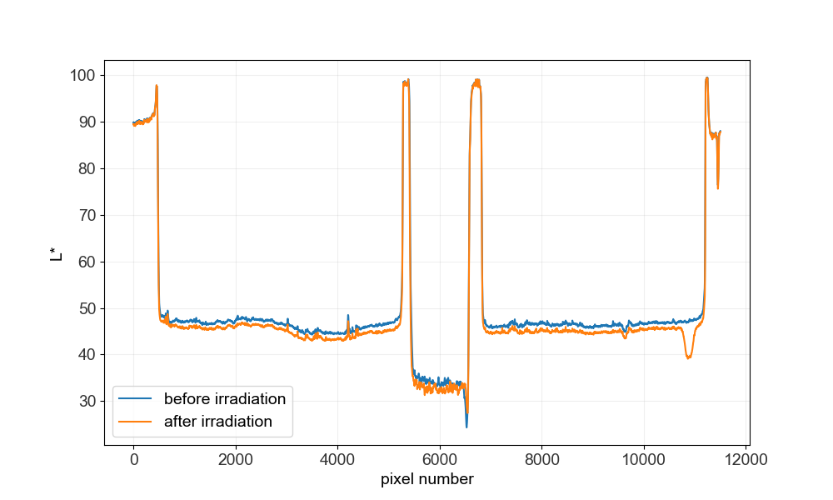
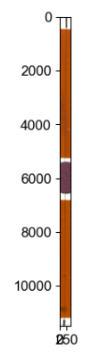
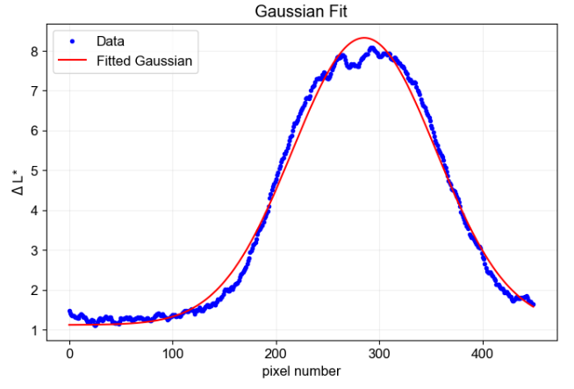
Image cropped to 300 px width around reference line.
CIELab parameters evaluated.
Impact of proton beam

Slide 20
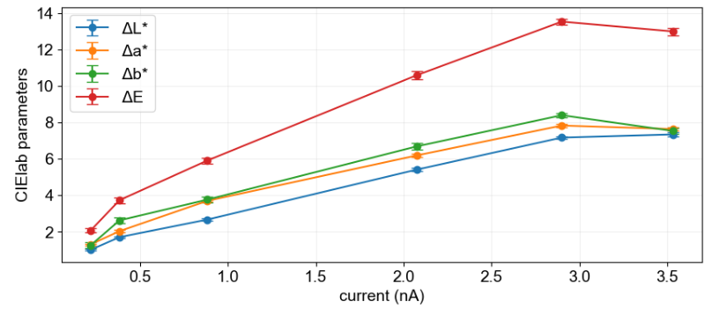
CIELab parameters from 10 minute exposures at various current values, at ELISA
Sample 16 - South Africa ochre with oil binder
All samples currently being processed

Slide 21
Add paper results

Slide 22
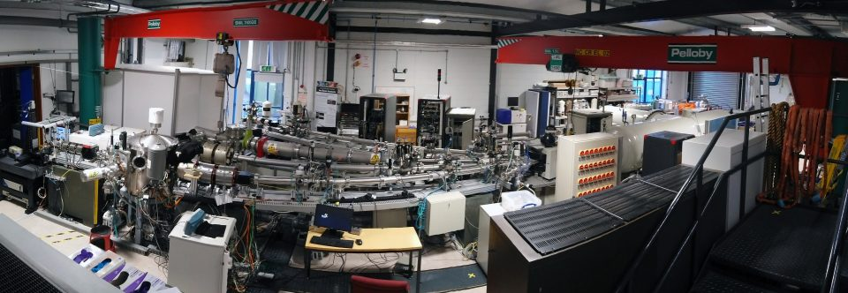
Surrey Ion Beam Centre
Many thanks to Pierre Couture (Surrey) and Maxim Korostelev for conducing this portion of the experiment.
External beamline, irradiation in air.
Parameter | Range available | Experimental parameters
Energy | 100 eV – 12 MeV | 2 MeV
Beam current | fA - mA | 0.2 – 2.0 nA

Slide 23
The next slides are a sneak peek at some preliminary results…

Slide 24
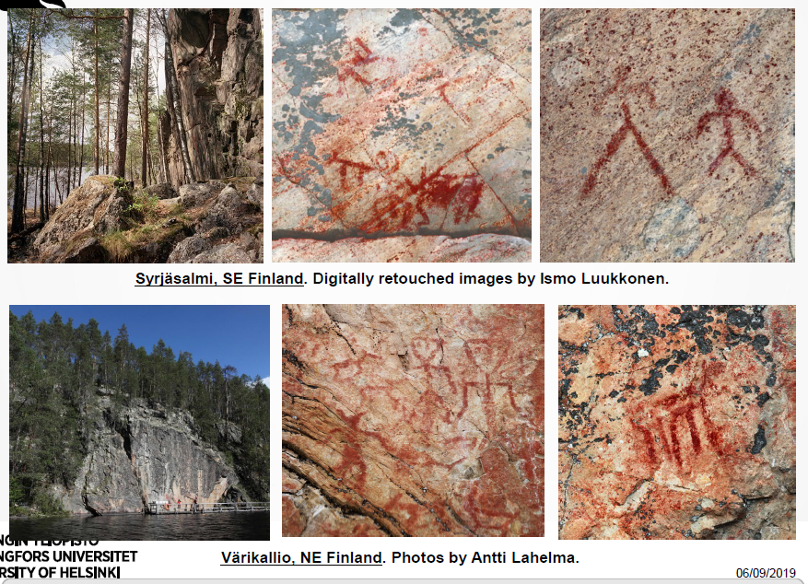
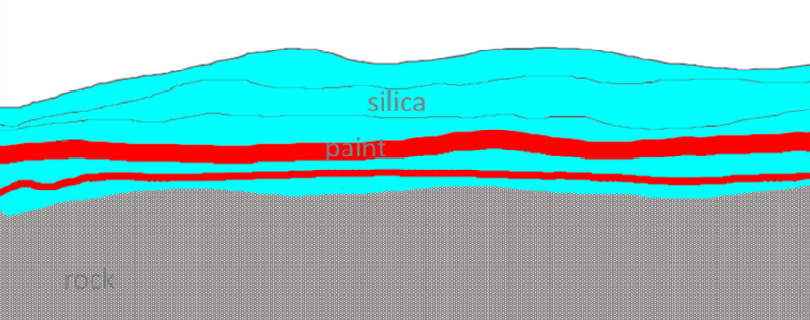
Preliminary results: Finnish Rock art analysed on XFM beamline at the Australian Synchrotron
Samples taken with permission by: Uine Kailamäki & Antti Lahelma, University of Helsinki
Slide from: Uine Kailamäki & Antti Lahelma, University of Helsinki , ‘CONTROLLING CHRONOLOGY’ talk, 2019

Slide 25
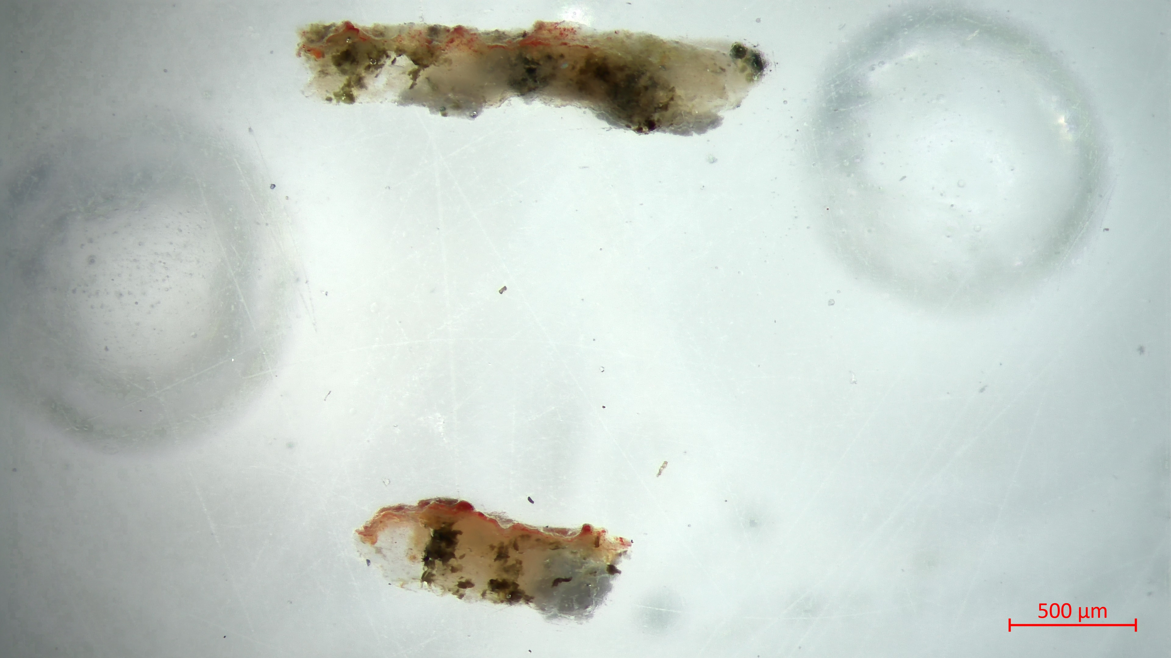
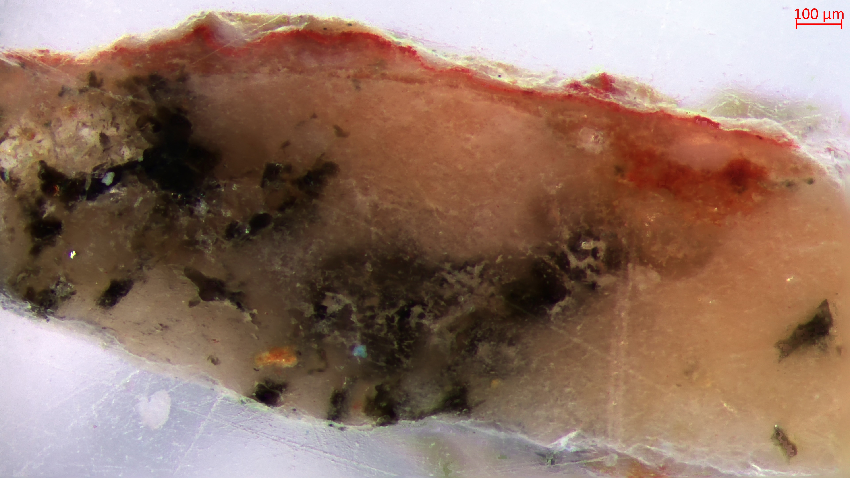
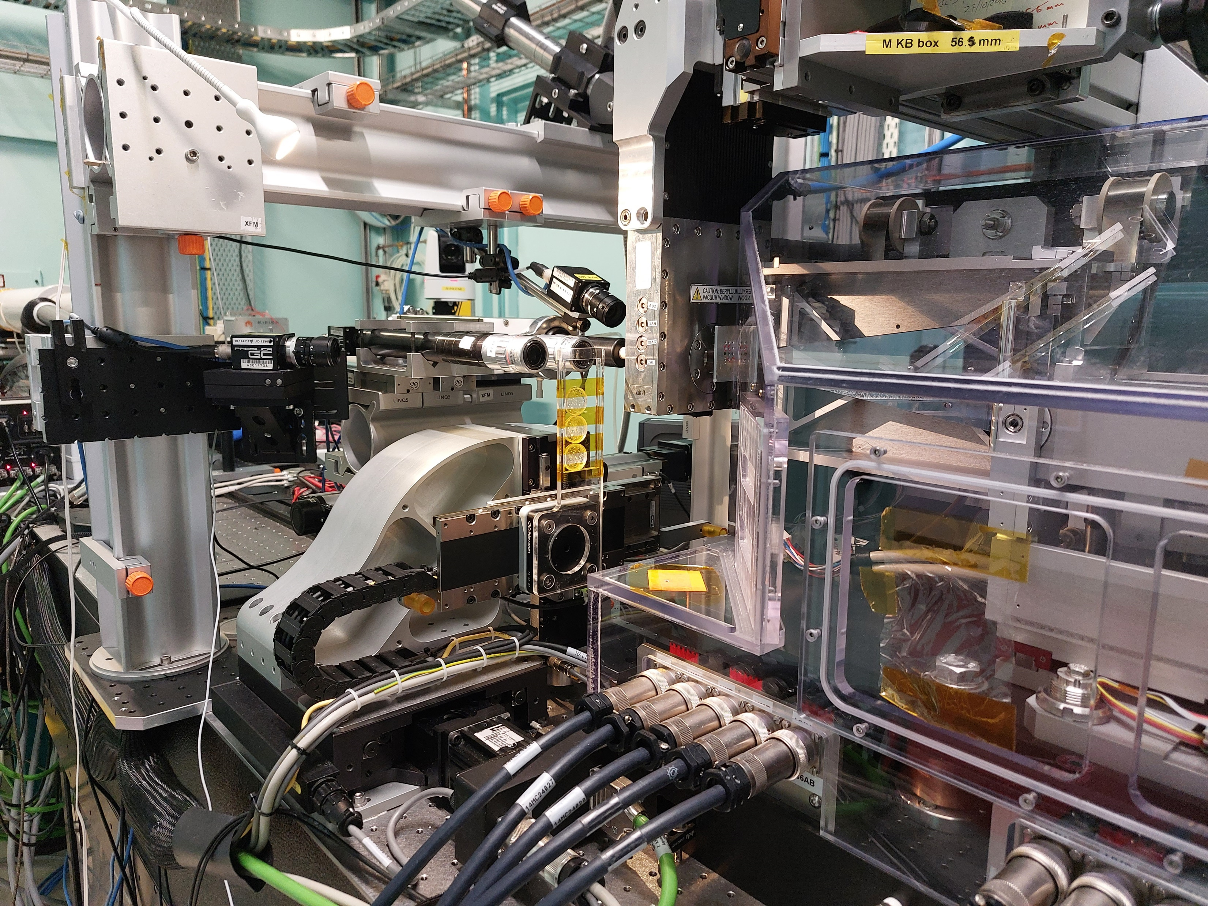
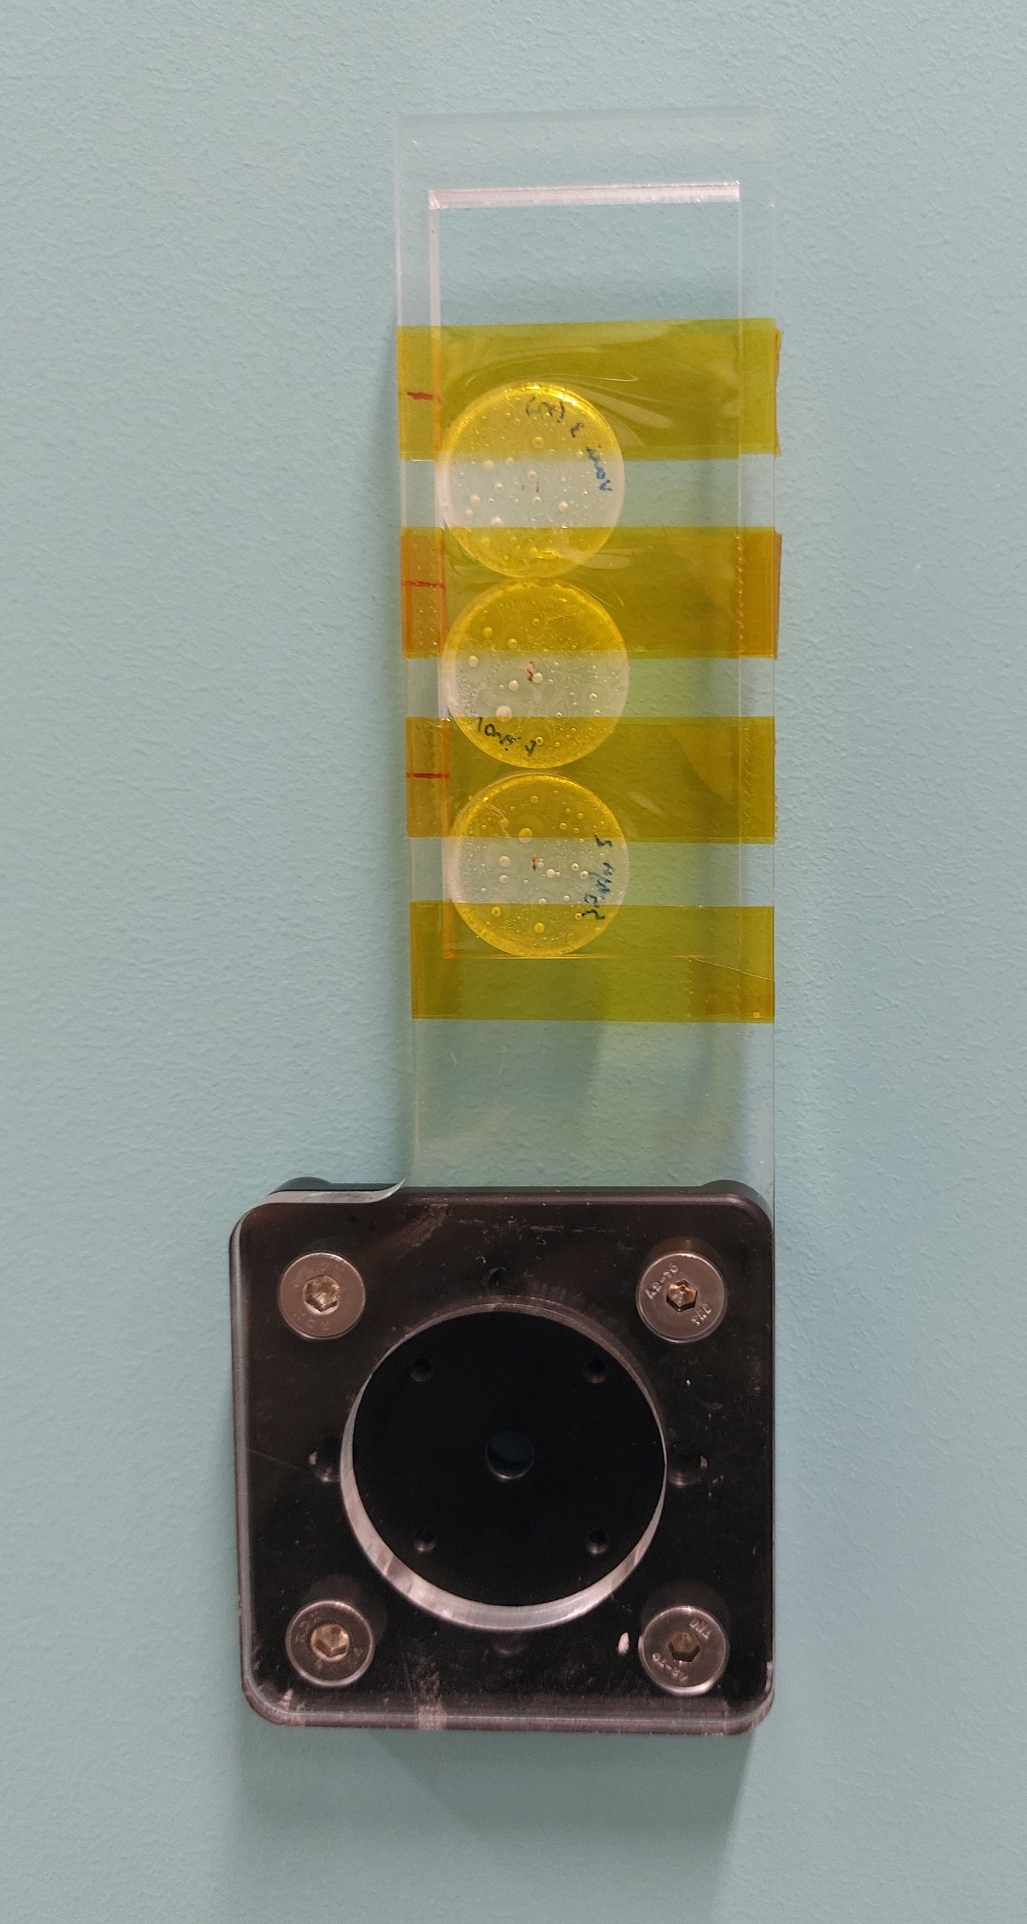
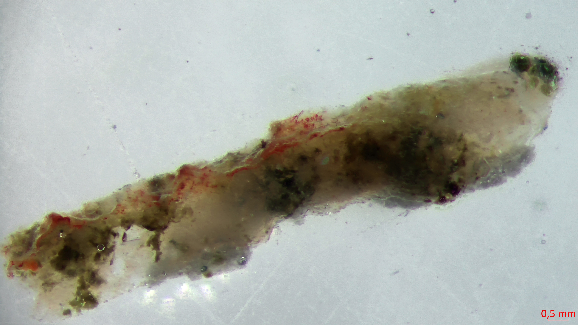
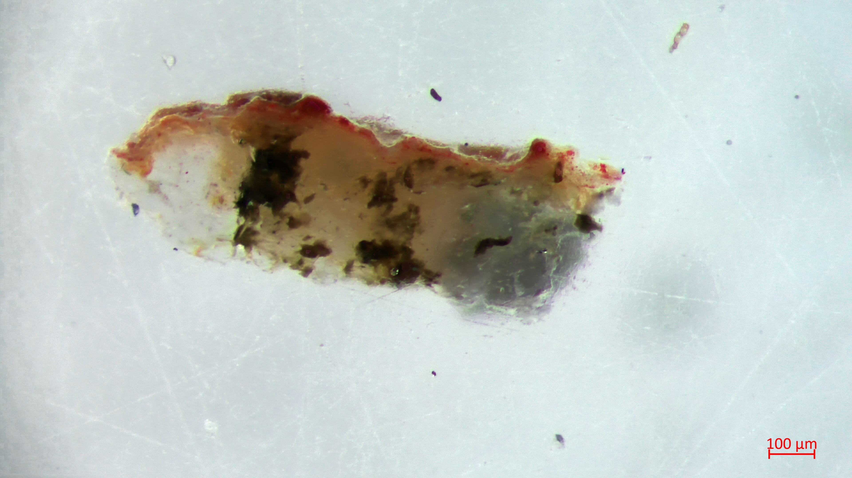
Preliminary results: Finnish Rock art analysed on XFM beamline at the Australian Synchrotron
Many thanks to the XFM beamline scientists Daryl Howard and Andrew Langenham

Slide 26
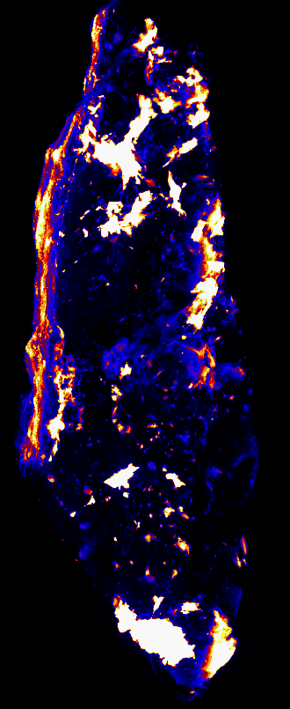
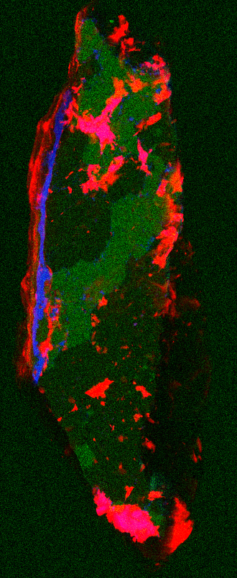
Fe concentration
Fe, Rb, K as RBG
Vari 1

Slide 27
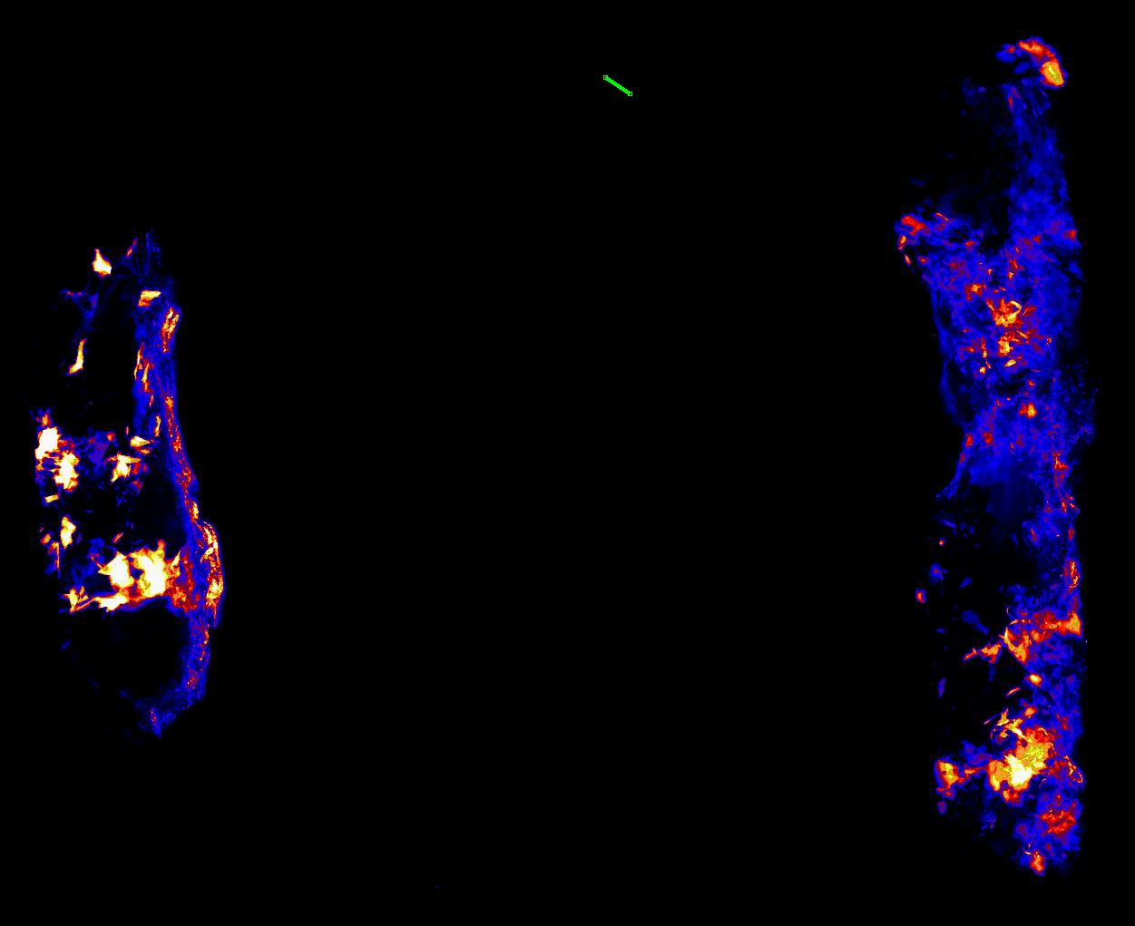
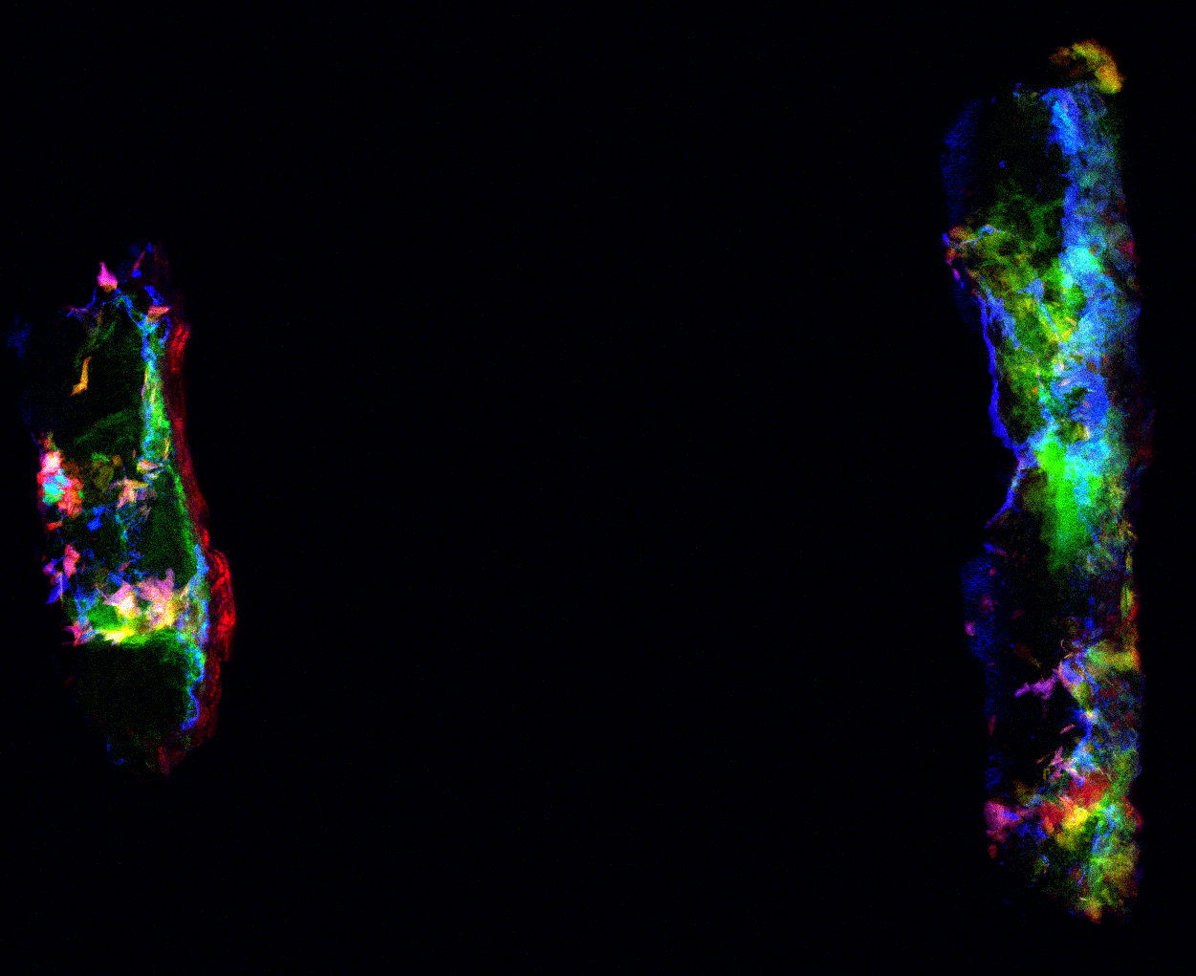
Fe concentration
Fe, Rb, K as RBG
Vari 3 (long)

Slide 28
Vari 3
Fe concentration
Fe, Rb, K as RBG
Notes:
Silica, paint, silica, paint.

Slide 29



Syrja
Fe concentration
Fe, Rb, K as RBG

Slide 30
Conclusion
Work is underway to developing a conceptual design of a compact, portable 2MeV accelerator for Ion Beam Analysis.
NOMAD (Non-destructive Movable Analysis Device)
Experiments conducted at CERN and Surrey Ion Beam Centre aim to determine damage thresholds for short pulse compared to continuous beam irradiation.
…

Slide 31
Backup slides

Slide 32

CERN and INFN collaboration, MACHINA (Movable Accelerator for Cultural Heritage In-situ Non-destructive Analysis), has already demonstrated proton acceleration in a compact 750 MHz RFQ.
March 2022 - first extracted 2 MeV beam.
Image credit: Taccetti, F., et al. MACHINA, the Movable Accelerator for Cultural Heritage In-situ Non-destructive Analysis: project overview. Rend. Fis. Acc. Lincei 34, 427–445 (2023)
Notes:
“A view of the MACHINA system during the tests at CERN. From left: the half rack holding the signal and waveform generators and hosting the module in charge of limiting the power injected into the cavities in case of exceedingly high pressure (higher than 10–5 mbar) in the accelerator; the two racks (blue frames) of the amplifers of the RF PS from which the copper waveguide connects the RF PSs to the cavities; the accelerator assembly (foreground the metal cage of the source and the HV power supplies switched on). In the background: the chillers for the cavities and for the RF PSs”

Slide 33




