Slide 1
Emittance Measurements and Beam Optics Matching for CLARA
Mark Johnson | IOP Particle Accelerators and Beams Conference 2025
ASTeC Accelerator Physics Group
STFC Daresbury Laboratory
mark.johnson@stfc.ac.uk

Slide 2
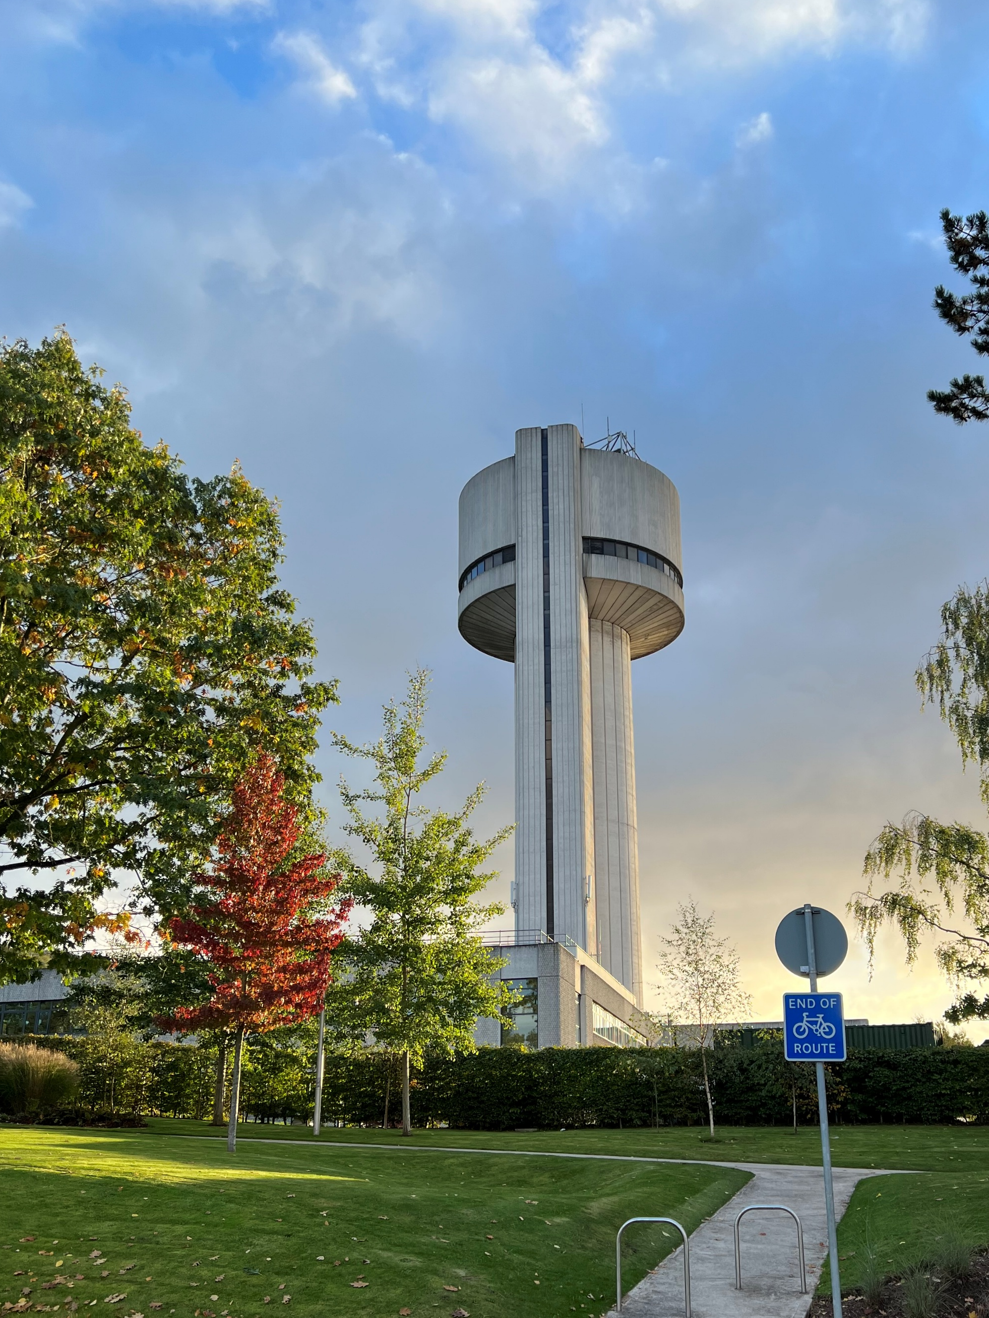
Outline
CLARA Overview
Software Development
Emittance Measurements
Outlook & Conclusions

Slide 3
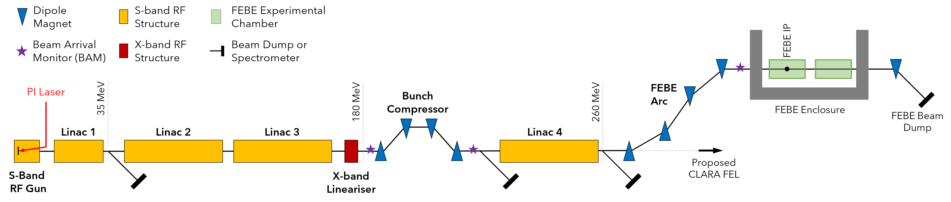
CLARA Key Parameters
High-brightness linear accelerator at STFC Daresbury
Laboratory, with a total length of ~80 m
Among the most advanced medium-energy electron beam
facilities in Europe when complete
Dedicated shielded Full Energy Beam Exploitation (FEBE) user
area, with access to 250 MeV/c electron beam and 100 TW laser
Parameter | Low Charge | High Charge
Beam momentum p_{z} [MeV/c] | 250
Bunch Charge Q [pC] | 5 | 250
RMS Bunch Length σ_{t} [fs] | 50 | 100
RMS Energy Spread σ_{E} [%] | < 1 | < 5
RMS Spot size σ_{x,y} [µm] | 20 | 100
Emittance ε_{x,y} [mm mrad] | 2.0 | 5.0
Above: Nominal “day one” CLARA beam parameters
for user experiments at the FEBE interaction points
Below Left: Schematic of the CLARA
accelerator (not to scale)

Slide 4
CLARA Status
CLARA is currently undergoing technical commissioning
with beam at its nominal momentum (250 MeV/c)
  Testing of RF, diagnostics, and controls,
  Commissioner training,
  High-level software development
Beam commissioning and machine optimisation
during the second half of 2025
All results shown here are PRELIMINARY
CLARA Commissioning Talk
Tom Pacey
Wednesday 14:40

Slide 5

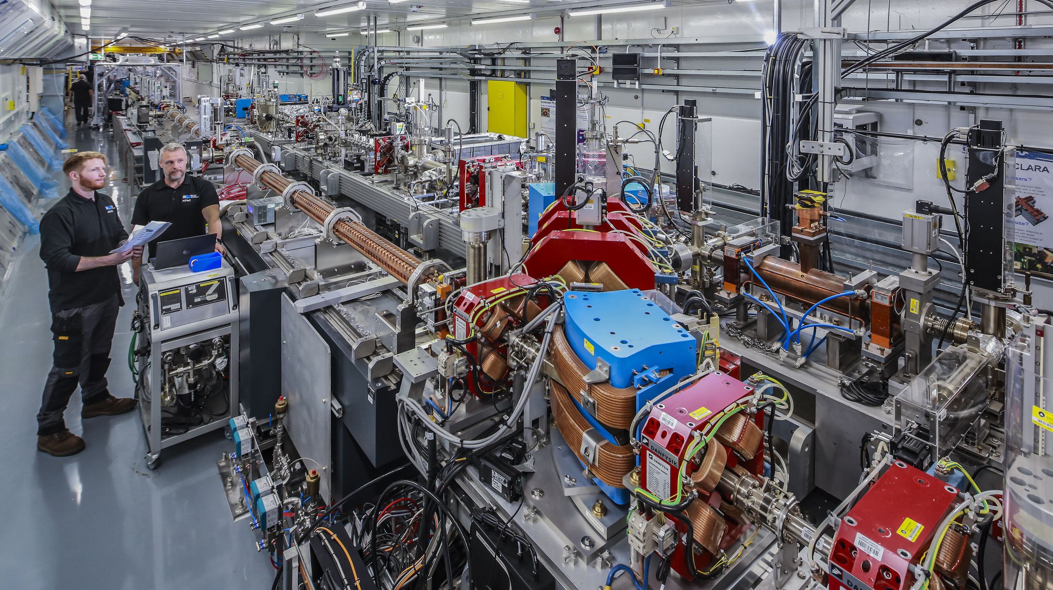

CLARA Key Dates (2025)
March 17th
First beam since CLARA shutdown (2022 – 2024)
April 2nd
Beam threaded to nominal momentum (250 MeV/c)
June 6th
First beam accelerated using Linac 1
June 19th
Bunch compression demonstrated using the VBC
and transverse deflecting cavity (TDC)

Slide 6

CLARA Software
Significant software development activity during the recent
CLARA shutdown (2022 – 2024)
Updated python-based tools underpin most scientific software:
  CATAP
  Accelerator middle layer, used for directly interacting
  with machine hardware
  CLARA Software Tools
  High-level interface with standardised procedures
  and analysis for physics measurements
Below: Block diagram showing the various layers of the CLARA software environment
Operators
High-level Interface
(CLARA Tools)
Physics-based
Hardware-based
Accelerator Middle Layer
(CATAP)
EPICS-Based Control System

Slide 7
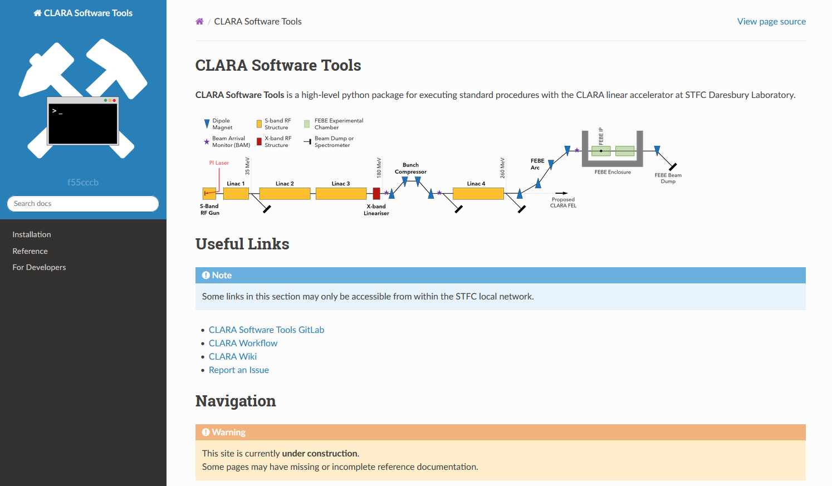
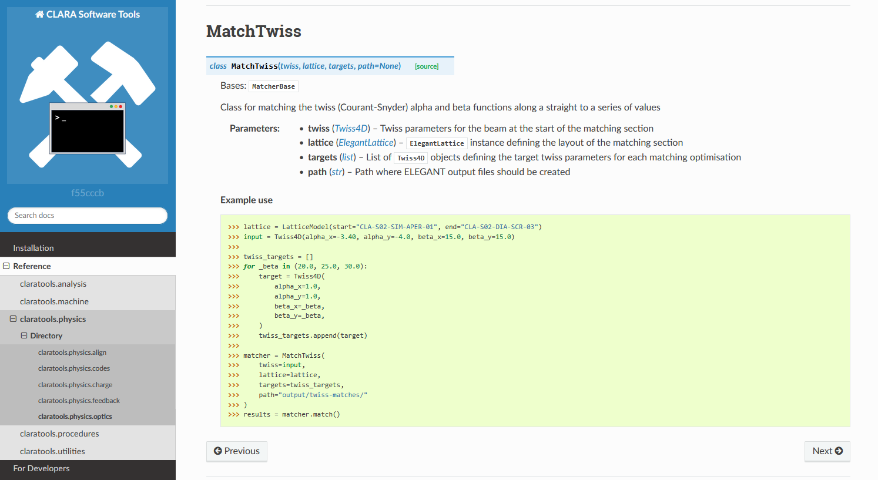
High-Level Software
CLARA tools is a high-level python package designed to
support physics measurements on CLARA. It includes:
Standardised code for common procedures:
  Quadrupole scans,
  Trajectory correction,
  RF cresting,
Utilities for experimental data handling,
Analysis functions for common data types
Above: Reference documentation for the CLARA Tools python package

Slide 8

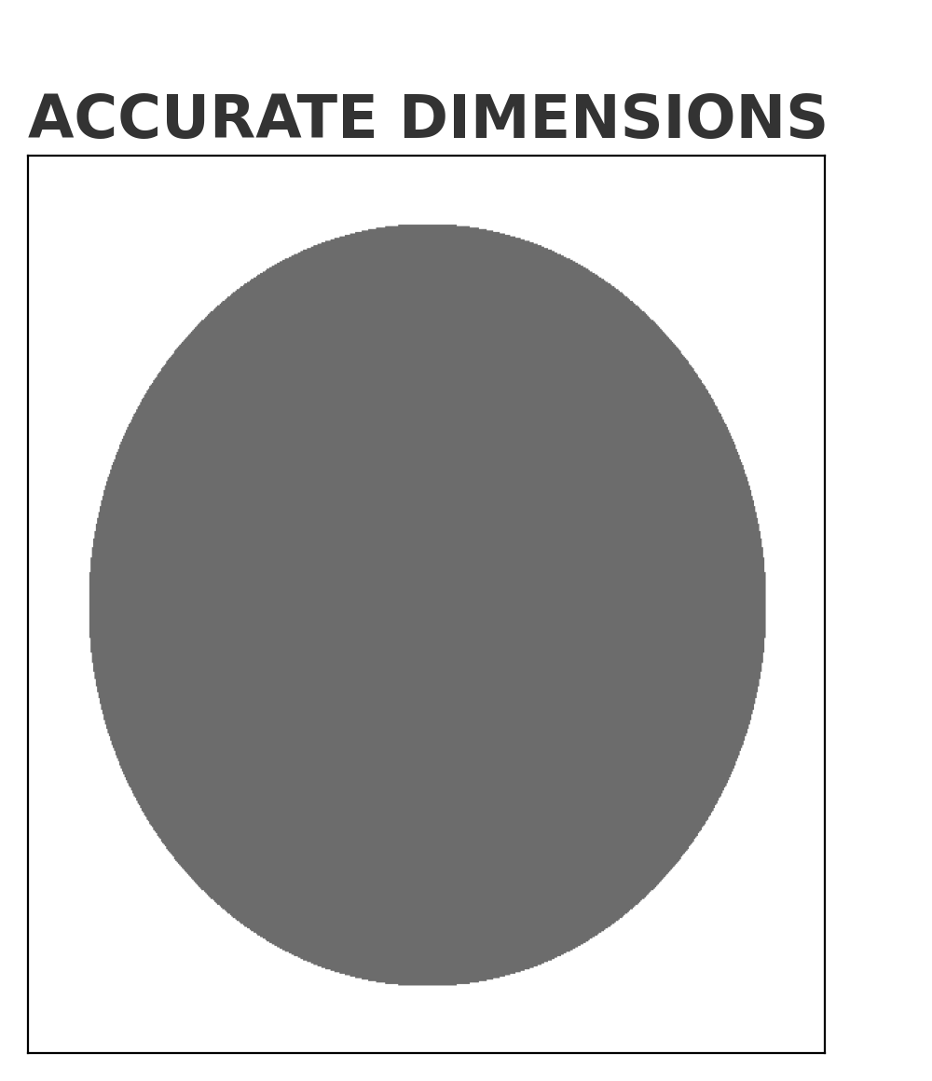
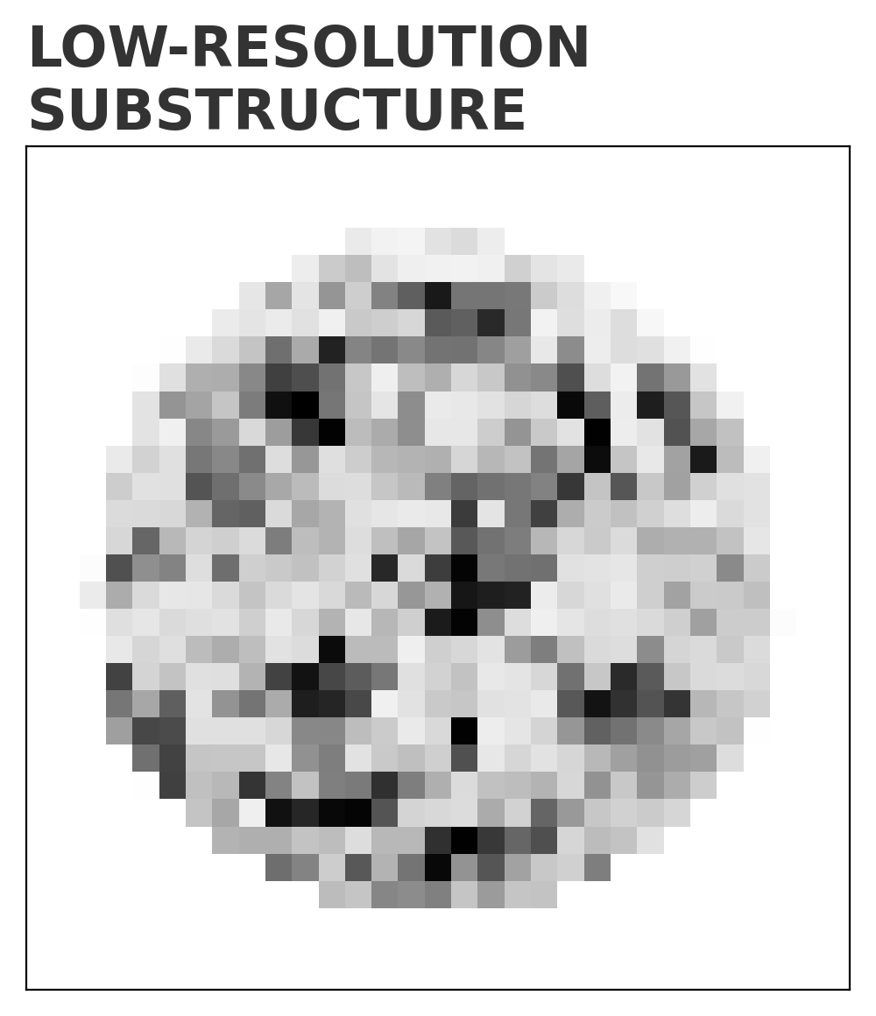
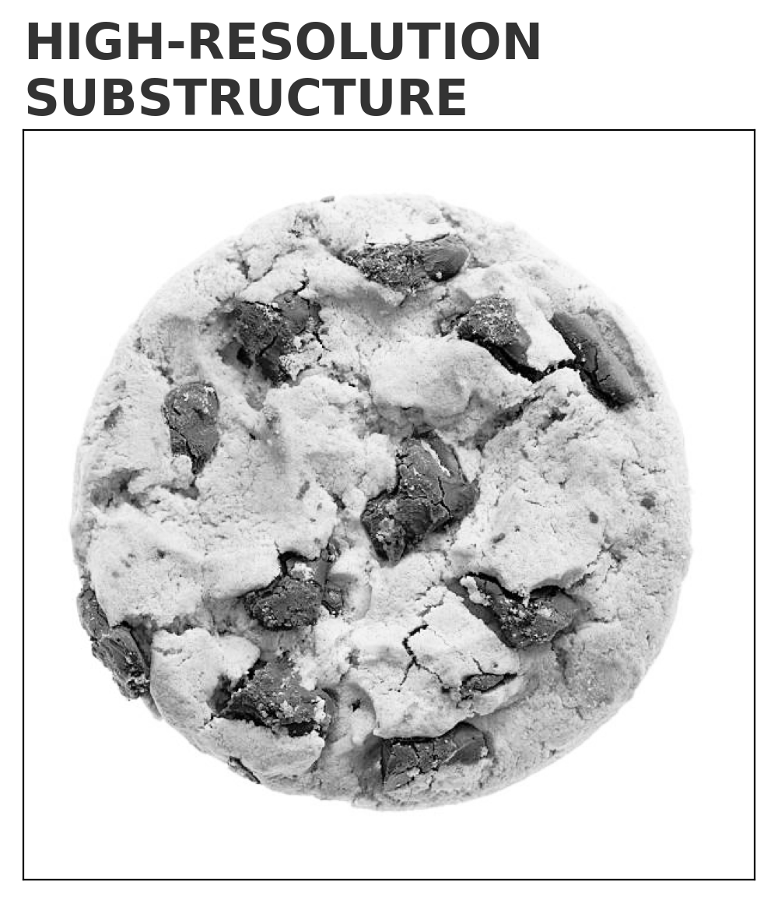
Beam Optics Measurements
Simple Quadrupole
Scans
A range of beam optics measurements will be critical
for CLARA beam commissioning:
  Optimisation of the emittance,
  Matching to the machine’s design optics,
  Phase space reconstruction, for accurate
  simulations and model validation
Multi-magnet
Quadrupole Scans
Increasing
Phase Space
Resolution
Phase Space
Tomography
Standardised high-level software for:
  Quadrupole scans
  Twiss calculations
  Beam optics matching
Machine Learning
Methods

Slide 9
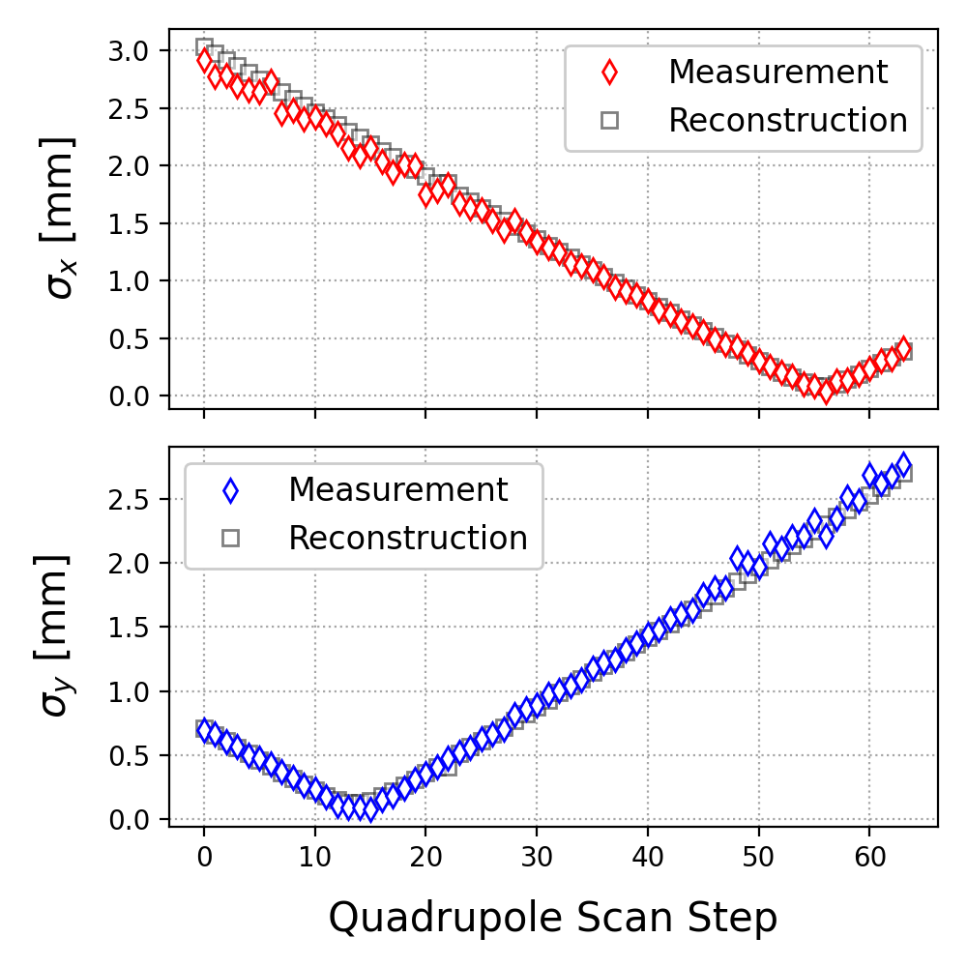
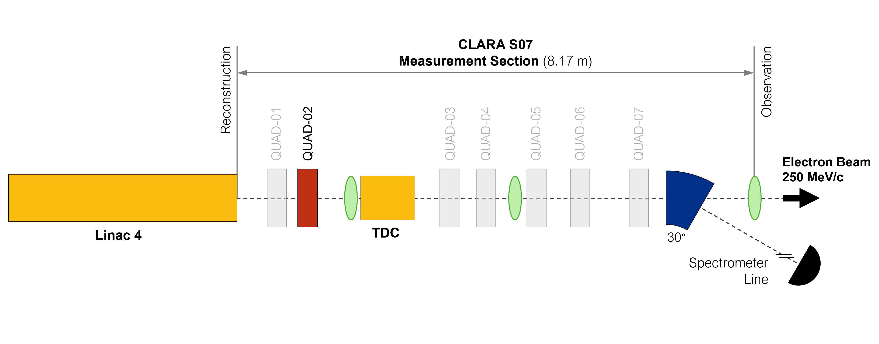
Simple Quadrupole Scans
Single-magnet quadrupole scans offer the fastest,
simplest measurement of the beam optics.
Measure the RMS beam size at a YAG screen
while varying the quadrupole strength
Large emittance uncertainty (typically ≳ 10%)
due to small beam sizes at the focal points

Slide 10
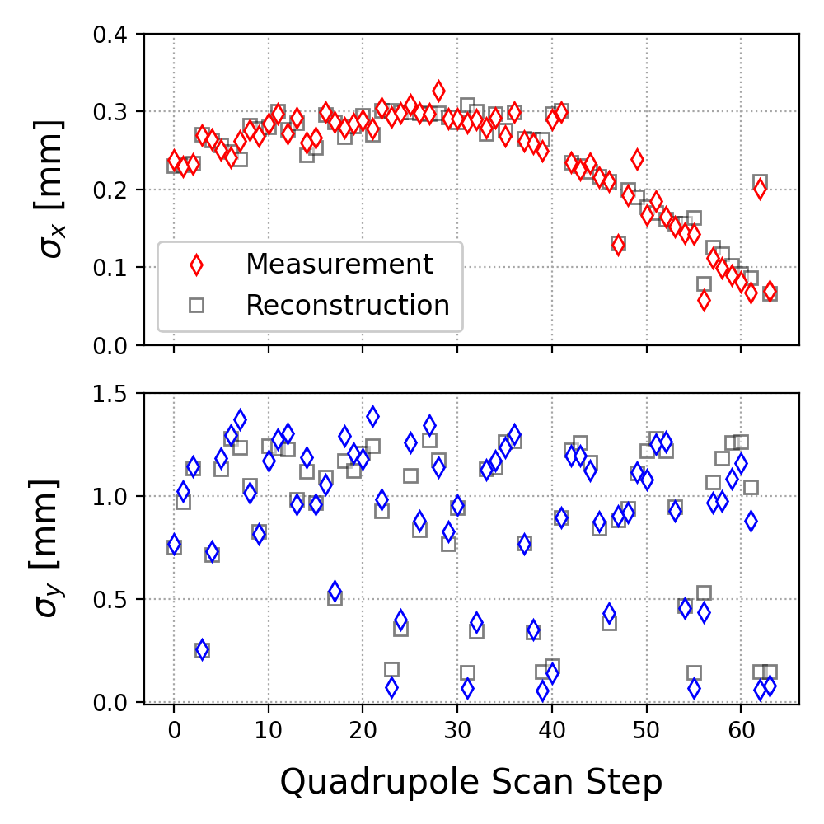
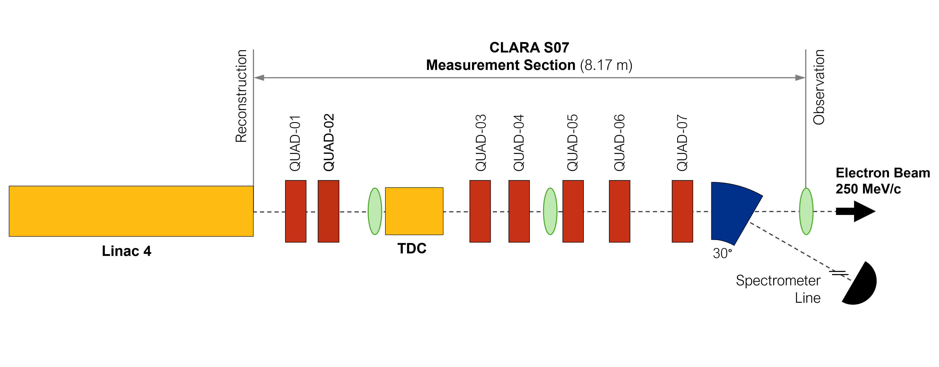
Multi-Magnet Quadrupole Scans
Vary several quadrupoles to maintain a fixed beam size
while constraining the transverse phase space ^{[1, 2]}
Multi-quadrupole scans can offer significantly smaller
emittance uncertainties
Sensitive to transverse coupling in the beam’s 4D
covariance matrix
[1] E. Prat and M. Aiba, Phys. Rev. Accel. Beams 17, 052801 (2014)
[2] A. Wolski et al., Phys. Rev. Accel. Beams 23, 032804 (2020)

Slide 11
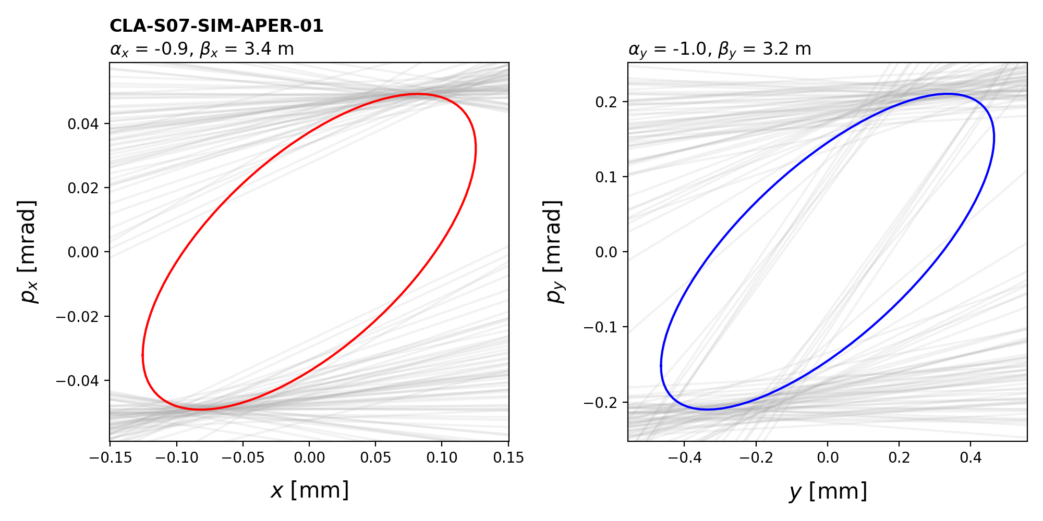
Multi-Magnet Quadrupole Scans
Vary several quadrupoles to maintain a fixed beam size
while constraining the transverse phase space ^{[1, 2]}
Multi-quadrupole scans can offer significantly smaller
emittance uncertainties
Sensitive to transverse coupling in the beam’s 4D
covariance matrix
[1] E. Prat and M. Aiba, Phys. Rev. Accel. Beams 17, 052801 (2014)
[2] A. Wolski et al., Phys. Rev. Accel. Beams 23, 032804 (2020)

Slide 12
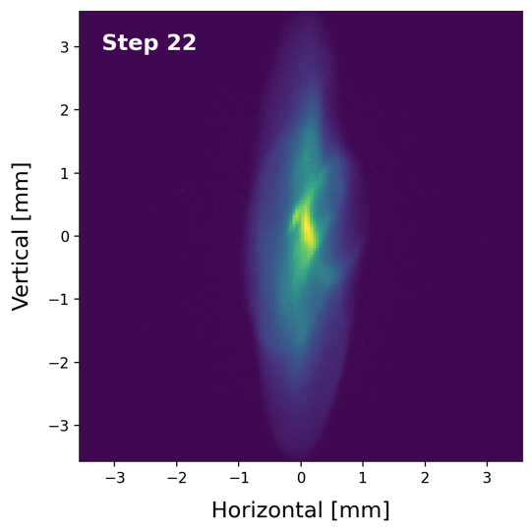
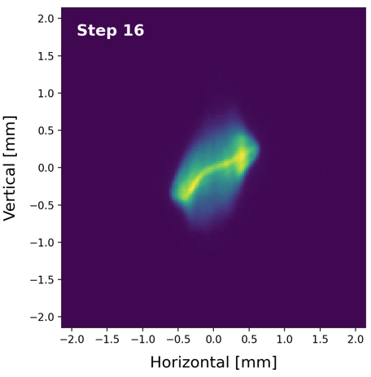
Beam Substructure
[1] A. Wolski et al., Phys. Rev. Accel. Beams 25, 122803 (2022)
[2] R. Roussel et al., Phys. Rev. Accel. Beams 27, 094601 (2024)
Analysis based solely on the beam size neglects
information about the beam substructure.
Phase space tomography uses full beam images to
reconstruct the charge distribution in 4D phase space (x, p_{x}, y, p_{y})
Recent machine learning advances ^{[1, 2]} have led
to faster, higher resolution tomography methods
Above and Left: Recent
CLARA beam images showing
significant substructure

Slide 13
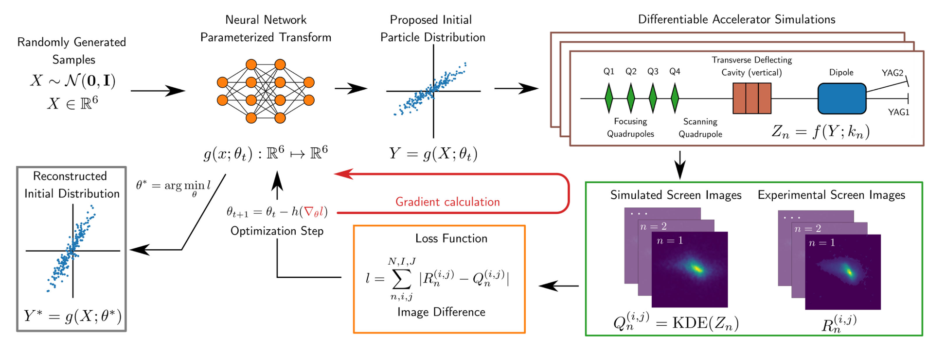
Machine Learning Methods
[1] R. Roussel et al., Phys. Rev. Lett. 130, 145001 (2023)
[2] R. Roussel et al., Phys. Rev. Accel. Beams 27, 094601 (2024)
[3] J. Kaiser et al., Phys. Rev. Accel. Beams 27, 054601 (2024)
Generative Phase Space Reconstruction (GPSR) is a new
technique developed by Ryan Roussel and others ^{[1, 2]}
It uses differentiable simulations ^{[3]} to train a neural network
and “learn” a phase space from experimental beam images
GPSR reconstructs high resolution phase spaces
for later use in simulations
Below: Diagram showing the GPSR method for reconstructing phase space
distributions from experimental data. Adapted from [2]

Slide 14
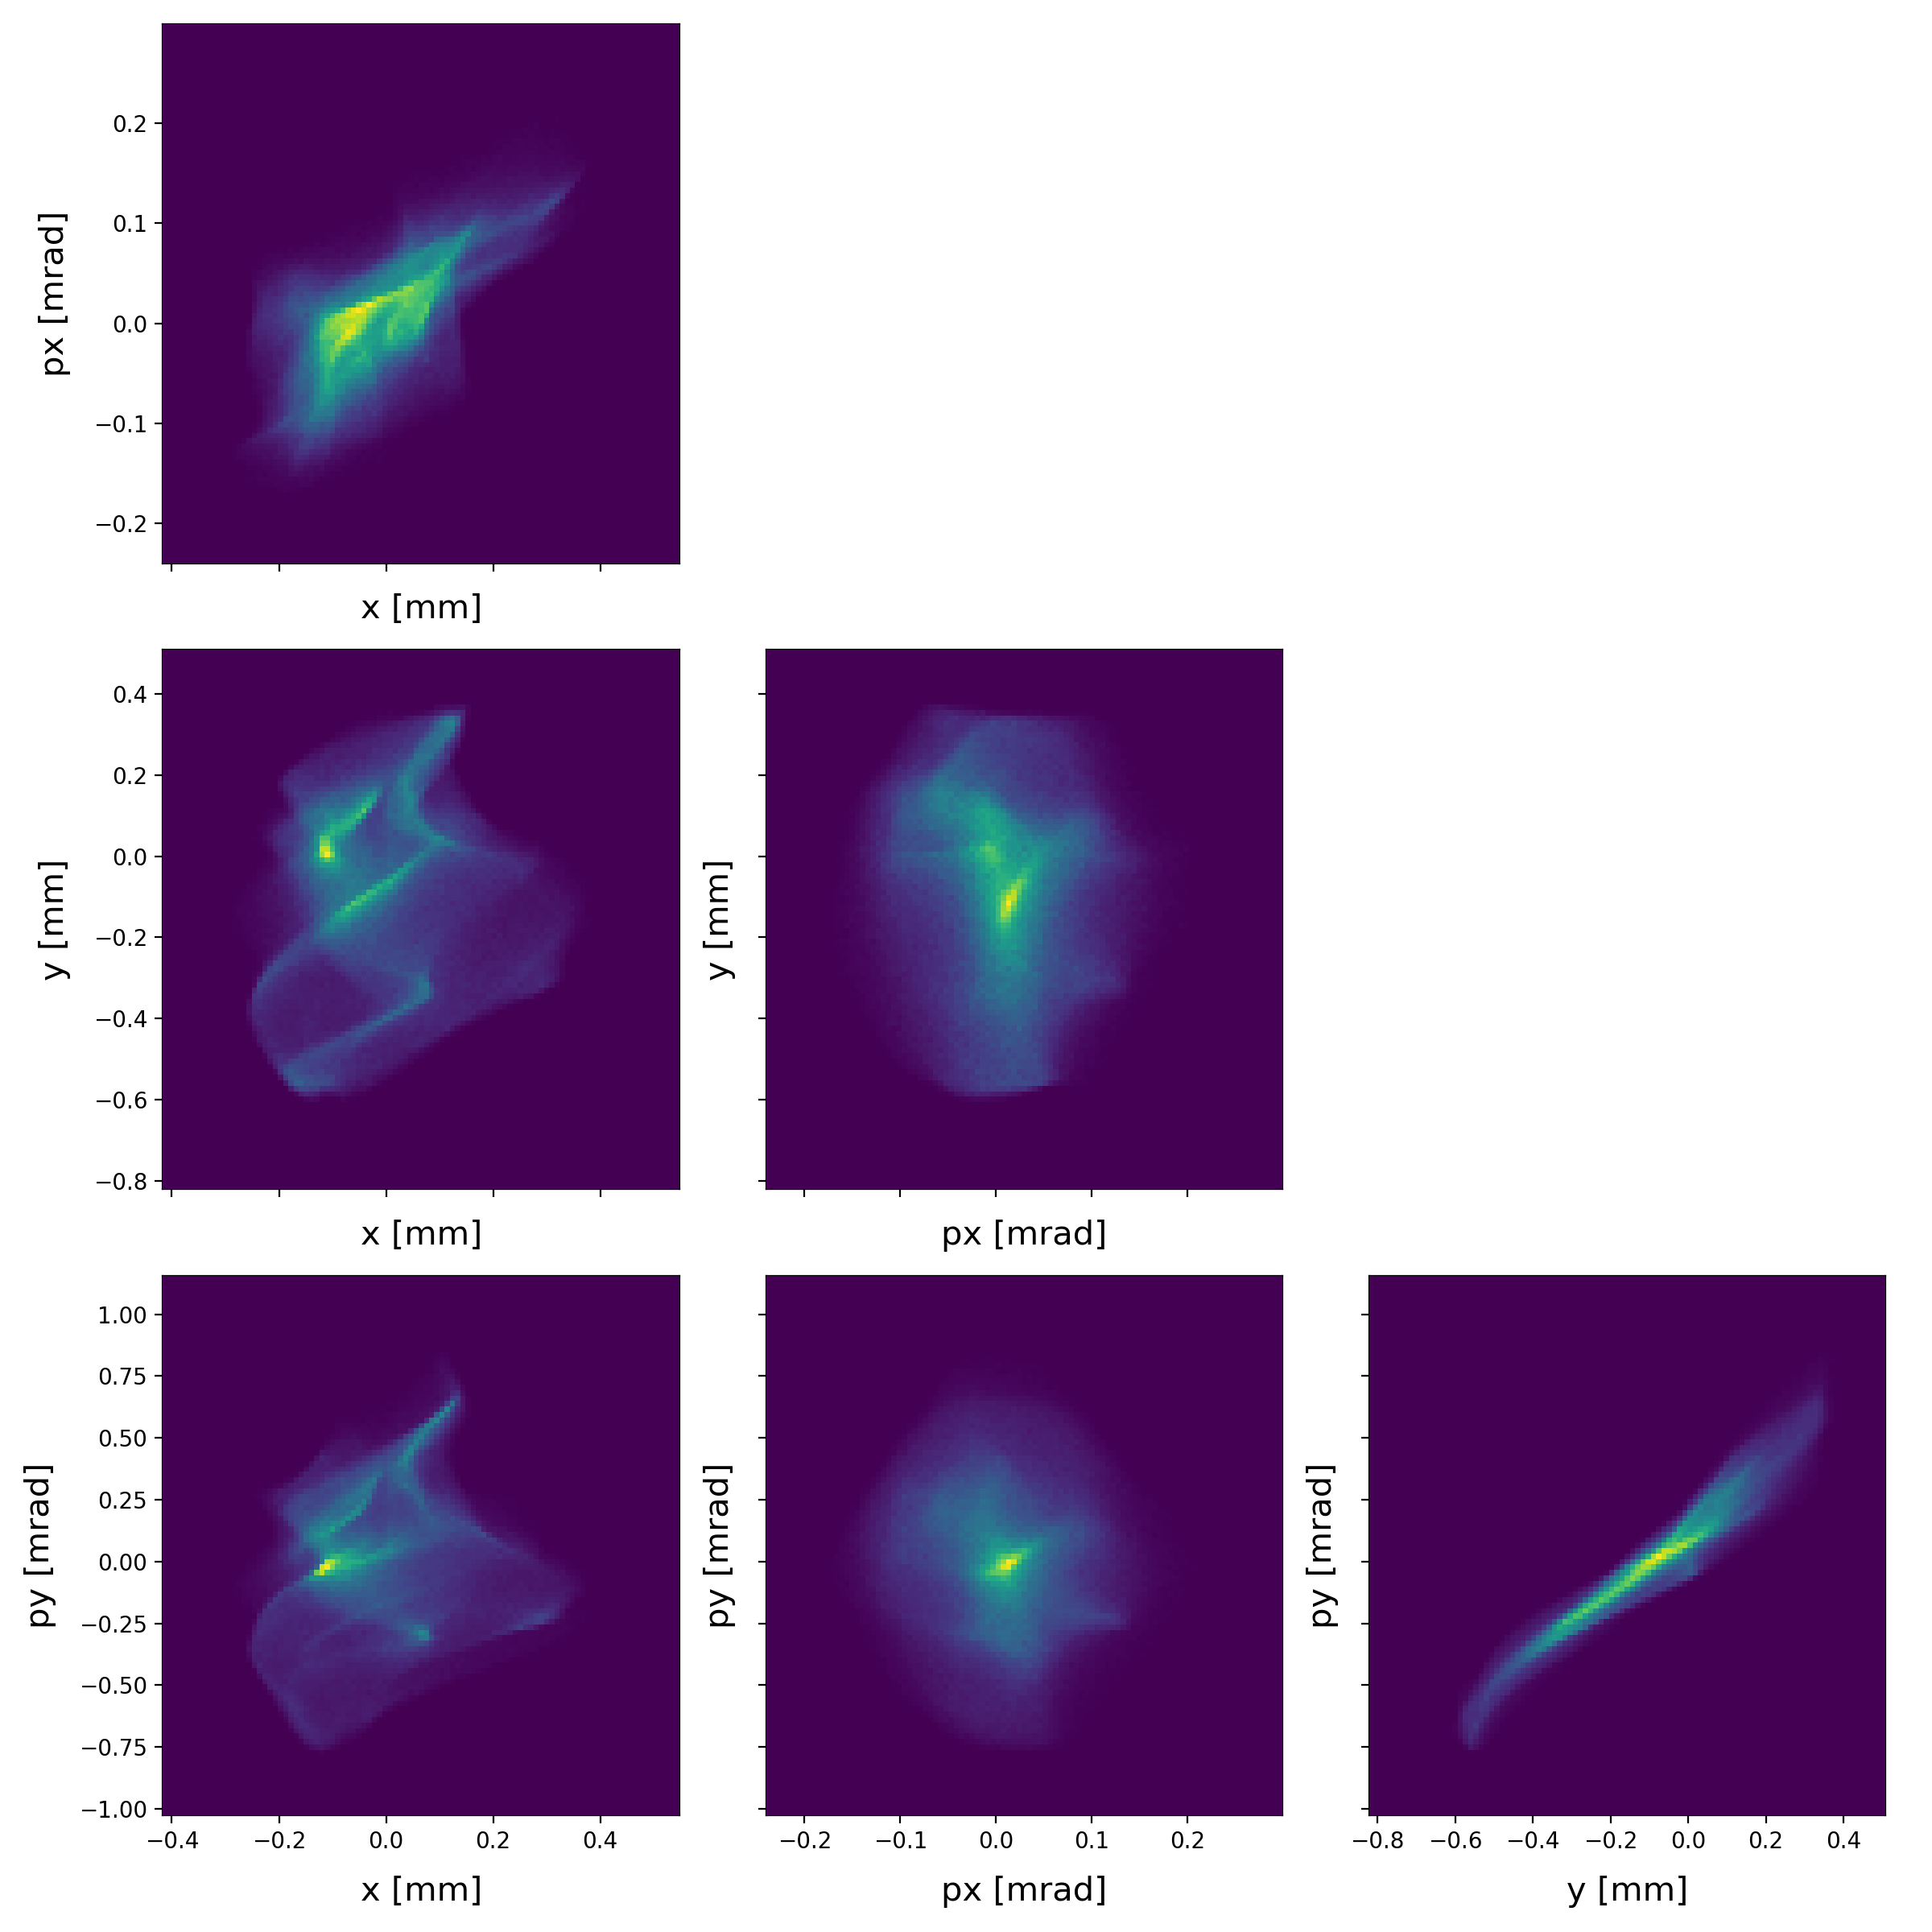
CLARA Reconstructed Phase Space
We have already demonstrated GPSR
using real CLARA data!
Below: Projections of the
4D transverse phase space reconstructed from CLARA beam images
4D phase space (x, p_{x}, y, p_{y}) reconstructed from 64 beam
images at the end of the CLARA straight-on line
  Momentum: 172 MeV/c
  Bunch charge: 30 pC
Significant beam substructure due to sub-optimal
machine setup without Linac 1
Reconstructed emittances: ε_{n,x} = 1.7 µm, ε_{n,y} = 5.0 µm

Slide 15
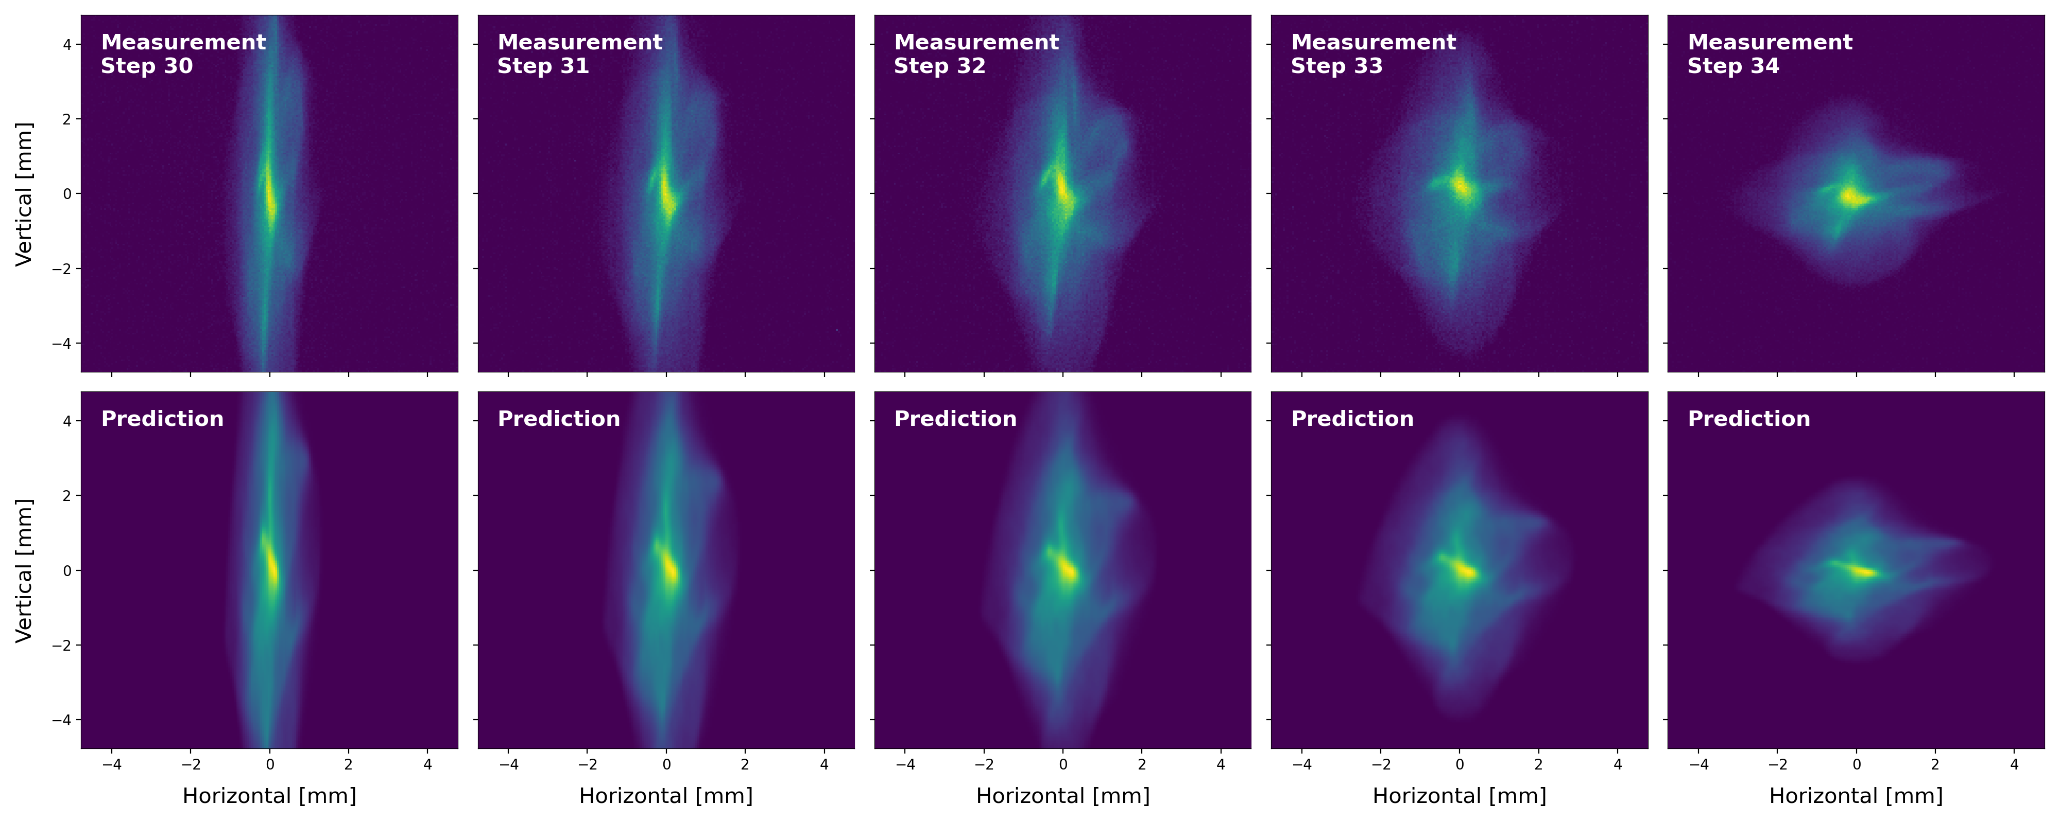
Reconstructed Beam Profiles
Trained
Neural Network
Reconstructed Phase Space
Simulation
New Quadrupole Settings
Predicted Beam Image(s)
Q1
YAG
Q2
Q3
Q4
Q5
Q6
Q7
EXPERIMENTAL
PREDICTED

Slide 16

Conclusions
CLARA is currently undergoing technical systems
commissioning with beam
The development of standardised software should lead
to rapid progress during beam commissioning
We are deploying advanced ML techniques for high-resolution phase space measurements
Special Thanks To…
Alex Brynes, James Jones, Matt King and Euan Gepp
ASTeC, STFC Daresbury Laboratory, UK
Andy Wolski
Department of Physics, University of Liverpool, UK

Slide 18
Backup
Slides

Slide 19
CLARA Beam Parameters
[1] E. W. Snedden et al., Phys. Rev. Accel. Beams 27, 041602 (2024)
Parameter | Commissioning |  |  | Machine Development
 | Low Charge | High Charge |  | Low Charge | High Charge
Beam momentum p_{z} [MeV/c] | 250 |  |  | 250
Bunch Charge Q [pC] | 5 | 250 |  | 5 | 250
RMS Energy Spread σ_{E} [%] | < 1 | < 5 |  | 0.1 | 1
RMS Bunch Length σ_{t} [fs] | 50 | 100 |  | ≪ 50 | < 50
RMS Spot size σ_{x,y} [µm] | 20 | 100 |  | ~ 1 | 50
Emittances
ε_{n,x} [mm mrad] | 2.0 | 5.0 |  | < 1 | < 5
ε_{n,y} [mm mrad] | 2.0 | 5.0 |  | < 1 | < 1
Above: Expected CLARA beam parameters at the FEBE interaction points (IP). Parameters are shown for initial commissioning, and those targeted following required periods of machine development ^{[1]}.

