Slide 1



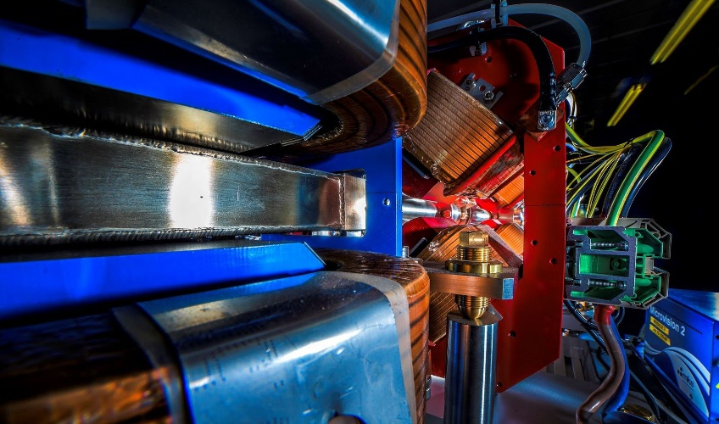
Making a brighter future through advanced accelerators
First High Energy Beam
from the CLARA
Electron Accelerator
and Commissioning Progress
Thomas Pacey
ASTeC, STFC Daresbury Laboratory
and The Cockcroft Institute
On behalf of the CLARA Team
IoP PAB Meeting, 9th July 2025

Slide 2
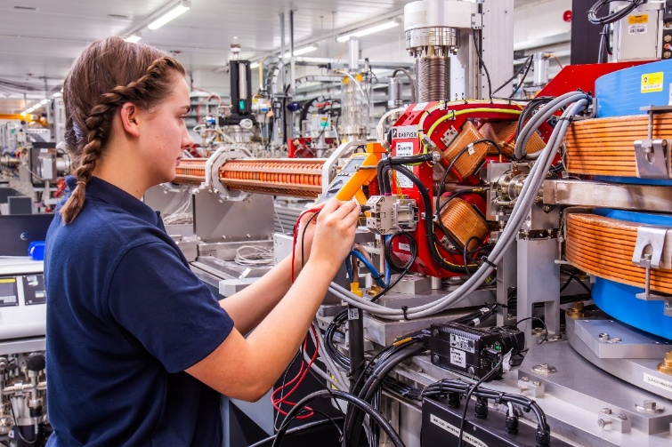
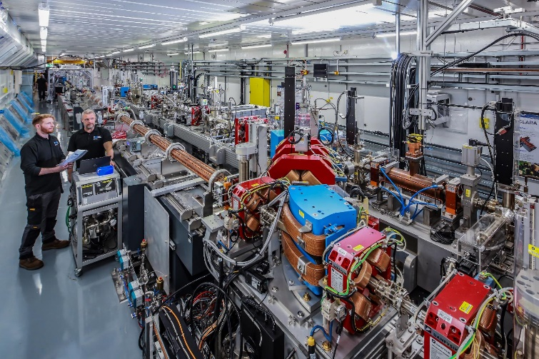
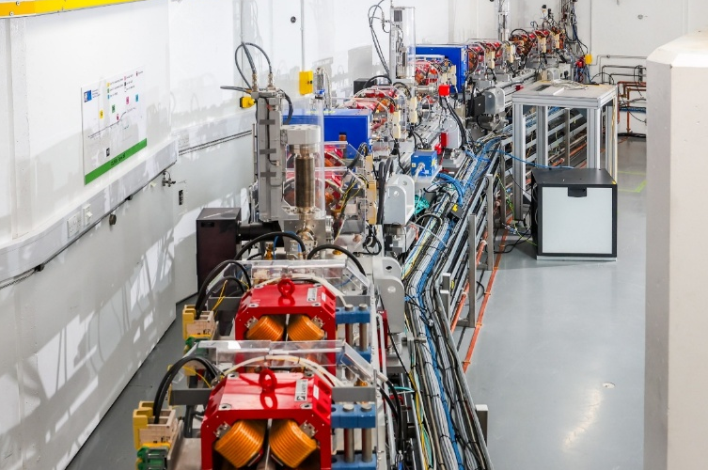

Outline
Making a brighter future through advanced accelerators
CLARA and Upgrade to 250 MeV
Recent highlights
Next steps in commissioning

Slide 3
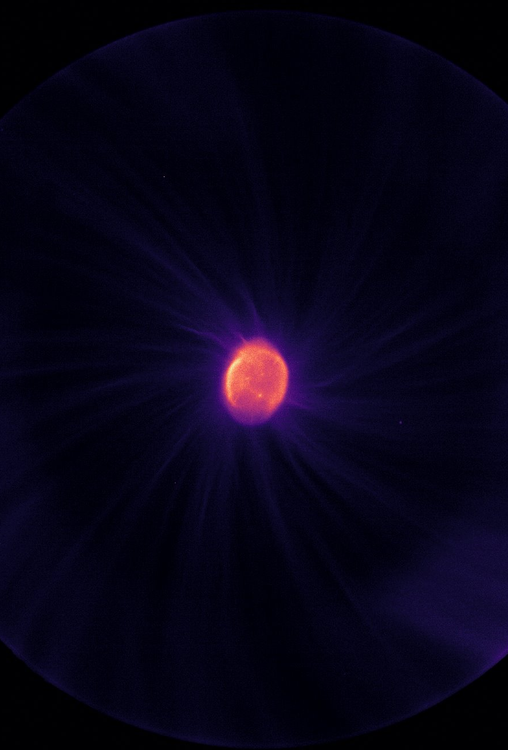
CLARA Overview
250 MeV ultra-bright electron linear accelerator facility
  Daresbury Laboratory in NW England
Ran as ‘CLARA Front End’
at 35 MeV 10Hz, with TW-class laser
  2 user runs 2018-2022
Since 2022 have been building, installing, conditioning and commissioning…
Achieved 250 MeV, 100Hz beams 2/4/25

Slide 4
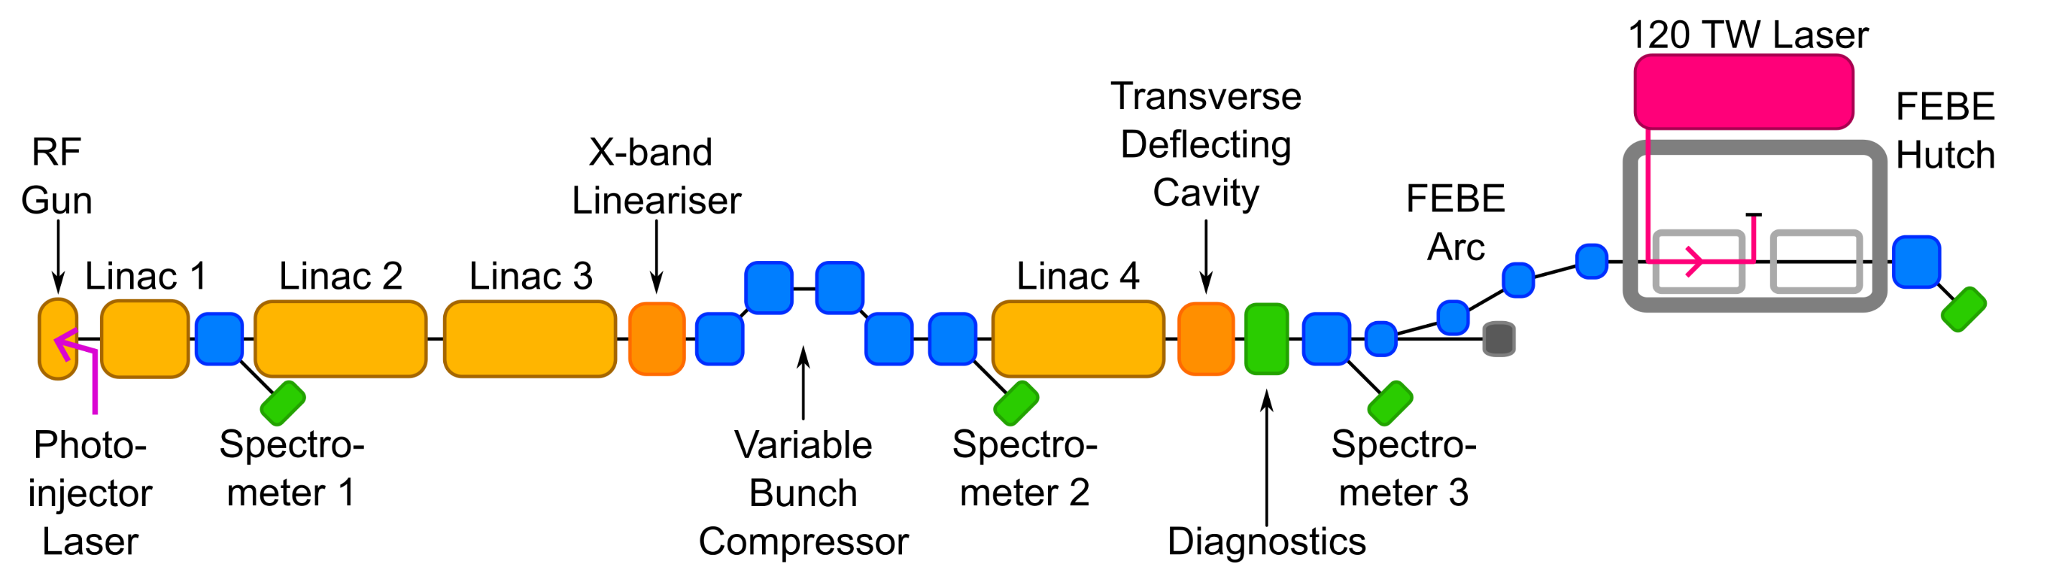
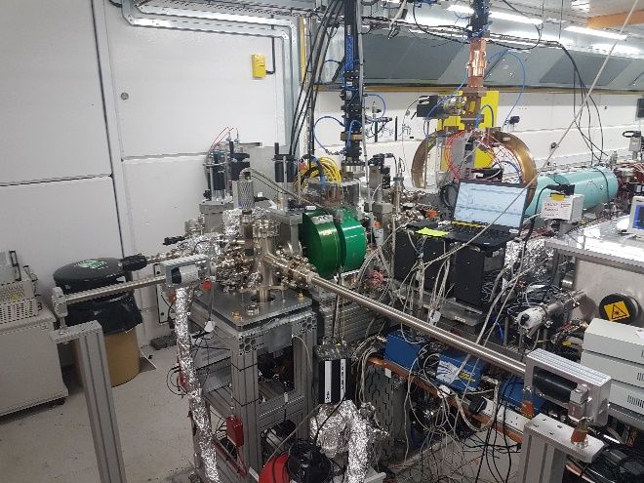
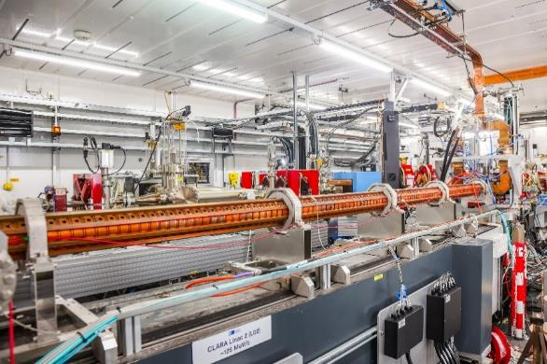
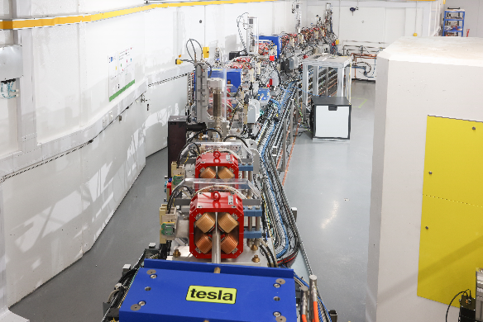
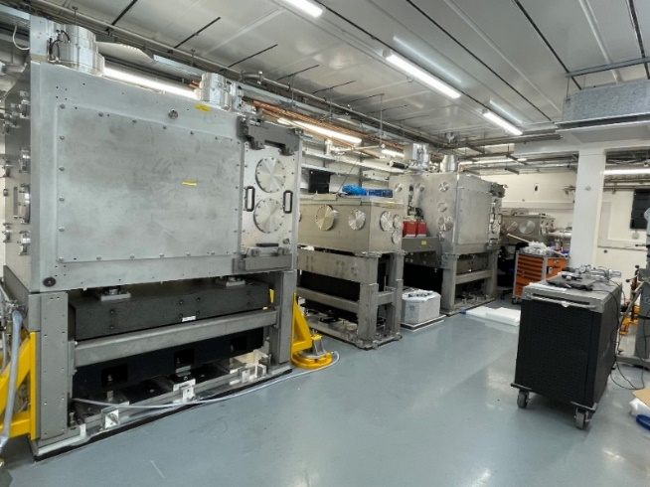
CLARA Layout
Accelerator Hall
~90m x 3.5m x 3m
Generate
Accelerate + Manipulate + Accelerate
Characterise in 6D
Experiment
CLARA Gun
S-band Linac
Arc to FEBE hutch
FEBE hutch

Slide 5
The Upgrade in Numbers
Example technical system | CLARA Front End | CLARA 250 MeV | CLARA + FEBE
RF Structures | 2 | 7 | 7
Magnets | 22 | 77 | 126
Diagnostic Systems | 13 | 65 | 94
Vac. Gauges + Pumps | 57 | 109 | 155
Notes:
Example systems only

Slide 6
The Upgrade in Numbers
Example technical system | CLARA Front End | CLARA 250 MeV | CLARA + FEBE
RF Structures | 2 | 7 | 7
Magnets | 22 | 77 | 126
Diagnostic Systems | 13 | 65 | 94
Vac. Gauges + Pumps | 57 | 109 | 155

Slide 7


First beams
through CLARA
to 250 MeV
All at 100 Hz!

Slide 8
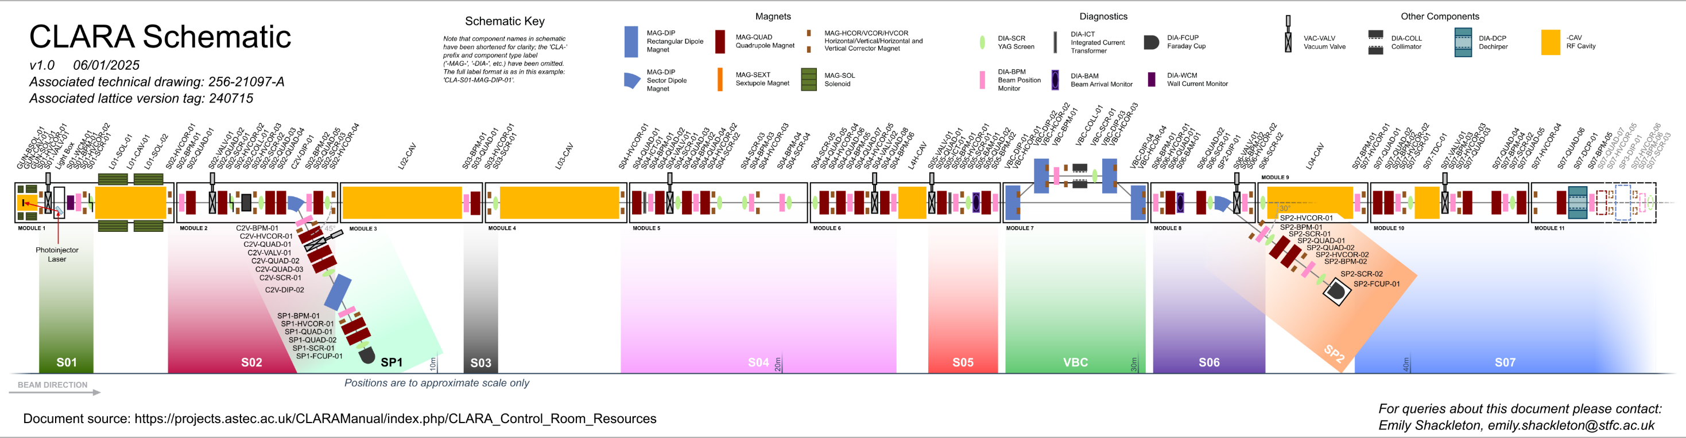
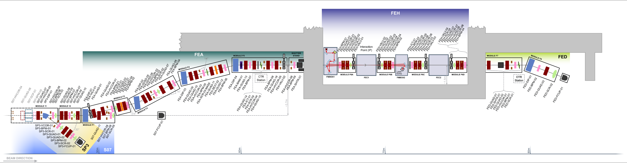
First Beam 17/3/25
Linac02 on , 28/3/25
Linac03 on , 2/4/25
Linac04 on , 2/4/25
Linac02 & 03 on 2/4/25
E=160 MeV

Slide 9
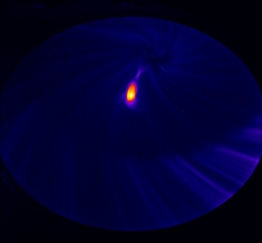
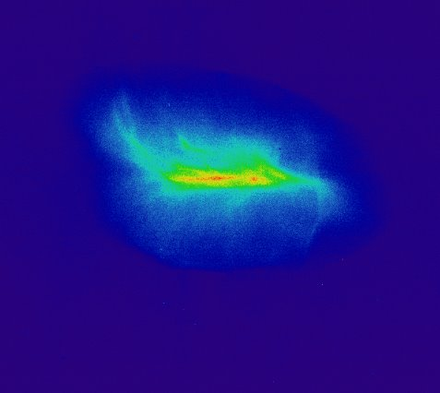
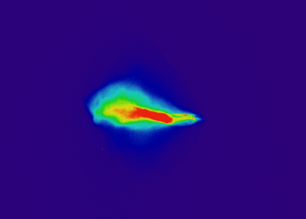
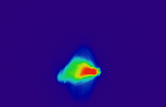
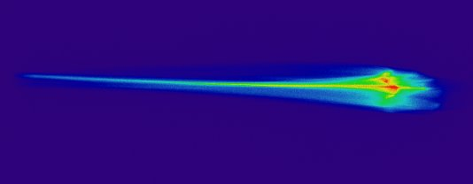
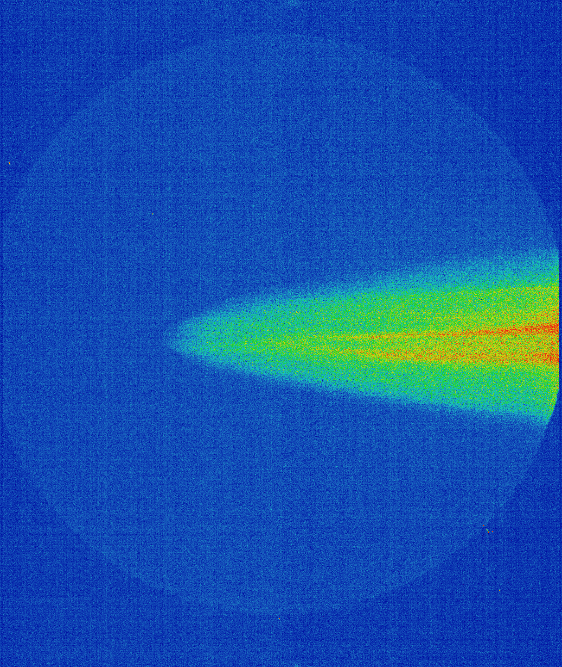
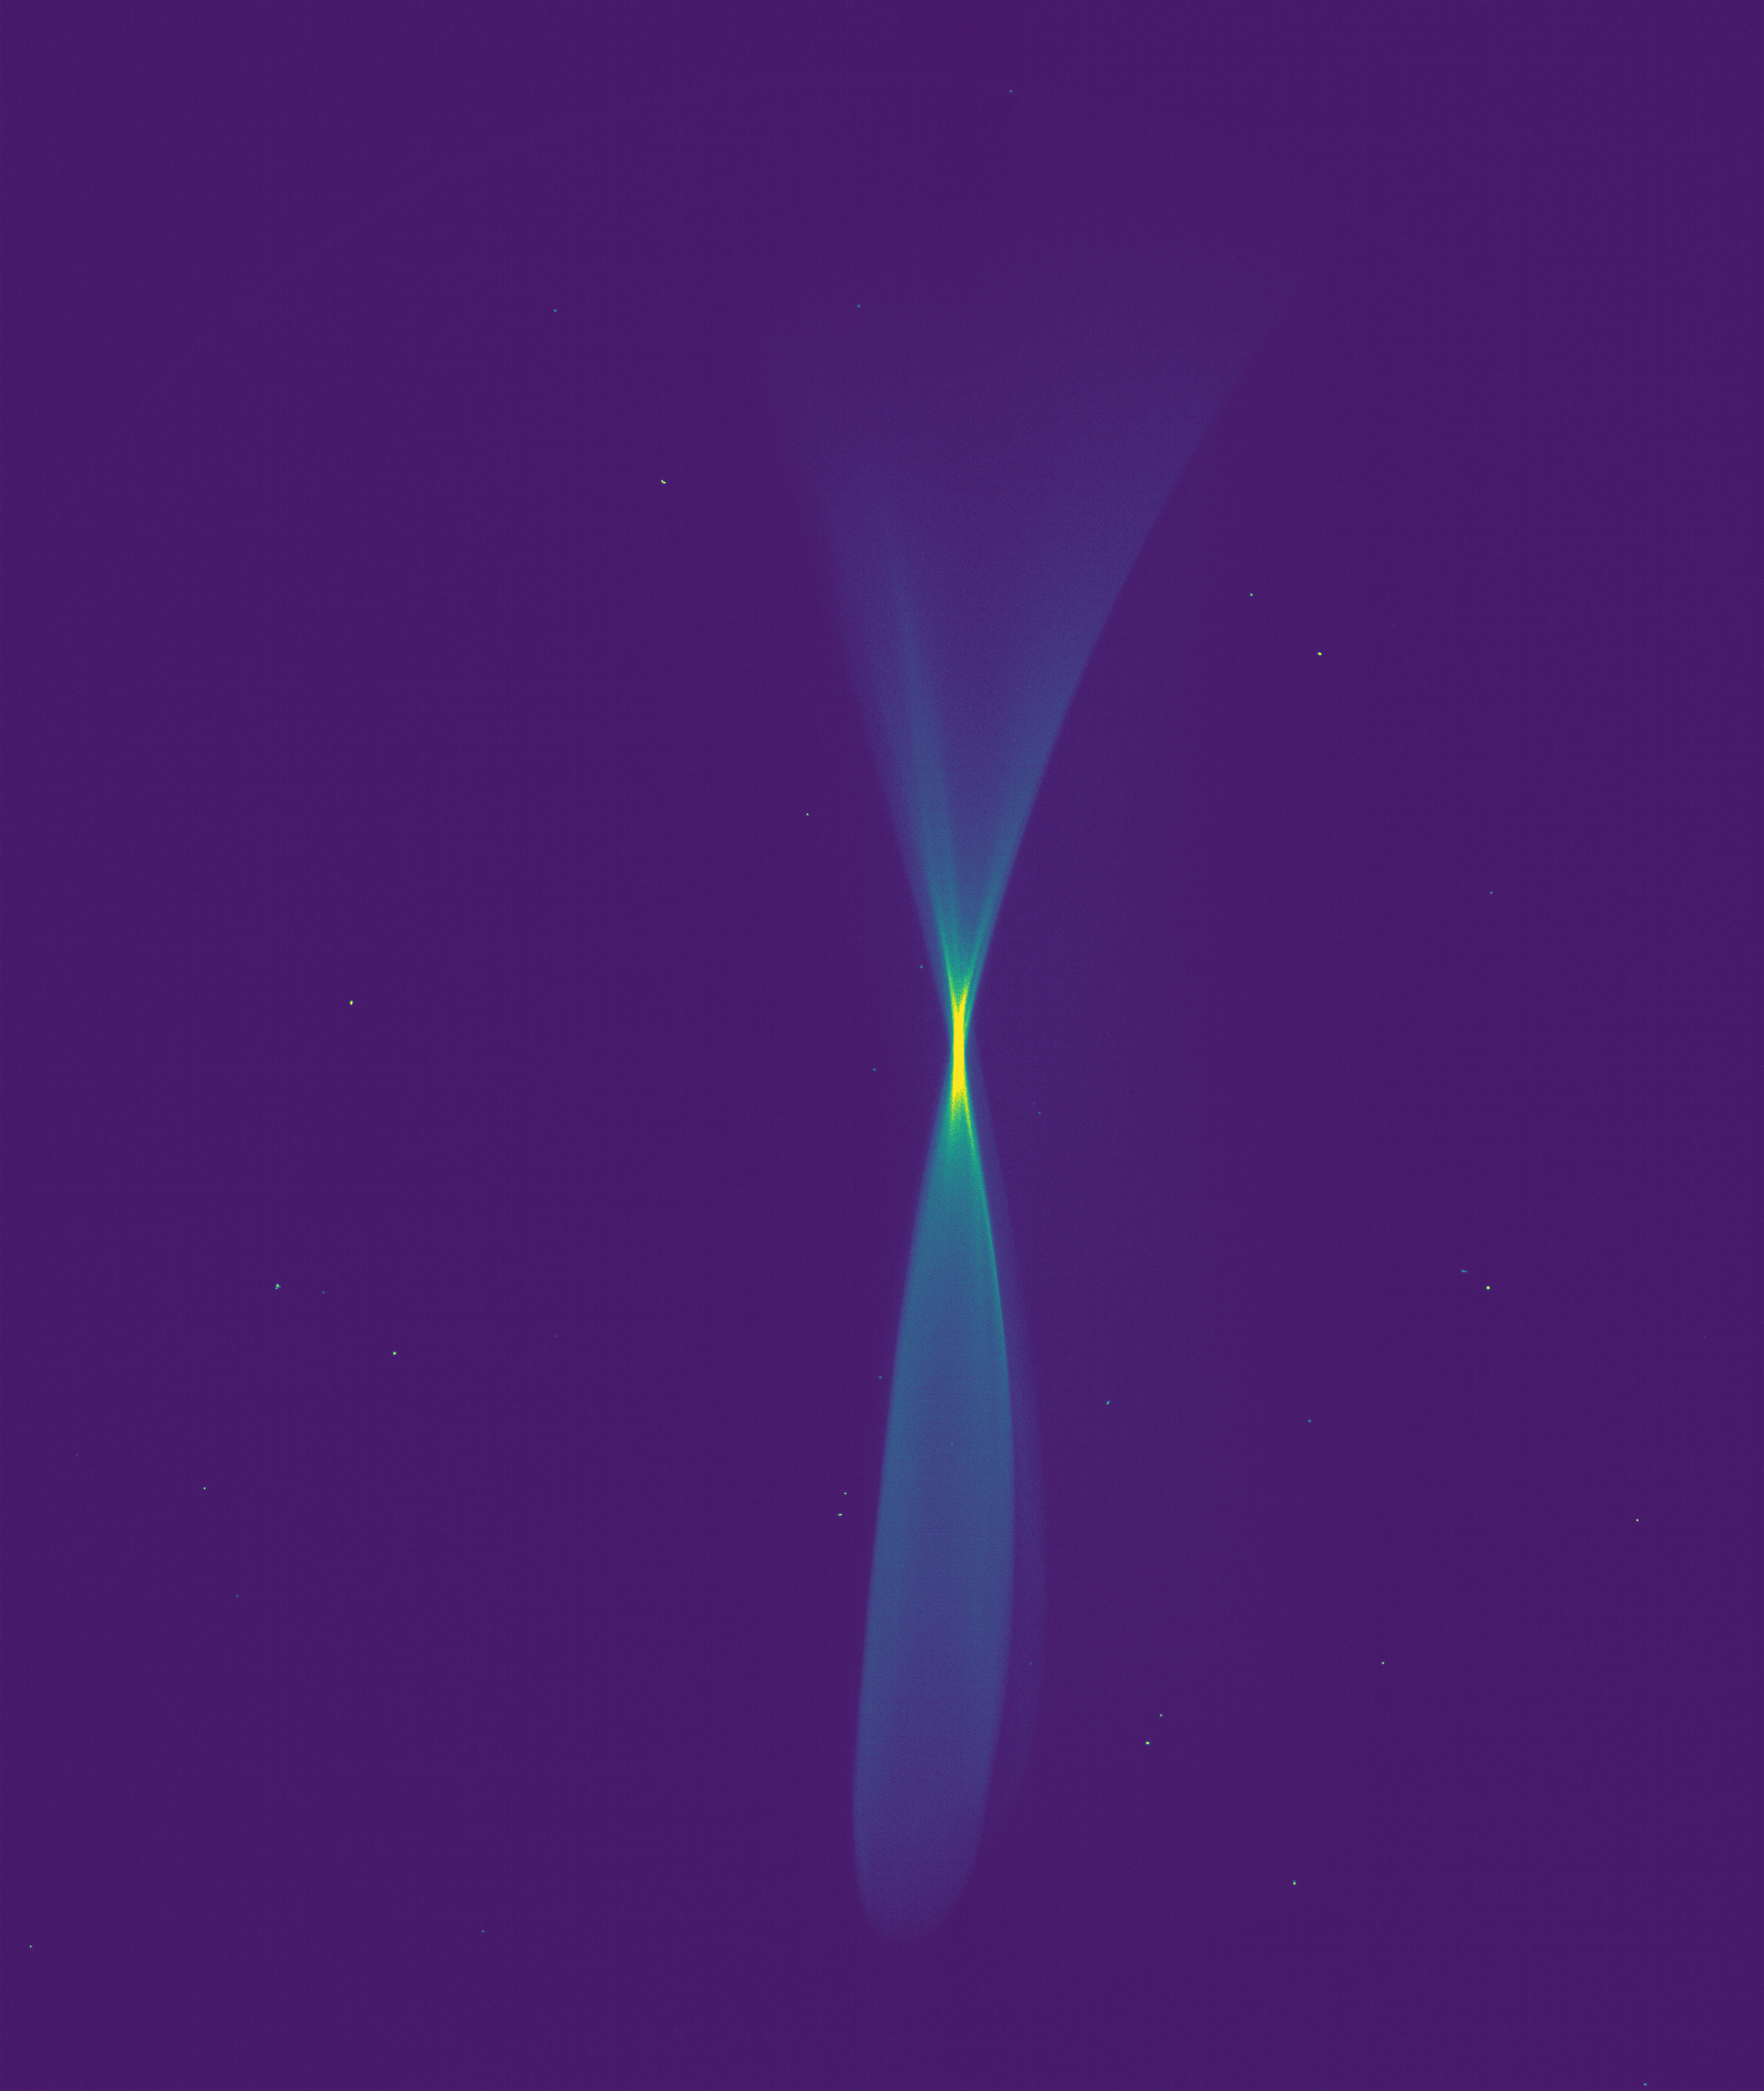
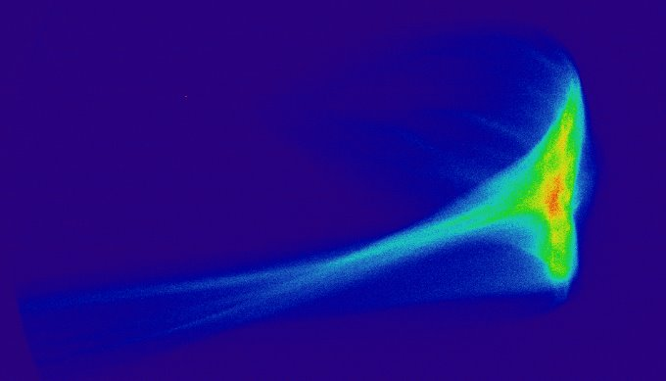
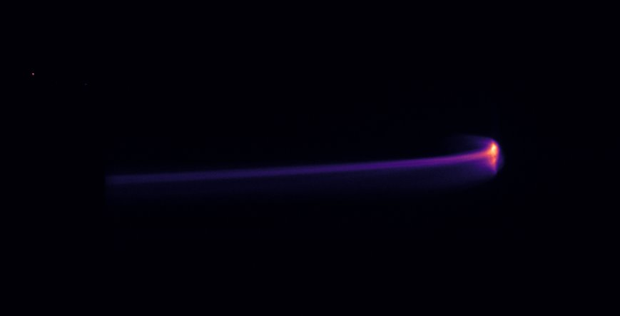
First Beam 17/3/25
Linac02 on , 28/3/25
Linac03 on , 2/4/25
Linac04 on , 2/4/25
Linac02 on 1/4/25
E=72 MeV
Beam Momentum
= 3.9 MeV/c
+ TDC beam streaking
on 11/4/25
E =240 MeV
Length ~30ps
Linac02 & 03 on 2/4/25
E=160 MeV
Linac02, 03 & 04 on, 2/4/25
E = 250 MeV

Slide 10
Machine Images: 10pC Setup 4/7/25
First Beam 17/3/25
Linac02 on , 28/3/25
Linac03 on , 2/4/25
Linac04 on , 2/4/25
Gun Beam
4 MeV
Post L01
33 MeV
Spec. 1
33 MeV
Post L02
100 MeV
Post L03
170 MeV
Post 4HC
170 MeV
Spec. 2
170 MeV
Post L04
250 MeV

Slide 11
Where are we now?
NB this is a topographically transformed Gantt chart;
box size does not indicate length of time.
Build
Technical
Systems
Comm.
RF Conditioning
CLARA Technical systems
Comm. w/ beam
Beam Commissioning
FEBE Hutch Tech.
systems Comm.
FEBE Technical systems Comm. w/beam
First User Run
Business As Usual
Users + MD + Maintenance
We are here

Slide 12
Recent
Commissioning
Highlights

Slide 13
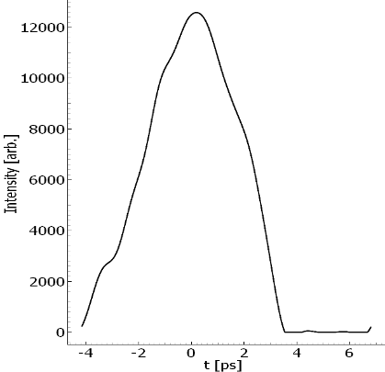
Longitudinal Dynamics: TDC & VBC
TDC Deflection & Calibration
TDC: Transverse Deflecting Cavity; S Band RF Structure
LPS Measurements at 250 MeV
y
x
TDC Streaking & Measurement
E
t
Under-compressed
Compressed
Over-compressed
Variation of VBC angle
VBC: Variable Bunch Compressor; Magnetic Chicane
RMS: 1.5ps
(arb. setup)
t
x

Slide 14
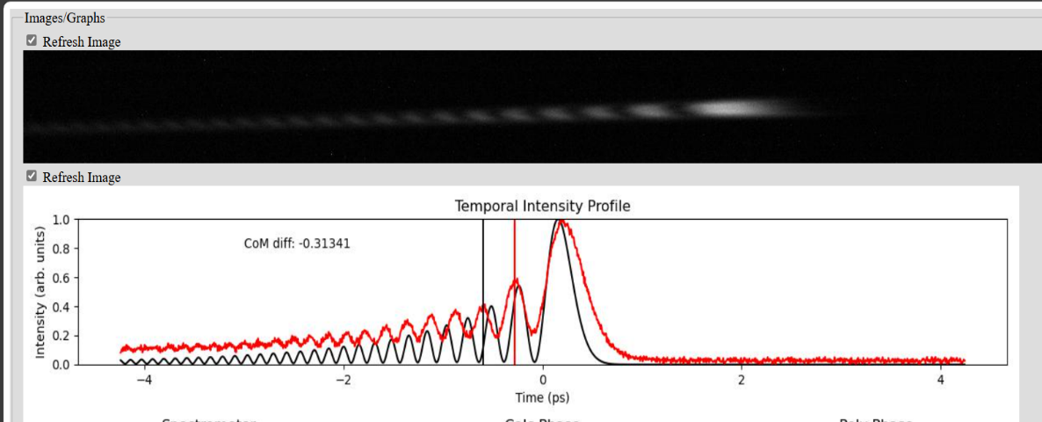
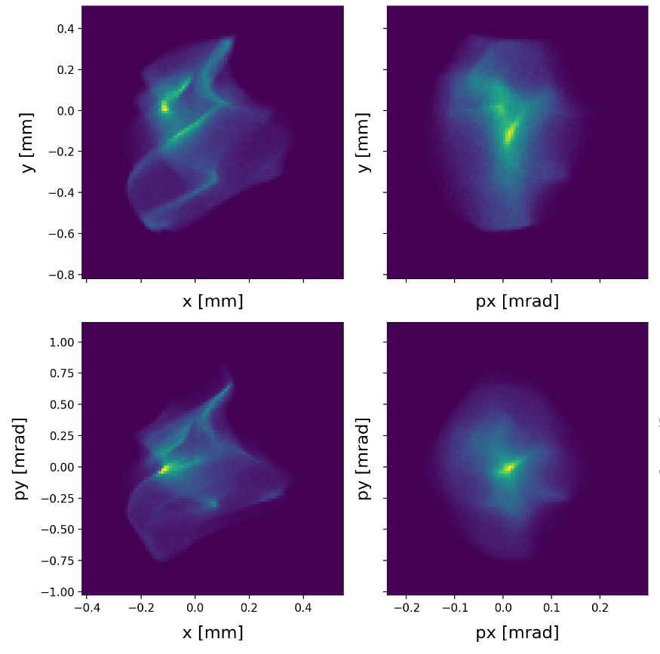
Advanced systems
Control of PI Laser Longitudinal Profile
Transverse Phase Space Tomography
PI: Photoinjector Laser, generates electrons at cathode
Setting an arbitrary complex profile in PI Lab
t
E
Mapping into LPS at 250 MeV
See following talk from M. Johnson
Both examples underpinned by ML techniques

Slide 15

Next steps for
CLARA Technical Commissioning
Cathode upgrade from Cu to Cs-Te
Bring X-Band lineariser online
Install dielectric wakefield dechirper
Notes:
Move this slide up before others?

Slide 16
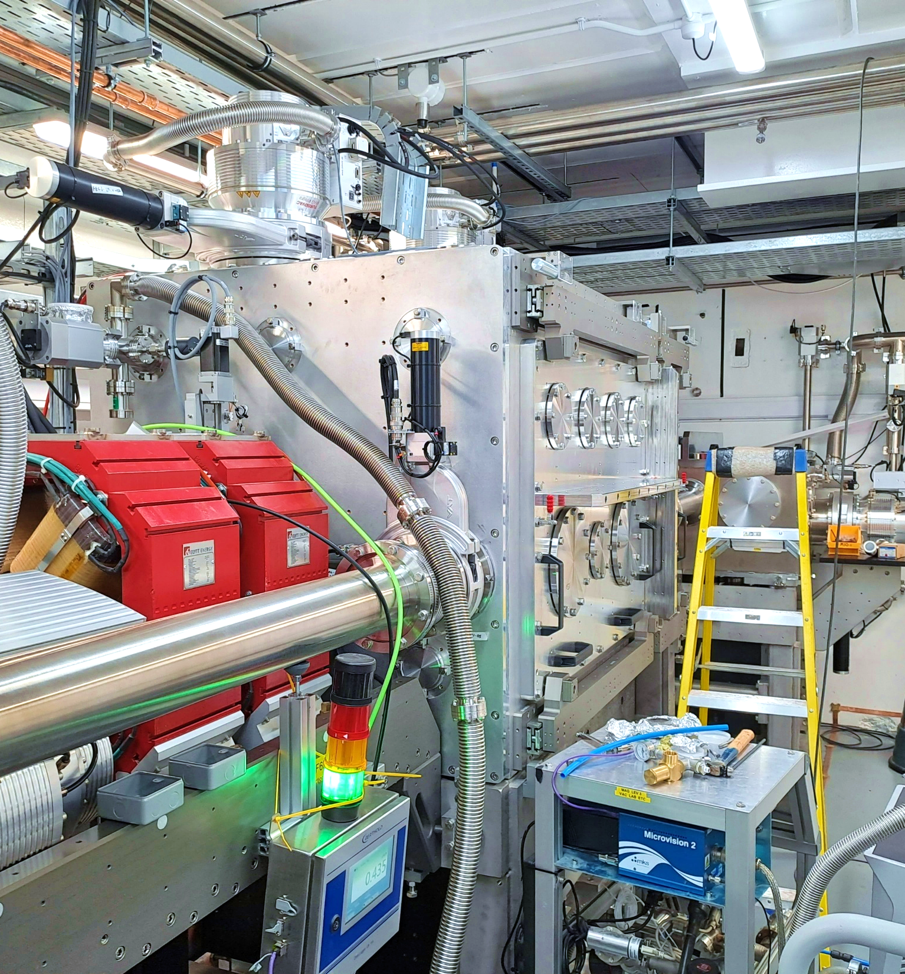
Next steps for FEBE Commissioning
FEBE Arc + Dump fully installed and commissioned
Technical systems commissioning has begun in hutch
FEBE 120 TW Laser has been installed.
  Targeting SAT Completion Q3 25
Targeting first electron beam delivery September 25

Slide 17
Day 1 Electron Beam Parameters
To be delivered at either FEBE Chamber IPs
Parameter | High charge | Low charge
Energy [MeV] | 250 | 250
Charge [pC] | 250 | 5
RMS t [fs] | 100 | 50
σ_{E}/E [%] | <5 | <1
RMS x [µm] | 100 | 20
RMS y [µm] | 100 | 20
ε_{N} x [µm] | 5 | 2
ε_{N} y [µm] | 5 | 2
These parameters are for short bunches.
If longitudinally compressed beam is not required, emittance will be reduced and transverse focus also reduced in size.
Further detail on FEBE beam parameters can be found in
Snedden, E. W., et al. "Specification and design for full energy beam exploitation of the compact linear accelerator for research and applications." PRAB 27.4 (2024): 041602.
https://doi.org/10.1103/PhysRevAccelBeams.27.041602

Slide 18
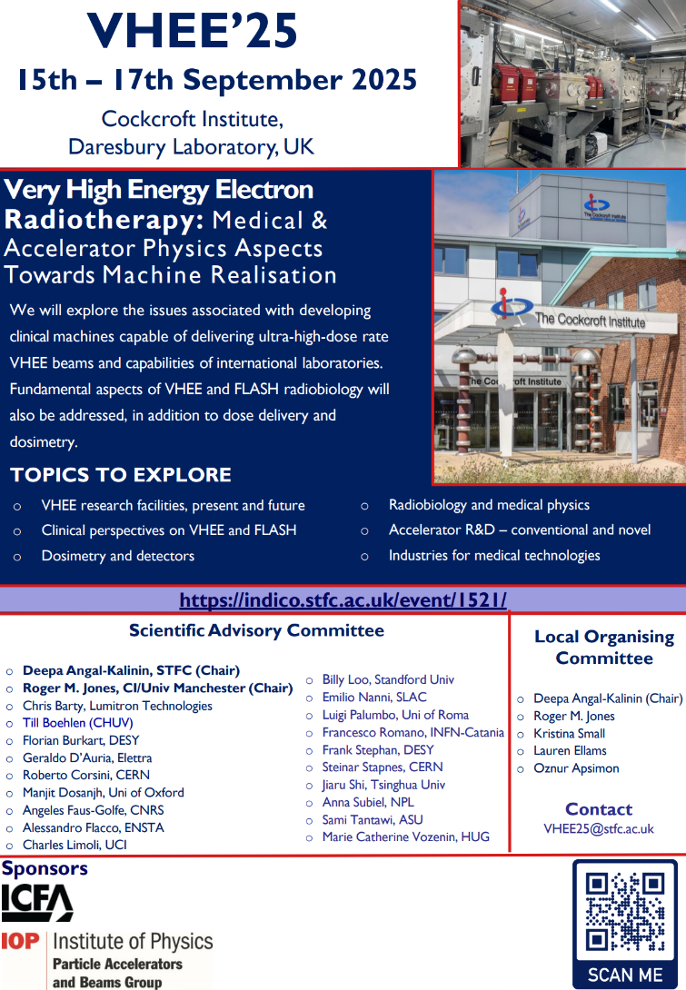

Topics
VHEE Research Facilities
Clinical perspectives
Dosimetry and detectors
Radiobiology and Medical Physics
Accelerator R&D
Industries for medical technology
indico.stfc.ac.uk/event/1521

Slide 19
Summary
Electron beams at 250 MeV, 100Hz have been delivered at CLARA
This is a major milestone for Daresbury Laboratory
and for UK Accelerator Infrastructure
Targeting delivery of beam through FEBE hutch in September ‘25
We are planning to welcome users in 2026
Notes:
Incredibly proud of what we have achieved in the last 6 months

