Slide 1



Conclusions from the
UK XFEL conceptual design and options analysis project
Dave Dunning, STFC Daresbury Laboratory
On behalf of the project team
9th July 2025
xfel.ac.uk
Notes:
The abstract pattern can be removed or repositioned if required. Be careful to ‘Send to Back’ so that it does not obscure any important information.

Slide 2
Introduction
Science Case to CDOA
Conceptual Design
Options Analysis
Conclusions and Next Steps

Slide 3






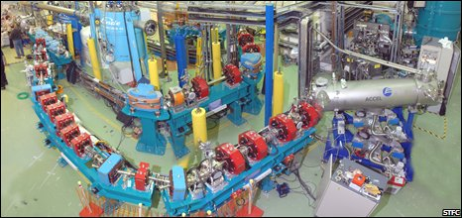
Introduction
SwissFEL
A long history of FEL facility activities
LCLS
SACLA
FERMI
PAL
Eu XFEL
LCLS-II
SHINE
LCLS-II-HE
2005
2010
2015
2020
2025
2030
2016
2018
2020
2022/23
Grow community
Demonstrate need
Develop plans at appropriate point
UK re-joins European XFEL
DiPOLE @ HiBEF
Hubs for Life and Physical Sciences
Science Case for a UK XFEL Published
UK XFEL CDOA funded
UK subscription to European XFEL up from 2% to ~5%
ALICE IR-FEL
+ CLARA: ‘FEL-ready’

Slide 4
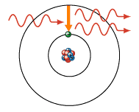
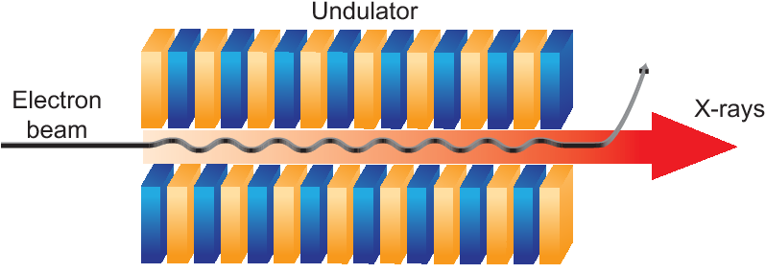

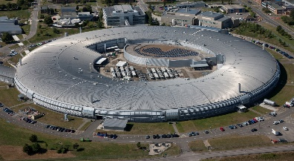
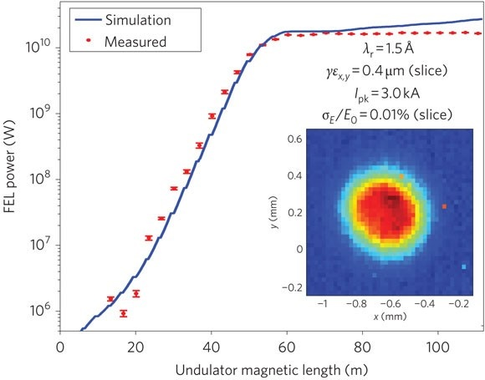
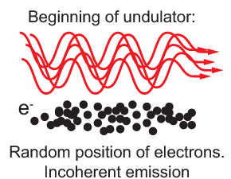
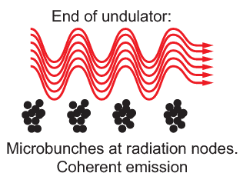
How XFELs work - and why it matters
Laser colour (wavelength) is usually constrained by differences between energy levels in an atom
Short Wavelength and High Brightness
XFEL = X-ray Free-Electron Laser
Dumped electrons
N
S
N
S
N
S
N
S
N
S
N
S
N
S
N
S
Particle
Accelerator
Experiments
(Detectors)
X-Rays
‘Free electrons’ = dissociated from atoms
S
N
S
N
S
N
S
N
S
N
S
N
S
N
S
N
Electron energy modulation
Electron micro-bunching
Radiation emission
(like a synchrotron)
X-ray intensity increases exponentially
“Lasing”
Notes:
@inproceedings{Nilsson2013ZonePF, title={Zone Plates for Hard X-Ray Free-Electron Lasers}, author={Daniel Nilsson}, year={2013}, url={https://api.semanticscholar.org/CorpusID:46905339} }

Slide 5
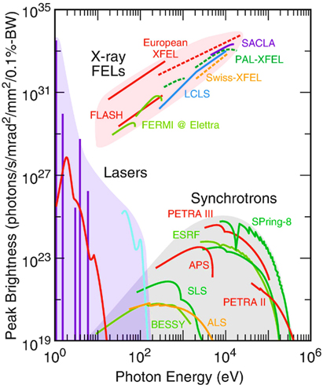
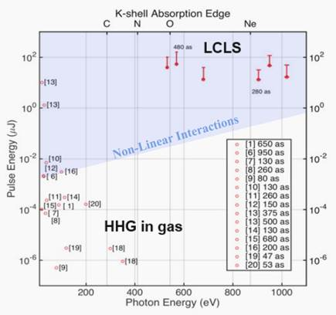
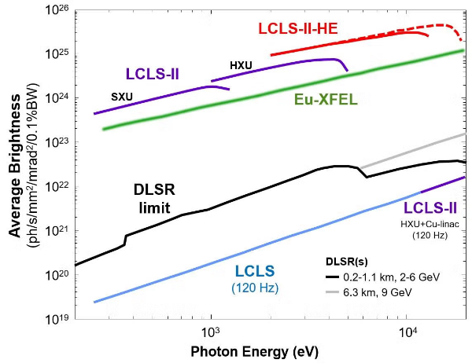
XFELs vs other types of facility
The next generation of XFELs will be the most advanced light sources the world has ever seen. They will have an average x-ray brightness more than a thousand times higher than 4th generation storage rings, and a peak brightest a billion times higher.
A billion times higher peak brightness compared with synchrotrons
Average brightness >1000 times higher than synchrotrons
Attosecond pulses with higher pulse energy at higher photon energies than HHG

Slide 6
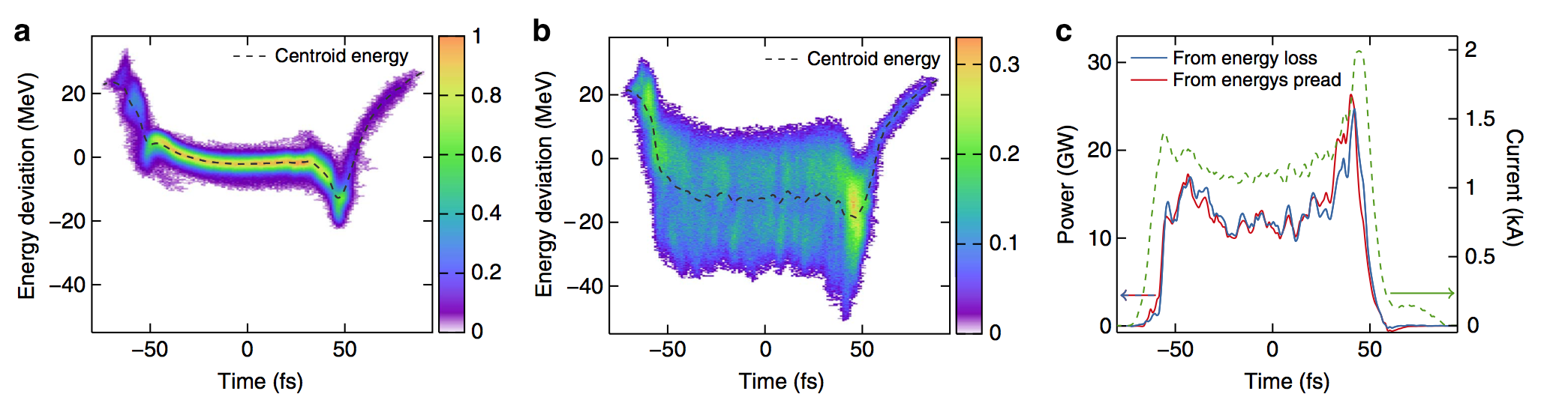
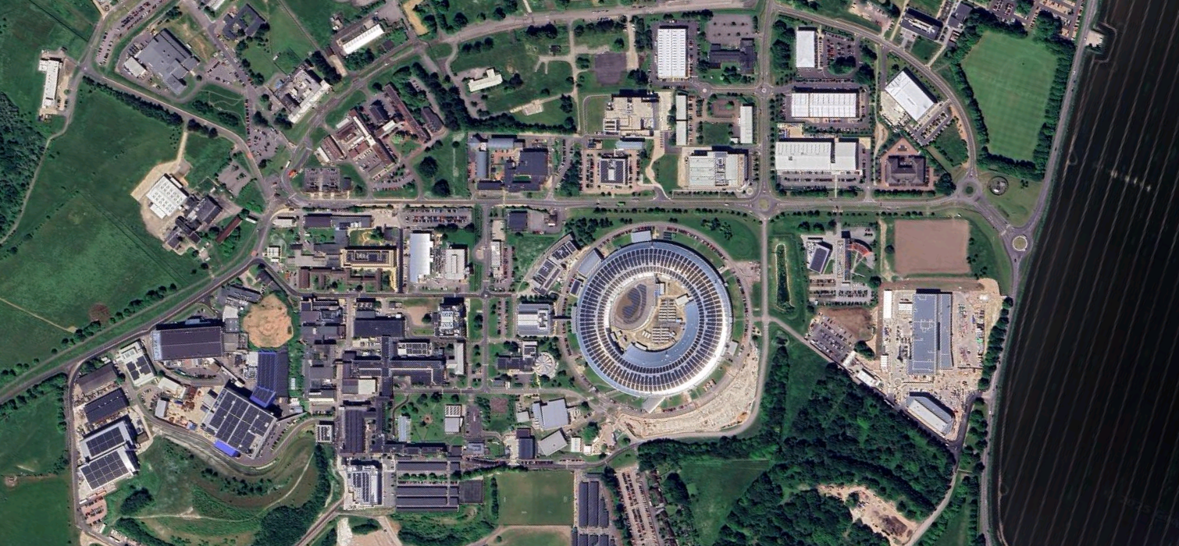
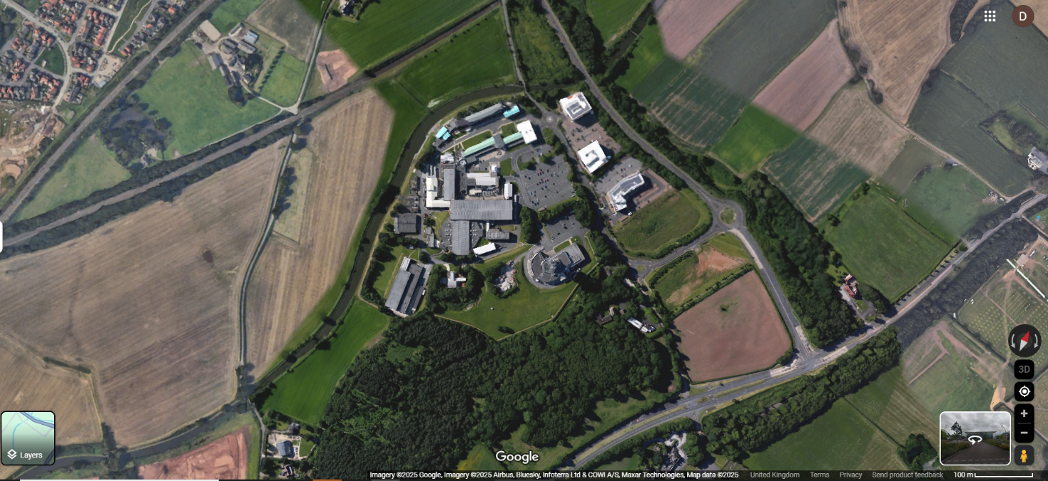
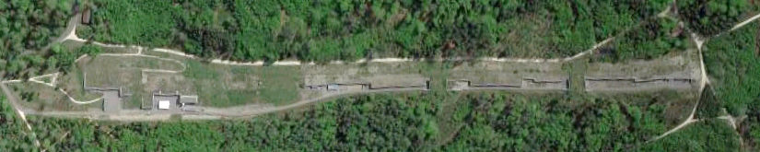
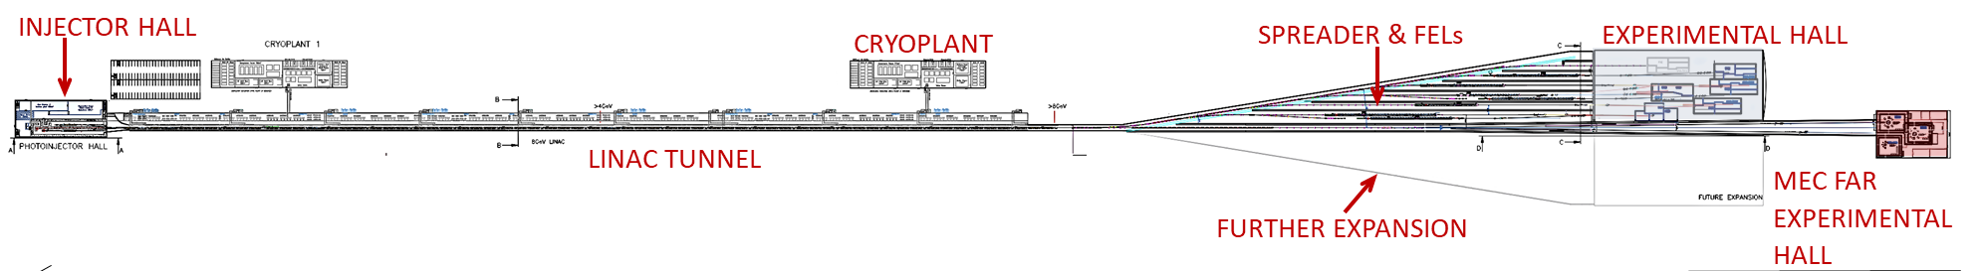
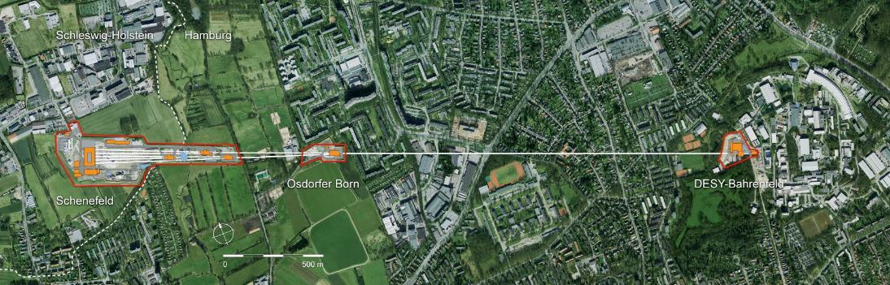
XFEL size in context
XFELs are based on linear accelerators because lasing blows up the energy spread
Fermi Avenue: ~1 km
CLARA: ~100 m, 250 MeV
UK XFEL design: ~1.8 km
SwissFEL: ~750 m
European FEL: ~3.4 km

Slide 7
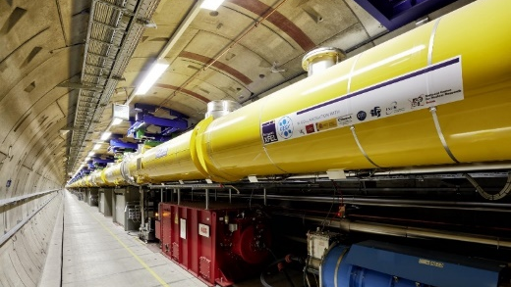
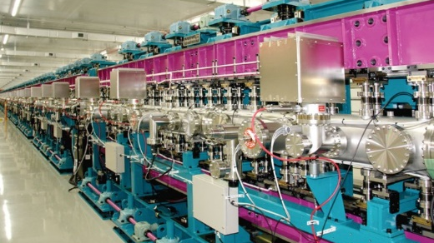
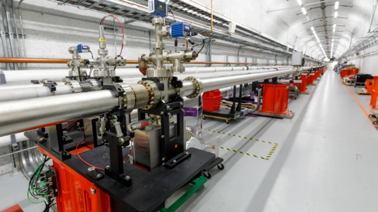

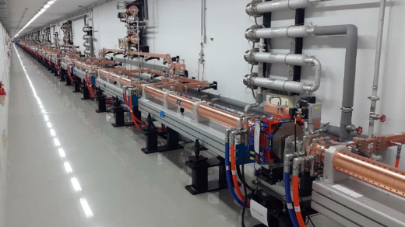
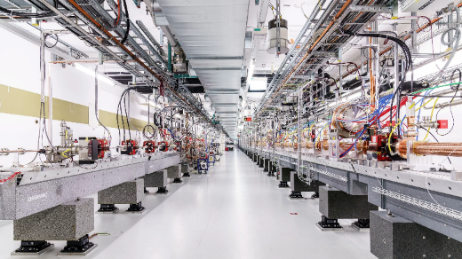
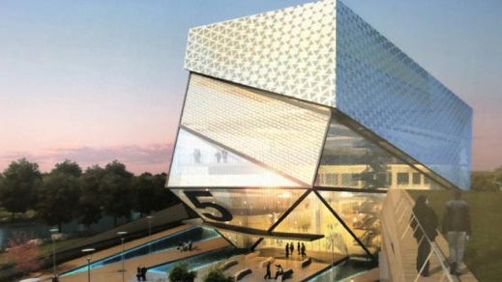
XFELs of the World
European XFEL
PAL XFEL
Normal Conducting and thus low repetition rate (~100 Hz)
LCLS
LCLS-II
(LCLS-II-HE)
Super Conducting and thus high repetition rate (>100 kHz)
SACLA
There are not many XFELs in the world
They have been scientifically pioneering
Yet, they are all constrained in some way, sometimes reusing existing civil and physical infrastructure
Access is very challenging because efficiency is very limited – very few end stations operate at a time
(SHINE)
SwissFEL
Notes:
Despite not having it’s own XFEL the UK has had long involvement in many of the existing facilities, delivering accelerator systems, detectors and inventing novel undulator techniques to many of these first generation machines . There currently ‘six’ major XFEL facilities world wide, all of which are fairly new.

Slide 8
Introduction
Science Case to CDOA
Conceptual Design
Options Analysis
Conclusions and Next Steps

Slide 9
The UK’s XFEL user community
The UK has a very strong XFEL user community: the second largest non-domestic user nation at both Eu-XFEL and LCLS
Non-domestic users of LCLS and Eu XFEL:
LCLS (2024)
Eu XFEL (2023)
Community growth – supported by the XFEL Hubs run by CLF (Physical Sciences) and Diamond (Life Sciences)
Notes:
To give you a sense of scale for the user community in the UK I’ve charted the 2024 data for two of the major facilities, (we have more data coming soon from the others, but it’s a similar story). The UK is the second largest non domestic user at both facilities. With use increasing from 6% in 2018 to 11% in 2024.

Slide 10

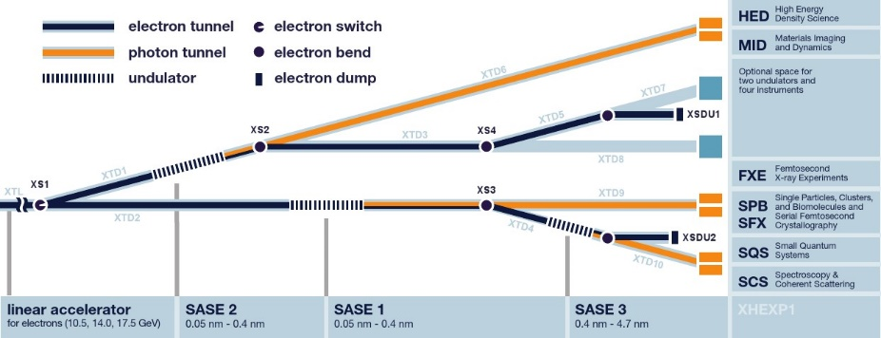
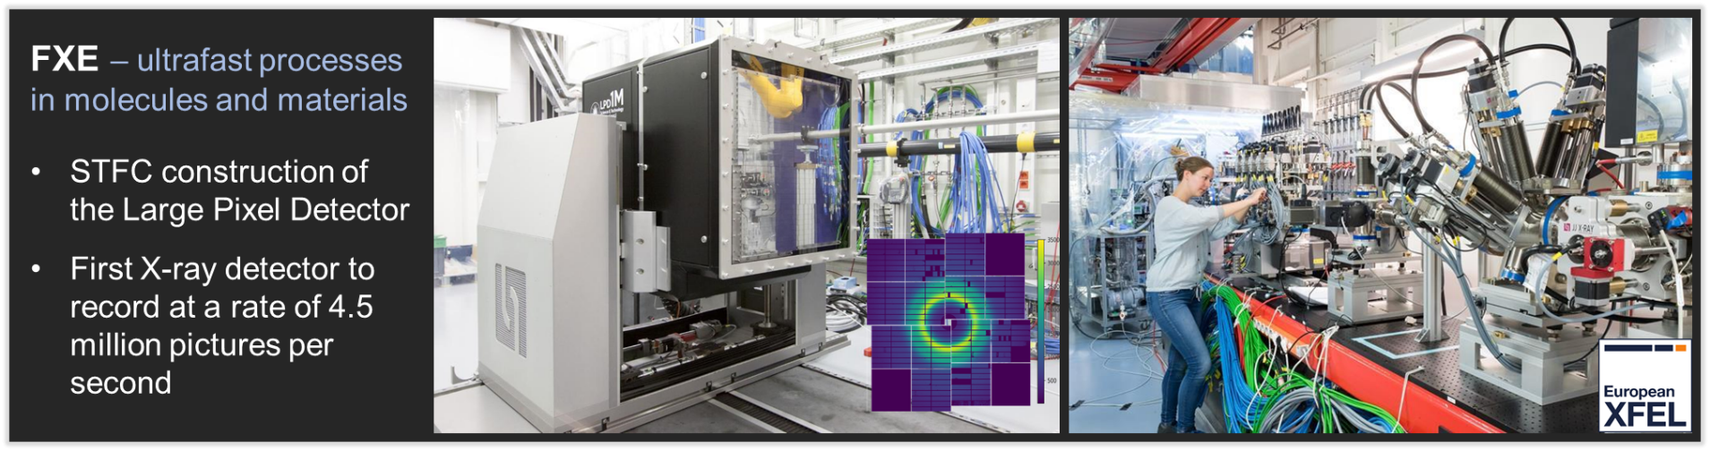
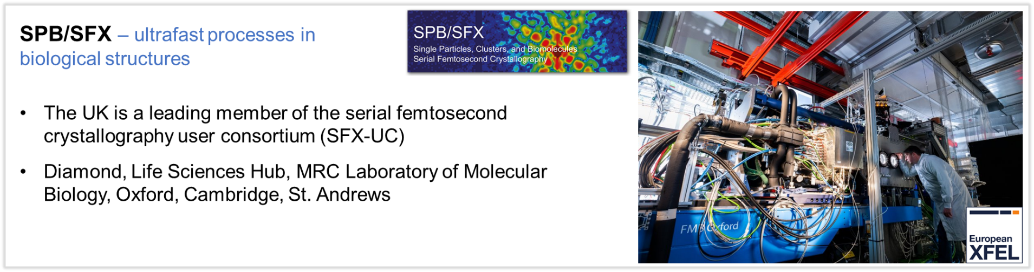
Eu-XFEL
Some key UK activities:

Slide 11

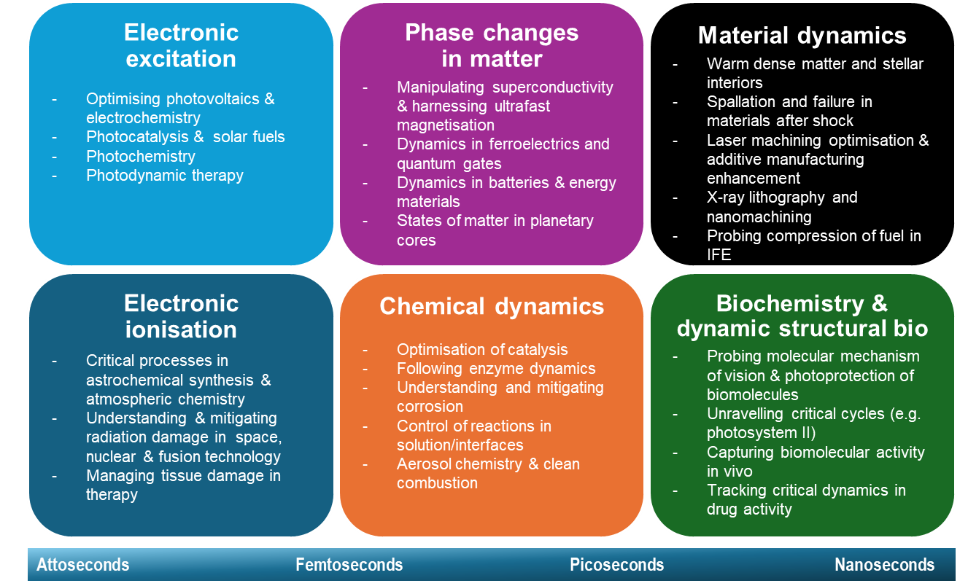
The Science and Technology Case
The UK XFEL Science Case (2019–2020) demonstrated the scientific need for ‘next-generation’ XFEL capability
Presently being updated and expanded to a Science and Technology Case (2022-2025)
Broad scientific case:
XFELs open the door to the ultrafast domain – access to the intrinsic timescales for physical, chemical and biological changes of matter on the timescales of electrons and atoms
Why this matters for society and industry:
Revolutionary x-ray capabilities that impact biotech, batteries, energy and catalysis, defence etc.
Ties into UK government missions: AI, engineering biology, future telecomms, semiconductors, and quantum tech

Slide 12
From Science Case to Conceptual Design and Options Analysis
We are now in a UKRI-funded Conceptual Design and Options Analysis (CDOA) phase (Oct 2022– Oct 2025):
Objectives:
Explore a Conceptual Design for a unique new UK facility, potentially including international partnerships
Examine other investment options at existing XFELs
Hold Town Hall user meetings around the UK to engage the user community
Update the Science Case to inform future decisions
Investigate the socioeconomic impact of a next generation XFEL
To develop a next-generation XFEL conceptual design,
we have assumed a new-build facility at an international scale,
without constraints from location or from upgrading an existing machine.

Slide 13
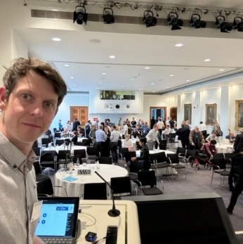
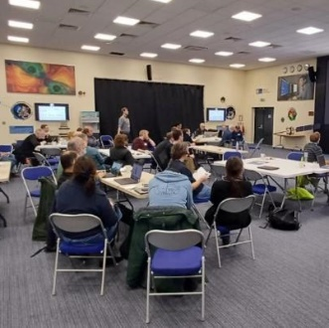

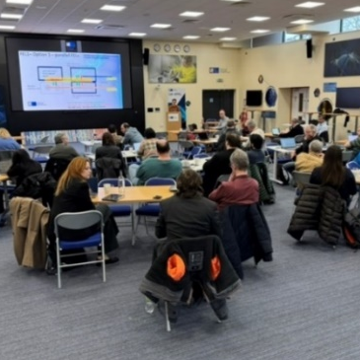
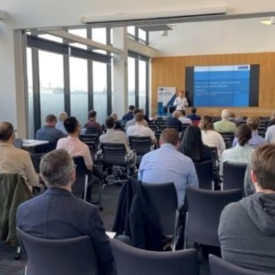
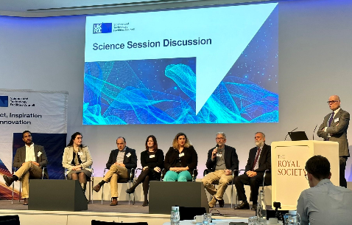
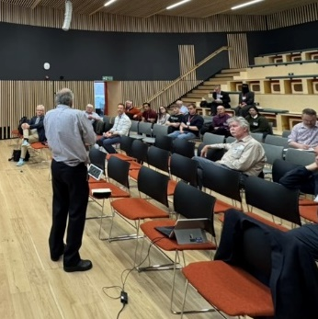
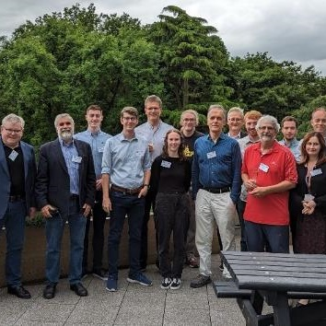

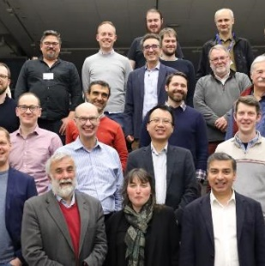
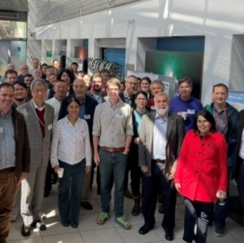


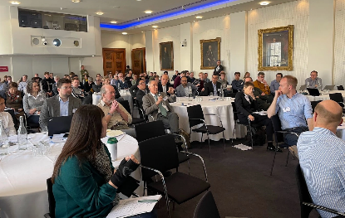




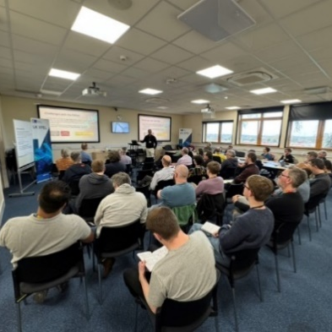
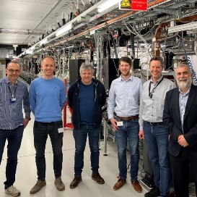
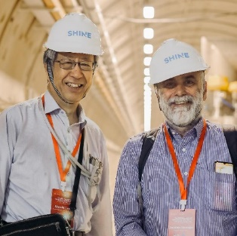
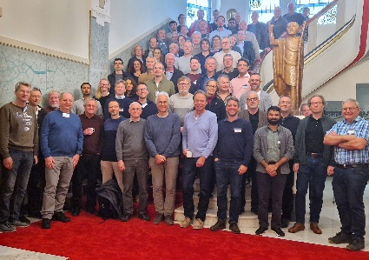
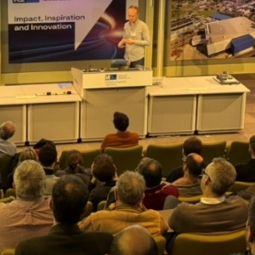
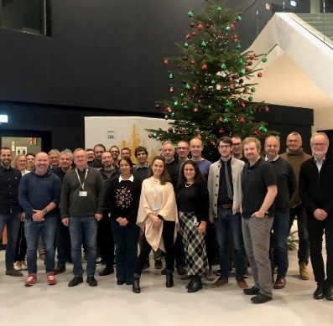
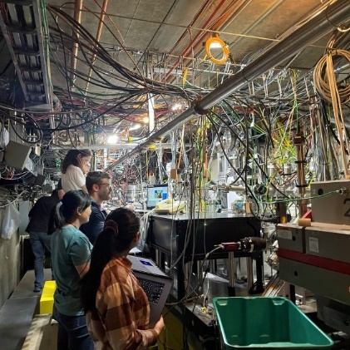
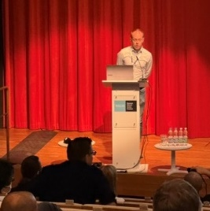
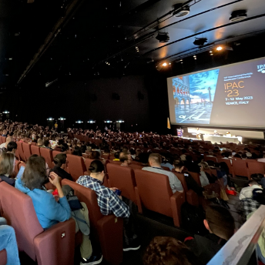
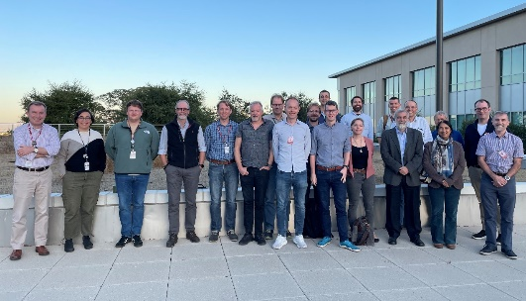
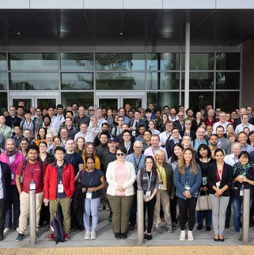
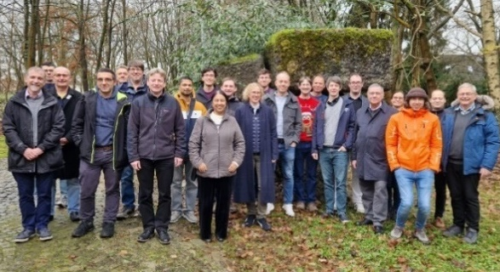
CDOA Timeline
Oct 23
Strathclyde TH
Feb 24
End Station Day
Oct 24
Defence Workshop
Jan 25
2nd End Station Day
User engagement
Jul 24 DLS TH
Jan 24
Plymouth TH
Jan 23
Launch Event
May 23
Ion Beams
WS
Aug 24
Manc TH
Sept 24
Cardiff TH
Jun 23
Belfast TH
Nov 23
Catalysis WS
June 24
Sheffield TH
Aug 24 Manchester TH
…writing up!
2022
2023
2024
2025
Year 1
Project launch event January 2023
Initial conceptual design and layout
Preliminary engagement with overseas XFEL facilities
Survey of the science team, workshops and Town Hall meetings begin
Year 2
Developing the conceptual design
R&D targeting gaps in key physics and technology areas
Collaborative activities and working groups with overseas XFEL facilities
Workshops and Town Hall meetings continue
Year 3
Summary of R&D activities
Preferred options identified, socio-economic analysis
Revision to science case published
CDOA phase completed September 2025
Future Phases
Nov 24
Self Consistent
Design WS
Apr 24 SHINE Visit
Apr 25
SPIE Optics Conf
Dec 22
Eu-XFEL Visit
Mar 23
SwissFEL
Aug 24
FEL 24
Jan 25
RAL Lecture
Facility engagement
Nov 23 LCLS Visit
Oct 24
Eu XFEL workshop
Jan 24
Eu XFEL User Meeting
May 23
IPAC 23
Sep 24 LCLS User Meeting
Dec 24 DESY Visit

Slide 14
Introduction
Science Case to CDOA
Conceptual Design
Options Analysis
Conclusions and Next Steps

Slide 15
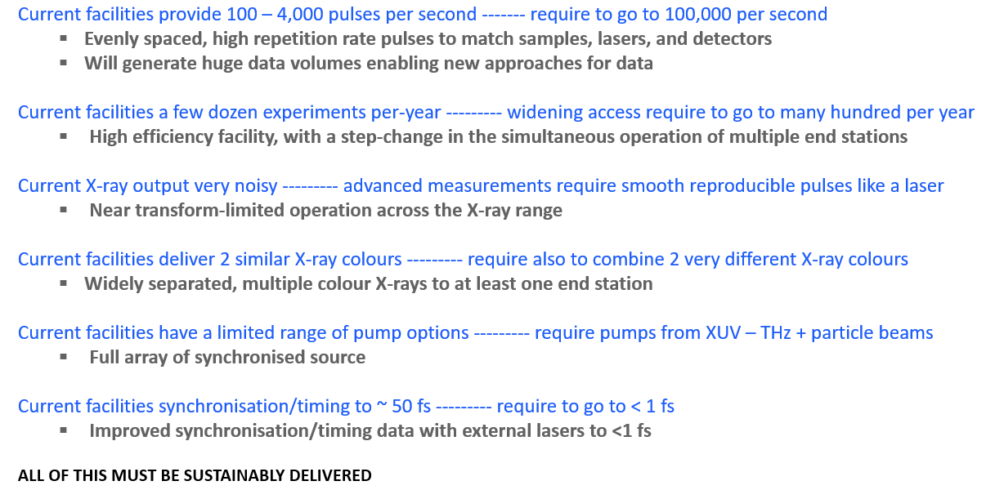
UK XFEL next generation capabilities
The Science Case calls for an ambitious, internationally-competitive machine, with ‘next-generation’ capabilities
Extremely high
pulse rep. rate
+ data and AI
Significantly increased capacity
Enhanced X-ray pulse qualities
A suite of laser-based synchronous sources
Environmentally Sustainable

Slide 16
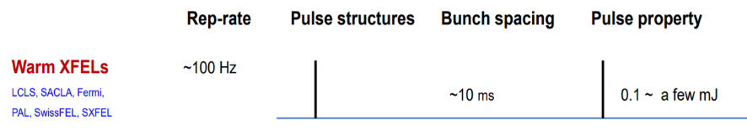






Extremely high pulse repetition rate
XFELs are a relatively new technology, with rapid ongoing development
Pulse repetition rates are increasing by a factor of 10,000 compared to first-generation XFELs (~100 Hz →~1 MHz)
Normal conducting
linacs
~100 Hz
LCLS
PAL
SACLA
SwissFEL
2000
2010
2020
2030
2040
2050
Super-conducting
linacs
Eu-XFEL
SHINE
Specified to reach 1 MHz
SRF linac technology is fundamental to meeting the high rep rate requirements
LCLS-II & -HE
27,000 pulses/s (‘burst mode’)
Adapted from: Outlook to Future XFELs, Dong Wang
Shanghai Advanced Research Institute, Chinese Academy of Sciences and SHINE
IPAC23, Venice, May 12, 2023
https://accelconf.web.cern.ch/ipac2023/pdf/FRXD2_talk.pdf

Slide 17


Top-level
facility design
choices
Acceleration Technology:
User Requirements from the Science Case & Survey
Important to recognise continuous vs bursts
ERLs
The core of the design is an ~8 GeV SRF accelerator at ~1 MHz to allow many simultaneous experiments at ~100 kHz
Max. photon energy strongly influences the required electron beam energy
Repetition rate largely dictates the type of acceleration technology
Always aiming for most efficient way to cover this parameter space
To meet most requirements, requires an ~8 GeV SRF linac
SRF
(CW)
LCLS-II-HE, SHINE, UK XFEL:
~8 GeV SRF CW
Pulses/sec
European XFEL
SRF
(Pulsed)
HRR NC
Physics and X-ray Photonics
Matter in Extreme Conditions
Quantum and Nanomaterials
Chemical Sciences and Energy
Life Sciences
Industry
NC
SACLA, SwissFEL, PAL XFEL
Electron Beam Energy:
~1-1.5 GeV
~2-3 GeV
~6-8 GeV
≥10 GeV

Slide 18




High data rate synergy with AI
Next-generation XFELs operating at MHz are expected to be some of the biggest data-generating machines on the planet
Huge synergistic opportunities for data/AI – from AI-optimised facility operation, to generating data to underpin foundation models
Robotics, Digital Twins etc. to optimise experiment efficiency
https://www.nature.com/articles/s41524-021-00644-z
The CERN computer centre
https://www.nature.com/articles/s41377-023-01233-z

Slide 19


Significantly increasing capacity
Getting access to XFELs is presently very challenging – very few end stations operate at a time compared to e.g. synchrotrons
Partly because synchrotrons (circular) can re-use the same electron bunch while XFELs (linear) can’t
But also because XFELs are a much newer technology (by about 3 decades)
Synchrotrons:
~30 x-ray source points
Present XFELs:
up to ~3 x-ray source points
2
1
3
Increasing capacity is a major opportunity for future XFEL projects

Slide 20
Facility concept
A step change in the simultaneous operation of multiple end stations
The aim is for ~10 FELs in simultaneous operation
Growing international consensus around this direction for superconducting XFELs
~10 FELs independently tuneable in terms of photon energy, pulse duration etc.
+ potential direct uses of electron beam
Kickers to split MHz bunch train to ~100 kHz per line
8GeV Beam Utilisation
FEL 6
FEL 5
Electron bunch properties tailored per FEL
FEL 4
FEL 3
Gun
FEL 5B
Injector 1
FEL 1a
FEL 2
MEC
SCRF 8GeV Linac
Cu Linac
Cu Linac
Injector 2
8GeV
~12 GeV
FEL 1b
FEL 2X
Fixed accelerator energy ~8 GeV, electron bunches at ~1 MHz
FEL 5Bx
FEL 3X
FEL 4X
FEL 5X
FEL 6X
Expansion
Injector
Linac
Spreader
FELs
Photon Transports
Experimental Halls

Slide 21



Facility concept: booster
A low repetition rate booster for extreme cases
The design includes a short booster section to reach ~12-15 GeV for the central two FELs
Some areas of science require extremely high pulse energy/high photon energy at low repetition rate (<200 Hz) – needs higher energy electrons
A high-gradient normal conducting booster is presently the most suitable solution
8GeV Beam Utilisation Expansion
(b) Booster to ~12-15 GeV for higher photon energy/ higher pulse energy at ~200 Hz
FEL 6
Energy boost for higher pulse energy/high photon energy
FEL 5
FEL 4
FEL 3
Gun
FEL 5B
Injector 1
FEL 1a
FEL 2
MEC
SCRF 8GeV Linac
Cu Linac
Injector 2
8GeV
~12 GeV
FEL 1b
FEL 2X
FEL 5Bx
PWFA is integrated from the start: the design includes a dedicated accelerator test line for ongoing R&D to keep pushing the frontiers of the facility’s capability
FEL 3X
FEL 4X
FEL 5X
FEL 6X
See talk from Fahim Habib
Expansion

Slide 22







Key facility design features
A world-class array of independently operable instruments, data handling, AI etc.
We have developed a self-consistent conceptual design that is:
Ambitious and ‘international-scale’, while robust and technically feasible
Highly modular in terms of design and civil engineering
Highly and independently customisable FEL & experimental lines
Specialised undulator features per line for near-TL pulses
A laser facility as well as an accelerator facility: high rep rate and high power/high pulse energy sources
8 GeV fixed energy and modular beam distribution
Makes use of established
SRF linac technology
(with the option to swap in thin-film SRF)
Two VHF-gun-based photo-injectors, with multiple lasers each - for flexibility and redundancy – a key R&D technology
Individually shielded undulator lines for independent operation
See talk from Alex Brynes

Slide 23
Introduction
Science Case to CDOA
Conceptual Design
Options Analysis
Conclusions and Next Steps

Slide 24



Options Analysis
UK XFEL (potential phasing route)
The project is now undertaking the options analysis
Based on strategic, socioeconomic, and environmental sustainability aspects
Comparing:
a UK-based facility (including a potential phased approach)
International ‘next-generation’ options:
  Eu-XFEL upgrades e.g. High duty-cycle, Second fan
  LCLS upgrades e.g. LCLS-X
No additional action
Eu-XFEL second fan indicative layout
LCLS-X schematic layout

Slide 25





Socioeconomic impact study
An initial exploration of how the socio-economic impact of the three broad options under consideration for the future of XFEL might be appraised and evaluated
A UK-based XFEL is expected to have many more impact pathways but risk and cost is reduced with other options

Slide 26




Environmental sustainability
https://arxiv.org/pdf/2501.14979
The balance between construction and operations changes from facility to facility but CO₂ Emissions are expected to be operations dominated
The biggest CO₂ contributors for UK XFEL operations need to be carefully quantified but initial findings suggest that using today’s technologies they will be:
  RF and Cryogenics
  Magnets
  Data handling
  Heating/cooling
  Travel
The impact of all of these have the potential to be reduced significantly
bit.ly/ruedi-sus

Slide 27
Introduction
Science Case to CDOA
Conceptual Design
Options Analysis
Conclusions and Next Steps

Slide 28

Conclusions and next steps
The next generation of XFELs will be the most advanced light sources the world has ever seen
We’ve produced a conceptual design for a next-generation XFEL to meet the Science Case requirements:
  Ambitious ‘international-scale’ scope
  Robust and technically feasible
  Scalable to a range of UK and international investment options
Options analysis and write-up currently in progress
It is a major decision for the UK to set its direction between the options
We are already making a significant contribution to the international XFEL field and expect this to continue

Slide 29


Acknowledgements
Science Team
Facility design and support
Matter in extreme conditions
Andy Higginbotham (York), Andy Comley (AWE), Emma McBride (QUB), Sam Vinko (Oxford), Marco Borghesi (QUB), Malcolm McMahon (Edinburgh), Justin Wark (Oxford)
Nano/Quantum materials
Anna Regoutz (UCL), Marcus Newton (Soton), Ian Robinson (UCL/Brookhaven), Mark Dean (Brookhaven), Shakil Awan (Plymouth), Paolo Raedelli (Oxford), Simon Wall (Aarhus), Sarnjeet Dhesi (Diamond),
Engineering/Materials/Applications
David Rugg (RR), Sven Schroeder (Leeds), David Dye (IC) Dan Eakins (Oxford), Mike Fitzpatrick (Coventry)
Life sciences:
Allen Orville (Diamond), Jasper van Thor (IC), Xiaodong Zhang (IC), Shakil Awan (Plymouth), Adrian Mancuso (Diamond), Tian Geng (Heptares)
Chemical sciences:
Öznur Apsimon, Can Davut, Ben Hounsell, Suzanna Percival, Julian McKenzie, Lee Jones, Louise Cowie, Hywel Owen, Andy Wolski, Andrew Potter, Adam Dixon, Frank Jackson, Joe Crone, Ian Bailey, Peter McIntosh, Alan Wheelhouse Anthony Gilfellon, Aaron Farricker, Anisullah Baig, Fahim Habib, Lily Berman, Alan Mak, Alex Hinton, Brian McNeil, Katie Morrow, Amelia Pollard, Matt King, Alex Aiken, Patrick Sterling, Chris Armstrong, Matthew Veale, Sion Richards, Ben Shepherd, Andrew Vick, James Bourne, Emily Baker, Sonja Scott-Jones, Lynn Caddick, Lauren Hamblett
Julia Weinstein (Sheffield), Russell Minns (Soton), Sofia Diaz-Moreno (Diamond), Alex Baidak (Manchester), Andrew Burnett (Leeds), Tom Penfold (Newcastle), Rebecca Ingle (UCL), Mark Brouard, Claire Vallance (Oxford)
Physical sciences:
Amelle Zair (KCL), Adam Kirrander (Edinburgh), Jason Greenwood (QUB), Jon Marangos (IC), Elaine Seddon (Cockcroft)
+ around 100 additional experts from around the world contributing to Science Case
29

Slide 30




































UK XFEL
Science Team
UK Research Councils & Government
Other XFELs
And Others….
Notes:
Uk-xfel misnomer?

Slide 31

Thank You
Contact: ukxfel@stfc.ac.uk
Notes:
The abstract pattern can be removed or repositioned if required. Be careful to ‘Send to Back’ so that it does not obscure any important information.

Slide 32
Next-Generation XFEL capability – FEL output estimates
High repetition rate (up to ~100 kHz), evenly spaced, transform-limited pulses from ~100 eV – 20 keV
FEL | Tuning | Harmonics | Polarisation | Mode | Technique | Transform Limited Pulse Duration* | Energy per pulse (brackets = with taper) | Nominal Pulse structure | Potential Burst Mode
FEL-6 | ~0.1 – 1.0 keV | Presumably not required (covered by other FELs) | Fully variable polarisation | Seeded | EEHG | 5 – 100 fs | 7 mJ for 100 fs (35 mJ for 100 fs) | High repetition rate, evenly spaced pulses. Up to ~100 kHz per FEL with potential for 200-300 kHz to be assessed | Option to send pulses at 1 MHz to individual lines in bursts up to 100 us to be assessed
FEL-5 | 0.25 – 3.0 keV |  |  | Long pulse | EEHG/HB | 100 fs – 20 fs | 6 – 1 mJ (30 – 5 mJ)
 |  |  |  | Short Pulse | XLEAP | 2 fs – 350 as
FEL-4 | 1.0 – 5.0 keV |  |  | Long Pulse | HB-SASE | 40 fs – 15 fs | 1500 – 300 μJ (7.5 – 1.5 mJ)
 |  |  |  | Short Pulse | XLEAP | 800 as – 275 as
FEL-3 | 3.0 – 13.0 keV | Potential for 3rd harmonic emission with ~1% pulse energy (with appropriate photon transport) |  | Long Pulse | HB-SASE | 20 fs – 10 fs | 500 – 90 μJ (2.5 – 0.5 mJ)
 |  |  |  | Short Pulse | XLEAP | 400 as – 200 as
FEL-2 | 5.0 – 20.0 keV |  |  | Long Pulse | HB-SASE | 16 fs - 12 fs | 300 – 50 μJ (1.5 – 0.25 mJ)
 |  |  |  | Short Pulse | XLEAP | 300 as – 200 as
 |  |  |  | Cavity | XFELO | ~ 100 fs
*For bandwidths, assume time-bandwidth product ~2 × transform-limited, e.g. 1/10/100 fs => ~4/0.4/0.04 eV
Higher pulse energy and higher photon energies (non transform-limited) at up to ~200 Hz or in short bursts
FEL | Tuning | Harmonics | Polarisation | Mode | Technique | Pulse Duration | Energy per pulse | Nominal Pulse structure | Burst Mode
FEL-1a | 5 – 20 keV | Potential for 3rd harmonic emission with ~1% pulse energy | Fully variable polarisation | High Pulse Energy | SASE | ~ 30 fs (not TL) (relative bandwidth ~0.1%) | ~50 mJ at 5 keV | Evenly spaced pulses up to ~200 Hz | ~10 pulses per burst, with >5 ns separation (216.67 MHz). Max. burst length ~1 us (100 ns separation/10 MHz)
FEL-1b | 20 – 45keV |  |  | High Photon Energy |  |  | ~1 mJ at 40 keV

Slide 33


Mapping instruments/end stations to FELs
Photon Energy [keV]
0.05
0.2
0.25
1
2
3
4
5
9
10
13
20
30
40
50
100
EUV
SXR: ~0.2 – 4 keV
HXR: ~4 – 100 keV
AMO (PES/Coincidence) [High data rate, full polarisation control, UV-IR lasers, < 1 fs time tool, option to take full laser power]
TXR: ~2 – 7 keV
End Station Away Day – Updated map
CDI (Forward and Bragg Scattering for HXR) [High performance detectors/ high sample rate]
Attosecond (Streaking/XAS/PES) [High data rate, full bw/high power delivery, liquids/solids/gases with XAS straight through geometry, 1 fs time tool, xray-x-ray modes]
MEC (Diffraction/Spectroscopy/Inelastic scattering) [High energy/power laser, high x-ray pulse energy/sub 20 meV bandwidth, rep-rate set by laser but > 100 Hz should be assumed]
Very HXR scattering for trXRD and trPDF measurements [High rep-rate if possible. trPDF on FEL2 also in 3rd harmonic
HRIXs/XAS (Momentum/energy resolved inelastic scattering, high resolution x-ray absorption/XES) [UV-THz, sub 5fs timing]
tr-SFX (Diffraction/nanocrystals) [High rep sample delivery/High data rate detectors]
Science Team End Station Away Days
(Feb 2024 & Jan 2025)
2-colour (Scattering, spectroscopy, X-ray pump-probe, UV-MIR/THz pump)
SXR/TXR X-ray spectroscopy (with mono/ but short pulse modes without mono but with down-stream spectrometer and/or seeded machine tuning)[High rep-rate]
Scattering + Spectroscopy (XAS/XES + Liquid phase scattering) [Narrow bandwidth x-rays, or pink beam for high tr, full range of synchronised sources UV-MIR/THz, sub 5fs timing]
It is recognised that present levels of demand could call for duplicating some capabilities (e.g. FEL-2) instead of or ahead of implementing others (e.g. FEL-4)
TXR ARPES
SXR ARPES
HAX-PES
FEL-6 (0.05 – 1.0 keV) |  |  |  |  |  |  |  |  | ~100 kHz
 | FEL-5 (0.25 – 3 keV)
 |  | FEL-4 (1 – 5 keV)
 |  |  | FEL-3 (3 – 13 keV)
 |  |  |  | FEL-2 (5 – 20 keV)
 |  |  |  | FEL-1a (5 – 20 keV) |  |  |  |  | ~~100 Hz
 |  |  |  |  |  |  | FEL-1b (20 – 40 keV)
Open ports – for user driven instrumentation in campaign (multiple beam time) mode
Ion/electron pulsed beams for radiolysis measurements by spectroscopy and scattering [need pulsed accelerators + radiation shielding] (this should probably be seen as distinct from MEC and might be done at high rep-rate)
FELs 1-6 sequentially distributed in photon energy:

Slide 34
UK XFEL next generation capabilities from 2020 Science Case
Current facilities provide 100 – 4,000 pulses per second ------- require to go to 100,000 per second
  Evenly spaced, high repetition rate pulses to match samples, lasers, and detectors
  Will generate huge data volumes enabling new approaches for data
Current facilities a few dozen experiments per-year --------- widening access require to go to many hundred per year
  High efficiency facility, with a step-change in the simultaneous operation of multiple end stations
Current X-ray output very noisy --------- advanced measurements require smooth reproducible pulses like a laser
  Near transform-limited operation across the X-ray range
Current facilities deliver 2 similar X-ray colours --------- require also to combine 2 very different X-ray colours
  Widely separated, multiple colour X-rays to at least one end station
Current facilities have a limited range of pump options --------- require pumps from XUV – THz + particle beams
  Full array of synchronised source
Current facilities synchronisation/timing to ~ 50 fs --------- require to go to < 1 fs
  Improved synchronisation/timing data with external lasers to <1 fs
ALL OF THIS MUST BE SUSTAINABLY DELIVERED
Notes:
To replace photo with one of your own. 1) Send the geometric shape overlay to the back – Right-Click > Send to Back > Send to Back. 2) Replace image – use the guides provided to correctly position it. 3) Send your image to the back so that the geometric overlay re-appears over the image. Please remove or amend the image credit if you are using a different image to the one provided.

Slide 35

Sustainability
The UK accelerator community is already very active in developing more sustainable technologies:
  Using permanent magnets instead of electromagnets
  Making use of different superconducting materials and coatings for RF cavities so that they can operate at 4K instead of 2K
  Developing more efficient RF power sources and much faster RF cavity tuners
In addition we are assessing accelerators more broadly in terms of carbon footprint throughout the full project life cycles (many other factors besides accelerator technology: buildings, travel, data centres etc.). This analysis will continue and feed directly into the CDOA project.
Notes:
It is essential that we assess, and optimise where possible, all of the options from a sustainability perspective.
many of which would have a significant positive impact on the power requirements of a new XFEL facility

