Slide 1



Acceleration-Induced Self-Interactions of Ultra-Short Electron Bunches
Ryan J. McGuigan
Supervisor: Prof. Steven P. Jamison

Slide 2
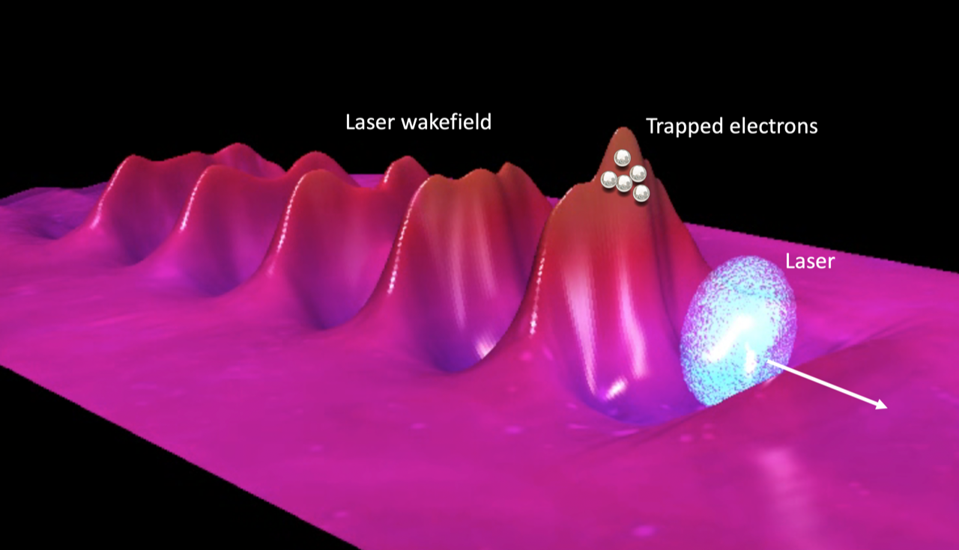

Background
New generation of novel acceleration methods (Plasma Wakefield,THz etc.) utilizing high electric fields ($E_{ext}$=1-100GeV/m)
High performance expectations for novel accelerators
(e.g. Successful demonstration of an FEL requires, low-energy-spread (<0.5%), beams with high charge (>30 pC))
What are the fundamental performance limitations of high-field gradient accelerators?
1
Bunch of electrons accelerated by wake-field of laser propagating through plasma; the basic idea of Laser Wakefield Acceleration (LWFA). (Image credits at end of presentation)
1
Félicie Albert et al, 2020 Roadmap on plasma accelerators, New J. Phys., (2021)

Slide 3
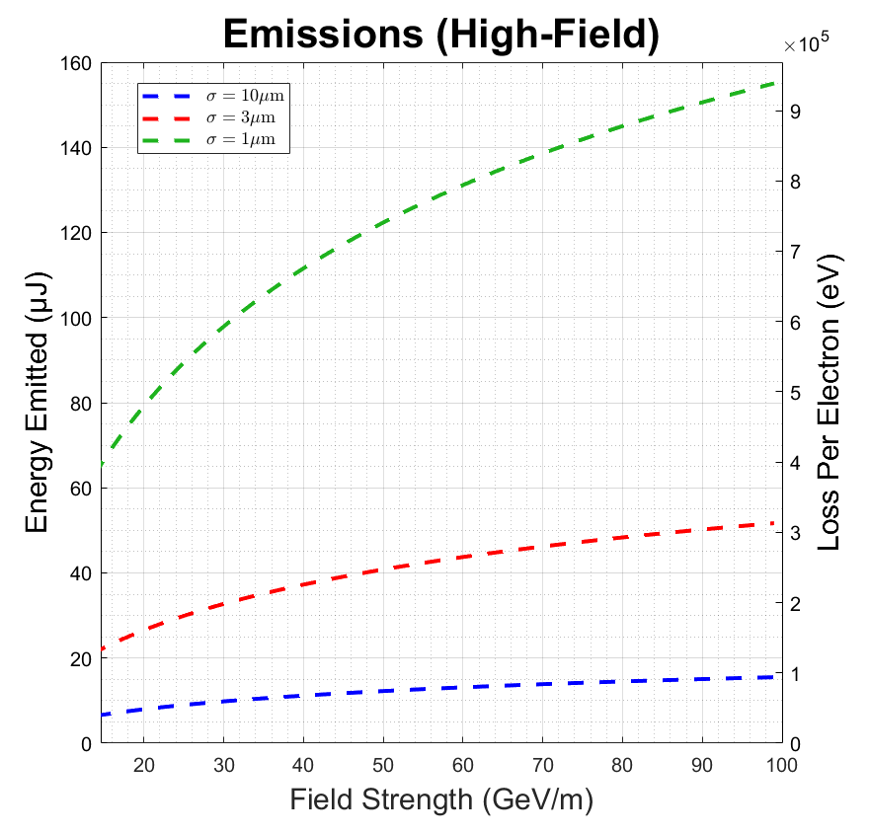


Background
In previous work we demonstrated that compact bunches emit a significant quantity of coherent radiation into the far field e.g. $O(100μJ)$.
Power of coherent radiation scales $N^{2}$
The emission process is understood to be related to the self-interaction of the bunch.
How does an accelerating bunch interact with itself during high-field gradient acceleration processes?
Predicted scaling of losses associated with coherent emission with external acceleration field for different values of bunch length $σ$.
Accelerator length $L=3$cm, $N=6.25×{10}^{8}$

Slide 4
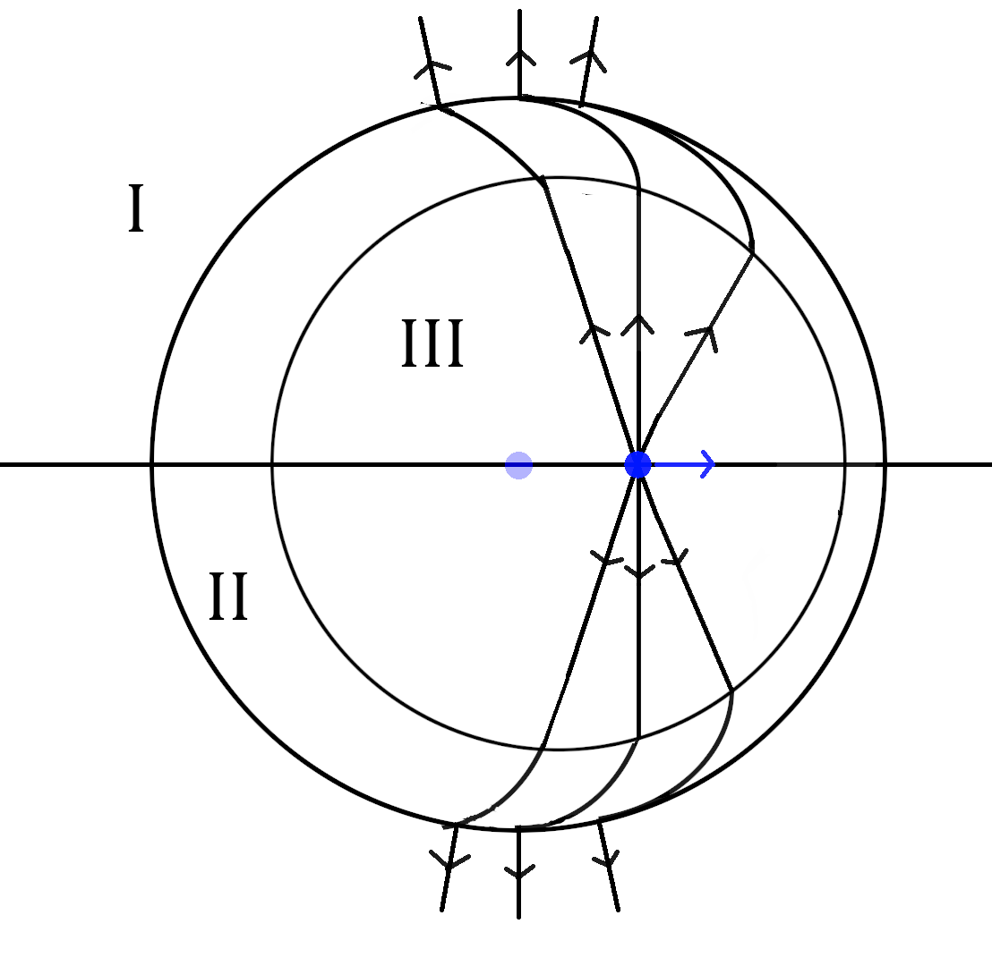
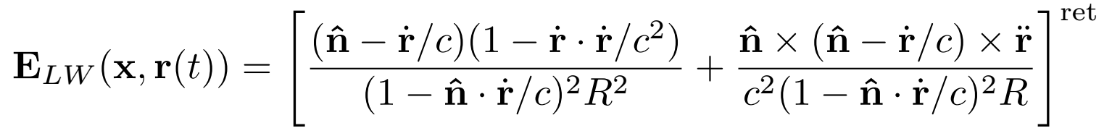
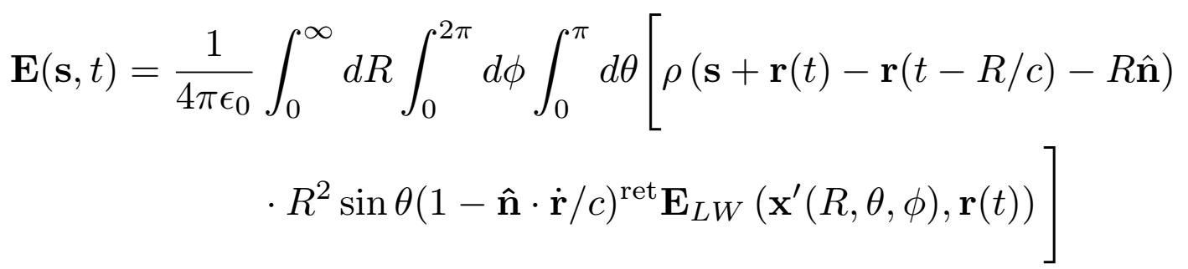

The Lienard Weichert Equations
Fundamental description of the electric field of a point charge with trajectory $r(t)$ is the Lienard-Weichert Field.
These fields appear to arise from a source in the past, ($r(t^{ret})$) .
This is known as retardation.
.
Integrate over the retarded-charge bunch over shells of fixed retarded distance R
Lienard Weichert Fields of point charge accelerated for finite time.
Transparent retarded charge coulomb field observed in region I. Radiation observed in II. Fields of charge at present time observed in III
s is a co-moving coordinate, $\hat{n}$ is a unit vector from source to observer
ρ is charge density, c is the speed of light and $ε_{0}$ is vacuum permittivity

Slide 5
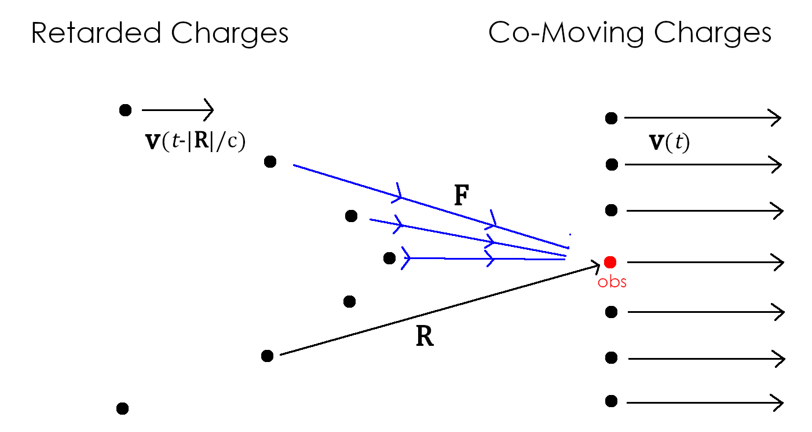
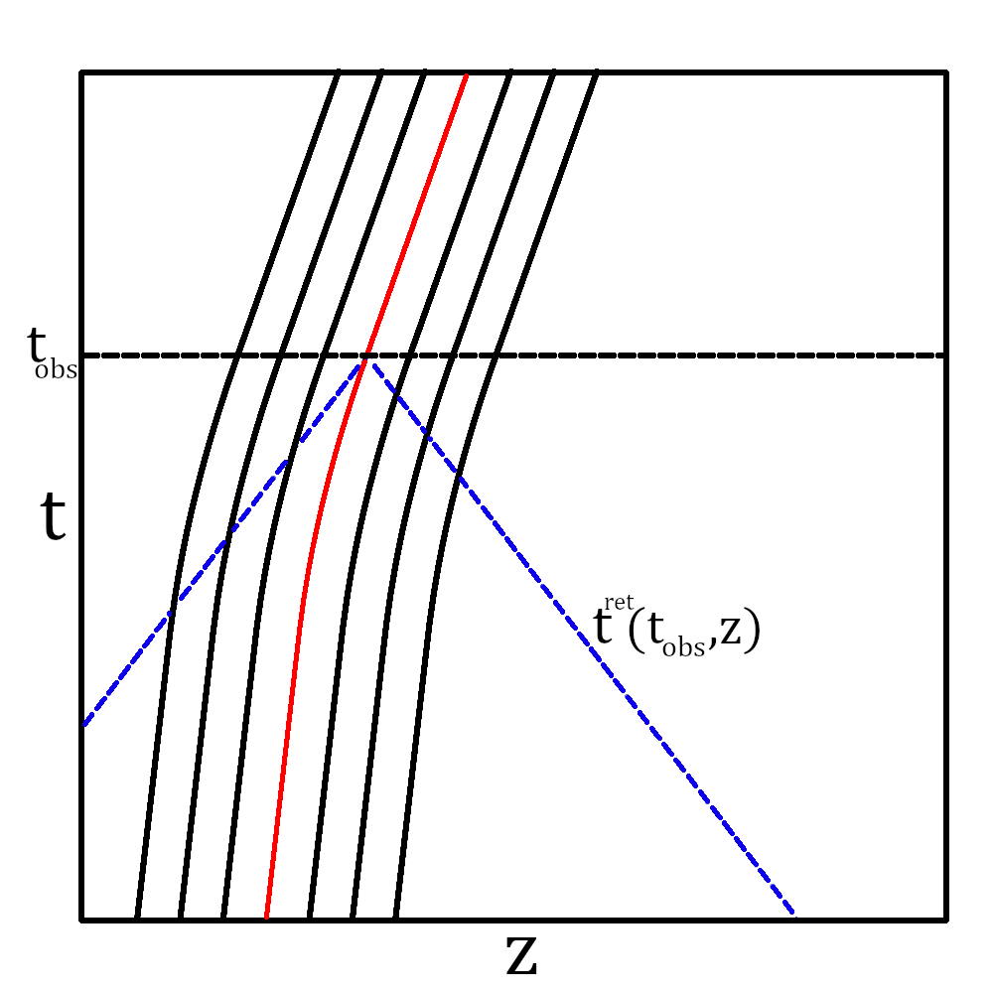

Retardation of a relativistic, accelerated bunch
Retardation property is key to understanding the self-interaction
Space-time diagram of longitudinally off-set charge about a test charge . Retarded time given by reading off intersection of the blue curve with the charged source trajectories trajectories.
Transversely offset charges on the RHS are co-accelerating at the same rate in the same plane. Neighboring charge is observed at an earlier retarded time $t^{ret}=t−|R|/c$, . Test charge in red, forces in blue.

Slide 6
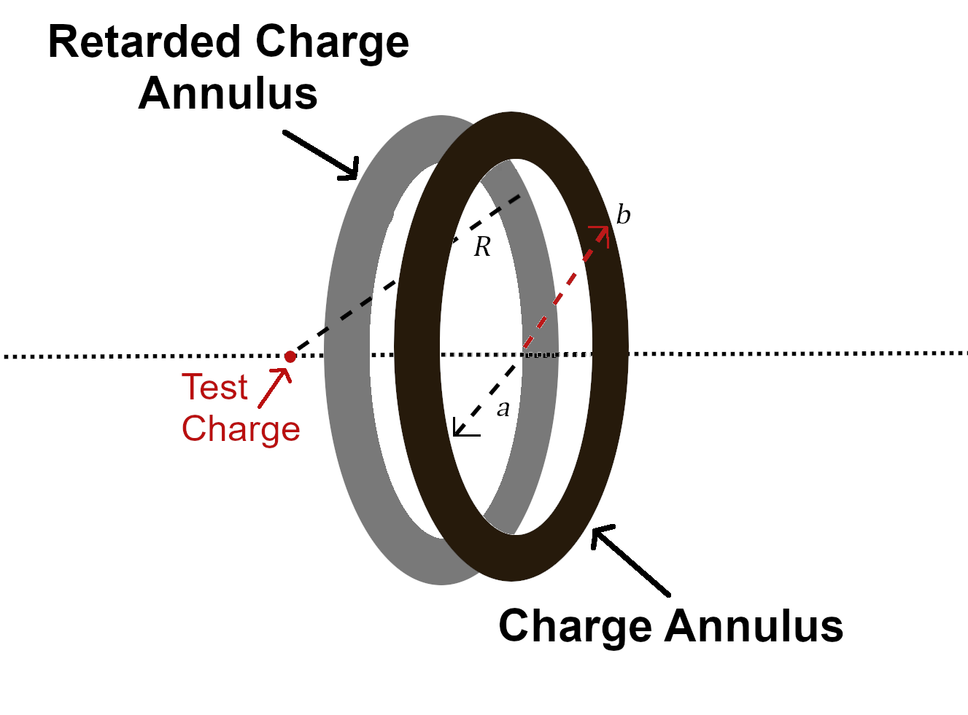
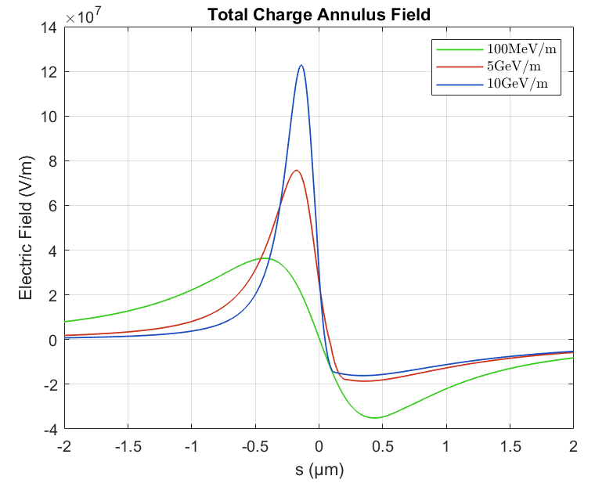

EXAMPLE: Charge annulus
We consider an accelerated charge annulus and a test-charge that can be moved along
the longitudinal axis.
Charge annulus with inner and outer radii a and b.
Figure 7: Electric field for a charge annulus of initial energy 50MeV, a=50 μm b=80μm, surface charge density $3.5×{10}^{−3}$C/$m^{2}$,at time $∆t$ =50ps for different values of acceleration. Field becomes asymmetric at higher field strengths, such that the energy gain is comparable to energy at injection $∆γmc^{2}≳γ_{1}{mc}^{2}$

Slide 7
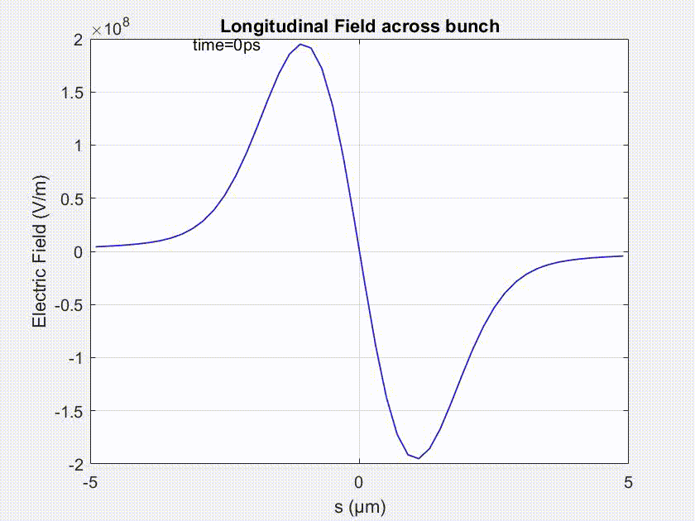
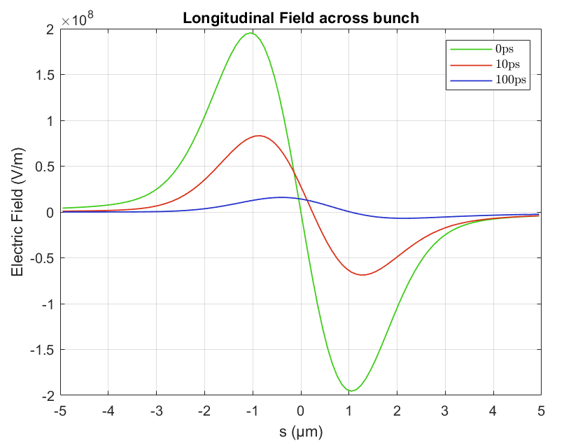


Fields of a Gaussian Bunch
Charge: Q=100pC ($N=6.25×{10}^{8}$)
Bunch Dimensions: $σ_{x,z}=1μm$
External Field: $E_{ext}=20$GeV/m
Accelerator Length: $∆t=100$ps (3cm)
Initial Energy: $γ=100$ (50MeV)
Animation of field evolution
Longitudinal electric field of an accelerated bunch in vacuum up-to 100ps.
Initial symmetric dipole
Asymmetric dipole field for $t>0$
Gradually reduces in magnitude as energy of the bunch increases

Slide 8
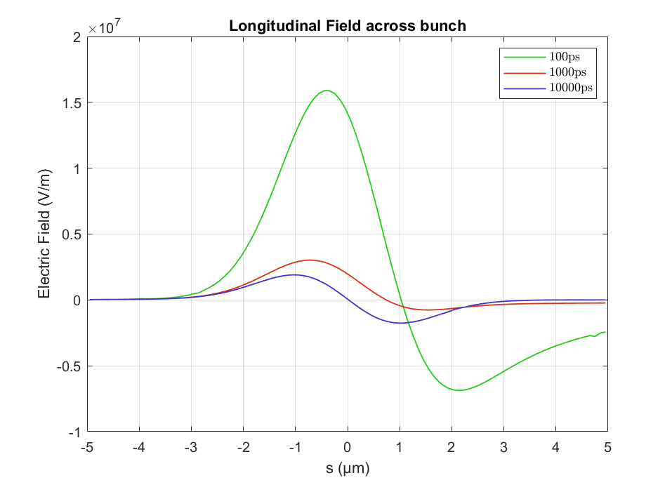

Fields of a Gaussian Bunch (Post-Acceleration)
Even after the acceleration, the induced field continues to propagate up-to the radiation formation length, $2σ_{z}γ_{fin}^{2}$
Remarked upon by Geloni et. al.
We account for additional contributions from the acceleration region
2
Evolution of transient longitudinal field after the acceleration process
2
G. Geloni, E. Saldin, E. Schneidmiller, M. Yurkov, Longitudinal wake field for an electron beam accelerated through an ultrahigh field gradient, Nuc. Instr. and Methods Sec. A:, Vol. 578, Iss. 1, (2007), pgs 34-46,

Slide 9
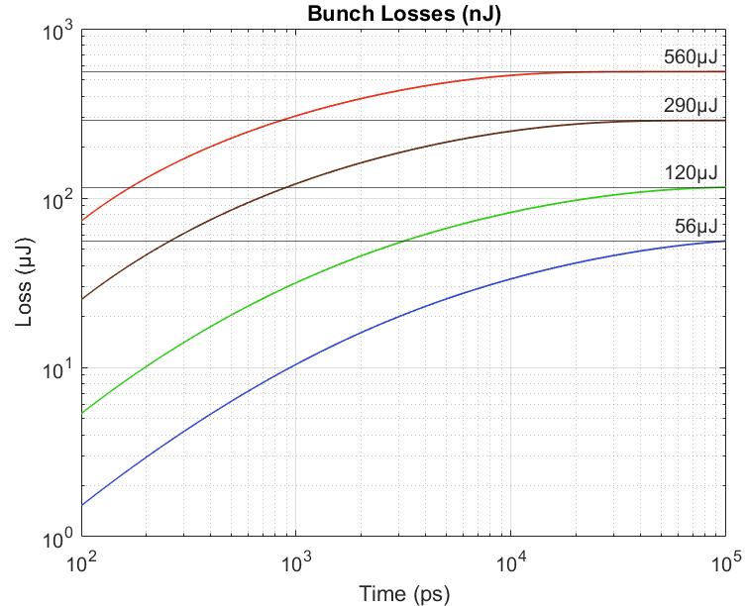
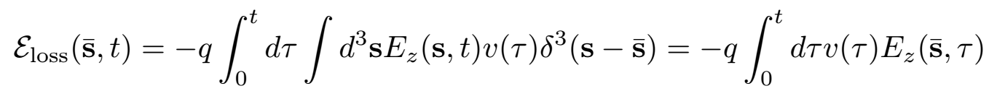
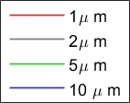
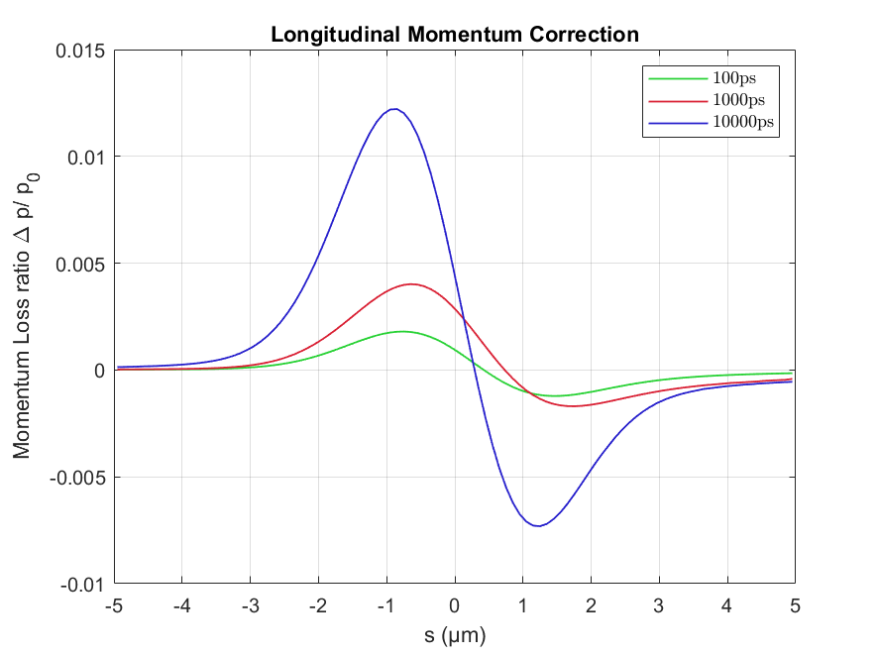


Gaussian Bunch (LOSSES)
Integrate over the fields to obtain the longitudinal chirp
Acceleration induced chirp is asymmetric wrt. to the bunch centroid, with energy spread $O(1\%)$
Losses per electron as a ratio of final energy at different times up to 10ns.
Depending on formation length, losses continue long after acceleration has ceased. However shorter, denser bunches experience dramatically greater losses in less time.
Gain $\sim 60000 μJ$, ~1% energy loss for 1μm
Overall loss scales $\sim {N^{2}}/{σ_{z}}$

Slide 10

Summary
What have we shown
Acceleration induces asymmetric longitudinal self-fields
Self-fields degrade the bunch inducing losses and chirp ($O(1\%)$for $Q=100pC, σ_{z}=1μ$m charge)
Loss scales ~${N^{2}}/{σ_{z}}$
For shorter bunches, field contributions during the acceleration process are increasingly important

Slide 11
Summary
Key Takeaway
This model points to an inherent vacuum beam-loading process that is exacerbated rather than compensated by higher-gradient accelerating fields
LWFA image credits: A. Debus, et. al., “Circumventing the Dephasing and Depletion Limits of Laser-Wakefield Acceleration”, (2019), Phys. Rev. X, Vol. 9, Iss. 3

Slide 12
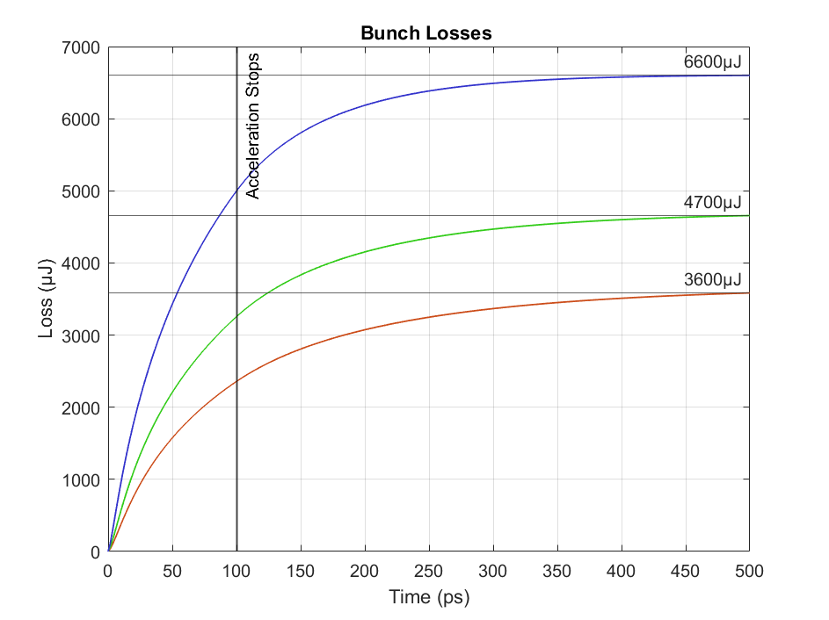

Gaussian Bunch (LOSSES)
A more extreme case for bunches of lengths 0.1μm, 0.075μm, 0.05μm
Increasingly significant bunch losses arise during the acceleration relative to the transients.
For especially short bunches losses approach O($10\%$) of the total energy of the bunch.

Slide 13
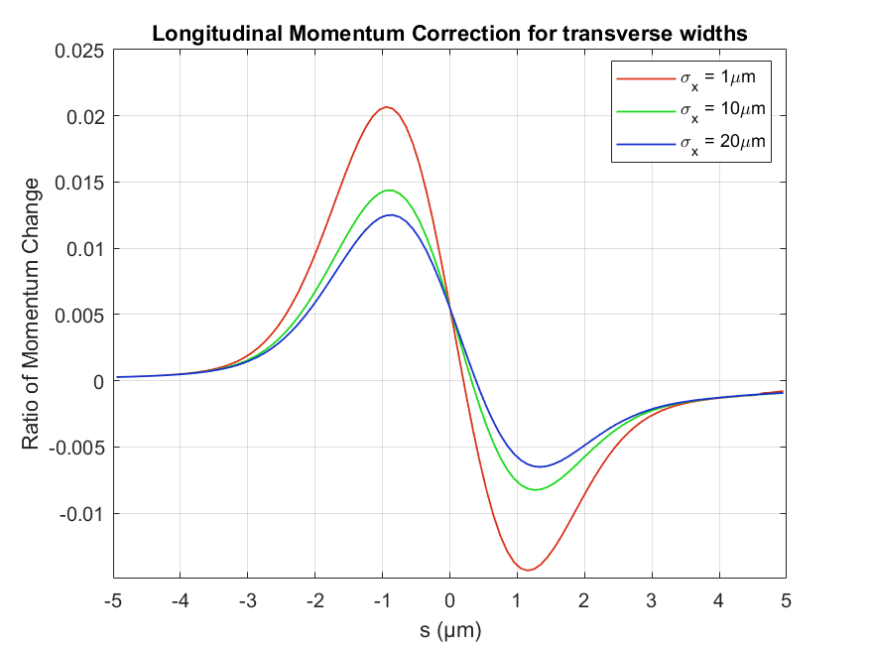
Transverse Scaling
Longitudinal momentum chirp for various transverse bunch lengths
The scaling with the transverse bunch length appears to be quite weak
A bunch only needs to be “compact” in the longitudinal dimension to experience these self-effects.

Slide 14

Retarded fields of a charge distribution
We promote the single-particle LW fields to an integral in the time domain. By exploiting the rigidity of the bunch, we can write the solution for the field about the centre of the bunch ($s=0$)
Where the integral kernel is
Form is convenient for numerical evaluation in the near-field as $1/R$, $1/R^{2}$ infinities have been eliminated!

Slide 15
Gaussian Bunch (LOSSES)
Integrate over the longitudinal fields to
obtain individual electron losses
Charge at the back and center loses energy whilst charge at the front gains energy due to space-charge.
Asymmetric dispersion reflects asymmetry in the fields, with net loss in energy overall. Peak losses exceed 1% of total energy.
Figure11: Losses per electron as a ratio of final energy at different times up to 1ns.

Slide 16
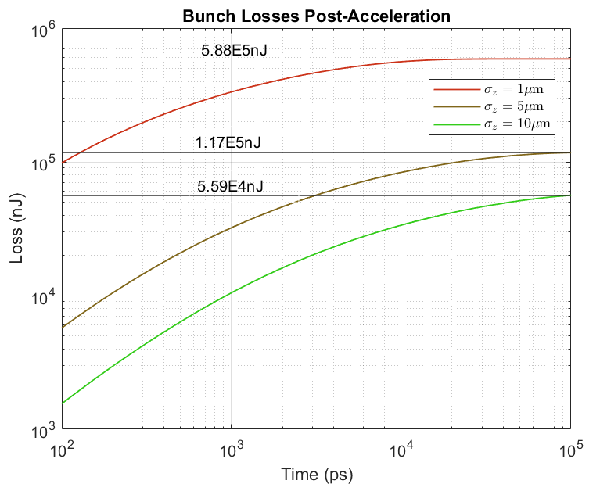
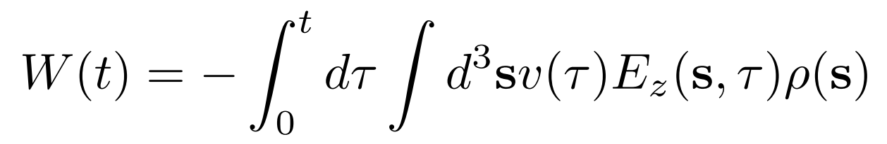


Example: Gaussian Bunch (TOTAL LOSSES)
Integrate over the bunch to find the total losses
Varies as $N^{2}$, same as coherent radiation losses
Depending on formation length, losses continue long after acceleration has ceased
However shorter, denser bunches experience dramatically greater losses in less time.
(corresponds to shorter and more energetic
radiation pulse)
Figure12: Total bunch losses after acceleration has finished for various bunch lengths.
Gain ~$6.5×{10}^{7}$nJ, $\sim 1\%$ energy loss for $1μ$m

Slide 17
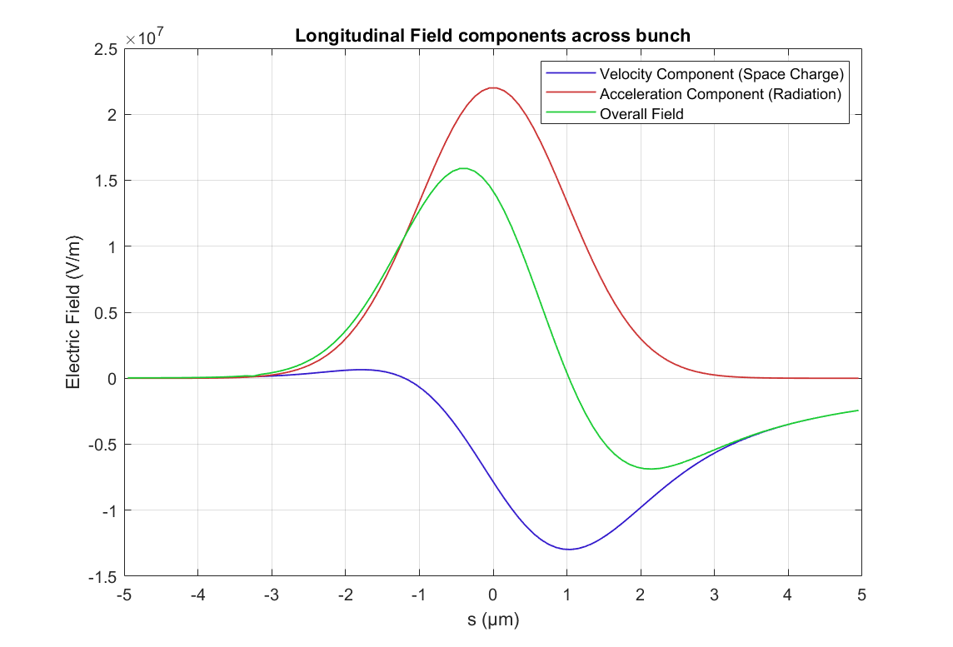
Fields of a Gaussian Bunch
Contributions from the Velocity term and the Acceleration term to the overall field.
The velocity term is dominated by space-charge fields from charge behind the observer, which does not appear to accelerate.
The negative field is compensated for by the positive acceleration field.

Slide 18
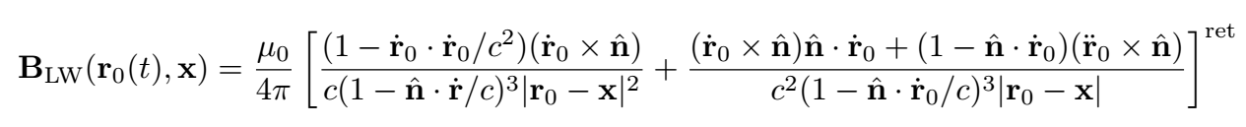

The Lienard Weichert Equations
Fields of a point charge moving with a trajectory $r_{0}(t)$ described by the “Lienard Weichert Fields”
The fields are retarded; they appear to emanate from a charge source at a previous or “retarded” time, $t^{ret}$
LW fields composed of velocity term and acceleration dependent term.
Lienard Weichert Fields of point charge accelerated for finite time.
Transparent retarded charge coulomb field observed in region I. Radiation observed in II. Fields of charge at present time observed in III
$x$, observer position, $\hat{n}$ unit vector from charge to observer

Slide 19
REFERENCES
[1] Félicie Albert et al, (2020) roadmap on plasma accelerators, 2021 New J. Phys. 23 031101
[2] R.J. McGuigan, S.P. Jamison, Coherent Radiation Of Ultra-Short Bunches from Linear Acceleration Processes (unpublished)
[3] Zangwill, A. (2012). Modern Electrodynamics. Cambridge: Cambridge University Press.
[4] Gianluca Geloni, et. al. (2007), Longitudinal wake field for an electron beam accelerated through an ultrahigh field gradient, Nuc. Instr. Research Sec. A, Vol. 578, Iss. 1,Pg. 34-46,

Slide 20
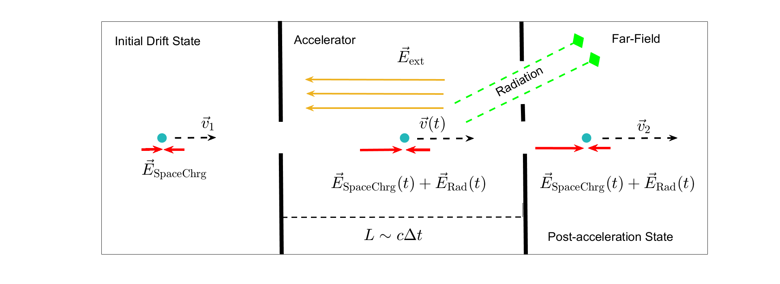

Model
Relativistic, “compact” electron bunch (longitudinal/transverse length scales ($σ_{z,x}<1$μm)
Constant field $E_{ext}$ is applied for a finite duration $∆t$; acceleration across a distance $L$
Acceleration of radiating charge (fields view)

Slide 21
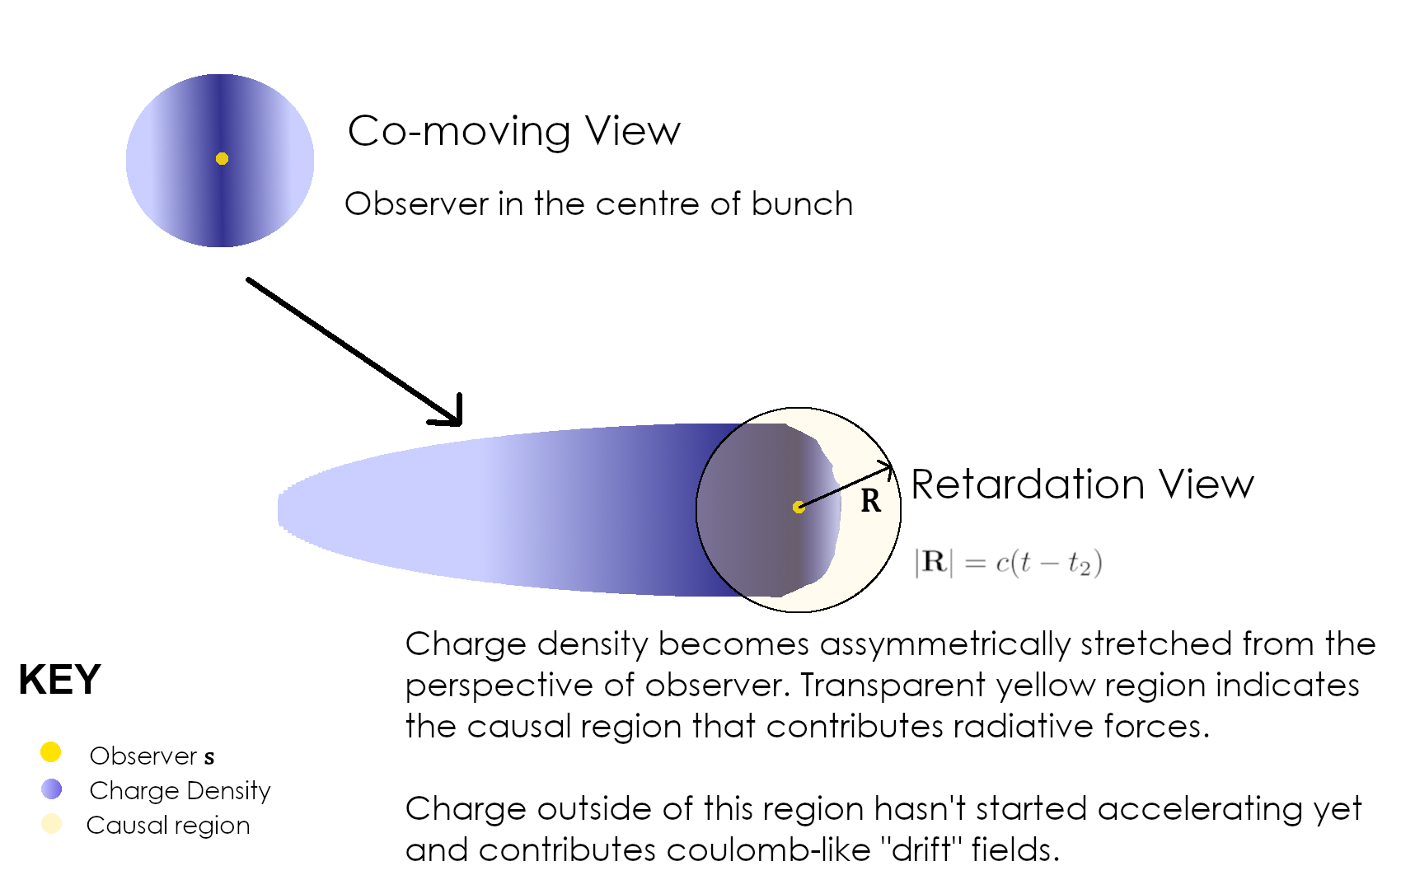
Retardation of a relativistic, accelerated bunch
Due to lack of simultaneity, a test charge observes surrounding charge in different phases of motion.
The back of the bunch appears to lag behind, whereas charge closer to the observer appears to radiate

Slide 22
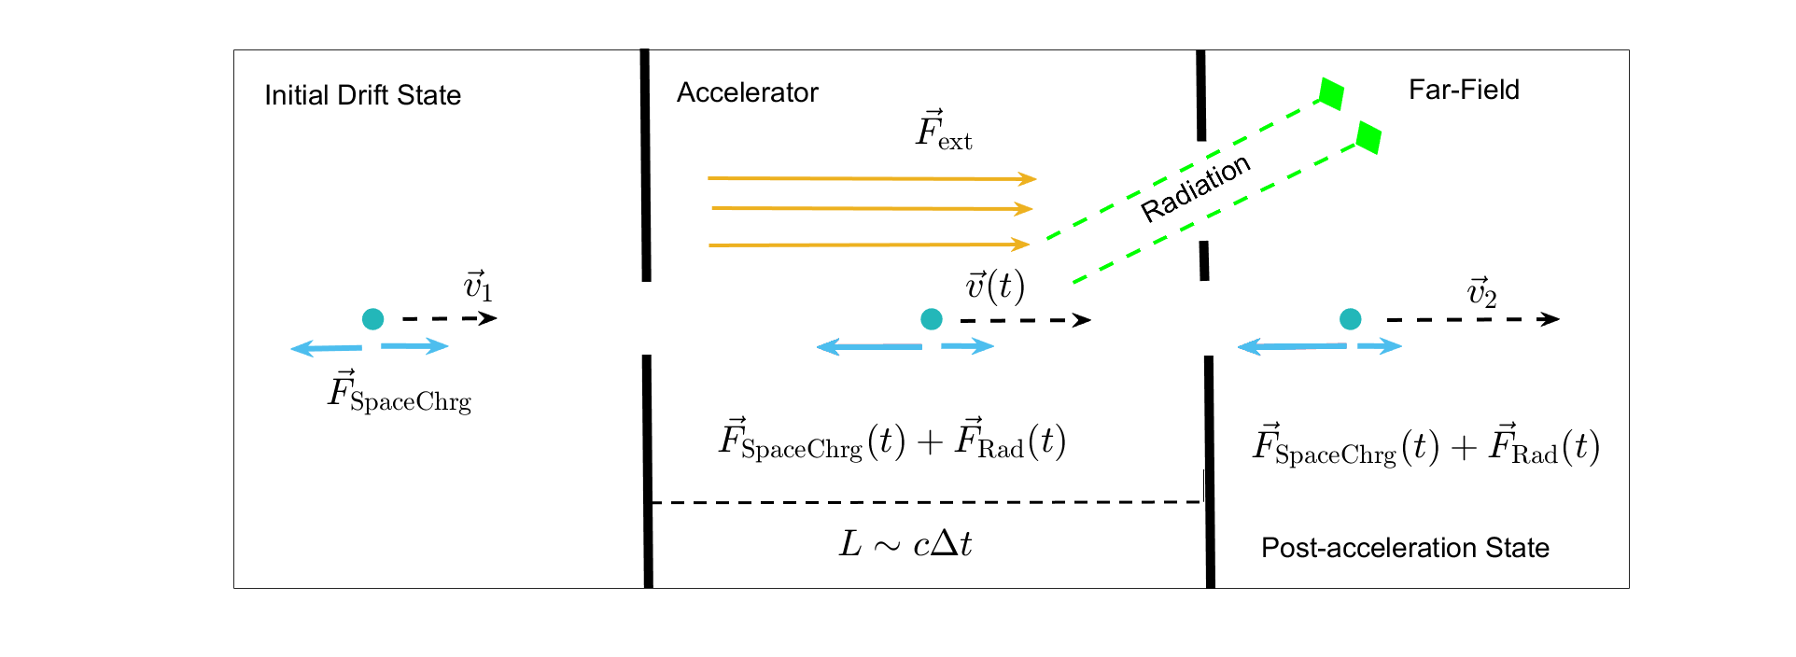
Model
Relativistic, “compact” electron bunch (longitudinal/transverse length scales ($σ_{z,x}<1$μm)
Constant field $E_{ext}$ is applied for a finite duration $∆t$; acceleration across a distance $L$
Acceleration of radiating charge (forces view)

