Slide 1

Proton beam divergence measurements from radiation pressure driven shock acceleration
Ginevra Casati, Nicholas Dover, Oliver Ettlinger, Charlotte Palmer, Igor Pogorelsky, Mikhael Polyanskiy, Zulfikar Najmudin.

Slide 2
Overview
Laser driven ion sources and collisionless shock acceleration
Previous work and main results
Importance of divergence measurement
Experimental set-up
Divergence data and analysis
Further work and Conclusions
2

Slide 3
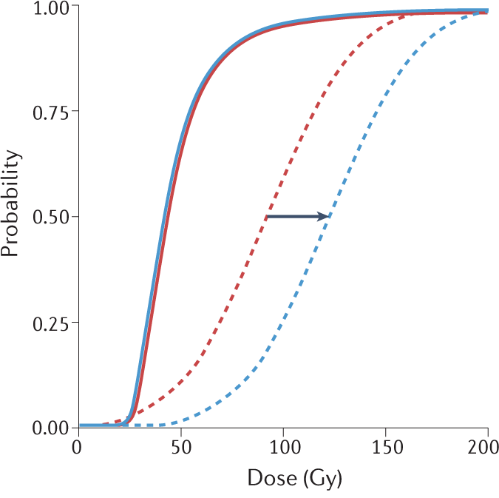
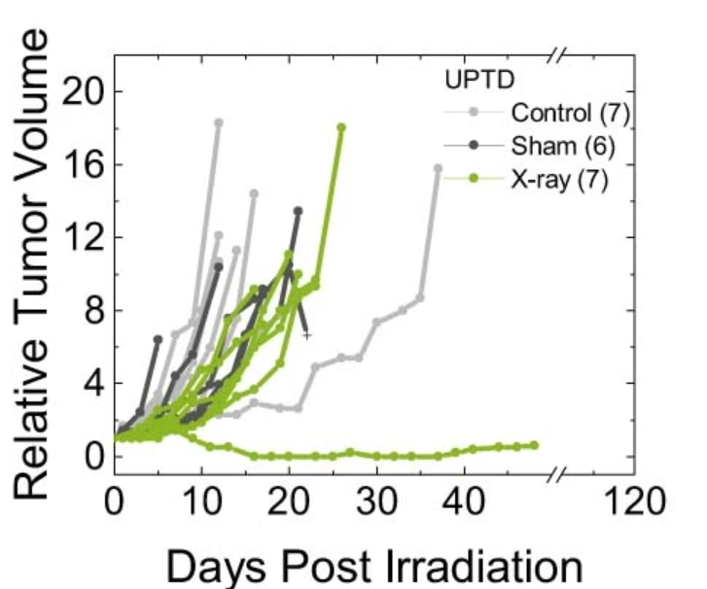
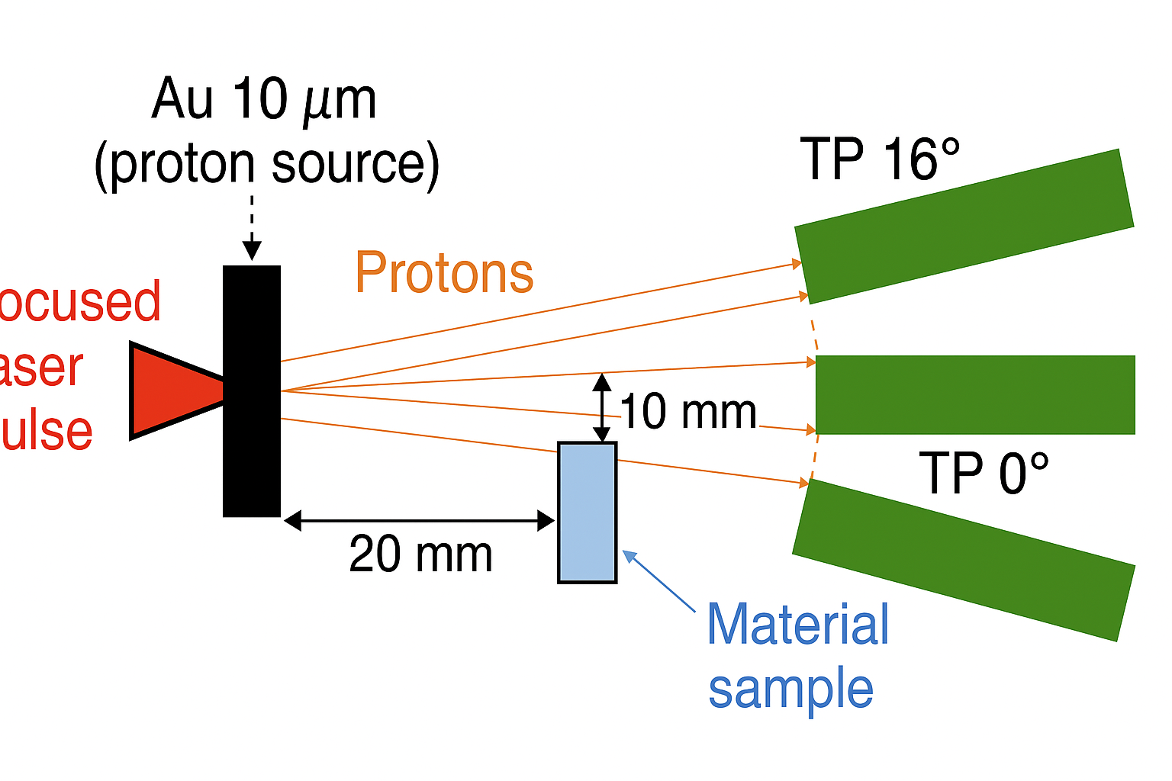


Why laser driven ion acceleration ?
Laser driven ion sources:
compact sources
high energy ions – above 100MeV
high peak currents
Low emittance
Short ion beams - ps to ns
high divergence beams ~${10}^{°}−$ ${20}^{°}$
Desirable characteristics for radiobiological and material sciences applications
Flash Irradiation therapy [1]
Stress testing of materials [2]
NTCP
w or w/ FLASH
3

Slide 4

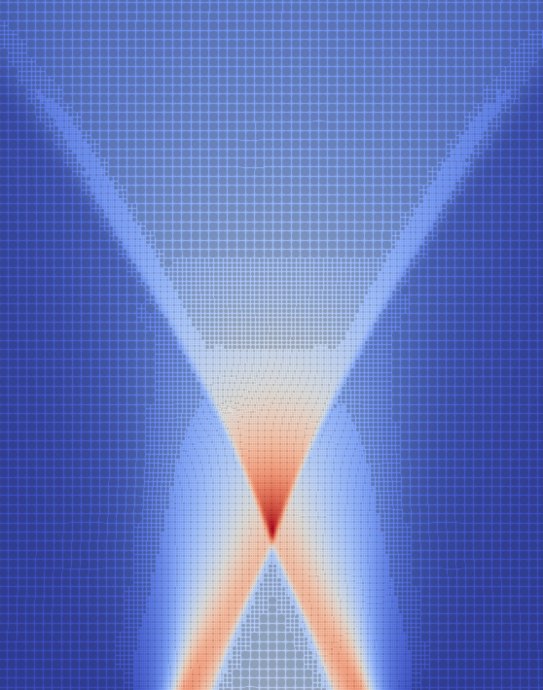
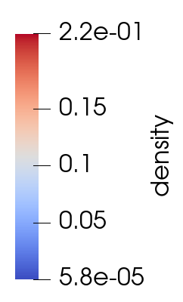

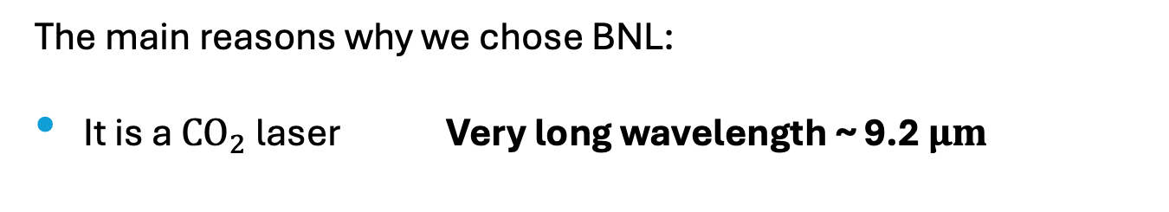

Why we chose the BNL ATF
The main reasons why we chose BNL:
It is a ${CO}_{2}$ laser Very long wavelength ~ 9.2 $μm$
This has several implications:
the a0 of the laser scales favorably as: ${ a}_{0}=\frac{E_{0}e \text{λ}}{m_{e}c}$
the critical density is 100 times lower than for Ti-sapph lasers: ${ n}_{c}=\frac{m_{e}ε_{0}}{e^{2}{\text{λ}}^{2}}$
Hence gas targets can be used and still be in the critical density regime !
Gas targets are important because:
they can produce pure beams, in particular the medical field wants pure He beams,
they don’t generate debris,
And they can operate at high rep rates
4

Slide 5
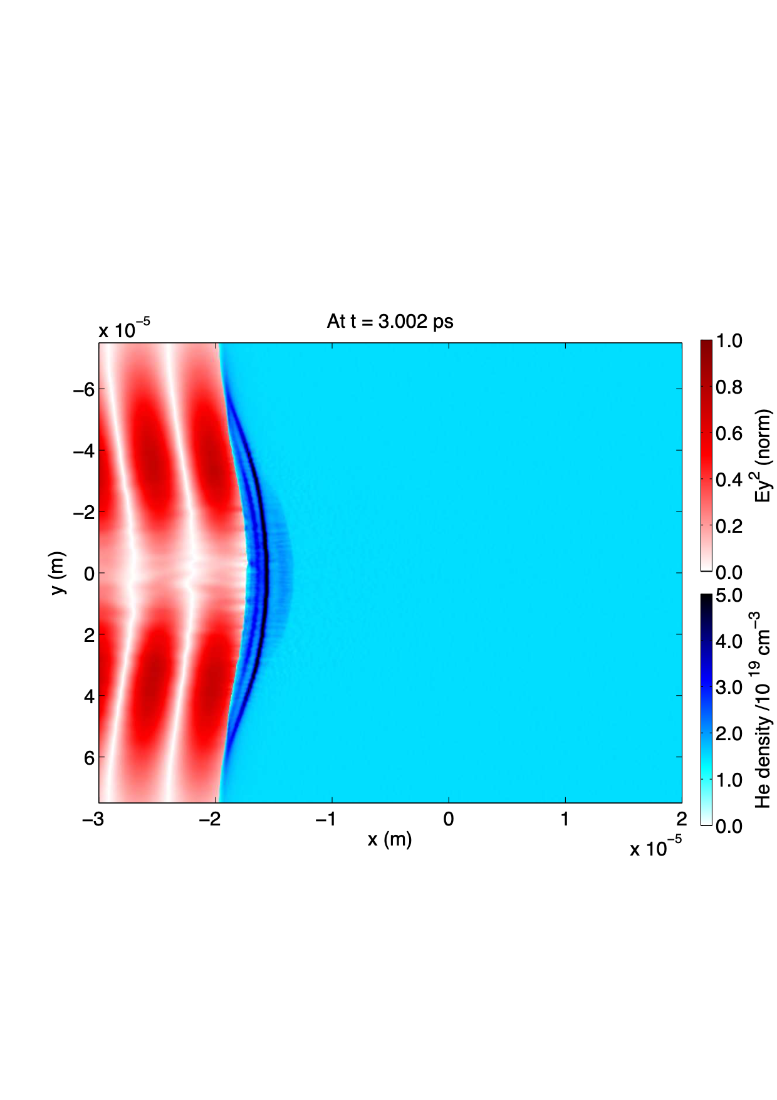
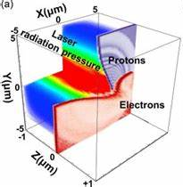
Collisionless shock acceleration
Radiation Pressure Acc. (RPA)
Vacuum
Opaque plasma
Very high intensities are required. In this regime a collisionless shock can arise.
Electrostatic shock front
Shock velocity
vs = Mcs
Ions’ velocity
vi = 2vs
Mono energetic ions great for medical applications!
5

Slide 6
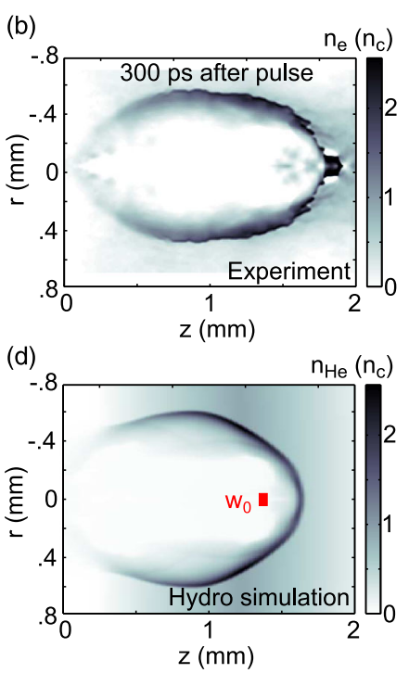
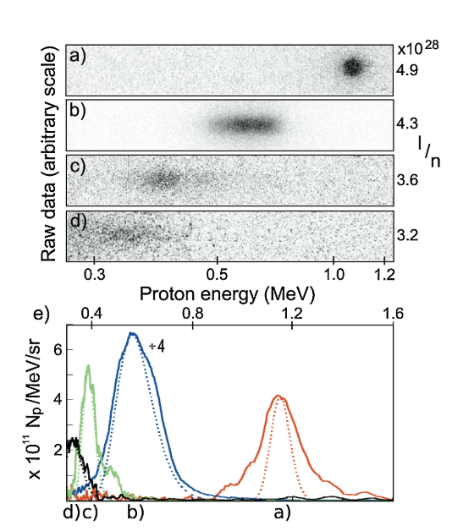
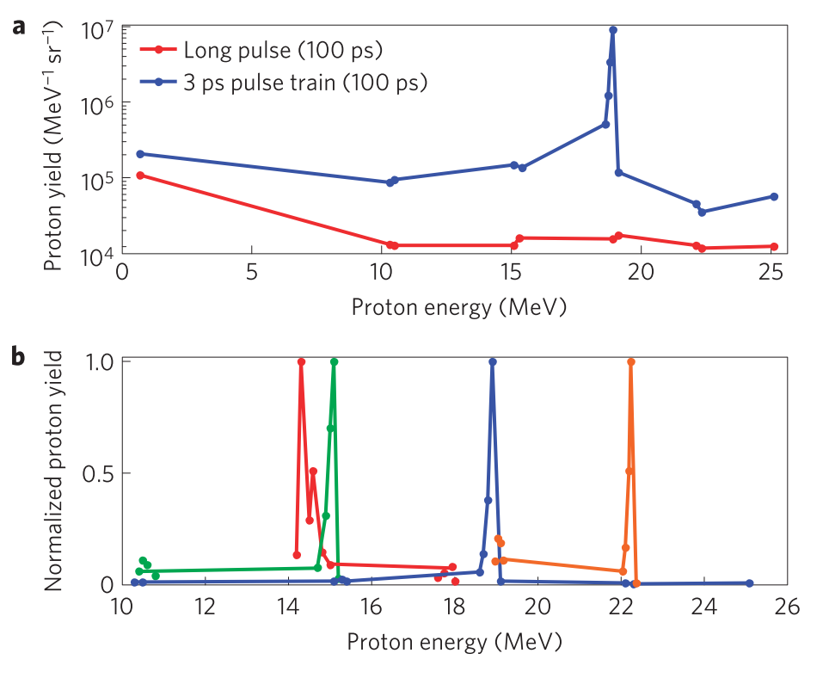
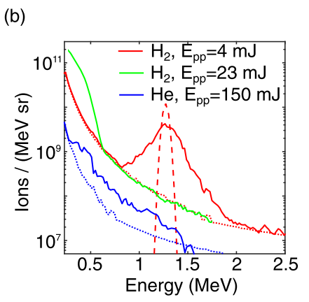
Previous work on CSA
Palmer+, Phys. Rev. Lett. 106, 014801 (2011)
Haberberger+, Nat. Phys. 8, 95 (2012)
First two major results in CSA: First monoenergetic ions (Palmer+) and monoenrgetic ions exceeding 20MeV (Haberberger+)
Dover+, J. Plasma Phys. 82, 415820101 (2016)
Tresca+, Phys. Rev. Lett. 115, 094802 (2015)
6

Slide 7
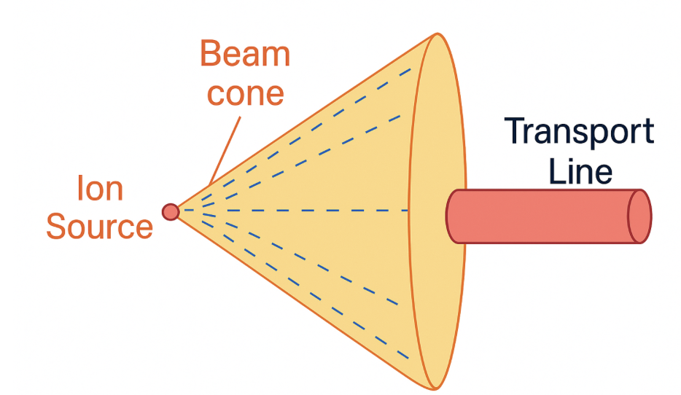
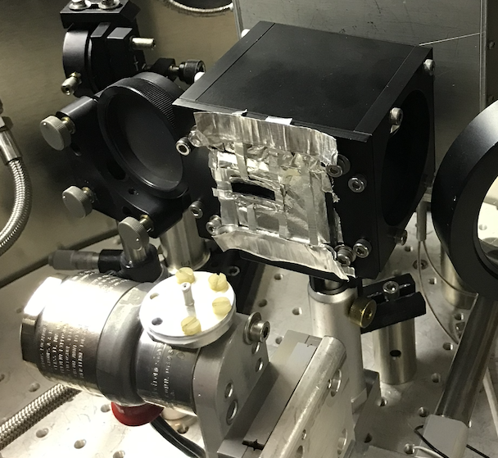
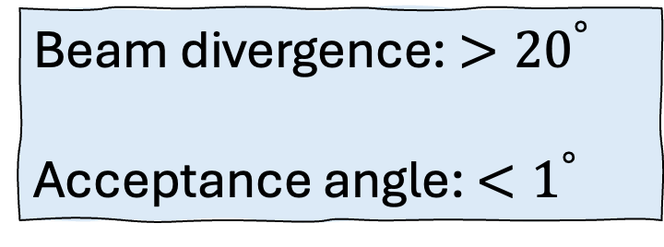
Divergence and transport lines
Beam divergence: ${>20}^{°}$
Acceptance angle: ${<1}^{°}$
Transport line
The first step to improve the divergence is measuring it in a reliable way.
Nick designed a novel proton spatial diagnostic
7

Slide 8
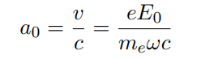
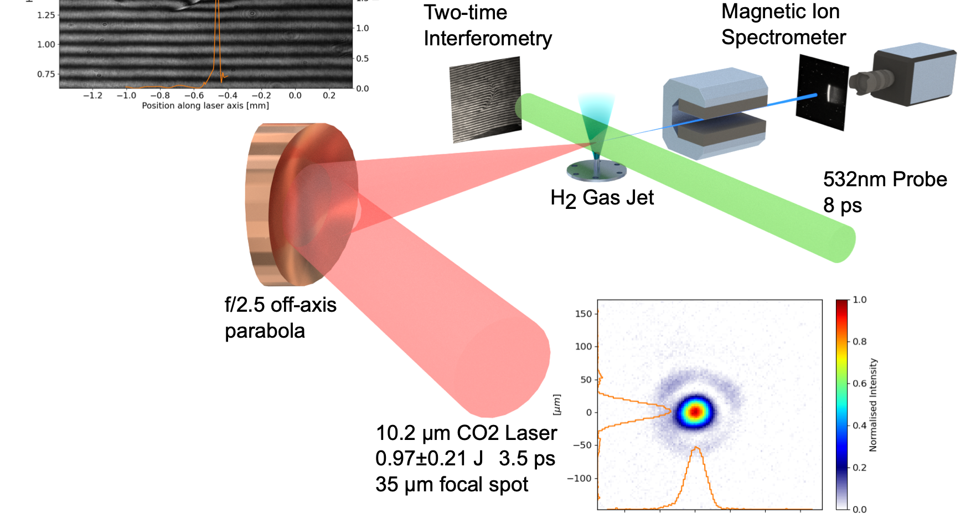
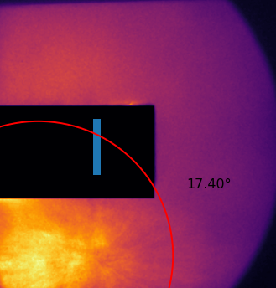
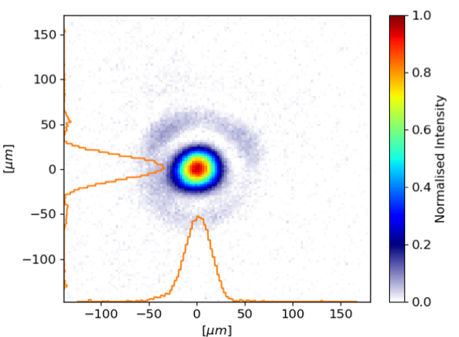

BNL ${CO}_{2}$ laser facility
Favorable scaling:
CO2 laser:
~ 9.2 μm wavelength
~ 3 ps pulse length
~ 5J Energy on target
~ 25 μm focal spot size
~ 9$∙{10}^{21}$ W/$m^{2}$
~ 5.4 $a_{0}$
Ti-Saph
100fs
f/1
Proton Spatial
Scintillator
Credits to Nick
8

Slide 9
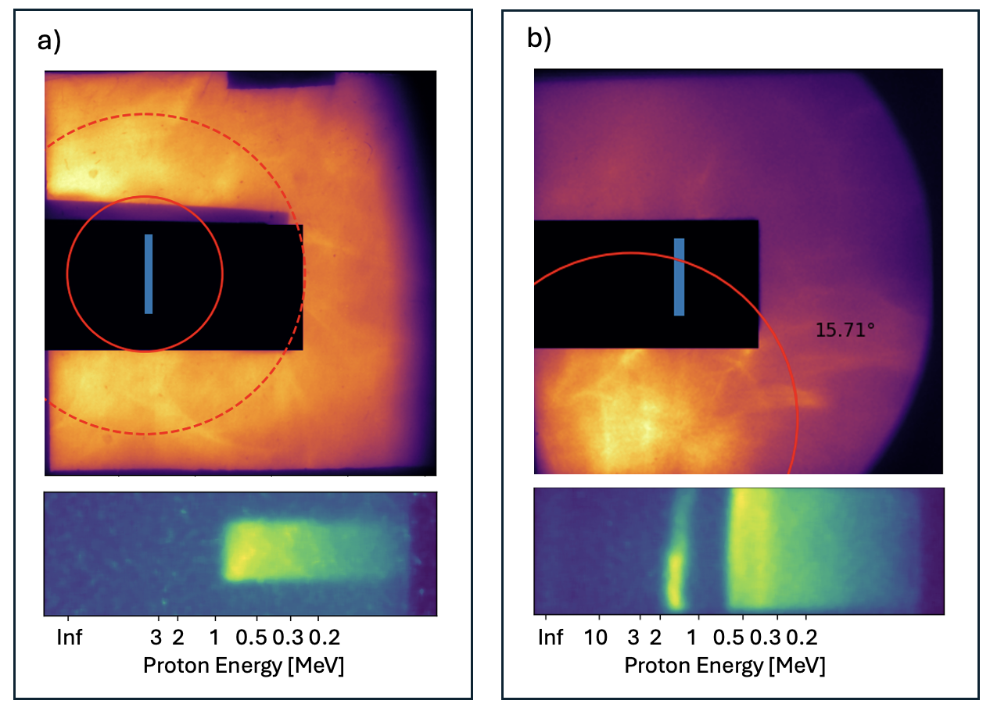
Effect of prepulse on ion beams
5mJ
40mJ
20º
a) High divergence Smooth thermal ion beam
10º
b) Low divergence beam with spatial structure and spectral variation
9
Notes:
Talk about centroids

Slide 10
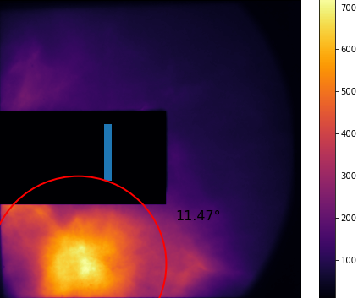
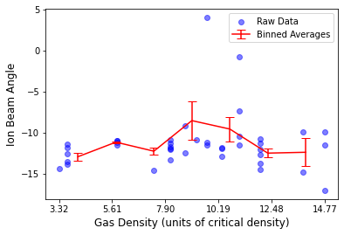
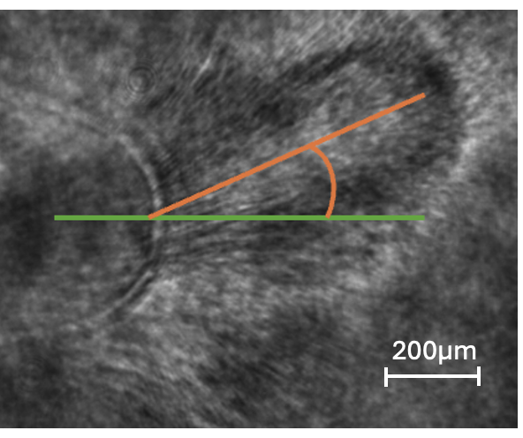
Divergence data
Deflection angles vs gas density
10
Notes:
Maybe in the morning plot divergence vs prepulse energy!

Slide 11
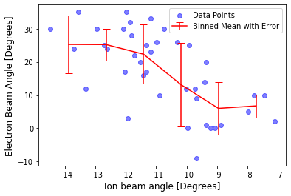
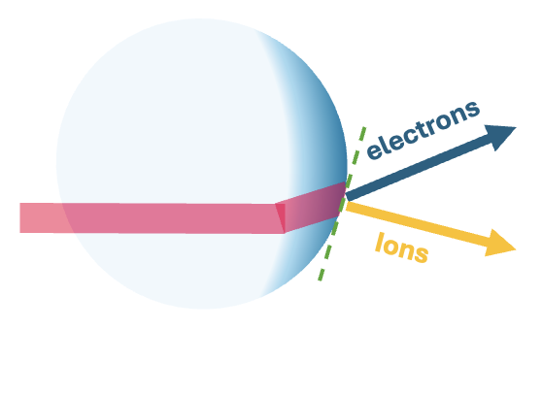
Divergence data and explanation
Laser
11
Notes:
Maybe in the morning plot divergence vs prepulse energy!

Slide 12
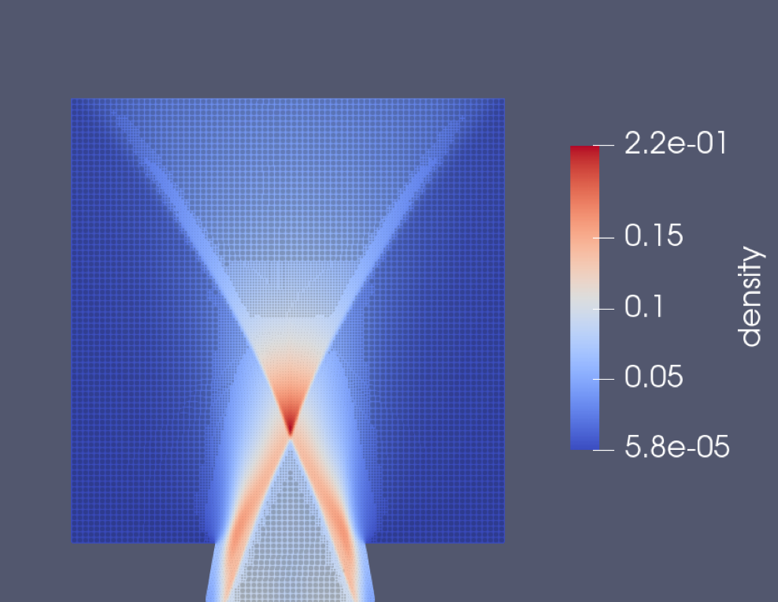
Divergence data simulations
OPENfoam used to simulate the density profile
FLASH simulations of realisitic BW formation using the OPENfoam profiles
SMILEI simulations using the FLASH BW
12
Notes:
Maybe in the morning plot divergence vs prepulse energy!

Slide 13
Conclusions
We gained better understanding of the behavior of ion beams produced through CSA, we measured their deflection and divergence angles, crucial properties for all applications.
Blast-wave pulse shaping improves beam divergence.
The ion beams showed a lot of structure, simulations are underway to explore possible causes.
We found that both ion and electron beams are deflected wrt the laser axis and that there is a negative correlation between the two deflection angles.
13

