Slide 1

Efficient Free-Electron Laser Modelling Using a Lorentz-Boosted Coordinate System
Runfeng Luo
Zulfikar Najmudin

Slide 2
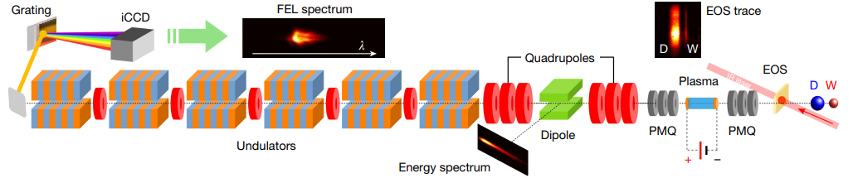
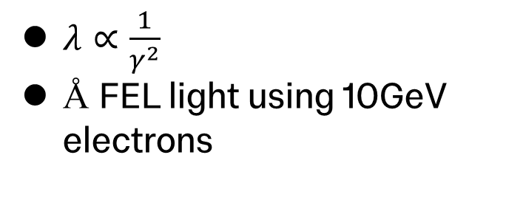
FEL
undulator
$λ∝\frac{1}{γ^{2}}$
Å FEL light using 10GeV electrons
electron beam
Demonstration of the plasma wakefield based FEL.
(Image from R. Pompili 2023 [1])

Slide 3
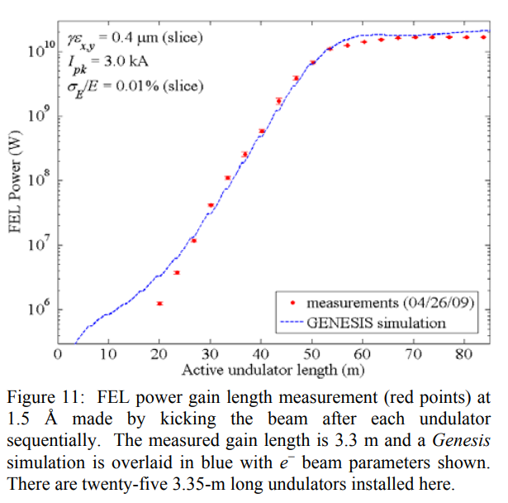
Genesis FEL code
Time dependent code
Solve Maxwell equations in paraxial approximation
Solve longitudinal slices
Doesn’t fully model longitudinal expansion
See S. Reiche [2]
See P. Emma 2009 [3]

Slide 4
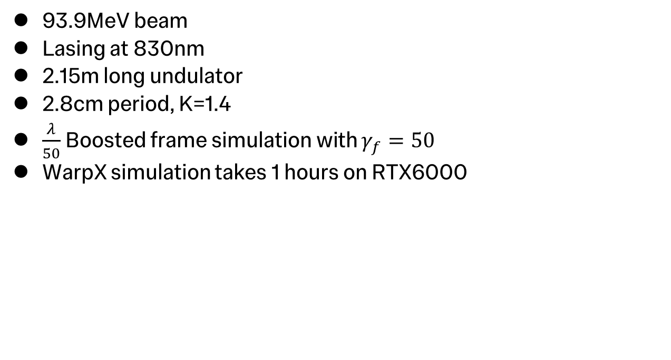
Principle of the Boosted Frame Simulations
lab frame
93.9MeV beam
Lasing at 830nm
2.15m long undulator
2.8cm period, K=1.4
$\frac{λ}{50}$ Boosted frame simulation with $γ_{f}=50$
WarpX simulation takes 1 hours on RTX6000
boosted frame
See J.-L. Vay 2018 [4]

Slide 5
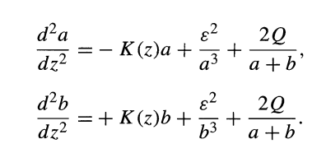
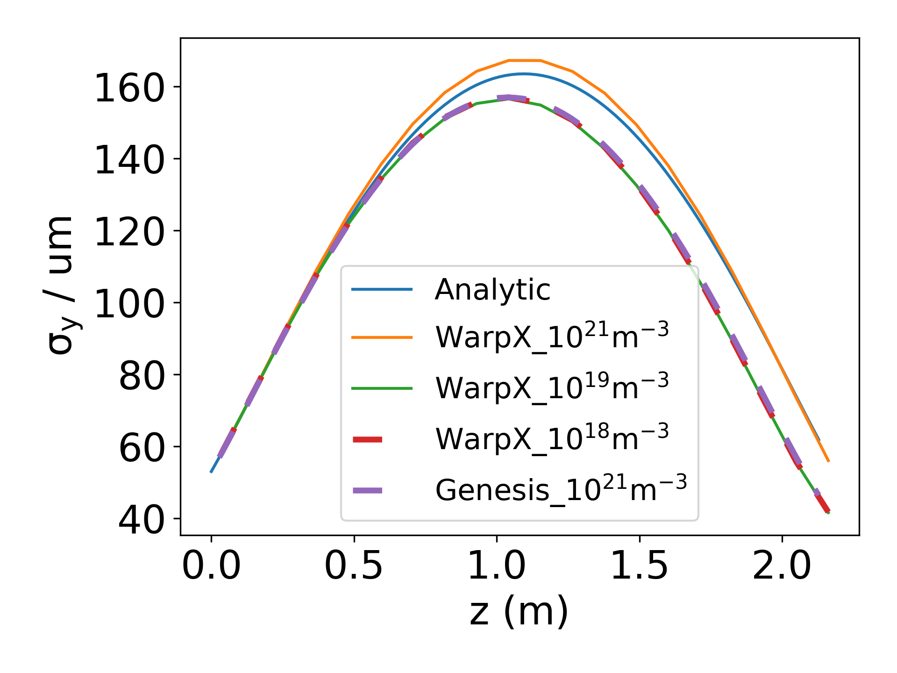
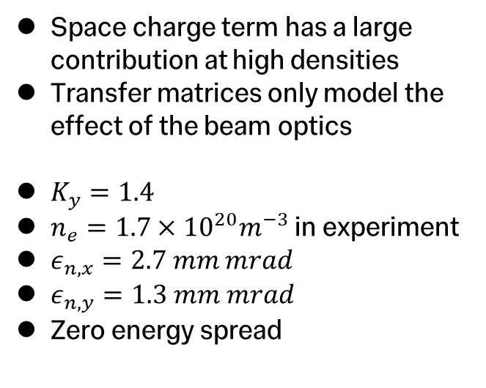
Motion along the Field Direction
Space charge term has a large contribution at high densities
Transfer matrices only model the effect of the beam optics
$K_{y}=1.4$
$n_{e}={1.7×10}^{20}m^{−3}$ in experiment
$ε_{n,x}=2.7 mm mrad$
$ε_{n,y}=1.3 mm mrad$
Zero energy spread

Slide 6
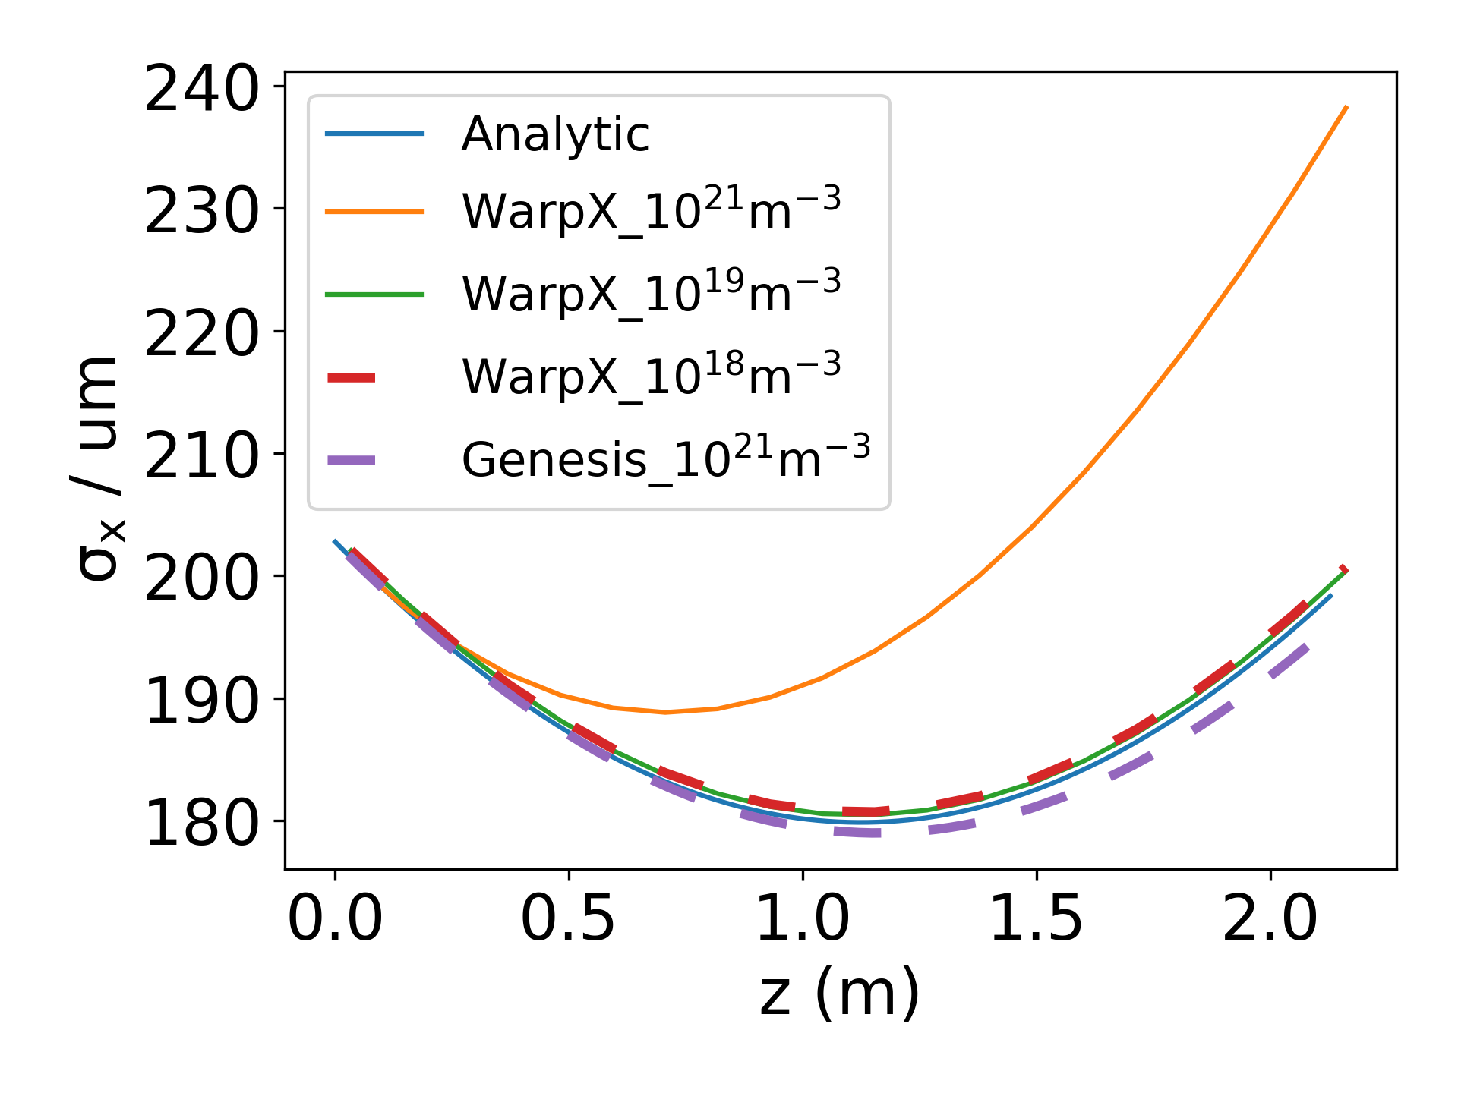
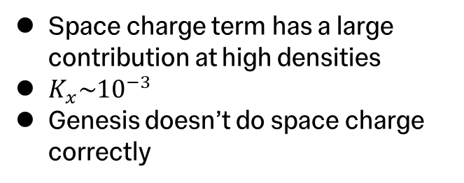
Motion along the Wiggling Direction
Space charge term has a large contribution at high densities
$K_{x}{\sim 10}^{−3}$
Genesis doesn’t do space charge correctly

Slide 7
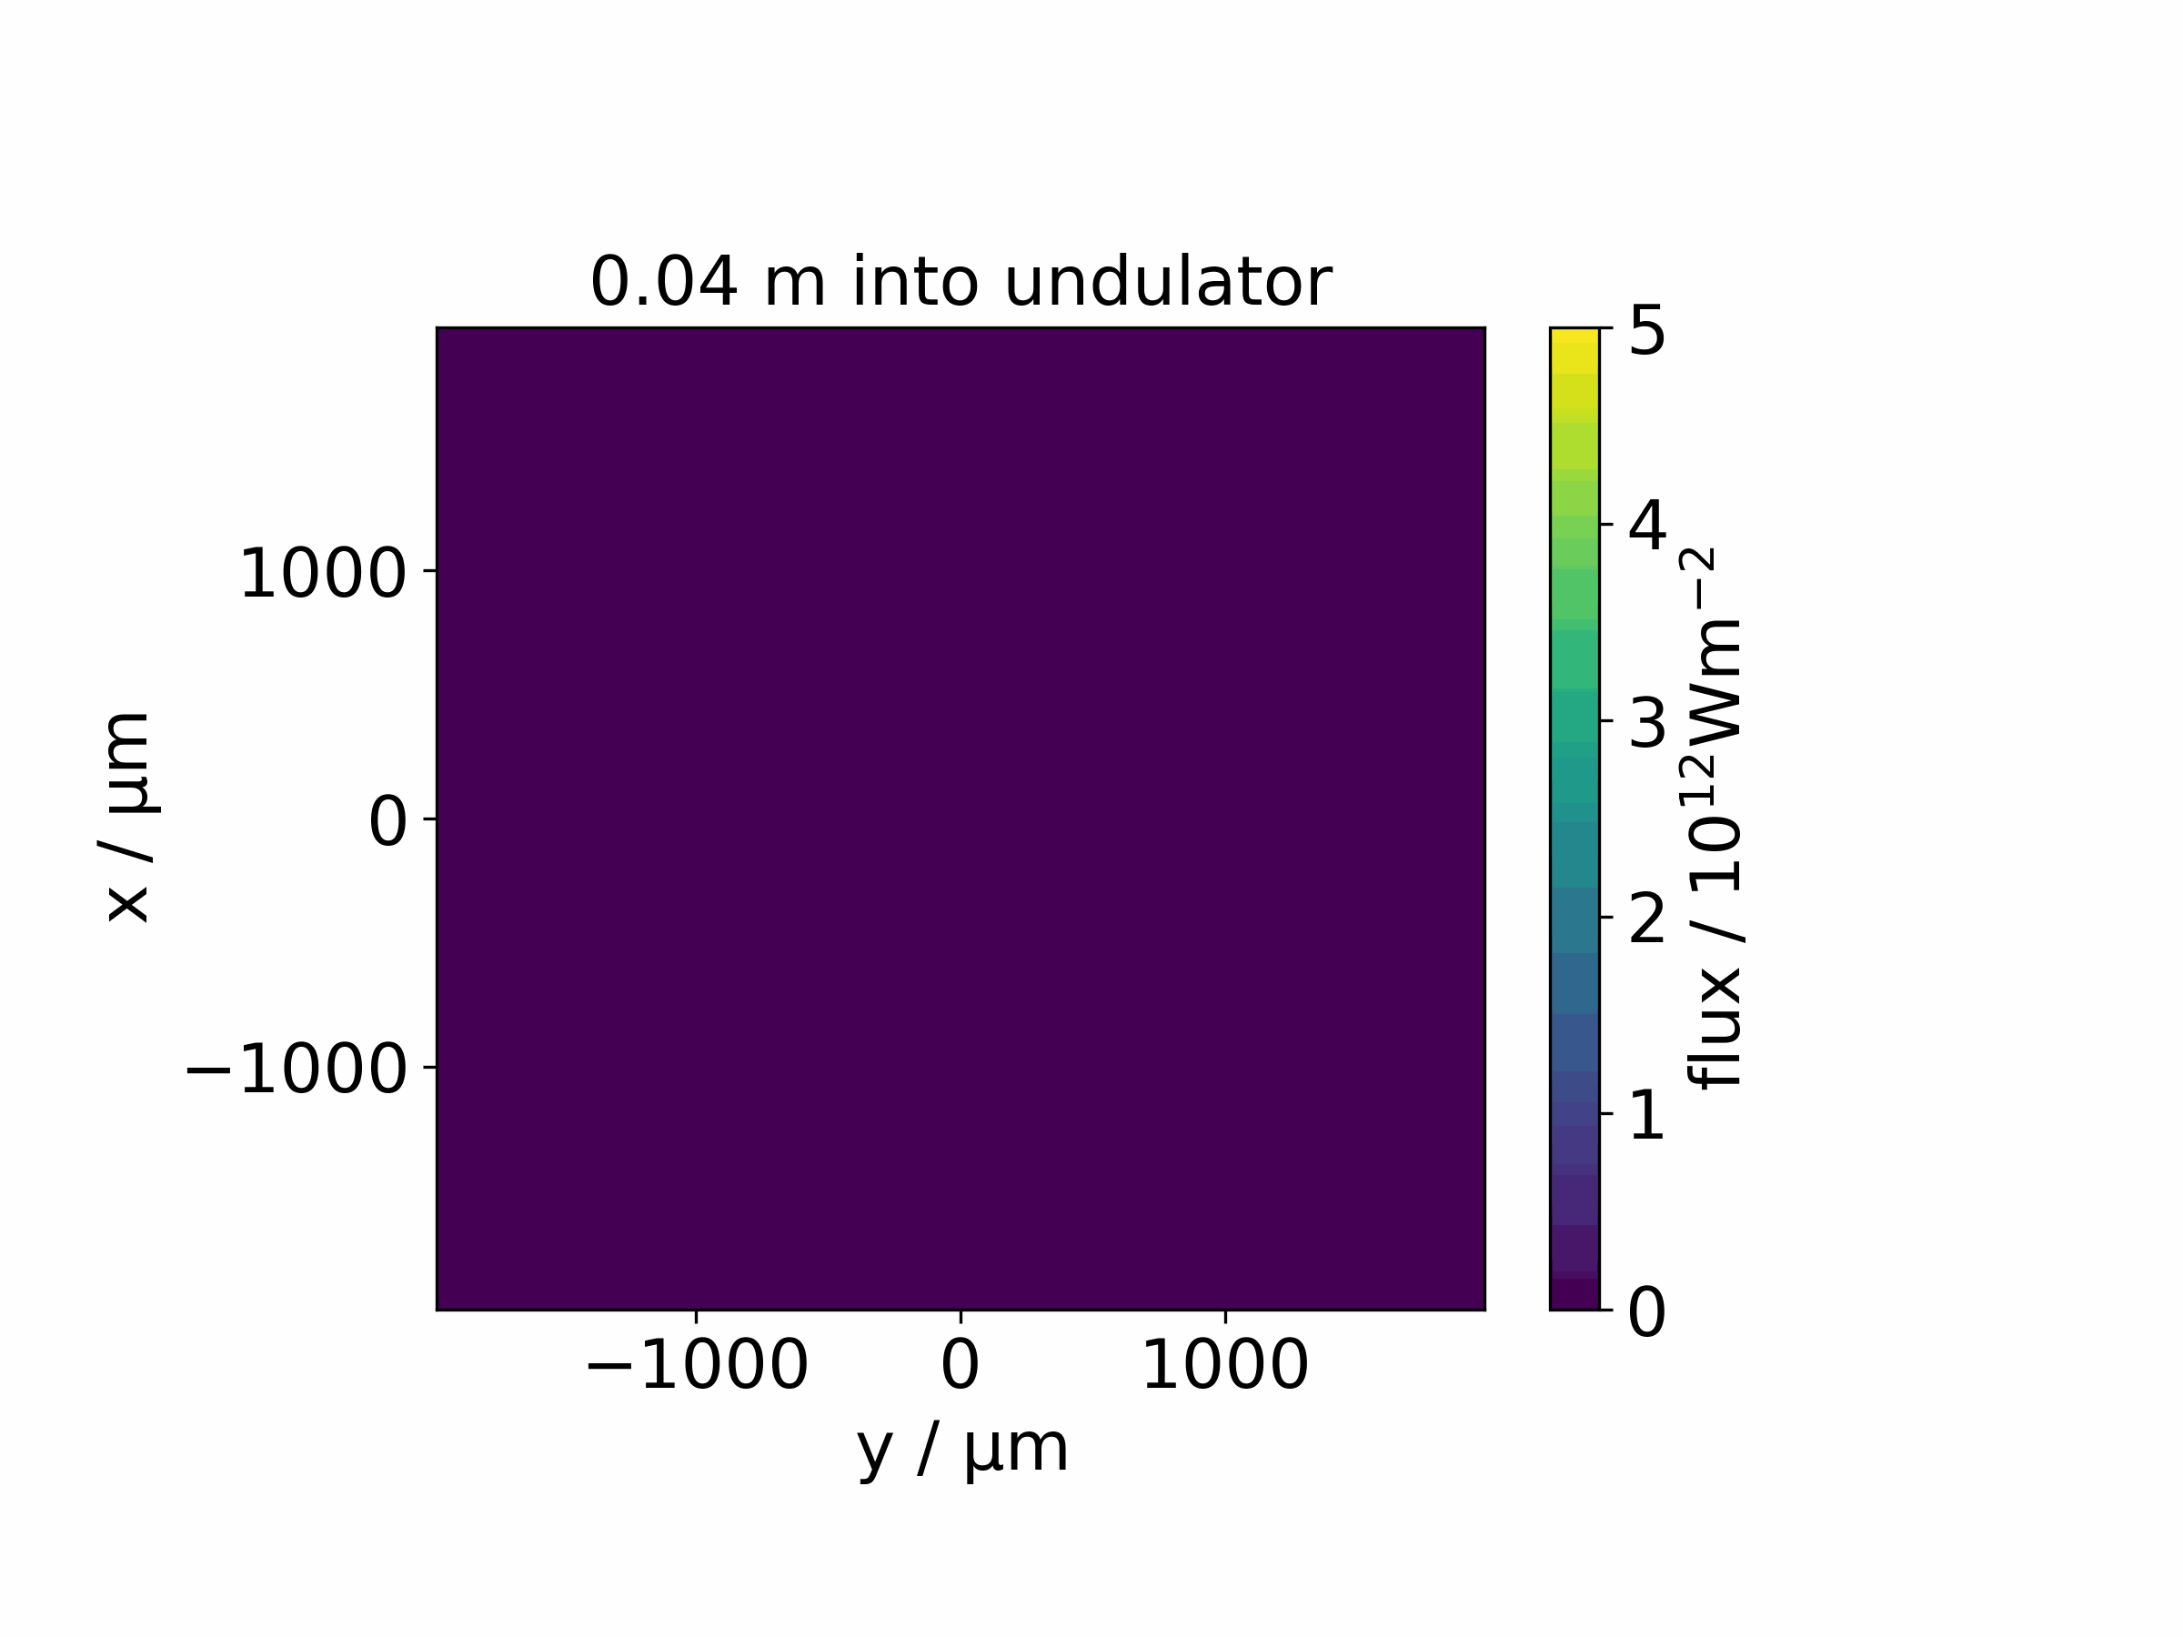
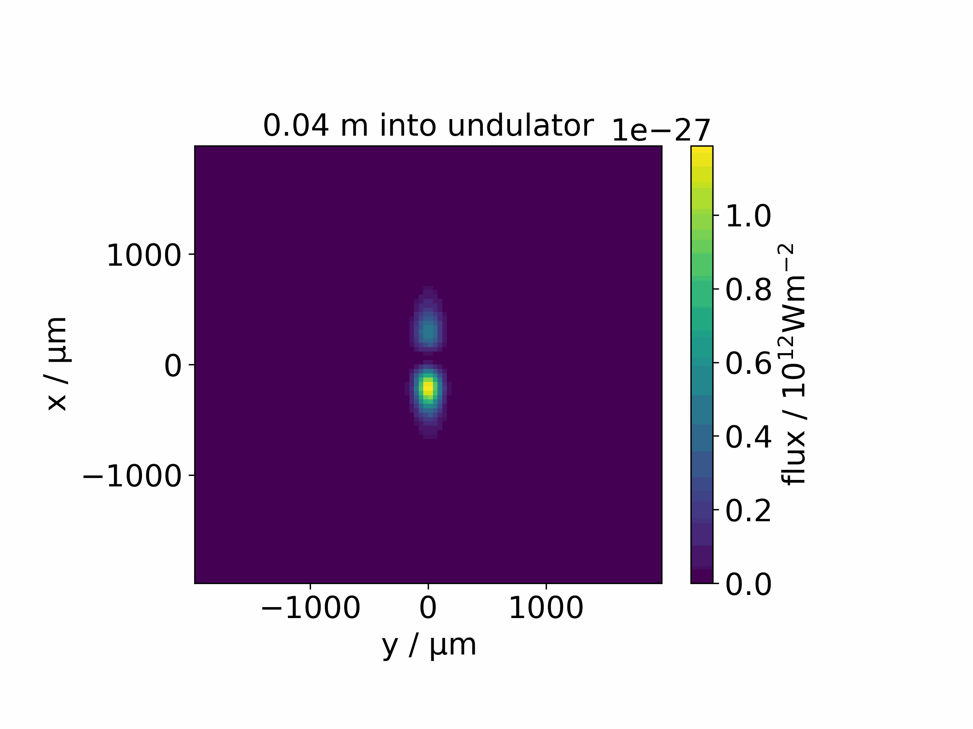

Radiation xy Plane
1um long beam
10um box (longitudinal)
Transverse flux 5um from the beam
$n_{e}={10}^{21}cm^{−3}$

Slide 8
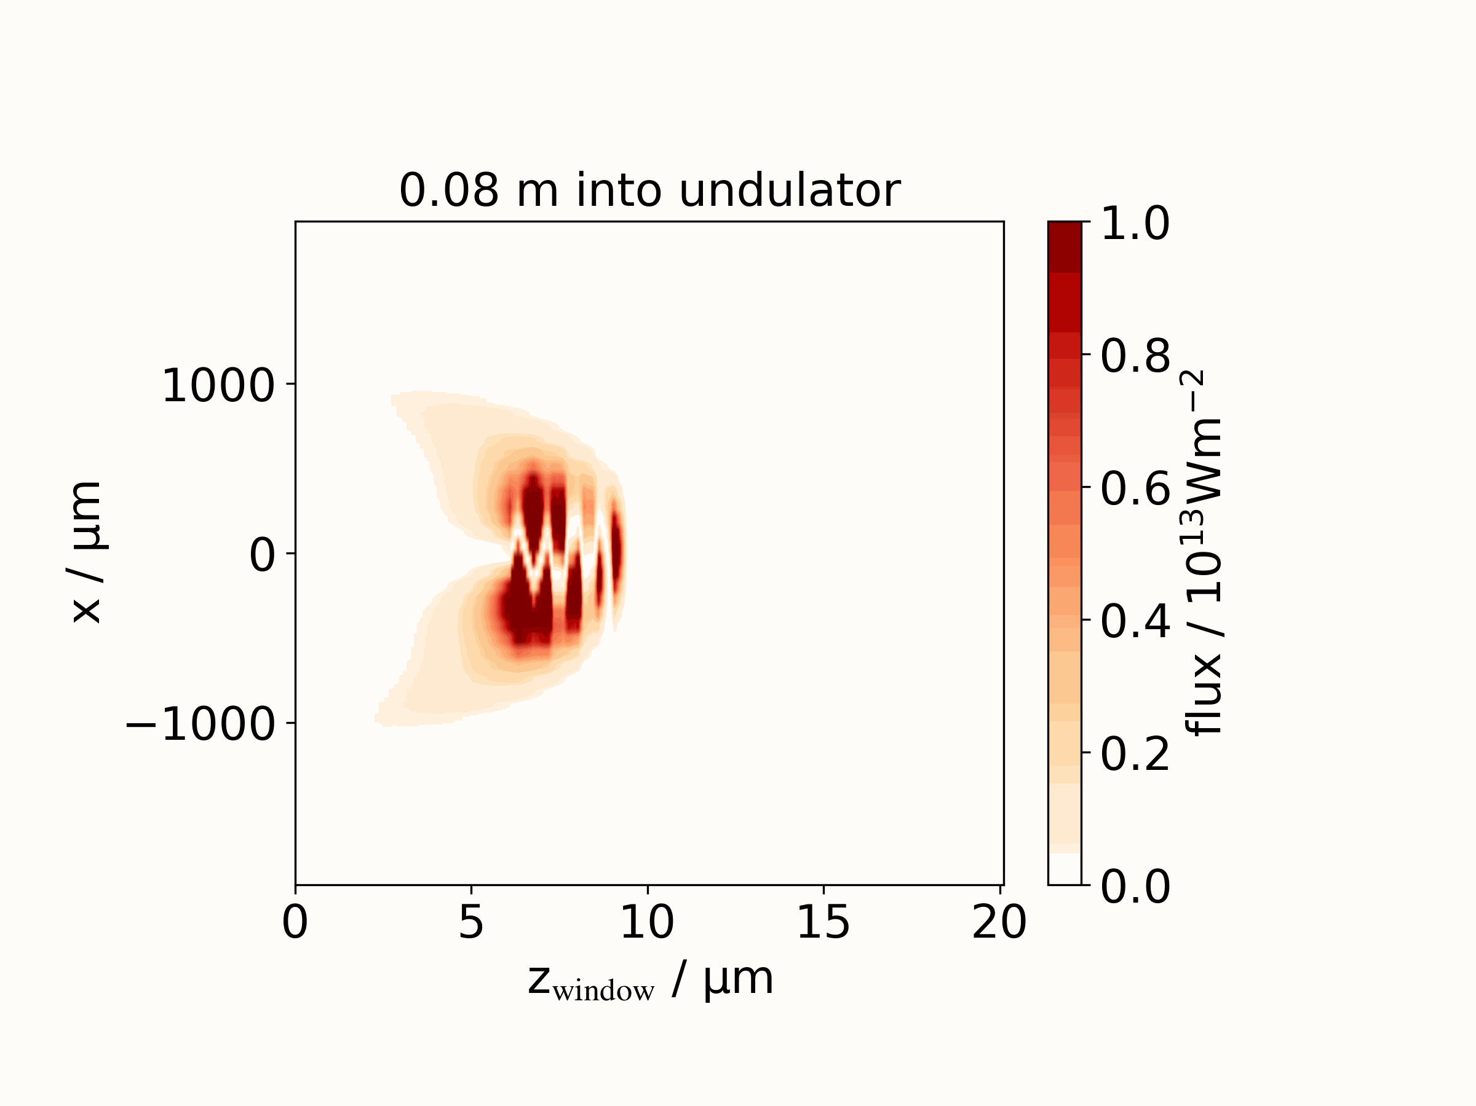
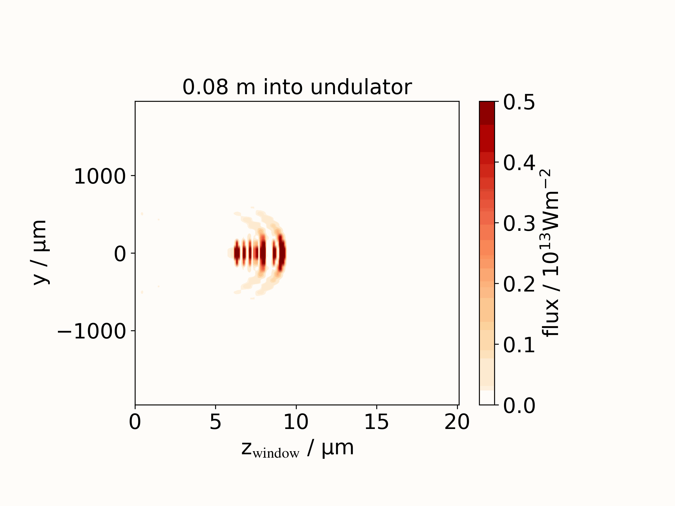
Longitudinal Slice

Slide 9
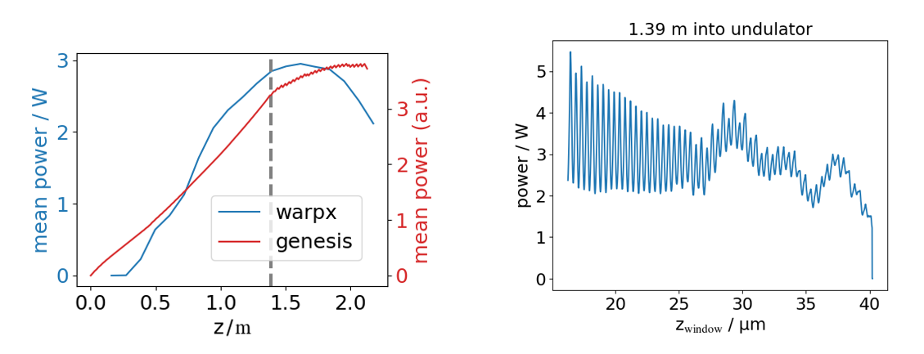
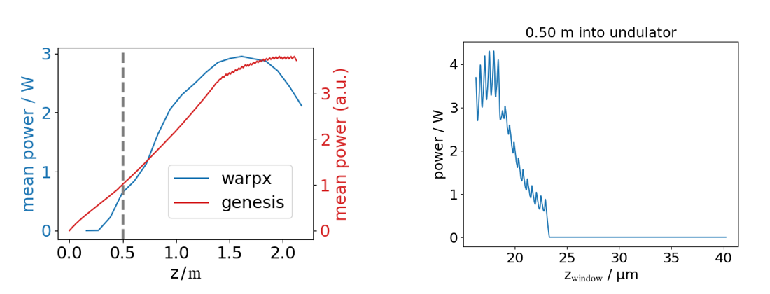
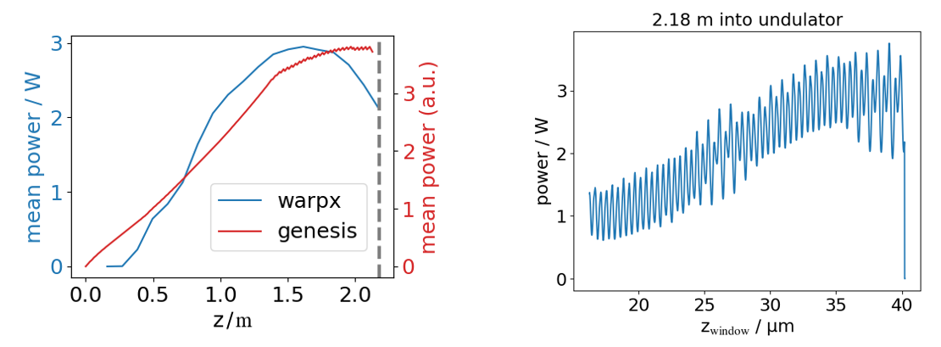
Motion along the Field Direction

Slide 10
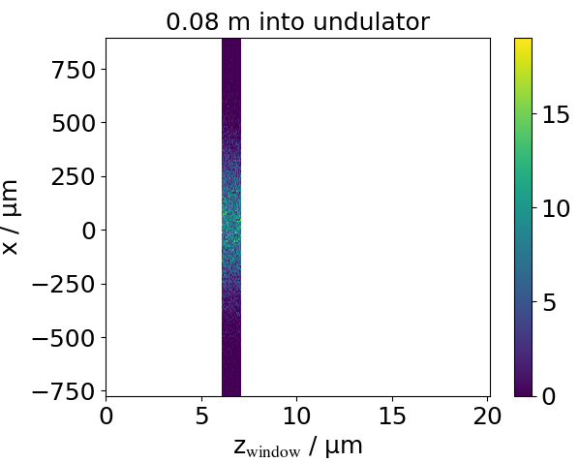
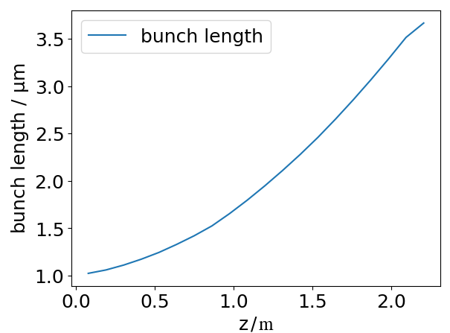
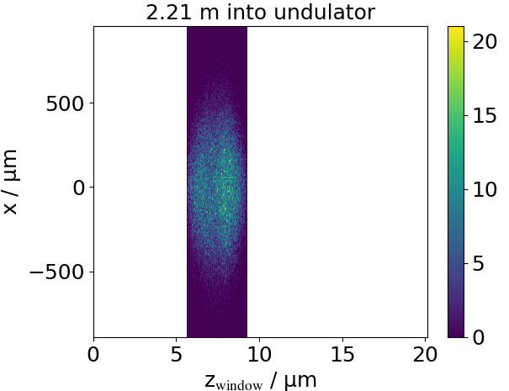
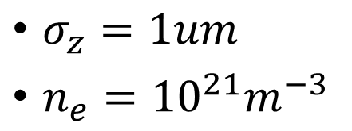
Longitudinal Bunch Expansion
$σ_{z}=1um$
$n_{e}={10}^{21}m^{−3}$

Slide 11
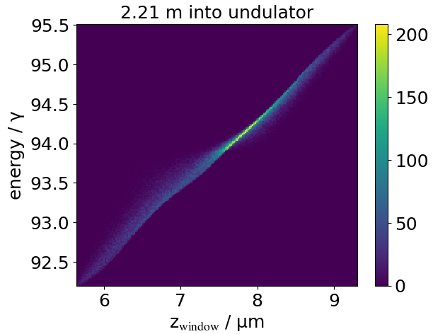
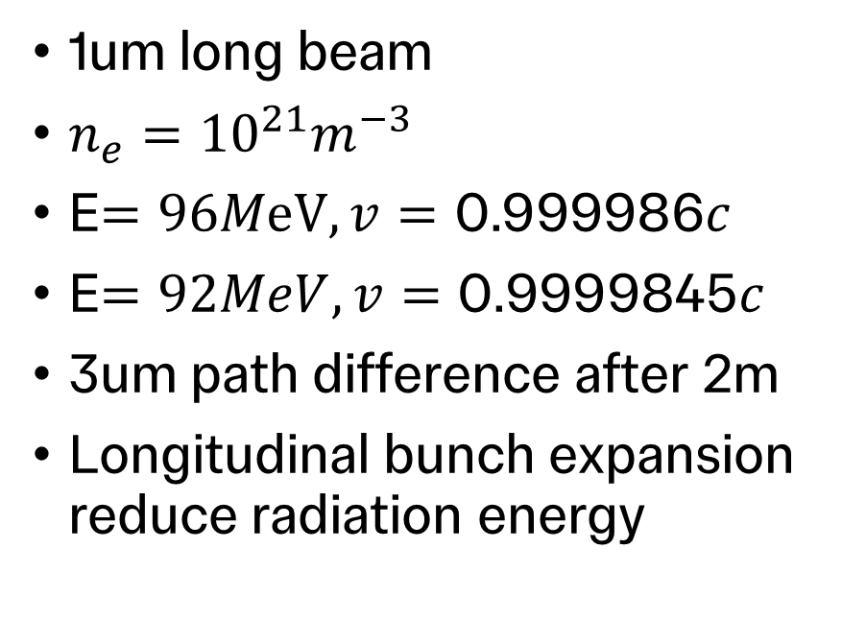
Energy Modulation
1um long beam
$n_{e}={10}^{21}m^{−3}$
E$=96MeV, v=\text{0.999986}c$
E$=92MeV, v=\text{0.9999845}c$
3um path difference after 2m
Longitudinal bunch expansion reduce radiation energy

Slide 12
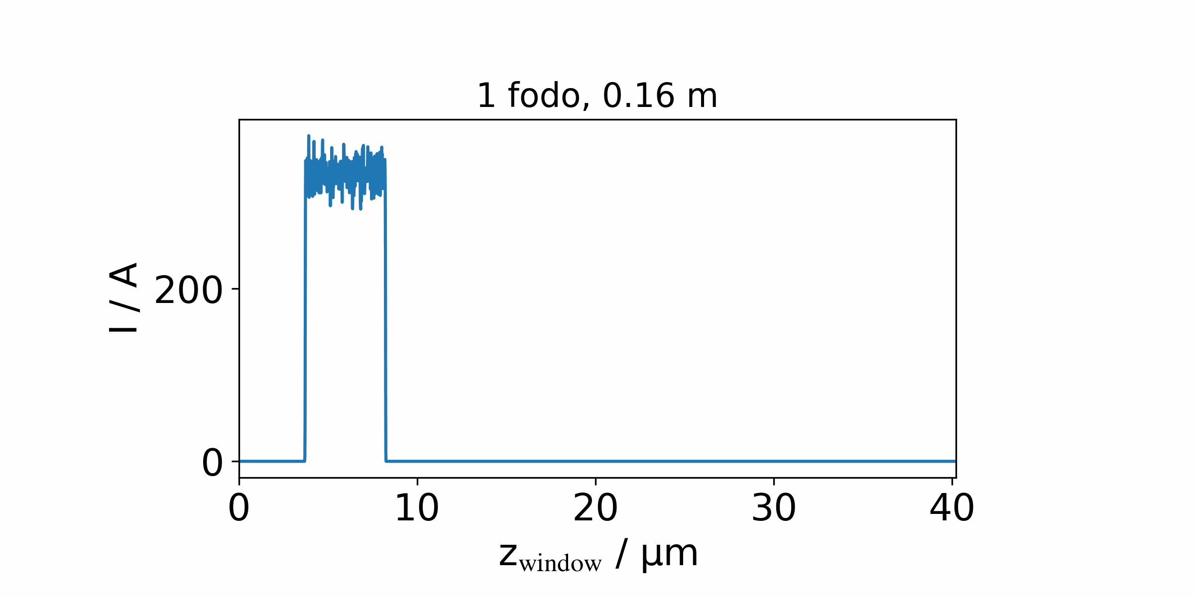
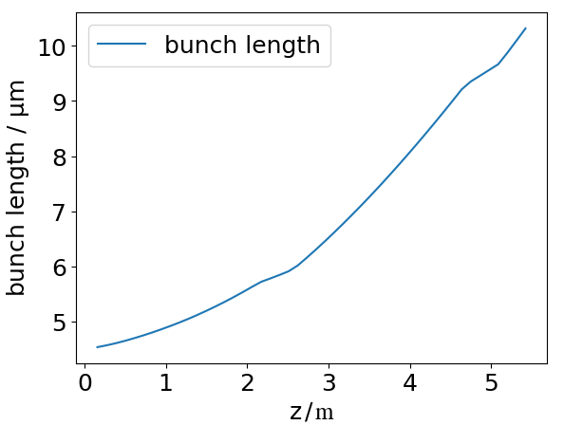

Microbunching
4.5um long beam
($σ_{z}=9um$ in experiment)
20pC charge

Slide 13

Conclusion
Space charge effects and energy modulation are significant for wakefield based FELs
Gensis don’t fully model space charge and longitudinal expansion
Boosted frame simulation fully captures the dynamics
Boosted frame simulation offers $γ^{2}$ speed up

Slide 14
References
[1] R. Pompili, el al. Free-electron lasing with compact beam-driven plasma wakefield accelerator. 2022.
[2] S. Reiche, GENESIS 1.3: a fully 3D time-dependent FEL simulation code
[3] P. Emma, et al. FIRST LASING OF THE LCLS X-RAY FEL AT 1.5 Å. 2009.
[4] J.-L. Vay, et al. Warp-X: a new exascale computing platform for beam-plasma simulations. 2018
[5] B. Julian, Pymoo

Slide 15
Thank you

Slide 16
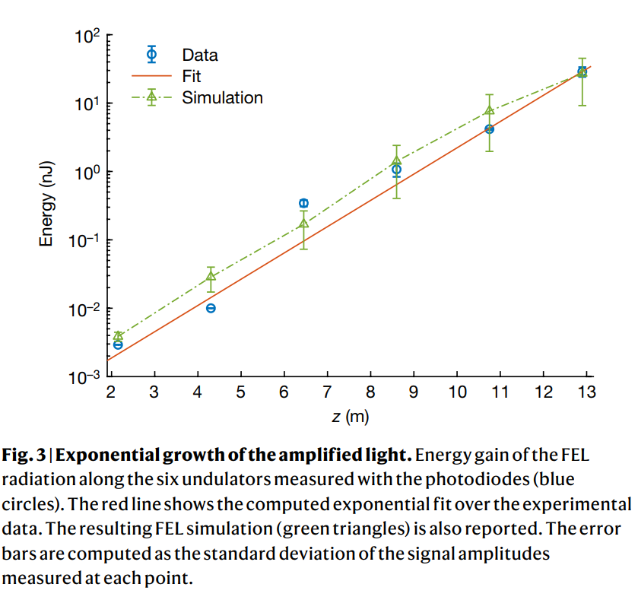
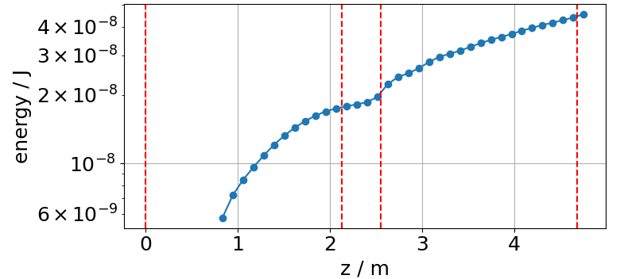
WarpX energy
Simulated ¼ of the beam
Zero initial energy spread

Slide 17
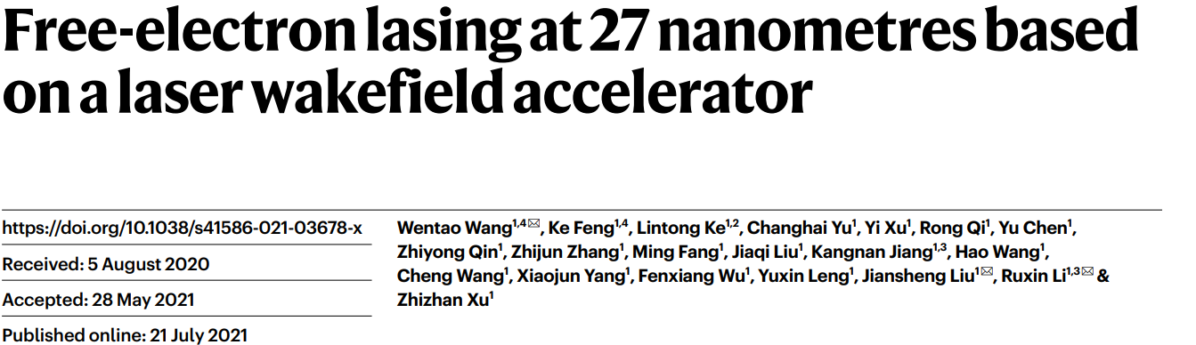
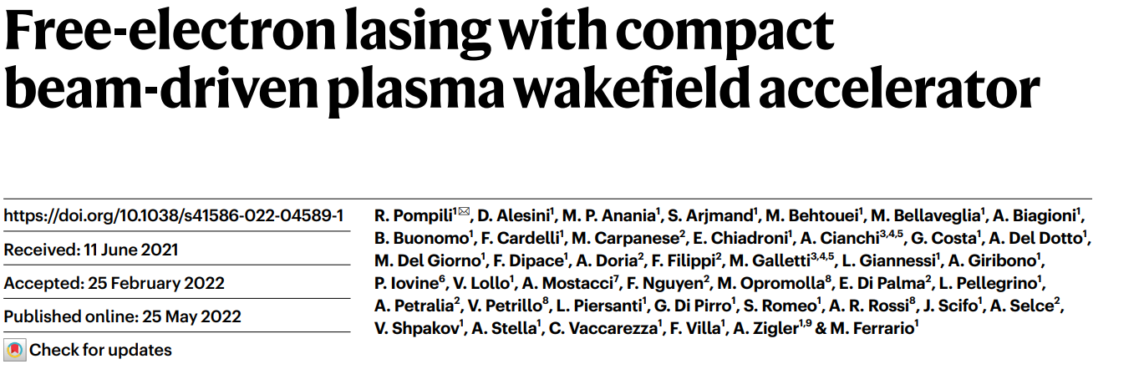
FEL using Wakefield Electrons
Notes:
Wakefield slides, add slides for FEL requirement

Slide 18


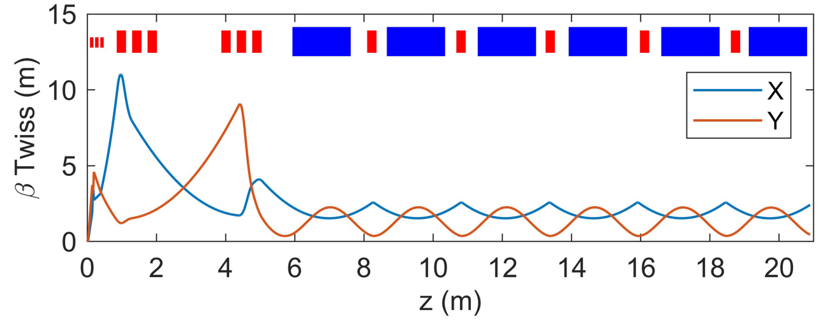
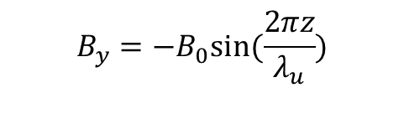
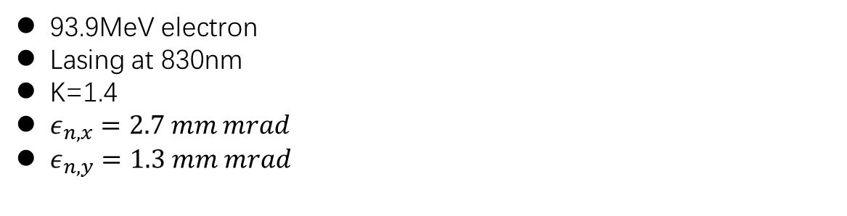
FEL Beamline
93.9MeV electron
Lasing at 830nm
K=1.4
$ε_{n,x}=2.7 mm mrad$
$ε_{n,y}=1.3 mm mrad$
$$B_{y}=−B_{0}sin⁡(\frac{2πz}{λ_{u}})$$
See R. Pompili 2023 [2]

Slide 19
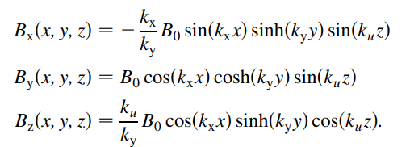
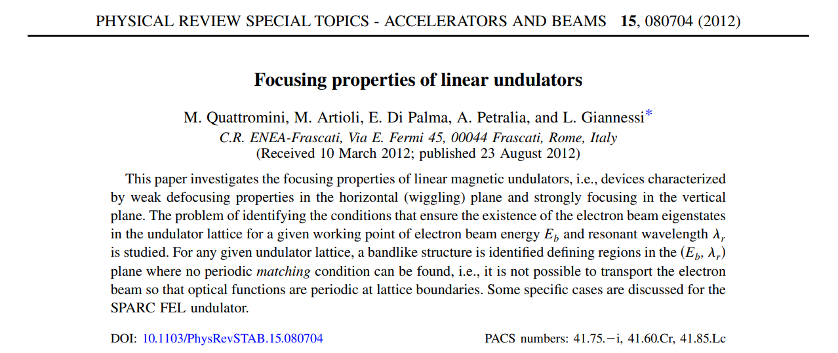
Undulator Field

Slide 20
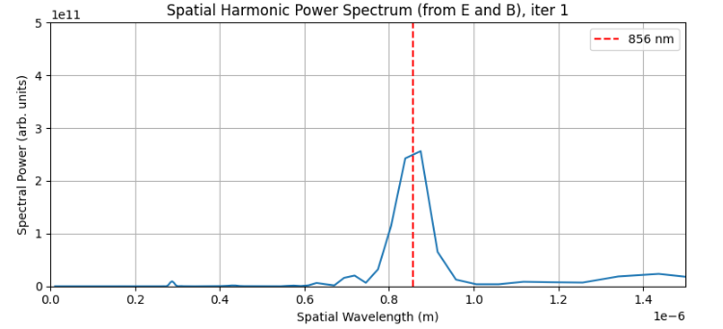

Resonant Wavelength
$λ_{thoery}=856nm$

Slide 21
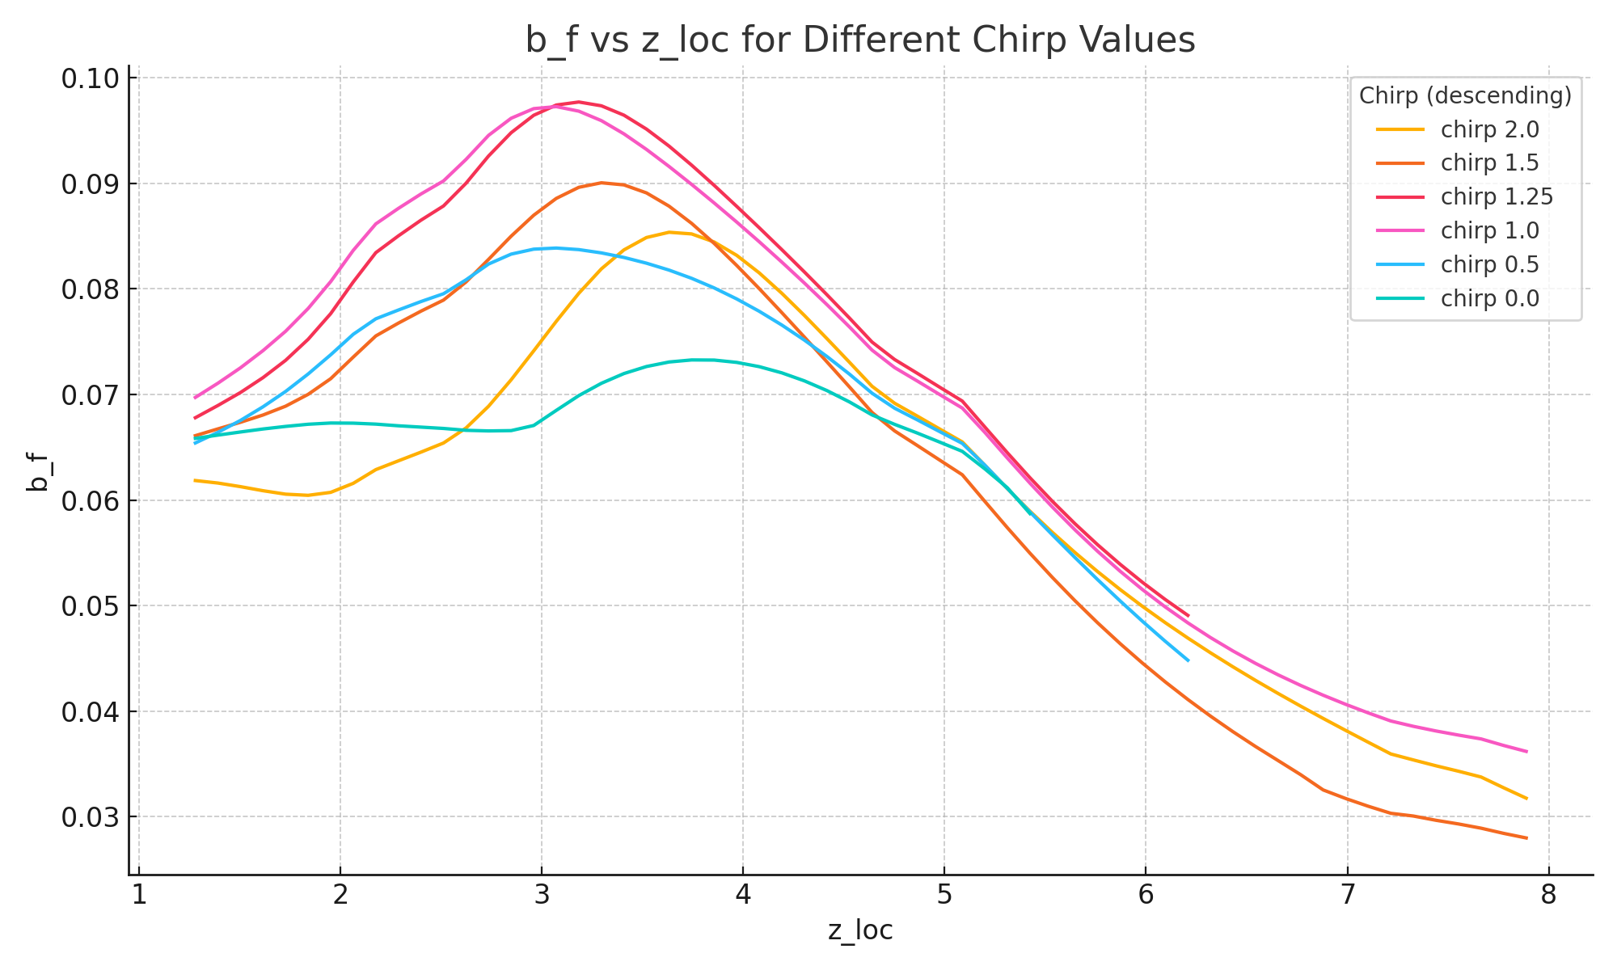
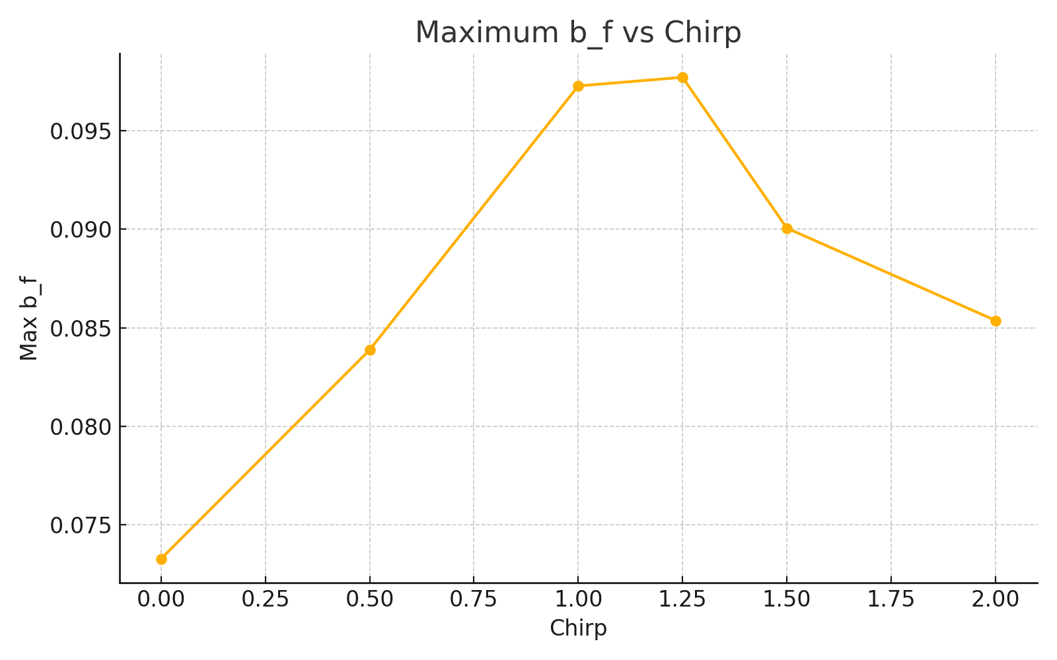
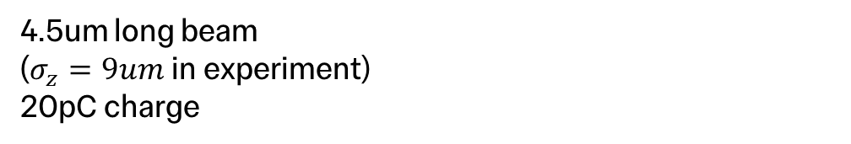
Bunching factor (chirp)
4.5um long beam
($σ_{z}=9um$ in experiment)
20pC charge

Slide 22
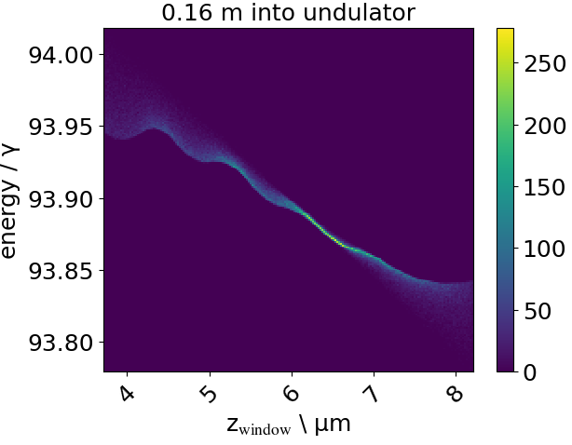
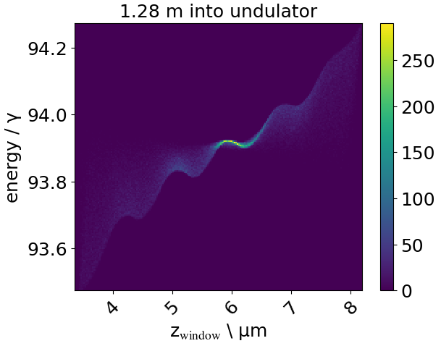
Chirp

Slide 23
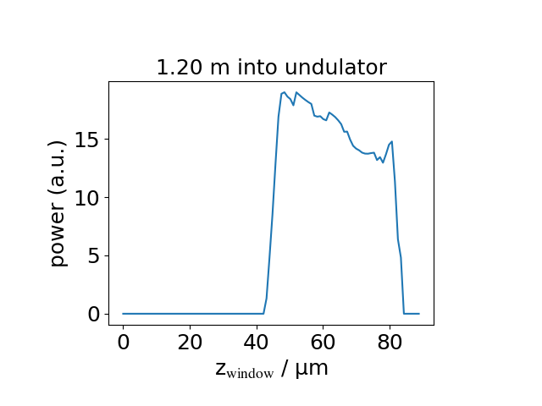
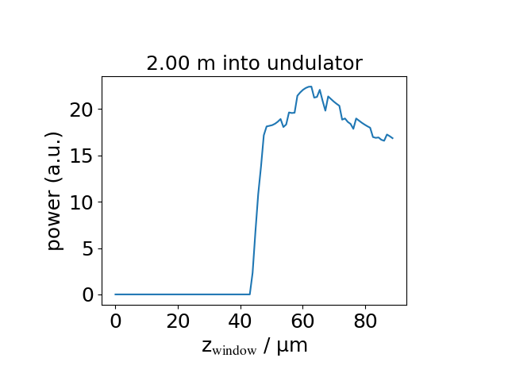
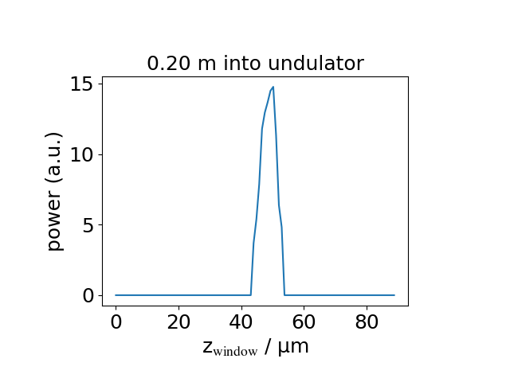
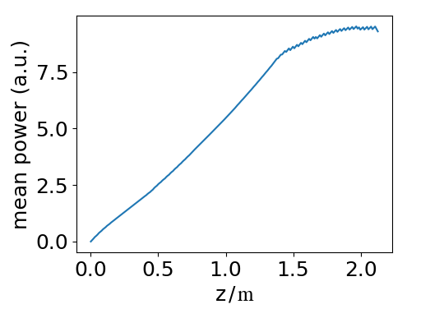
Genesis Radiation Power
Notes:
Stress how power is measured, add comparison to PIC

Slide 24
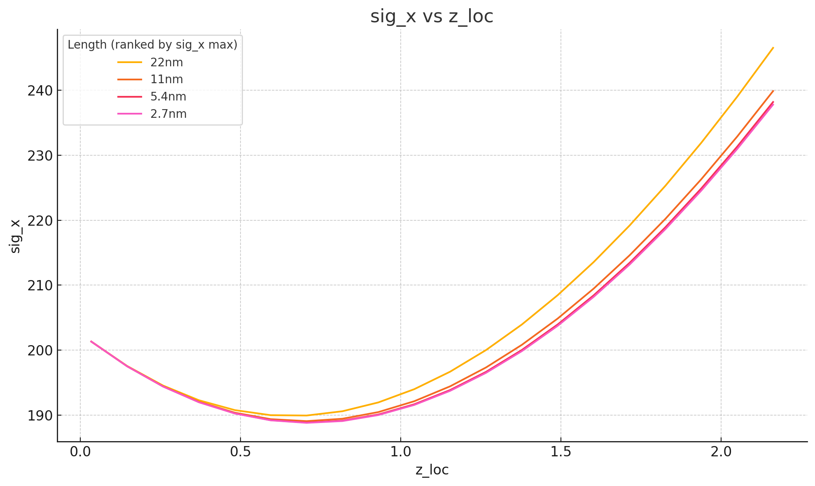
Convergence scan (1um beam)

Slide 25
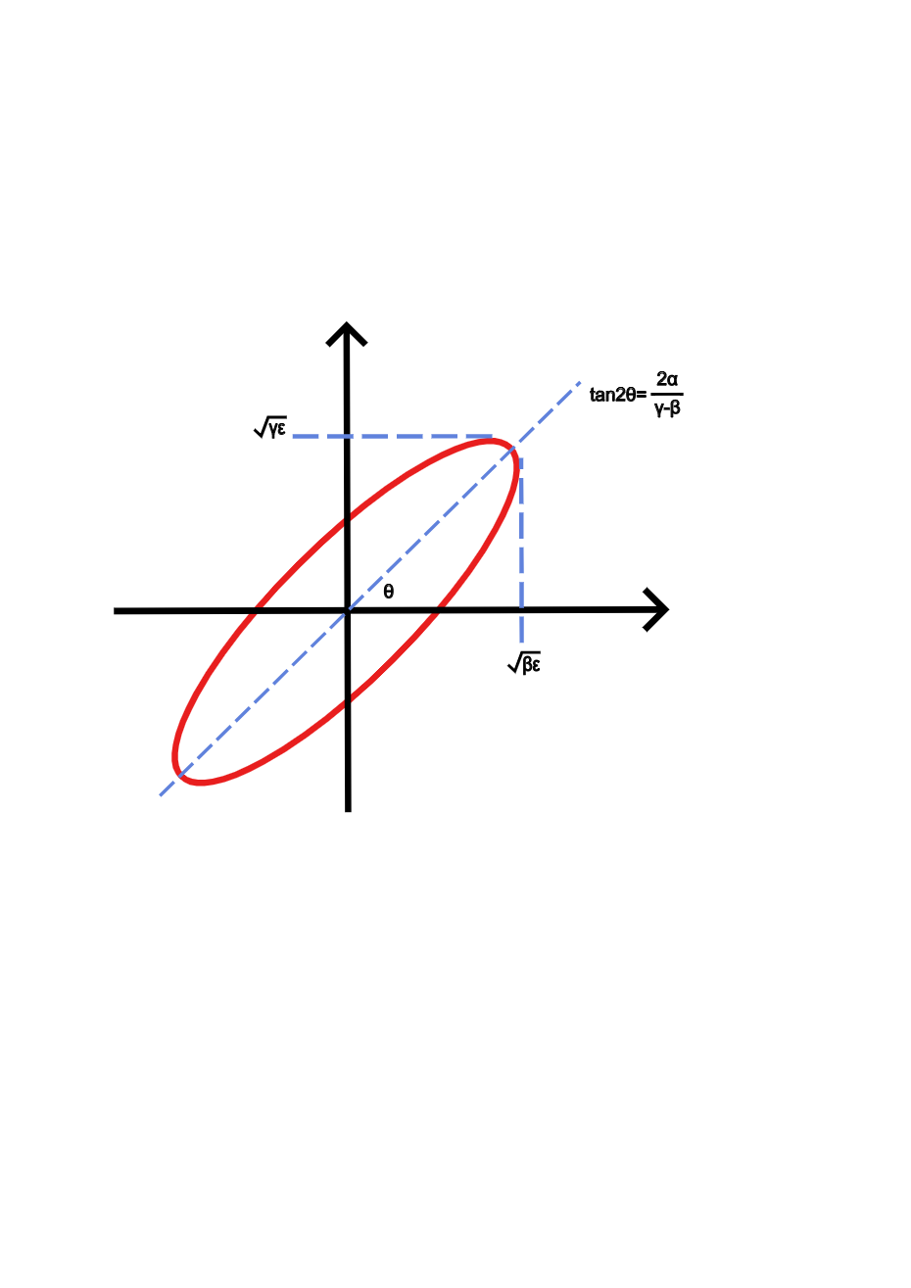
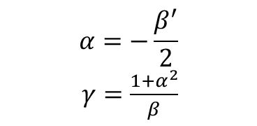

Twiss Parameters
x’
$$α=−\frac{β_{ }^{′}}{2}$$
$γ=\frac{1+α^{2}}{β}$
$$<x^{2}> =εβ$$
$$<{x′}^{2}> =εγ$$
$<xx^{′}> =−εα$
x

Slide 26


Matching with 8 Inputs and 6 Constraints
A period
Matching is performed for a single section
Section: undulator + drift + quad + drift
Functions for optimisation
Minimise area under $β_{x}$
Minimise area under $β_{y}$
Constraints
${β_{x,y}}_{i}=β_{{x,y}_{f}}$
$α_{{x,y}_{i}}=α_{{x,y}_{f}}$
(gradient of $β$)
$β_{x,y} >0$
Variables
Drift space length
Quad strength
Quad length
4 Twiss parameters

Slide 27


Optimised Results

