Slide 1
Multi-objective genetic algorithm optimisation of the Diamond-II storage ring optics
Neven Blaskovic Kraljevic, Hossein Ghasem, Ian Martin Diamond Light Source

Slide 2
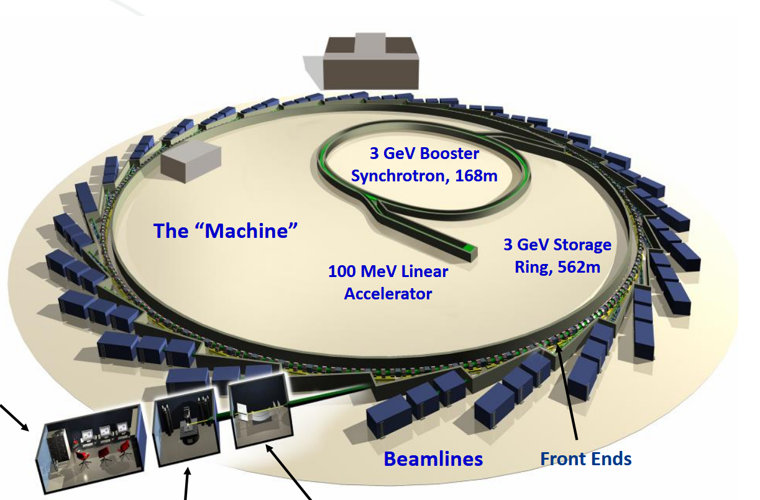
Diamond and the Diamond-II upgrade
Diamond currently has a 3 GeV electron synchrotron:
The Diamond-II synchrotron will:
Upgrade the energy from 3 GeV to 3.5 GeV to increase X-ray beam brightness
Upgrade the Double Bend Achromat (DBA) cell to a 6 Bend Achromat (6BA) cell to reduce the beam emittance from 3.1 nm rad to 120 pm rad
Add capacity for extra beamlines
Existing Diamond Cell Layout
Control cabin
Diamond-II Cell Layout
Experiment hutch
Optics hutch
Mid-straight
Diamond-II CDR
Neven Blaskovic Kraljevic et al., PAB 2025

Slide 3
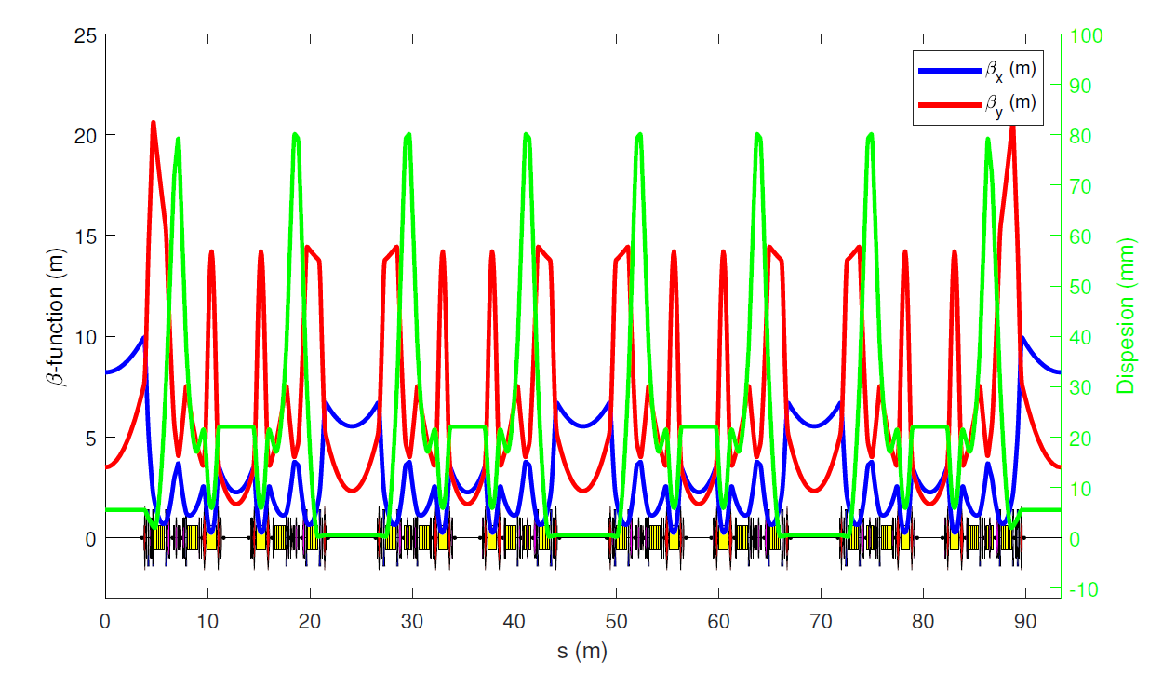
Diamond-II optics
superperiod
Total: 6 superperiods
cell
cell
cell
cell
Total: 24 cells
We have 3 types of straight:
Long (L): between superperiods, can accommodate e.g. injection
Standard (S): between cells within a superperiod
Mid (M): in the middle of each cell – new for Diamond-II
L
M
S
M
S
M
S
M
L
Diamond-II TDR
Neven Blaskovic Kraljevic et al., PAB 2025

Slide 4
Diamond-II optics
Chromatic sextupoles (high dispersion, correct chromaticity)
Harmonic sextupoles (low dispersion, maximise dynamic aperture)
Octupoles (maximise dynamic aperture)
superperiod
cell
cell
cell
cell
S1X
S2A
S3A
S4A
S5X
S6X
S6X
S5X
S4A
S3A
S2A
S1X
L
M
S
M
S
M
S
M
L
L
M
S
O0X
O1X
O1X
Diamond-II TDR
Neven Blaskovic Kraljevic et al., PAB 2025

Slide 5
Optimisation
We want to optimise the machine in the presence of errors, to maximise both:
  Electron beam lifetime (mainly Touschek scattering)
  Injection efficiency
To find a solution which is robust against any specific set of errors, we optimise against the mean of 5 random error seeds (including alignment, field strength and multipole errors)
To enhance the losses, we use a larger off-axis injection offset of -4.5 mm instead of the design of -4 mm
We include all apertures, including closed insertion devices and collimators
Under these conditions, the performance for the nominal design is:
  Touschek lifetime: 2.15 h – without bunch lengthening from harmonic cavity (expected to increase lifetime by a factor of ~3.5)
  Injection efficiency: 96.3%
Neven Blaskovic Kraljevic et al., PAB 2025

Slide 6
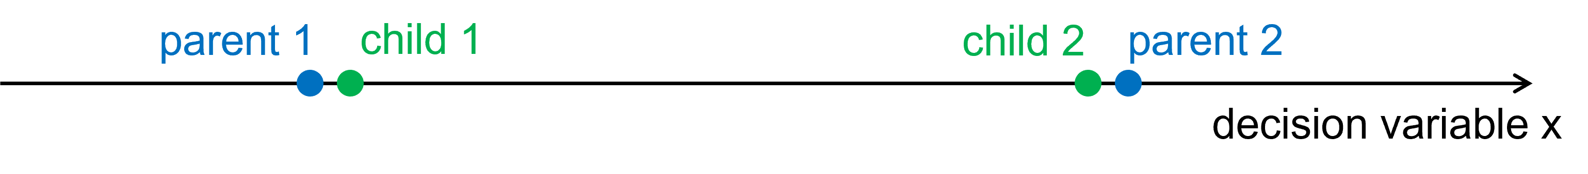
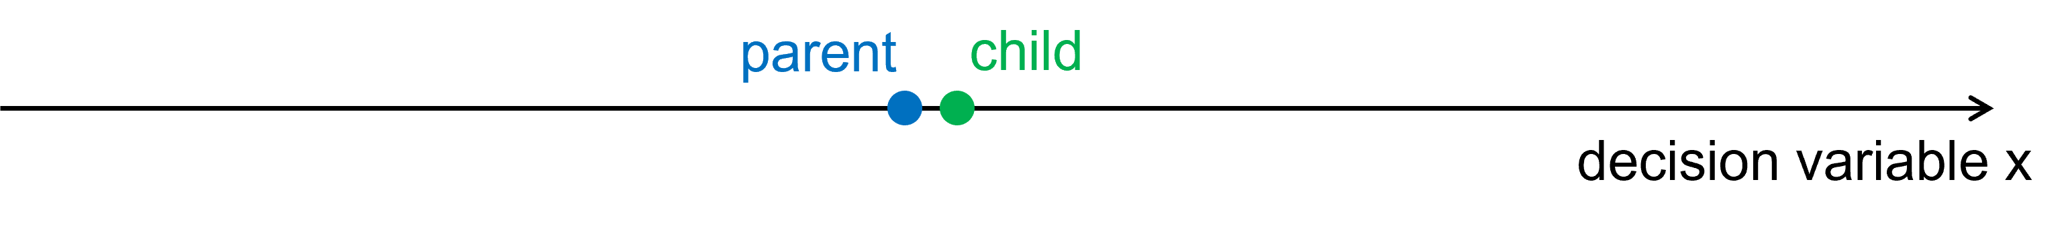
Multiple-Objective Genetic Algorithm (MOGA)
The NSGA-II code starts off with a random population of 20, 40 or 100 chromosomes (each chromosome is a set of values for all the decision variables), with the nominal solution ‘injected’ as the first chromosome
The algorithm evaluates the lifetime and injection efficiency of each chromosome in AT2 and ranks the solutions; rank 1 solutions dominate in lifetime and/or injection efficiency and constitute the Pareto front
Best-ranked chromosomes are used as ‘parents’ to generate ‘children’ for subsequent generations through:
  Crossover
  Mutation
Repeat for up to 25 generations
  Computation time: 7 days for 25 generations & 100 chromosomes (using 36 nodes with 40 cores/node)
  Current emphasis is on testing and fine-tuning the algorithm
Specific changes:
  Increased chance of mutation from 10% to 40% or 50%
  Increased mutation scale factor
  Increased distance from parents to children in crossovers
Neven Blaskovic Kraljevic et al., PAB 2025

Slide 7
Simulation procedure
Vary different sets of variables, beginning with nominal optics:
  Case 1) x & y tune
  Case 2) x & y chromaticity by adjusting strengths of all 3 families of chromatic sextupoles (S2A, S3A, S4A)
  Case 3) x & y tune, x & y chromaticity
  Case 4) strengths of all 3 families of harmonic sextupoles (S1X, S5X, S6X) and both families of octupoles
  Case 5) strengths of all sextupoles and octupoles
Using Accelerator Toolbox (AT2) in MATLAB:
Apply input sextupole/octupole strengths if varied as part of the MOGA search
Apply alignment and field strength errors
Orbit and tune correction with sextupoles/octupoles off (necessary to find a closed orbit if using step 1)
Turn on sextupoles and octupoles
Add random and systematic multipoles to quadrupoles and sextupoles
Orbit correction
Tune correction
Chromaticity correction using all 3 families of chromatic sextupoles (S2A, S3A, S4A)
Neven Blaskovic Kraljevic et al., PAB 2025

Slide 8
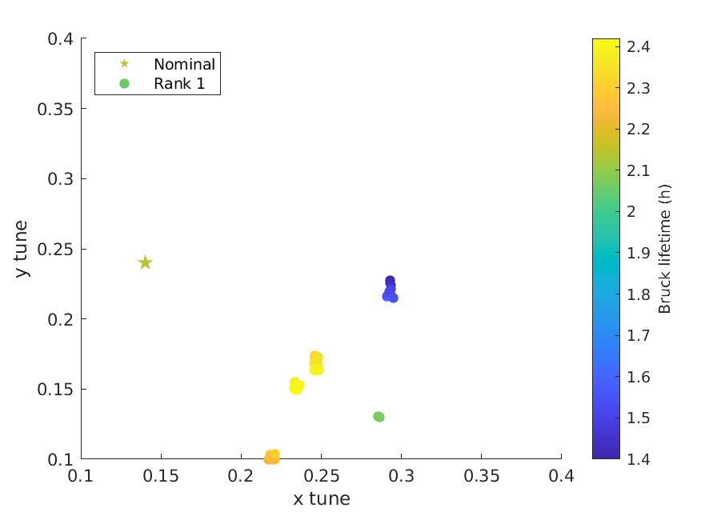
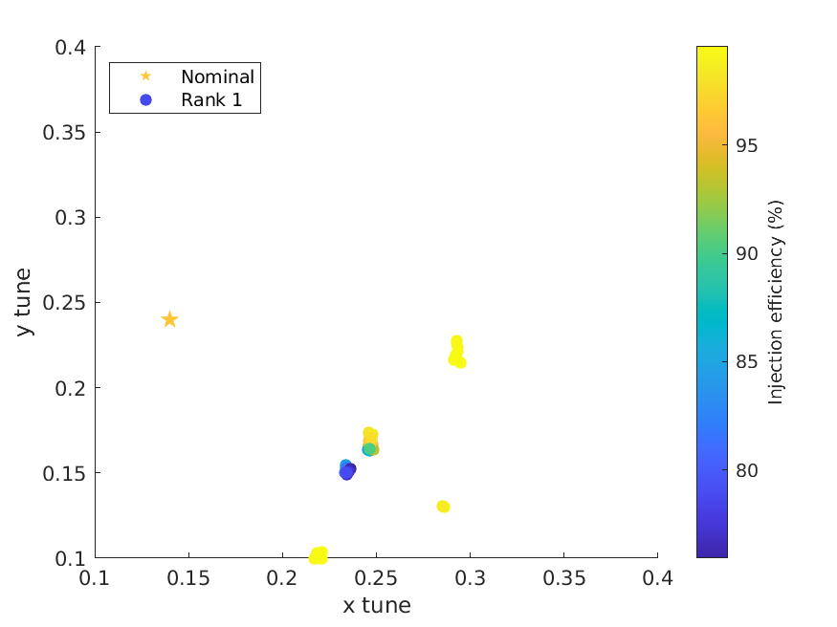
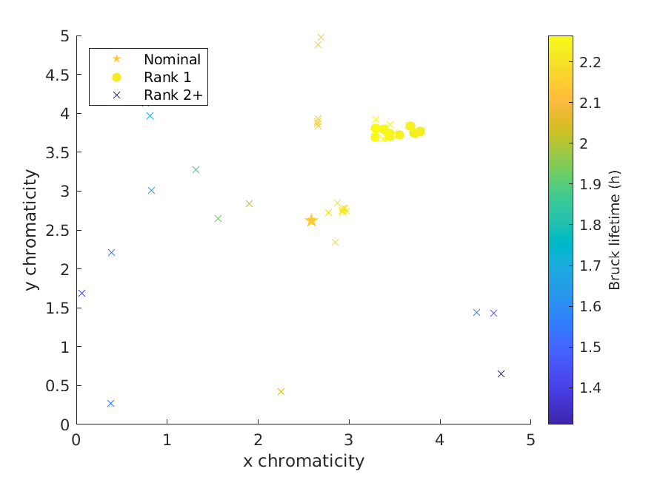
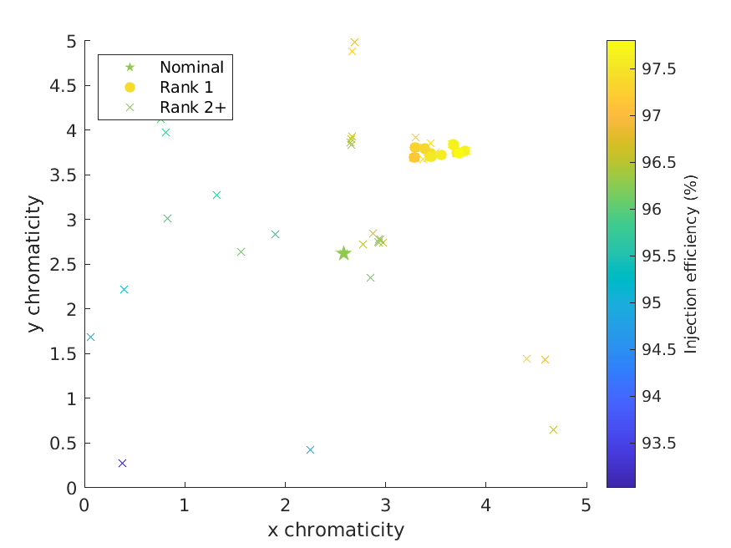
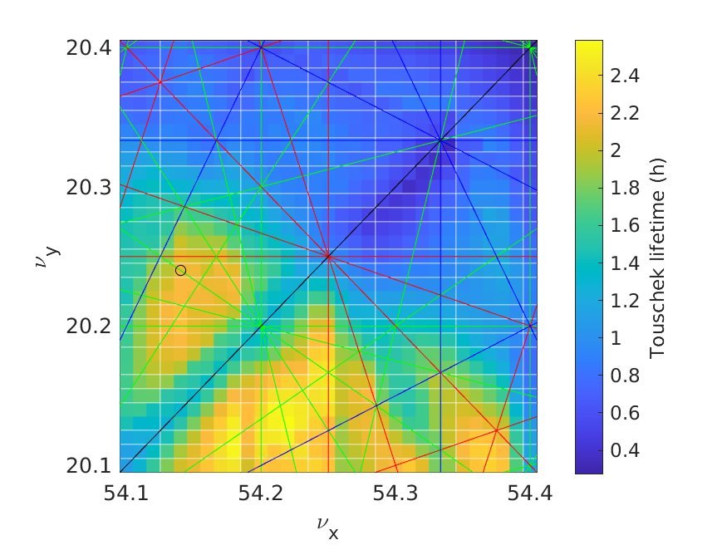
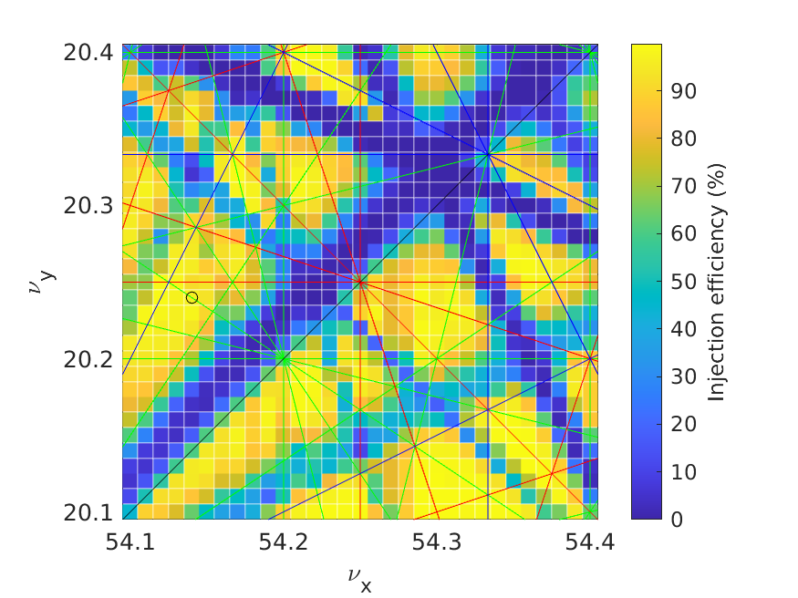
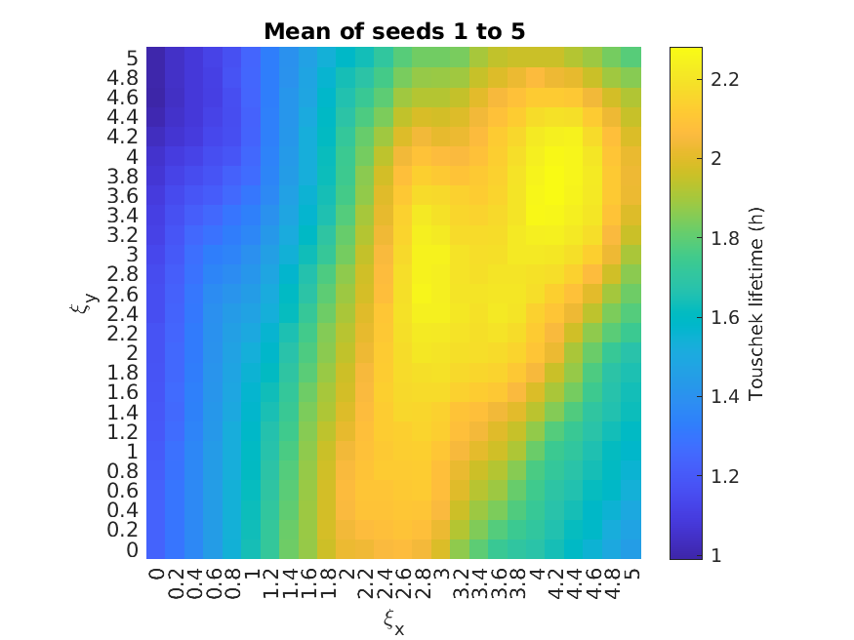
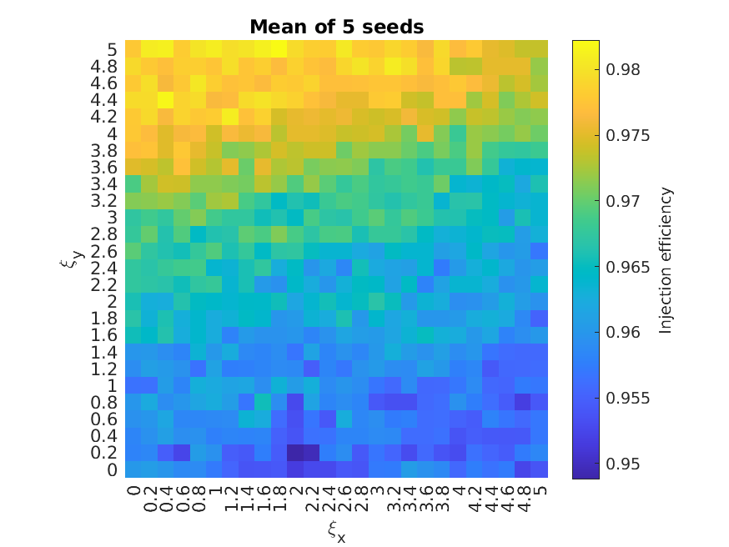
Results
Case 1) Decision variables: x & y tune
Case 2) Decision variables: x & y chromaticity
c
c
y tune
Lifetime (h)
Injection efficiency (%)
Lifetime (h)
Injection efficiency (%)
y tune
y chromaticity
y chromaticity
a
a
b
b
MOGA in AT2
x tune
x tune
x chromaticity
x chromaticity
 | x tune | y tune | Lifetime (h) | Inj. eff. (%)
☆ | 54.14 | 20.24 | 2.15 ± 0.08 | 96.3 ± 3.1
a | 54.25 | 20.17 | 2.38 ± 0.12 | 96.4 ± 4.7
b | 54.22 | 20.10 | 2.28 ± 0.29 | 99.5 ± 0.5
 | x chrom. | y chrom. | Lifetime (h) | Inj. eff. (%)
☆ | 2.585 | 2.621 | 2.15 ± 0.08 | 96.3 ± 3.1
c | 3.675 | 3.837 | 2.24 ± 0.18 | 97.7 ± 1.4
(quoting mean ± std across 5 seeds)
Elegant scans
Injection efficiency (%)
y tune
Lifetime (h)
y tune
y chromaticity
Lifetime (h)
Injection efficiency (%)
y chromaticity
x tune
x tune
x chromaticity
x chromaticity
Neven Blaskovic Kraljevic et al., PAB 2025

Slide 9
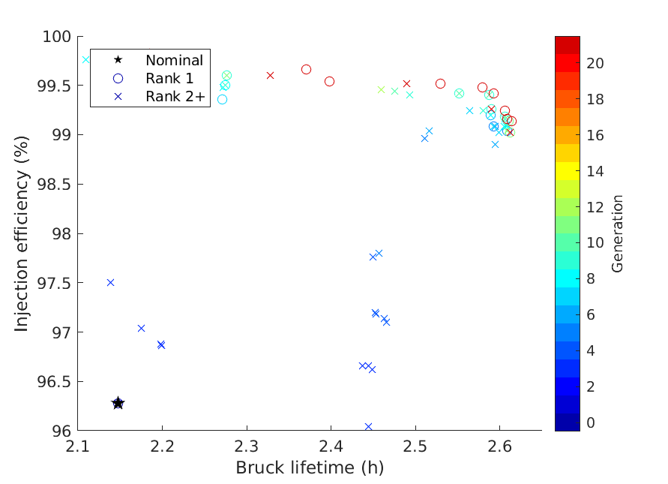
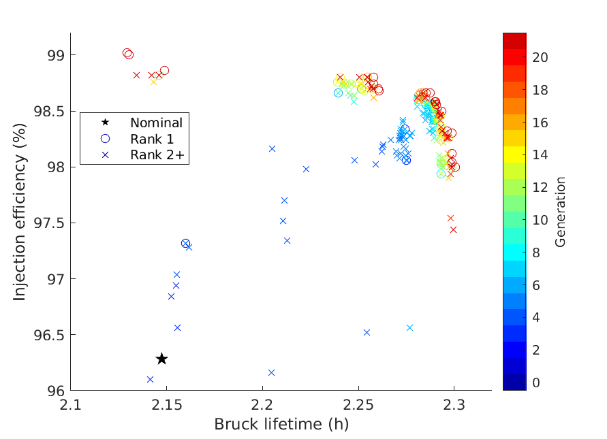
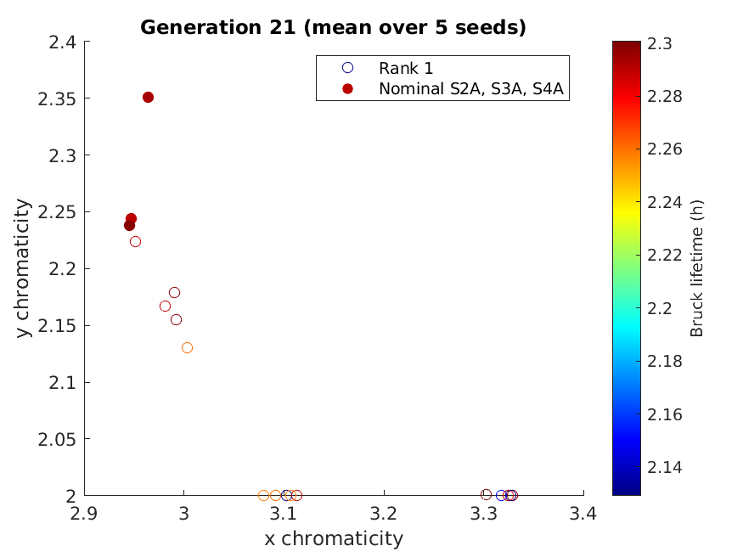
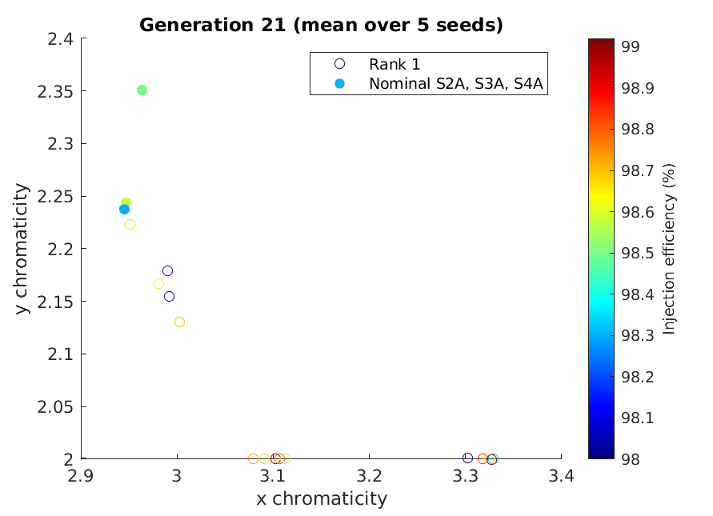
Results
Case 3) Decision variables: x & y tune, x & y chromaticity
 | x tune | y tune | x chrom. | y chrom. | Lifetime (h) | Inj. eff. (%)
Nominal | 54.14 | 20.24 | 2.585 | 2.621 | 2.15 ± 0.08 | 96.3 ± 3.1
Best lifetime | 54.32 | 20.10 | 2.509 | 3.552 | 2.58 ± 0.15 | 99.2 ± 0.7
Best inj. eff. | 54.23 | 20.10 | 4.140 | 4.812 | 2.14 ± 0.14 | 99.8 ± 0.2
Injection efficiency (%)
Generation
Lifetime (h)
Case 4) Decision variables: harmonic sextupoles (S1X, S5X, S6X), octupoles (O0X, O1X)
 | S1X (m⁻³) | S5X (m⁻³) | S6X (m⁻³) | O0X (m⁻⁴) | O1X (m⁻⁴) | Lifetime (h) | Inj. eff. (%)
Nominal | 37 | -79 | -14 | 246 | -3889 | 2.15 ± 0.08 | 96.3 ± 3.1
Best lifetime | 41 | -76 | -9 | 251 | -3899 | 2.30 ± 0.06 | 97.8 ± 2.1
Best inj. eff. | 46 | -65 | -12 | 184 | -3914 | 2.13 ± 0.23 | 99.0 ± 1.0
Injection efficiency (%)
Generation
Lifetime (h)
Chromaticity ≥ 2 to mitigate transverse instabilities
Chromaticity ≤ 5 for an optimum efficacy of the transverse multi-bunch feedback
Best lifetime closest to nominal chromaticity
y chromaticity
Lifetime (h)
Injection efficiency (%)
y chromaticity
x chromaticity
x chromaticity
Neven Blaskovic Kraljevic et al., PAB 2025

Slide 10
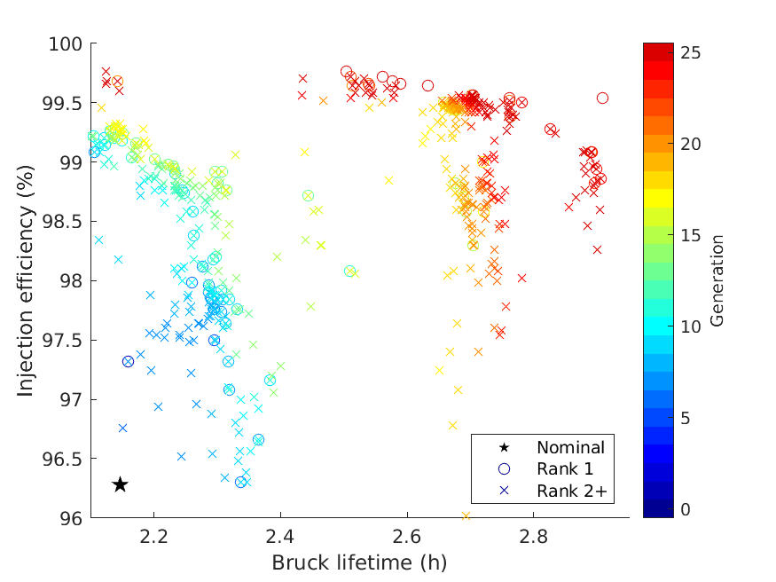
Results
Case 5) Decision variables: sextupoles (S1XL, S1XS, S2AL, S2AS, S3AL, S3AS, S4AL, S4AS, S5X, S6X), octupoles (O0X, O1X)
Subdivide sextupole families according to if they are next to L or S straight (as each sextupole is on an individual power supply)
Chromaticity corrected to be between 2 and 5
using chromatic sextupoles
Lifetime: 2.91 h
Injection efficiency: 99.5%
S1XL
S2AL
S3AL
S4AL
S5X
S6X
S6X
S5X
S4AS
S3AS
S2AS
S1XS
L
M
S
Neven Blaskovic Kraljevic et al., PAB 2025

Slide 11
Conclusions
The Diamond-II beam lifetime and injection efficiency has been optimised using MOGA by varying:
  Tune and chromaticity
  Sextupole and octupole strengths
We include:
  All apertures, including closed insertion devices and collimators
  Alignment, field strength and multipole errors
  Optimisation on the average of 5 error seeds
20% increase in lifetime by varying tune and chromaticity, but with a vertical tune close to integer resonance
35% increase in lifetime, with an injection efficiency of >99%, by varying sextupole and octupole strengths, including within families – 12 decision variables possible by using MOGA
Further work:
  Validate results using 20 seeds
  Use optimum solution as input to a new MOGA run
  Expand the population size and/or number of optimisation generations
  Apply to more challenging optics (e.g. lower β in the straights)
Neven Blaskovic Kraljevic et al., PAB 2025

Slide 12
Thank you for your attention!
Neven Blaskovic Kraljevic et al., PAB 2025

