Slide 1
RF breakdown detection and localization using optical fibers
Ana Guisao-Betancur^{1,2}, Joseph Wolfenden^{1,2,3}, Angus Jones^{1,2},
Aaron Farricker⁴, Thomas Pacey⁴, Storm Mathisen⁴, Carsten Welsch^{1,2}
A.M.Guisao-Betancur@liverpool.ac.uk
¹. Department of Physics, University of Liverpool, Liverpool L69 7ZX, UK
². Cockcroft Institute, Sci-Tech Daresbury, Daresbury WA4 4AD, UK
³. D-Beam, Sci-Tech Daresbury, Daresbury WA4 4AD, UK
⁴. ASTeC/STFC, Sci-Tech Daresbury, Daresbury WA4 4AD, UK

Slide 2
Contents
Problem description
Optical fiber beam loss monitor
Technical implementation
Experimental results
Conclusions and future developments

Slide 3
1. Problem description

Slide 4
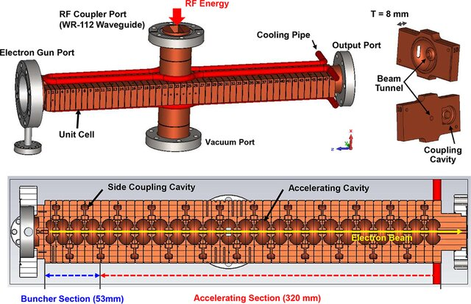
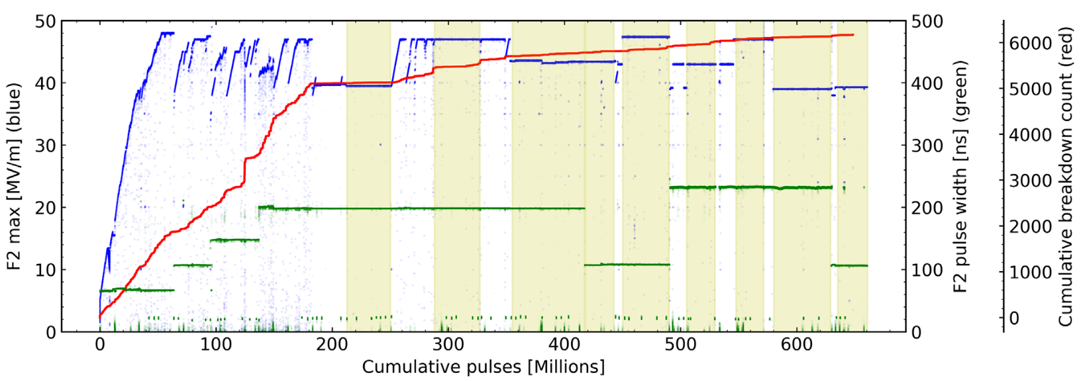
1. Problem description
Radiofrequency (RF) cavities
RF cavities are metallic structures that use electromagnetic fields to accelerate particles.
Before operational use, the structures need a conditioning process: a gradual increase of the accelerating gradient to operational levels.
Breakdowns/vacuum arcing limit achievable gradient and risk cavity damage.
Blue line: Accelerating gradient [MV/m]
Red line: Cumulative breakdown count
Figure 2: Overview of the conditioning period at XBOX2 test stand for CLIC*.
*Image from [1]: https://doi.org/10.1103/PhysRevAccelBeams.25.104601
Figure 1: Example configuration of a side‐coupled linac*.
*Image from: https://doi.org/10.1002/mp.15077

Slide 5
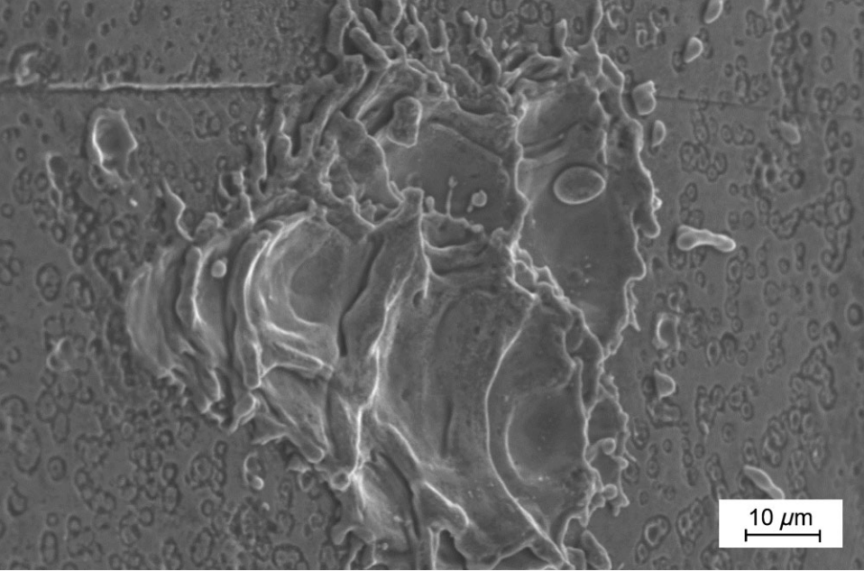
1. Problem description
Monitoring RF breakdowns
RF breakdowns (are thought to) occur at localized regions with enhanced electric fields, caused by:
Contaminants
(particles, impurities).
Geometrical features
(sharp edges, iris shapes).
Crystal defects
(material imperfections).
Effects of the RF input power.
Why is it important to monitor RF cavity breakdowns?
Prevent damage.
Ensure operational stability.
Optimize the conditioning process.
Machine protection.
Advance research.
Need for diagnostics for detection and/or localization.
Figure 3: Example of a crater after a breakdown on the surface of a copper RF cavity*.
*Image from [1]: https://doi.org/10.1103/PhysRevAccelBeams.25.104601
Goals:
Real-time.
Non-invasive.
Existing diagnostics use reflected (and transmitted) power and require careful calibration.

Slide 6
2. Optical fiber beam loss monitor

Slide 7
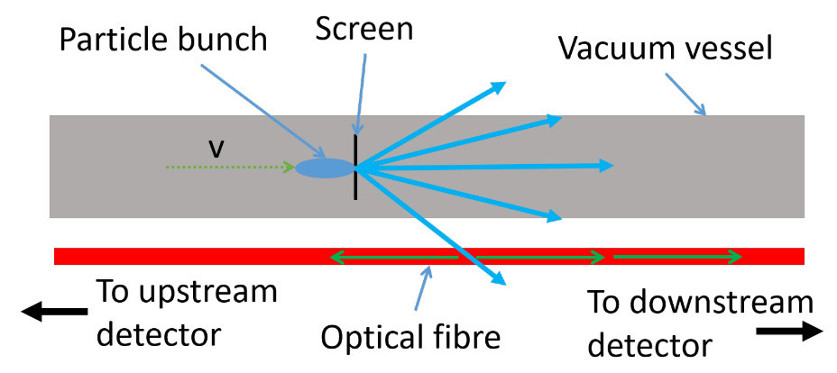
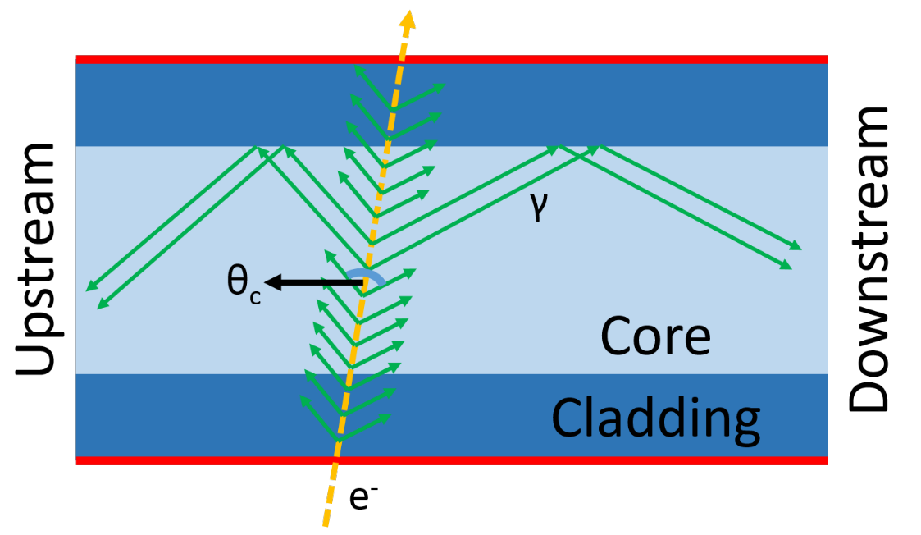
2. Optical fiber beam loss monitor
Detection principle: Cherenkov radiation
Cherenkov radiation is produced when a charged particle travels through a transparent medium at a speed greater than the speed of light in that medium.
Charged showers
Cherenkov
radiation
Figure 4: Schematic of a loss event and the location measurement by the optical fiber system*.
Figure 5: Simplified schematic of the generation, capture, and propagation of Cherenkov radiation in an optical fiber*.
*Image from [4]: https://doi.org/10.3390/s23042248
*Image from [4]: https://doi.org/10.3390/s23042248

Slide 8
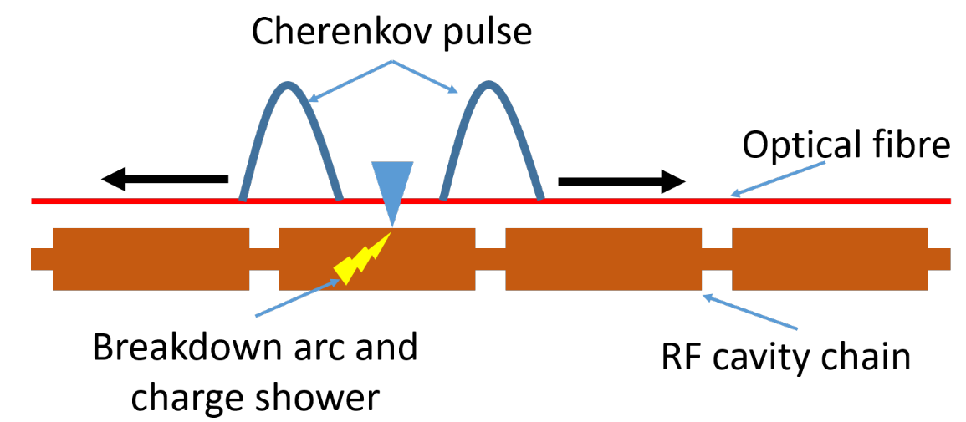
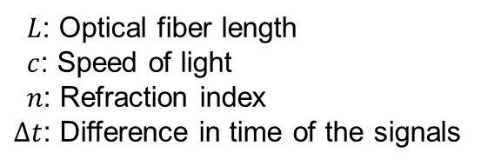
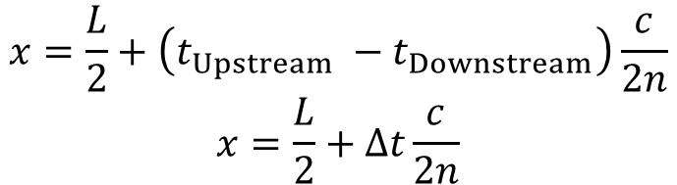

2. Optical fiber beam loss monitor
Application to RF breakdown detection
Bidirectional signal propagation in the fiber.
It’s possible to perform time-of-flight analysis to determine the position $x$ where the fiber is hit.
$$x=\frac{L}{2}+\left(t_{Upstream} −t_{Downstream}\right)\frac{c}{2n}$$
$$x=\frac{L}{2}+Δt\frac{c}{2n}$$
Figure 6: Schematic of a chain of accelerating structures and how the optical fiber system can identify the cavity to cause a breakdown.*.
$L$: Optical fiber length
$c$: Speed of light
$n$: Refraction index
$Δt$: Difference in time of the signals
*Image from [4]: https://doi.org/10.3390/s23042248
Advantages:
Non-invasive.
Scalable.
Longitudinal coverage.

Slide 9
3. Technical implementation

Slide 10
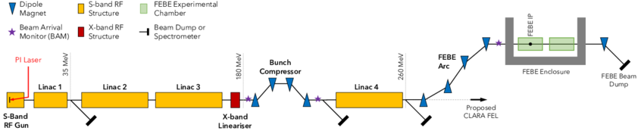
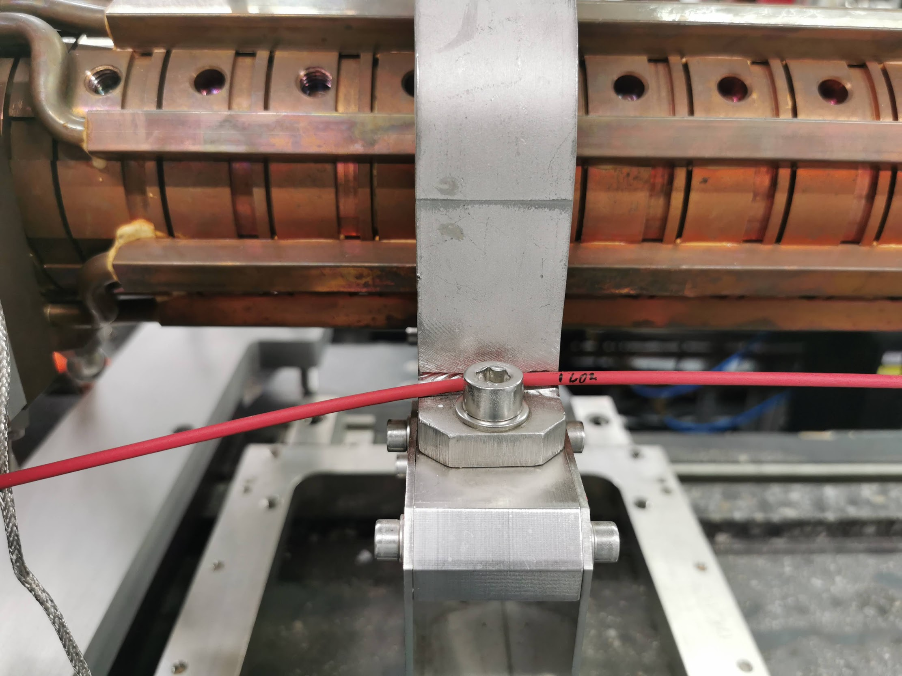
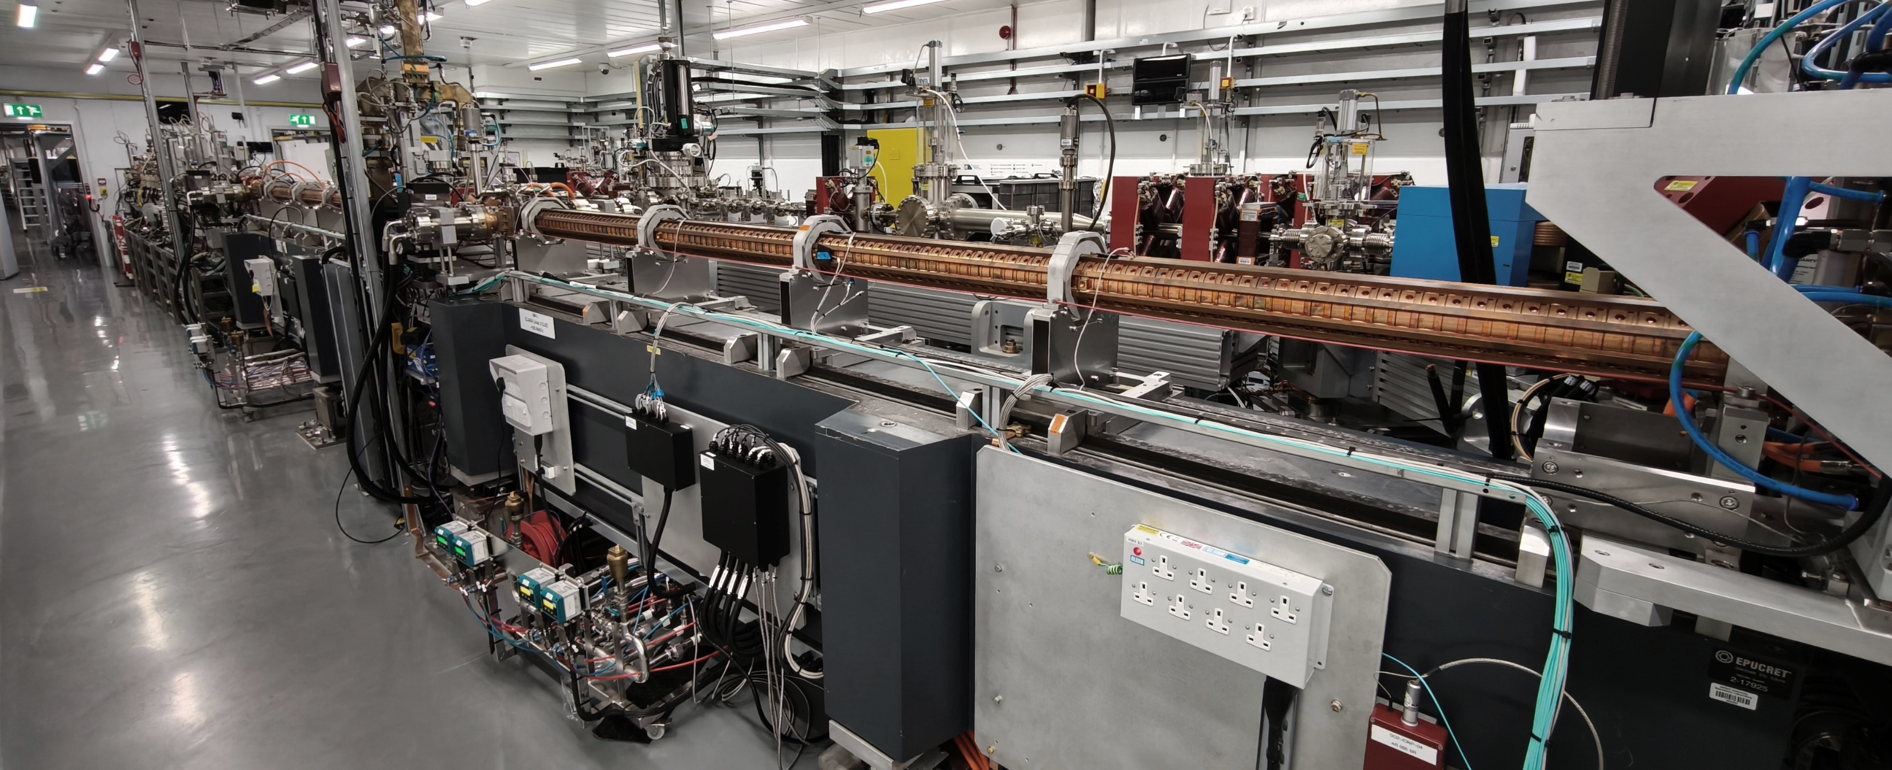
3. Technical implementation
Location of setup at CLARA
JACoW-IPAC-23-TUPL143
Cavity
L02
L03
L03
L02
Optical
fiber
Upstream
Figure 7: Fiber placement along the CLARA beam line.

Slide 11
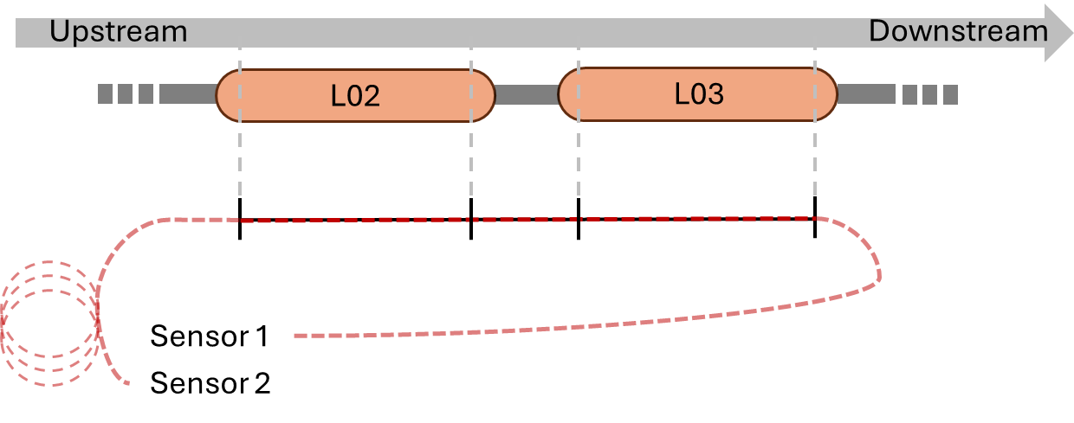
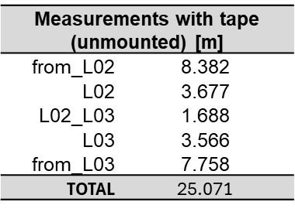
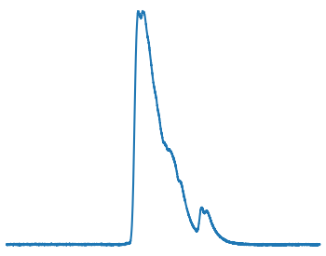
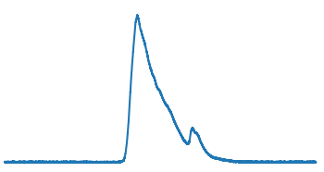




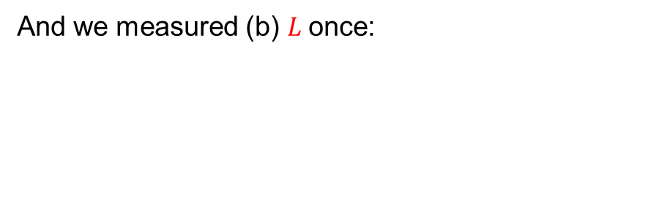

3. Technical implementation
RF breakdown localization method
Remembering the time-of-flight equation, we need to measure (a) Δ𝑡 and (b) $L$.
For each event $n$, we calculate (a) Δ𝑡:
$$x=\frac{L}{2}+Δt\frac{c}{2n}$$
Optical fiber
Type: Core multimode
Reference: FT600UMT
Channel 1: C1 | Channel 2: C2 Downstream | Channel 3: C3 Upstream
Trigger | Sensor 1 (standard) | Sensor 2 (amplifier)
Photodetectors (in custom detector box)
Type: Silicon photomultiplier (SiPM)
Reference: ON Semi J-Series 30020
Figure 8: Schematic of the setup.
And we measured (b) $L$once:
$$L=25.0710±0.0013 m$$
$$Δt_{n}= ?$$
From seven required measurements, $ΔL_{\text{total} } =\sqrt{{\left(ΔL_{1}\right)}^{2}+⋯+{\left(ΔL_{7}\right)}^{2}}$
Measurements with tape (unmounted) [m]
from_L02 | 8.382
L02 | 3.677
L02_L03 | 1.688
L03 | 3.566
from_L03 | 7.758
TOTAL | 25.071

Slide 12
4. Experimental results

Slide 13
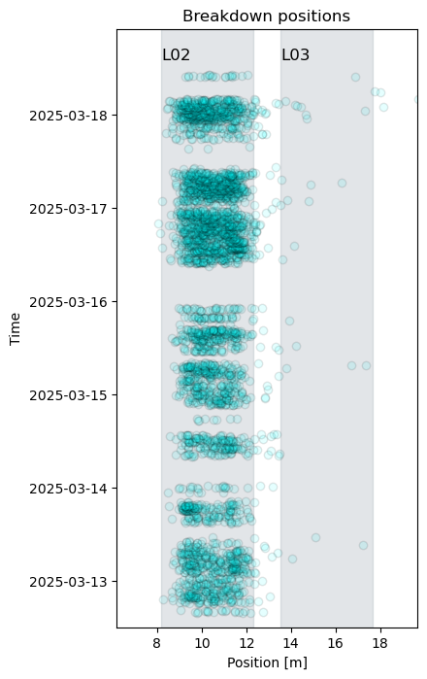
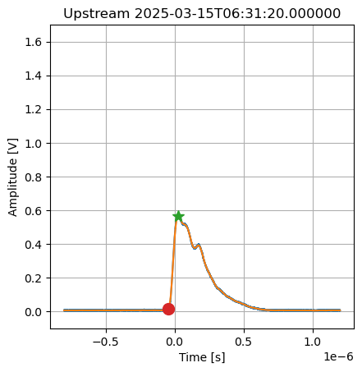
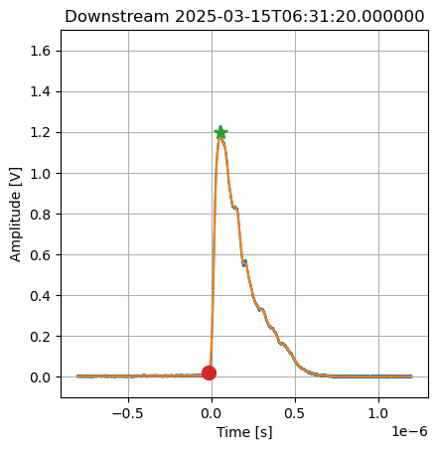
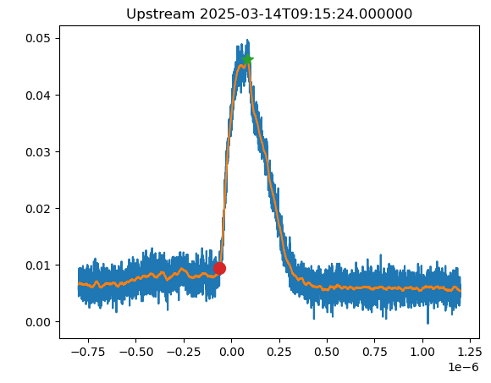



4. Experimental result
Description of the data and resulting breakdown locations
Data from RF conditioning. Finding the time of the signals with a percentage of the maximum ( ) as the rising edge ( ) [5].
Some events were found outside the expected boundaries but could come from signals with poor signal-to-noise ratio making the timing calculation unreliable.
$$Δt_{n}=t_{ Upstream} −t_{ Downstream}$$
$$x_{n}=\frac{L}{2}+Δt_{n}\frac{c}{2n}$$
Figure 9: Signals from a single RF breakdown event.
Figure 10: Resulting locations for the $n≈5000$ events, within the timeframe.

Slide 14
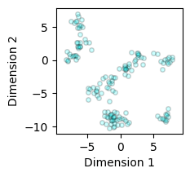
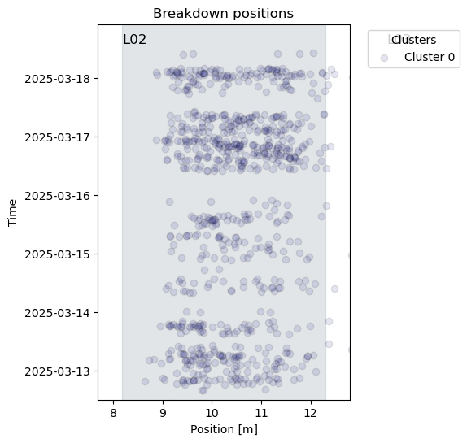
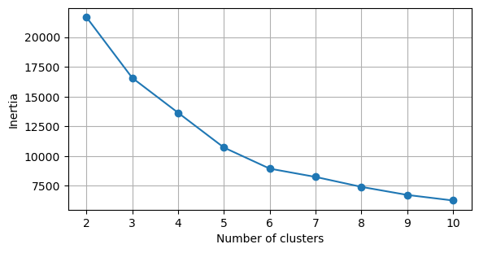
4. Experimental result
Clustering of the results in search of common features
Example of clustering data
For this initial analysis, we decided to test k-means as clustering algorithm to try to find shared features in the breakdown events.
Some initial observations about the clusters:
Some share a location, suggesting hotspots (see clusters 2 and 3).
Some seem to spread/drift in the cavity as time progresses (1,3,5).
What are the defining features?
Inertia: sum of squared distances of each data point to its closest cluster center.
Figure 11: Determination of an optimal number of clusters for k-means.
Figure 12: Clusters found for k=6.
Cluster 4 is out of the bounds of L02 but has only 5 elements (suggesting they might be noise).

Slide 15
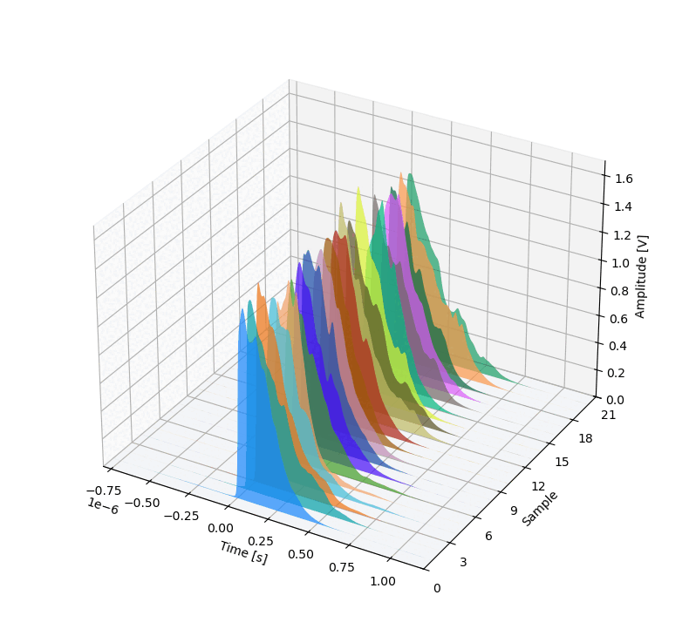
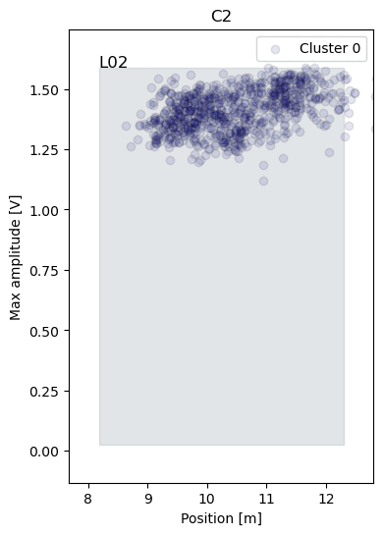
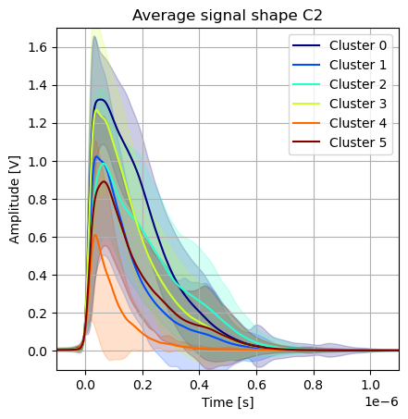
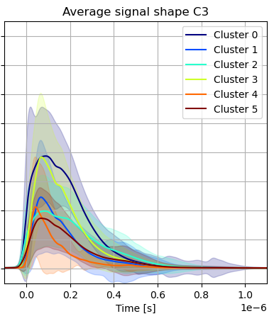
4. Experimental result
Analysis of the clusters’ features
While looking at the signals, shapes and amplitudes seem to be the features that mostly describe the clusters at the different locations.
Figure 14: Cluster visualization for amplitude vs. location and signal samples for C2.
Cluster 4 is out of the bounds of L02.
Channel 2: C2 Downstream | Channel 3: C3 Upstream
Figure 13: Shape features of the different clusters.

Slide 16
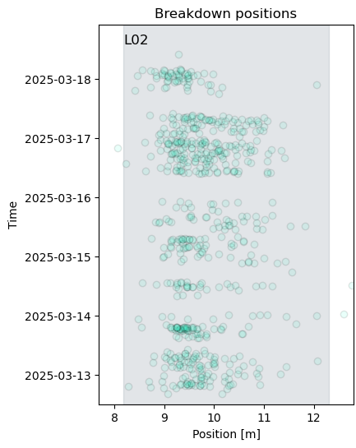
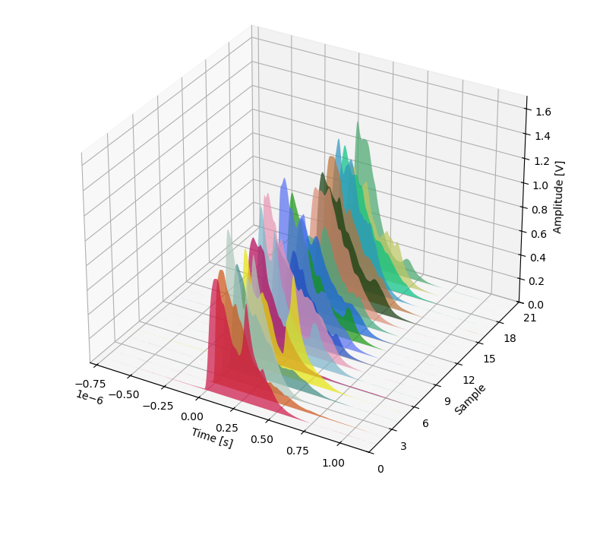
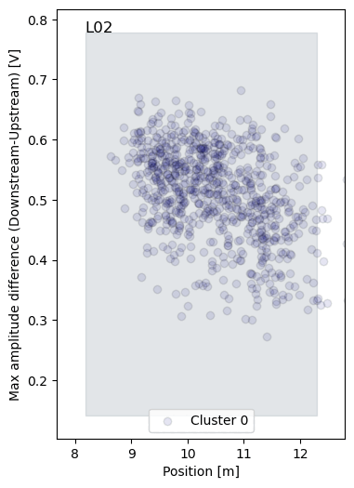
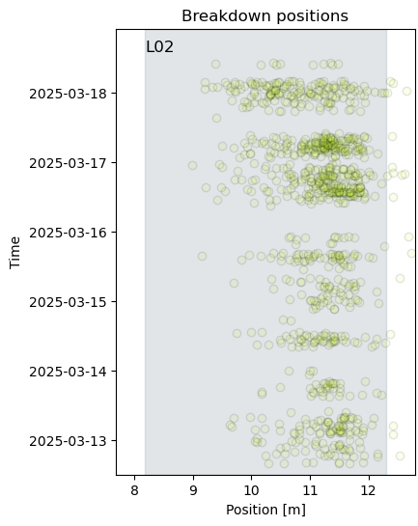
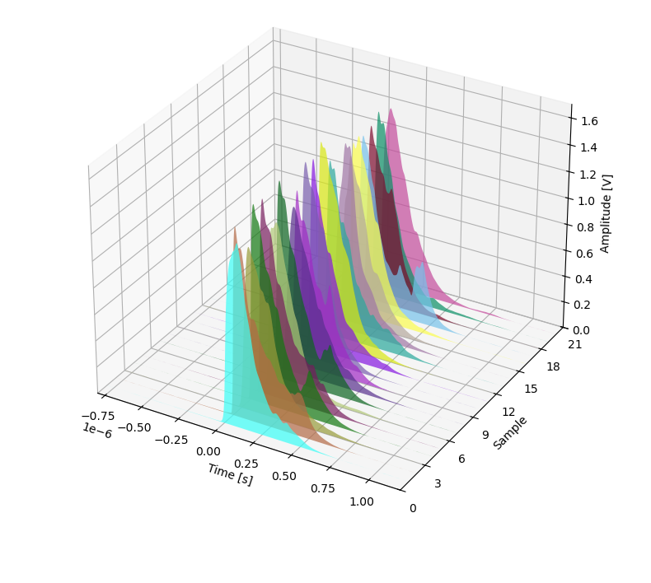
4. Experimental result
Next steps in the analysis of the clusters’ features
Look into highly localized events and the geometry / resulting signals.
More spread in distances of elements in cluster in comparison to amplitude alone.
What other features and algorithms could help describe the data better.
Figure 16: Cluster visualization for amplitude differences between both signals.
Cluster 4 is out of the bounds of L02.
Figure 15: Signal shape visualization for localized events.

Slide 17
5. Conclusions and future developments

Slide 18
5. Conclusions and future developments
Key Advantages of the Technique:
Longitudinal coverage:
Possible to monitor entire cavity structure with a single sensor.
Non-invasive:
No interference with cavity operation.
Scalable:
Adaptable to multi-cavity systems and different setups.
Future Developments:
More analysis of the signals: provide more description and explanation about the measurements.
Machine learning integration: enhance event classification and work towards prediction.
Real-time processing: enable instant breakdown detection and response.
System integration: incorporate into accelerator control and machine protection systems.

Slide 19
References
C. Obermair et al., “Explainable machine learning for breakdown prediction in high gradient rf cavities,” Phys. Rev. Accel. Beams, vol. 25, no. 10, p. 104601, Oct. 2022, doi: 10.1103/PhysRevAccelBeams.25.104601.
N. Shipman, “Experimental study of DC vacuum breakdown and application to high-gradient accelerating structures for CLIC,” University of Manchester, 2014.
A. E. Pollard, A. J. Gilfellon, and D. J. Dunning, “Machine Learning for Rf Breakdown Detection At Clara,” Proc. - Linear Accel. Conf. LINAC, pp. 859–863, 2022, doi: 10.18429/JACoW-LINAC2022-THPORI16.
J. Wolfenden et al., “Cherenkov Radiation in Optical Fibres as a Versatile Machine Protection System in Particle Accelerators,” Sensors, vol. 23, no. 4, p. 2248, Feb. 2023, doi: 10.3390/s23042248.
M. King et al., “A Systematic Investigation of Beam Losses and Position-Reconstruction Techniques Measured with a Novel oBLM at CLEAR,” Instruments, vol. 9, no. 1, p. 4, Feb. 2025, doi: 10.3390/instruments9010004.

Slide 20
Thank you!
Any questions?
Ana Guisao-Betancur^{1,2}, Joseph Wolfenden^{1,2,3}, Angus Jones^{1,2},
Aaron Farricker⁴, Thomas Pacey⁴, Storm Mathisen⁴, Carsten Welsch^{1,2}
A.M.Guisao-Betancur@liverpool.ac.uk
¹. Department of Physics, University of Liverpool, Liverpool L69 7ZX, UK
². Cockcroft Institute, Sci-Tech Daresbury, Daresbury WA4 4AD, UK
³. D-Beam, Sci-Tech Daresbury, Daresbury WA4 4AD, UK
⁴. ASTeC/STFC, Sci-Tech Daresbury, Daresbury WA4 4AD, UK

