Slide 1

Optimization of Gas-Curtain based Ionization Profile Monitor for Laser-Driven Proton Therapy Applications
Farhana Thesni M P
University of Liverpool/ Cockcroft Institute

Slide 2
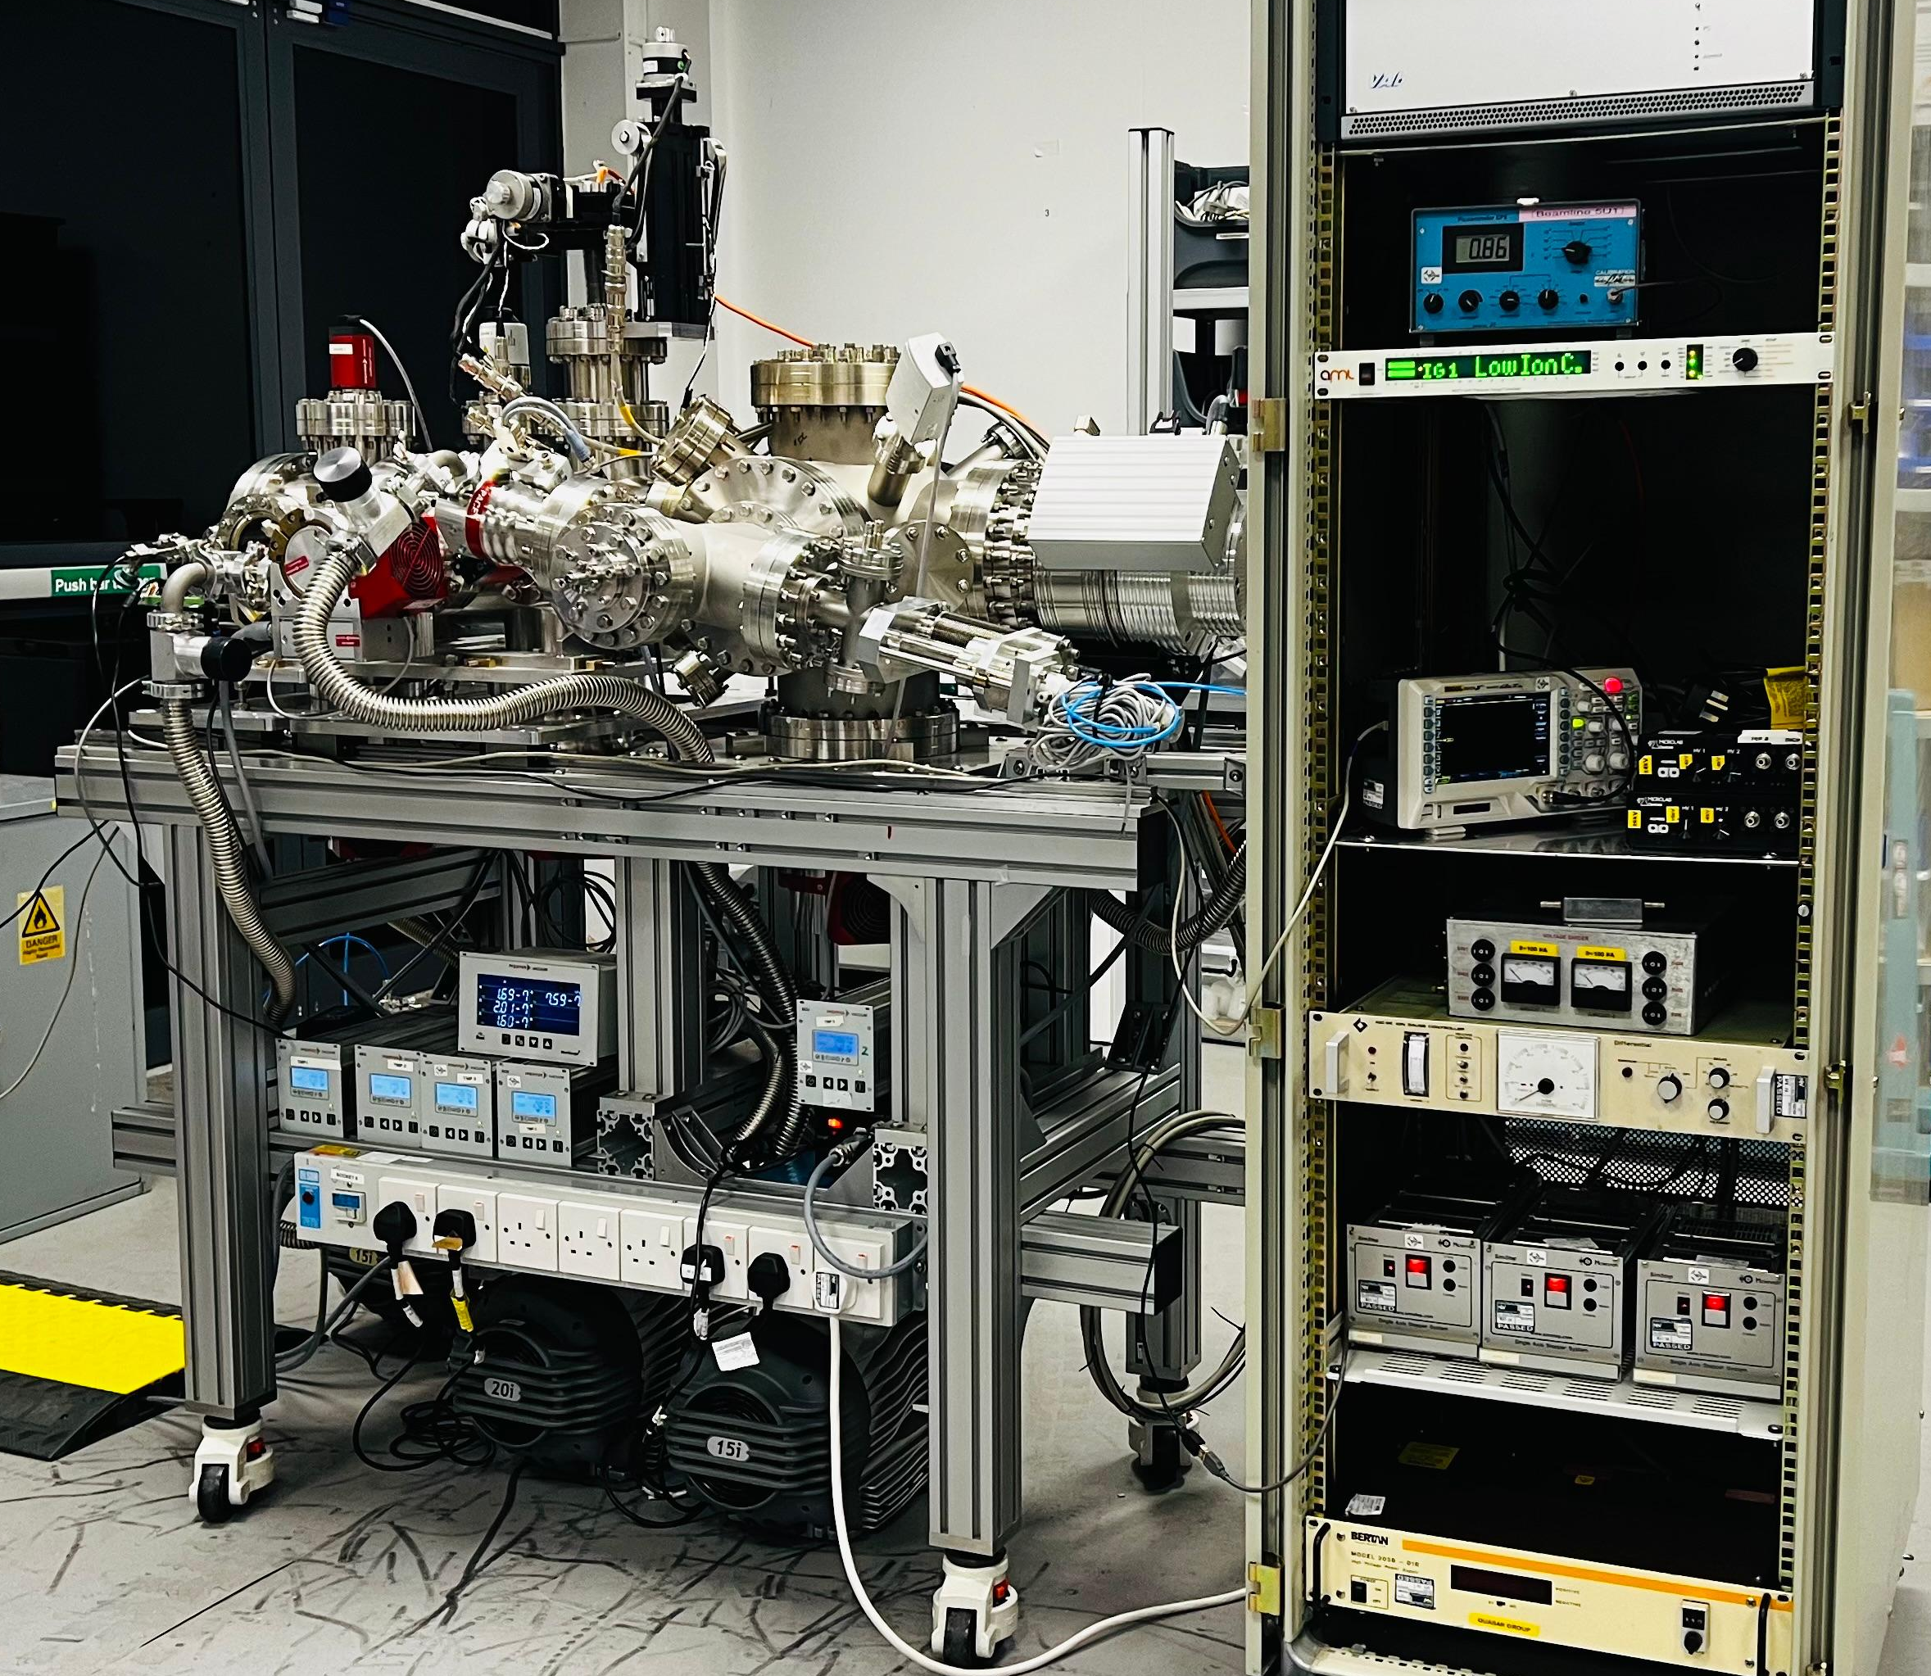
Overview
Motivation
Gas-Jet Monitor
Detector System Simulations
Conclusion and Future Plans

Slide 3
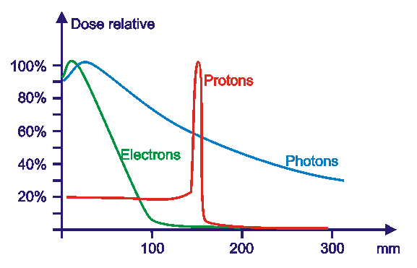

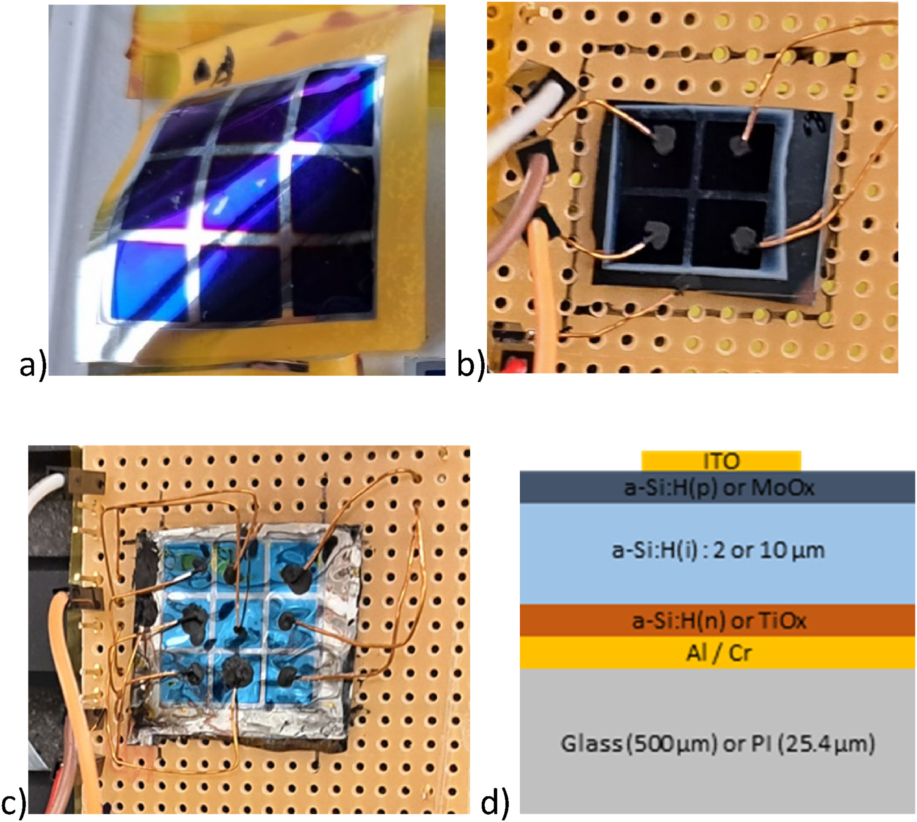

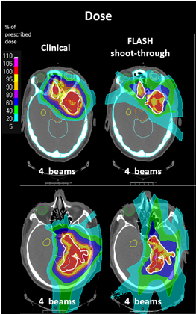

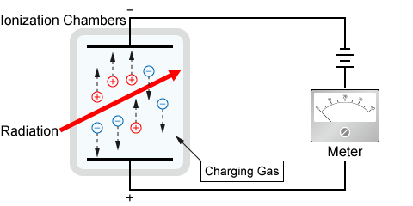

Proton FLASH Therapy
Increased dose conformity to the tumour and Organ At Risk (OAR) sparing
Significant increase in number of proton therapy centres, globally
Amorphous silicon detector
Novel treatment techniques like FLASH and Proton Arc Therapy
Development of advanced facilities for pre-clinical studies.
Ionization Chamber
Durante, M. ,et al., Br J Cancer 120, 777–778 (2019). https://doi.org/10.1038/s41416-018-0329-x
Kneepkens E, et al., Phys Med Biol. 2023 Nov 2;68(21). doi: 10.1088/1361-6560/ad0280. PMID: 37820687.
Plan comparisons for clinical IMPT and proton FLASH plans.

Slide 4

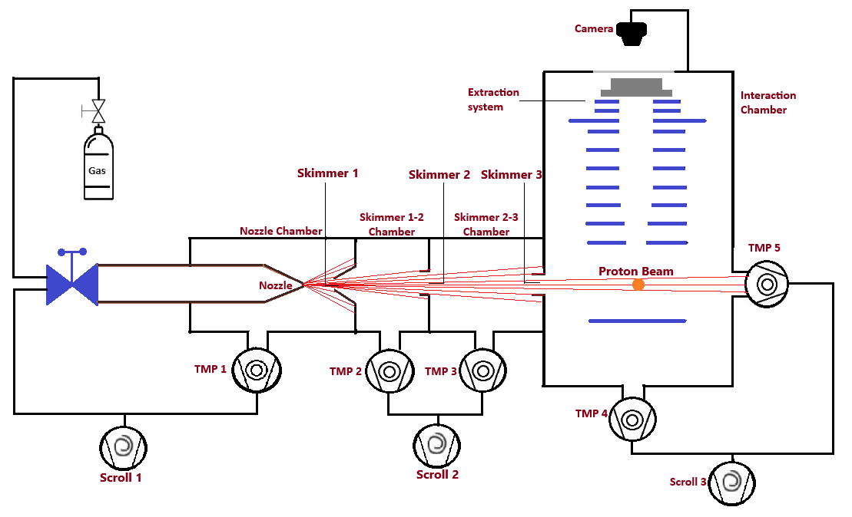
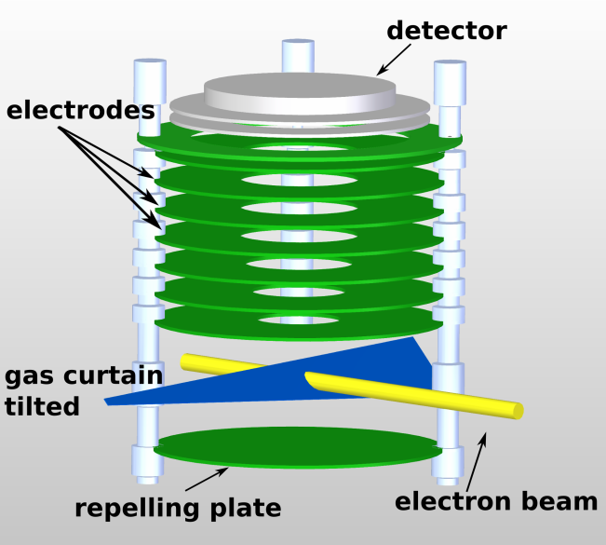
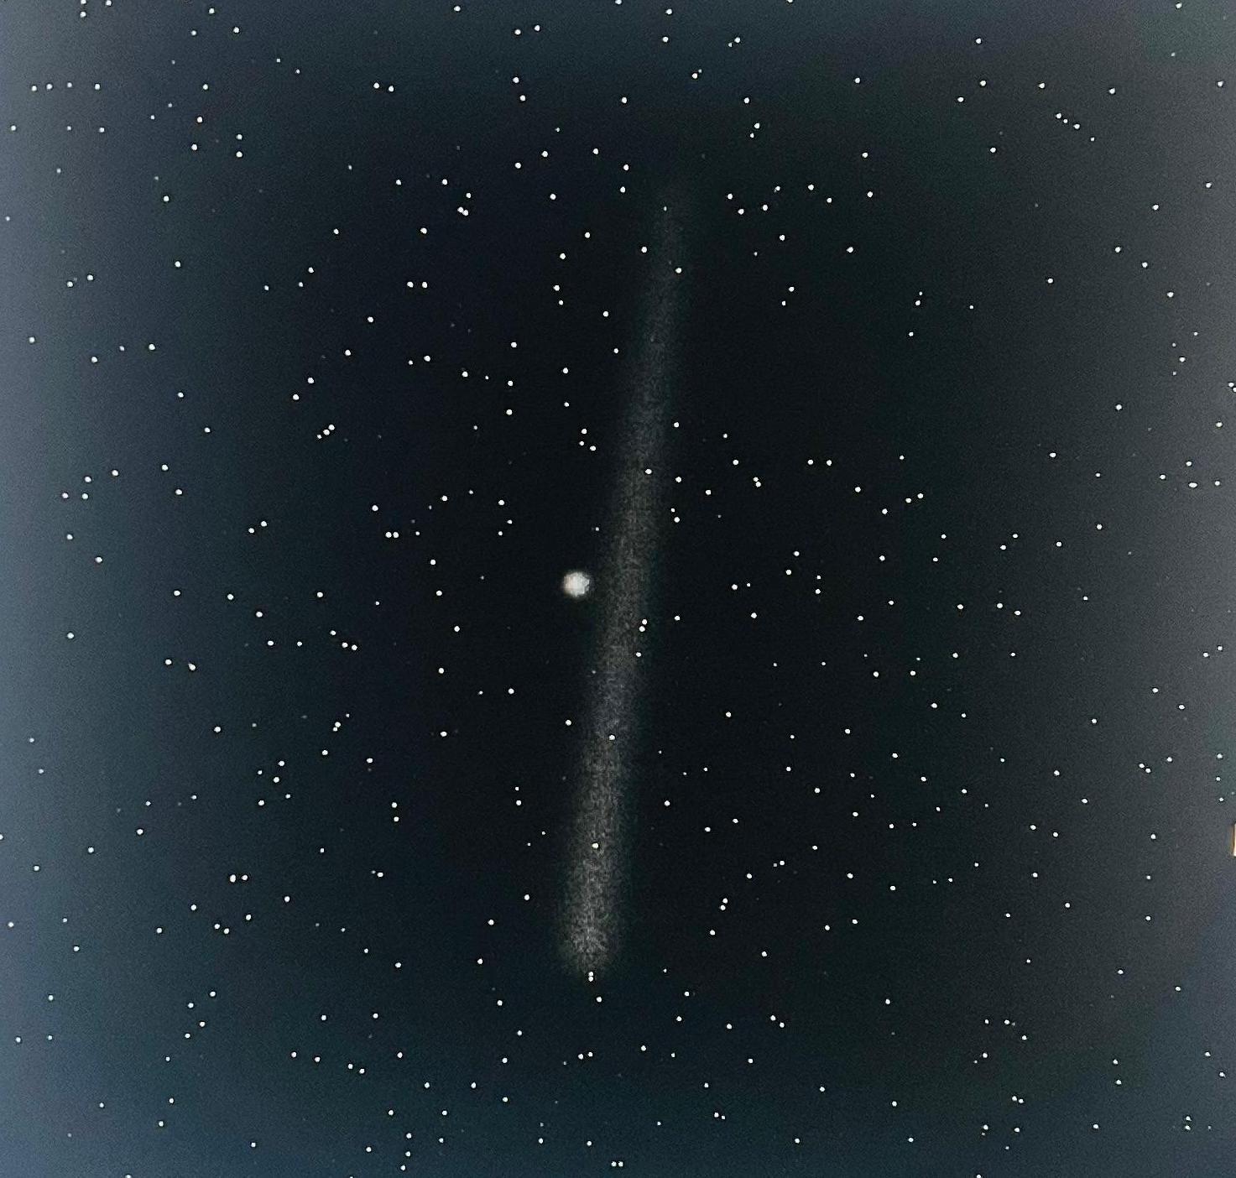

Gas-jet Monitor
Camera
Visible light
Phosphor screen
MCP
Ions extraction
Ionization

Slide 5
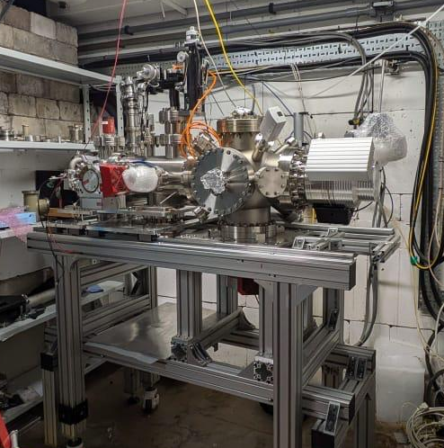
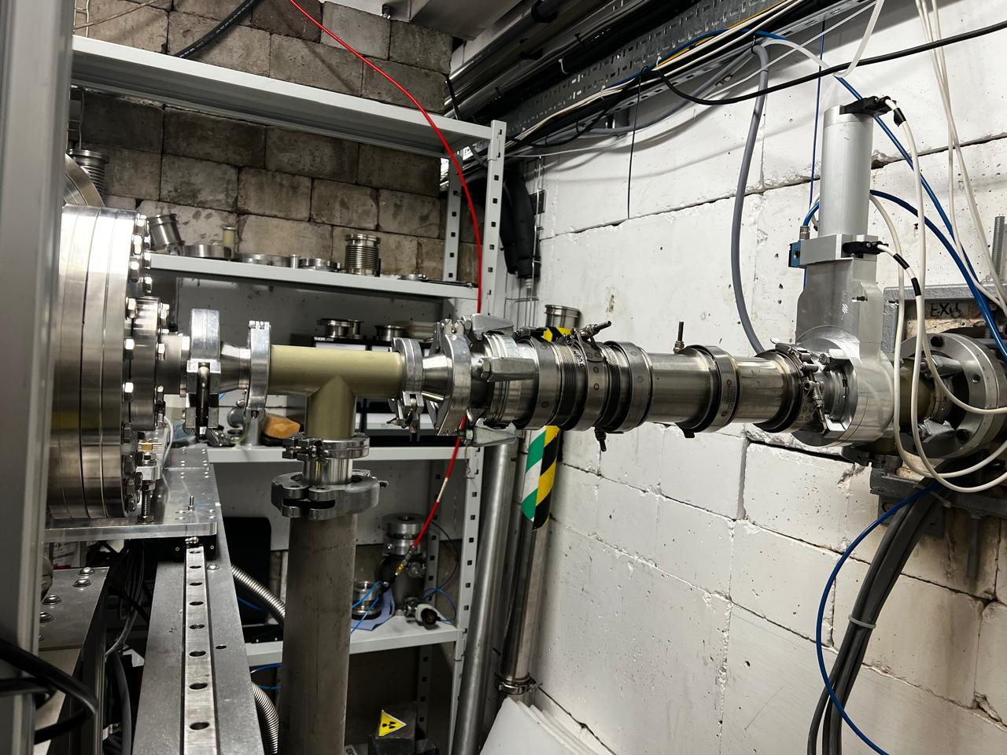
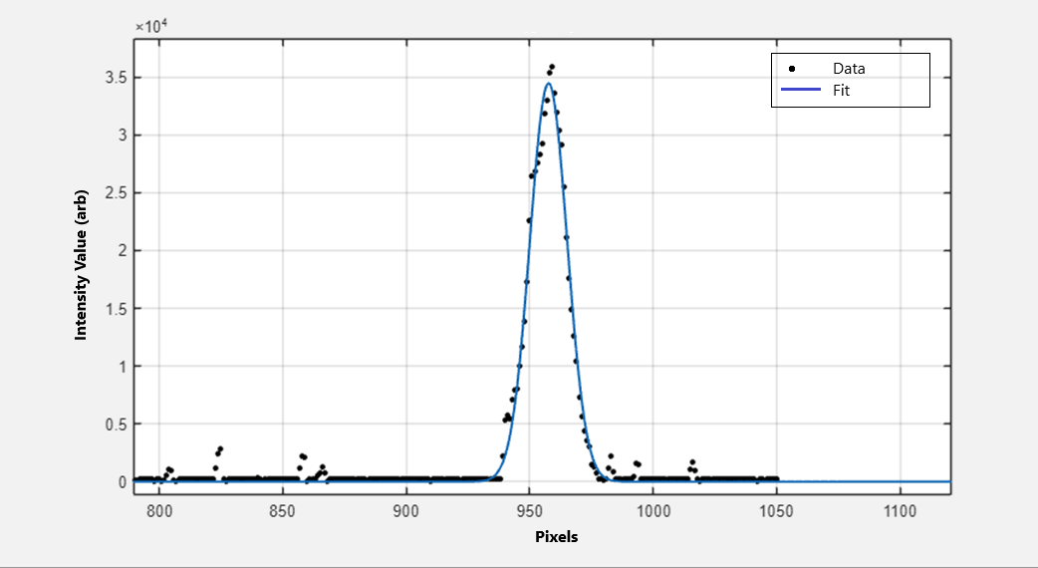
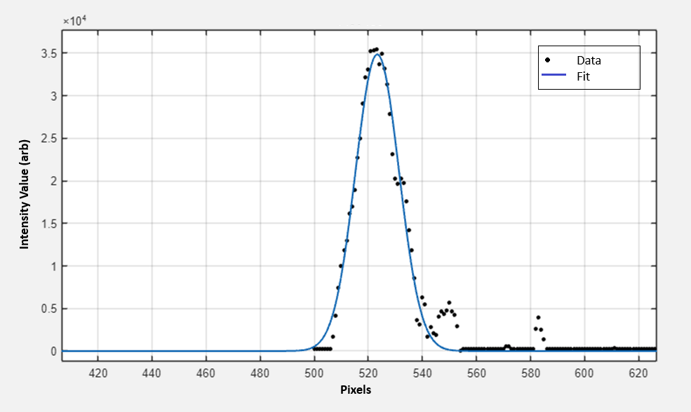
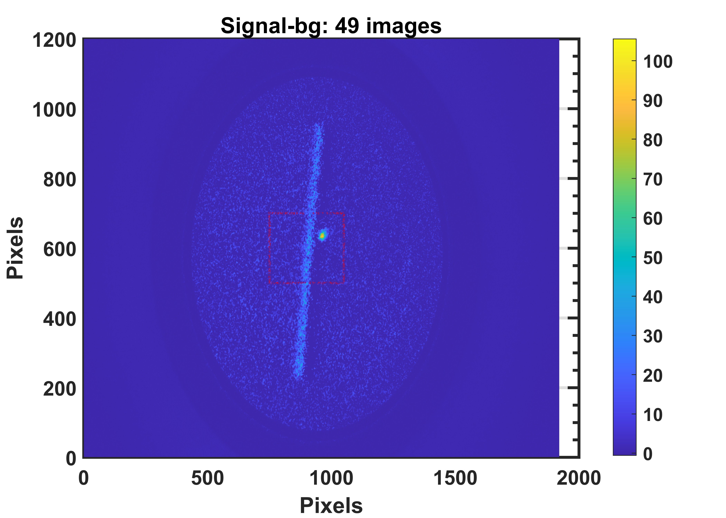
Proton Beam Profile Measurement
Proton beam of MC40 cyclotron at UoB.
Proton beam of energies 10.8, 16, 20 and 28 MeVs and different beam currents.
Horizontal= 1.215 ± 0.026 mm​
Vertical= 1.234 ± 0.044 mm​
Data
Fit
Data
Fit
Selecting the gases according to the beam to get higher ionization cross sections
Optimized jet profile
Intensity (arb)
Intensity (arb)
Improvement in reconstruction of data (Machine Learning)
Improved extraction system
Pixels
Pixels
The X and Y profiles 28 MeV and 69.06 nA with 500 ms integration time

Slide 6
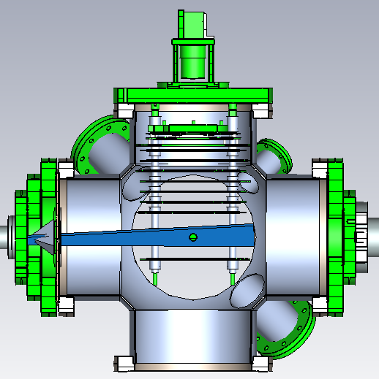
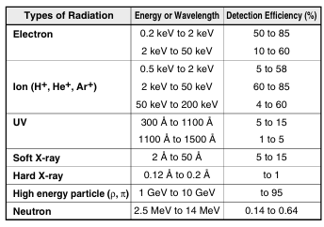
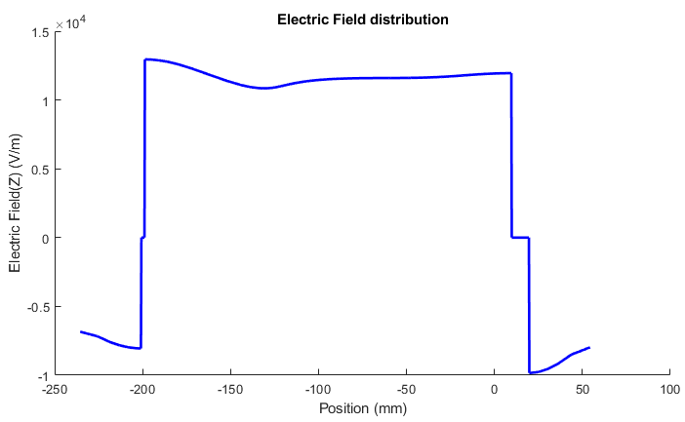


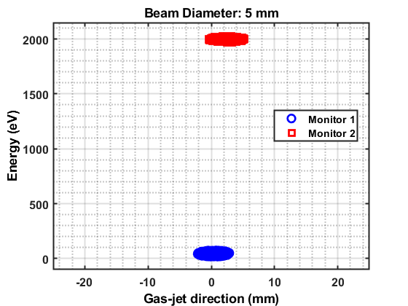
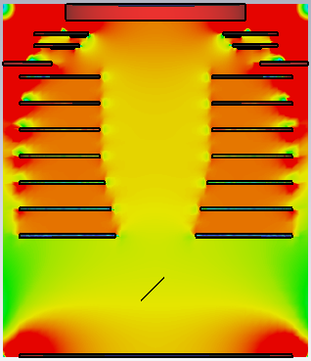
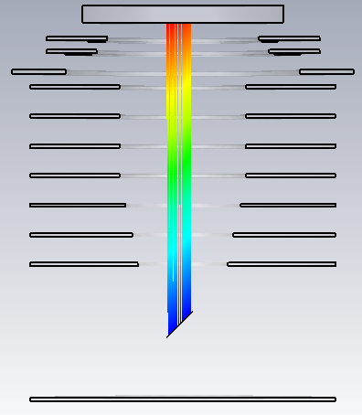
Extraction System-V0
Electric field (Z) (V/m)
  V0: ±17.6%
Detection efficiency of MCP
Drift direction
Electric field distribution along drift region
The electric field distribution and trajectory of argon ions
Trajectory shift (around 2.35 mm)
https://www.hamamatsu.com/eu/en/resources/library.html

Slide 7
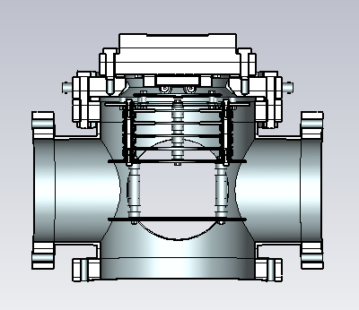
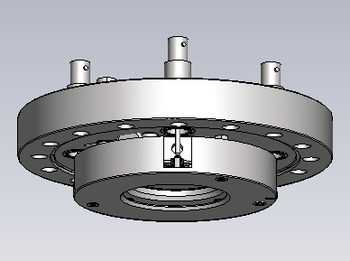
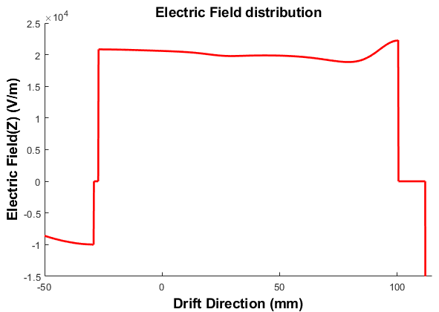
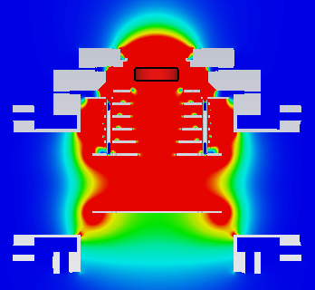
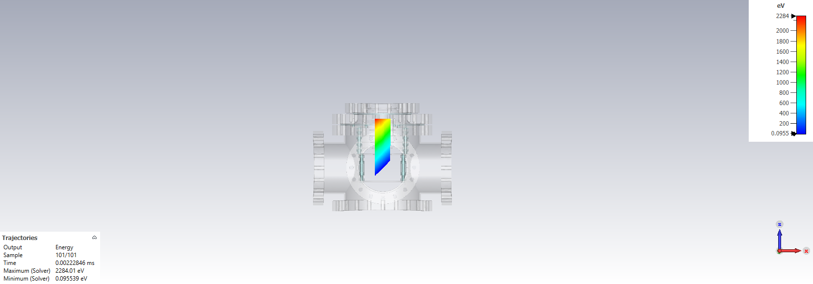


Compact Extraction System- V1
  V1: ±5.03%
Electric field distribution along the drift region
Electric field distribution and trajectory of V1 extraction system.

Slide 8
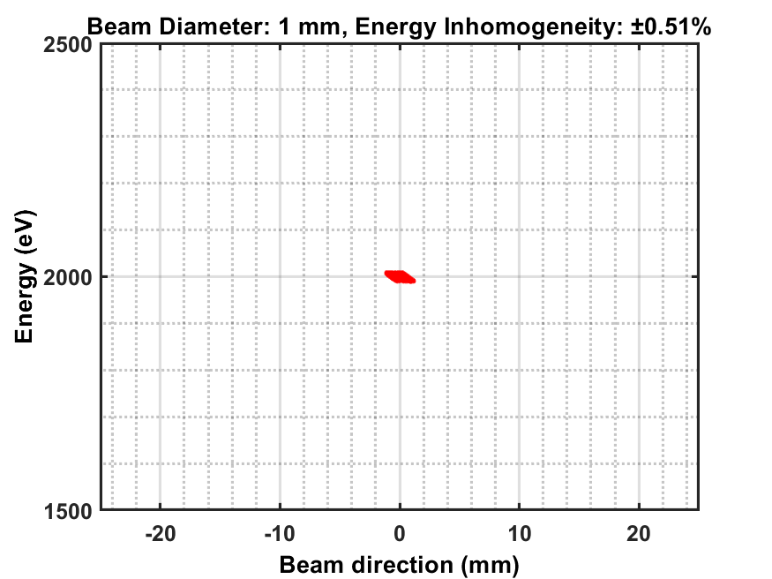
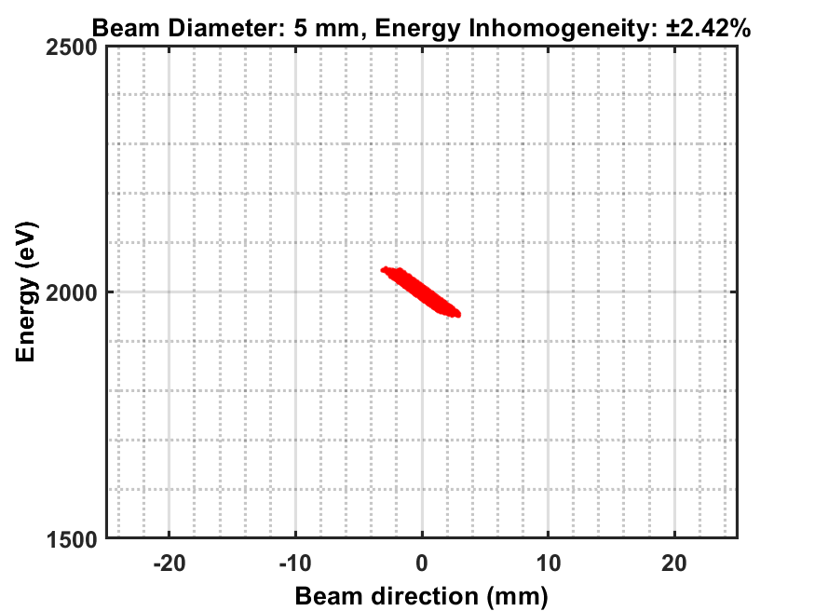
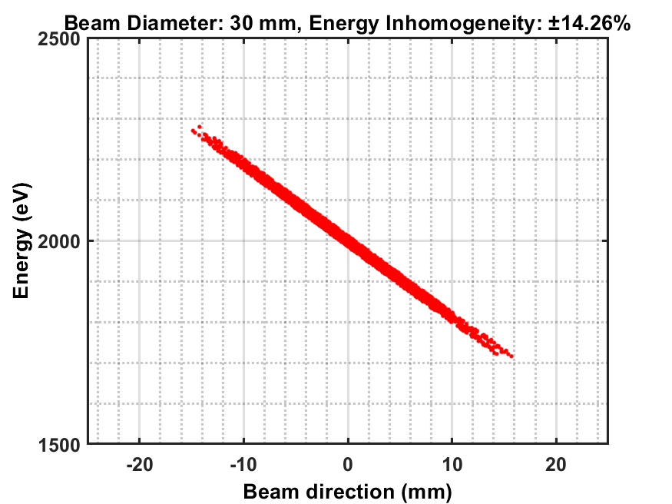
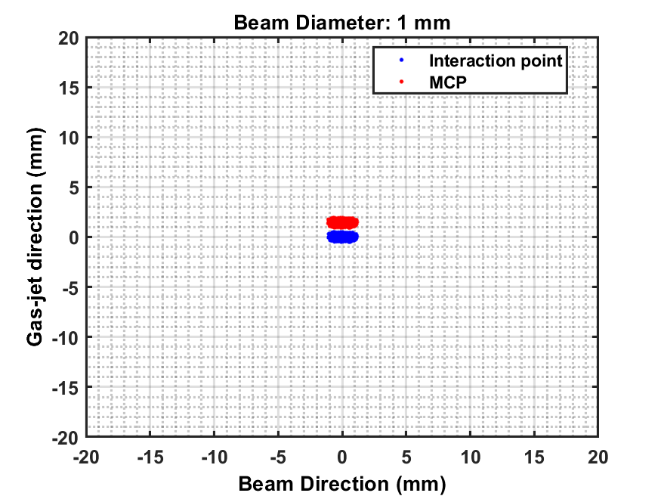
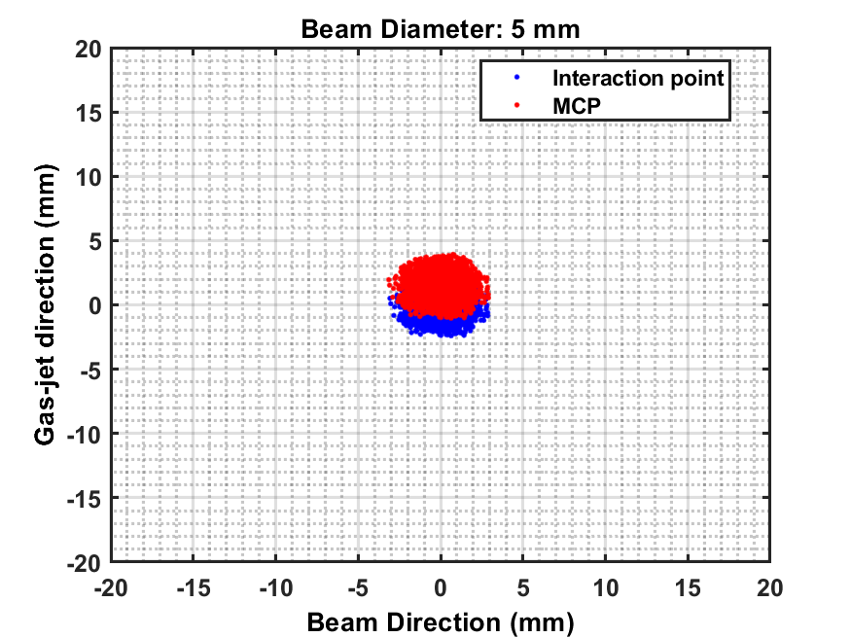
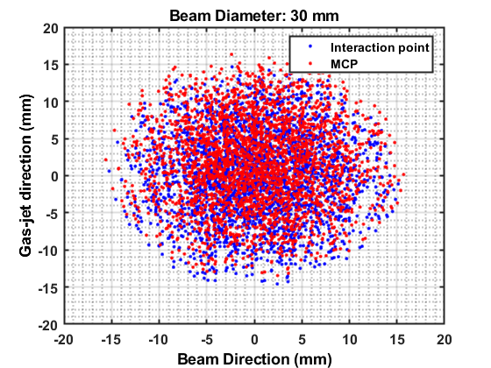
Energy Distribution and Shift in the profile
1.41 mm off-centre

Slide 9
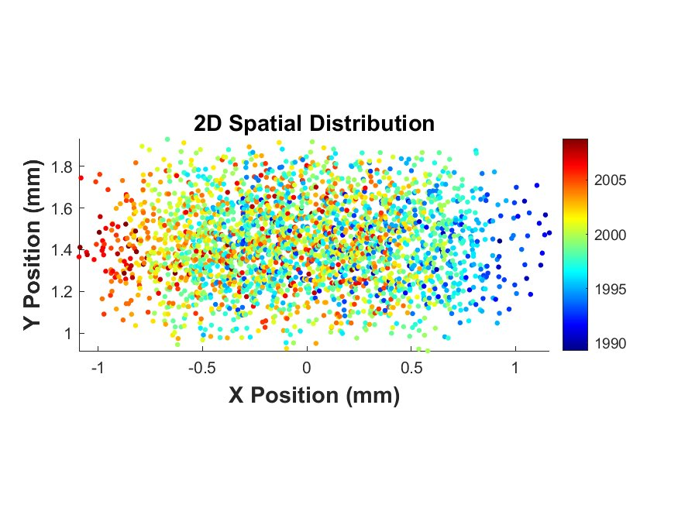
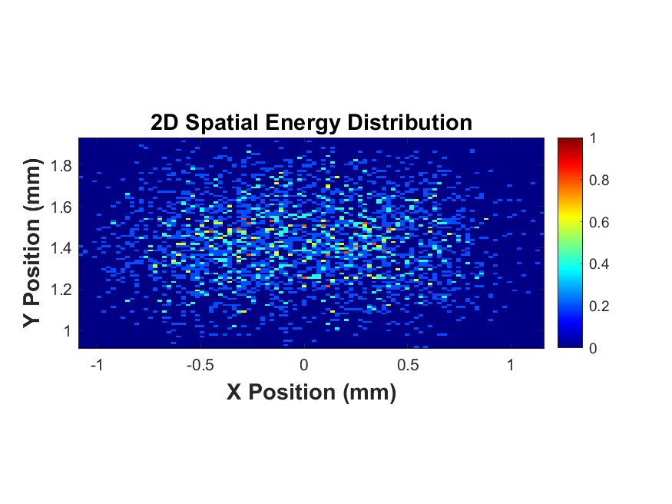
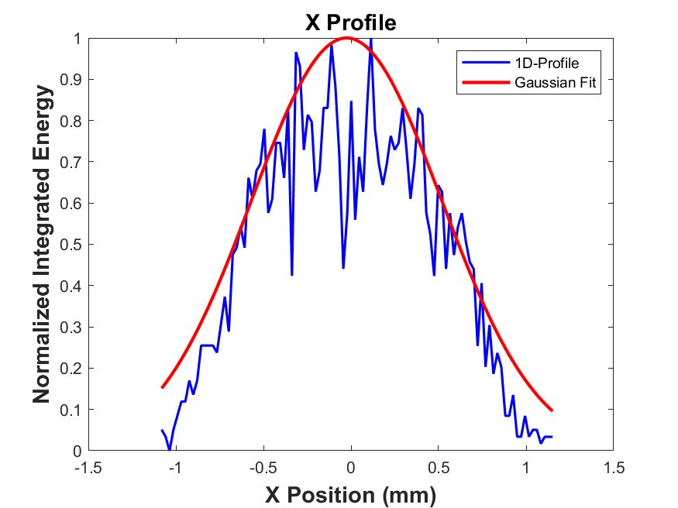
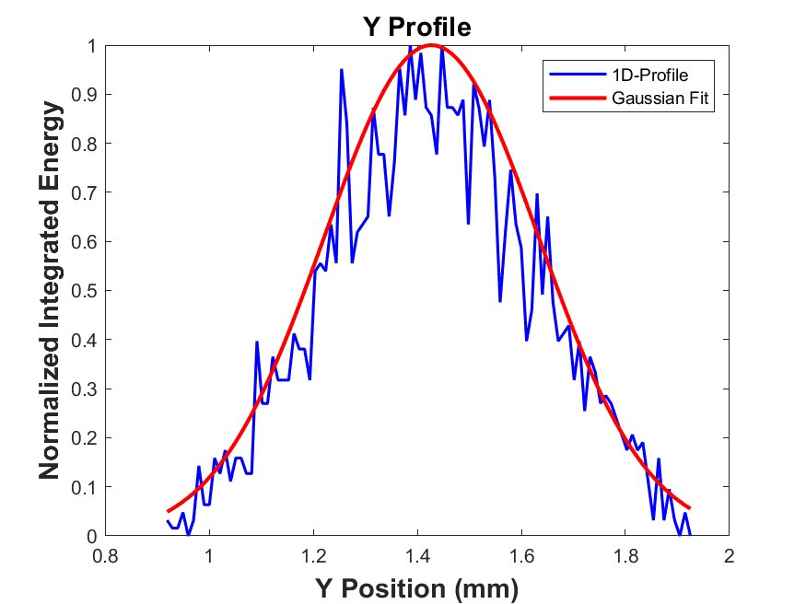
Beam Profile at MCP
Input beam radius : 0.5 mm
Horizontal profile at MCP : 1.28 mm
Vertical profile at MCP : 0.49 mm

Slide 10
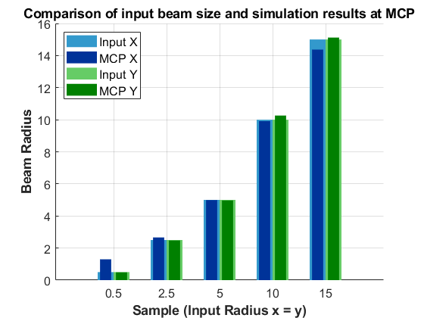
Beam Profile at MCP
Input Beam (mm) | X-profile (mm) | Y-profile (mm) | Variation (%)
0.5 | 1.28 | 0.49 | X= 160.07 Y=0.78
2.5 | 2.66 | 2.47 | X=6.54 Y= 1.17
5 | 4.99 | 4.97 | X=0.2 Y=0.6
10 | 9.91 | 10.26 | X=0.9 Y=2.6
15 | 14.37 | 15.12 | X=4.21 Y=0.8

Slide 11
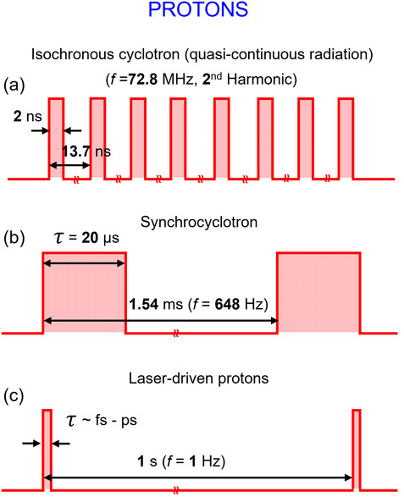
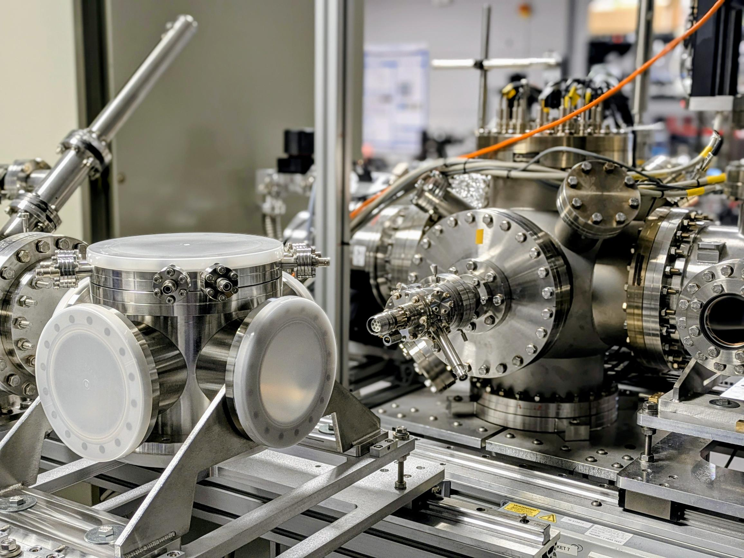
Conclusions and Future
Potential of Real-time beam profile monitoring.
Shot-by-shot measurement of beam profile for laser-driven protons.
Uniform potential distribution with less variation:
  V0: ±17.6%
  V1: ±5.03%
Beam size limitation of less than 40 mm.
Comparison of experiment and simulation.
Study the impact of Beam misalignment.
Commissioning and testing the new extraction system.
The design modification to accommodate broader range of beam sizes.

Slide 12
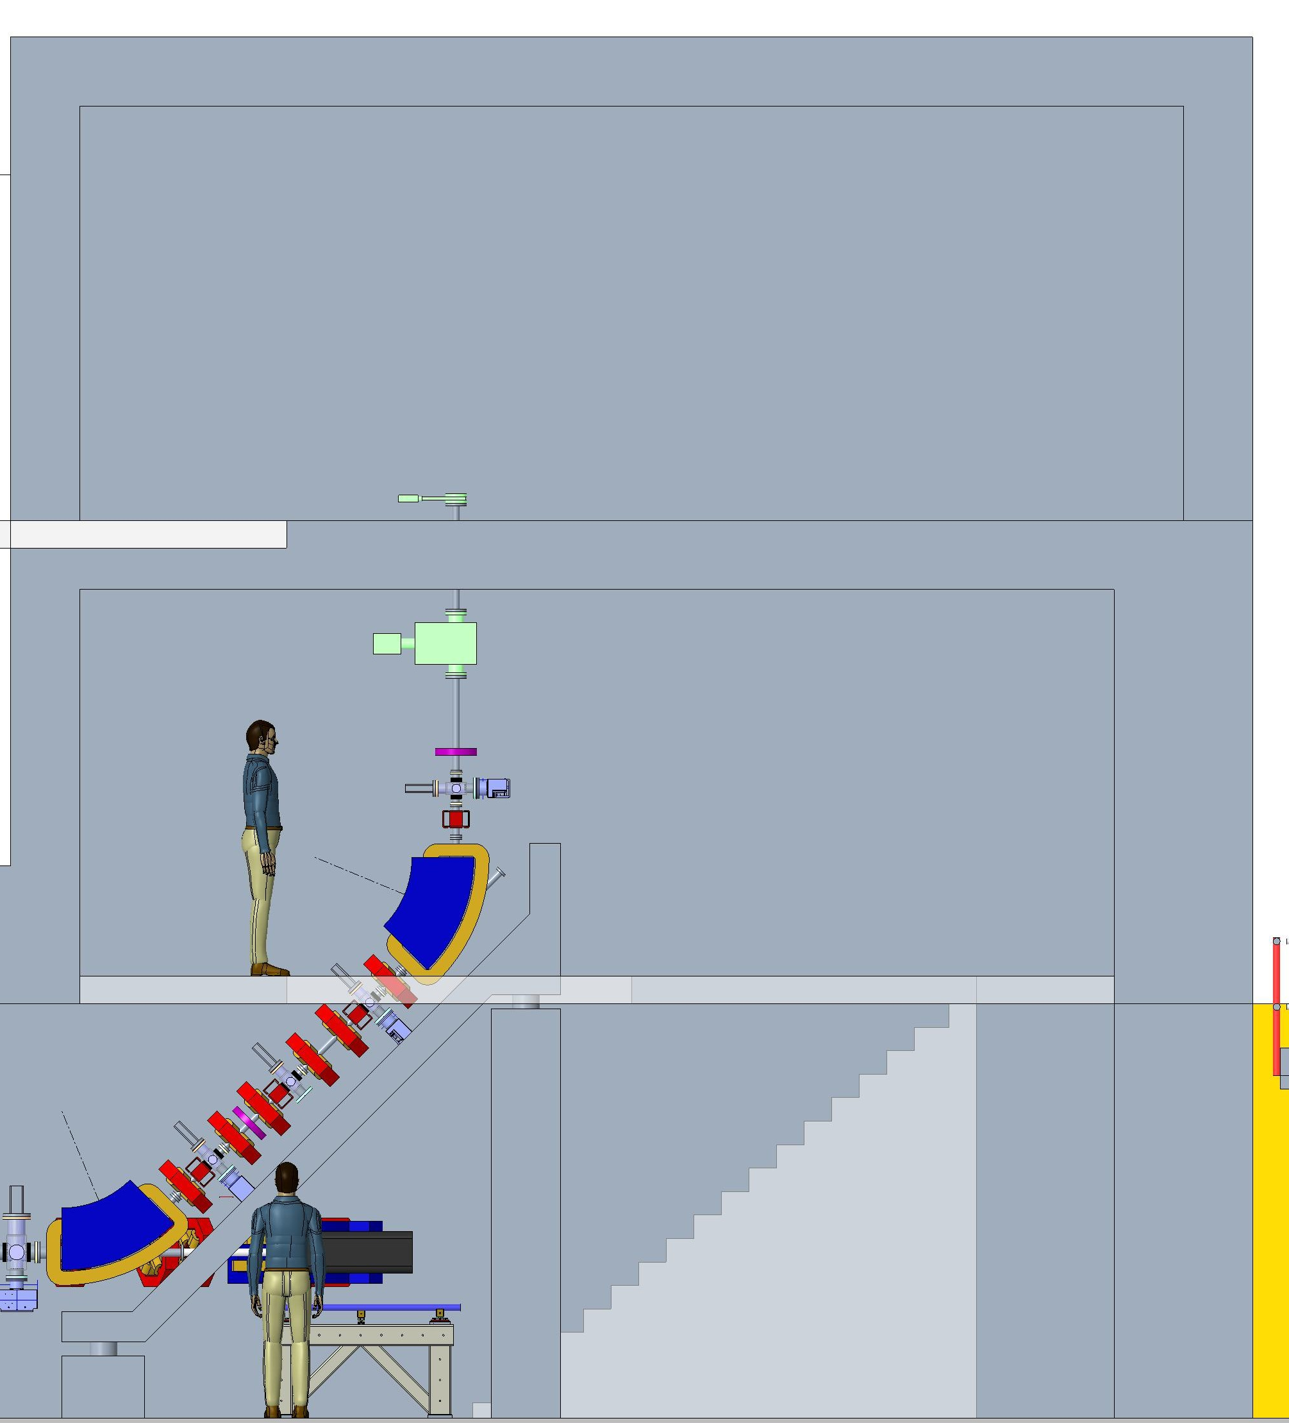

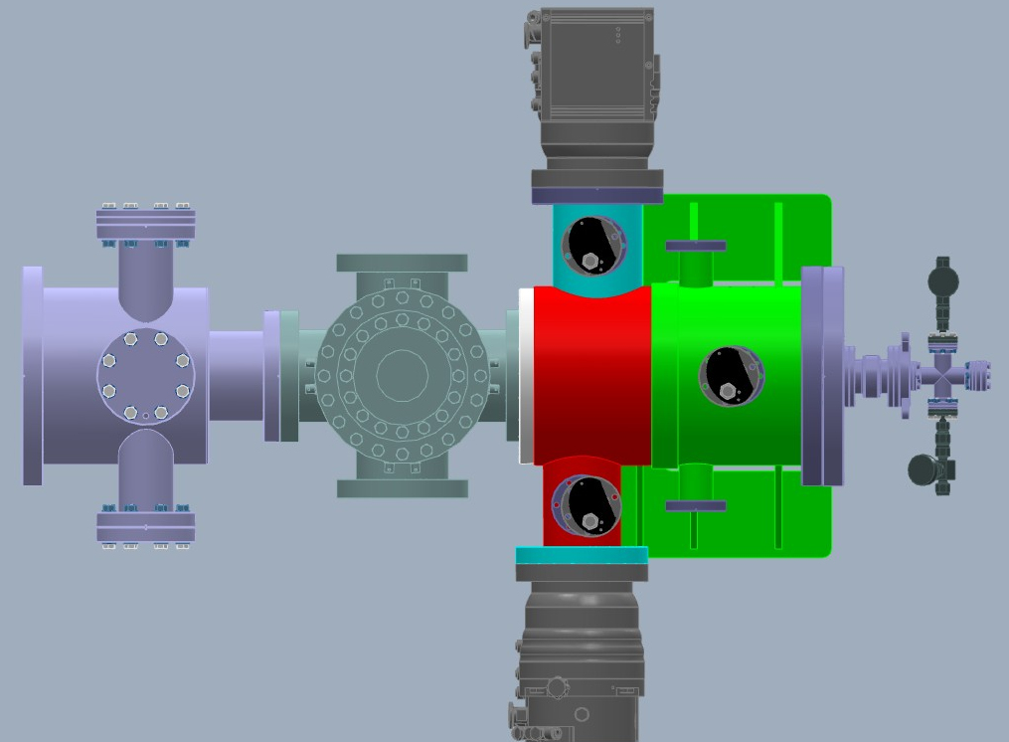

Thank you!
8m
1m
3m
0.85m
0.5m
7.5m
Team: Narender Kumar
Milaan Patel
William Butcher
Carsten Welsch
2.8m
0.2m
3m

