Slide 1
Microwave instability driven by terahertz-scale resistive-wall impedance in electron synchrotrons
Dmitrii Rabusov

Slide 2
Talk outline
Motivation. NEG coating and resistive-wall impedance
Simulation setup and convergence studies
Parameters of NEG coating and Diamond-II example case
Variation of coating thickness and the microwave instability
Multipeak structure of longitudinal impedance and momentum-spread growth
Summary and conclusions
Dmitrii Rabusov, Particle Accelerator and Beams Conference, Oxford, 2025

Slide 3
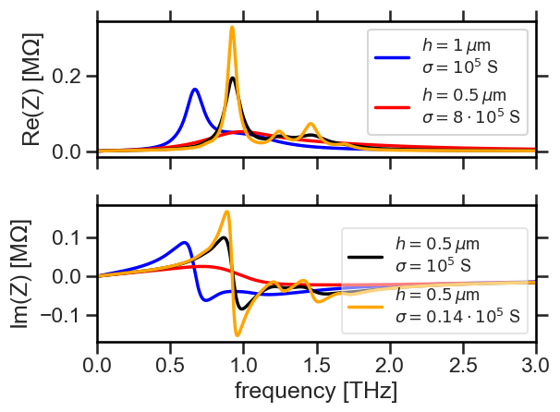
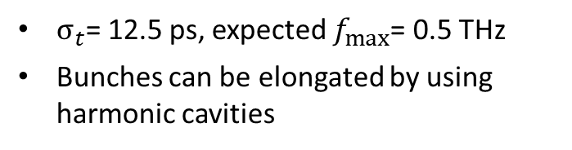
Metallic coatings (NEG) and longitudinal impedance
Nonevaporable getter (NEG) coated vacuum vessels providing distributed wall pumping for residual gases
C. Benvenuti, P. Chiggiato, F. Cicoira, Y. L’Aminot; Nonevaporable getter films for ultrahigh vacuum applications. J. Vac. Sci. Technol. A 1 January 1998; 16 (1): 148–154. https://doi.org/10.1116/1.580963
Metallic coatings contribute to the resistive-wall component of the impedance
Resonant-like peak in the longitudinal impedance on a terahertz (THz) scale
Migliorati, M., Belli, E., & Zobov, M. (2018). Impact of the resistive wall impedance on beam dynamics in the Future Circular e+e- Collider. Phys. Rev. Accel. Beams, 21(4), 041001. https://doi.org/10.1103/PhysRevAccelBeams.21.041001
THz-scale impedance driving microwave instability
Gamelin, A., & Foosang, W. (2023). Influence of the coating resistivity on beam dynamics. Phys. Rev. Accel. Beams, 26(5), 054401. https://doi.org/10.1103/PhysRevAccelBeams.26.054401
$σ_{t}$= 12.5 ps, expected $f_{max}$= 0.5 THz
Bunches can be elongated by using harmonic cavities
Dmitrii Rabusov, Particle Accelerator and Beams Conference, Oxford, 2025

Slide 4
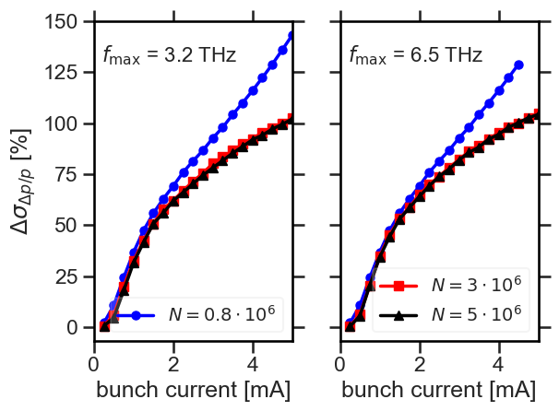
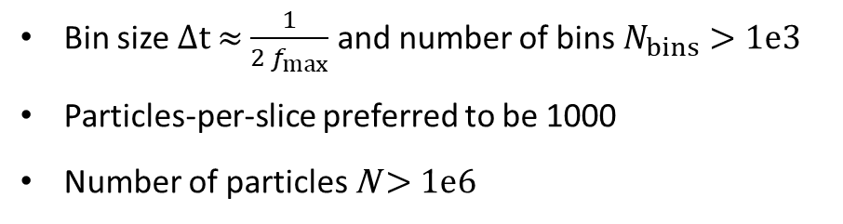
Simulation setup and convergence studies
Material | Length [m]
NEG-coated copper | 423.9
Stainless steel | 45.67
Copper | 45.35
NEG-coated aluminium | 43.04
Ti-coated alumina | 2.6
Based on Diamond-II impedance database in 2024
Coating thickness h, conductivity σ
h=1 μm, σ=1e5 S reference case
Columnar NEG σ=0.14e5 S
Dense NEG σ=8e5 S
3HC = 3rd harmonic cavity used in simulations
Bin size Δt ≈ $\frac{1}{{2 f}_{max}}$ and number of bins $N_{bins}>1e3$
Particles-per-slice preferred to be 1000
Number of particles N > 1e6
Dmitrii Rabusov, Particle Accelerator and Beams Conference, Oxford, 2025

Slide 5
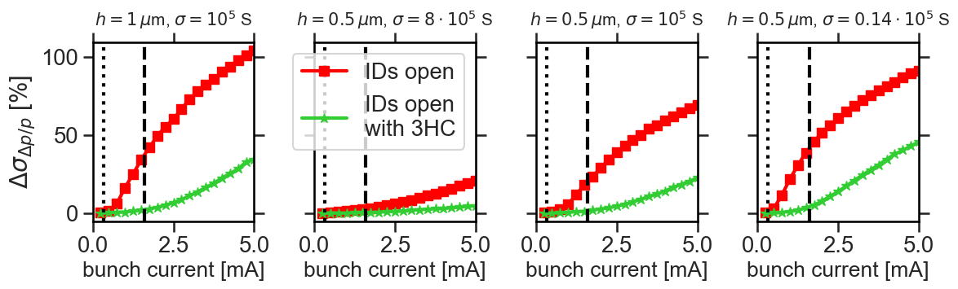
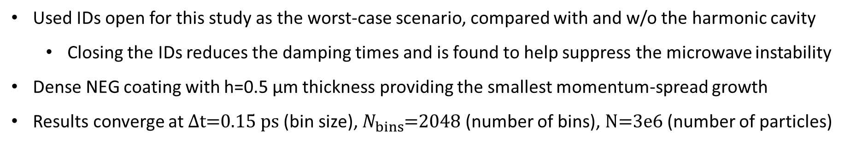
Parameters of NEG coating and Diamond-II example case
Used IDs open for this study as the worst-case scenario, compared with and w/o the harmonic cavity
  Closing the IDs reduces the damping times and is found to help suppress the microwave instability
Dense NEG coating with h=0.5 μm thickness providing the smallest momentum-spread growth
Results converge at Δt=0.15 ps (bin size), $N_{bins}$=2048 (number of bins), N=3e6 (number of particles)
Dmitrii Rabusov, Particle Accelerator and Beams Conference, Oxford, 2025

Slide 6
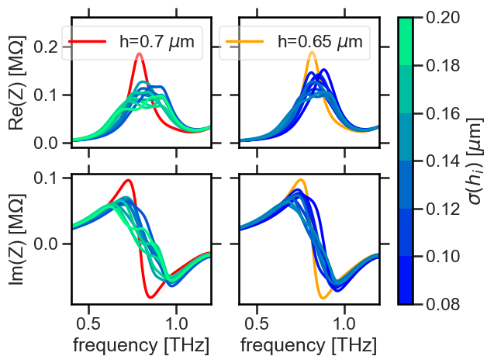
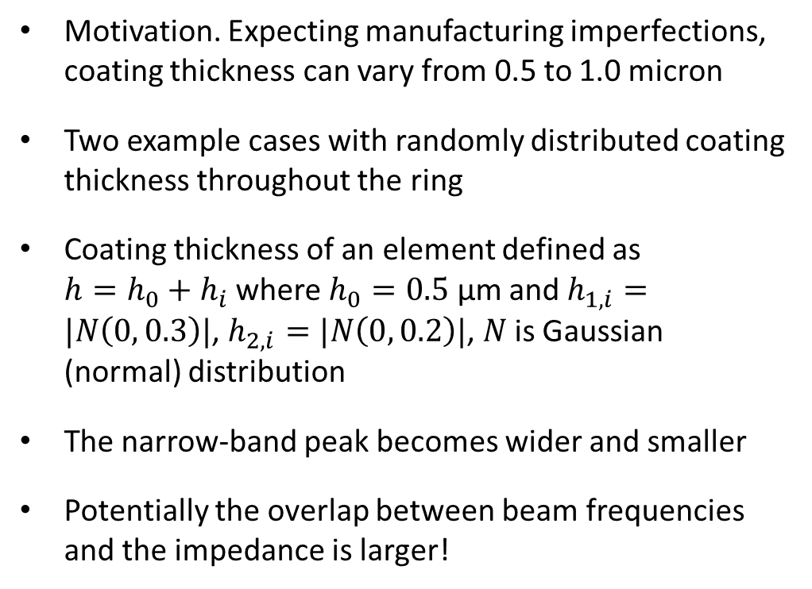
Variation of coating thickness and the microwave instability
Motivation. Expecting manufacturing imperfections, coating thickness can vary from 0.5 to 1.0 micron
Two example cases with randomly distributed coating thickness throughout the ring
Coating thickness of an element defined as ${h=h_{0}+h}_{i}$ where $h_{0}=0.5$ μm and $h_{1,i}=|N\left(0, 0.3\right)|$, $h_{2,i}=|N\left(0, 0.2\right)|$, $N$ is Gaussian (normal) distribution
The narrow-band peak becomes wider and smaller
Potentially the overlap between beam frequencies and the impedance is larger!
Dmitrii Rabusov, Particle Accelerator and Beams Conference, Oxford, 2025

Slide 7
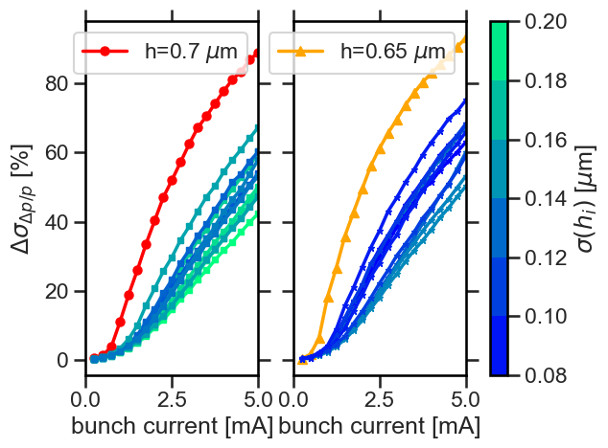
Variation of coating thickness and the microwave instability
Narrower peaks leading to larger momentum-spread growth
Deliberately varying the coating thickness when designing elements of the vacuum chamber of a synchrotron light source can be used as a microwave-instability mitigation measure
Dmitrii Rabusov, Particle Accelerator and Beams Conference, Oxford, 2025

Slide 8
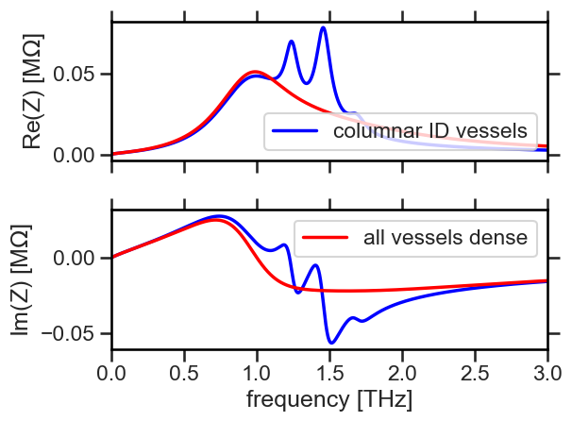
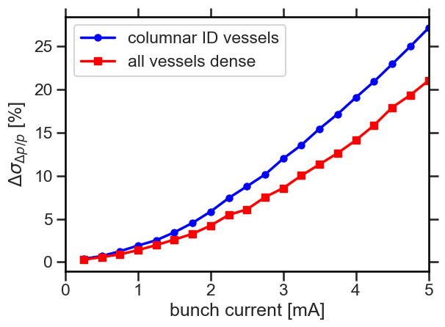
Multipeak structure of longitudinal impedance and momentum-spread growth
Using dense NEG instead of columnar as a coating material reduces the multi-peak structure in the longitudinal impedance
Special attention should be paid when amplitude of the peaks caused by ID vessels is comparable to the amplitude of the main peak
Dmitrii Rabusov, Particle Accelerator and Beams Conference, Oxford, 2025

Slide 9
Summary and conclusions
Longitudinal impedance corresponding to different vacuum vessels with various parameters of NEG coating was compared
NEG-coated components of the vacuum chamber might cause a resonator-like peak or in some cases even a multi-peak structure in the total longitudinal impedance.
Higher conductivities with a smaller coating thickness are beneficial for suppressing the microwave instability.
Variation in the coating thickness throughout the ring results in reduced momentum-spread growth
Including randomised coating when designing vacuum components is beneficial
Insertion devices featuring rectangular geometry and NEG coating with low conductivity might cause a multi-peak structure of the longitudinal impedance
When the additional peaks have a comparable strength to the main peak, the microwave instability is stronger.
Dmitrii Rabusov, Particle Accelerator and Beams Conference, Oxford, 2025

Slide 10
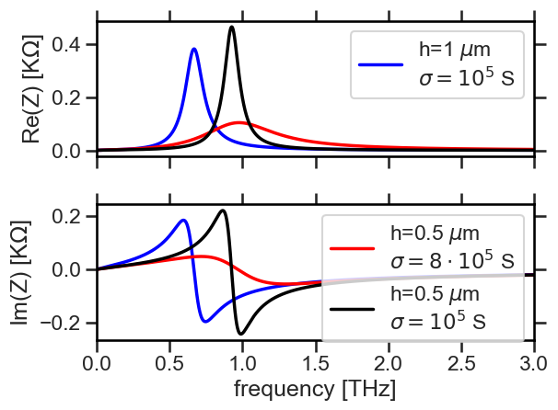
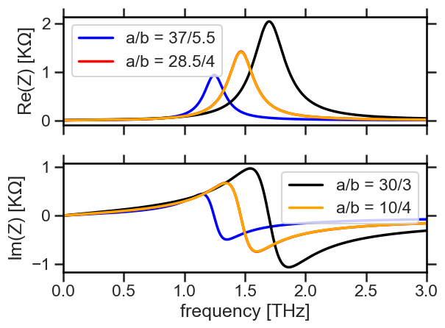
Backup slides
Dmitrii Rabusov, Particle Accelerator and Beams Conference, Oxford, 2025

Slide 11
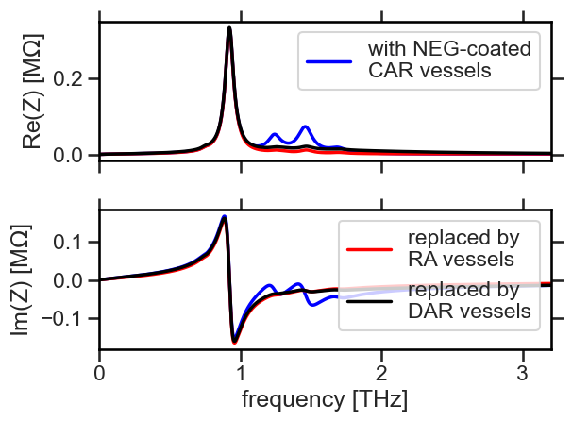
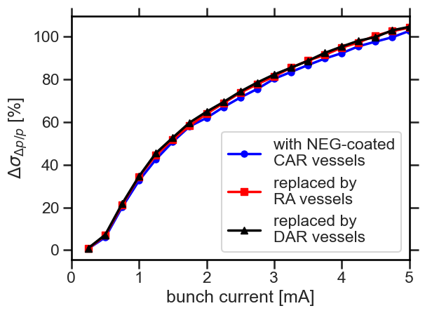
Backup slides
Dmitrii Rabusov, Particle Accelerator and Beams Conference, Oxford, 2025

