Slide 1
RELIEF: Tanning of Leather using electron beams
PAB 2025
Rob Apsimon¹, Kay Dewhurst^{1*}, Sadiq Setiniyaz^{1**}, Rebecca Seviour², Matt Southerby¹⁺, Dan Turner¹⁺⁺
¹Lancaster University and Cockcroft Institute, Lancaster, UK
²University of Huddersfield, Huddersfield, UK
* Now at Dalton Cumbria Facility, University of Manchester, UK
** Now at JLab, Virginia, US
⁺ Now at UCLH, London, UK
⁺⁺ Now at CERN, Meyrin, Geneva, Switzerland

Slide 2
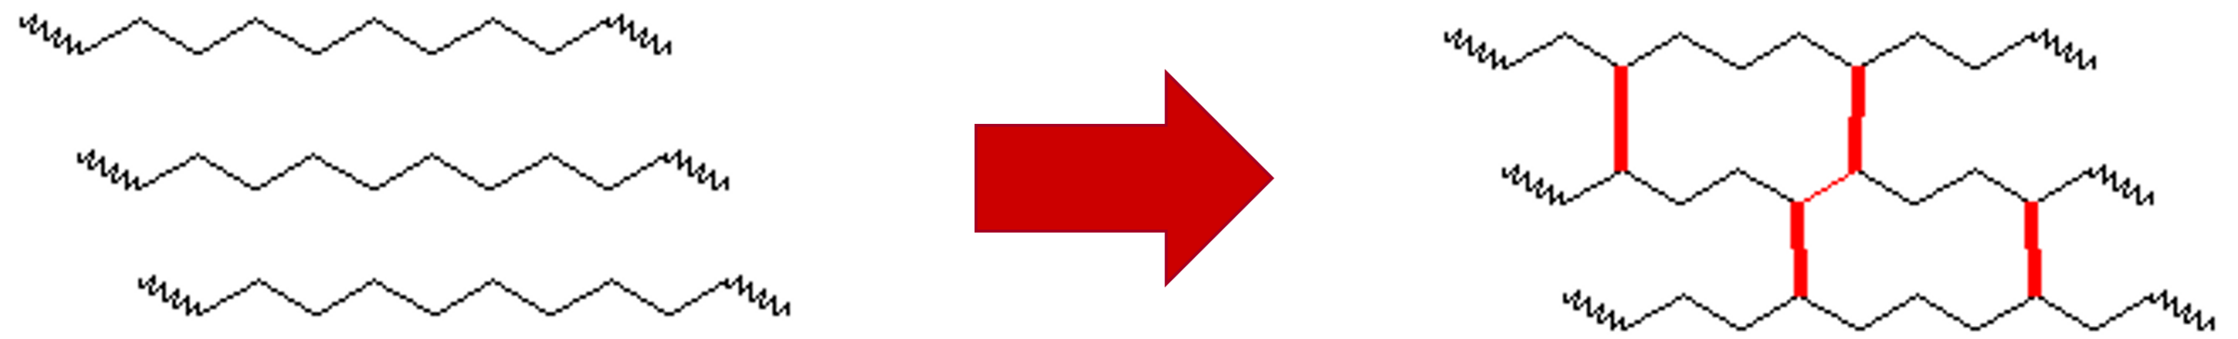
What is tanning?
Tanning is a chemical process to modify the physical and chemical properties of hides
  Prevent biological degradation (putrefaction)
  Improve durability, tensile strength etc (depends on end user requirements)
This involves creating branching and/or crosslinking between protein chains
  This depends on which tanning agents are used.
    Branching: results in more flexible leather for handbags, jackets etc
    Crosslinking: stiffer, more durable leather, used for boots and furniture
Image source: http://chemistry2.csudh.edu/rpendarvis/Polymer.html

Slide 3
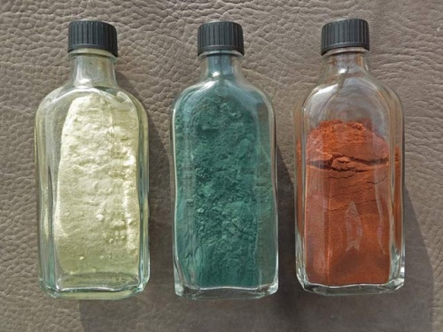
What is tanning?
Tanning is achieved by adding chemicals to the hides, which bind to the proteins.
  The chemicals are called tanning agents, tannins or tannages.
There are three main classes of tanning agents:
  80% of the world’s leather is produced
  with chrome (III) sulphate due to the high
  quality end product.
  These chemicals can have an acute impact
  to the local environment if not properly
  treated and disposed of.
Synthetic tannins
Metal tannins
Vegetable tannins
Image source: https://www.leather-dictionary.com/index.php/Tannins

Slide 4
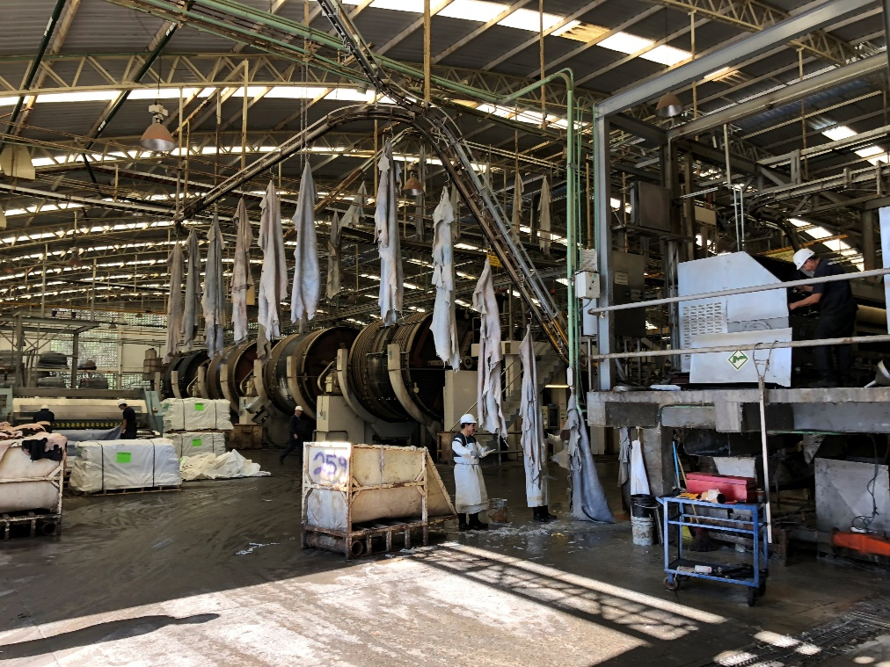
Conventional tanning
Hides are conventionally tanned in large drums, which can hold up to 500 – 600 hides and 20 – 40 tons of water and chemicals.
The process takes 12 – 36 hours for metal and synthetic tannins
  Veg tanning can take up to 1 year
Tanning drums use 150 – 250 kW of power to mix hides and tanning solution
The mechanical action of turning the drums produces heat, to keep the mixture at ~30ºC.
Most large tanneries use conveyor systems to transport hides from one area to the next.
This is a picture of a tannery we visited in Mexico.

Slide 5
Environmental impact: chromium
Most common oxidisation states are Cr(III) and Cr(VI)
  Cr(III) is stable, green in colour and benign as it can’t pass through cell membrane.
  Cr(VI) is less stable, red or orangey-yellow in colour and is hemotoxic, genotoxic and carcinogenic.
    Small enough to pass through cell membrane, reduces to Cr(III) and tans DNA!
  Cr(III) can be oxidised to Cr(VI) by sunlight or acidic conditions
What if chromium wastewater is improperly disposed of in the local environment?
  Chromium contaminates water supplies
  Ingested by animals and absorbed by plants within the watershed
  By contaminating food and water supplies, chromium persists within the local environment.

Slide 6

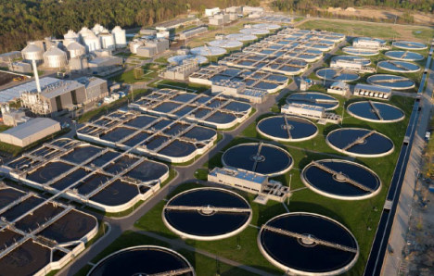
Environmental impact: wastewater/effluent
How wastewater and effluent is dealt with can vary significantly around the world, depending on factors such as environmental policies, regulation and enforcement.
  However, regardless of whether wastewater is disposed of in a lake/river, or treated in a specialist effluent treatment plant, there is still an environmental impact to consider.
Guanajuato, Mexico
Water treatment plant
Image source (right image): https://envirotech.com/wastewater/

Slide 7
Environmental impact: wastewater/effluent
Improper disposal/discharge of effluent
  This may be discharged into lakes/rivers or a domestic sewage treatment plant
  Long-term contamination of local food and water supplies
  Increasing focus on green credentials
  Enforcement of policies requires resources and will impact leather industry
    This may have major consequences on economy in lower-income countries.
Wastewater treatment
  Removes hazardous chemicals from wastewater that domestic sewage treatment plants can’t
  Energy intensive process with large carbon footprint
  Significant cost to tanneries (~30% of total production cost of leather)
Solution to both problems is to eliminate wastewater production

Slide 8
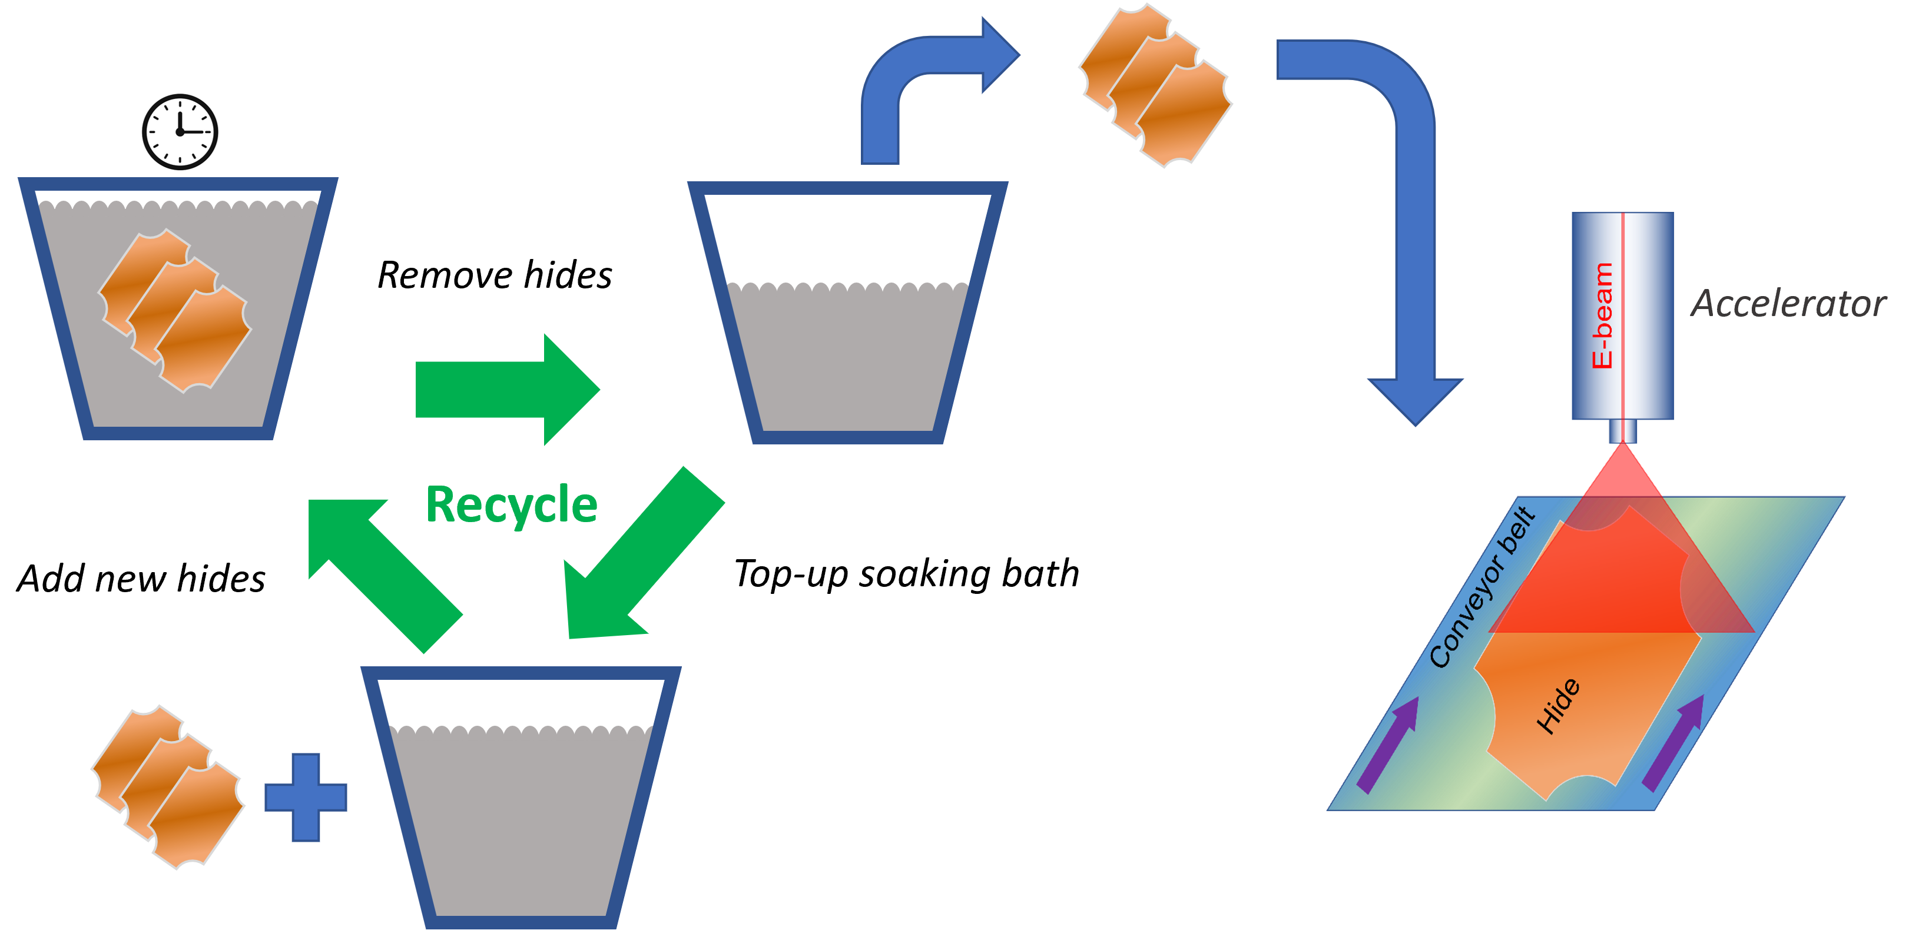
E-beam tanning: concept
Our solution: soak the hides in the required tanning agents, then irradiate with an electron beam to tan the hides

Slide 9
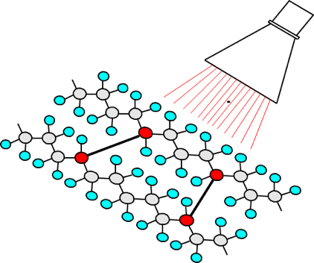
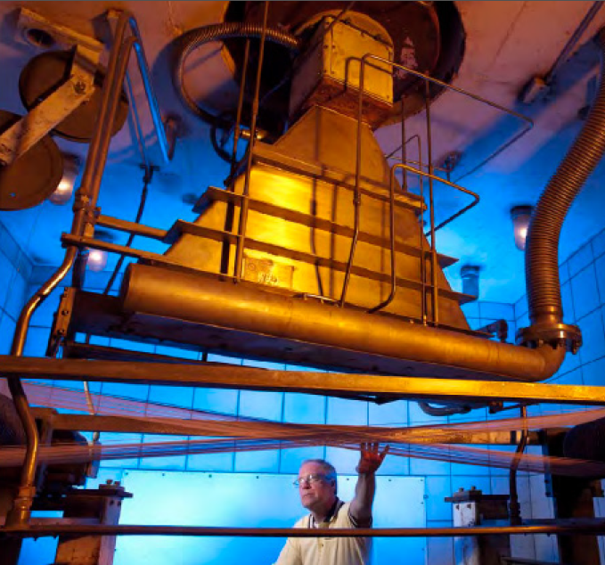
E-beam tanning: concept
Our process is inspired by the industrial crosslinking of polymers to modify its material properties
  This is very often achieved with electron beams
  Instead of polymers, we are modifying proteins
Image source (right image): https://www.miottisrl.com/en/does-the-radox-cable-radiation-cross-linking-process-occur/

Slide 10
E-beam tanning: benefits
Compared to conventional drum tanning, e-beam tanning has the following benefits:
  ~90% reduction in wastewater production
    Any drippage pre-irradiation can be recycled
  Reduction in water (~50%) and energy (~10%) consumption during tanning stages
    This excludes indirects such as wastewater treatment
  Turns tanning from a batch process to a continuous process
  By instantaneously tanning (rather than taking 12 – 36 hours), novel tanning agents could be used which are too unstable for conventional tanning

Slide 11
Accelerator requirements
Conventional tanning:
  1 tanning drum tans 500 – 600 hides in 12 – 36 hours (~1 – 3 minutes per hide)
  Requires 20 – 40 tons of water
  150 – 250 kW of power to run the tanning drums
  A tanning drum costs ~£100k – 250k and will last ~10 years
E-beam tanning:
  ~ 0.4 MeV/mm of hide thickness (2 – 10 mm depending on requirements)
  Assume 200 kGy required dose, need ~45 kW beam power to tan 1 hide in 90 s
    For a 2 mm thick hide
  Accelerator costs >£1M depending on specific requirements
    E-beam tanning cost effective for medium/large tanneries (>200k hides/year)
  Need to optimise dose distribution and energy efficiency

Slide 12
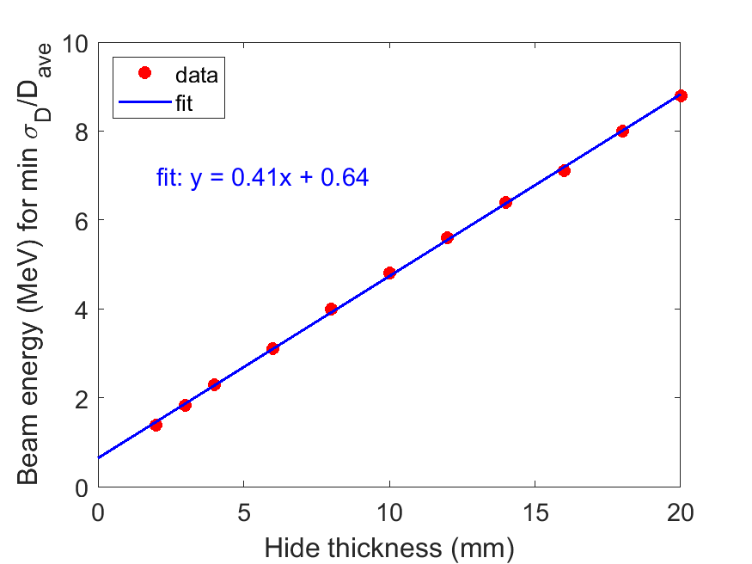
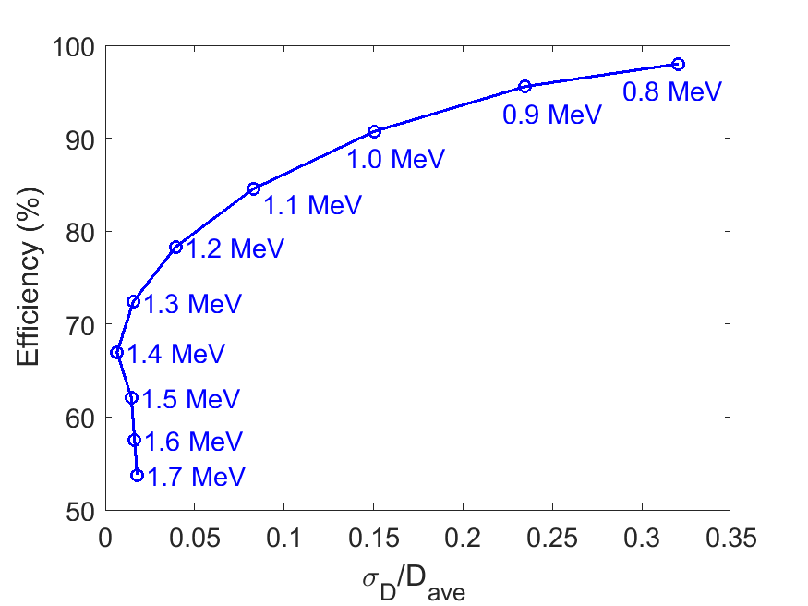
Optimisation of beam parameters
Simulations in G4Beamline allow us to determine the relationship between dose uniformity and energy deposition efficiency.
For optimal beam energy, the required energy scales linearly with hide thickness
  Higher deposition efficiency can result in a 20 – 30% reduction in beam current
Poor dose uniformity
optimum
Poor efficiency and dose uniformity

Slide 13
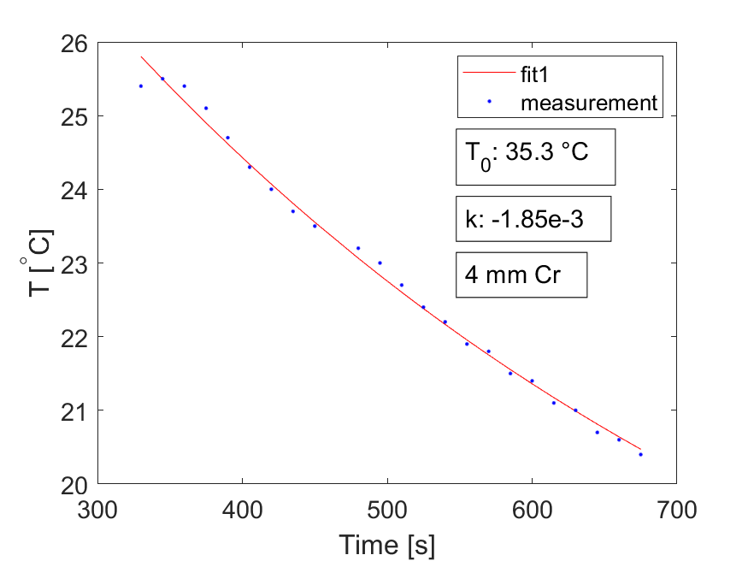
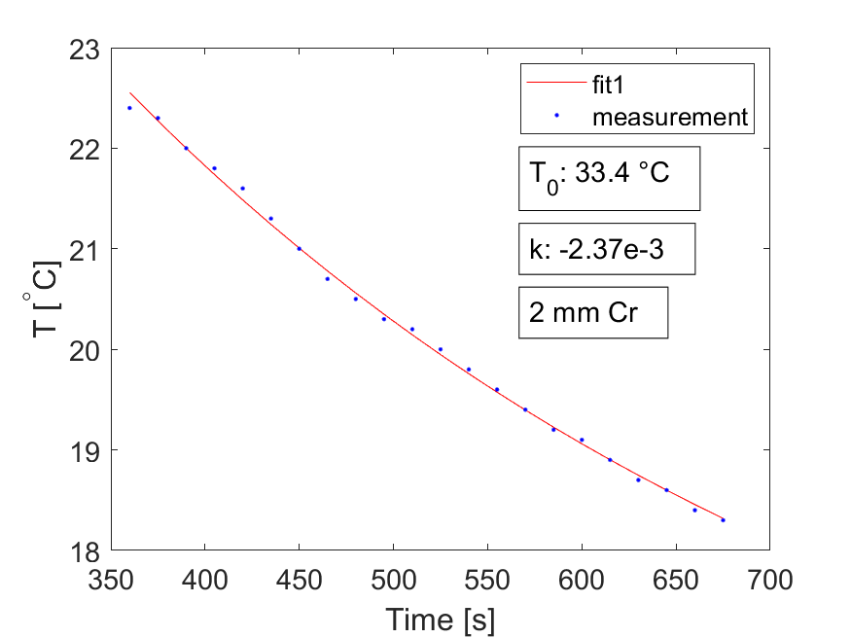
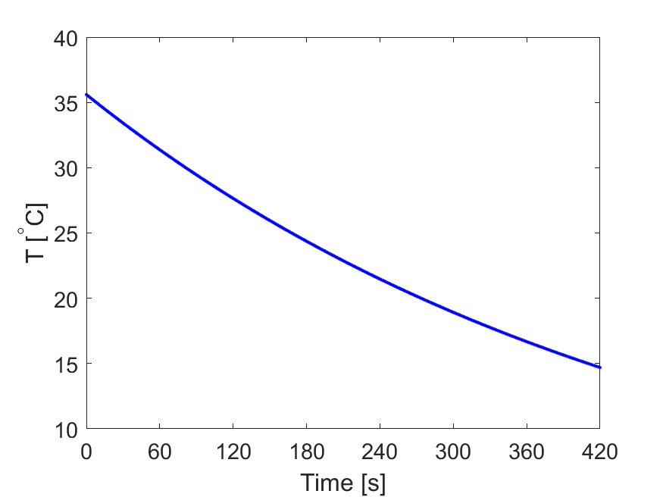
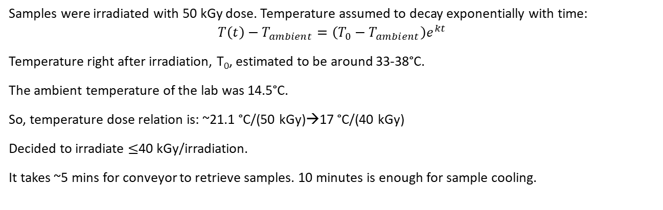

Heating test results
Samples were irradiated with 50 kGy dose. Temperature assumed to decay exponentially with time:
$$T\left(t\right)−T_{ambient}=\left(T_{0}−T_{ambient}\right)e^{kt}$$
Temperature right after irradiation, T₀, estimated to be around 33-38°C.
The ambient temperature of the lab was 14.5°C.
So, temperature dose relation is: ~21.1 °C/(50 kGy)→17 °C/(40 kGy)
Decided to irradiate $≤$40 kGy/irradiation.
It takes ~5 mins for conveyor to retrieve samples. 10 minutes is enough for sample cooling.
$$T\left(t\right)=14.5+21.1e^{−0.0021t}$$

Slide 14
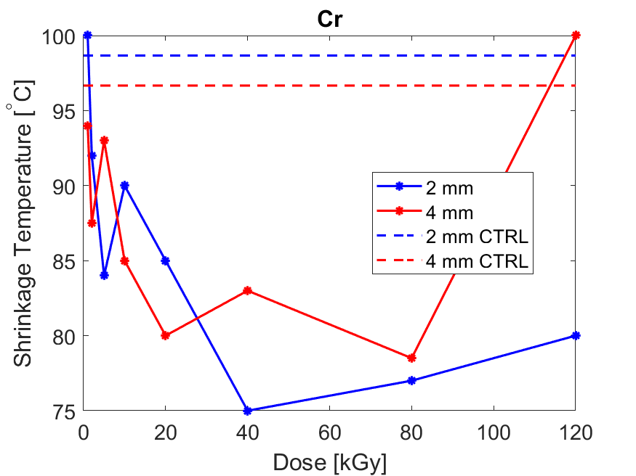
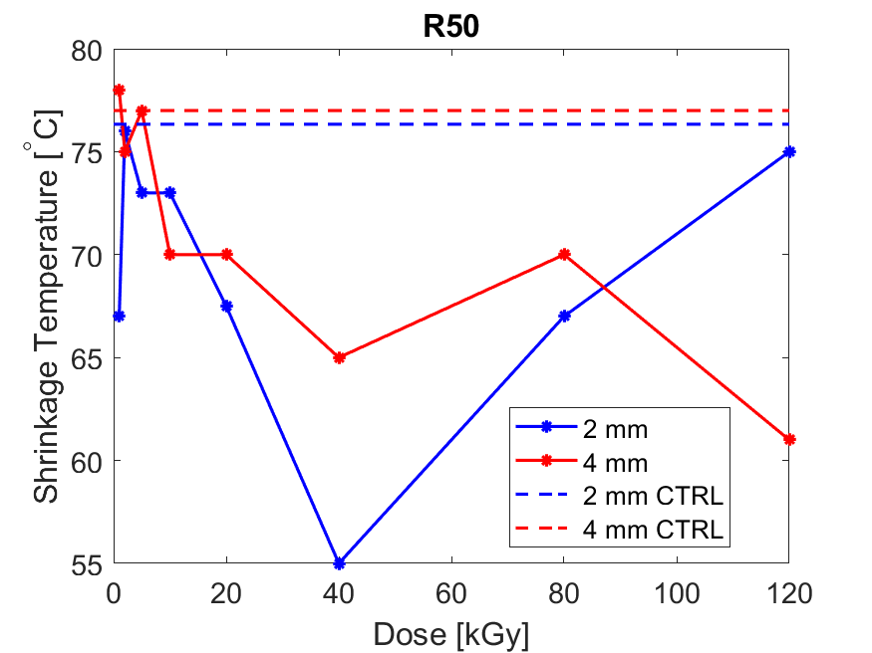
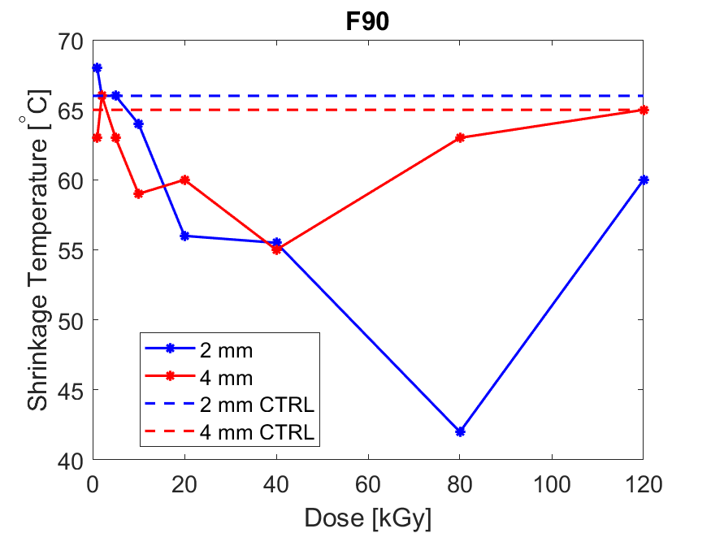
Dose scan test results
Control samples (CTRL) are not irradiated. Higher dose samples stay under ozone for longer, can cause oxidisation.
Doses < 40-60 kGy: less oxidisation damage, samples slowly tan over the 2-3 weeks until analysed
Doses > 40-60 kGy: more tanning starts to offset damage from oxidisation
We expect the damage to be primarily due to oxidisation, but it’s likely that the chemistry is more complicated than this and there will be other effects too.
Total Dose (kGy) | Beam Current (mA)
120 | 4.25
80 | 4.25
40 | 4.25
20 | 4.25
10 | 4.25
5 | 4.25
2 | 1.7
1 | 0.85

Slide 15
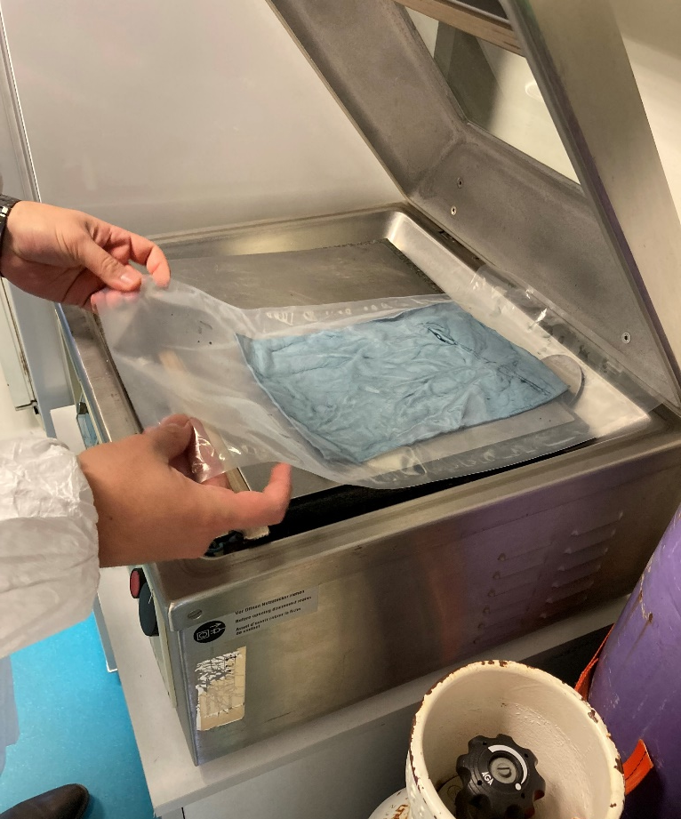
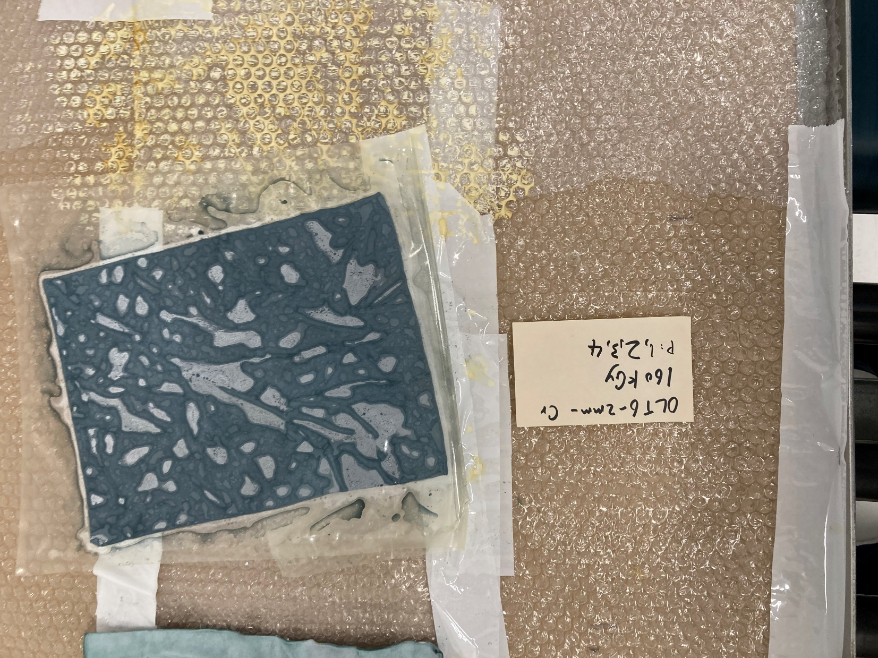
Inert atmosphere samples
Electron beam can create ozone in the air, which can cause oxidization in the samples.
2-mm thick Cr samples were used to test tanning without ozone.
Samples placed inside the vacuum sealer, which
first sucks out the air
then replenishes with nitrogen
then sucks out most nitrogen
finally seals the samples in bag

Slide 16
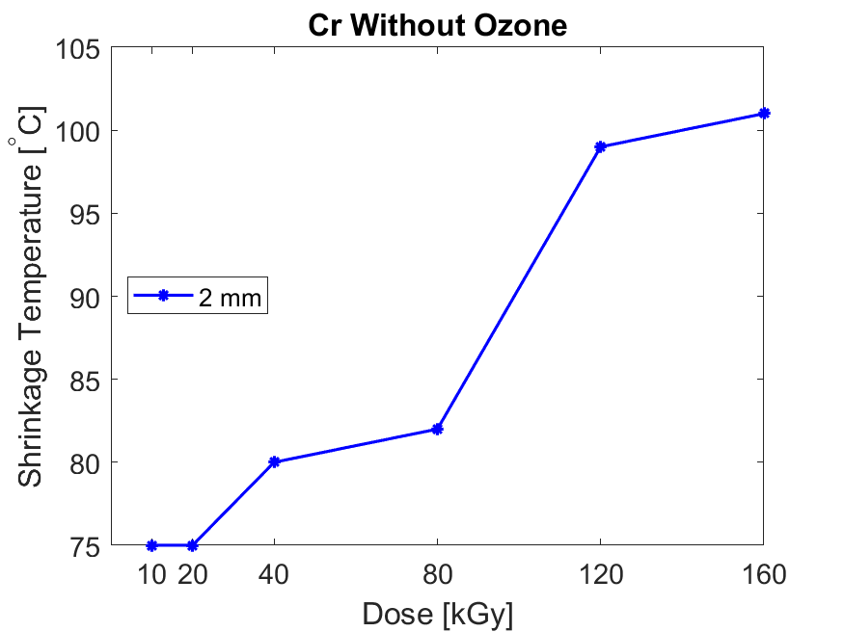
Inert atmosphere test results
Strong positive correlation between shrinkage temperature and dose, as expected.
Inert atmospheric environment prevented ozone oxidization to damage the hide.
Appears to prevent any further tanning once sealed.
  Is oxygen involved in tanning process?
Total Dose (kGy) | Beam Current (mA)
160 | 4.25
120 | 4.25
80 | 4.25
40 | 4.25
20 | 4.25
10 | 4.25

Slide 17
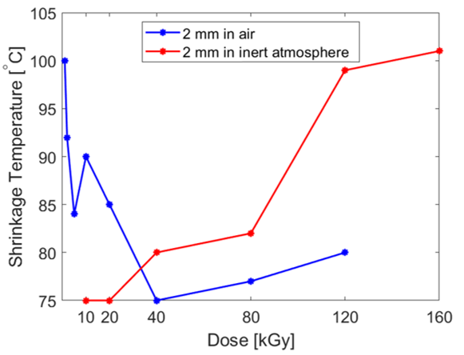
Comparison of inert atmosphere tests vs in-air tests

Slide 18
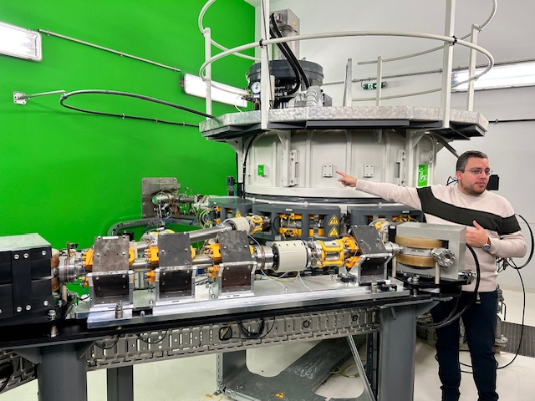
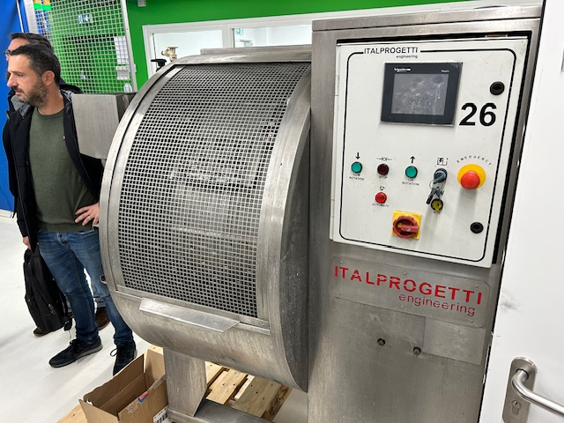
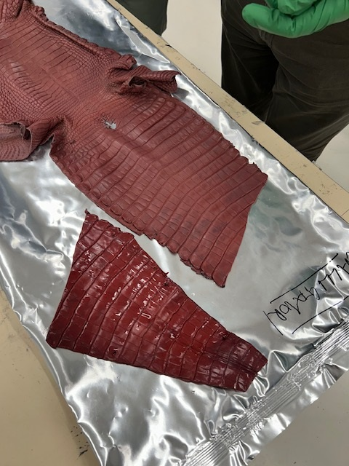
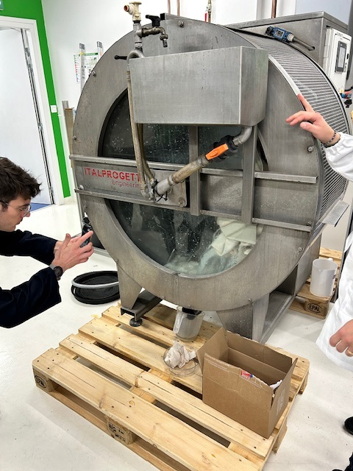
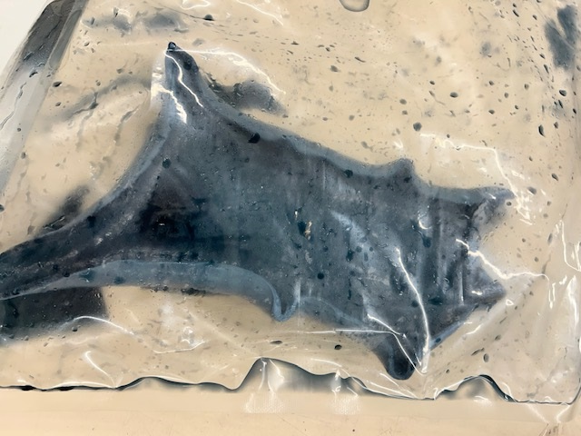
Latest tests

Slide 19
Thank you!
Questions?

