Slide 1

Diamond II Mechanical Engineering
Paul Vivian
With contributions from Walter Tizzano, Xia Liu and the wider Accelerator Mechanical Team
Particle Accelerators and Beams Conference 2025
09/07/25

Slide 2
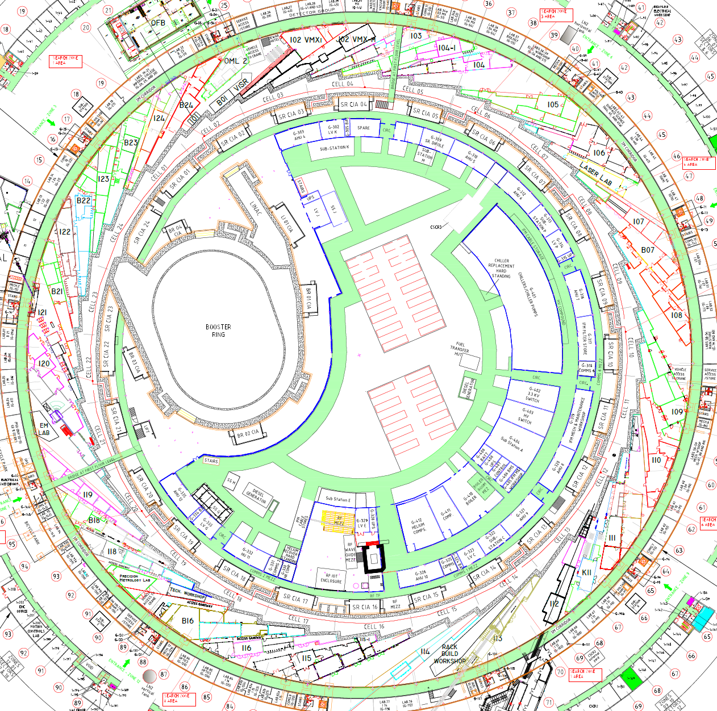
Accelerator Mech Eng Introduction
P. Vivian, W. Tizzano, X. Liu PAB 2025
Notes:
This is an overview drawing of Diamond, the orange sections highlight sections of the machine which are to be completely replaced for D-II – Booster, Transfer lines and storage ring.

Slide 3
Key Mechanical Requirements for Diamond II
Improved Stability to enable reduced emittance
  Short term – vibration
    Ground and cooling water driven
  Medium term – Thermal effects
  Long Term – Drift
    Thermal & radiation effects
Assembly and installation alignment accuracy
  Both for Accelerator Physics requirements and physical constraints
  Reduced clearances and integration
    Assembly and maintenance challenges
Design to enable swift installation and commissioning
  Minimise dark period as far as possible
Special photon extractions
  Diamond underwent incremental upgrades over many years enabling numerous unique photon extractions – Diamond II needs to enable all of these from Day 1
P. Vivian, W. Tizzano, X. Liu PAB 2025
Notes:
The overall drive for Diamond-II is to enable improved experimental outcomes for users to do this from a machine perspective the key requirements is increasing X-ray brightness and coherence.
To do this though requires many mechanical design aspects to be considered carefully.

Slide 4
Injection
Walter Tizzano
P. Vivian, W. Tizzano, X. Liu PAB 2025

Slide 5
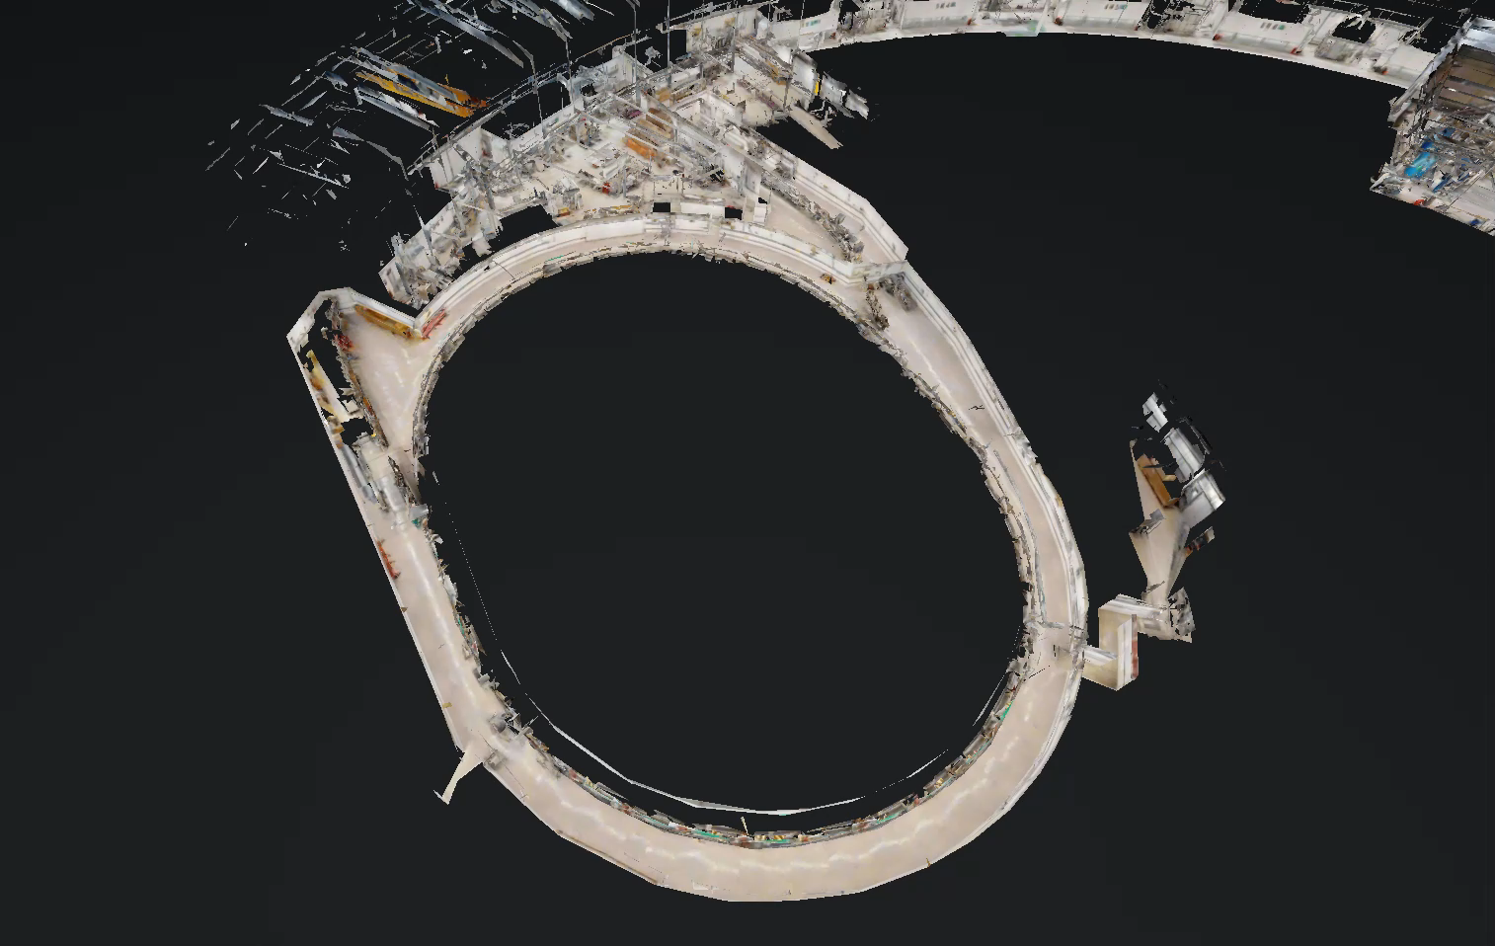
Injection Introduction
P. Vivian, W. Tizzano, X. Liu PAB 2025
Notes:
We have laser scanned the whole machine to help with development of D-II, this is a walk through of the laser scan model from the LINAC to the Booster.

Slide 6
D-II Booster
To ensure high injection efficiency into the Diamond-II Storage Ring, a new booster with reduced extracted beam emittance and bunch length compared with existing values is required [1]
The new booster will also have an increased extraction energy, to match the 3.5 GeV energy of the new Storage Ring
The new booster will be made up of 50 girders of 8 functionally different types
The gaps in the straights are for pulsed magnets (septa and kickers), RF and additional diagnostics.
Unit
D-II Booster
Existing Booster
Energy range
GeV | 0.15 – 3.5 | 0.1 – 3
nm.rad | 17.4 | 134
ps | 38 | 100
m | 163.8 | 158.4
Emittance
Bunch Length
Circumference
P. Vivian, W. Tizzano, X. Liu PAB 2025

Slide 7
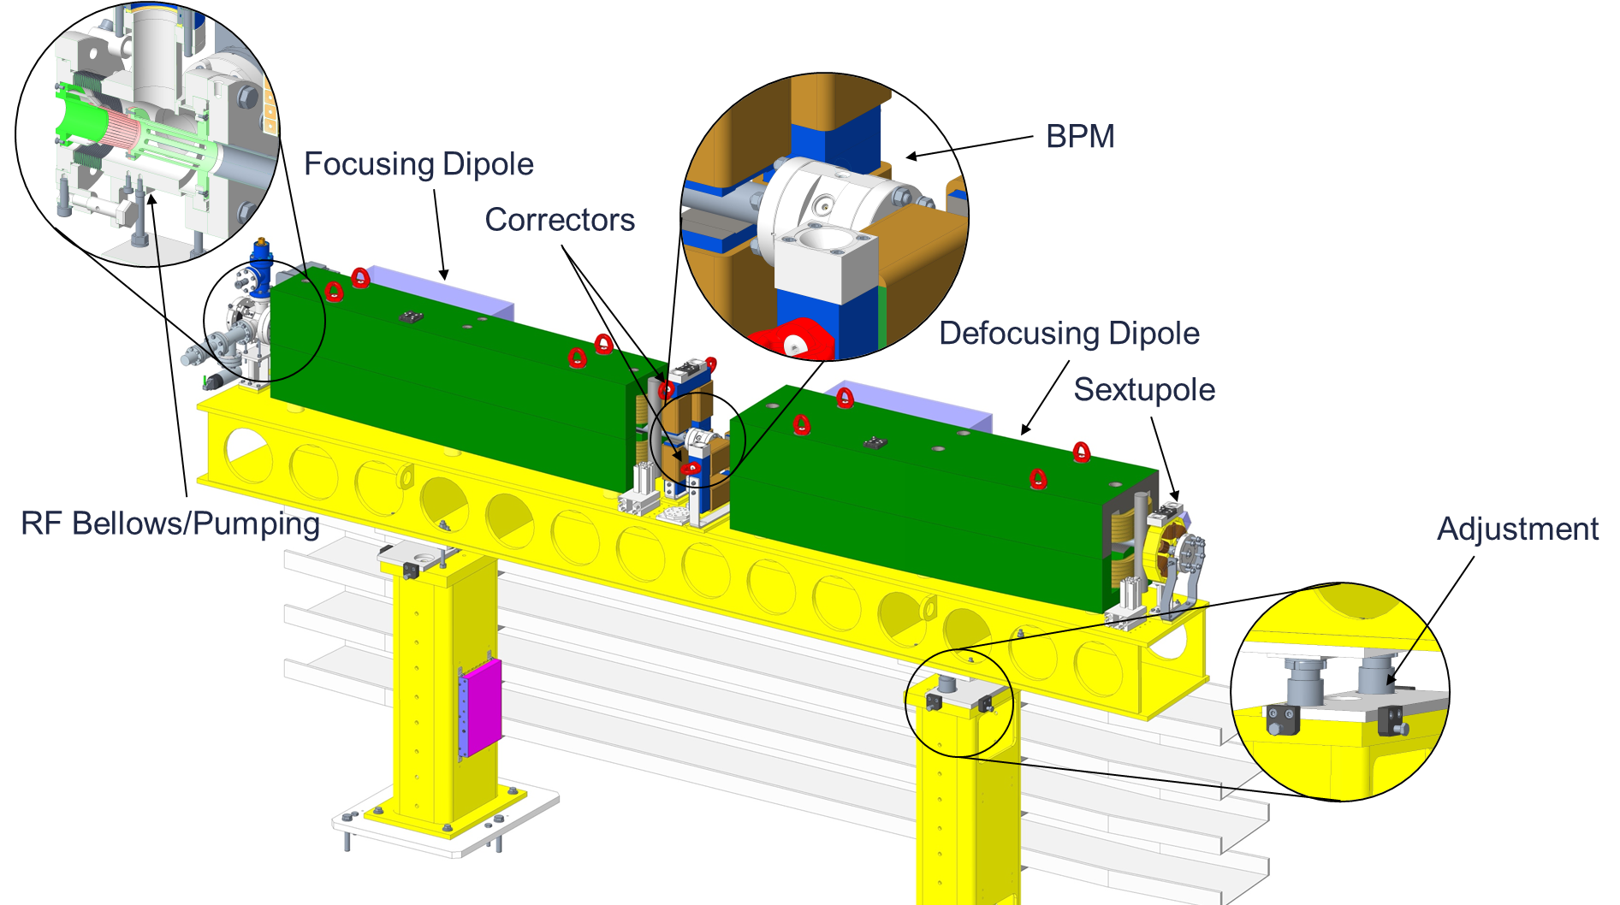
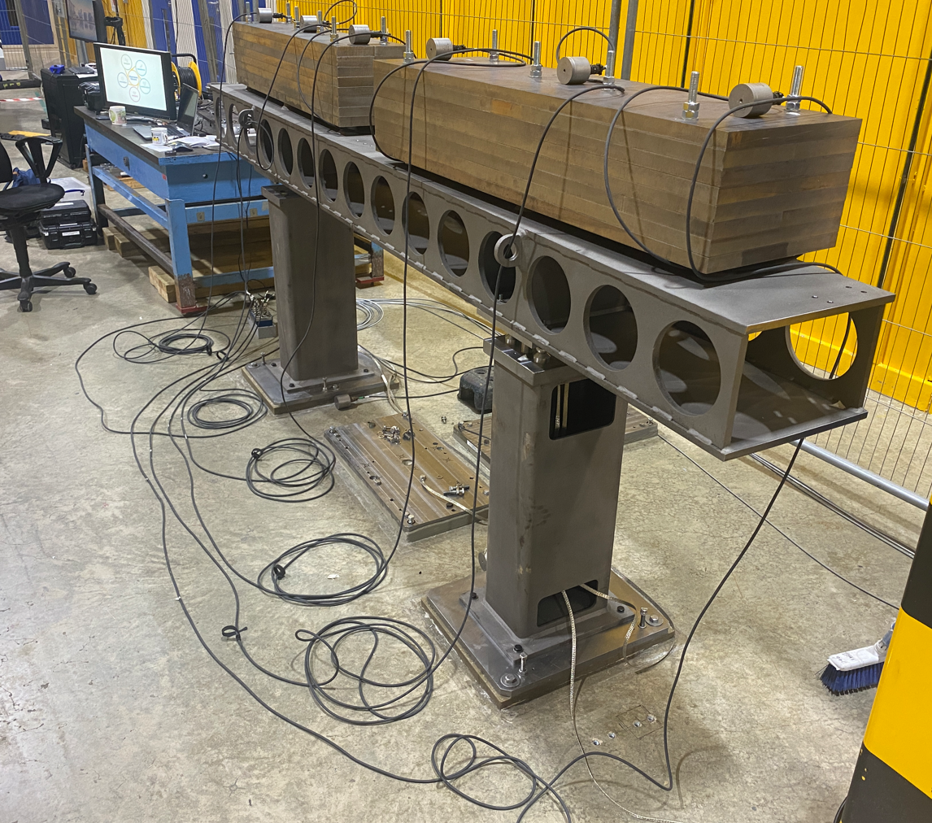
Booster Girders
Pre-assembled/pre-aligned by supplier using shims
Combined function dipoles
Girder adjustment uses a combination of vertical adjustors and lateral push blocks
A pumping vessel with integrated RF bellows acts as interface between girders
Design is based on the existing booster with some changes to improve stability such as the adjustment system
Extensive vibration analysis and measurements have been carried out and combined with accelerator physics models to confirm required performance can be met
Vibration test of prototype girder with dummy magnet masses
P. Vivian, W. Tizzano, X. Liu PAB 2025

Slide 8
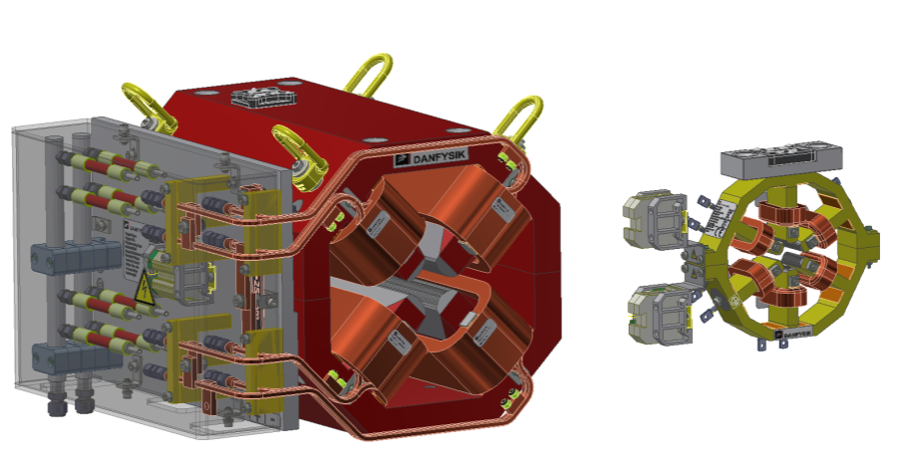
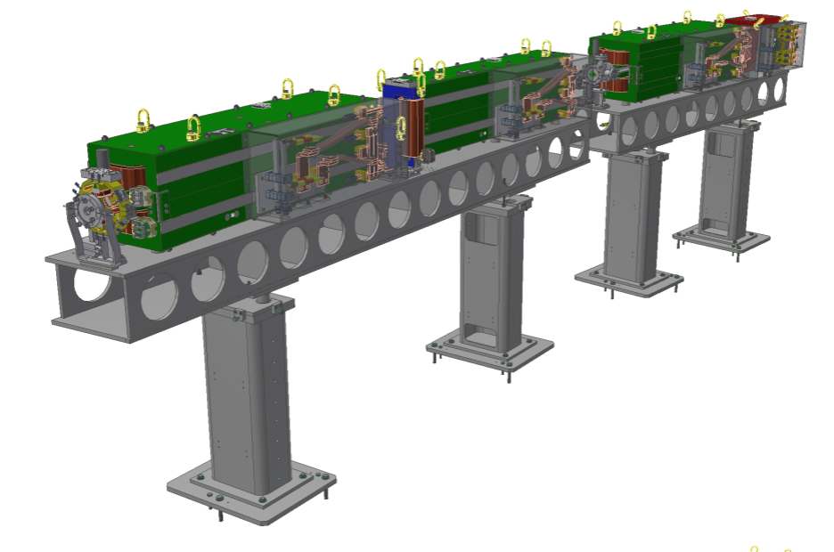
Booster Current Status
ITT
Sent on
Contract
Signed on
Kick-off
PDR
Held on
FDR
Held on
Held on
April 2024
August 2024
August 2024
October 2024
April March 2025
FAT Magnets
September 2025
FAT Vacuum
July 2025
Planned for
Planned for
Contract is current on schedule with the first FAT’s due this month
Booster multipoles, Courtesy of Danfysik
Girders 1 and 6, Courtesy of Danfysik
P. Vivian, W. Tizzano, X. Liu PAB 2025

Slide 9
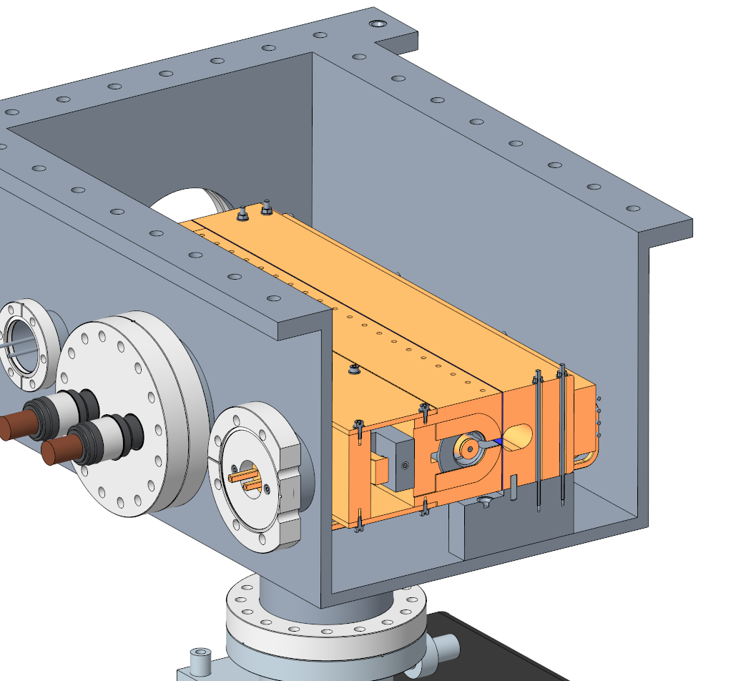
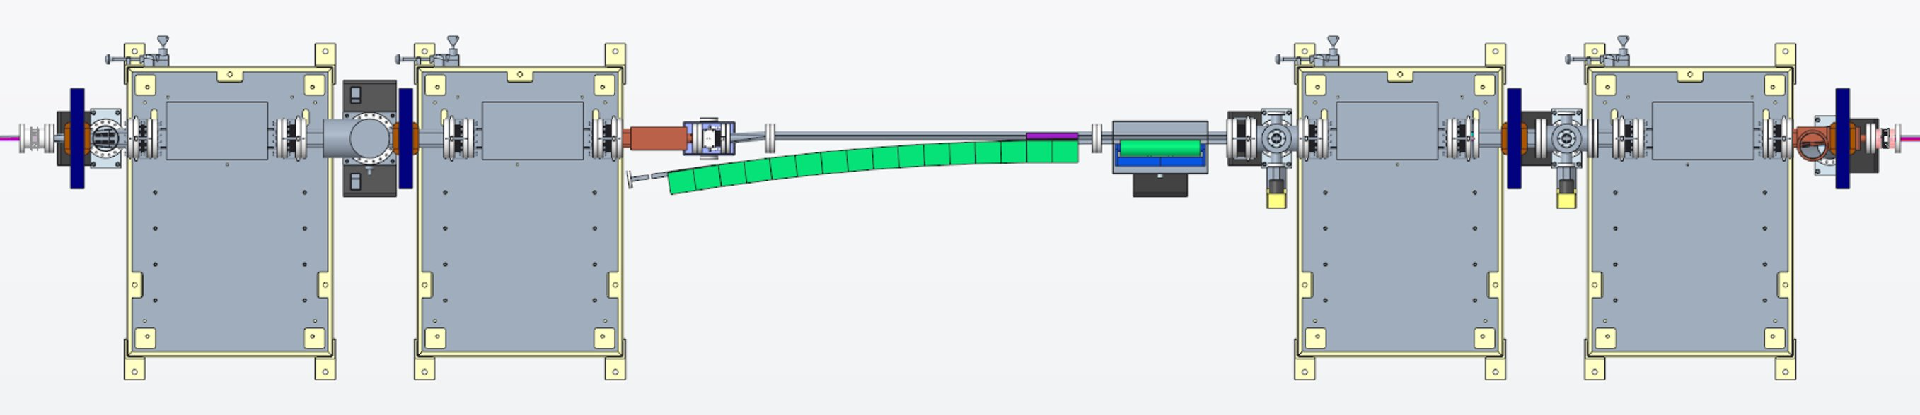
SR Injection Straights I01 - Specifications
I01 is functionally similar to the current injection straight and a four-kicker bump will be used for off-axis injection during commissioning and to fill the storage ring
The reduced dynamic aperture requires a more sophisticated SR Injection Septum, which will include an out of vacuum thick septum with permanent magnets and an in-vacuum thin septum
The position of the electron beam with regards to the septum will be fine-tuned by using chicane magnets operated in DC.
Kicker magnet
Thick septum
Thin septum
Chicane magnet
Thin Septum Magnet Engineering Concept
P. Vivian, W. Tizzano, X. Liu PAB 2025

Slide 10
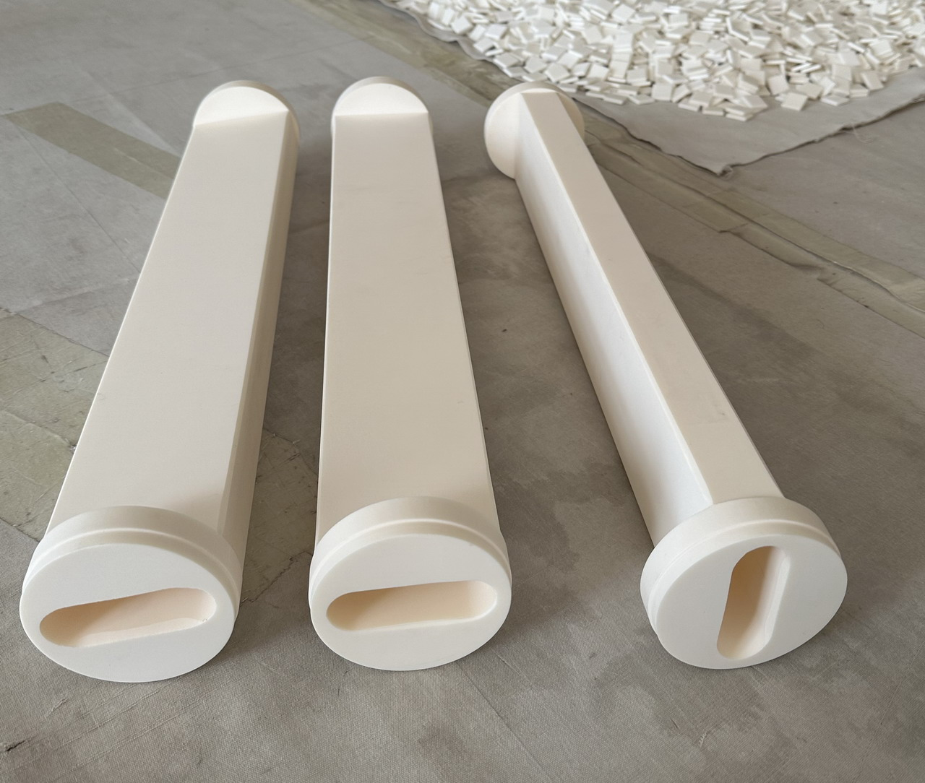
SR Injection Straights I01 - Status
A layout has been proposed and can be finalised once the septum design is available
Raytracing will be needed to confirm thermal and vacuum performance
The ceramic kicker vessels are notoriously challenging components and require a conductive layer on the inner surface, generally consisting in Titanium coating
We have prototypes for the ceramic kicker vessels and bonding to the Ti flanges is being tested by an external company. Coating trials will follow
P. Vivian, W. Tizzano, X. Liu PAB 2025

Slide 11
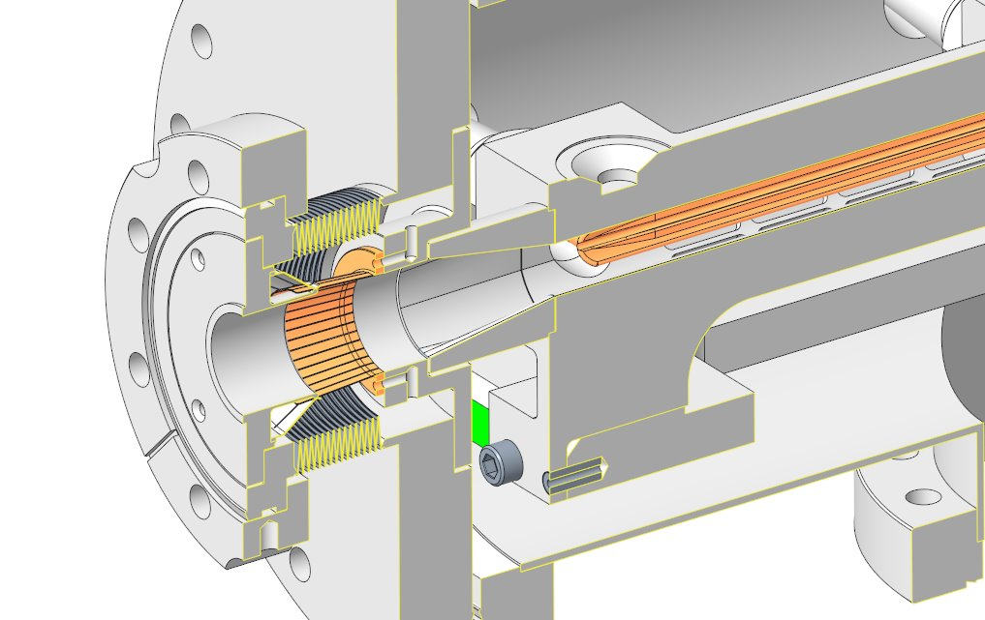
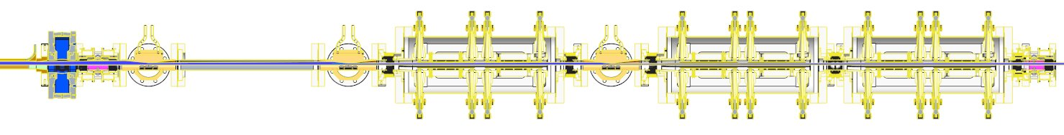
SR Injection Straights K01 - Status
Specifications:
K01 mid-straight will host stripline kickers that will enable transparent injection
The striplines include a ‘notch’ to protect them from dipole radiation
Status:
The stripline design is progressing well and a prototype has already been tested in the booster to storage ring transfer line and is currently installed in straight I19 for further testing
Stripline with notch
Absorber
Stripline module
Walter Tizzano, Tech. Away Day 2024

Slide 12
Storage Ring
P. Vivian, W. Tizzano, X. Liu PAB 2025

Slide 13
Storage Ring
The D-II Storage Ring:
Maintain 3.5 GeV low emittance beam at 300 mA
Freeing space for 24 mid-straights
  Enabling new beamlines and additional RF cavities
To make this possible:
Complete removal and replacement of D-I storage ring
52 new girder assemblies (48 installed + 4 Spare)
  12 ‘Special’ Girder assemblies
~4000 new floor anchors to be installed
100 new PeBPM’s
47 new straight assemblies
Modifications to numerous FE components
P. Vivian, W. Tizzano, X. Liu PAB 2025
Notes:
The new storage ring for D-II enables 24 new mid straights which enables new beamline such as K14/Swift but also enables 8 RF cavities, this includes redundancy to maintain maximum machine uptime.
The removal of the existing machine is a significant task in itself, in the storage ring 71 girders and their associated equipment removed and the floor made good ready to accept the new machine, there is a significant logistical challenge in organising the removal and installation hence various internation workshops on the topic have been held.

Slide 14
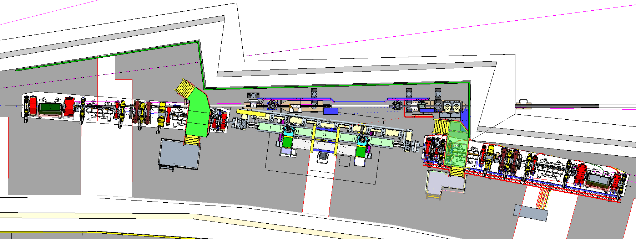
Girder Assemblies
Mid-Straight
Key Differences to D-I
2x 8m long Girders per cell vs 3 Girders
New mid straights between girders in cell
Standard and long straights between cells
Similar to previous DDBA upgrade
Vessel diameters smaller – conductance limited
Power loads higher
Higher power densities
More types of magnet
  Octupoles
  Octupole Correctors
  Fast correctors
  Dipole-Quadrupole – DQ
  Longitudinal gradient permeant magnet dipoles - DL (4 types)
  All magnets individually aligned on girder
Front End
Mid-Straight
ML Girder
Long Straight
LM Girder
P. Vivian, W. Tizzano, X. Liu PAB 2025
Notes:
Summary of differences form D-I to D-II with example layout of cell 4/5 and long straight between them showing..
DL permanent magnet dipole also shown which is unusual in that it fully detailed design produced by DLS and manufactured to print whereas most magnets are refercne designs with magnet suppliers defining final details, the first production magnet is currently having permanent magnet blocks installed at Diamond.

Slide 15
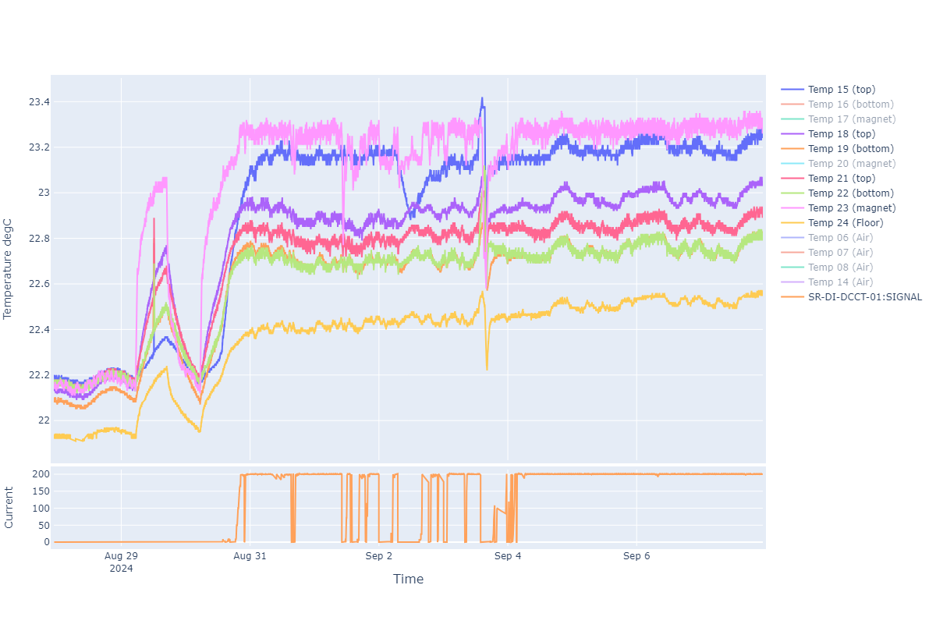
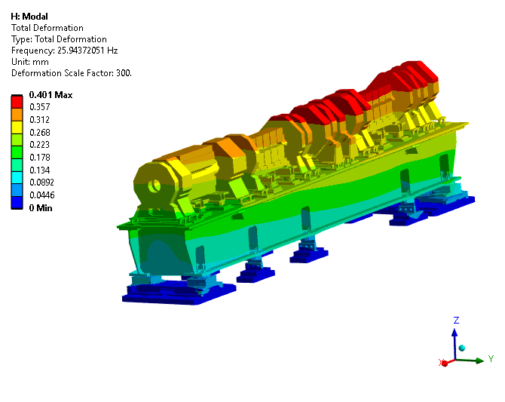
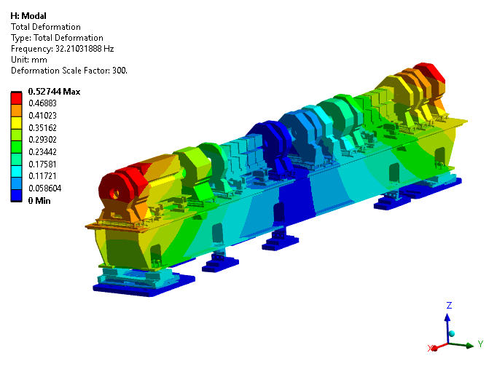
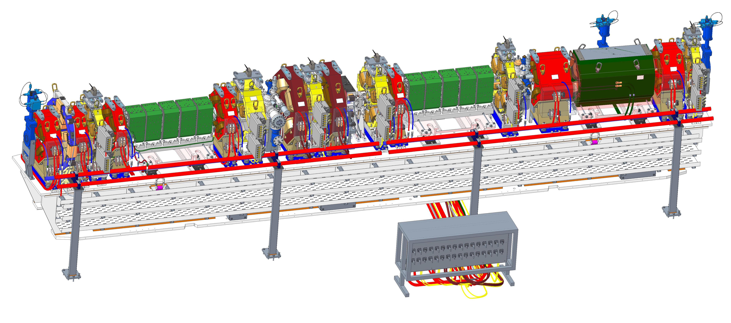
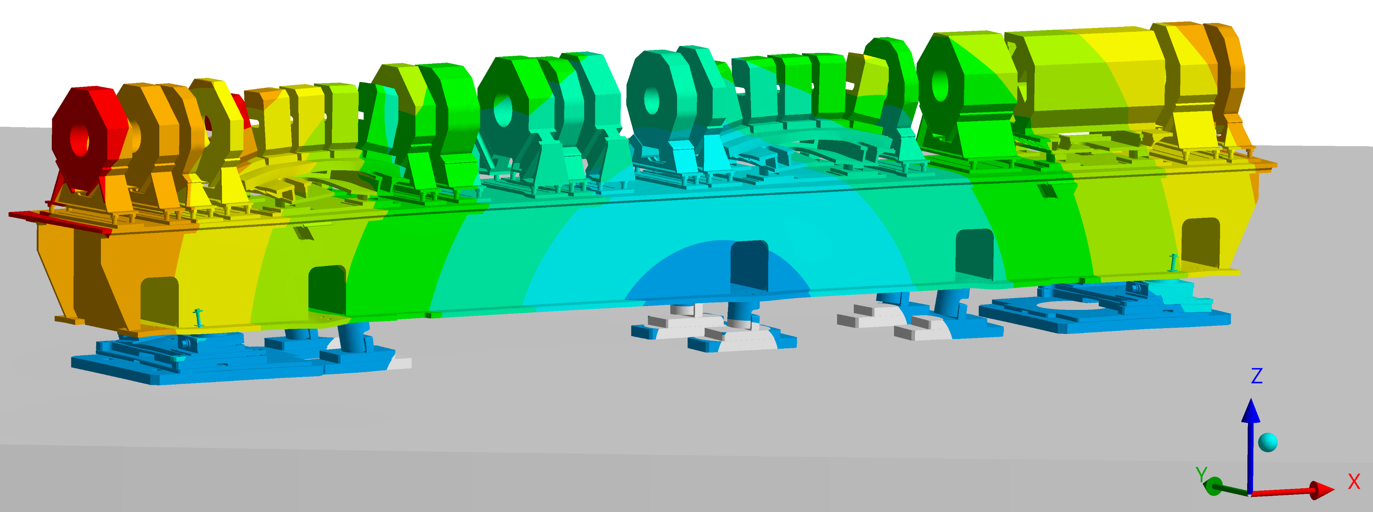
Key Challenges
Stability
Thermal
  Differential expansion
  Air Handling variability
Vibration
  Floor
  Water Flow induced
P. Vivian, W. Tizzano, X. Liu PAB 2025
Notes:
As mentioned stability is one of the key factors which is considered in everything we design.
We have installed 100’s of air and surface mount temperature sensors in the Diamond storage ring to understand how the temperature changes both spatially and temporally during startup, steady state and beam loss. The air handling system is outside the scope of the D-II upgrade and so we have used the measured data from Diamond to model the expected displacemnts on our new girders and magnets and believe they are acceptably small currently.
There are potential future upgrades to improve the air handling systems which have already been identified.
The plot shows the temperature rise of various locations on a girder and the concrete floor during startup – its clear there is not insignificant variation which is what prompted us to look into this in more detail. We have subsequently also looked at the impact of cable heating also.
Vibration is another significant concern, significant lessons have been learnt from Diamond to minimise the impact of sources of vibration o the girder assemblies and thus electron beam, this includes:
* Change to an over constrained girder mover system – Diamonds kinematic mover system is good from a motion and alignment perspective but not good from a vibration perspective with its 1st eigen frequency around 12Hz
* D-II system ~doubles this 1st eigen Frequency
* The vibration analysis and experimental data have been included in AP models to verify that we can meet our required beam stability
Water handling – in Diamond extensive on girder watermanifolds were used often with orifice plates causing significant flow induced vibration which has been isolated as a key source in testing on Diamond
For Diamond II the water manifolds have been moved off the girder and all connections to the girder are made with flexible hoses only
All watercooled magnets have been designed to have a common 6bar pressure drop negating the need for flow balancing such as orifice plates on magnet circuits
Vessel circuits still require some flow balancing but this will be achieved on the off girder manifold.
Water flow velocity limit has also been reduced to 2.5 m/s to minimise flow induced vibration

Slide 16
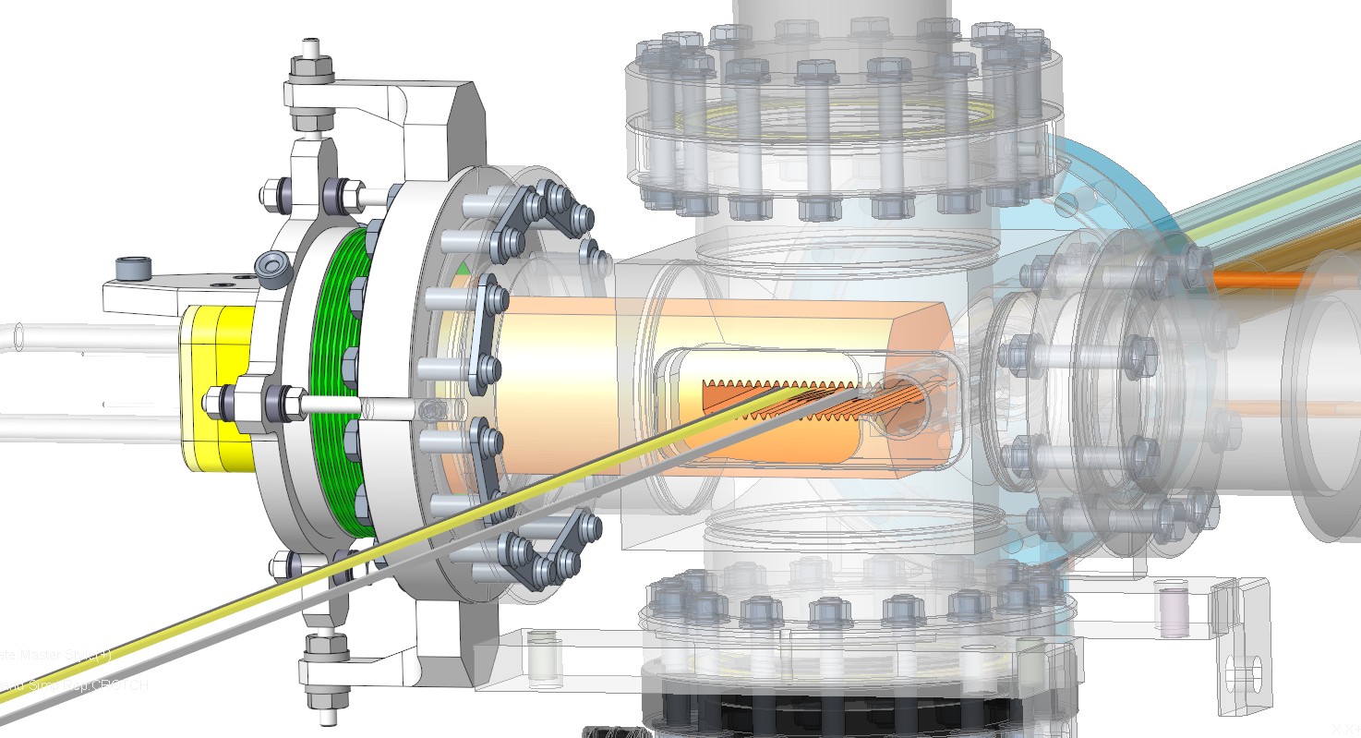
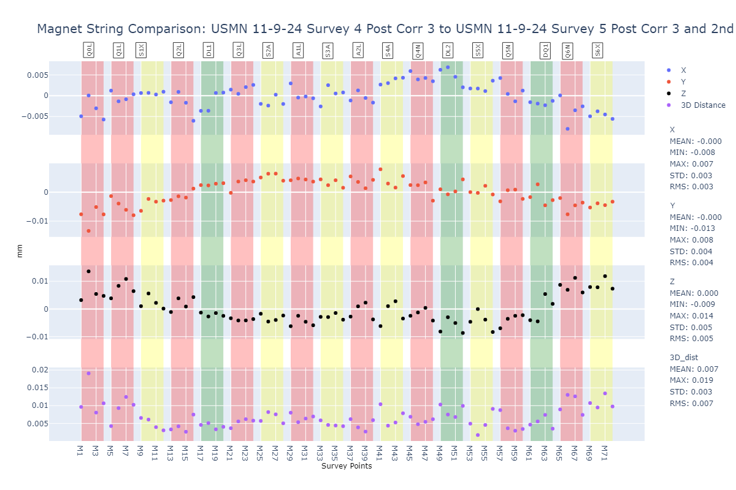
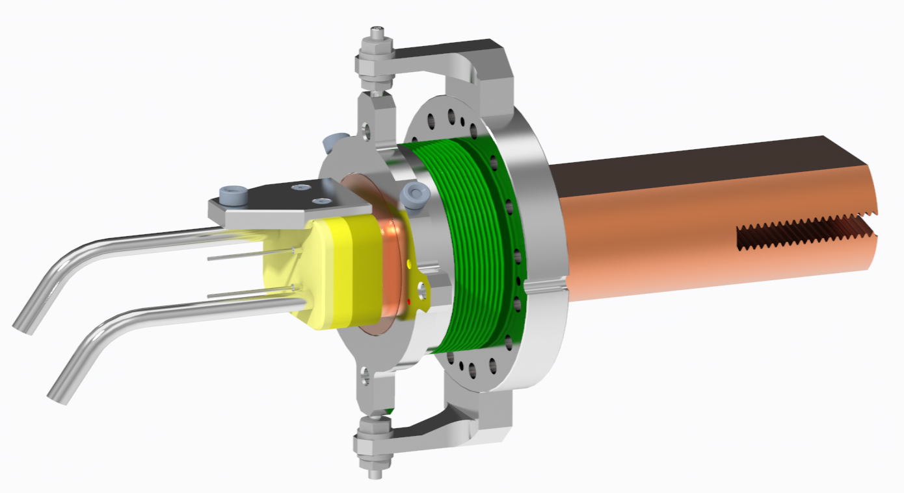
Key Challenges
Wire position measurement | 5
Magnetic measurement | 5
Survey Feature position measurement | 5
Magnet surveyed into position on girder | 25
Splitting/joining Of Magnet | 8
Survey ball in cone repeatability | 3
Transport | 25
SMR Centering | 3
Combined Uncertainty of magnet position on Girder | 38
Alignment Requirements
Magnet alignment uncertainty budget – 0.038 mm
Girder Initial installation global position tolerance +/- 0.075 mm
Post initial commissioning relative girder move accuracy - +/- 0.010 mm
All magnets and key component such as crotch absorbers individually aligned
P. Vivian, W. Tizzano, X. Liu PAB 2025
Notes:
The alignment requirements for all 4th generation facilities are pushing the limits of available measurement technologies.
* Our magnet alignment budget is 0.038 mm which is made up of various factors in the table here, (summed in quadrature)
The ellipse here shows visually what the typical laser tracker (our typical measurement instrument) measurement uncertainty looks like with the long axis in the laser direction
By taking multiple measurements from different positions and with different instruments we can combine these together in a unified spatial metrology network to reduce the measurement uncertainty to <0.025 mm depending on the environment <0.015 mm can be achieved.
We are limited in the tunnel to perform such multi position measurmenets and so have to work to a looser tolerance here of 0.075 mm
However we have a requirement for being able to make relative movements of the girder assemblies with an accuracy of <0.010 mm
Laser trackers are not able to measure this with any certainty and so we utilise a series of encoders on the girder to make such moves
Extensive testing has been carried out to confirm that these moves can be made the magnet string kept in alignment with this plot showing the deviation of the whole test girder string following a full alignment trial
All key beam handling componentns are individual aligned on the girder also such as the crotch absorbers shown
The primary tool we use is a laser tracker which is well known and understood however by using new methodologies to combine multiple measurmeents w

Slide 17
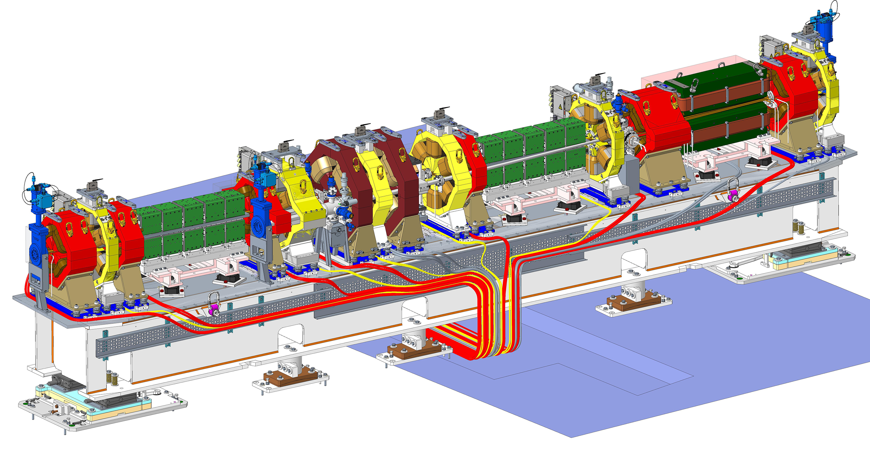
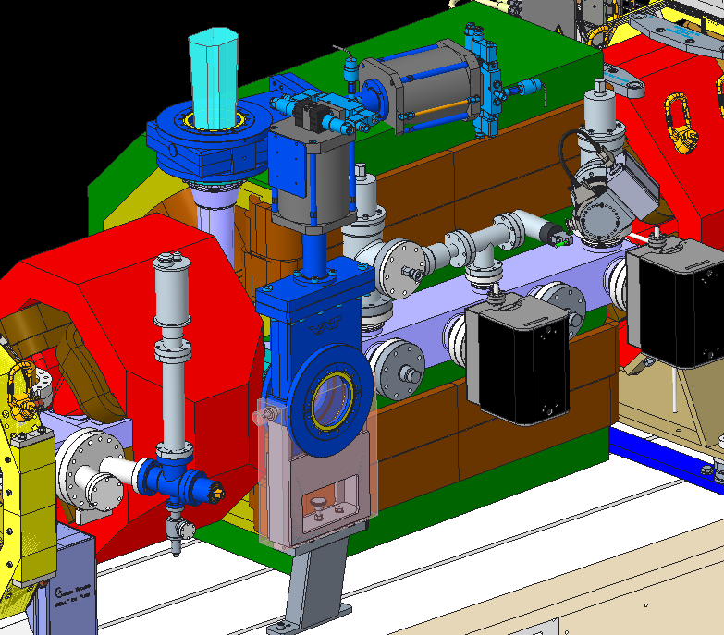
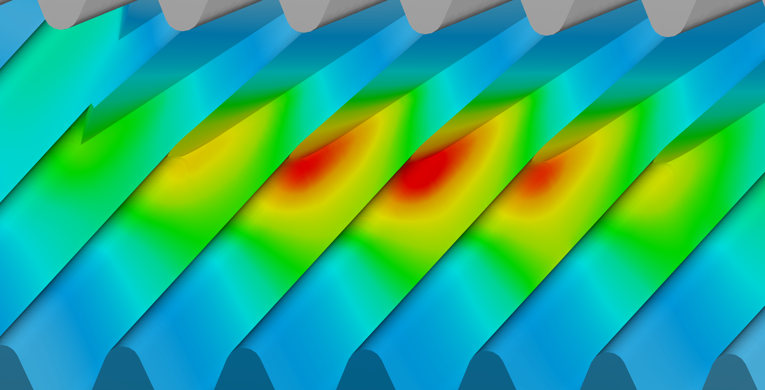
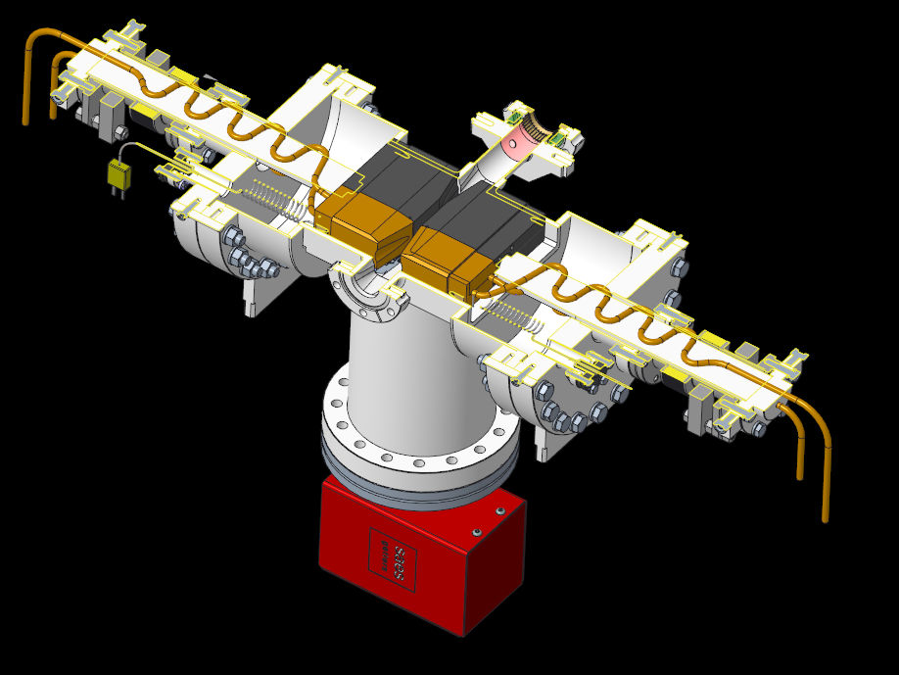
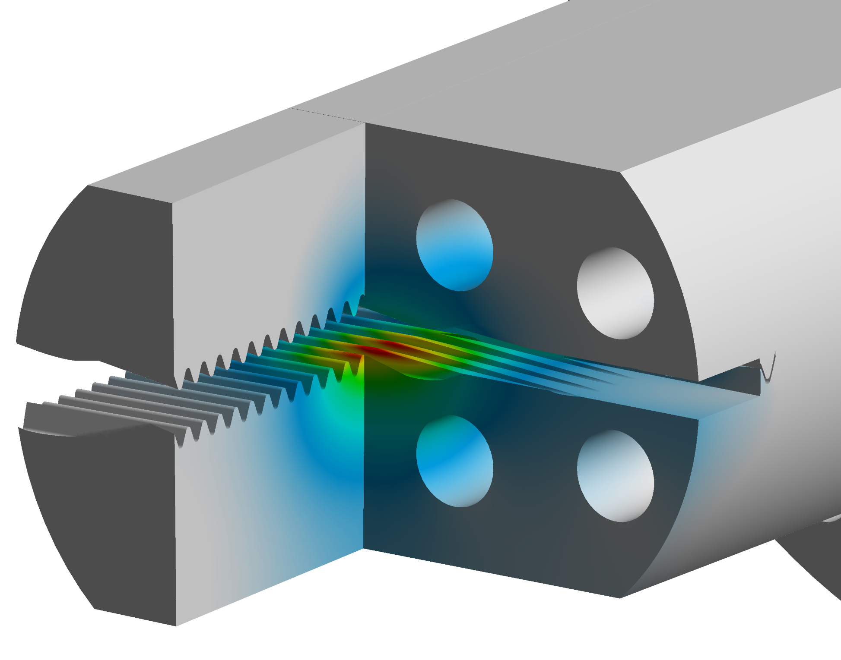
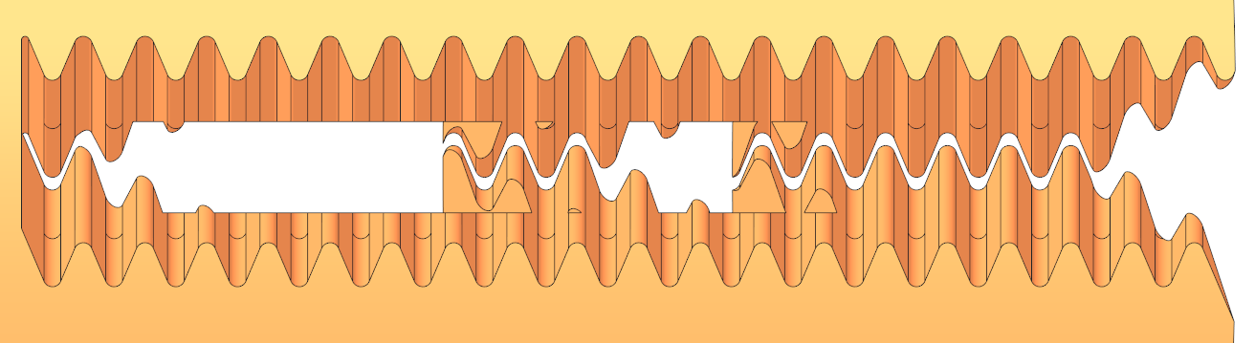
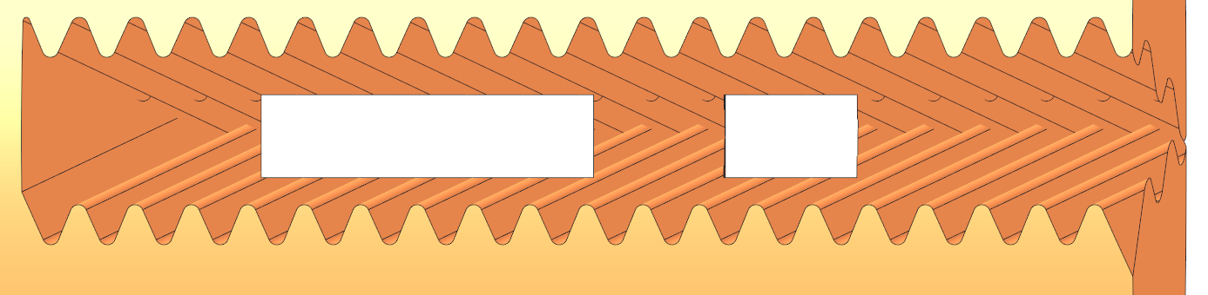
Key Challenges
Space
More magnets in less space!
Numerous ‘special’ elements
  B22 IR Extraction
  Visible Light Extraction
  Collimators
Accessibility for assembly and maintenance
Power Loads
Each girder vessel string and absorbers need to manage 5-12 kW of thermal power
I05 is particularly challenging with 3.6 kW on the crotch alone
P. Vivian, W. Tizzano, X. Liu PAB 2025
Notes:
There is much less ‘free’ space in Diamond-II which is challenging from an assembly and mainatenance perspective with many mockups being produced to ensure we can get tools where required
There are as mentioned lots of special elements which need to be designed for Day 1 operations which includes 6 collimators, IR extraction for B22 and visible light extraction for diagnostics to name a few.
As mentioned the power load and power density has increased for Diamond-II in the most challenging locations a single crotch absorber received 3.6kW
Reflected power is also a significant concern as while the percentage reflected is low when the total power is very high it can lead to uncooled sections receiving not insiginifcant amounts of power
Significant effort has gone into understanding the surface roughness and reflectivity properties for our vessels which are then modelled in synrad to simulate photon load on the whole vessel string and identify and hot spots

Slide 18
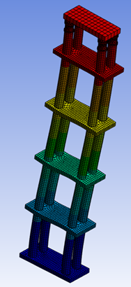
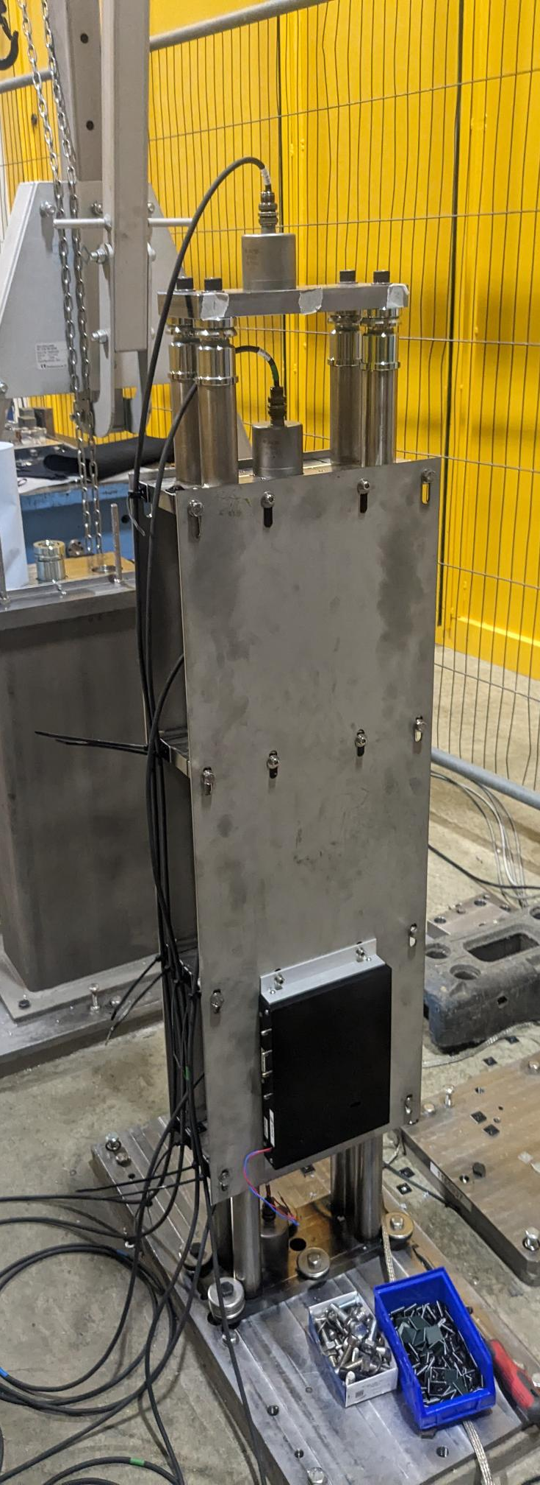
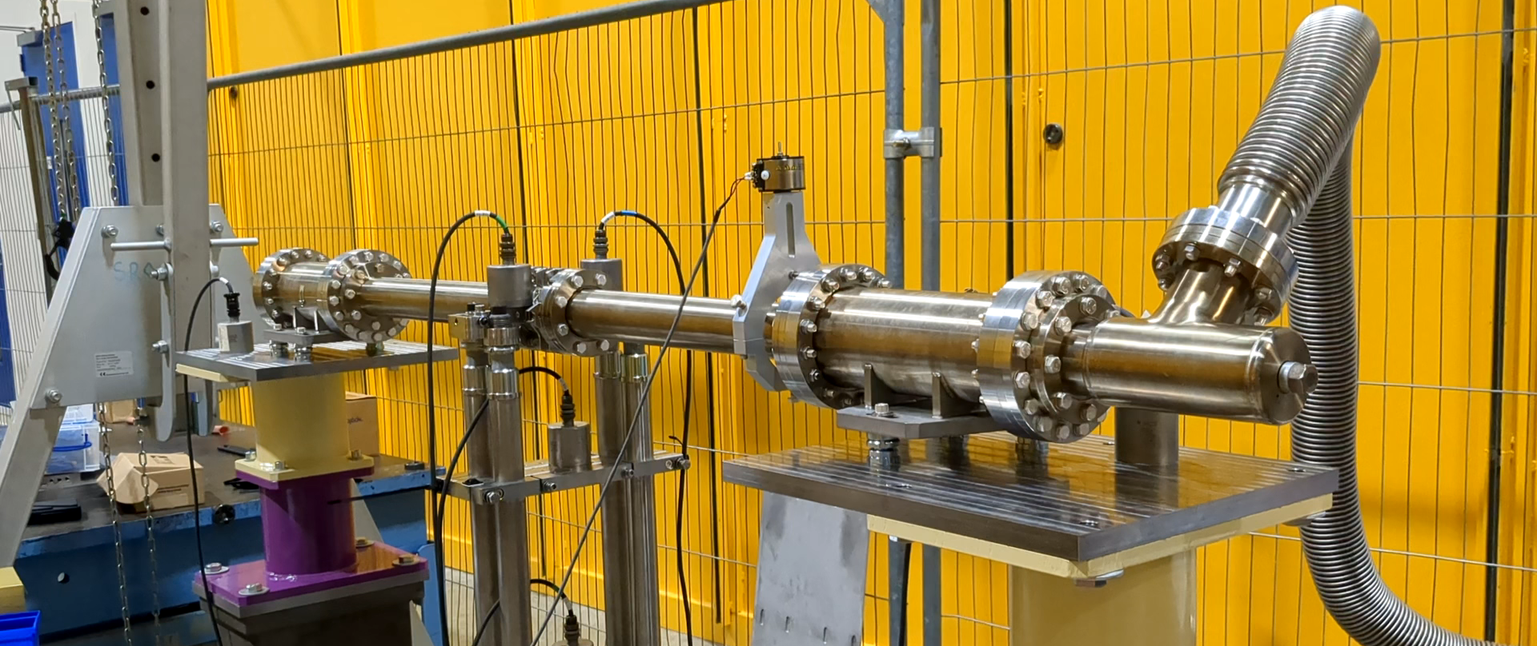
PeBPM Mechanical Testing
Primary Electron Beam Position Monitors (PeBPM) monitor the position of the electron beam in a fixed plane in the new storage ring
The major concerns of the design are structural and thermal stability
  Invar 36 is used as main structural material to minimise thermal expansion effects on BPM position
Design was influenced by those used at APS-U and NSLS-II
Extensive experimental testing carried out to establish vibration performance
  Data being integrated into diagnostics simulation models
Testing has identified opportunities to improve the designs vibration performance
  Geometry tweaks
  Addition of bracing plates
P. Vivian, W. Tizzano, X. Liu PAB 2025
Notes:
Our PEBPM’s are our master reference point for the beam position as such we want them to remain as stable as possible over all timescales
To enable this we have followed on from work done by APS-U and NSLS-II and used invar columns and bracing
Invar has a very low CTE, so the temperature rise in the machine you saw in the earlier slide will have minimal (<5 microns) impact on the BPM position
Space for the BPM’s is very constrained and so following testing we have identified changes to improve its vibration stability further also.

Slide 19
Front Ends
Xia Liu
P. Vivian, W. Tizzano, X. Liu PAB 2025

Slide 20
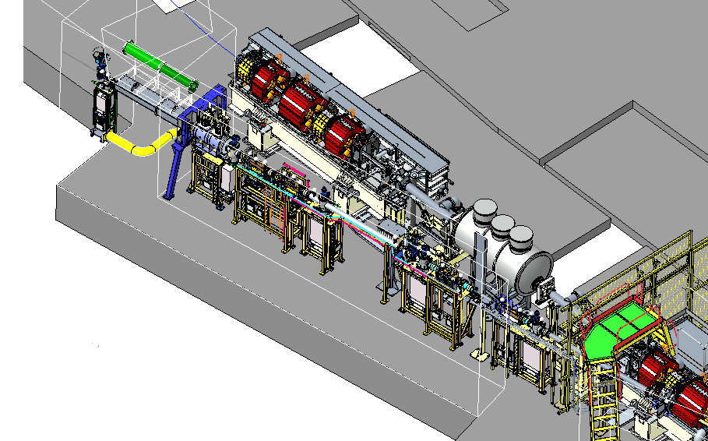
31 Existing Front Ends Diamond-II Upgrade
24 existing insertion device front end will be upgraded – FE I13 has major redesigns.
New design for converting Dipole FE to ID FE in 7 beamlines.
Added insertion device branch to FE B07 is technically very challenging.
Three dipole front ends upgrade –Special efforts made for bespoke designs of B22, B23 and B24.
K11 Front Ends shown with the I12 ID in Diamond Storage Ring
The changes of the existing front end upgrade are summarised in 10 categories. The project work are deployed accordingly.
  1: New module zero
  2: Accommodating NC cavity
  3: Front end realignment
  4: Changes to wall penetration shielding
  5: Wall hole modification
  6: Change of photon exit aperture
  7: Upgrade of Absorbers
  8: Change of beam splitters
  9: New first aperture
  10: Additional lead shielding
P. Vivian, W. Tizzano, X. Liu PAB 2025
Notes:
There are 31 front ends installed in the ring. This slides shows the scope of the D-II upgrading work for all the existing FEs.

Slide 21
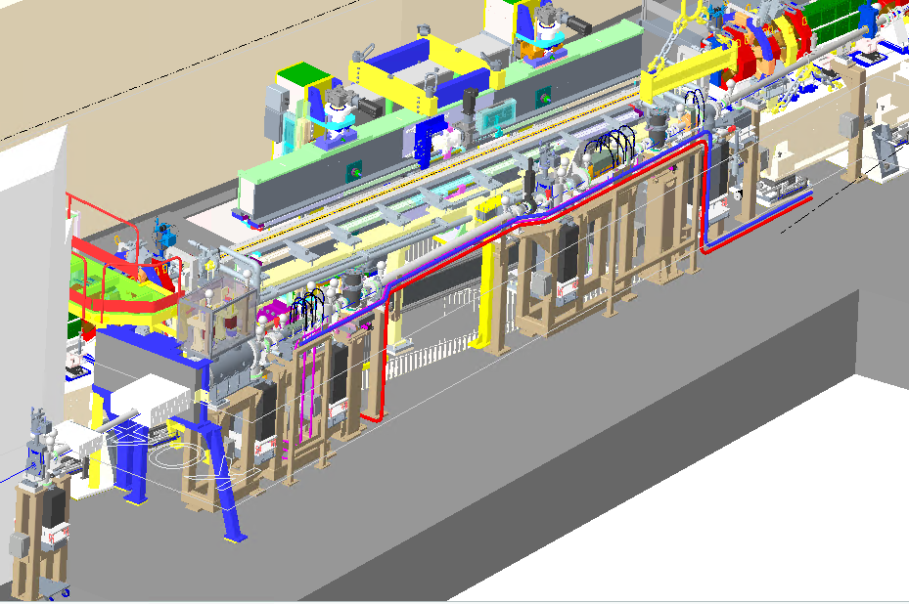
Diamond-II New Insertion Device Front Ends
Delivering 8 new insertion device front ends in Diamond-II. This includes 3 Diamond-II flagship lines, 4 front ends for converting existing dipole lines and FE I13 major redesign.
Design standardization is employed to deliver efficiently.
K04, K16 and K21 have identical designs.
K14, K18 and I17 will be 70% similar to the identical design.
Bespoke FE K07 is using standard design modules where possible.
K04 Front Ends shown with the I05 ID
P. Vivian, W. Tizzano, X. Liu PAB 2025
Notes:
This slide shows the delivery approach FE team employed. We are delivering new front ends for D-II flagship beamlines. We also delivery new front end for the Dipole beamline changing to ID beamline. Front end I13 will need major redesign due to significantly increased photon beam power.

Slide 22
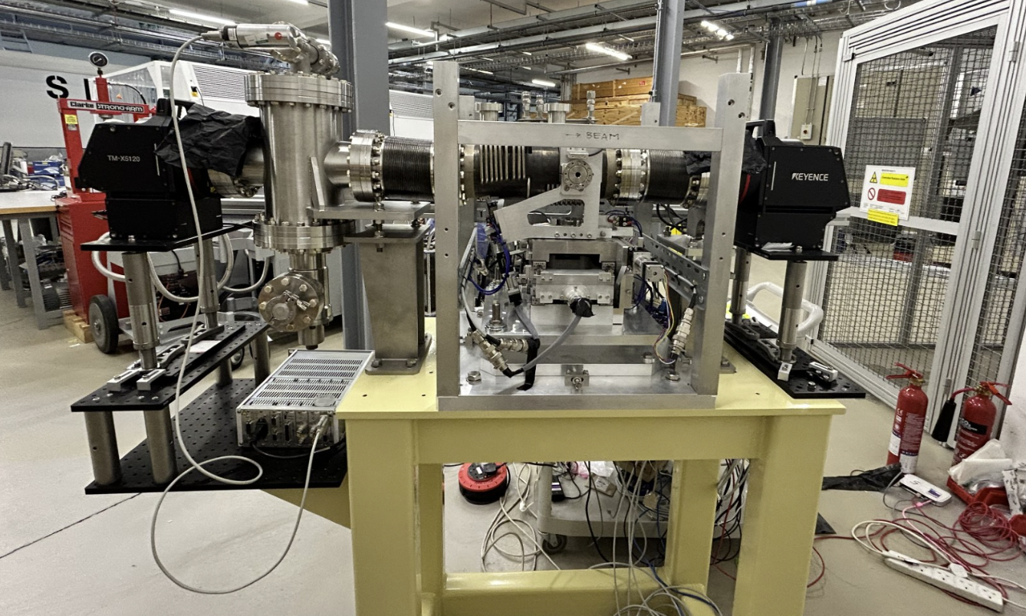
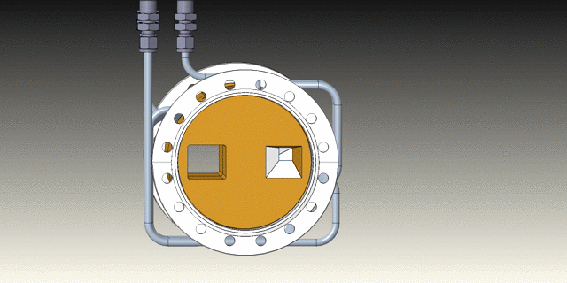
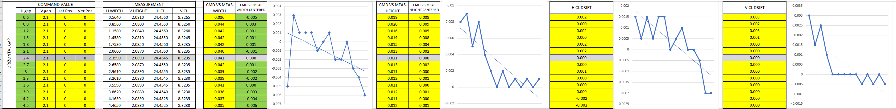
Technology Predevelopment - Rotatable Slit Prototype
In-air measurements shows good correlation between commanded values and measured values with total errors of +/- 5 microns at full deflection.
In-vac measurements are proving more difficult to measure as the extra vacuum equipment puts the Keyence optical micrometre outside its focal range.
P. Vivian, W. Tizzano, X. Liu PAB 2025
Notes:
This predevelopment is for the use on two front ends with different requirements. I13 beamline uses the front end slits as its virtual source. The existing I13 slits has to be changed due to increased beam power in Diamond-II. But the traditional front ends slits configuration – with two pairs of blade placed more than 500mm away, could not be used as the virtual focal point. The traditional slits would not suit the available space in K07. K07 beamline has space shortage because of dual branch geometry. A compact slits design is required. The rotatable slits assembly has a compact geometry. It only half the length of a traditional slits, yet handles all the beam power.

Slide 23
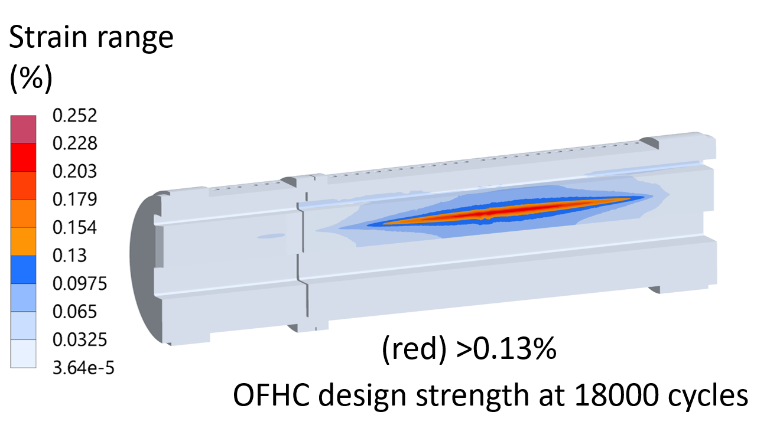
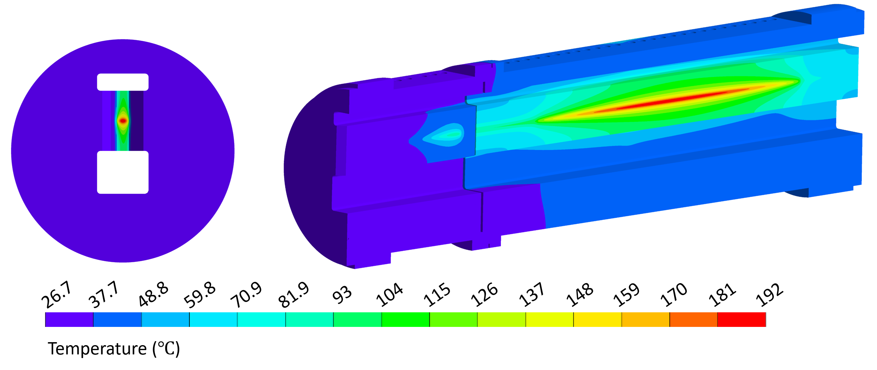
Beam Absorbing Components on I02 Front End
British Pressure Vessel Standard (EN BS 13445) requires safety coefficients in both strain range and number of cycles using the factor x1.5 strain range + x10 number of cycles. Annealed OFHC strain range limit is 0.13% when these safety factors are applied.
FEA analysis of I02 Front End beam absorbing components with Diamond II increased energies show this strain range limit is exceeded for OFHC material
Courtesy of J. Linde Cerezo
P. Vivian, W. Tizzano, X. Liu PAB 2025
Notes:
We keep having new challenges. This is a recent R&D project.

Slide 24
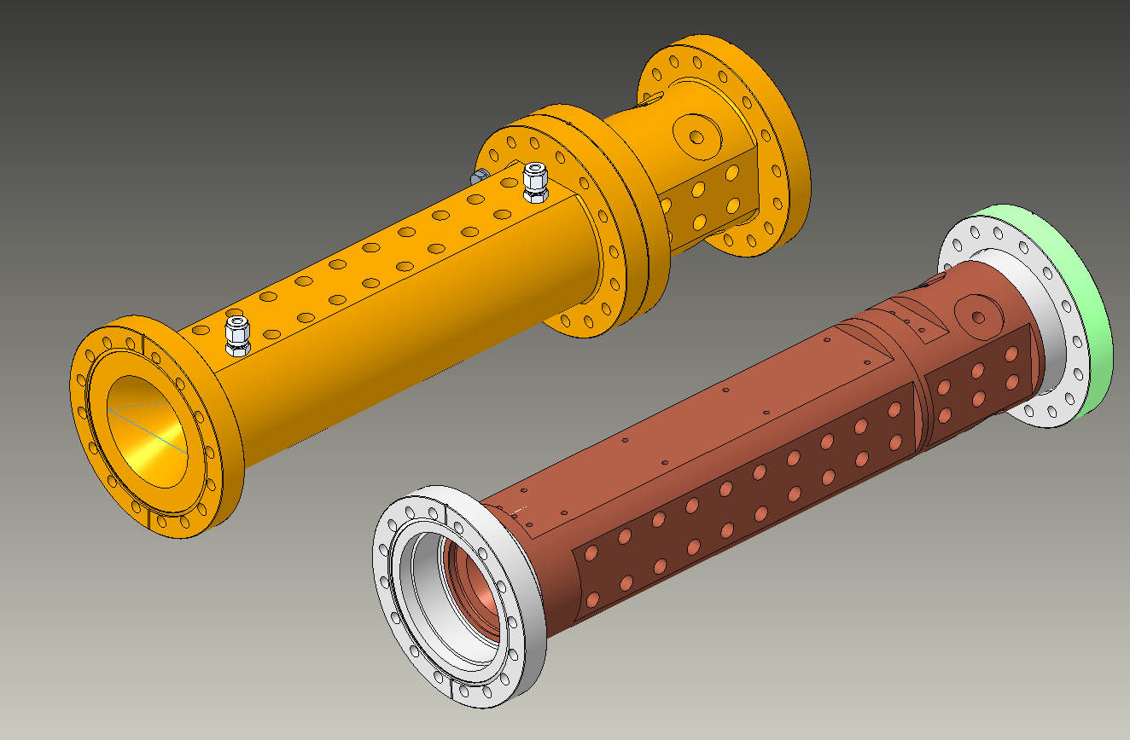
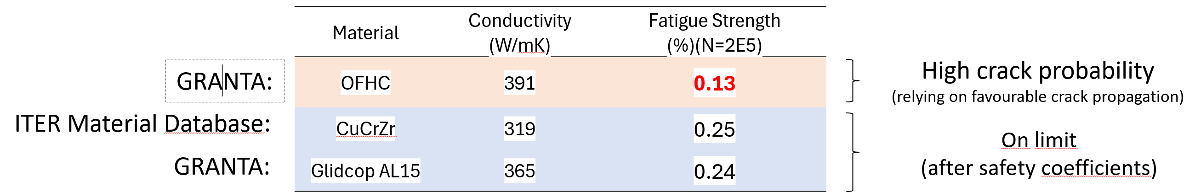
Beam Absorbing Components on I02 Front End
CuCrZr (annealed) or Glidcop AL15 offer similar performance in terms of strain range. However, higher temperatures are reached because of the reduced thermal conductivity but fatigue strength is doubled at 20000 cycles.
Two designs are being proposed using CuCrZr. One is an electron beam welded (EBW) assembly while the other is a flange bolted assembly. The flange bolted assembly has potential issues with maintaining vacuum at elevated temperatures whereas the EBW assembly has process difficulties. Discussion is ongoing with FMB Berlin to agree the EBW process.
P. Vivian, W. Tizzano, X. Liu PAB 2025

Slide 25
Thank you
P. Vivian, W. Tizzano, X. Liu PAB 2025

