Slide 1



ECFA-UK: Lessons, Progress, and Opportunities for UK Accelerator Science
(ECFA-UK Update)
Haroon Rafique
ISIS Accelerator Physics Group – Plenary ECFA (UK)
IOP PAB Conference, Oxford
9 – 10 July 2025

Slide 2
Contents
What is ECFA?
ESPPU & UK Input
Restricted ECFA UK Meeting
Joint ECFA NuPPEC APPEC Symposium 2025
UK / STFC Strategy for Engagement with CERN Update
CERN Opportunities

Slide 3
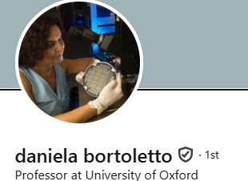

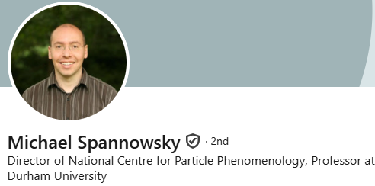
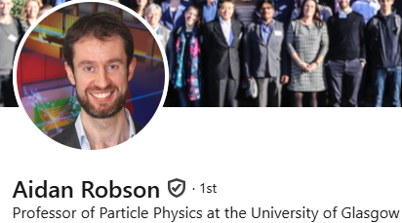
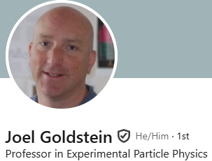
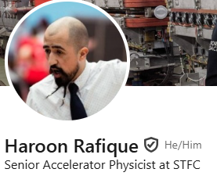
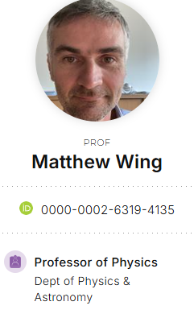
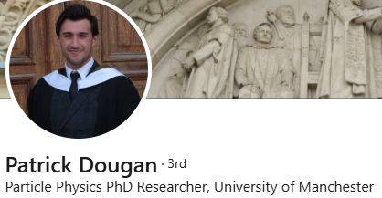


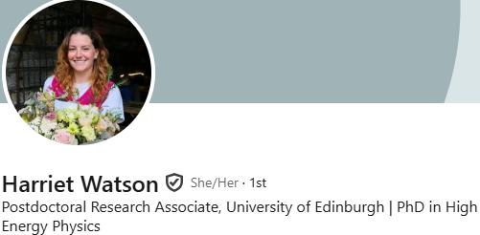
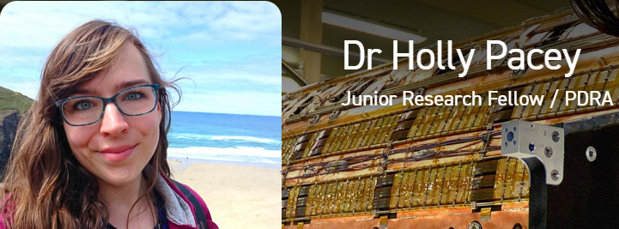
What is ECFA?
Founded 1963 by CERN DG & CERN Scientific Policy Committee to co-ordinate planning of next-generation high-energy accelerators in Europe.
Regular meetings (Plenary & Restricted) to formulate and recommend strategic actions.
Organising symposia and conferences.
Forming ad hoc study groups for specific challenges.
Country visits – issuing recommendations to governments and physics community.
Monitoring strategic plans (European Particle Physics Strategy and its Updates)
A few ‘plenary’ delegates per members state, one RECFA delegate
UK RECFA Delegate
UK Plenary ECFA Delegates
UK ECR ECFA Delegates
Notes:
ECFA functions as the strategic steering committee for Europe’s high-energy accelerator projects—guiding long-range planning, fostering equitable international collaboration, balancing research infrastructure, and ensuring alignment with broader European strategy through continual review and engagement.

Slide 4
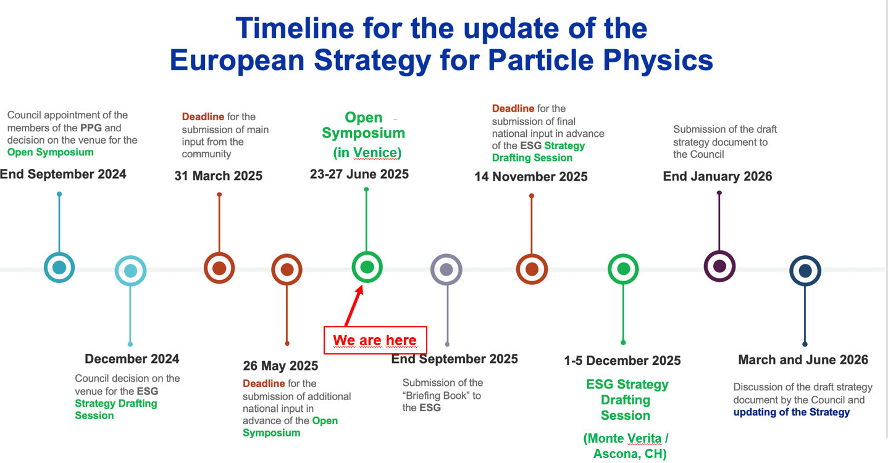

2026 Update to the European Strategy for Particle Physics (ESPPU)
Briefing Book:
Comprehensive factual summary of the current state of particle physics, compiled by the Physics Preparatory Group (PPG) including:
Scientific landscape
Technological capabilities and roadmaps
Community input summary
Options and considerations
It provides the evidence base for informed discussion and decision making.
UK Drafting Meeting 1 (Daresbury)
UK Drafting Meeting 3 (RAL)
UK Meeting to be announced
UK Kick-Off (Durham)
UK Drafting Meeting 2 (UCL)
We are here
ESPPU Open Symposium: https://agenda.infn.it/event/44943/overview
Notes:
What will CERN build next? What experiments are needed to answer the big questions in physics?
The ESPP is Europe's long-term plan for particle physics. It sets scientific priorities, guides investments in accelerators, experiments, and R&D, and aligns national efforts with global projects.
The ESPPU is the periodic update of the ESPP—typically every 7–8 years. It collects community input, evaluates progress, and recommends future directions.

Slide 5
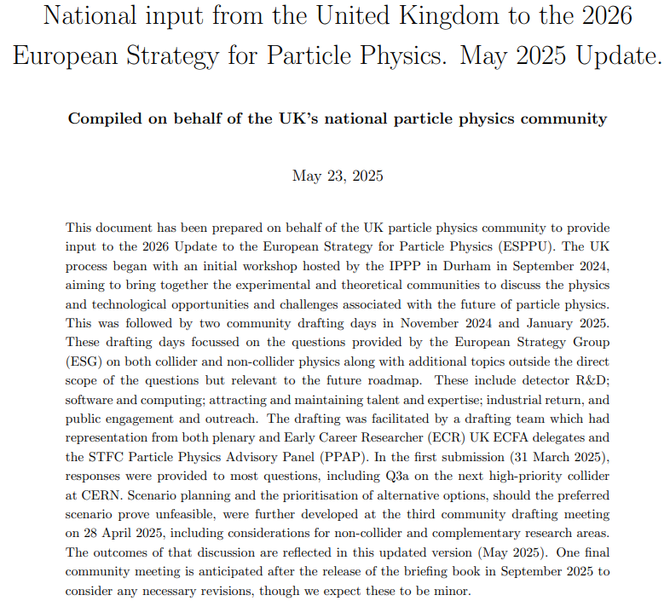
ESPPU UK Input
Kick-off + 3 Drafting Days
~ 500 Participants engaged
80+ Pages of minutes and summaries
~ 15 Internal drafting meetings
+ Many hours of drafting
All Contributions to the ESPPU: https://indico.cern.ch/event/1439855/contributions/
Drafting Team:
Jim Clarke (Director of ASTeC), Sinead Farrington (Director of STFC PPD), Mark Lancaster (UK representative on the European Strategy Group), Ruben Saakyan (Chair of PPAP)
UK ECFA delegates: Daniela Bortoletto (Oxford), Joel Goldstein (Bristol), Haroon Rafique (STFC ISIS), Aidan Robson (Glasgow), Michael Spannowsky (Durham), Sarah Williams (Cambridge), Matthew Wing (UCL)
UK ECR ECFA delegates (who did most of the minute taking): Patrick Dougan (Manchester), Allison Elliot (STFC PPD), Harriet Watson (Edinburgh), Aidan Wiederhold (Manchester), Holly Pacey (Oxford)
Plus numerous colleagues providing specific input / representation
Notes:
Process so far involved …
Available here with the update
Thanks to drafting team

Slide 6
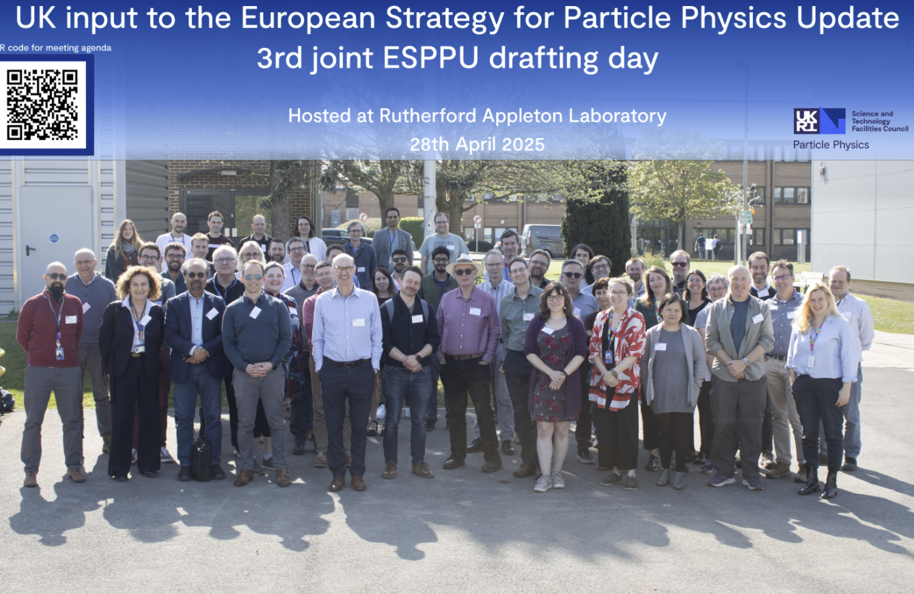
ESPPU UK Input
4 Events
Kick Off
  23rd – 26th September 2024 @ Durham https://conference.ippp.dur.ac.uk/event/1357/overview
3 Drafting Days
  4th Nov 2024 @ DL https://conference.ippp.dur.ac.uk/event/1391/
  Minutes
  9th January @ UCL https://indico.stfc.ac.uk/event/1183/
  Minutes
  28th April 2025 @ RAL https://indico.stfc.ac.uk/event/1430/
  Minutes
Thank you for all contributions!
Photo credit: STFC, Kai Gregory

Slide 7

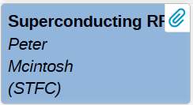

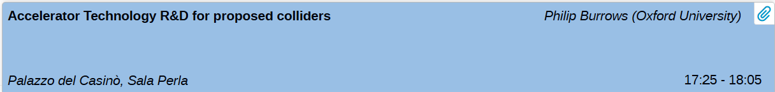
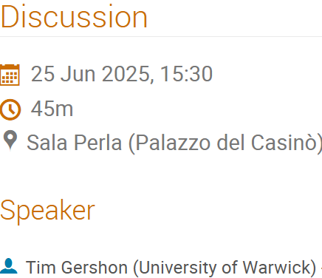

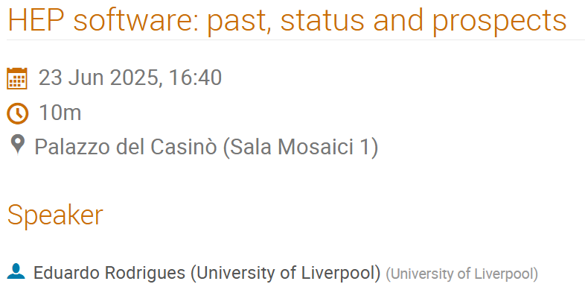
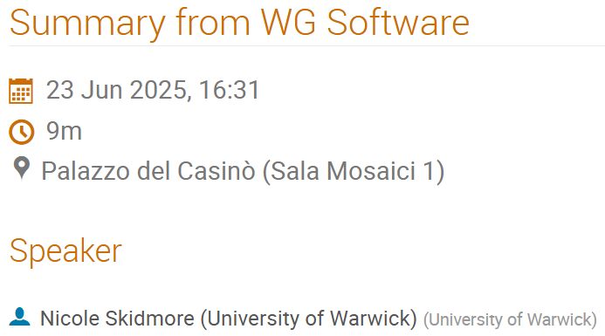
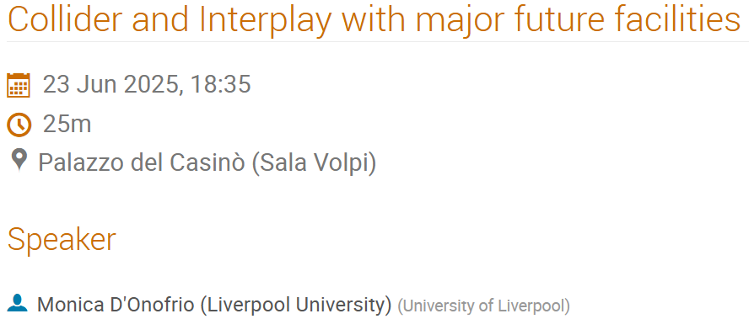
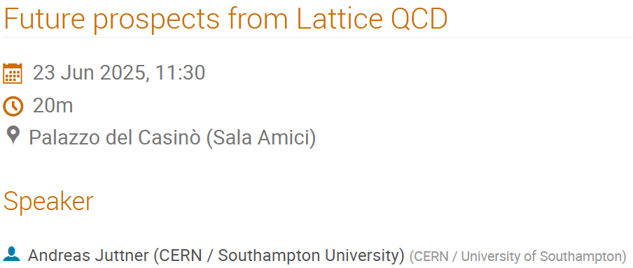
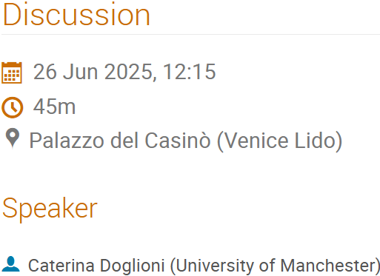
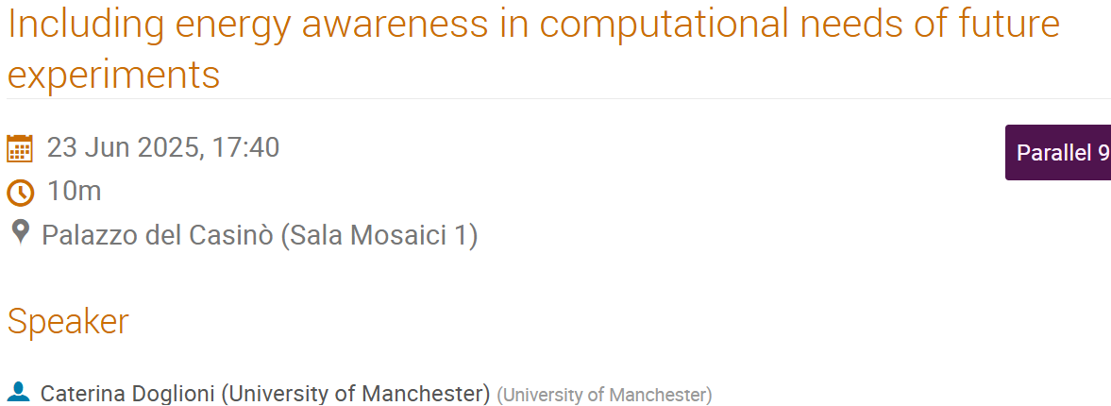
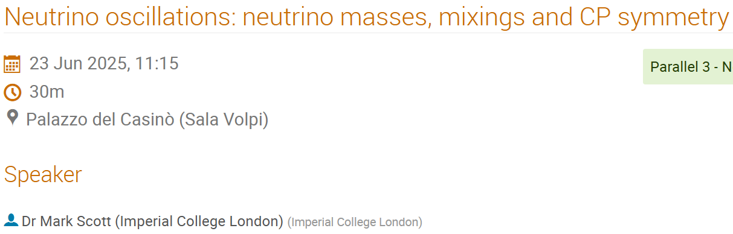
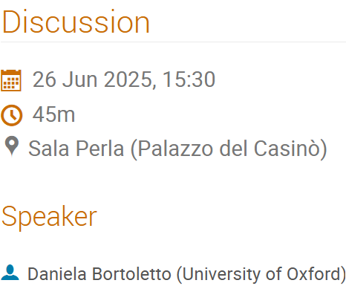


UK Contributions to Open Symposium
Notes:
Significant expertise in the UK – Accelerators, Computational, Detectors, various aspects of PP

Slide 8
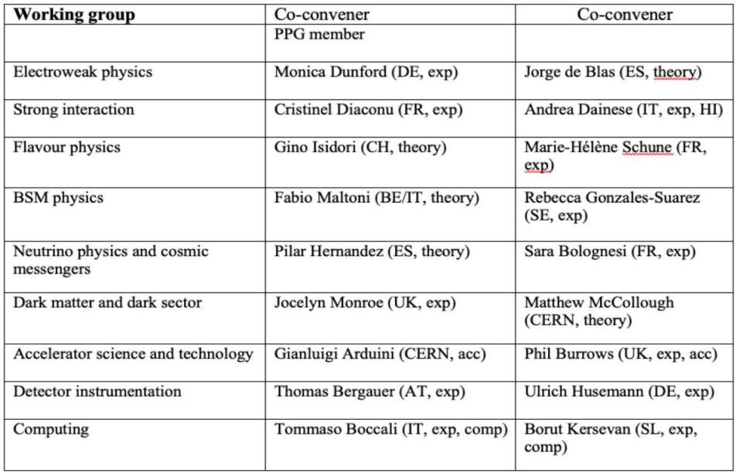
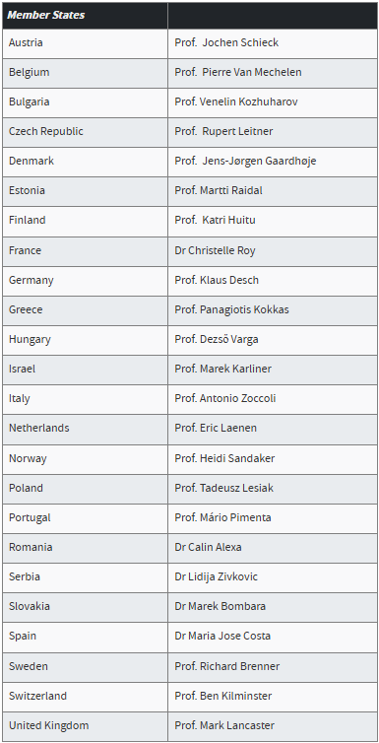
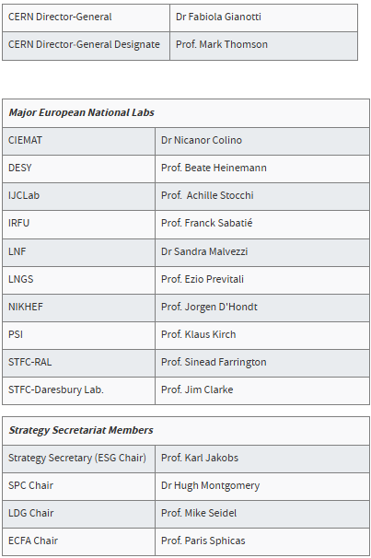
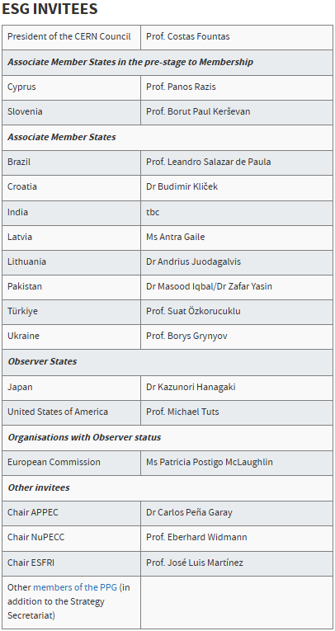
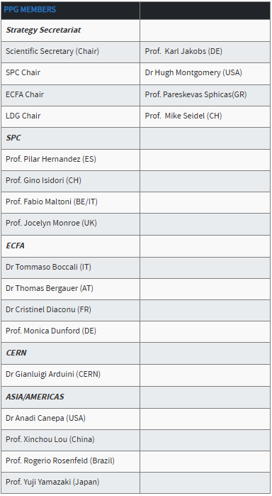
UK Involvement in ESPP / ESG / PPG
ESPP Working Groups and Conveners
Physics Preparatory Group
Previously
Prof. Dave Newbold
European Strategy Group
Notes:
Strong UK representation in ESPP, PPG who prepare the Briefing Book, and ESG who will compile the update

Slide 9
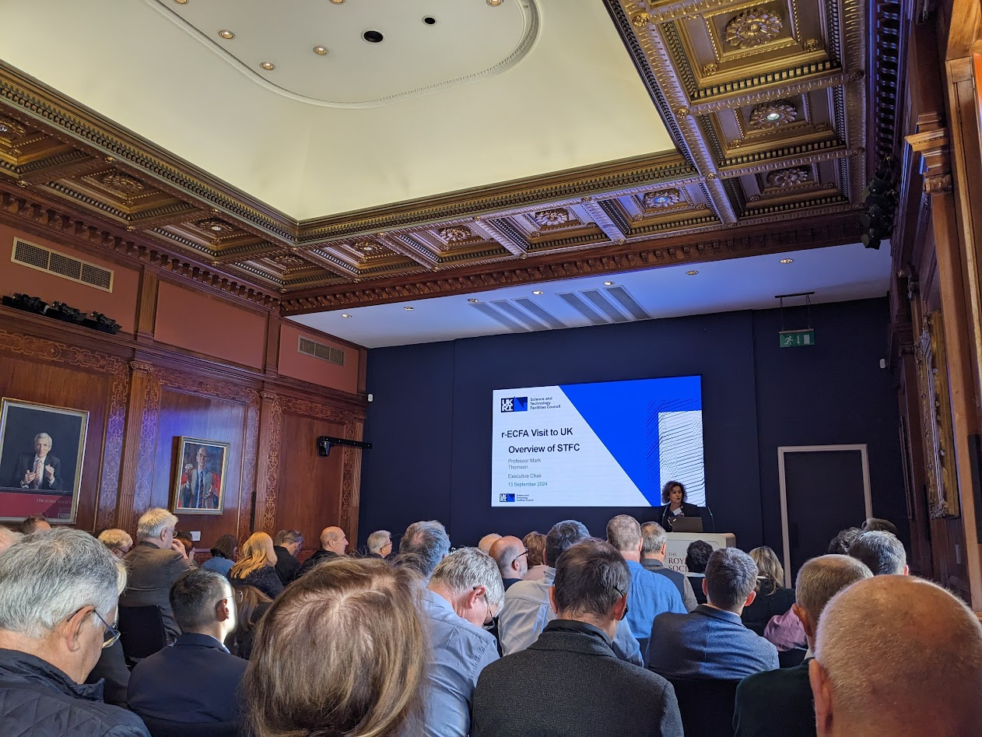
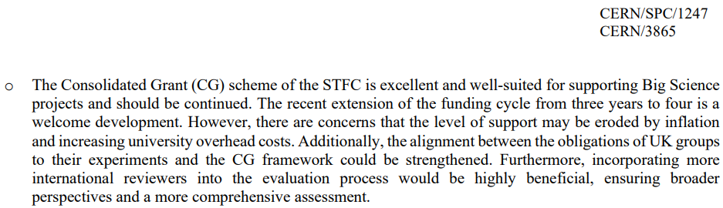
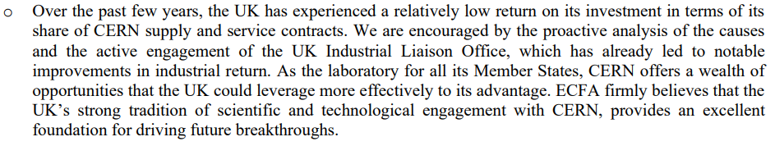
RECFA UK Meeting (Sep 2024)
Happens once every ~ 7 years
Monitor and assess status of particle physics (and associated Accelerator, Detector, Computing) in CERN Member (and Associate) States
Meet with funding agencies (STFC), lab directors, university researchers and other stakeholders
Consider:
  Health of particle physics community
  Ongoing and planned projects
  National commitments to international collaborations
Identify challenges in education, funding, infrastructure, career prospects
Provide recommendations to stakeholders and European community to:
  Strengthen national programs
  Improve integration into European strategies
https://indico.cern.ch/event/1348500/overview
Outcomes in: https://cds.cern.ch/record/2922249/files/English.pdf
Notes:
RECFA meetings ensure that European particle physics planning reflects the realities and needs of individual countries, promotes balanced development, and strengthens collaborative ties across Europe.

Slide 10

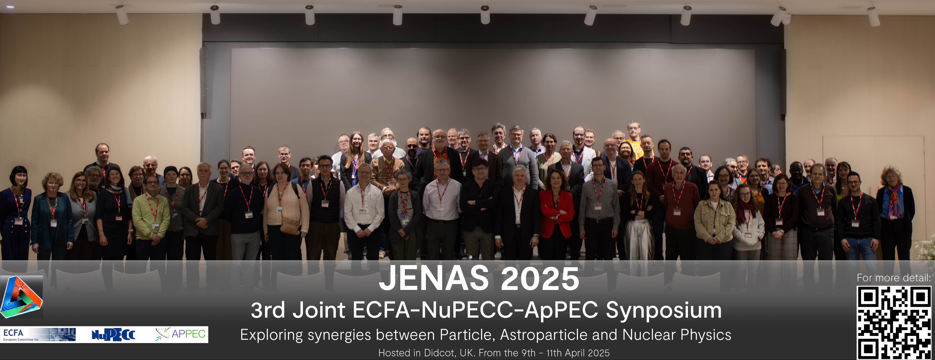
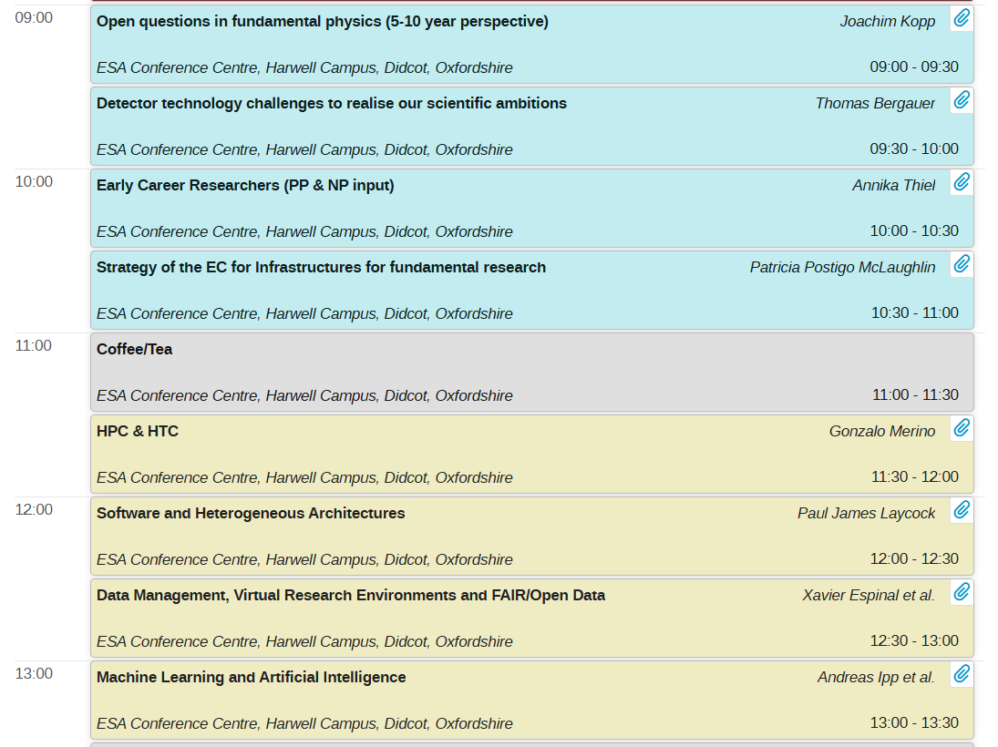
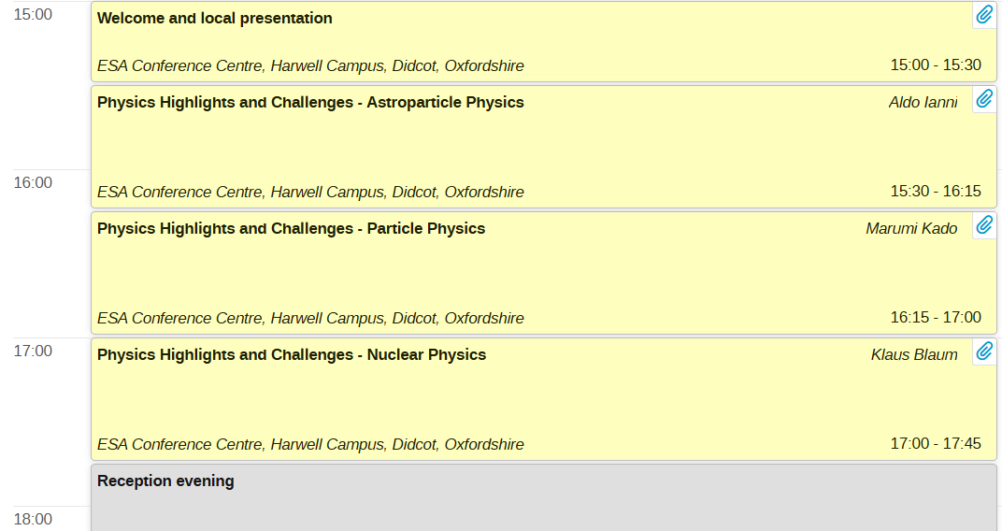
JENAS
The 3rd Joint ECFA-NuPECC-ApPEC Symposium JENAS is a prestigious joint meeting of particle, nuclear and astroparticle physics scientific communities exploring synergies and highlighting recent achievements and challenges. (April 2025)
https://indico.global/event/5574/overview
Photo credit: STFC, Kai Gregory
Notes:
What are the big questions in physics?
Where are the synergies? How can we support each other in European big science?
Lots of overlap in computing infrastructures – LIGO, CERN, national facilities all based on large data

Slide 11






Slide 12
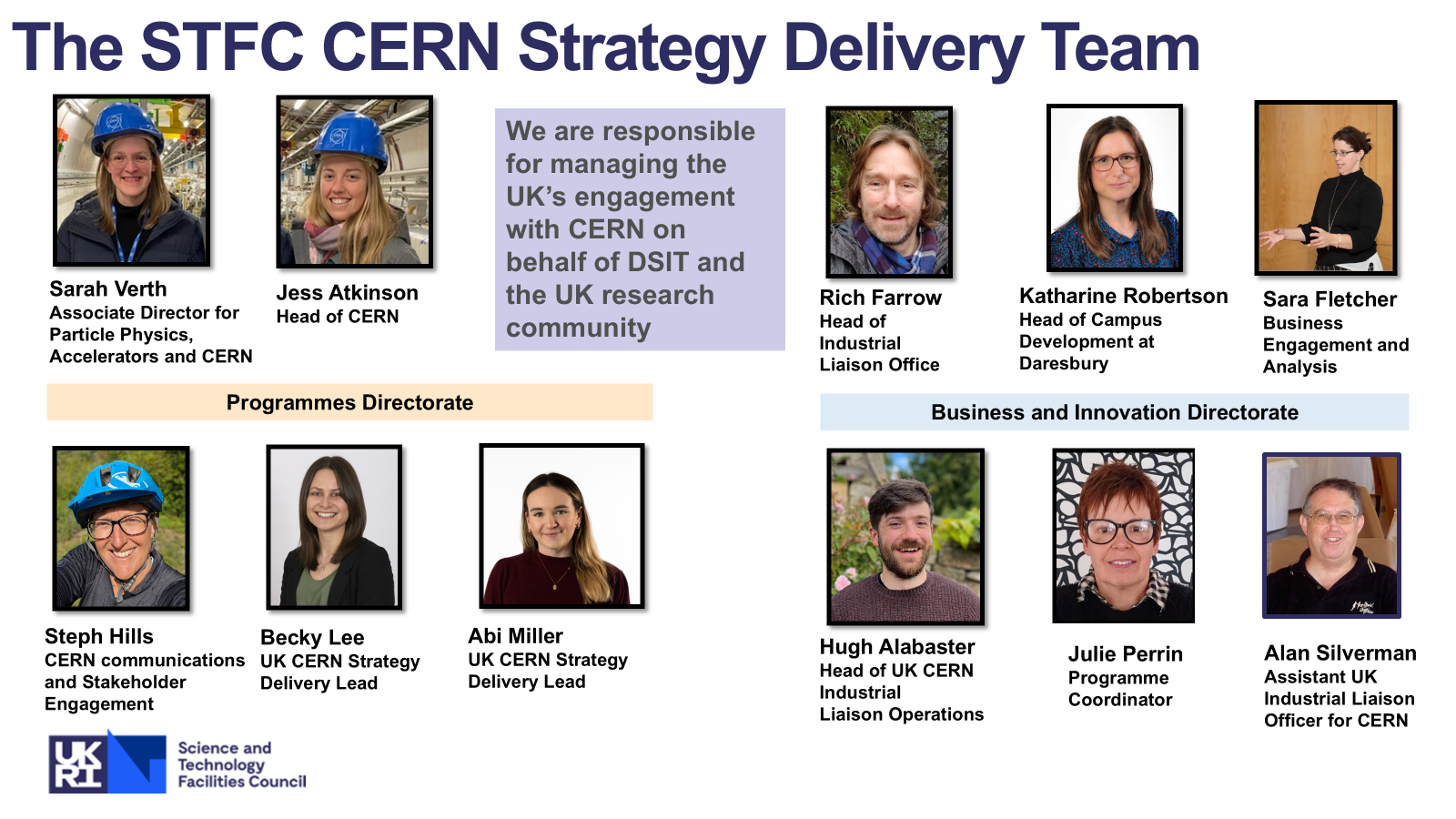
Slides courtesy of the STFC CERN Strategy Delivery Team
Notes:
Thanks to Abi, Becky, Steph and team for putting these slides together

Slide 13
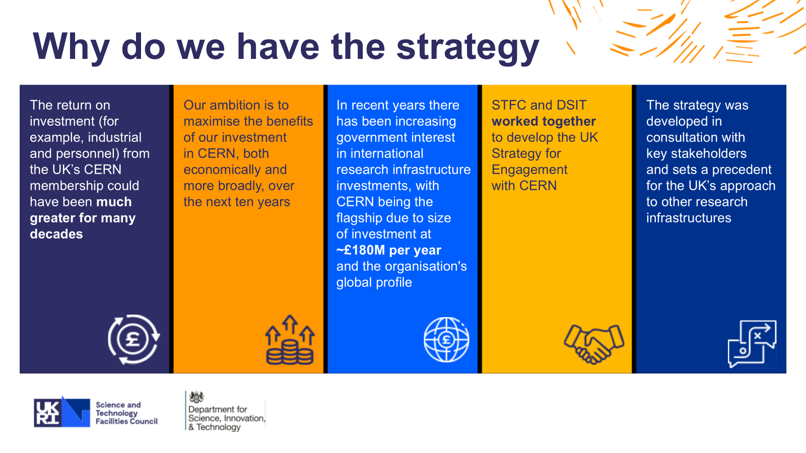
https://assets.publishing.service.gov.uk/media/6516a9bb6a423b0014f4c604/uk_strategy_for_engagement_with_cern.pdf
Slides courtesy of the STFC CERN Strategy Delivery Team
Notes:
Low return on investment – make a plan to get more out of our £180 mill spend
Plenty of opportunities, supported by a soon to be UK DG

Slide 14
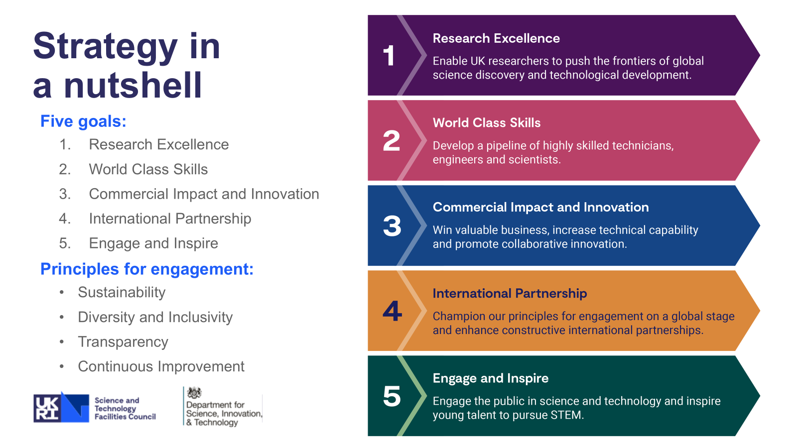
Implementation of Strategy
Slides courtesy of the STFC CERN Strategy Delivery Team
Notes:
Accelerators can benefit strongly from
skills pipeline
how do we get UK companies involved in R&D / production for <whatever CERN builds next>
International partnerships – what we’re good at
etc

Slide 15
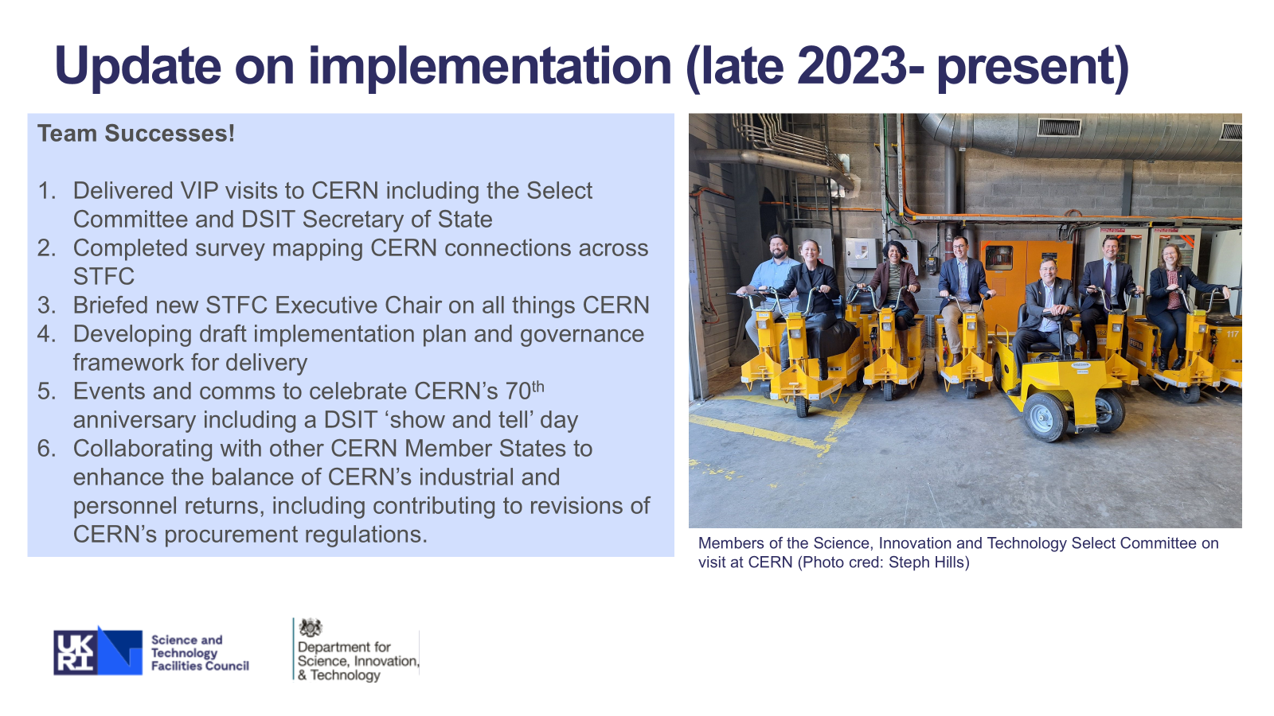
Slides courtesy of the STFC CERN Strategy Delivery Team
Notes:
Mapping CERN connections across STFC
Enhancing balance of industrial returns

Slide 16
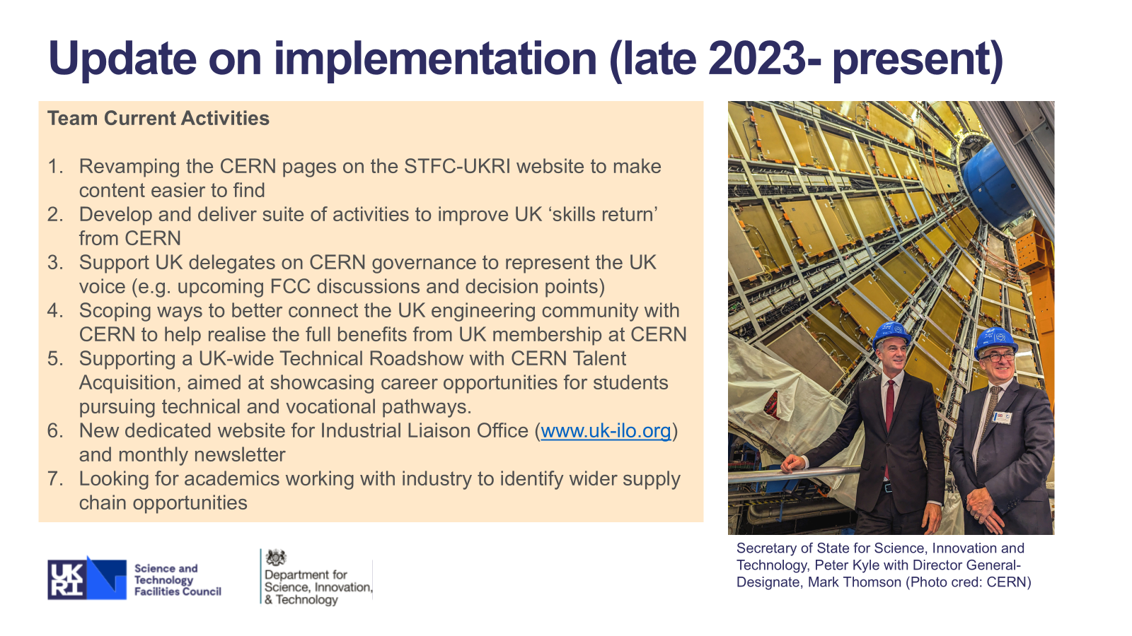
Slides courtesy of the STFC CERN Strategy Delivery Team
Notes:
Improve skills return
Better ways to connect UK engineering community with CERN
Technical roadshow
Industrial liaison: looking for academics working with industry

Slide 17
UK Engagement with CERN: Get Involved
🌟 Share Your CERN Success Stories
Have a great CERN-related achievement or impact story? Help us showcase the value of UK investment in CERN by sharing it with us!
👥 Become a UK CERN Champion
Support CERN HR by promoting studentships, fellowships, ORIGIN, and QUEST opportunities in UK universities.
📧 Contact: career.events@cern.ch
🔭 Future Focus & Industry Links
What technologies or capabilities will you focus on next?
Which UK companies or sectors should we connect with?
See www.uk-ilo.org for more information
🚧 Barriers to Collaboration
Faced challenges working with UK companies or recruiting UK students/grads?
Let us know what’s holding things back so we can help improve collaboration.
Tell your network about the work you do and the wide range of work going on at CERN e.g. online (LinkedIn, Instagram etc. using #UKatCERN) and/or tell us!
Send us a quick email with a lab/workshop/experiment photo!
Contact:
UKatCERN@stfc.ukri.org
Science and Technology Facilities Council
@STFC_matters
Science and Technology Facilities Council
Slides courtesy of the STFC CERN Strategy Delivery Team
Notes:
Share CERN stories with the strategy delivery team – encourage more ROI
Share CERN opportunities with students, technicians, etc – benefit from skills pipeline
Foster industry links (get in early for CERNs next project)

Slide 18



CERN Opportunities
Reach out to Barbara on LinkedIn to discuss opportunities at CERN
Professionals (Staff Positions): https://careers.smartrecruiters.com/CERN/staff
Postdocs: https://careers.smartrecruiters.com/CERN/experienced-graduates
PhD students (or soon to be): https://jobs.smartrecruiters.com/CERN/744000066291646-doctoral-student-programme-2025-3
Entry levels (bachelor's and master's graduates): https://careers.smartrecruiters.com/CERN/entry-levels
Technical Students: https://careers.smartrecruiters.com/CERN/tech
Summer Student Programme (will open in November): https://careers.cern/summer
Administrative Student Programme: https://jobs.smartrecruiters.com/CERN/744000066298255-administrative-student-programme-2025-3
Notes:
Not just physics
All levels
Share and apply

Slide 19








CERN Jobs
(Junior Fellow)
(Senior Fellow)
Reach out to Barbara on LinkedIn to discuss opportunities at CERN
Notes:
CERN Fellowships revamped
A selection of relevant positions
Talk to Barbara

Slide 20
Summary
ECFA:
  ECFA have been busy with the 2026 ESPPU
    UK Input process shows strong physics case for next flagship collider
    Look out for Briefing Book release and next UK input meeting
    Input needed for prioritisation of ‘Plan B’
  JENAS summarised big questions in physics
    Much to be gained through collaboration across disciplines
    Computing infrastructure synergies
  RECFA outcomes
    Encouraged funding to DSIT/STFC
    Celebration of UK leadership and contribution
Engagement with CERN:
  Strategy implementation
    Implementation plan and governance framework
    Enhancing industrial liaison www.uk-ilo.org
    Improving skills return
    Get involved!
  Opportunities / CERN Jobs
Notes:
Need input for plan B and next UK drafting meeting – please attend
JENAS showed synergies particularly in computing infrastructure
RECFA encouraged funding
Strategy: plan in place, improving UK return

Slide 21
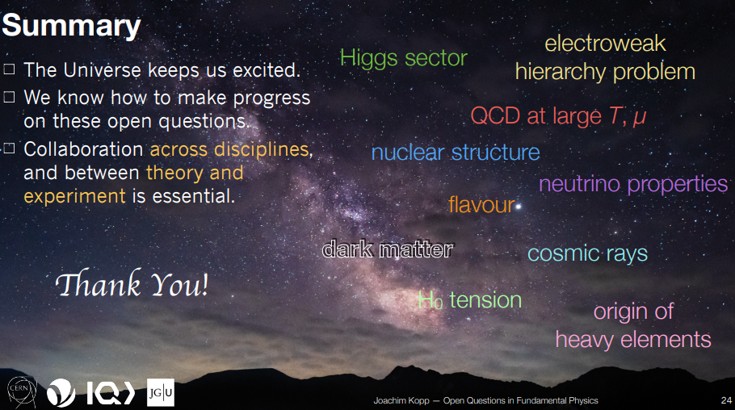
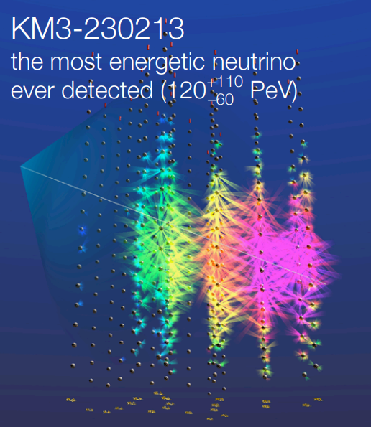
Thank You – Questions?
Connect with me on LinkedIn
Notes:
Big questions in physics
Nice discovery

