Slide 1

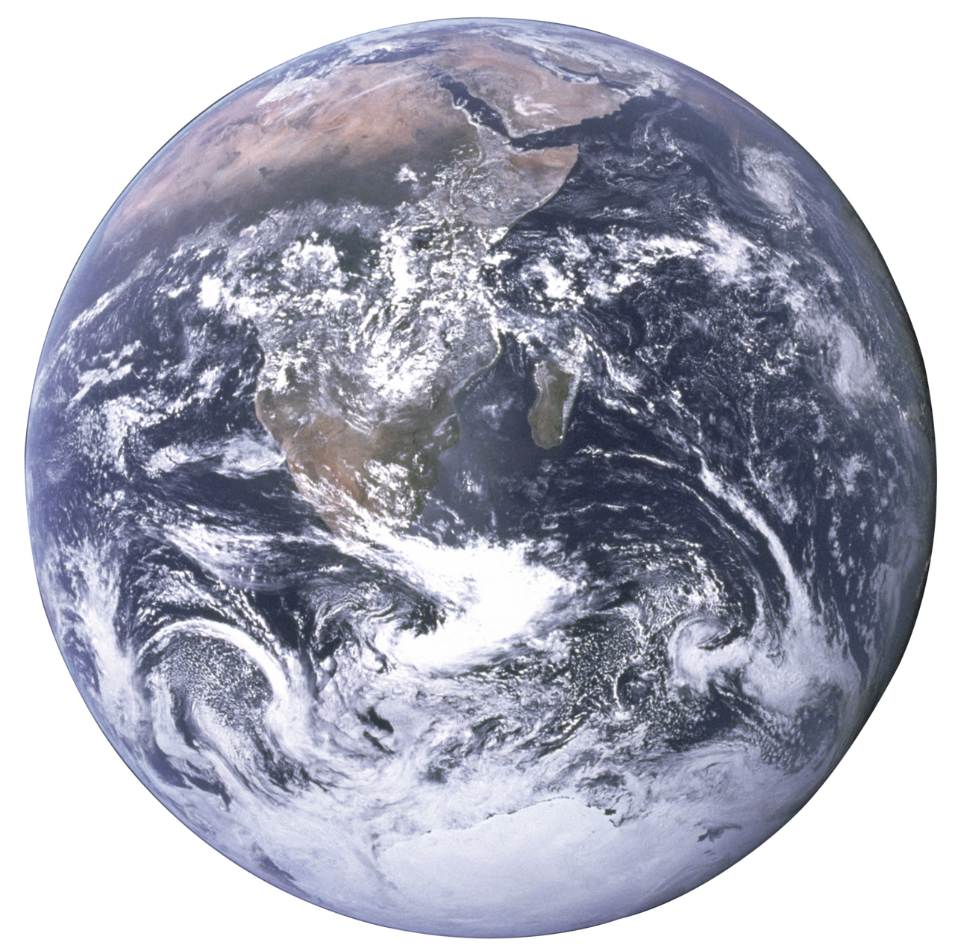


Communicating environmental sustainability guidelines for large accelerator facilities
Particle Accelerators and Beams Conference
Oxford | July 2025
Dr. Hannah Wakeling

Slide 2

Overview
Intersection of particle accelerators and environmental sustainability
High-level guidelines
Communication and collaboration
2
PABG 2025 | July 2025 | Dr. H. M. Wakeling

Slide 3
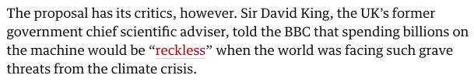
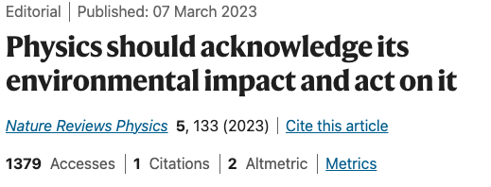
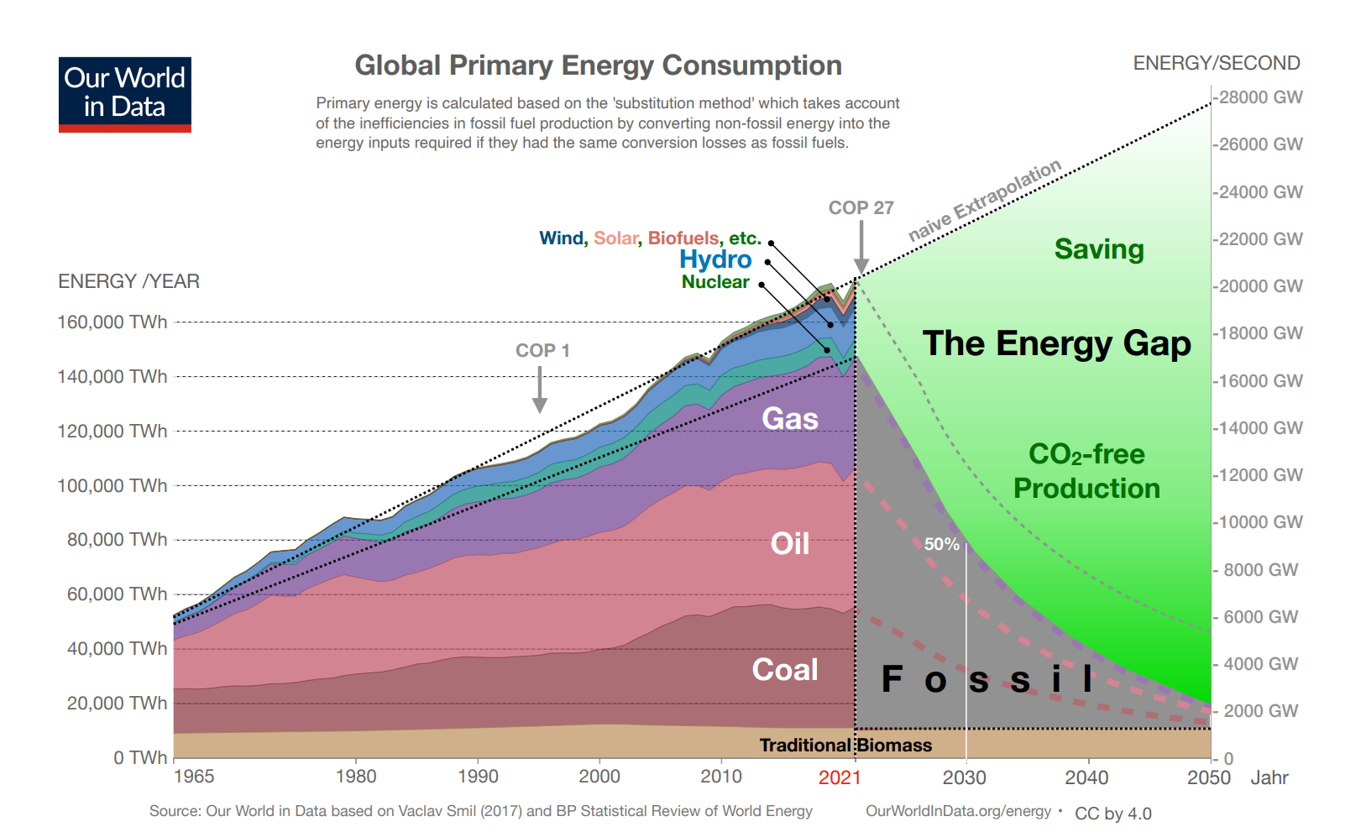
Environmental impact
Cern aims to build €20bn collider to unlock secrets of universe
Link
Large particle accelerator facilities have signifiant scientific, economic, and societal benefits
Next generation of accelerators is on the way
Require considerable resources to operate effectively
Climate crisis
  Challenge of balancing the need for increased scientific output, size, and/or power with the global need to reduce resource consumption
Environmental sustainability in basic research: a perspective from HECAP+
3
PABG 2025 | July 2025 | Dr. H. M. Wakeling

Slide 4
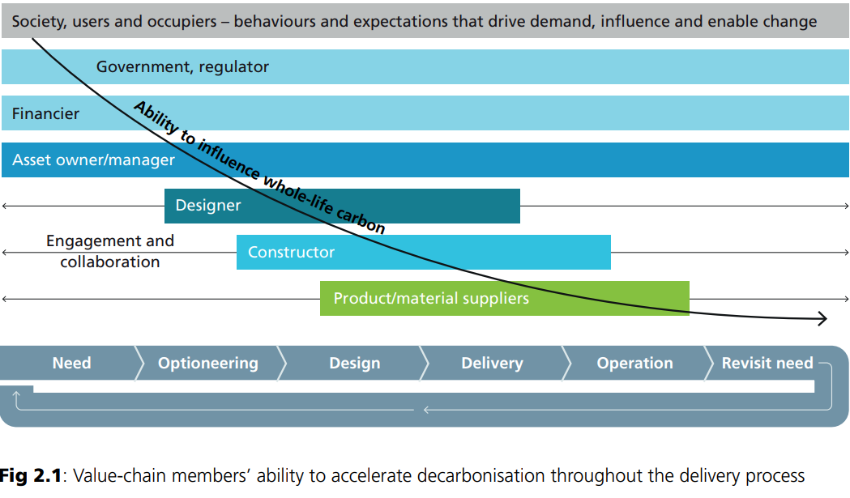
Embedding sustainability into decision-making
At every design stage decisions are made
  Machine layout, beam energy, beam current, technologies, etc.
Those decisions will consider many different factors including:
  Scientific performance, reliability, technology readiness level, effects on other subsystems, cost, risk, etc.
Sustainability should be embedded in the design process and considered at every stage
Appropriate weight alongside other factors
Prioritise impact reduction early on
$$$
PABG 2025 | July 2025 | Dr. H. M. Wakeling
PAS 2080 guidance document: Practical actions and examples to accelerate the decarbonisation of buildings and infrastructure
4

Slide 5
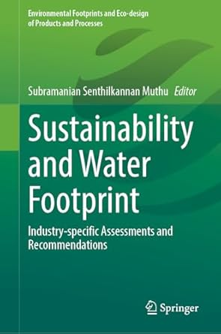
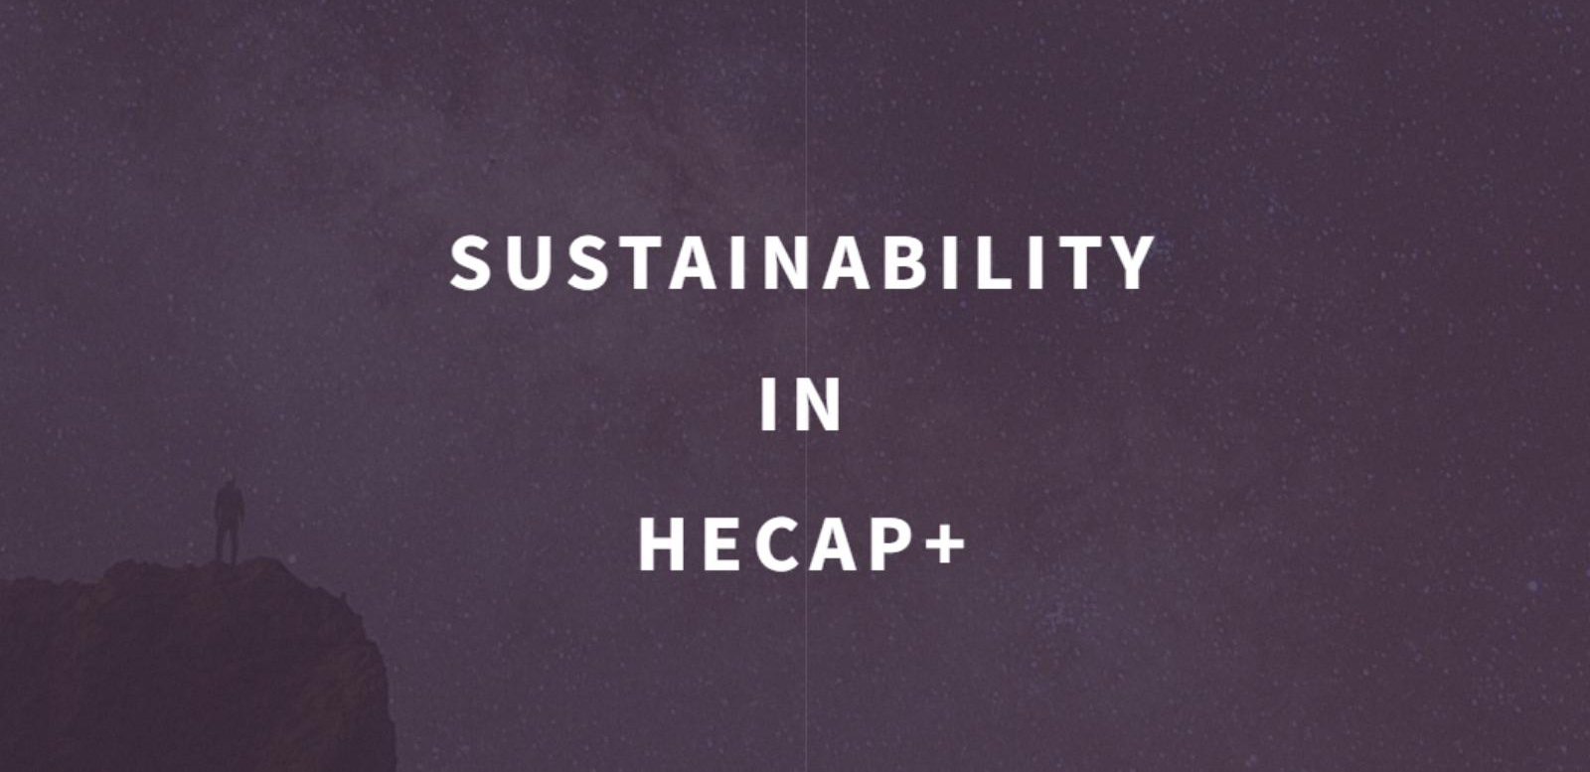
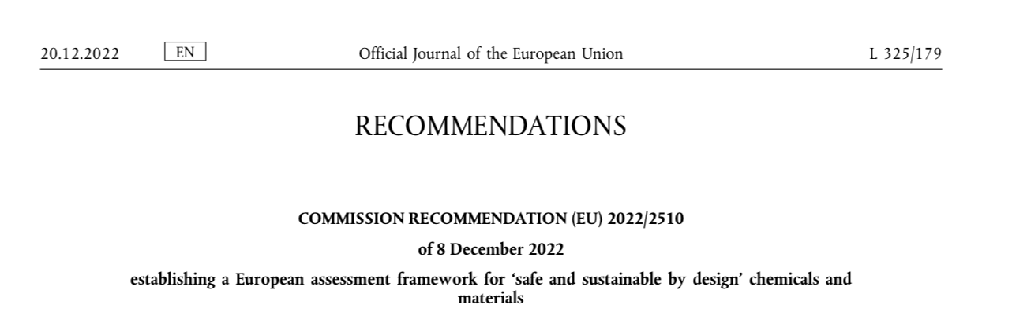
The challenge: how?
Generic sustainability guidelines, recommendations and opportunities exist
Yet a common issue is that specific recommendations are not available for niche areas
  such as accelerators!
5
PABG 2025 | July 2025 | Dr. H. M. Wakeling

Slide 6
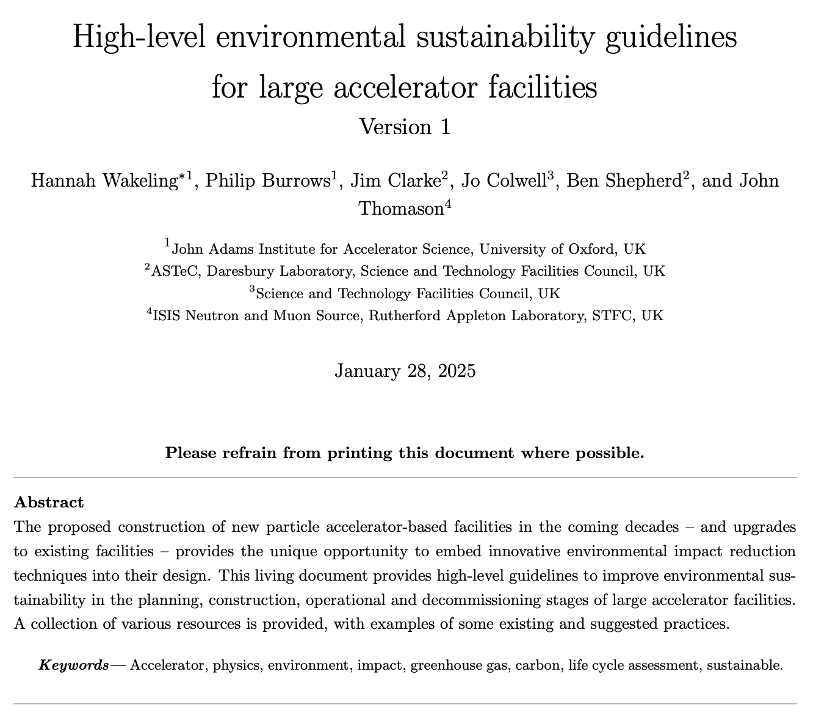
A solution
Living document created:
  “High-level environmental sustainability guidelines for large accelerator facilities”
Version 1 available: https://arxiv.org/abs/2501.14979
PABG 2025 | July 2025 | Dr. H. M. Wakeling

Slide 7
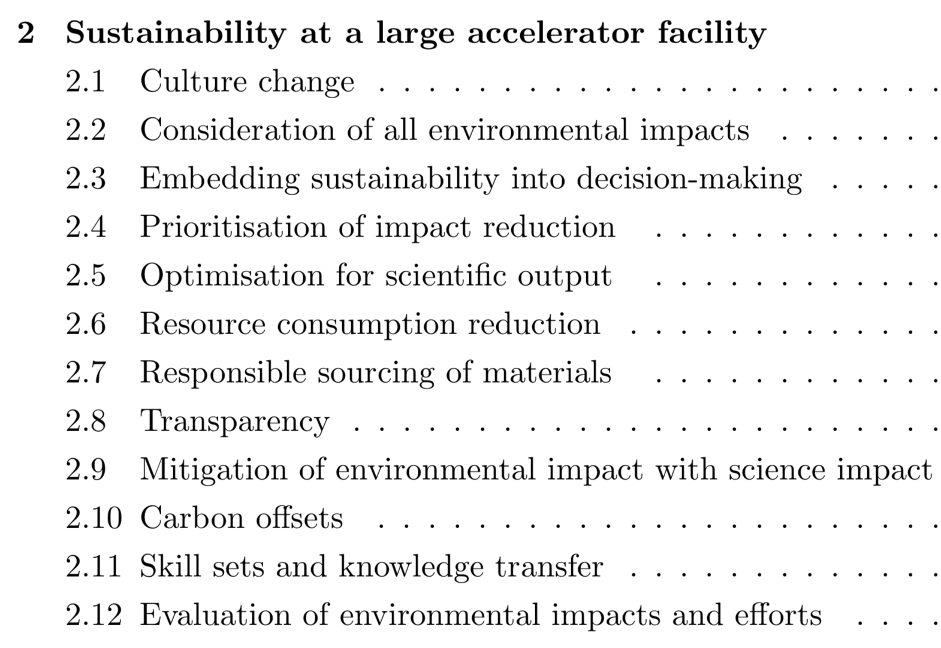
A solution
Version 1 available: https://arxiv.org/abs/2501.14979
Presents sustainability concepts with a focus on accelerators
PABG 2025 | July 2025 | Dr. H. M. Wakeling

Slide 8

















A solution
Version 1 available: https://arxiv.org/abs/2501.14979
Presents sustainability concepts with a focus on accelerators
Environmental impact reduction recommendations
  Construction
  Operation
  Decommissioning
PABG 2025 | July 2025 | Dr. H. M. Wakeling

Slide 9
A solution
Version 1 available: https://arxiv.org/abs/2501.14979
Presents sustainability concepts with a focus on accelerators
Environmental impact reduction recommendations
Resources
  Organisations
  Tools
  Certifications
  Recurring conferences/workshops
  Publications
PABG 2025 | July 2025 | Dr. H. M. Wakeling

Slide 10
Communication and collaboration
Version 1 released in January 2025
Attention has now turned to development of Version 2
Open to input and collaboration
  Case studies and publications
  Best practices and strategies
  Tools and resources
  And more (i.e. currently out of scope)
10
PABG 2025 | July 2025 | Dr. H. M. Wakeling

Slide 11
Conclusion
Environmental sustainability is essential
Researchers should lead by example
Reducing environmental impact is not straightforward and shouldn’t require one to become an expert in sustainability
High-level “living” document of recommendations available
Welcoming input for future editions!
https://arxiv.org/abs/2501.14979
11
PABG 2025 | July 2025 | Dr. H. M. Wakeling

Slide 12
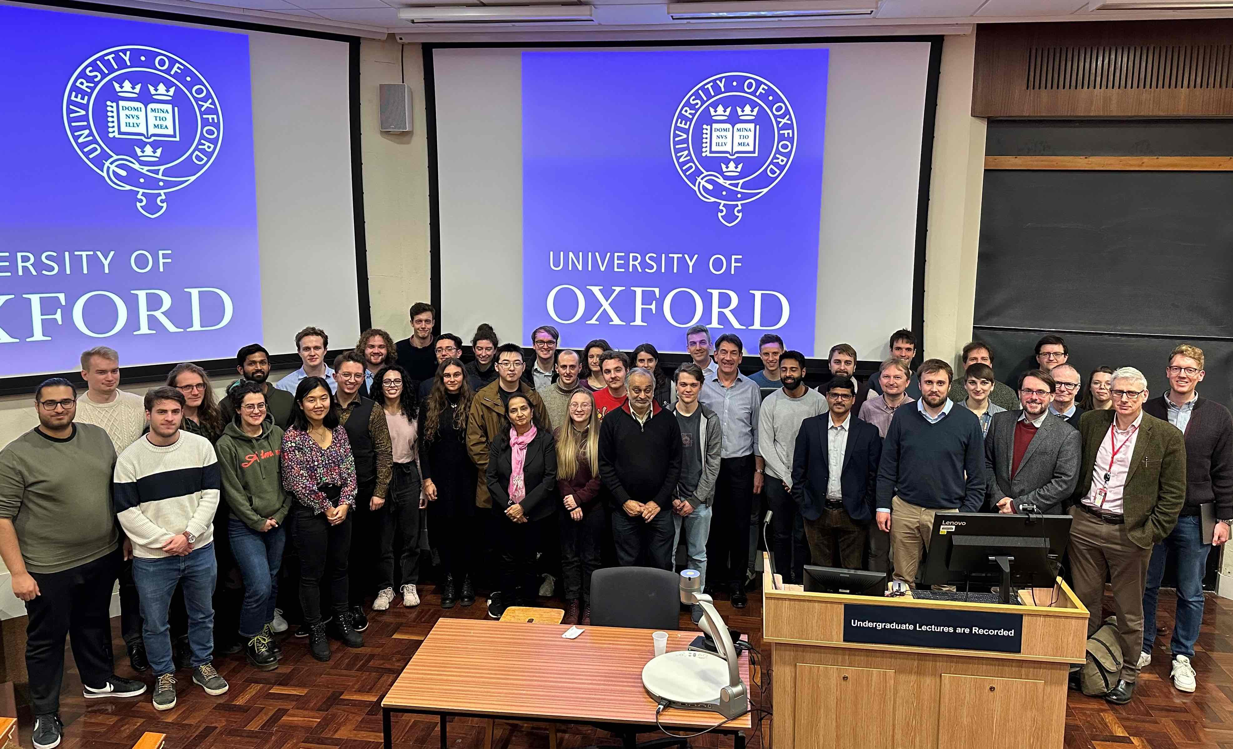
Thank you
Contact: hannah.wakeling@physics.ox.ac.uk
PABG 2025 | July 2025 | Dr. H. M. Wakeling

Slide 13
Back-up slides
PABG 2025 | July 2025 | Dr. H. M. Wakeling

Slide 14
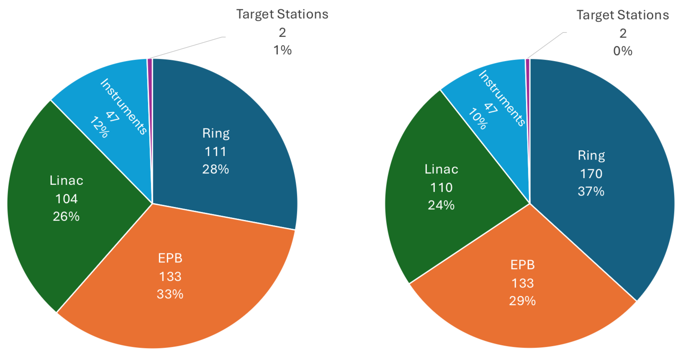
Environmental impact reporting
Transparency
Mitigation of environmental impact with science impact
14
PABG 2025 | July 2025 | Dr. H. M. Wakeling

Slide 15
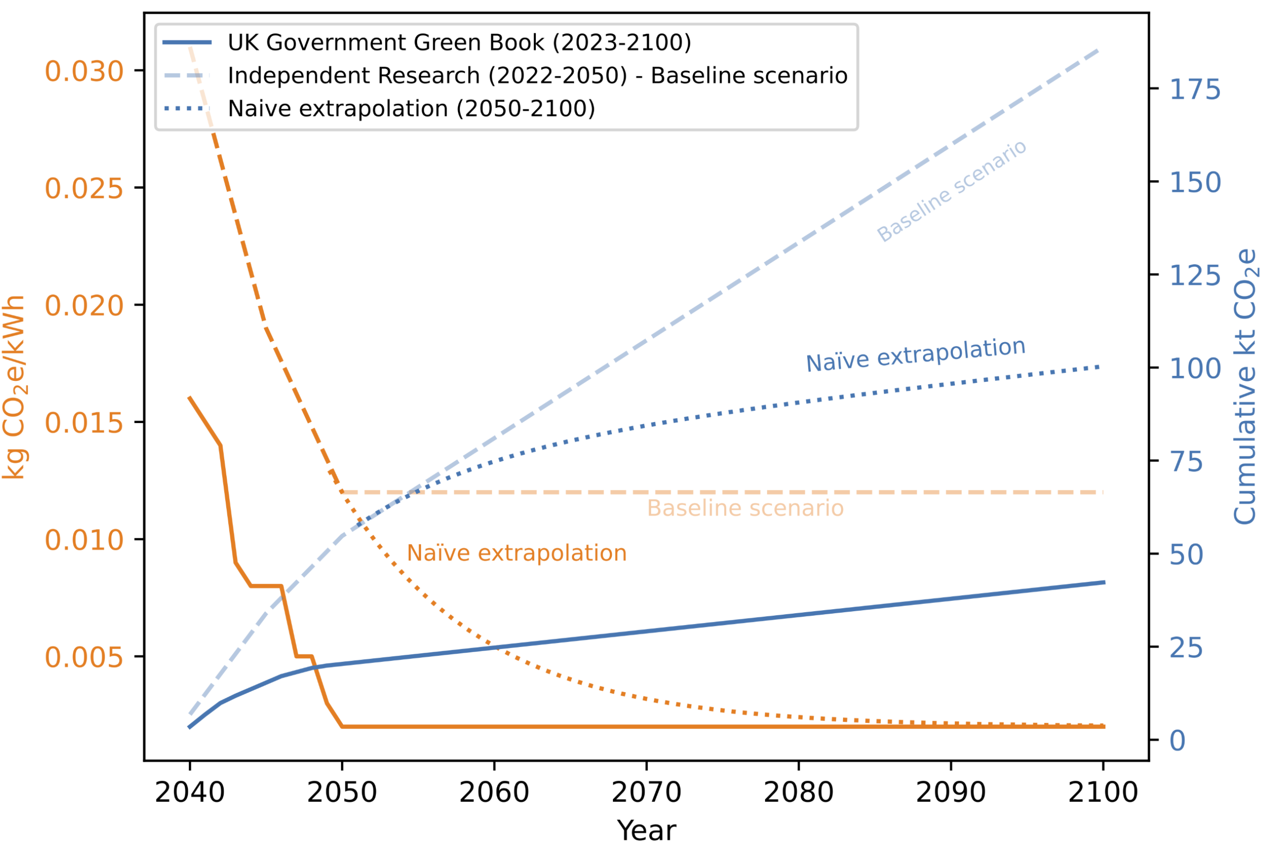
Resources and materials
Recycle
Reduce
Reuse
Dispose
Prevent
Reduce resource consumption
Source materials responsibly
15
PABG 2025 | July 2025 | Dr. H. M. Wakeling

Slide 16
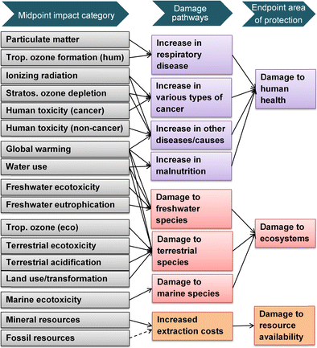
Consideration of all environmental impacts
Often the phrase “environmental sustainability” is interpreted as “carbon impact”
Other environmental impacts like:
  Toxicity
  Pollution
  Biodiversity
  Land use
  Etc.
Evaluate the wide range of environmental impact factors other than CO₂e emissions and identify areas and opportunities for improvement
16
PABG 2025 | July 2025 | Dr. H. M. Wakeling

Slide 17
Culture change
Greatest potential for impact on environmental sustainability
Hardest to implement and measure success
It should be considered as part of our role as scientists and engineers to incite this culture change
Should be enabled and facilitated from the top
  policy, training, budget
Day-to-day and long-term actions
Track, monitor and celebrate progress and achievements
17
PABG 2025 | July 2025 | Dr. H. M. Wakeling

