Slide 1
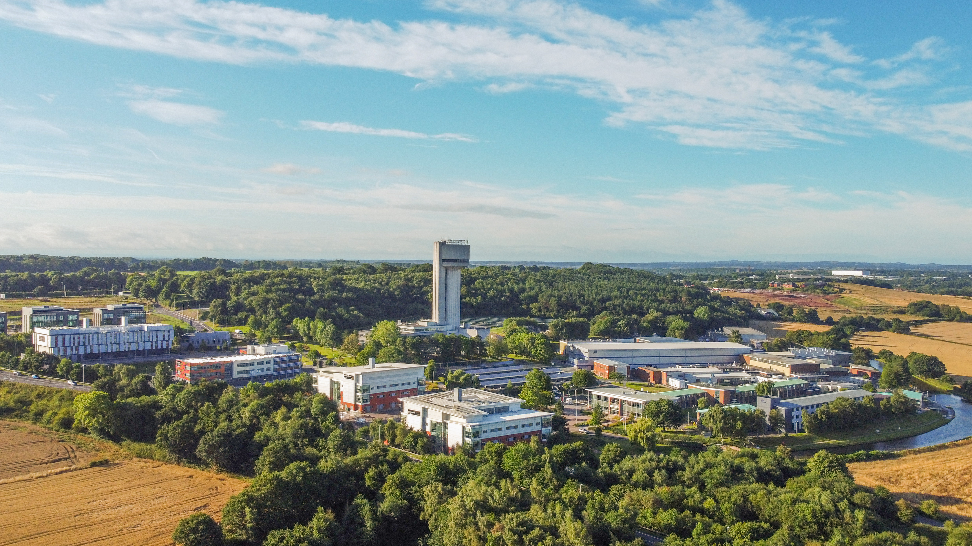


Sustainable Accelerator R&D in the UK
Ben Shepherd
on behalf of ASTeC’s Sustainable Accelerators Task Force
Accelerator Science and Technology Centre, STFC Daresbury Laboratory, UK
Sustainable HEP Workshop × IOP PAB Conference
10-12 June 2024
Ben Shepherd
Magnets
Alan Wheelhouse
RF
Anthony Gleeson
Business
Gary Hughes
Facilities
Storm Mathisen Diagnostics
Hywel Owen
Acc Physics
Andrew Vick
Vacuum
Katie Morrow
Lasers

Slide 2
Overview
Sustainable accelerator technologies
  Thin film superconducting RF
  Permanent magnets
The CESA proposal: a new UK centre of excellence
Accelerator carbon footprint: the RUEDI case study

Slide 3
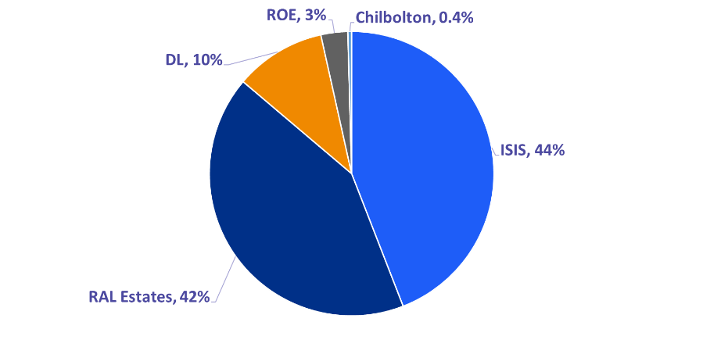
Accelerator Context
UKRI has committed to reach Net Zero by 2040
Electricity usage is 75% of STFC’s emissions – mostly big facilities ➔
Particle Accelerators are core to many of our major science facilities:
  ISIS Neutron and Muon Source
  Diamond Light Source
  CLARA electron beam test facility
  Large Hadron Collider at CERN
  European X-ray Free Electron Laser in Hamburg
  ESRF in Grenoble
  … and more in the pipeline: ISIS-II, Diamond-II, HL-LHC, RUEDI,
  EPAC, PIP-II, ESS, ITRF, UK-XFEL, EIC, …
They are essential tools for enabling green research, but…
They consume large amounts of electrical power and other resources
The UK electricity grid is decarbonising but not to zero
  Last coal plant closing Sep ‘24
  Phase change fossil → renewable
  Expect 100 gCO₂e/kWh by 2030, ~20% of 2000 value
← mostly fossil
you are here
mostly renewable →

Slide 4
Bigger and Better?
In general, the next generation facilities are physically larger and consume more power and other resources during operations than their predecessors
Example:
  Future Circular Collider is being proposed
  as a potential successor to HL-LHC
  Tunnel: 26 → 90km
  Energy consumption: 0.75 → 4.0 TWh/year
JP Burnett, FCC Week 2023
F Gianotti, FCC Week 2023

Slide 5
Thin Film Superconducting RF

Slide 6
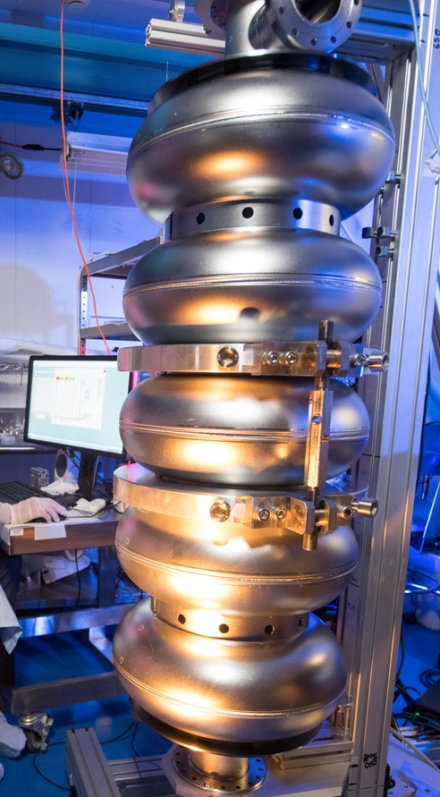
Why a TF SRF programme?
Future challenge identified - niobium reaching performance limit
Technology development required for next generation of machines to meet challenging specifications
Fits our skills and strategy
Sustainability advantages can not be ignored
Vision: To deliver high performing thin film SRF cryo modules to future infrastructure projects

Slide 7
Replacing Nb bulk cavities
Use Of Thin Films On Copper
Improve Accelerator Performance
More Sustainable Accelerators
  Reduce costs
  Easier to machine
  Higher thermal conductivity than Nb
  Reach higher Q₀ and E_{acc}
  Utilise various high T_{c} materials
  e.g. Nb₃Sn, V₃Si, NbN, NbTiN, MgB₂
  Multilayers
  Bulk Cu vs Bulk Nb
  Reduce cryogenic power consumption
  Shorter accelerator structures
  Up-cycling existing cavities

Slide 8
Strategy
Hi-Lumi LHC
Infrastructure to build cryomodules
Experience of cryomodule production
ESS Hi Beta Cavities
Infrastructure to test cavities
Experience of cavity production
PIP II
Infrastructure to build cryomodules
Experience of cryomodule production
SRF Thin Films
3D geometry:
6 GHz Cavity
High Power tests:
1.3 GHz Cavity
Prototype Cryomodule for ISIS II or UKXFEL
Surface preparation
Film deposition and testing
Coating and testing of 3D geometry
Performance of thin film at high powers
Performance of thin film at suitable frequency cavity
ISIS-II and
UK-XFEL

Slide 9
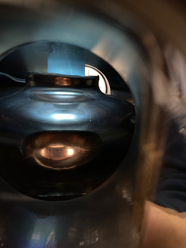
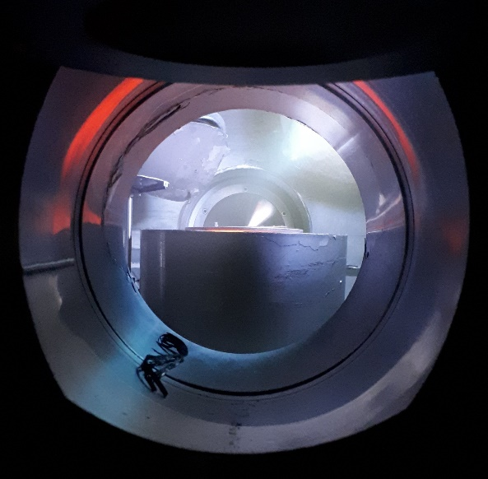
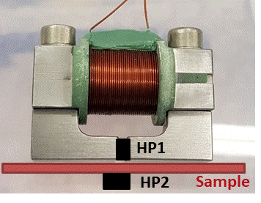
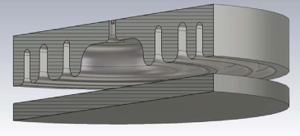
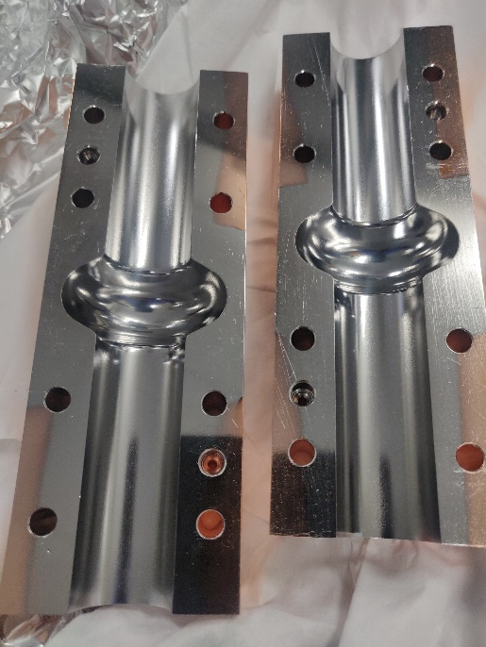
Thin Film SRF
📣 For more info,
see Daniel Seal’s talk this week
at IOP PAB conference
Thin film deposition
PVD: DC, pulsed, HIPIMS…
Film characterisation
SEM, FIB, AFM,
Real cavity measurement
Cavity deposition
(PE)CVD, (PE)ALD
XPS, XRD, RBS, TEM…
Superconducting RF properties evaluation
Superconducting properties measurement
RRR, H_{c}, H_{fp}, H_{sh}, …
Choke cavity
Nb, NbN, Nb₃Sn, MgB₂, SIS, etc.
Surface preparation
Cleaning, etching,
Polishing, passivating
DC magnetic susceptibility,
Field penetration
SEM image of a NbN thin film
Test cavity
Film deposition
  1.3 & 6 GHz elliptical
  1.3 & 6 GHz split cavities
DC magnetisation
Notes:
ARIES is going to the end by 30th April this year.
A new H2020 funded collaboration is starting on 1st May for another 4 year.
It is call IFAST: Innovation Fostering in Accelerator Science and Technology.
Our team has successfully applied for further development of superconducting thin films for SRF applications.
We will continue all activities started with ARIES,
In addition to Physical Vapour Deposition methods, an Atomic Layer Deposition will be explored.
However the main emphasis will be shifted on applying the result of ARIES to the deposition and testing of the half-wave RF cavities at 6, 3 and 1.3 GHz.

Slide 10
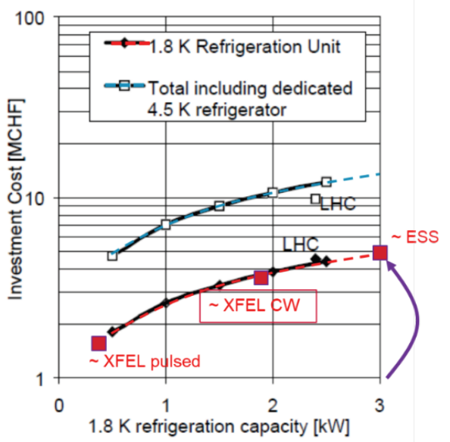

Thin Films: impact on cost and energy usage
Antoine, IPAC 2023 MOYD3
Capital costs:
  Cooling to 1.8 K represents 35-40% of the total →
Operating costs:
  Combination of Carnot efficiency (thermodynamic limit)
  and refrigerator efficiency (technological limit)
  3x lower cooling power at 4.2 K
  Approx annual figures for an 8 GeV SC linac
 | 1.8 K | 4.2 K
η_{C} | 0.6% | 1.4%
η_{th} | 15-20% | 25-30%
$$η_{C}= \frac{T_{cold}}{T_{hot}−T_{cold}}$$
Solid Nb at 1.8 K
Thin film at 4.2 K
70 GWh
23 GWh

Slide 11
Permanent Magnets

Slide 12
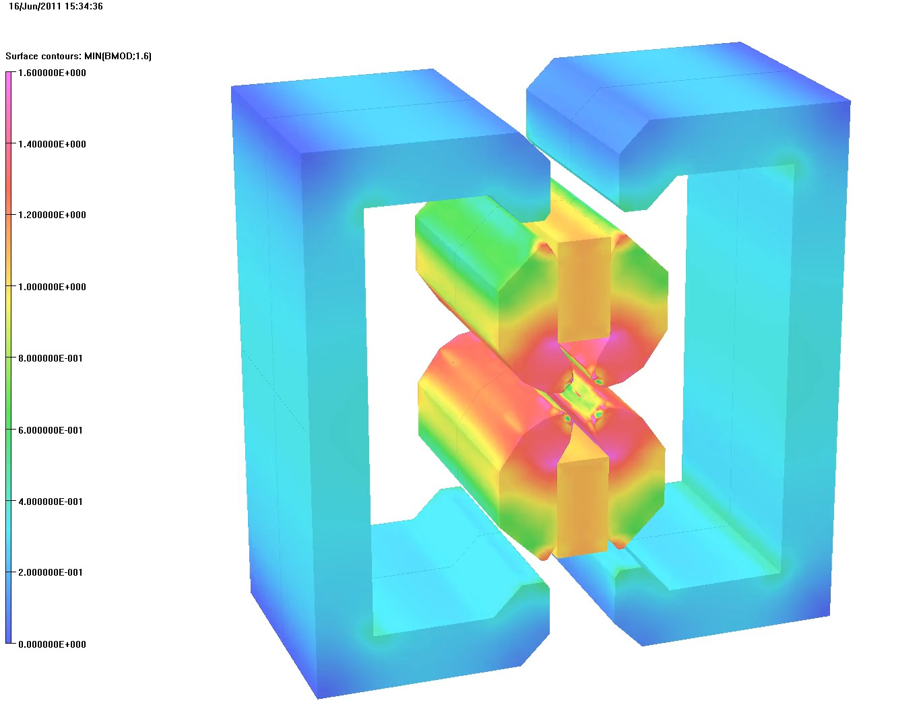
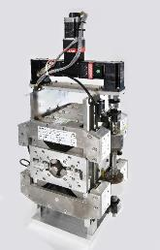
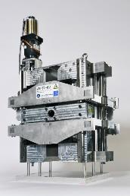
The ZEPTO concept
Shepherd et al, IPAC2014 TUPRO113
Zero-Power Tuneable Optics
Highly adjustable PM quadrupole and dipole magnets to replace electromagnets
  Large tuning range using motors to move PMs
  Same physical footprint
  No energy usage
  (except a tiny amount when adjusting)
  Less infrastructure required
  (no big current cables, power supplies, cooling)
Two prototype quads built at Daresbury Laboratory
  27 mm aperture
  230 mm length
  15-60 T/m, 4-35 T/m ranges
  Fixed poles, movable PMs
  Simple control system with one motor

Slide 13
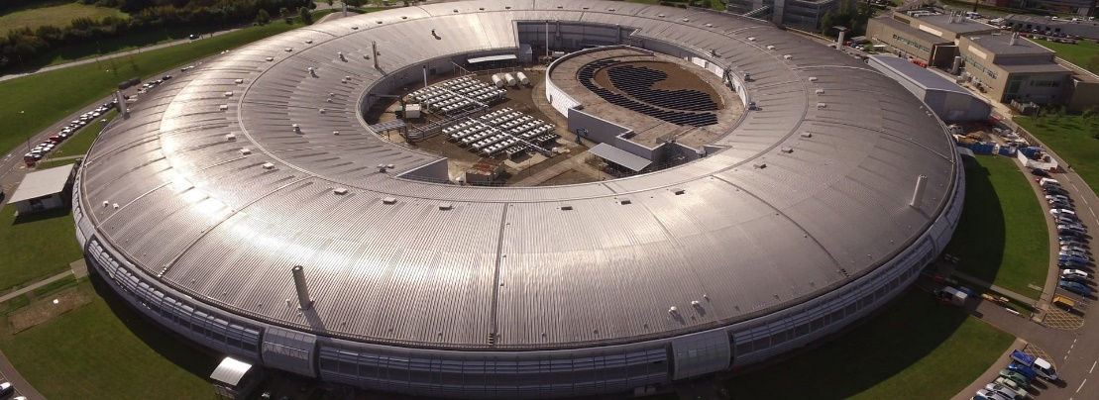

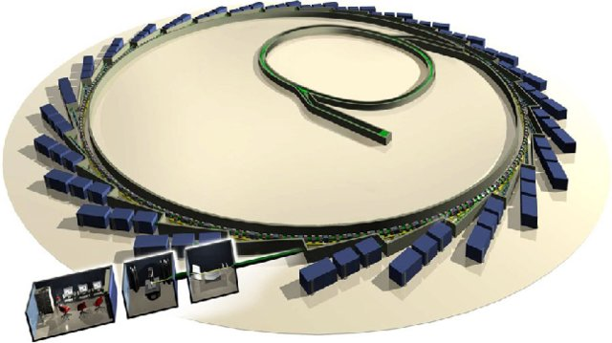
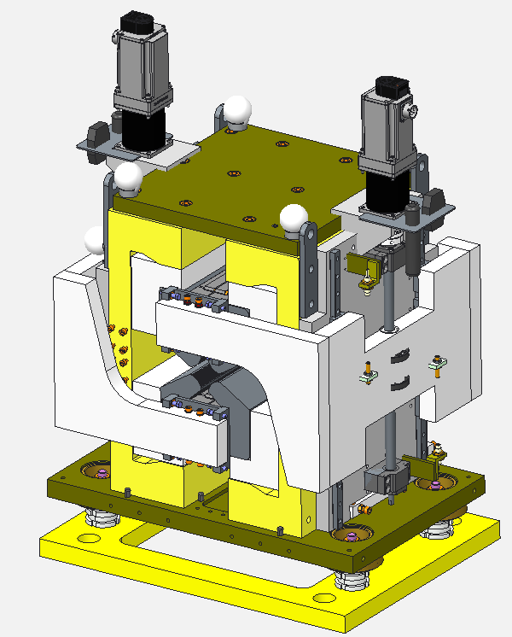
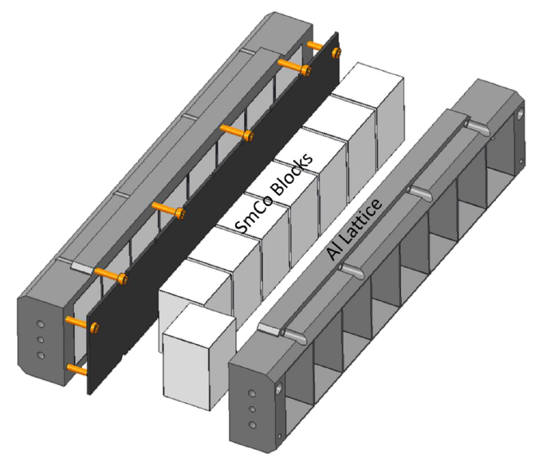
ZEPTO Diamond Quadrupole
Aim: demonstrate operation of a ZEPTO quadrupole on a working accelerator
Install a tuneable PM quad as a drop-in replacement for an EM quadrupole
Installed at Diamond Light Source,
on the BTS transfer line
Enabled by STFC’s Proof of Concept Fund
  Step towards commercialisation of ZEPTO
Assembled and tested at Daresbury
Installation at Diamond
in August 2022 shutdown
Operated successfully at
Diamond for 12 months
Next steps: remove, retest,
ensure no radiation damage
BTS
  Similar design to ZEPTO-Q2
    Outer shell for large tuning range
  Max gradient 19 T/m
  Min gradient 0.5 T/m
  Movement range 90 mm
  Aperture diameter 32 mm
  Improvements to design:
    SmCo blocks
      improved temperature stability
      radiation resistance
    Splittable to allow installation around vacuum chamber
    Two independent motors for magnetic centre correction
    Ice cube tray concept for easy installation of PM blocks

Slide 14
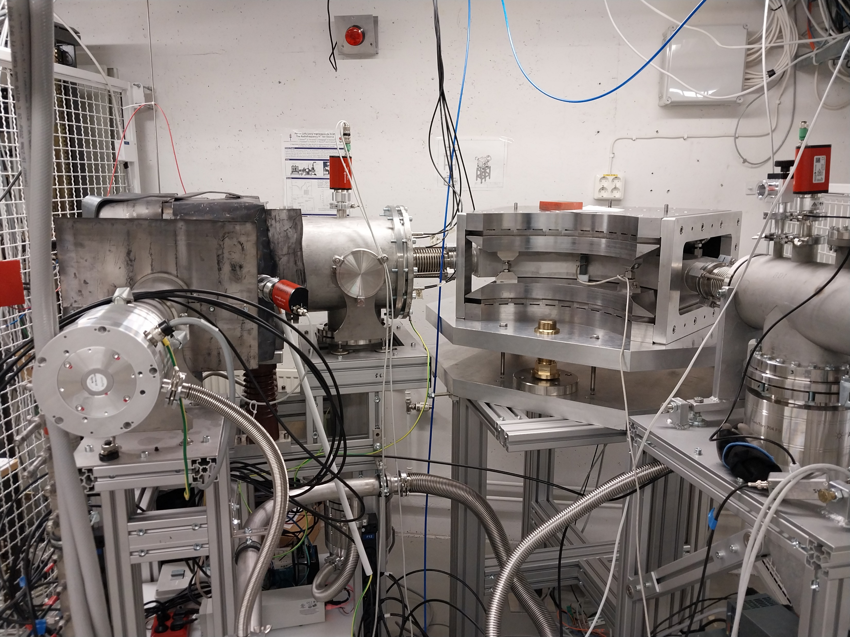
ECRIS: adjustable
PM dipole for ion sources
Olli Tarvainen et al, Nuclear Physics B (2022)
Compact ion source applicable to
  Thin Films centre
  Materials characterisation at ISIS
Includes PM-based m/q separator
  Simpler than traditional EM-based system
Mechanical adjustment: 65-87 mT
Assembled and tested at DL in 2022
Excellent agreement with modelling
Field quality 5x10⁻⁴
Installed and operating at Jyväskylä, Finland
Transported Ar⁶⁺ to Ar¹²⁺ beams, May 2024
  Magnetic adjustment “works really well”

Slide 15
CESA: Centre of Excellence in Sustainable Accelerators

Slide 16
What is CESA?
Our vision is that CESA is a centre of mass for UK-based accelerator R&D with a specific mission to make accelerators significantly more sustainable
  Receives sufficient funding for a coherent and targeted R&D programme enabling a step change in the rate of progress at a timescale relevant to our future pipeline
  Collaborating directly with industry so that new products can be procured commercially as they are developed and proven, enhancing the UK economy and return from CERN
  Has a small core team who provide training to engineers, technicians and scientists in sustainable design practices backed up by providing access to sustainability software tools and databases
  Works collaboratively with international partners
We need to invest now to ensure we are ready in time for the potential mega-projects which are on the horizon – such as ISIS-II, UK XFEL, and FCC
  It will take many years to demonstrate new technologies
  We still have time but need to get going as they aim to start construction in the early ‘30s

Slide 17
Initial R&D Scope
CESA Technology R&D
Thin Film SRF
Fast Reactive Tuners
High Efficiency Klystrons
PM-based magnets
HTS magnets
Machine Learning
Wakefield Accelerators

Slide 18
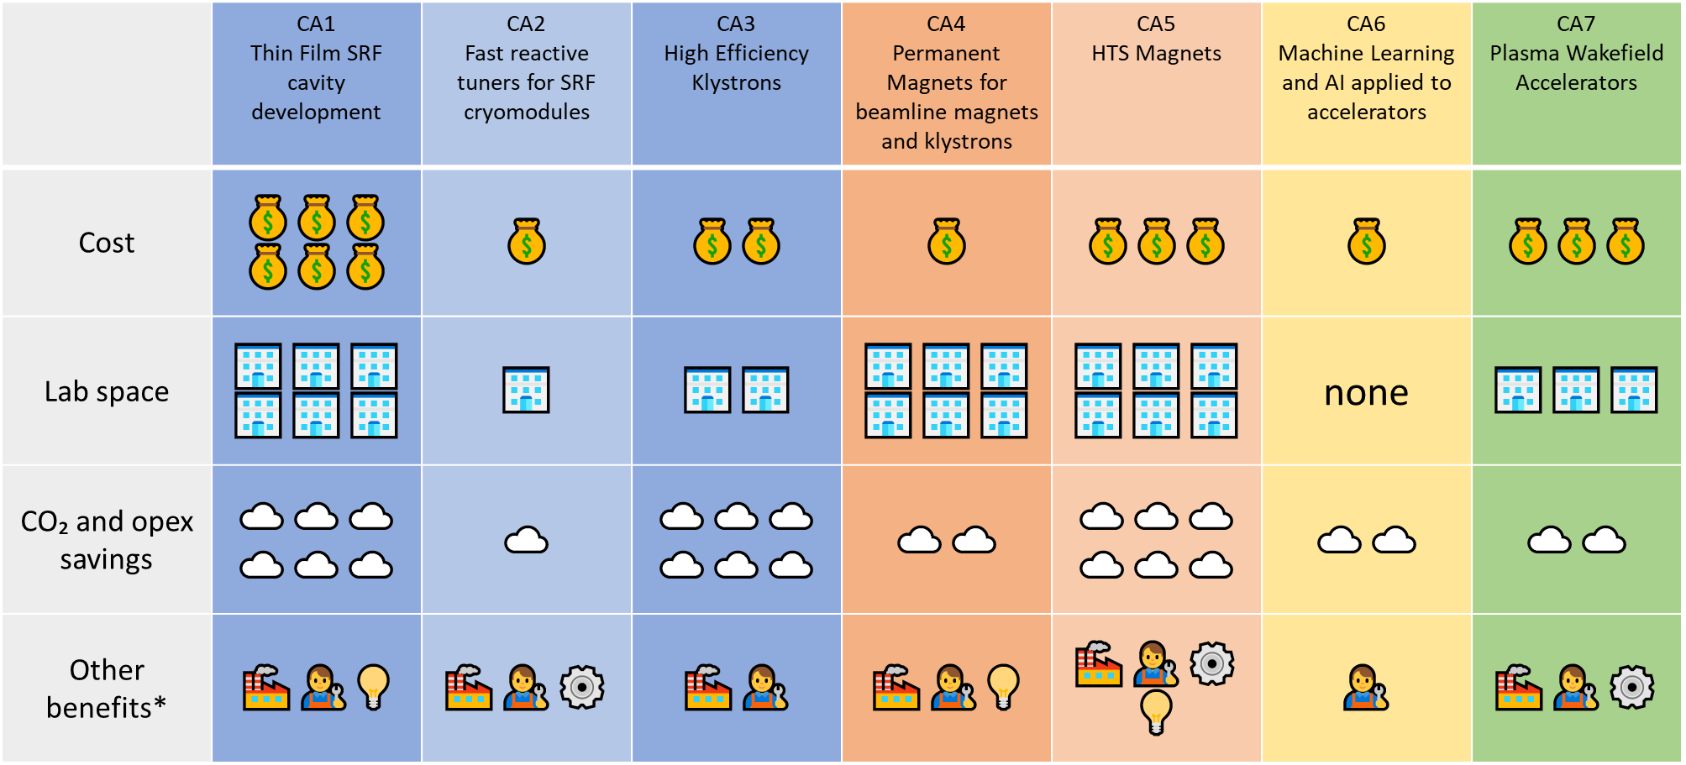
CESA Technology R&D Areas: one-page overview
*🏭 partnership with industry; 👨‍🔧 skills development; 💡 development/exploitation of IP; ⚙️ enabler for other green technologies

Slide 19
CESA’s Objectives
💡
🧰
🌍
🎓
📣
R&D in key technology areas to drive sustainability improvements for current and next-generation accelerators
Tools, expertise and support to measure and optimise lifecycle carbon emissions in support of UKRI’s Net Zero 2040 target
Develop strong international collaborations with other international accelerator institutes, and industrial partners
Training for new and current accelerator designers in sustainable design; knowledge sharing
Education and outreach on the themes of sustainability and accelerator technology

Slide 20
Power / cost / CO₂ savings illustration: UK-XFEL
UK-XFEL conceptual design & options analysis in progress
Baseline:
  8 GeV, 1.3 GHz superconducting linac, solid Nb cavities
  Room temperature electromagnets
Energy consumption estimates:
Total per year: 113 GWh, £29m, 7900 tCO₂e
Using CESA-developed technologies:
Potential annual savings on the order of 85 GWh, £24m, 6600 tCO₂e
CESA will pay for itself many times over during the 40+ year lifetime of a mega-project
Cryogenics 70 GWh
SRF 32 GWh
Magnets 11 GWh
Thin film SRF: 1.8K → 4.2K; x3 reduction in cryo power
FRTs: higher Q → x10 reduction in RF power
HTS / PM: x10 reduction in magnet power
Cryogenics 23 GWh
3.2
1 .1
Notes:
Caveat for these numbers, not intended to be accurate, just for illustration.
Similar savings are possible for other Big Projects like ISIS-II and FCCee. Scale and mix of technologies will be different in each case.

Slide 21
Options for CESA
Preferred Option
New building
Repurpose existing building
Distributed centre
Virtual entity
Hybrid entity
Engage with international effort
A new/existing centre
with a major virtual presence
Collaborate with
other sustainability
groups
Across several
different sites
At DL or RAL
‘Hub and spoke’?
At DL or RAL
Space reserved
by Estates
key criteria
core R&D
Initial options analysis carried out
Evaluated each option against
key criteria
  Delivery of core R&D
  New lab space
  Innovation & collaboration
  Workforce development
  Value for money
  Net Zero targets
  UK leadership
  Deliverability within 5 years
and also against delivery of core R&D

Slide 22
CESA Next Steps
Questions? Feedback? Want to get involved?
Contact us: ben.shepherd@stfc.ac.uk
Coming soon: www.cesa.ac.uk
We have written a Viability Case (a mini business case) for CESA and presented it to an internal STFC Viability Panel (this is an STFC process for major new initiatives)
Received very positive feedback to help us strengthen the Case
Updating the Viability Case now, to be presented to STFC Executive Board in June
We will take on board their feedback and begin drafting the Outline Business Case
We will be asking for funding to ramp up from 2025 – this could come from the next government Spending Review, the UKRI Infrastructure Fund, or a specific
Net Zero fund

Slide 23
Accelerator Carbon Footprint: RUEDI

Slide 24
Aims
Answer the question:
“What is the carbon footprint of an accelerator?”
Hard to find an accurate and definitive answer
  Especially before the design is complete
  But this is the critical time to do it
Can we provide some guidance though?
Look for the biggest possible gains
Influence the design to minimise overall lifetime emissions

Slide 25


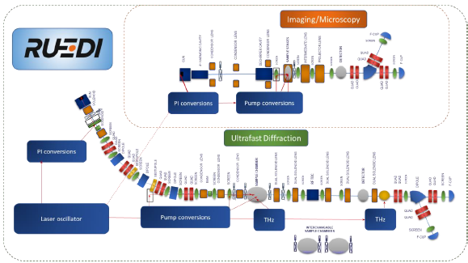
https://ruedi.uk/
Relativistic Ultrafast Electron Diffraction and Imaging
Facility to be built at STFC’s Daresbury Laboratory
  4 MeV; diffraction at 10-100 fs; imaging at 10-100 nm; fC-pC bunches
TDR was completed early 2024
  Not published yet; available on request
£124m for construction announced March 2024
2022: Conceptual Design Review (CDR)
2023: Technical Design Review (TDR)
and capital funding bid
2024: Final detailed design
25-26: Procurement
26-29: Construction and assembly
28-29: Technical systems commissioning
29-30: Science commissioning and initial user programme
31-35: First five-year operational run

Slide 26
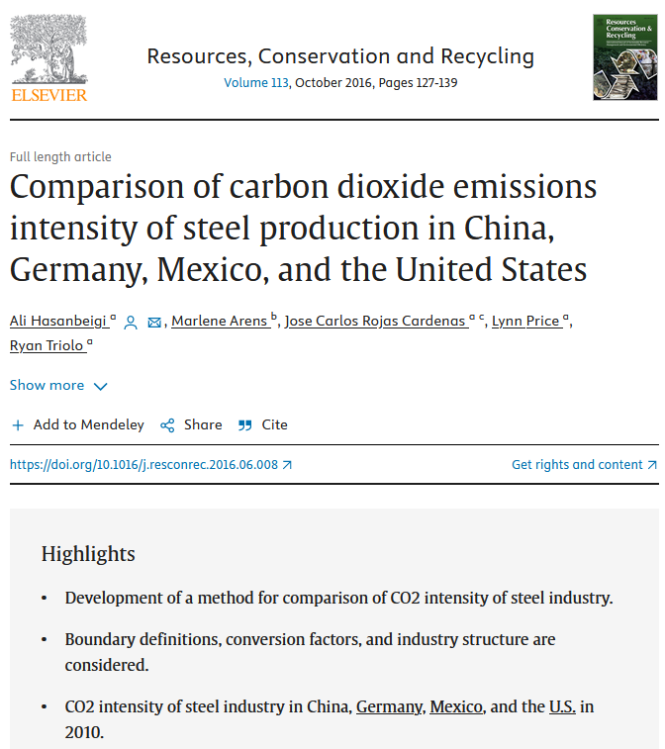
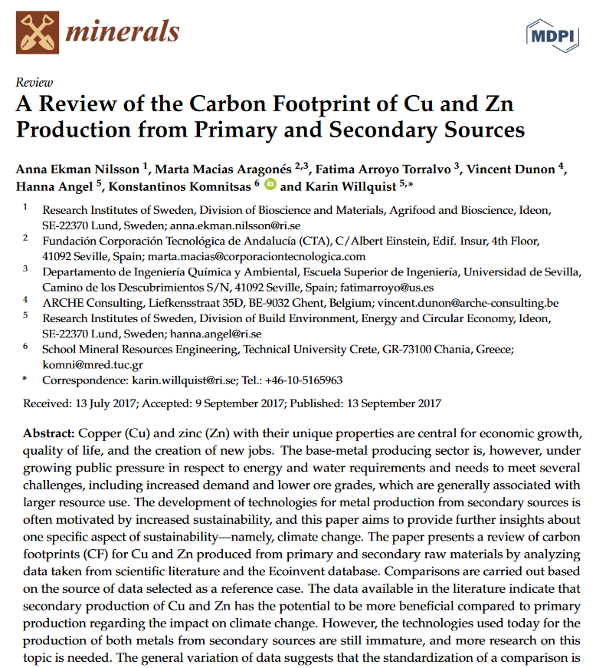
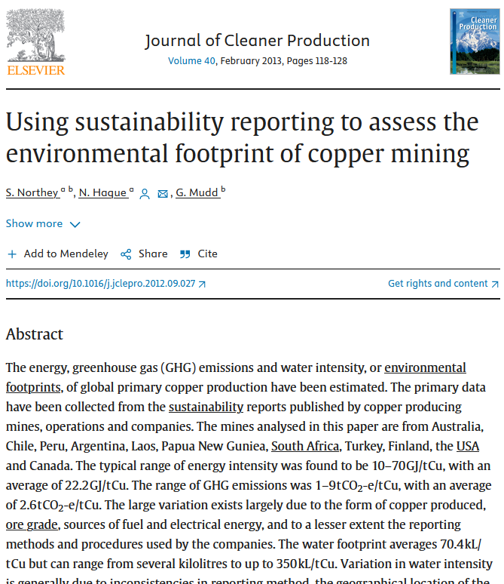
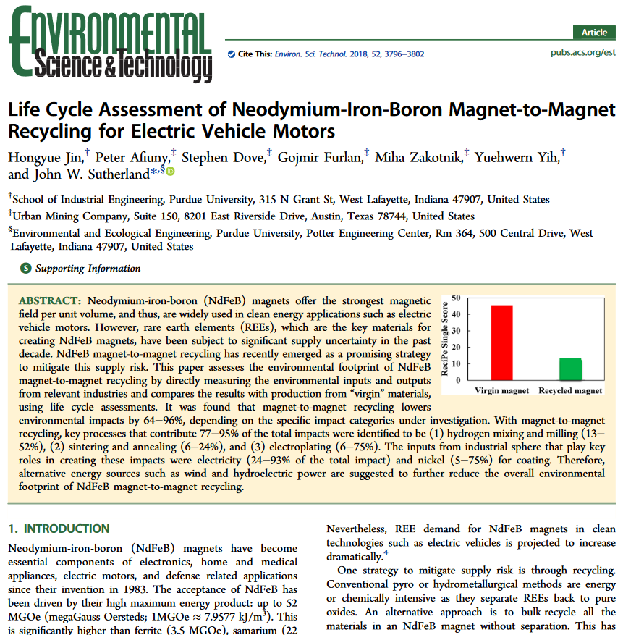
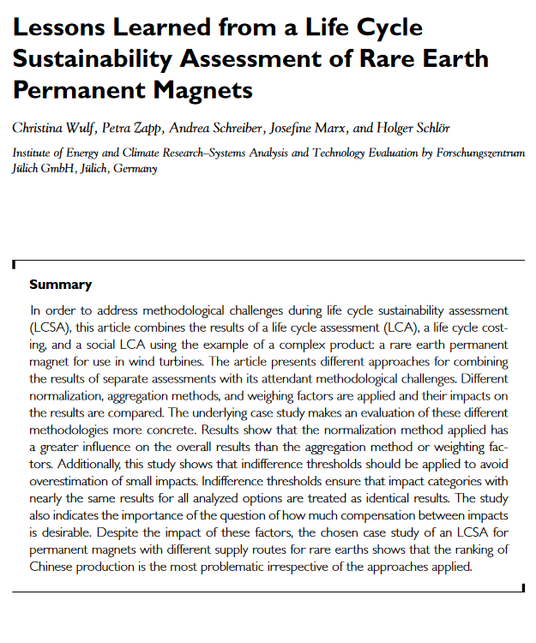
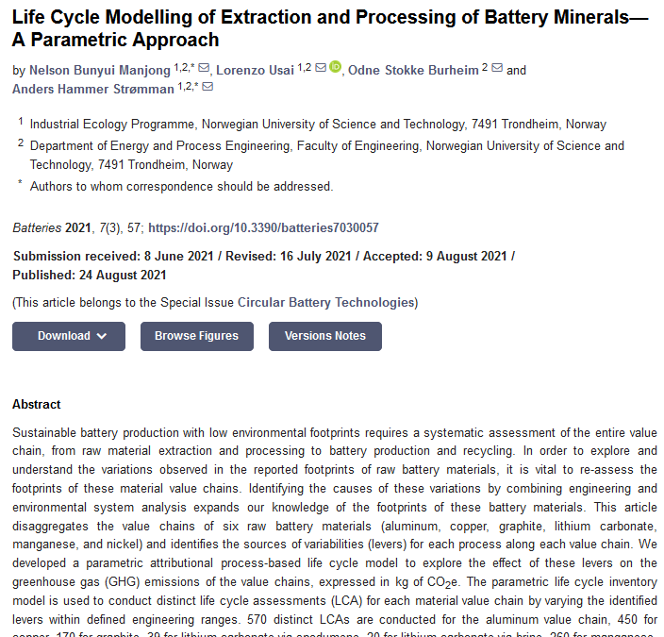
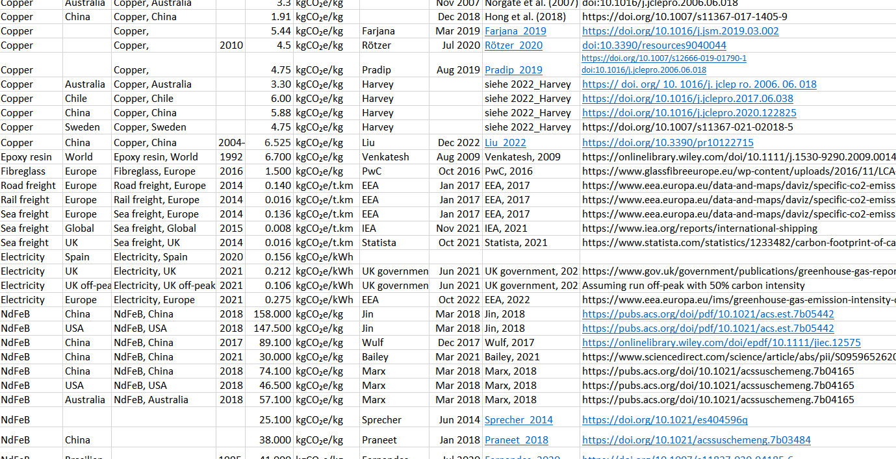
Carbon inventory: methodology
RUEDI
Magnets
Steel
Copper
RF
Copper
Aluminium
Steel
Lasers
Diagnostics
Shielding
…
Break accelerator down into subsystems
  Mirrors organisational structure of our department
For each one, make a guess at what parts are needed
  Not always specified in detail
  Makes it harder but also more valuable
  This is the best time to do it –
  not afterwards when all the decisions are made
Use this to build up a materials inventory
  Make an educated guess about sources of materials
  Concentrate on biggest items (by mass)
  Assume smaller things have less of an impact
For each material, establish a carbon intensity (kgCO₂e / kg)
  Use published literature
  Try to find multiple sources
  Build up database – makes the process easier next time
  Open data: available to share on request

Slide 27






Included and excluded
Raw materials – yes
  BUT not everything
  Biggest contributors by mass
Processing at factory - no
  Often proprietary data, or too hard for manufacturers to estimate
  BUT – got some interesting info from magnet manufacturers – see later
Transport to our site – no
  Not easy to estimate distances
  Probably small compared to materials extraction anyway
Operations – yes
  Electricity use only
  Grid of 2030-40 assumed 50% greener than today; 2500 operating hours per year
Maintenance and repair – no
  Too hard
  Probably not significant
End of life – no
  Too many questions about where materials end up

Slide 28

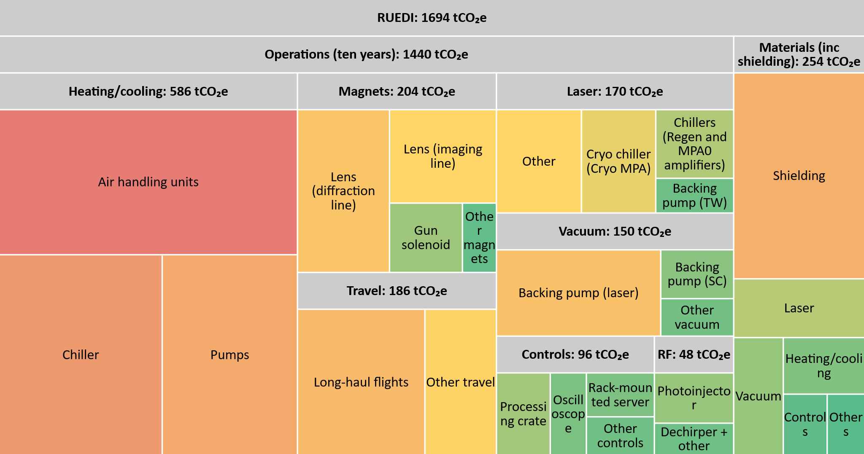
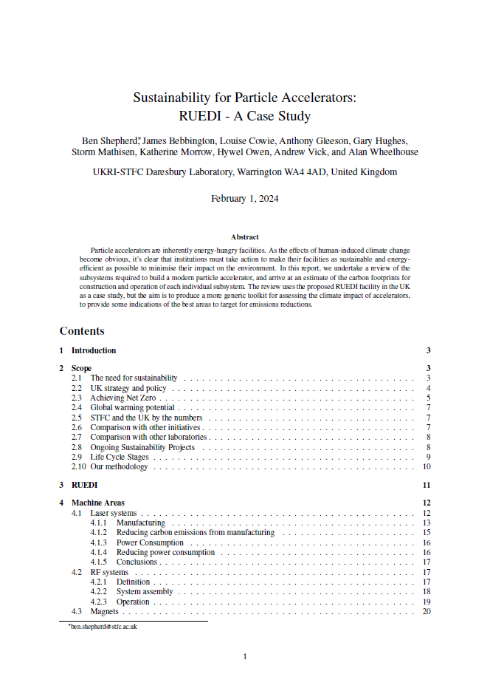
Results
RUEDI report:
bit.ly/ruedi-sus

Slide 29







Recommendations
Reuse shielding from previous projects
  New blocks to be standardised and made from low-carbon concrete
Temperature stability
  Consider variable-speed drives, free cooling
Permanent magnets
  Tricky but possible for solenoid lenses?
Consolidate cooling
  Integrate + centralise laser system cooling
Reuse waste heat
  Use heat removed from the accelerator to heat offices in winter
Demand shifting
  Schedule heavy energy use for windy or sunny periods
Submetering
  Look for energy consumption hotspots

Slide 30


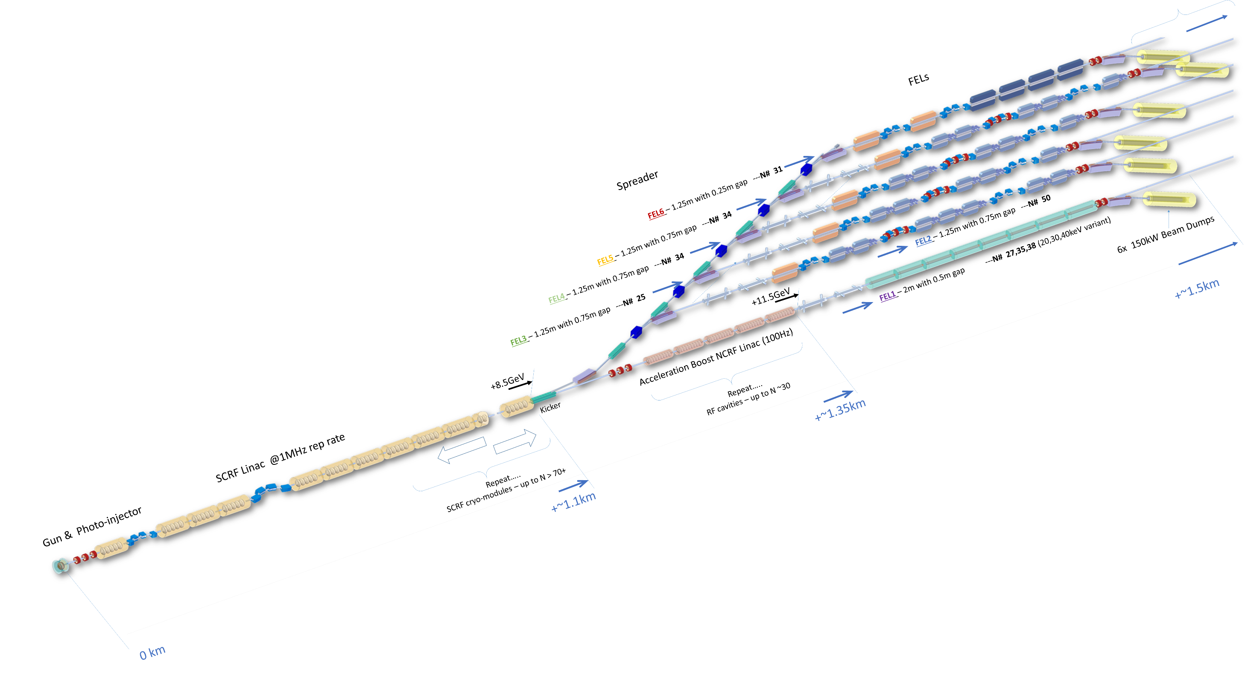
Next steps
xfel.ac.uk
Liaise with RUEDI team and implement recommendations
Outline carbon accounting for UK-XFEL design study
  Baseline: 8 GeV, 1.3 GHz SC RF linac, 1.1km length
  Definitely not LCA-standard!
  Make a set of assumptions, produce rough figures for comparison
  Design is evolving
  Aim: embed sustainability into decisions about facility design

Slide 31

Summary
Our accelerators are vital tools for science
We need to ensure they operate in the most efficient way
ASTeC aims to be the go-to place for sustainable accelerator technology
We are developing cutting-edge green technologies,
as well as tools to understand our footprint
We have an ambitious plan to build a global Centre of Excellence: CESA
Acknowledgements
  SATF: Alan Wheelhouse, Anthony Gleeson, Gary Hughes, Rachael Buckley,
  Storm Mathisen, Hywel Owen, Andrew Vick, Katie Morrow, Hannah Wakeling
  RUEDI: Julian McKenzie, Alex Bainbridge, Mike Ellis, Tim Noakes
  Icon credits: brick wall, heat pump, magnetic field, cold, heater, solar energy, mining cart, factory, truck, light bulb, maintenance, recycling

Slide 32
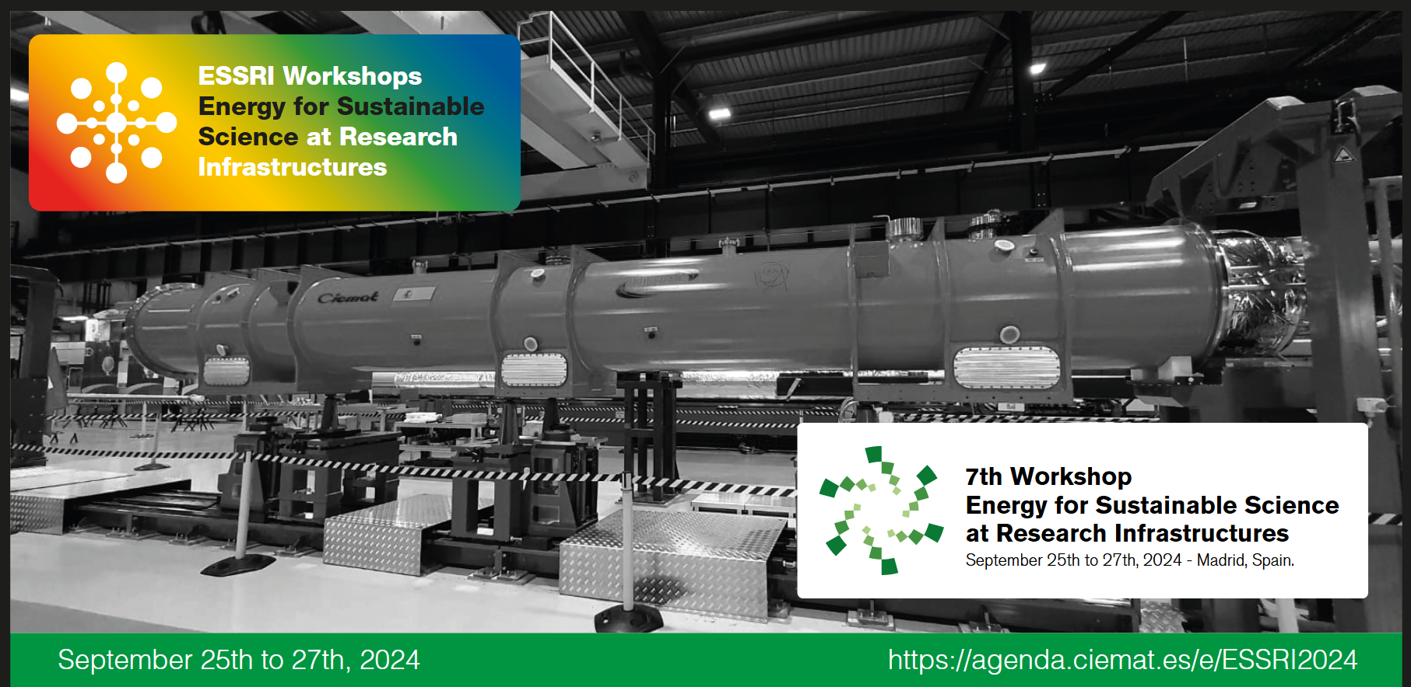

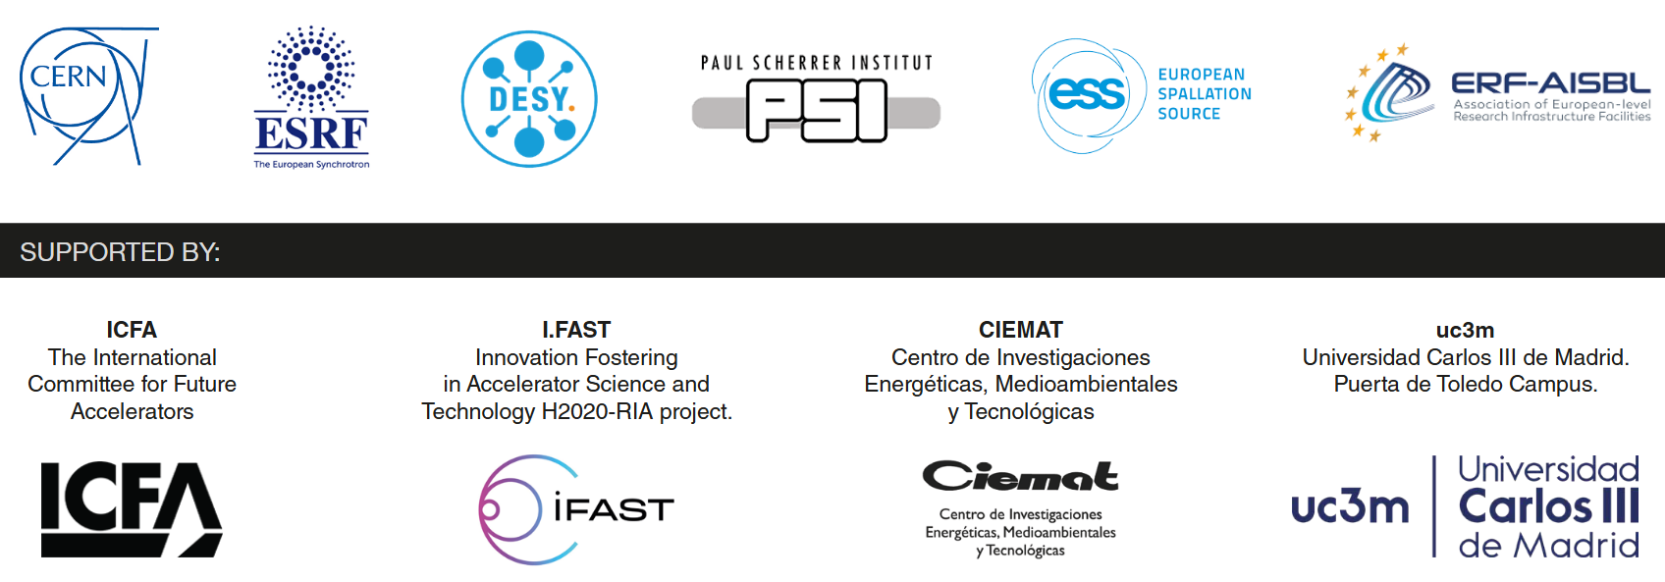

Slide 33
Spare slides

Slide 34
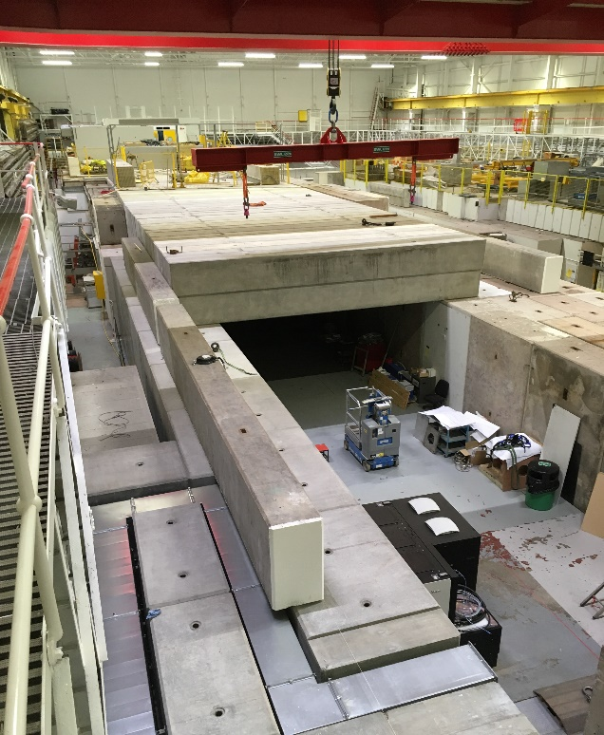
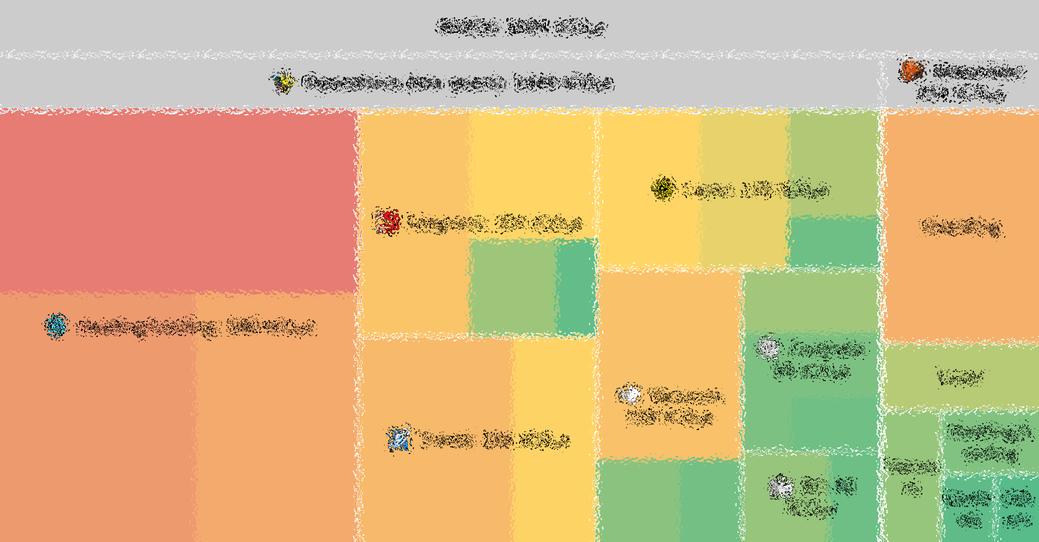
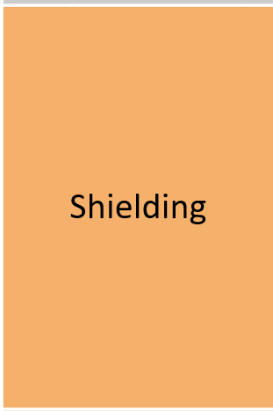
Shielding
Concrete: almost the ideal shielding material
  Absorbs gammas and neutrons well
  Long-lasting and durable
  Easy to manufacture
  Acts as a structural material
BUT: big carbon impact
  High temperatures involved in cement production (1450°C)
  Concrete production accounts for 8% of global CO₂ emissions
For RUEDI, need 0.7m thick walls, plus roof
  Using existing building, no need for new floor
  Total 927 tonnes of concrete ➔ 137 tonnes CO₂e
Can we do better?
  Reuse old blocks (long history of this at our 60-year old lab)
  Use concrete with additives in place of 100% cement
  Including 50% GGBS can reduce carbon intensity of concrete by 42%
Images credit: Jim Clarke, UKRI

Slide 35
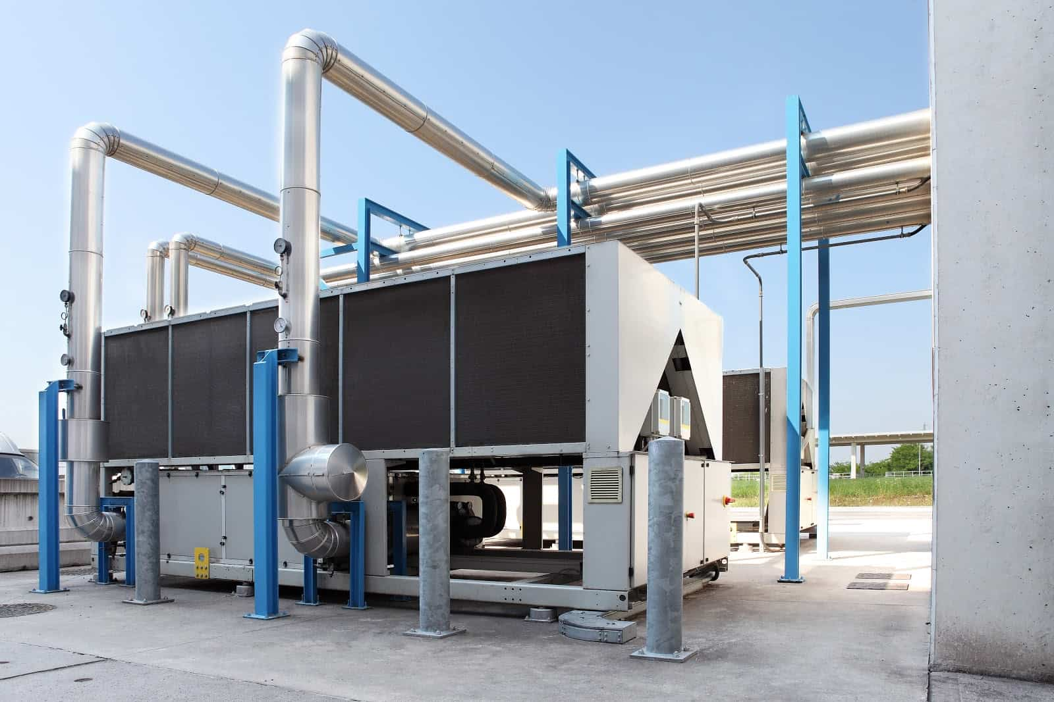
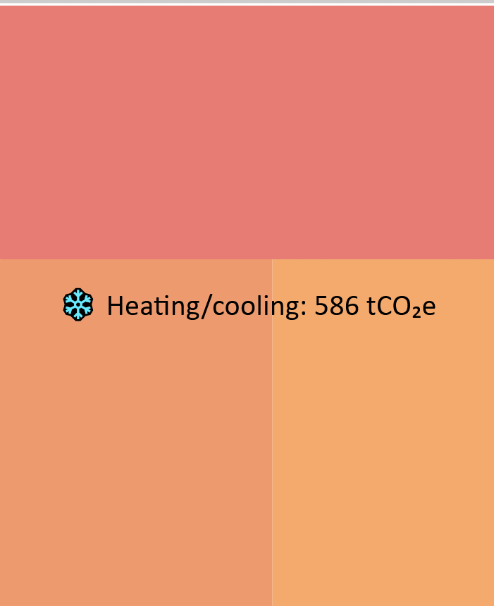
Heating and cooling
Image credit: AirFixture
Some systems (RF, magnets, laser) have water cooling – this is counted as an overhead for those areas (rule of thumb: 35%)
In addition, need to keep the accelerator hall stable to 0.1°C
Item | Count | Power demand [kW] | Operating hours per year | Energy usage [MWh/year] | Carbon emissions [tCO₂e/year]
Air handling units | 11 | 36.5 | 8766 | 320 | 24.8
Chillers | 11 | 96.1 | 2500 | 240 | 18.6
Pumps | 2 | 22.5 | 8766 | 197 | 15.3
Total |  | 155 |  | 758 | 58.6

Slide 36
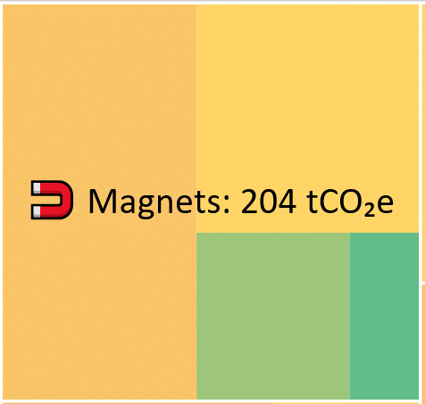
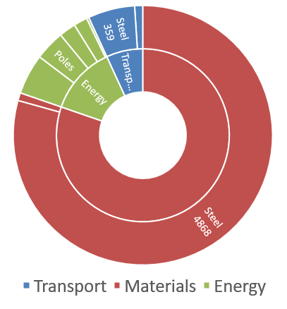
Magnets
Image credit: Danfysik
RUEDI is a low energy machine (4 MeV)
Need a few dipoles and quadrupoles
to transport the beam (52 magnets, total 600W)
Biggest impact is solenoid focusing lenses
  9 magnets, total 77 kW
Hard to replace with alternatives
  PM solenoids – not easy to build
  Quadrupole focusing – introduces more aberrations
Note that due to low energy, RF is a tiny fraction of emissions
  Photoinjector, TDC, dechirper – no linacs. Total 24kW
  Would be very different for a GeV-level facility (synchrotrons, FELs)
Analysis of processes to produce a ‘typical’ accelerator quadrupole. Emissions for
raw materials are the dominant source.
Credit: Tesla Engineering, UK.

Slide 37
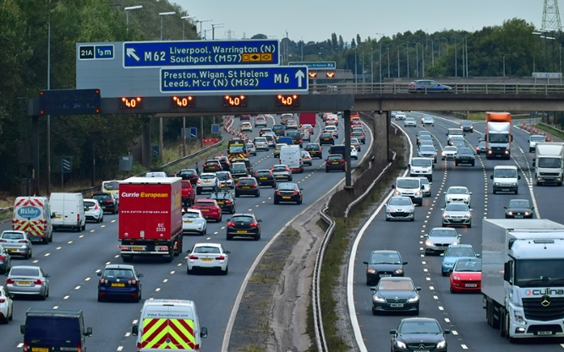
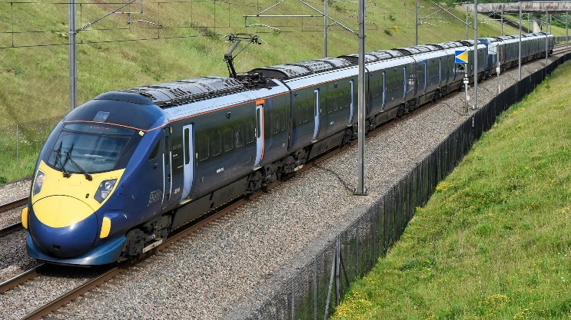
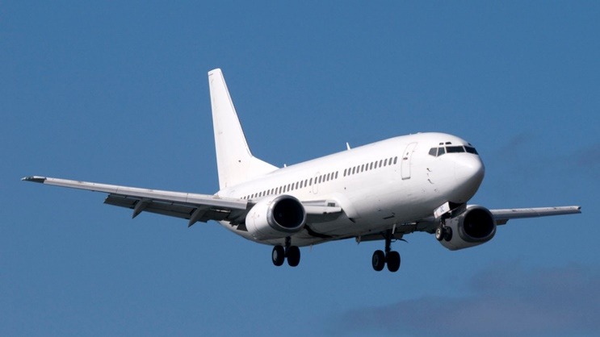

Travel
Image credit: iStock
Image credit: Southeastern Railway
Image credit: Sky News
RUEDI is a national facility – assume most users are from the UK
Occasional long-haul trips (3 per year) made by facility staff to present at conferences
Adds up to a significant contribution
User site visits are more frequent
but have less impact
The message:
reduce long-haul flights
wherever possible
Mode | Yearly trips | One way distance [km] | Carbon emissions [tCO₂e/year]
Rail | 40 | 300 | 0.318
Petrol car | 30 | 300 | 2.95
Electric car | 30 | 50 | 0.029
Short-haul flight | 6 | 1500 | 3.29
Long-haul flight | 3 | 10000 | 12
Total |  |  | 18.6

