Slide 1
ISIS Upgrade: 40 Years of the ISIS Neutron and Muon Source
B. Kyle
PAB 2024, Cumbria
11/06/2024

Slide 2
Outline
Introduction to ISIS
  The ISIS Facility
  40 Years of ISIS: Milestones and Major Upgrades
Neutron Sources
  Types of Neutron Sources
  Applications of Neutron Sources
  Spallation Neutron Sources
Recent ISIS Upgrades
  Tank 4 Replacement
  Synchrotron RF Upgrade
  Target Station 1 Upgrade
Upcoming ISIS Upgrades
  EPICS Migration
  Q-Kicker Damping System
  MEBT
  Novel RF Plasma Source
ISIS-II
  Design Options
  Studies Underway
  FETS FFA

Slide 3
Introduction to ISIS

Slide 4
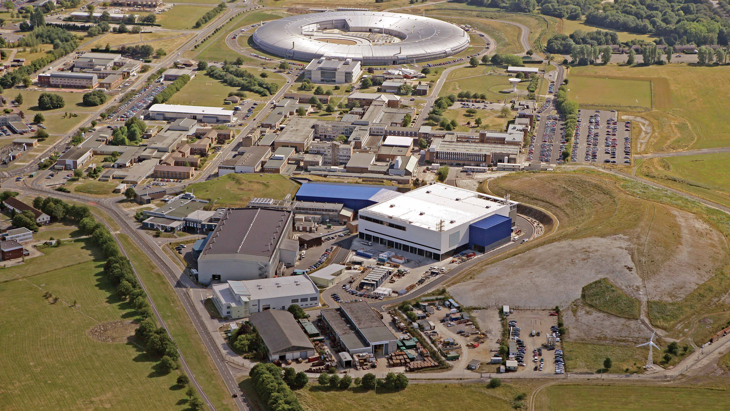

Slide 5
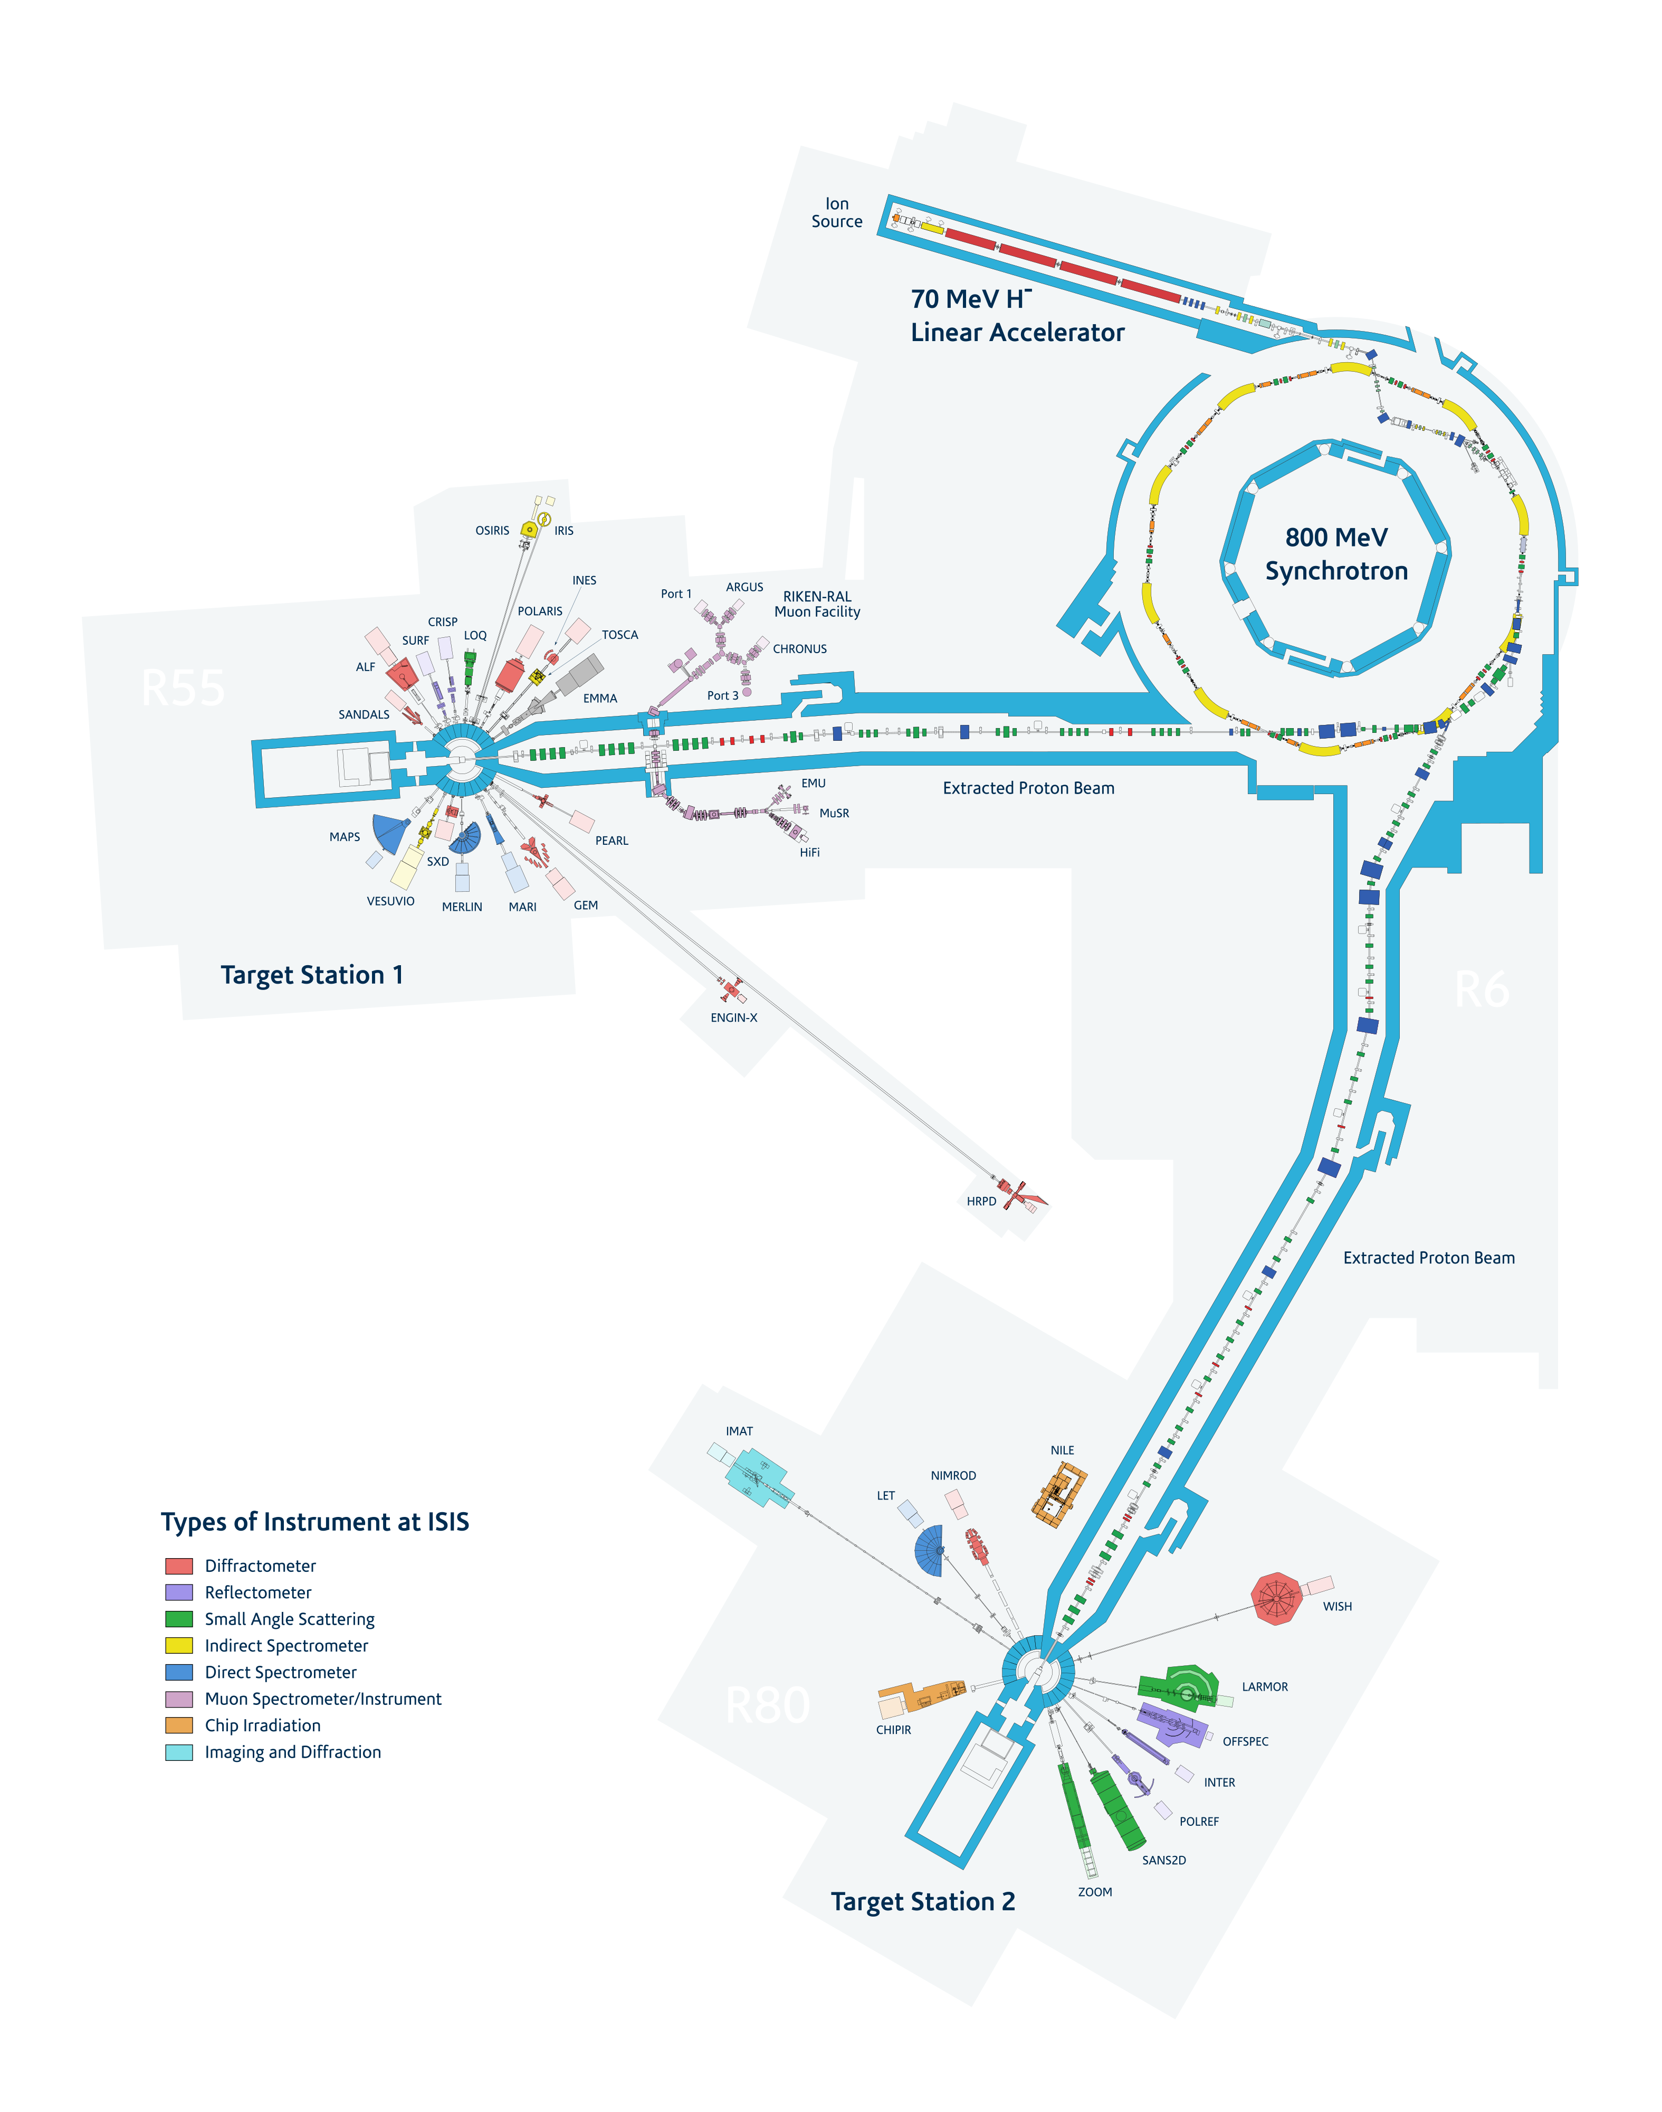
The ISIS Facility
H⁻ source (RFQ + DTL)
800 MeV RCS
Target Station 1
Target Station 2

Slide 6
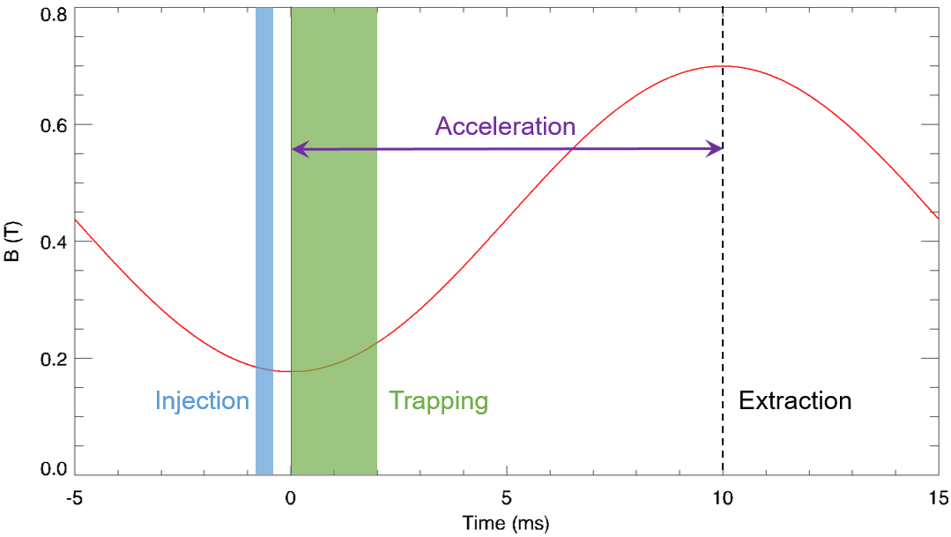
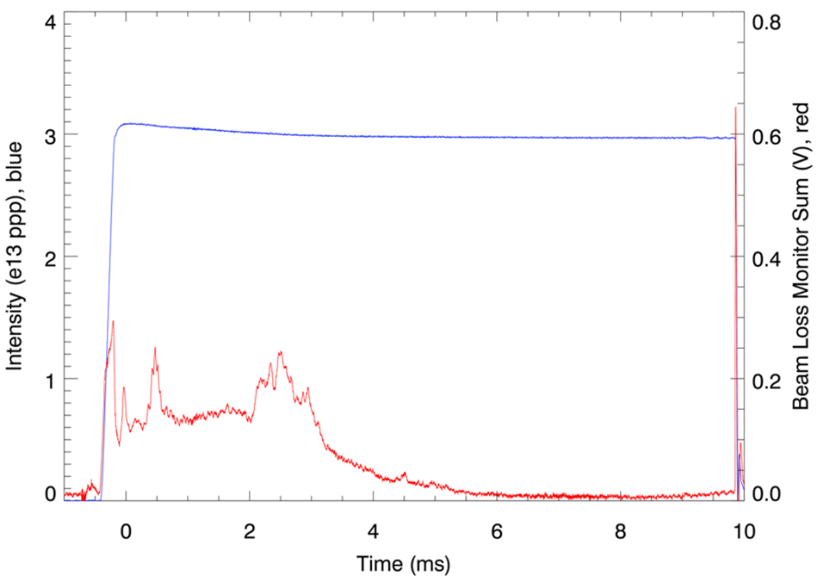
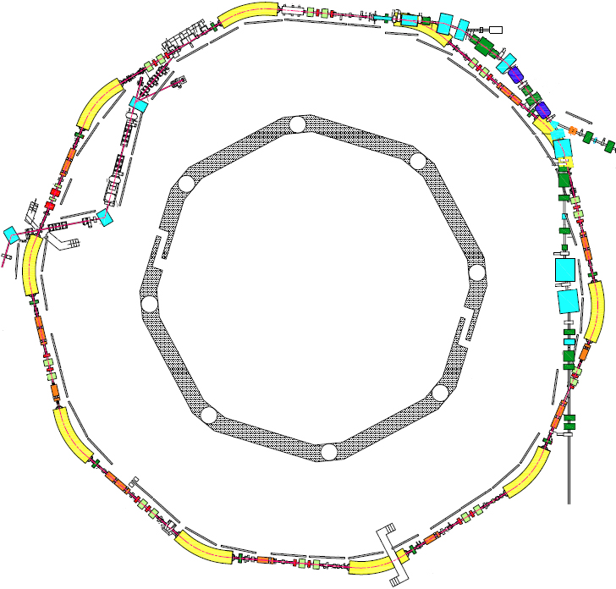
The ISIS RCS
Mean Radius | 26 m
Beam Energy | 70 – 800 MeV
Intensity | ~3e13 ppp
Repetition Rate | 50 Hz
Lattice Periodicity | 10 SP
Injection | 220 μs, 130 turns (charge exchange)
Painting | Dispersive horizontal, injected beam position scanned vertically
Extraction | Single turn, vertical
Betatron Tune | (Q_{x}, Q_{y}) = (4.31, 3.83), programmable
Beam Losses | Injection: 2%, Trapping: <3%, Acceleration/Extraction: <0.5%
RF System | 6 × fundamental (h=2) @ 160 kV/turn, 4 × 2nd-harmonic (h=4) @ 80 kV/turn
Extraction
TS2
Injection
TS1

Slide 7
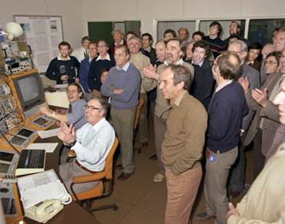
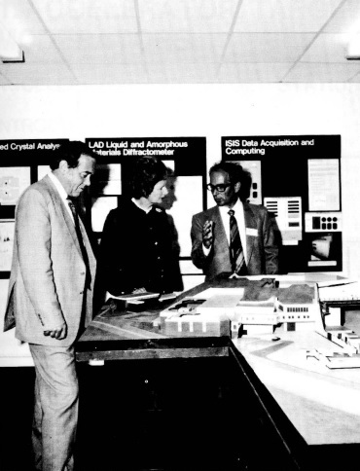
ISIS@40
ISIS celebrates its 40th birthday this year. Major milestones and achievements include:
First neutrons Dec 1984
Regular runs from Jan 1985 (25 Hz, 10 µA, 550 MeV)
Operational phase began in 1986 (50 Hz, 30 µA, 550 MeV)
First muons 1987
Design energy and current achieved 1994 (50 Hz, 200 µA, 800 MeV)
Most powerful pulsed neutron source in the world in 2004 (now surpassed)
Longest operational lifetime of any UK accelerator
ISIS named for Egyptian goddess of re-birth, as well as the traditional name of the River Thames as it flows through Oxford:
Linac originally commissioned as injector upgrade for Nimrod
RCS constructed in the hall of the old Nimrod accelerator
Re-used many components of Nimrod and NINA accelerators

Slide 8
ISIS@40: Statistics
Over the last 40 years, the ISIS RCS has delivered 8×10²³ protons to the neutron targets.
This corresponds to:
½ a teaspoon of protons (assuming H atom volume)
100 coronavirus virions (assuming nuclear volume in close-packing regime)
1.3 mol of ionised hydrogen
Looking at installation and operational costs of the ISIS facility, £1 will purchase 2×10¹⁴ 800 MeV protons
Over the last 40 years, approximately 28.5 GWh of energy has been deposited on the targets
In order to produce that proton beam power, approximately 0.9 MT CO₂ has been emitted (from wall-plug power)

Slide 9
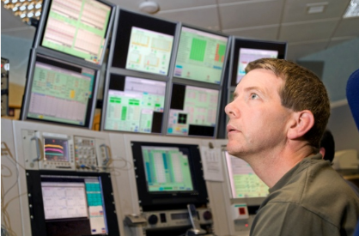
ISIS@40: Major Upgrades
1987: 6 fundamental RF cavities operational; new extract septum
1989: orbit correction system
1991: new extraction kickers
1993: diagnostic chopper, betatron Q-control system, MPS (BLM trips)
2001: move to tantalum-coated tungsten target material
2002: collimation system; new extract septum
2004: CW generator replaced with RFQ; 2nd-harmonic RF
2008: Target Station 2 first neutrons

Slide 10
Neutron Sources

Slide 11
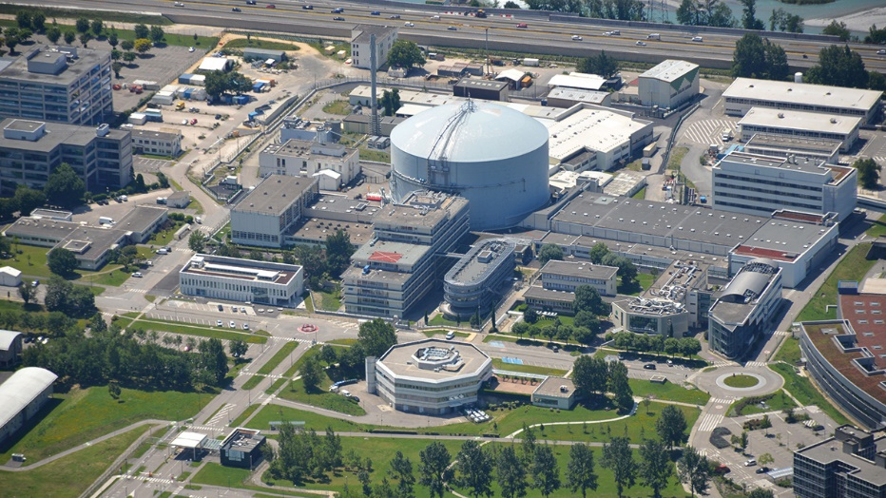
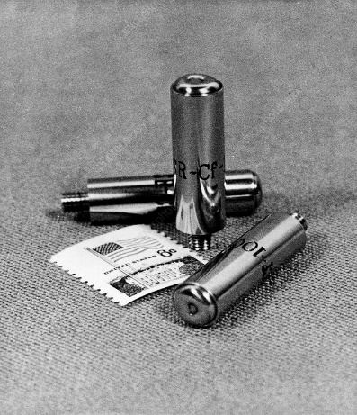
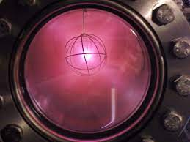
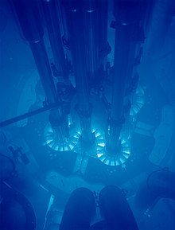
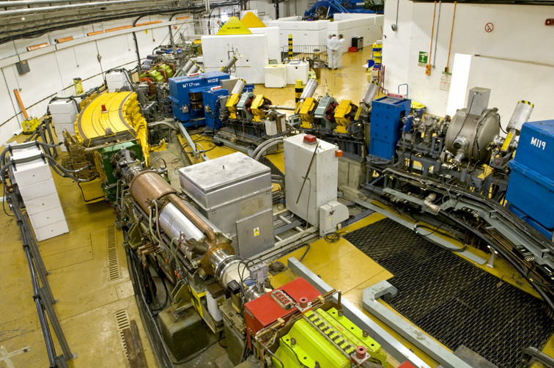
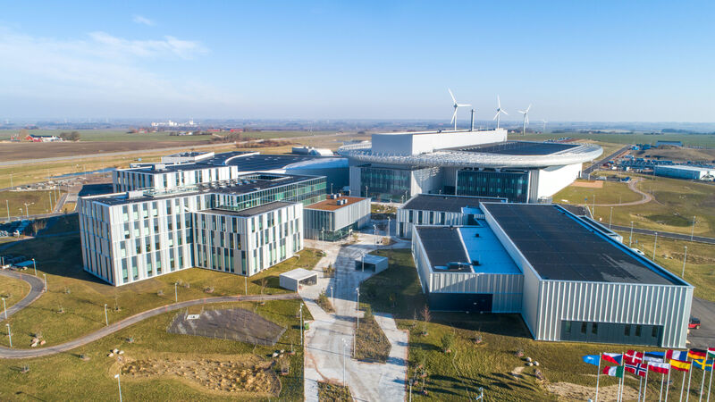
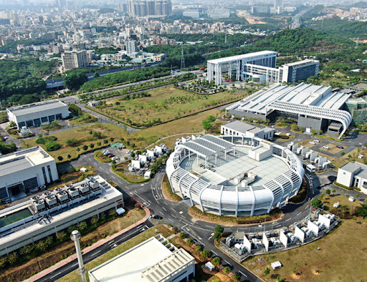
Types of Neutron Sources
Many types of sources, of varying size:
Radioisotope devices (e.g spontaneous fission, alpha-emitters, photo-neutron)
  Typically capsule sized, filled with powder
  Unstable nuclei, sometimes mixed with secondary light nuclei
  Integrated fluxes ~ 10⁶ – 10⁹ n s⁻¹
Plasma-based devices (e.g. Z-pinch, inertial electrostatic confinement)
  Table-top devices
  Exploit nuclear fusion reactions
  Z-pinch devices can be pulsed (single-shot, ~10¹² – 10¹⁴ n/pulse)
Nuclear reactor sources
  Most ubiquitous source of research neutrons
  Very high continuous flux (10¹⁴-10¹⁵ n s⁻¹cm⁻²), very reliable
  Very large installations
Spallation Neutron Sources
  Pulsed, high rep-rate
  Very large installations
  Very high flux (10¹⁶ – 10¹⁸ n s⁻¹)
  High(ish)-energy proton accelerator driver
Cf-252 source
Institut Laue-Langevin
IEC fusor
Advanced Test Reactor core
ISIS Synchrotron
European Spallation Source
China Spallation Neutron Source
Notes:
Can make a little joke here about not needing to explain what a neutron is
Alpha-emitter sources use secondary interactions with light nuclei to generate neutrons
Photo-neutrons are from high energy gamma collisons with lighter nuclei (typically Be)
Z-pinch is the self-confinement of axial plasma current by own mag field

Slide 12
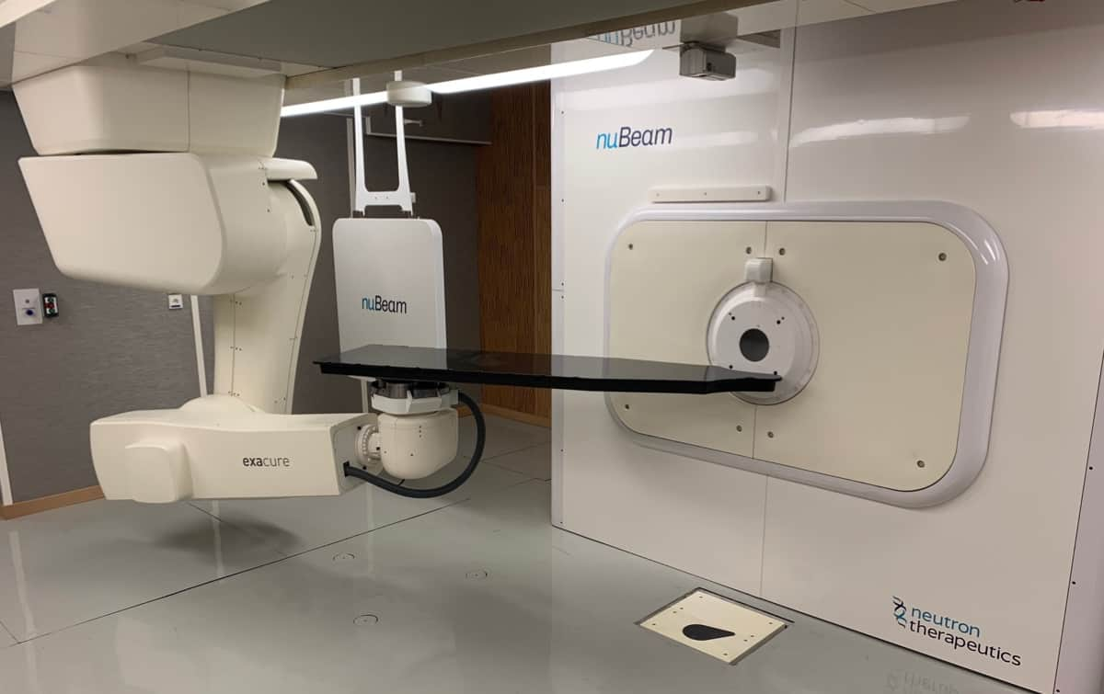
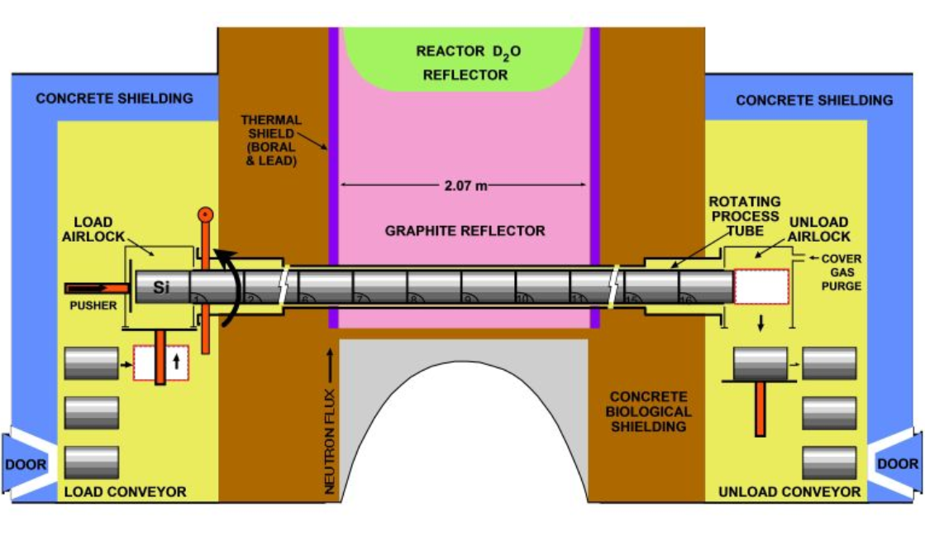
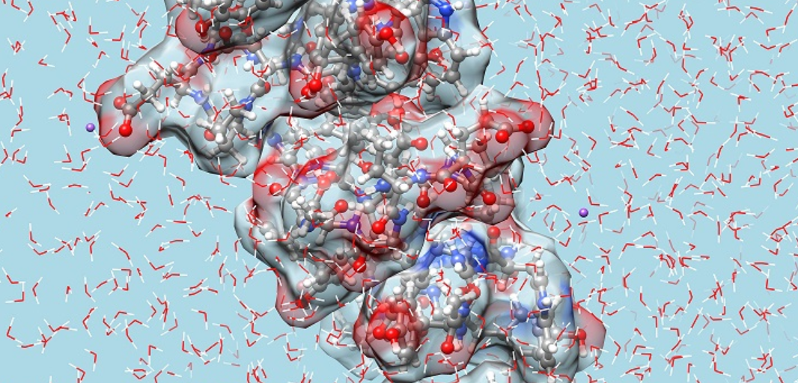
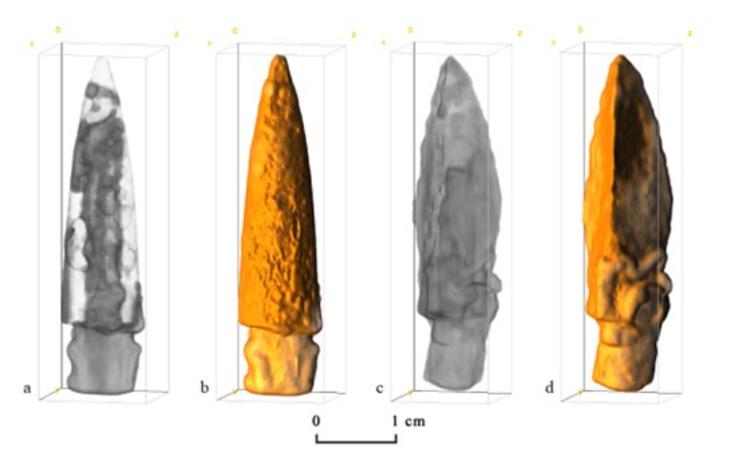
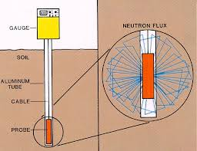
Applications of Neutrons
Industrial Uses
  Non-destructive materials testing and analysis (neutron radiography)
  Stress analysis
  Oil and gas exploration
  Silicon doping for semiconductor manufacturing
Research
  Nuclear fuel development
  Materials science
  Biomedical research
  Cultural heritage
  Neutron activation analysis
  Condensed matter research
Medical
  Cancer therapy (NCT)
  Medical imaging
  Radioisotope production
Agriculture and Environment
  Soil moisture and nutrient content
  Trace element analysis
  Crop breeding and genetics
  Nuclear waste analysis
Notes:
Introduce as four main areas – maybe don’t
1.1 e.g. weld-quality, general quality control
1.4 widest adopted

Slide 13
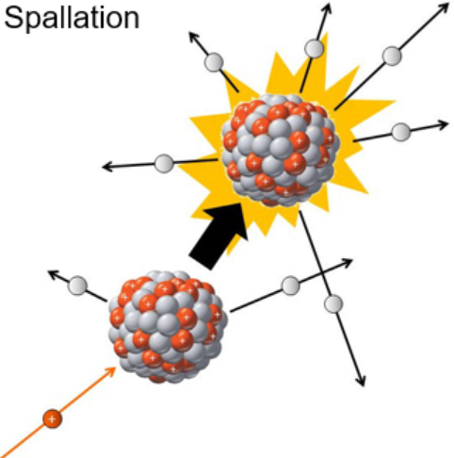
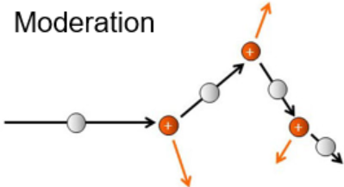
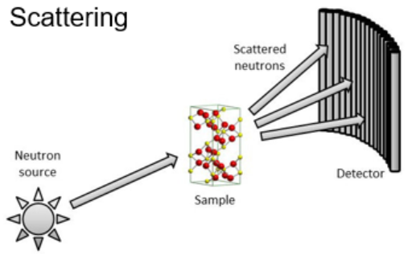
Spallation Neutrons
High energy proton hits a heavy nucleus, generating neutrons as debris from collision
Image credit: J Thomason

Slide 14
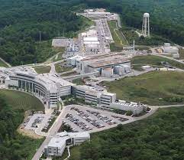
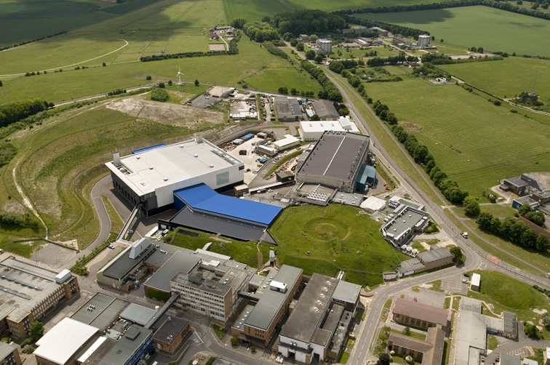
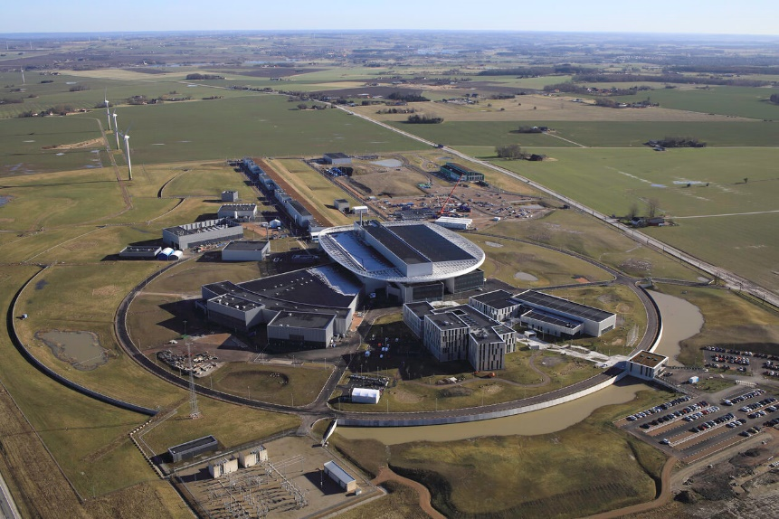

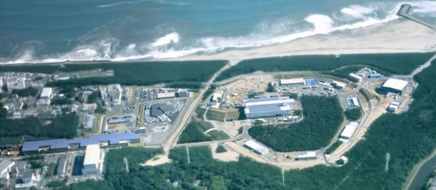


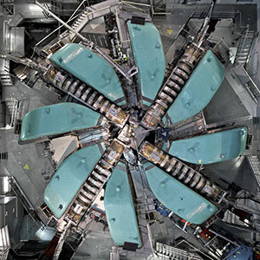

Spallation Neutron Sources
ISIS Neutron and Muon Source
800 MeV proton beam
200-250 µA
50 Hz
2 Target Stations
Short pulse
Also produces muons for spectroscopy
2e16 n s⁻¹
SNS
1 GeV proton beam
1.4 mA
60 Hz
Short pulse
1e17 n s⁻¹
ESS
Still under-construction
2 GeV proton beam
62.5 mA
14 Hz
Long pulse
Will be the most powerful source in the world – 5 MW
1e18 n s⁻¹
J-PARC
3 GeV proton beam
300-400 µA
25 Hz
Short pulse
Also produces muons for spectroscopy
1e17 n s⁻¹
SINQ
590 MeV proton beam
2.3 mA
Continuous beam
Also produces muons for spectroscopy
1e17 n s⁻¹
Honourable mentions:
CSNS
LANSCE
n_TOF

Slide 15
Recent ISIS Upgrades

Slide 16
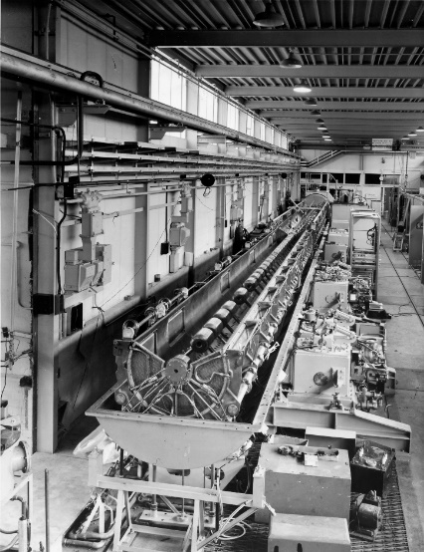
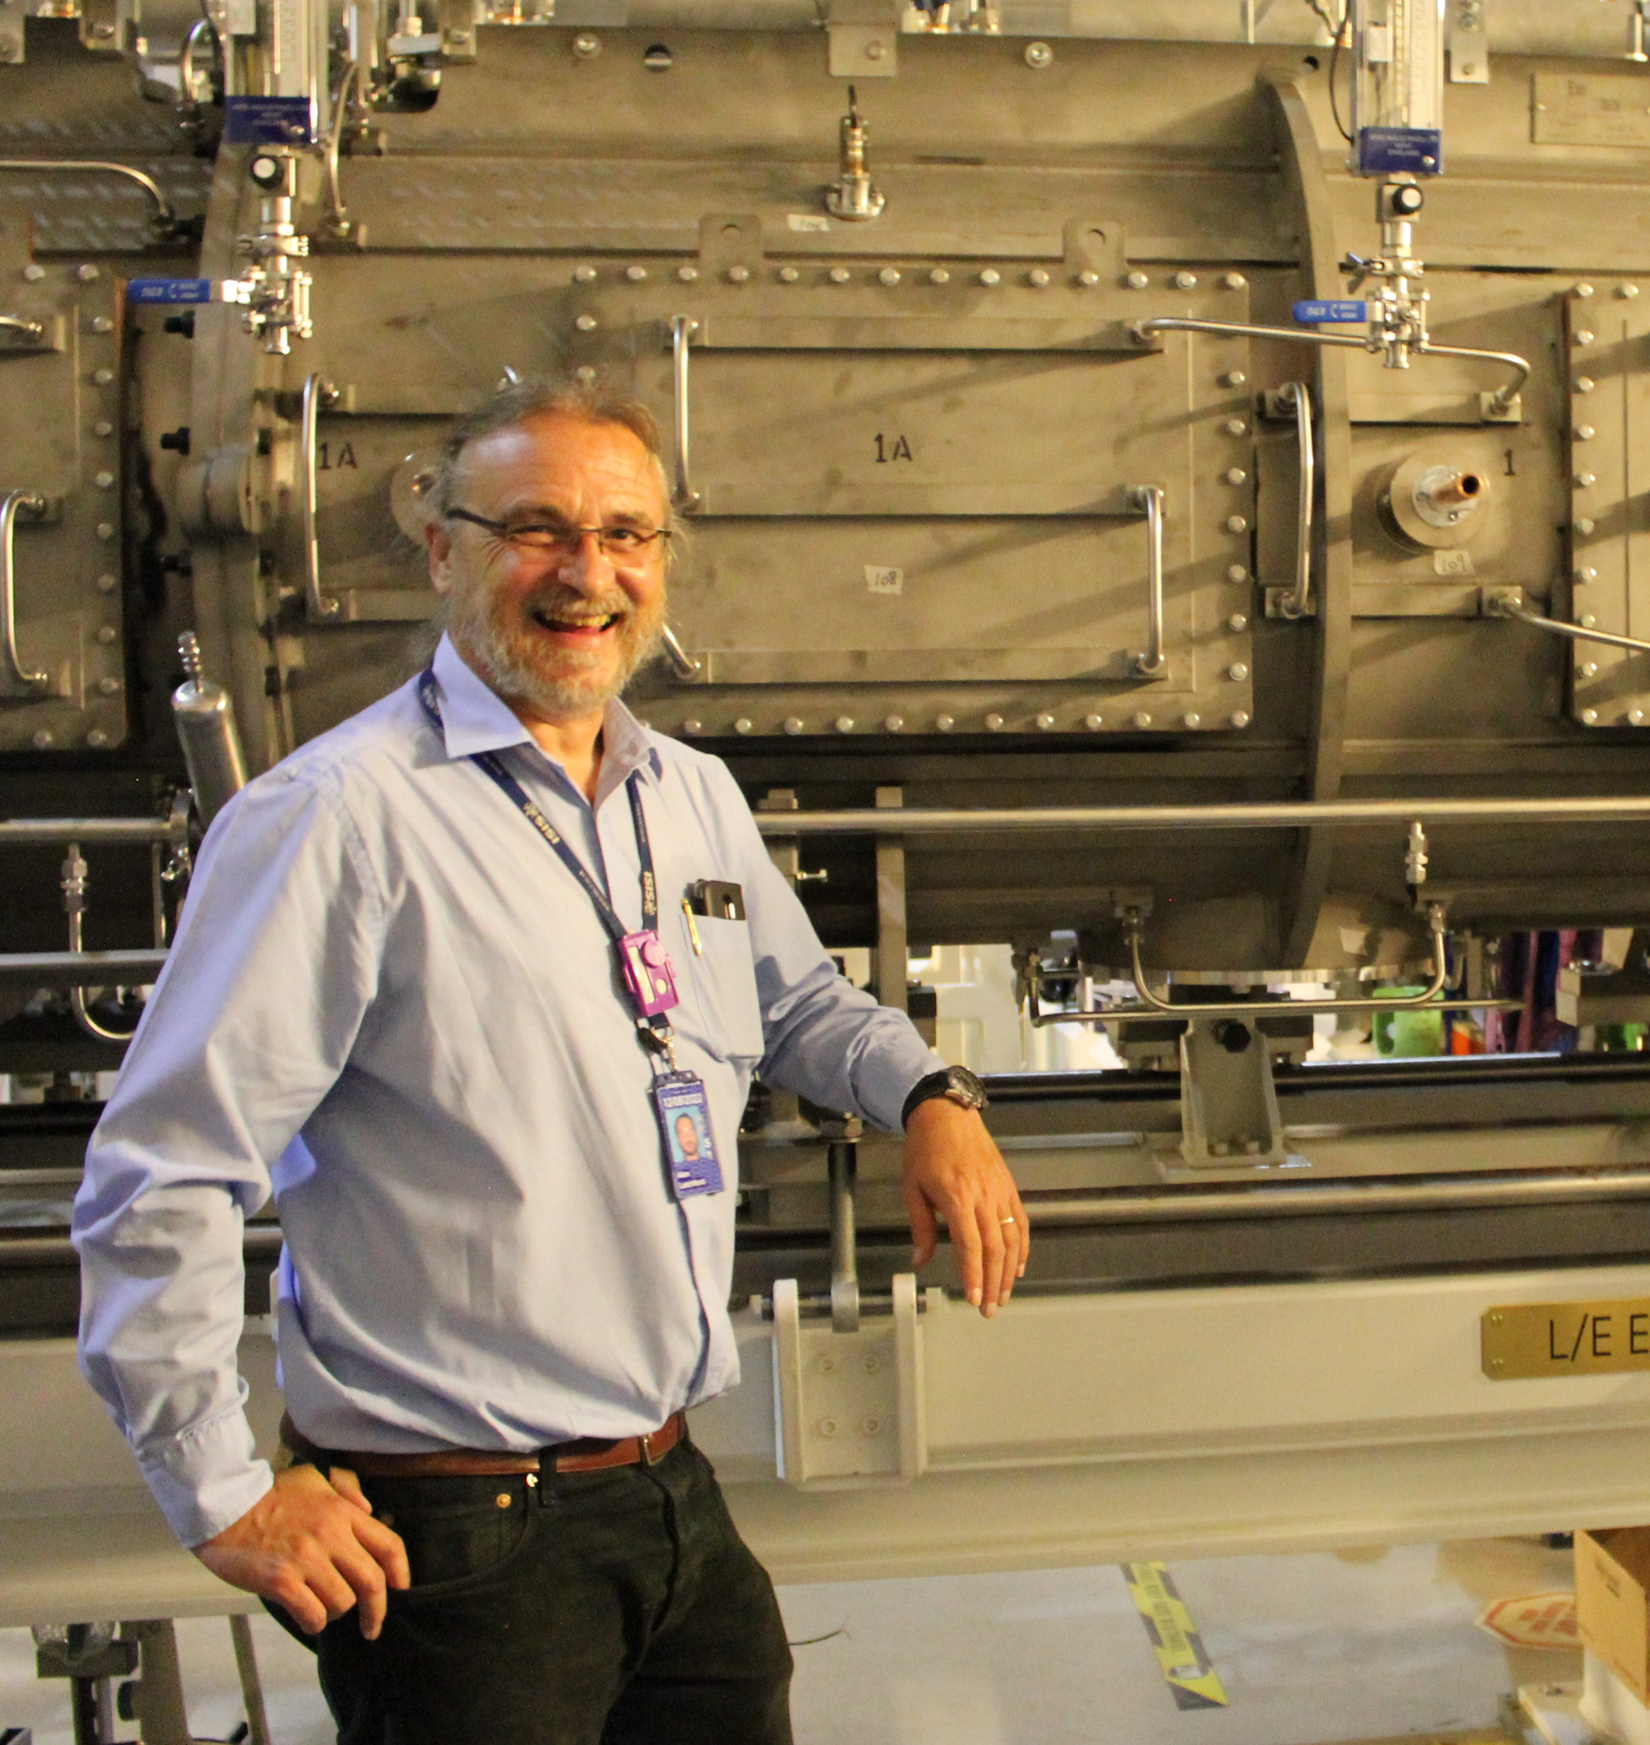
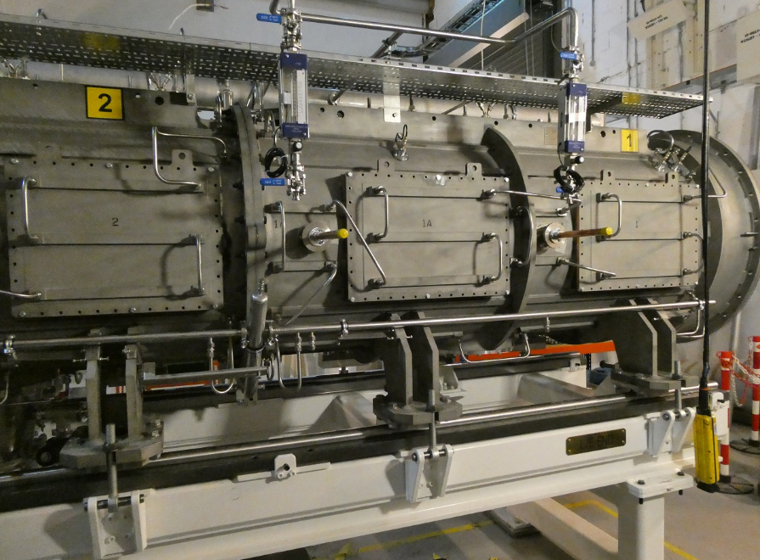
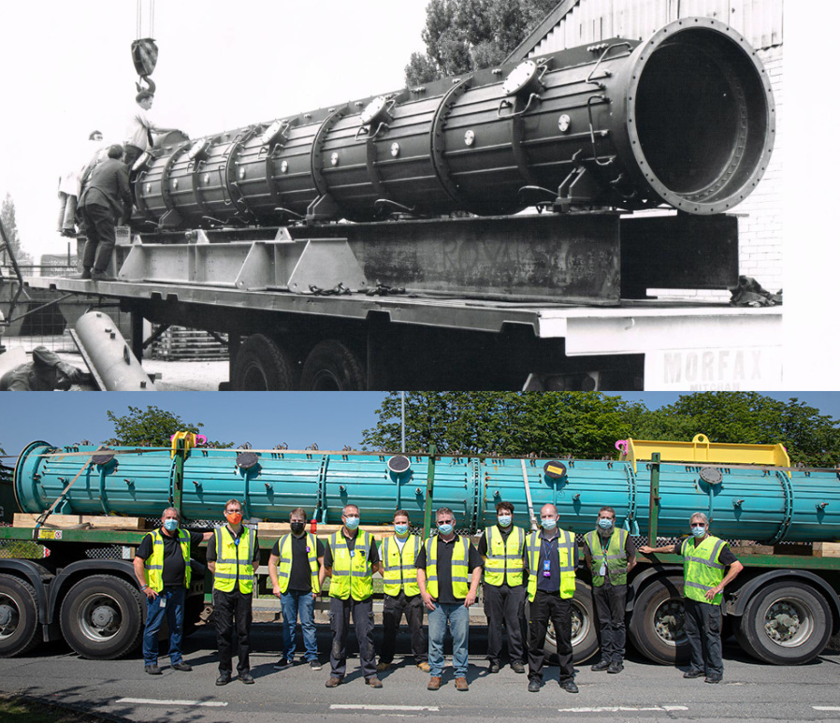
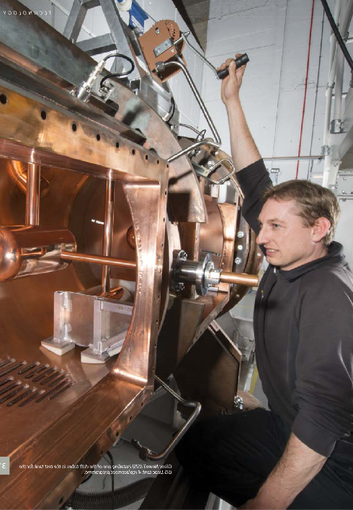
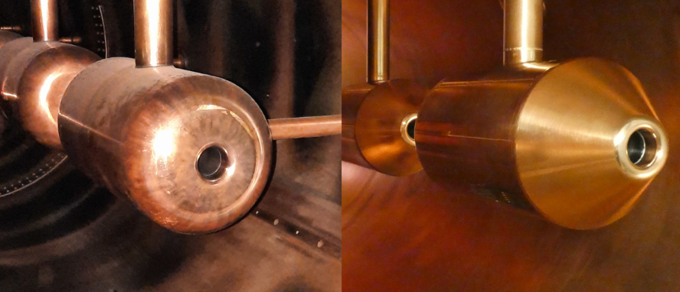
Tank 4 Replacement
Image Credit:
[1] Atomic Energy Research Establishment Harwell Photographic Group, courtesy AIP Emilio Segrè Visual Archives, Physics Today Collection
[2] Letchford, A. “UPGRADES AND DEVELOPMENTS AT THE ISIS LINAC”, LINAC2022
[3] ISIS
ISIS linac is re-purposed from Nimrod:
50 → 70 MeV injector upgrade (never realised for Nimrod)
Tanks 2 & 3 re-purposed from the Proton Linear Accelerator (PLA)
Tanks 1 & 4 constructed in 1970s (based on Fermilab design)
[1]
[3]
New Tank 4 installed during 2021 long shutdown.
Direct “plug-in” replacement of original tank
Increased reparability with new maintenance hatches
Sections bolted together (originals welded)
New drift-tube design improving TTF
[2]
[2]
[2]
[3]

Slide 17
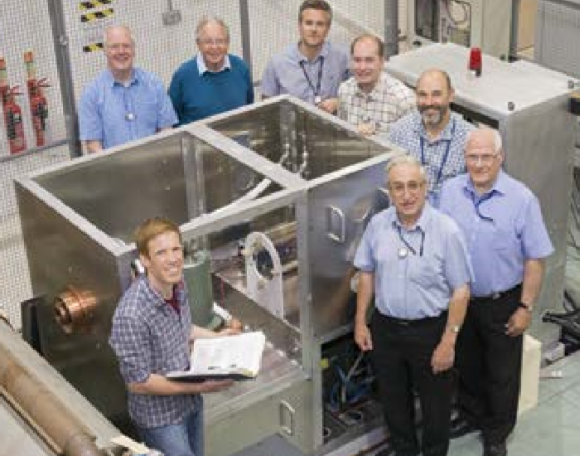
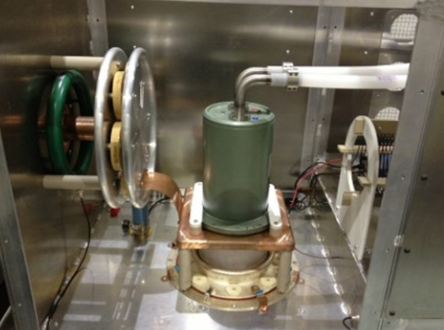
Synchrotron RF Upgrade
Fundamental RF high-power drives (HPDs) replaced during 2021 long-shutdown
Old HPDs use pair of Burle valves: concern over obsolescence and sourcing of replacements
New HPD runs off single Thales valve
2nd-harmonic systems to receive similar update at next long shutdown
Image Credit: ISIS

Slide 18
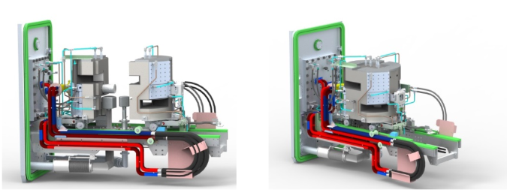
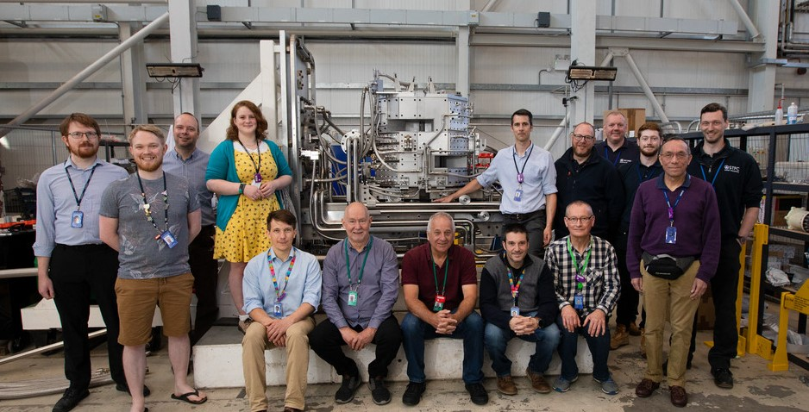
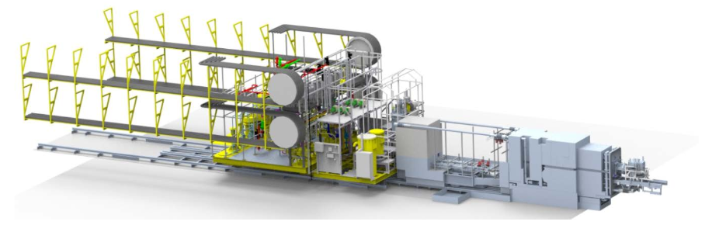
Target Station 1 Upgrade
Target reflector and moderator (TRAM) assembly also upgraded in 2021 long shutdown.
New TRAM provides:
Extended lifetime for TS1
Improved neutron flux, due to solid Be reflector
Easier remote handling capability
Simplified decommissioning
Commissioning began 4 Nov 2022, fully commissioned 2023
[1]
[2]
[1]
Image Credit:
[1] Coates, D. “ISIS Target Station One Upgrade Project – An overview of the
development work being undertaken to improve the Target,
Reflector and Moderator (TRaM) support systems”, J. Phys.: Conf. Ser. 1021 012059, doi :10.1088/1742-6596/1021/1/012059
[2] ISIS

Slide 19
Ongoing and Upcoming Ugrades

Slide 20
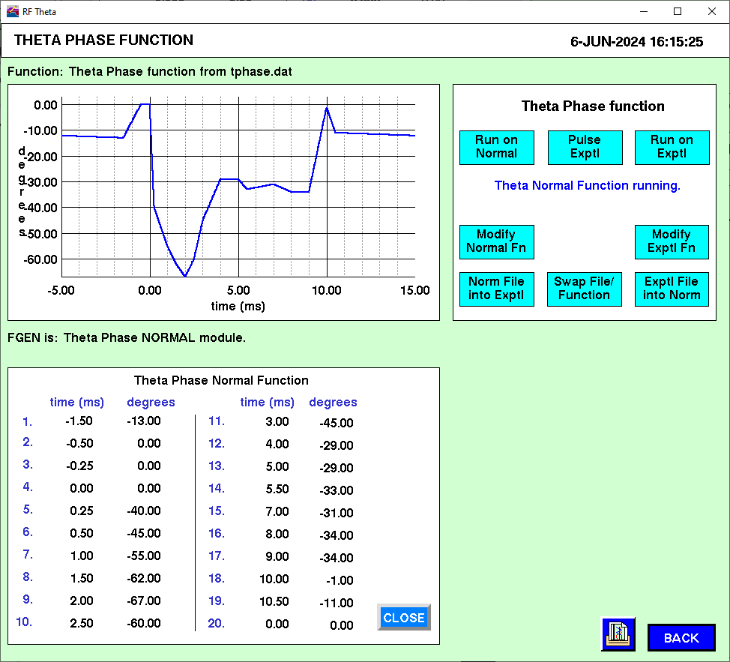
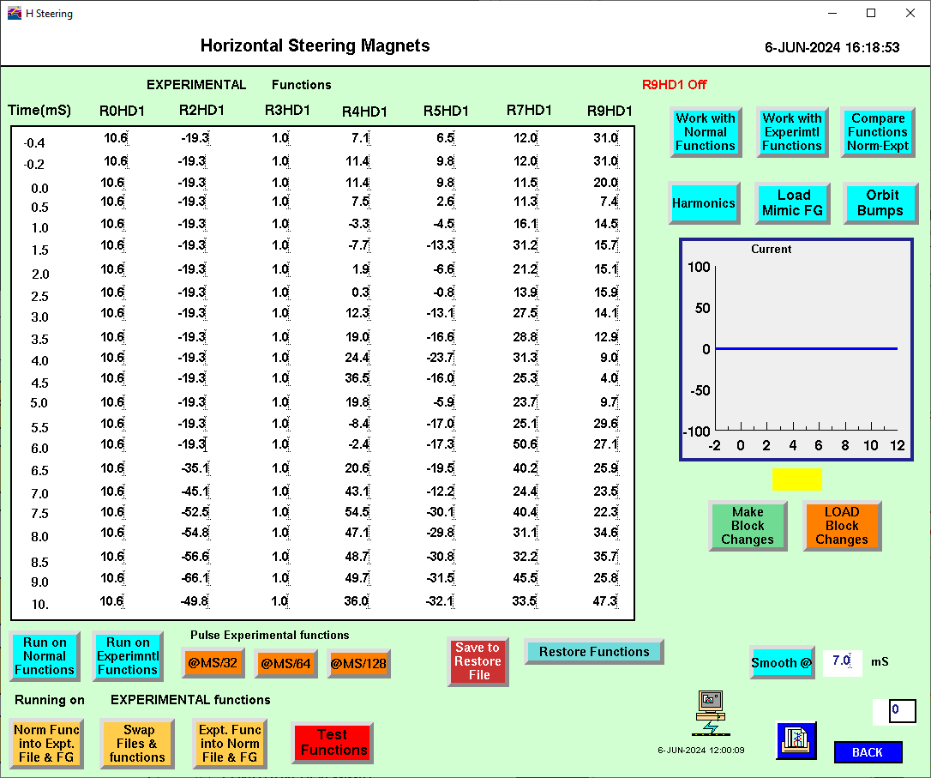
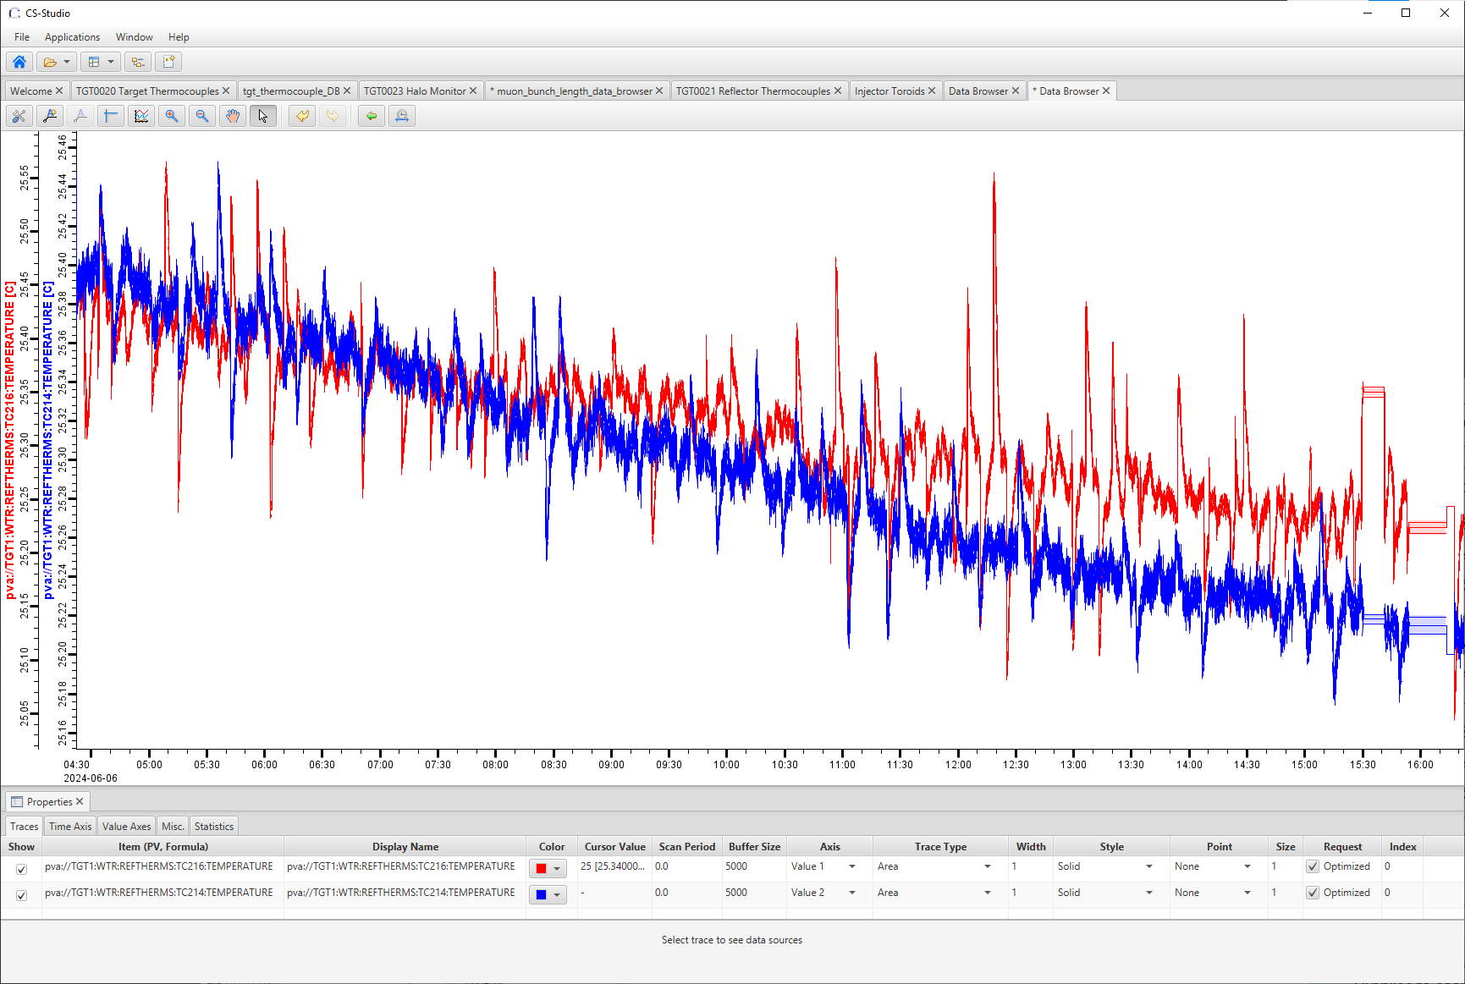
EPICS Migration
Current VSYSTEM-based control software has been running since the 90’s
Instrumentation has been using EPICS-based (IBEX) since 2018
Migration to EPICS currently underway:
Easy interfacing with custom python scripts
Opportunity to revisit/redesign accelerator controls and add functionality
Facilitates easy-access to time-series data of set/read values and measurements
Removal of obsolete/unused control screens

Slide 21
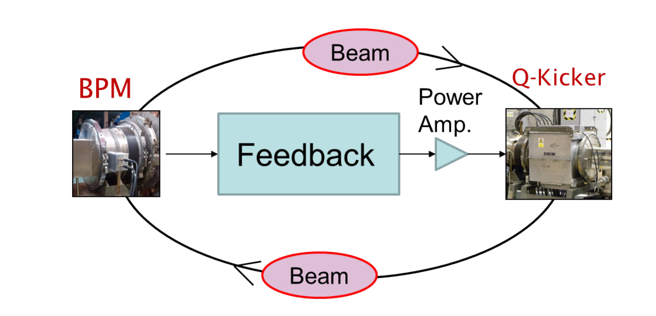
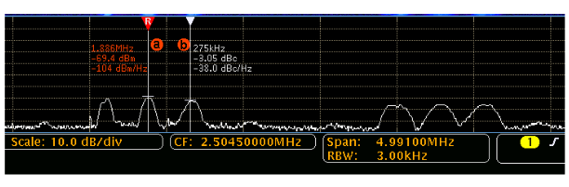
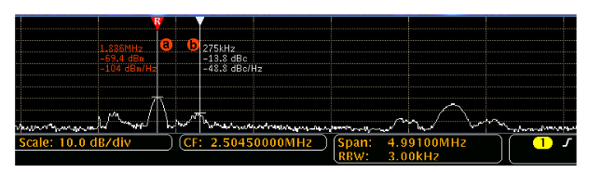
Q-kicker Damping System
Head-tail instability is a significant limit on ISIS intensity.
Vertical displacement oscillation
Mode structure longitudinal
Driven by characteristic ring impedance
Multi-pronged effort to:
Characterise the instability
Diagnose the source impedance
Develop methods for mitigation
The Q-kicker is a ferrite-loaded electromagnetic kicker, already installed on ISIS, used for tune measurements.
A feedback system using a ring beam position monitor and the Q-kicker are under development, with the aim of damping vertical oscillations.
Initial tests demonstrate reduction in instability, but not fully commissioned for 50 Hz operations
Image Credit: Pertica, A. “EXPERIMENTAL DAMPING SYSTEM WITH A FERRITE LOADED
KICKER FOR THE ISIS PROTON SYNCHROTRON”, IBIC2017

Slide 22
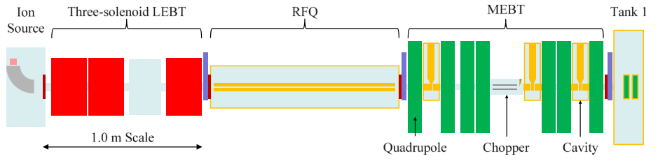
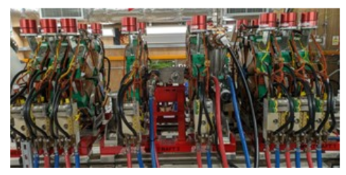
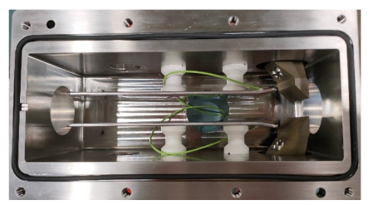
MEBT Installation
Currently, no matching performed between RFQ and DTL:
Limit injector efficiency (lower energy losses)
Limit injection efficiency (70 MeV losses)
Medium energy beam transport (MEBT) section planned installation during next long shutdown
Addition of quadrupole focusing, rebunching cavity, diagnostics, and electrostatic chopper
6-dimensional matching into DTL
Better operational tuning of injector
Longitudinal matching of pulse train to synchrotron RF acceptance
[1]
[2]
[2]
Image Credit:
[1] Wood, T. et. al. “The ISIS pre-injector reconfiguration”, Rev. Sci. Instrum. 87, 02B121, doi:10.1063/1.4934658
[2] Speed, J. et. al. “PRACTICAL DESIGN AND MANUFACTURING
OF THE NEW ISIS MEBT CHOPPER”, IPAC2024

Slide 23
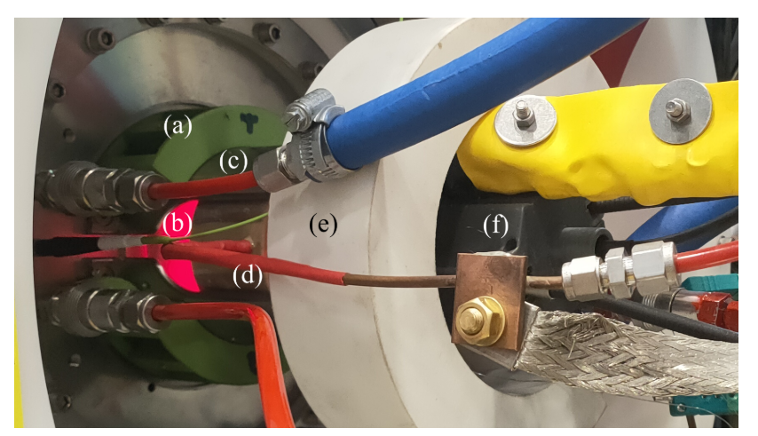
RF Ion Source
Current ISIS ion source is Penning-type caesiated surface-plasma H—source
Caesium limits lifetime (typically ~ 2-3 weeks):
Significant technical effort to maintain hot spares
Limits availability to neutron users
Can pose limit on machine optimisations
Examining possibilities of upgrade to a volume-plasma RF-driven source:
Significantly improved lifetime
No requirement of caesium
Potential to increase synchrotron current through longer pulse length
Required spec:
30 mA H⁻ current
4-rms emittance < 1.5 π mm mrad
200 µs pulse length
The RF ion source installed and operating at full duty cycle. Visible components
include filter magnets (a), plasma light visible through translucent plasma chamber and cooling
jacket (b), main support housing (c), RF coil (d), cooling jacket connection manifold (e) and
ignition gun (f).
Image and text sourced from:
Lawrie, S. et. al. “Plasma commissioning in a high power external RF-coil volume-type H− ion source”, J. Phys.: Conf. Ser. 2244 012033

Slide 24
ISIS-II

Slide 25
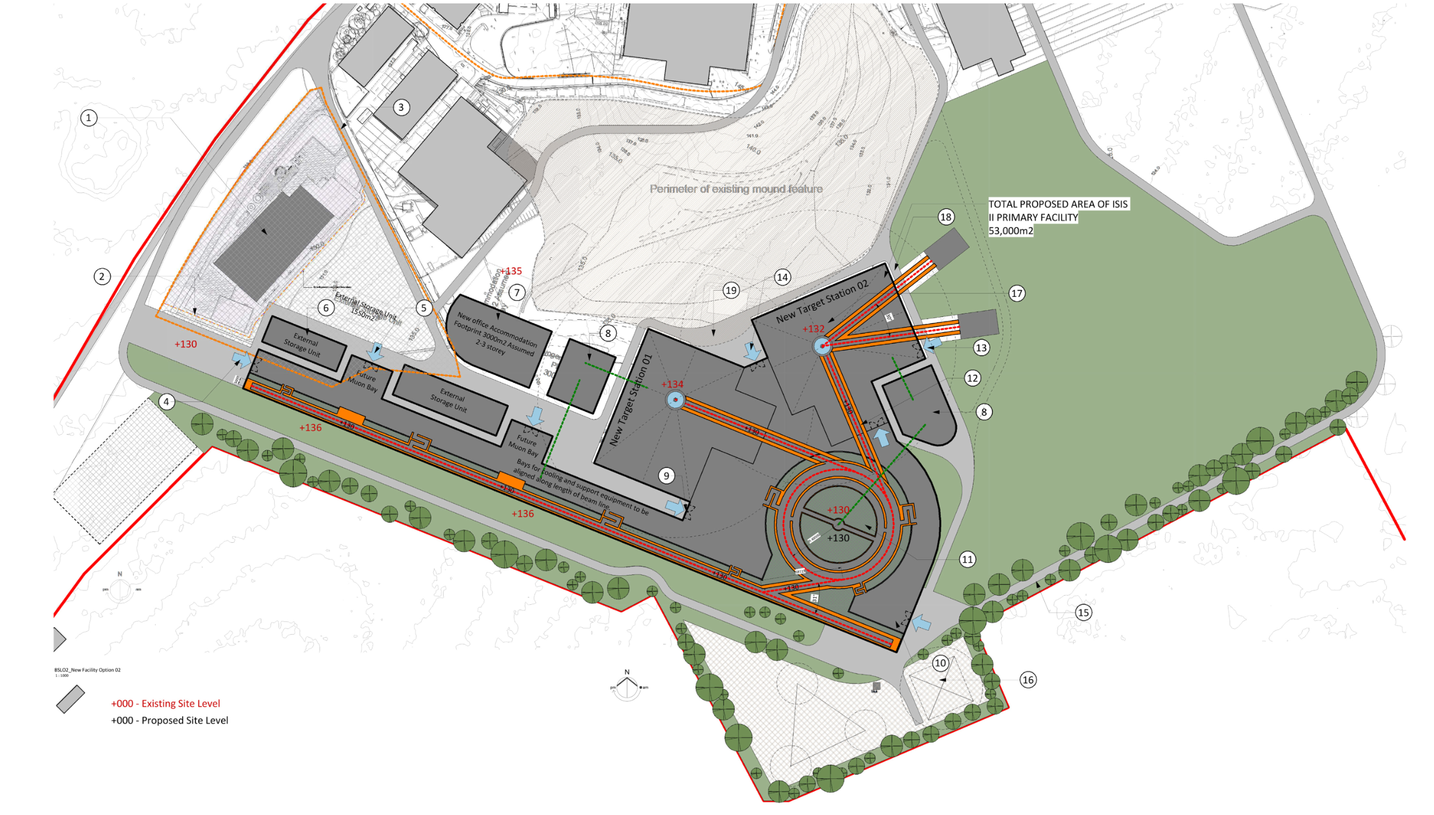
ISIS-II Megawatt Upgrade
Europe (incl. UK) is a world leader in neutron-based science
Decommissioning of reactor sources of neutrons
Potential European “neutron drought”
ISIS-II vital to maintain European competitiveness with Japanese (J-PARC) and American (SNS) short-pulse neutron sources
ESFRI Neutron Scattering Facilities in Europe Report (2016)
“…by far the most cost effective solution would therefore be to build a MW-class short pulse facility at ISIS, reusing existing infrastructure and facilities as well as drawing upon on-site competences. The current facility could operate until the new facility is operational with its initial suite of instruments.”
Sentiment echoed in UKRI Infrastructure Opportunity Report (2023)
ISIS-II Working Specifications
1.25 MW proton accelerator
1.2 GeV beam on target
0.1% beam-loss
Conventional Ring (RCS, AR) and FFA options being explored
Special focus on
Sustainability of the future machine
Ensuring health of the neutron user community during construction phase
Phase 1
Phase 2
Phase 3
2019
2021
2027
2031
2040
Feasibility, design studies and R&D
Integrated facility technical design
ISIS-II construction
Phase 1.1
Physics design
Small-scale prototypes
Phase 1.2
Physics design
Large-scale prototypes

Slide 26








ISIS-II “Conventional” Rings
Longitudinal Simulations
Working Point
Lattice Design
Completed exploratory designs Feb 2022
  2 x Rapid Cycling Synchrotron
  2 x Accumulator Rings
New sustainability-focussed designs under investigation
Closed Orbit Correction
Life-Cycle Analysis
Injection Straight & Foil Temperature
Collimation Simulations
3D Simulations

Slide 27










ISIS-II “Conventional” Rings R&D
Tune Plane Measurements
  Frozen space charge halo
Understanding loss mechanisms key to success of ISIS-II design
Reliable prediction of loss (~0.01%)
Understanding of beam halo dynamics
Origin of losses
Beam Instability Studies
Transverse Profiles
  Non-linear components
Measured
ORBIT
Chromaticity
Likely need to develop custom beam dynamics and design codes
Benchmark against other codes
Benchmark against measurement

Slide 28



ISIS-II FFA Option
FFA-option aims for
Sustainability
Reliable operation
Capacity
Capability
Currently, proof-of-concept machine under development (FETS FFS)
Platform for development of ISIS-II FFA driver
Experimental study of injection painting, orbit correction, resonances, collimation, etc.

Slide 29





ISIS-II FFA R&D: FETS FFA
HV-testing underway for RF cavity magnetic alloy and ferrite cores
3 – 12 MeV
4 – 4.4 m radius
50 Hz beam repetition
3x10¹¹ protons per bunch
30 W power
Space charge tune shift ~-0.35
Still a work in progress
Completion of CDR by March 2025
Prototype BPM and wire scanner tests at KURNS

Slide 30




ISIS-II FFA R&D: Beam Stacking
Beam stacking is a method for increasing the circulating current in FFA
Inject, accelerate, and de-cohere beam at top energy
Inject and accelerate second beam
Stack in longitudinal phase space
Experimental verification of beam stacking at KURNS FFA:
Schottky analysis of incoherent signals
Determine energy and energy spread stacked beams
Potential use at ISIS as diagnostic tool
Studies underway to repeat experiment on the ISIS RCS

Slide 31
Summary
ISIS has seen many changes over 40 years
  Numerous challenges encountered
  Numerous upgrades
  Lots of re-purposed equipment
  Huge collaborative effort
ISIS is still one of the most productive neutron sources in the world
Continued development and refurbishment are aimed at extending ISIS’ operational lifetime
ISIS (along with FETS) will be the test-bed upon which ISIS-II is developed
Several design options still under consideration for ISIS-II, each with its own challenges and research questions

