Slide 1

Sustainability discussion:
Current challenges in accelerator technologies and future sustainability

Slide 2
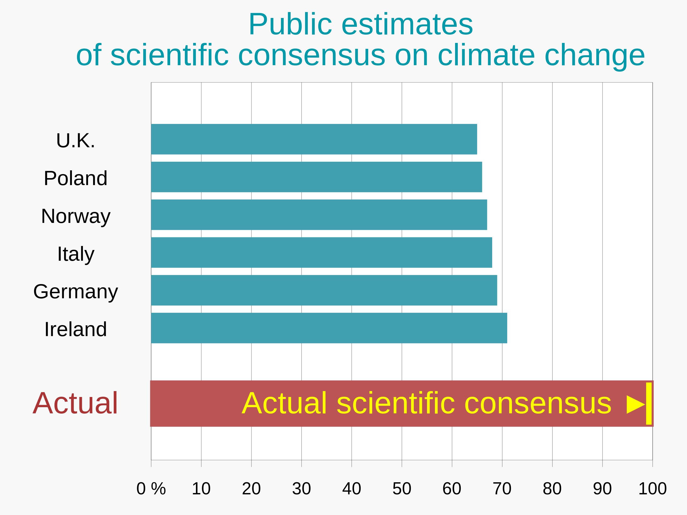
Source: bobby.duffy@kcl.ac.uk

Slide 3
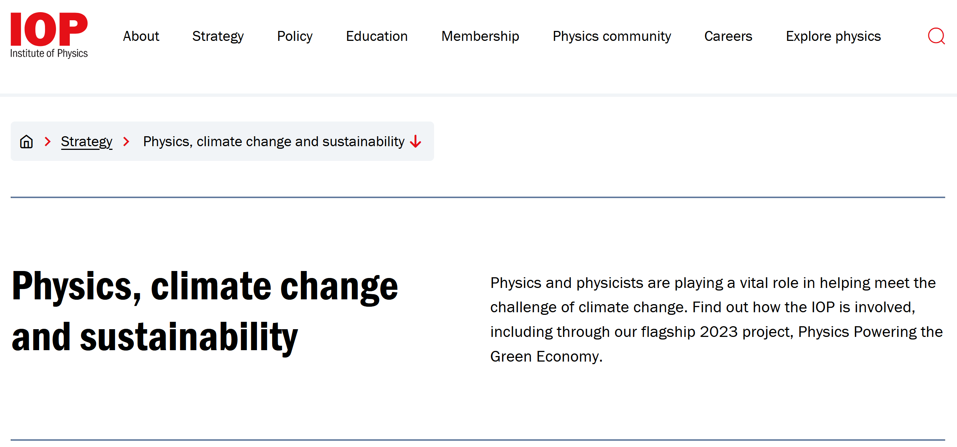

Slide 4
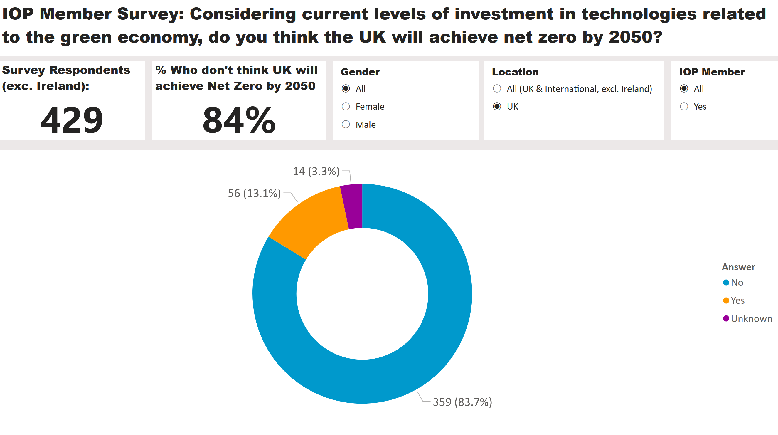

Slide 5
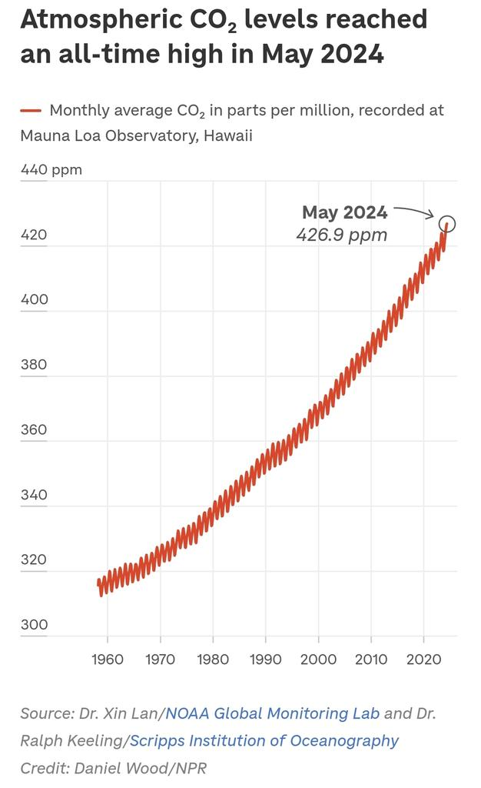

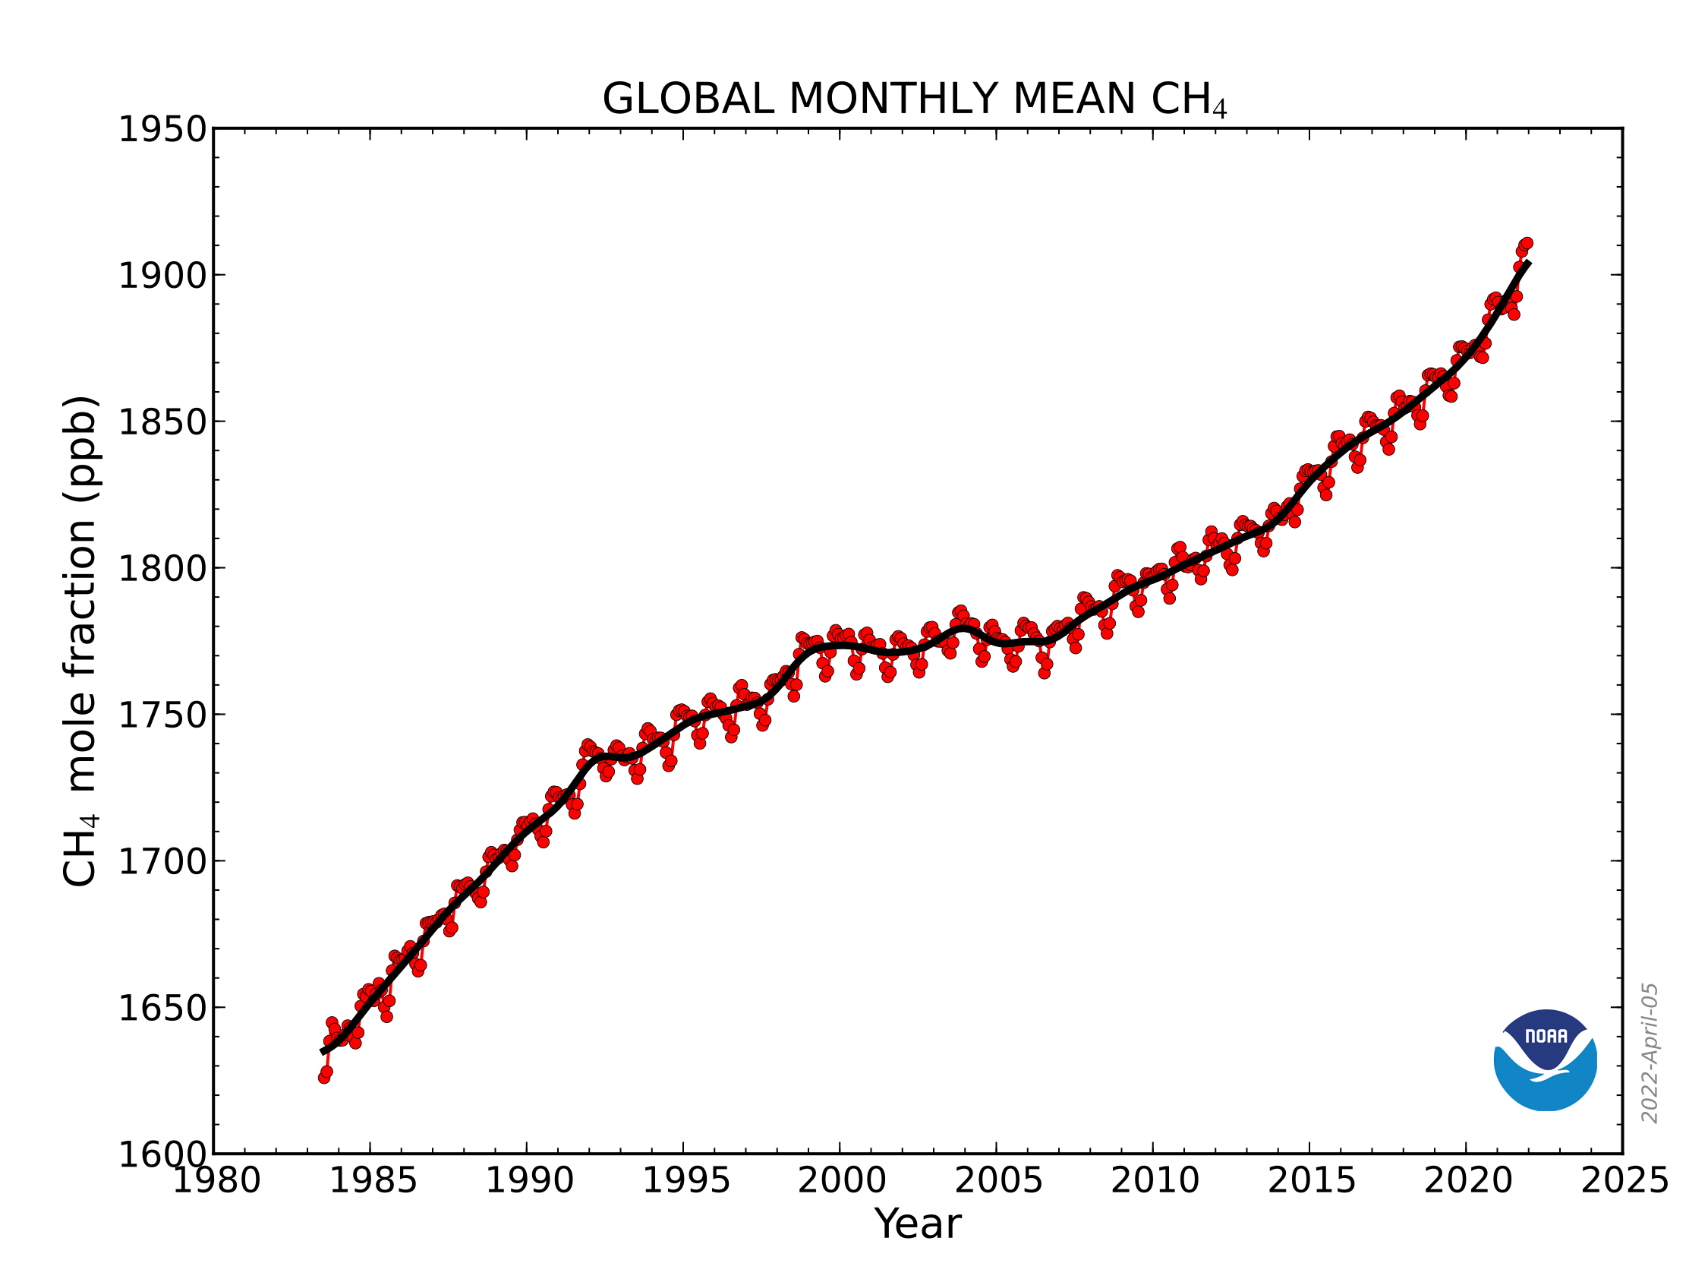
Secretary General of the UN:
Increase of 1/3

Slide 6
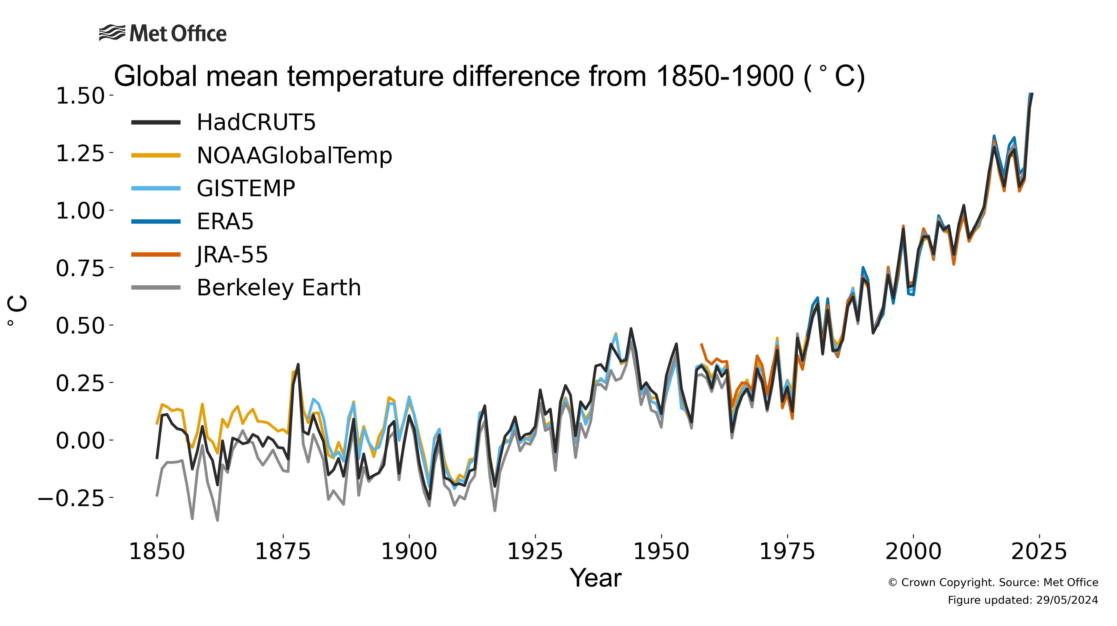

Slide 7
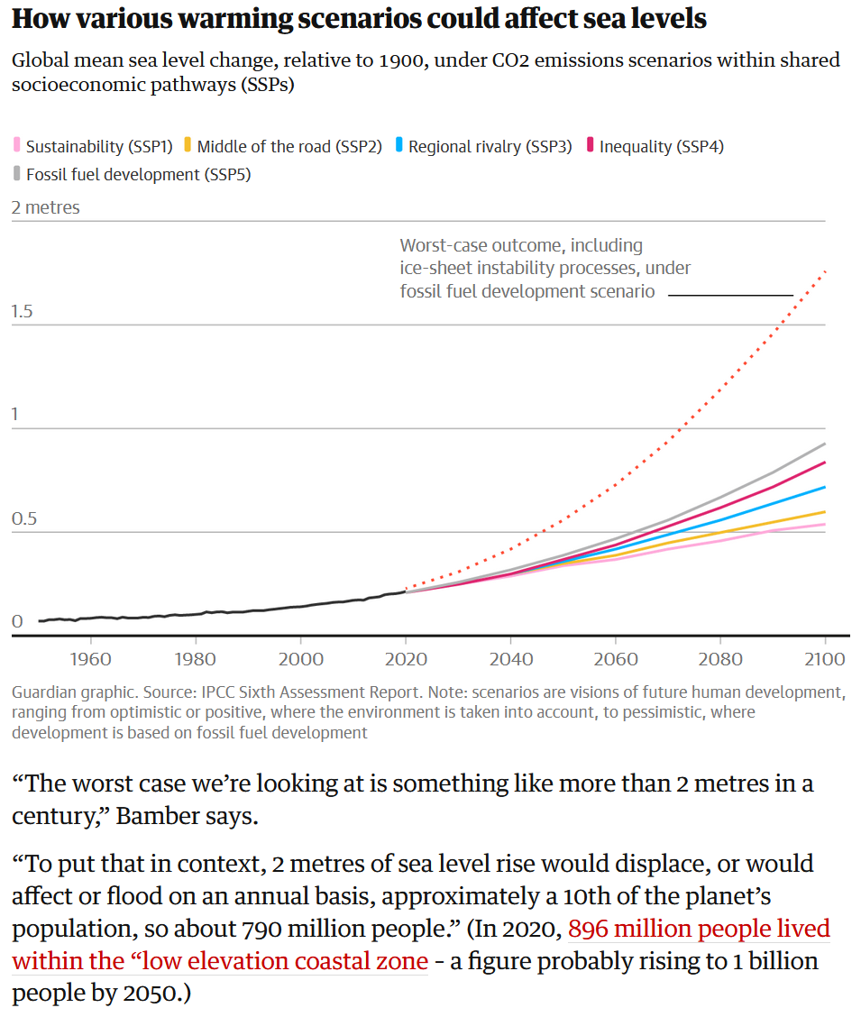
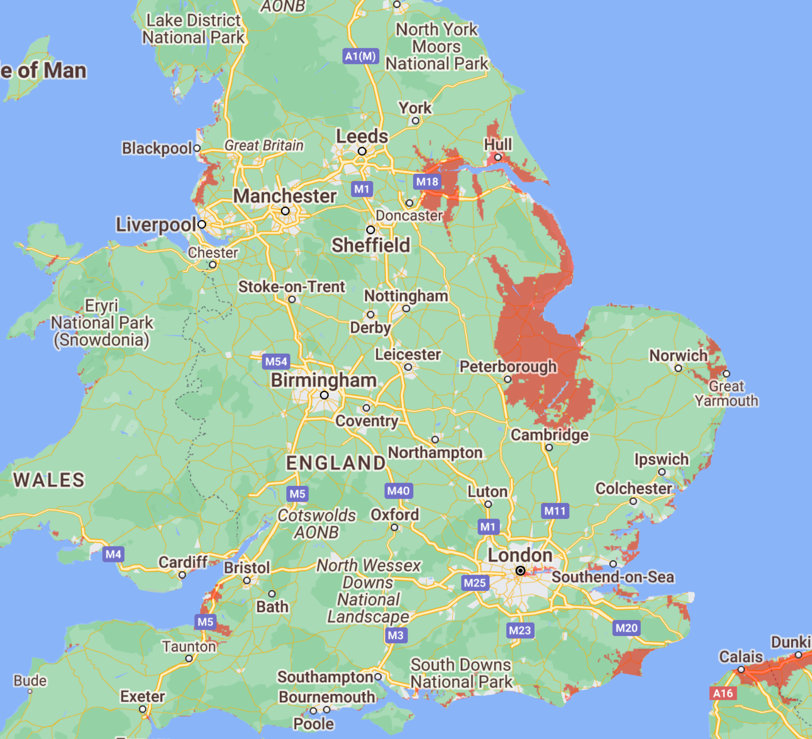
Sea level rises by 2050? (From: Climate Central)

Slide 8
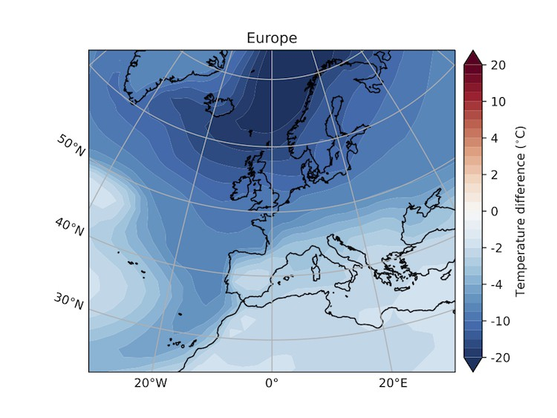
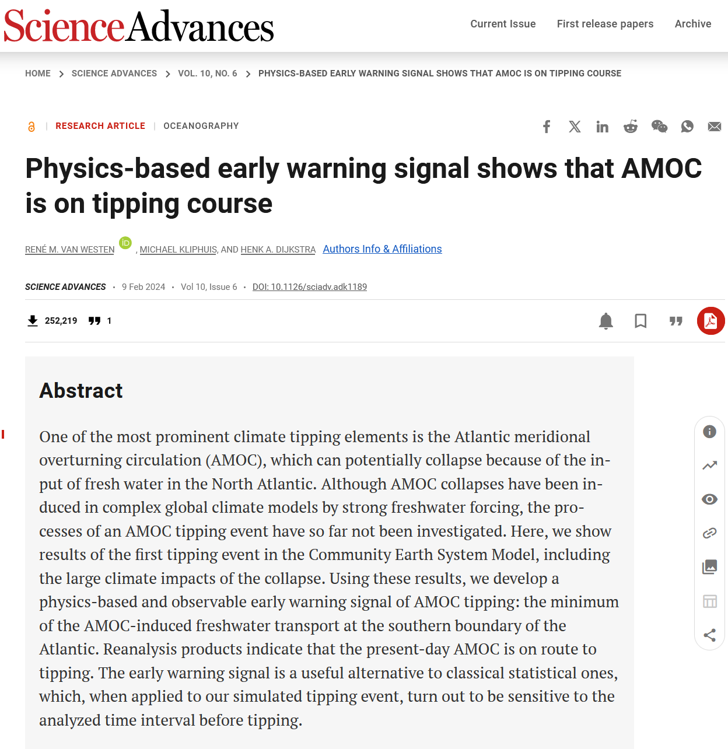
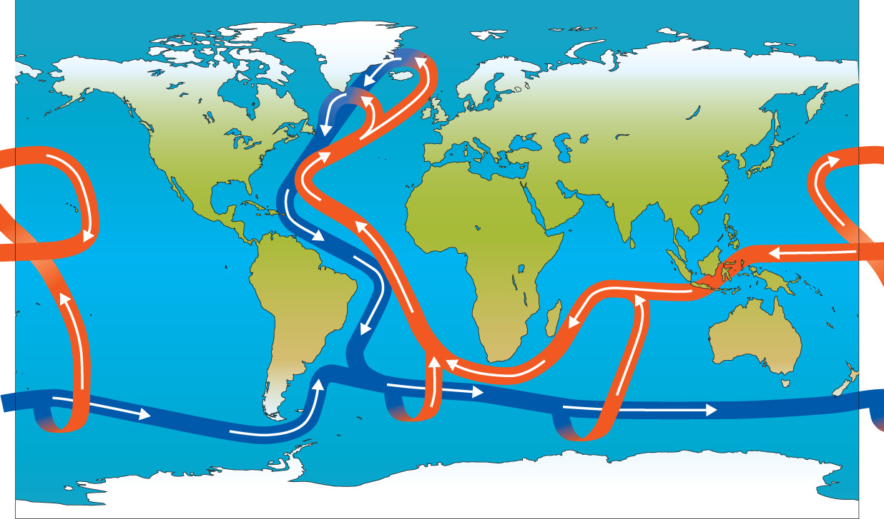
Atlantic meridional overturning circulation (AMOC)

Slide 9
Potential Sustainability Solutions - examples

Slide 10
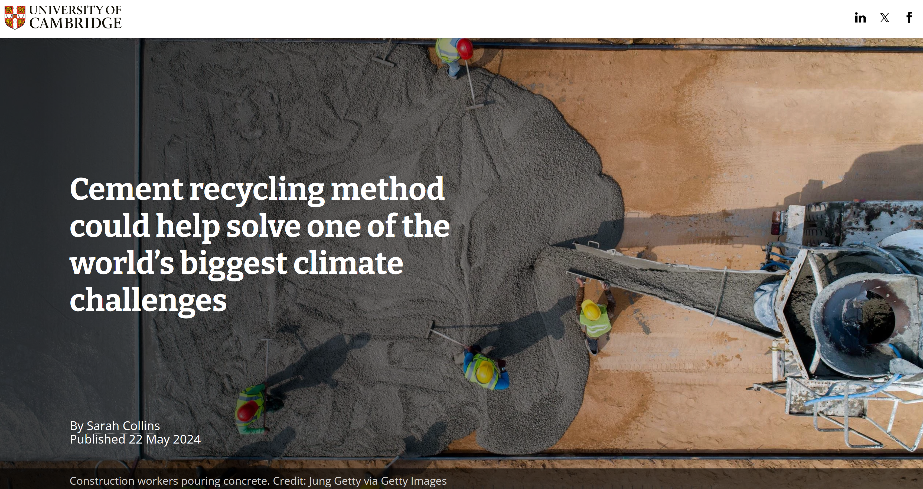
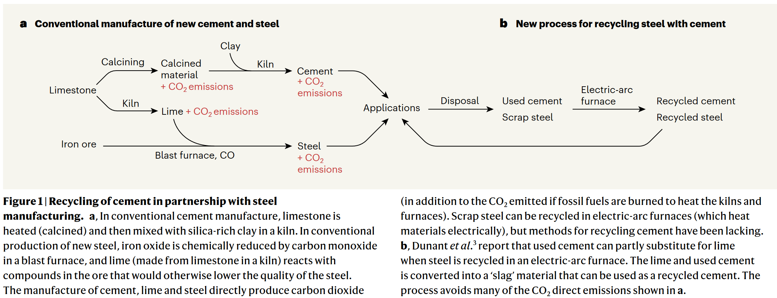

Slide 11
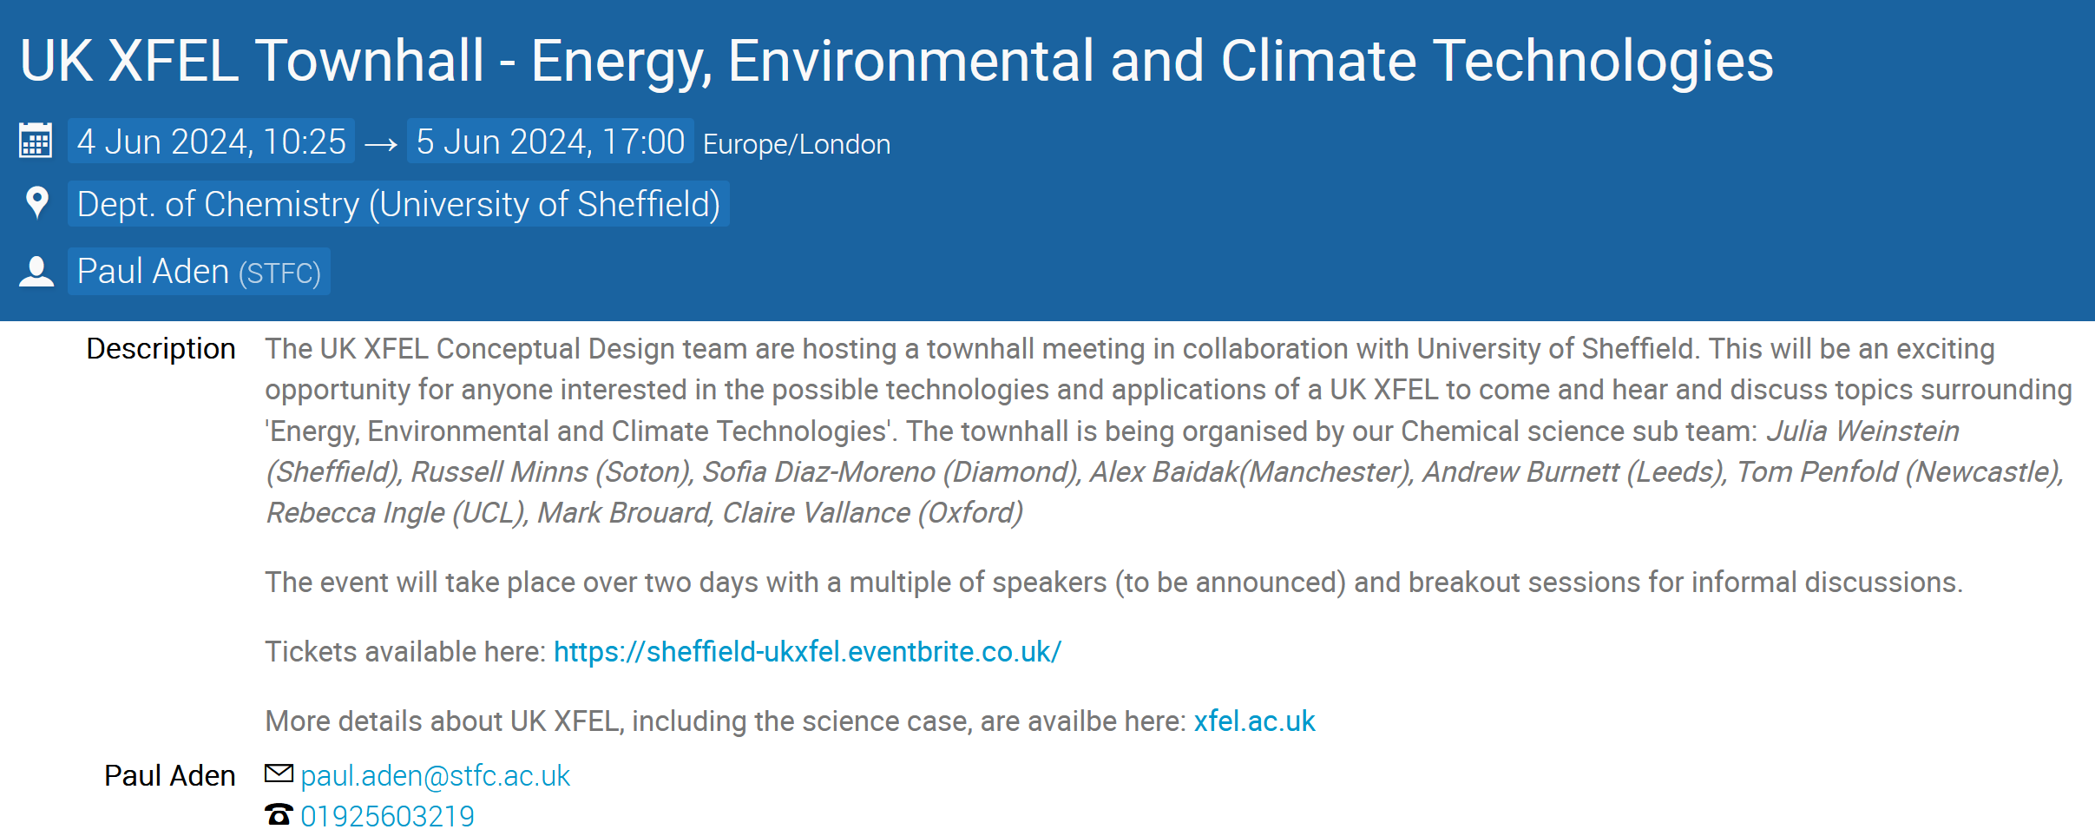

Slide 12
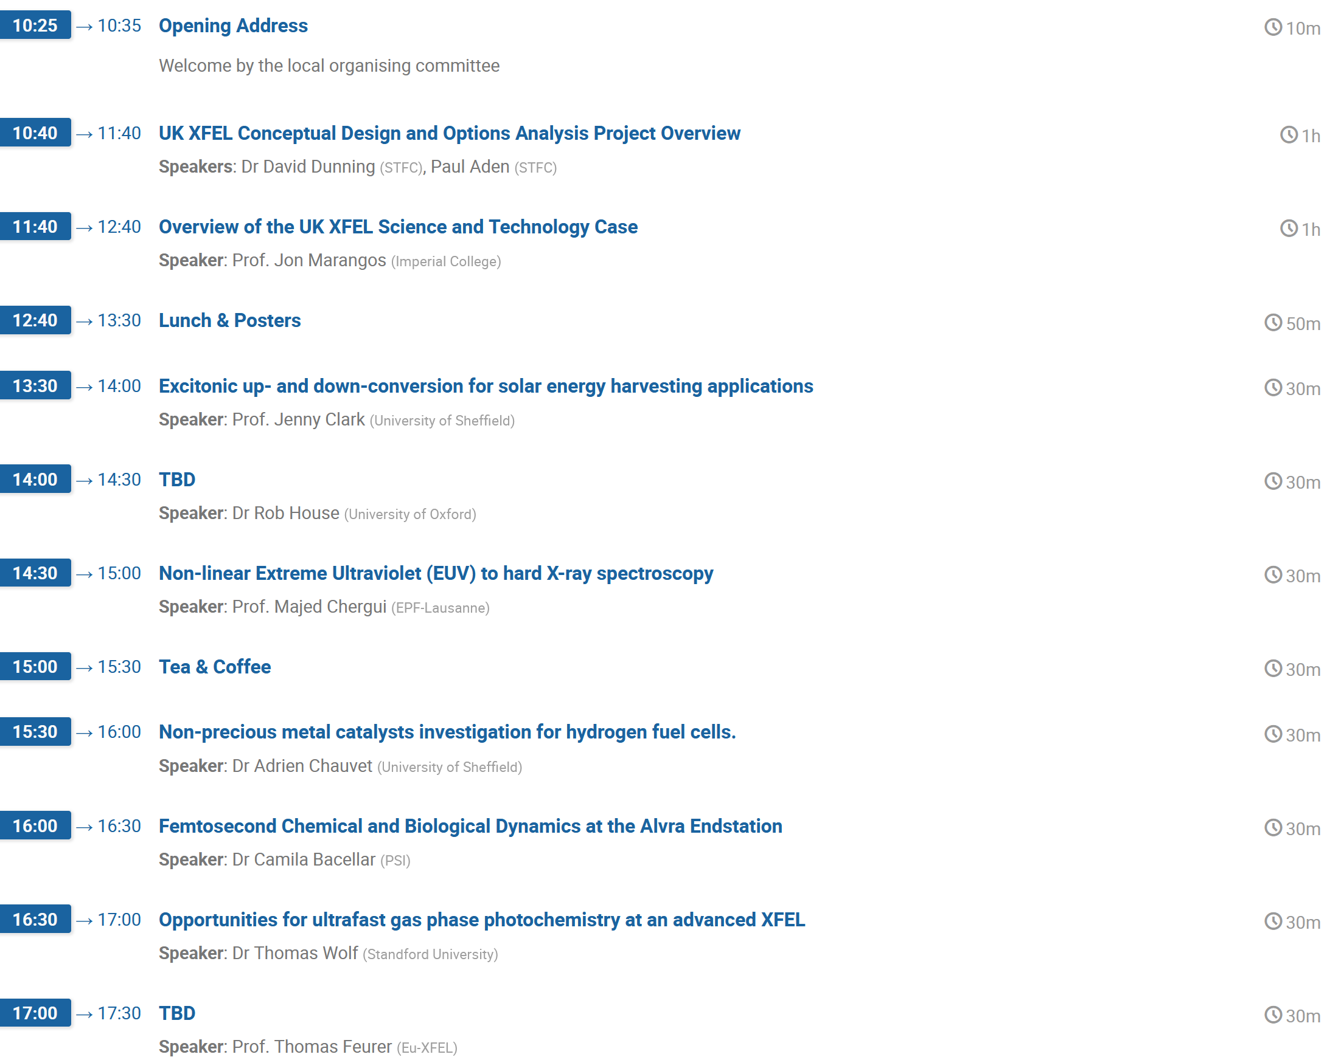

Slide 13
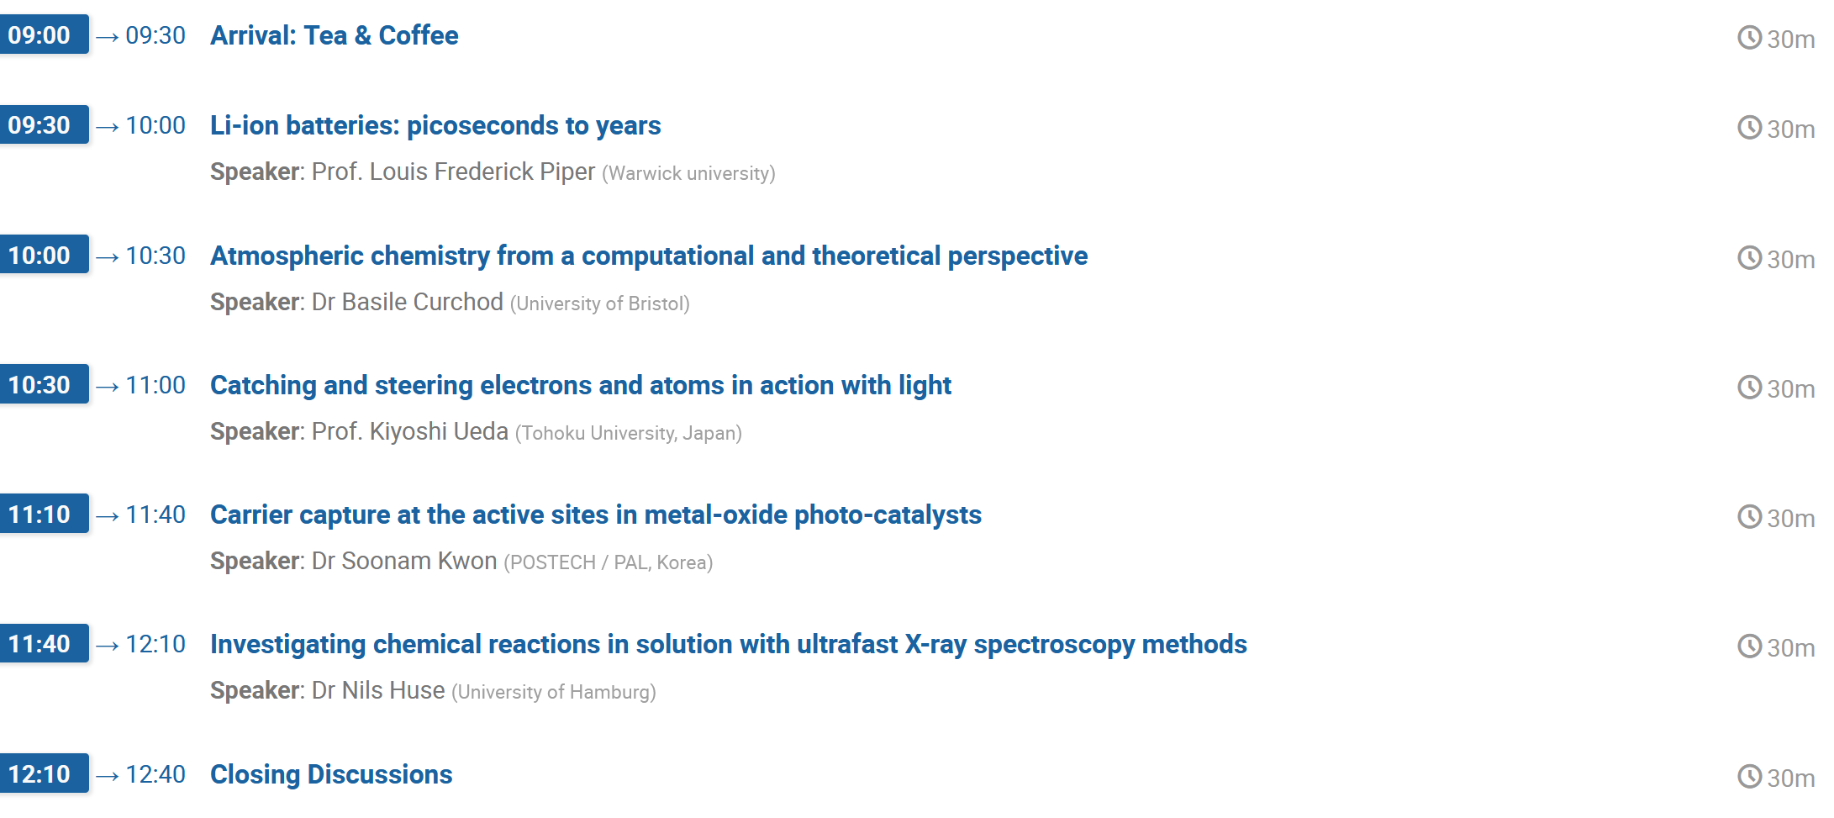
Don’t forget, Accelerator technology can also help improve efficiency, and new methods, of energy generation!

