Slide 1
Sustainable RF for future accelerators
Prof Graeme Burt, Lancaster University / Cockcroft Institute
Acknowledgements: Igor Syratchev, Nuria Catalan Lasheras, Alick MacPherson (CERN), Nik Shipman (HZB), Oleg Malyshev, Reza Valizadey (STFC)

Slide 2
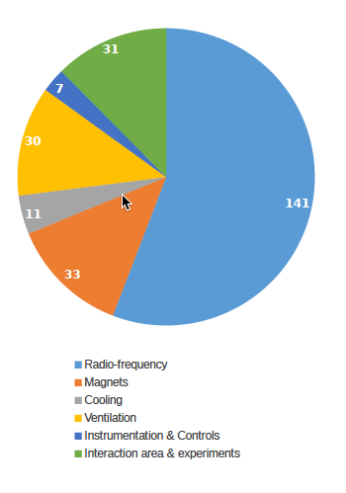
How much of the power budget for future machines is RF?
1.5 TeV CLIC Power MW
Just drive beam RF
RF power includes all DC power, modulators, chillers, liquifiers and pumps, and magnets required as part of the entire RF system
Most linacs have between 40-77% of their total site power going into the RF system.
Synchrotron need more RF power at higher energy due to frequency scaling of synchrotron radiation
Stapnes CLIC mini workshop 2023

Slide 3
Medical and Industrial linacs
Modulator is ~10 kW
Magnetron RF has a duty cycle of 0.1 %, and is 5 MW ~5 kW so around 50% efficiency
Beam Power is typically 100 μA 6 MeV so 600 W average
Efficiency is around 6%
Standby mode is around 50-100 kWh per day which is larger than operational power per day
There are 11440 medical linacs in the world, which is an installed power demand of 500 GW
Linacs operate on average 9 hours a day 5 days a week
6500 fractions (a round of treatment) are delivered per year per linac with the average fraction 15 min hence around 1625 hours operation per year
Hence annual power of all radiotherapy machines is ~500 GWh
ILC’s annual power use is 700 GWh so 1 linear collider uses the same energy annually as the entire worldwide install base of radiotherapy linacs (11,440)

Slide 4
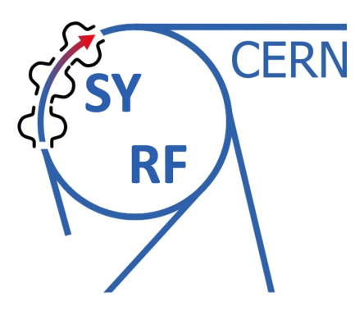

RF amplifiers
RF amplifiers are not particularly efficient, the most common type is a klystron
Typically have a max efficiency 40-70%
  10% of the power goes to modulator losses
  35% is heat in the collector from the spent beam
  Efficiency limited by extraction of spent beam without reflection and beam energy spread (limited by slowest electrons)
But only have that efficiency at max power, need LLRF headroom so typically operate backed off (for example ESS uses 25%), reducing the operational efficiency by around 10%
Nuria Catalan Lashera, IFAST meeting, 2023

Slide 5
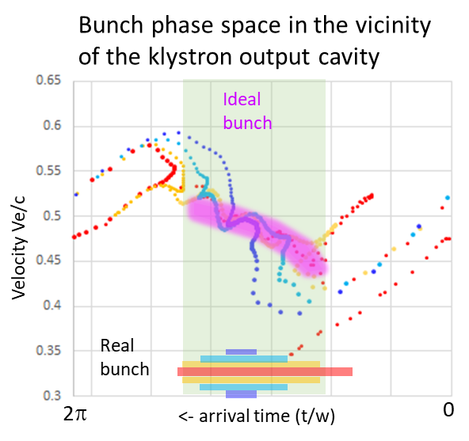
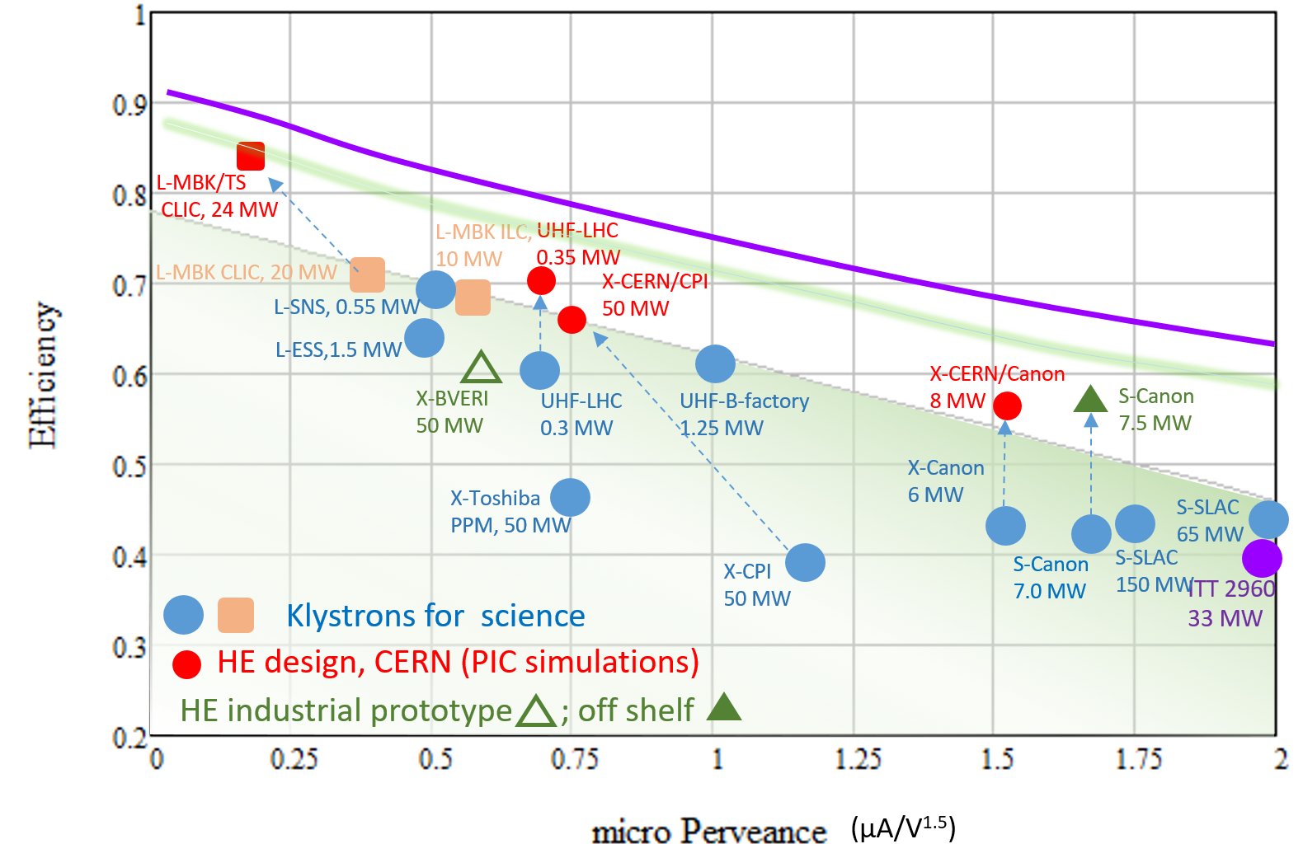
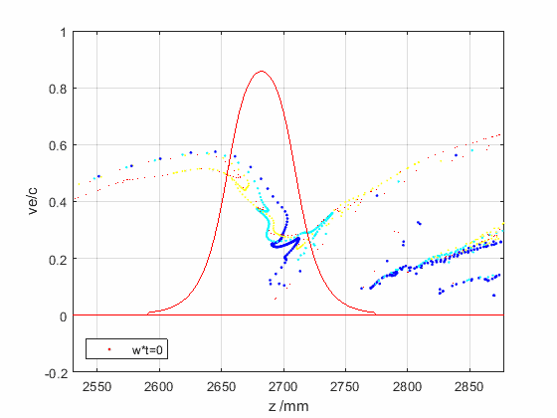
How efficient can RF amplifiers be?
Perveance is a measure of space charge (I/V^{3/2})
The higher the perveance the lower the efficiency
Going to a higher efficiency means a higher voltage which causes other issues
Recent studies have shown we can increase efficiency by around 10-15% from current maximum
Only a few percent more could be gained before hitting the ultimate limit
Arrival plane
The limits are due to energy spread in the extracted beam after the final cavity and the need to avoid reflecting electrons back (which would cause oscillations)

Slide 6
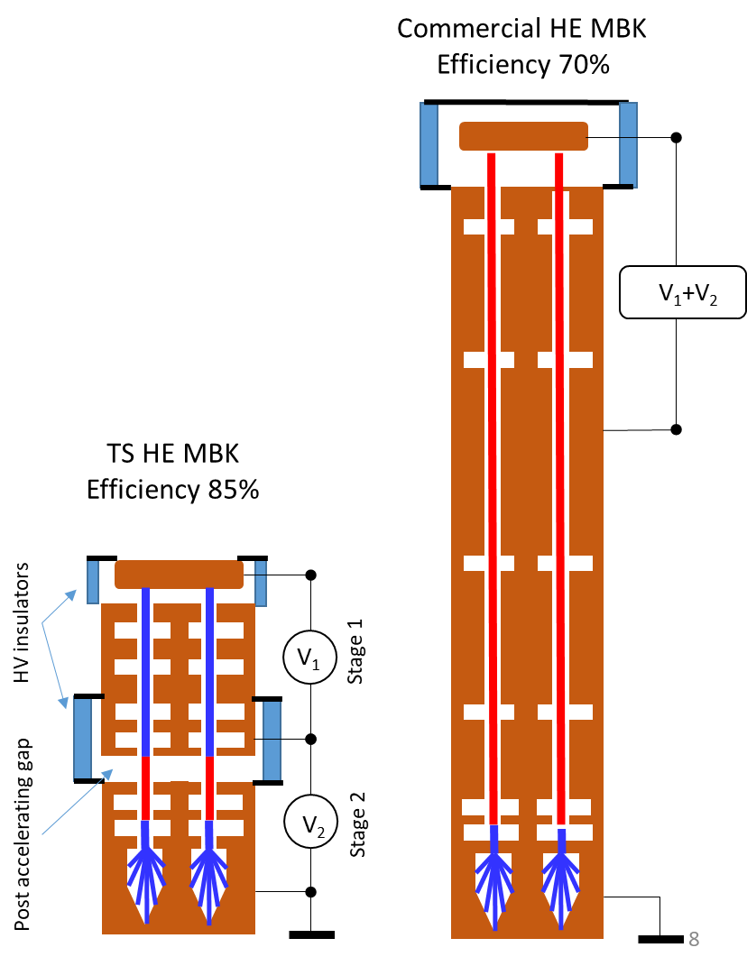
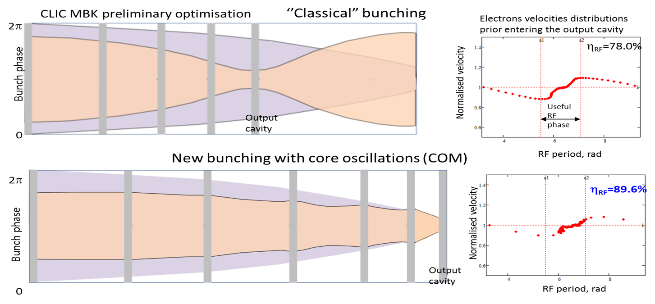
New Klystron Concepts
How do we achieve bunch saturation? We cause the core of the bunch to oscillate while focusing the anti-bunch electrons slowly. There ae 4 ways to do this:
Bunch-Align-Collect (BAC): Using lots of RF cavities closely spaced
Core oscillation method (COM): Using the beams space charge forces
Core stabilization method (CSM): Using higher harmonic cavities
Two stage (TS): Making COM shorter by using a low beam energy and post-accelerating

Slide 7
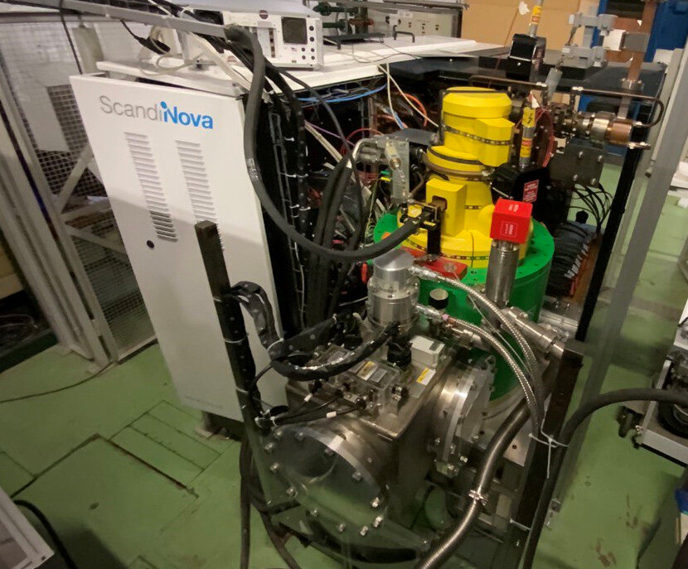
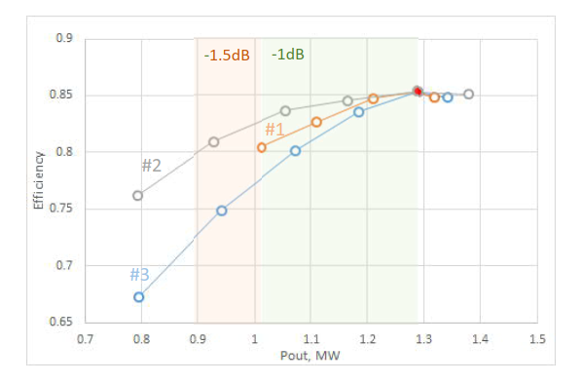
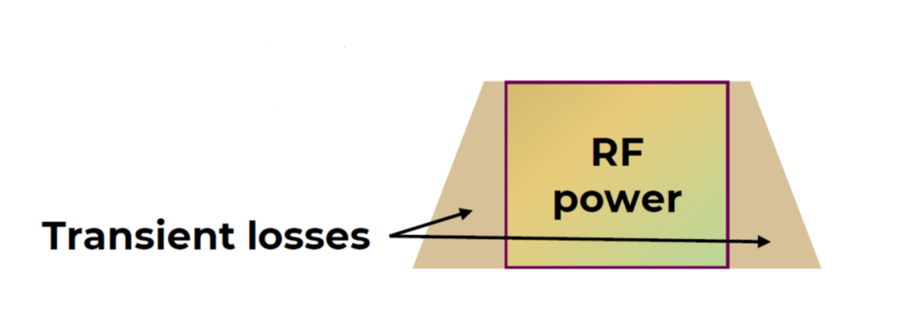
Other Klystron Issues
Smart Modulators:
ESS have demonstrated power modulation without reducing efficiency by varyingDC voltage
‘Smart’ Modulator concept that at any required power level, klystron will be operated at saturation by adjustment of modulator voltage on a microsecond time scale. This adds 10% to the operational efficiency
Transient Losses:
At each stage there is a rise time that gets sequentially worse
  The modulator has a rise time
  The klystron has a rise time
  The cavity has a fill and empty time (for SRF this is on the order of ms)
The power during the rise and fall is not suitable for acceleration so is lost energy
Solenoid magnets:
A Cu-based solenoid magnet, currently consuming ~20 kW/Klystron, corresponding to ~ 100 MW for ~ 5,000 Klystrons for CLIC-380.
This can be significantly reduced by using a superconducting or permanent magnet solenoid

Slide 8
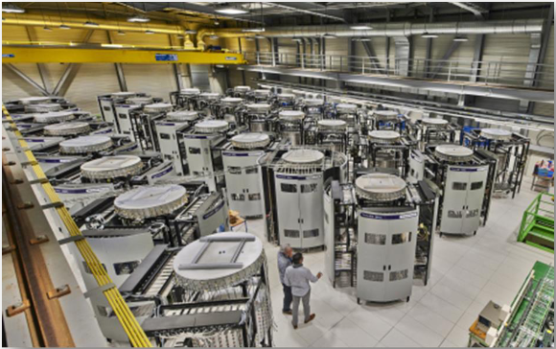
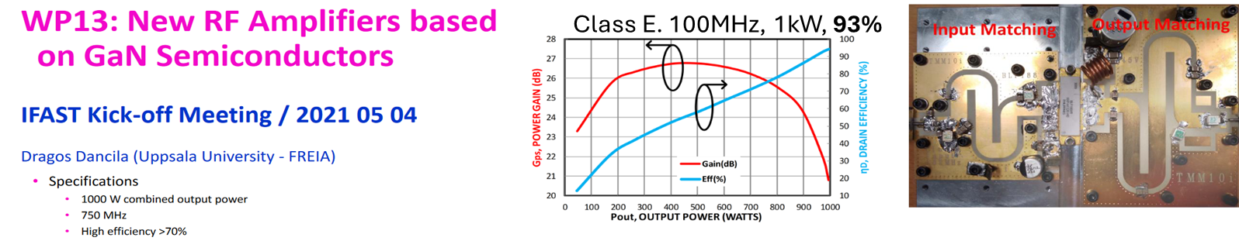
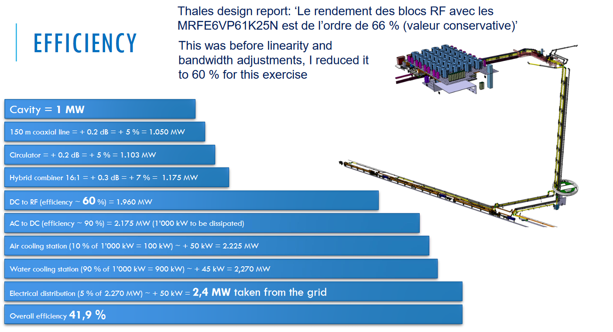
Are SSPA a solution?
Transistors can achieve very high efficiency below 1 GHz does that mean they could be a solution for sustainable accelerators?
Transistors are limited to 100-1000 Watts so relevant powers require combining many transistors
This is a lossy process, for a 200 MHz 1 MW amplifier the efficiency is only 40%
Doesn’t scale to higher powers of frequencies well

Slide 9
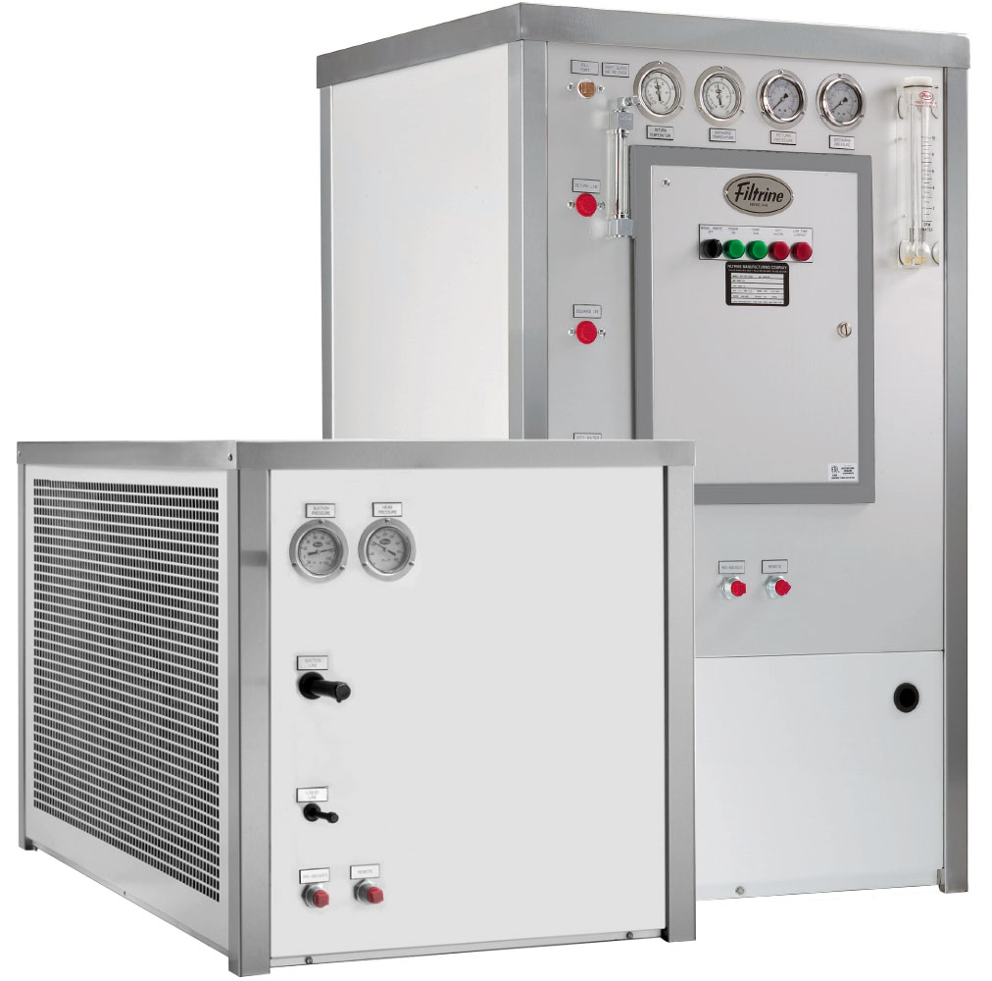
Chillers
There is often a desire to lump chillers for RF in with conventional facilities but this hides the true energy consumption of the RF system.
Improving the efficiency of the RF system also improves the power required from the chillers
Our Chillers are refrigeration based systems, the efficiency of the whole process is about 60% to 70%. This means to provide 100 kW cooling, the plug power is around 35kW.
Also heats up the room (air conditioning costs)
Including the modulator and chiller every Watt of RF saved from sustainable tech reduces the wall plug power by 1.5 Watts

Slide 10
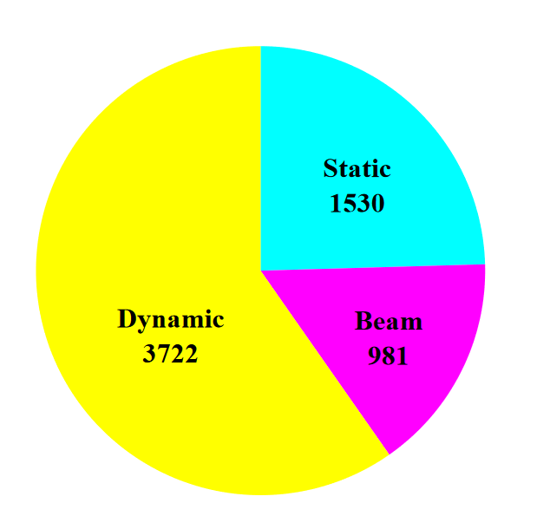
SRF
By going to SRF we reduce the RF power loses, but we then need cryogenics. How does this change power usage?
All refrigerators have a technical efficiency, η_{T} of 20%-30%
The Carnot efficiency is given by
The dynamic heat load, P_{c}, is the rf power dissipated in the cavity walls.
A static heat load, P_{s}, adds an additional heating (~5-10 W)
Liquid helium transfer lines require 0.1-1W per metre, so total loss is length L (More efficient lines can be used)
It is standard to fill to an overcapacity, O (~50%)
Overall efficiency of a refrigerator at 2 K temperature is around 0.1 % to improve this we need to run at a higher temperature to improve Carnot efficiency
ESS cryo loads

Slide 11
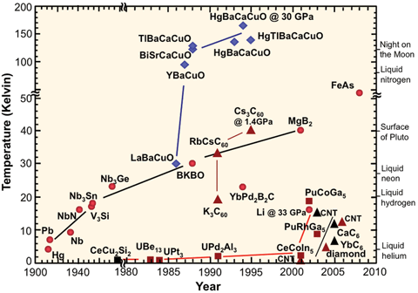
RF Superconductivity Transition Temperatures
SRF losses increase exponentially with temperature reaching normal conducting values at a transition temperature T_{c}
For Nb T_{c} is 9.3 K so operation temperature is 2-4 K
To operate at higher temperatures we need materials with higher T_{c}
Unfortunately most of these have high RF losses. The green box shows those suitable for RF
The best candidates are the A15’s like Nb₃Sn which has a T_{c} of 18.3 K
It is however brittle so depositing as a thin film may be the best approach

Slide 12
Potential Impact of Thin Film SRF Cavities
Using UK XFEL as an example:
The cryogenic system required to operate the UK XFEL linear accelerator at 2 K will consume ~8 MW of electrical power.
If we can successfully develop an equivalent thin film coated cavity that can operate at 4.2 K then the power requirement will reduce to ~2.7 MW.
The power consumption for the cryoplant per year will fall from 58 GWhr to 19 GWhr. At current prices this equates to £11.5m per year or 3000 tCO2e/yr, assuming 2030-40 grid intensity of 77.4 gCO2e/kWh.
Currently STFC is investing <£1m/yr into this R&D. If we want to reap the benefit of this technology on our pipeline projects this investment needs to radically increase.
From ISAS presentation P Williams STFC

Slide 13
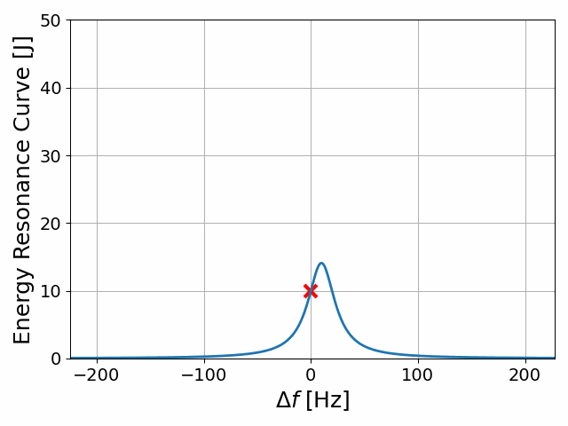

Microphonics
Microphonics cause the cavity resonant frequency to vary in time by anywhere from 10 Hz to 1 kHz.
As we have seen before the reflections are dependent on the difference between the drive and natural frequencies.
As the detuning angle is proportional to the Q factor it leads to an poor coupling for SRF cavities, which have high Q’s.
To avoid this a lower external Q is chosen than the ohmic Q, ie the coupler is not matched.
Power demand for 1 watt ohmic heating in ALICE
$$S_{11}=\frac{V_{−}}{V_{+}}=\frac{β−1−iδ}{β+1+iδ}$$

Slide 14
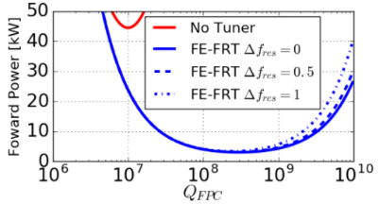
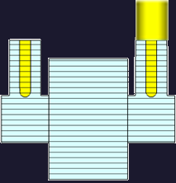
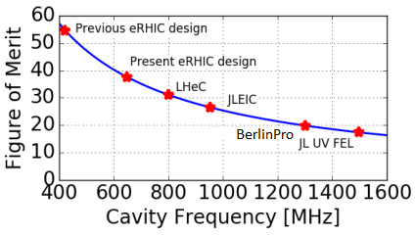
FRT Concept
Circulator
HV Line
FRT
RF Amplifier
FPC
FRT Antenna
Load
Case study: RF power for PERLE vs QL with and without FRT
An Fast reactive Tuner (FRT) is a shorted co-axial structure containing a ferro-electric element
RF power flows into the FRT and is reflected back to the cavity
Voltage applied to the ferro-electric changes its permittivity
Permittivity change → Phase change of the reflected power → Cavity frequency change
Tuning speed measured at less than 600ns, limited by HV circuit
Estimated FRT FoM vs RF frequency

Slide 15
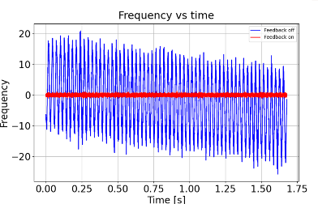
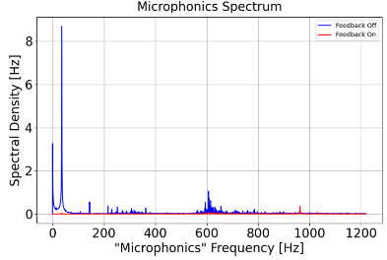
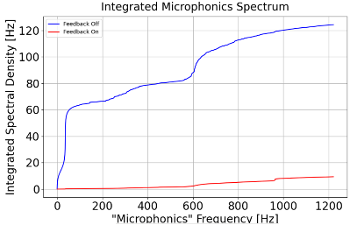
Microphonics suppression results
Vibration generator set to 37Hz
Spectral density also shows good suppression at higher frequencies e.g. ~600Hz
Peak deviation with correction 1.2Hz
N.B. long transmission line, lossy brazing
  Low FoM
  Little to no RF power reduction
F
No correction
With correction

Slide 16
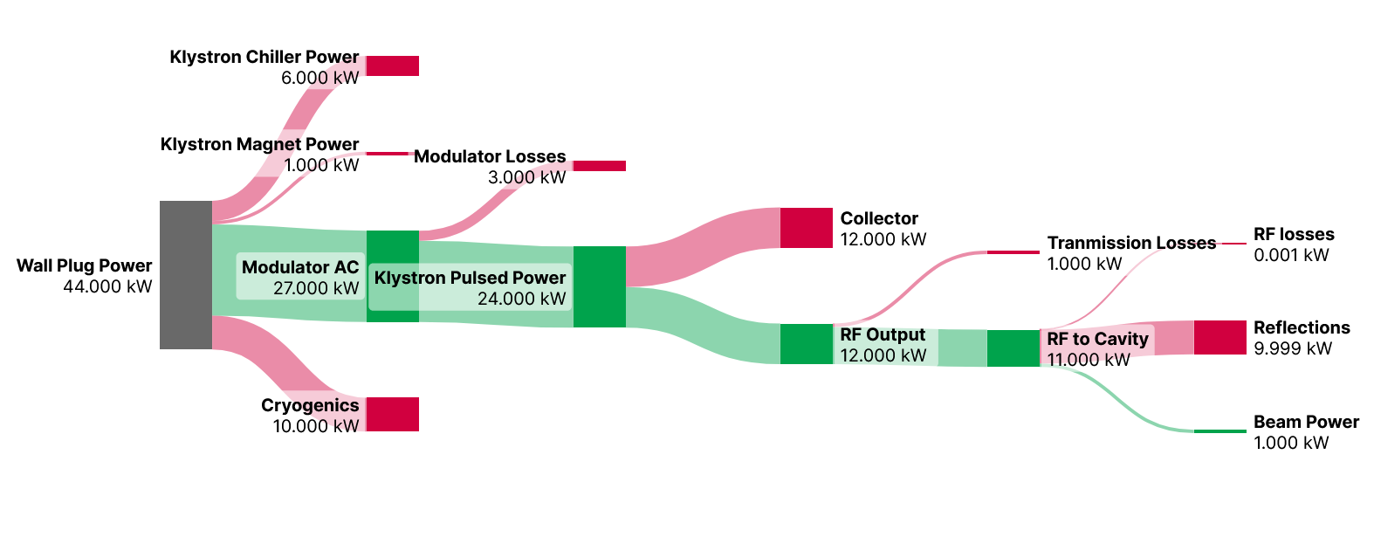
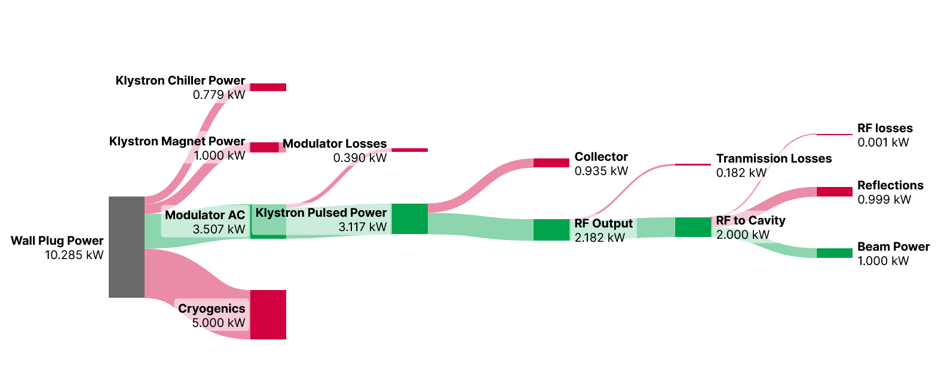
Putting it together (SCRF)
Fast reactive tuners can reduce this by 10
High efficiency Klystrons can halve this
By going superconducting we reduce the RF power losses but we now have cryogenic losses and RF reflections
Klystrons are still a big issue.
Microphonics makes it difficult to transfer power to the cavity
Carnot efficiency makes cryogenics inefficient
Typically, only 2-10% of the wall plug power ends up in the beam but there is scope to improve this.
Thin film SRF can halve this

Slide 17
Conclusions
The next generation of accelerators are likely to be linacs and hence the vast majority of energy use is the RF system
Typical wall-plug to beam efficiency is 5-20%
The largest wastes of energy are the RF amplifiers, refrigerators and RF reflections and there is current R&D aiming to reduce these
  High efficiency klystrons to reduce power dumped in collectors as heat (can increase RF system operational efficiency by 10-20%)
  Fast reactive tuners to reduce the effect of microphonics (reduces reflections by an order of mag)
  Thin film SRF to operate at higher temperatures (doubles cryo efficiency)
Even with all these improvements the efficiency of the RF system will not exceed 50%.

