Slide 1



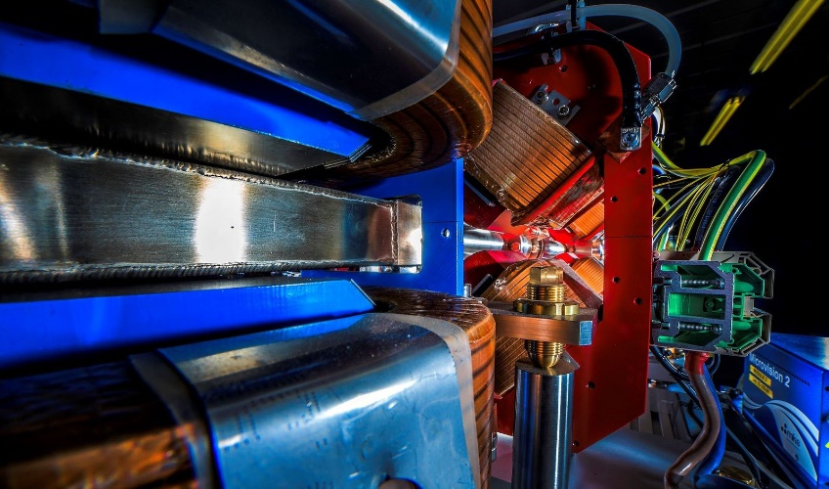
Making a brighter future through advanced accelerators
Status of CLARA Test Facility at Daresbury Laboratory
Deepa Angal-Kalinin on behalf of the CLARA Team
ASTeC, STFC Daresbury Laboratory and The Cockcroft Institute
PAB Conference, 11th -12th June 2024, Workington

Slide 2
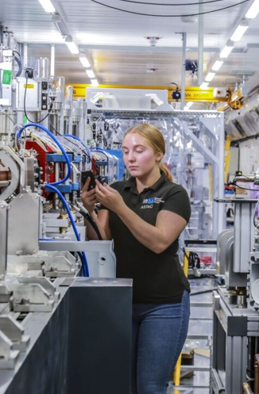

Making a brighter future through advanced accelerators
Outline
Introduction
CLARA Phase 2
Current Status
Preparations: CLARA as User Facility

Slide 3
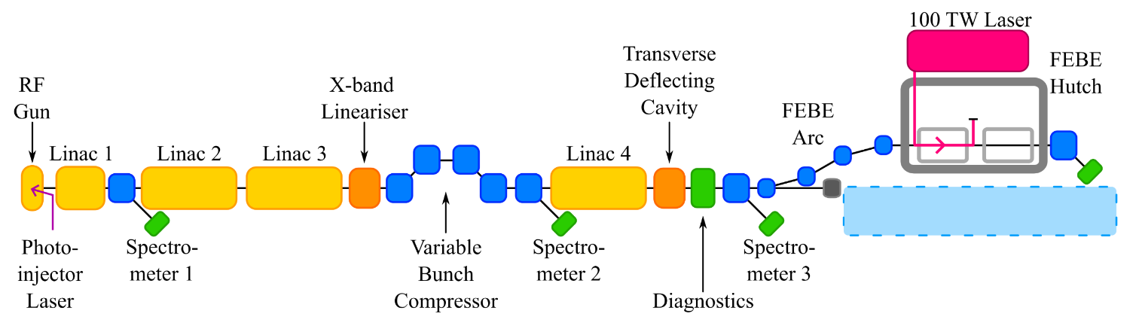
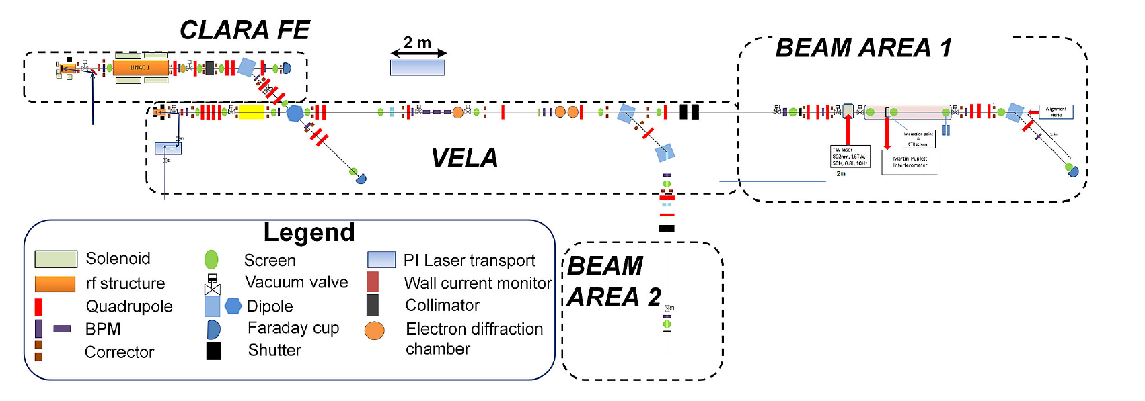
CLARA Introduction
CLARA (Compact Linear Accelerator for Research and Applications) is a 250 MeV ultra-bright electron beam test facility under construction at STFC Daresbury Laboratory.
Conceived to test advanced Free Electron laser schemes, front end of CLARA has been used for user-led experiments in a wide range of disciplines.
Installation to complete CLARA to deliver 250 MeV FEL ready beam now nearly complete.

Slide 4
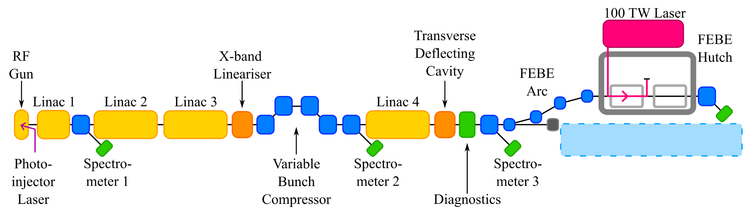
CLARA Overview and Status
PHASE 1:
50 MeV,
250 pC, 10 Hz
Beam exploitation,
inc. novel acceleration
(2018-2023)
PHASE 2:
250 MeV ASSEMBLED & INSTALLED OFFLINE
Installation in accelerator hall almost complete.
Beam Commissioning to follow later this year.
FEBE Hutch
SHIELDED USER AREA
Flexible user experiment space with FEL quality beam
100 TW class laser
Straight-on:
FEL technology development
NOT YET FUNDED
Tied to UKXFEL CDOA and decision on next stages

Slide 5
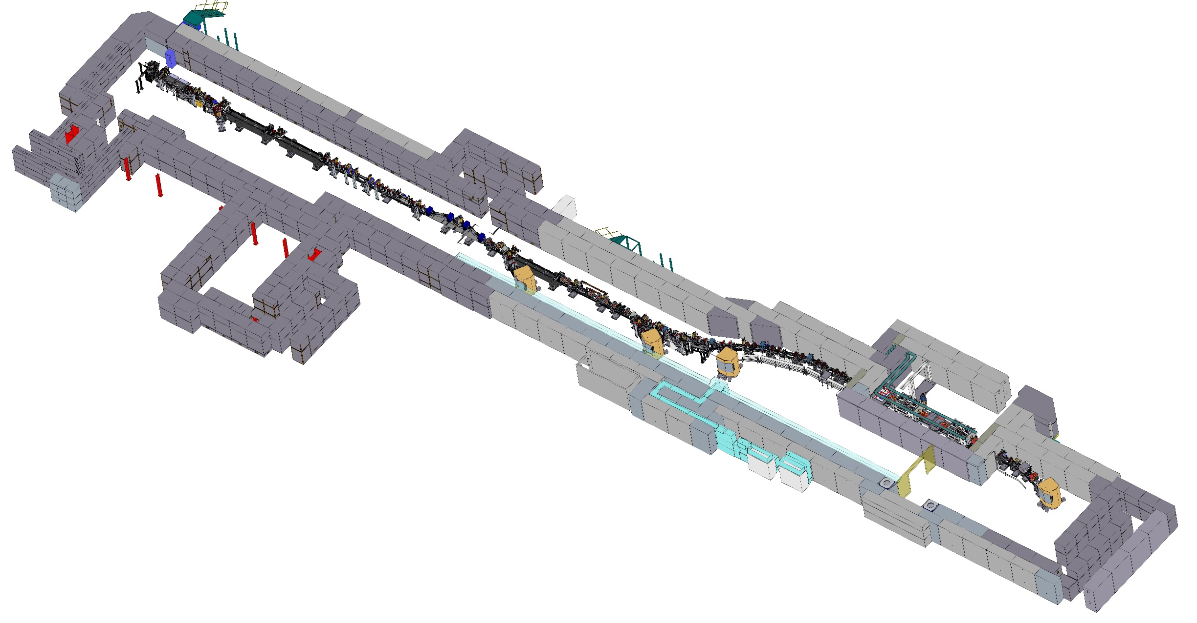
CLARA Overview
RF Photoinjector (S band)
3 Linacs (S band)
Linearizing Cavity (X band)
Magnetic Bunch Compressor
1 Linac (S band)
Transverse Deflecting Cavity (S band)
FEBE Beamline
FEBE User Hutch
9.8m x 5.4m x 3.0m
~95m
Straight Ahead Space for 100nm FEL
No-FEL dump line
FEBE Laser on Roof

Slide 6
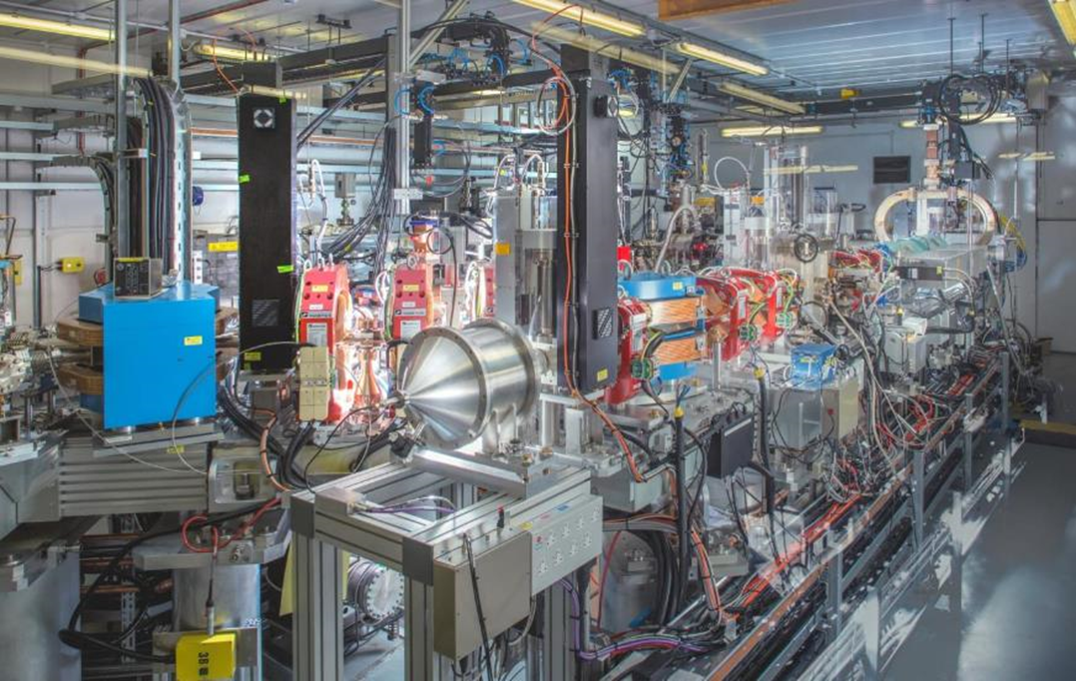
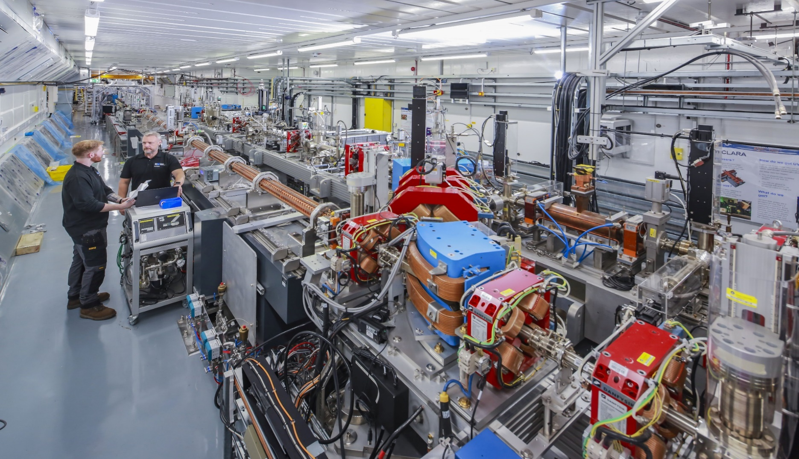
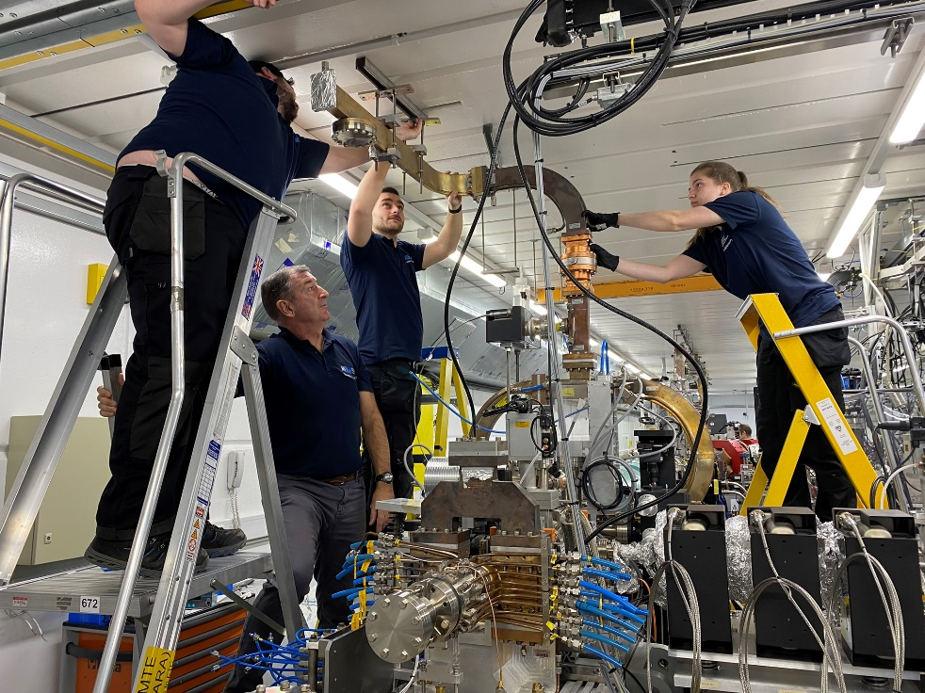
CLARA
CLARA Front End until April 2023
CLARA installation in FE area - October 2023

Slide 7
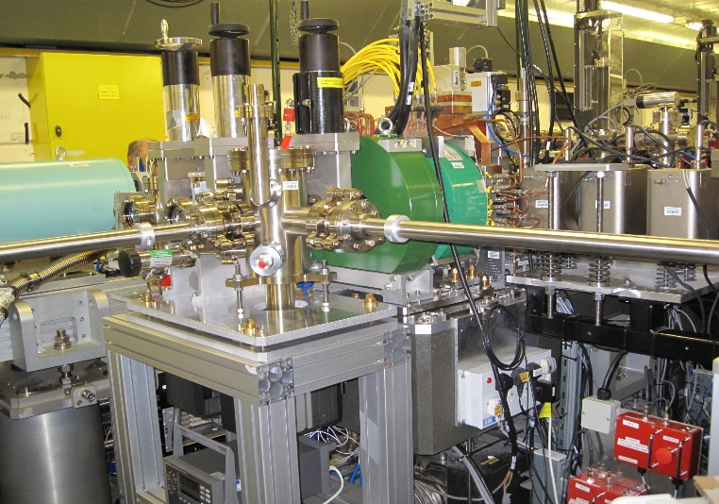
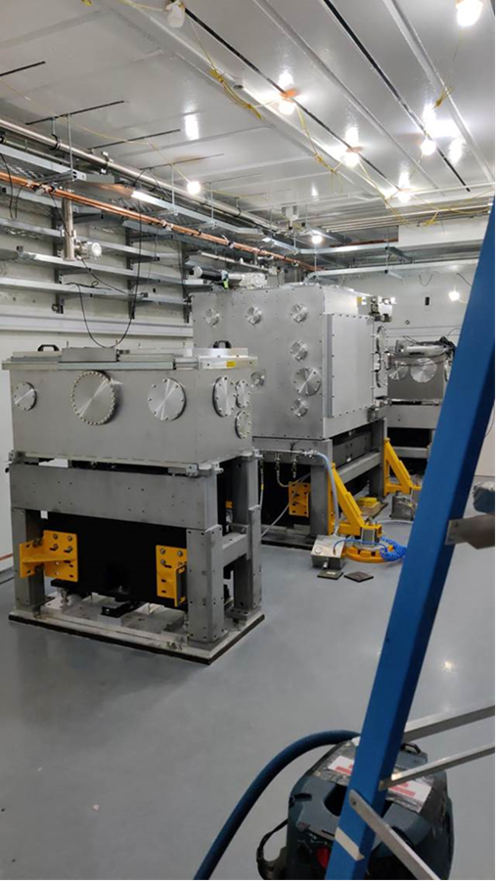
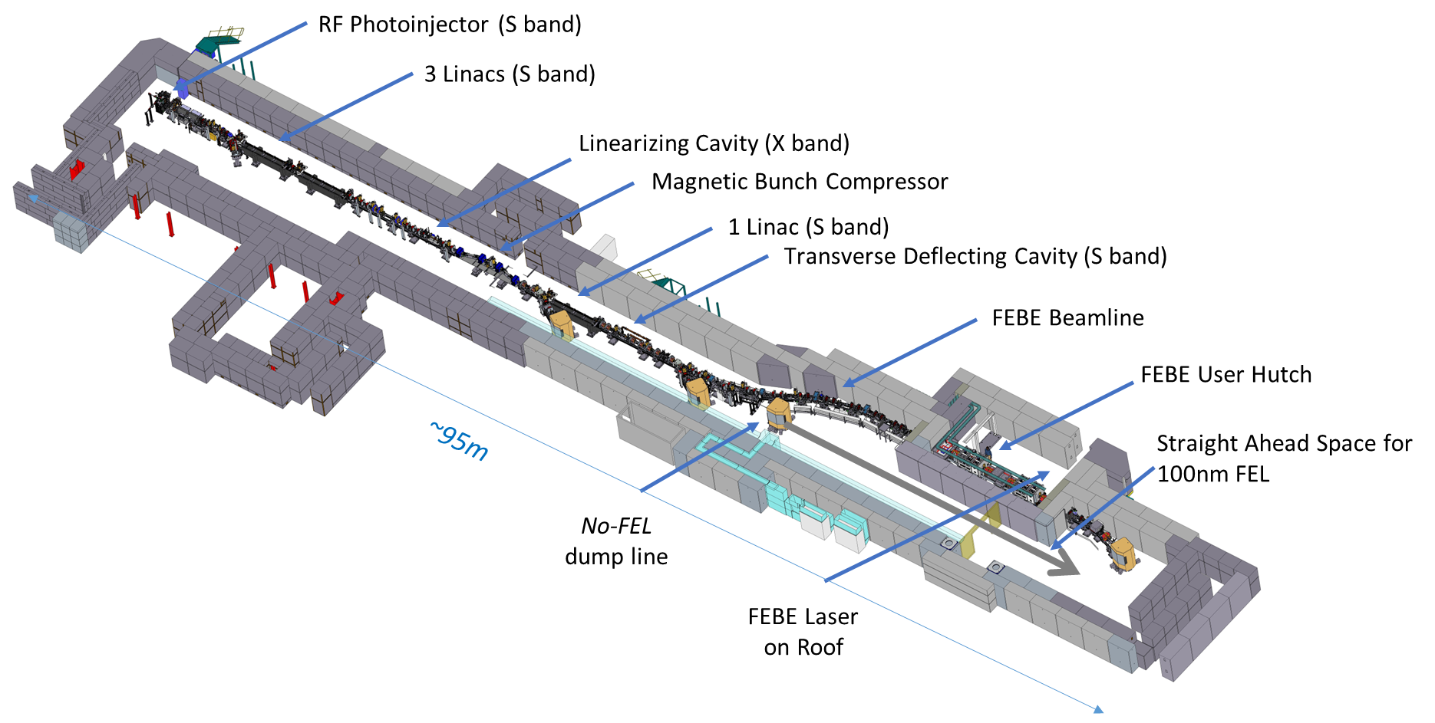
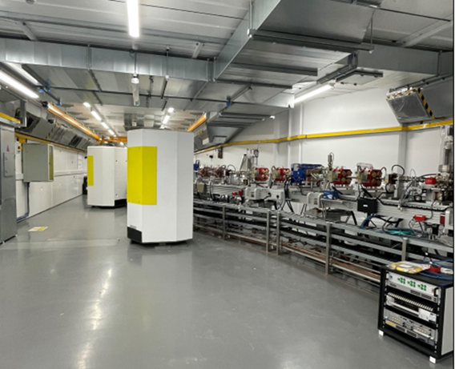
Making a brighter future through advanced accelerators
CLARA Gun
FEBE hutch – FMBOX1, FEC1, FMBOX2 installed
View of CLARA from the other end with shielded beam dumps at the end of spectrometer beamlines.

Slide 8
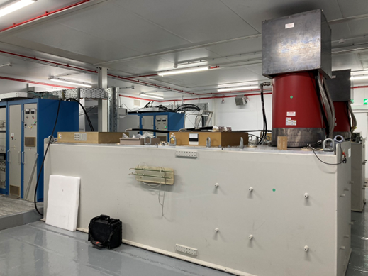
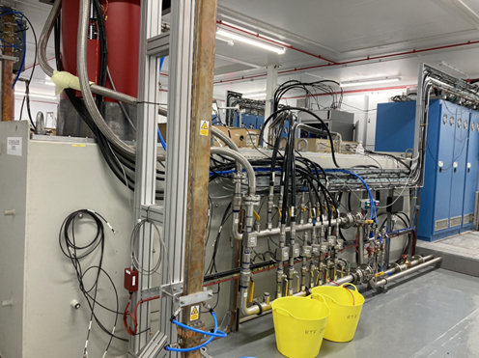
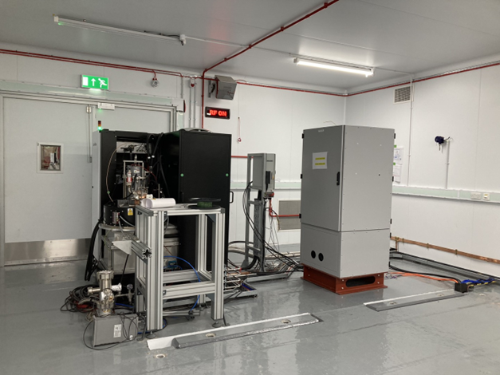
CLARA Phase 2 Shutdown Status
Phase 2 shutdown is ~95% complete.
Linac 3 modulator with Linac 2 modulator in the background
Linac 2 modulator with Linac 3 modulator in the background
4HC modulator
Delay in completing shutdown due to some technical issues.
Commissioning of technical systems carried out as and when systems were ready, even if shutdown was not fully completed.
Have started RF conditioning (using in-house developed automated script) of Linac 2 and Linac 3 from last week of March 24.
The focus is to complete all work in the accelerator hall to start Gun conditioning followed by beam commissioning whilst beamline and services installation in the FEBE hutch will be progressed.

Slide 9
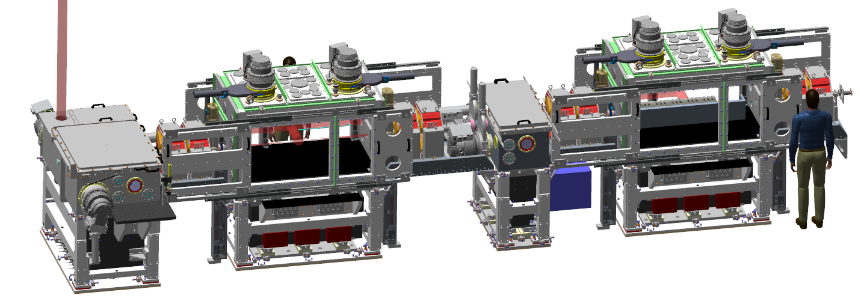
FEBE Experimental Hutch
Two chambers: possible route to ‘interaction’ and ‘characterisation’ experiments with novel components.
  Offered parameters to evolve
  ‘Day 1’ → Nominal → R&D
Laser from roof
Parameter | High charge | Low charge
Energy [MeV] | 250 | 250
Charge [pC] | 250 | 5
RMS t [fs] | 100 (50) | 50 (≤50)
σ_{E}/E [%] | <5 (1) | <1 (<1)
RMS x [µm] | 100 (50) | 20 (1)
RMS y [µm] | 100 (50) | 20 (1)
ε_{N} x @ 250 MeV [µm] | 5 (<5) | 2 (1)
ε_{N} y @ 250 MeV [µm] | 5 (<1) | 2 (<1)
250 MeV
FEL ready e- beam
FEC1
Primary IP
~1.5m length
FEC2
Flexible array of diagnostics
To be confirmed through measurement using appropriate diagnostics (and R&D)
FEBE design details: E Sneddon et al, PRAB, 27, 041602 (2024)

Slide 10
Diagnostics and Instrumentation
Making a brighter future through advanced accelerators
Diagnostics undergoing active R&D
Access to well-developed diagnostics (not shown): BPMs, YAGs, ICTs
Dielectric streaker & EO
BAM
CSR
ML based Virtual diagnostics
CTR/CDR
OTR: <5um spot size
OTR based emittance
PM spectro-meter
High dynamic range
charge

Slide 11
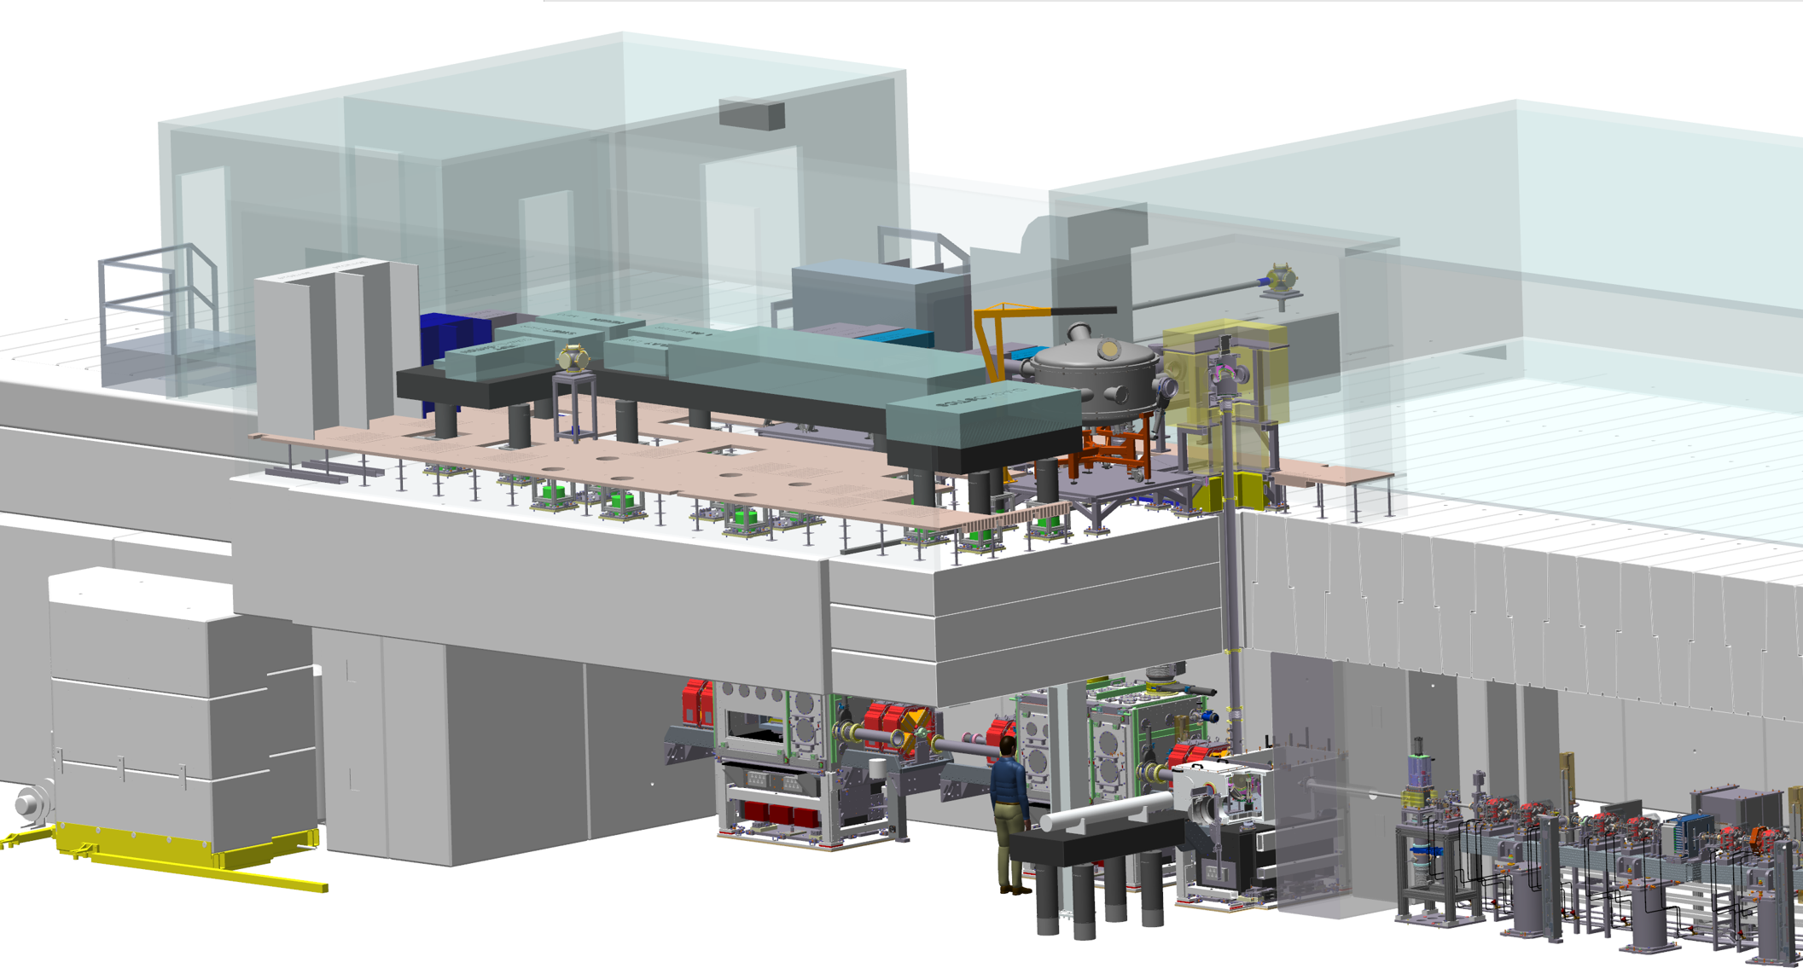
FEBE Laser
Making a brighter future through advanced accelerators
FEBE laser contract signed with Amplitude April 2023 to provide 122 TW laser (upgradable to 220 TW) in room above FEBE hutch for combined high-power laser and electron beam experiments.
Mechanical design of laser room has been finalised. HVAC and electrical install currently underway with support frames and false floor scheduled for installation summer 2024.
Laser control room
FEBE laser project timeline:
July 2024 – FAT
Nov 2024 – SAT
Q1 2025 – laser transport to FEBE and electron beam synchronisation
Laser room

Slide 12
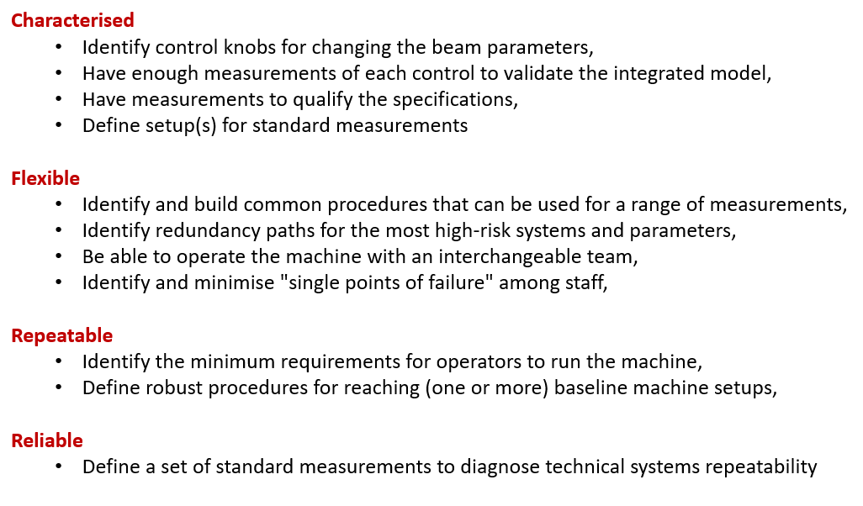
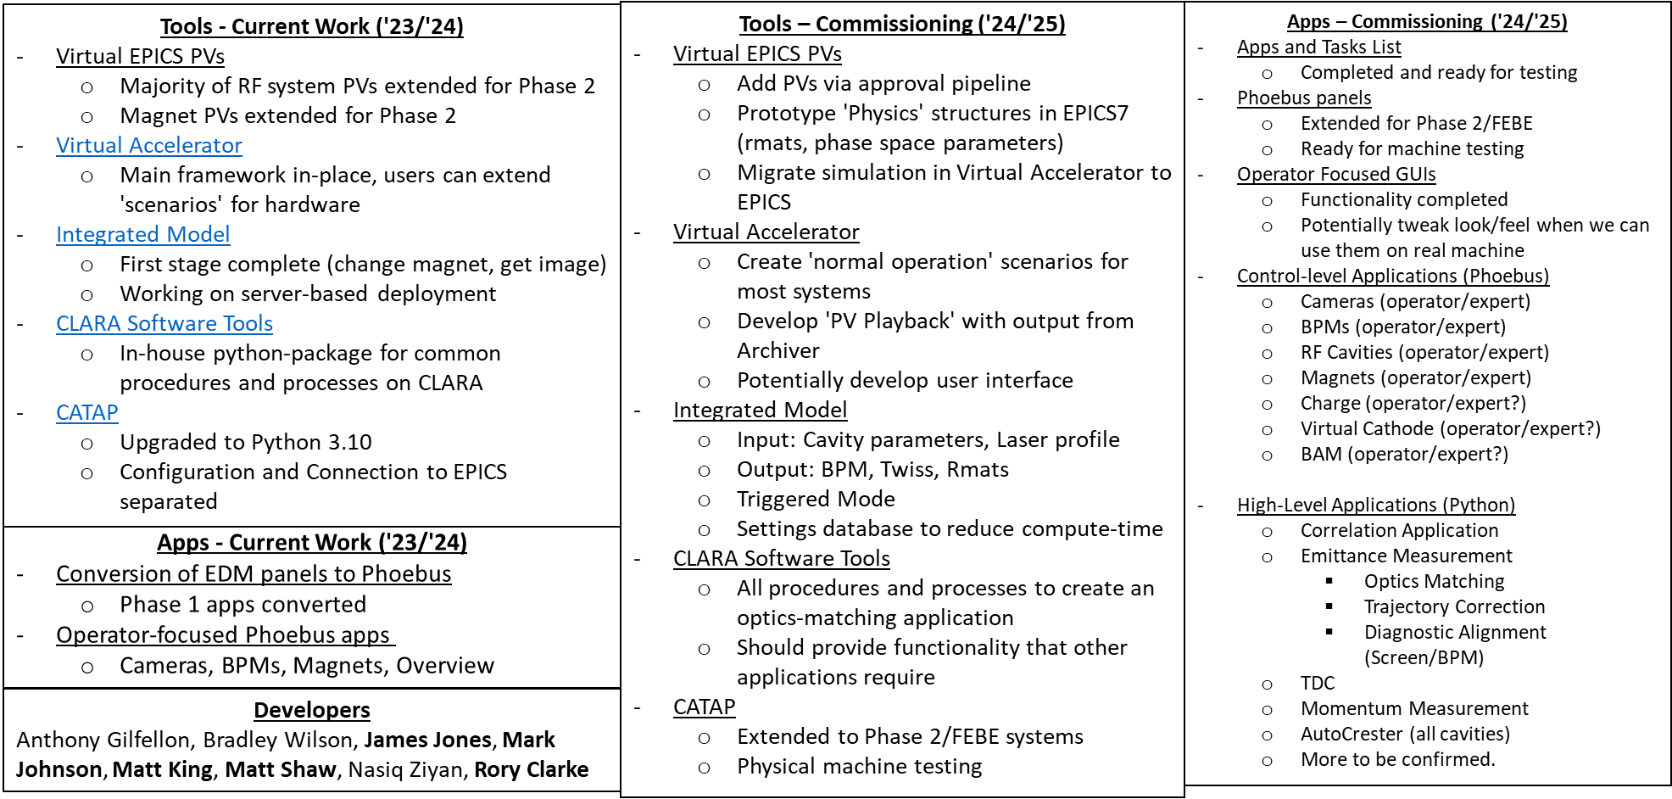
CLARA Commissioning Plans
Detailed beam commissioning plans are being developed by Core CLARA commissioning team; with focus on detailed jitter simulations, High Level Apps and Digital Twin (Next slide) – which allows to develop Apps ahead of beam commissioning.
Technical systems commissioning with beam threading is expected to begin late summer after completion of RF conditioning of 7 RF systems.
Goal is to confirm “Day 1” parameters experimentally.
Plan is to develop number of standard setups as a starting point to deliver beams to wide range of ambitious experiments.

Slide 13
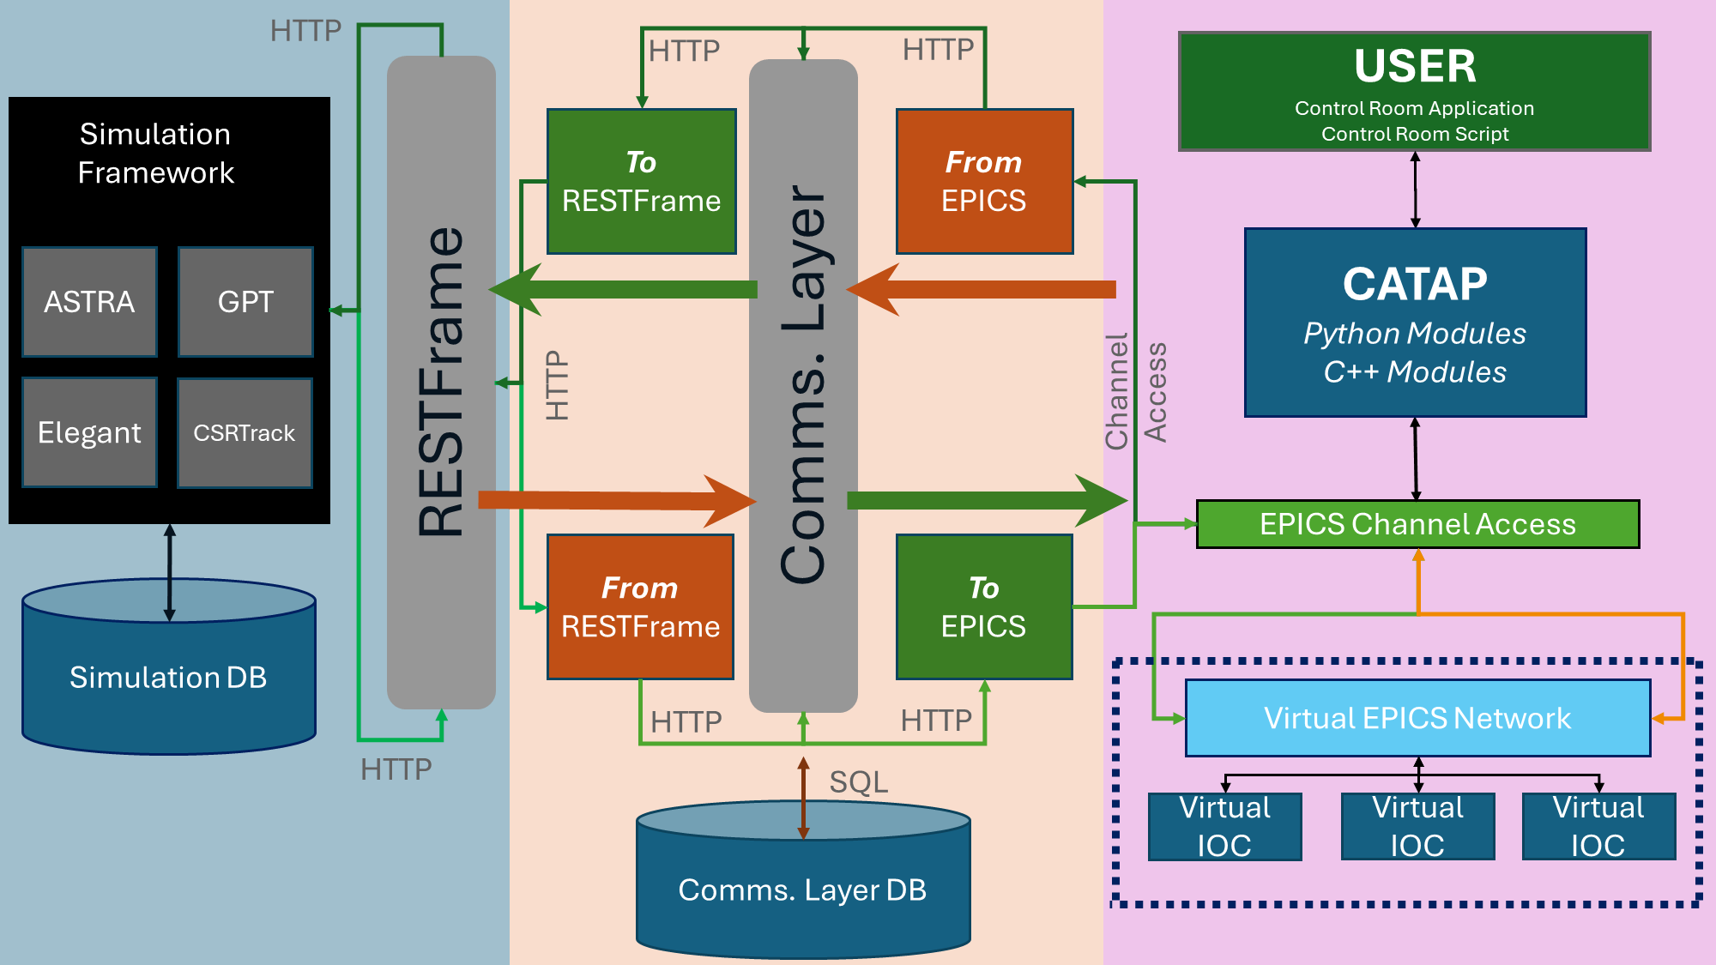
Digital Twin of CLARA

Slide 14
Preparations for CLARA as User Facility
Current plan is to have User Kick-off meeting early December 2024 to update users about the status, beam time request call details and timeline.
We are currently revising the beamtime access policy and updating the paperwork for beam time request proposals.
At the start, CLARA facility time will be divided as follows:
  6 months for user experiments
  3 months for machine development
  3 months for maintenance + shutdown
  This will be reviewed in future as the facility will be established for users.
Machine development will focus on achieving the ‘Future’ beam parameters, and improved repeatability/reliability of beam delivery.
Plan is to operate on long day (10-12 hour shifts) on weekdays to allow users to have access to beam at start of their shift at 9 am and allowing few hours after 5 pm for data taking etc.
If you are interested in using CLARA beam for the first time; do get in touch with me.

Slide 15







Science and Technology Facilities Council
@STFC_matters
Science and Technology Facilities Council
Notes:
The abstract pattern can be removed or repositioned if required. Be careful to ‘Send to Back’ so that it does not obscure any important information.

