Slide 1



UK XFEL
Conceptual Design
and Options Analysis
Dave Dunning, STFC Daresbury Laboratory
On behalf of the project
11th June 2024
xfel.ac.uk
Notes:
The abstract pattern can be removed or repositioned if required. Be careful to ‘Send to Back’ so that it does not obscure any important information.

Slide 2
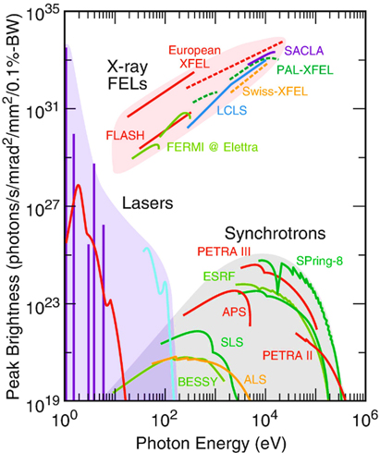
Introduction to XFELs
XFEL = X-ray Free-Electron Laser
‘free-electron’ means the electrons are not bound in atoms but ‘freely’ propagating in a particle accelerator
Undulator (period λ_{u} ~0.01 m)
Output
High brightness,
short pulse of coherent
soft to hard X-rays
XFEL radiation wavelength
λ_{r} ~ λ_{u} ϒ⁻²
Electron source
~ 0.5-1 km of linear
accelerator
~100 m
~ 4 – 15 GeV, Lorentz factor ϒ ~ several thousand
Lasing
(exponential amplification)
Electron energy modulation
Electron micro-bunching
Radiation emission

Slide 3
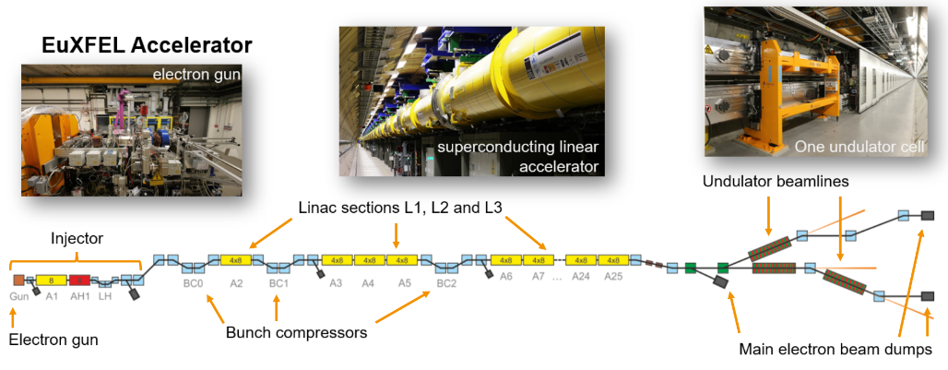
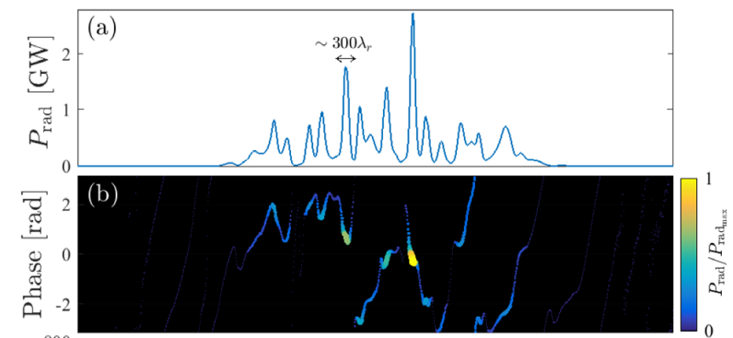
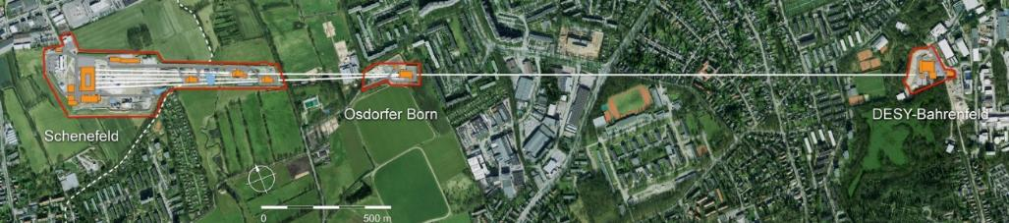
XFEL challenges and opportunities
The XFEL lasing process spoils the electron bunch quality (can’t be re-used). So XFELs are based on linear accelerators – less easy to serve many simultaneous experiments
The X-ray pulses are naturally far from transform limited (amplified noise) In the default SASE mode, there is an intrinsic coherence length of ~hundreds of wavelengths (hundreds of attoseconds at X-ray)
t
There are also many demonstrated or emerging techniques for transform limited pulses
But bunch repetition rates are increasing by a factor of 10,000 compared to first-gen XFELs (~100 Hz -> ~1 MHz)
Multiplexing to more simultaneous experiments, with much higher average flux and much higher data rates
Increasing capacity and capability go hand in hand

Slide 4



The Science Case for UK XFEL 2019-2020
xfel.ac.uk
In the last decade XFELs have had an impressive scientific impact, but there is clearly scope to do much, much more
Taking a long view we looked at what kind of science we will do with an advanced XFEL operating from mid 2030’s. Extrapolating current technology advances to frame what will be possible
Science Case Objectives:
To demonstrate scientific need
To define a next generation XFEL capability
To inform the technology that must be developed
Published in 2020 – available online at xfel.ac.uk
xfel.ac.uk

Slide 5
Ultrafast X-rays probe attosecond electron
dynamics, radiation
interaction with materials
& biomolecules and elementary processes in chemical reactions and light harvesting
High data rate
will advance the understanding of structural biology and biochemistry under the conditions of life
X-rays synchronized to ultrafast lasers, THz and electrons uncover the fundamentals of chemical dynamics in the environment, space and energy materials
Transform limited X-rays and high data rates enable probing with optimal temporal/spectral resolution and optimisation of quantum materials, ultrafast magnetisation & functional materials
Future XFEL Science Highlights
High energy/power optical lasers and bright X-rays access the conditions inside planets, stars and shocked materials important in engineering, defence & fusion energy with high temporal/spectral resolution

Slide 6

Real-time access to structural and electronic dynamics
Synchrotrons
XFEL (future)
XFEL (Current)
Electron-ion coupling timescales in conductors/ thermalisation in hot dense plasma
Material damage spallation, melting etc.
Primary photoexcitation
Lattice dynamics, exciton dynamics, magnon dynamics etc.
Nuclear processes
Vibronic coupling timescales
(chemical reaction)
Secondary/tertiary structure dynamics
in biomolecules timescales
Valence electron dynamics
Ro-vibronic coupling timescales
(structural fluctuation)
Inner shell electron dynamics
Timescales of excited modes at thermal equilibrium (T = 10K)
Timescales of excited modes at thermal equilibrium (T = 300 K)
Attosecond
Femtosecond
Picosecond
Nanosecond
10⁻¹⁷
10⁻¹⁶
10⁻¹⁵
10⁻¹⁴
10⁻¹³
10⁻¹²
10⁻¹¹
10⁻¹⁰
10⁻⁹
10⁻⁸
10⁻⁷
Time s
Notes:
XFELs drive scientific discovery through real-time access to structural and electronic dynamics in matter

Slide 7

UK XFEL Next Generation Definition
Near transform-limited operation across the x-ray range
  Photon energies from 0.05-20 keV
  Pulse durations from 100 as to 100 fs
  Non-transform-limited operation at 20-50 keV
High efficiency facility, with a step-change in the simultaneous operation of multiple end stations
  Minimum of six FELs, with upwards of ten end stations to be simultaneously operated
Evenly spaced, high repetition rate pulses to match samples, lasers, and detectors
  100 kHz per FEL, with flexibility of repetition rate
Improved synchronization/timing data with external lasers to <1 fs
Widely separated, multiple colour x-rays to at least one end station
Full array of synchronized sources
  XUV-THz, e-beams, ion beams, high power & high energy lasers at high repetition rate
Minimal carbon footprint with minimal energy consumption for both operation and build
xfel.ac.uk
UK XFEL Science Case Overview
Notes:
To replace photo with one of your own. 1) Send the geometric shape overlay to the back – Right-Click > Send to Back > Send to Back. 2) Replace image – use the guides provided to correctly position it. 3) Send your image to the back so that the geometric overlay re-appears over the image. Please remove or amend the image credit if you are using a different image to the one provided.

Slide 8
The UK XFEL Conceptual Design and Options Analysis (CDOA) Project
The UKRI Infrastructure Fund enables the development of future infrastructures by supporting pilot, design and scoping studies. This can help UKRI better understand the costs or de-risk and refine the approach before a full proposal is developed.
The CDOA is just this type of Preliminary Activity.
The budget allocated is £3.2m over three years.
The CDOA project formally started on 1st October 2022.
https://www.ukri.org/what-we-offer/creating-world-class-research-and-innovation-infrastructure/

Slide 9
The UK XFEL Conceptual Design and Options Analysis (CDOA) Project
By October 2025:
Explore a Conceptual Design for a unique new machine
Examine investment options at existing XFELs
Compare all of the options in terms of research capability & capacity, costs, benefits, risks and sustainability
Update the Science Case and hold multiple Town Hall meetings around the UK engaging with the user community
https://www.ukri.org/what-we-offer/creating-world-class-research-and-innovation-infrastructure/

Slide 10
CDOA Timeline Overview
xfel.ac.uk
We’re just over halfway through the CDOA phase – the focus is on developing a self-consistent conceptual design and on the Town Hall meetings.
Year 1
Project launch event January 2023
Preliminary engagement with overseas XFEL facilities
Survey of the science team, workshops and town halls meetings begin
Initial conceptual design and layout
Year 2
Developing the concepts
R&D targeting gaps in key physics and technology areas
Collaborative activities and working groups with overseas XFEL facilities
Workshops and town hall meetings continue
Year 3
Summary of R&D activities
Preferred options identified, socio-economic analysis
Revision to science case published
CDOA phase completed September 2025
To develop a next-generation XFEL concept, we initially assume a new-build facility at an international scale, without constraints from location or from upgrading an existing machine.

Slide 11
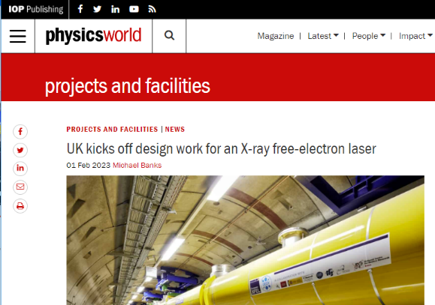

Launch Event
The UK XFEL project was successfully launched at the Royal Society on 30th January 2023
Over 150 in-person attendees from a range of institutions, with another 150 attending virtually.
The event attracted positive attention on society media from the research community, including articles from leading research outlets:
  Physics World, including podcast including interview with John Collier, Chemistry World
Presentations from the meeting are now available on the UK XFEL website: https://xfel.ac.uk/

Slide 12
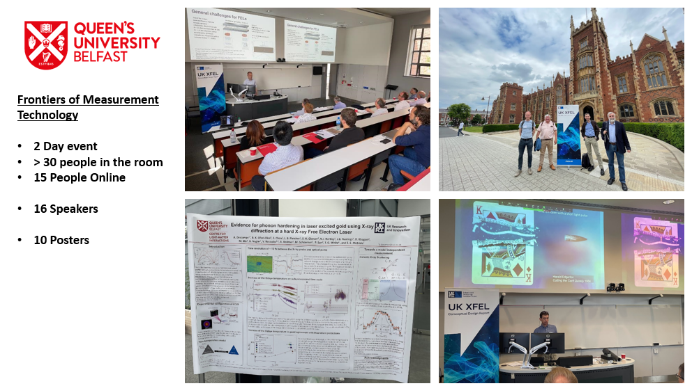
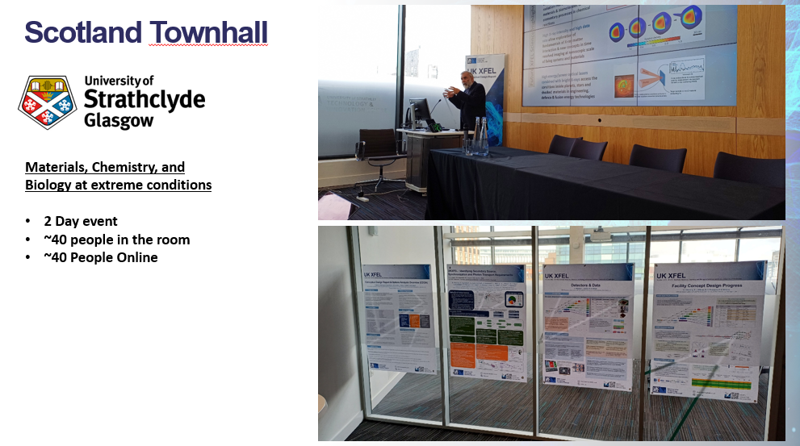

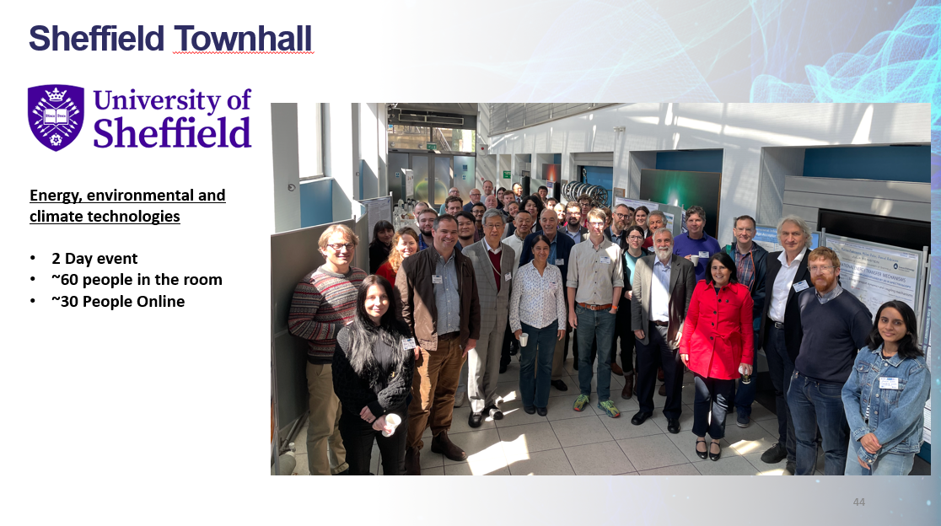

Town Hall Meetings (4 have been held, 3 coming up soon)

Slide 13
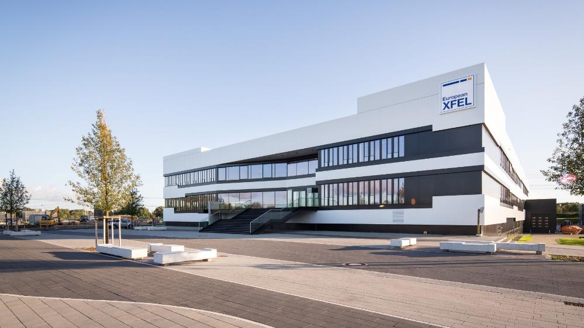
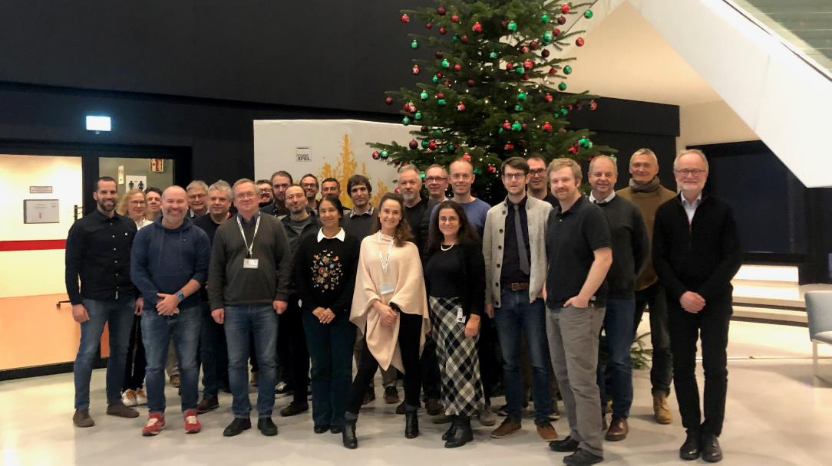
Eu-XFEL
Multiple Eu-XFEL/DESY visits to DL
A list of prioritised topics was agreed included Synchronisation, Injector and few topics in beam dynamics
Monthly seminars on each topics with collaborative ideas from both sides took place between September-February 23
Regular meetings continue on a quarterly basis
Plan to discuss SRF and FELs as UK XFEL design progresses
Aim to implement specific MoU
Proposing a face to face meeting of few key people in DESY this Autumn.

Slide 14
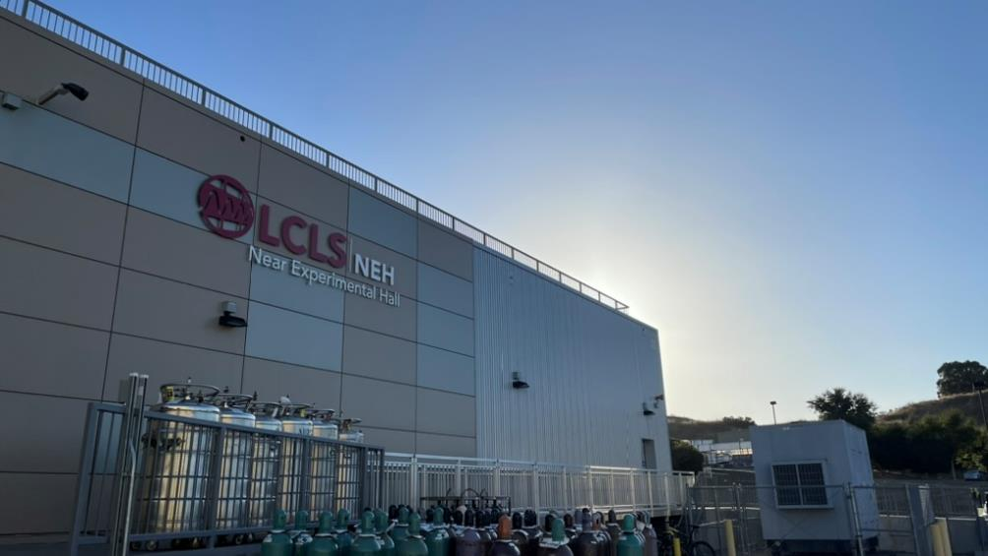
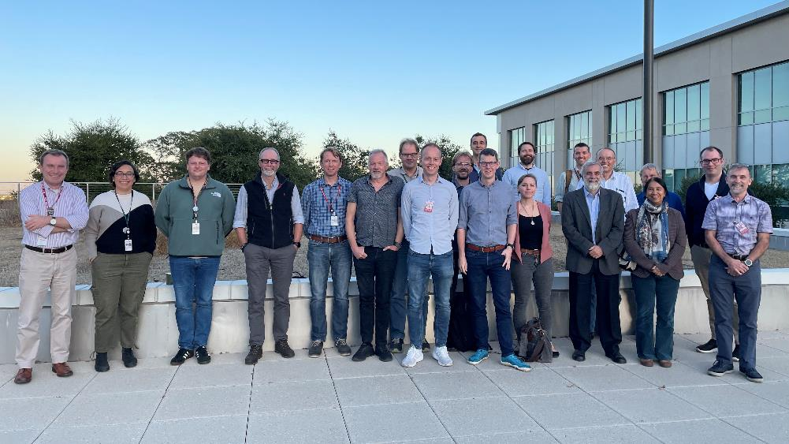
LCLS
Senior STFC Staff have visited LCLS
Mark Thomson is soon to visit SLAC too
Multiple ‘touch base’ meeting
Second in person meeting planned for Sept
STFC would also like to engage with SLAC on ultrafast electron diffraction (UED) for the RUEDI project.
Aim to formalise collaboration agreement

Slide 15
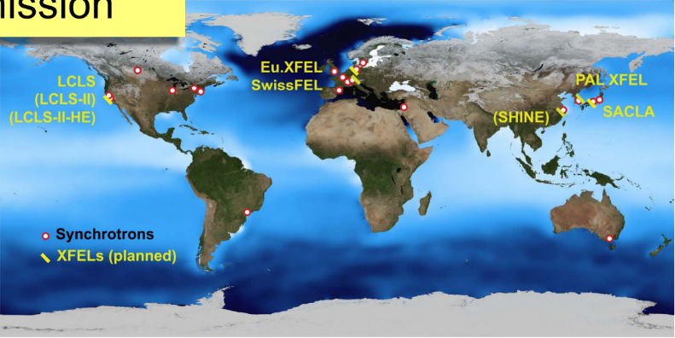
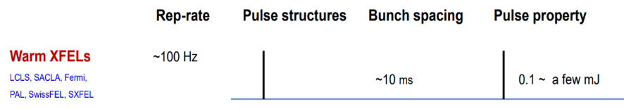
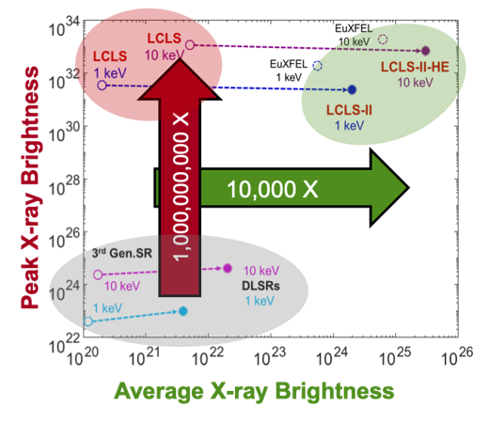
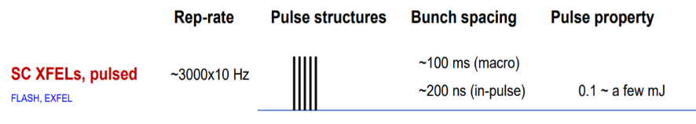
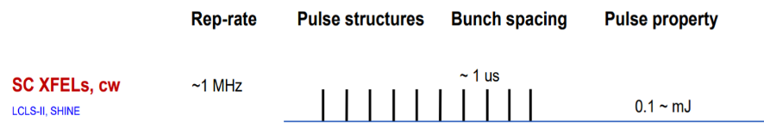
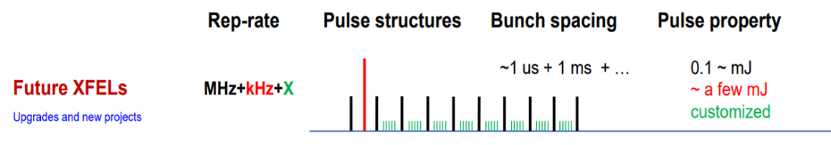
Progress in XFEL accelerator tech
Hard X-ray FELs
LCLS
PAL
Allen Orville, Diamond, UK XFEL Town Hall Meeting
https://www.clf.stfc.ac.uk/Pages/final_AMOrville_RS-TownMeeting_16July2019-b2.pdf
SACLA
SwissFEL
2000
2010
2020
2030
2040
2050
Eu-XFEL
SHINE
LCLS-II & -HE
15
Mike Dunne, SLAC, Future Developments at LCLS, UK XFEL Launch Event 2023 https://youtu.be/sxipwNyXMhg
Adapted from: Outlook to Future XFELs, Dong Wang
Shanghai Advanced Research Institute, Chinese Academy of Sciences and SHINE IPAC23, Venice, May 12, 2023
https://accelconf.web.cern.ch/ipac2023/pdf/FRXD2_talk.pdf

Slide 16
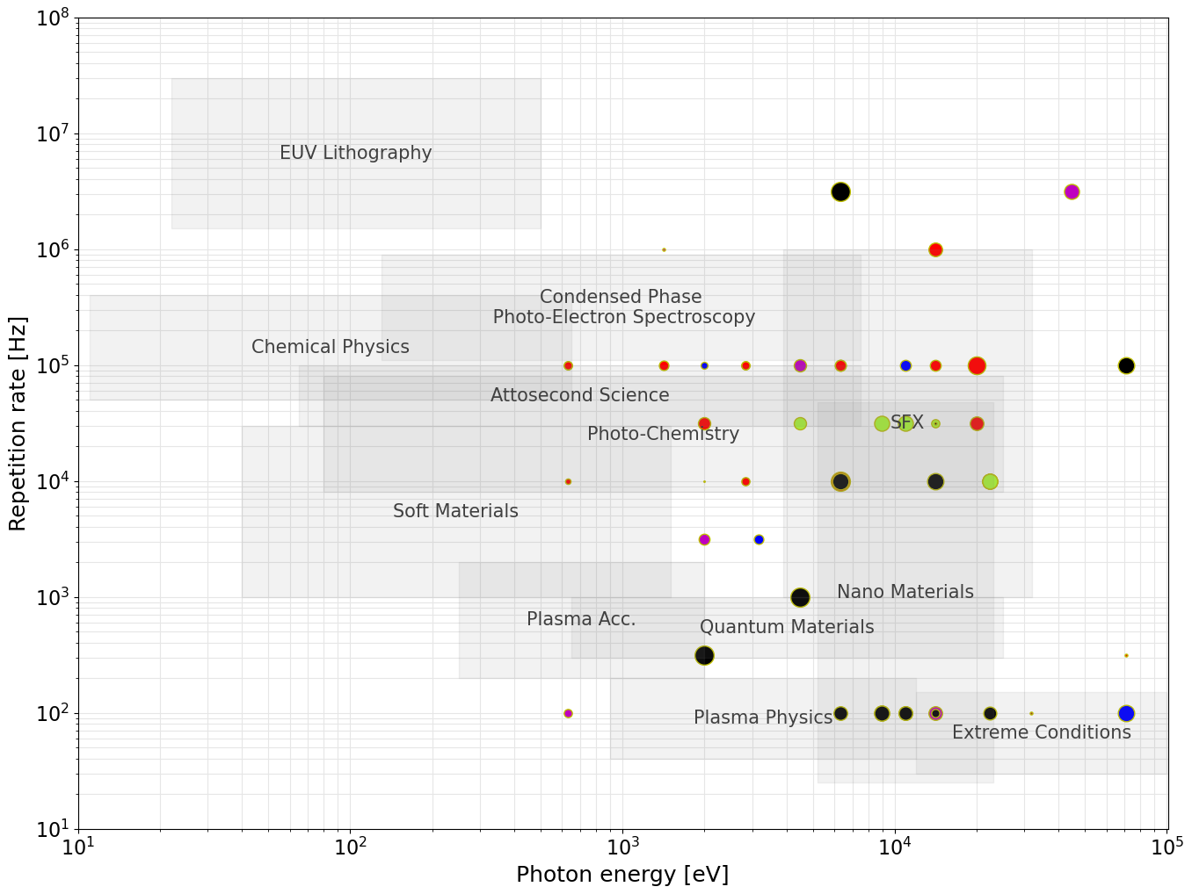

Acceleration Technology:
Top-level
facility parameters
User Requirements from the Science Case & Survey
ERLs
SRF
(CW)
Preliminary focus for
UK-based option:
~8 GeV SRF CW
Max. photon energy strongly influences the required electron beam energy
Repetition rate largely dictates the type of acceleration technology
Requirements suggest
~8 GeV superconducting RF linac
SRF
(Pulsed)
HRR NC
NC
Electron Beam Energy:
~1-1.5 GeV
~2-3 GeV
~6-8 GeV
≥10 GeV

Slide 17
Facility concept: a step change in the simultaneous operation of multiple end stations
~6-10 FELs independently tuneable in terms of photon energy, pulse duration etc.
+ potential direct uses of electron beam
Kickers to split MHz bunches to ~100 kHz per line
Electron bunch properties tailored per FEL
FEL-6
FEL-5
FEL-4
FEL-3
FEL-2
FEL-1
Fixed accelerator energy ~8 GeV, electron bunches at ~1 MHz
Energy boost for higher pulse energy/high photon energy
100 kHz Kicker

Slide 18
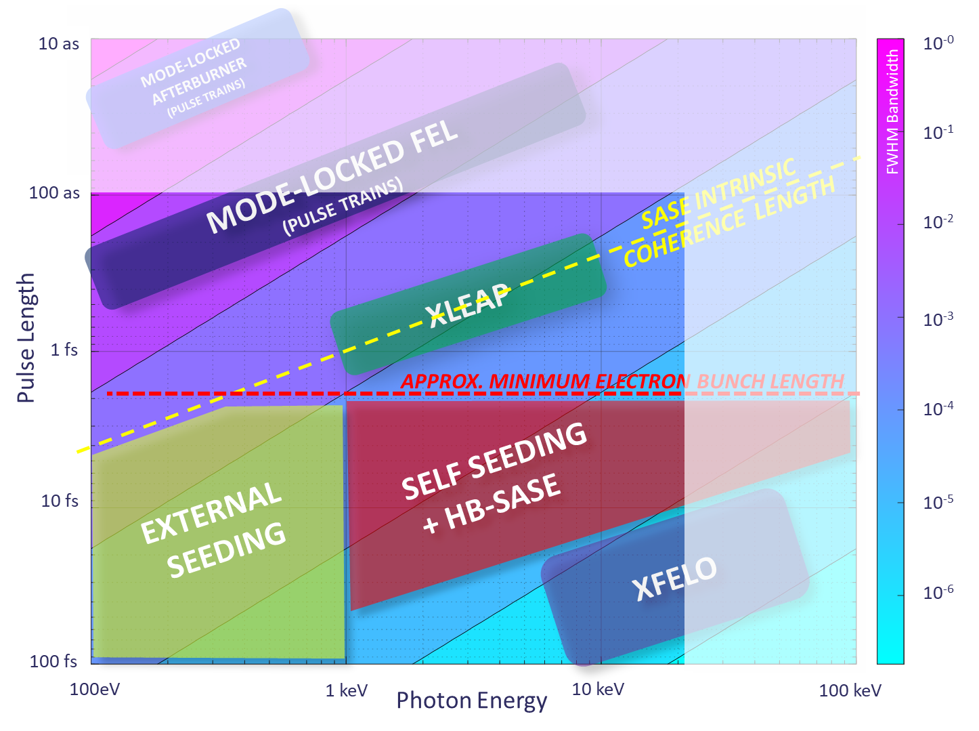
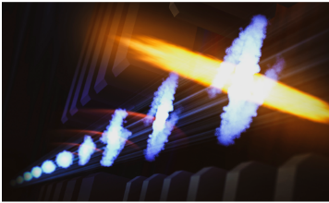

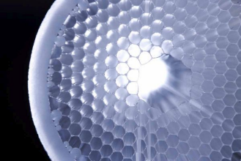
Transform-limited pulses
Transform-limited pulses across a wide range of energies and pulse lengths requires a wide range of techniques.
Attosecond pulses tightly synchronised to external sources (e.g. XLEAP)
HB-SASE-2.0 for 25 keV, 2.5 fs duration, TW peak power, >mJ pulse energy, 8 × 10⁻⁵ FWHM BW, at any e-beam repetition rate
XLEAP
HB-SASE schematic
Advances in high rep-rate lasers (e.g. Kagome fibres) for ≤ 1MHz UV seeding + harmonic FEL conversion to ≤ 2 keV
Enhanced self-seeding for few-GW 30 fs stable coherent SXR pulses
Cavity XFELs: RAFEL, XFELO for narrowest bandwidth
Notes:
Single-cycle undulator light with carrier-envelope phase control

Slide 19
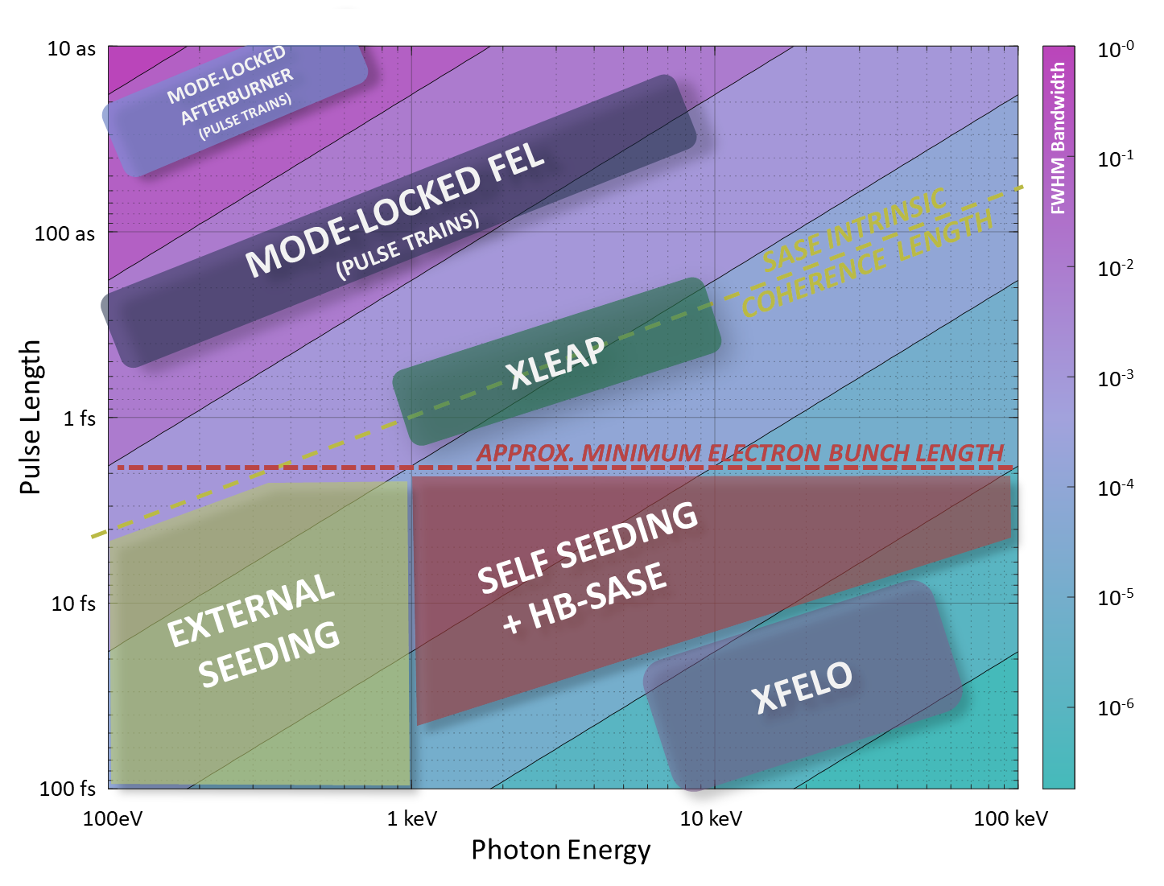
Each FEL has 1-3 primary operating modes, covering both short-pulse and long-pulse options
Proposed FEL modes
FEL | Tuning | Mode | Technique | Transform Limited Pulse Duration
FEL-6 | 0.05 – 1.0 keV | Seeded | EEHG | 5 – 100 fs
FEL-5 | 0.25 – 3.0 keV | Long pulse | EEHG/HB | 100 fs – 20 fs
 |  | Short Pulse | XLEAP | 2 fs – 350 as
FEL- 4 | 1.0 – 5.0 keV | Long Pulse | HB-SASE | 40fs – 15fs
 |  | Short Pulse | XLEAP | 800 as – 275 as
FEL-3 | 3.0 – 13.0 keV | Long Pulse | HB-SASE | 20 fs – 10 fs
 |  | Short Pulse | XLEAP | 400 as – 200 as
FEL-2 | 5.0 – 20.0 keV | Long Pulse | HB-SASE | 16 fs - 12 fs
 |  | Short Pulse | XLEAP | 300 as – 200 as
 |  | Cavity | XFELO | ~ 100 fs
FEL-1 | 9 – 20 keV | High Power | SASE | ~ 30 fs (not TL)
 | 13 – 30keV* | High Energy
 | 20 – 40keV* | High Energy
100 eV – 20 keV
100 as to 100 fs
Short Pulse Modes
FEL-3
FEL-4
FEL-2
FEL-5
FEL-6
Seeded
Long Pulse Modes
FEL-1
High Energy
Cavity
*via booster, possibly at lower rep. rate
Pulse durations estimated from simulations/scaling, intermediates between short and long pulse modes also accessible.
Notes:
Single-cycle undulator light with carrier-envelope phase control

Slide 20
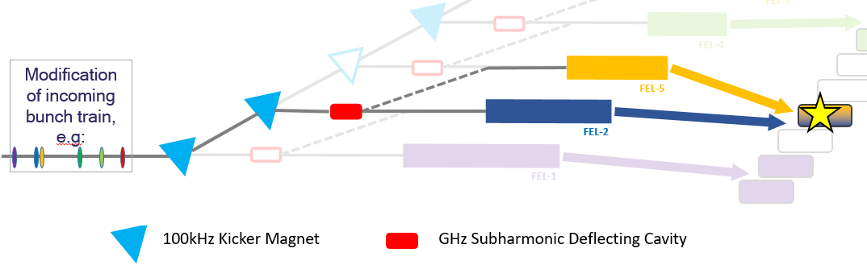
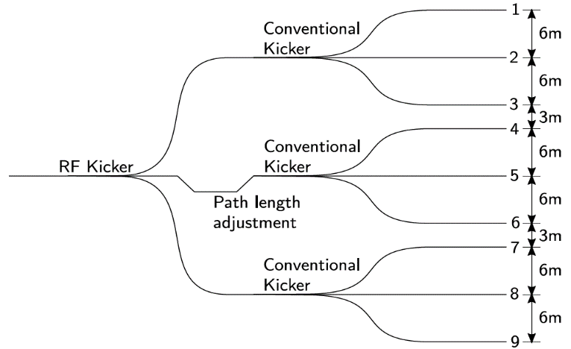
Concepts for two-colour
(a)
Widely-separated two-colour capability could be a key feature of a next-generation XFEL – but how and to what extent is it best to implement it?
End station away day activities were very useful for this topic: a specific combination has been identified for detailed studies (FEL-5 + FEL-2)
Concepts developed with similar key features:
  bunch pattern from the injector is adjusted to bring two bunches into adjacent RF cycles (Δt = 0.77 ns)
  a GHz subharmonic deflecting cavity used to deflect one bunch onto an adjacent FEL
  path length difference compensates the temporal separation
(b)
FEL-2
FEL-5
(c)
FEL-2
FEL-5

Slide 21
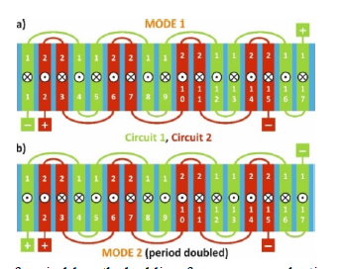
FEL for matter in extreme conditions
Requirement for 10’s of mJ at 5-10keV, and as many mJ as possible at up to 40keV
To approach 10’s mJ pulse energy, and to reach 40keV, we need a beam energy considerably greater than 8 GeV – assume booster to ~12 GeV
But we also need a wide photon energy range….
Suggestion is to use an undulator with dual periods.
EuXFEL are developing a planar SCU which incorporates period doubling:
At maximum current of 450A:
  SCU17: Period 17mm, B = 1.26T, K = 2
  SCU34: Period 34mm, B = 2.6T, K = 8.54
At 12 GeV:
  SCU17: Tunes 26keV (K = 2) to 53keV ( K = 1)
  SCU34: Tunes 1keV (K = 8.54) to 26keV ( K = 1)

Slide 22
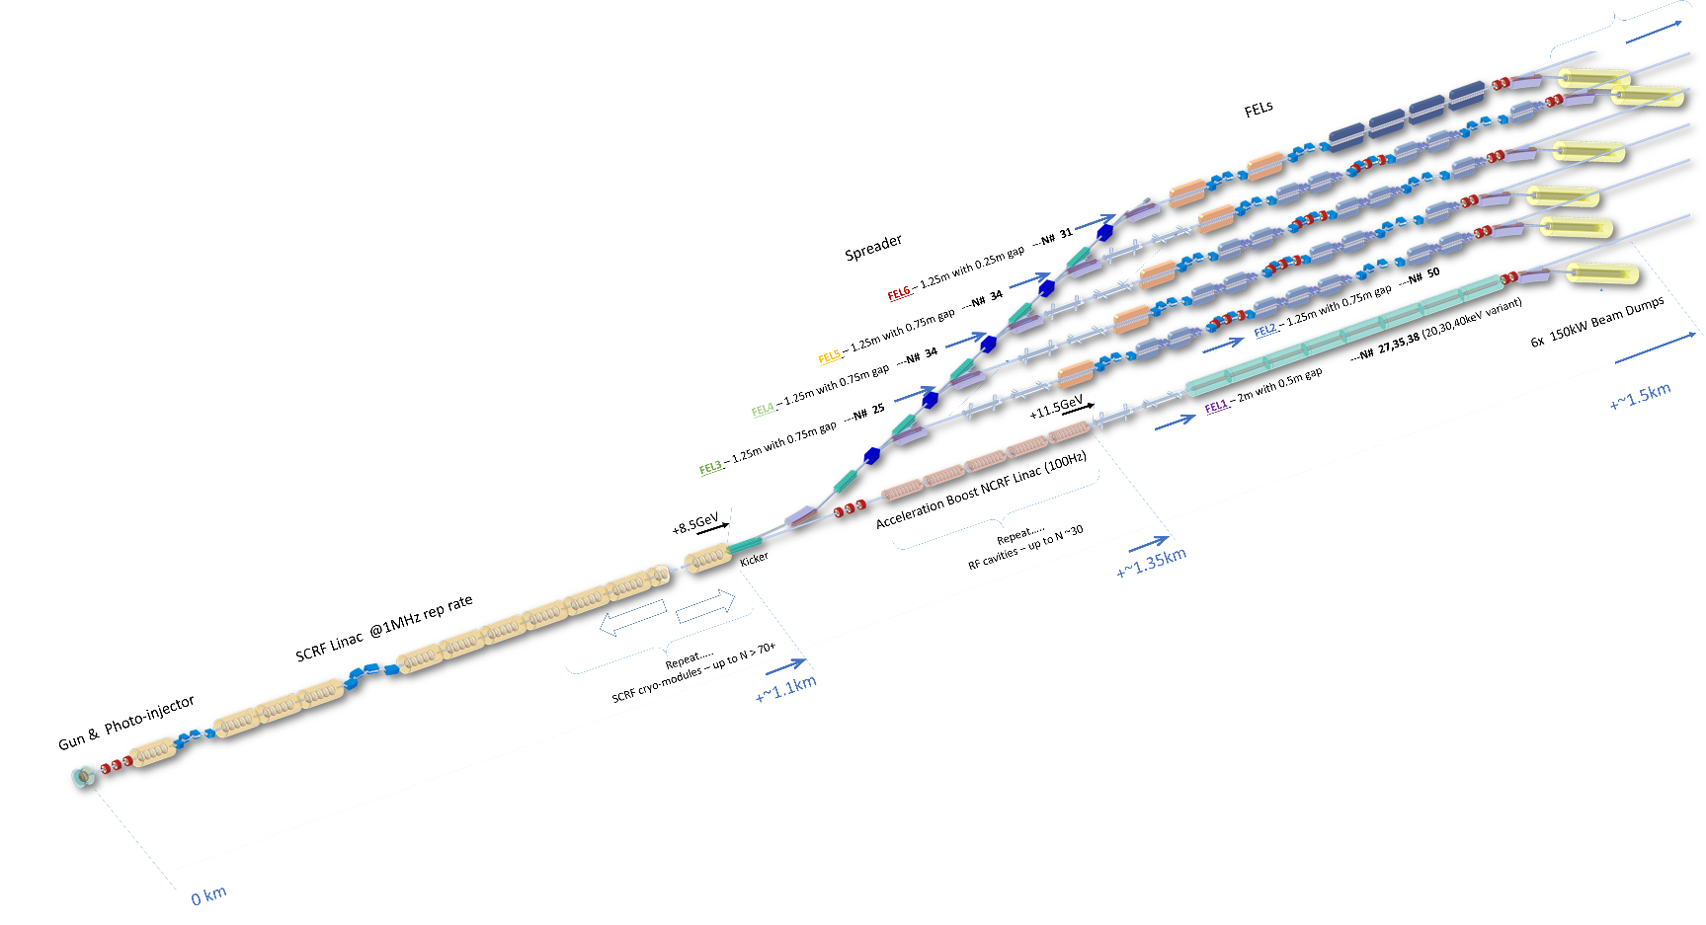
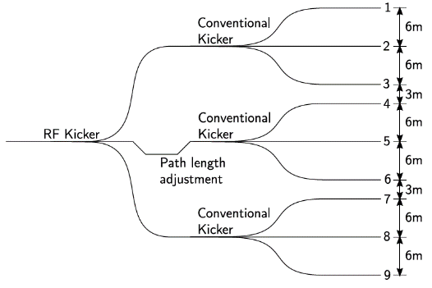








Layout progress
FEL | Tuning
FEL-6 | 0.05 – 1.0 keV
FEL-5 | 0.25 – 3.0 keV
FEL-4 | 1.0 – 5.0 keV
FEL-3 | 3.0 – 13.0 keV
FEL-2 | 5.0 – 20.0 keV
FEL-1 | 9 – 20 keV
 | 13 – 30keV*
 | 20 – 40keV*
Work on the layout is still very much in progress – 3D layouts of one option have been developed but others are also under consideration.
FELs ~350 – 400 m
KEY
Cryomodule
Delay Chicane
Kicker + Septum
Passive Wakefield Structure
LINAC 8 GeV ~750 m
2m Planar Undulator
2m APPLE-X
1.25m APPLE-X
With delay chicane
2m HELICAL SCU

Slide 23
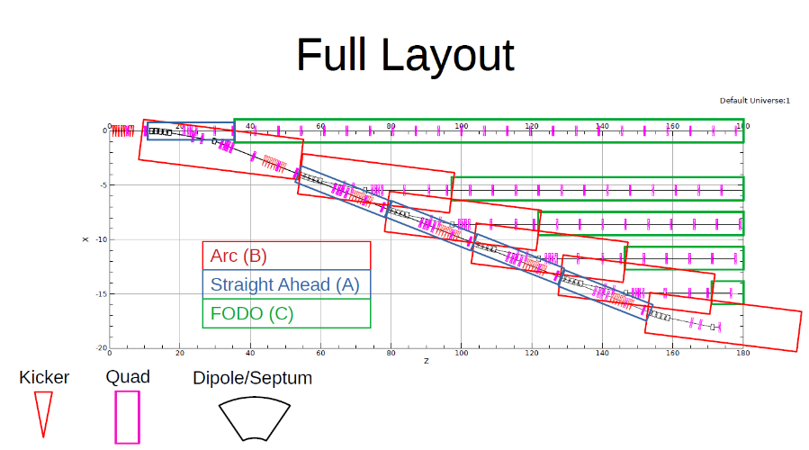
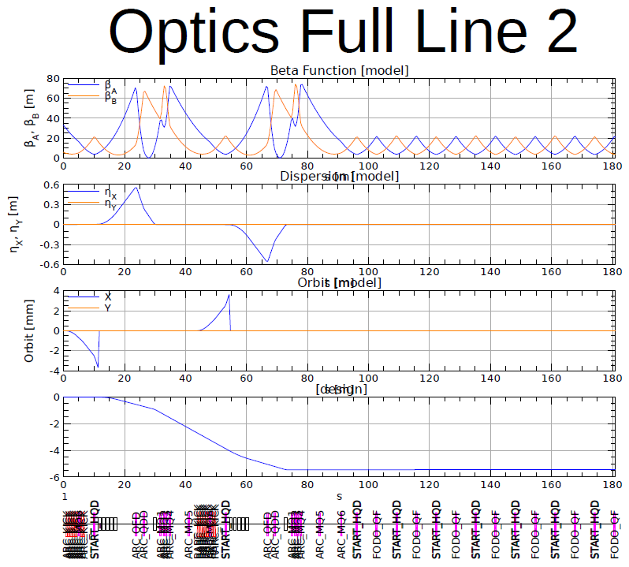
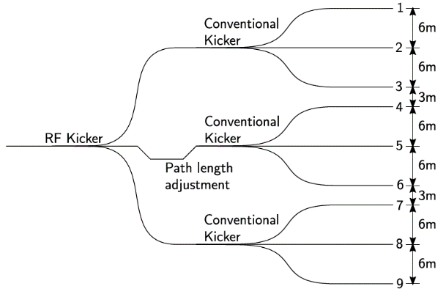
Spreader options under consideration
Approach – compare fully kicker-septum based planar system with RF distribution based planar system.​
​
Completed optics design for kicker-septum based system
Work underway on RF-based system

Slide 24
Injectors
Poster by Can Davut:
SRF L-Band Gun Based Design Option for the UK XFEL Low Energy Beamline
The main features of the facility present various challenges for the photoinjector:
Multiplexing to multiple FELs with variable bunch properties
  calls for a VHF or L-band gun as described – and to do so with variable bunch properties will likely require multiple photoinjector lasers or multiple copies of these guns (this would also provide the benefit of redundancy)
The two-colour concept
  requires either one L-band gun or two VHF guns in order to give a compensatable time delay between bunches
The FEL for matter in extreme conditions
  requires a very bright, high-charge source at low repetition rate, possibly VHF or L-band gun
Other potential applications such as a PWFA test line require a high bunch charge (≥ 500 pC) at higher emittance (~1 mm-mrad), and a two-bunch mode – this could be considered as a variant of the other requirements.
It seems likely that multiple photoinjectors will be highly beneficial; how to combine the required features within a reasonable number is one of the project’s main challenges at present. Synchronisation is recognised as an important issue.

Slide 25
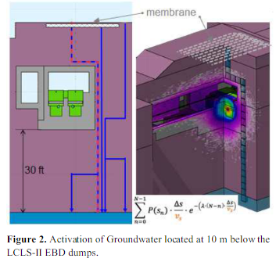
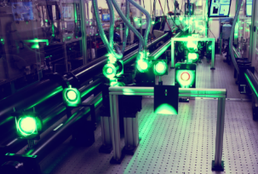
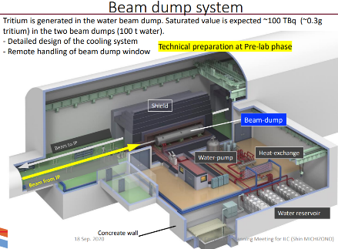
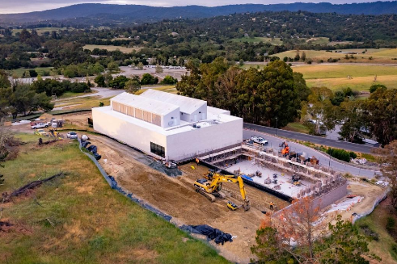
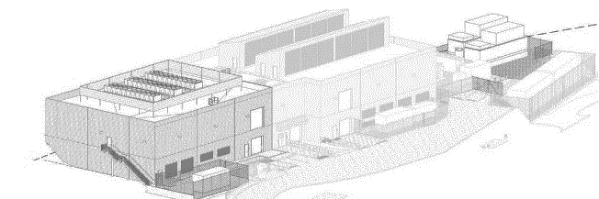
Other facility features and challenges
Synchronous sources
Next-gen XFELs are expected to be some of the biggest data machines on the planet
Unprecedented requirements in both data rates (towards TB/s) and scale (PB per data set). AI potential for real-time feedback for experiment steering. Trend for data processing at the detector as part of combined detector-data pipeline
Focus is on the following areas:
Data handling
Applications of Machine Learning at an XFEL
Conceptual designs and frameworks to enable Machine Learning
Developing connections with relevant AI and Exascale expertise within the UK
Local shielding requirements
A laser facility as well as an XFEL facility:
High rep. rate femtosecond pumping from 10 nm - 10 µm, as per UK Artemis and Ultra facilities
A high power (multi-PW, >1022 Wcm-2)
and high energy (kJ-class) laser facility as large as budget allows
  Scalable and tunable diode-pumped laser technology (e.g. CLF DiPOLE)
  High repetition-rate (> 10 Hz)
Data Centres
Central Laser Facility's Gemini facility
Footprint ~ 80x30m
Power ~ 6MW
Beam Dumps

Slide 26
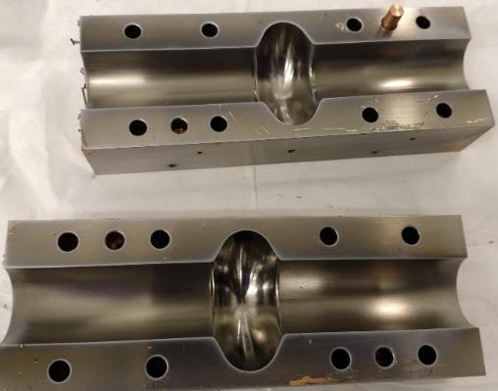
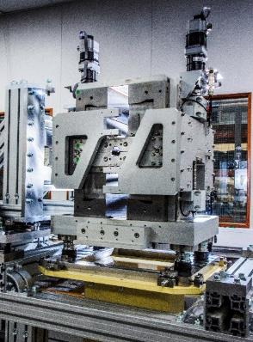

Sustainability
The UK accelerator community is already very active in developing more sustainable technologies, Using permanent magnets instead of electromagnets.
  Making use of different superconducting materials and coatings for RF cavities so that they can operate at 4K instead of 2K.
  Developing more efficient RF power sources and much faster RF cavity tuners.
In addition we are assessing accelerators more broadly in terms of carbon footprint throughout the full project life cycles. This analysis will continue and feed directly into the CDOA project.
Notes:
It is essential that we assess, and optimise where possible, all of the options from a sustainability perspective.
many of which would have a significant positive impact on the power requirements of a new XFEL facility

Slide 27
Expected future timelines
Evaluate
  2019 to 2020 Science Case – Completed
  Oct 2022 to Oct 2025 Conceptual Design and Options Analysis
  Oct 2025 to ~2028 Technical Design Review
  ~2028 onwards Civil Construction work
  ~2029 onwards Accelerator Construction work
Design
Currently here
Construction
Funding Bids would need to be approved before the start dates suggested.

Slide 28
Summary and Next steps
X-ray free-electron lasers (XFELs) are a revolutionary technology, which are likely to continue to develop substantially in capability and capacity in coming years
We’ve made significant progress in producing a concept to meet the key requirements, aiming to produce a full self-consistent design by October 2024
We will compare UK vs international investment options + identify key R&D areas for future phases
Continue town hall meeting series to extend the community and inform the design https://xfel.ac.uk/events/
Central England Townhall (hosted Royal Society, 29th and 30th July 2024)
Focus discussion topic: Lifesciences and Biomedicine
North-West England Townhall (hosted by Royce Institute, 8th and 9th August 2024)
Focus discussion topic: Electronics, photonics and quantum technologies
Wales Townhall (hosted Cardiff 17th and 18th September 2024)
Focus discussion topic: Advanced materials and manufacturing

Slide 29




























UK XFEL
Science Team
UK Research Councils & Government
Other XFELs
Notes:
To replace photo with one of your own. 1) Send the geometric shape overlay to the back – Right-Click > Send to Back > Send to Back. 2) Replace image – use the guides provided to correctly position it. 3) Send your image to the back so that the geometric overlay re-appears over the image. Please remove or amend the image credit if you are using a different image to the one provided.

Slide 30
Thank You
Notes:
The abstract pattern can be removed or repositioned if required. Be careful to ‘Send to Back’ so that it does not obscure any important information.

