Slide 1



CLARA Dielectric Dechirper Performance Studied by Simulations
B. Higuera González, T. J. Overton, T. H. Pacey, Y. M. Saveliev, G. Xia

Slide 2
DECHIRPER CONCEPT
Cherenkov radiation is generated when the speed of the electron bunch is higher than the speed of light in the medium.
The speed of light is reduced by the dielectric layer.
The wakefield generated is synchronous with the electron bunch.
Longitudinal decelerating wakefields strength increases towards the bunch tail.
The decelerating field can compensate the extra energy towards the tail in a negatively chirped bunch.

Slide 3
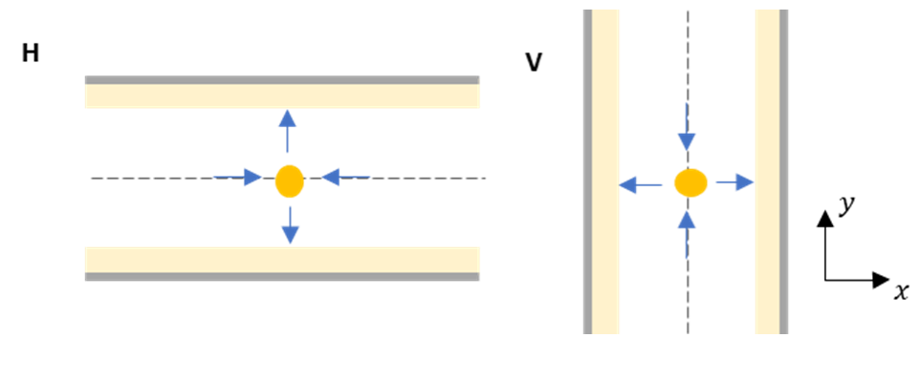
DECHIRPER DESIGN
Aim to optimise energy spread reduction without increasing emittance.
H+V DLW design to compensate transverse wakefields and minimise emittance growth.
Independently adjustable dielectric gap for better transverse wakefields compensation.

Slide 4
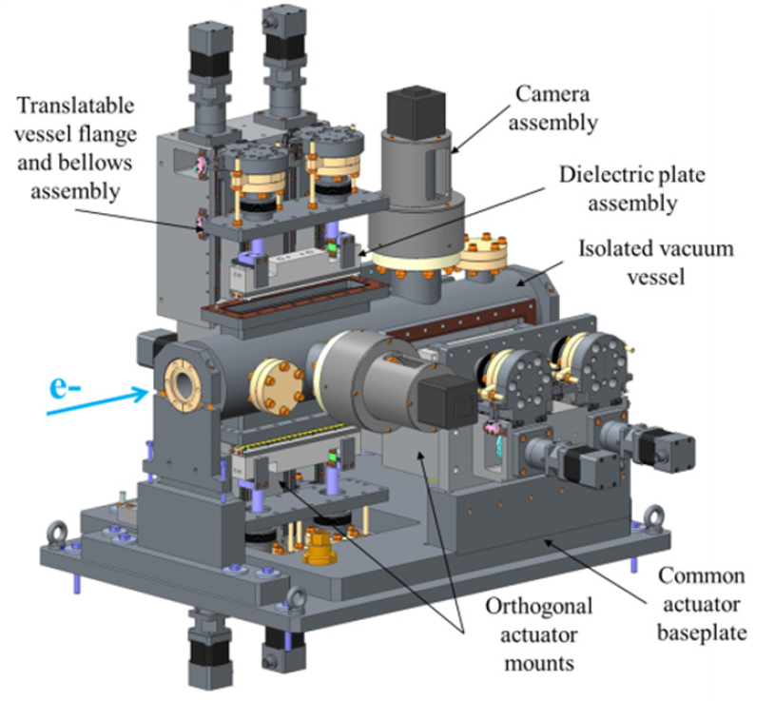
DECHIRPER PERFORMANCE SIMULATIONS
DiWaCAT in-house software package
Toby Overton (2023) https://doi.org/10.5281/zenodo.10219459
Simulations performed using CLARA beam parameters: two levels of energy spread at different bunch lengths.
Obtain optimal gap for energy spread reduction.
Obtain optimal gap for emittance growth compensation.
Bunch Length | 20, 50, 100, 300 fs RMS
Transverse Size | 50 µm RMS
Average Energy | 250 MeV
Total Charge | 250 pC
Normalised Emittance | 1 µm rad
Full Energy Spread | 6, 12 MeV

Slide 5
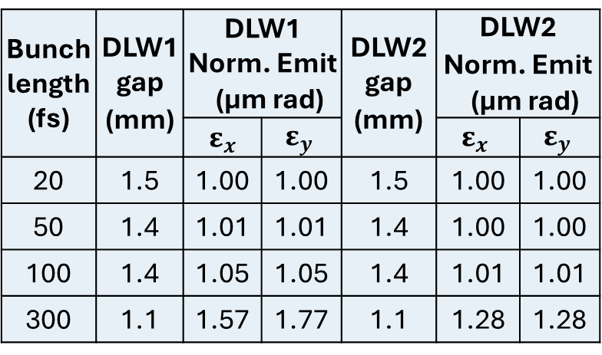
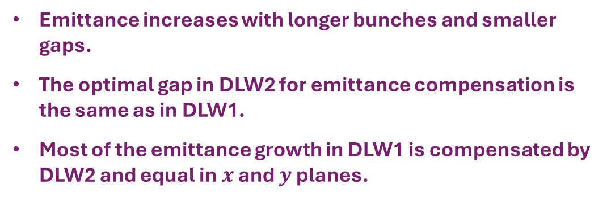
SIMULATIONS: Low Energy Spread
At optimal dielectric gap for each bunch length, energy spread is reduced from 3.5 MeV to ~0.3 MeV FWHM (~91%).
The optimal gap for energy spread compensation, reduces as RMS bunch length increases.
Bunch length (fs) | DLW1 gap (mm) | DLW1 Norm. Emit (µm rad) |  | DLW2 gap (mm) | DLW2 Norm. Emit (µm rad)
 |  | $$ε_{x}$$ | $$ε_{y}$$ |  | $$ε_{x}$$ | $$ε_{y}$$
20 | 1.5 | 1.00 | 1.00 | 1.5 | 1.00 | 1.00
50 | 1.4 | 1.01 | 1.01 | 1.4 | 1.00 | 1.00
100 | 1.4 | 1.05 | 1.05 | 1.4 | 1.01 | 1.01
300 | 1.1 | 1.57 | 1.77 | 1.1 | 1.28 | 1.28
Emittance increases with longer bunches and smaller gaps.
The optimal gap in DLW2 for emittance compensation is the same as in DLW1.
Most of the emittance growth in DLW1 is compensated by DLW2 and equal in $x$ and $y$ planes.

Slide 6
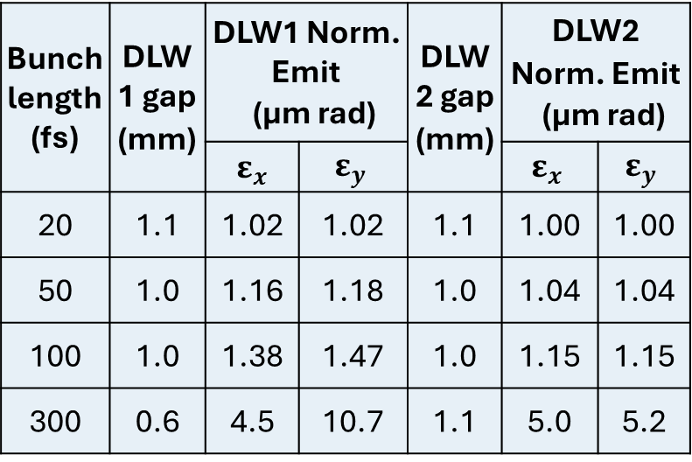
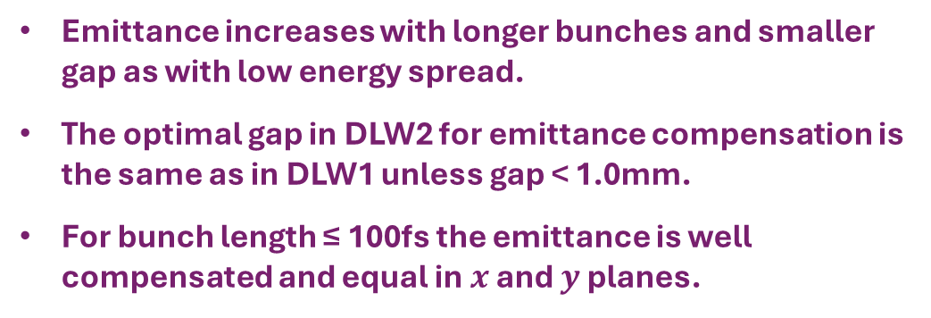
SIMULATIONS: High Energy Spread
At optimal dielectric gap, energy spread is reduced from 7.0 to ~0.4 MeV FWHM (~94%).
The optimal gap for energy spread compensation, reduces as RMS bunch length increases.
Bunch length (fs) | DLW1 gap (mm) | DLW1 Norm. Emit (µm rad) |  | DLW2 gap (mm) | DLW2 Norm. Emit (µm rad)
 |  | $$ε_{x}$$ | $$ε_{y}$$ |  | $$ε_{x}$$ | $$ε_{y}$$
20 | 1.1 | 1.02 | 1.02 | 1.1 | 1.00 | 1.00
50 | 1.0 | 1.16 | 1.18 | 1.0 | 1.04 | 1.04
100 | 1.0 | 1.38 | 1.47 | 1.0 | 1.15 | 1.15
300 | 0.6 | 4.5 | 10.7 | 1.1 | 5.0 | 5.2
Emittance increases with longer bunches and smaller gap as with low energy spread.
The optimal gap in DLW2 for emittance compensation is the same as in DLW1 unless gap < 1.0mm.
For bunch length ≤ 100fs the emittance is well compensated and equal in $x$ and $y$ planes.

Slide 7
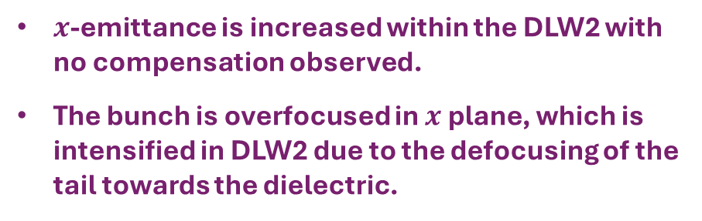
SIMULATIONS: High Energy Spread in 300fs bunch
$x$-emittance is increased within the DLW2 with no compensation observed.
The bunch is overfocused in $x$ plane, which is intensified in DLW2 due to the defocusing of the tail towards the dielectric.
At smaller DLW2 gaps the final 𝑦-emittance is higher with respect to that at the exit of DLW1.
This is due to the exponentially stronger vertical fields in DLW2 generated by a larger vertical beam size after DLW1 (~100 µm).

Slide 8
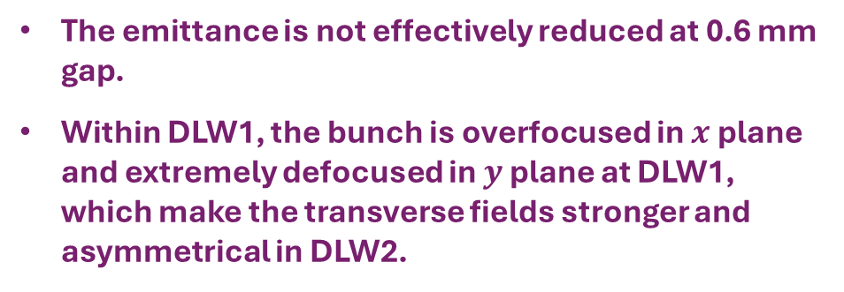
SIMULATIONS: High Energy Spread 300fs bunch
The emittance is not effectively reduced at 0.6 mm gap.
Within DLW1, the bunch is overfocused in $x$ plane and extremely defocused in $y$ plane at DLW1, which make the transverse fields stronger and asymmetrical in DLW2.
By using a 1.0 mm gap, the emittance is well compensated, but the optimal dechirping is not achieved.

Slide 9
CONCLUSION
The CLARA dechirper can reduce the energy spread by ≥ 90%.
The H+V dechirper design is effective for transverse wakefields compensation in bunch lengths ≤ 100fs.
For bunch lengths ≥ 100fs and high energy spread, the H+V design is less effective in compensating emittance growth.
Optimal dechirping and emittance compensation may not be possible to achieve simultaneously for bunch lengths ≥ 100fs and high energy spread.

Slide 10
Any Questions?
beatriz.higueragonzalez@postgrad.manchester.ac.uk
beatriz.higuera-gonzalez@cockcroft.ac.uk

