Slide 1



Electron beam jitter suppression and diagnostic using terahertz-induced modulation
Joseph T. Bradbury
3rd year PhD student
joseph.bradbury-2@manchester.ac.uk
Terahertz Acceleration Group @ The Cockcroft Institute www.THzAG.uk

Slide 2
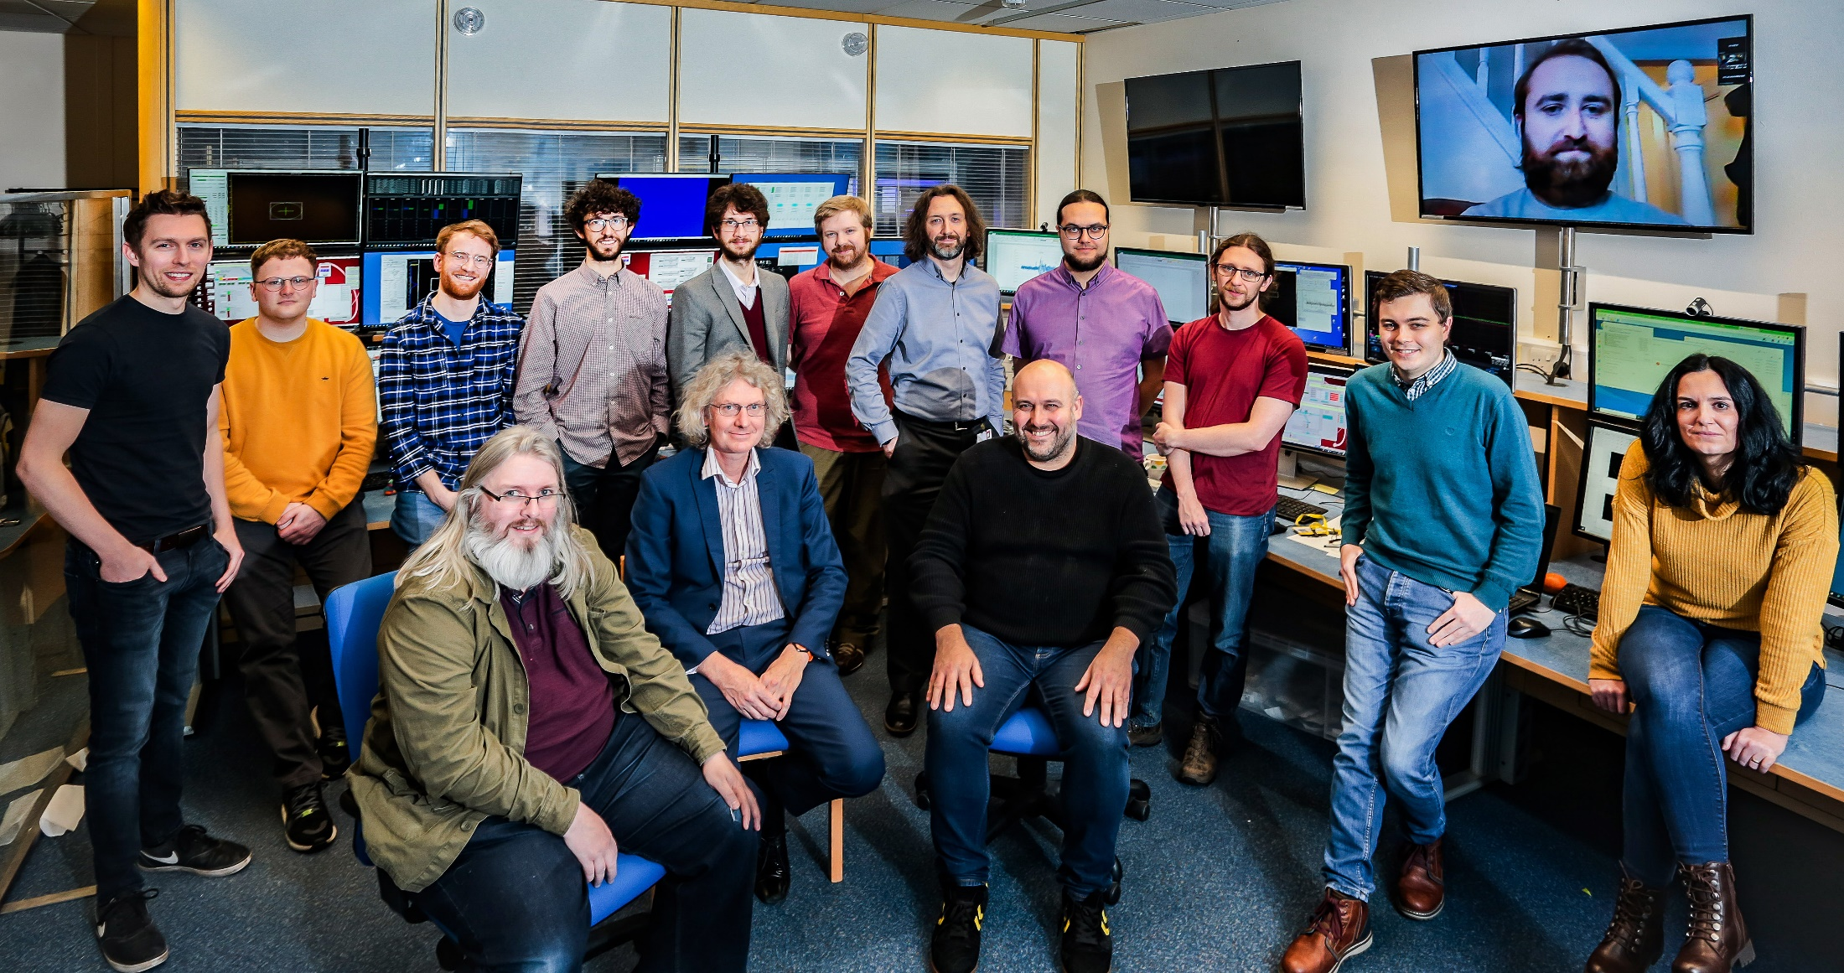

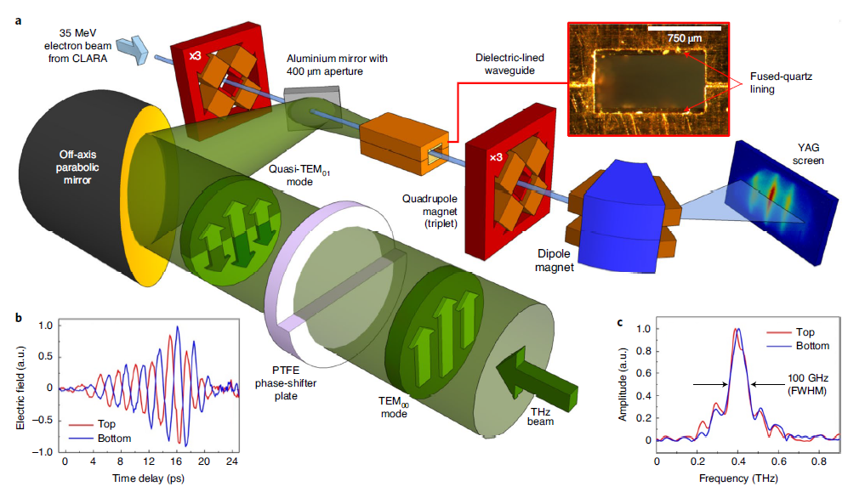

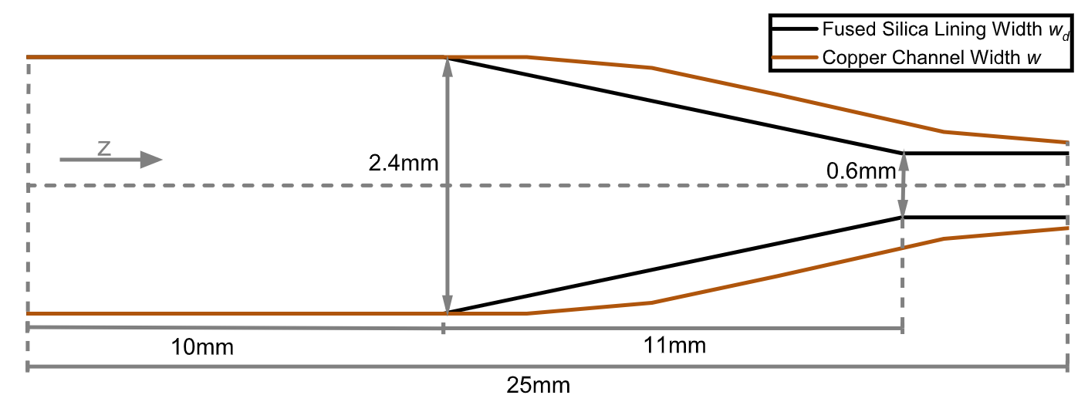
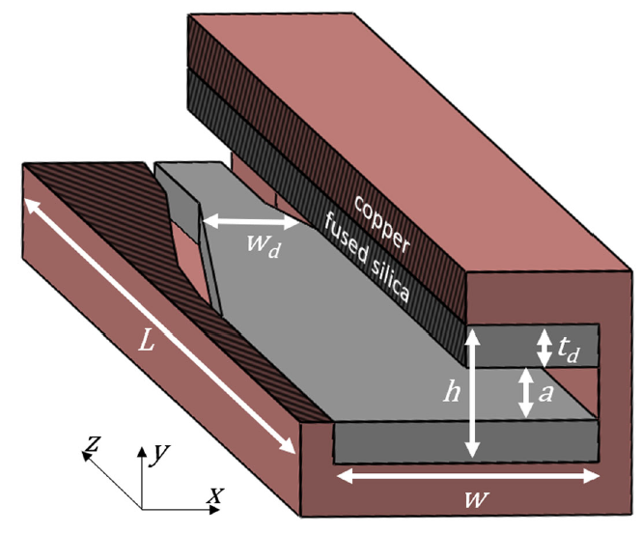

THz Acceleration Group @ www.THzAG.uk
1/10
Our research group
Novel terahertz (THz)-based techniques for electron beam acceleration and manipulation.
Higher driving frequency compared with conventional RF accelerators.
THz source development.
Morgan Hibberd
Joseph Bradbury
Sergey Siaber
Darren Graham
Laurence Nix
Connor Mosley
Dan Lake
Christopher Shaw
Beatriz
Higuera Gonzalez
Graeme Burt
Steven Jamison
Rob Appleby
Relativistic acceleration
Sub-relativistic acceleration
Recent publication
Poster by me on this topic
M. T. Hibberd et al. “Acceleration of relativistic beams using laser-generated terahertz pulses” Nature Photonics 14,755-759 (2020)
L. J. R. Nix et al. “Terahertz-driven acceleration of subrelativistic electron beams using tapered rectangular dielectric-lined waveguides” Phys. Rev. Accel. Beams 27 041302 (2024)

Slide 3
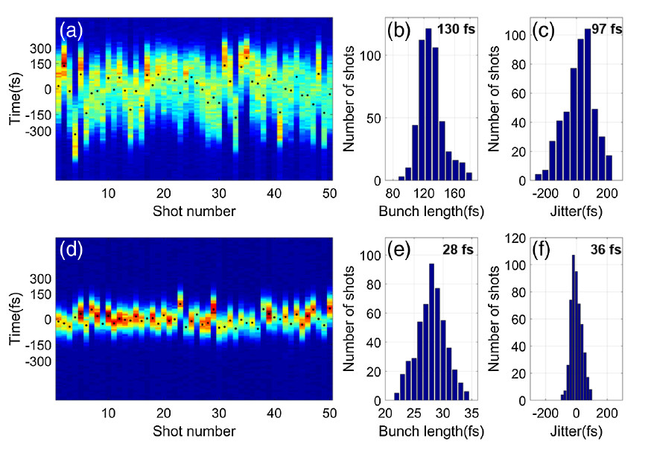
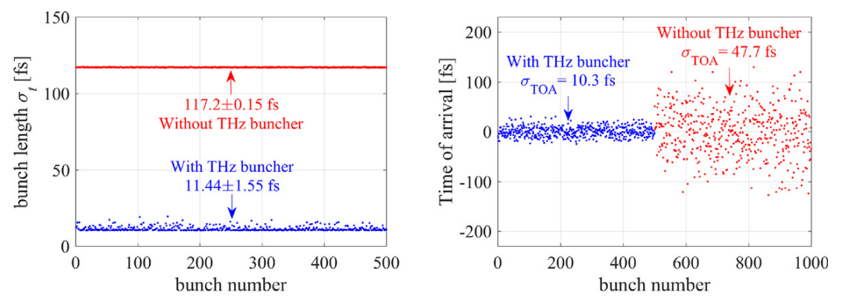
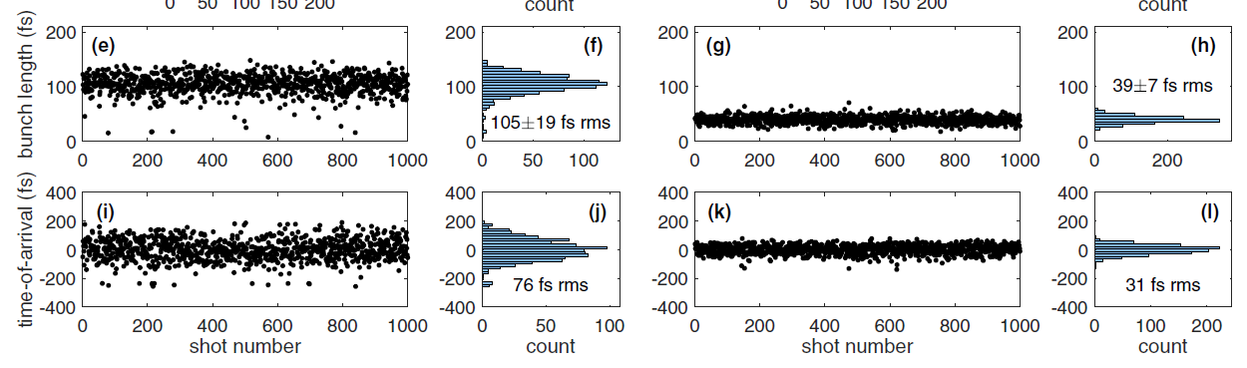
About this talk
2/10
Coming up…
I will present experimental results and supporting simulations showing how THz energy modulation can be used to diagnose and suppress jitter from other accelerator systems.
Content
Longitudinal phase space diagnostic using THz energy modulation
Compression and bunching
Jitter modelling and extraction using THz energy modulation
Jitter suppression
Motivation
Diagnosing and suppressing jitter in electron beams using THz is an active research area.
Using ultra-short fs duration bunches requires excellent timing stability.
Laser-synchronised bunches with fs-scale jitter are key for
  Pump-probe experiments.
  Time-resolved electron diffraction imaging.
  External injection into e.g. PWFA and FELs.
Y. Song et al. “MeV electron bunch compression and timing jitter suppression using a THz driven resonator” Nucl. Instrum. Methods Phys. Res. Sect. A, 1047, 167774 (2023)
L. Zhao et al. “Femotosecond Relativistic Electron Beam with Reduced Timing Jitter from THz Driven Beam Compression” Phys. Rev. Letters 124, 054802 (2020)
E. C. Snively et al. “Femtosecond Compression Dynamics and Timing Jitter Suppression in a THz-driven Electron Bunch Compressor” Phys. Rev. Letters 124, 054801 (2020)

Slide 4
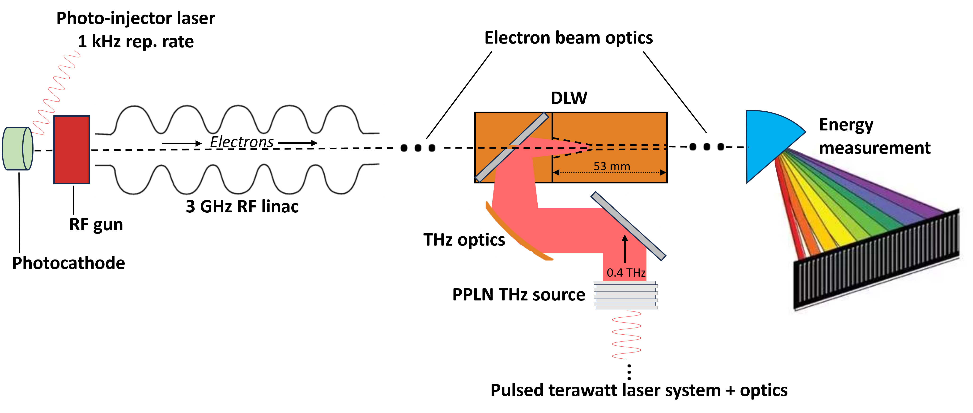
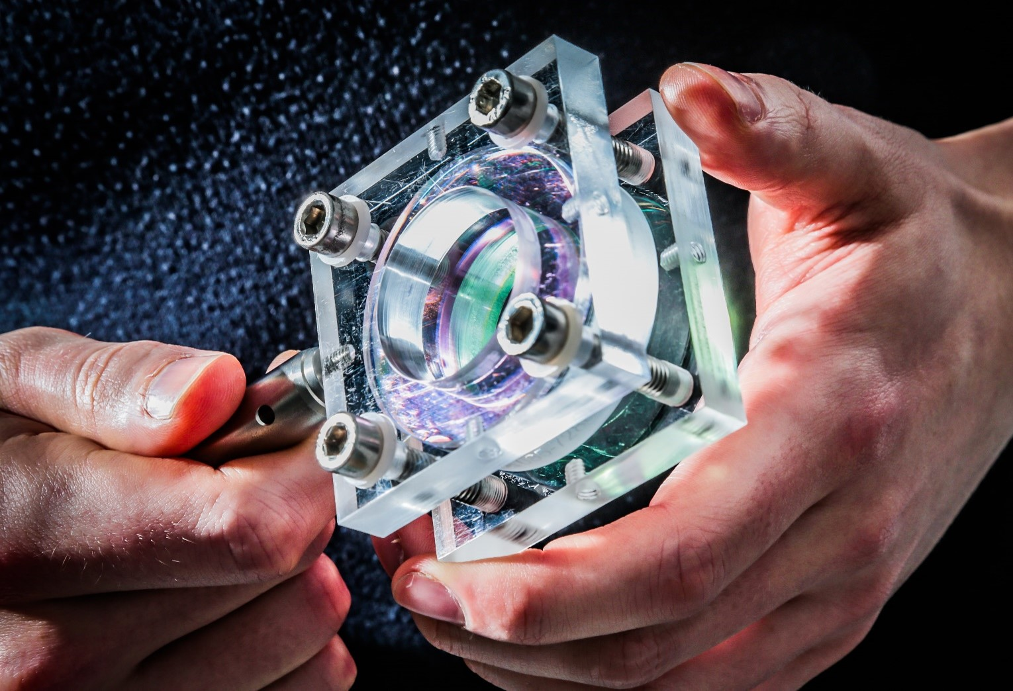
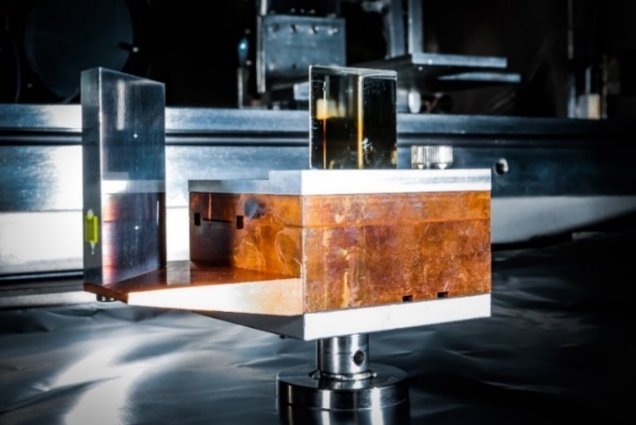
Introduction to the experiment
3/10
C ompact
L inear
A ccelerator
R esearch
A pplications
Beam parameters
35.5 MeV
6 ps FWHM
Chirped bunches
100 pC
Laser-generated narrowband 0.4 THz pulses using periodically-poled lithium niobate (PPLN) wafers stacks
(Poster by Patrick Dalton)
THz pulse and electron beam injected into dielectric-lined waveguide (DLW)
Electron energy measurement using dipole spectrometer
Stack of PPLN wafers for producing laser-generated THz radiation.
DLW installed in the vacuum chamber.

Slide 5
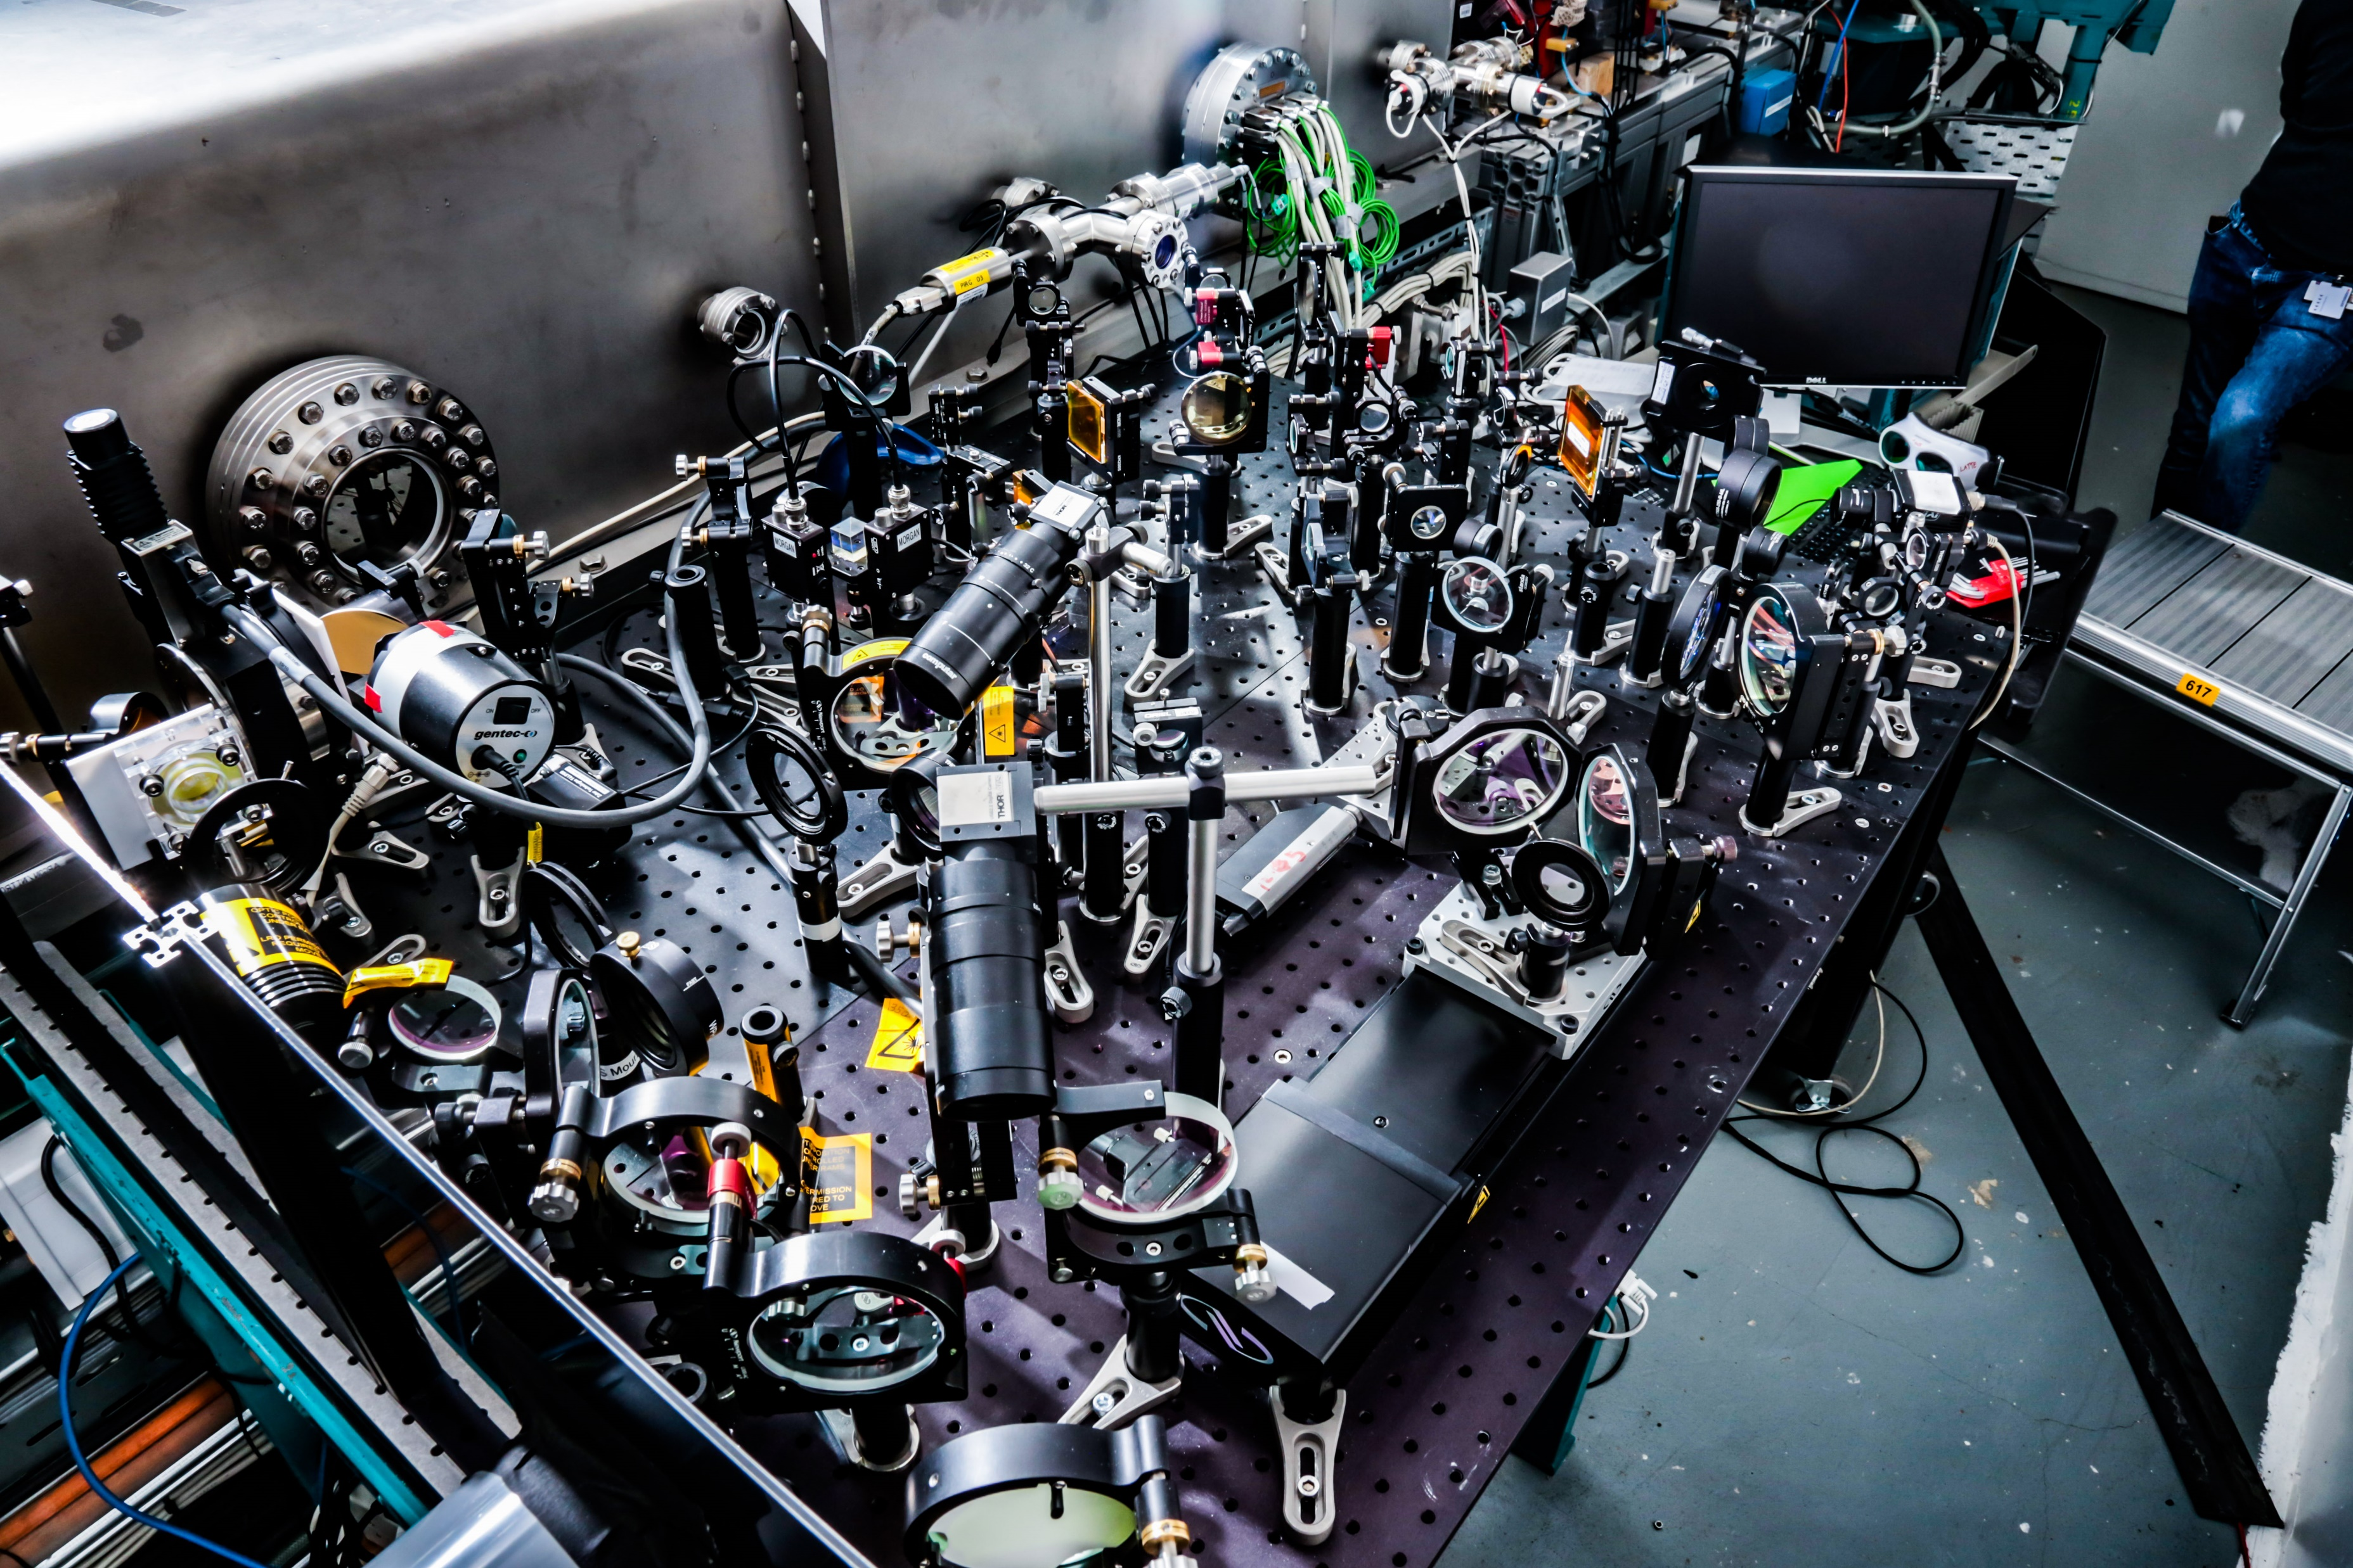
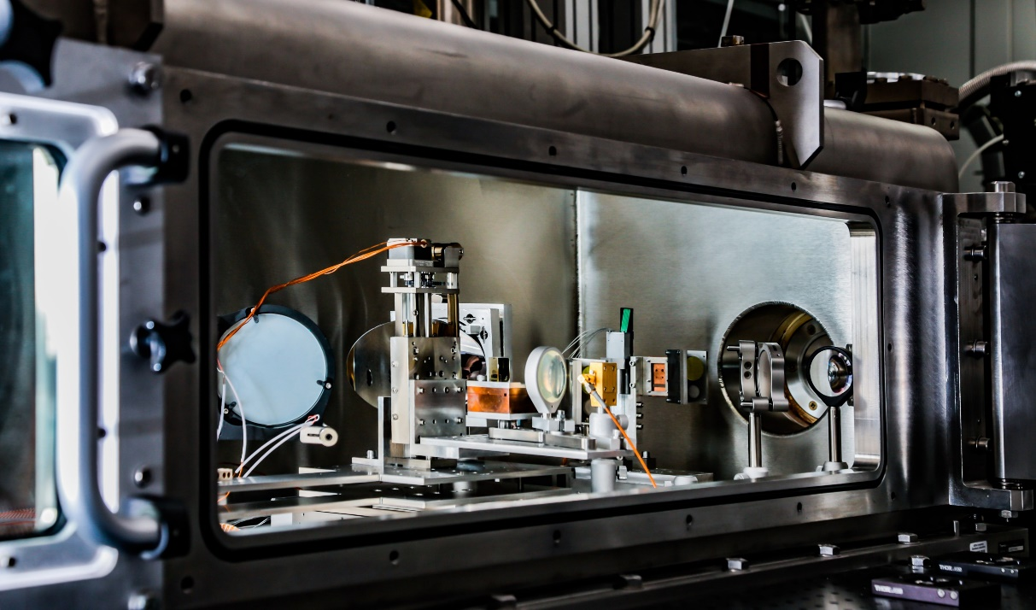
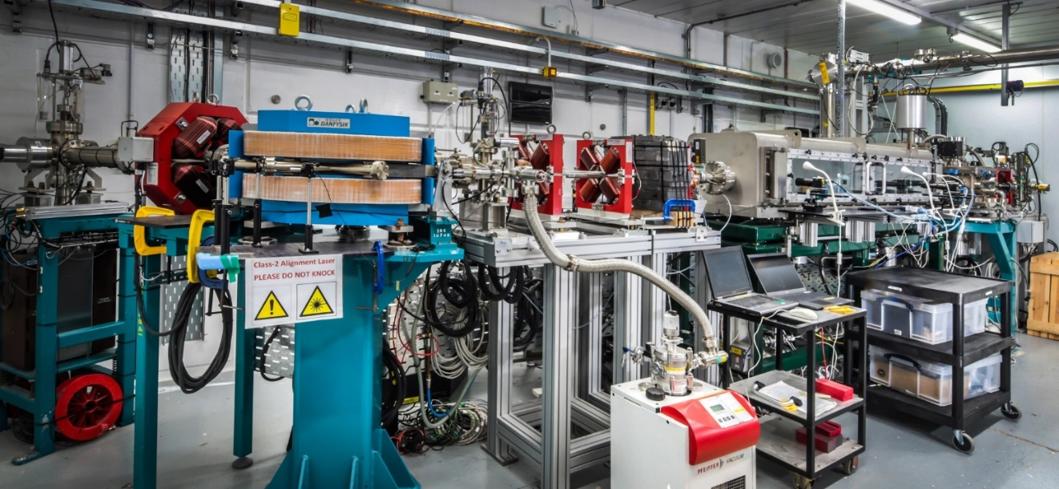
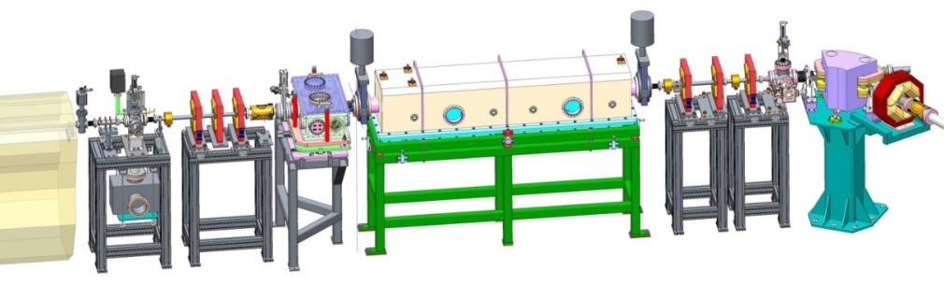
Introduction to the experiment
4/10
Laser and THz optics outside the vacuum chamber
THz-electron interaction point inside the vacuum chamber
Energy spectrometer
Interaction chamber
Beam Area 1
Optical breadboard

Slide 6
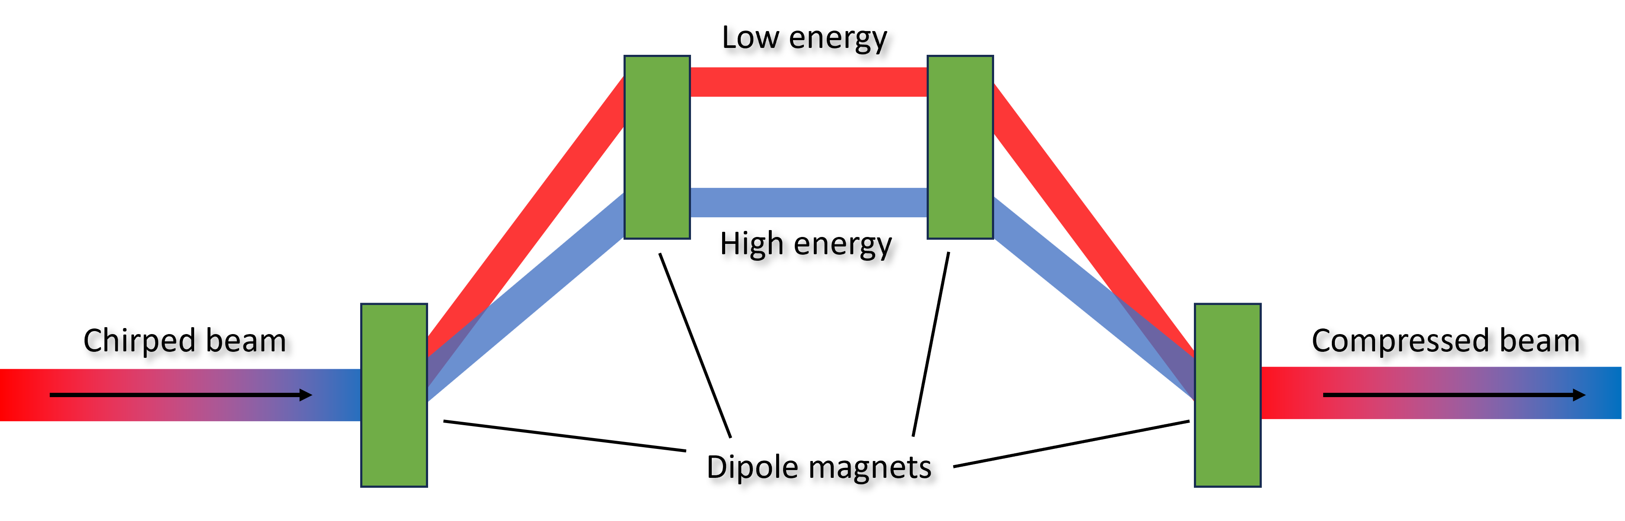
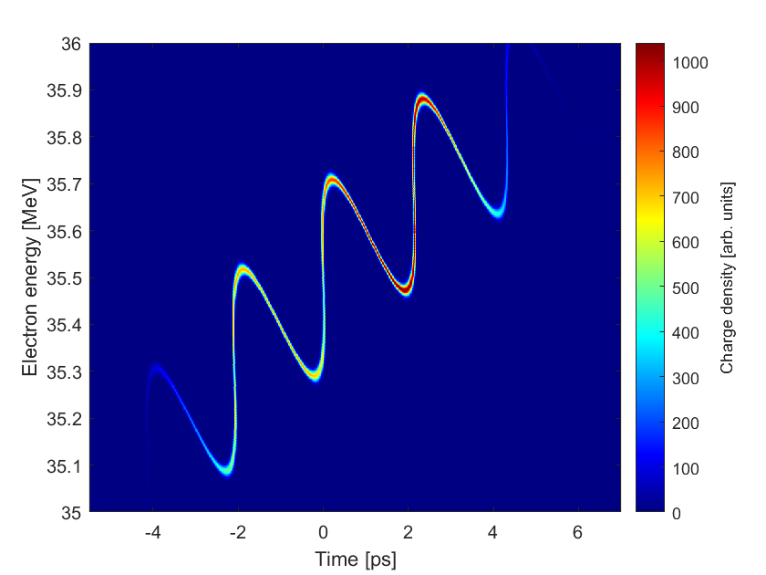
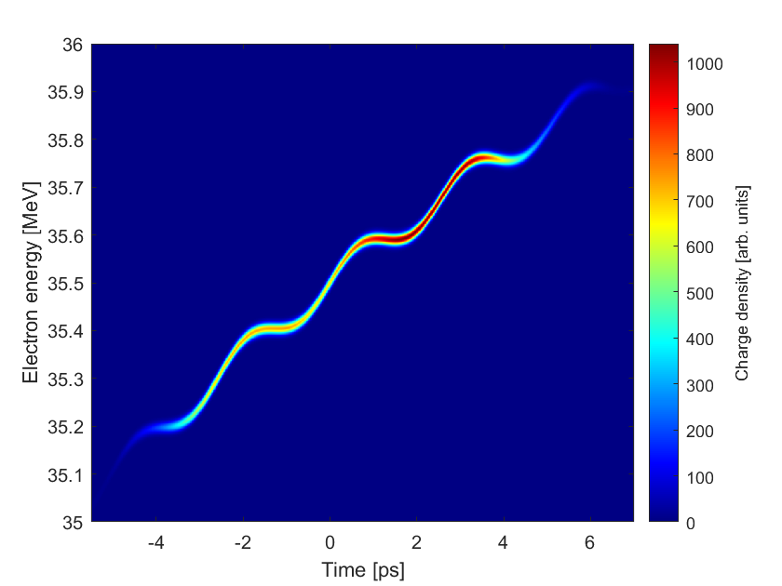
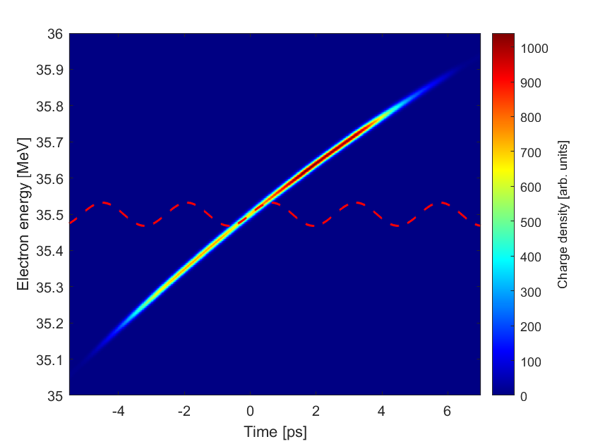


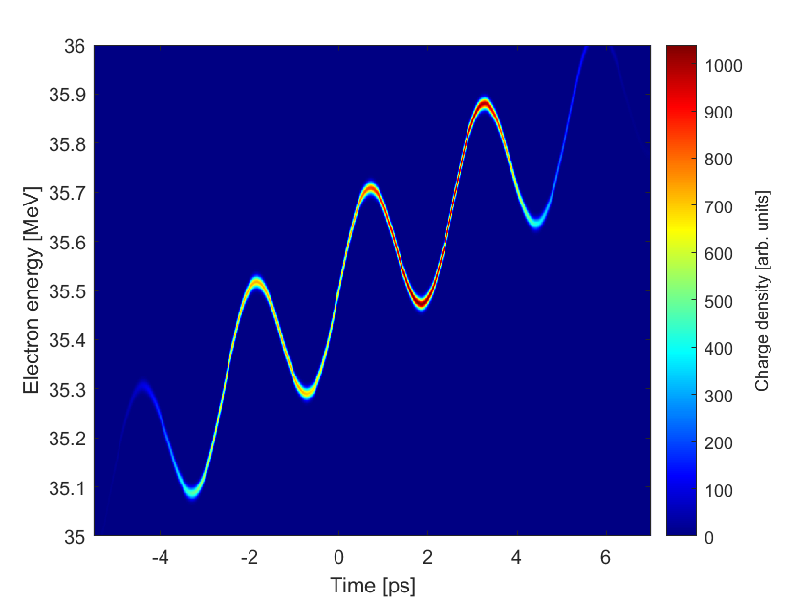
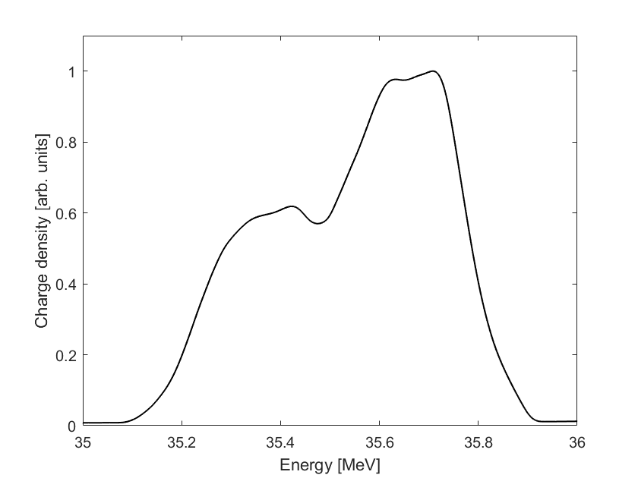
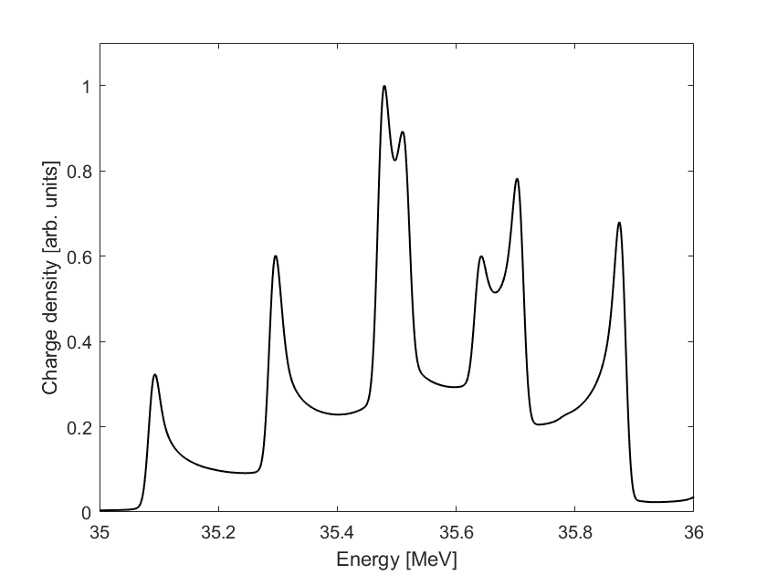
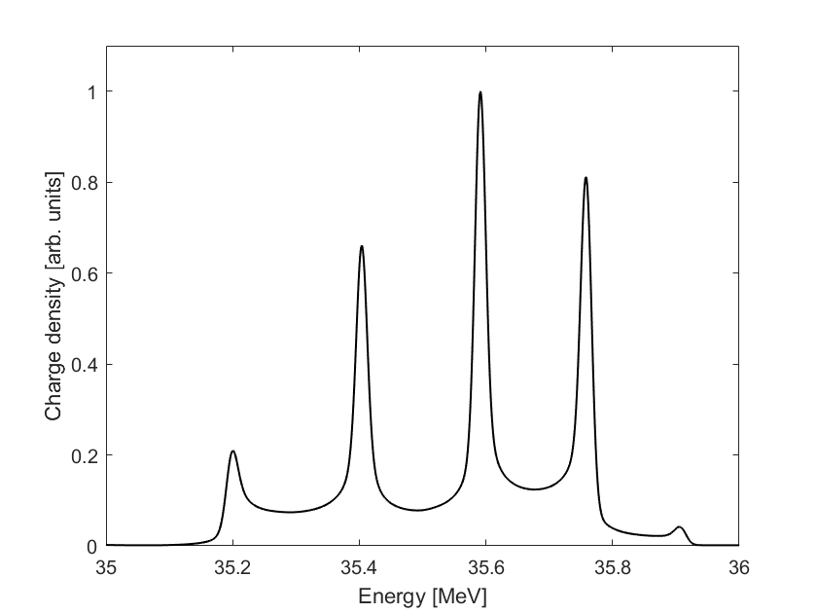
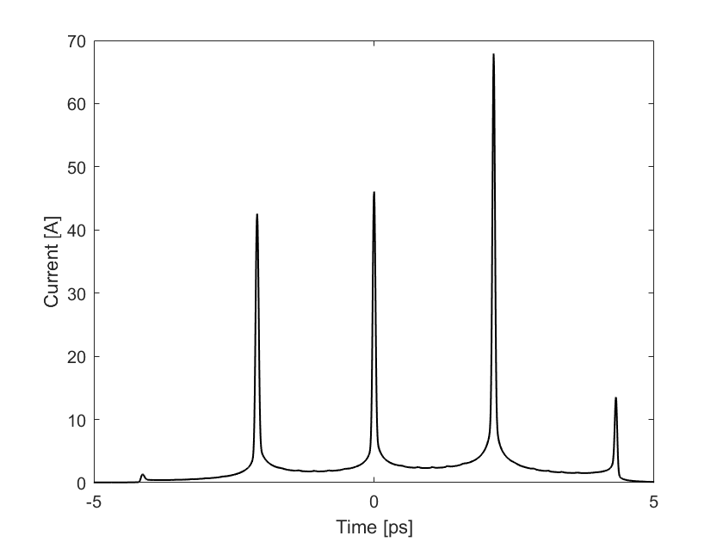

Compression
Accurate longitudinal phase space reconstruction
5/10
THz phase scans allow time-slice properties to be diagnosed which are otherwise complex / inaccessible
Magnetic chicane
2.5 ps THz period allows sharp features in the phase space to be exploited
Initial bunch phase space from CLARA
The width of energy spikes indicate the slice uncorrelated energy spread
Electrons receive a longitudinally dependent energy change
Interaction strength is optimised for diagnostics by producing sharp energy peaks
Increased THz field strength
Example compression using moderate THz field
Overmodulation
Chirp
Compression
Uncorrelated energy spread
σ_{E} = 8 keV
ΔE
ΔE
60 fs FWHM
0.4 THz wave
$chirp= \frac{\text{Δ}\text{E} }{T}$
Curved phase space from non-linear chirp
Energy spikes are separated in time by one THz cycle.
T = 2.5 ps (0.4 THz)
Chirp ≈ 73 keV ps⁻¹
THz-frequency train of < 100 fs, 5 pC micro-bunches.
Short single bunch compression is also possible.

Slide 7
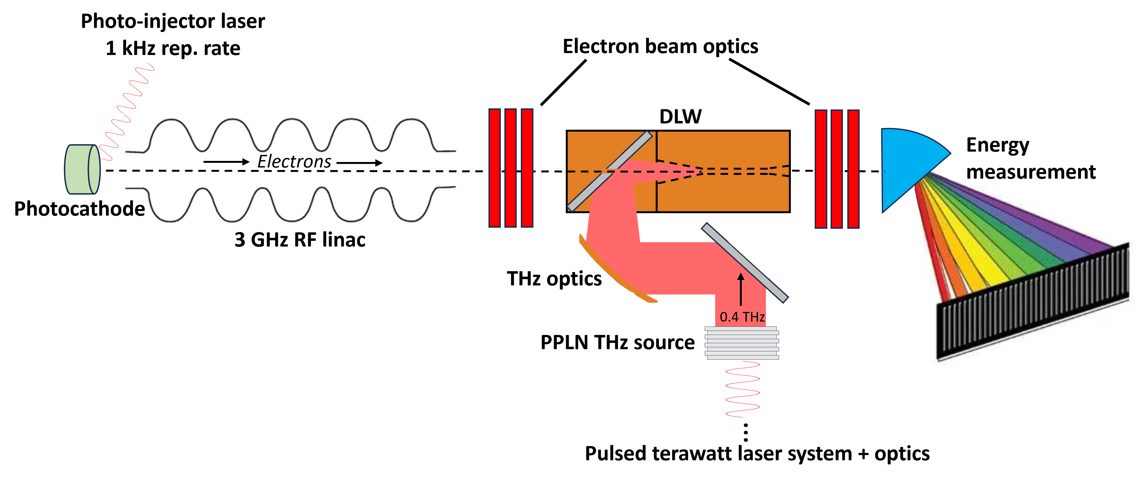
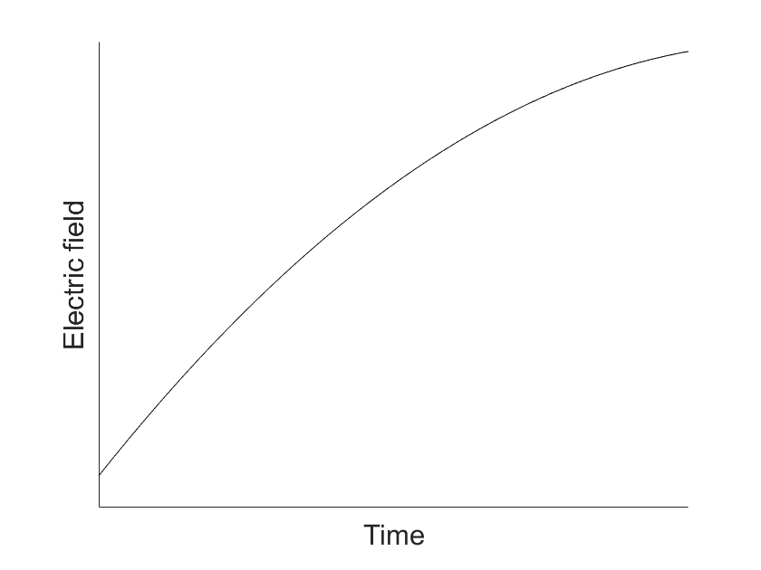
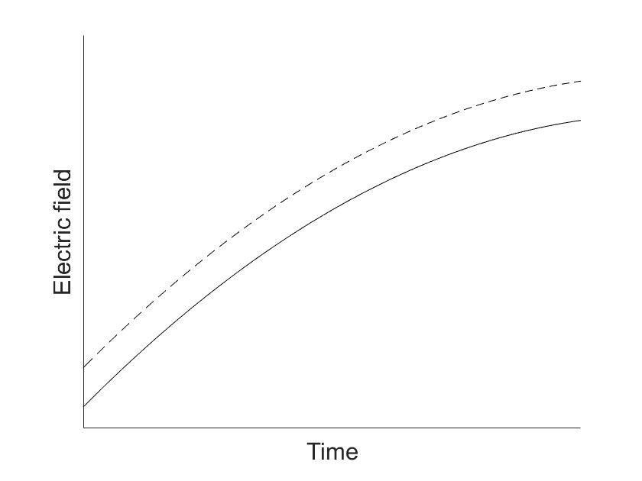
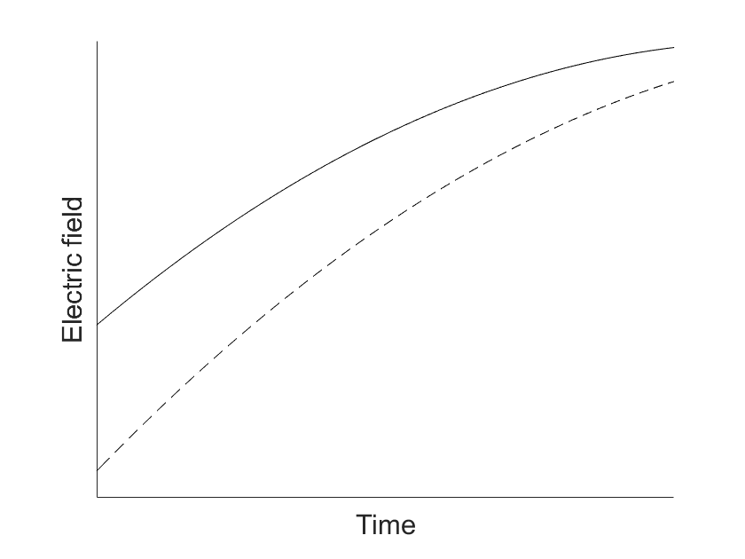
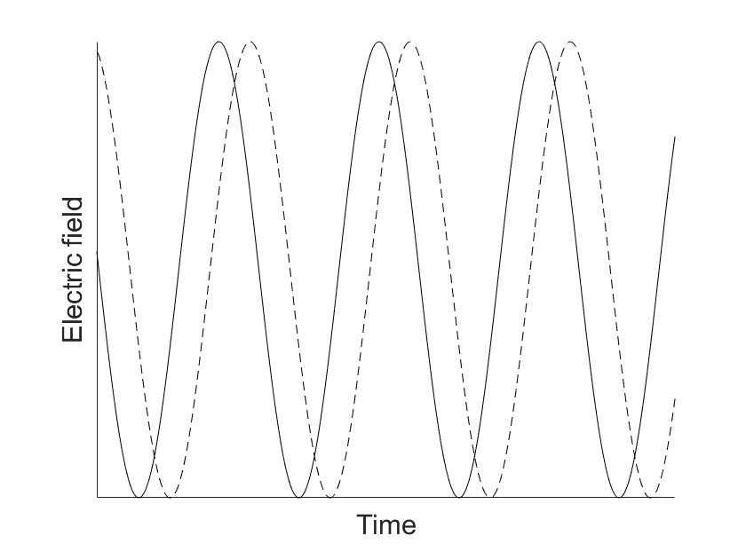
Sources of jitter
6/10
Bunch arrival time jitter
Jitter in injection time into the linac.
RF amplitude jitter
RF field strength can vary.
RF phase jitter
RF phase affects the initial bunch energy and chirp.
THz arrival time jitter
Alters the phase of the energy modulation imposed on the bunch

Slide 8
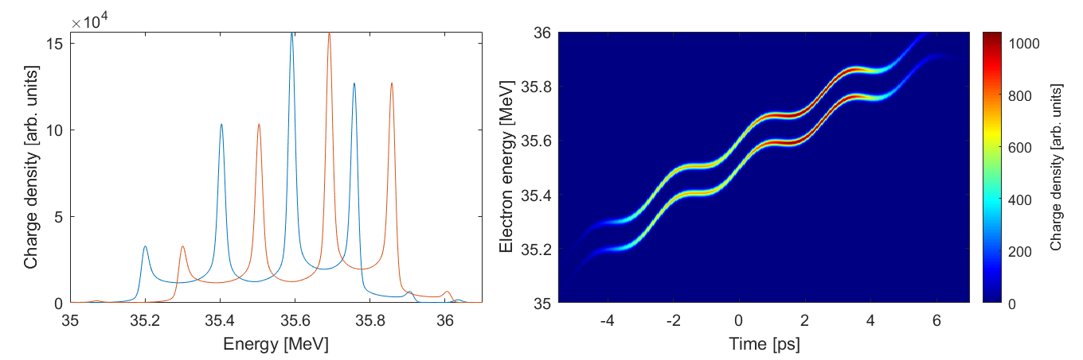
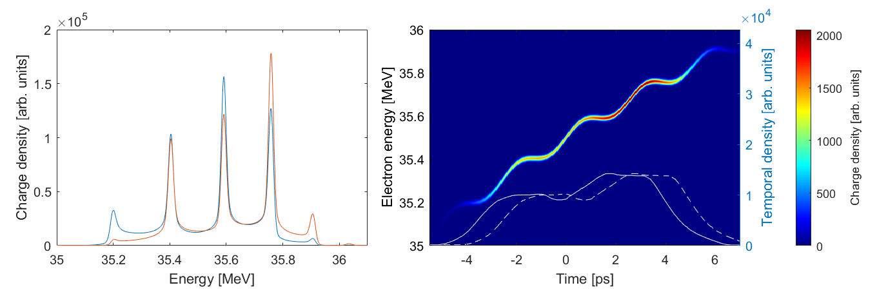
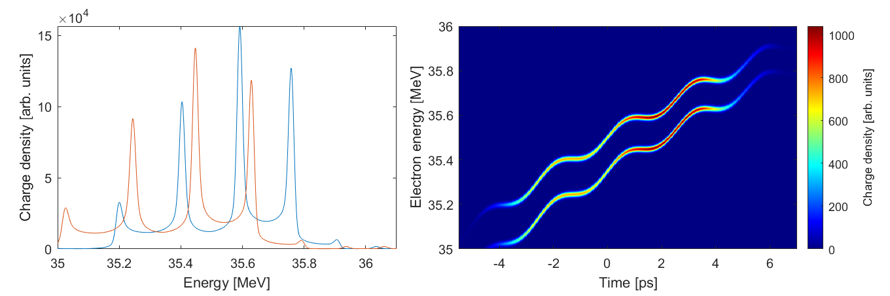
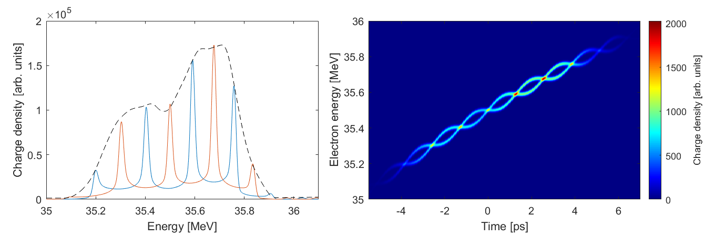

Jitter modelling and extraction
7/10
Each source of jitter produces a unique effect in the energy spectrum, and can therefore be extracted independently.
RF amplitude jitter
Bunch arrival time jitter
ΔE_{b}
ΔE_{b}
Peaks are locked
ΔE_{a}
ΔE_{a}
Bunch profiles
Pedestal shifted
Equal energy shift to each peak
Phase space moved vertically in energy
Pedestal is shifted
Peaks remain at fixed energy
Phase space remains overlapped
Bunch profile arrives at a different time
ΔE_{a} = ΔE_{b}
ΔE = 0
RF phase jitter
THz arrival time jitter
ΔE_{d}
THz off
ΔE_{d}
THz off spectrum (norm.)
ΔE_{f}
ΔE_{e}
ΔE_{c}
ΔE_{c}
Energy shift to peaks depends on local chirp
Chirp profile is of underlying bunch is changed
THz off LPS has different curvature
Peaks are shifted along the underlying phase
Pedestal is still fixed to the energy of THz off beam
THz phase alters the energies where LPS is flattened
Chirp profile of underlying bunch unchanged
ΔE_{c} > ΔE_{d}
ΔE_{e} ≈ ΔE_{f}

Slide 9
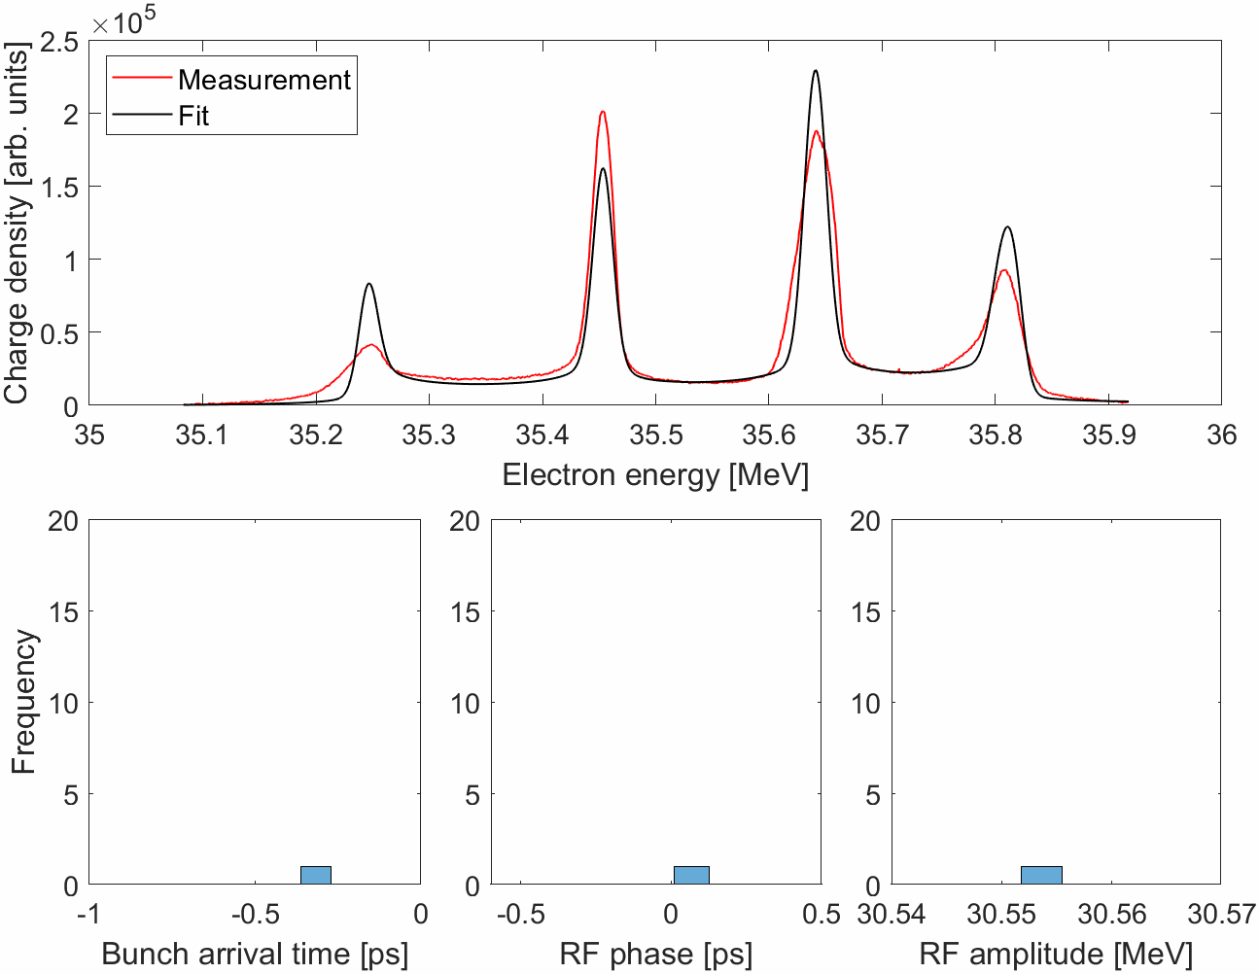
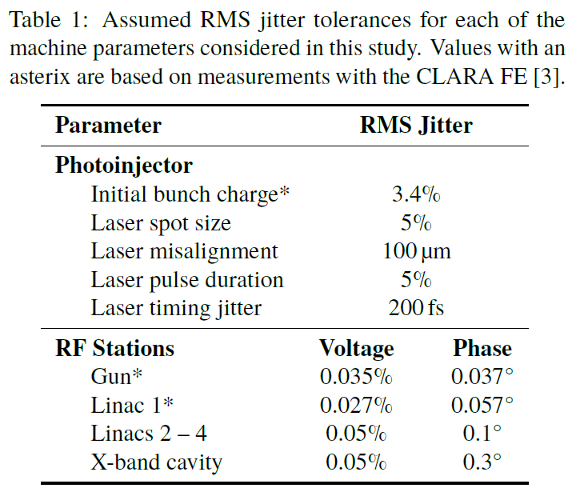
Jitter modelling and extraction
8/10
Measured energy spectra of
50 consecutive THz-modulated bunches.
A best fit to the energy spectrum extracts the phase space.
Values for each source of jitter are found shot-by-shot.
By converting the units, we find the extracted jitter compares well with previous work on CLARA.
Jitter source | Bunch arrival time | RF phase | RF amplitude
RMS jitter extracted from fitting (rel. to THz drive laser) | 157 fs | 211 fs | 5.3 keV
< M. A. Johnson, J. K. Jones, P. H. Williams,
‘Jitter Tolerance for the FEBE Beamline on
CLARA’, IPAC 2023, JaCoW Publishing
(Units chosen for convenient simulation)

Slide 10
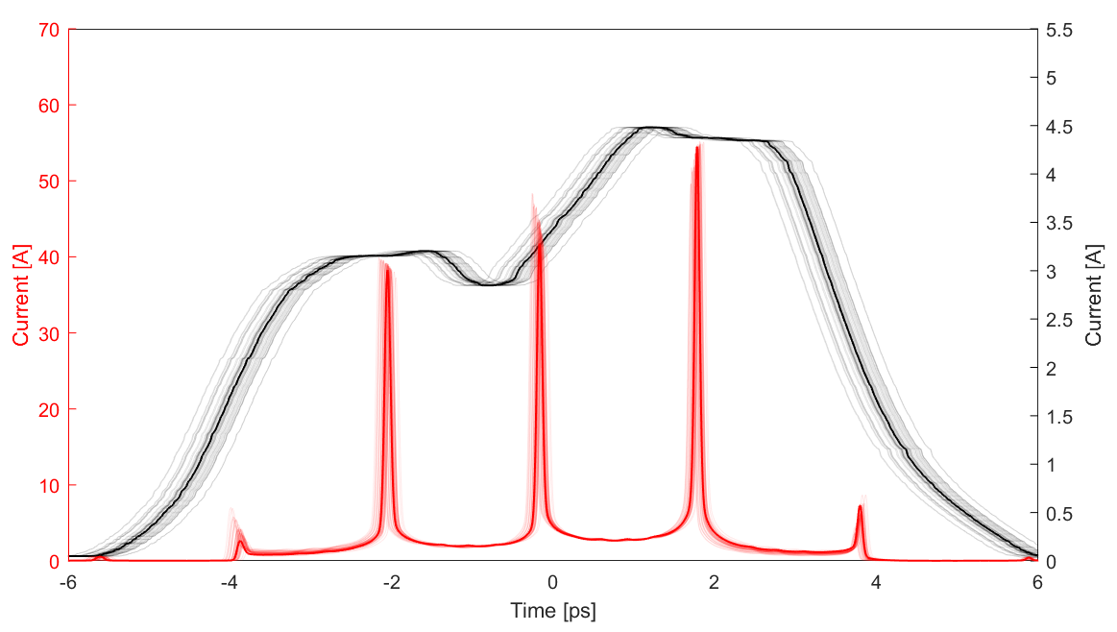

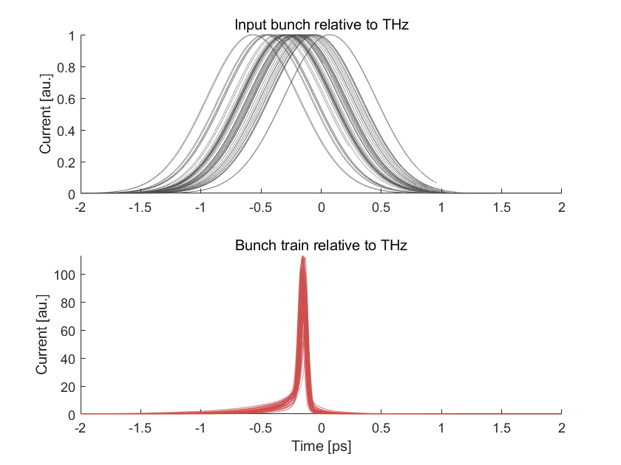
Jitter suppression
9/10
Long bunches for diagnostics,
shorter bunches for compression…
1.5 ps FHWM
Lower chirp
1.5 x higher THz field
R₅₆ – 2.44 ps/MeV
Jitter relative to the laser is reduced by a factor of 13 x.
δ_{t} = 33 fs rms
δ_{t} = 38 fs rms
δ_{t} = 43 fs rms
δ_{t} = 144 fs rms
Bunch from CLARA
δ_{t} = 29 fs rms
δ_{t} = 144 fs rms
50 shots
Base beam from CLARA (black) - 144 fs rms jitter
Corresponding compressed bunch trains with THz on (red) - 30 fs rms jitter
R₅₆ – 3.46 ps/MeV
Compressed bunch with THz
δ_{t} = 11 fs rms
The compressed bunch train becomes locked to the laser.
Timing jitter relative to the laser is reduced by a factor of up to 5.

Slide 11
Summary
10/10
THz modulation experiments using CLARA
LPS diagnostic using THz modulation
Jitter from upstream accelerator components can be diagnosed using THz modulation.
THz-modulated / chirped bunches can be compressed into micro-bunch trains or ultra-short single bunches.
Bunch from CLARA
The compressed bunches can be locked to the THz drive laser, with rms jitter of 11 – 30 fs.
δ_{t} = 144 fs rms
A directly scalable technique…
Jitter suppression can be readily improved be increasing the THz field and using a lower value of R₅₆, bringing bunches with fs-scale duration and synchronisation within reach.
Compressed bunch with THz
δ_{t} = 11 fs rms
Thank you for listening!

Slide 12

Thanks for listening! Any questions?
Thanks to all the people involved
Morgan T. Hibberd^{1,2}, Christopher T. Shaw^{1,2}, Daniel S. Lake^{1,3}, Connor D.W. Mosley^{1,3}, Sergey Siaber^{1,3}, Beatriz Higuera Gonzalez^{1,2}, Thomas H. Pacey^{1,4}, James K. Jones^{1,4}, David A. Walsh^{1,4}, Robert B. Appleby^{1,2}, Graeme Burt^{1,3}, Darren M. Graham^{1,2}, and Steven P. Jamison^{1,3}
1
2
3
4
joseph.bradbury-2@manchester.ac.uk
Terahertz Acceleration Group @ The Cockcroft Institute - www.THzAG.uk

