Slide 1
Crystal experiments and recent measurements at CERN
K.A. Dewhurst, on behalf of the NDC (Non-linear Dynamics and Collimation) Section
12 June 2024

Slide 2
Contents
Why use bent crystals?
Crystals for collimation of the lead ion beam
The TWOCRYST experiment
Channelling efficiency measurements
Summary

Slide 3
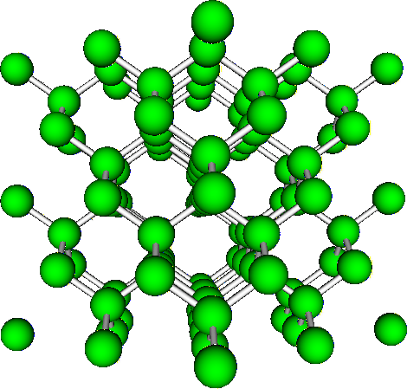
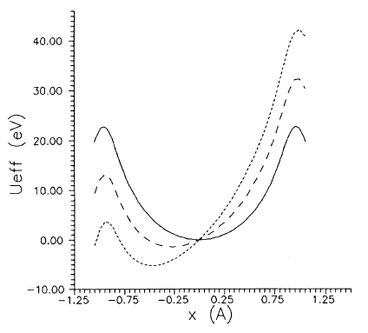
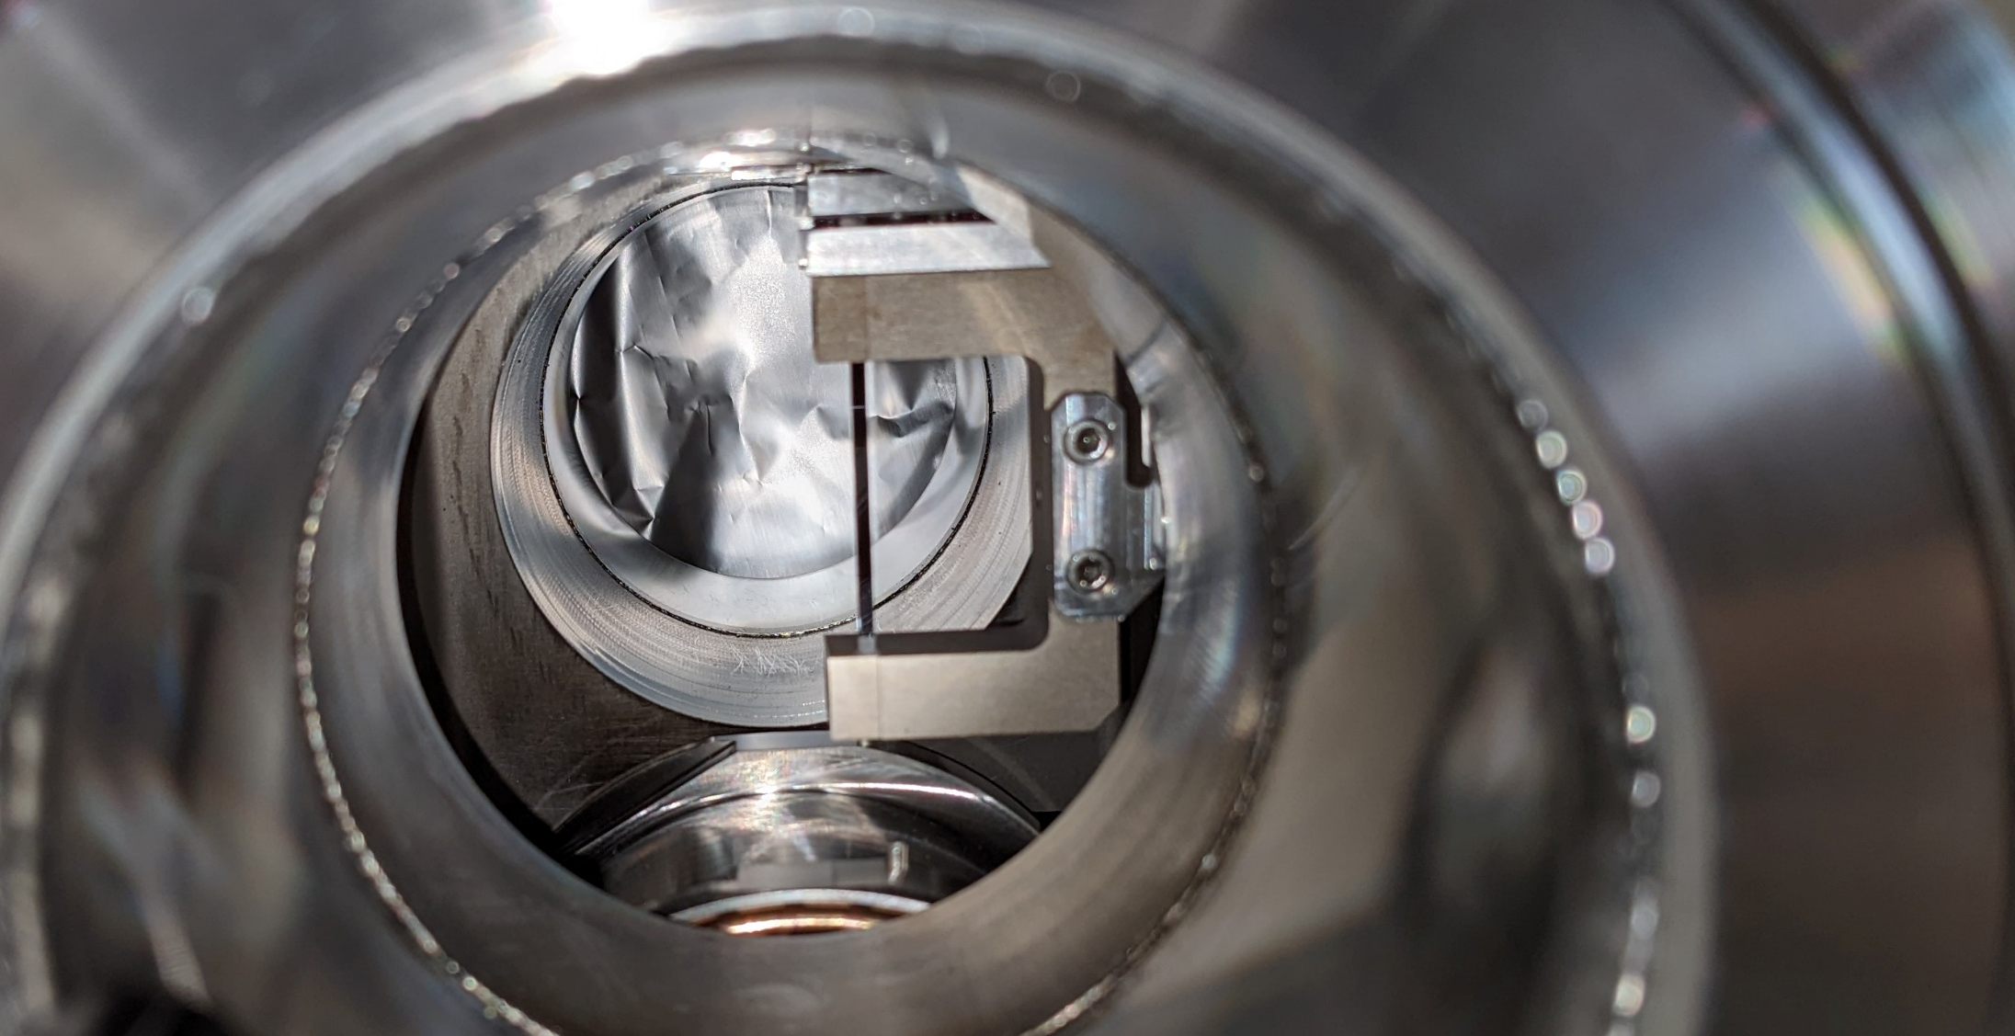
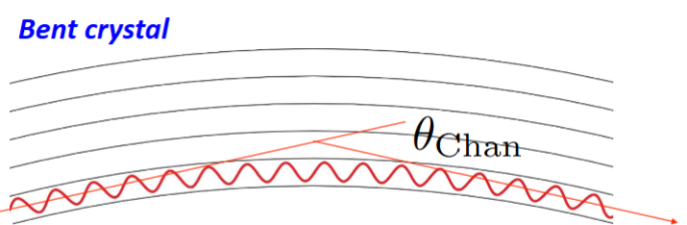
Why use bent crystals?
Charged particles follow the lattice structure of the silicon crystal. Holders clamp the silicon crystal sheet into a bent position. With bent crystals, particle trajectories can be bent in a short distance.
Crystal lattice
Channel particles
Bend trajectory
Critical angle
No bending
1 GeV/cm
2 GeV/cm
V. M. Biryukov et al., 1997
doi: 10.1007/978-3-662-03407-1.

Slide 4
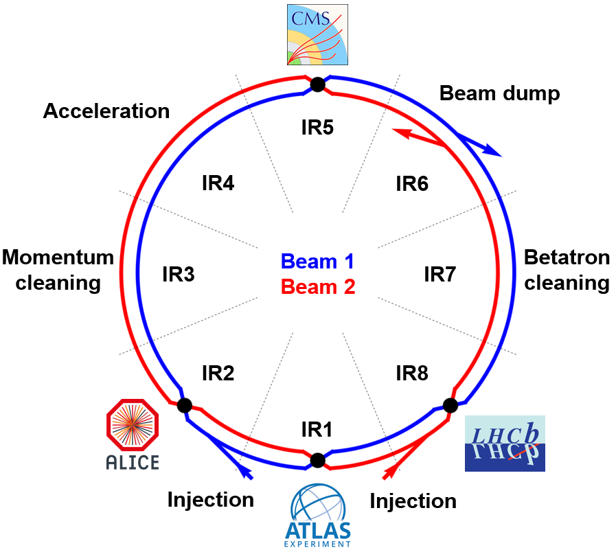
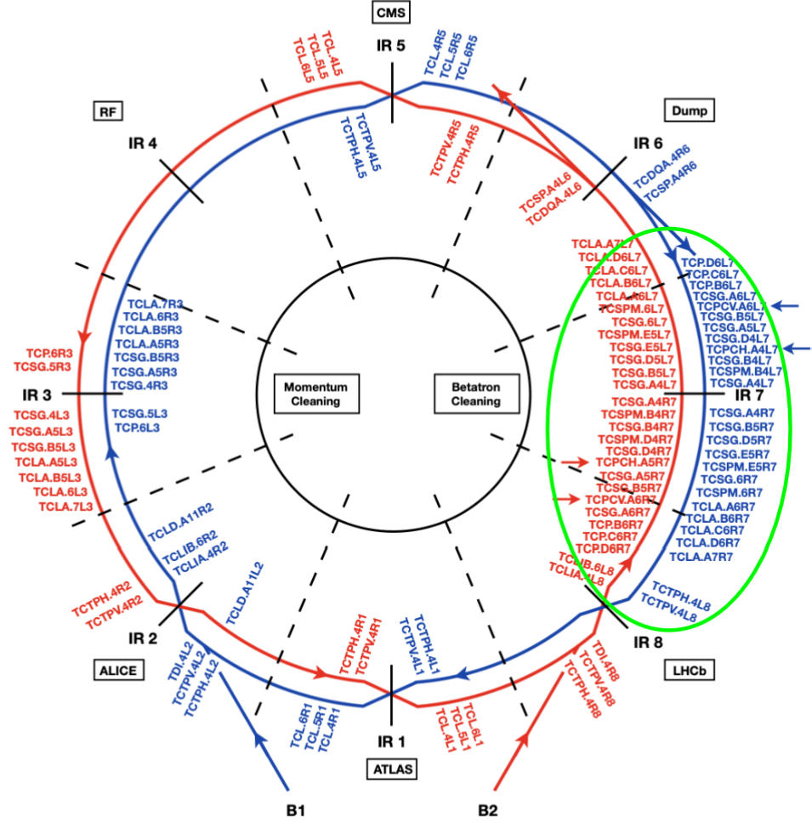
Crystals for collimation
LHC
Collimators
IR3 – momentum cleaning
IR7 – main collimation region (betatron cleaning)

Slide 5
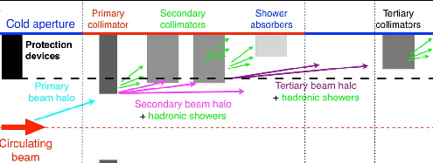
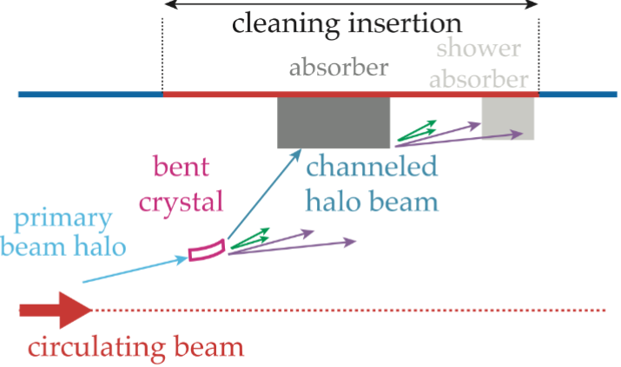
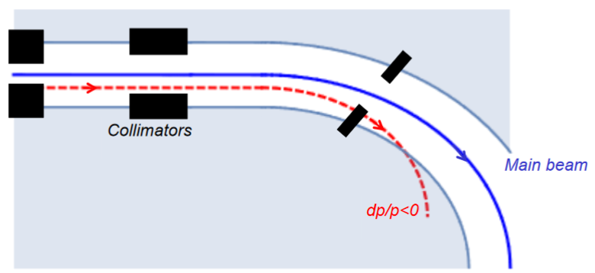
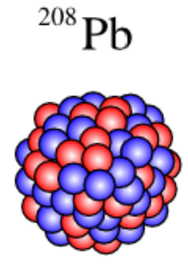
Crystals for collimation
A hierarchy of collimators scatter, and eventually absorb particles from the beam halo. Works for the LHC!
Projected collimation performance at the HL-LHC:
OK for proton beams!
Not OK for lead ion beams ☹

Slide 6
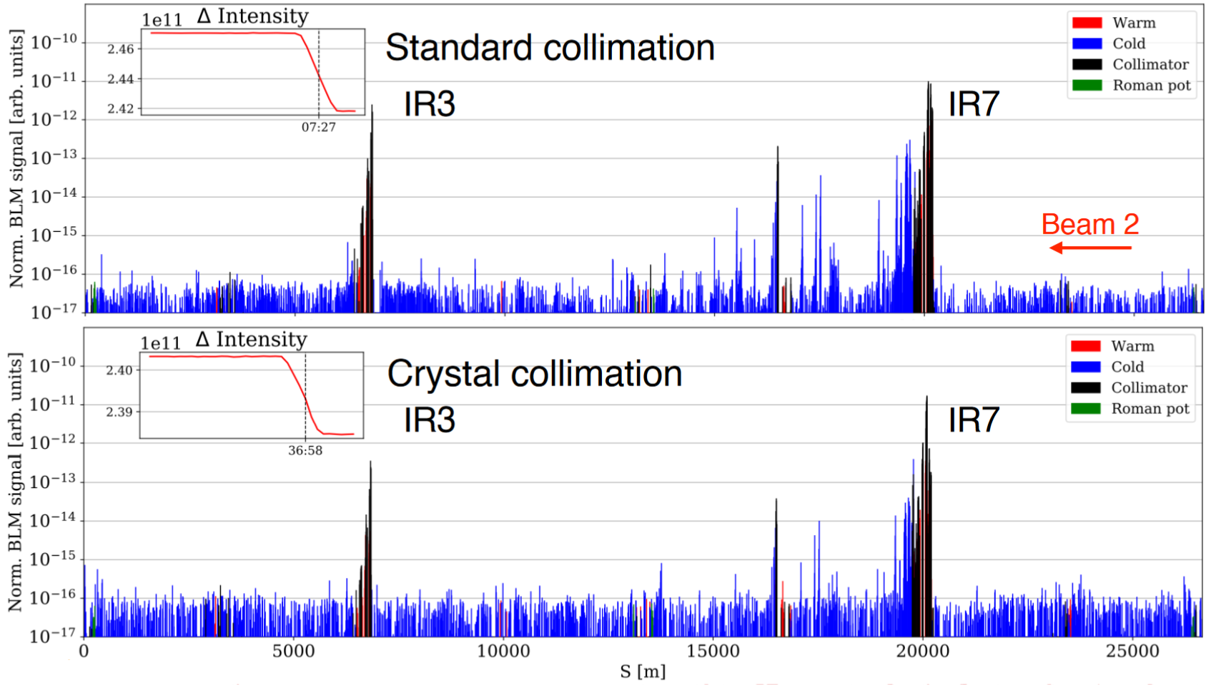
Crystals for collimation
Area of interest

Slide 7
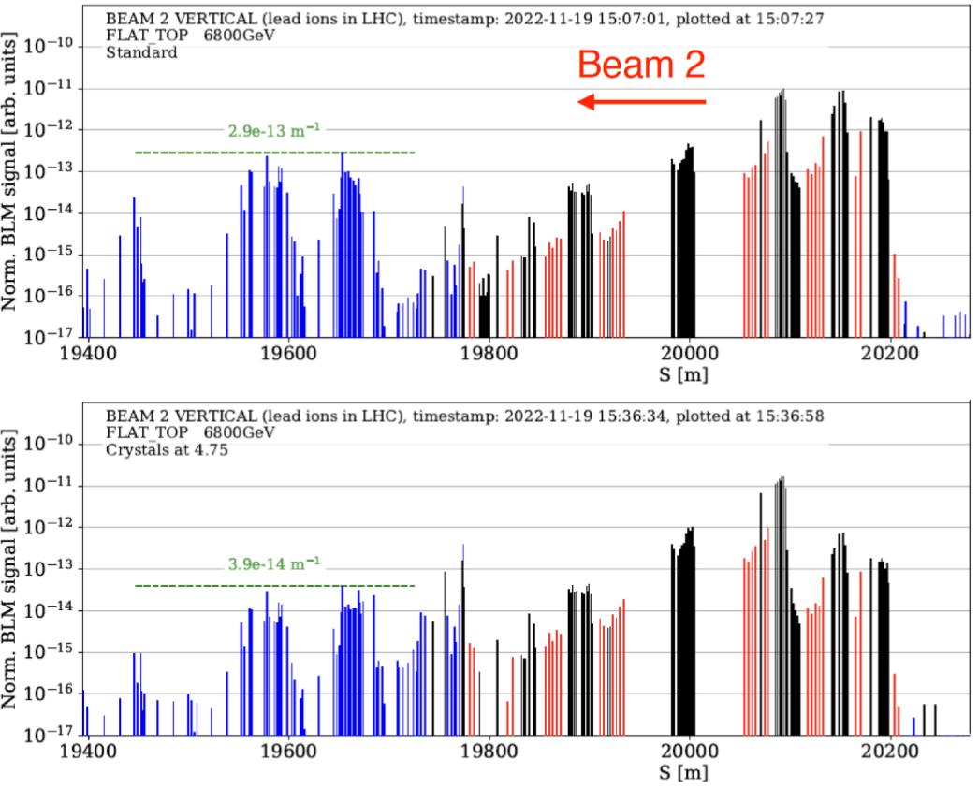
Crystals for collimation
The first comparisons of cleaning the LHC 6.8 Z TeV lead ion beams with crystal collimation was carried out in 2022/2023.
The crystal collimators are located in IR7.
Cleaning efficiency was improved in every case. Empirical comparisons indicate gains with a factor >5 for the best crystals!
Find out more, read the paper:
D’Andrea et al., Operational performance of crystal collimation with 6.37 𝑍 TeV Pb ion beams at the LHC, Jan 2024 https://doi.org/10.1103/PhysRevAccelBeams.27.011002
IR7 Standard collimation
2.9e-13 m⁻¹
IR7 Crystal collimation
3.9e-14 m⁻¹

Slide 8
Contents
Why use bent crystals?
Crystals for collimation of the lead ion beam
The TWOCRYST experiment
Channelling efficiency measurements
Summary

Slide 9

Physics Beyond Colliders: IR3 experiment
ALADDIN
An Lhc Apparatus for Direct Dipole-moments INvestigation
🚩
Final PBC double-crystal experiment
Aim: To measure the magnetic and electric dipole moments of rare baryons (Λ_{c}).
Run 4
HL-LHC
2029 +
TWOCRYST
Proof-of-principle (PoP) test stand
Aims: To gain operational and technical experience.
To characterise the IR3 crystals.
To measure crystal channelling efficiency at TeV energies.
Run 3
LHC
2025 +
Crystals in the LHC
Collimation crystals are already installed in IR7.
Crystal prototypes for IR3 are being manufactured and tested.
Run 3
LHC
2023 (today)

Slide 10
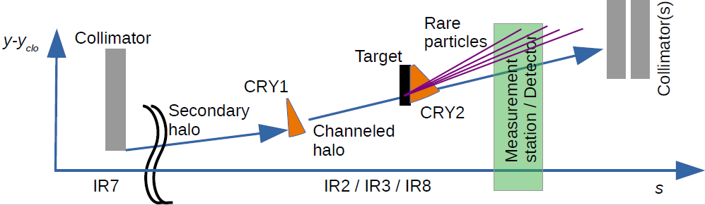
The final PBC experiment: ALADDIN double-crystal setup – high intensity operation
TCCS
TCCP
Protons impact the collimator (TCP in IR7) – some particles form a secondary halo
Intercept halo particles with a first bent crystal (CRY1) directing them towards a fixed target
Fixed target at safe distance from beam Proton interactions produce rare baryons
Detector including spectrometer: measure precession + decay products
Collimators: safely absorb residuals of the channelled halo
A second bent crystal enforces precession of the rare baryons

Slide 11

A Proof of Principle experiment: TWOCRYST low intensity operation at TeV energies
Target TGT retracted
Absorber
TCLA
Pixel detector PIX 1
Crystal 2
TCCP
Crystal 1
TCCS
Beam ➡
1 m
One goal on the journey: find the channelling efficiency of crystal 2 (TCCP)
Align CRY1 with the edge of the main beam (~5σ) to produce channeling – one spot on pixel detector
Align CRY2 (linear and angular position) to produce double-channelling – second spot on pixel detector
Measure intensity of double-channelled halo spot on the detector, to find the channelling efficiency of CRY2.
For a prediction from simulations see IPAC paper doi: 10.18429/JACoW-IPAC2024-TUPC64.

Slide 12
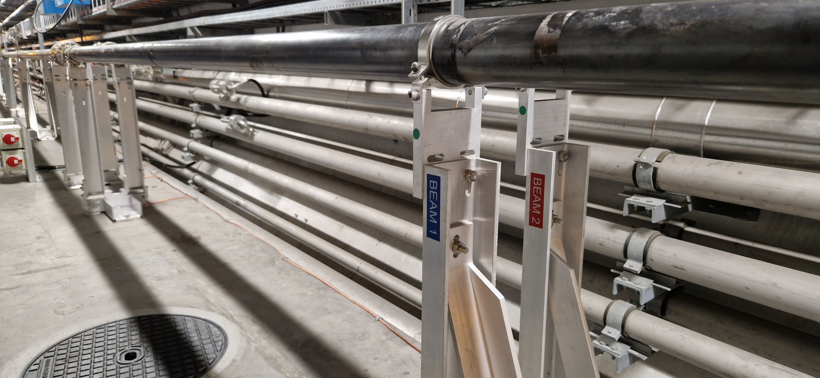
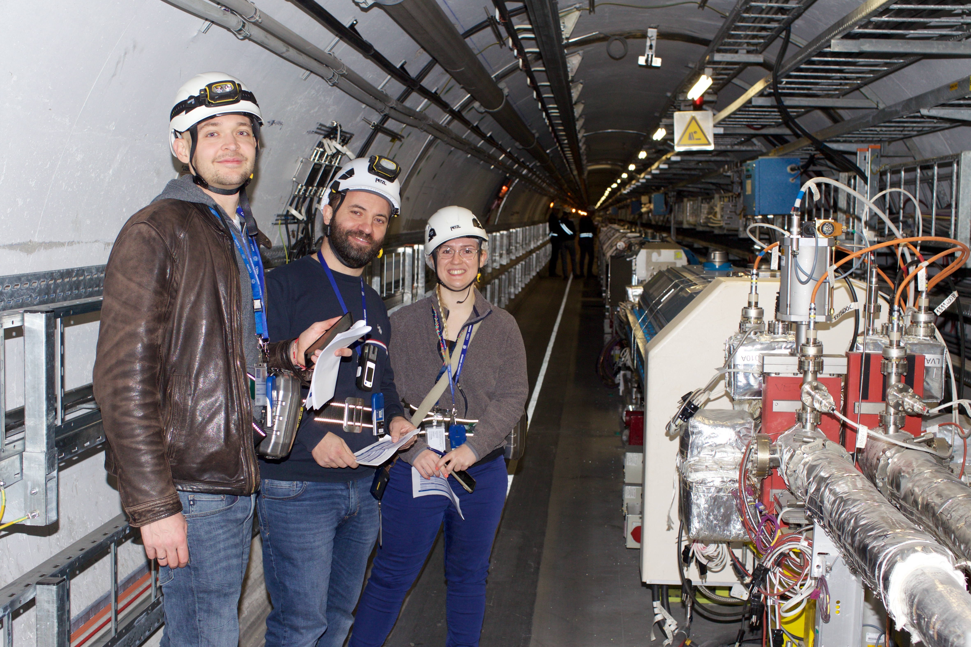
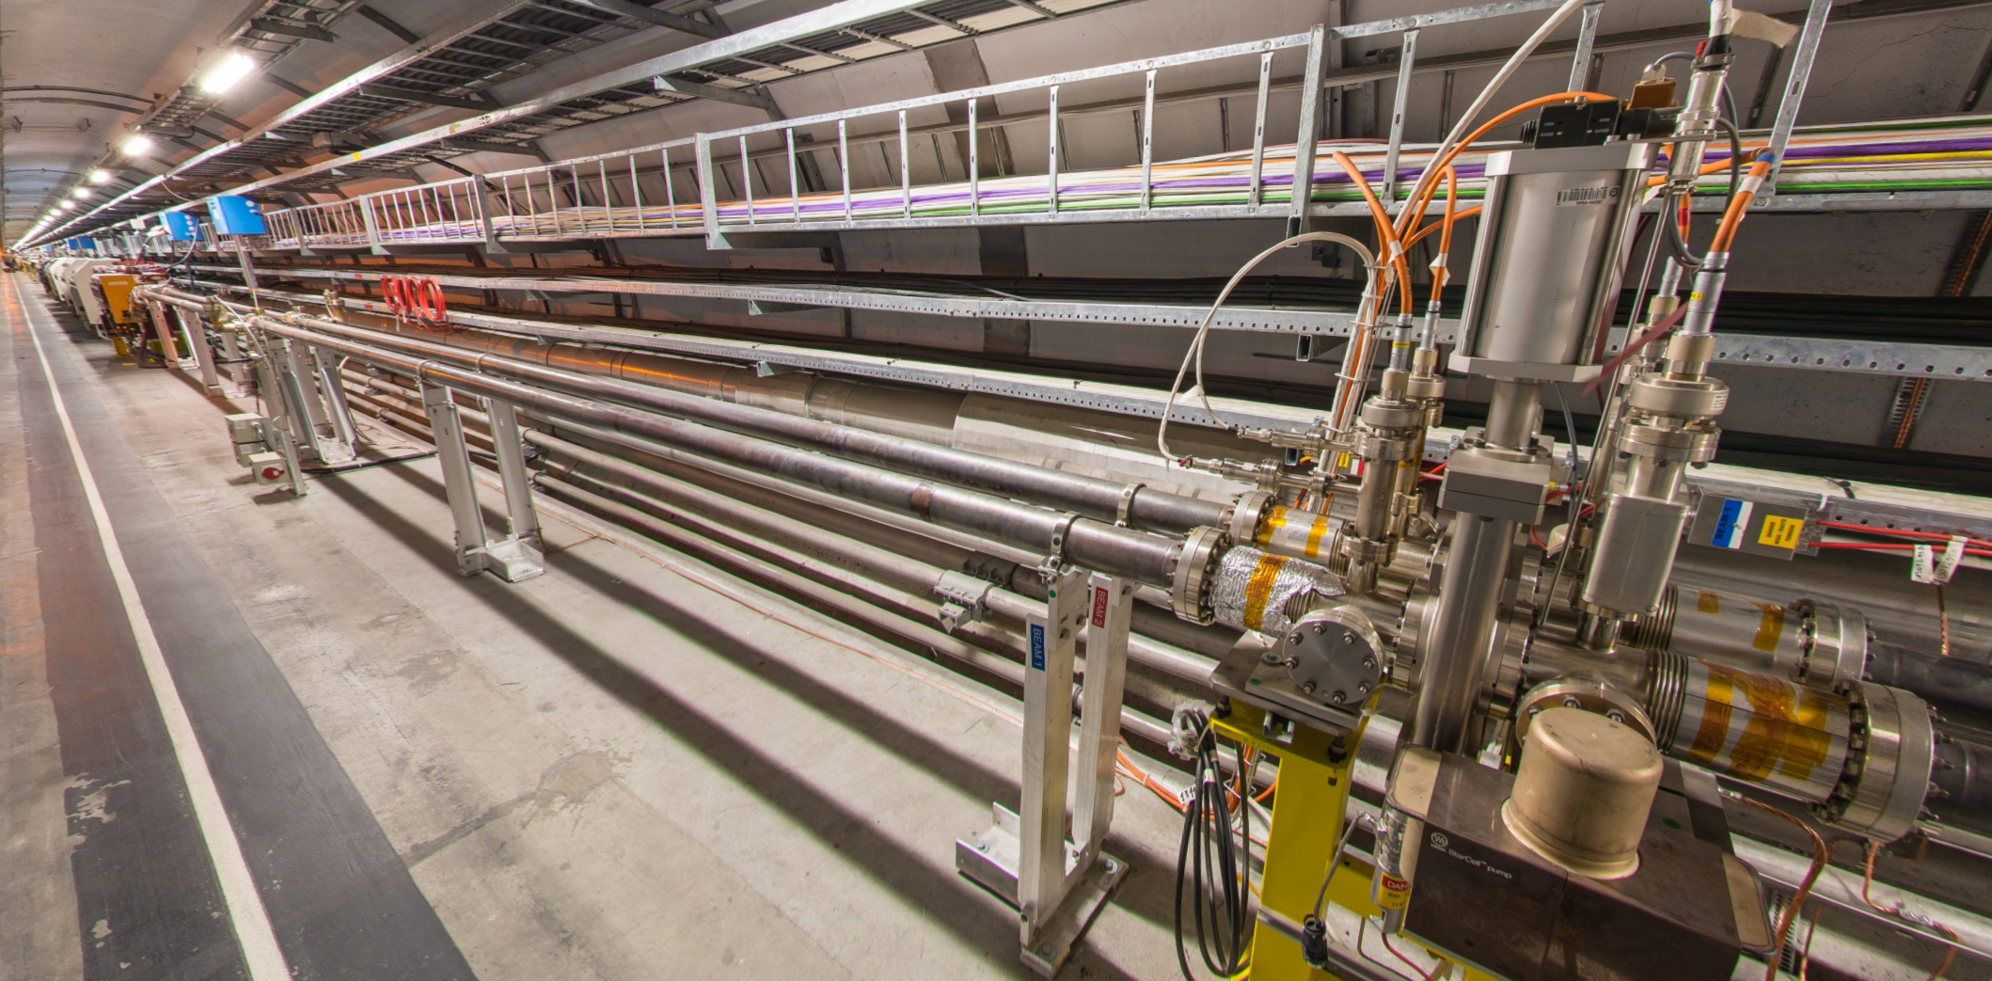
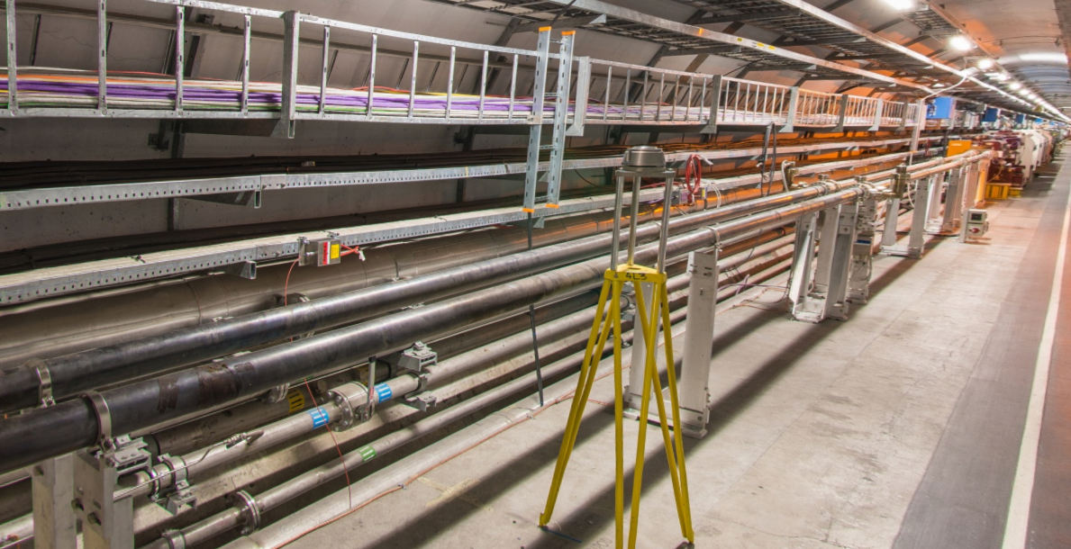
TWOCRYST to be installed this year
Visit to IR3 in February 2023 to check component positions and space requirements.
Components will be installed in the Year-End-Technical-Stop (YETS) of 2024/2025.
Measurements will take place in 2025.
Crystal 1 at 6775 m
Space available
Crystal 2 at 6655 - 6675 m
Plenty of space available

Slide 13
Contents
Why use bent crystals?
Crystals for collimation of the lead ion beam
The TWOCRYST experiment
Channelling efficiency measurements
Summary

Slide 14
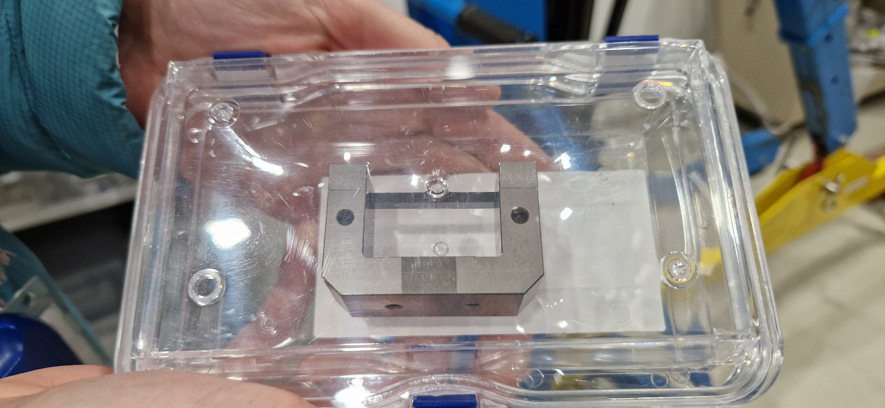
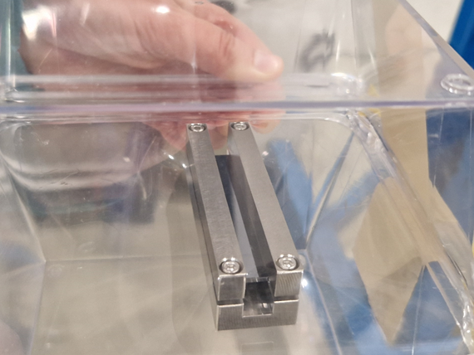
The TWOCRYST crystals: TCCS and TCCP
The TCCS and TCCP were delivered to CERN in summer 2023. Single-pass experiments were carried out to measure the single-pass channelling efficiency.
TCCS (crystal 1) TCCP (crystal 2)
Prototype

Slide 15
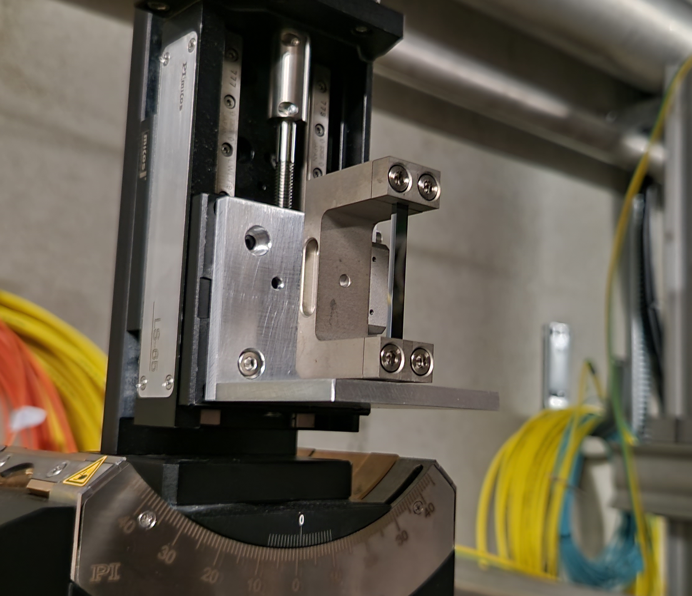
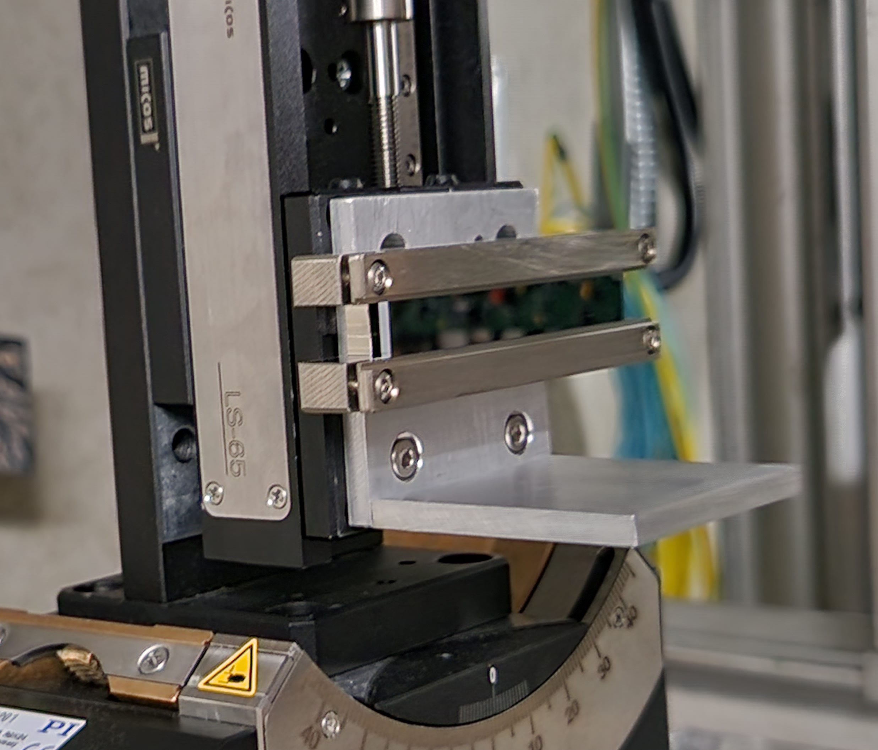
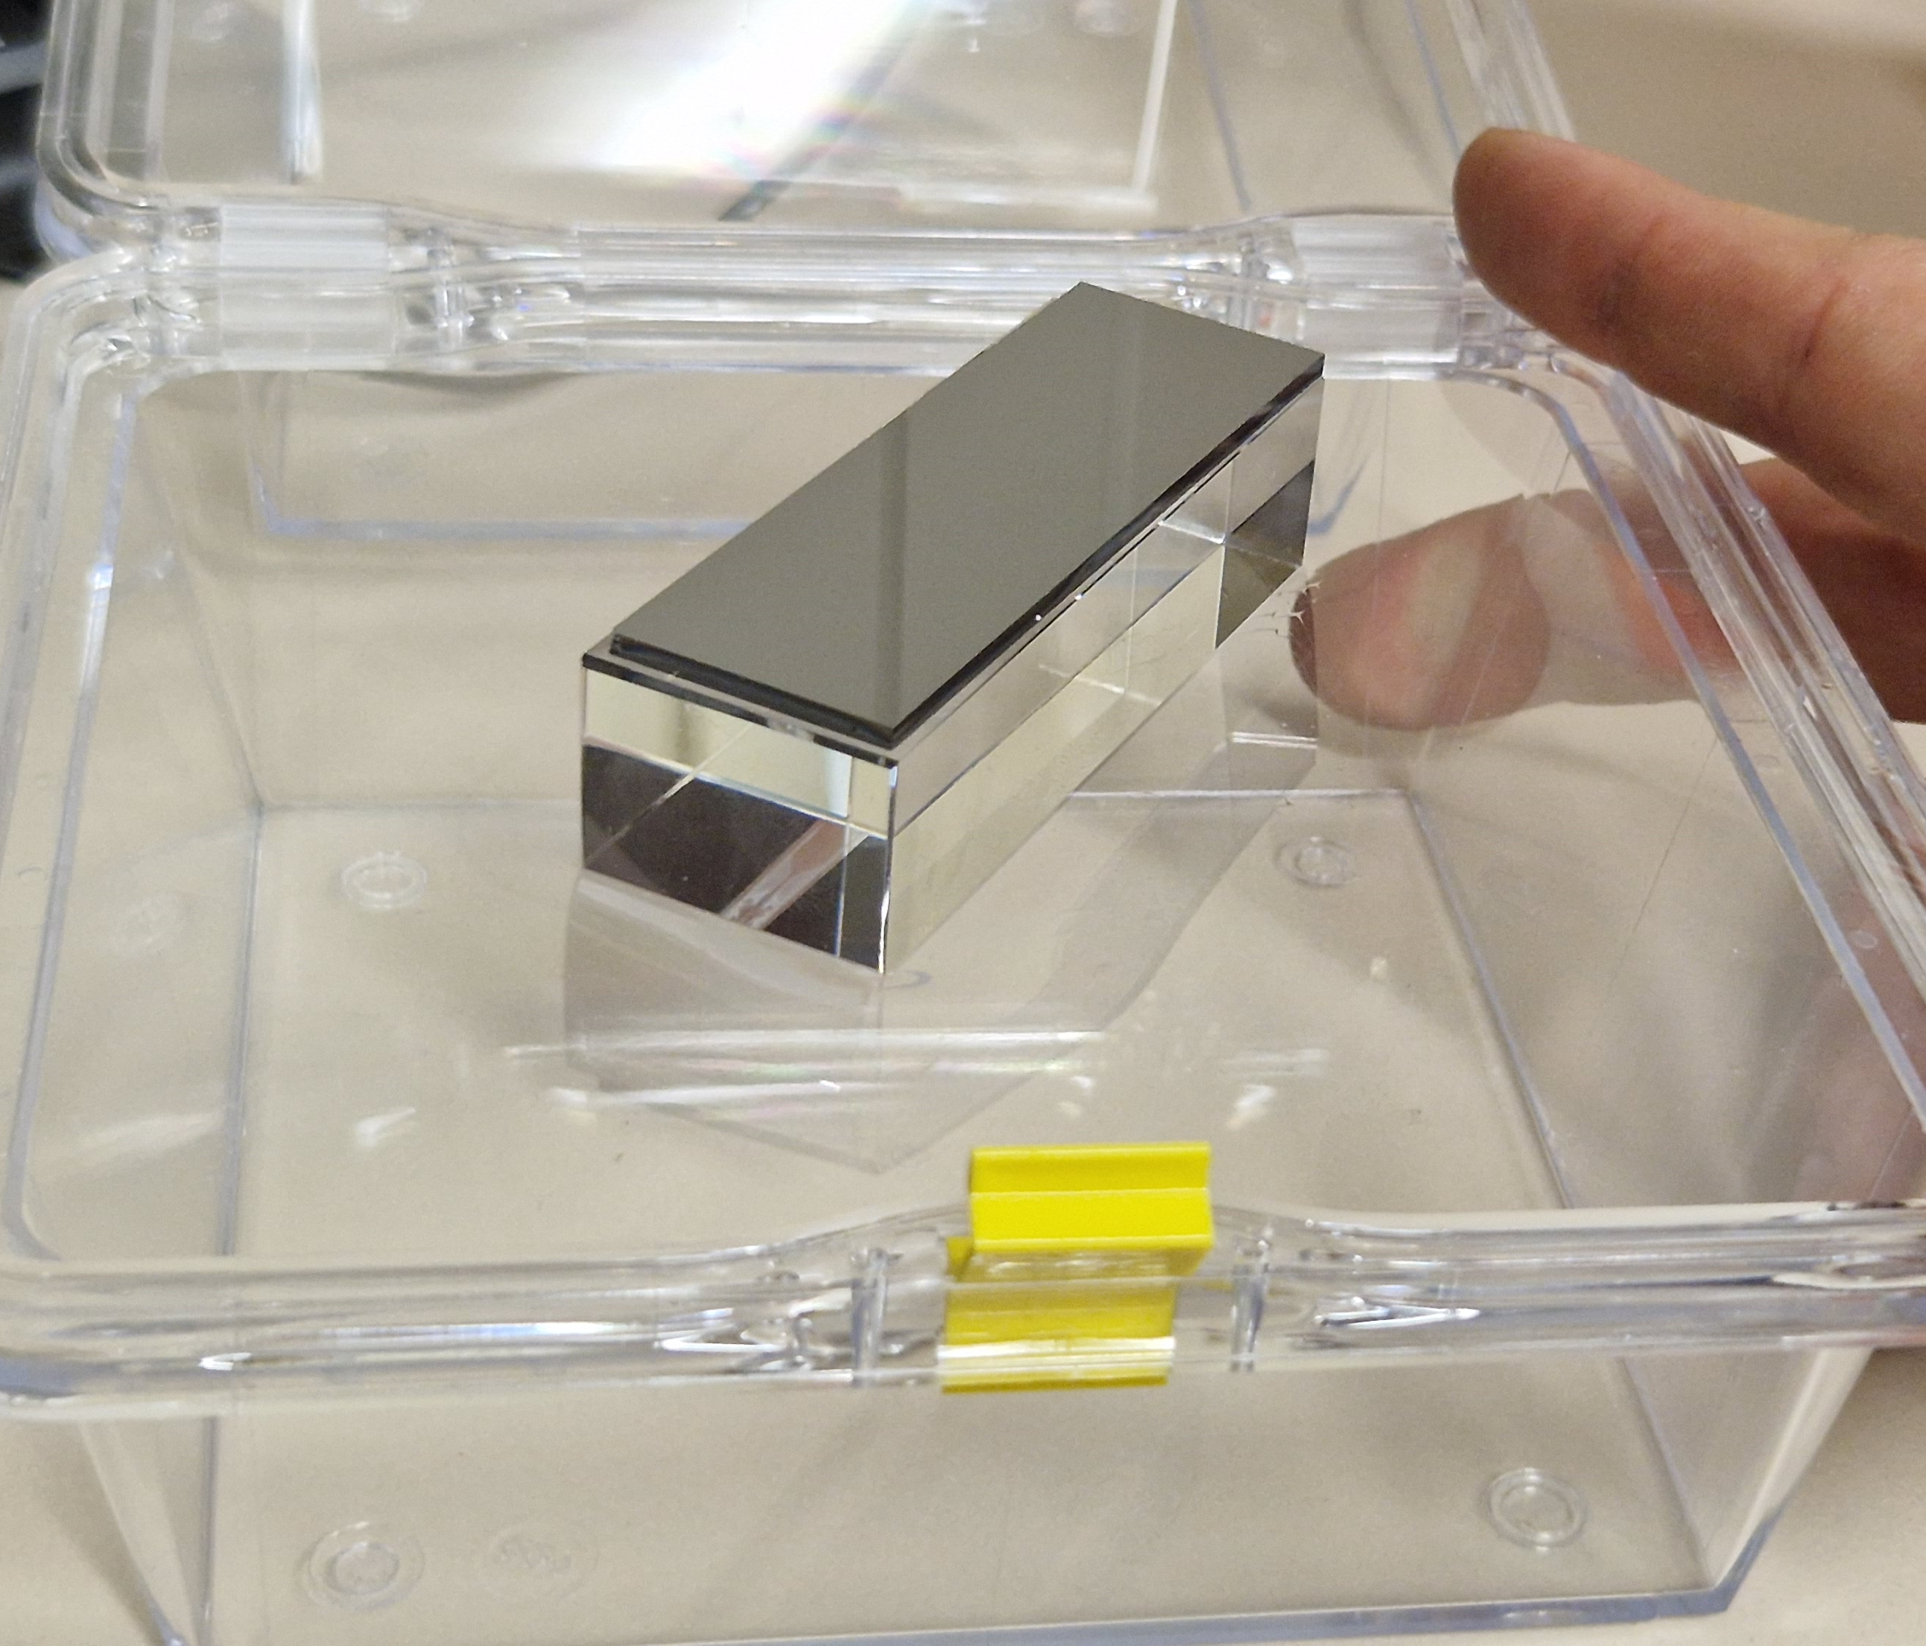
3. The TWOCRYST crystals
Crystal 1 (short)
Crystal 2 (long)
Anodic-bonded crystal
Crystal properties:
Length 4 mm
Material Silicon
Bend radius 80.0 m
X dimension 2 mm
Y dimension 35 mm
Crystal properties:
Length 70 mm
Material Silicon
Bend radius 10.0 m
X dimension 2 mm
Y dimension 8 mm
Crystal properties:
Length 70.5 mm
Material Silicon
Bend radius 5.3 m
X dimension 2 mm
Y dimension 22.5 mm

Slide 16
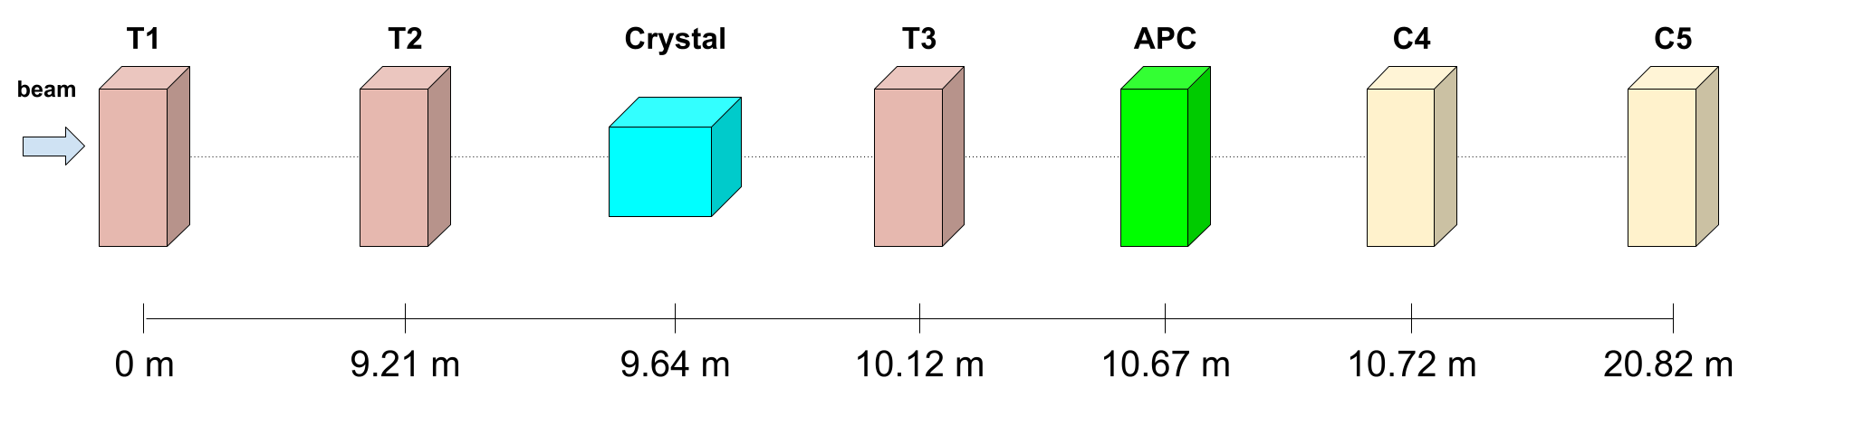
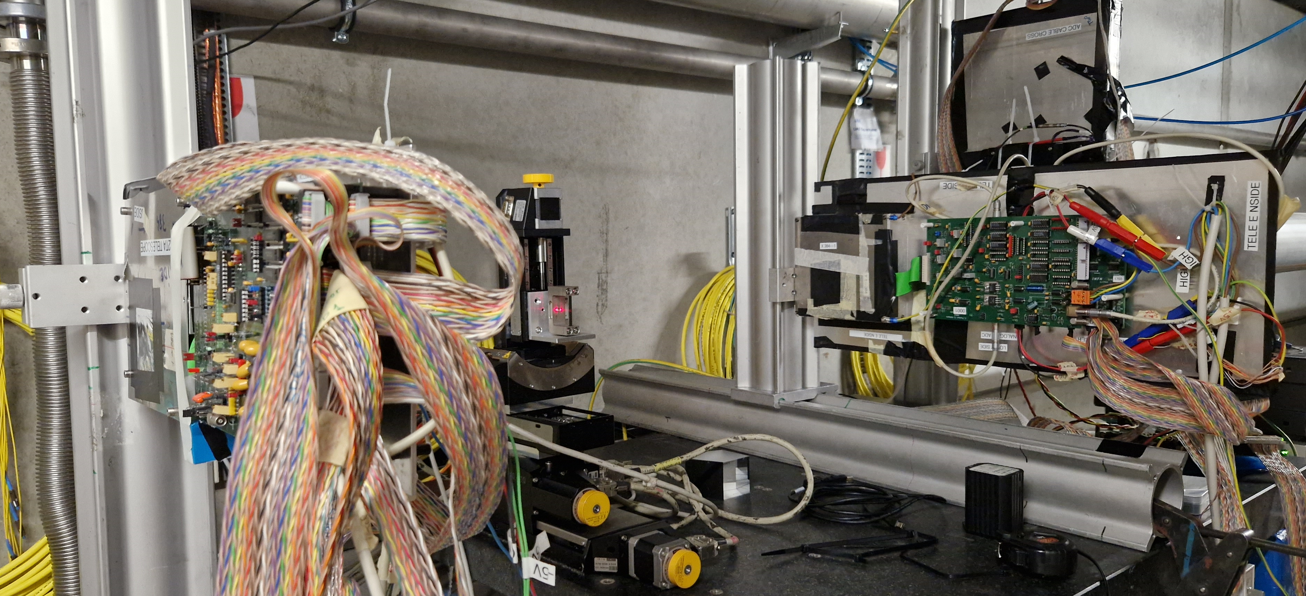
The TWOCRYST crystals: TCCS and TCCP
Single-pass experiments were carried out in Aug 2023 in the CERN North Area (beamline H8) to measure the single-pass channelling efficiency. Results soon to be published.
H8 experiment
Preliminary results:
cut at half of the critical angle
θ_{in}
θ_{out}
Crystal and data cut point | Ch. Eff. expected from simulation | Whole crystal Ch. Eff. H8 data | Central 2.5 mm Ch. Eff. H8 data | Bend angle H8 data
Crystal 1 (TCCS) (+/- 7.7 µrad) | ~77 % | 59.7 % | 63.4 % | 48 µrad (aim 50)
Crystal 2 (TCCP) (+/- 7.3 µrad) | ~36 % | 8.0 % | 13.0 % | 6915 µrad (aim 7000)
Anodic-bonded crystal (+/- 7.0 µrad) | ~ 30 % | 10.0 % | 12.4% | 13280 µrad (expected 13302)
T2
Crystal
T3

Slide 17
Summary
Why use bent crystals?
- For collimation: the bend angle does not vary with the mass-to-charge ratio.
- For spin-precession: short-lived particles can traverse a short (cm-length) crystal before they decay.
Crystals for collimation of the lead ion beam
- Have been show to improve the cleaning efficiency
The TWOCRYST experiment
- Components will be installed in the upcoming YETS
- Measurements in the LHC will take place in 2025
- Single-pass channelling efficiency measurements have been carried out in the North Area

Slide 18

Thank you.
Read the IPAC 2024 papers: https://doi.org/10.18429/JACoW-IPAC2024-TUPC64 https://doi.org/10.18429/JACoW-IPAC2024-TUPC65 https://www.jacow.org/ipac2024/doi/jacow-ipac2024-frxn3/index.html
Kay Dewhurst | Crystal experiments and recent measurements at CERN

