Slide 1
Monte Carlo Techniques for Modelling X-Ray Detector Systems
L. Eley^{1,2}, D. Aflyatunova^{1,2} , P. Betteridge³ , J. Cameron³ , M. Contino³ , A. Hill¹, A. Mavalankar³ , S. Wells³ , C. P. Welsch^{1,2}
¹ University of Liverpool, Liverpool, UK
² Cockcroft Institute, Warrington, UK
³ Adaptix Ltd, Oxford, UK

Slide 2

Digital tomosynthesis
[1] S.H Chou et al., Digital Tomosynthesis of the Chest: Current and Emerging Applications. Radiographics, 2014
Background
Digital Tomosynthesis (DT) is a mode of 3D imaging ^{[1]}
Varying positions of an x-ray source creates different projections (‘slices’) that can be reconstructed into a 3D image of the object
Conventional DT does this by rotating an x-ray tube 30º – 60º over the object

Slide 3
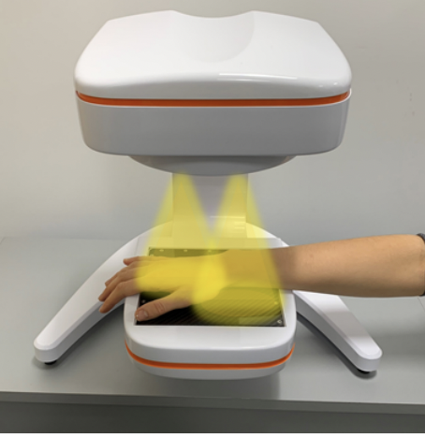
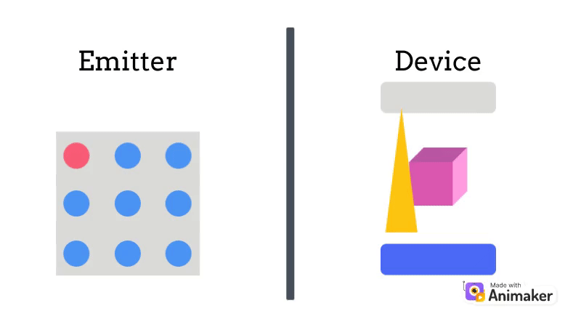
Adaptix digital tomosynthesis
[2] S Wells et al.. Modelling the Use of Stationary, Rectangular Arrays of X-Ray Emitters for Digital Breast Tomosynthesis. In Medical Imaging 2020: Physics of Medical Imaging, SPIE, 2020
[3] Adaptix Ltd, www.adaptix.com
Background
The Adaptix DT approach is different to conventional DT in the imaging approach^{[2]}
  Square array of emitters vs x-ray tube
  Still low dose, low cost
  Greater mobility

Slide 4
X-Ray detectors
[4] T. Hatsui and H. Graafsma, “X-ray Imaging Detectors for Synchrotron and XFEL sources”, IUCrJ, vol. 2, no. 3, pp. 371 2015
[5] E. Samei and M. Flynn, “A method for measuring the presampled MTF of digital radiographic systems using an edge test device,” Med. Phys., 1998
Background
Modern x-ray detectors are flat-panel digital detectors (medical and accelerator) ^{[4]}
  Indirect vs direct
  Electronic readout (fast, no intermediate step required)
  Good for mobility
  Geometry characteristic to system and purpose
Accepted Parameters ^{[5]:}
Modulation Transfer Function (MTF)
Noise Power Spectrum (NPS)
Detector Quantum Efficiency (DQE)

Slide 5
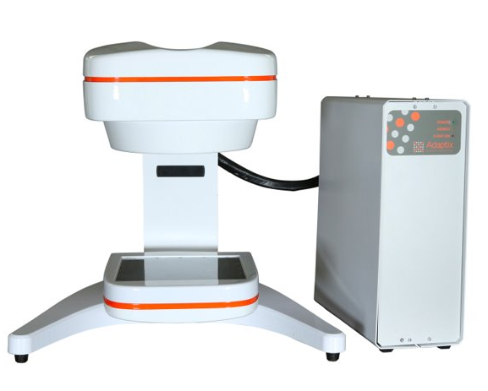
Adaptix detector focus
Motivation
While flat-panel source is designed in-house, flat-panel detector is commercially sourced
Creates questions:
  If this detector was designed in-house, what would the optimal design look like?
  How to parameterise the suitability of the detector?
  What are the key characteristics of a ‘good’ detector?
    Inform ‘most suitable’ commercially available option

Slide 6
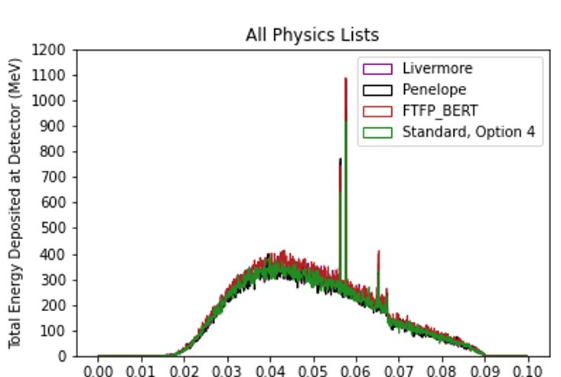
Monte carlo techniques : Geant4
[6] S. Agostinelli et al., “Geant4—a simulation toolkit”, Nuclear Instruments and methods in physics research section A: Accelerators, Spectrometers, Detectors and Associated Equipment, 2003
Method
This work uses Geant4 ^{[6]}
Tested a range of electromagnetic physics lists and settings
  Used Livermore (within error, faster runtime)
  5 um range cut
  Energies in range of 60 keV – 150 keV of interest
  Between 1 x 10⁴ and 2 x 10⁹ primary particles simulated
  Sensitive detector creates CSV readout

Slide 7
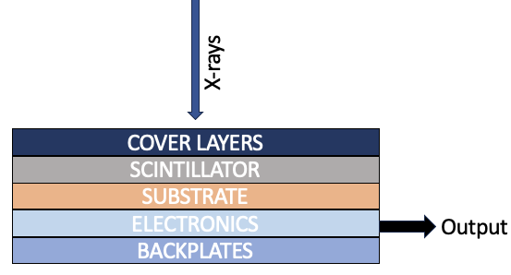
Building a detector in geant4
Method
Key elements of simulation are the target, filters and the phantom
Implementation of optics
  Numerical handling; sourced from literature
Recreation of detector layers from actual detector used
Change geometrical choices in the environment (e.g. scintillator material)

Slide 8
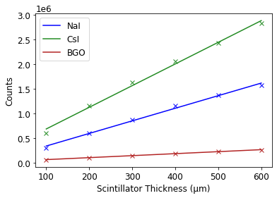
Preliminary tests
Results
Varying scintillator material and thickness to validate optical behaviour
  Bismuth Germanate (BGO), CsI (Caesium Iodide), NaI (Sodium Iodide) as most commonly used crystal scintillators
Expect linearity
  Due to numerical handling already discussed
Different gradient corresponds to differing photon yield

Slide 9
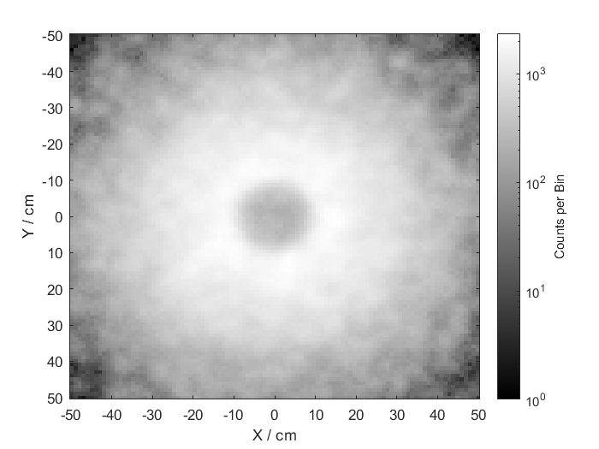
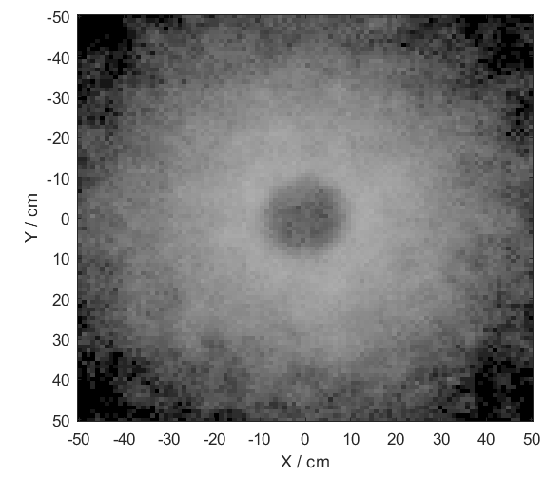
Preliminary tests
Results
A key capability of any x-ray detector is the ability to produce analysable images
By applying a binning grid over the detecting layer, analogous readout to pixel-by-pixel binning can be achieved
The images read optical photon count per bin
  The images shown show the shadow cast by a cylindrical steel phantom
  Attenuation differentials key for reconstruction
CsI
BGO

Slide 10
Findings & Future work
Conclusions
The scintillating layers showed the expected linearity in photon yield
The images created reflect the necessary attenuation and pixel detail that make it comparable to real-life detector systems
The next steps are to quantify known parameters (MTF, NPS, DQE) and benchmark simulation to experimental data
This will allow change of geometry and simulation conditions to answer the questions

Slide 11

Thank you for listening!
References
[1] S.H Chou et al., Digital Tomosynthesis of the Chest: Current and Emerging Applications. Radiographics, 2014
[2] S. Wells et al.. Modelling the Use of Stationary, Rectangular Arrays of X-Ray Emitters for Digital Breast Tomosynthesis. In Medical Imaging 2020: Physics of Medical Imaging, SPIE, 2020
[3] Adaptix Ltd, www.adaptix.com
[4] T. Hatsui and H. Graafsma, “X-ray Imaging Detectors for Synchrotron and XFEL sources”, IUCrJ, vol. 2, no. 3, pp. 371, 2015
[5] E. Samei and M. Flynn, “A method for measuring the presampled MTF of digital radiographic systems using an edge test device,” Med. Phys., 1998
[6] S. Agostinelli et al., “Geant4—a simulation toolkit”, Nuclear Instruments and Methods in Physics Research Section A: Accelerators, Spectrometers, Detectors and Associated Equipment, 2003
Any questions?
CONTACT ME:
Lauryn Eley lauryn.eley@liverpool.ac.uk

