Slide 1
CARP
Development of a new tool for modelling medical radionuclide production
Duncan Mayhem
11th June 24
Not protectively marked
Notes:
Name
Role
How long
Background

Slide 2

Acknowledgements
This work was partially undertaken within the SECURE project funded by the European Union under grant agreement No. 101061230.
“Strengthening the European Chain of sUpply for the generation medical RadionuclidEs”
Sustainability of medical isotope production
Focus on irradiation target and production route developments
Not protectively marked

Slide 3
Presentation Contents
What is CARP?
How does CARP work? (ish)
Example inputs and outputs
Verification & Validation work
Intended uses and future work
Not protectively marked

Slide 4
What is CARP
Computational Assessment of Radionuclide Production
New tool for modelling the nuclide composition of irradiated target materials
Inputs:
  Target information (geometry, composition, mass etc.)
  Irradiation conditions
Outputs
  Stepwise evolution of the target nuclide inventory
  Inc. parameters of interest e.g per nuclide contributions to alpha, beta and gamma emissions
  Nuclide agnostic
Not protectively marked
Notes:
Irradiation conditions can be as variable as you like incl cooling
Outputs @ user specified irradiation and cooling times incl reirradiation, recooling…
Nuclide agnostic – unlike some other tools, CARP isn’t preferential towards a set desired nuclide. All desired nuclides and undesirable byproducts are treated the same

Slide 5
What is CARP?
Aims:
To produce a flexible, batch operable, and easy to use tool for the quick assessment and optimisation of radionuclide production routes by incident particle beams.
To produce simple, human readable and flexible outputs to advise on the pitfalls and benefits of production routes.
To produce a collaborative tool for research purposes to support the medical radionuclide production community, and accelerator system and research reactor beam communities.
Not protectively marked

Slide 6
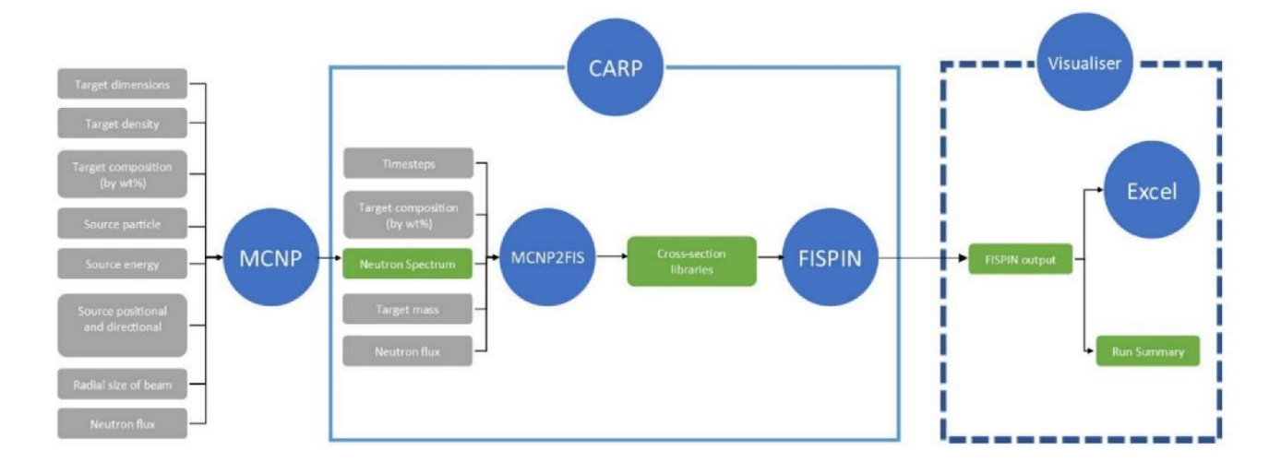
How does CARP work?
Not protectively marked

Slide 7
How does CARP work? - FISPIN
So what is FISPIN?
UK nuclear fuel inventory code – used for validation of UK reactors, reprocessing facilities etc.
In development since the 70’s, FISPIN 10 (90’s/00’s) was used for various reactor validation cases throughout Europe
New version FISPIN 11 – acts as a calculation kernel – not constrained to reactors – can model incident particle scenarios
0 dimensional…
Not protectively marked
Notes:
FISPIN 10 – quite a crude method for estimation of Bateman equation solutions using the infamous LEVEL parameter – due to CPU constraints
- 556 nuclides
FISPIN 11 – no longer has these constraints, calculates definitively
- 2609 nuclides
- allows explicit declaration of the incident particle flux, and (multi) particle type definition
Beam and target geometries must be introduced via the x-sec libs – MCNP/Serpent

Slide 8
How does CARP work? – MCNP -> CARP
Energy dependent neutron spectrum
Incident neutron reaction cross- section database
FISPIN format cross-section library
Uses recommended NJOY equations to emulate continuous neutron flux – as in ORIGEN
Translates beam and target information into a FISPIN usable format
TENDL-2017, 2021, ENDFB-VIII
Energy bin agnostic
Not protectively marked
Notes:
Convolve
This process makes CARP energy binning structure agnostic

Slide 9
How does CARP work? - Summary
MCNP generates a beam specific particle spectrum across the target
This particle spectrum is cross-referenced against a cross-section database to produce a FISPIN cross-section library containing the beam data
The FISPIN kernel calculates the stepwise inventories of the target using this data, producing inventories at the user specified timesteps
A number of behind the scenes calculations e.g. activity, mass
  Visualised into a user friendly excel file
Not protectively marked

Slide 10
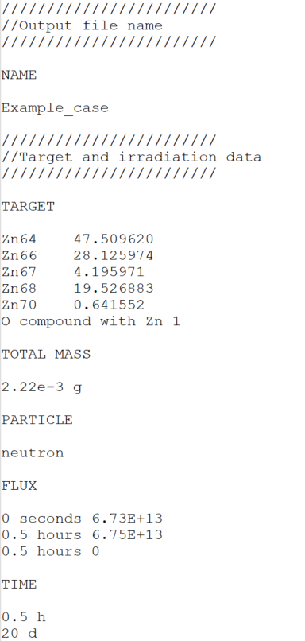
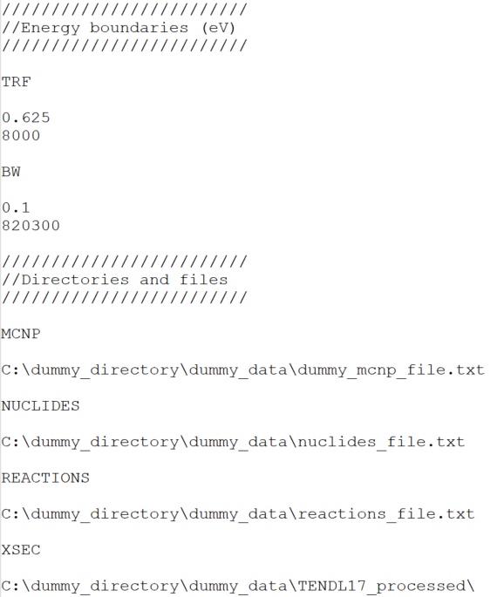
Example inputs/outputs - Input
Target information
MCNP file
Nuclide and reaction files
Beam information
Calculation times
Cross-section libraries
Not protectively marked

Slide 11
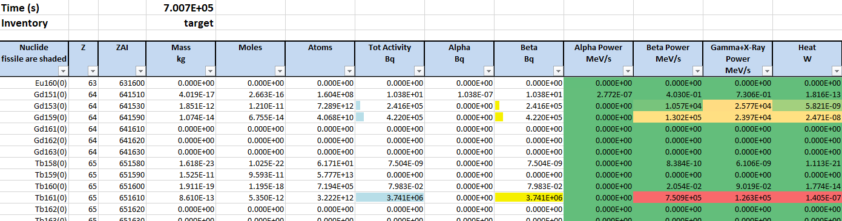
Example inputs/outputs - Output
Not protectively marked

Slide 12
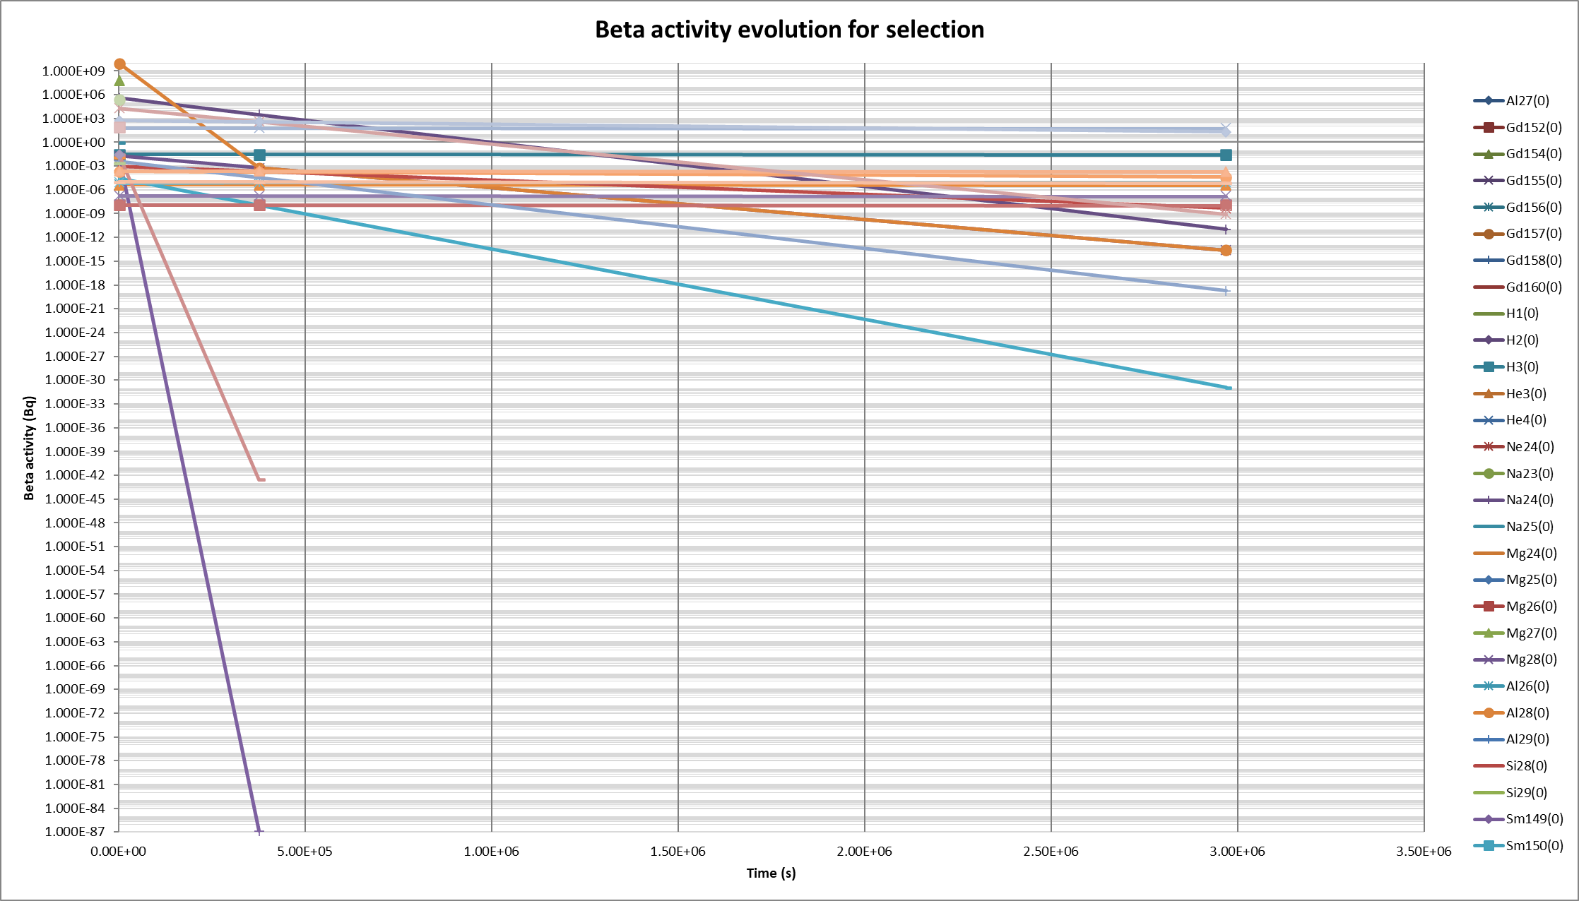
Example inputs/outputs - Output
Not protectively marked

Slide 13
Verification & validation work – EK data
Acquired V&V data from EK under the EU SECURE project:
  EK run the Budapest Research Reactor (BRR)
  Multiple beam lines
  Irradiating samples for medical radionuclide production research
  Gamma scan data and FISPACT modelled data made available
Not protectively marked
Notes:
EK – Energiatudomanyi Kutatokozpont – Centre for energy research (CER)
Explain about the EU SECURE programme
Explain about EKs BRR reactor

Slide 14
Verification & validation work – EK data
Three target types irradiated in three beam lines for 30-60 mins, cooled for ~4-6 days
Gd diluted Al foil → Tb-161
Lu diluted Al foil → Lu-177
Pt diluted Al foil → Au-199
Not protectively marked
Notes:
EK – Energiatudomanyi Kutatokozpont

Slide 15
Verification & validation work – EK data
Not protectively marked
Notes:
After discussion with EK, they say their ch17 beam model is their most confident, and ch47 and 72 require additional work

Slide 16
Verification & validation work – EK data
Two further target types irradiated in a single beam line for 20-30 mins, cooled for 8 and 41 days
Gd2O3 → Tb-161
Lu2O3 → Lu-177
Product nuclide | FISPACT (Bq) | Gamma spec (Bq) | CARP (Bq)
Tb-161 | 3.79E+06 | 2.87E+06 | 3.74E+06
Lu-177 | 7.26E+07 | 5.12E+07 | 6.87E+07
Not protectively marked

Slide 17
Verification & validation work
We hope to receive further reactor beam validation data from other SECURE partners
Verify against FISPACT
Always on the search for more!
  Accelerator beam scenarios
  Alternative particle types
    (Where nuclear data is available…)
Not protectively marked

Slide 18
Intended uses and future work
Future developments
  Batch mode
  User defined thresholds
  Mid process separation
Intention is to use CARP in collaborative work
  Optimising existing experiments
  Modelling novel and/or complex scenarios
And to collaborate in understanding what CARP should do!
Not protectively marked
Notes:
EK – Energiatudomanyi Kutatokozpont

Slide 19
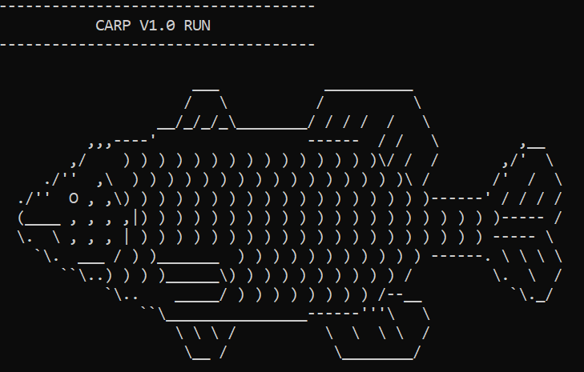
Thank you!
Duncan Mayhem
Nuclear & Reactor Physics Team
NNL
duncan.mayhem@uknnl.com
This work was partially undertaken within the SECURE project funded by the European Union under grant agreement No. 101061230.

